Slide 1
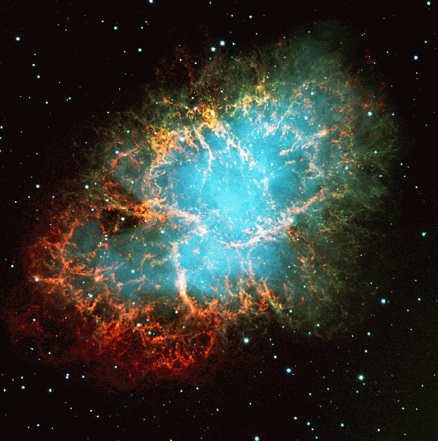
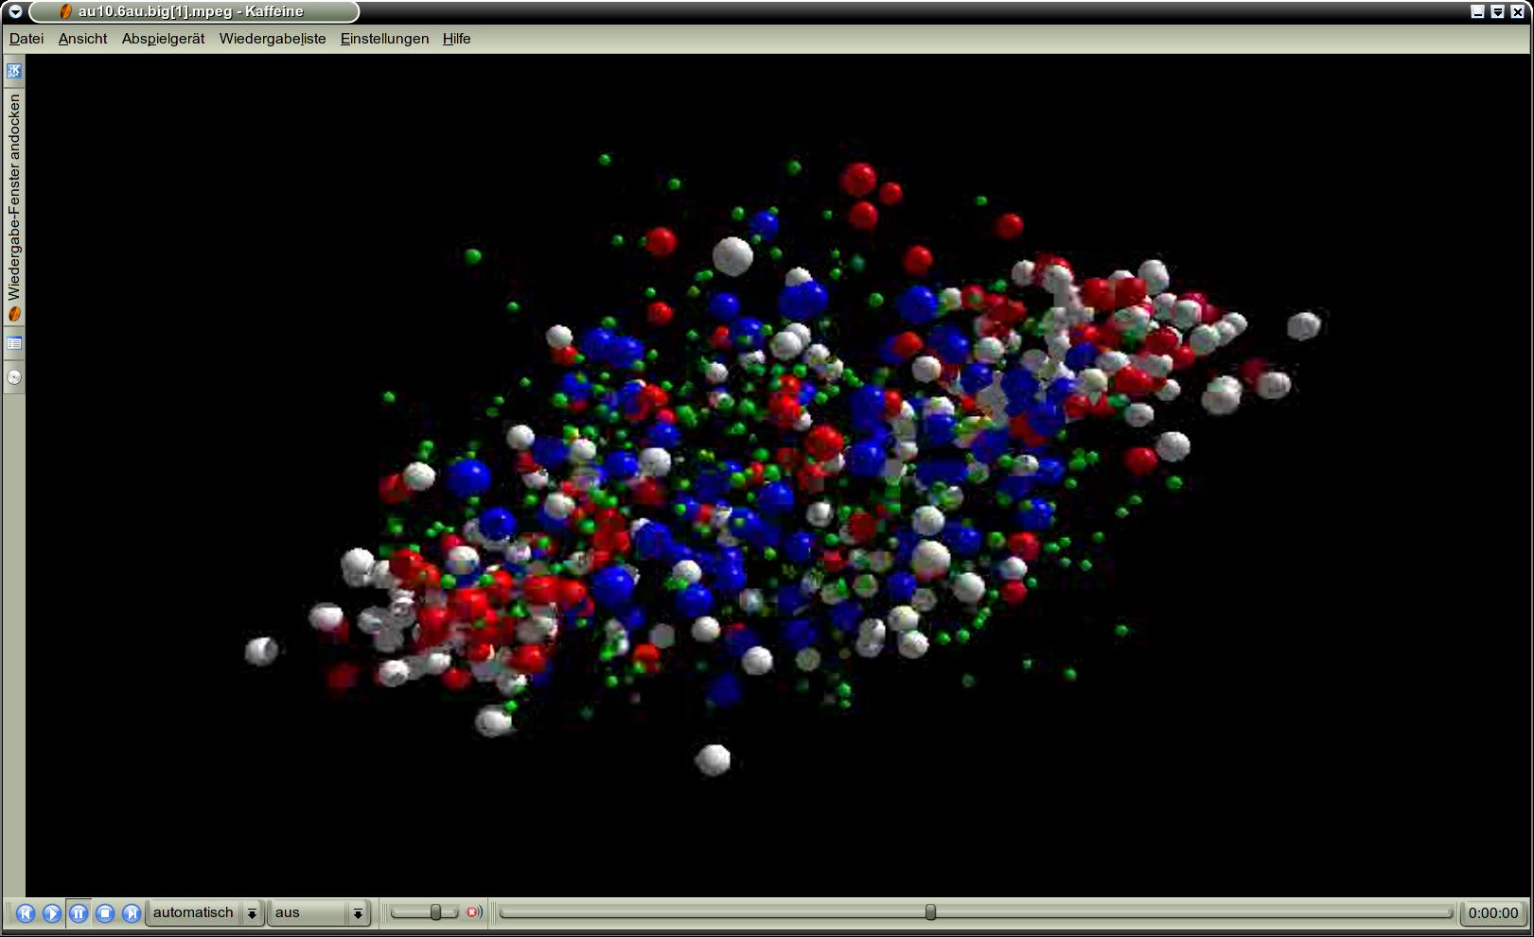
Cosmic Matter in the Laboratory -
The Compressed Baryonic Matter experiment
Peter Senger
Outline:
The evolution of matter in the universe
Exploring the QCD phase diagram
The Compressed Baryonic Matter experiment
FAIR days in Tehran, International workshop on scientific prospects of the FAIR project
April 20 – 22, 2017, Teheran, Iran

Slide 2
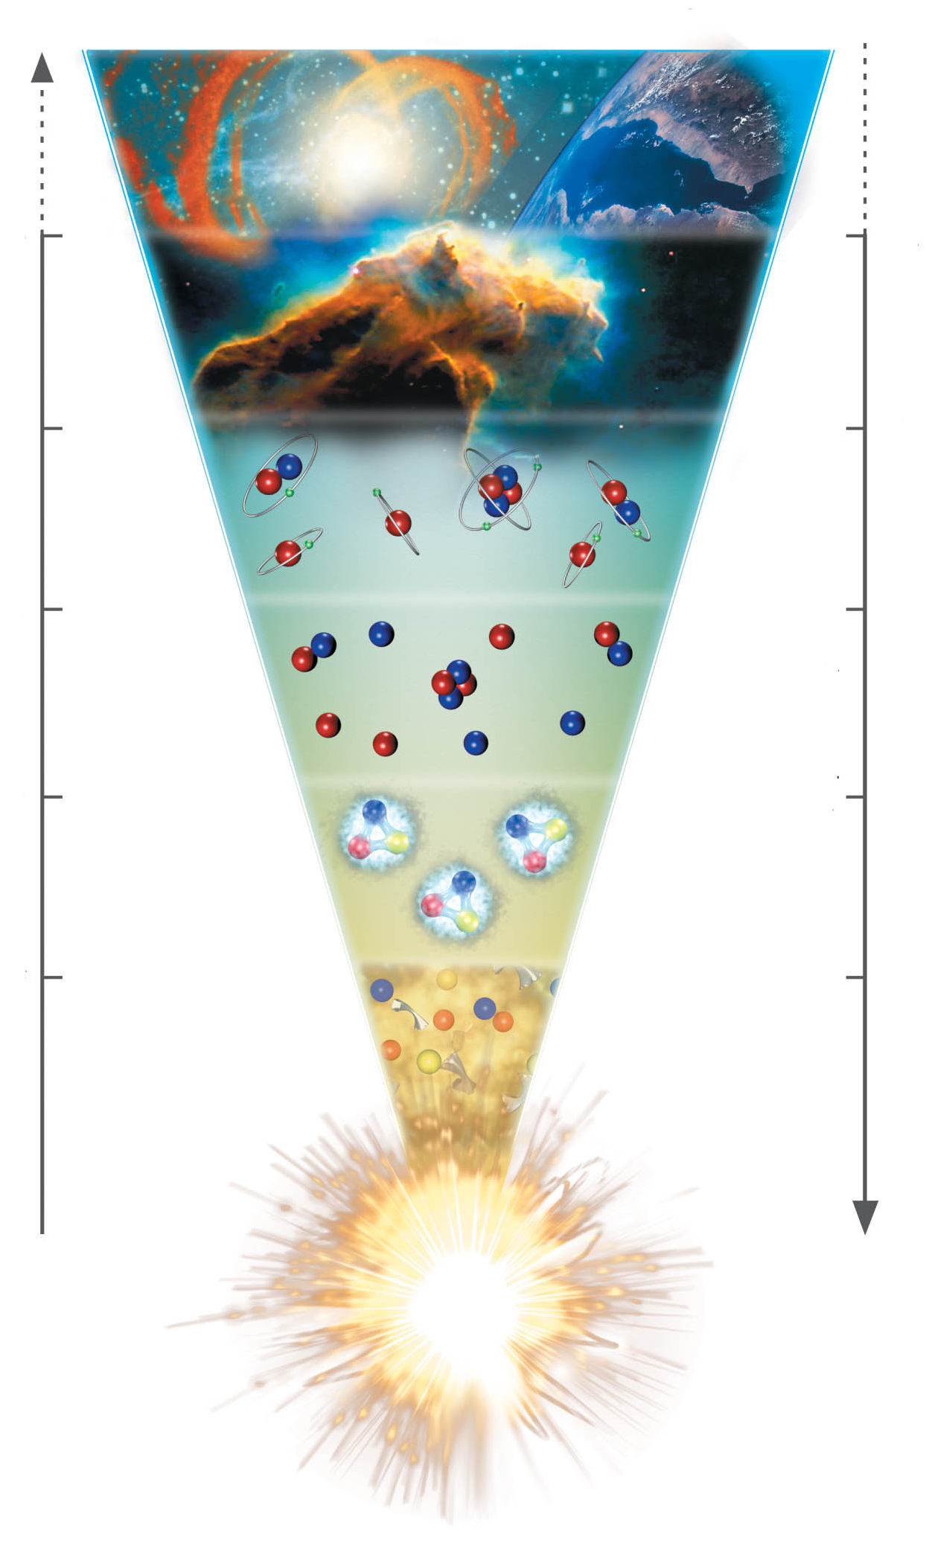
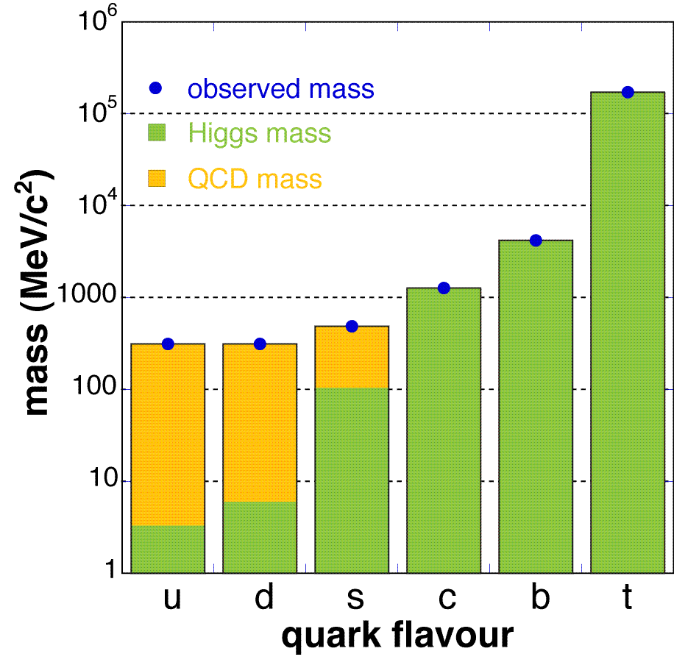
The evolution of matter in the universe
15 billion years
3 K
1 billion years
20 K
time
300.000 years
3000 K
temperature
3 minutes
10⁹ K
1 millisecond
10¹² K
1 microsecond
Explicit breaking
of Chiral Symmetry
(Higgs mechanism)
m_{u} ≈ 5 MeV,
m_{d} ≈ 10 MeV,
m_{s} ≈ 150 MeV
distance

Slide 3
The evolution of matter in the universe
15 billion years
3 K
1 billion years
20 K
time
300.000 years
3000 K
temperature
3 minutes
10⁹ K
1 millisecond
10¹² K
1 microsecond
The soup of the
first microsecond:
quarks, antiquarks,
electrons, positrons,
gluons, photons
distance

Slide 4
The evolution of matter in the universe
15 billion years
3 K
1 billion years
20 K
time
300.000 years
3000 K
temperature
3 minutes
10⁹ K
1 millisecond
10¹² K
1 microsecond
Spontaneous/dynamical
Chiral Symmetry breaking:
Hadrons acquire mass by
coupling to the virtual
quark-antiquark pairs
of the chiral condensate
distance

Slide 5
The evolution of matter in the universe
15 billion years
3 K
1 billion years
20 K
time
300.000 years
3000 K
temperature
3 minutes
10⁹ K
1 millisecond
10¹² K
1 microsecond
Annihilation of particles
and antiparticles, only
10⁻⁹ of particles survived
distance

Slide 6
The evolution of matter in the universe
15 billion years
3 K
?
1 billion years
20 K
time
300.000 years
3000 K
temperature
3 minutes
10⁹ K
1 millisecond
10¹² K
1 microsecond
distance

Slide 7
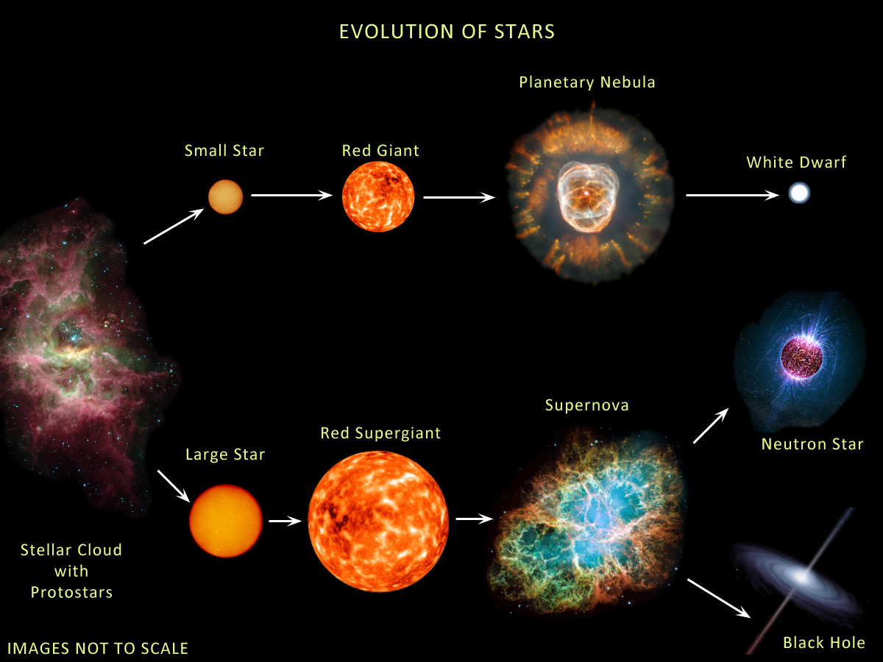
The evolution of stars
M < ≈ 8M → white dwarf
8M< M < 15M → neutron star: 1.4M< M_{core}< 2M
M >≈15M → black hole: M_{core} >≈ 2M
Courtesy of Anna Watts

Slide 8
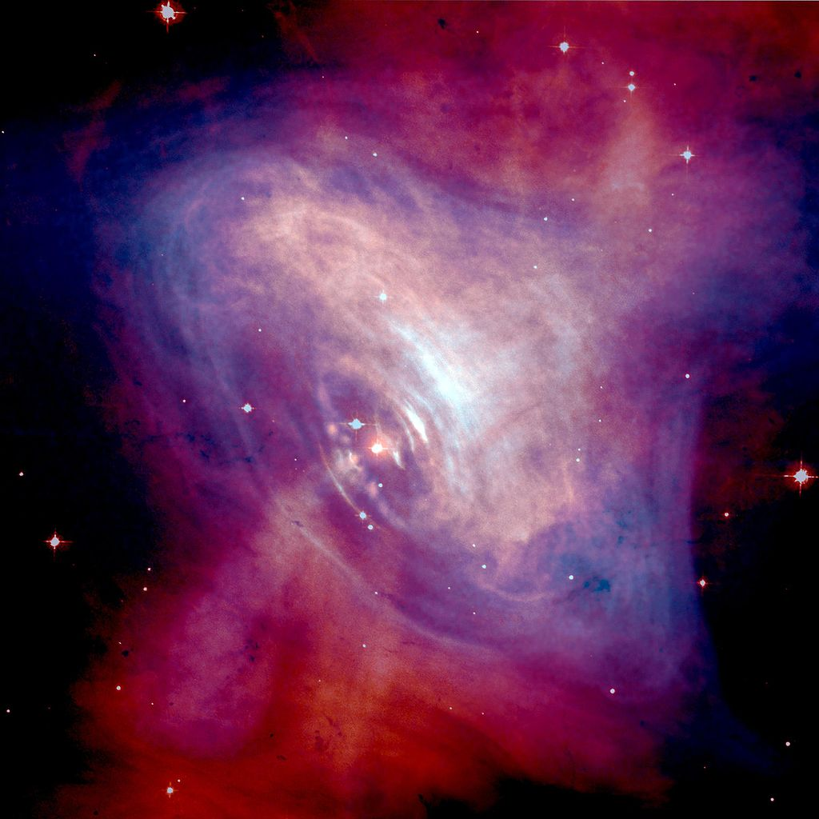
Discovery of the first pulsar in 1968
Crab nebula:
ashes of a core collapse supernova observed in 1054 by Chinese astronomers.
The “visiting star” was as bright as the Venus for more than 20 days.

Slide 9
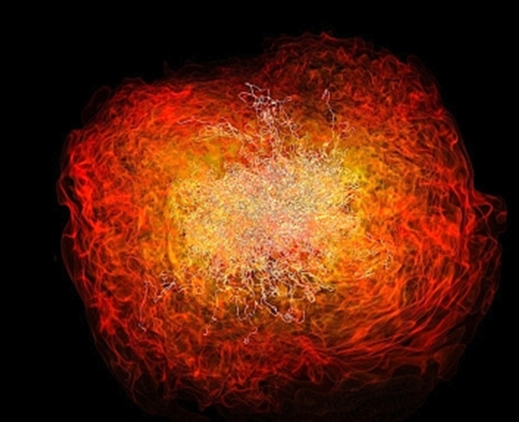
NASA simulation of two merging neutron stars

Slide 10
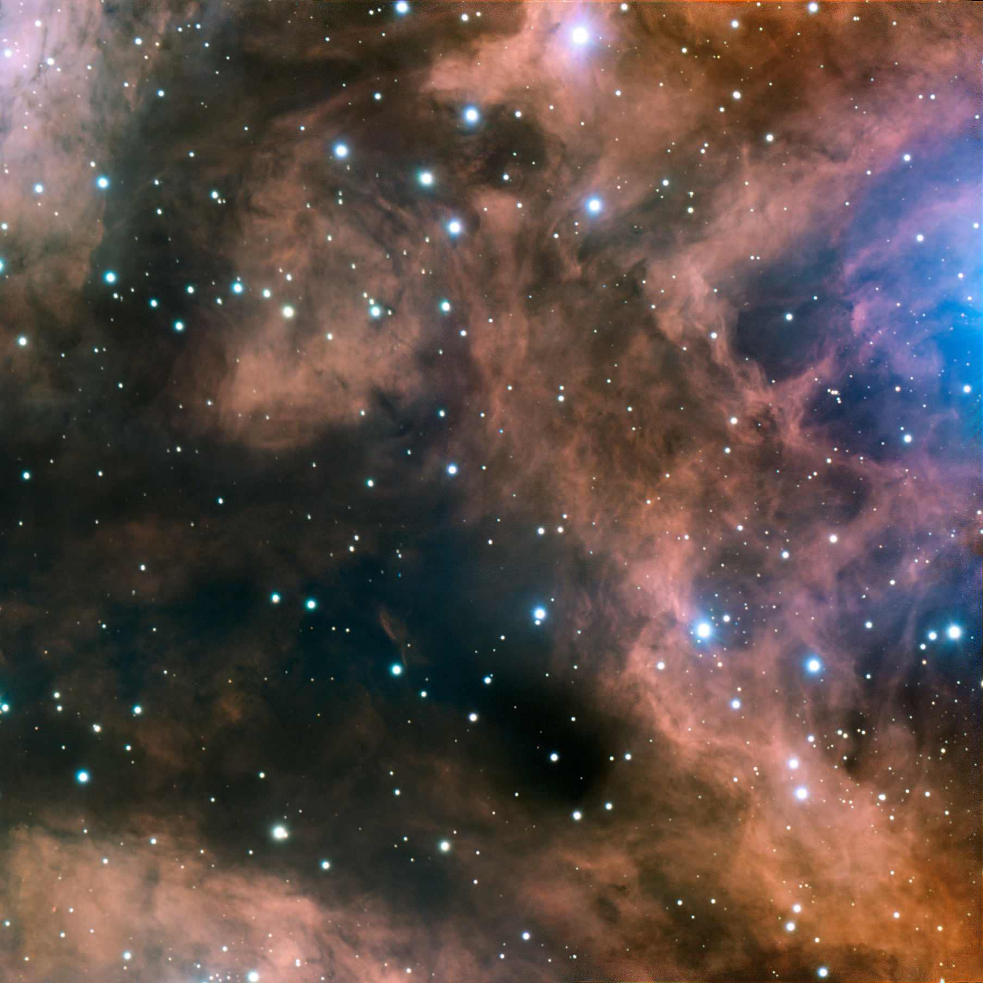
Fundamental questions
What is the origin of the mass of the universe?
What is the origin of the elements ?
What is the structure of neutron stars?
Can we ignite the solar fire on earth ?
Does matter differ from antimatter ?
Why do we not observe individual quarks ?
→ to be explored at the future international
Facility for Antiproton and Ion Research (FAIR)

Slide 11
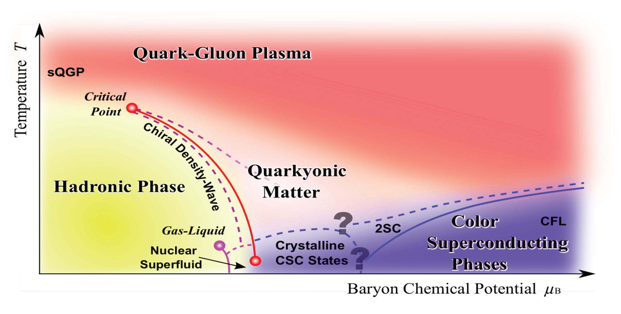
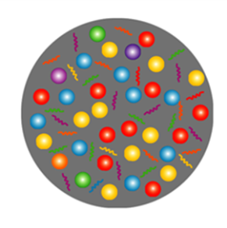
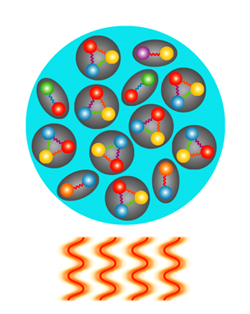
Exploring the QCD phase diagram
Courtesy of K. Fukushima & T. Hatsuda
At very high temperature:
➢ N of baryons ≈ N of antibaryons
Situation similar to early universe
➢ L-QCD finds crossover transition between
hadronic matter and Quark-Gluon Plasma
➢ Experiments: ALICE, ATLAS, CMS at LHC
STAR, PHENIX at RHIC

Slide 12
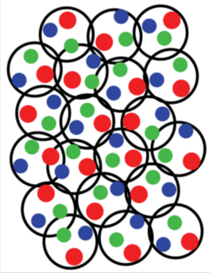
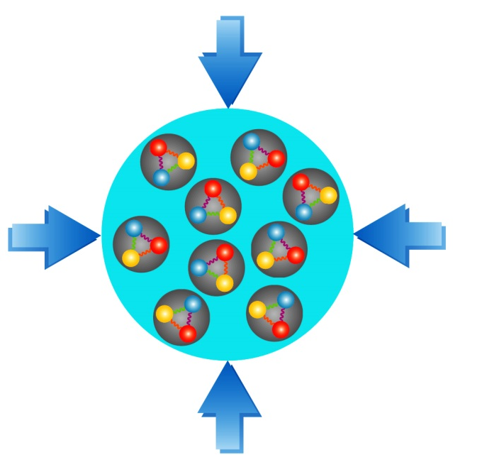
Exploring the QCD phase diagram
Courtesy of K. Fukushima & T. Hatsuda
At high baryon density:
➢ N of baryons >> N of antibaryons
Densities like in neutron star cores
➢ L-QCD not (yet) applicable
Models predict first order phase transition
with mixed or exotic phases
Experiments: BES at RHIC, NA61 at CERN SPS,
CBM at FAIR, NICA at JINR, J-PARC

Slide 13
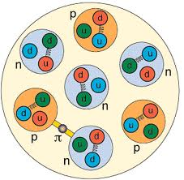
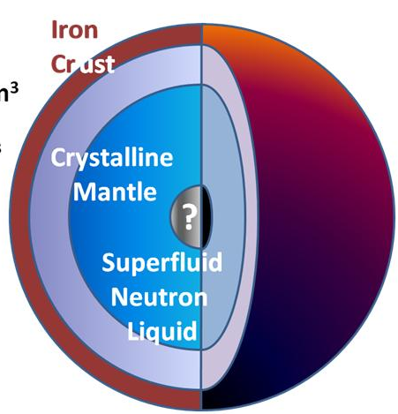
Density estimates
Atomic nucleus:
Radius R = 1.2 fm A^{1/3} (σ_{reac} = π R²)
Volume V = 4/3 π R³ = 4/3 π 1.2³ A fm³
Nucleon density ρ₀ = A/V = 3/ (4 π 1.2³) fm⁻³ ≈ 0.14 fm⁻³
Mass of nucleon m = 1.67 ⋅ 10⁻²⁴ g
Mass density of cold nuclear matter ρ₀ ⋅ m ≈ 270 Mio t/cm³
Limits of nucleon density:
Au-nucleus: R ≈ 7 fm, V ≈ 1400 fm³
Nucleon: R ≈ 0.8 fm, V ≈ 2 fm³
200 Nucleons: V ≈ 400 fm³
At 3 – 4 ρ⁰: nucleons overlap, Fermi see of quarks?
Neutron star:
Radius R ≈ 10 km,
Volume V ≈ 4200 km³
Mass M ≈ 2 solar masses = 2 ⋅ 2 ⋅ 10³³ g
Average mass density ρ = M/V ≈ 1000 Mio t/cm³ ≈ 3.6 ρ⁰ ⋅ m
Core density 5 – 10 times nuclear density

Slide 14
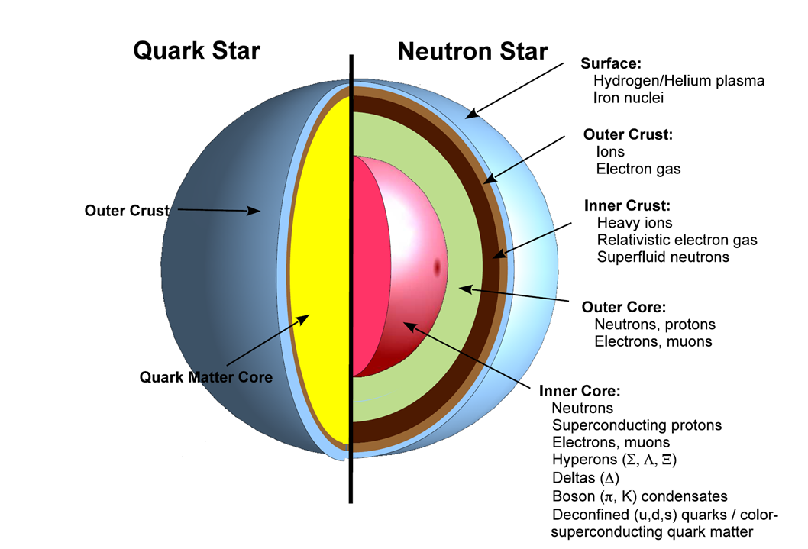
?

Slide 15
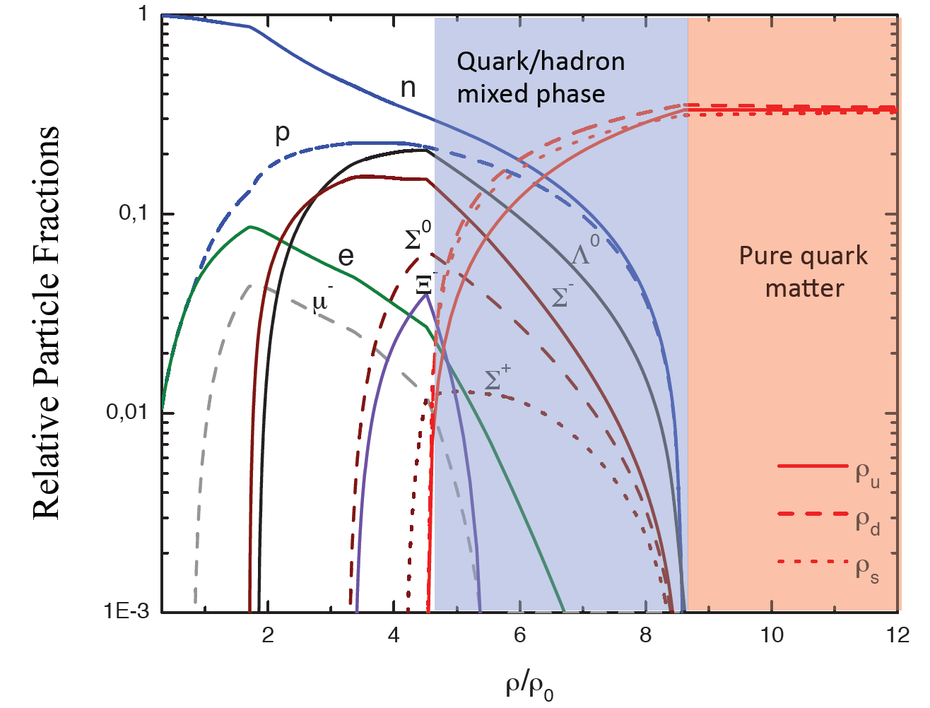
Quark matter in massive neutron stars?
M. Orsaria, H. Rodrigues, F. Weber, G.A. Contrera, arXiv:1308.1657
Phys. Rev. C 89, 015806, 2014

Slide 16


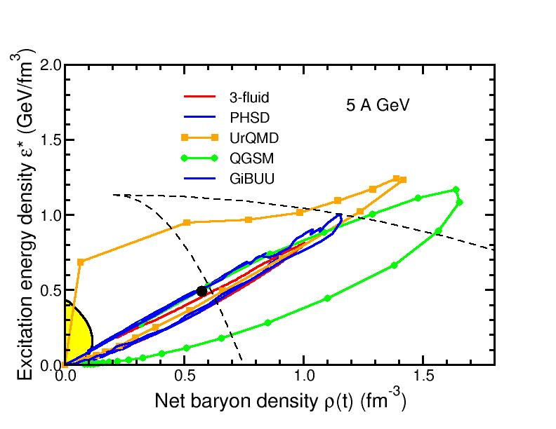
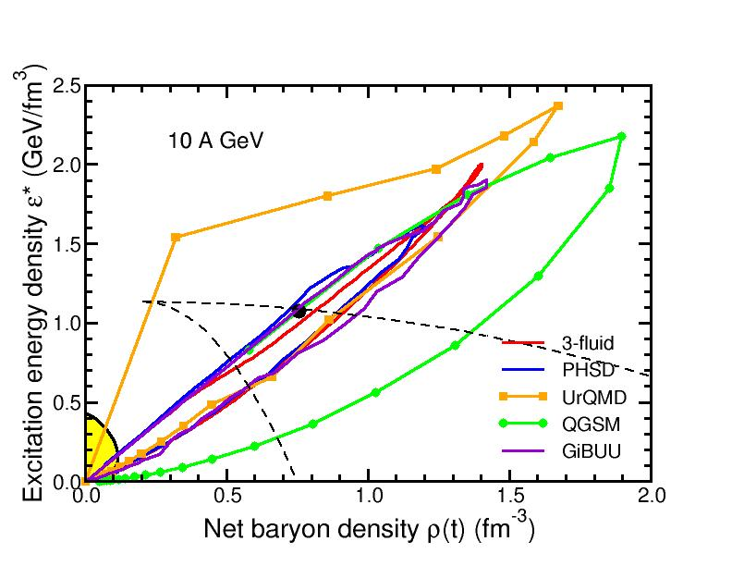
Baryon densities in central Au+Au collisions
I.C. Arsene et al., Phys. Rev. C 75, 24902 (2007)
5 A GeV
10 A GeV
8 ρ₀
5 ρ₀
phase
coexistence
phase
coexistence

Slide 17
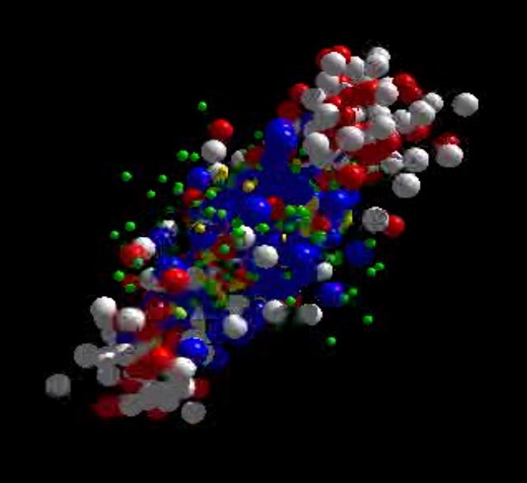
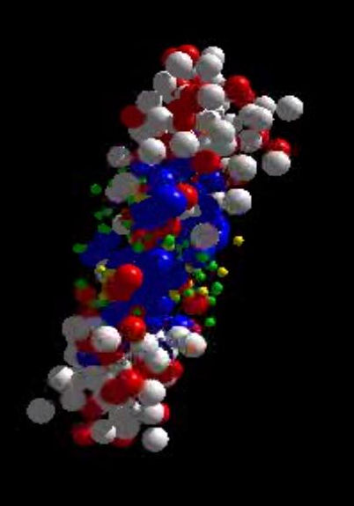
Messengers from the dense fireball:
CBM at FAIR
UrQMD transport calculation Au+Au 10.7 A GeV
Ξ⁻, Ω⁻, φ
π, K, Λ, ...
p, Λ, Ξ⁺, Ω⁺, J/ψ
ρ → e⁺e⁻, μ⁺μ⁻
resonance decays
ρ → e⁺e⁻, μ⁺μ⁻
ρ → e⁺e⁻, μ⁺μ⁻

Slide 18

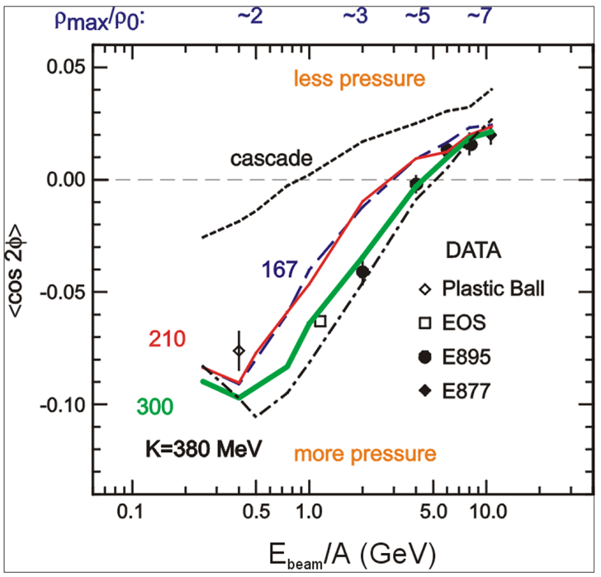
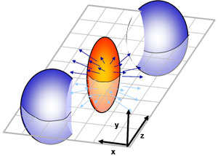
CBM physics case and observables
The QCD matter equation-of-state at neutron star core densities
➢ collective flow of identified particles (π,K,p,Λ,Ξ,Ω,...)
driven by the pressure gradient in the early fireball
AGS: proton flow in Au+Au collisions
Azimuthal angle distribution:
dN/dφ = C (1 + v₁ cos(φ) + v₂ cos(2φ) + ...)
P. Danielewicz, R. Lacey, W.G. Lynch, Science 298 (2002) 1592

Slide 19
CBM physics case and observables
The QCD matter equation-of-state at neutron star core densities
➢ collective flow of identified particles (π,K,p,Λ,Ξ,Ω,...)
driven by the pressure gradient in the early fireball
➢ particle production at (sub)threshold energies via
multi-step processes (multi-strange hyperons, charm)
Direct multi-strange hyperon production:
pp → Ξ⁻ K⁺K⁺p (E_{thr} = 3.7 GeV)
pp → Ω⁻ K⁺K⁺K⁰p (E_{thr} = 7.0 GeV)
pp → Λ⁰Λ⁰ pp (E_{thr} = 7.1 GeV)
pp → Ξ⁺ Ξ⁻ pp (E_{thr} = 9.0 GeV)
pp → Ω⁺ Ω⁻ pp (E_{thr} = 12.7 GeV
p
p
p
p
Λ⁰
(uds)
Hyperon production via multiple collisions
pp → K⁺Λ⁰p, pp → K⁺K⁻pp,
pΛ⁰→ K⁺ Ξ⁻ p, πΛ⁰→ K⁺ Ξ⁻ π,
Λ⁰Λ⁰→ Ξ⁻ p, Λ⁰K⁻ → Ξ⁻ π⁰
3 . Λ⁰ Ξ⁻ → Ω⁻ n, Ξ⁻K⁻ → Ω⁻ π⁻
Antihyperons
1. Λ⁰ K⁺ → Ξ⁺π⁰ ,
2. Ξ⁺ K⁺ → Ω⁺ π⁺.
p
K⁺
p
Λ⁰
Ξ⁻
(uds)
(dss)
Ω⁻
p
K⁺
p
(sss)
p
Λ⁰
(uds)
K⁺
p
n

Slide 20
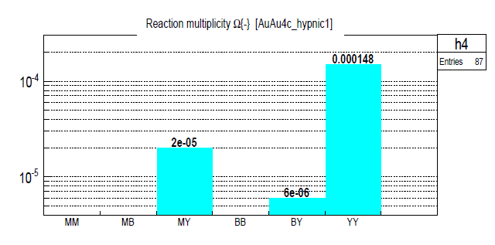
CBM physics case and observables
The QCD matter equation-of-state at neutron star core densities
➢ collective flow of identified particles (π,K,p,Λ,Ξ,Ω,...)
driven by the pressure gradient in the early fireball
➢ particle production at (sub)threshold energies via
multi-step processes (multi-strange hyperons, charm)
Direct multi-strange hyperon production:
pp → Ξ⁻ K⁺K⁺p (E_{thr} = 3.7 GeV)
pp → Ω⁻ K⁺K⁺K⁰p (E_{thr} = 7.0 GeV)
pp → Λ⁰Λ⁰ pp (E_{thr} = 7.1 GeV)
pp → Ξ⁺ Ξ⁻ pp (E_{thr} = 9.0 GeV)
pp → Ω⁺ Ω⁻ pp (E_{thr} = 12.7 GeV
Ω⁻ production in 4 A GeV Au+Au
Hyperon production via multiple collisions
pp → K⁺Λ⁰p, pp → K⁺K⁻pp,
pΛ⁰→ K⁺ Ξ⁻ p, πΛ⁰→ K⁺ Ξ⁻ π,
Λ⁰Λ⁰→ Ξ⁻ p, Λ⁰K⁻ → Ξ⁻ π⁰
3 . Λ⁰ Ξ⁻ → Ω⁻ n, Ξ⁻K⁻ → Ω⁻ π⁻
Antihyperons
1. Λ⁰ K⁺ → Ξ⁺π⁰ ,
2. Ξ⁺ K⁺ → Ω⁺ π⁺.
HYPQGSM calculations , K. Gudima et al.

Slide 21
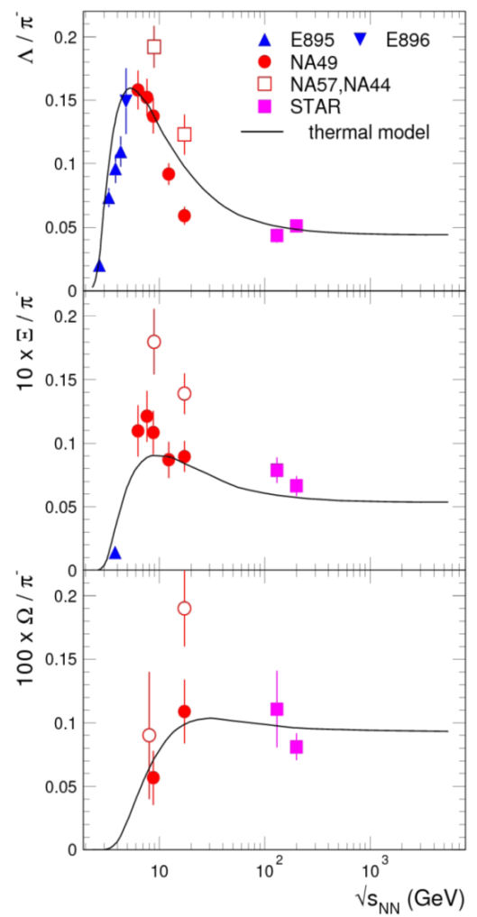
CBM physics case and observables
The QCD matter equation-of-state at neutron star core densities
➢ collective flow of identified particles (π,K,p,Λ,Ξ,Ω,...)
driven by the pressure gradient in the early fireball
➢ particle production at (sub)threshold energies via
multi-step processes (multi-strange hyperons, charm)
Direct multi-strange hyperon production:
pp → Ξ⁻ K⁺K⁺p (E_{thr} = 3.7 GeV)
pp → Ω⁻ K⁺K⁺K⁰p (E_{thr} = 7.0 GeV)
pp → Λ⁰Λ⁰ pp (E_{thr} = 7.1 GeV)
pp → Ξ⁺ Ξ⁻ pp (E_{thr} = 9.0 GeV)
pp → Ω⁺ Ω⁻ pp (E_{thr} = 12.7 GeV
Hyperon production via multiple collisions
pp → K⁺Λ⁰p, pp → K⁺K⁻pp,
pΛ⁰→ K⁺ Ξ⁻ p, πΛ⁰→ K⁺ Ξ⁻ π,
Λ⁰Λ⁰→ Ξ⁻ p, Λ⁰K⁻ → Ξ⁻ π⁰
3 . Λ⁰ Ξ⁻ → Ω⁻ n, Ξ⁻K⁻ → Ω⁻ π⁻
Antihyperons
1. Λ⁰ K⁺ → Ξ⁺π⁰ ,
2. Ξ⁺ K⁺ → Ω⁺ π⁺.
Very few data
at FAIR energies

Slide 22
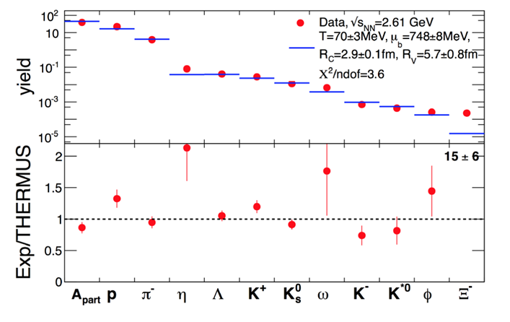
CBM physics case and observables
Phase transitions from partonic to hadronic matter
excitation function of strangeness: Ξ⁻(dss),Ξ⁺(dss),Ω⁻(sss),Ω⁺(sss)
→ chemical equilibration at the phase boundary
Particle yields and thermal model fits
Very few data
at FAIR energies
A. Andronic et al., Jour. Phys. G38 (2011)
HADES: Ar + KCl 1.76 A GeV
G. Agakishiev et al., arXiv:1512.07070

Slide 23
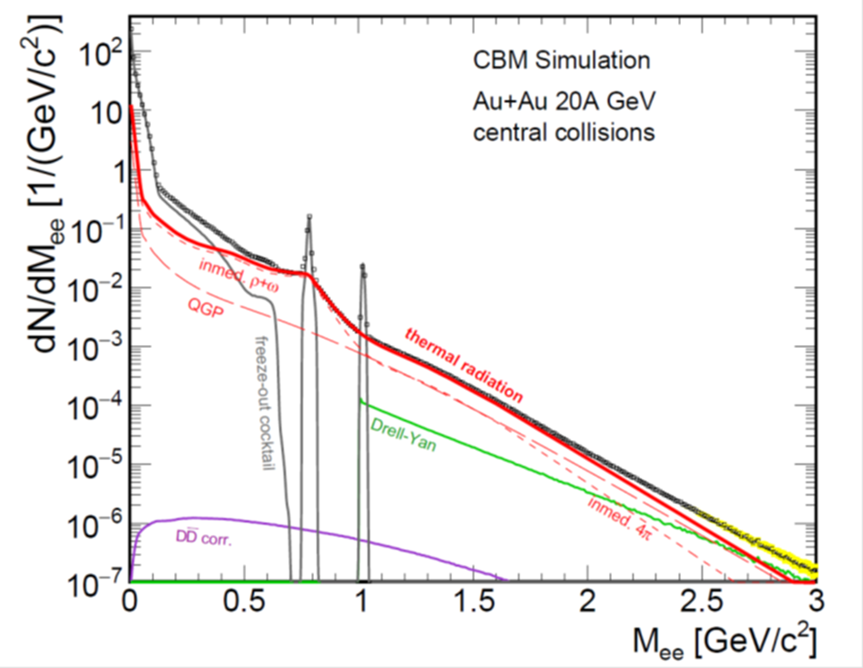
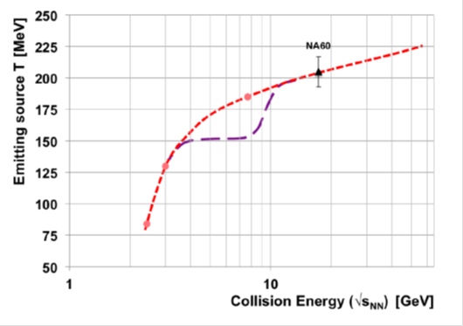
CBM physics case and observables
Phase transitions from partonic to hadronic matter
➢ excitation function of strangeness: Ξ⁻(dss),Ξ⁺(dss),Ω⁻(sss),Ω⁺(sss)
→ chemical equilibration at the phase boundary
Phase coexistence
excitation function (invariant mass) of lepton pairs:
thermal radiation from QGP, caloric curve
Invariant mass distribution of lepton pairs
Slope of dilepton invariant mass spectrum
1 GeV/c² < M_{inv} < 2.5 GeV/c²
No data
at FAIR energies
The CBM Collaboration, arXiv:1607.01487

Slide 24
CBM physics case and observables
Phase transitions from partonic to hadronic matter
➢ excitation function of strangeness: Ξ⁻(dss),Ξ⁺(dss),Ω⁻(sss),Ω⁺(sss)
→ chemical equilibration at the phase boundary
Phase coexistence
excitation function (invariant mass) of lepton pairs:
thermal radiation from QGP, caloric curve
➢ anisotropic azimuthal angle distributions: “spinodal decomposition”
Spinodal decomposition of the mixed phase: net baryon number density fluctuations
C. Herold, M. Nahrgang, I. Mishustin, M.Bleicher
Nuclear Physics A 925 (2014) 14
Jan Steinheimer, Jorgen Randrup
Phys. Rev. C 87, 054903 (2013)
Eur. Phys. J. A (2016) 52: 239

Slide 25
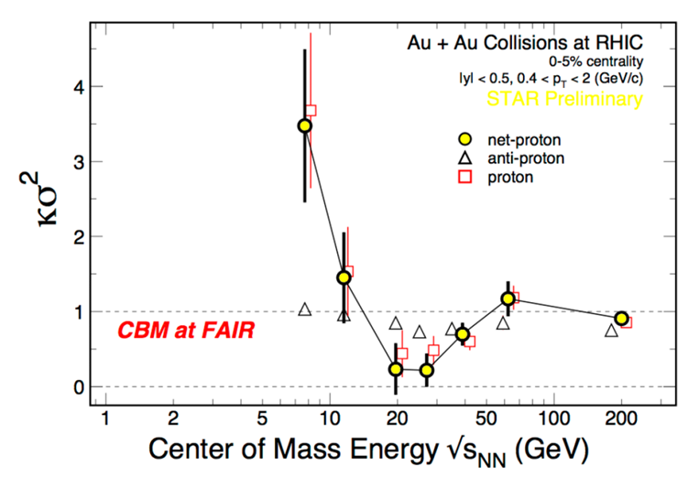
CBM physics case and observables
Phase transitions from partonic to hadronic matter
➢ excitation function of strangeness: Ξ⁻(dss),Ξ⁺(dss),Ω⁻(sss),Ω⁺(sss)
→ chemical equilibration at the phase boundary
Phase coexistence
excitation function (invariant mass) of lepton pairs:
thermal radiation from QGP, caloric curve
anisotropic azimuthal angle distributions: “spinodal decomposition”
Critical point
event-by-event fluctuations of conserved quantities (B,S,Q)
“critical opalescence”
4th moment of net-proton
multiplicity distribution:
critical fluctuations
STAR preliminary
No data
at FAIR energies

Slide 26
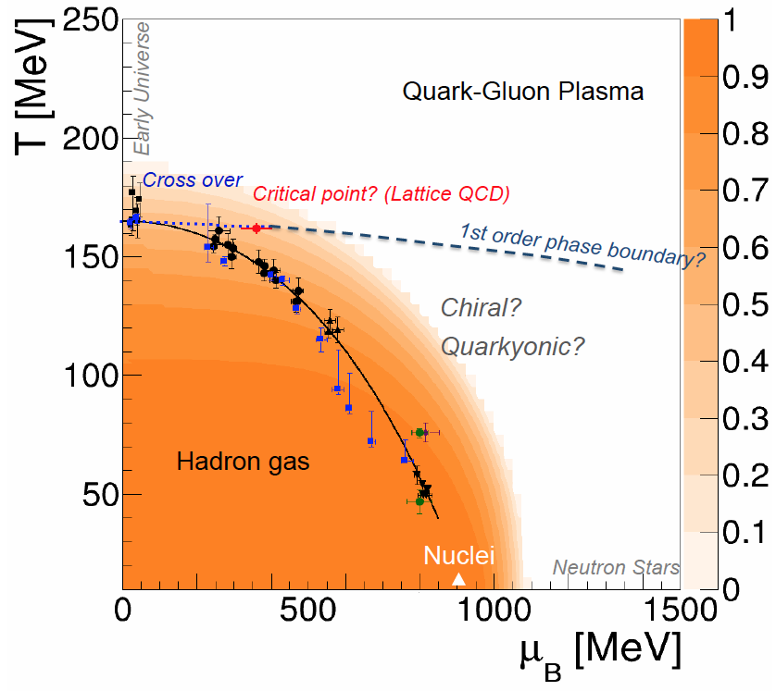
CBM physics case and observables
Onset of chiral symmetry restoration at high ρ_{B}
➢ in-medium modifications of hadrons: ρ,ω,φ →e⁺e⁻(μ⁺μ⁻)
➢ dileptons at intermediate invariant masses: 4 π → ρ-a₁ chiral mixing
Origin of quark masses
Orange region: Chiral condensate

Slide 27

CBM physics case and observables
Onset of chiral symmetry restoration at high ρ_{B}
➢ in-medium modifications of hadrons: ρ,ω,φ →e⁺e⁻(μ⁺μ⁻)
➢ dileptons at intermediate invariant masses: 4 π → ρ-a₁ chiral mixing
No data
at FAIR energies

Slide 28

CBM physics case and observables
N-Λ, Λ-Λ interaction, strange matter?
➢ (double-) lambda hypernuclei
➢ meta-stable objects (e.g. strange dibaryons)
No data
at FAIR energies
Double lambda hypernuclei production
in central Au+Au collisions at 10 A GeV:
 | Multiplicity | Yield in 1 week
⁵_{ΛΛ}H | 5 ⋅ 10⁻⁶ | 3000
⁶_{ΛΛ}He | 1 ⋅ 10⁻⁷ | 60
Assumption for yield calculation:
Reaction Rate 1 MHz
BR 10% (2 sequential weak decays)
Efficiency 1%
SIS100
A. Andronic et al., Phys. Lett. B697 (2011) 203

Slide 29
CBM physics case and observables
Charm production at threshold energies in cold and dense matter
➢ excitation function of charm production in p+A and A+A (J/ψ, D⁰, D±)
UrQMD calculation including subthreshold charm production via
N* → Λ_{c} + D and N* → N +J/ψ
No data
at FAIR energies
29
J. Steinheimer, A. Botvina, M. Bleicher, Phys. Rev. C 95, 014911 (2017), arXiv:1605.03439v1

Slide 30
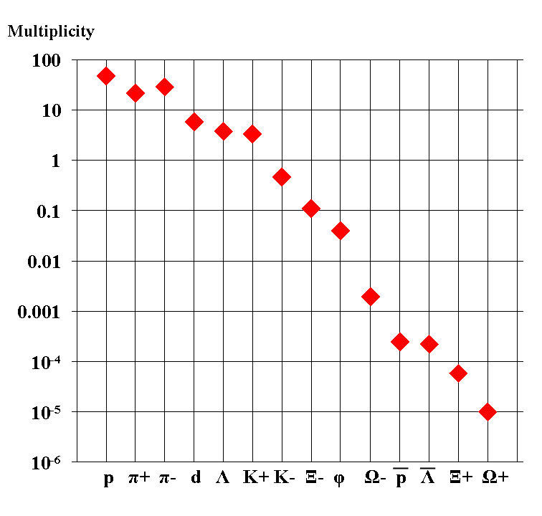
Experimental challenges
Particle yields in central Au+Au 4 A GeV
Statistical model, A. Andronic, priv. com.
AGS
extremely high
interaction rates
required !
e⁺e⁻
μ⁺μ⁻

Slide 31
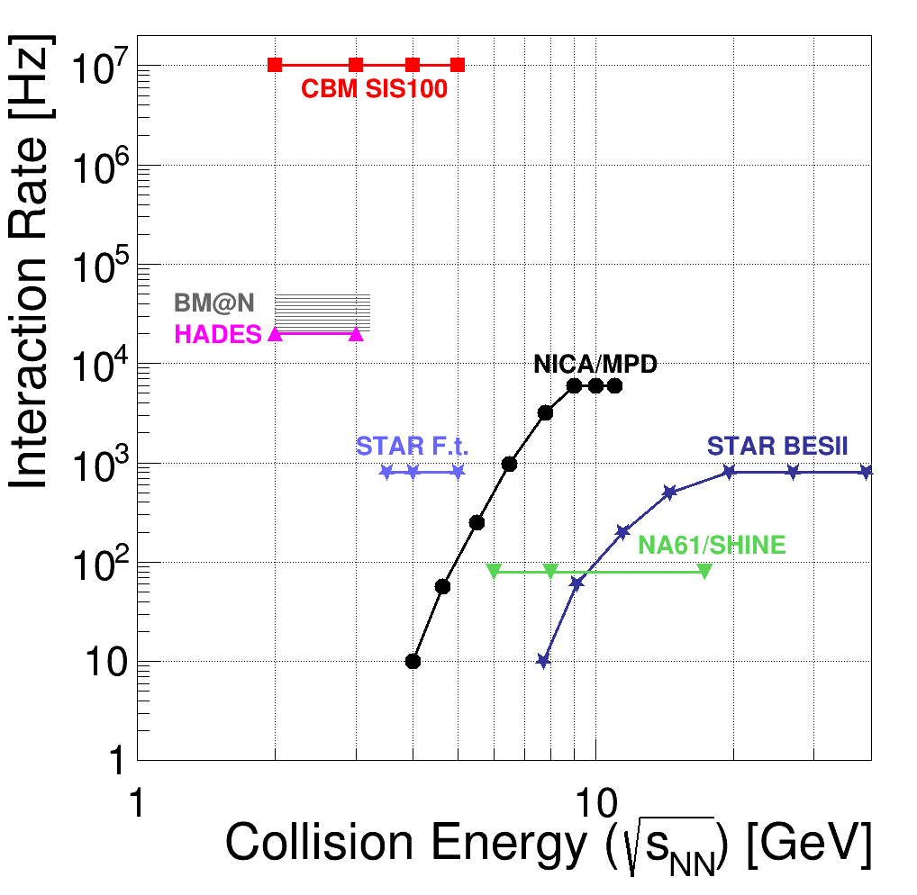
Existing and future experiments
exploring dense QCD matter
high baryon densities
The CBM Collaboration,
arXiv:1607.01487

Slide 32
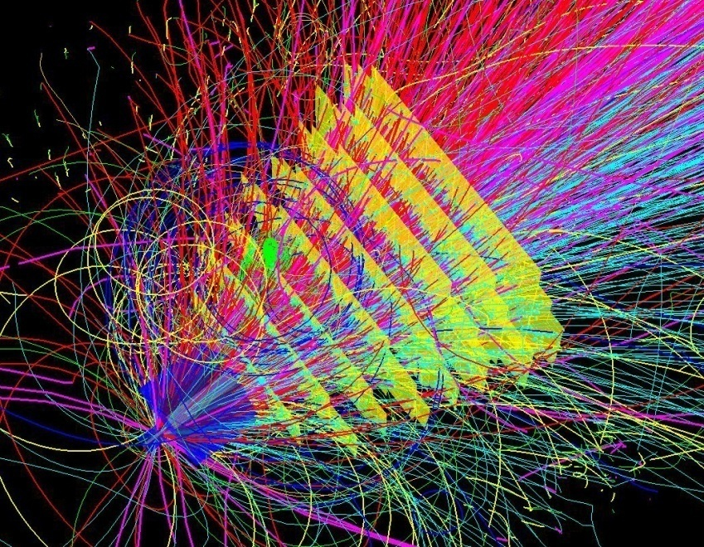
Experimental requirements
10⁵ - 10⁷ Au+Au reactions/sec
determination of displaced vertices (σ ≈ 50 μm)
identification of leptons and hadrons
fast and radiation hard detectors and FEE
free-streaming readout electronics
high speed data acquisition and high performance
computer farm for online event selection
4-D event reconstruction
Notes:
32
32
32

Slide 33
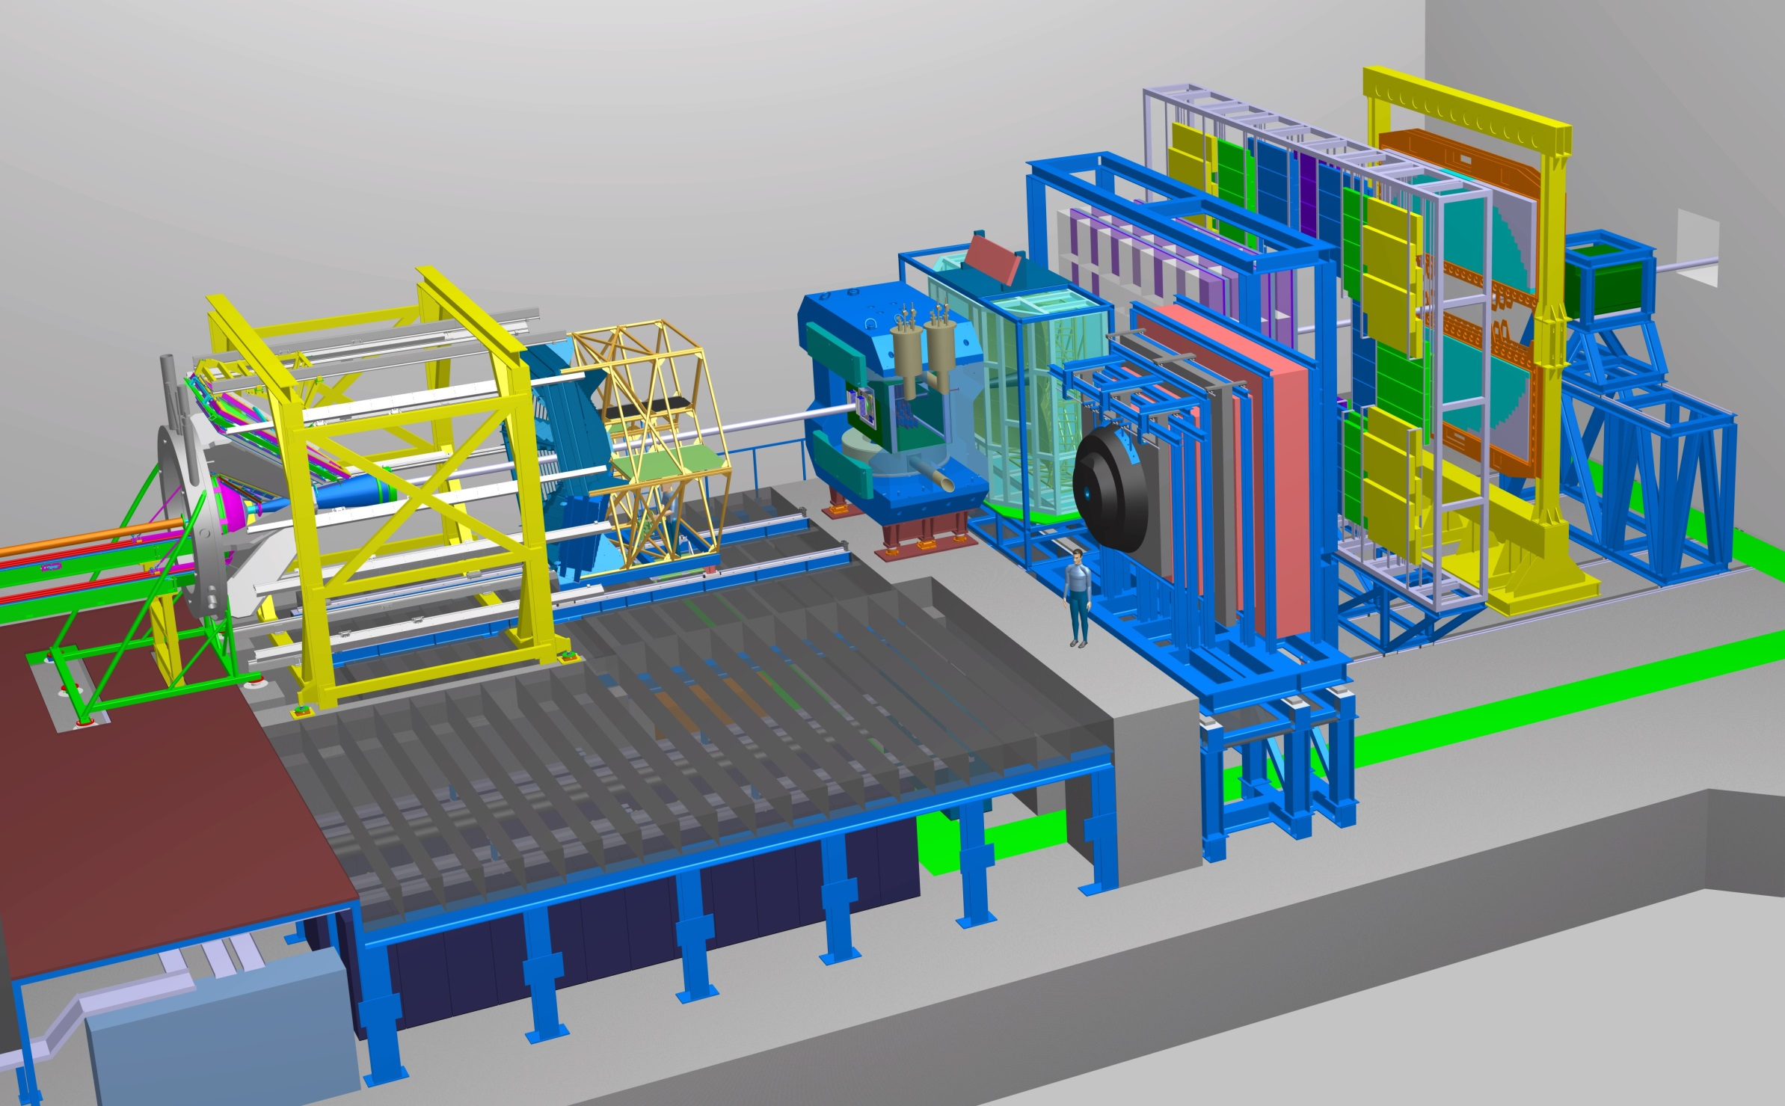
Experimental requirements
Transition
Radiation
Detector
Time of Flight
Detector
Ring
Imaging
Cherenkov
Dipol
Magnet
Silicon
Tracking
System
HADES
p+p, p+A
A+A (low mult.)
Micro
Vertex
Detector
Muon
Detector
Projectile
Spectator
Detector
DAQ/FLES HPC cluster

Slide 34
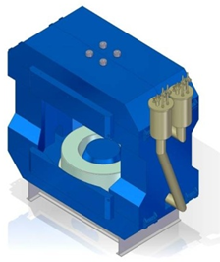
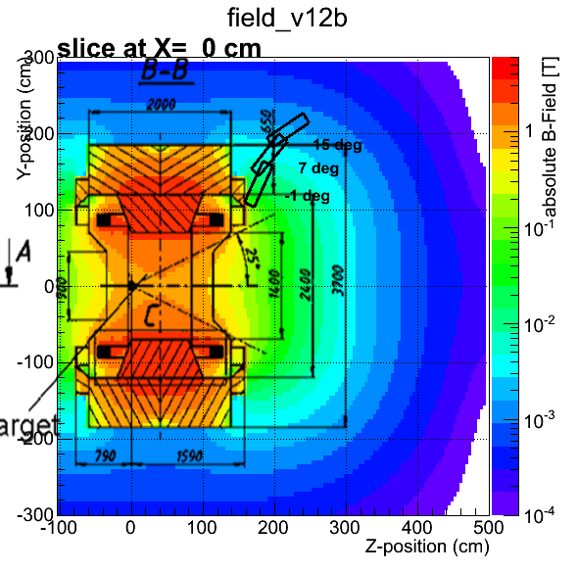
Superconducting Dipole Magnet
Large-acceptance superconducting dipole magnet.
The pole gap is 144 cm, the bending power 1 Tm.
Participating institutes:
JINR Dubna, BINP Novosibirsk, GSI Darmstadt
34

Slide 35
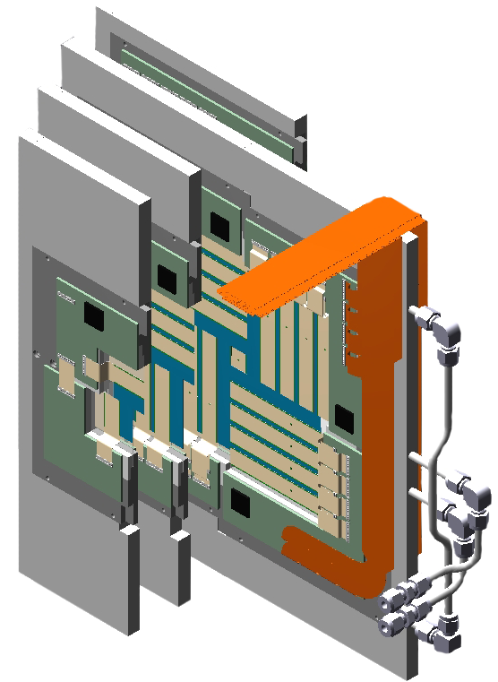
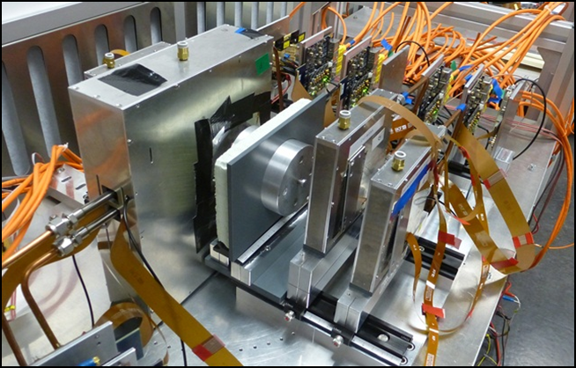
Micro Vertex Detector
➢ Background suppression for di-electron measurements
Determination of secondary vertices of open charm decays (τ = 10⁻¹²-10⁻¹³ s)
Improved tracking for hyperon-ID
The MVD consists of highly granulated Monolithic Active Pixel Sensors (MAPS) arranged in four ultra-thin detector arrays positioned close to the target. Determination of secondary vertices with high precision which is
required for the identification of charmed mesons.
Participating institutes: Univ. Frankfurt, IPHC Strasbourg
35

Slide 36
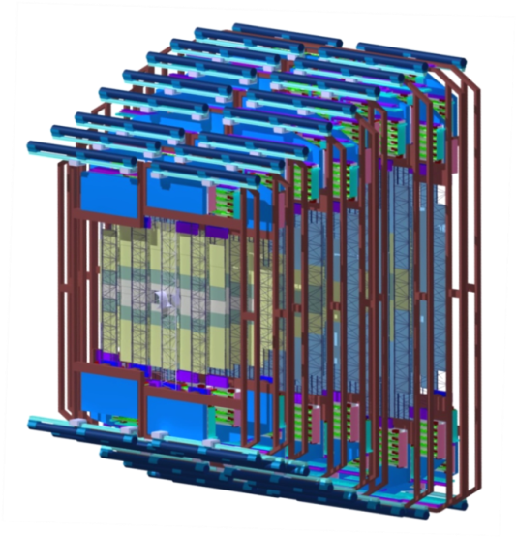
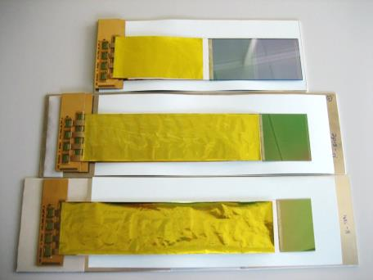
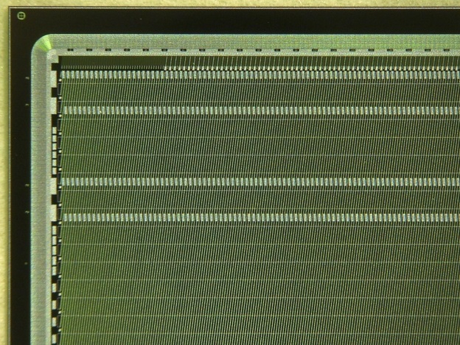
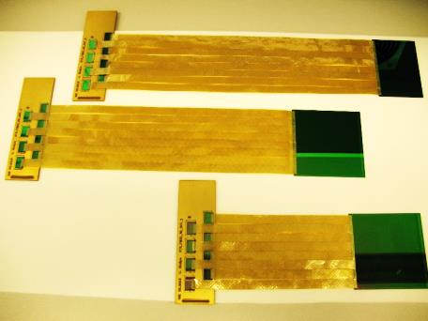
Silicon Tracking System
Silicon microstrip sensors
CiS (Germany), Hamamatsu (Japan)
The STS consists of about 1000 double-sided silicon micro-strip sensors arrangeg in 8 detector arrays located inside the dipole magnet. The detector provides track reconstruction and momentum determination for up to 1000 particles per event. The detector is operated at about -10°C, heat dissipation of the front-end electronics 40 kW, bi-phase CO₂ cooling system
Participating institutes: GSI, Darmstadt, JINR Dubna, KIT,
INR Kiev, AGH and UJ Krakow, Univ. Tübingen, Warsaw UT
36

Slide 37
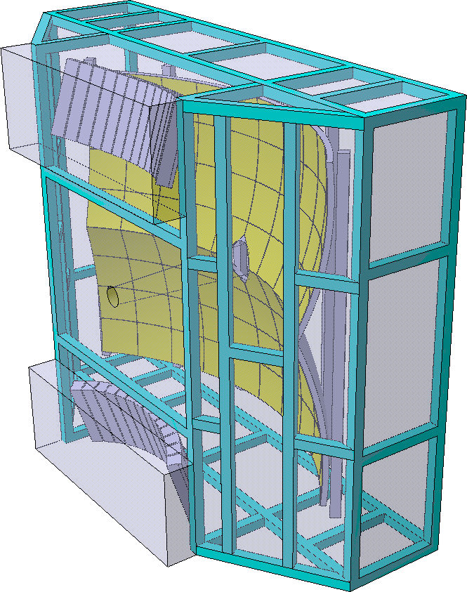
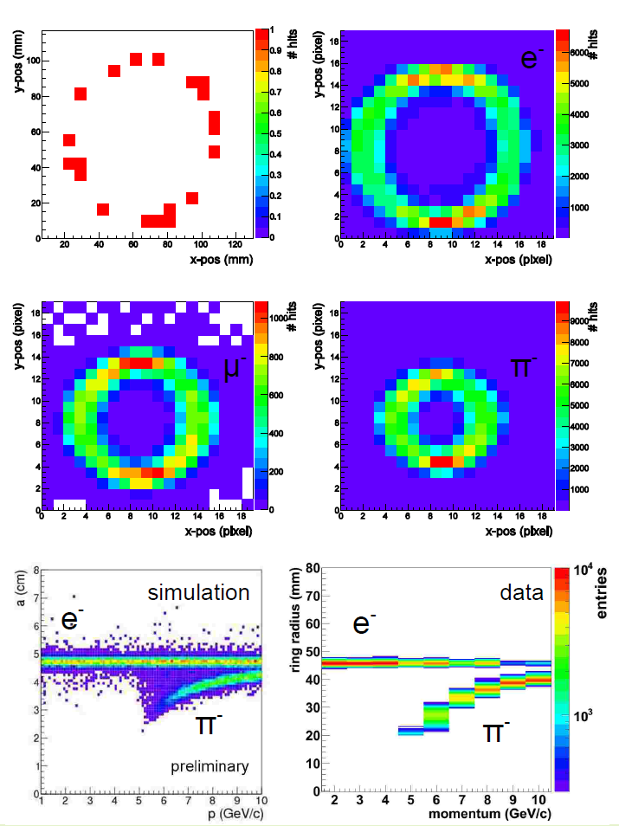
Ring-Imaging Cherenkov (RICH) Detector
The RICH is used for the identification of electrons with momenta below 8 GeV/c (pion suppression factor of more than 500).
Participating institutes:
Univ. Gießen, Univ. Wuppertal, PNPI Gatchina,
37

Slide 38
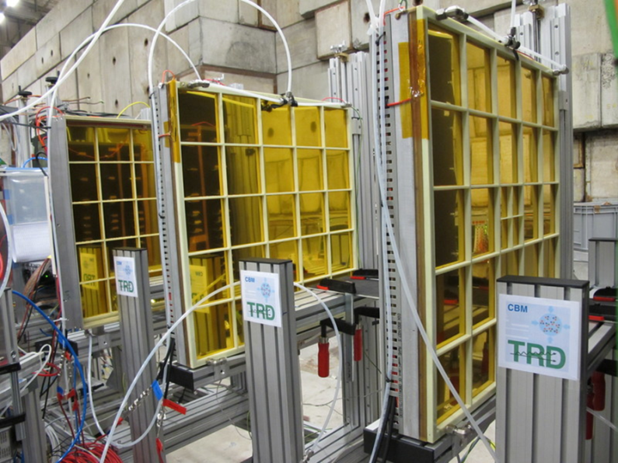
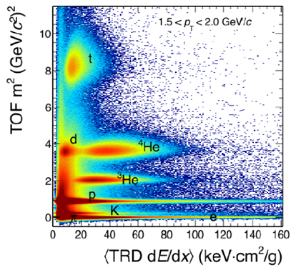
Transition Radiation Detector (TRD)
Challenge: ε(e±)= 90%, ε(π) = 7.5% at 100 kHz/cm²
The TRD consists of 4 detectors layers. It provides identification of electrons with momenta above 1.5 GeV/c, and an energy-loss measurement
Participating institutes:
NIPNE Bucharest, JINR Dubna, Univ. Frankfurt, Univ. Heidelberg,
Univ. Münster
38

Slide 39
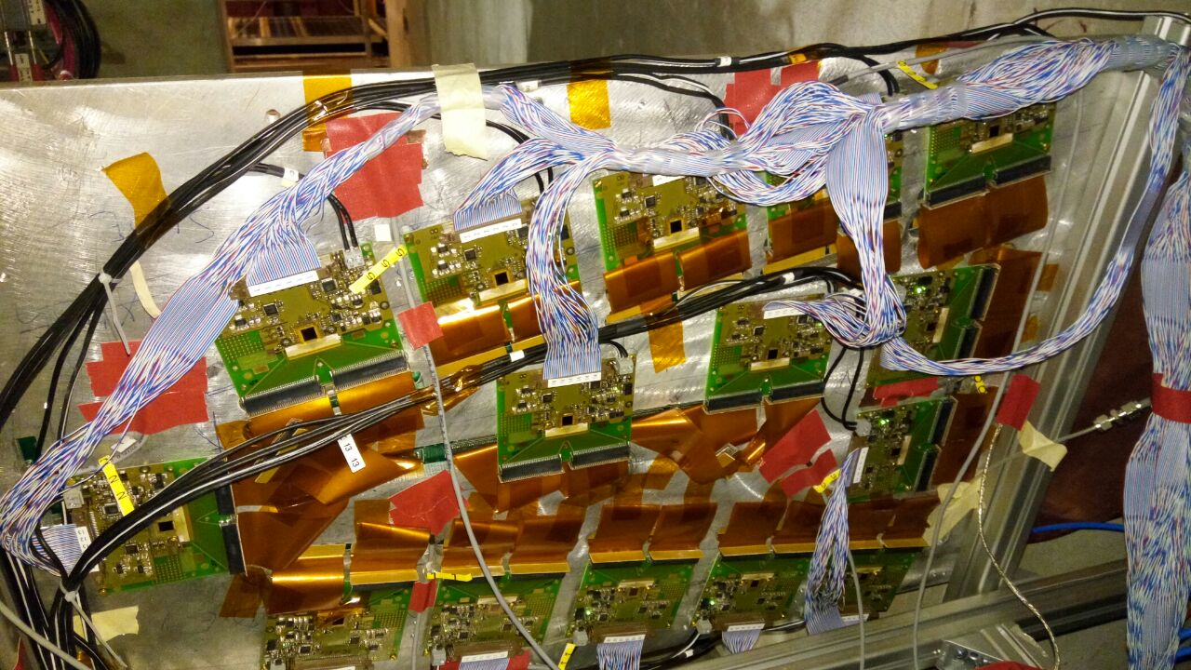
Muon Chamber (MuCh) System
PSD
Full size GEM detectors tested with free-streaming read-out electronics at the CERN-SPS Nov.-Dec. 2016
The MUCH consists of a combination of 15 detector stations sandwiched between one carbon and 4 iron absorber layers for hadron suppression. The MUCH provides the identification of muons with momenta above 1.5 GeV/c.
Tracking station 1+2: Two Gas-Electron-Multiplier (GEM) detector triplets
Tracking station 3+4: two low-resistivity Bakelite trigger RPC triplets
Tracking station 5: four Transition Radiator Detectors (used only as trackers)
Participating institutes: VECC Kolkata + 12 Indian Inst., PNPI Gatchina
39

Slide 40
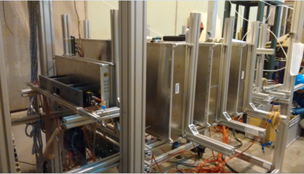
The high-rate MRPC TOF wall
ToF MRPC detectors tested with free-streaming read-out electronics at the CERN-SPS Nov.-Dec. 2016
Multigap Resistive Plate Chambers (MRCP) provide the time-of-flight measurement for hadron identification. Challenge: Time resolution of 60 ps at rates of 25 kHz/cm², inner part low-resistivity glass electrodes, area 100 m²
Participating institutes: THU Beijing, NIPNE Bucharest, GSI Darmstadt, TU Darmstadt, IfI Frankfurt, USTC Hefei, Univ. Heidelberg, ITEP Moscow, HZDR Rossendorf, CCNU Wuhan
40

Slide 41
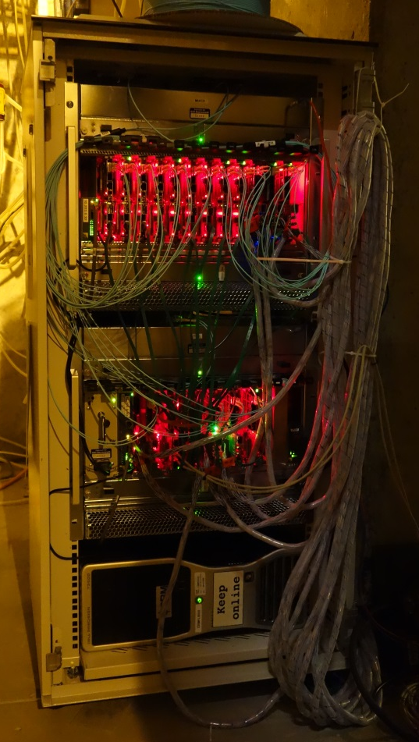
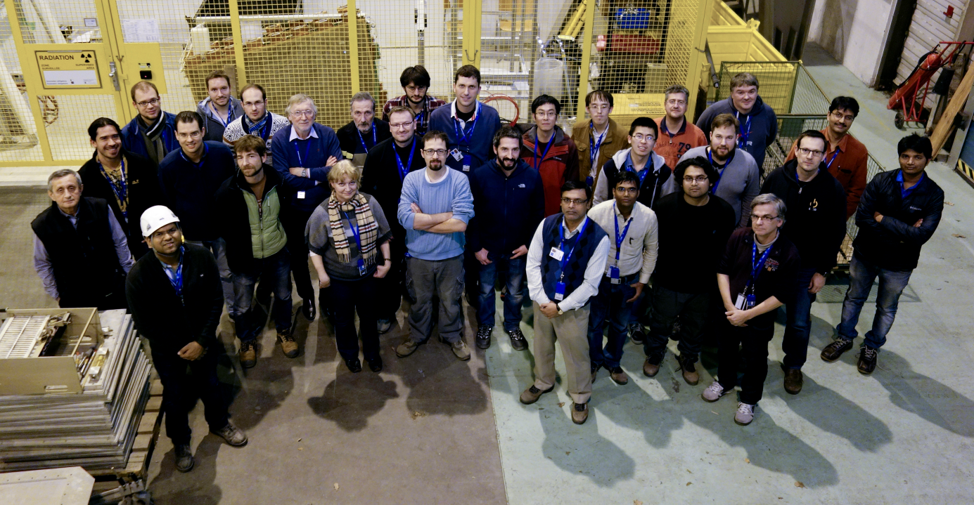

Test beam at CERN Nov.-Dec. 2016
Prototype TOF, MuCh-GEM, TRD and
diamond detectors with common free-
streaming readout system and DAQ.
Pb+Pb collisions at 13, 30 and 160 A GeV.
3 weeks in Nov. – Dec. 2016
Teams from China, Germany, India, Romania
41

Slide 42


Projectile Spectator Detector
Fully assembled PSD module
at INR Moscow
The PSD is a lead-scintillator calorimeter and is used for the determination of the collision centrality and the orientation of the reaction plane.
Participating institutes:
INR Moscow, Prague, Rez, TU Darmstadt
42

Slide 43


CBM online systems
First-level Event Selector
GSI Green IT Cube
CBM features a novel data readout and acquisition system:
no hardware trigger on events, detector hits with time stamps, full online 4-D track and event reconstruction
Participating institutes:
Univ. Frankfurt, FIAS, GSI Darmstadt, KIT Karlsruhe, IIT Kharagpur, Warsaw UT
43

Slide 44



4D reconstruction
Au beam 8 A GeV
one single ion
passing the target
FairIon + GEANT3
Au+Au 8 A GeV
central collision
UrQMD + GEANT3
Au+Au 8 A GeV
peripheral collision
UrQMD + GEANT3

Slide 45

4D reconstruction
Hit time distribution for
Au+Au 10 AGeV mbias events at 10 MHz (UrQMD)
and 10⁹ Au ions/s passing the target (delta electrons)
ns

Slide 46

4D reconstruction
Track time distribution for
Au+Au 10 AGeV mbias events at 10 MHz (UrQMD)
and 10⁹ Au ions/s passing the target (delta electrons)
ns

Slide 47



Simulation and reconstruction
Event generators UrQMD 3.3
Transport code GEANT3, FLUKA
Realistic detector geometries, material budget and detector response
reconstruction
Track reconstruction efficiency
min. bias Au+Au 25 A GeV
Notes:
47
47
47

Slide 48

Online particle identification in CBM:
The KF Particle Finder
successfully used online in the STAR experiment

Slide 49








Simulations: central Au+Au collisions at 8A GeV and 10A GeV
Hyperons at 10 A GeV
Dileptons 8A GeV
D mesons 30 GeV p+Au
e⁺e⁻
µ⁺µ⁻
η
ω
φ
ρ
Hypernuclei at 10 A GeV
D mesons Ni+Ni 15A GeV
Charmonium at 10 A GeV
49

Slide 50

Simulation and reconstruction
Hypernuclei in central Au+Au 10 AGeV

Slide 51
Simulation and reconstruction
Hyperons in
Au+Au 10 AGeV
(dds)
missing mass analysis
(uus)
(uus)

Slide 52


For further reading ...
“Challenges in QCD Matter Physics – the scientific programme of the Compressed Baryonic Matter Experiment at FAIR”
135 contributions, 220 pages
ISBN 978-3-9815227-4-7.
https://repository.gsi.de/record/186952/
files/CBM-PR-2015%20[pdf].pdf
Ablyazimov, T. et al. Eur. Phys. J. A (2017) 53: 60. doi:10.1140/epja/i2017-12248-y

Slide 53




FAIR phase 0 experiments on dense QCD matter
1. Install, commission and use 430 out of 1100
CBM RICH multi-anode photo-multipliers (MAPMT)
in HADES RICH photon detector
2. Install, commission and use
10% of the CBM TOF modules
including read-out chain
at STAR/RHIC (BES II 2019/2020)
3. Install, commission and use 4 Silicon
Tracking Stations in the BM@N experiment
at the Nuclotron in JINR/Dubna
(start 2019 with Au-beams up to 4.5 A GeV)
4. Install, commission and use the
Project Spectator Detector at the
BM@N experiment
53

Slide 54


The CBM Collaboration: 55 institutions, 460 members
China:
CCNU Wuhan
Tsinghua Univ.
USTC Hefei
CTGU Yichang
Czech Republic:
CAS, Rez
Techn. Univ. Prague
France:
IPHC Strasbourg
Hungary:
KFKI Budapest
Eötvös Univ.
Germany:
Darmstadt TU
FAIR
Frankfurt Univ. IKF
Frankfurt Univ. FIAS Frankfurt Univ. ICS
GSI Darmstadt
Giessen Univ.
Heidelberg Univ. P.I.
Heidelberg Univ. ZITI
HZ Dresden-Rossendorf
KIT Karlsruhe
Münster Univ.
Tübingen Univ.
Wuppertal Univ.
ZIB Berlin
Russia:
IHEP Protvino
INR Troitzk
ITEP Moscow
Kurchatov Inst., Moscow
VBLHEP, JINR Dubna
LIT, JINR Dubna
MEPHI Moscow
PNPI Gatchina
SINP MSU, Moscow
Ukraine:
T. Shevchenko Univ. Kiev
Kiev Inst. Nucl. Research
India:
Aligarh Muslim Univ.
Bose Inst. Kolkata
Panjab Univ.
Rajasthan Univ.
Univ. of Jammu
Univ. of Kashmir
Univ. of Calcutta
B.H. Univ. Varanasi
VECC Kolkata
IOP Bhubaneswar
IIT Kharagpur
IIT Indore
Gauhati Univ.
Korea:
Pusan Nat. Univ.
Poland:
AGH Krakow
Jag. Univ. Krakow
Warsaw Univ.
Warsaw TU
Romania:
NIPNE Bucharest
Univ. Bucharest
?
CBM Scientists
29th CBM Collaboration meeting at GSI
20-24 March 2017
54

Slide 55
Possible contributions to CBM
Construction of:
Detector modules (Silicon sensors, MWPCs, RPCs, GEMs)
Supply systems (gas systems, cooling systems, ...)
Mechanical support structures
Contribution to software components for:
Data acquisition and control systems
Online monitoring and calibration
Event reconstruction
Physics analysis
Experiment simulation
Participation in feasilility studies within the physics working groups:
Hadrons and hypernuclei
Dileptons
Open and hidden charm
Collective flow, correlations, fluctuations

Slide 56
Participation in CBM Phase-0 Physics with HADES at GSI starting 2018
Combination of secondary pion, proton and heavy ion beams with a large acceptance dilepton spectrometer - world wide unique.
Improved performance including electron/positron purity and efficiency, RICH upgrade, ECAL, forward tracker and increased DAQ rate capability.
Anticipated runs (each 1 month beam on target):
𝜋 + (CH₂)_{n} / LH₂ / A
  Baryon el. mag. transition form factors (FF), validity of VMD - input to microscopic calculations for rho meson in-medium spectral function
  Strangeness production off cold matter
  Partial Wave Analysis
p + A / p+p: strangeness/vector mesons in medium
  Baryonic resonances with strangeness, vacuum and in-medium
  First measurements of dielectron decays of excited hyperons
  (el. mag. transition FF)
  Production of multistrange hyperons (cascade) close to threshold
  Vector mesons in medium
  Short range correlations
Ag + Ag 1.65 AGeV:
  Multi-strange baryons
  ϕ production study via K⁺K– and e⁺e–
  Dileptons around and beyond vector meson mass region
Highlights
Role of VMD in baryonic resonance decay
(ρ in meson cloud)
In-medium modification of hadrons
Ξ production mechanism
Chiral symmetry restoration
Notes:
Slide for Joint Scientific Council Meeting

Slide 57

Summary
CBM scientific program at SIS100:
Exploration of the QCD phase diagram in the region of neutron
star core densities → large discovery potential.
First measurements with CBM:
High-precision multi-differential measurements of hadrons incl.
multistrange hyperons, hypernuclei and dileptons for different
beam energies and collision systems → terra incognita.
Status of experiment preparation:
Prototype detector performances fulfill CBM requirements.
7 TDRs approved, 4 TDRs in preparation.
FAIR Phase 0:
HADES with CBM RICH photon detector,
use CBM detectors at STAR/BNL and BM@N/JINR
Participation of groups from Iran highly welcome

Slide 59

4D reconstruction
10 MHz Au+Au, 10 AGeV,
300k mbias UrQMD events, ideal PID
 |  | K⁰s | Λ | Λ̅ | Ξ⁻
 | ε_{method}, % | 68.6 | 61.2 | 67 | 46.7
 | ε_{4π}, % | 20.7 | 19.4 | 28 | 10.5
 | S/B | 10.6 | 23.7 | 12.7 | 21.8
 | ε_{method}, % | 68.5 | 62.0 | 62 | 45.2
 | ε_{4π}, % | 21.1 | 20.6 | 32 | 11.7
 | S/B | 9.8 | 12.9 | 10 | 14.2
 | ε_{method}, % | 67.5 | 60.9 | 59 | 46.0
 | ε_{4π}, % | 19.4 | 18.7 | 26 | 10.6
 | S/B | 9.3 | 12.5 | 10 | 12.3
 | ε_{method}, % | 66.8 | 60.0 | 64 | 41.8
 | ε_{4π}, % | 17.6 | 16.7 | 28 | 8.2
 | S/B | 9.2 | 12.2 | 8 | 11.7
3 D
0.1 MHz
1 MHz
10 MHz
all mother particles emitted from one primary vertex

Slide 60
The chiral symmetry of QCD
left-handed quarks
right-handed quarks
Possible for massive quarks only!
inertial system with opposite velocity
Chiral symmetry ➔ quarks are massless
Broken chiral symmetry ➔ quarks are massive

Slide 61

The chiral symmetry of QCD
Chiral symmetry is broken in nature:
Explicit breaking (Higgs mechanism):
m_{u} ≈ 5 MeV, m_{d} ≈ 10 MeV, m_{s} ≈ 150 MeV
Spontaneous/dynamical breaking:
Hadrons acquire mass by coupling to the
virtual quark-antiquark pairs of the chiral condensate
<qq> ≠ 0
physical vacuum:
q q-bar condensate
<qq> = 0
© J. Stroth

