Slide 1
Use cases of FairLinks
FairLink is a unique pointer to any object stored in a TTree (even in different files)
Main purpose: Propagation of MC information
Possible to point to different types of (MC) information (MC Track, MC Point, …)
Possible to have more than one MC information
FairLinks as meta data very powerful
Looking at FairLinks immediately tells how pure a reconstruction step was
Additional use cases
Combination of different types of data e.g. track candidates
Ideal track finder

Slide 2
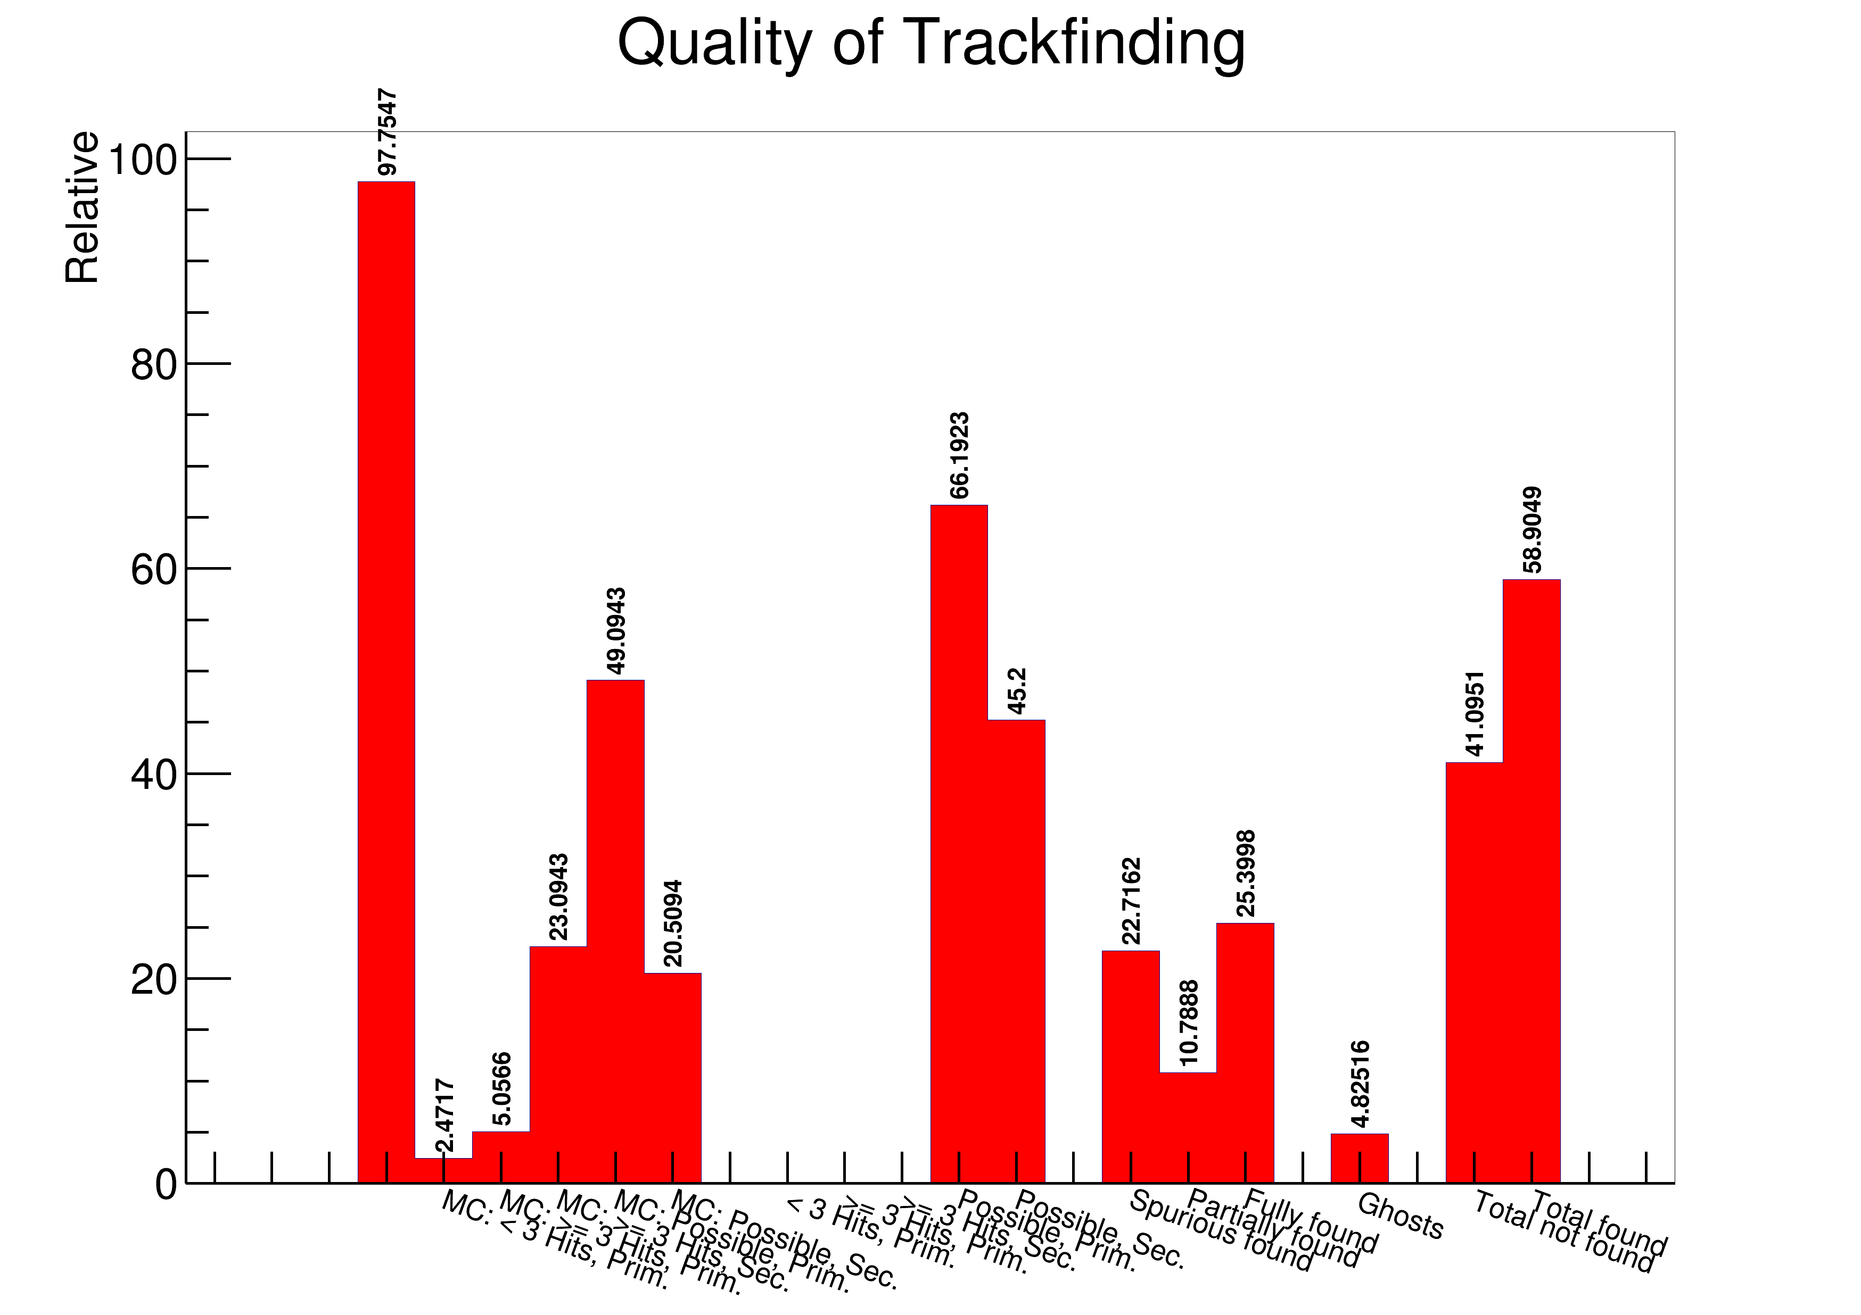
Example

Slide 3
Connections FairRoot with FairLinks
FairRootManager::GetBranchName and FairRootManager::GetBranchId
Conversion of branch name into the TypeId of the FairLinks
TObject* FairRootManager::GetCloneOfLinkData(FairLink)
Return of a pointer to an object a FairLink is pointing to
Automatic assignment of EntryNr
EntryNr is a FairLink to the object itself
In event-based simulation it is easy to generate this information by the way the object is accessed
In time-based simulation you do not know from which entry in the branch the data is coming from ➔ no easy way how to get this information
Automatic assignment of EntryNr in FairRootManager::GetData
| Tobias Stockmanns

