Slide 1
Torino, June 15th, 2009
Status of the Pattern Recognition with the Hough
transform and the STT system alone.
Gianluigi Boca

Slide 2
Parametrization of the Helix trajectory
x – x₀ = Rcos(Kz + ϕ₀)
y – y₀ = Rsin(Kz + ϕ₀)
Y
ϕ = Kz + ϕ₀
P(x ,y, z)
5 parameters :
R
x₀ ≡ abscissa of center of
cylinder
(x₀ ,y₀)
ϕ
y₀ ≡ ordinate of center of
cylinder
ϕ₀ ≡ azimuthal angle at z = 0
R ≡ radius of cylinder
Z
K ≡ rate of increase of ϕ
X

Slide 3
Last collaboration meeting status and problems
……the program gets very slow, about 87 hours of CPU for an
event with a single track, 15 hits in the straws parallel to the Z
axis and 10 hits in the skew straws ! This is on a 2.0 GHz clock
AMD Athlon 3000+ processor
NO WAY!

Slide 4
First challenge :
speeding up the code

Slide 5
Improvements since then
First step unchanged : calculate all possible circles on the XY plane
with all possible triplets of parallel straws.
Also added cut : il R of circle < 20 cm DISCARD IT → 33% reduction
in the # of combinations
drift circumference
Y
Here I show only 3 of the
8 possible circles
X

Slide 6
Improvements since then
Second step changed : do the Hough trasform plot for the x₀, y₀
R (actually it turned out it is more efficient to use D and
Φ ) parameters of the Helix first
drift circumference
Y
x₀
,y₀
D
Φ
X

Slide 7
Improvements since then
Second step changed : do the Hough trasform plot for the x₀, y₀
R (actually it turned out it is more efficient to use D and
Φ ) parameters of the Helix first
Φ
R
D
D
R
Φ

Slide 8
Improvements since then
Third step (NEW) : use the values of R, D and Φ found from
the Hough transform for the trajectory circle. With such circle do
all possible combinations with the skew straws (in this way much
less combinations → much faster algorithm)

Slide 9
Improvements since then : finding of the two remaining
parameters of the Helix : K and ϕ₀
NEW : change coordinates from x, y on the surface
of the trajectory cylinder to z, ϕ of the cylindrical coordinates :
it is like ‘cutting’ the trajectory cylinder at ϕ = 0 and spreading it
on a plane
Y
cut here
P(x ,y, z)
R
(x₀ ,y₀)
ϕ
Z
X
9

Slide 10
Improvements since then : finding of the two remaining
parameters of the Helix : K and ϕ₀
NEW : change coordinates from x, y on the surface
of the trajectory cylinder to z, ϕ of the cylindrical coordinates :
it is like ‘cutting’ the trajectory cylinder at ϕ = 0 and spreading it
on a plane
ϕ = Kz + ϕ₀
ϕ
2π
z
The Helix trajectory is a sequence of straight lines

Slide 11
Improvements since then : finding of the two remaining
parameters of the Helix : K and ϕ₀
…. and the intersection between the skew straws equidrift cylinder
and the cylinder of the Helix trajectory now contains all the
mathematical ugliness since the dependence of ϕ as a function of
Z is nasty BUT
ϕ
Helix trajectory
cylinder
2π
Skew straws
intersection
Helix trajectory
Helix trajectory
z
The Helix trajectory is a sequence of straight lines

Slide 12
T
P
N
Y
Cylinder on which the
helix lies
Helix
equidrift cylinder of
the skewed straw
Z
T = tangent to helix
X
N = perpendicular to equidrift cylinder

Slide 13
Improvements since then : finding of the two remaining
parameters of the Helix : K and ϕ₀
…. and the intersection between the skew straws equidrift cylinder
and the cylinder of the Helix trajectory now contains all the
mathematical ugliness since the dependence of ϕ as a function of
Z is nasty BUT
ϕ
Helix trajectory
cylinder
2π
Skew straws
intersection
Helix trajectory
Helix trajectory
z
The Helix trajectory is a sequence of straight lines

Slide 14
NO MORE ITERATIVE SOLUTIONS !
…. it turns out that one can approximate the skew straw intersections
with an ellipse. So the Hough transform in this space reduces to
finding those pieces of straight lines tangent to two ellipses.
Analytical solution, NO ITERATIONS. Much better !!!
ϕ
Helix trajectory
cylinder
2π
Skew straws
intersection
Helix trajectory
Helix trajectory
z

Slide 15
NO MORE ITERATIVE SOLUTIONS !
also, when there is more than 1 turn one can
imagine to shift one skew straw intersection
up by 2π so that now the problem reduces to finding ONE straight line tangent to two
ellipses
Skew straws
intersection
shifted
ϕ
Helix trajectory
Helix trajectory
cylinder
2π
Skew straws
intersection
Helix trajectory
Helix trajectory
z

Slide 16
By the way, this new way of looking at the problem shows immediately
that there are a denumerable infinity of solutions corresponding to a
given number of turns
No turns, 4 solutions
ϕ
Helix trajectory
cylinder
2π
Helix possible trajectories
Skew straws
intersection
z

Slide 17
1 turn, 8 more solutions
ϕ
Helix trajectory
cylinder
2π
Helix possible trajectories
z

Slide 18
1 turn, 8 more solutions
2 turns, 8 more solutions
…and so on.
I consider only the 0 and 1 turns solutions under the
assumption that for a real track the majority of the
skew straw hits will be less than 1 turn contiguous

Slide 19
A further ESSENTIAL semplification
(an example from a μ track of P┴ = P_{z} = 1 Gev/c)
I notice that due to the geometry and small inclination ( 3°) of the skew straws the tangency of the straight line essentilly occurs at the edges of the ellipses
ϕ
Helix trajectory
cylinder
Helix trajectory
skewed straw
intersection
z
ϕ
Consequently a further essential
semplification is possible in the
algorithm : instead of tangency just find the straight line passing
through the edges of the ellipses !
Helix trajectory
cylinder
Helix trajectory
z

Slide 20
This is demonstrated further by
this picture of all the skew
straws intersections projected onto the ϕ z diagram
ϕ
skewed straw
intersections
MC true helix trajectory
z
Consequently a further essential
semplification is possible in the
algorithm : instead of tangency just find the straight line passing
through the edges of the ellipses !
Hough transform algorithm now gets superfast

Slide 21
Just to start, a simple example :
a one μ track of P┴ = P_{z} = 1 Gev/c event
without the 150 μm resolution smearing in
the straw tube drift radius

Slide 22
Hough transform plot for the R, D and Φ parameters of the Helix
drift circumference
Y
x₀
,y₀
R
D
Φ
X

Slide 23
Hough transform plot for the R, D and Φ parameters of the Helix
maximum in the Hough transform plot
R
Φ
D

Slide 24
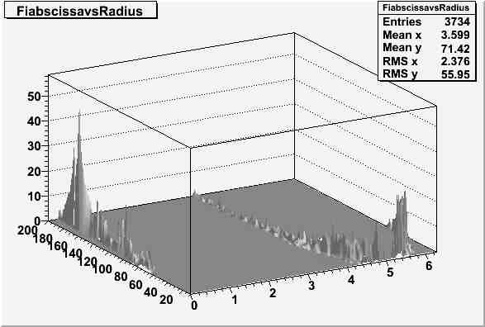
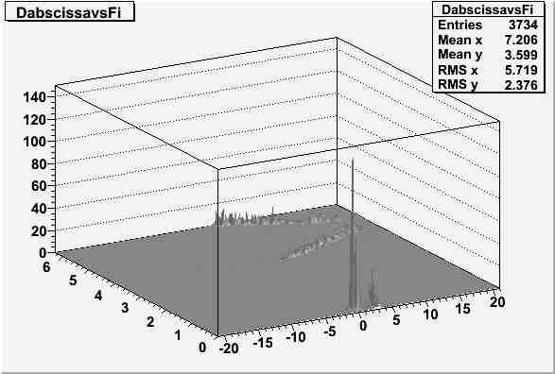
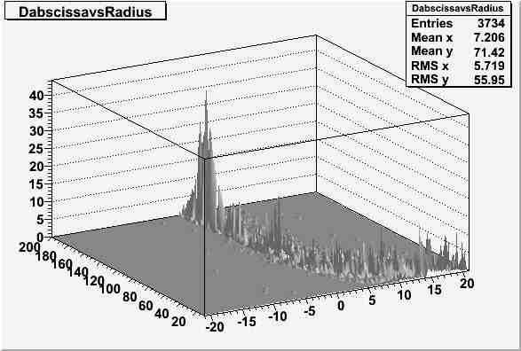
An example from one μ track of P┴ = P_{z} = 1 Gev/c : Hough transform
plot for the R, D and Φ parameters of the Helix projected in the XY
plane (notice though that in this particular MC it is still assumed an
‘ideal’ drift radius)
Projections of the 3-D Hough plot
maximum
R
Φ
Φ
D
R
D

Slide 25
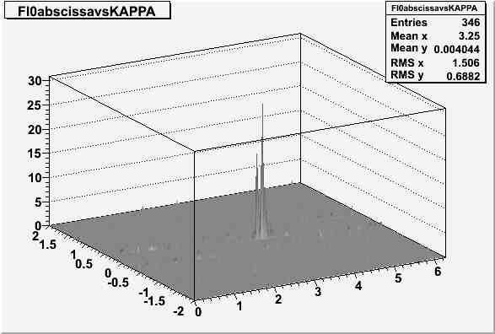
An example from a μ track of P┴ = P_{z} = 1 Gev/c : Hough transform
plot for the K and ϕ₀ parameters of the Helix (notice though that in
this particular MC it is still assumed an ‘ideal’ drift radius)
maximum in the Hough transform plot
K
ϕ₀

Slide 26
An example from one μ track of P┴ = P_{z} = 1 Gev/c : hit collection
(notice though that it is still assumed an ‘ideal’ drift radius, see below
for the results with a ‘real’ drift radius)
result of the parallel straws hit collection
result of the skew straw hit collection
ϕ
y
Helix trajectory found
x
z
Helix trajectory found
Things work rather well at this level, the track finding efficiency is
basically 100 % and so is the collection of hits belonging to a track

Slide 27
Further code written
Once all 5 parameters of the Helix are found with the Hough transform
plots, it is necessary to collect all the hits in the straw system belonging
to the Helix. At this point it is also possible to determine the x-y-z
positions and errors of the hits : DONE
In the previous example there was only 1 track, but of corse it is
necessary to allow possibly for up to 10 tracks, so the code must find
up to 10 peaks in the Hough plots. I think this is one of the most
difficult tasks since unfortunately a computer is not like the human
eye and brain : DONE BUT NOT SATISFACTORY YET , see below

Slide 28
…..also :
used the latest geometry with part of the carbon supports and the
slit for the target pipe
used the 150 μm resolution effect in the straw drift radius
simulated 1, 2 and 3 tracks per event, each track with 0.5, 1, 2, 3 GeV/c
momentum . The tracks are generated uniformly over the solid
angle in the range 15° < θ < 160° and 0° < ϕ < 360°
with all this life becomes much more complicated !

Slide 29
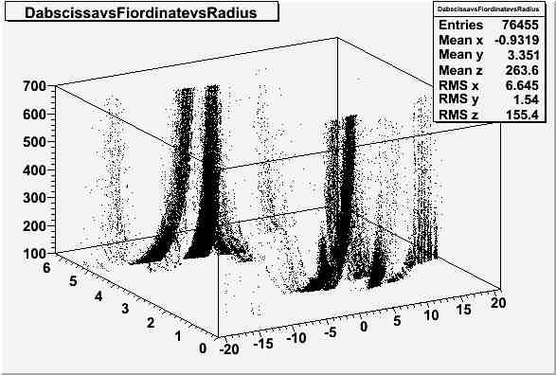
Hough transform plot for the R, D and Φ parameters of the Helix for
a 3 track event, 1 GeV/c each
R
Φ
D

Slide 30
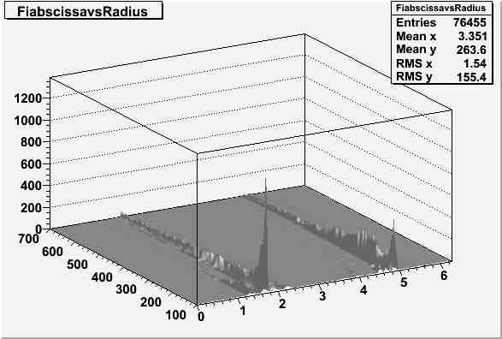
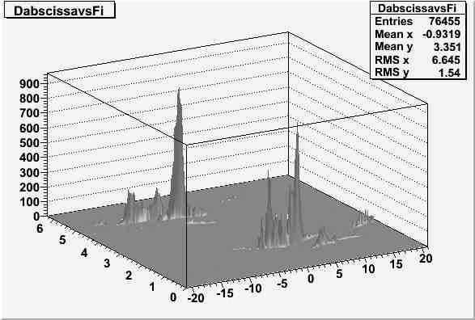
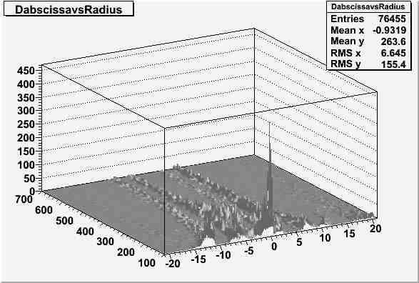
Hough transform plot for the R, D and Φ parameters of the Helix for
a 3 track event, 1 GeV/c each
Projections of the 3-D Hough plot
R
Φ
Φ
D
R
D
30

Slide 31
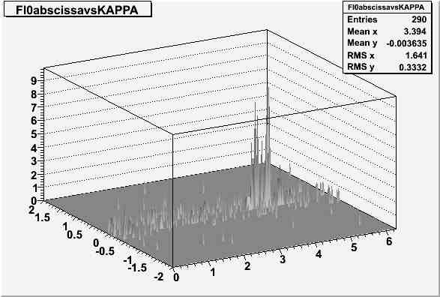
Hough transform plot for the K and ϕ₀ parameters of the Helix for
a 3 track event, 1 GeV/c each
K
ϕ₀
31

Slide 32
The good news
At the March collaboration meeting :
……the program gets very slow, about 87 hours of CPU for an
event with a single track, 15 hits in the straws parallel to the Z
axis and 10 hits in the skew straws ! This is on a 2.0 GHz clock
AMD Athlon 3000+ processor
AND NOW ?

Slide 33
Total P (Gev/c) | # generated tracks | Cputime/event (sec)
0.5 | 1 | 0.11
0.5 | 2 | 0.12
0.5 | 3 | 0.15
1.0 | 1 | 0.10
1.0 | 2 | 0.13
1.0 | 3 | 0.14
2.0 | 1 | 0.11
2.0 | 2 | 0.13
2.0 | 3 | 0.15
3.0 | 1 | 0.10
3.0 | 2 | 0.12
3.0 | 3 | 0.10
Of course I need to check the Cputime/evt up to 10 track per event
but for now I can say the algorithm is fast

Slide 34
The bad news

Slide 35
Total P (GeV/c) | Generated tracks | Found R, D, Φ (%) | Found K, ϕ₀ (%) | Hits belonging to Helix found in parallel straws (%) | Hits belonging to Helix found in skew straws (%) | Spurious tracks found (%)
0.5 | 1 | 89 | 80 | 100 | Bad | 80
0.5 | 2 | 44 | 13 | 100 | Bad | 11
0.5 | 3 | 86 | 85 | 100 | Bad | 112
1.0 | 1 | 92 | 85 | 100 | Bad | 85
1.0 | 2 | 83 | 83 | 100 | Bad | 83
1.0 | 3 | 94 | 93 | 100 | Bad | 154
2.0 | 1 | 84 | 82 | 100 | Bad | 12
2.0 | 2 | 82 | 81 | 100 | Bad | 81
2.0 | 3 | 83 | 83 | 100 | Bad | 110
3.0 | 1 | 56 | 49 | 100 | Bad | 22
3.0 | 2 | 63 | 54 | 100 | Bad | 54
3.0 | 3 | 76 | 66 | 100 | Bad | 69

Slide 36
In summary :
the algorithm has been tested for events with up to 3 tracks for
the time being;
when it works, the algorithm works VERY well in finding the
true track parameters R, D and Φ, the hits of the straws
parallel to the Z axis and it works quite badly in finding the
parameters K and ϕ₀ and the the hits of the skew straws.
EXAMPLES

Slide 37
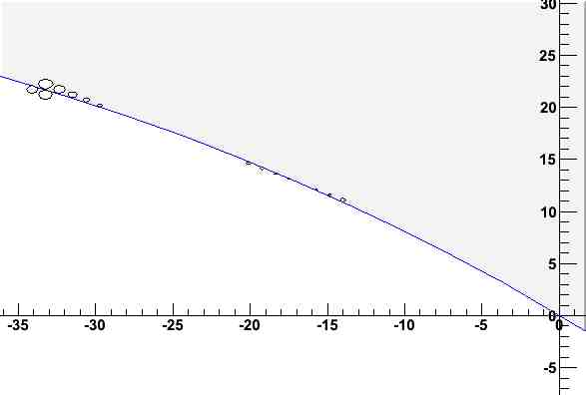
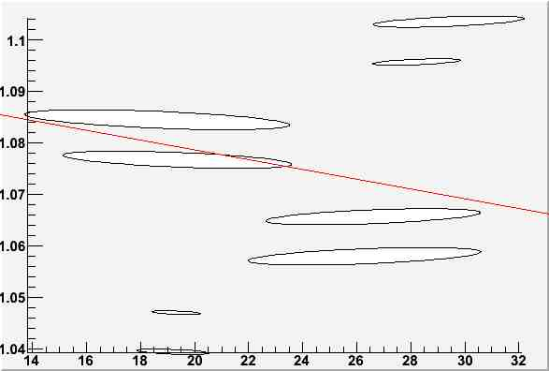
example : 1 track generated, 1 GeV/c total momentum
y
Helix found in XY plane
x
Helix ‘found’ in ZΦ plane
ϕ
z

Slide 38
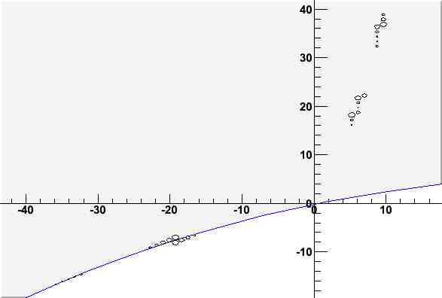
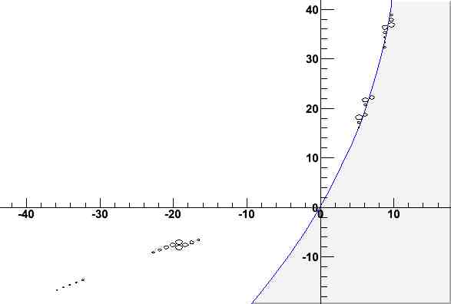
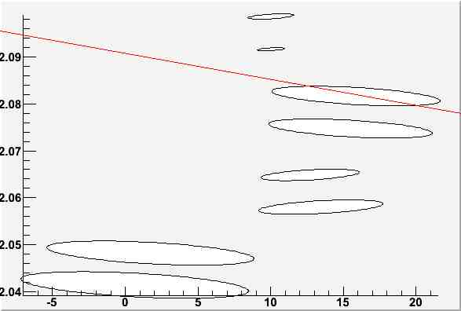
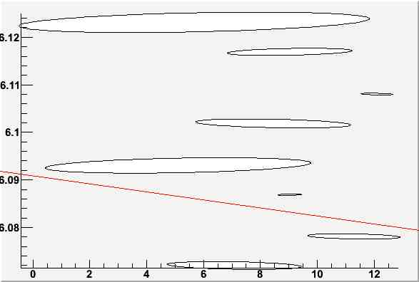
example : 2 tracks generated, 1 GeV/c total momentum each
y
y
Helix found in XY plane
Helix found in XY plane
x
x
ϕ
Helix ‘found’ in ZΦ plane
ϕ
Helix ‘found’ in ZΦ plane
z
z

Slide 39
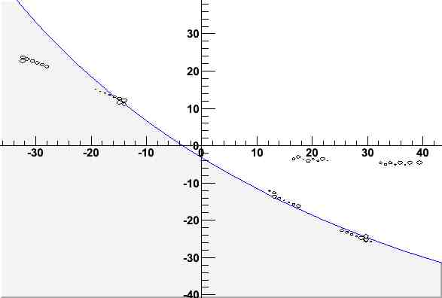
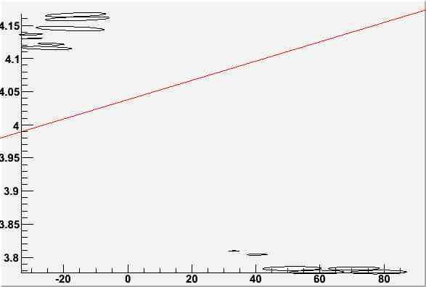
example : 3 tracks generated, 1 GeV/c total momentum each
y
Helix found in XY plane
x
Helix ‘found’ in ZΦ plane
ϕ
z

Slide 40
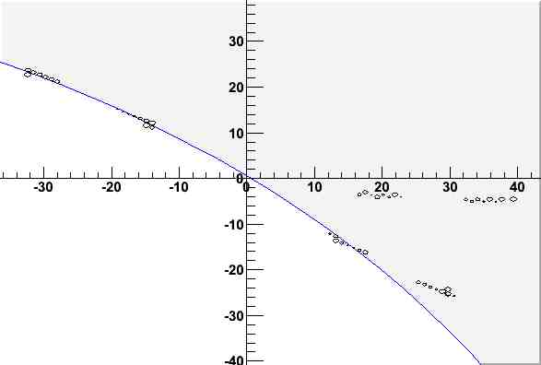
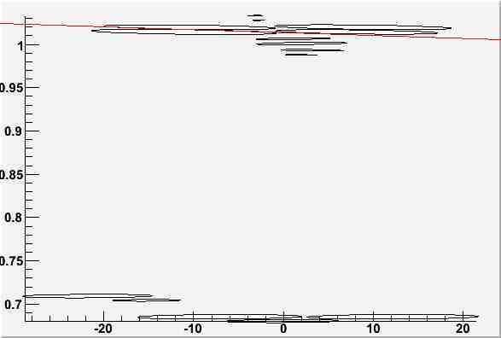
example : 3 tracks generated, 1 GeV/c total momentum each
y
Helix found in XY plane
x
ϕ
Helix ‘found’ in ZΦ plane
z

Slide 41
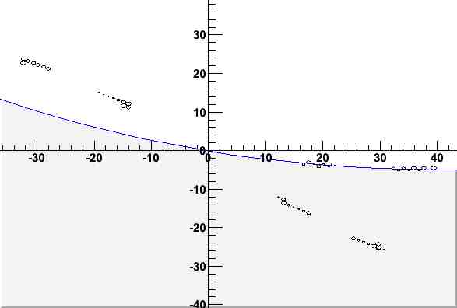
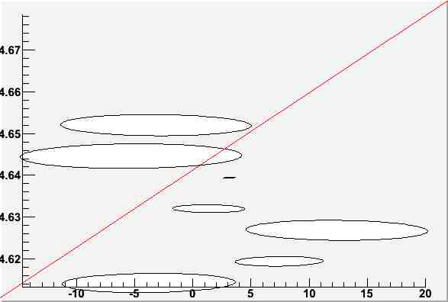
example : 3 tracks generated, 1 GeV/c total momentum each
y
Helix found in XY plane
x
Helix ‘found’ in ZΦ plane
ϕ
z

Slide 42
Future plans
I will concentrate first on the peak finding algorithm that is one of
the key steps of this track finder. I will work to make it 100%
efficient in the case of 1 track only for any type of track of any
reasonable momentum and to eliminate as much as possible
fake combinations
Then I will abandon the idea of analysing all the parallel hits
together and find all the tracks in the XY plane at once because
that’s not efficient.
I will rather try to combine hits in ‘roads’ in the XY plane in
order to have less confusion in the Hough plots

Slide 43
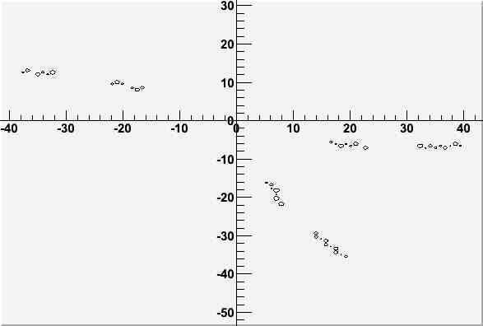
EXAMPLE
use the first hits to find circle and select only hits
that are reasonably close to it. Only with those hits
do the Hough plots.

Slide 44
Conclusions
Algorithm is very fast now thanks to the use of the Z ϕ space
and semplifying assumptions of the mathematics behind it.
The peak finding in the Hough plots is now the key issue and the
toughest. One one hand that’s not surprise since finding shape
patterns with a computer algorithm is generally very difficult.
In this case the problem is even worse since the algorithm
cannot be to slow.
To deal with the multitrack case I will try to find suitable ‘roads’
such that I will reduce the problem in somesense to the single
track case.

