Slide 1
Differences of PWO crystals
with different levels of the radiation hardness

Slide 2
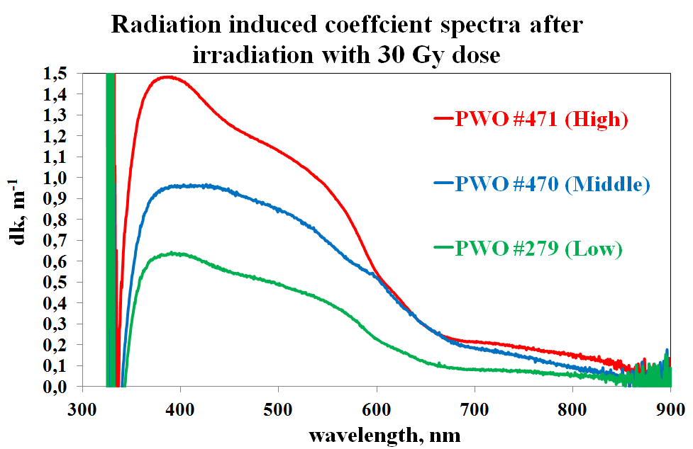
Three samples of Forward EndCap geometry produced at 2009 were chosen for tests
Samples were irradiated with 11 doses (Gy):
Before and after the irradiation with every dose
Light Yield and Longitudinal Optical Transmittance were measured at room temperature.
Measurements were done in 30 minute after the irradiation
0.3 | 0.5 | 0.7 | 1 | 3 | 5 | 10 | 30 | 50 | 100 | 200

Slide 3
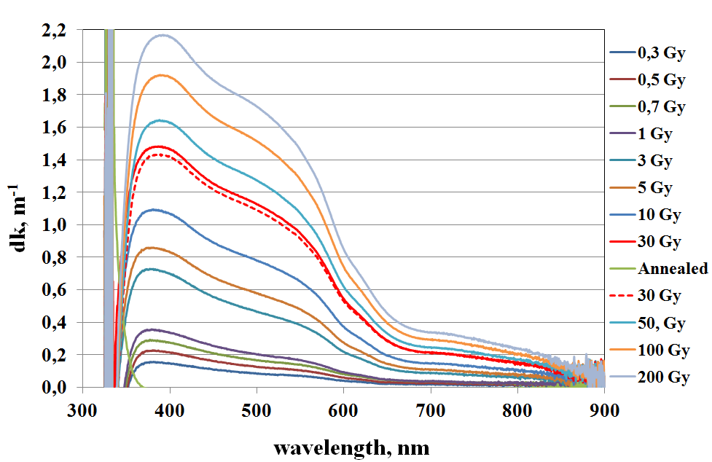
Radiation induced coefficient spectra of the sample with High level of the radiation damage

Slide 4
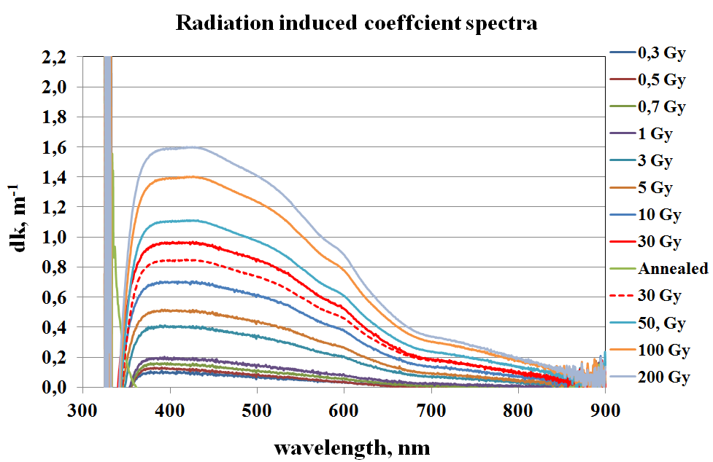
Radiation induced coefficient spectra of the sample with Middle level of the radiation damage

Slide 5
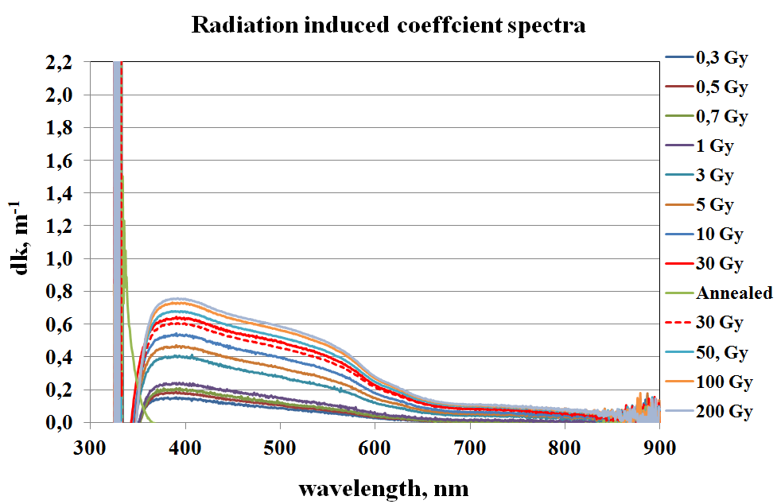
Radiation induced coefficient spectra of the sample with Low level of the radiation damage

Slide 6
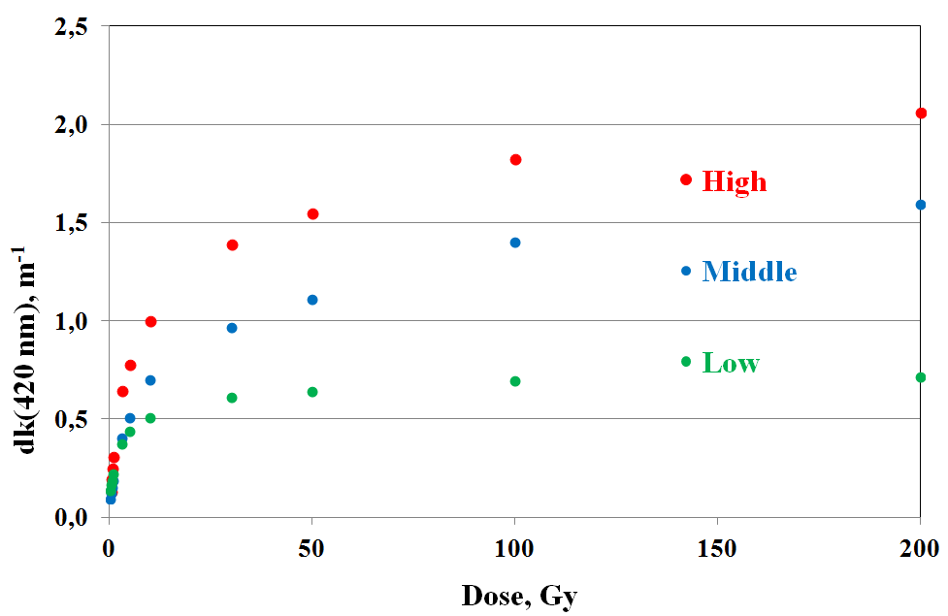
Radiation induced coefficient vs dose

Slide 7
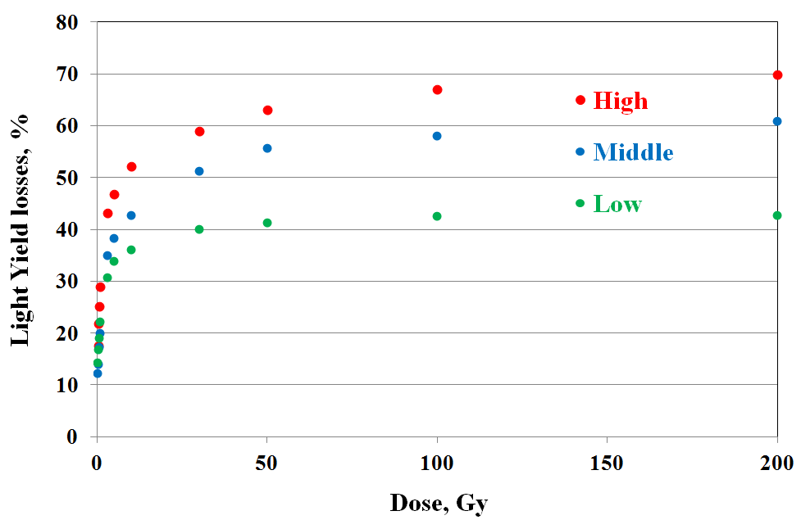
Light Yield losses vs dose
12-17 % Light Yield losses after irradiation with 0.3 Gy dose

Slide 8
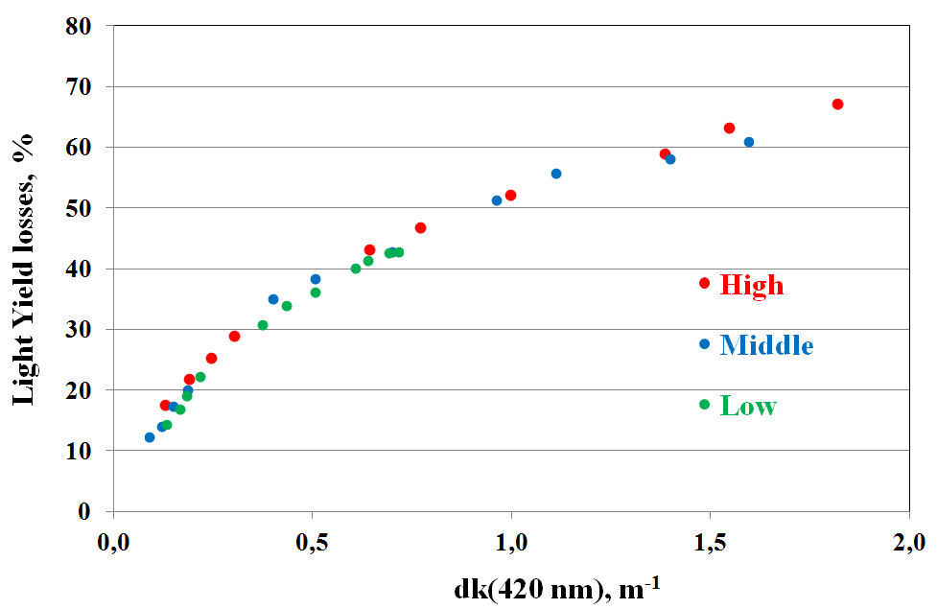
Light Yield losses vs radiation induced coefficient

Slide 9
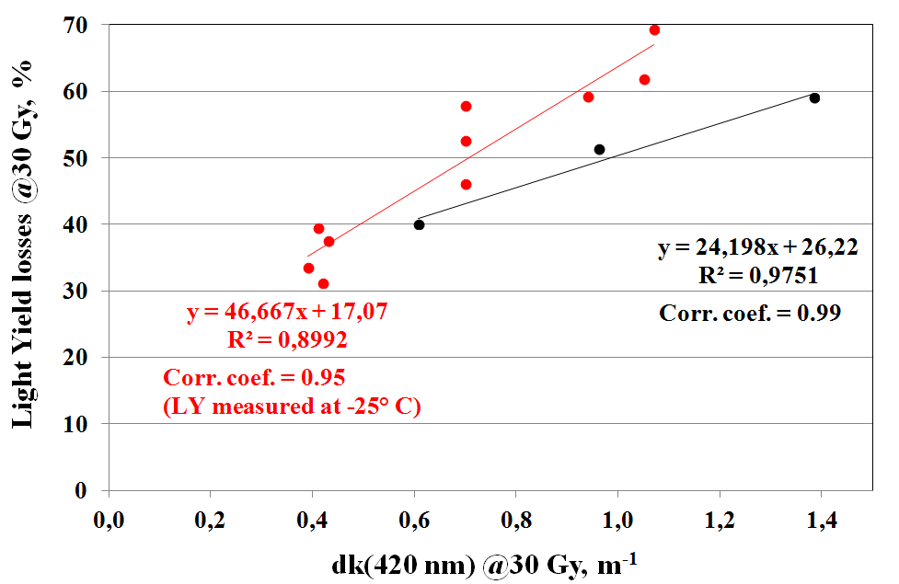
Correlation of Light Yield losses vs dk
after 30 Gy dose irradiation

Slide 10
Summary
All crystals show significant level of the Light Yield losses at relatively low doses
The same dk value gives the same level of the Light Yield losses independently on crystal quality (amount of color centers)
It has a sense to do crystals selection according to the radiation hardness level (dk) before mounting of the calorimeter
Tests at -25° C are needed

