Slide 1
Hyperon Spectroscopy Status Report
Mar 8, 2017 | Albrecht Gillitzer, IKP Forschungszentrum Jülich
PANDA Collaboration Meeting 17/1, GSI Darmstadt, March 6-10, 2017

Slide 2
Items
Requirements to FTS detectors
Modified EMC acceptance
Fitting decay tree with longlived charged particles ($Ξ^{−},Ω^{−},Σ^{±}$)
First results on simulation & analysis of $\overline{p}p→Ξ^{−}{\overline{Ξ}}^{+}π^{0}$

Slide 3
Part I: Required Completeness of FTS
4.4 GeV/c $\overline{p}p→{\overline{Ξ}}^{+}{Ξ\left(1820\right)}^{−}→{\overline{Ξ}}^{+}ΛK^{−}→\overline{p}π^{+}π^{+}pπ^{−}K^{−}$
$\sqrt{s}−\sqrt{s_{thr}}=52 MeV$
full sim chain for 400000 events, available for analysis
analysis of sim_complete.root to get detector ‚points‘
analysis #1: combined MCTrack & FTSPoint information with focus on hit distribution on the 6 FTS planes
analysis #2: combined MCTrack & MVDPoint, STTPoint, GEMPoint, FTSPoint information, focus on overall hit distribution

Slide 4
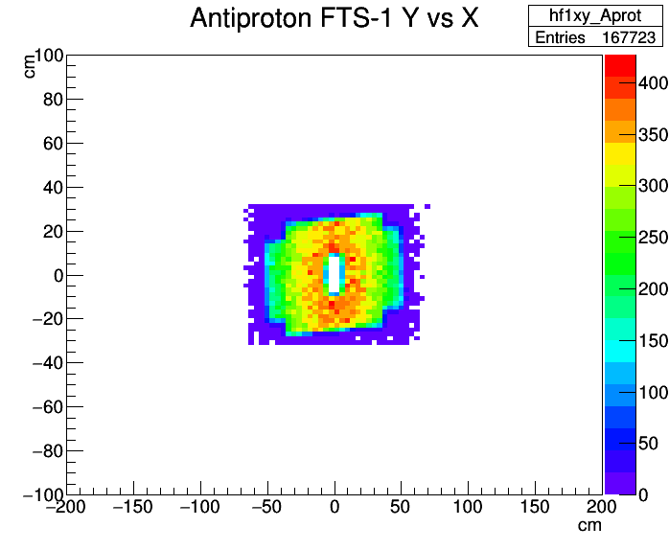
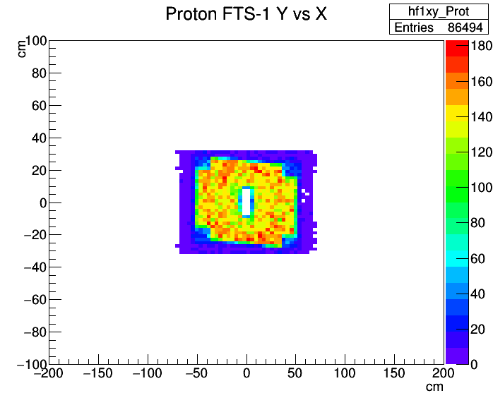
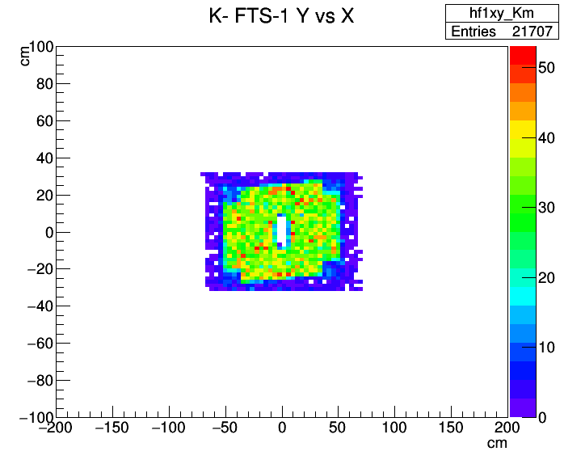
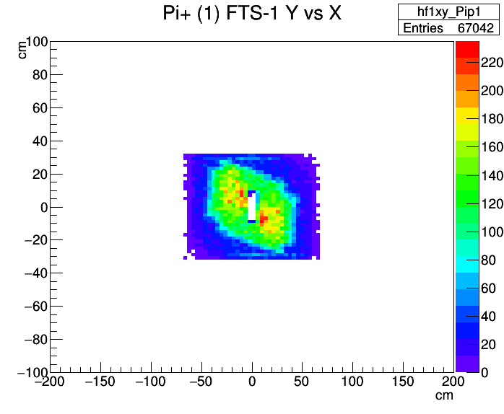
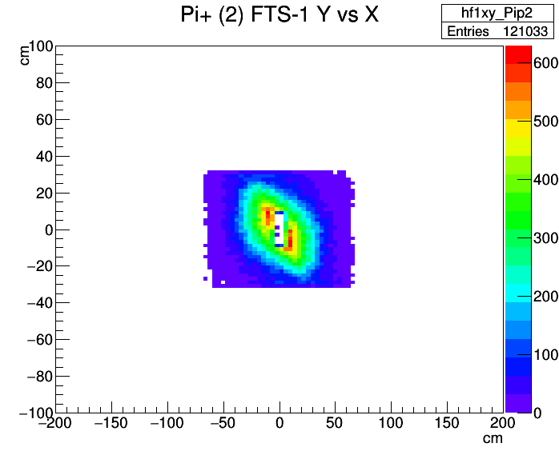
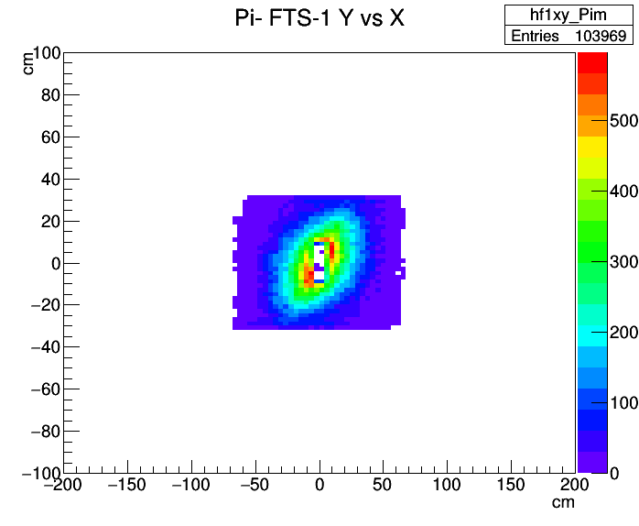

Slide 5
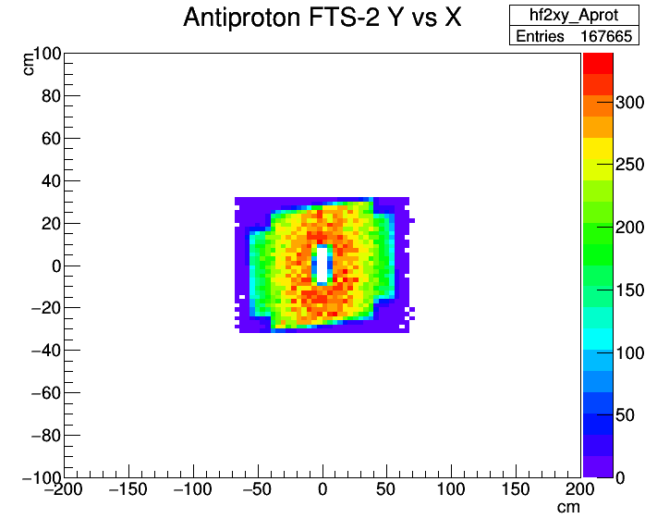
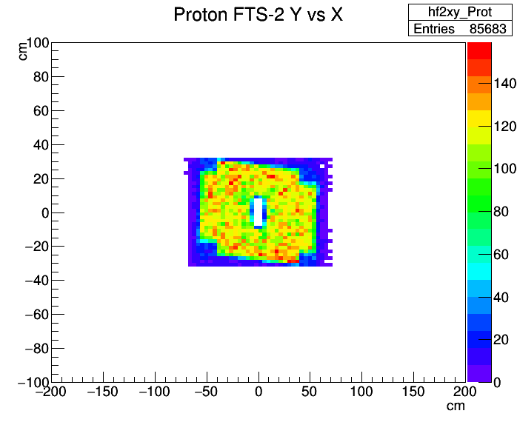
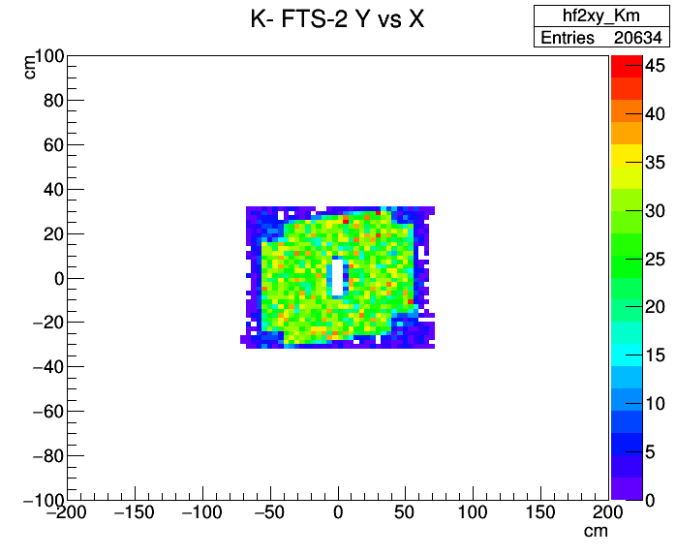
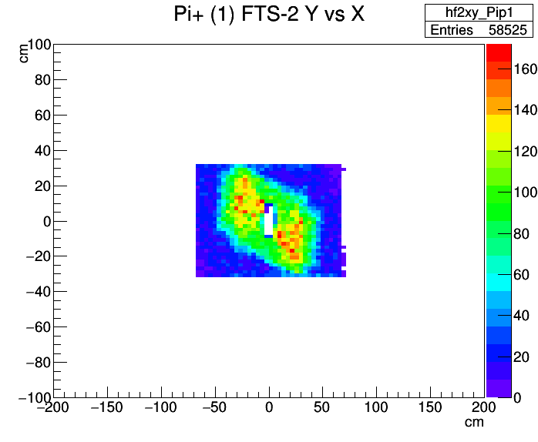
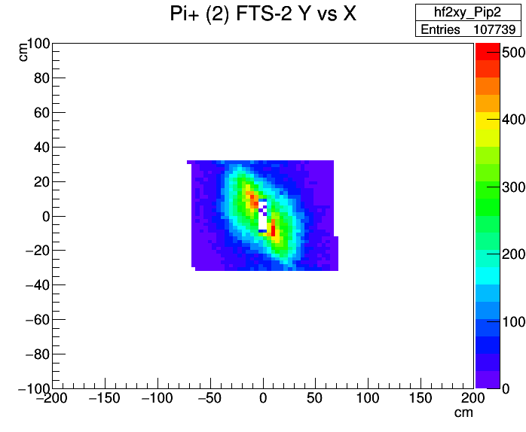
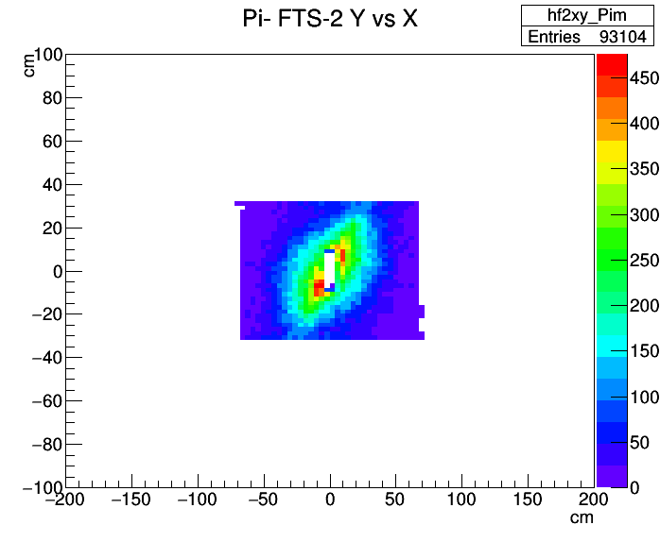

Slide 6
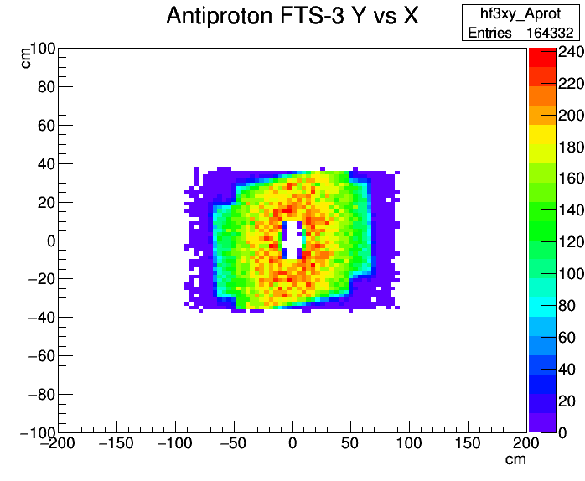
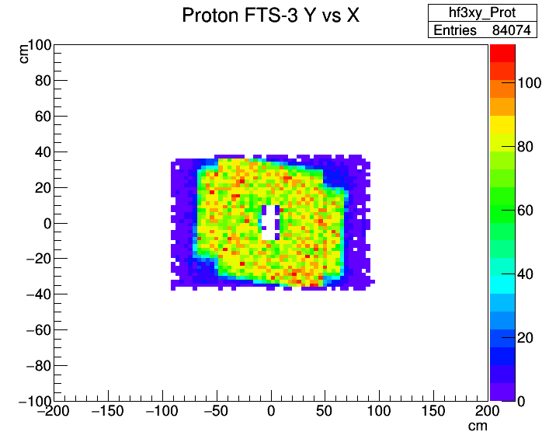
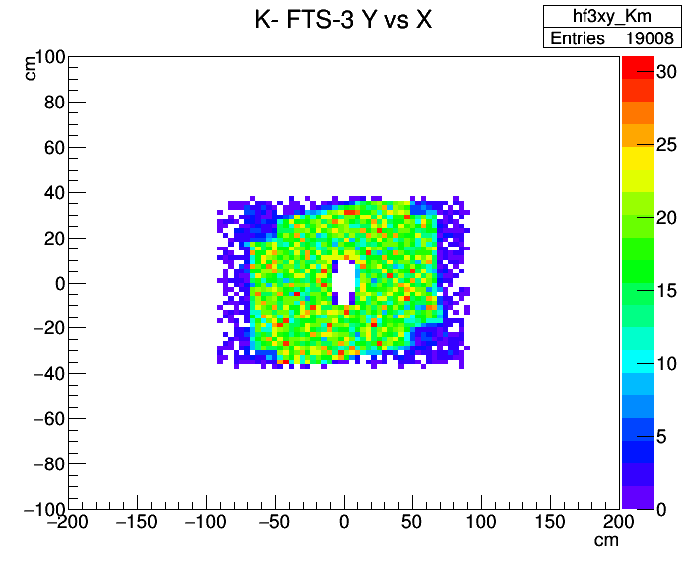
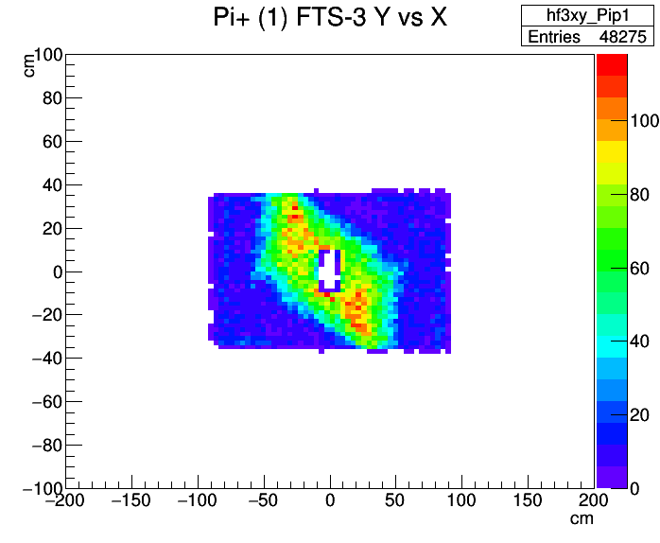
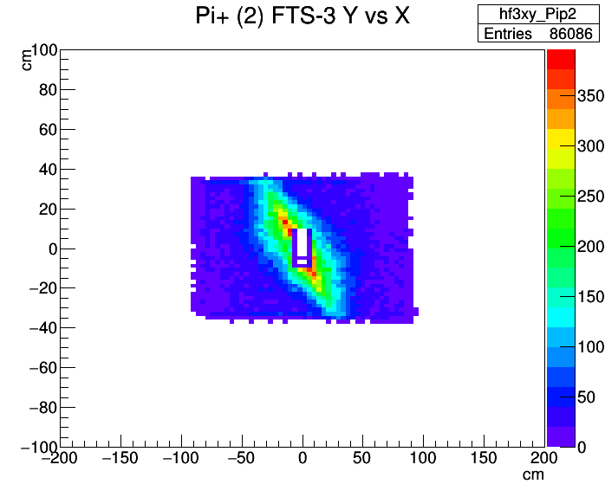
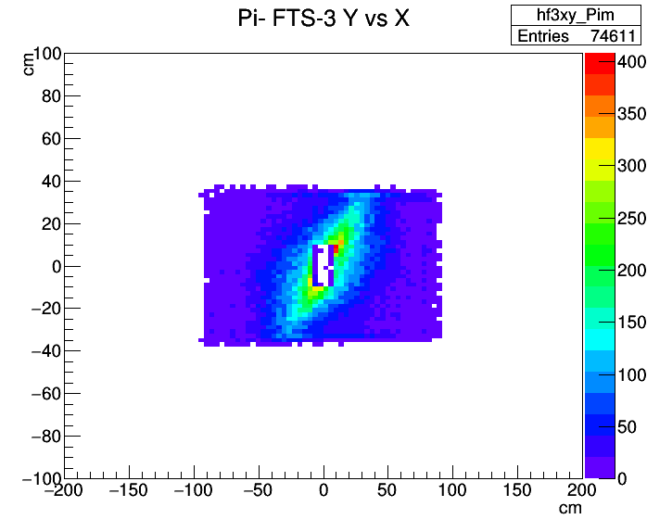

Slide 7
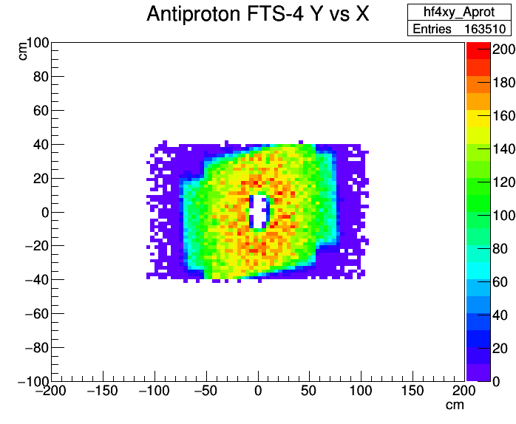
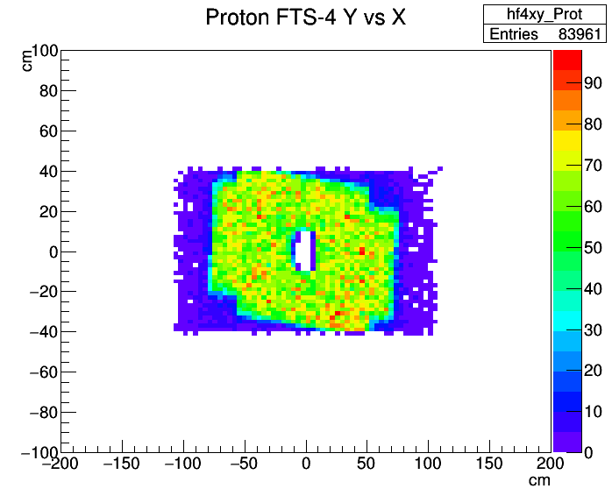
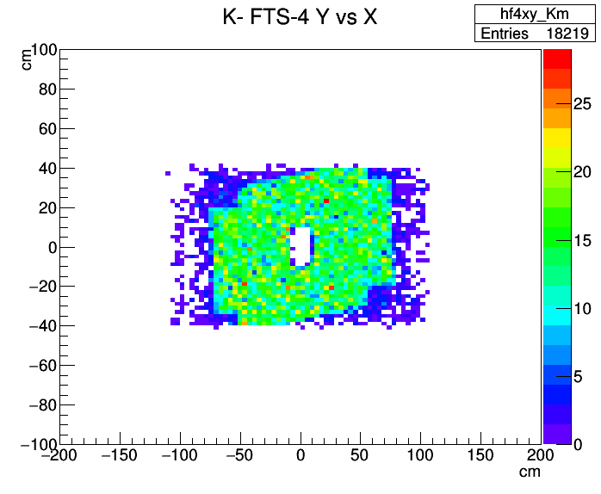
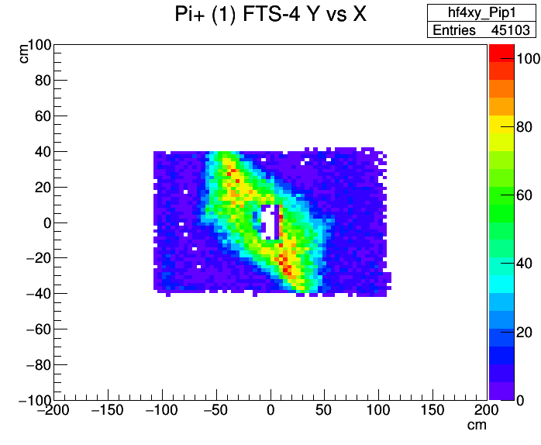
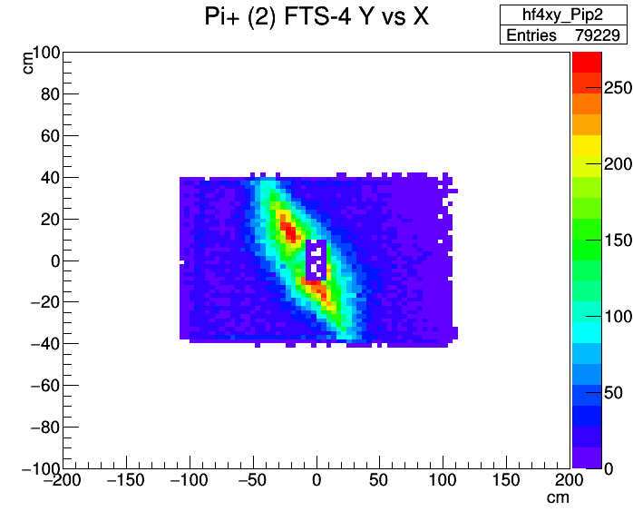
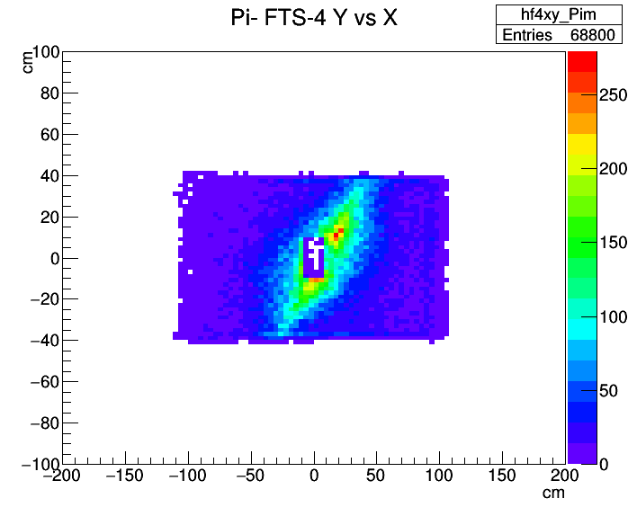

Slide 8
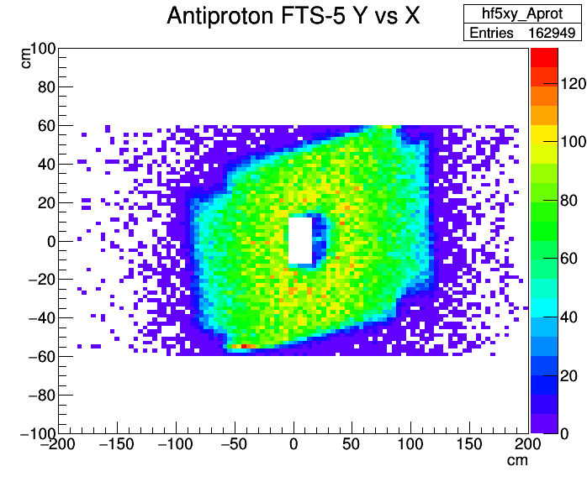
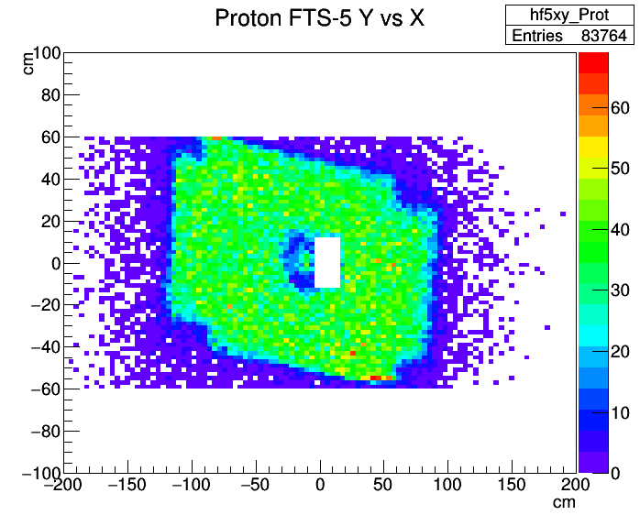
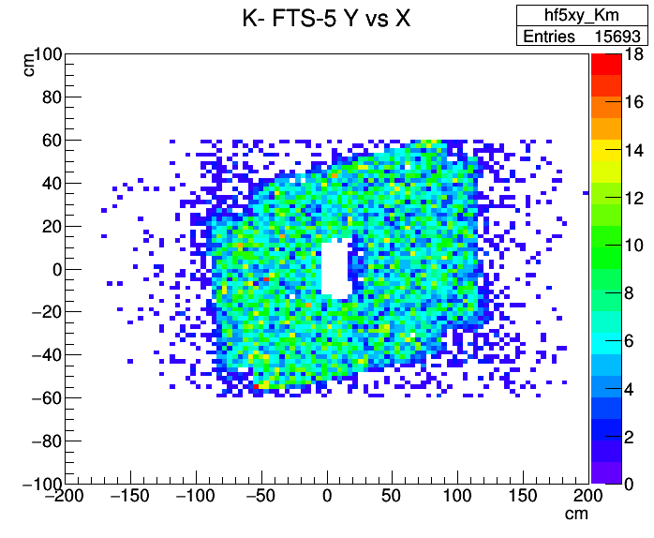
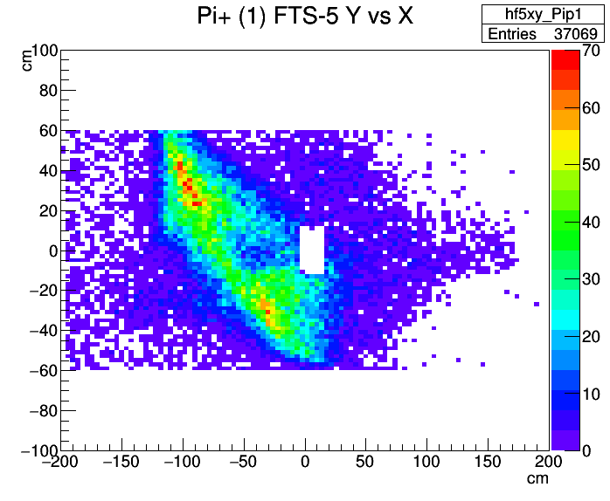
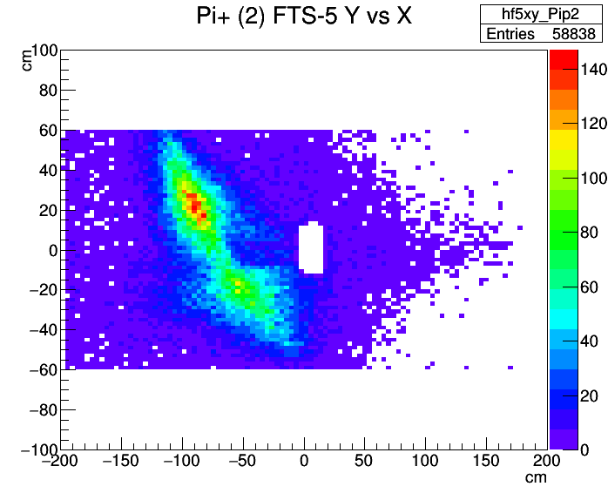
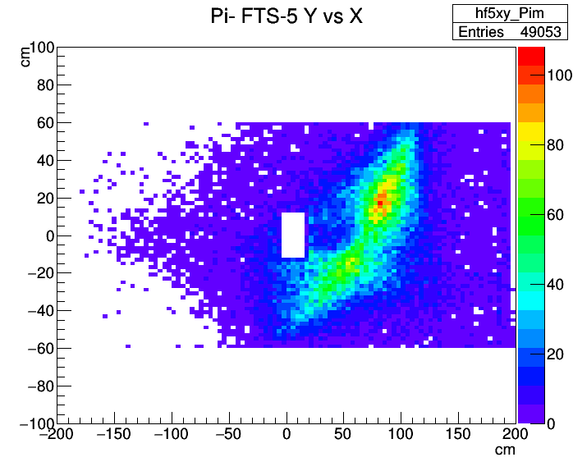

Slide 9
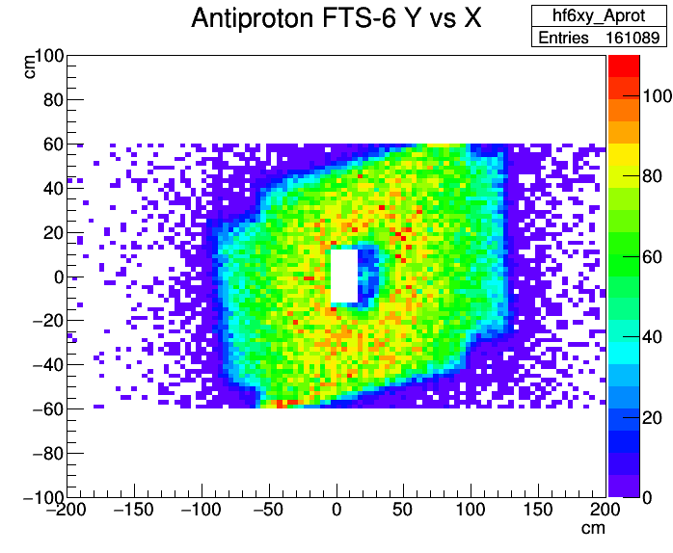
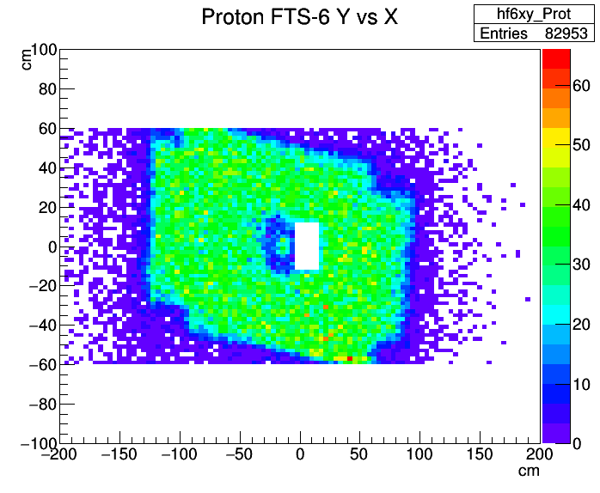
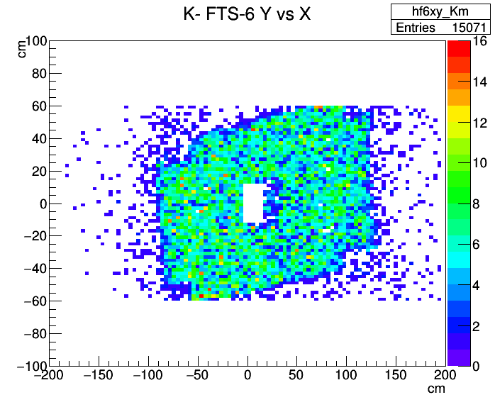
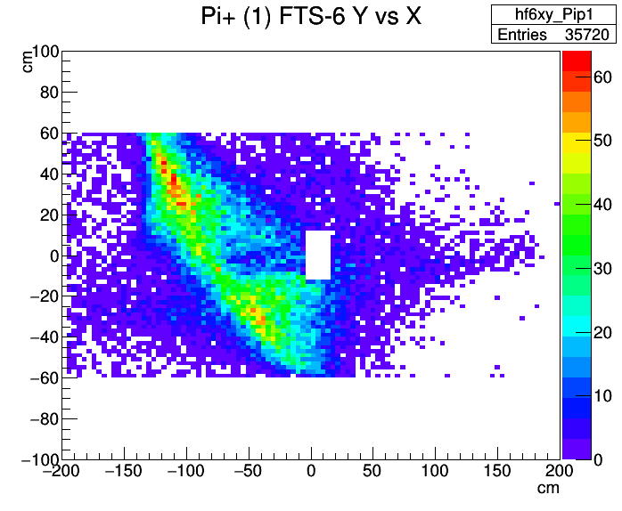
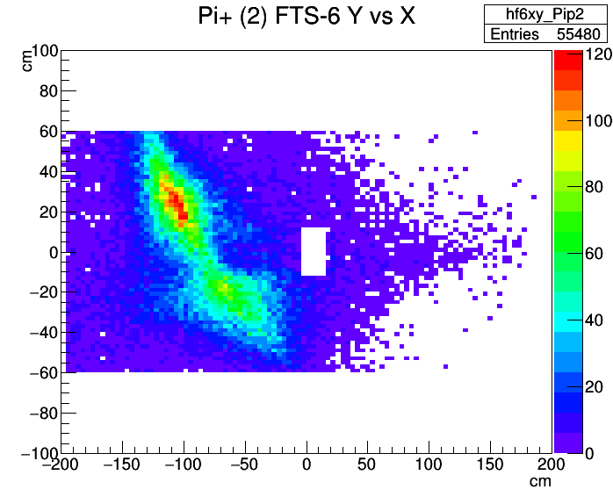
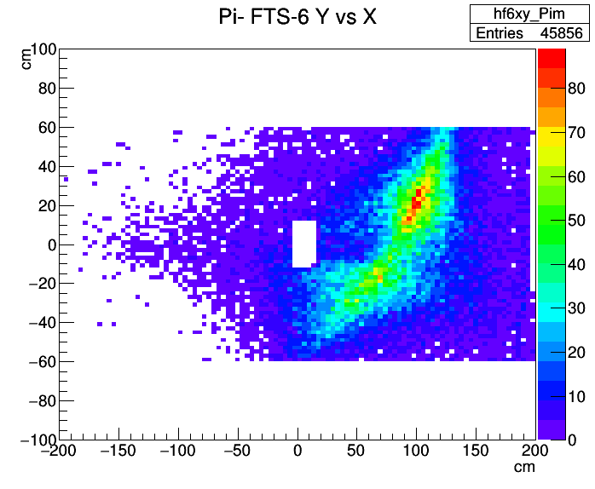

Slide 10
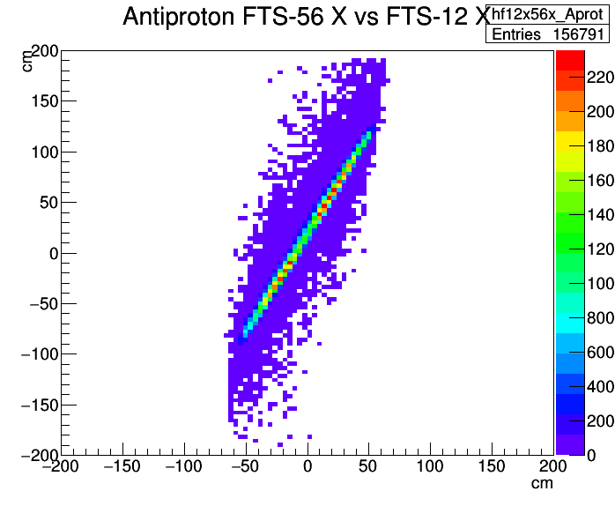
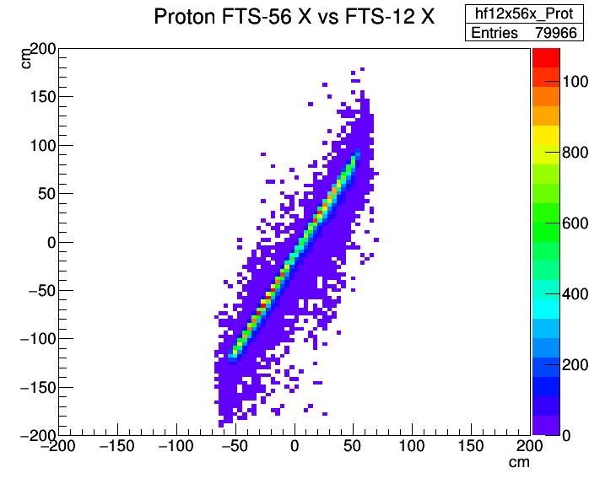
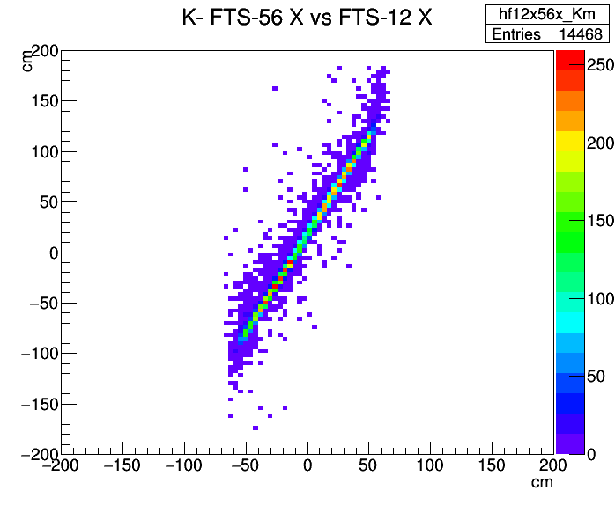
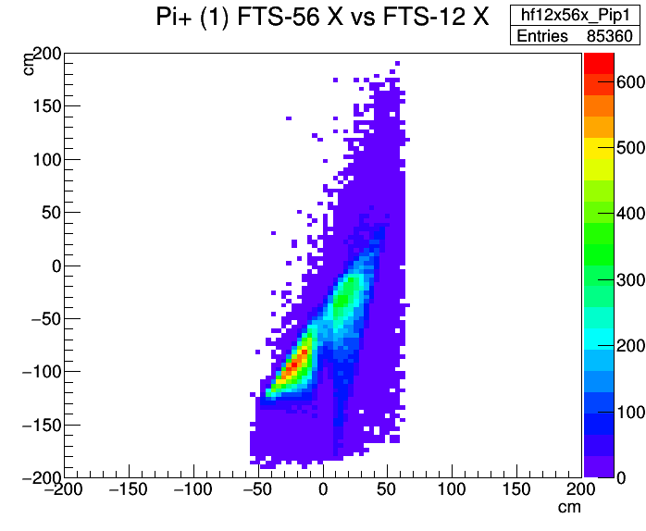
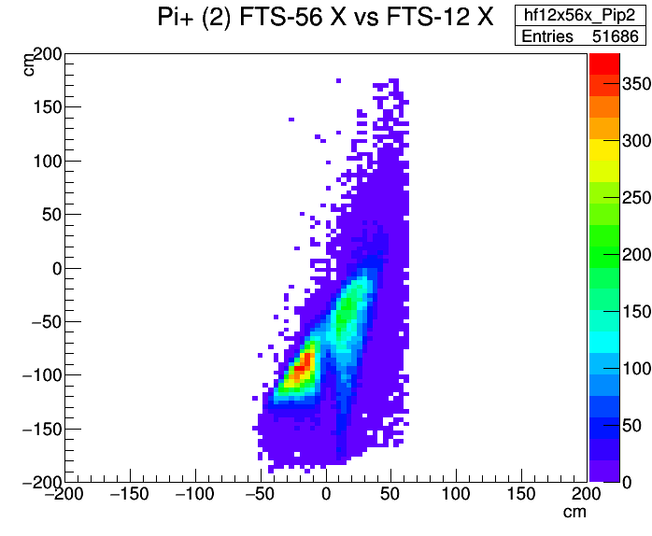
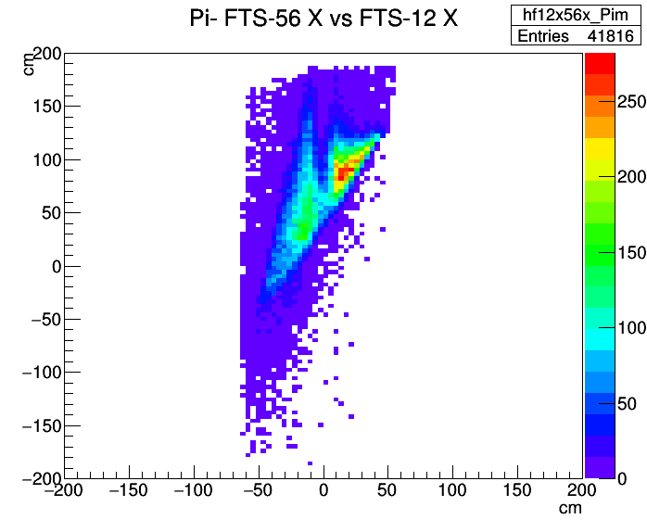

Slide 11
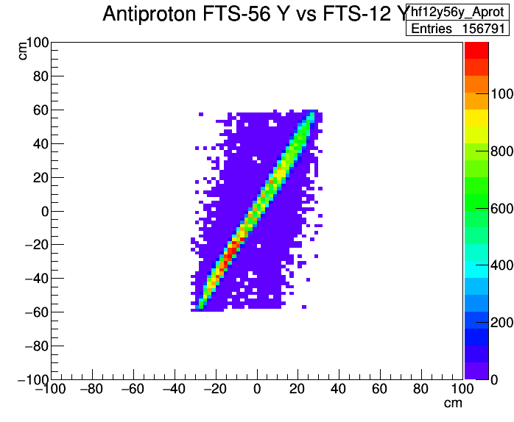
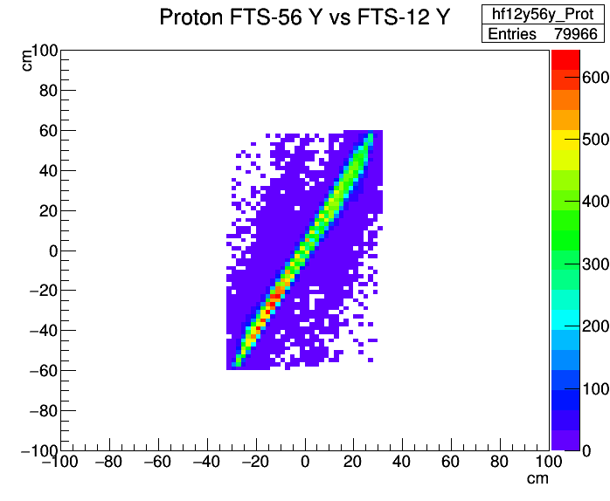
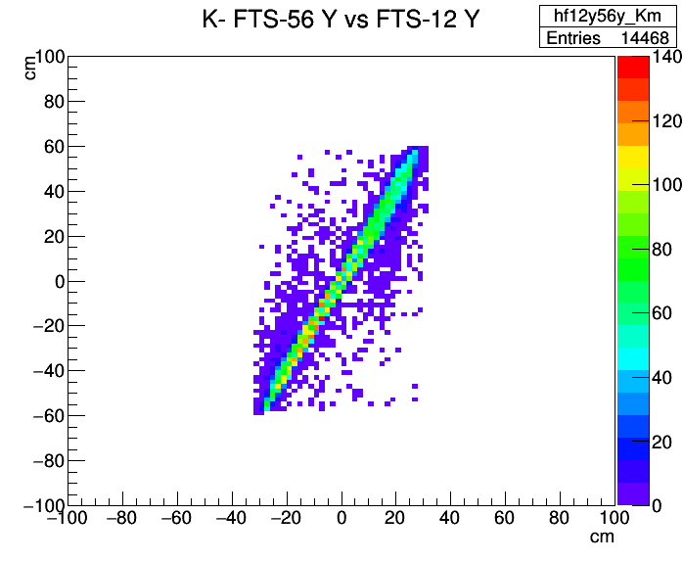
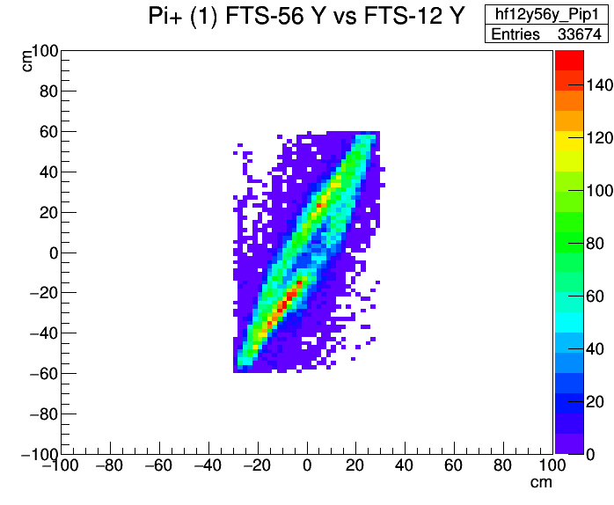
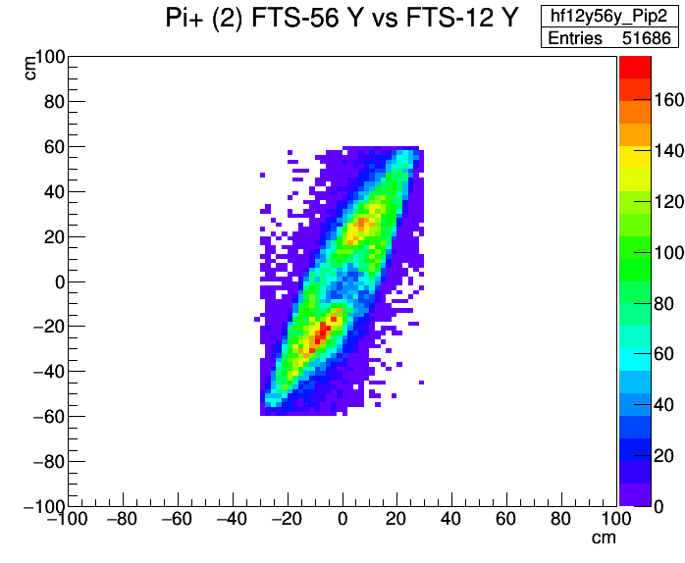
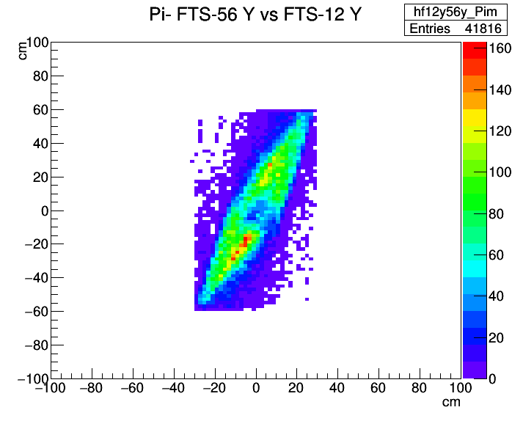

Slide 12
Hits in Subdetectors
particle | N_{MVD} = 0 >= 3 | N_{STT} = 0 >= 3 | N_{GEM} = 0 >= 3 | N_{FTS} = 0 >= 3
$$\overline{p}$$ | 0.395 0.158 | 0.666 0.266 | 0.118 0.836 | 0.570 0.429
$$p$$ | 0.210 0.449 | 0.354 0.588 | 0.131 0.769 | 0.777 0.222
$$K^{−}$$ | 0.037 0.860 | 0.256 0.720 | 0.660 0.260 | 0.944 0.055
$${π^{+}}_{1}$$ | 0.110 0.526 | 0.248 0.732 | 0.289 0.602 | 0.826 0.171
$${π^{+}}_{2}$$ | 0.368 0.189 | 0.325 0.647 | 0.194 0.742 | 0.680 0.315
$$π^{−}$$ | 0.212 0.432 | 0.332 0.645 | 0.245 0.663 | 0.721 0.275
-

Slide 13
Hits in FTS Planes
FTS-1 - 6: numbers are in % of total number of generated particles
particle | F_{FTS-1} | F_{FTS-2} | F_{FTS-3} | F_{FTS-4} | F_{FTS-5} | F_{FTS-6} | F₆ / F₁
$$\overline{p}$$ | 41.9 | 41.9 | 41.1 | 40.9 | 40.7 | 40.3 | 0.960
$$p$$ | 21.6 | 21.4 | 21.0 | 21.0 | 20.9 | 20.7 | 0.959
$$K^{−}$$ | 5.43 | 5.16 | 4.75 | 4.55 | 3.92 | 3.77 | 0.694
$${π^{+}}_{1}$$ | 16.8 | 14.6 | 12.1 | 11.3 | 9.27 | 8.93 | 0.533
$${π^{+}}_{2}$$ | 30.3 | 26.9 | 21.5 | 19.8 | 14.7 | 13.9 | 0.458
$$π^{−}$$ | 26.0 | 23.3 | 18.7 | 17.2 | 12.3 | 11.5 | 0.441

Slide 14
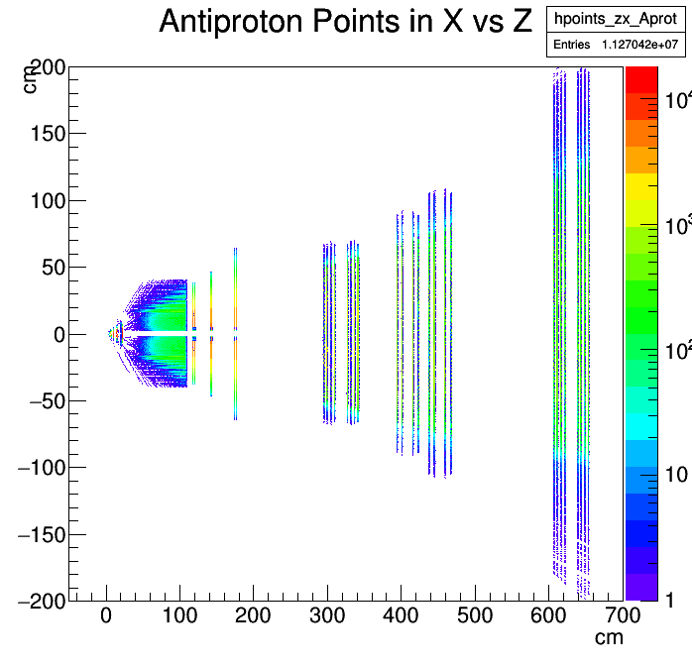
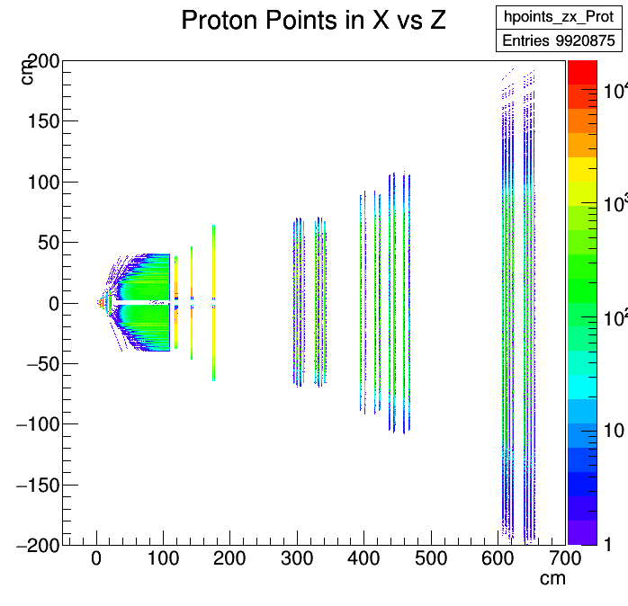

Slide 19
Summary Part I
40% of $\overline{p}$ have no hit in MVD, and 67% of $\overline{p}$ no hit in STT.
except for $K^{−}$, all particles have high probability to hit the GEM detector.
except for $K^{−}$ (5%), the probability to hit the FTS is between 17% ($π_{1}^{+}$) and 42% ($\overline{p}$).
if within the FTS acceptance, the transmission probability to FTS-6 is very high for $p$ and $\overline{p}$ (96%), whereas losses are ~50% for pions.
$p$ and $\overline{p}$ do not extend the full x range of FTS-5,6

Slide 20
Part II: Modified EMC Acceptance
Discussion to shift BWEC by 5 cm upstream → gap between Barrel and BWEC
Discussion to remove the innermost layer of crystals → reduced θ_{max}
Gap from $θ={142.0}^{o}$ to $θ={151.2}^{o}$, $θ_{max}={167.4}^{o}→{165.9}^{o}$
Hyperon spectroscopy also needs to measure decay modes with neutrals: $Ξ^{∗−}→π^{0}π^{0}, Ξ^{−}{π^{0}π}^{0},Ξ^{−}η$
Photon detection is important !

Slide 21
Losses for selected channels
final state | p [GeV/c] | acc_{old} [%] | acc_{new}[%] | rel. loss[%]
$$Ξ^{−}{\overline{Ξ}}^{+}π^{0}$$ | 4.6 | 95.2 | 95.0 | 0.25
 | 5.0 | 95.0 | 94.8 | 0.23
$$Ξ^{−}{\overline{Ξ}}^{+}{π^{0}π}^{0}$$ | 4.6 | 90.6 | 90.1 | 0.49
 | 5.0 | 90.2 | 89.8 | 0.45
 | 5.5 | 89.6 | 89.2 | 0.42
$Ξ^{−}{\overline{Ξ}}^{+}η$, $η→2γ$ | 5.3 | 94.8 | 94.6 | 0.21
 | 6.0 | 94.4 | 94.2 | 0.19
 | 7.0 | 93.7 | 93.6 | 0.16

Slide 22
Summary Part II
The acceptance loss caused by shifting the BWEC and removing the innermost crystal layer for the selected channels is marginal (<1%)

Slide 23
Part III: Longlived Charged Particles in EvtGen
from Xinying
signal events usually generated by EvtGen up to the final state of the decay tree
decay point of long-lived charged particles such as $Ξ^{−}$ is chosen along a straight flight path
in reconstruction of initial $\overline{p}p$ system, $Ξ^{−}$ and ${\overline{Ξ}}^{+}$ are back propagated along a helix trajectory → no common vertex, different relative momenta
the MC generated decay tree is inconsistent with initial $\overline{p}p$ 4-momentum !

Slide 24
Possible Solution
stop EvtGen at production of $Ξ^{−}$ and ${\overline{Ξ}}^{+}$ and let them propagate and decay by GEANT3/4
either simulate all decay modes, or
modify the physics table of GEANT
apply a correction matrix to transform position and momentum components at $Ξ$ decay and downstream from “straight” to “helix”
switch off the charge of $Ξ^{−}$ and ${\overline{Ξ}}^{+}$ in vertex and kinematic fitters (I don’t like this)

Slide 25
Summary Part III
This problem must be solved or proven that the error is marginal (which I don‘t believe)

Slide 26
Part IV: Simulation of $\overline{p}p→Ξ^{−}{\overline{Ξ}}^{+}π^{0}$
π⁰
4.6 GeV/c $\overline{p}p→Ξ^{−}{\overline{Ξ}}^{+}π^{0}$ (PHSP)
2∙10⁵ events simulated
preliminary analysis of 1∙10⁵ events
focus on reconstruction efficiency and momentum & position resolution
charged and composite particles: MC truth matched (correct PID, correct mother)
photons: include neutral candidates whose mother is a photon and whose grandmother is pbarpSystem
from Xinying

Slide 27
Reconstruction Efficiencies
reconstruction efficiencies in % :
note:
Ideal tracking, no condition on #hits yet
ideal PID
MC truth matching (correct mother)
KinVtxFitter → vertex, KinFitter → M, 4CFitter → initial p4
composite particles: significant loss due to mass & probability cut
$$p$$ | $$\overline{p}$$ | $$π^{−}$$ | $$π^{+}$$ | $$π^{0}$$ | $$Λ$$ | $$\overline{Λ}$$ | $$Ξ^{−}$$ | $${\overline{Ξ}}^{+}$$ | $$\overline{p}p$$
83.2 | 80.0 | 81.9 | 81.8 | 71.8 | 46.3 | 44.0 | 30.4 | 28.7 | 4.6

Slide 33
$$Ξ^{−}π^{0}$$
$$Ξ^{−}{\overline{Ξ}}^{+}$$
$${\overline{Ξ}}^{+}π^{0}$$
entries in unphysical region above the kinematic limit
4C fitter does not conserve masses of composite particles in decay tree

Slide 34
Summary Part IV
10⁵ events of $\overline{p}p→Ξ^{−}{\overline{Ξ}}^{+}π^{0}$ analyzed, results still very preliminary
problems in vertex and kinematic fitting of complex decay tree including neutral particles:
inappropriate usage
improper functionality
significant contribution of e⁺, e⁻ in neutral candidates to π⁰ yield (~44% → ~72%)
to do: test Decay Tree Fitter, add required #hits per track, realistic PID

