Slide 1
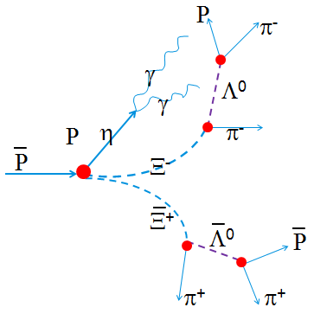
Status Report of Analysis on pp→Ξ⁻Ξ⁺ η (η→γγ)
Dr. Xinying Song^{1,2} (x.song@fz-juelich.de)
1:IKP-1,Forschungszentrum Juelich, Helmholtz Association of Germany Research Centers
2: Institute of High Energy Physics, Chinese Academy of Science

Slide 2
The Reconstruction of Λ, Ξ, η(tentative)
Particle | Rec. eff(%) MC Matched
η | 40.31±0.49
P | 79.44±0.40
Anti-p | 72.91±0.44
π⁻ from Λ⁰ | 84.10±0.36
π⁻ from Ξ⁻ | 82.03±0.38
π⁺ from Λ⁰ | 84.64±0.36
π⁺ from Ξ⁺ | 81.97±0.38
Λ⁰ /Λ⁰ | 43.65±0.50 /40.44±0.49
Ξ⁻ /Ξ⁺ | 30.05±0.45 /27.62±0.45
Ρ
v.t.f & m.c.f
Λ⁰
v.t.f
π⁻
Ξ⁻
π⁻
Ρ
v.t.f & m.c.f
Λ⁰
π⁺
v.t.f
Ξ⁺
π⁺
m.c.f: mass constraint fit
v.t.f: vertex fit
γ
m.c.f
η
γ
Trunk 29675

Slide 3
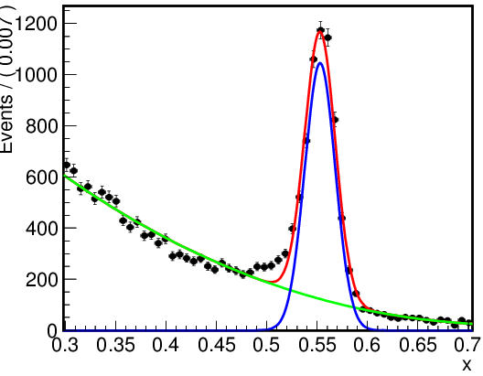
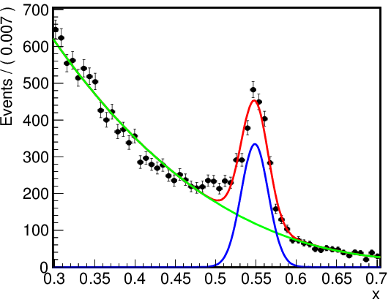
Reconstruction of η (10k events)
γγ combinations
which can’t be MC matched
All the γγ combinations
5672±95
In 10k events:
Recontructed : 4031 η (MC matched) ~1600 η (γ e conversion on 1 γ )
m.c.f : 5993 η (retained) 3409 η (MC matched)

Slide 4
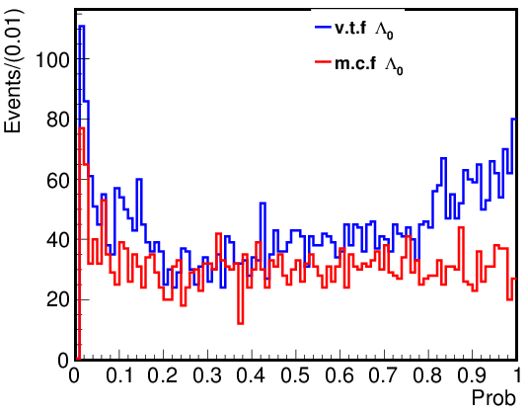
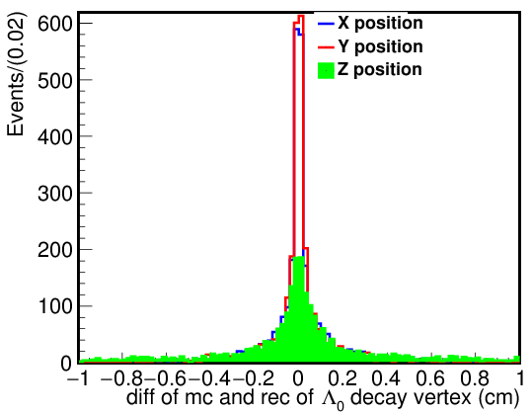
Reconstruction of Λ₀ from p and π⁻

Slide 5
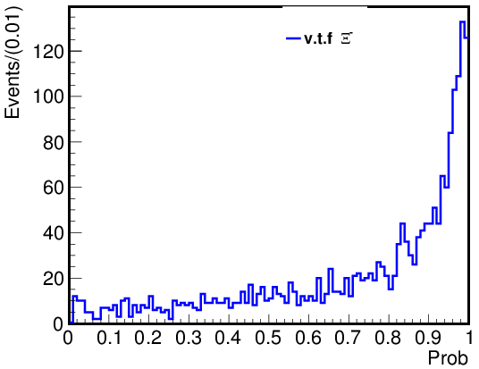
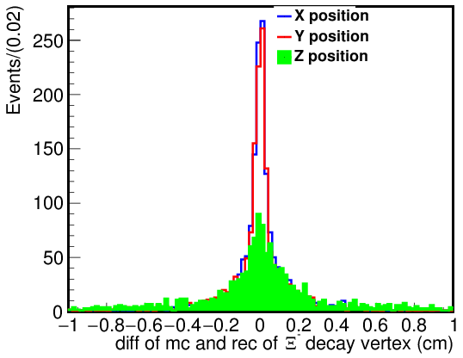
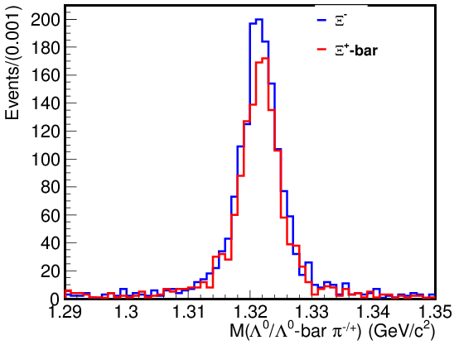
The Reconstruction of Ξ⁻ from Λ₀ and π⁻

Slide 6
Two tests on the reconstructed Ξ⁻ , Ξ⁺ , η
Test1：
v.t.f on Ξ⁻ , Ξ⁺ , η with
FitAll()
PndKinVtxFitter
PndKalmanVertexFitter
Use the fittedcand
4C fit
PndKinFitter
Pnd4Cfitter
Test2：
DecayTreeFitter (d.t.f in short)
Suggested by Ralf

Slide 7
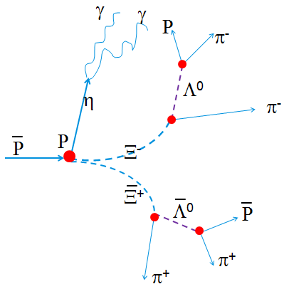
A problem in this case…
GEANT: Only particles of final state ( P ,P , γ, γ, π⁺,π⁻ ) has interaction with detector.
Tracks of Ξ⁻ /Ξ⁺ are not helixes!
the performance of the fitter on v.t.f or 4C fit may not reflect the real case...
EvtGen

Slide 8
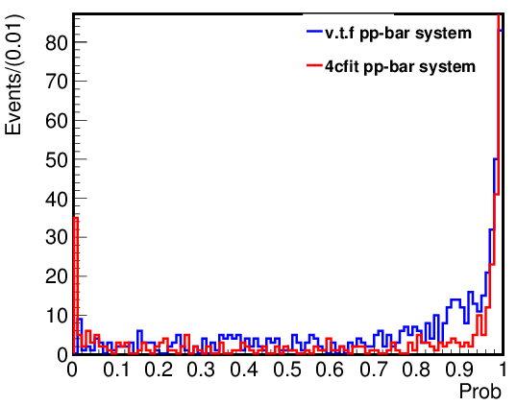
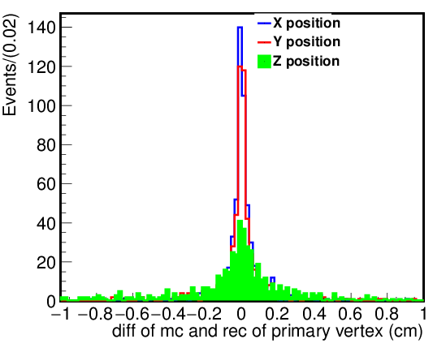
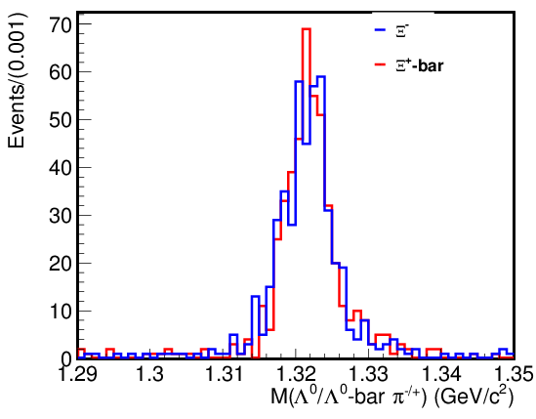
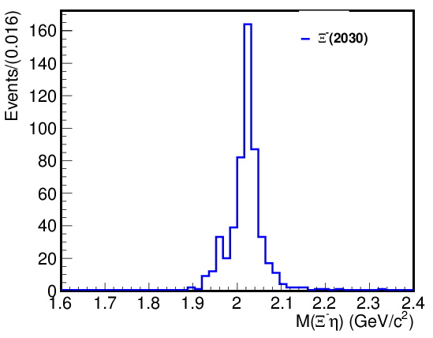
Test1 with FitAll()
PndKinVtxFitter &PndKinFitter

Slide 9
Test1 with FitAll()
PndKalmanVtxFitter： Most of the vertex fit gives Chi2()<0, so few event survived.
PndKinVtxFitter &Pnd4CFitter：give same distribution with PndKinVtxFitter &PndKinFitter

Slide 10
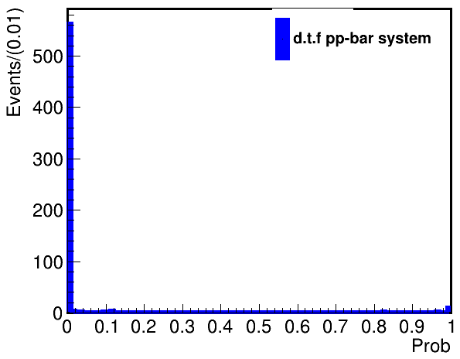
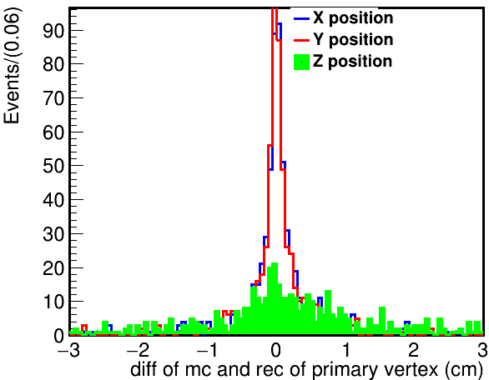
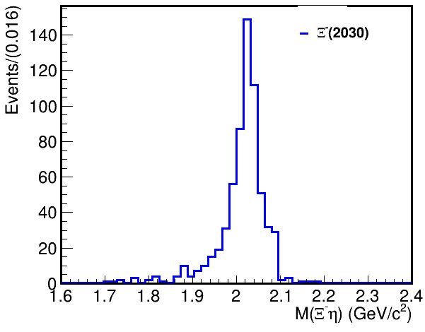
Test2: DecayTreeFitter()
Secondary vertex fit done before(neutral and charged tracks, refitted tracks)
Mass constrains on η,Ξ in d.t.f

Slide 11
Summay & next to do
Impact from magnetic field on simulation on Ξ⁻Ξ⁺
Modify the momentum and position after EvtGen
Fitters:
vtf:
neutral & charged → Jennifer Puetz (FZJ)
Two charged with sencondary vertex(e.g. Ξ⁻Ξ⁺)
4Cfit(PndKinFitter, PndDecayTreeFitter)
Two charged with sencondary vertex(e.g. Ξ⁻Ξ⁺)
η→π⁺π⁻π⁰ mode to be processed…

Slide 12
BACKUP

Slide 13
γ
γ
Ρ
π⁻
Λ⁰
η
π⁻
Ρ
Ρ
Ξ⁻
Ξ⁺
Λ⁰
Ρ
π⁺
π⁺

