Slide 1
The Technical Design Report (TDR) and the Detailed (functional) Specification of the CBM Superconducting Dipole
G. Moritz
CBM Dipole Conceptional Design Review
May 22-24 2017
GSI Darmstadt

Slide 2
CBM Dipole
Design history
  work by JINR, Dubna
Technical Design Report (TDR) (October 2013)
  by JINR and GSI
Collaboration Contract with BINP, Novosibirsk for the design, prototyping, production, delivery and testing
  Annex 3: Detailed Specification

Slide 3
Milestone | Work Description | Validation Criteria | Date
1.1 (M5) | Detailed work plan Quality Plan | Technical Specifications Consideration and approval of the Plan | 12/2016
1.2 (A6) | Conceptual Design of the whole system and the components | Conceptual Design Review (CDR) | 04/2017
1.3 (M6) | Technical Design of the whole system and the components | Preliminary Design Review (PDR) | 09/2017
2.1 (M7) | Final design of the whole system (all documents, drawings necessary for the production) | Final Design Review (FDR), production approval | 12/2017
2.2 (M9) | Manufacturing of all components | Assembly and test of the whole magnet at BINP Factory Acceptance Test passed | 12/2019 (end of 2021)
2.3 (M10) | mechanical assembly and installation in CBM Cave Delivery and SAT of all components | Site Acceptance Test passed | 06/2020
2.4 (M11) | Acceptance Test | Complete Magnet assembled and tested Ready for beam | 12/2020

Slide 4
Design history
CDR review 1/2012
CDR review 6/2012
TDR review 11/2012
Travel to RIKEN/TDR update in 2013
TDR final 10/2013
BINP collaboration contract 10/2016

Slide 5
Main Dipole Parameters
CDR review 1/2012
Geometry
Opening angle: ±25° vertically, ± 30° horizontally from the target
Free aperture: 1.4 m x.1.4 m, no conical geometry!
Field
Field integral within STS detector (along straight lines): 1 Tm
Field integral variation over the whole relevant aperture along straight lines: ≤ 20%
Fringe field downstream < 10 Gauss at a distance of 1.6m from target)
Operating conditions:
100% duty cycle, 3 months/year, 20 years
No time restriction on the ramp
Radiation damage (<10MG for organics): no problem

Slide 6
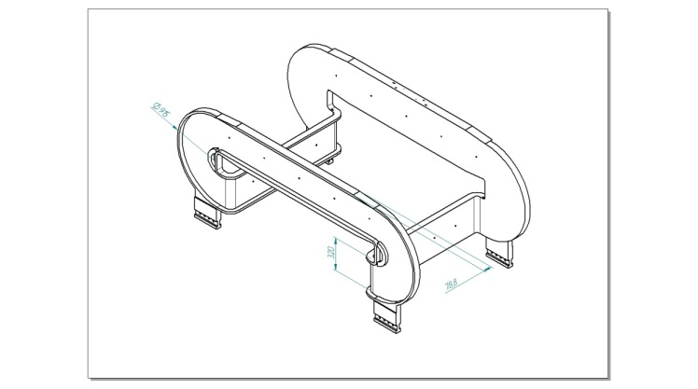
CDR review 1/2012
Design options
Coil dominated versus iron dominated dipole
Resistive vs. superferric
Coil design
Conductor
Cooling method
Materials/Mechanical support
Cossack saddle type

Slide 7
From minutes: Conclusions and recommendations
CDR Review 1/2012
The committee believes that the superferric design is the best solution for the CBM dipole. However it proposes a comparison with the resistive option...
The committee (dismissed a saddle coil and) recommends a more ‘simple’ coil (similar to a racetrack coil) for a superferric magnet
H-type dipole with race track coils has to be optimized. That was considered as the baseline option to be pursued.
A commercially available conductor should be chosen, if at all possible. It must have enough copper stabilizer to stay within the allowed hot spot temperature and coil voltage during a quench without heaters.
No specific recommendations about the mentioned cooling methods (thermosyphon via channels, radiator embedded in the coil casing, direct or indirect cooling,…) were given.

Slide 8
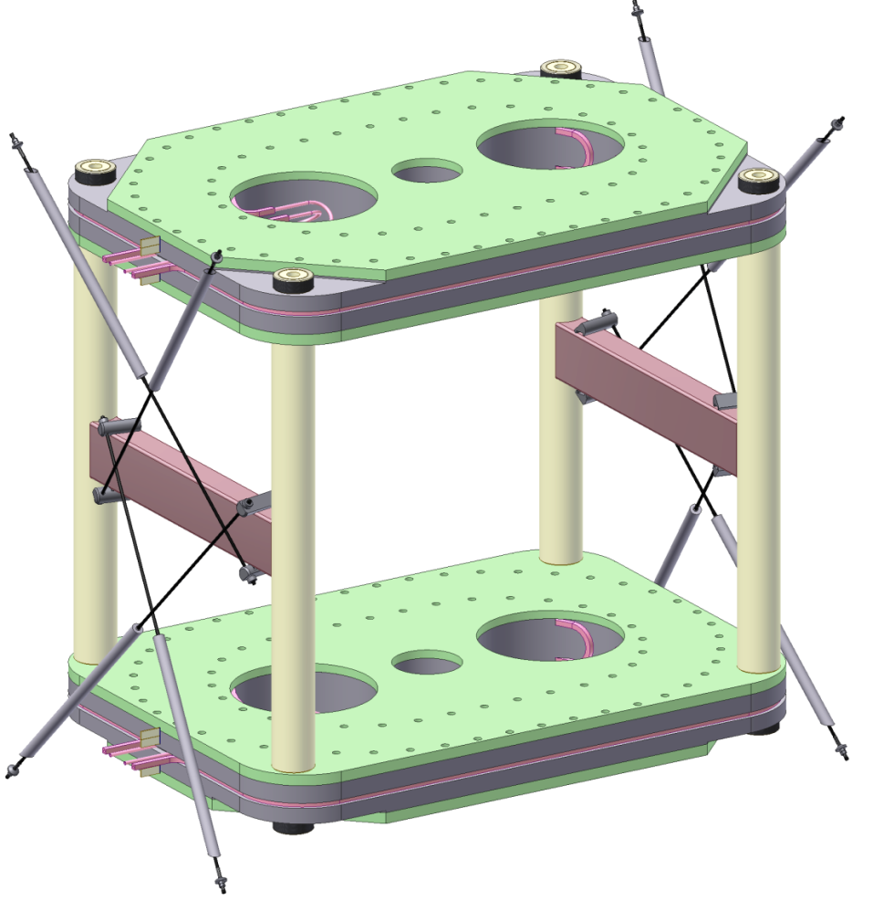
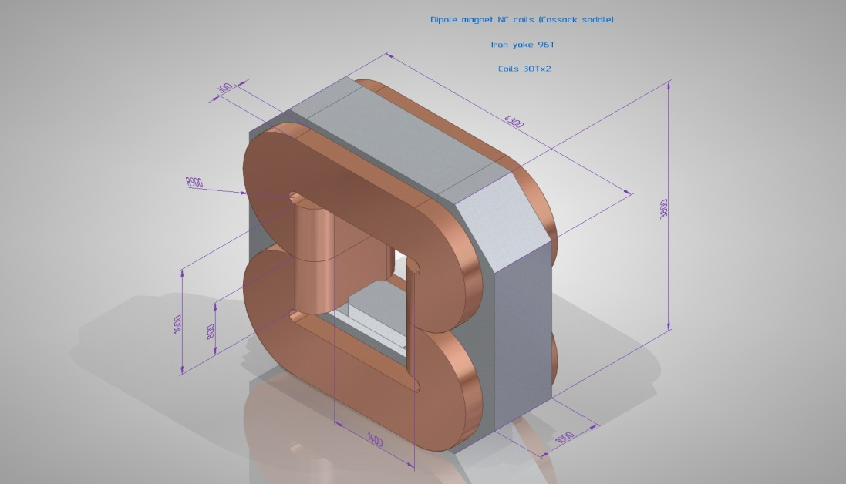
CDR Review 6/2012
Type of coils | Current N*I | Power
Cossack saddle | 760 kA | 1,5MW
SF racetrack | 1700 kA | ~35kW

Slide 9
CDR Review 6/2012
Conclusion and recommendations
The committee recognizes that the horizontal aperture was increased since the last meeting from 1.4m to 1.8m, which lead to a lot of additional work.
It became obvious during the meeting that a resistive version has to be dismissed due to too excessive power consumption. A superferric design is clearly the best choice.
The presented WF-version with 1.6m aperture fulfils all requests. It has the advantages of a relatively simple and reliable coil support structure and of one compact cryostat. All forces are compensated within the cold mass. ....
However, regarding the large forces on the coil, the committee recommends to investigate also the H-type version, which will reduce the ampereturns and the field in the coil and will consequently reduce forces and stored energy and increase margins. Saturation of the iron in superferric magnets is not as large a problem as in resistive magnets. It only requires more amp-turns....

Slide 10
CDR Review 6/2012
As a first preliminary choice the ATLAS solenoid conductor was chosen. In principle an operating current of 7600 A is possible (single magnet, leads are available, the length of the supply cables are less than 100m). However, a more conventional conductor (with an operating current of some hundred amps) will be more economical and more vendors will be capable of manufacturing it. This will also reduce winding R&D requirements as technology required for large conductor requires significant development. This solution must be investigated...
The number of turns is determined by the quench voltage. Therefore in parallel with the conductor design quench calculations have to be done, which deliver the quench voltage and the hot spot temperature.....

Slide 11
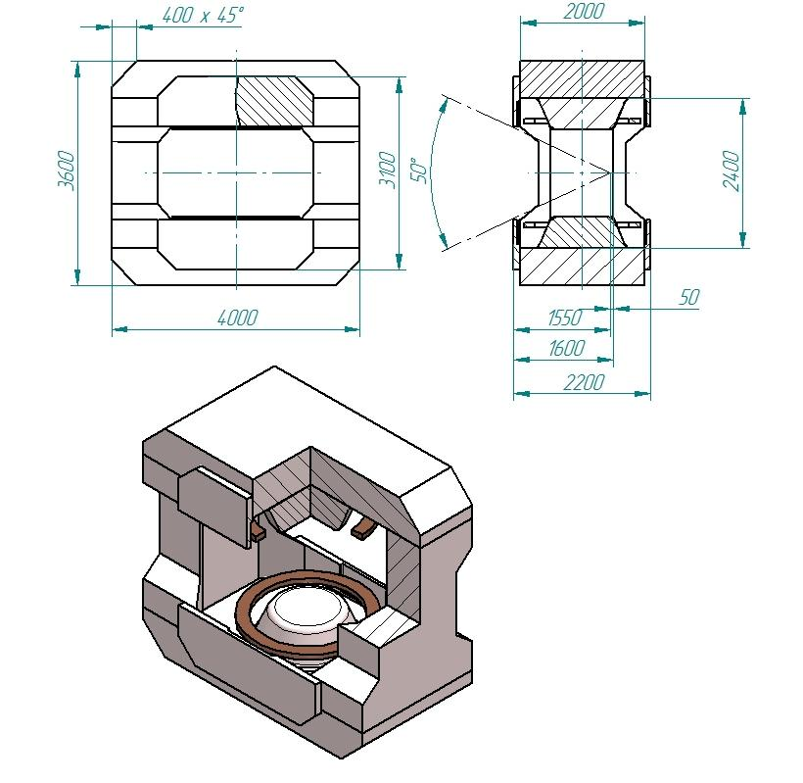
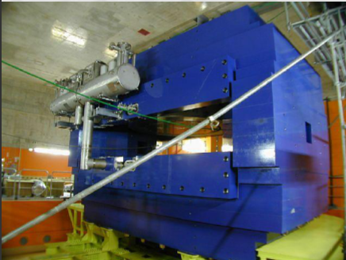
Magnet report 10/2012
Samurai dipole magnet (H-type)
RIKEN, Japan, 2012
first H-type design

Slide 12
Magnet report 10/2012
Parameter | WF type | H type
Magnetomotive force | 1,52MAT/coil | 0,92MAT/coil
Magnetic field | 6,8T | 3,5T-4,8T
Magnetic field in coil | 6,78T | 2,8T-3,3T
Magnetic field in yoke | 2,8T | 2,46T
Sum Forces ,Z | ~400tons | ~220-260tons
Sum Forces,Y | ~260tons | ~90tons
Sum Forces ,X | ~350tons | ~90tons
Current density max | 167A/mm2 | 65A/mm2
Stored energy | 10MJ | 4MJ
Yoke weight | ~120tons | ~150tons
Working aperture | 1,4x1,8m | 1,4x2,5m
Magnet dimensions | 4,12x4,8x1m | 3,6x4x2m
Conclusions: currents, forces, coil field and stored energy are lower for the H- type dipole!!

Slide 13
Review 11/2012
“We agreed on the following design: We will build a superferric dipole of the H-type with cylindrical potted coils in 2 separate cryostats. The coil will be potted (not cryogenically stable), the protection scheme will include a dump resistor.”
  -> TDR

Slide 14
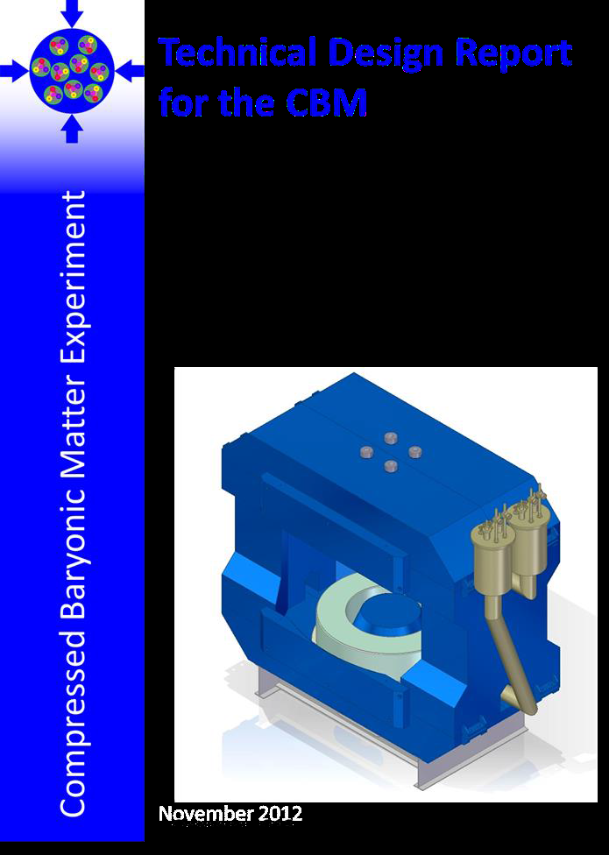
Technical Design Report (TDR) October 2013

Slide 15
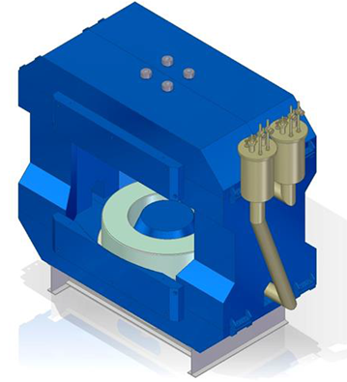
Main design principles
Warm iron yoke ( huge vertical and horizontal balks)
Warm round (tapered) poles
Removable field clamps
cylindrical NbTi coils wound on cylindrical bobbin , cooled with LHe
Thermal shield cooled with Helium gas (50-80K)
Two independent cold masses and cryostats
Vertical forces transferred from the coil to the cryostat and finally to the yoke
Normal conducting leads
Challenges:
stored energy: 5.2 MJ
forces of the order of 300 tons

Slide 16
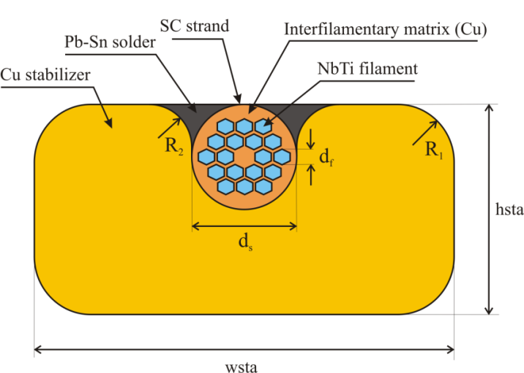
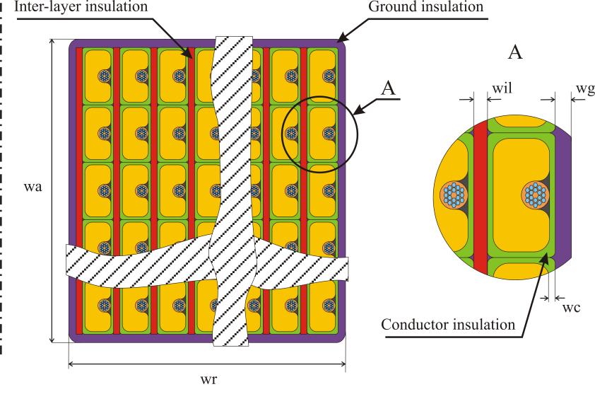
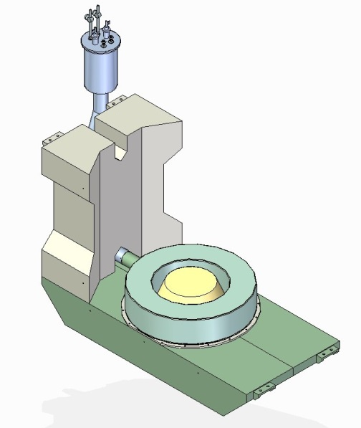
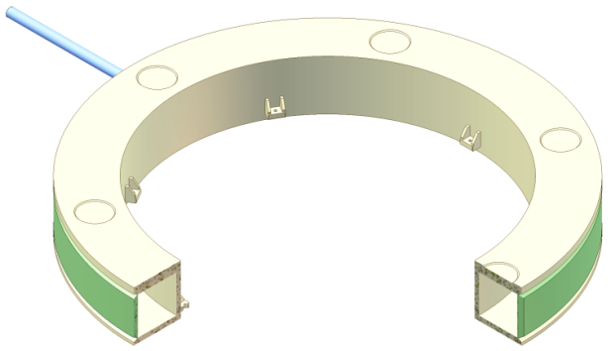
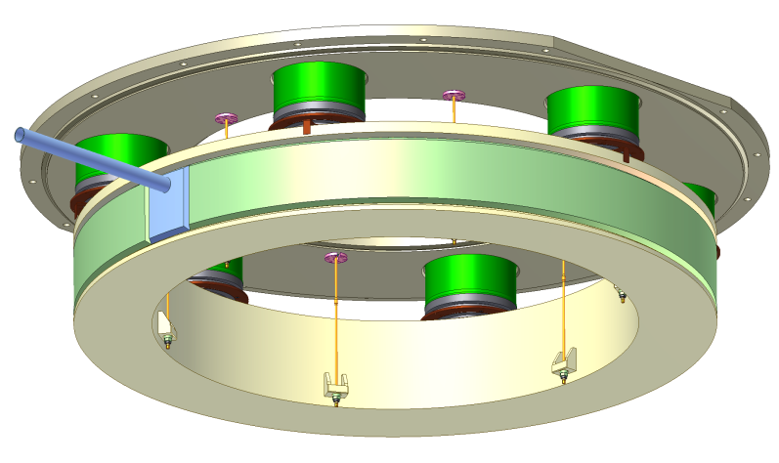
CMS strand, ‚wire in channel‘ with copper as stabilizer
coil
coil case
cryostat with support struts and tie rods
lower coil in the yoke

Slide 17
CBM Dipole Detailed Specification
  Annex 3 to the collaboration contract (Magnet and Power Converter)
Functional specification
  main parameters
  main procedures
  interfaces
  rules, regulations, technical guidelines...
but within this framework
  freedom of the contractor
  responsibility of the contractor
mandatory!!

Slide 18
Main Parameters (mandatory)
Geometry
Opening angle: ±25° vertically, ± 30° horizontally from the target
Free aperture: 1.44 m vertically x 1.8 m horizontally, no conical geometry
Distance target- magnet core end: 1m (STS detector must fit in)
Total length: 1.5 m
Space upstream of the magnet: <1 m
Field
Field integral within STS detector (along straight lines): 0,972 Tm --> max. Field ≈ 1 T, depending on the magnet length
Field integral variation over the whole opening angle along straight lines: ≤ 20% (± 10%)
Fringe field downstream < reasonable value of the order of 50 to 100 Gauss at a distance of 1.6 m from the target (RICH only)
more

Slide 19

Conductor
Material: NbTi,
Copper to superconductor ratio: > 9.1
Filament size: less than 60 µm
Insulation: The conductor insulation consists of 2x 0.05 mm polyimide tape and 2 x 0.1 mm glassfiber material (tape or braid), in total 0.3 mm.
The nominal current should be less than 50% of the critical current at 4.5K along the load line
I_{n}/I_{loadmax}< 0.5
The nominal current should be less than 30% of the critical current at the max. coil field at nominal current:
I_{n}/I_{c}(4.5K,B_{m})< 0.3
TDR example

Slide 20

Coil and coil case
interlayer insulation (mm) | 0.3
ground insulation thickness (mm) | 2
Material coil case | Stainless steel 316LN
Design pressure coil case | 20 bar
TDR example

Slide 21
Cryostat and heat loads
Cryostat deformation < 0.1 mm
Heat load per cryostat < 11W at 4.5K (SAMURAI much better!)
Heat load per cryostat < 45W at 80K
He liquefaction for the leads < 0,15 g/s
TDR example

Slide 22
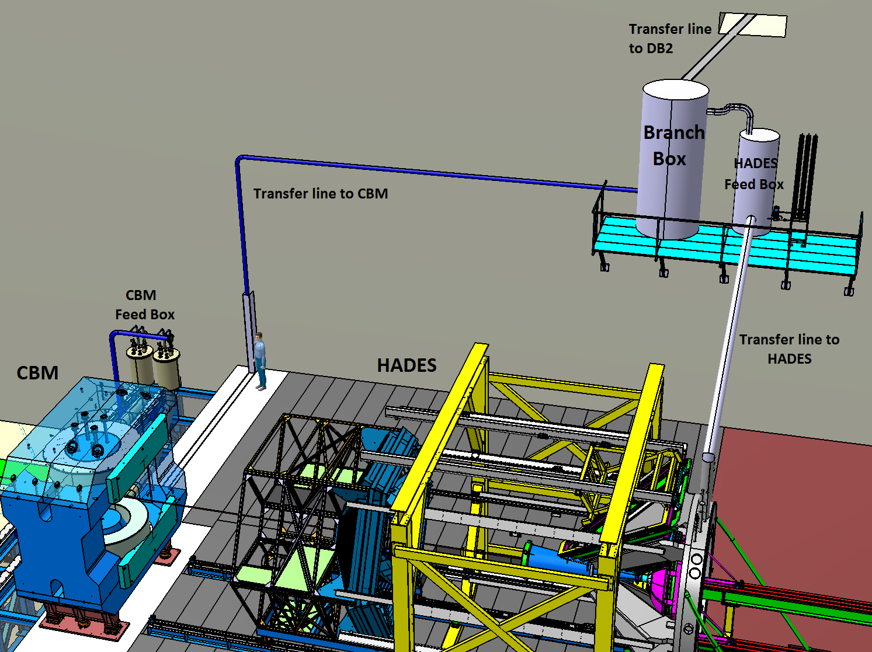
Cryogenics
    4.9.1 Functional and technical design requirements for the CBM FB and BB
Technical Guidelines:
F-TG-K-50.1e_Cryogenic_Operation_Parameter
F-TG-K-3.76e_ Instrumentation of FAIR cryogenic cooling
    All helium lines have to be designed for a maximum pressure of 20 bar*.
    etc..........
    etc..........
Scheme
Interfacepoint

Slide 23
Quench detection and protection
without external dump resistor:
  maximum quench voltage < 1500 V
  maximum hot spot temperature < 120 K
  to make the magnet self-protecting!
However, a Quench Detection and Protection circuit
together with an external dump resistor will be used!

Slide 24
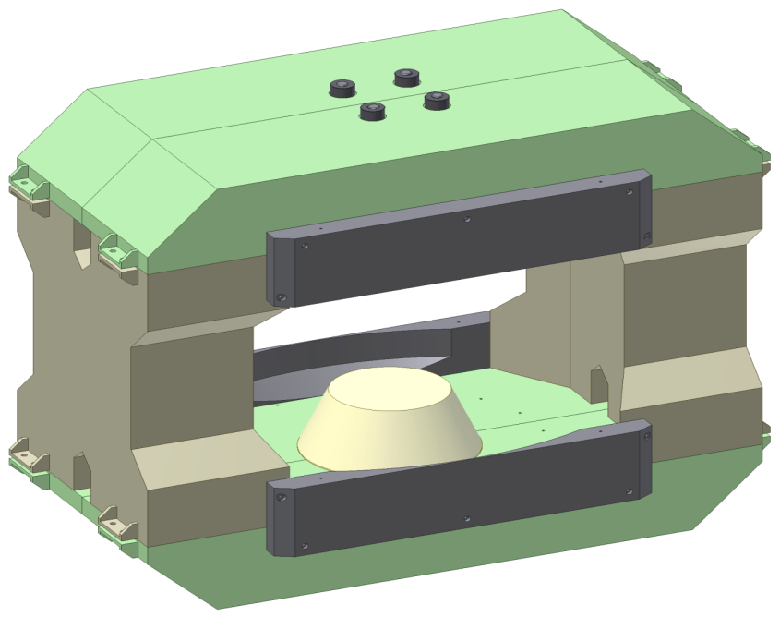
Alignment
during magnet production:
  references: planes, fit drill-holes and grooves
after installation at the final place:
  fiducials: sockets and removable targets
Stand and feet
Fit drill-holes 10H7
Independent horizontal (x,y) and vertical (z) movement
3 jacks for vertical alignment, supporting a base plate
3 x-y alignment tables, mounted on the base plate
Alignment range: ±20 mm in x,y,z
Reference planes

Slide 25
Summary
CBM Dipole - Design history
CBM Dipole – as described in the TDR of October 2013
CBM Dipole – detailed specification (Annex 3 of the contract)
  functional specification for
    the magnet including feedbox and branchbox
    the Power Converter including QD/QP system
  It is the mandatory basis for the design work of the contractor.
  The existing design - as given in the TDR- is only one option.

