Slide 1
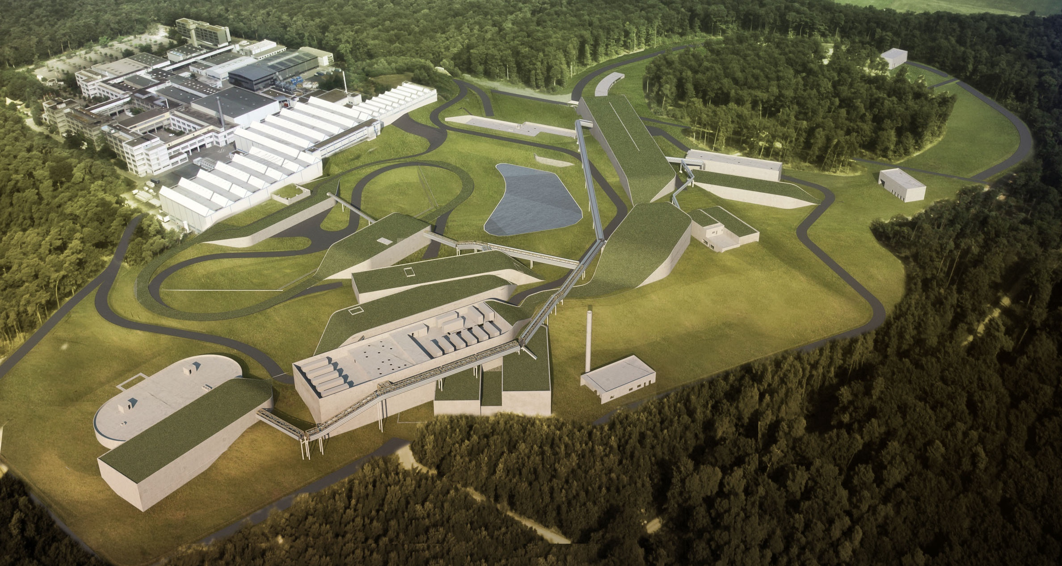
Facility for Antiproton & Ion Research
A World-Wide Unique Accelerator Lab
Peter Senger, GSI
ESFRI Landmark
Top priority for European
Nuclear Physics Community

Slide 2
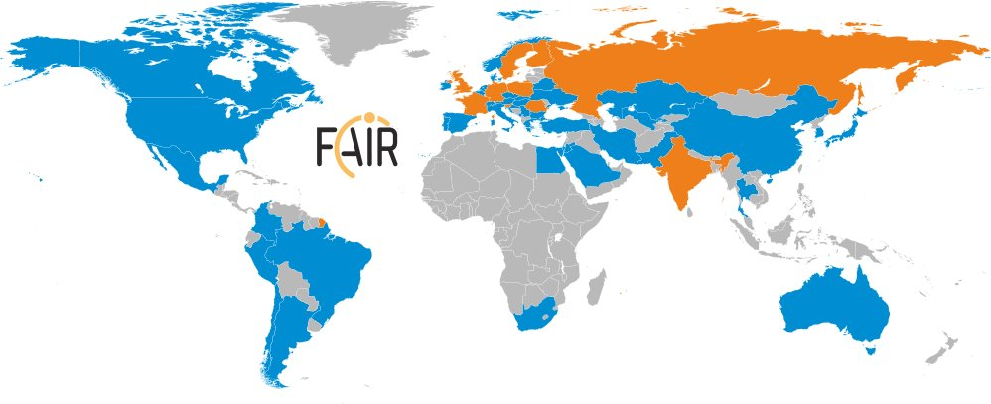
International Participation in FAIR
FAIR governed by international convention
  9 shareholders + 1 assoc. partner (orange)
Scientists from all over the world are engaged
  More than 200 institutions from 53 countries are involved with their scientists (orange + blue) → FAIR community growing

Slide 3

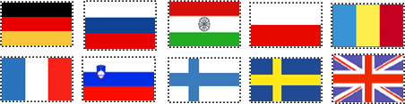
Facility for Antiproton & Ion Research
p-Linac
SIS100/300
SIS18
Primary Beams
10¹²/s; 1.5 GeV/u; ²³⁸U²⁸⁺
10¹⁰/s ²³⁸U⁹²⁺ up to 11 (35) GeV/u
3x10¹³/s 30 (90) GeV protons
Compressed Baryonic
Matter
HESR
Secondary Beams
Anti-Proton Physics
Super Fragment-Separator:
Nuclear Structure
and Astrophysics
radioactive beams up to
1.5 - 2 GeV/u;
10¹¹ antiprotons 1.5 - 15 GeV/c
Technical Challenges
CR
FAIR phase 1
FAIR phase 2
rapid cycling superconducting magnets
dynamical vacuum
100 m

Slide 4
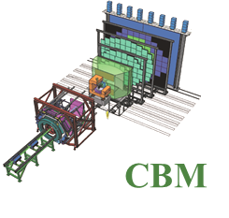
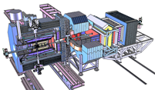
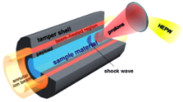
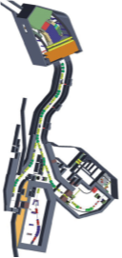
Facility for Antiproton & Ion Research
Experimental programs:
APPA: Atomic & Plasma Physics & Applications
➢ Highly charged atoms
➢ Plasma physics
➢ Radiobiology
➢ Material science
p-Linac
SIS100/300
SIS18
CBM: Nucleus-nucleus collisions
➢ Nuclear matter at neutron
star core densities
➢ Phase transitions from
hadrons to quarks
Compressed Baryonic
Matter
HESR
Anti-Proton Physics
NUSTAR: Rare Isotope beams
➢ Nuclear structure far off stability
➢ Nucleosynthesis in stars and supernovae
Super Fragment-Separator:
Nuclear Structure
and Astrophysics
PANDA: Antiproton-proton collisions:
➢ Charmed hadrons (XYZ)
➢ Gluonic matter and hybrids
➢ Hadron structure
➢ Double Lambda hypernuclei
CR
FAIR phase 1
FAIR phase 2
100 m

Slide 5
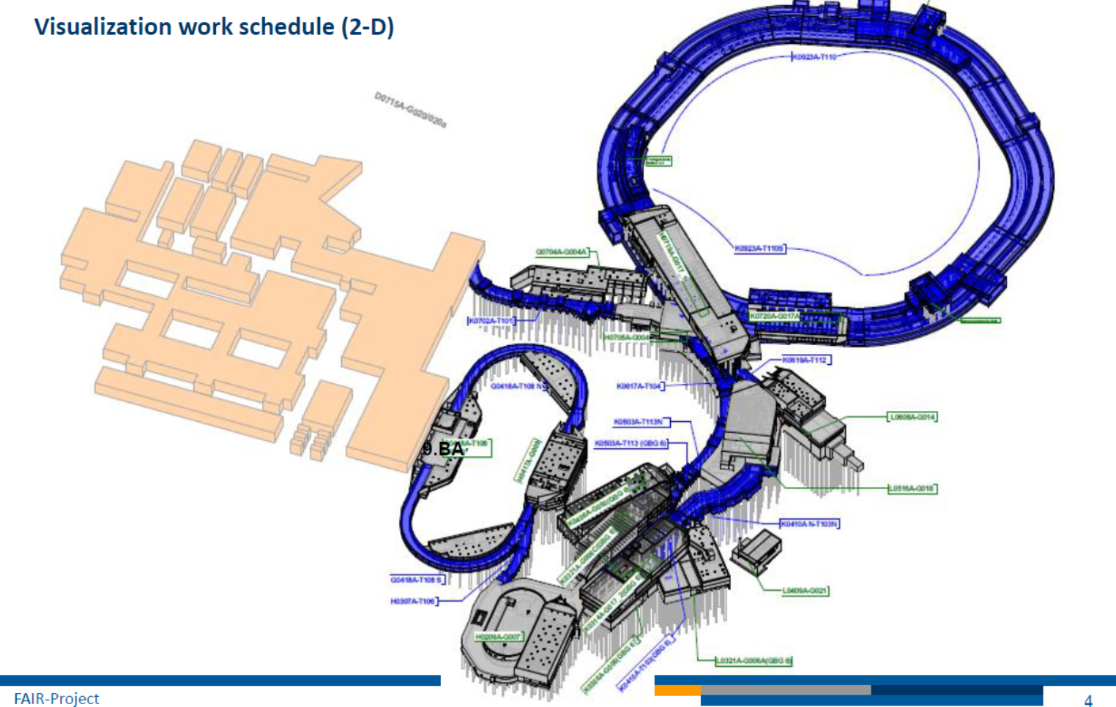
Status of FAIR
On Sept. 13, 2016 BMBF gave green light and 203 M€ to start civil construction.
1st call for tender Sept. 26, 2016: water management and excavation
2nd call for tender Nov. 22, 2016:
shell construction ‘north area’, includes SIS100 and CBM cave
Start of construction mid of 2017
Installation incl. commissioning of the experiments is planned during 2021-2024
Full completion of FAIR by 2025

Slide 6
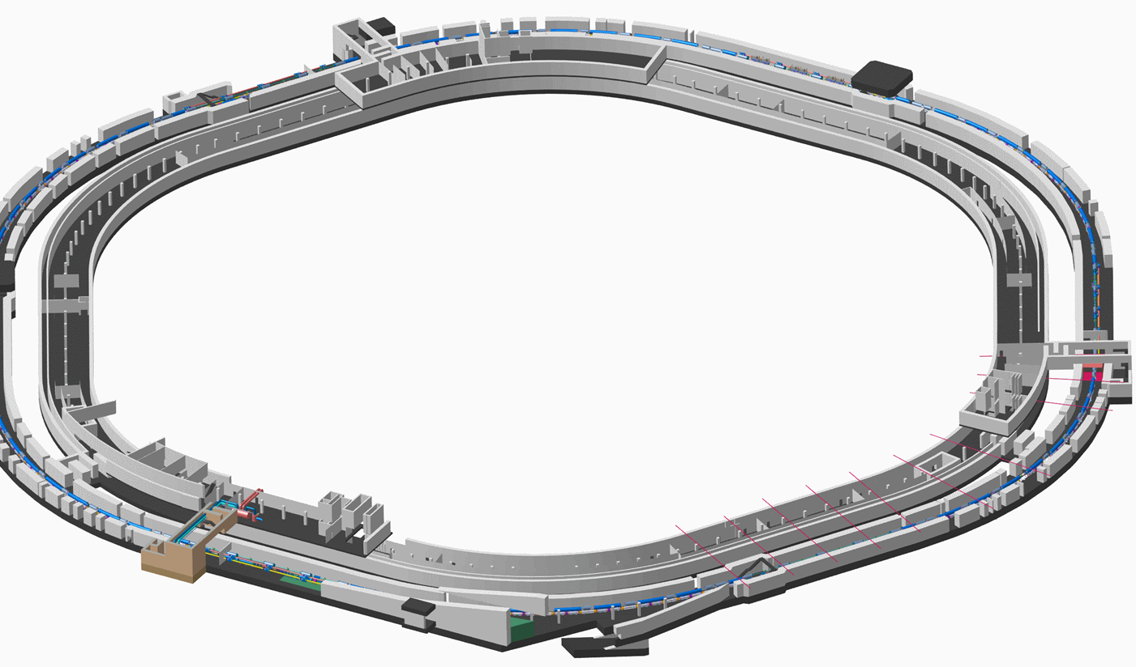
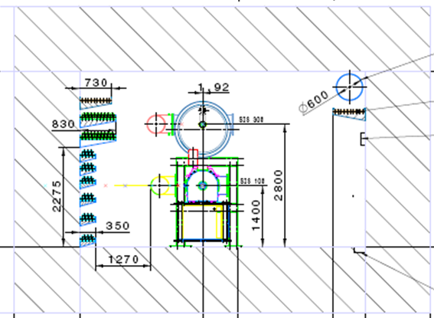
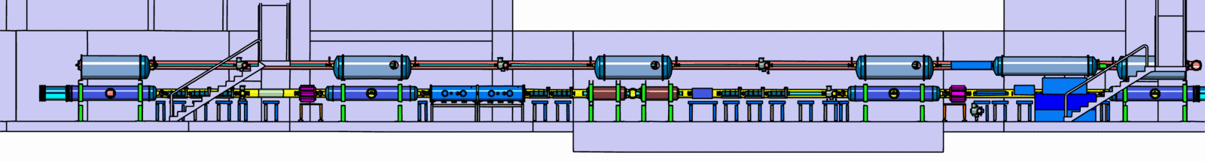
Tunnel for SIS100/300

Slide 7
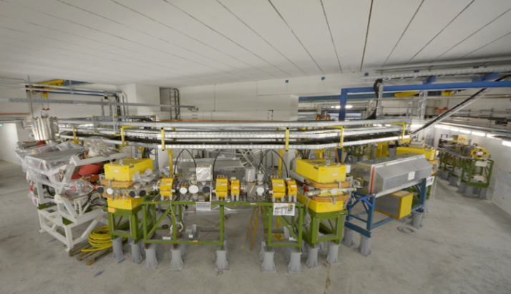
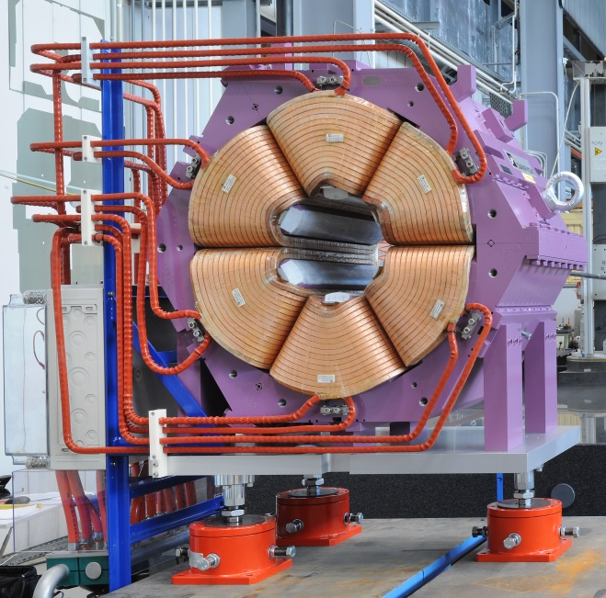
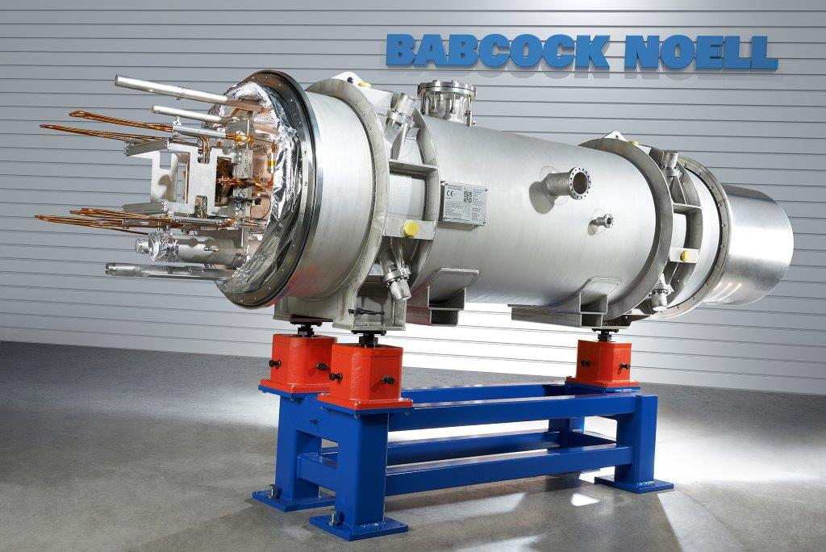
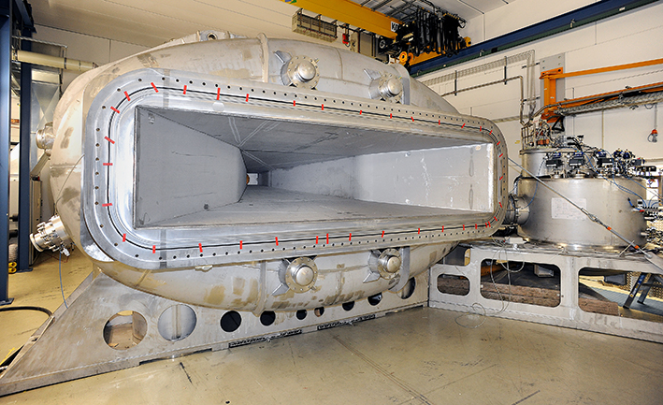
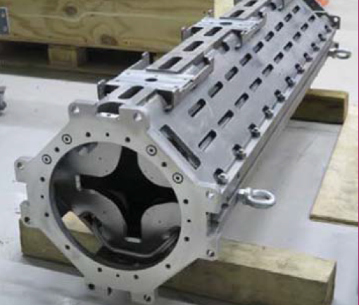
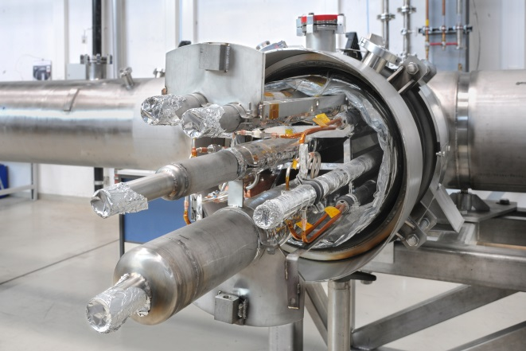
Procurement of FAIR components
Sweden
Germany
Denmark
France
Poland
Russia
Accelerator and detector contributions from many different partner institutions

Slide 8
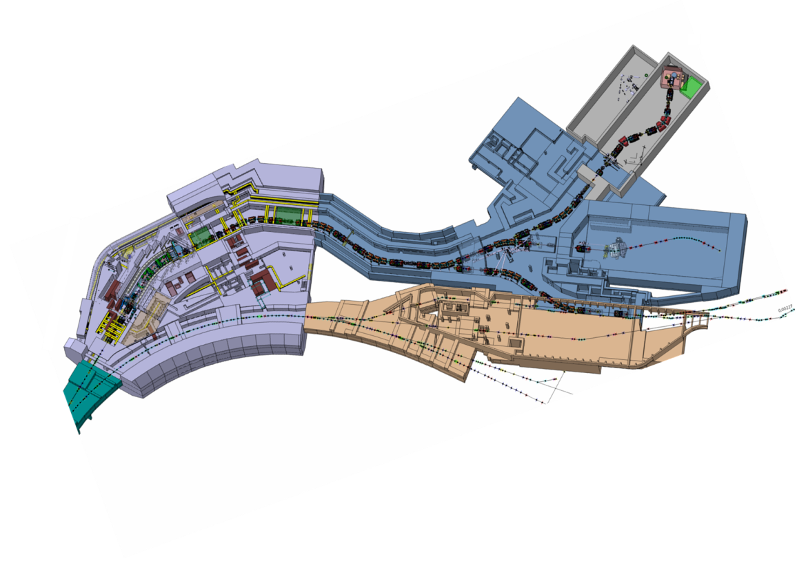
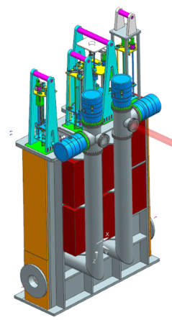
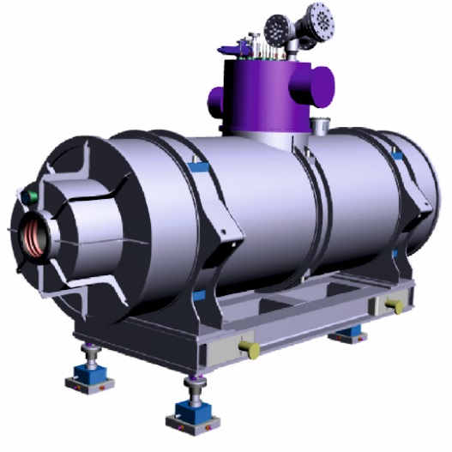
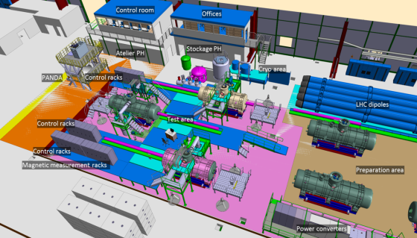
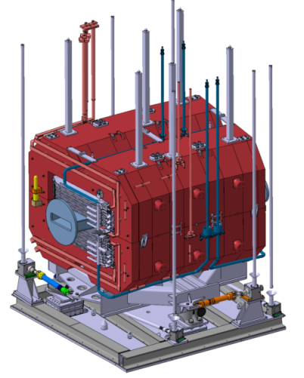
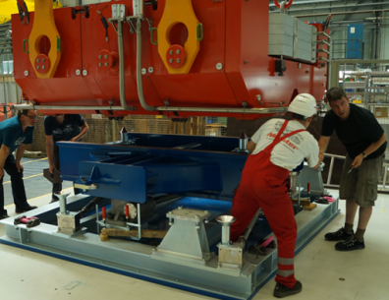
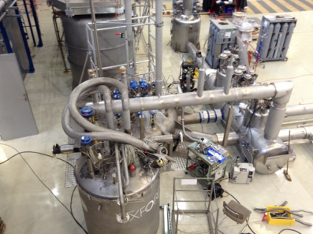
Procurement of Super-FRS components
~70 ton
6950 mm
Target chamber with plug ins. Collaboration and R&D contracts with KVI-CART (NL)
FOS s.c multiplett: PDR approved in July. Steel and wire orderd. Coil mock-up in production (Italy).
Collaboration agreement signed with CEA, including design and technical follow-up (France)
Set-up of test facility started at CERN, Commissioning of cryogenics system in 2016. First magnet end of 2017.
Radiation hard dipole. Prototype testing almost completed. Tendering on short term (Russia)

Slide 9
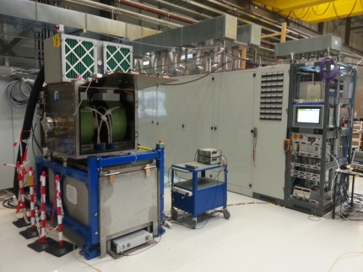
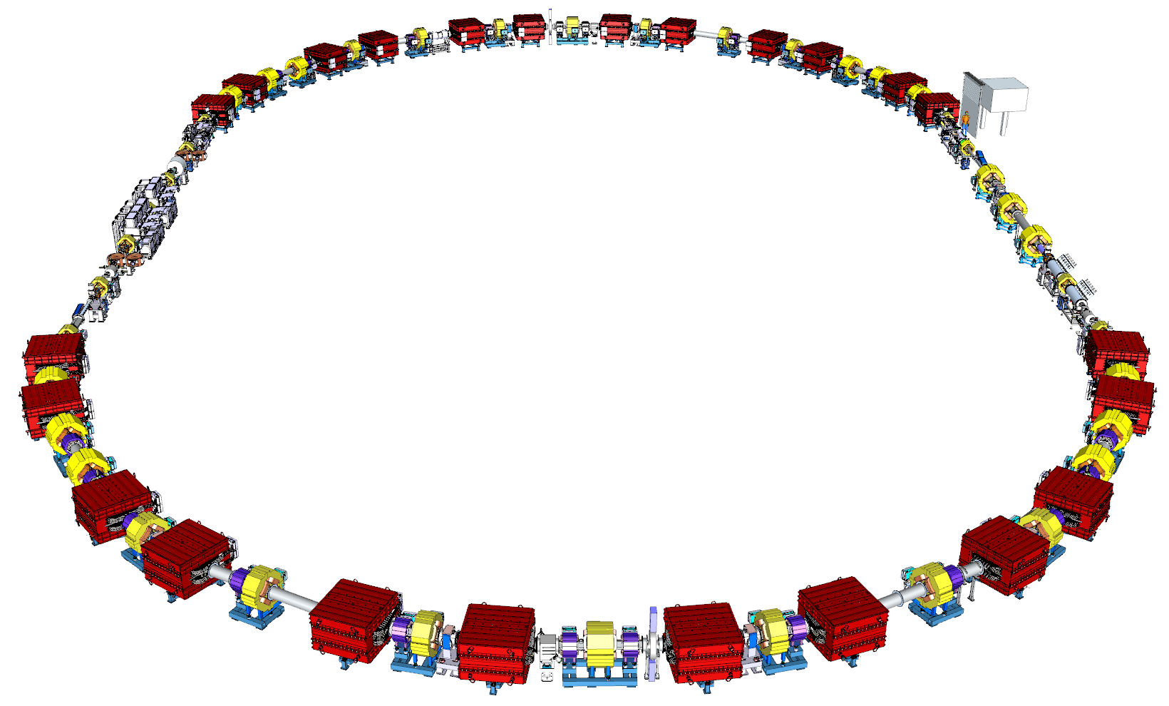
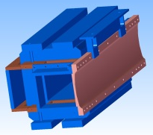
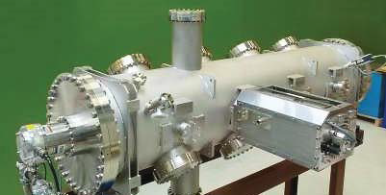
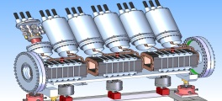
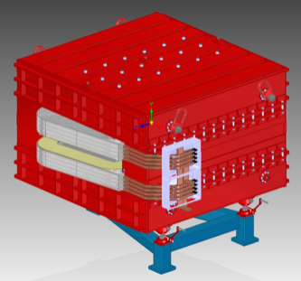
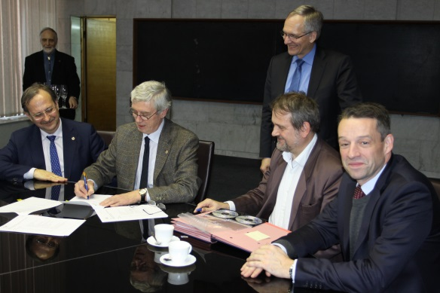
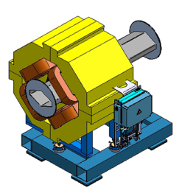
Procurement of Collector Ring
FOS debuncher cavity SAT ongoing.
Prototype stochastic cooling tank at GSI
  The update of TDR (Annex) is ready and approved. Several spec. completed
  The full 3D model of CR system is ready (DMU model)
  MA debuncher cavity in SAT at GSI.
  Prototype of Stochastic cooling Pick–up under development.
December 2016: Collaboration contract signed for the
dipole magnets (production until 2021) with BINP

Slide 10
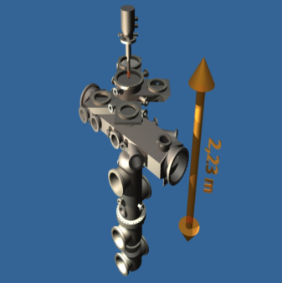
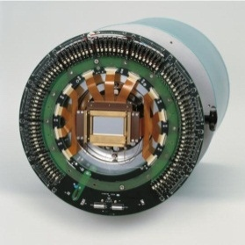
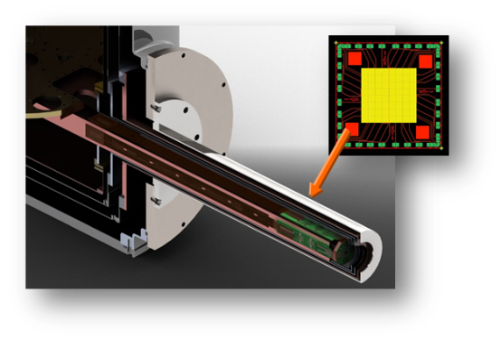
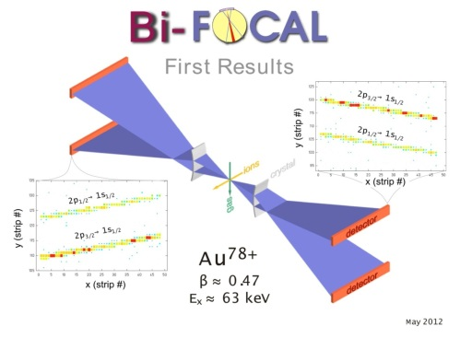
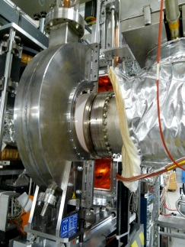
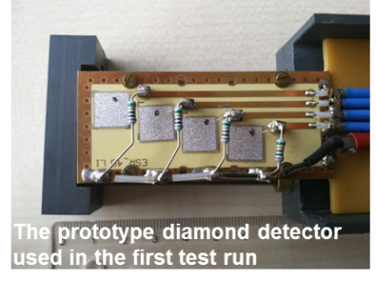
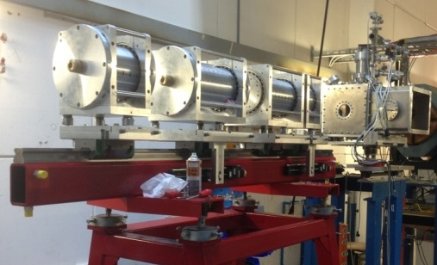
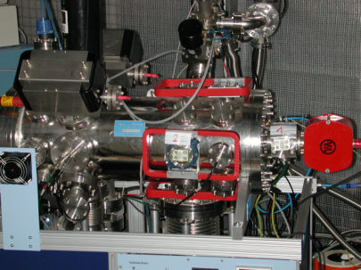
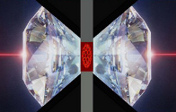
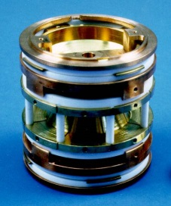
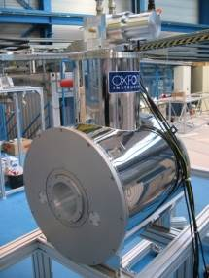
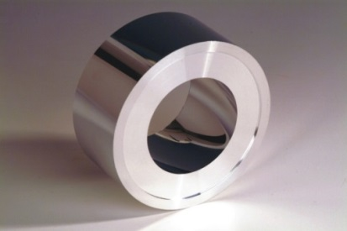
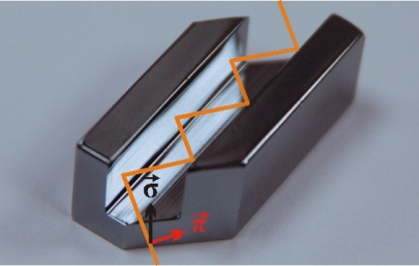
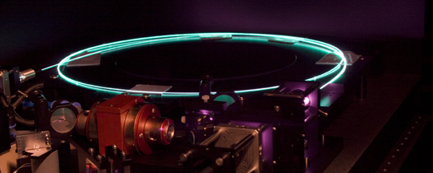
APPA – Detector Development
Targets
Position-sensitive solid-state detectors
High-resolution spectrometers
Particle detectors
Particle spectrometers
High pressure cell
Traps
X-ray optics, channel-cut crystals
Laser systems

Slide 11
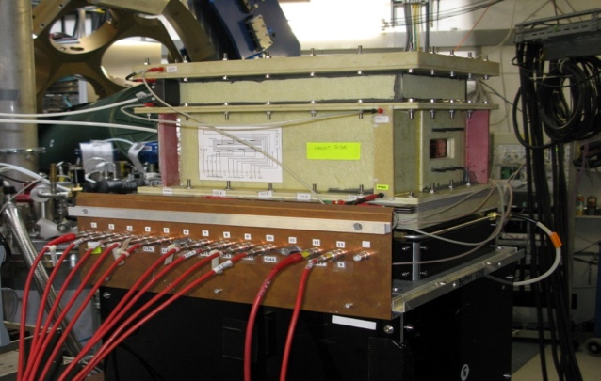
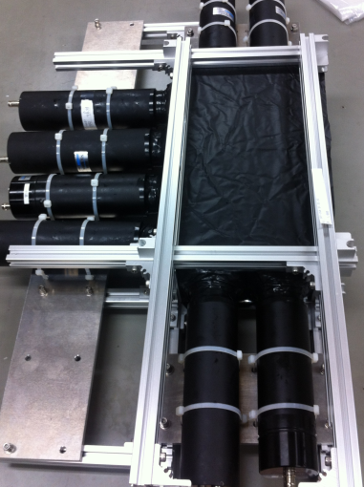
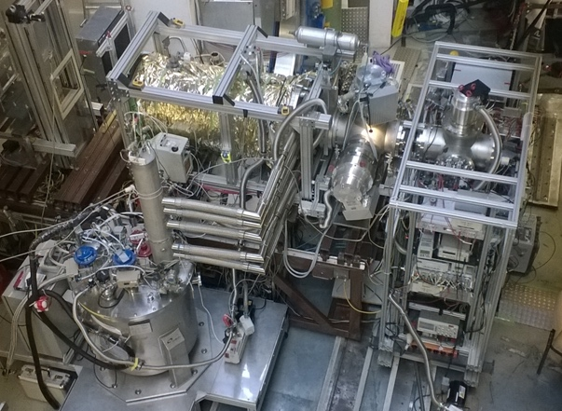
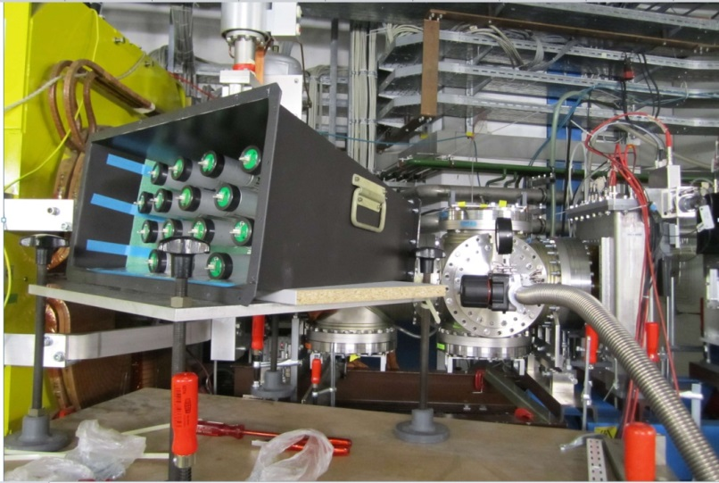


NUSTAR – Detector Development
O-TPC
Backward-angle neutron detector
Ion Catcher → LEB-MATS/LASPEC
GADAST prototype measurements at S2
Full integrated S2 fiber tracker

Slide 12






PANDA – Detector Development
STT
Endcap Mech.
EMC Alveoli
Support: Central trackers
CMS
PANDA 7x14 mm²

Slide 13








CBM – Detector Development
TRD
MUCH
TOF
DAQ
Diamond
Silicon tracker

Slide 14



Preparatory Work for FAIR
SIS18 upgrade
  Machine upgrade
  Shielding re-enforcement
Campus development
  New canteen
  More office space
  Green IT-Cube

Slide 15


Integrated Project Time Schedule – Level 1:
FAIR Buildings, Accelerators & Experiments
FAIR
Buildings
7/2017 –
12/2022
FAIR
Acc. &
Exp. Install.
and
commiss.w/o
beam
1/2021
-
8/2024

