Slide 1
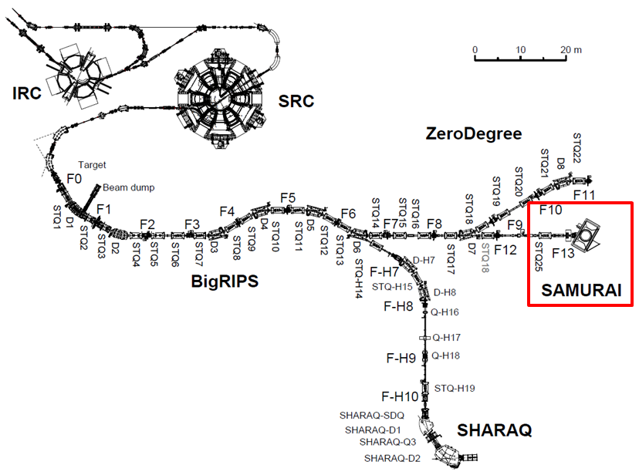

SAMURAI
Superconducting Analyzer for Multi-particles from Radioisotope beams

Slide 2
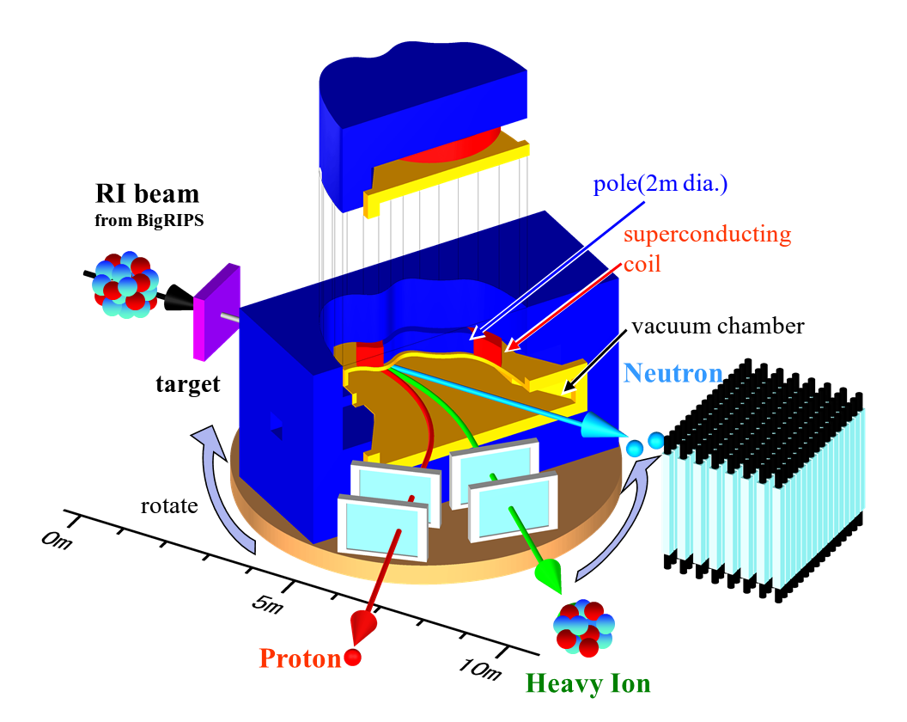
Overview
The SAMURAI spectrometer is designed for kinematically complete reaction measurements by detecting multiple particles in coincidence.
Large angular- and momentum-acceptance
Large pole gap
Wide horizontal opening of a yoke
SAMURAI consists of …
Superconducting dipole magnet
Heavy Ion detectors
Proton detectors
Neutron detectors
Large vacuum chamber
Rotatable base
The construction of the SAMURAI was completed in Feb. 2012.

Slide 3
Requirements for Magnet
Requirements
  Large field integral --> for high precision momentum analysis
  Large pole gap --> for large vertical acceptance for neutrons
  No coil link --> for large acceptance in the horizontal direction
  Small fringing field --> for detectors around the target region and tracking detectors
  Flexibility --> for various experimental conditions
  Large momentum acceptance --> for heavy fragments and protons in coincidence
  High momentum resolution --> for deuteron-induced reactions
  Field Integral 7 Tm (dR/R ~ 1/700 @ 2.3 GeV/c for A/Z=3)
  --> mass separation σ_{A}=0.2 for A=100
  Large Gap (0.8 m --> vertical ±5 degrees)
  Large opening (3.4 m --> holizontal ±10 degrees)
  Small Fringing Field (< 50 gauss @ 50cm from magnet)
  H-type magnet with cylinder poles (2m in diameter)
  Magnetic field … about 3T at center by ~1.9MAT
  Field clamp
  Build-in vacuum chamber
  Rotatable base (from -5 to 95 deg, 0.1deg/sec)

Slide 4
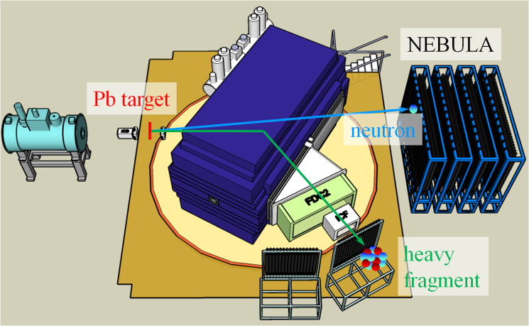
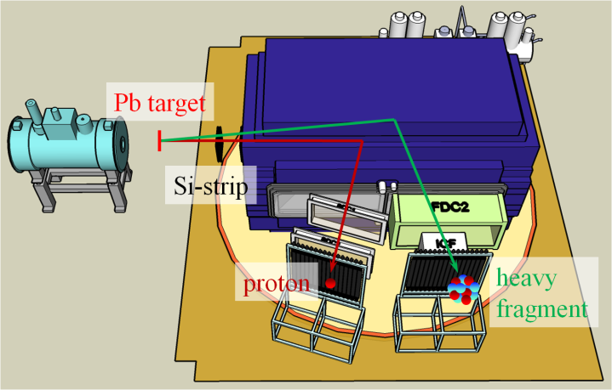
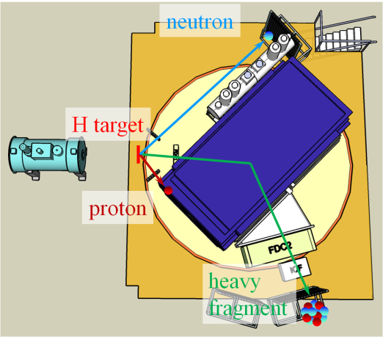
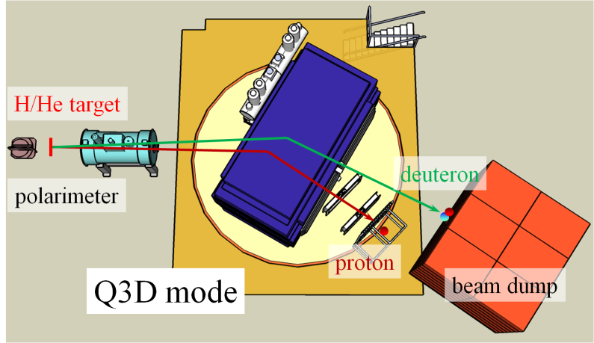
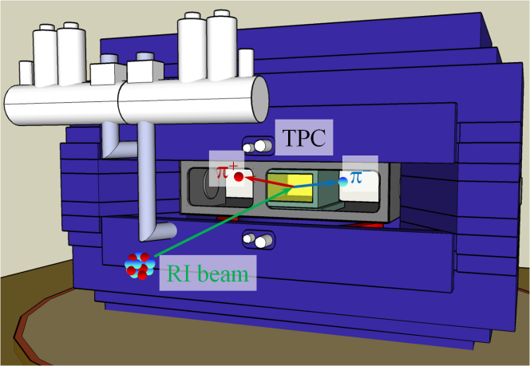
Versatile usage
Magnet can rotate around it’s center.
(γ, n) reaction: neutron-rich side
(γ, p) reaction: proton-rich side
(p,p’), (p,2p), (p,pn), …
30deg
90
90deg
45deg
0
pol. d-induced reaction
EOS measurement
30deg
0deg
Flexibility of settings is one of the good properties of SAMURAI.

Slide 5
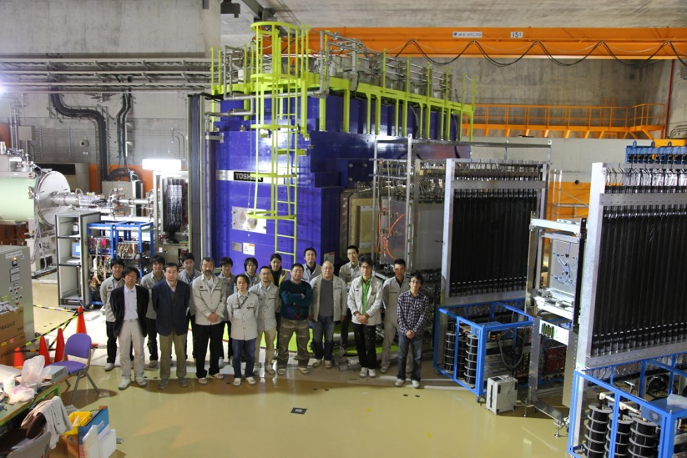
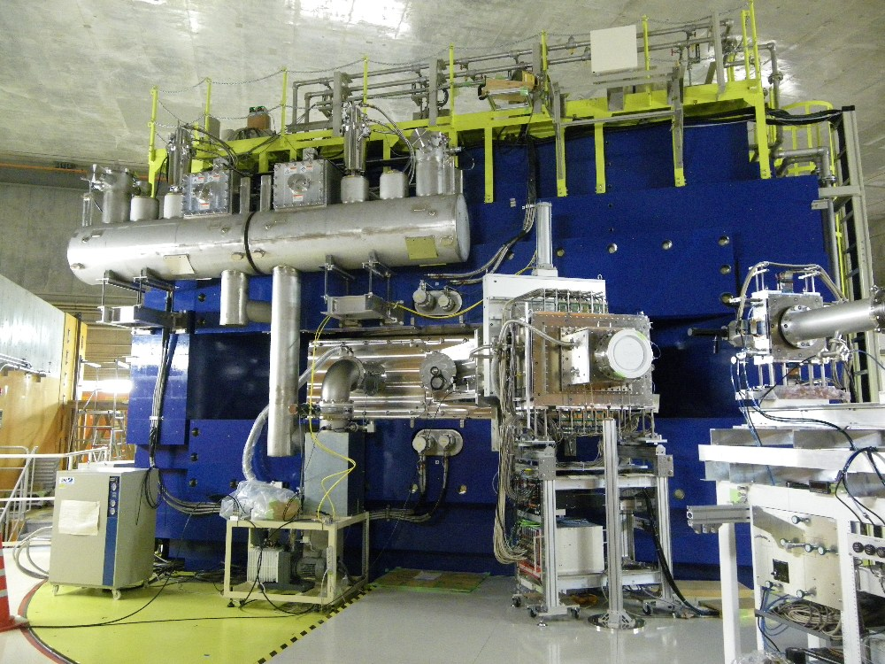
Photo
target
LHe reservoir vessels
Field cramp
side view
upstream
Vacuum chamber
* The magnet was rotated at an angle of 30º.

Slide 6
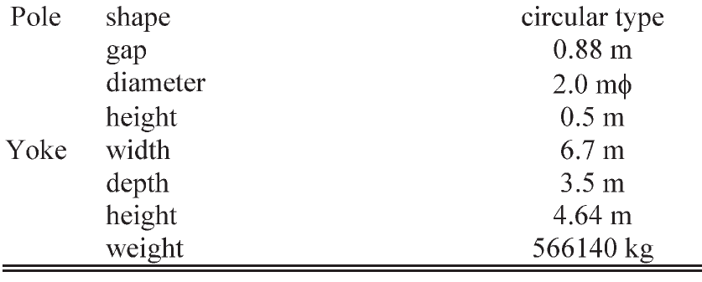
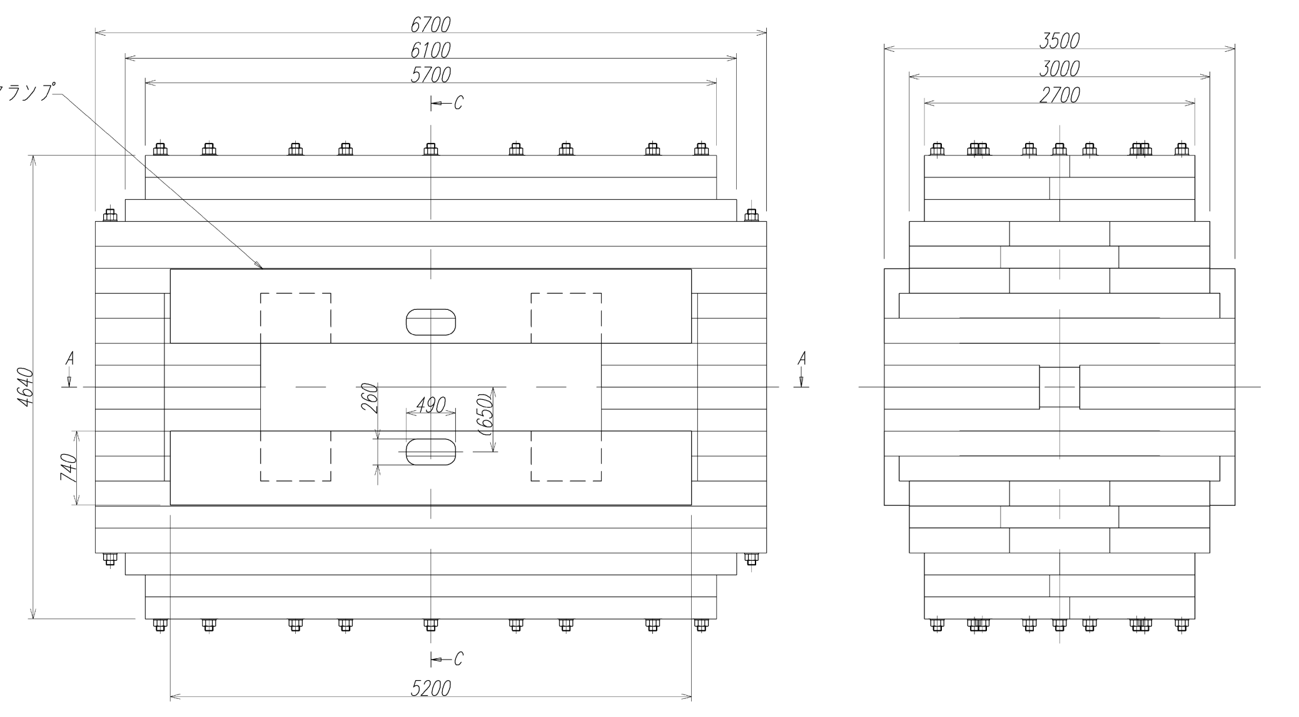
Yoke
hole
field clamp
hole
880

Slide 7
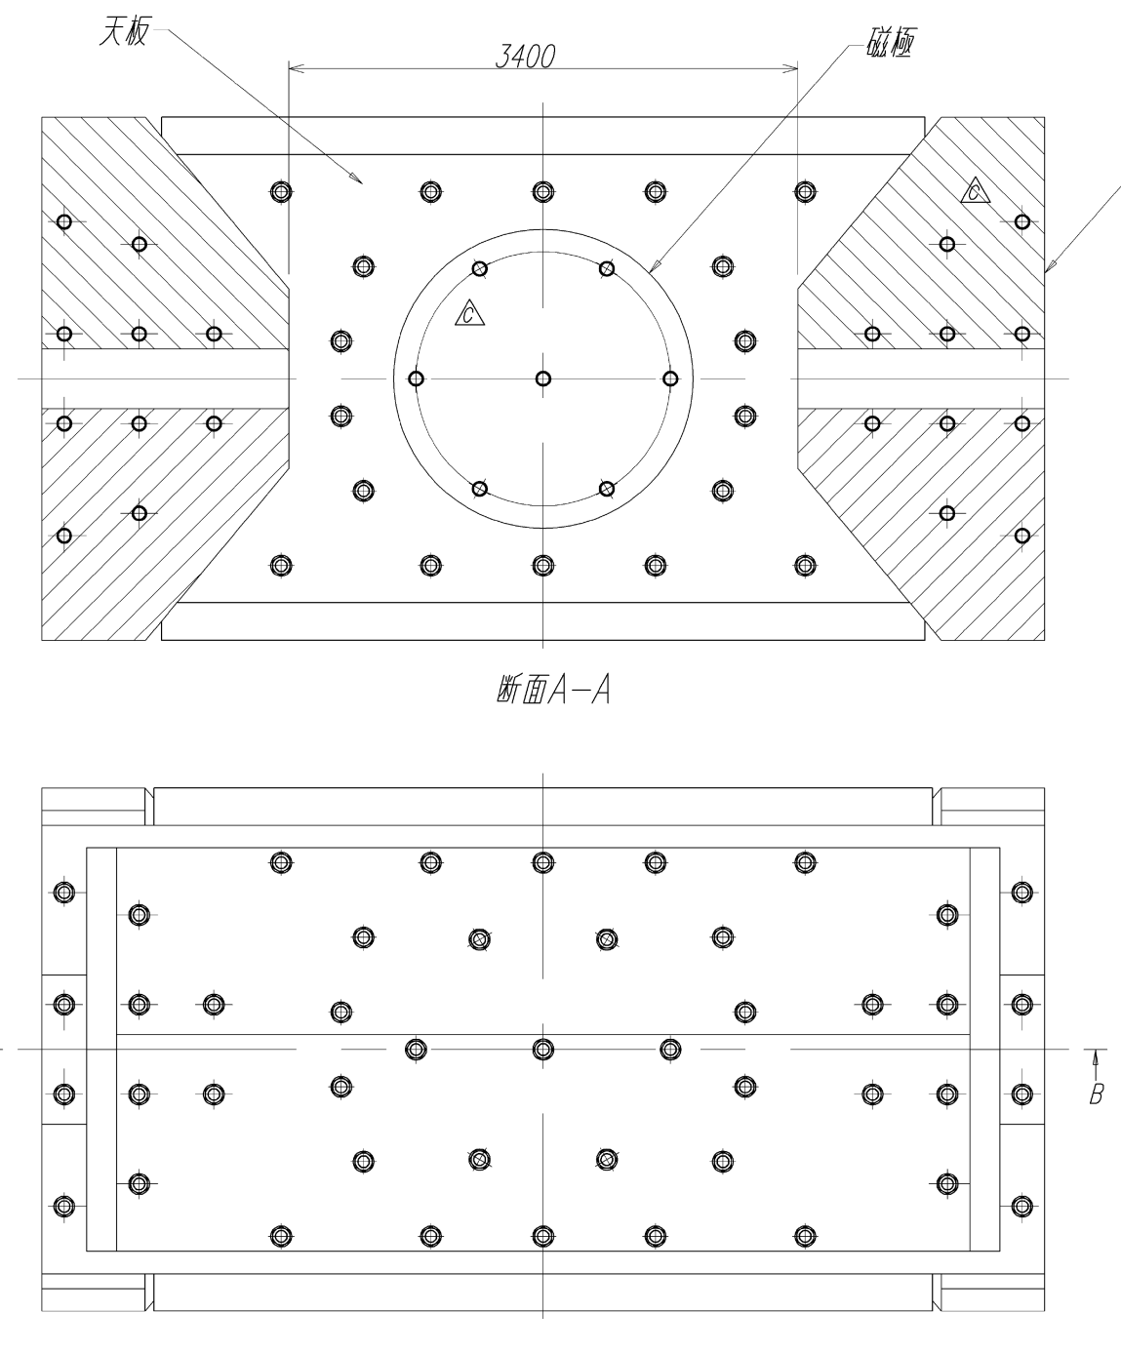
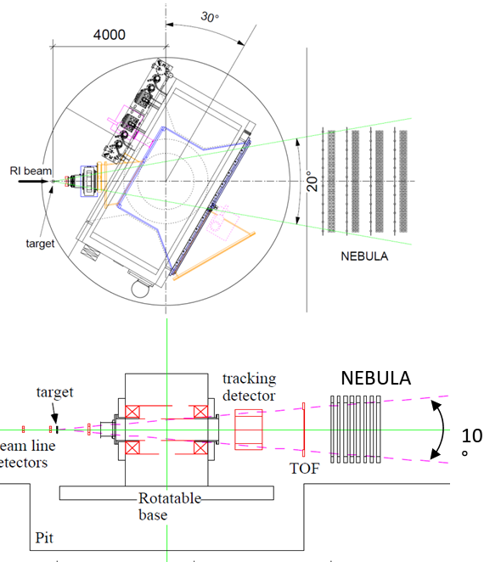
Yoke
cutaway view at median plane
pole (2m dia.)
side yoke
top view

Slide 8
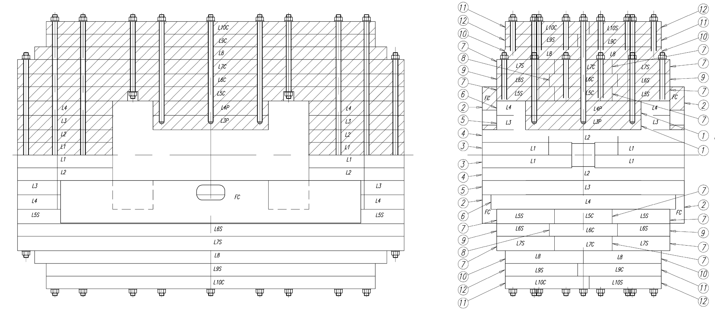
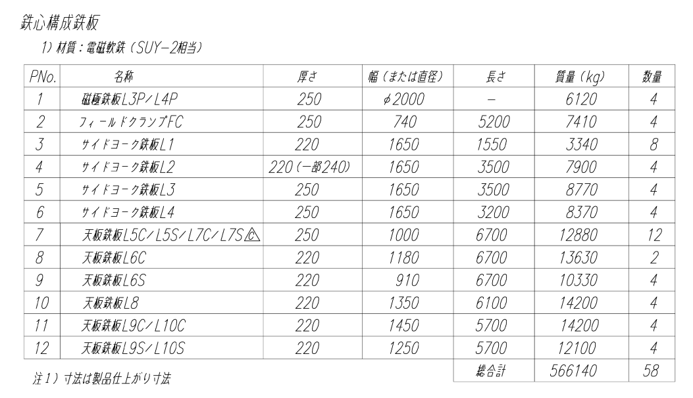
Yoke
70 stud bolts
M90, S45C
yoke = 58 slabs
The slabs weigh less than 15 tons due to the load limit of the crane.

Slide 9
Specifications of the soft steel
Company: JFE Steel Corporation
Product name: Hot Rolled Steel Plate
Model: JFE-EFE 2003
SPEC: SUY-2 (defined in JISC2504)
Chemical components
 | C | Si | Mn | P | S | Cu | Cr | Mo | Al | N
[%](mass) | < 0.03 | < 0.20 | < 0.50 | < 0.03 | < 0.03 | (0.15) | (0.05) | (0.02) | (0.06) | (0.01)
Mechanical properties
0.2% proof stress | > 120 MPa
tensile strength | > 220 MPa
Elongation | > 20%
DC magnetic properties
H [A/m] | 300 | 500 | 1000 | 4000
B [T] | > 1.15 | > 1.30 | > 1.45 | > 1.60
coercive field strength | < 100 A/m @1.5 T

Slide 10
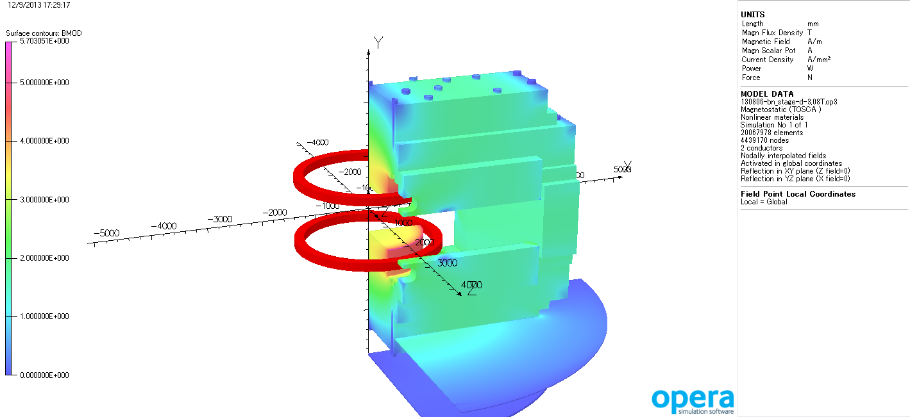
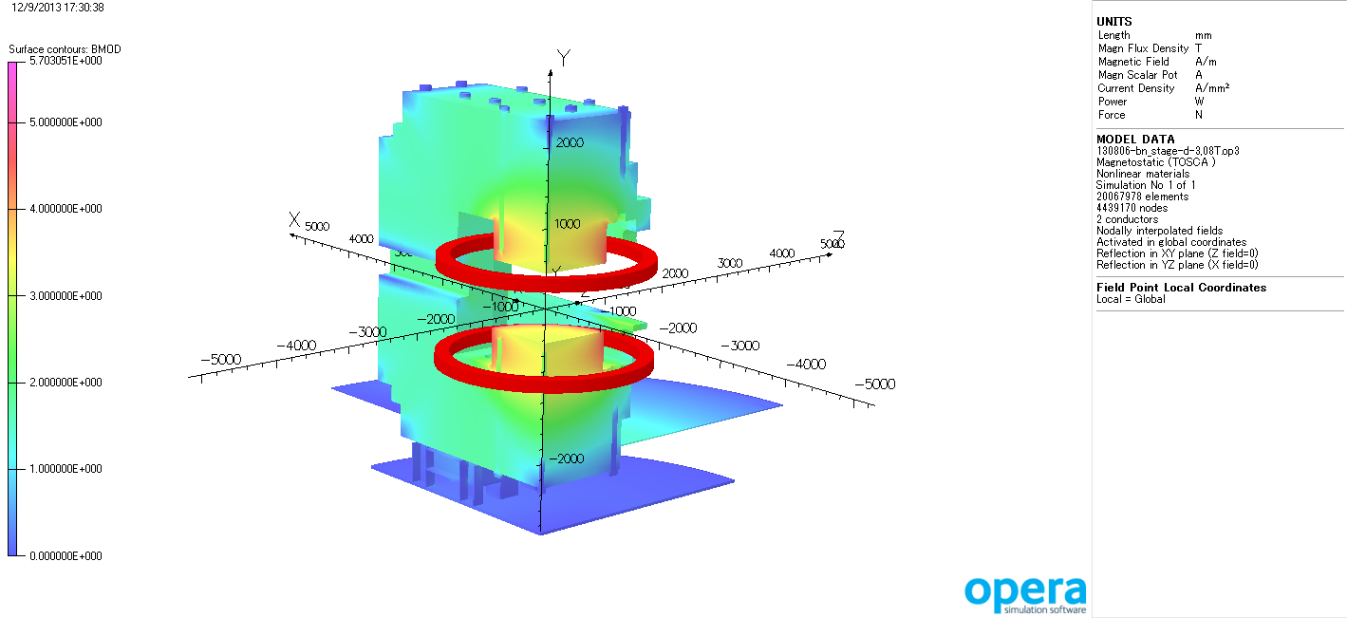
Saturation of the Yoke
B(0)=3.08 T
|B| [T]
5.703051
5.0
4.0
3.0
2.0
1.0
0.0
|B| [T]
5.703051
5.0
4.0
3.0
2.0
1.0
0.0

Slide 11
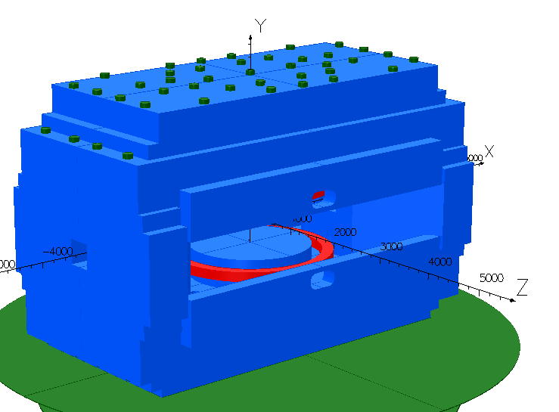
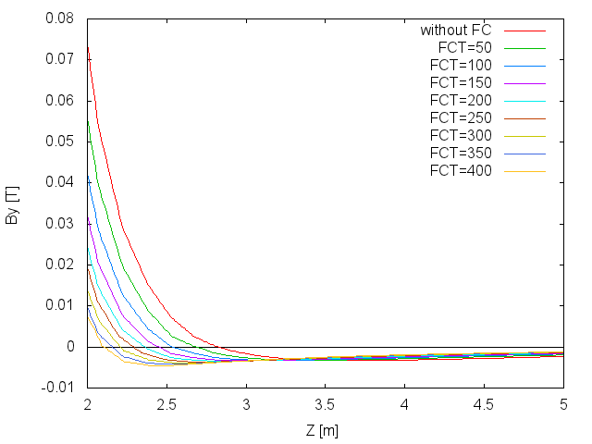
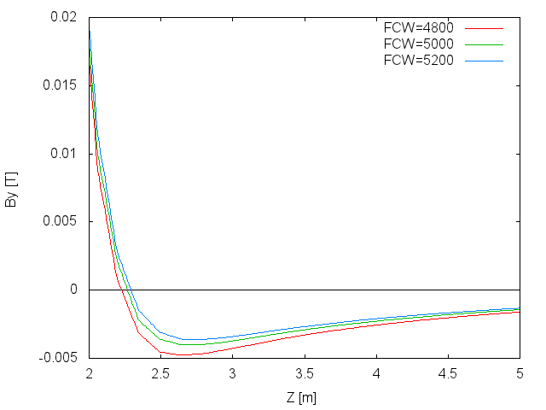
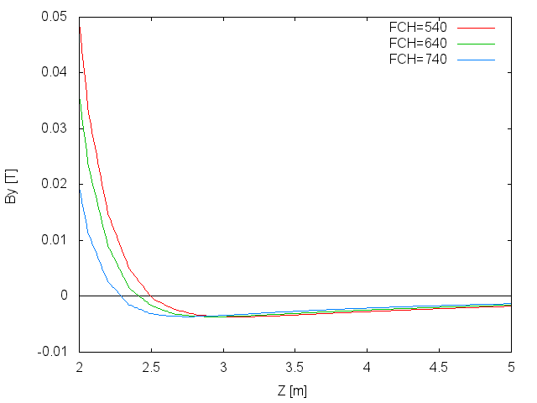
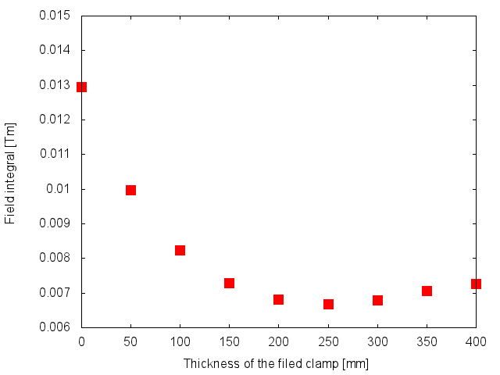
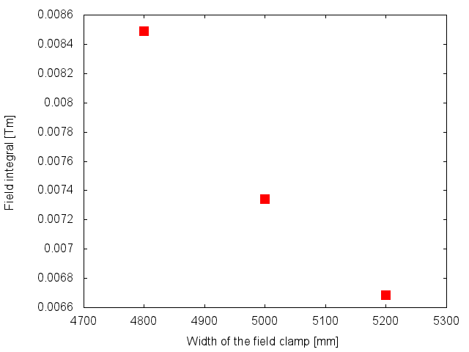
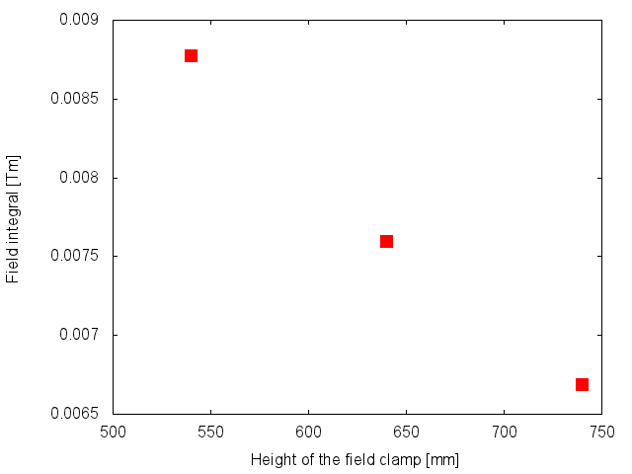
Field clamp
Field clamp (W5400 x H740 x D250) was designed so as to obtain smaller fringe field.
B=3.08T
Thickness dependence
W5400 x H740 x D***
Width dependence
W**** x H740 x D250
Height dependence
W5200 x H*** x D250
2.2 < Z < 5.0
2.2 < Z < 5.0
2.2 < Z < 5.0
field integral
field integral
field integral

Slide 12
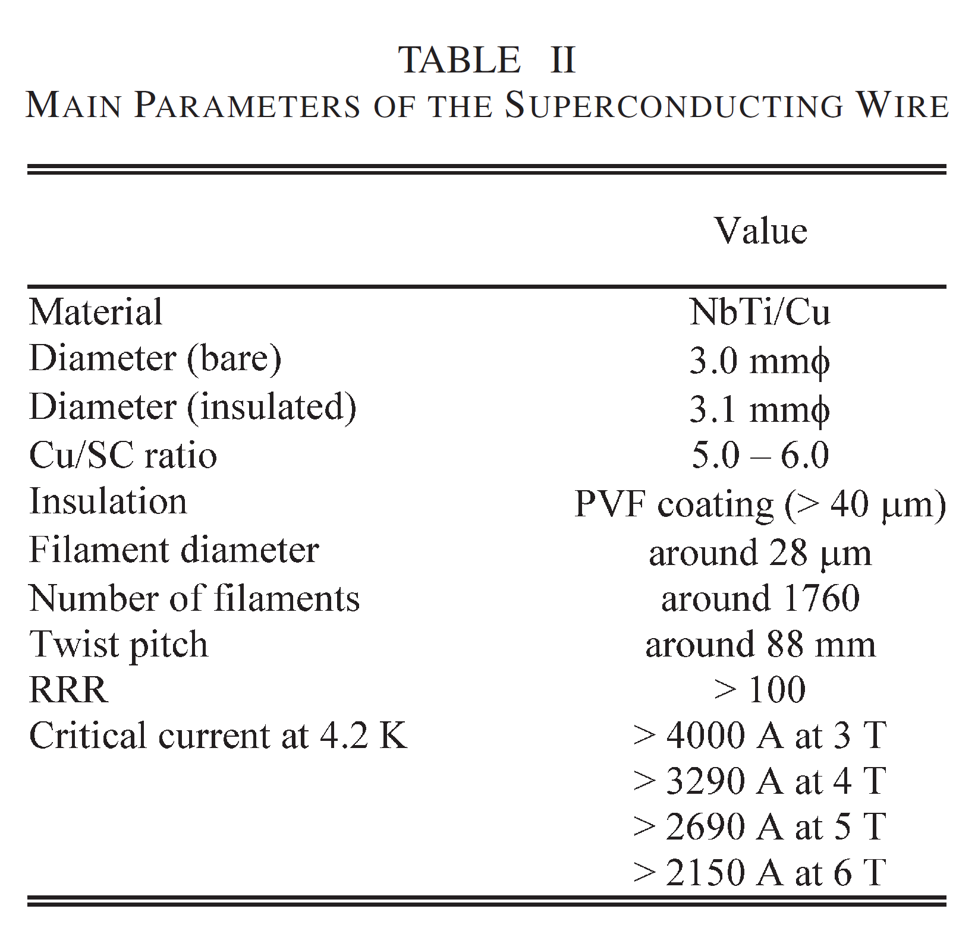
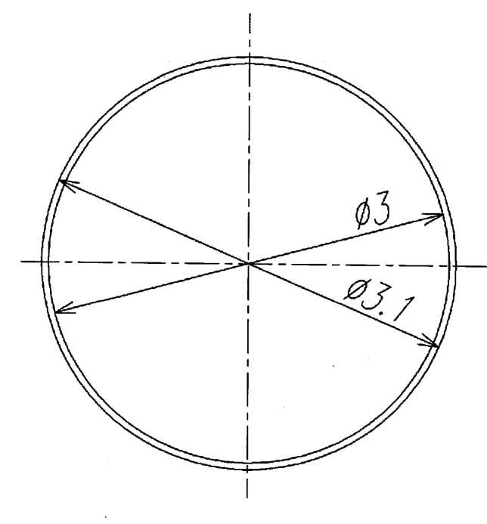
Super conducting wire
PVF insulation
NbTi/Cu
FURUKAWA ELECTRIC CO., LTD.

Slide 13
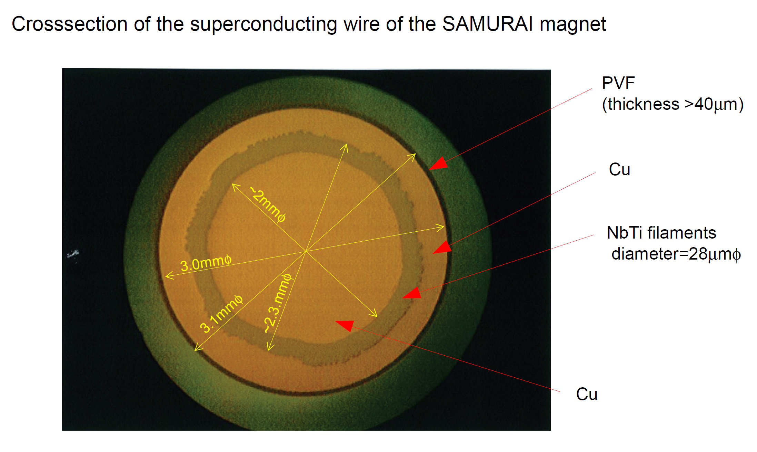
SC wire

Slide 14
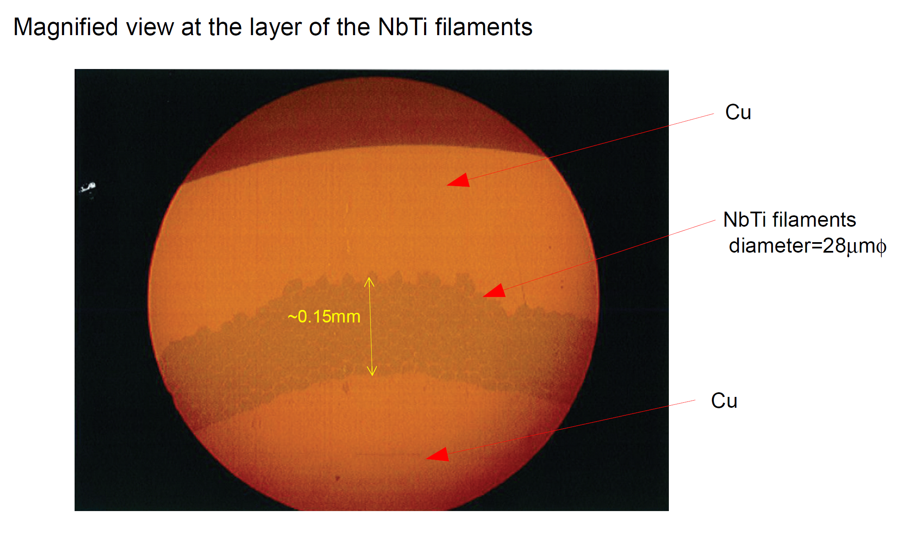
SC wire

Slide 15
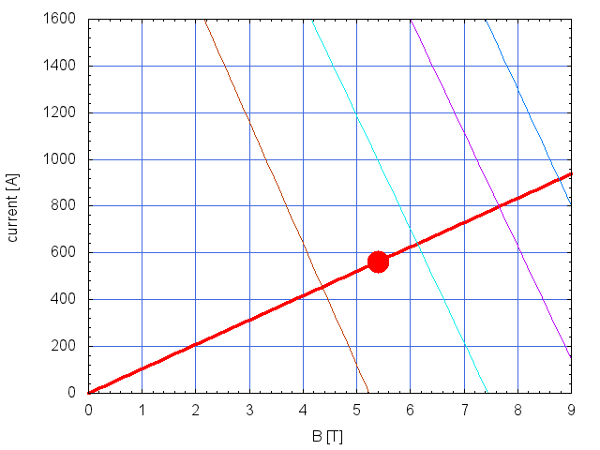
SC wire
Ic @6K
Ic @4.2K
Ic @7K
Ic @5K
Load Line
563 A
5.4 T
Load factor : 60% @4.2K

Slide 16
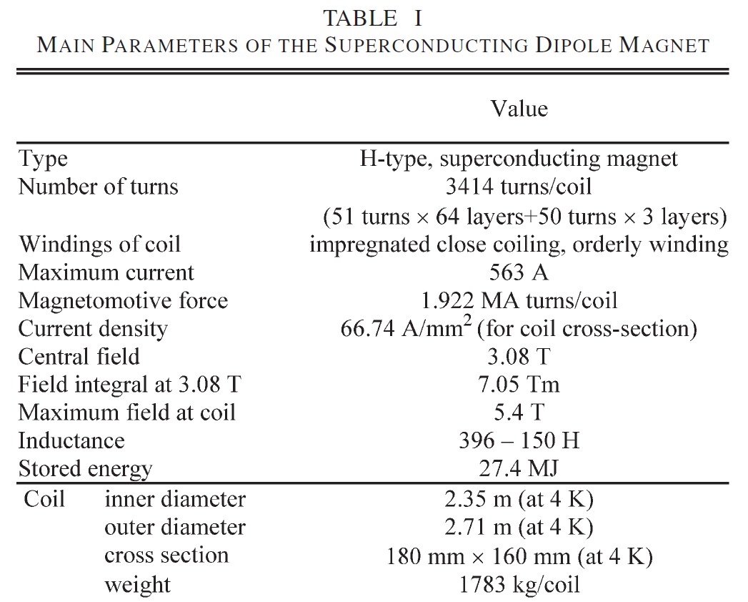
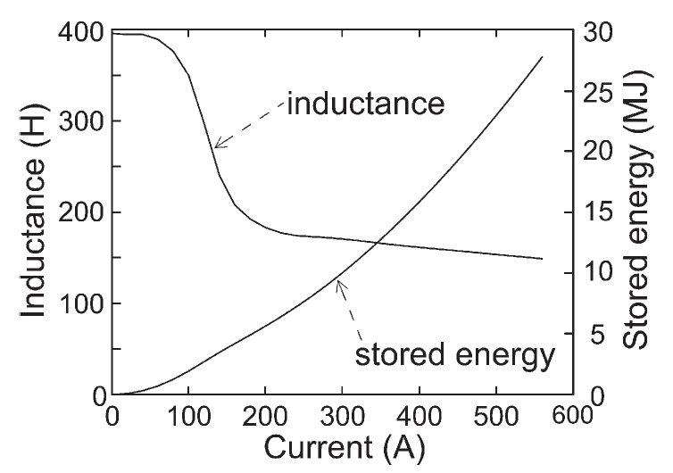
Specifications of the coil
NOT stabilized
Wet winding using the special epoxy resin

Slide 17
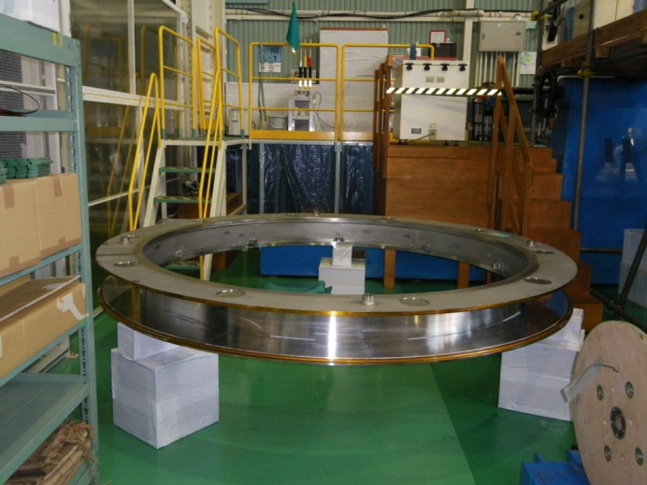
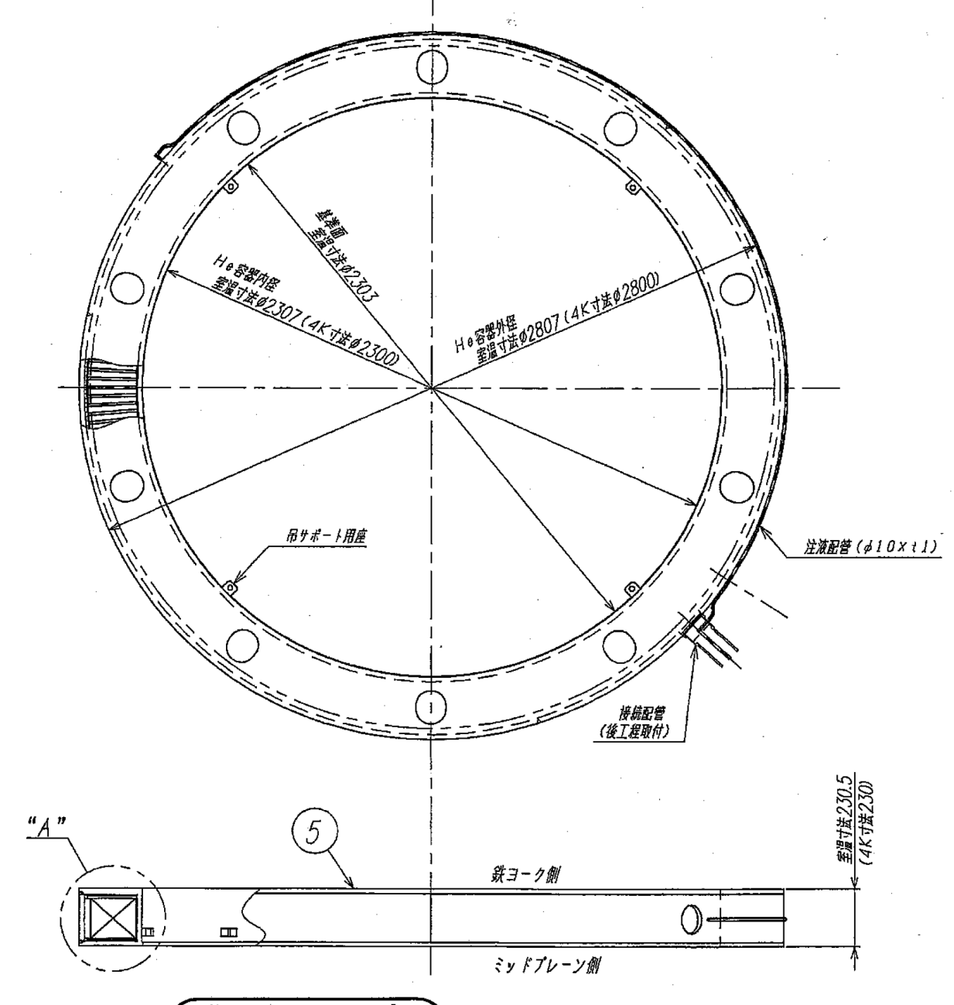
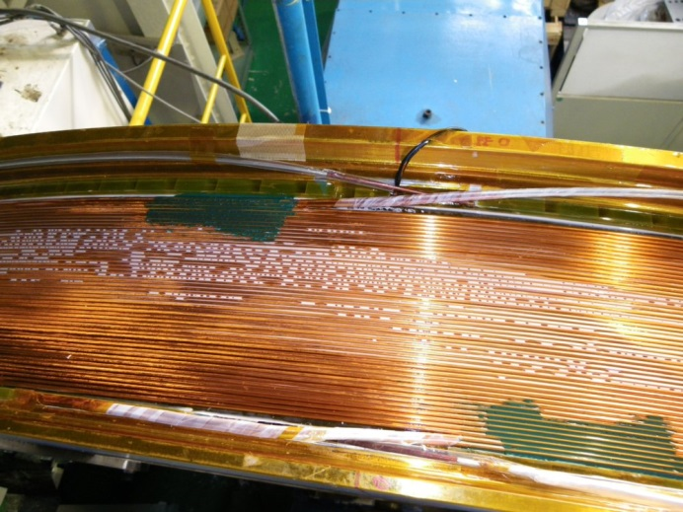
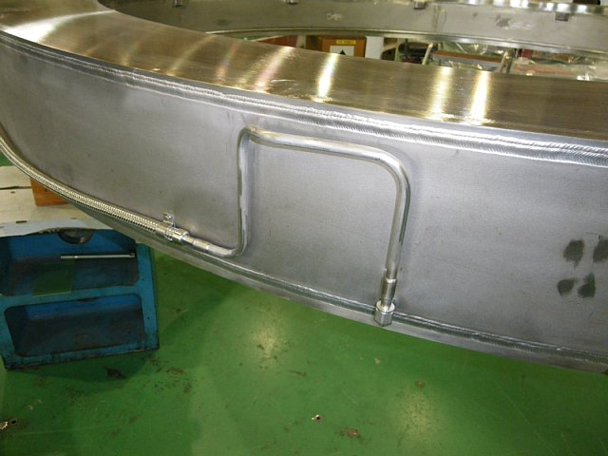
Coil vessel
SUS316L
total weight: 3 ton
coil: 1.8 ton
vessel: 1.2 ton
2300
2800
tube (φ10x1^{t})
LHe
welding
LHe: 57.4 L
pre-stress
radially by welding

Slide 18
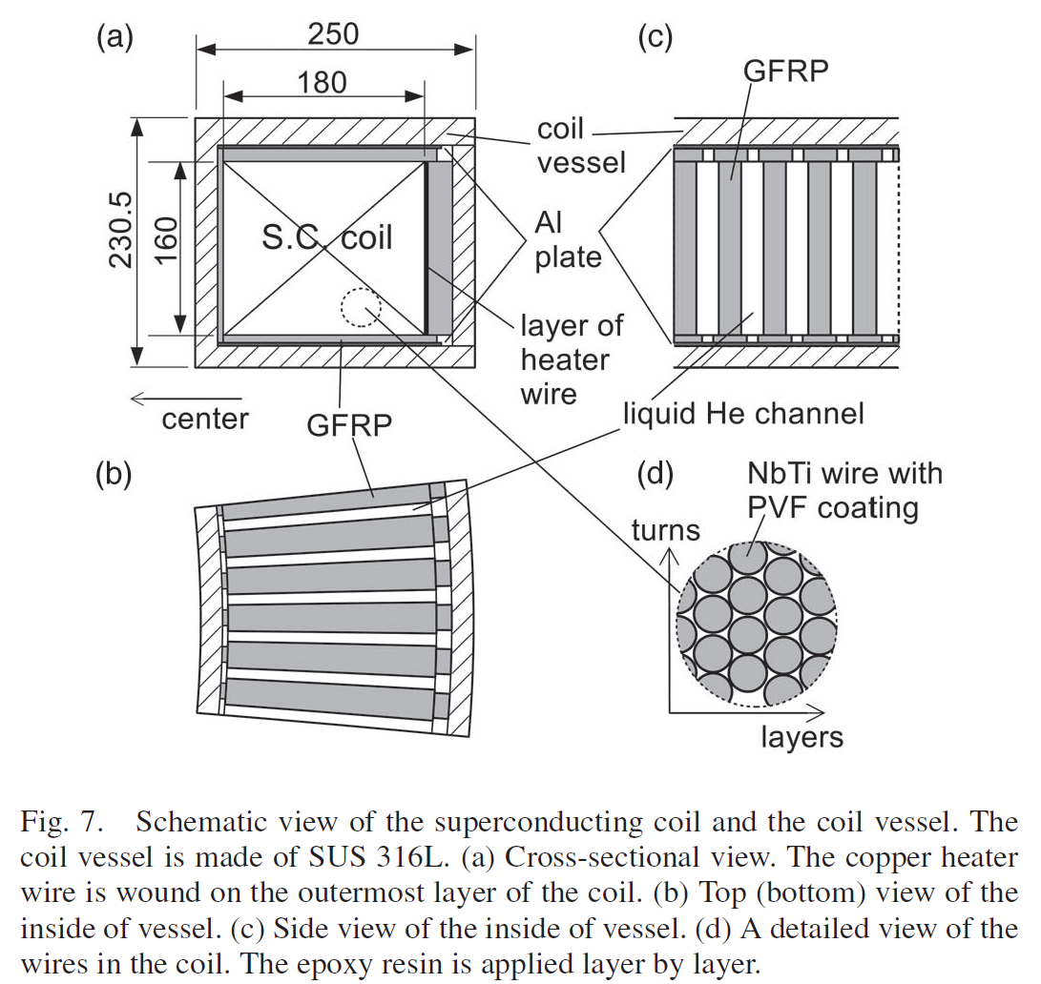
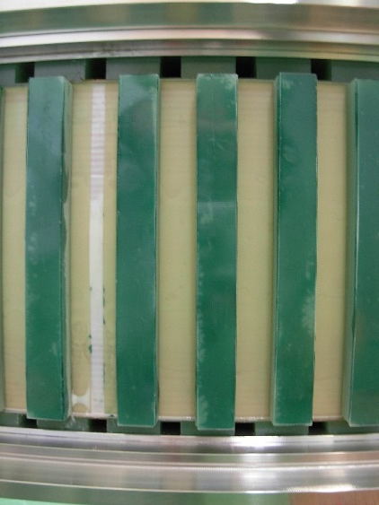
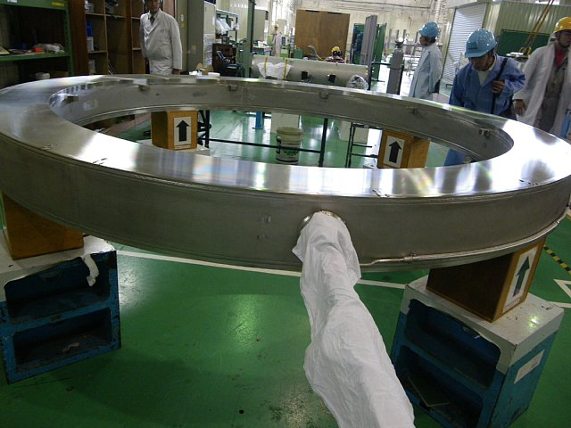
Coil
(A1050)

Slide 19
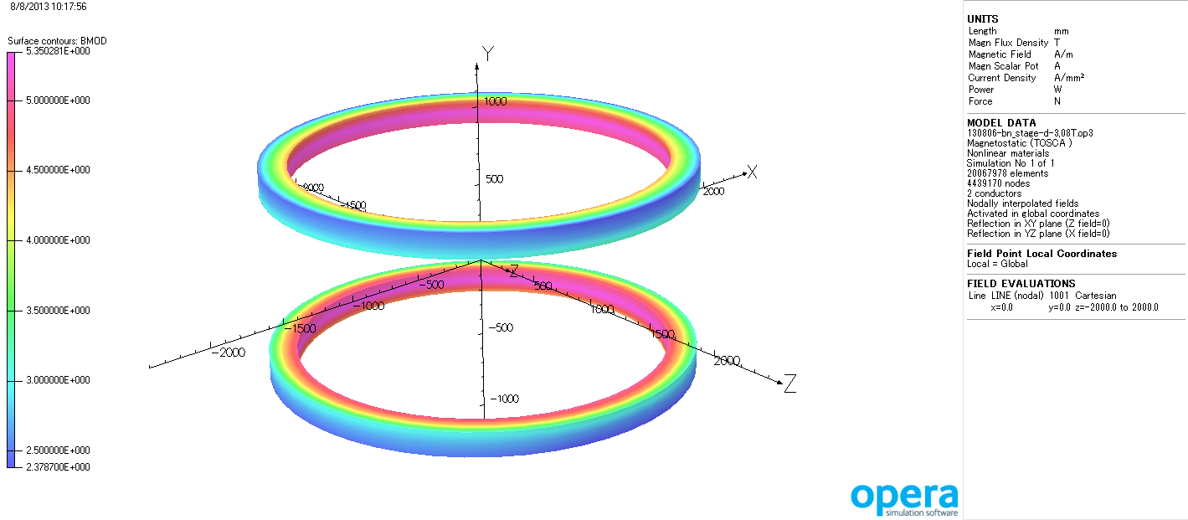
Coil
Fields at the coil surface
I=563 A, B=3.08 T
|B| [T]
|B|max=5.4 T

Slide 20
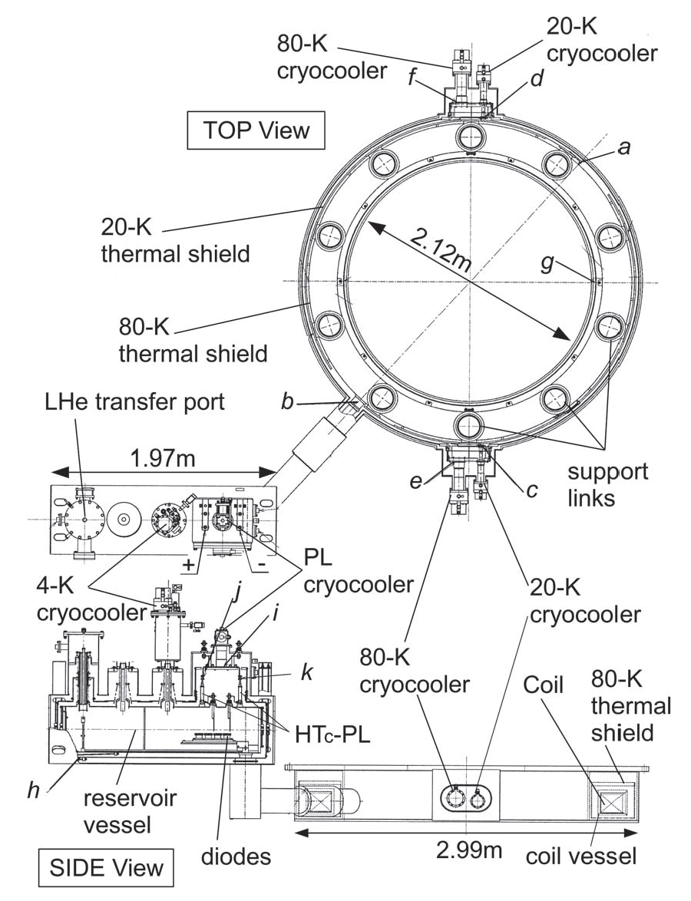
Cryostat
Upper coil
Cold mass (@4.2K)
coil: 1.8 ton
coil vessel: 1.2 ton
reservoir vessel+pipe: 0.5 ton
3.5 ton / coil
From RT to 4.2K …
LN2: 3000L/coil
LHe: 1500L/coil
3 weeks / 2coils
Amount of LHe
coil vessel: 57.4 L
reservoir vessel: 165.4 L
pipe: 10.9 L for upper coil
16.7 L for lower coil
165.4L
~240 L/coil
57.4L

Slide 21
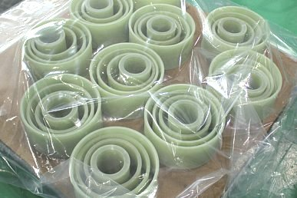
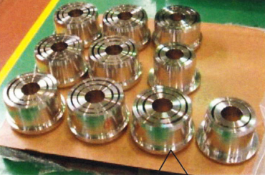
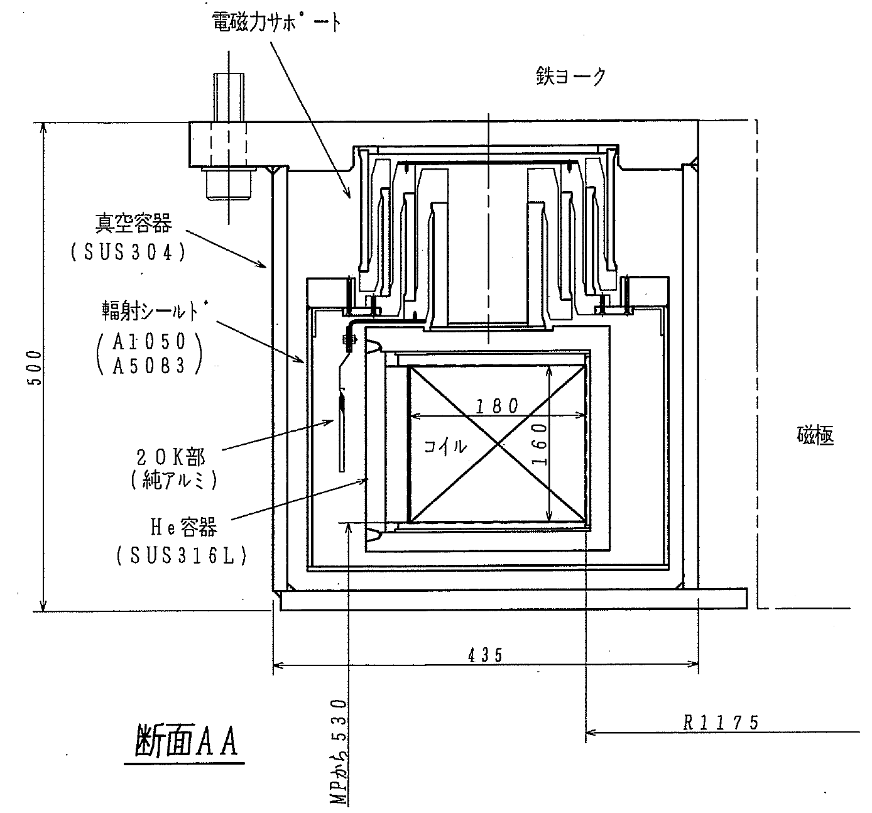
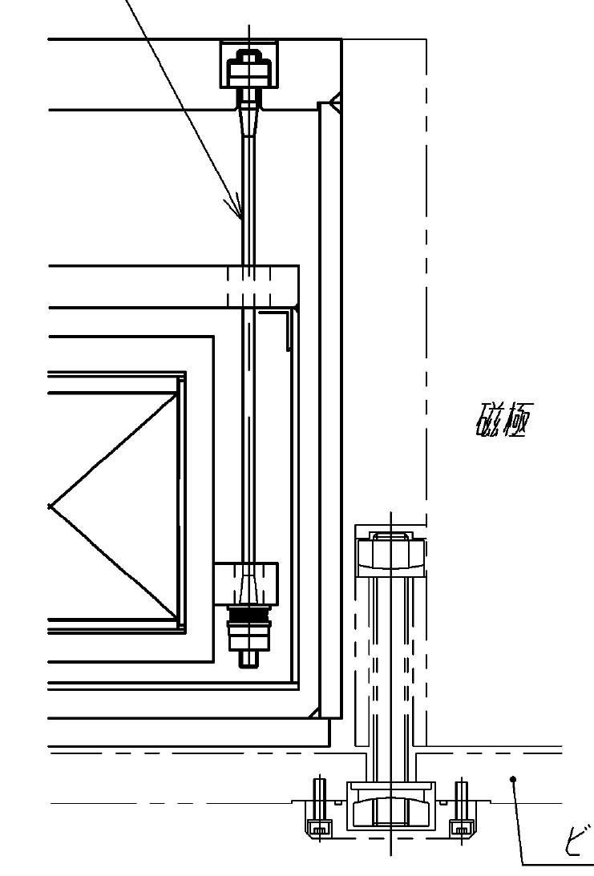
Cryostat
support link
(GFRP)
(SUS304N2)
GFRP
suspension rod
(GFRP)
SUS304N2
cryostat
(SUS304)
80K shield
(A1050)
(A5083)
20K
(pure AL)
coil
4.2K
coil vessel
(SUS316L)

Slide 22
Estimated Heat load/coil
( calculated for the lower coil )
4K part
Place | Parts | Heat load | @ramping | @I=560 A | @I=0 A
In the cryostat + Chimney pipe | Thermal shield | Radiation | 0.40 | 0.40 | 0.40
 | Support | Conduction | 1.35 | 1.35 | 1.35
 | Coil | AC loss | 0.50 | 0.00 | 0.00
In the reservoir vessel (port) | Thermal shield | Radiation | 0.52 | 0.52 | 0.52
 | Support | Conduction | 0.04 | 0.04 | 0.04
 | Power leads | Conduction + Joule loss | 0.54 | 0.54 | 0.30
 | He gas | Conduction | 0.57 | 0.57 | 0.57
 | Bellows |  | 0.07 | 0.07 | 0.07
 | Signal leads |  | 0.12 | 0.12 | 0.12
Sum |  |  | 4.11 | 3.61 | 3.37
GM/JT 2.5W@4.3K x2
20K part
Place | Parts | Heat load | @ramping | @I=560 A | @I=0 A
In the cryostat | Thermal Shield | Radiation | 0.08 | 0.08 | 0.08
 | Support | Conduction | 4.88 | 4.88 | 4.88
Sum |  |  | 4.96 | 4.96 | 4.96
GM 4.2W@12K x2

Slide 23
Estimated Heat load/coil
80K thermal shield
Place | Parts | Heat load | @ramping | @I=560 A | @I=0 A
In the cryostat + Chimney pipe | Thermal shield | Radiation | 23.79 | 23.79 | 23.79
 |  | Residual gas | 0.60 | 0.60 | 0.60
 | Support | Conduction | 53.83 | 53.83 | 53.83
Sum |  |  | 78.22 | 78.22 | 78.22
GM 100W@80K x2
Power lead
Place | Parts | Heat load | @ramping | @I=560 A | @I=0 A
In the reservoir vessel (port) | Vacuum chamber | Radiation | 10.99 | 10.99 | 10.99
 |  | Residual gas | 0.28 | 0.28 | 0.28
 | Support | Conduction | 0.47 | 0.47 | 0.47
 | Power lead | Conduction + Joule loss | 40.496 | 40.496 | 22.344
 | Bellows | Conduction | 1.708 | 1.708 | 1.708
Sum |  |  | 53.94 | 53.94 | 35.78
GM 54W@40K x1

Slide 24
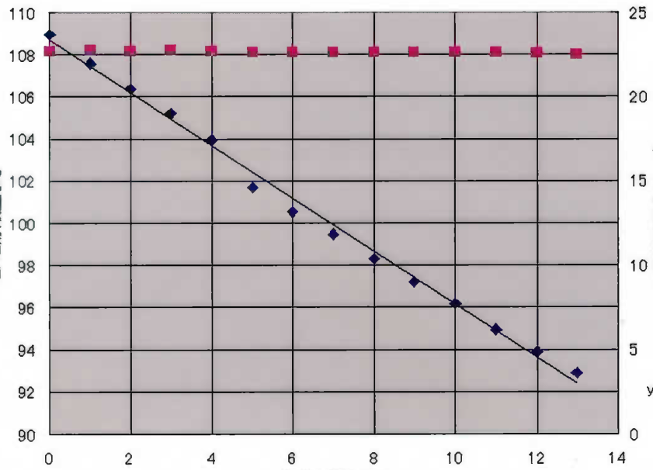
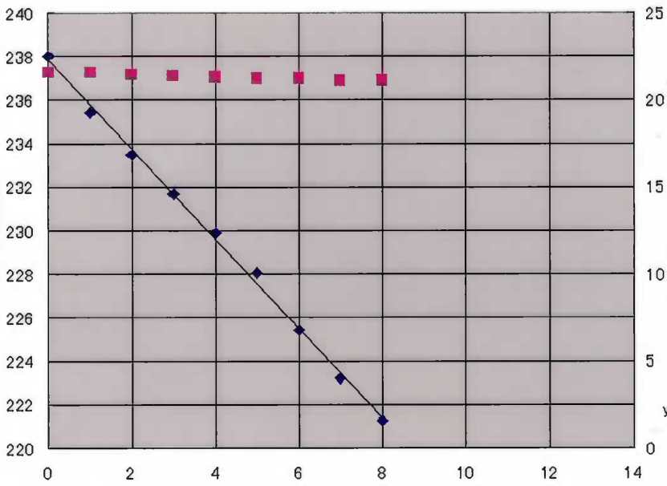
Heat load @4K
Heat load @4K /coil (estimation)
 | @Ramping [W] | @I=560 A [W] | @I=0 A [W]
4 K part | 4.11 | 3.61 | 3.37
Evaporation rate of LHe (measurement @I=0 A)
Upper cryostat
Lower cryostat
pressure
pressure
LHe
LHe [L]
Pressure in vessel [kPaG]
LHe [L]
2.05 L/h
Pressure in vessel [kPaG]
1.25 L/h
LHe
Time [hour]
Time [hour]
0.9 W
1.5 W
Two GM/JTs were prepared, but the measured heat load is smaller than the estimated value. Thus, just one GM/JT is used now.

Slide 25
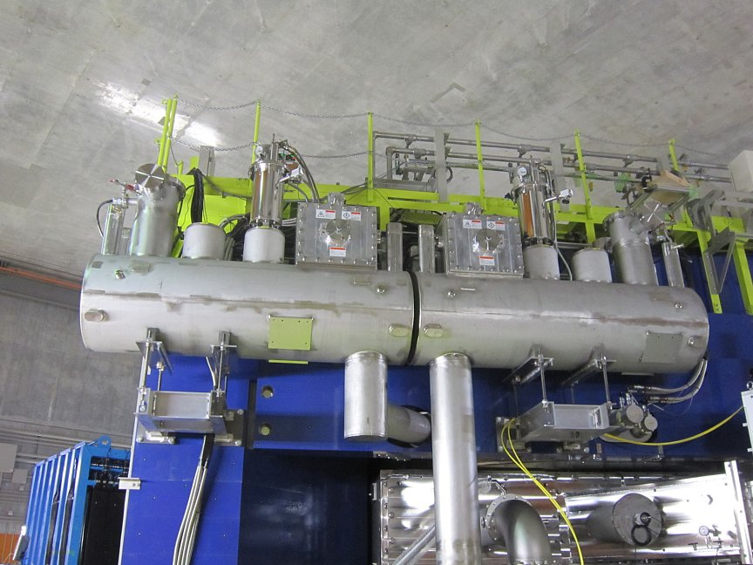
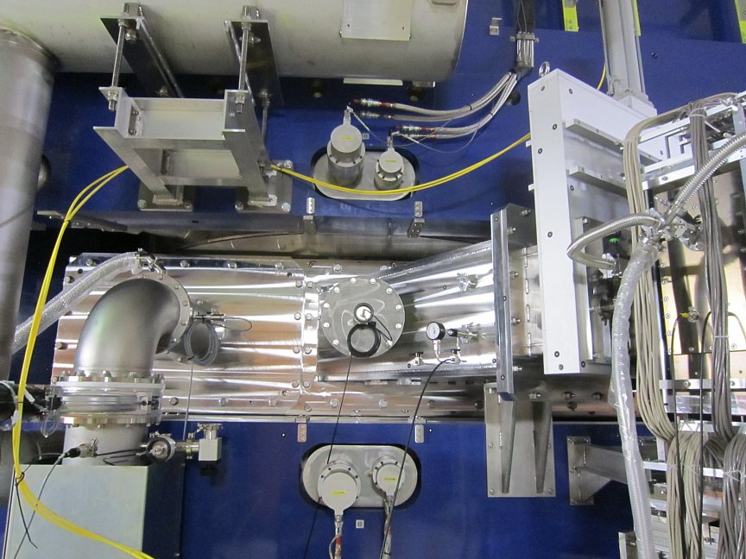
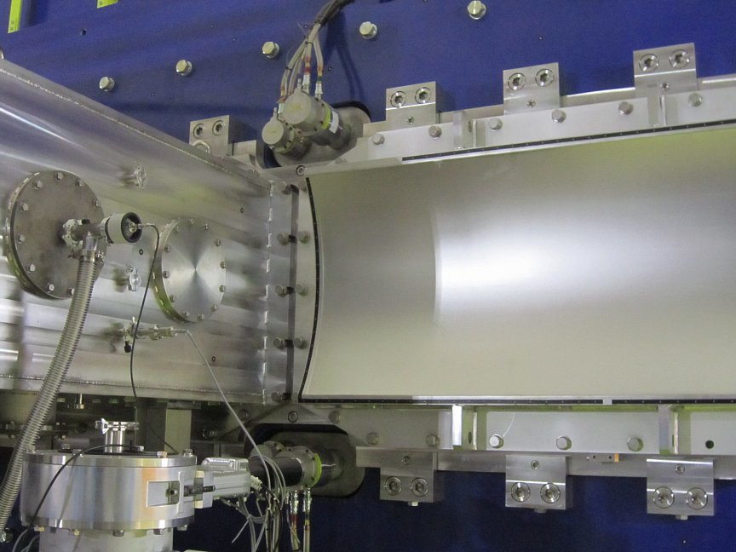
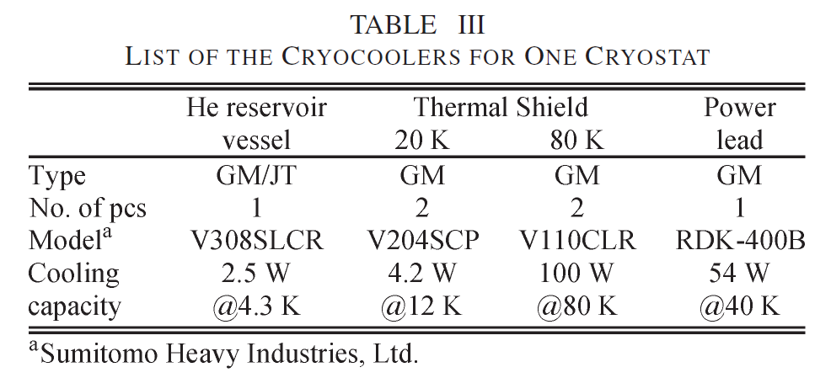
Cryocoolers
4K GM/JT
80K GM
20K GM
PL GM
20K GM
80K GM
12 cryocoolers are equipped.

Slide 26

Temperature
monitor screen of the controller
(6 Sept. 2013)
 | Place | Upper coil [K] | Lower coil [K]
a | He vessel (outside of the wall) | 4.2 | 4.3
b | He vessel (port) | 7.1 | 7.1
c | 20K GM A | 11.8 | 11.9
d | 20K GM B | 11.6 | 11.2
e | 80K GM A | 40.9 | 43.3
f | 80K GM B | 41.6 | 40.6
g | 80K thermal shield | 45.1 | 47.5
h | 80K thermal shield (reservoir vessel) | 45.3 | 43.8
i | PL GM | 42.6 | 41.5
j | PL (+) | 42.9 | 41.6
k | PL (−) | 42.8 | 41.6

Slide 27





Structural Analysis
FEM analysis: coil + coil vessel + support link
Support link
25mm
GFRP(12mm)
Magnetic forces as a function of the azimuthal angle
coil
Al(3mm)
Coil vessel
(SUS316L)
GFRP(25mm)
20mm
GFRP(7mm)
20mm
Al(3mm)
GFRP(5mm)
20mm
coil
integrate
Fr
coil
Fr=5x10³ kN
(2000ton/coil)
Fy=1.5x10³ kN
(600ton/coil)
Fy

Slide 28




Structural Analysis
R-direction
Principal stress in the coil
Displacement of the coil
[mm]
95
[MPa]
1.89
90º
66
51
0.65
90º
0º
29
-0.18
7
-0.60
0º
Allowable stress=180MPa@RT
Y-direction:0.22 mm
R-direction
Von Mises stress in the vessel
Displacement of the vessel
205
[MPa]
1.82
[mm]
155
0.97
90º
105
0º
55
90º
-0.09
0º
5.2
-0.72
Allowable stress=600MPa@4K
Y-direction:0.19 mm

Slide 29
Safety interlock
 |  |  | Action
 | Interlock | Condition | CUT OFF (DCCB open) | Quench back heater ON | Power supply OFF | Alarm
1 | Failure of power supply | Over voltage, Over current, Water leakage, Door open |  |  | ○ | ○
 |  | Fuse break Cryo-controler down | ○ | ○ |  | ○
2 | Water flow (PS) down | < 40 L/min |  |  | ○ | ○
3 | Quench | Vdiff > 1 V Duration time > 0.5 s | ○ | ○ |  | ○
4 | Power failure | Power failure | ○ | ○ |  | ○
5 | Failure of the PL cryocooler | Stop |  |  | ○ | ○
6 | Voltage of HTc-PL | VPL > 10 mV, VPL < -10 mV | ○ | ○ |  | ○
7 | Temperature of HTc-PL 1 | T > 70 K |  |  | ○ | ○
8 | Temperature of HTc-PL 2 | T > 75 K | ○ | ○ |  | ○
9 | Lack of LHe | Level < 80% |  |  | ○ | ○
10 | Pressure of the vessel 1 | P > 19 kPaG (120.3 kPa) |  |  |  | ○
11 | Pressure of the vessel 2 | P > 40 kPaG (141.3 kPa) |  |  | ○ | ○
12 | Emergency stop | Push emergency button | ○ | ○ |  | ○
cryostat
DCCB
PS OFF
The coils are forced to quench. The current is discharged through the diodes in the cryostat and the coils.
The current is discharged through the diodes mounted in the power supply.
power supply

Slide 30

Quench protection
Quench
1. The detector recognizes the quench. (1V, 0.5s)
2. DCCB open (Coils are cut off.)
3. Current flows to the heater layer on the outermost of the coil.
4. Backup heaters switch on within 50 ms.
5. Coils are forced to quench from the outer to inner layer.
6. Stored energy is dumped by the superconducting coils.
In the case …
cryo-conroler down
power failure
|VPL| > 10 mV
TPL > 75 K
emergency stop
Same procedure as the quench case will be done.

Slide 31



Quench analysis
change of Vdiff after quench
quench propagates longitudinal direction
vq =10 m/s
current
current
Vdiff (Vu-Vd)
Vdiff > 1V at 1.2 sec.
Vdiff
0.5 sec. before cut off
+
0.3 sec. delay before heater on
180
160
quench propagates transverse (radial) direction
vq =0.05 m/s (estimated from the value of KEK-SKS)
Total: 2 sec.
current
current
temperature (K)
current
temperature (K)
temperature at the outermost layer
Temperature rise is moderate and acceptable

Slide 32


Quench analysis
(a)
(b)
180
160
(c)
~700 V
Induced voltage is moderate and acceptable

Slide 33

Coil protection
In the case …
over voltage
over current
door open
water leakage
water flow down
PL cryocooler failure
TPL > 70 K
LHe level < 80%
pHe > 40 kPaG
1. Power supply is cut off
2. Stored energy is dumped by diodes in the power supply
3. Diodes are cooled by heat-sink and fan
from 560A to 0A : ~1 hour
decay const. : 0.25A/sec

Slide 34




Cryostat assembling
coil winding

Slide 35




Cryostat assembling
reservoir vessel
cryostat chamber

Slide 36

Cryostat assembling
Lower cryostat assembling
support link
coil vessel
part of cryostat chamber
part of 80K shield
support link

Slide 37



Cryostat assembling
support links
coil vessel
80K shield
pipe for liq. He transfer
20K GM head is attached here
80K shield
80K shield

Slide 38


Cryostat assembling
Upper cryostat
Upper cryostat
suspension rod
(GFRP)
80K shield
coil vessel
Lower coil

Slide 39

Cryostat assembling
Upper cryostat
cryostat chamber
20K GM
80K GM

Slide 40



Cryostat assembling
LHe
transfer port
Upper cryostat
current port
PL GM
Lower cryostat
reservoir vessel
4K GM/JT port

Slide 41




Test in Toshiba factory
GM for 80K
GM/JT for 4K
GM for PL
GM for 20K
magnetic shield for GM head
Upper cryostat
Lower cryostat
reservoir vessel
Excitation test (1st time)
polarity check by applying 1 A
apply 10A -> cut off to check the protection sequence
excite to 518.4 A -> training quench happened @450 A
Excitation test (2nd time)
excite to 530 A -> success without quench
~4 T in the coil region
~624 ton

Slide 42






On site assembling
Rails for rotatable base (11/13/2010)
Rotatable base with the first layer of the yoke
Magnet yoke with poles
Coils with cryostats, LHe reservoir vessels
Vacuum chamber
After day-one experiments (9/19/2012)

Slide 43


Excitation test
May 2011, excitation test was performed.
A training quench happened in the lower coil at 561 A (3.07 T), which corresponds to 99.6% of the maximum operation current, 563 A (3.08 T).
During subsequent excitation testing after refilling of LHe, the current reached 563 A without quenching and the test was continued up to 573 A (3.10 T) successfully.

Slide 44


Magnetic Field
They are determined in response to changes is the inductance of the coil so as to keep the induced voltage below 20 V, which is the maximum voltage of the power supply.

Slide 45




Magnetic Field
The value of the central field is compared between measurements and calculations (TOSCA).
model 1
Y
X
$$\frac{B_{meas}−B_{calc}}{B_{meas}}$$
Z
model 2
Y
Z

Slide 46



Fringe Field
By [Gauss]
TOSCA
FDC2
HODO
distance [mm]
|By|_max [Gauss]
B(0) dependence on |By|_max
B(0) [T]

Slide 47
Fringe Field
TOSCA
FDC2
HODO
B(0) dependence on |By|_max

Slide 48


Fringe Field
x
By(center)=3.08T
TOSCA
Z
FDC2
measured
HODO
TOSCA
B(0)=3.0T
The calculated values and measured values agree well with each other. The fringe fields are smaller than 50 Gauss in the region more than 0.5 m distant from the edge of iron yoke, satisfying our experimental requirements.

Slide 49
Summary
Large-acceptance spectrometer “SAMURAI” has been constructed at RIKEN RIBF.
The construction of the H-type superconducting dipole magnet was finished in June 2011.
Large pole gap (800mm effectively)
Wide horizontal opening (3400mm)
Central field =3.08T, BL=7.05Tm, I=563A, E=27.4MJ
The coils are cooled by liquid He.
Twelve cryocoolers are used to keep the temperature.
The first reaction experiments using SAMURAI were carried out in May 2012, and the second experiments were carried out in April 2013.

