Slide 1

UMER nonlinear optics: experiment, simulations, development of octupole magnet and nonlinear insert
Kiersten Ruisard
Heidi Baumgartner, David Matthew, Santiago Bernal, Irving Haber, Brian Beaudoin, Timothy Koeth
Institute for Research in Electronics and Applied Optics, University of Maryland, College Park
Space Charge Workshop 2017

Slide 2
Outline
Why do we want to do this? (motivation)
How will we do this? (experimental plans)
How well will it work? (simulations and characterizations)

Slide 3
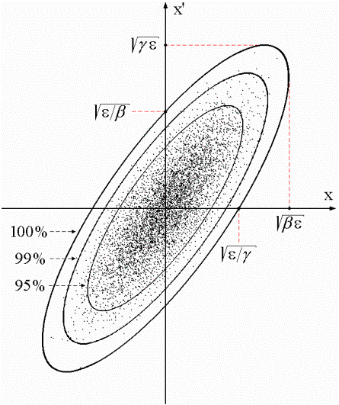
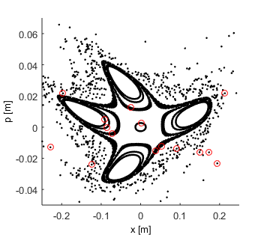
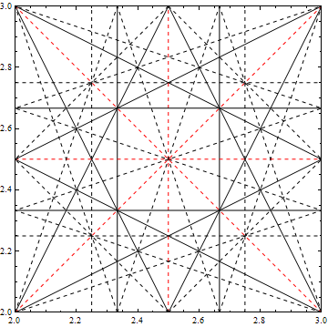
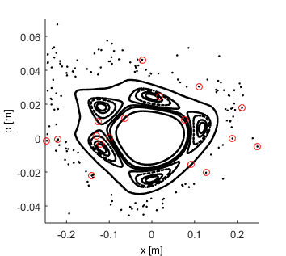
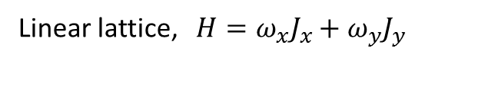
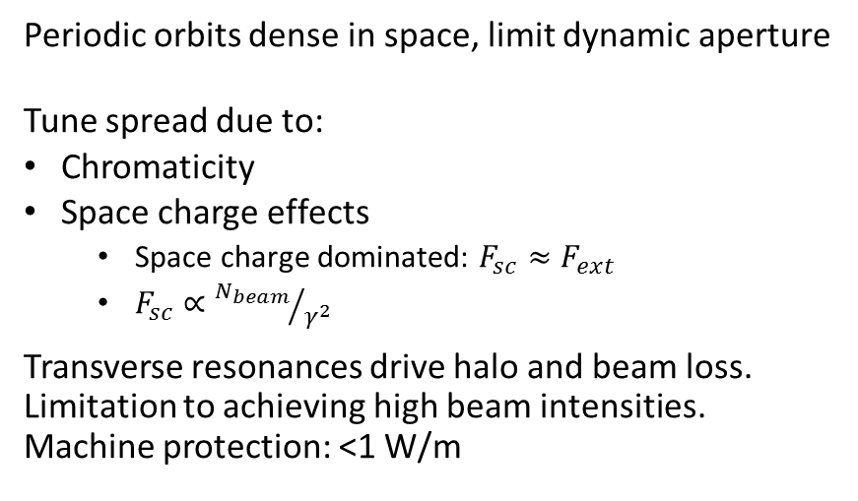


Motivation for Nonlinear Lattices
Periodic orbits dense in space, limit dynamic aperture
Tune spread due to:
Chromaticity
Space charge effects
  Space charge dominated: $F_{sc}≈F_{ext}$
  $F_{sc}∝{N_{beam}}/{γ^{2}}$
Transverse resonances drive halo and beam loss.
Limitation to achieving high beam intensities.
Machine protection: <1 W/m
Linear lattice, $H=ω_{x}J_{x}+ω_{y}J_{y}$
$$ν=3.747$$
$$ν=5.79$$
We already build lattices with nonlinear correcting magnets. But, nonlinear perturbation destroys invariants of motion → chaotic motion, unbounded orbits, reduced dynamic aperture
Tune diagram, up to 3rd order resonance

Slide 4
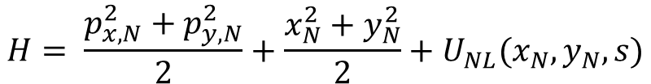
Theory of Nonlinear Integrable Optics
  Danilov, Nagaitsev, Phys. Rev. ST Accel. Beams 13, 2010
Add (unspecified) nonlinear potential to Hamiltonian:
Choose U(x,y) to be independent of s, H is conserved.
For integrability, find U(x,y) that gives second invariant and satisfies Laplace’s equation
β_{x}= β_{y}
1 0
-k 1
Simple model of nonlinear integrable lattice
$$H= \frac{p_{x,N}^{2}+p_{y,N}^{2}}{2}+\frac{x_{N}^{2}+y_{N}^{2}}{2}+U_{NL}(x_{N},y_{N},s)$$
Nonlinear U(s)
Linear lattice: Focusing lens
Recall U(x,y) must be independent of s in normalized particle frame
Nonlinear field V in lab frame must scale with envelope function:
Normalized Hamiltonian is conserved!
Notes:
They found a way to add arbitrary nonlinear potential to the SP Hamiltonian that preserves 2 invariants of motion.

Slide 5
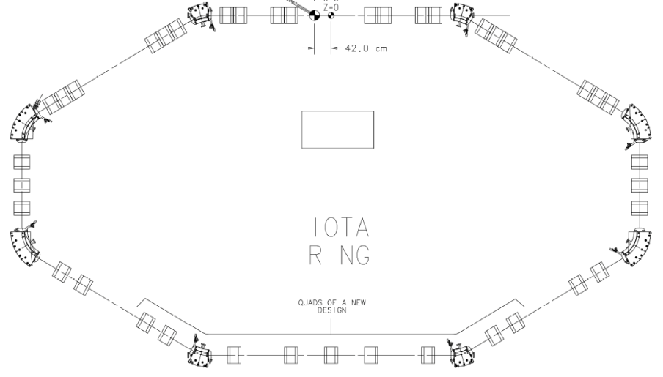

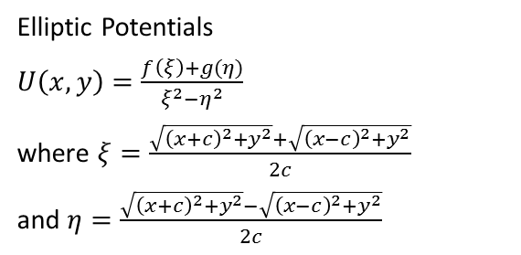
Test of 2D Integrability at IOTA
NL1
Elliptic Potentials
$U\left(x,y\right)=\frac{f\left(ξ\right)+g(η)}{ξ^{2}−η^{2}}$
where $ξ=\frac{\sqrt{{\left(x+c\right)}^{2}+y^{2}}+\sqrt{{\left(x−c\right)}^{2}+y^{2}}}{2c}$
and $η=\frac{\sqrt{{\left(x+c\right)}^{2}+y^{2}}−\sqrt{{\left(x−c\right)}^{2}+y^{2}}}{2c}$
β_{x}= β_{y}
1 0
-k 1
Nonlinear Element
T-insert

Slide 6
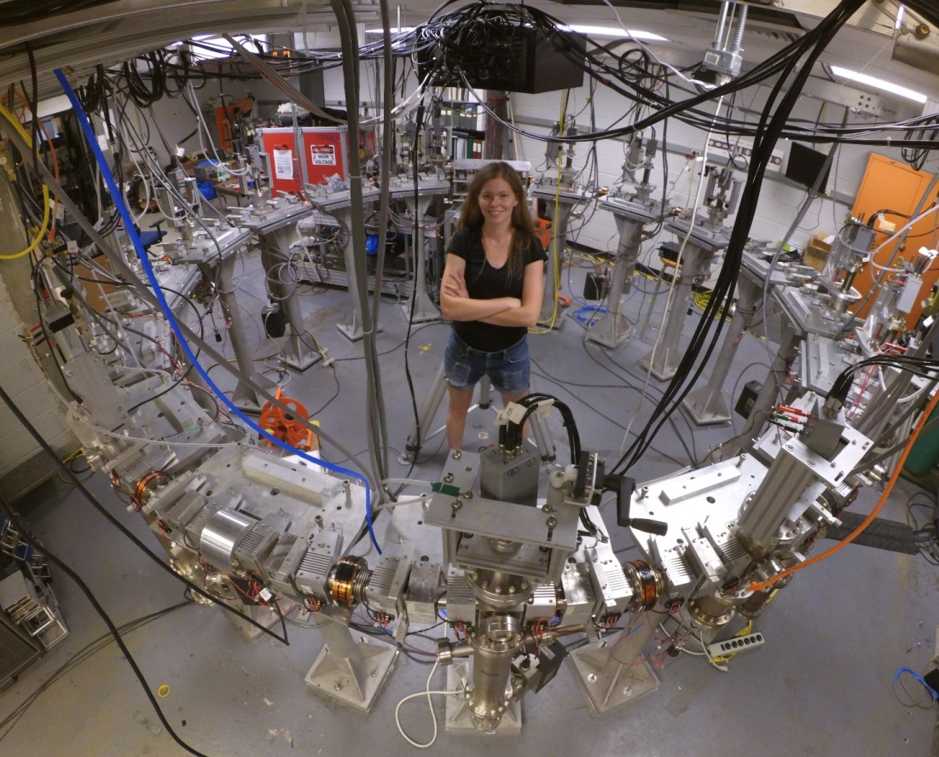
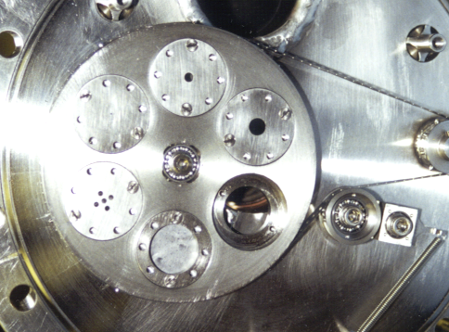

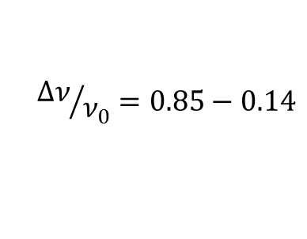
University of Maryland Electron Ring
System Parameters
Beam energy 10 keV
Circumference 11.52 m
Beam Length 20-140ns
Circulation Time 197ns
Beam current 0.6 - 100mA
Beam radius 0.25 - 10mm
Tune ν_{x}~ ν_{y}~ 6.8
$${Δν}/{ν_{0}}=0.85−0.14$$
Current [mA] | Initial rms ε [µm] | Avg. Radius [mm] | ν/ν_{o} | Coherent tune shift | Incoherent tune shift
0.6 | 0.4 | 1.6 | 0.85 | -0.005 | 0.94
6.0 | 1.3 | 3.4 | 0.62 | −0.05 | 2.4
21 | 1.5 | 5.2 | 0.31 | −0.17 | 4.5
78 | 3.0 | 9.6 | 0.18 | −0.67 | 5.4
104 | 3.2 | 11.1 | 0.14 | −0.91 | 5.6
$$Δν=0.94 −5.6$$
We (typically) operate in high intensity, “extreme” space charge regime
Notes:
Our goal is to demonstrate a quasi-integrable lattice, in support of studies at IOTA, and start building the insight into the dynamics and implementation of a strongly nonlinear lattice.
Existing facility
Intuition about operation
Well benchmarked codes (WARP)
Variable intensity
Flexible lattice
Low-cost upgrade to nonlinear lattice
Not designed as precision machine
Not designed for non-fodo lattice
Dense lattice with limited space
Need to share with other experiments with AG lattice
Too much intensity?

Slide 7
Outline
Why do we want to do this?
How will we do this? (experimental plans)
How well will it work? (simulations and characterizations)

Slide 8
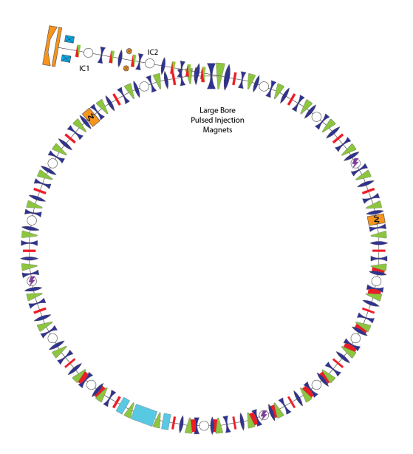
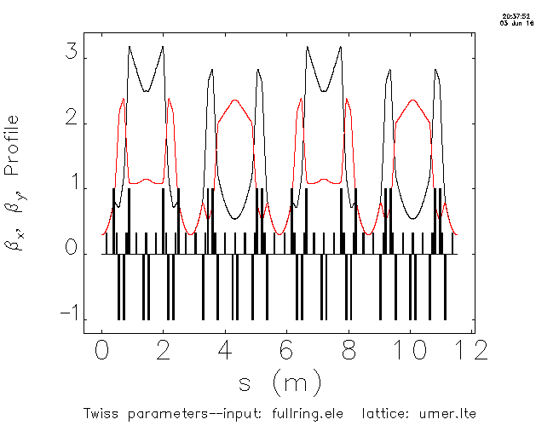
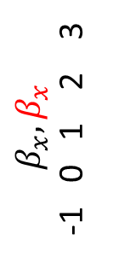
Overview of quasi-integrable octupole lattice experiment at UMER
Single Channel experiment:
IOTA-like
Max tune spread possible ~0.2
Custom ring section, new lattice solution
The deep unknown
Lattice design:
β_{x}= β_{y} in nonlinear insert
Ring transfer matrix equivalent to thin lens kick
Phase advance nπ
Achromatic
Experimental Layout:
Linear lattice is effective thin-lens transformation
$$β_{x}, β_{x}$$
-1 0 1 2 3
Octupole Channel
(20° of ring)
0 2.88 s(m) 11.52

Slide 9
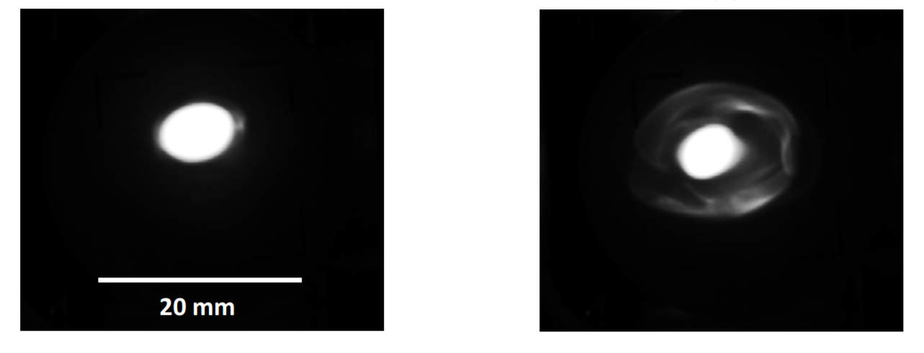
Experimental Plans
UMER Beams for NLO experiments
Tune/ lattice function measurement
Propagate through octupole channel
Tune scan around quasi-integrable condition; Measure losses, H invariant
Dependence on octupole channel longitudinal profile
Halo/mismatch damping
Current [muA] | Initial rms ε [µm] | ν/ν_{o} | Coherent tune shift | Incoherent tune shift
40 | 300 µm,100 µm | 1.00 | ~0 | 0.005
60 | 0.13 | 0.95 | ~0 | 0.3
600 | 0.4 | 0.85 | -0.005 | 0.94
Dialed-in Halo
Predicted maximum octupole-induced tune shift is ~0.2 absolute
Need low-current beams with smaller space charge tune shift (~60 µA)
Need low phase errors
Need large number of turns
Beam Current | End erosion timescale(# turns) | Approx. # Turns with Long. Focusing
60 μA | 72
600 μA | 25 | 1,000
6.0 mA | 9 | 100
21 mA | 6
104 mA | 3

Slide 10
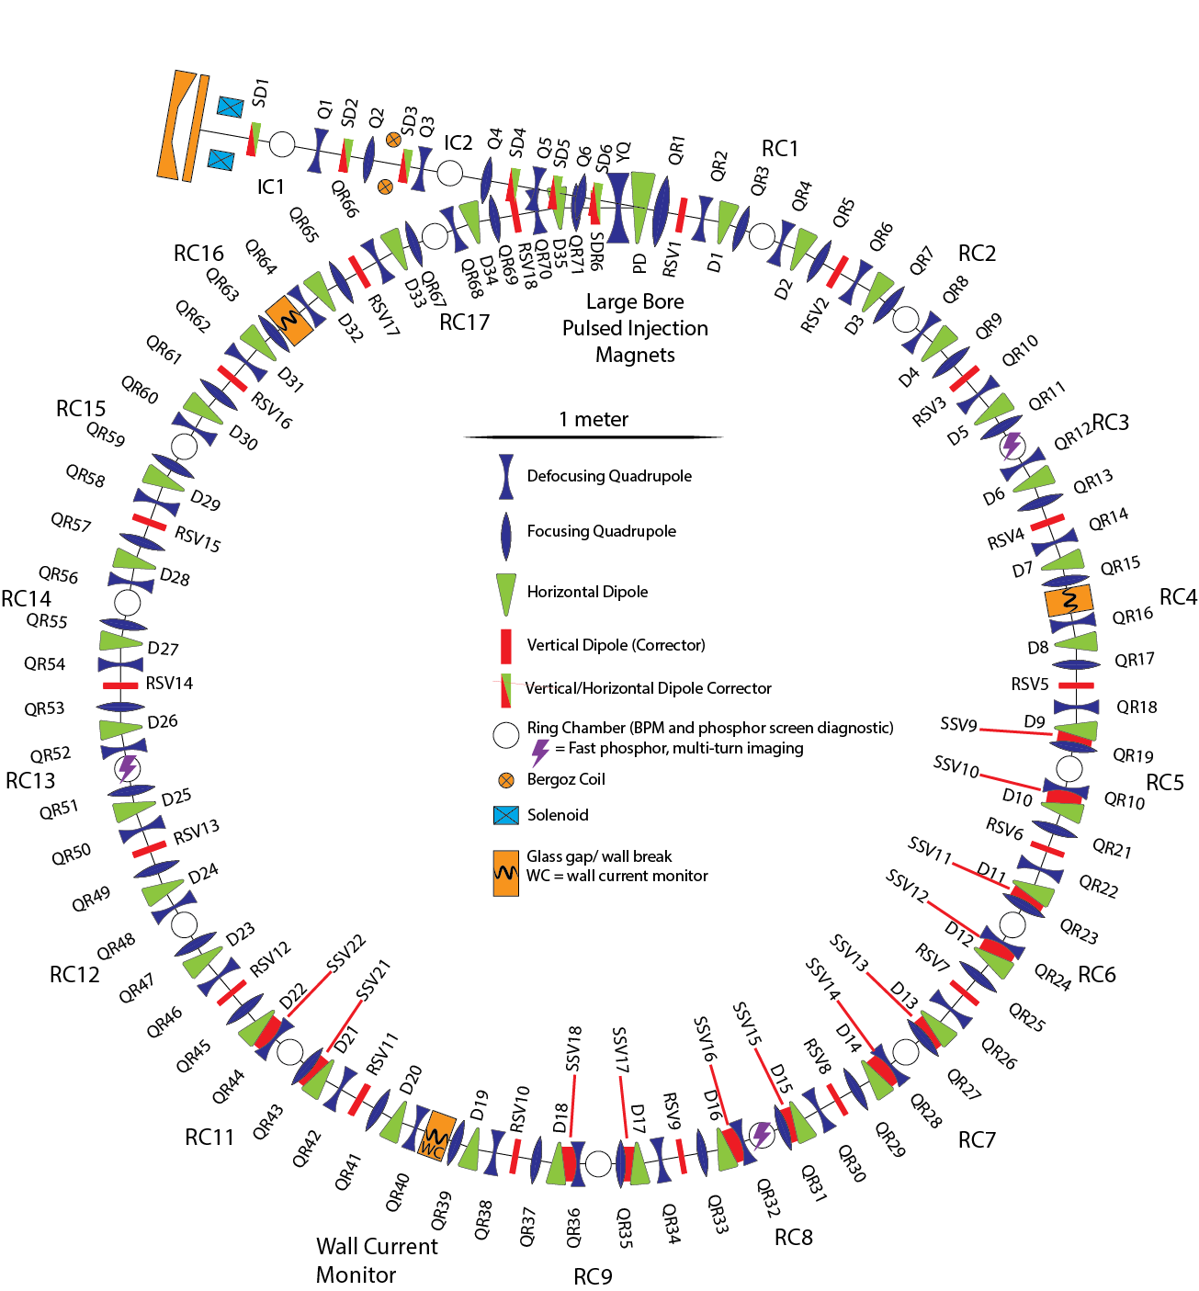
Designing lattices for octupole channel experiments
Periodicity | # Free Quads
1 | 68
2 | 32
3 | 20
6 | 8
9 | 4
18 | 0

Slide 11
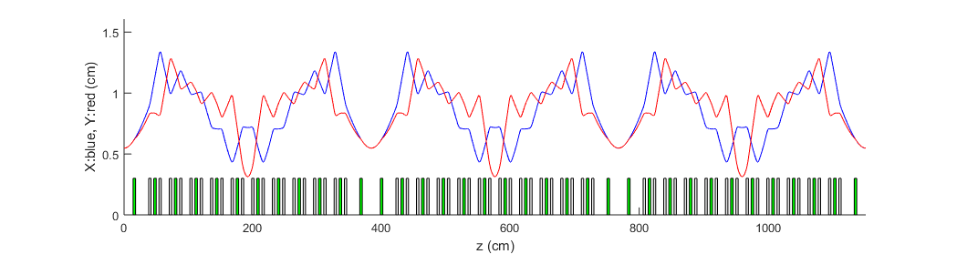

Lattice Solution
“Low-current” 60 mu-A beam: $ε≈100 μm$
$$ν_{x}=3.269$$
$$ν_{y}=3.277$$
Inject beam
Octupole insert placed here

Slide 12
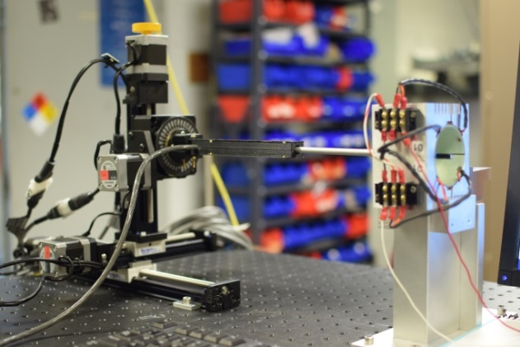
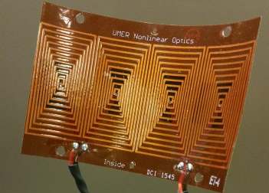
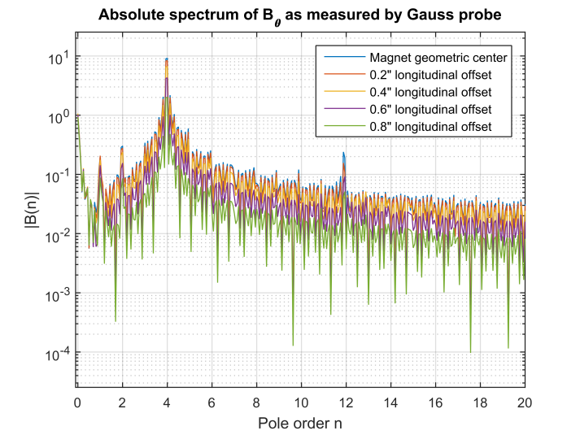
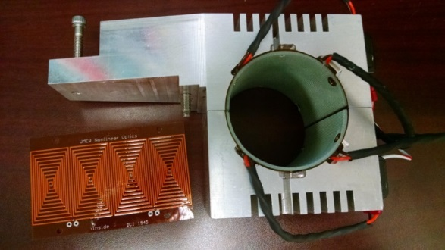
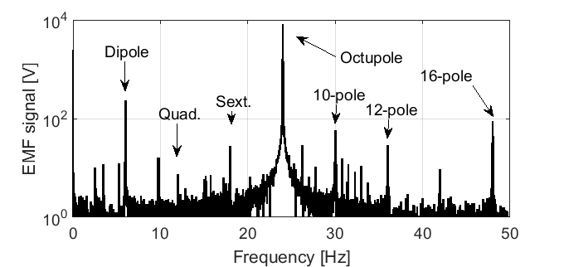
Printed circuit octupole magnets have been designed and characterized
Heidi Baumgartner, Dave Matthew
Measured: 51.6 ± 1.5 T/m³/A
Predicted: 49 T/m³/A
Lower order multipoles suppressed by > 2 orders
Rotating coil data
H. Baumgartner et al, Quantifications of octupole magnets at the University of Maryland Electron Ring, NAPAC 2016

Slide 13
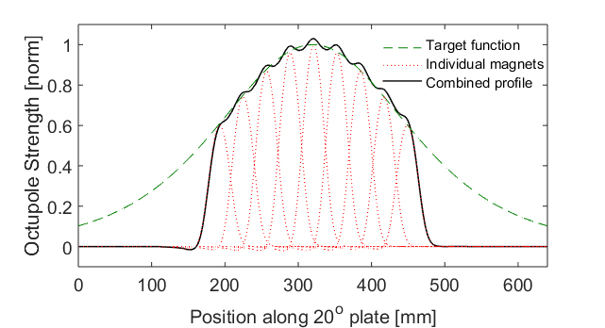
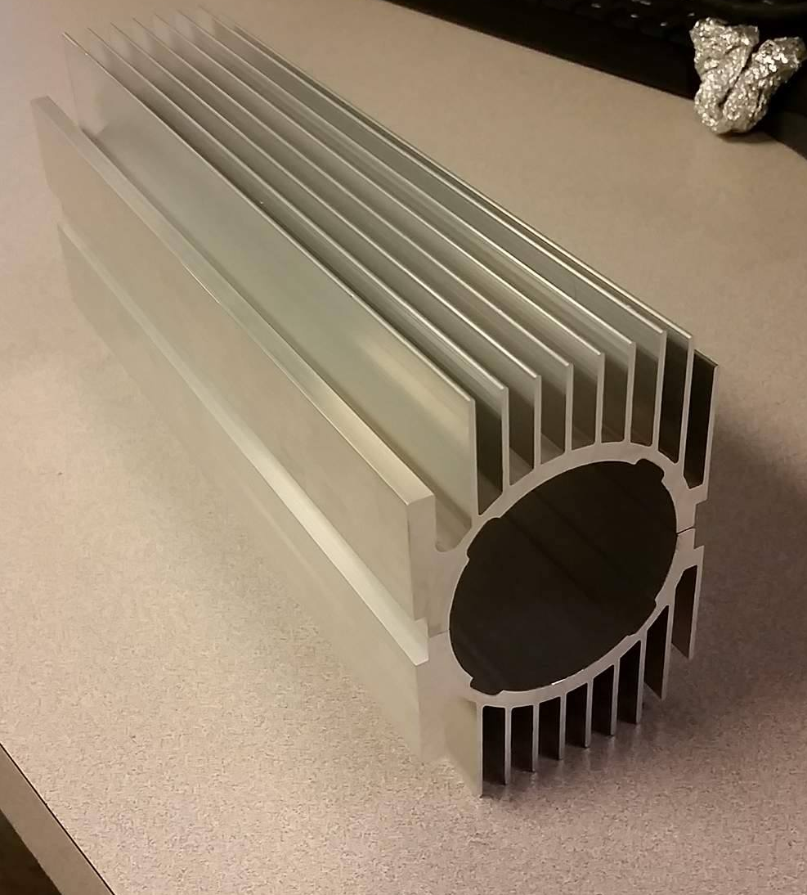
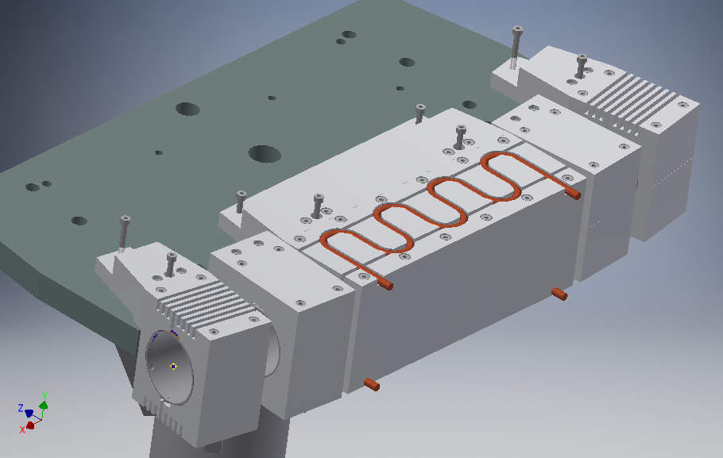
Long octupole channel is composite of many short printed circuit octupoles
Heidi Baumgartner
Dipoles
Custom extruded housing for improved temperature control
Octupoles

Slide 14
Outline
Why do we want to do this?
How will we do this? (experimental plans)
How well will it work? (simulations and characterization)

Slide 15
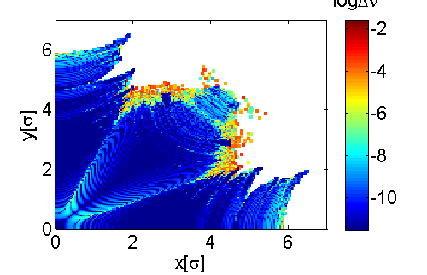
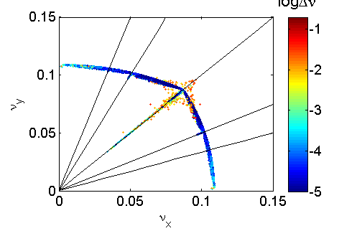

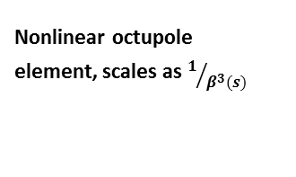
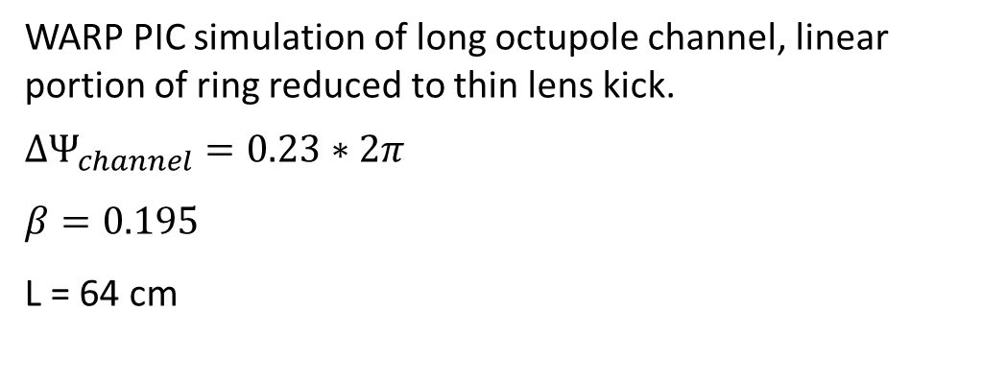

“Simple model” of octupole channel predicts tune spread, dynamic aperture
WARP PIC simulation of long octupole channel, linear portion of ring reduced to thin lens kick.
$$ΔΨ_{channel}=0.23∗2π$$
$$β=0.195$$
L = 64 cm
Amplitude space
logΔν
Β function in drift, $β\left(s\right)= β^{∗}+\frac{{(s−s^{∗})}^{2}}{β^{∗}}$
Nonlinear octupole element, scales as $1/{β^{3}(s)}$
Axisymmetric thin lens kicks
Tune space
logΔν
Tolerances from simple model calculations:
Orbit distortion | 0.2 mm
ambient field (1 plane) | <100 mG
Phase error $ν_{x}−nπ$ | 0.1
phase error $ν_{x}−ν_{y}$ | 0.01
Notes:
Predicted tune spread 0.2

Slide 16
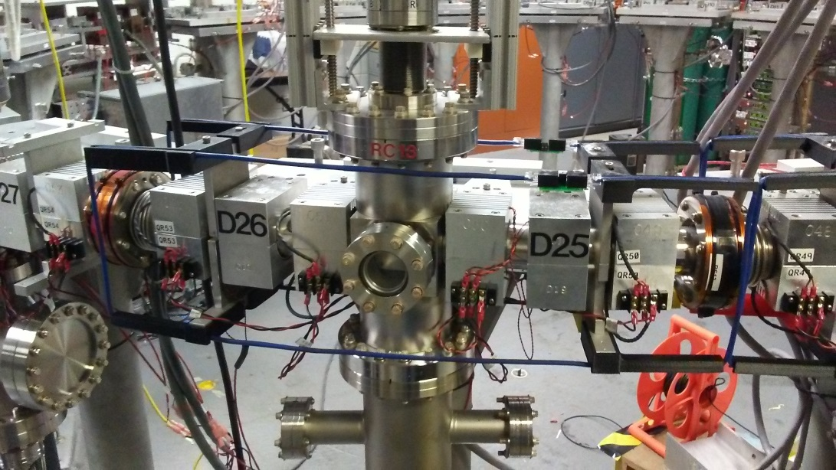
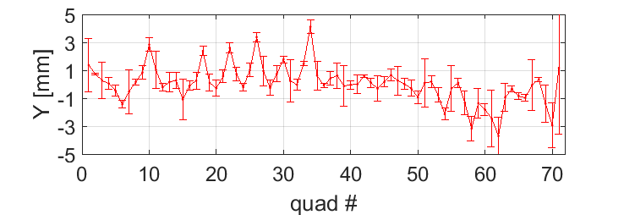
Measured orbit distortion is approaching desired steering tolerance
1st turn orbit control; deviation from quadrupole center
 | 2013 | 2016 | 2017
X RMS [mm] | 3.4 | 1.2 | 0.4
X Maximum [mm] | > 20 | 4.1 | 1
Y RMS [mm] | 7.4 | 3.2 | 1.3 (0.4)
Y Maximum [mm] | > 20 | 10.8 | 4.0 (1.1)
Multi-turn control < 1 mm
ring realignment
Radial-field cancelling Helmholtz coils
Diagnostic location
B-earth
Ring re-alignment: Dave Sutter, Eric Montgomery

Slide 17
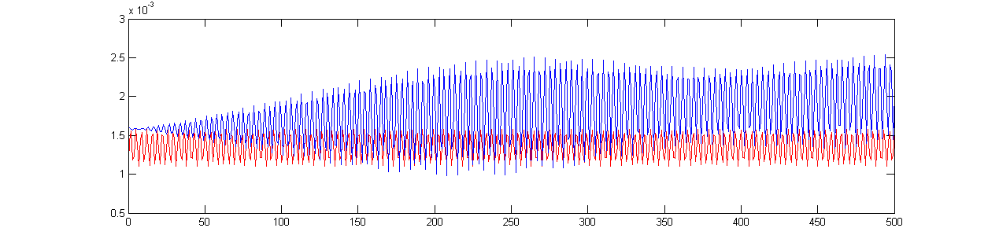
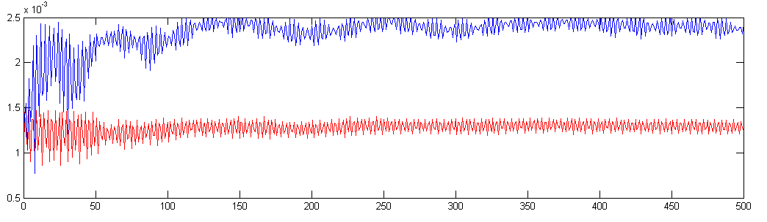
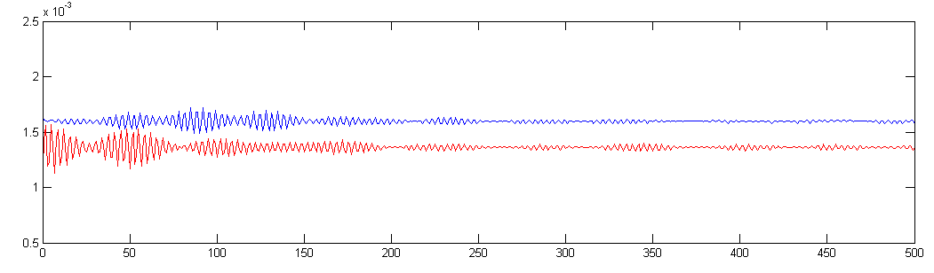
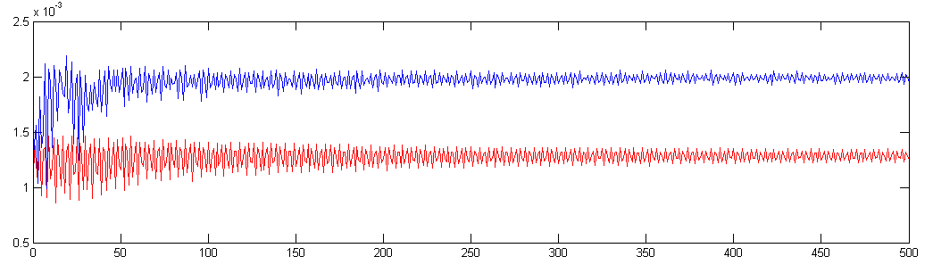
Simple model predicts reduced damping effect on halo growth when space charge is included
Halo evolution in simple model with varying charge
0.03 mA beam, octupoles off
0.6 mA (pencil) beam, octupoles off
X-extent
0.03 mA beam, octupoles on
0.6 mA (pencil) beam, octupoles on
Propagation distance (0 to 500 passes)
Current [mA] | Incoherent tune shift
0.6 | 0.94
6.0 | 2.4
21 | 4.5
78 | 5.4
104 | 5.6
Would like to start with less charge!
K. J. Ruisard, I. Haber, R. A. Kishek, T. Koeth, Nonlinear optics at the University of Maryland Electron Ring, AAC 2014

Slide 18
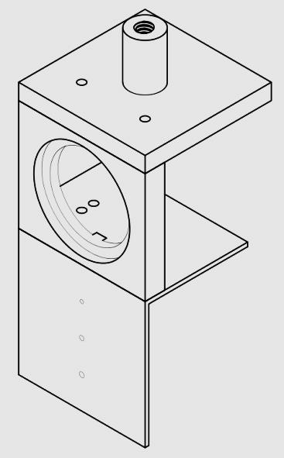
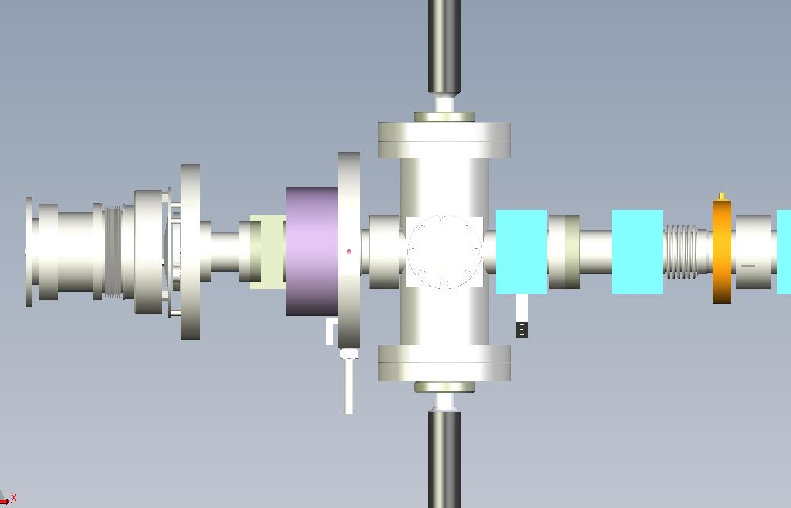
Low-current apertured beam will be possible through installation of double aperture
Santiago Bernal, Sam Ehrenstein, Matthew Teperman, Will Hartmann
In UMER, typically, $Δν=0.94−5.6$, but predicted maximum nonlinear tune shift is $\sim 0.2$, we intend to operate UMER in the range $Δν=0.1 −0.5$
Current [µA] | Initial rms ε [µm] | ν/ν_{o} | Incoherent tune shift
600 | 0.4 | 0.85 | 0.94
60 | 0.13 | 0.95 | 0.3
single apertured beam
double apertured beam
Actuator
IC1
E-Gun
AP1
Bergoz
Transf.
iQ1
iQ2
Aperture holes
Solenoid
Window
Actuator
10 cm
Z=0
Notes:
The aperture would allow us to inject currents from 10 μA - 1 mA, in combination with old apertures and solenoid.
The additional aperture would be fully retractable.

Slide 19
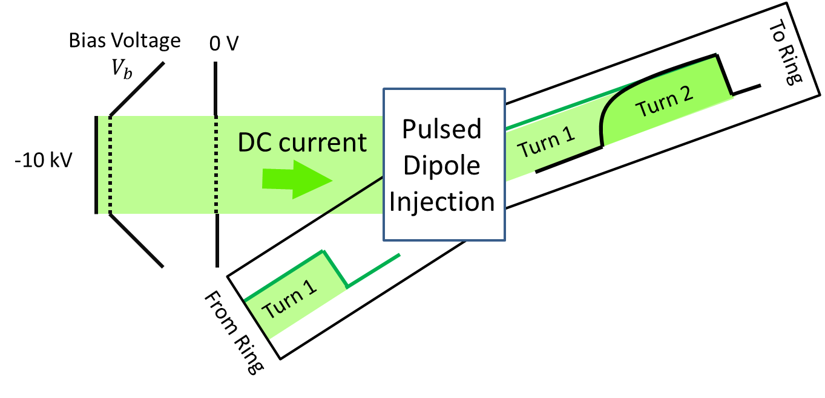
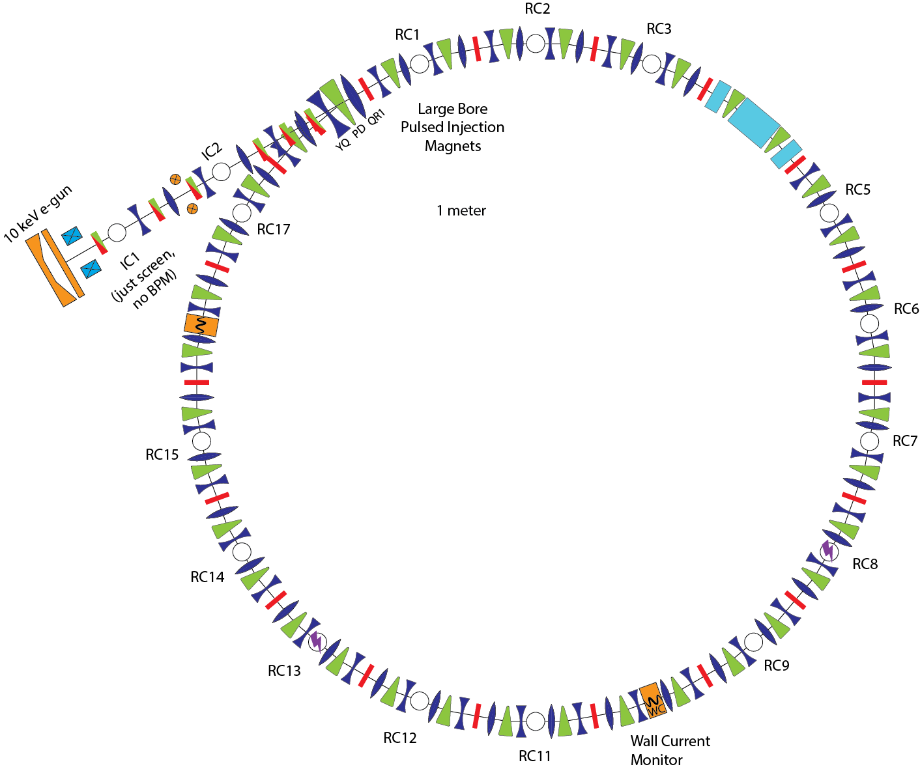
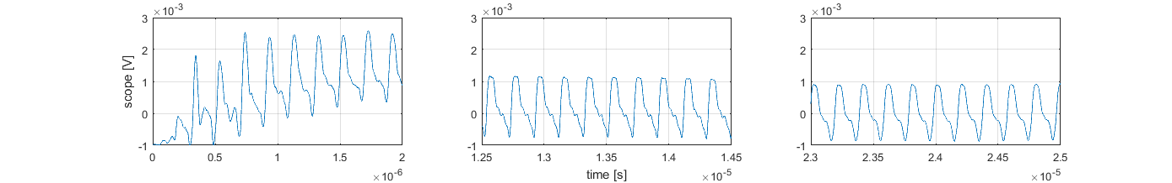
Low-current “DC-beam”
Irving Haber, Santiago Bernal, David Matthew
Method | Beam Current, pulse length | Measurement
DC Electron Gun | 10 –100 µA, 100 ns | 40 µA
DC beam current
Signal from Wall Current Monitor
Pulse shape formed by pulsed dipole polarity reversal on second turn
6
7
8
9
4
5
2
3
1
Time →

Slide 20

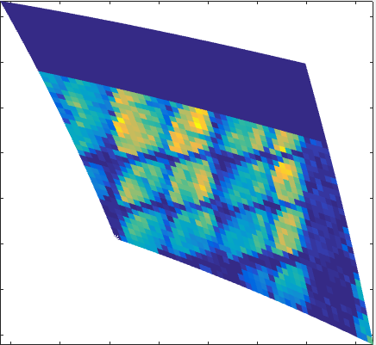


Survival plot for 60 µA “DC-beam” shows little beam loss over 100’s of turns
Current [µA] | Initial rms ε [µm] | ν/ν_{o} | ν-ν_{o}
40 | 300 µm,100 µm | 1.00 | 0.005
Turns 1-9
Turns 117-126
Virtually no end erosion and low losses beyond first 10 turns (out to 125)!
125th turn
Notes:
Color scale is wrt 2nd turn.

Slide 21
Summary
Pieces falling into place for low-charge long-octupole lattice test
  Low-current beam operation
  Lattice design ready to test in linear ring
  Octupole channel being assembled
  Addition of radial field-canceling coils should bring vertical steering within tolerances
Future Direction
  Characterization/tuning of low-current beam in linear lattice
  Transport with octupole insert
  Test breaking quasi-integrability (octupole profile, tune)
  Higher-current beam halo studies

Slide 22
Acknowledgements
UMER: Rami Kishek, Dave Sutter, Eric Montgomery, Matthew Teperman, Levon Dovlatyan, Ben Cannon
IOTA Group @ FNAL (Sergei Nagaitsev, Sasha Valishev, Sergey Antipov, Jeff Eldredge, Sasha Romanov)
Wider IOTA Collaboration
Thank you for your attention!

Slide 23
Comparison of UMER beams with other high-intensity accelerators
MACHINE | CIRC. | KINETIC ENERGY Peak Curr. | RMS ε_{x,y} (norm.) | TUNE ν_{0x,y} | β | K, and/or ppp | ν /ν₀ , ν₀−ν
UMER e⁻ | 11.52 m | 10 keV, 6 mA | 1.3 μm | 6.68 | 0.195 | 9.0×10⁻⁵ 3.8×10⁹ | 0.63, 2.4
UMER e⁻ |  | 10 keV, 40 μA | 5 μm |  |  | 6.0×10⁻⁷ 2.5×10⁷ | 1.00, 0.005
UMER e⁻ |  | 10 keV, 60 μA | 0.13 μm |  |  | 9.0×10⁻⁷ 3.8×10⁷ | 0.95 0.3
HIF Driver Xe⁺⁸ | 522 m | 10 GeV, 1 kA | 35.7 μm | 8.3 | 0.291 | 1.1×10⁻⁵ | 0.76, 2.0
ALS (LBNL) e⁻ | 197 m | 1.2 GeV, 400 mA | 3.5 nm | 14.277 | 1.000 | 3.8×10⁻¹⁵ | 1.00, 0.00
SNS p Acc. Ring (ORNL) | 248 m | 1.0 GeV, 52 A | 120 μm | 6.23 | 0.875 | 5.6×10⁻⁷ 1.5×10¹⁴ | 0.98, 0.15
SIS-18 U²⁸⁺ (FAIR-GSI) | 216 m | 200 MeV/u, 15.1 mA (inj.) | 150,50 μm | 4.17, 3.29 | 0.566 | 1.5×10¹¹ | 0.86, 0.45
Planned, new UMER beams
Courtesy Santiago Bernal, Presented AAC 2014

Slide 24
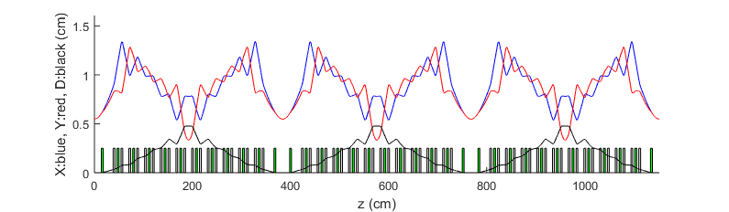

Lattice Solution
“Low-current” 60 mu-A beam: $ε≈100 μm$
$$ν_{x}=2.858$$
$$ν_{y}=3.293$$

Slide 25
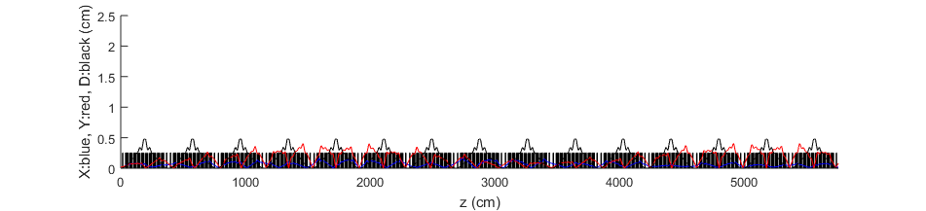
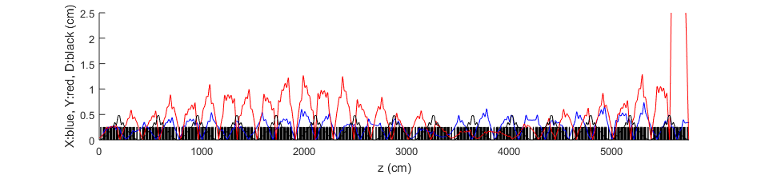
Injecting small-emittance beams into “low-space charge” lattice solution
“Low-current” 60 mu-A beam: $ε=0.13 μm$
0.6 mA pencil beam: $ε=0.40 μm$
5 turns

Slide 26
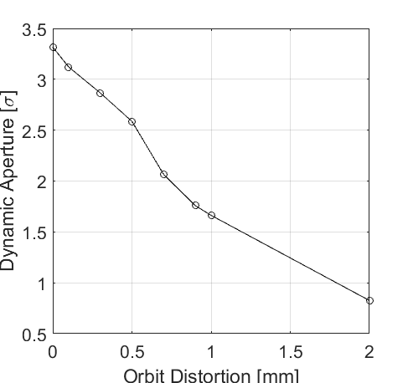


Steering tolerances for beam through long octupole channel
“Toy model” WARP simulations with steering error;
Left: dependence on orbit distortion
Right: immersed in background field
Beam with closed orbit distortion
Beam immersed in background field
Notes:
How many turns were these calculations for? 1024 turns
Can flesh out slide w/ group presentation notes

Slide 27


Octupole nonlinearity couples into 3rd order resonance with detectable losses for 60 µA “DC-beam”
Current [µA] | Initial rms ε [µm] | ν/ν_{o} | ν-ν_{o}
40 | 300 µm,100 µm | 1.00 | 0.005
single octupole powered up to 3 A, 155 T/m³
Increasing nonlinearity
125th turn
Notes:
Line plot is after 200 turns

Slide 28



6 mA tune scan
Current | Initial rms ε | Avg. Radius | ν/ν_{o} | Coherent tune shift | Incoherent tune shift
6.0 mA | 1.3 µm | 3.4 mm | 0.62 | −0.05 | 2.4
Turn 9
20th turn
Notes:
Comments:
Observe some broadening and shifts of integer resonance structure as effect of octupoles
Integer difference resonance apparent in some locations
Don’t see much quarter-integer or above. Possible higher-order structure but difficult to see due to longitudinal current loss.

