Slide 1


Impact of Space Charge on Beam Dynamics and Integrability in the IOTA Ring
C. Hall
Space Charge 2017 Workshop
4-6 October 2017
This work is supported by the U.S. Department of Energy, Office of Science, Office of High Energy Physics, under Award Number DE-SC0011340.

Slide 2
Motivation
IOTA – the Integrable Optics Test Accelerator
  Study suppression of instability in high-intensity proton beams
Space charge will break assumptions in the Danilov & Nagaitsev model
Simulation effort required to understand impact of space charge and verify that nonlinear decoherence will still suppress instabilities
Danilov & Nagaitsev, “Nonlinear accelerator lattices with one and two analytic invariants,” PRSTAB 13, 084002 (2010)

Slide 3
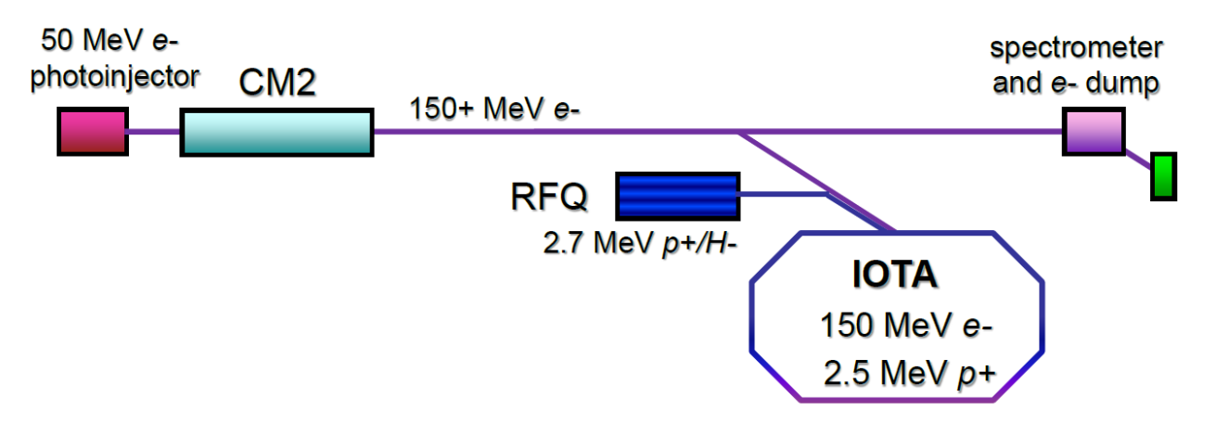
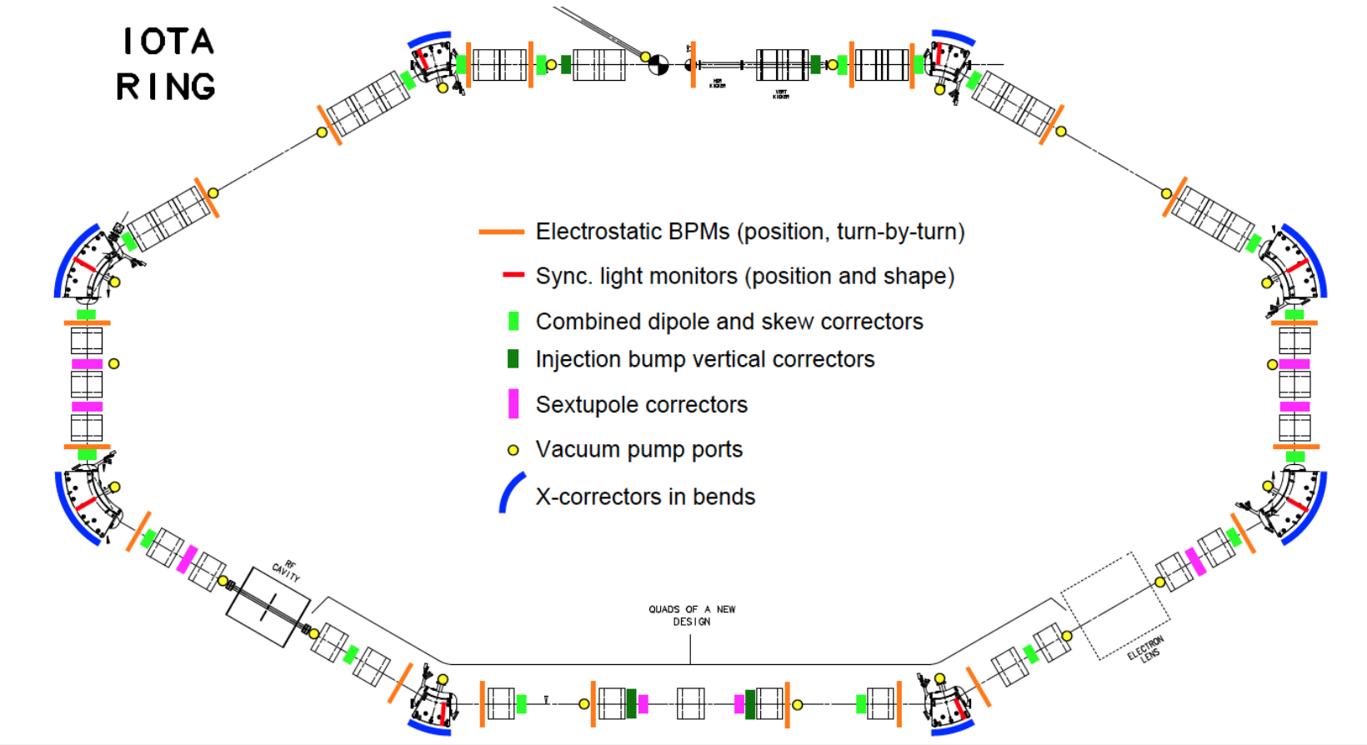
The IOTA Ring

Slide 4
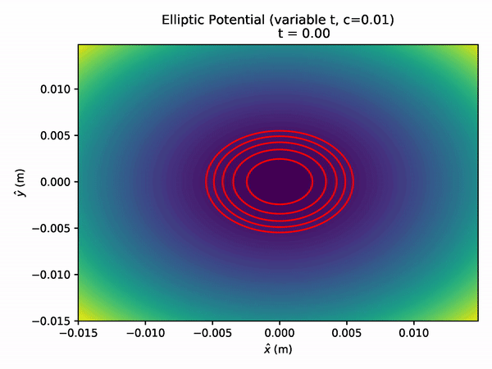
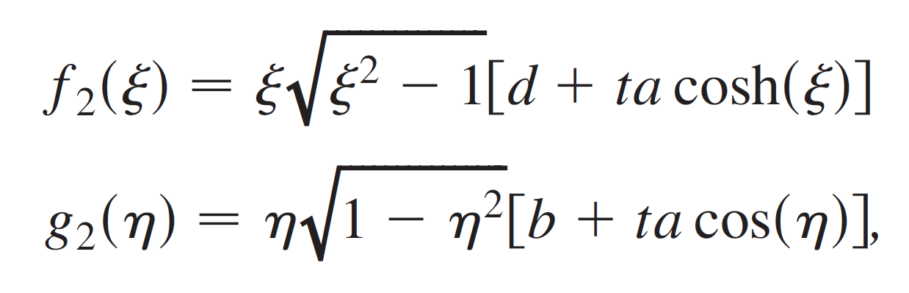
The Potential of the Nonlinear ‘Elliptic’ Magnet
‘Elliptic’ potential has the form:
Where the elliptic coordinates are:

Slide 5
Simulation Tools
Results presented here are based primarily on Synergia
  developed by Fermilab’s accelerator simulation group
  important contributions through code modifications and technical support
  J. Amundsen, Q. Lu, A. Macridin, L. Michelotti, C.S. Park, E. Stern, T. Zolkin
Synergia has unique features that have enabled our success
  control of linear, 2nd-order, … or fully nonlinear dynamics in each element
  2D space charge algorithms: both gridded Poisson and ‘frozen’ models

Slide 6
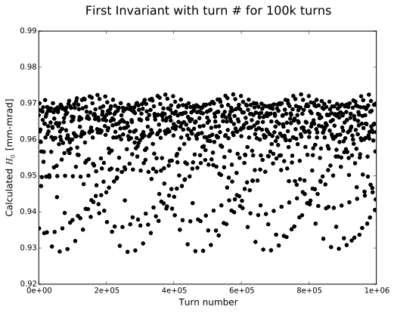
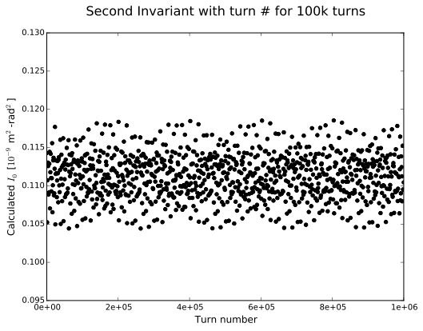
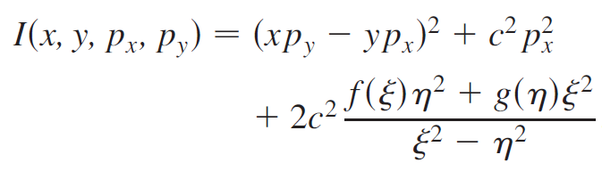
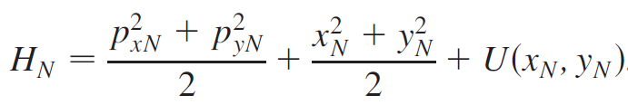
IOTA – no space charge – 1 million turns
Coasting proton bunch in IOTA w/ single NL ‘elliptic’ magnet
  Generalized KV distribution with H0 = 9.47x10⁻⁶
  ex = 0.03 mm-mrad (rms normalized), dp/p = 0
Resulting variation remains consistent
  𝜎_{H} = 1.07%, 𝜎_{I} = 2.56% for the particle shown below
  Periodic variation which appears bounded
1M
1M

Slide 7
Space Charge breaks Integrability
Singe-particle invariants are broken
Ensemble average is better behaved
With space charge:
‘Time independence’ of Danilov & Nagaitsev theory is broken
Both zero-current invariants now fluctuate significantly at 2 frequencies
Some ensemble properties still appear to be approximately maintained
  we don’t yet understand how meaningful this may be
Bounded motion + nonlinear decoherence may be all that is required

Slide 8
Adjusting for Space Charge Tune Depression
Need an nπ phase advance around the ring between the exit and entrance of the nonlinear magnet with space charge.
NL insert
nπ phase advance
One then selects an optimal current to approximately zero the x, y phase advances.
Iterative matching is used to correct the lattice for any tune depression and preserve the phase advance.
Results shown here are optimized for a modest depression of dQ_{SC}= 0.03
A. Romanov, G. Kafka, S. Nagaitsev, A. Valishev, “Lattice Correction Modeling for Fermilab IOTA Ring,” TUPRO058 IPAC 2014.

Slide 9
Results with the Compensated Lattice
Phase advance around the ring is now corrected with the new compensated lattice.
This leads to much better behavior of the first invariant (the Hamiltonian).

Slide 10
Results with the Compensated Lattice
Phase advance around the ring is now corrected with the new compensated lattice.
This leads to much better behavior of the first invariant (the Hamiltonian).

Slide 11
Matching to the Potential
ε is a generalized emittance; ~H
A generalized KV distribution would be ideal
  Linear space charge
  Analytic tune depression
  No tune spread
Problems with KV Distribution:
  It is prone to numerical instabilities, which manifest as rapid emittance increase
  Not a realistic distribution

Slide 12
Matching to the Potential
ε is a generalized emittance; ~H
A generalized KV distribution would be ideal
  Linear space charge
  Analytic tune depression
  No tune spread
Problems with KV Distribution:
  It is prone to numerical instabilities, which manifest as rapid emittance increase
  Not a realistic distribution
Solution: Use a waterbag distribution
  Uniform distribution out to the max value: 0 < ε < ε₀
  Not prone to numerical instability
  More ‘realistic’ distribution
Nonlinear space charge forces
  Large tune spread

Slide 13
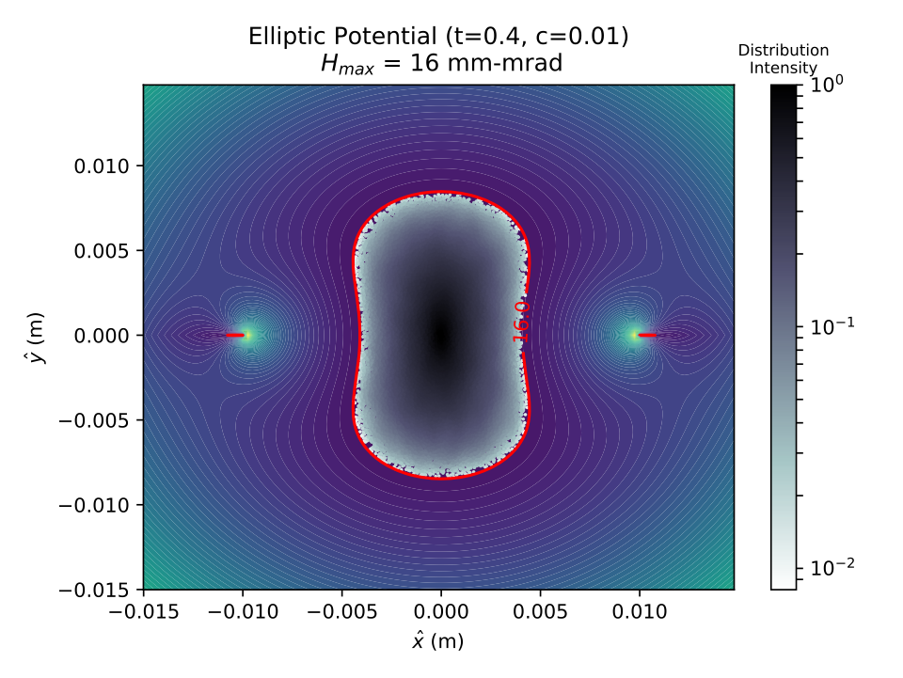
Matching to the Potential – Generating Particles
Best stability achieved if bunch distribution is matched into the elliptic potential:
Bunch Generation Routine:
Generate a trial particle inside some bounds
Check that tU ≤ ε
Assign remaining momentum based on ε - tU

Slide 14
Matching to the Potential – Waterbag in H
Recall that the generalized emittance, ε ~ H

Slide 15
Matching to the Potential – X/Y Distribution
The x/y distributions do not assume the usually expected parabolic forms due to the fact that we are matching to the elliptic potential.

Slide 16
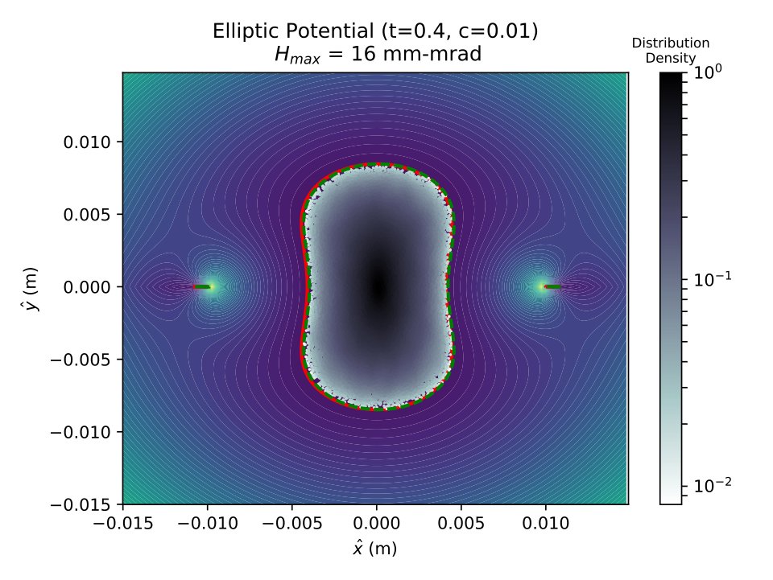
Simulating Nonlinear Decoherence
We simulate a disturbance to the bunch as follows:
  Create matched bunch as described above
  Displace the bunch centroid horizontally
  Tune spread from the nonlinear magnet should restore centroid.

Slide 17
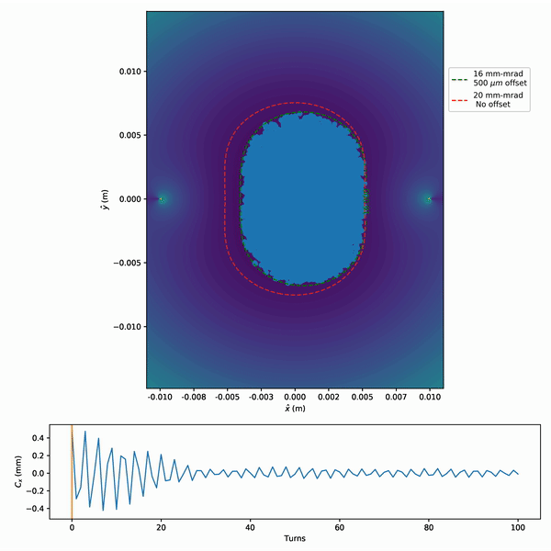
Simulating Nonlinear Decoherence
Simulation without space charge:
Centroid motion rapidly damps.
Horizontal bound now set by new equipotential line.
No change in vertical bound

Slide 18
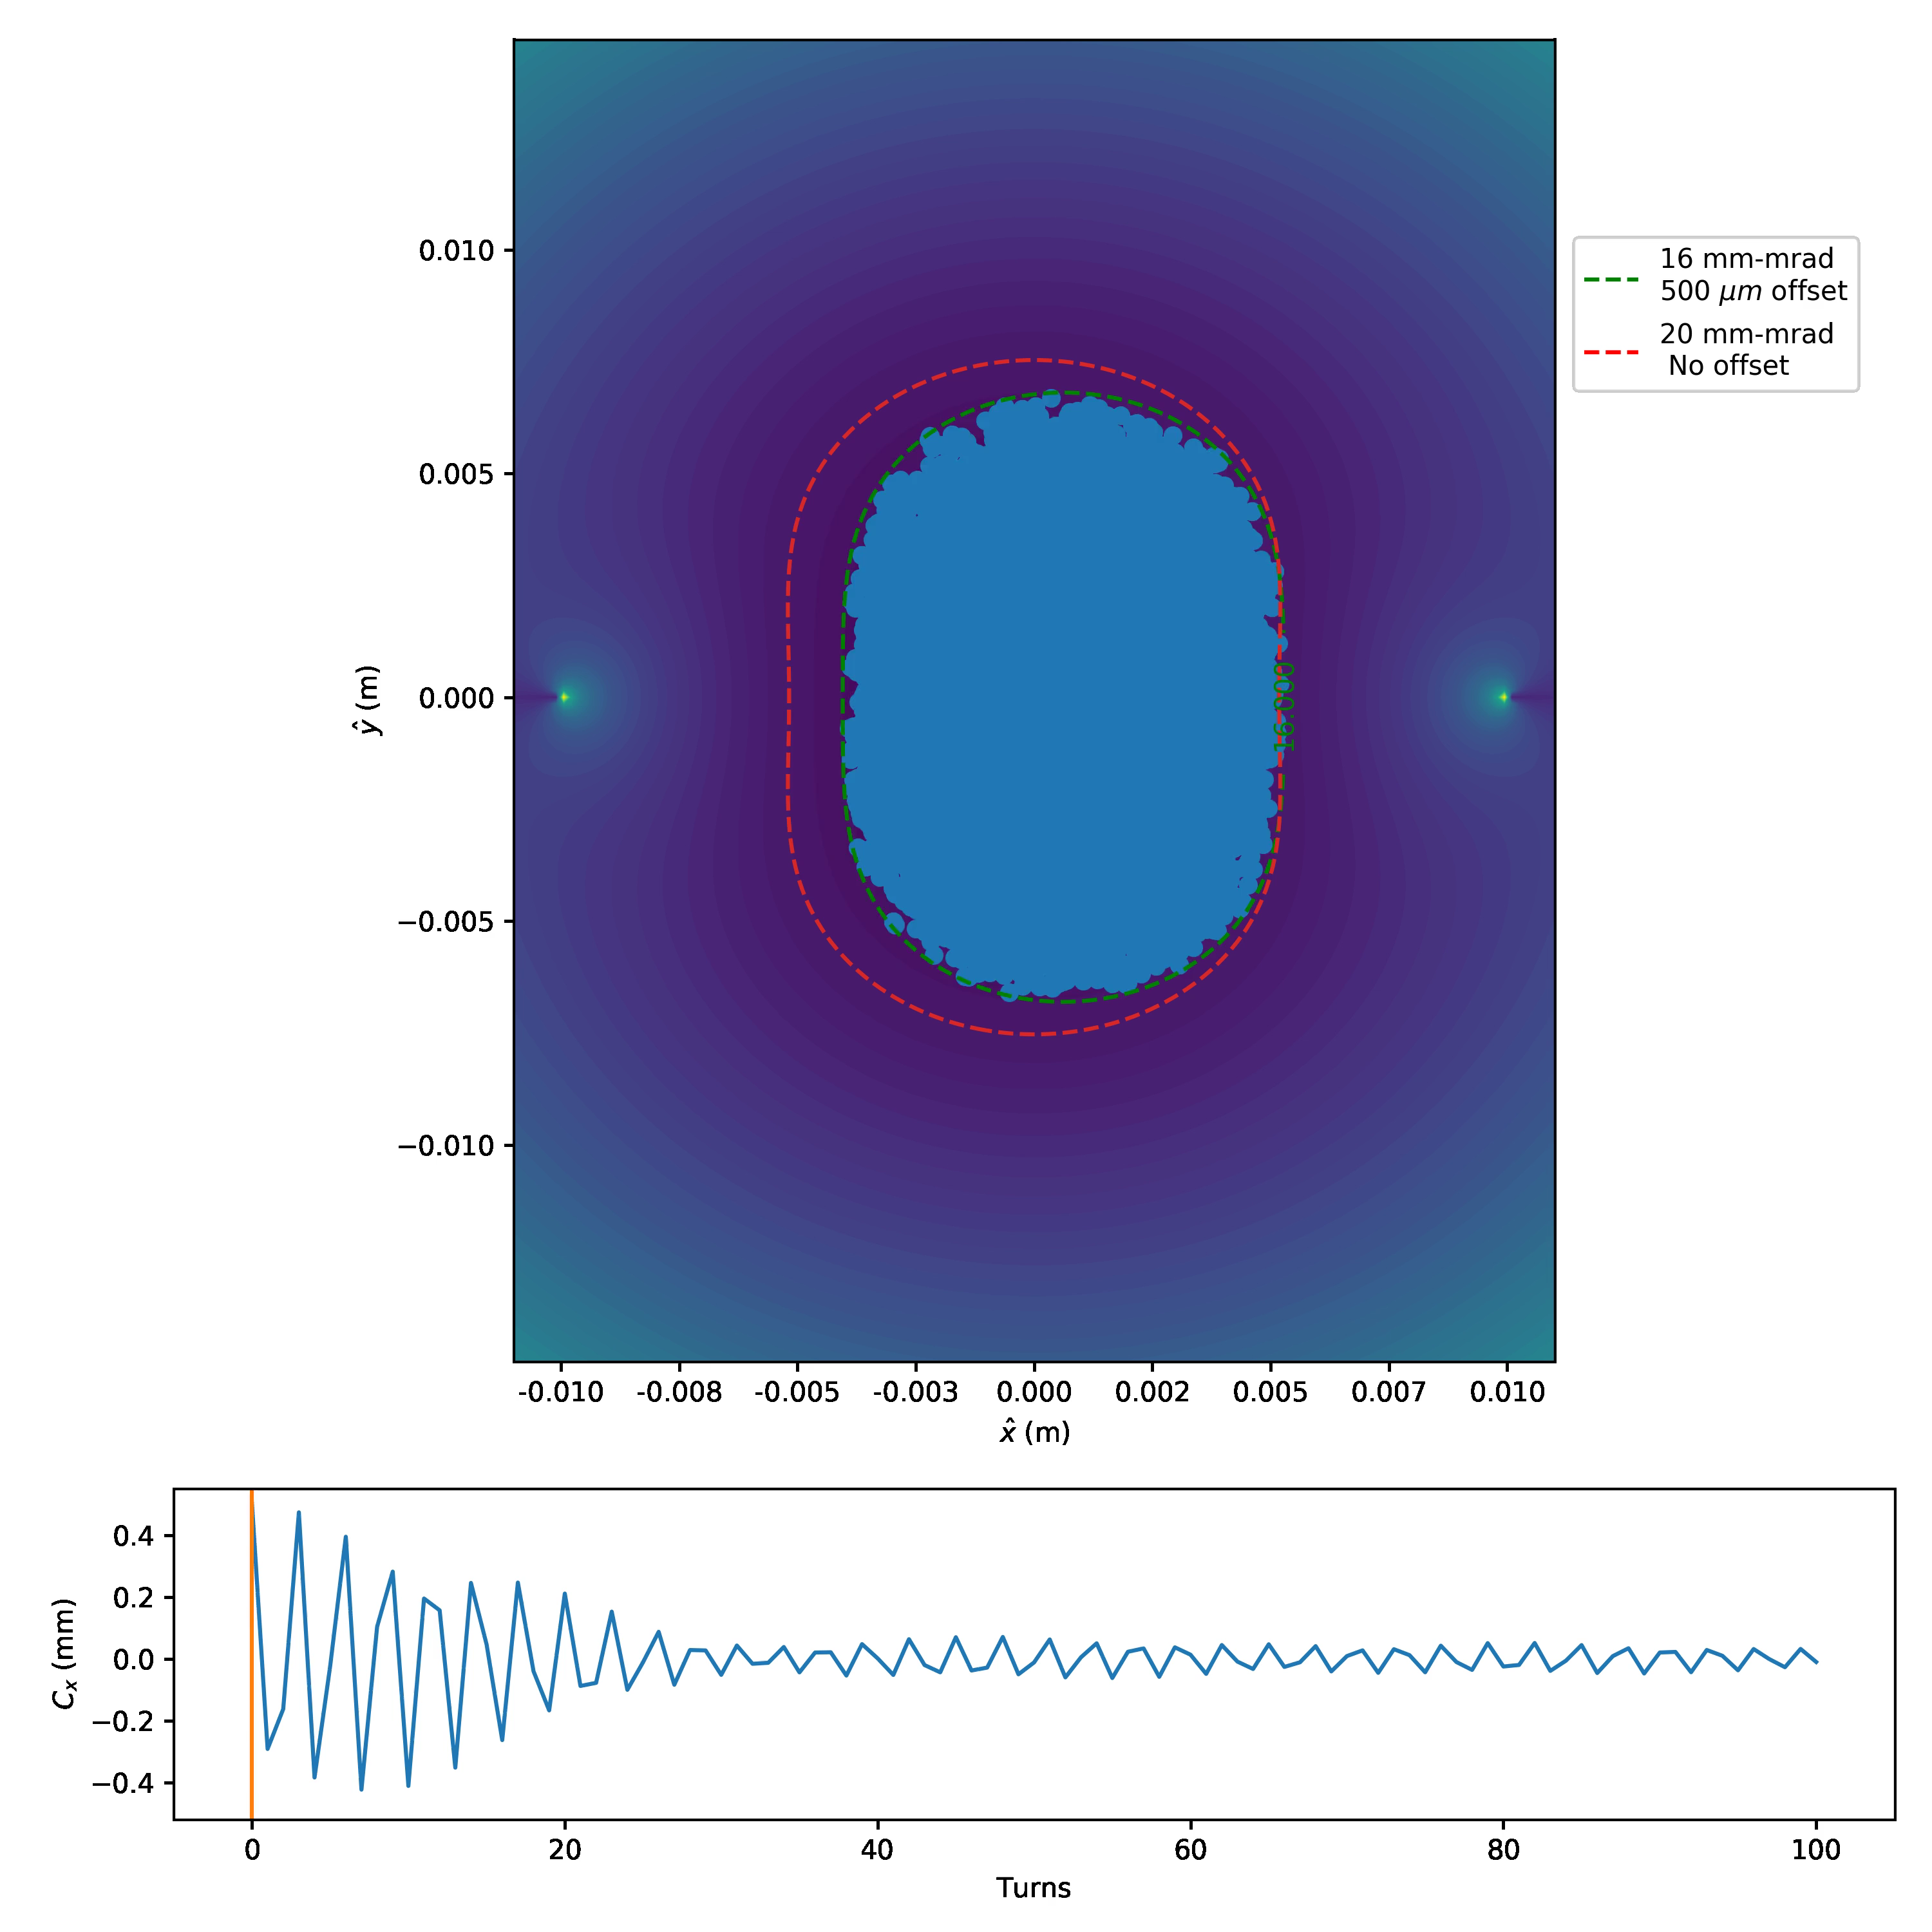
Simulating Nonlinear Decoherence
Simulation without space charge:
Centroid motion rapidly damps.
Horizontal bound now set by new equipotential line.
No change in vertical bound
What happens to the nonlinear decoherence when space charge is included?
See next slide…

Slide 19
Nonlinear Decoherence – with Space Charge
Space charge acts as a driving term against the nonlinear decoherence.

Slide 20
Decoherence for nonlinear insert at ‘half’ strength
t = 0.2
For t=0.2 (max value is t=0.5), decoherence is too weak
  some improvement seen at large emittance

Slide 21
Decoherence for nonlinear insert at ‘full’ strength
t = 0.4
For t=0.4 (close to max of 0.5), decoherence is effective
  phase space mixing speeds up as emittance is increased

Slide 22
Summary & Future Work
We’ve established a working point with space charge
Theoretical understanding of IOTA is improving
  detailed understanding of phase advance(s), nonlinearities, space charge
  observe scaling of nonlinear decoherence with emittance nonlinear magnet strength
Integrability lost due to space charge – what are the implications?
  zero-current integrability may still be important
  dynamic aperture may be the merit function
Symplectic space charge solvers are essential
  nonsymplectic noise is injected into the dynamics at every step. Very difficult to believe tracking of invariants over ~10K turns

Slide 23




The IOTA Collaboration (beam physics):
Thank You!
Acknowledgments:
N. Cook& D.L. Bruhwiler& S.D. Webb& Webb& A. Romanov# E. Prebys# A. Valishev# G. Stancari# J. Eldred# S. Nagaitsev# C. Mitchell% R. Ryne% D.T. Abell& R. Kishek^{ψ} S. Chattopadhyay$,# S. Szustkowski$ F. Blampuy$
Supporting members of the Synergia development team:
E. Stern# J. Amundson# A. Macridin# C.S. Park# L. Michelotti#
%
$
^{ψ}
&
#
This work is supported by the U.S. Department of Energy, Office of Science, Office of High Energy Physics, under Award Number DE-SC0011340.

Slide 24
Backup Slides

Slide 25
KV Distributions with Self-Consistent Space Charge
Initially used 2D particle-in-cell (PIC) to model transverse space charge of the proton beam.
Found invariants to be poorly maintained.
For a KV bunch the distribution in H starts as a delta function but quickly spreads.

Slide 26
Diffusive Behavior of the First Invariant
Large numerical diffusion appears.
Dependent on macroparticle number but not completely vanishing.

Slide 27
Comparison with simple Octupole
Octupole
Nonlinear Magnet
It is possible to achieve comparable rates of damping with an octupole
Octupole produces larger fluctuations
Requires high pole-tip magnetic fields

Slide 28
Tune Spreads – Octupole vs ‘Elliptic’ Nonlinear Insert
Octupole
Nonlinear Insert
Centroid motion removed from tune calculation

