Slide 1
Space charge and Landau damping effects in measurements with quadrupolar pickups
Workshop
Space Charge 2017
Darmstadt, October 4-6, 2017
Ingo Hofmann
GSI Darmstadt / TU Darmstadt / Frankfurt U

Slide 2
Introduction
Transverse Quadrupolar modes in coasting beams
De-coherence vs. Landau damping
“Hardt – formula” regime
New 2nd order modes: coupled envelope and odd modes
Concluding remarks

Slide 3
Transverse quadrupole modes of oscillation “envelope modes” – “second order modes”
F. Sacherer’s rms envelope equation, 1968
y
Split tunes (Q_{x} > Q_{y} ):
Q_{coh 1,2} = 2(Q_{x,y} +3/8 ΔQ_{x,y})
x
coherent tune shift
corresponds to
“reactive impedance”
Equal tunes:
“fast” or “breathing” mode
Q_{coh f} = 2(Q +1/2 ΔQ)
“slow” or “quadrupolar” mode
Q_{coh s} = 2(Q +1/4 ΔQ)
y
y
x
x

Slide 4
3 ways of quadrupolar mode excitation
instability
impedances ? (small?)
parametric resonance
ω₂=1/2
resonance
ω_{m}=n
(magnet driven)
mismatch
(envelope)
de-coherence
(“Landau damping”)
exponential growth +
Landau damping
Landau damping
De-coherence + LD inter-related if space charge present
use term “LD” for both

Slide 5
Experimental application: “quadrupolar diagnostics”
W. Hardt (1966), M. Chanel (1996), R. Bär (1998), R. Singh (2014), E. Metral (2016), A. Oeftiger (2017)
Measure coherent tune shift
“direct measurement” of space charge
quantify injection MM
basis experiment to explore de-coherence and Landau damping
GSI: challenge is bunched beams
quadrupolar kick after bunching?
explore “tail Landau damping”
Q_{coh 1,2} = 2(Q_{x,y} +3/8 ΔQ_{x,y})
(split tunes!)

Slide 6
Landau damping of modes in a potential
ω= Q_{coh m} =mode frequency=m(Q_{x} +ΔQ_{coh})
Q_{x} = Q_{0x}-ΔQ_{x,inc} “average s.p. tune”
ΔQ_{coh}>0 equivalent to reactive impedance (→ Im ω)
Assume non-propagating transverse modes
→ theory different from original theory for waves
Spread of Q_{x} due to space charge nonlinearity matters
damping by resonantly excited particles → transverse halo
ΔQ_{coh}
f(Q_{x})
ω/m
Q_{x} < ω/m
Q_{x} > ω/m
Q_{x}
m=2
m=4
For monotonic distribution functions only positive coherent shifts (positive energy modes (Landau, Gardner, 1970’s)
y
y
x
x

Slide 7
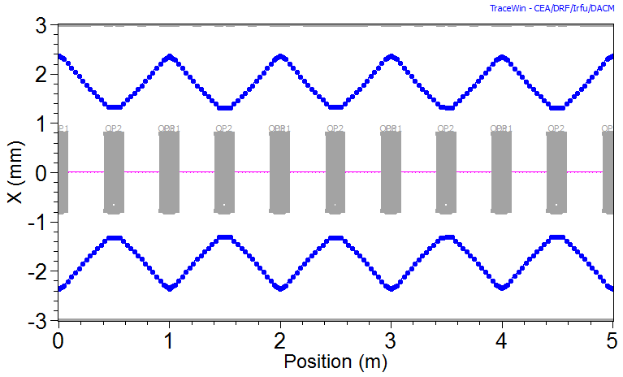
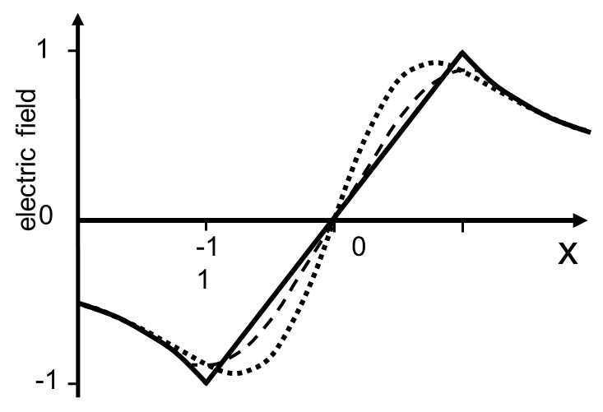
Simple linear “toy” lattice + space charge nonlinearity – simulated by TRACEWIN 3D particle-in-cell code for coasting + short bunches
FODO: 1 cell = 1 turn
k_{0x}/k_{0y}=65⁰/80⁰ (Q_{0x}/Q_{0y}=0.18/ 0.22)
PIC-simulation of typically 600 cells (turns)
N=10⁴ – 10⁵ particles sufficient resolution for quadrupolar mode
Only direct space charge (no images)
only source of nonlinearity (non-KV beams)
→ Controls Landau damping of transverse density oscillations
Ignore chromatic effects (in bunched beams?)
Ignore image charge effects
G
WB
KV

Slide 8
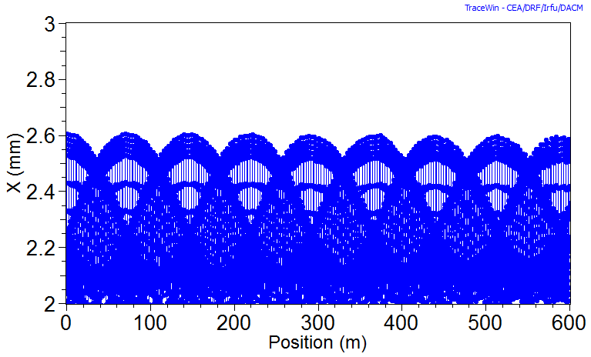
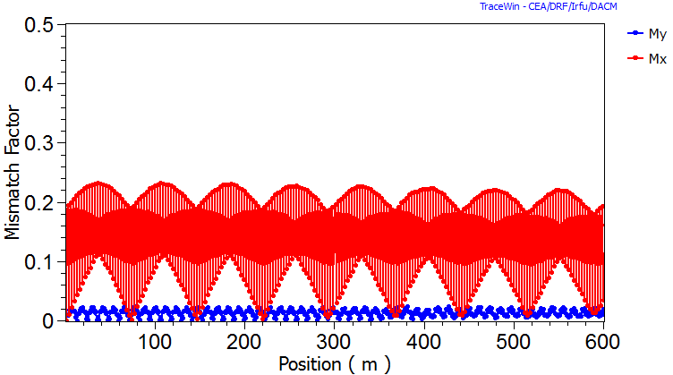
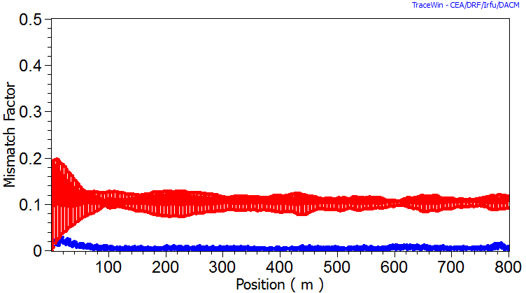
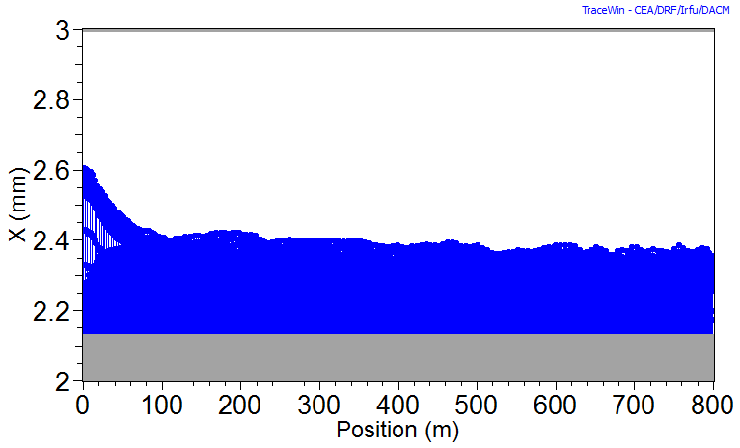
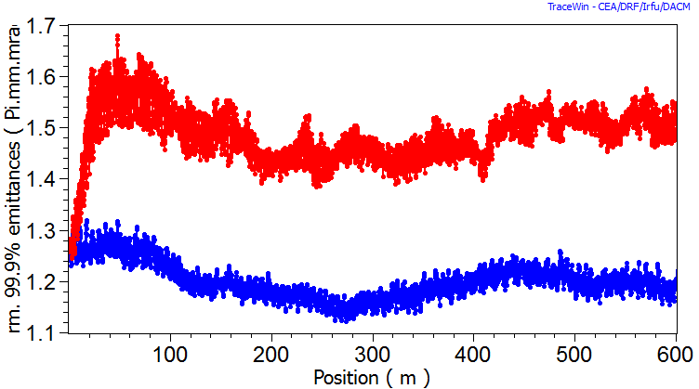
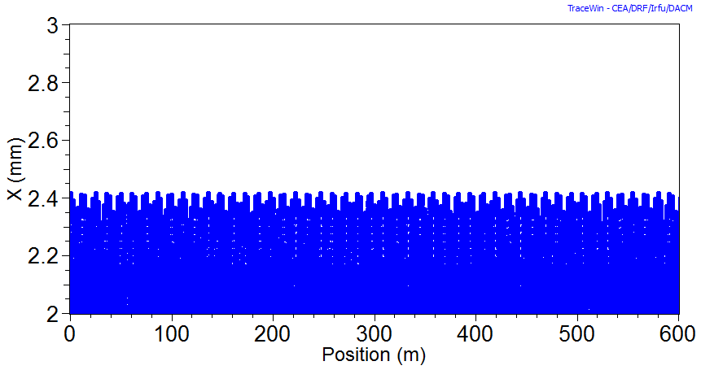
Excite quadrupolar mode by 10% initial x-mismatch for coasting beam
no LD for WB
missing overlap
Mismatch (MM) as indicator
LD for Gaussian
works well due to overlap
results in ~ 30% growth of 99.9% emittance
Resonant Process
consistent with spectral footprint
Zero space charge:
no energy transfer to particles
purely phase mixing in a nonlinear lattice
Waterbag
x-envelope
MM/MM_{initial}
x
y
cells
cells
Gauss/4σ
MM/MM_{initial}
x-envelope
cells
99.9% emittance
cells
x
Gauss/4σ zero space charge/ 10% MM
y
cells
cells

Slide 9
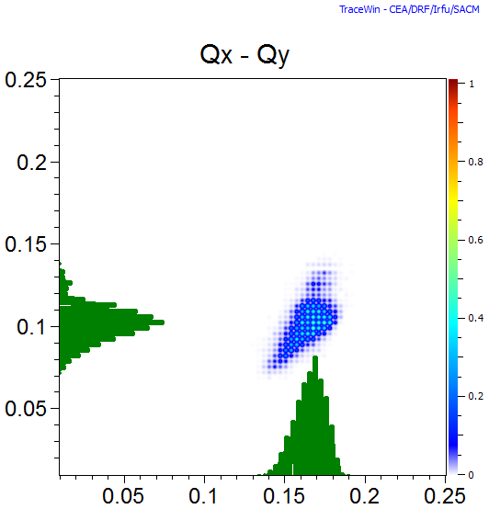
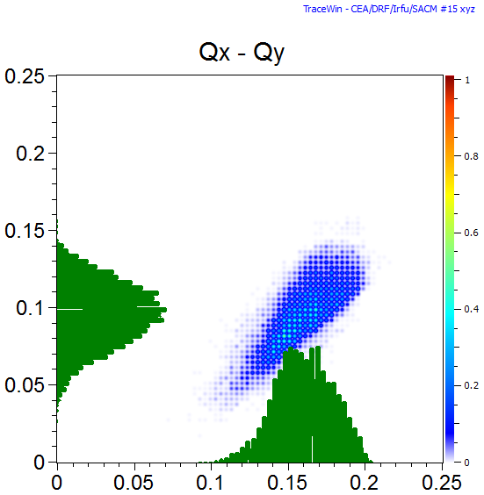
Shift of coherent mode frequencies by s.c. crucial ω_{m}=Q_{coh,m} = m(Q_{x} +ΔQ_{coh,m})
y
y
ΔQ_{coh,m} can be calculated analytically for m=2...4
in I.H., Phys. Rev. E, 1998
m=2
x
m=4
x
Q_{coh} ₂ undamped for waterbag
Q_{coh} ₂ at edge of Gaussian
Q_{coh} ₂ at edge of Gaussian
ω_{3rd}/3
Q_{0x}
Q_{y}
ω_{4th}/4
Q_{y}
Q_{x}
Q_{coh} ₂ /2
positive energy modes
Q_{coh} ₂ /2
Waterbag
(matched)
Gauss/4σ
(matched)
Q_{x}
Q_{x}

Slide 10
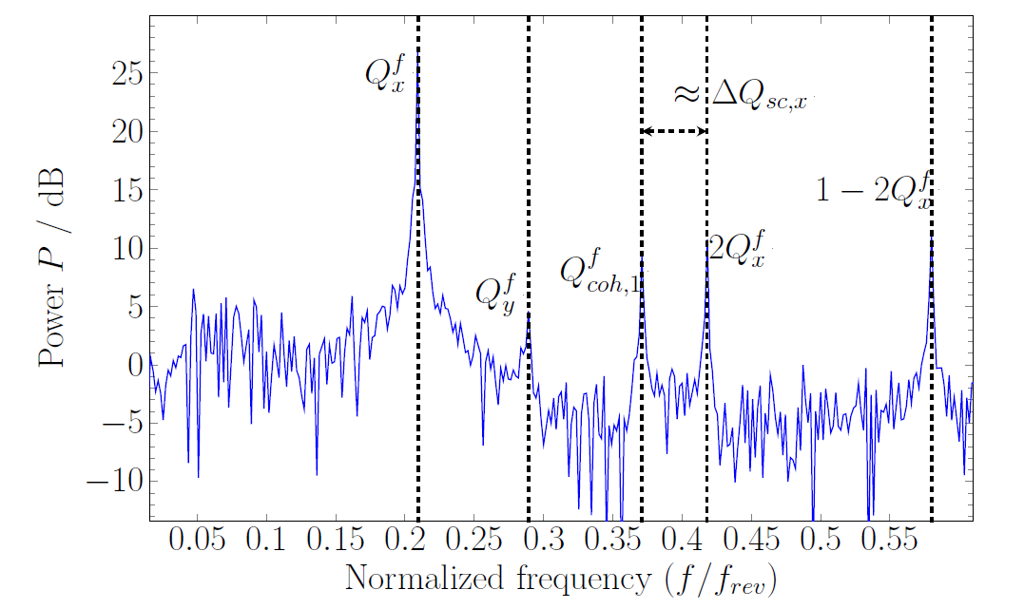
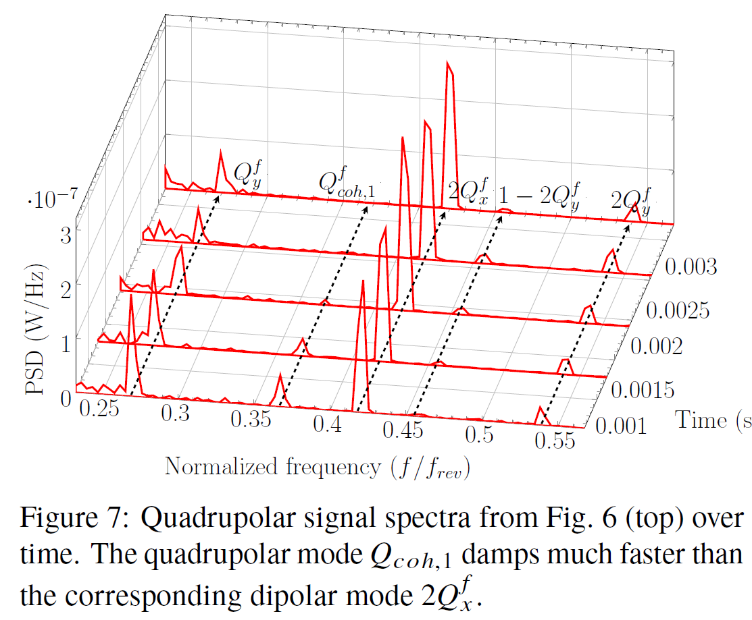
Excitation of quadrupolar mode by injection MM Measured at SIS18 / GSI for coasting beam
R. Singh et al., 2014, IBIC2014
quad mode Q_{coh} ₁
Q_{coh 1} - 2Q_{0x} =-5/4 ΔQ_{x inc}
High intensity (coasting) beam immediately after injection
fast decay consistent with transverse Gaussian
suggestion to experimentalist
truncate more truncated beam (WB) initially
bunch and re-kick to explore de-coherence

Slide 11
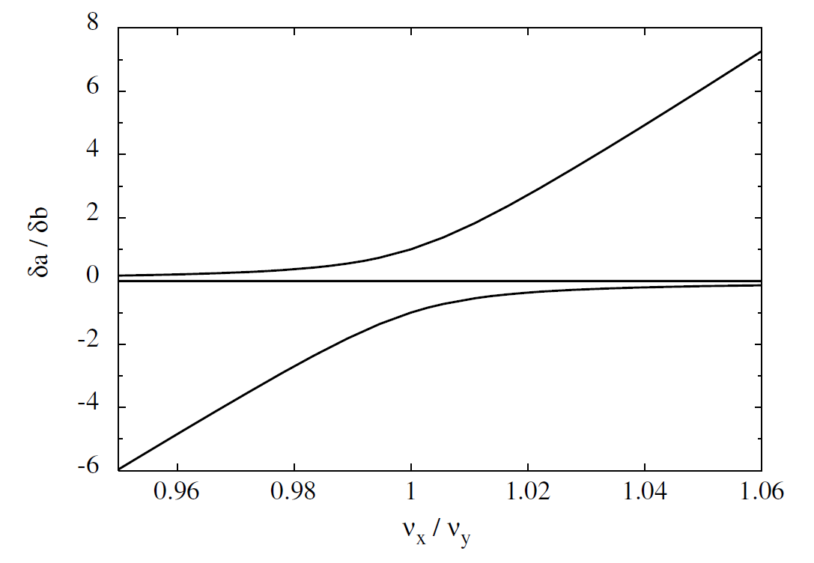
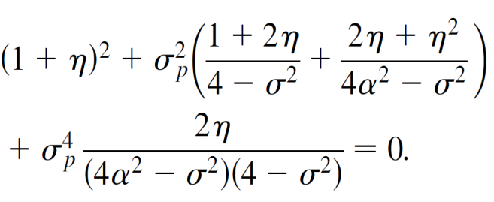
Two distinct regimes: large and small tune split
General 2nd order “even modes”
dispersion equation:
Ratio of envelope perturbations for ΔQ_{y}/Q_{y}=0.2:
I.H., Phys. Rev. E, 1998
ε_{x}/ε_{y}=1
δa/δb
“Hardt”-regime
“symmetric”
“Hardt”-regime
“anti-
symmetric”
“Hardt-formula” uses:
Q_{coh 1,2} = 2(Q_{x,y} +3/8 ΔQ_{x,y})
Q_{x}/Q_{y}
M. Aslaninejad and I.H., PRSTAB, 2003
“Hardt” regime for tune split > 0.1 x ΔQ_{y}/Q_{y}

Slide 12
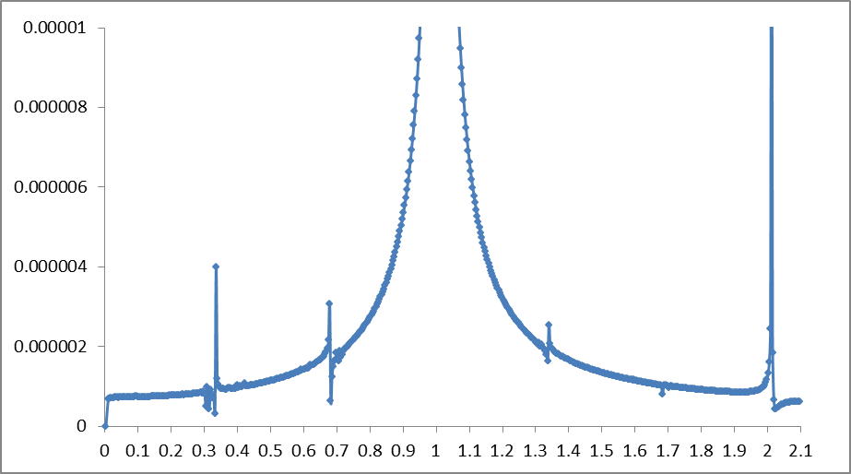
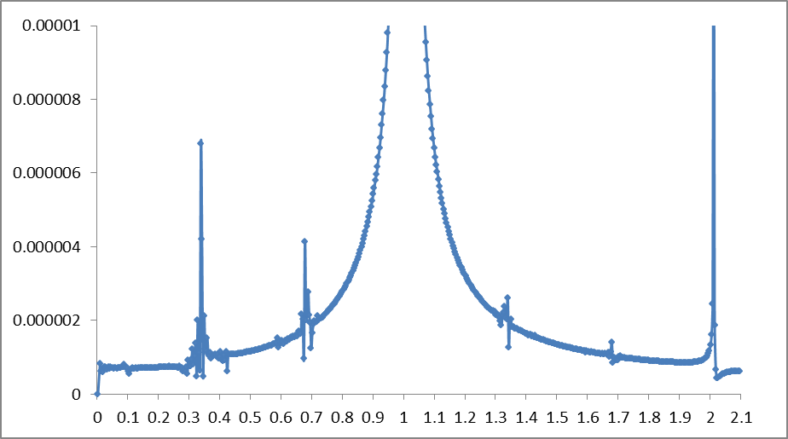
Accurate determination of quad mode frequency by FFT of <x²> (or <x³>, <x⁴>) in TRACEWIN code
FFT /<x²>
Waterbag
Q_{coh} ₂ /2=0.168
no mismatch – “well-matched”
FFT moment <x²>
over 585 cells (2¹¹ data points)
modes seeded by “noise”
quadrupolar mode frequency practically identical for rms equivalent WB and Gauss (consistent with Sacherer’ rms envelope equations)
m=4
Gauss/3σ
Q_{coh} ₂ /2=0.168
m=4

Slide 13
Extend quadrupolar mode discussion to: Coherent second order “sum and difference” modes
see 2D Vlasov mode analysis in I.H., Phys. Rev. E, 1998 )
Second order “odd” modes
differ from “even” envelope modes
“sum” and “difference” modes exist
involve rotation in real space – like skew motion
y
x
Q_{coh/sum} = Q_{x} + Q_{y} + ΔQ_{coh/sum}
α_{sum} ΔQ_{inc}
O. Boine-Frankenheim, I.H. and J. Struckmeier, PoP 2016
I.H. and O. Boine-Frankenheim, PRAB 2016
New: “Coupled envelope” modes
the 2 (even) envelopes couple with each other
as sum or difference modes (even)
y
Q_{coh/c.e.} = Q_{x} + Q_{y} + ΔQ_{coh/c.e.}
x
α_{c.-e.} ΔQ_{inc}

Slide 14
Overview on second order coherent modes:
2 even modes (so far) → 6 modes
Q_{coh} = 2(Q_{x,y} + ΔQ_{coh/quad/1}) (split tunes→ “Hardt” formula)
Q_{coh/sum} = 2(Q_{x,y} + ΔQ_{coh/quad/2} ) (weakly split tunes)
Q_{coh/sum} = Q_{x} + Q_{y} + ΔQ_{coh/sum}
Q_{coh/diff} = Q_{x} - Q_{y} + ΔQ_{coh/diff}
Q_{coh/c.e.-sum} = Q_{x} + Q_{y} + ΔQ_{coh/c.e.-sum}
Q_{coh/c.e.-diff} = Q_{x} + Q_{y} + ΔQ_{coh/c.e.-diff}
even modes
(from Sacherer’s r.m.s. envelope equations)
odd modes
(from Vlasov theory or “Chernin equations”
very different frequencies!
coupled envelope (even) modes
(in principle from Sacherer, or Chernin
upcoming paper in PRAB by Yaoshuo Yan et al. based on “Chernin equations “

Slide 15
Why excite them?
Additional measurement data
cross check ΔQ_{inc} from even modes
measure presence of skewed injection (odd mode)
skew errors
Enhanced signal strength? exciters?
Experimental verification
benchmarking of theory
stability issues
Landau damping models
45⁰ rotated?

Slide 16
How to excite these modes?
Statistical fluctuations
sufficient in (most) codes
practically impossible in real beams
Injection mismatch
minimize signal
BTF exciter
modified exciters?
Lattice Errors (integer res. cond.)
low order resonances – often destructive
Parametric excitation (half-integer res. cond.)
destructive on structure resoances
error driven: destructive?

Slide 17
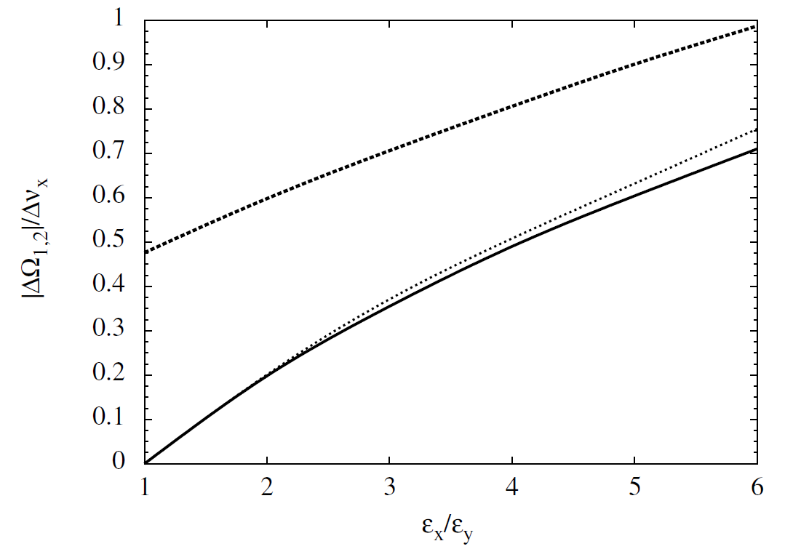
Coherent tune shifts for second order odd modes
Normalized coherent tune shifts practically independent of intensity
ΔQ_{coh,odd}/ΔQ_{inc,x}
M. Aslaninejad and I.H., PRSTAB, 2003
coherent sum mode
Application:
Resonance conditions with field errors:
Q_{x} + Q_{y} + ΔQ_{coh/sum} =N
Q_{x} - Q_{y} + ΔQ_{coh/diff} =N
coherent difference mode
ε_{x}/ε_{y}
ΔQ_{coh/diff} = 0 for ε_{x}/ε_{y}=1 → Landau damping?

Slide 18
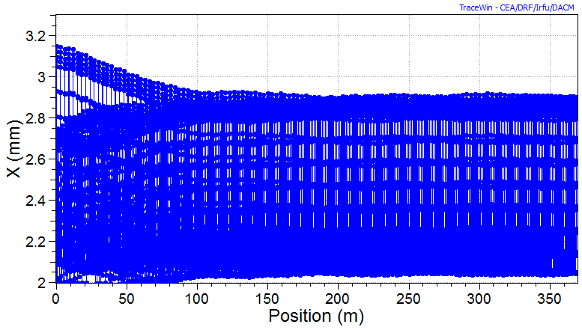
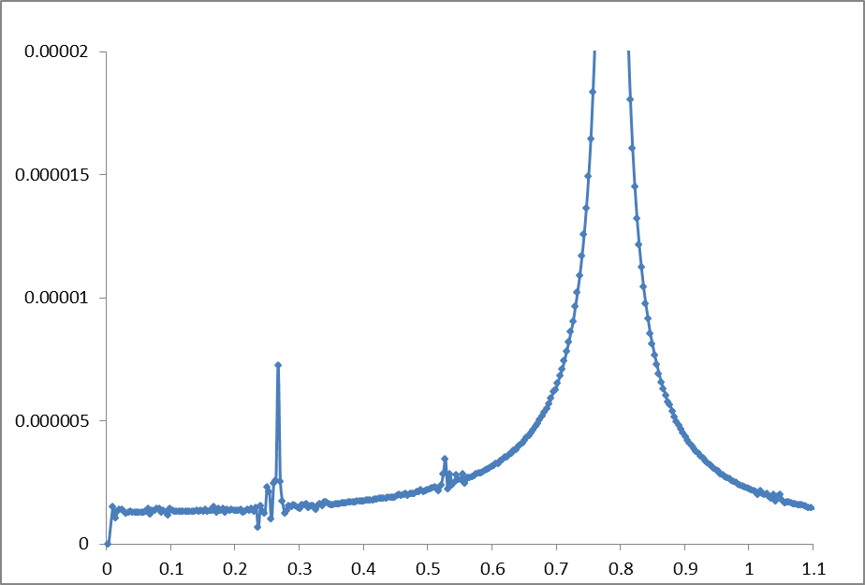
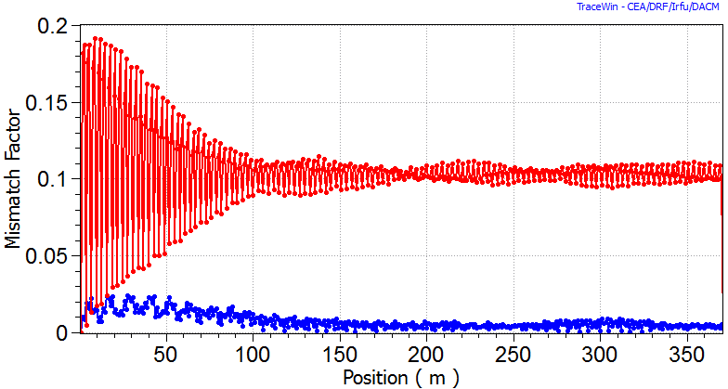
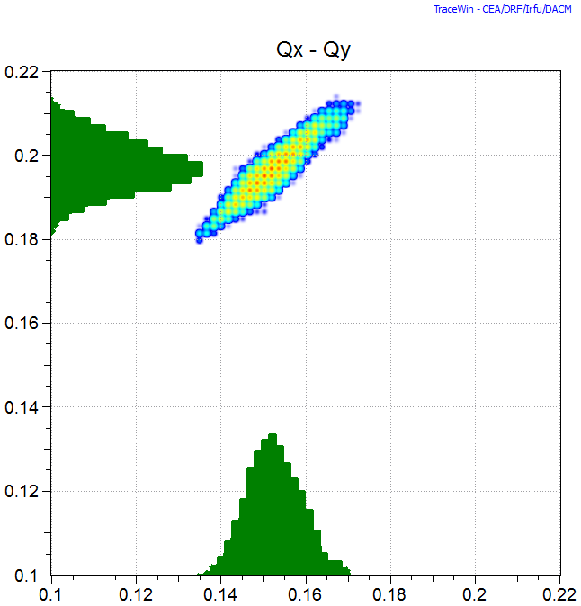
Extend to 3D “short” bunches → quadrupolar mode is also damped for waterbag beam!
k_{0x}/k_{0y}/k_{0z}=65⁰/80⁰/22.6⁰ (Q_{0x}/Q_{0y}/Q_{0z}=0.18/0.22/0.05)
ε_{z}=5 ε_{xy}
WB: effectively damped contrary tocoasting beam!
cells
MM in x
in y
cells

Slide 19
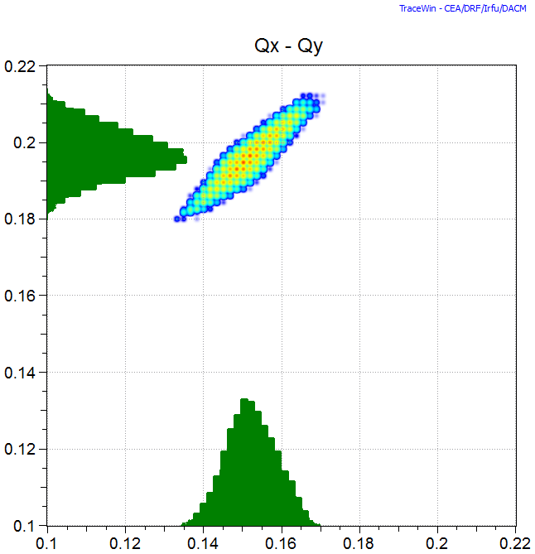
Extended waterbag spectrum with longitudinal oscillations – incompletely plotted in TRACEWIN
no MM
Q_{0x}/Q_{0y}
10% MM – final
coasting
Q_{coh} ₂ /2=0.17
(same as coasting beam)
resonant particles
bunch tail “higher tunes” extend LD
- during fraction of longitudinal oscillation
ΔQ_{x/tail} < ΔQ_{x/center}
“extra” tails in spectrum due to longitudinal oscillation
(no mismatch)

Slide 20
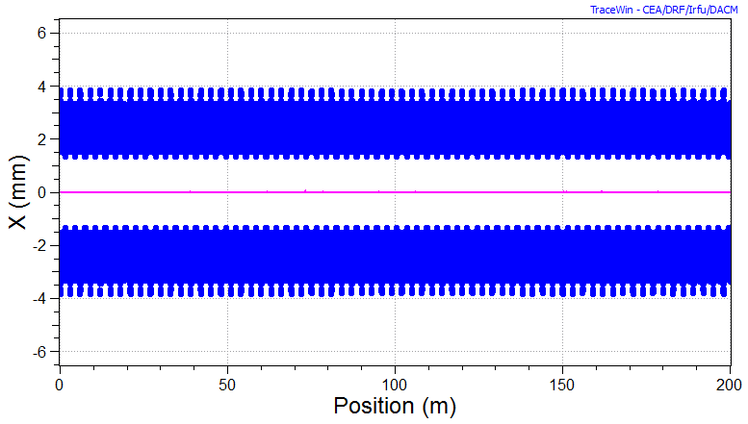
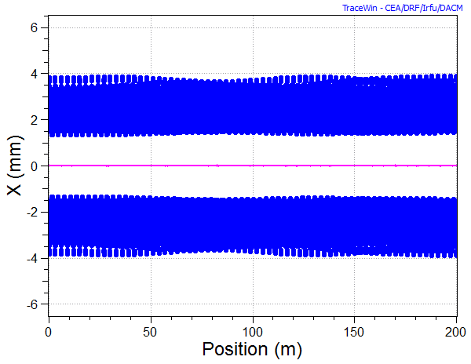
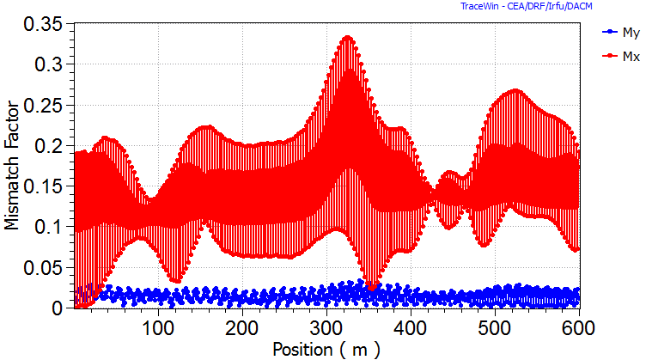
Very short bunches (near spherical) 10% initial MM - not on parametric resonance de-coherence disappears again for WB – also (!) Gauss
k_{0x}/k_{0y}/k_{0z}=65⁰/80⁰115⁰ (ν_{0x}/ν_{0y}=0.18/ 0.22/0.30)
k_{x}/k_{y}/k_{z}=55⁰/70⁰110⁰
WB
Gauss
k=55.5/70.5/110
Mismatch factor

Slide 21
Conclusions
De-coherence and LD largely the same
Extended spectrum of m=2 transverse modes to coherent sum and difference modes
Suggest experimental verification of “new modes”
Require realistic 3D fully self-consistent simulation for bunched beams
Benchmarking of 3D Landau damping effects

