Slide 1
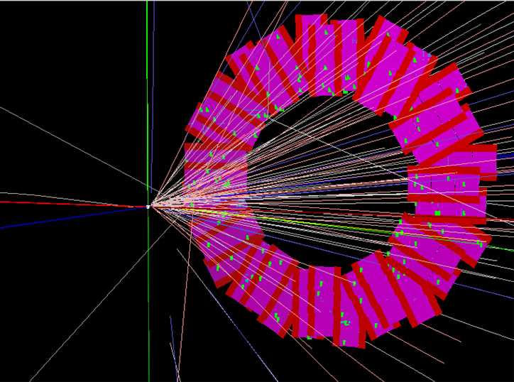
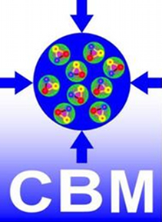
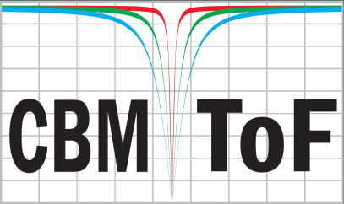
eTOF - status and plan
Ingo Deppner
Physikalisches Institut
der Uni. Heidelberg
Outline
Introduction
eTOF acceptance
eTOF status
Plan for the next years
Milestones
Summary
Event display of a Au + Au reaction at 25 AGeV
CBM-STAR joint Workshop

Slide 2
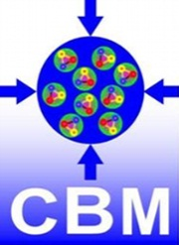
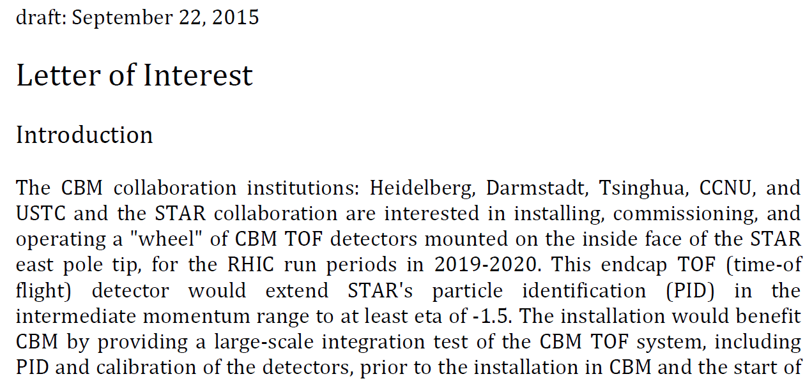
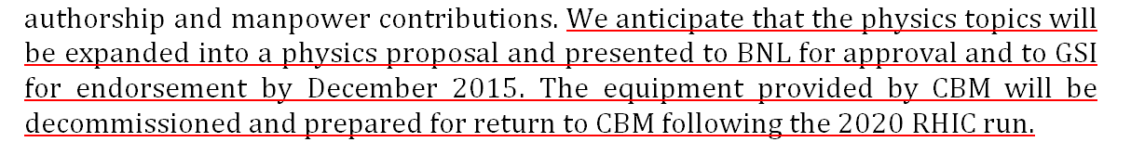



Letter of interest
$$⋮$$

Slide 3
Benefits
Benefit for STAR:
providing critical TOF coverage for BES II
- PID extension to y = 1.2 in collider mode
- access to energies from 4.5 to 7.7 GeV in the fixed target program
Benefit for CBM:
providing a large-scale integration test of the CBM TOF system, including PID and calibration of the detectors (hardware and software)
preparation for day one experiment at SIS 100
Benefit for CBM-TOF group members:
participation in the analysis of the physics data provided by the CBM TOF detectors, including authorship of any publications from this data.

Slide 4
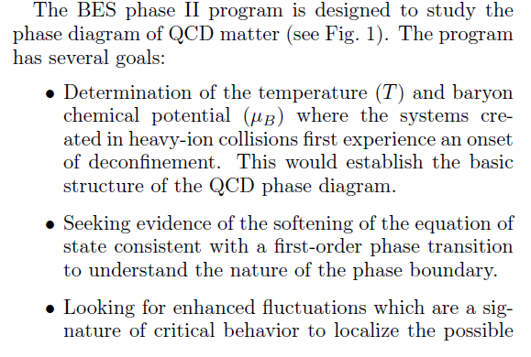
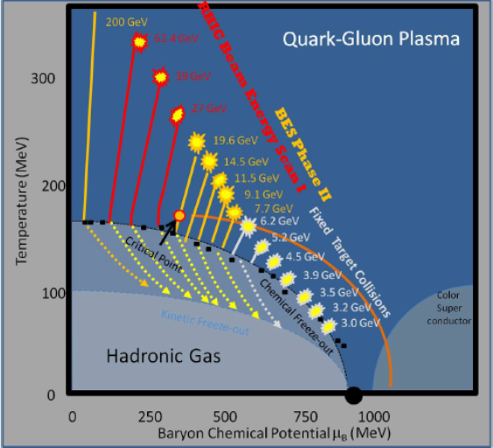
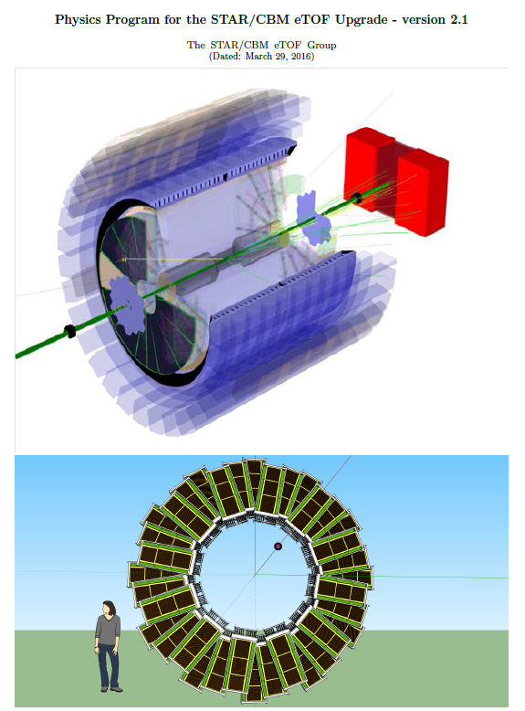
Physics Goals
The general physics goals are common for STAR and CBM
arXiv:1609.05102v
Onset of deconfinement
Chiral symmetry restoration
1st order phase transition
Critical point
Strange states of matter
Rapidity dependence
Di-lepton
Directed flow
Elliptic flow
Fluctuations
Hypernuclei
Physical observables

Slide 5
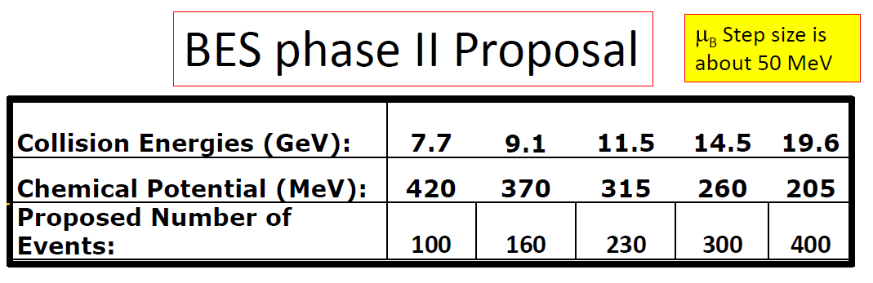

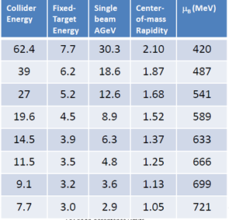
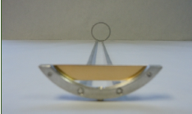
Beam Energy Scan phase II
Fixed Target Program
cms energies from 3 to 7.7 GeV
Baryon chemical potential range from 420 MeV to 720 MeV
Fixed target program not yet approved

Slide 6
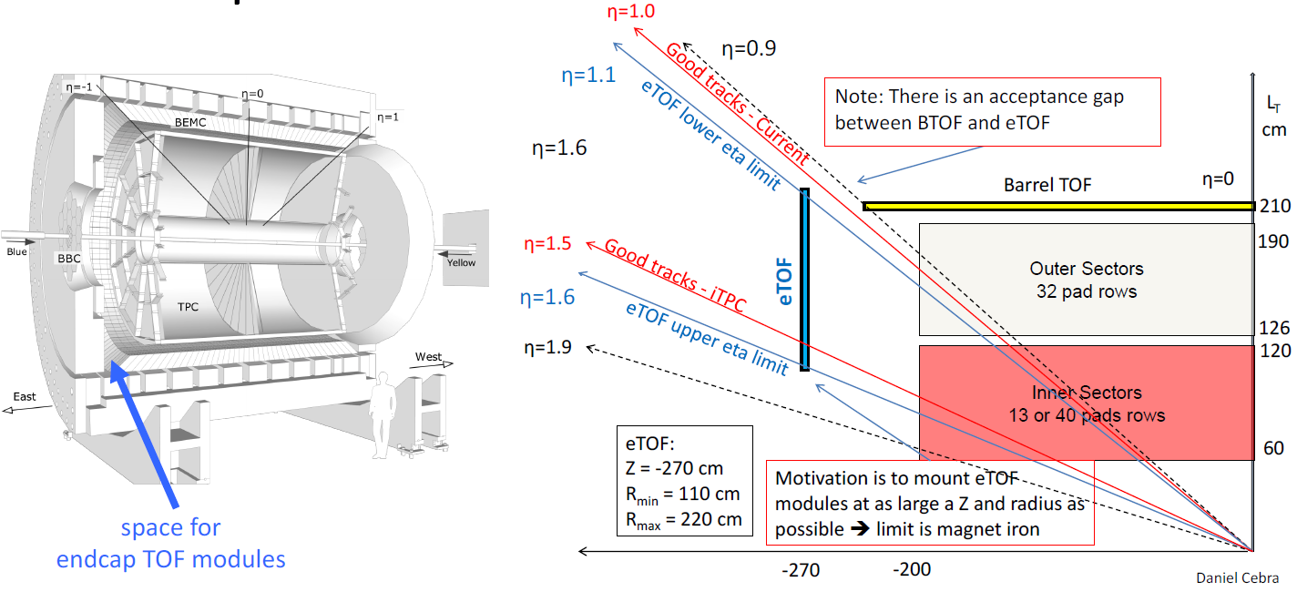
Acceptance in collider mode

Slide 7
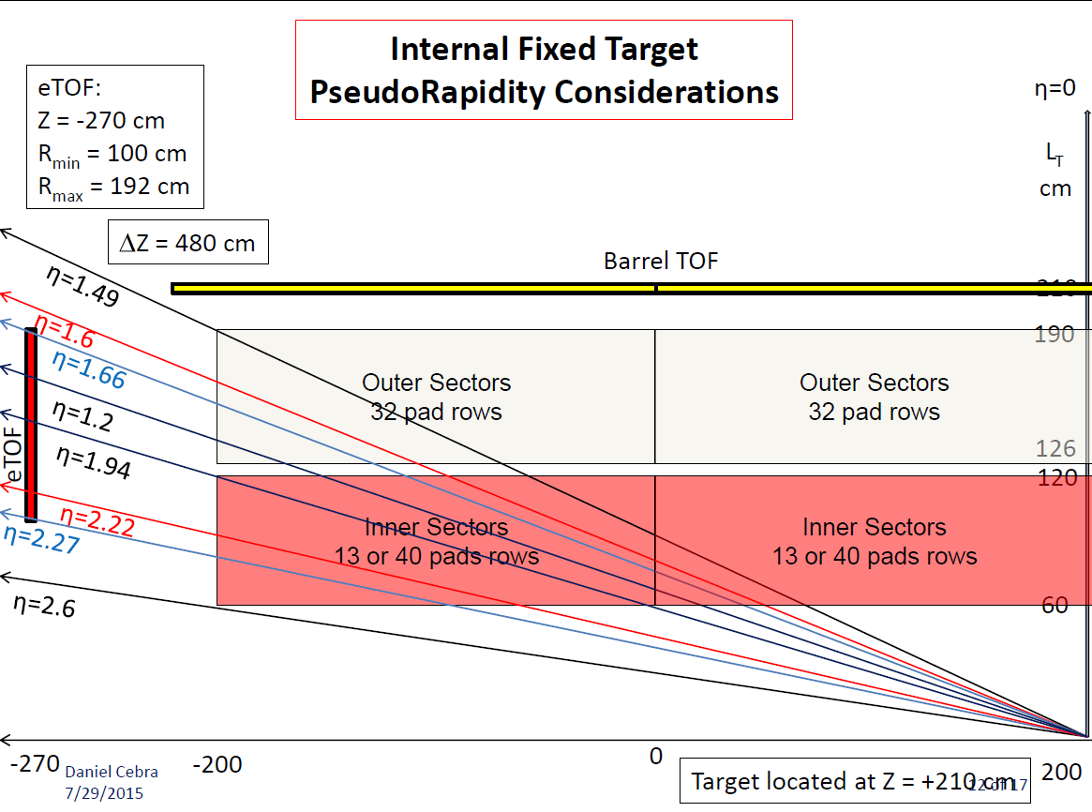
Acceptance in fixed target mode

Slide 8
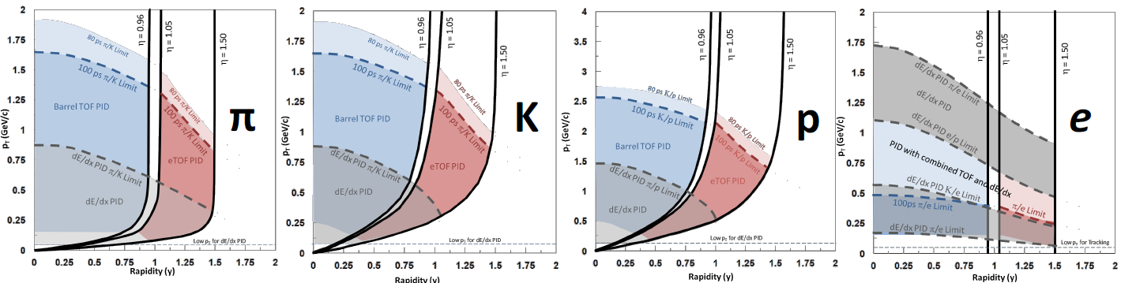
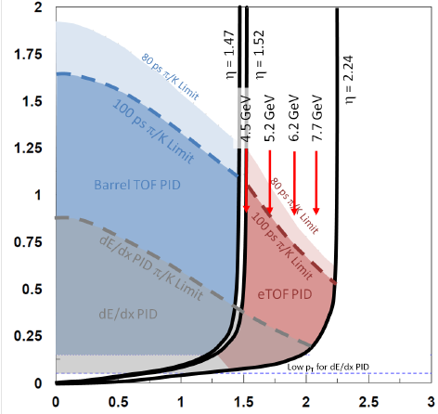
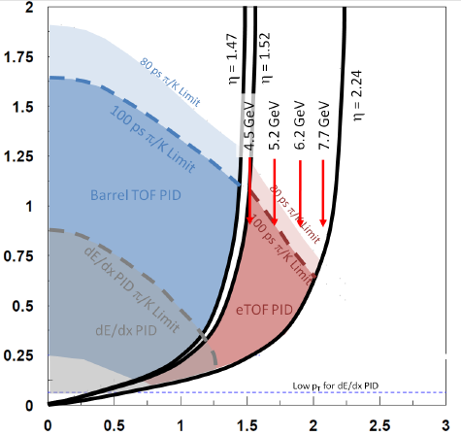
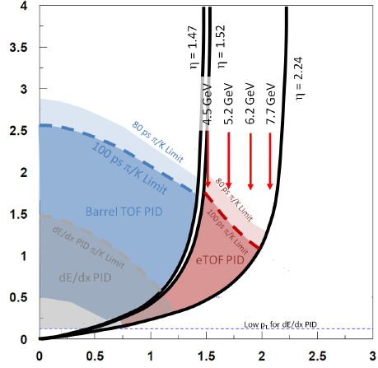


Acceptance in collider mode
Pseudo rapidity range for eTOF 1.05 ≤ η ≤ 1.5 (FXT: 1.66 ≤ η ≤ 2.27)
Low p_{t} limit - from track length of the TPC (multiple scattering)
High p_{t} limit – time resolution of the TOF system
collider
Fixed Target
arXiv:1609.05102v

Slide 9
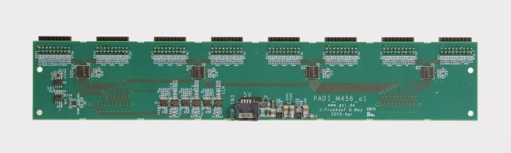
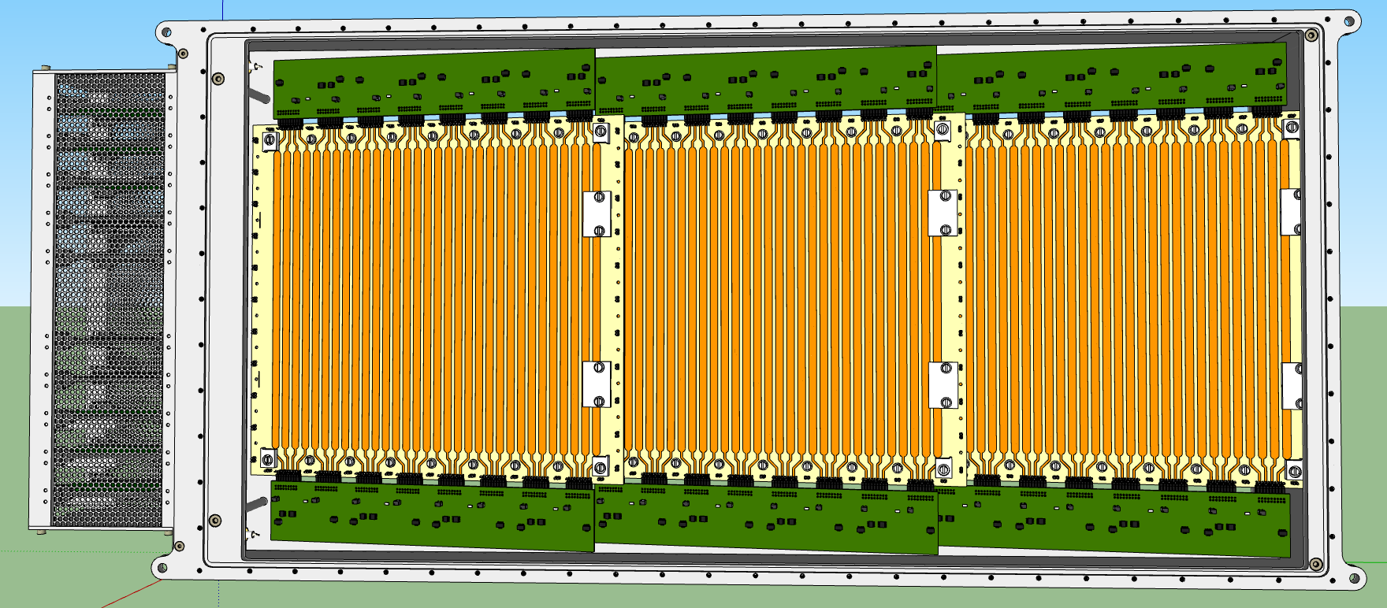
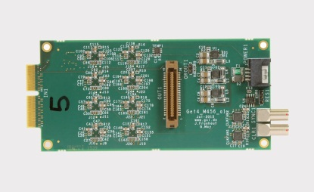
eTOF module
3 MRPCs (MRPC3a/b) – tilted by ≈7°
32 strips/MRPC with a pitch of 1 cm
27 cm strip length
Active area about 92 cm x 27 cm
192 read out channels
Preamplifier PADI boards
TDC GET4 boards
Strip 1
overlapping strips
Strip 96
9

Slide 10
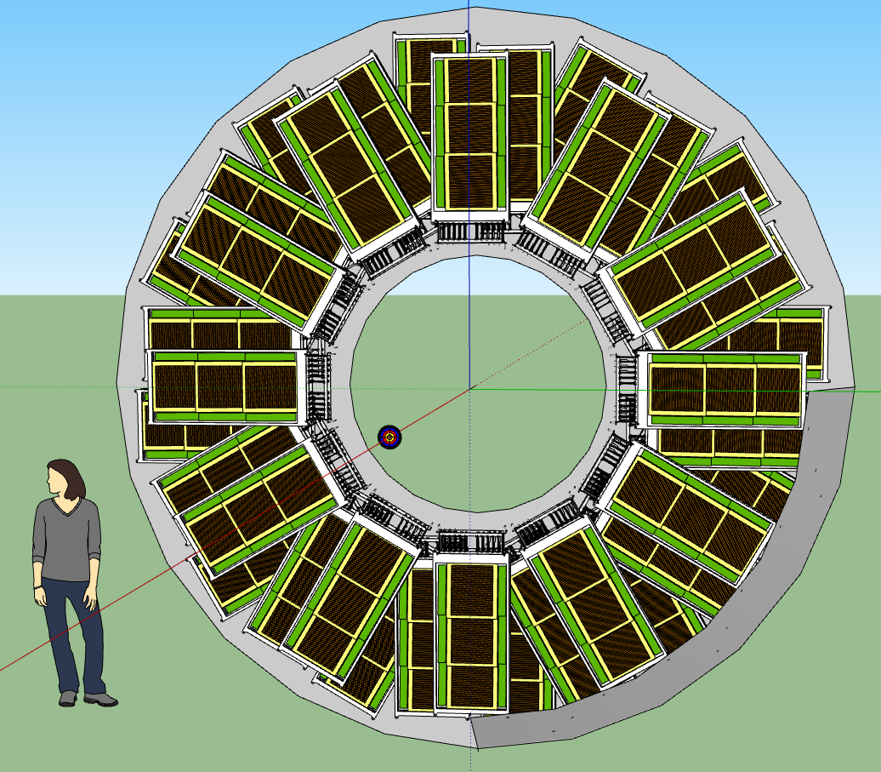
eTOF wheel
A conceptual design
- 36 modules
- 3 layers
- 12 sectors
- 6912 channels
- Sector counting matches the TPC sectors
- Total depth about
14.2” (36 cm)
24
13
23
14
22
15
21
16
20
17
19
18

Slide 11
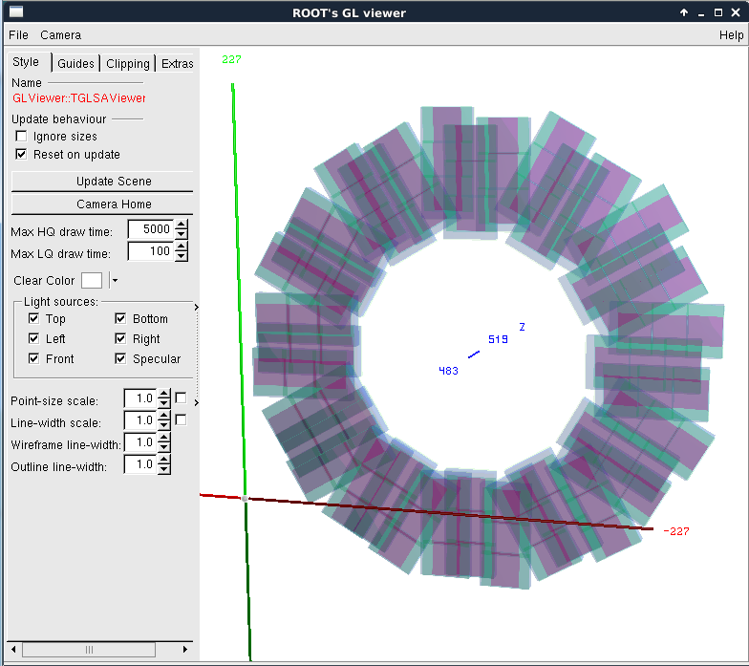
eTOF geometry in CBM ROOT
Fixed target at 4.8 m from eTOF
(2.1 m from center)
MRPC
- Active gas
- Glass
Electronics
Aluminum box

Slide 12
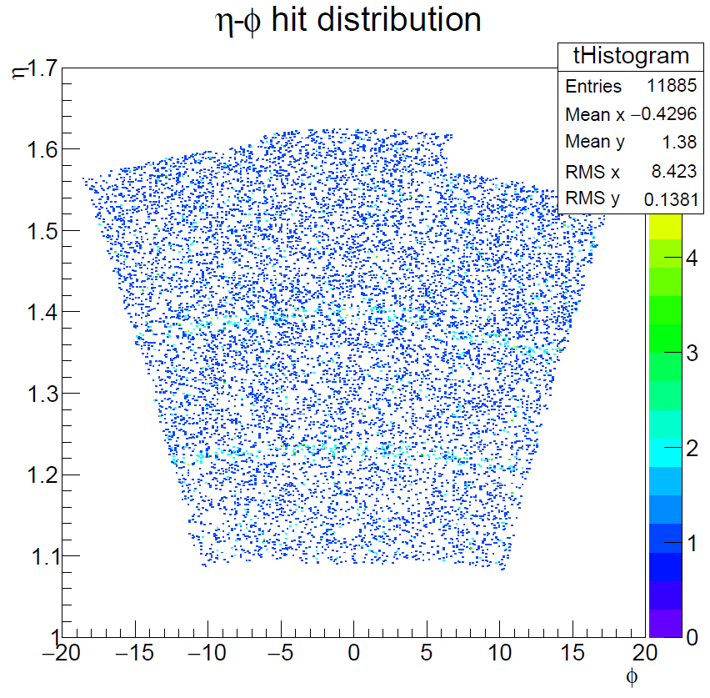
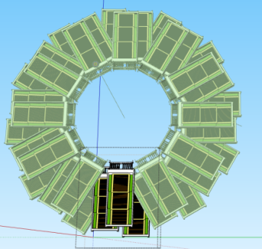
Acceptance of one sector
Collider mode
Interaction point 2.7 m
1.09 < eta < 1.62
Good tracks - iTPC

Slide 13
Acceptance of one sector
Collider mode
Interaction point 2.7 m
1.09 < eta < 1.62
Good tracks - iTPC

Slide 14
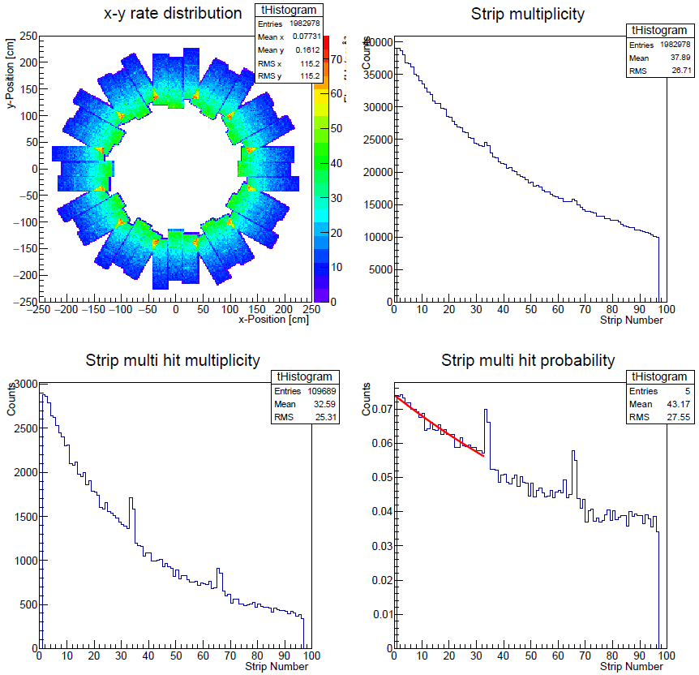
Rate and multi-hit
All particles
Beam energy 25 AGeV
Interaction rate 10kHz
(2kHz recording rate)
Fixed target position
4.8 m
Particle flux < 45Hz/cm²
Multi-hit probability
< 7.4 %
overlapping strips

Slide 15
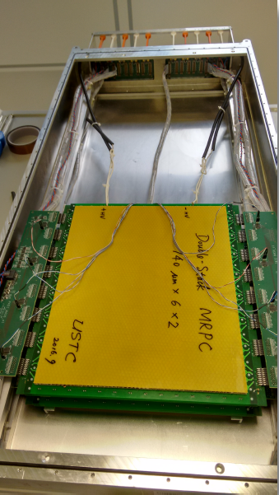
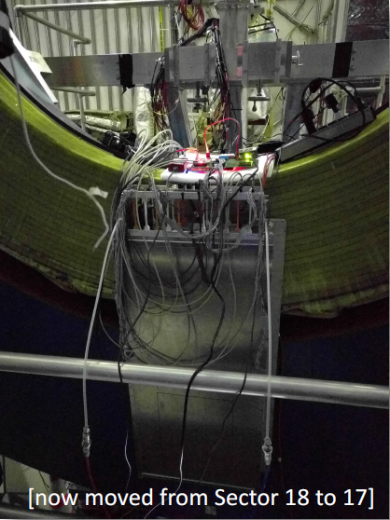
Setup in Jan 2017
Open module
Module fixed at the pole-tip

Slide 16
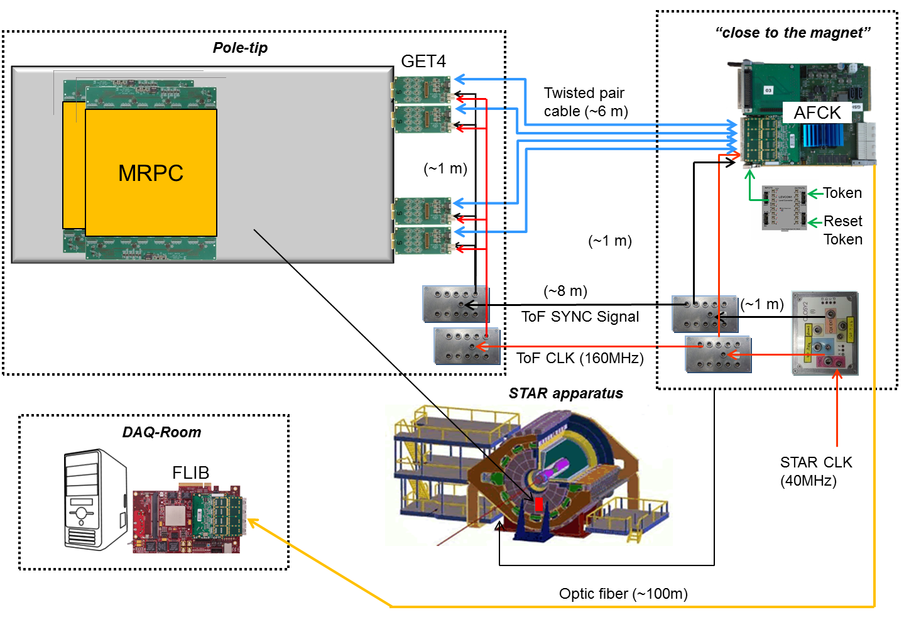
Setup in Jan 2017

Slide 17
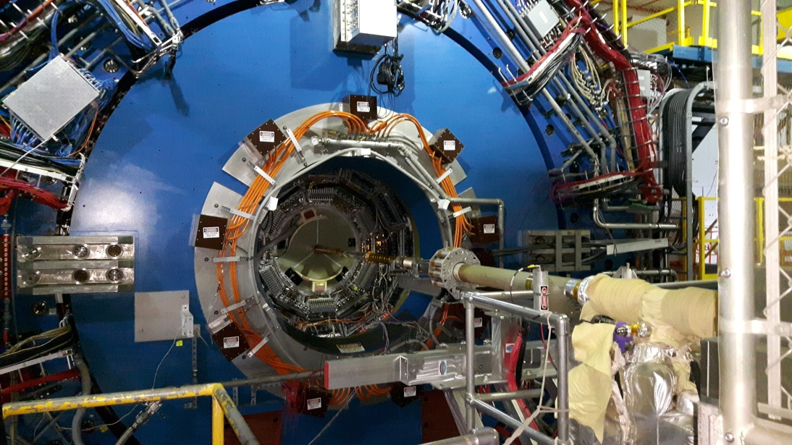
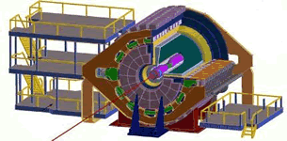
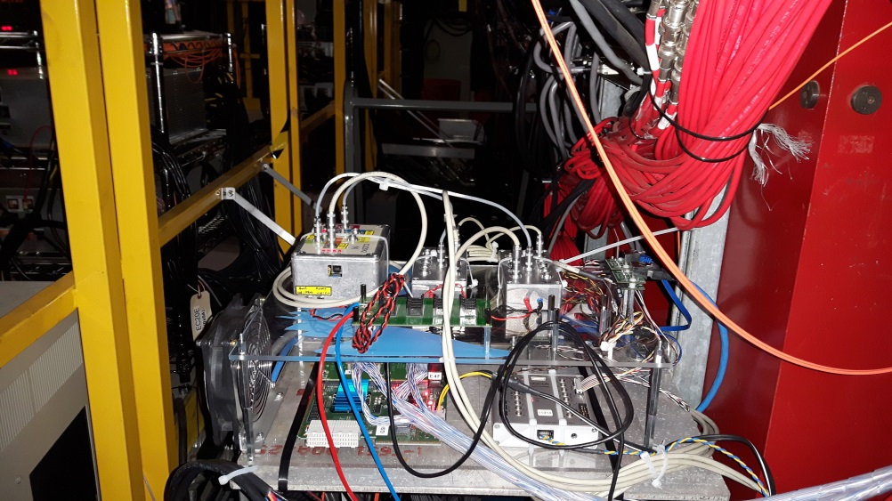
Setup in Jan 2017
place for CLK and AFCK
6m cable
CLK / SYNC + DATA/
LV power

Slide 18
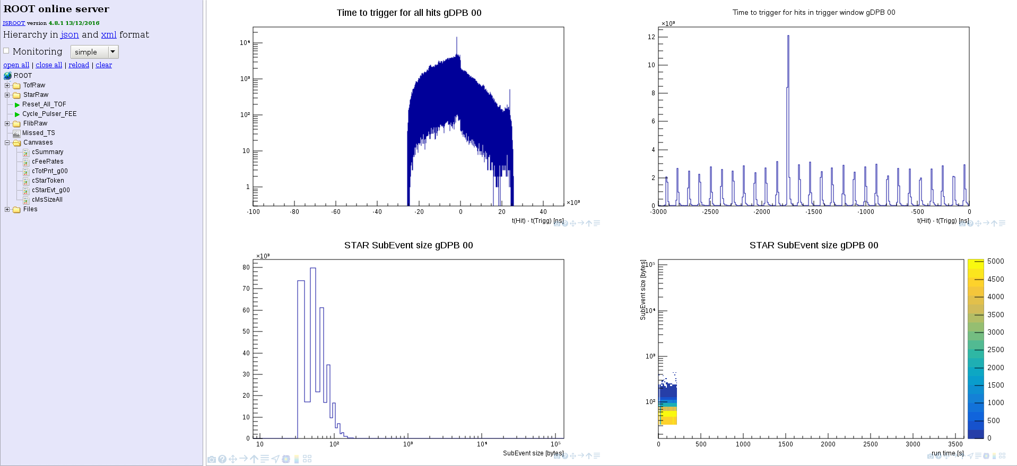
Setup in Jan 2017
Online monitoring

Slide 19
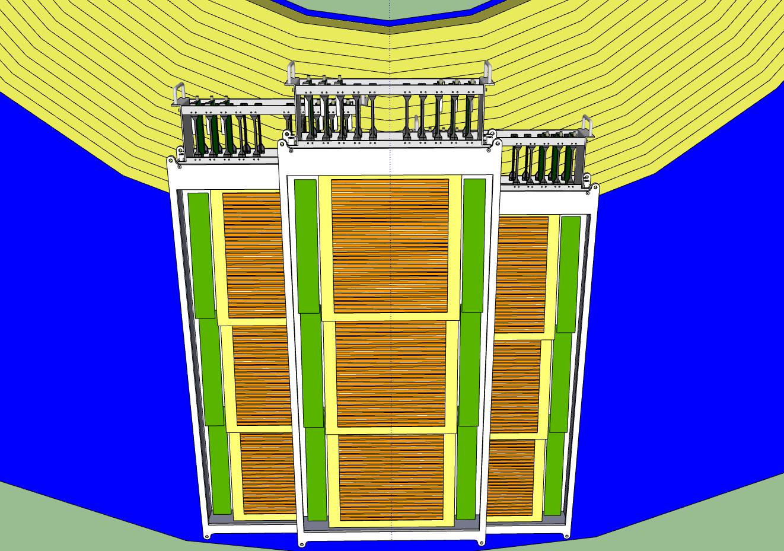
Setup in Jan 2018
One full sector
6 MRPCs with float glass (USTC)
3 MRPCs with low resistive glass
(Tsinghua Univ.)
Review readiness report March 2017

Slide 20
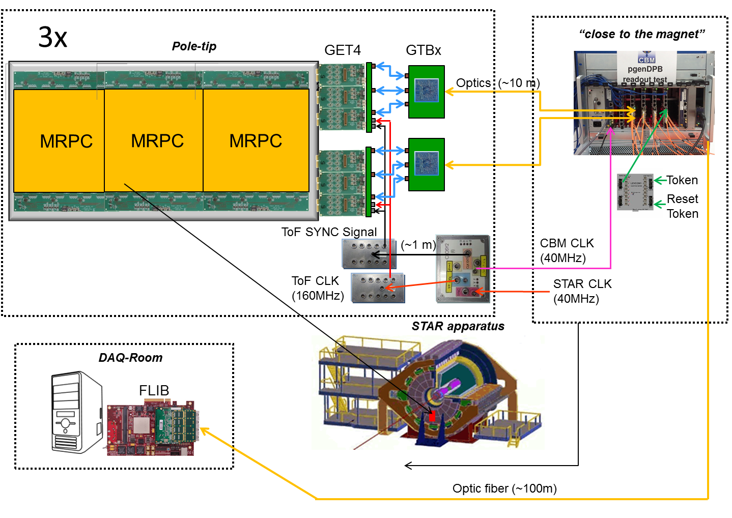
Setup in Jan 2018

Slide 21
Setup in Jan 2019/2020
24
13
23
14
22
15
21
16
20
17
19
18

Slide 22
Milestones
December 2015 submit the physics proposal to GSI and BNL for approval
Summer 2016 shipping a real size module to BNL and installing it on the east side pole of STAR
Feb. 2017 1st system integration test with one module by participating in the Run17 beam time in STAR
Fall 2017 shipping and installation of one sector
Feb. 2018 2nd system integration test with one sector by participating in the Run18 beam time in STAR
Summer 2018 shipping all 36 modules including infrastructure (gas system, LV-, HV-power supply) to BNL
Fall 2018 Installation and commissioning
Feb 2019 Start of the BES II campaign
Summer 2021 Decommissioning and shipping of all modules including infrastructure to FAIR

Slide 23
Summary
eTOF offers unique opportunities within the next 3 years
Hardware performance test
- counter performance
- DAQ stability
Software development environment
- calibration
- PID methods
Physics analysis experience (with eTOF data)
- flow
- fluctuations
- strange resonances
eTOF can be realized as part of the CBM FAIR phase 0 program
New people and contributions are highly welcome

Slide 24
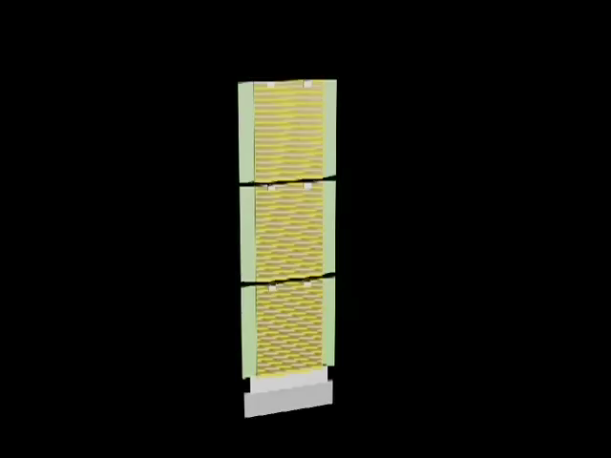
Thank you for your attention

Slide 25
Backup
Backup Slides
80 Ω
1 ns

Slide 26

Acceptance of one sector
Collider mode
Interaction point 2.7 m

Slide 27
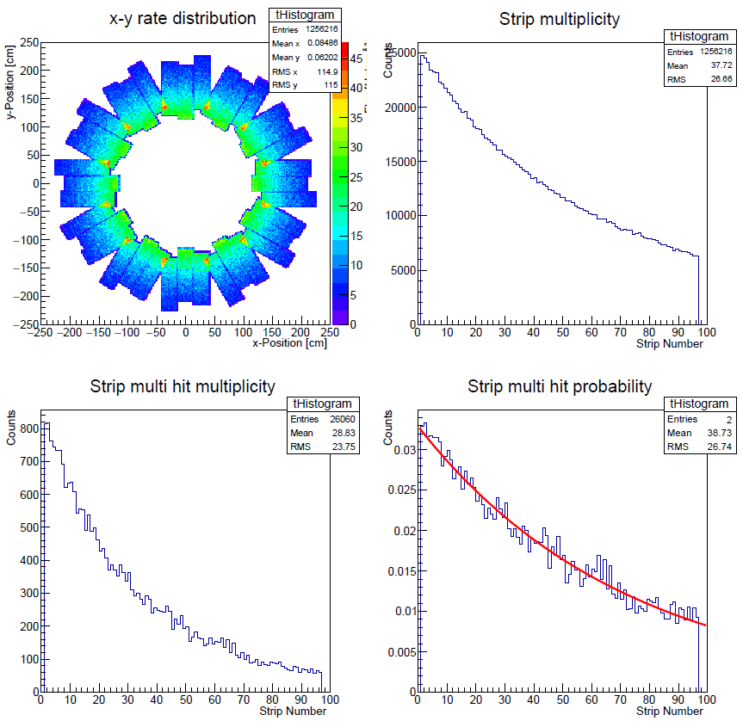
Rate and multi-hit
Primary particles
Beam energy 25 AGeV
Interaction rate 10kHz
(2kHz recording rate)
Particle flux < 25 Hz/cm²
Multi-hit rate < 3.6 %
overlapping strips

Slide 28
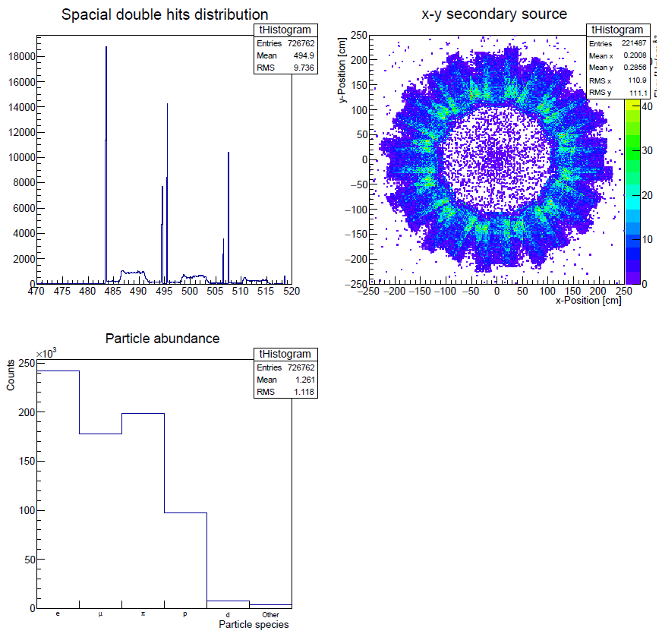
Rate and multi-hit
Box cover
Secondary particles
Beam energy 25 AGeV
Interaction rate 10kHz
(2kHz recording rate)
Majority of secondary's are produced in the box cover
RPC

Slide 29
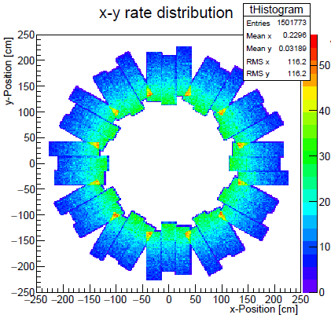
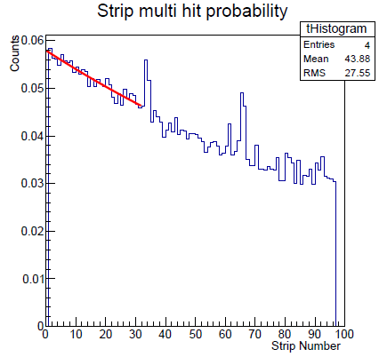
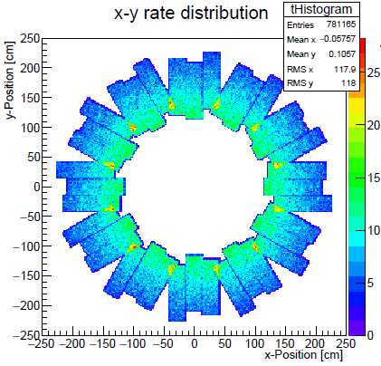
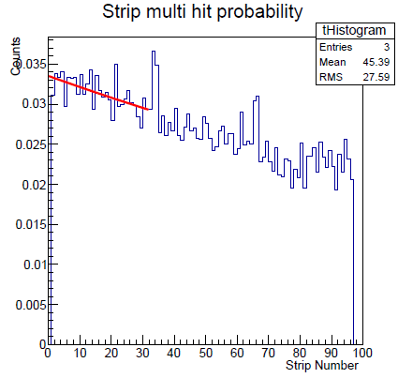
Rate and multi-hit
All particles
Beam energy 10 AGeV
Interaction rate 10kHz
(2kHz recording rate)
Fix target position 4.8 m
Particle flux < 30Hz/cm²
Multi-hit rate < 5.8 %
Beam energy 4 AGeV
Interaction rate 10kHz
(2kHz recording rate)
Fix target position 4.8 m
Particle flux < 15Hz/cm²
Multi-hit rate < 3.4 %

Slide 30
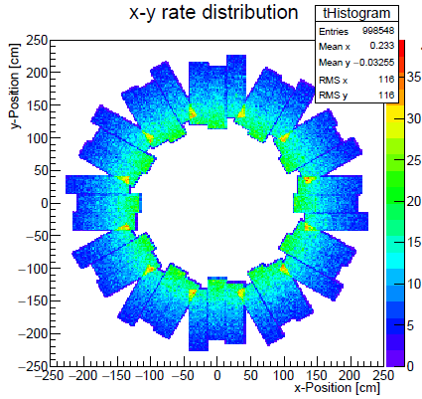
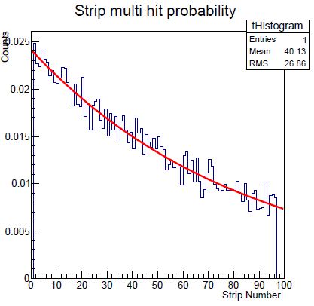
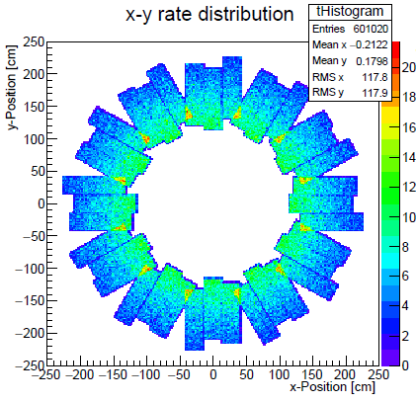
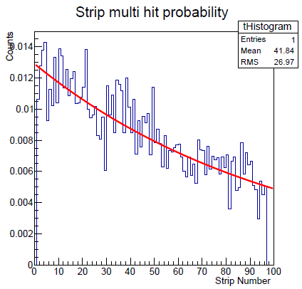
Rate and multi-hit
Primary particles
Beam energy 10 AGeV
Particle flux < 20 Hz/cm²
Multi-hit rate < 2.4 %
Beam energy 4 AGeV
Particle flux < 12 Hz/cm²
Multi-hit rate < 1.3 %

Slide 31
Summary on rate and multi-hit probability
Beam energy | 4A GeV | 10A GeV | 25A GeV
Max. rate of all particles [Hz/cm²] | 15 | 30 | 45
Max multi-hit prob. of all part. [%] | 3.4 | 5.8 | 7.4
Max rate of prim. particles [Hz/cm²] | 12 | 20 | 25
Max multi-hit prob. of prim. part [%] | 1.3 | 2.4 | 3.6

