Slide 1
Phys/PubCom session the agenda
General announcements
Physics matters: PANDA @ “phase one” (P1)
“Phase-one” document layout and procedure
Status & perspectives of benchmark highlights
Time line, assignments, and next steps towards P1 paper
Publication matters: addendum 9
Concise publication rules: status & procedure
A.O.B.

Slide 2
Announcements
Thanks to Paola and Marc for past coordination efforts
Proposed change in “charmonium” PWG
Elisa Fioravanti stepped done as convenor
“Ad-interim” solution by Marc Pelizaues and Frank Nerling
Thanks to Elisa for all her work and to Marc and Frank for helping!
Publication Committee
This CM: new elections
Thx to Albrecht, Elisabetta, Gianluigi, Klaus, Karin for their services
Second JSC held on 14/15th of November 2016

Slide 3
Joint Scientific Council (JSC) progress meeting
14-15th of November: JSC meeting at GSI
Focus on plans from phase-zero to phase-one of each FAIR pillar
Questionnaires as input (send to PhysCom)
Case presented by each pillar with closed discussion sessions
JSC in general pleased with progress of all pillars!
Next JSC 19-20th of June 2017

Slide 4
PANDA phase-zero
Already 2018++ PANDA equipment/analysis tools will be used for physics
Straw Trackers at HADES Excited Hyperon Transition Formfactors Cracow, Juelich, Orsay, Uppsala, +TRK
Backward PWO Calorimeter at MAMI Magnetic Moment of the Δ(1232), e-μ universality, multi π⁰ prod. Mainz Uni and HIM, +EMC
Develop/apply PWA tools at e.g. Jlab, BES-III Meson spectroscopy with (non)exotic quantum numbers Bochum, GSI, Mainz +PhysAna
Aspect strongly emphasized by JSC!!!

Slide 5
Physics perspectives with PANDA at “phase one” (P1)
towards a comprehensive
highlight & feasibility document

Slide 6
Why now a P1 physics paper?
Convey strong message to the outside: alive and excellent program at “day one”
Follow-up of physics performance booklet
Sharpen and prioritize our “day-one" goals
Stimulus for internal activities

Slide 7
 | 2016 | 2017 | 2018 | 2019 | 2020 | 2021 | 2022 | 2023 | 2024 | 2025 | 2026+
PANDA Phase 0
PANDA Start Setup
PANDA Phase 1
PANDA Full Setup
PANDA Phase 2
PANDA Phase 3 RESR
Pre-Commissioning & First Physics
Design
Construction
Installation
Commissioning
PANDA Hall available
Physics
Design
Construction
Installation
Physics

Slide 8
 | 2016 | 2017 | 2018 | 2019 | 2020 | 2021 | 2022 | 2023 | 2024 | 2025 | 2026+
PANDA Phase 0
PANDA Start Setup
PANDA Phase 1
PANDA Full Setup
PANDA Phase 2
PANDA Phase 3 RESR
Pre-Commissioning & First Physics
Design
Construction
Installation
Commissioning
PANDA Hall available
Physics
Phase-one physics document
Design
Construction
Installation
Physics
Phase-two physics document??
Phase-three physics document??

Slide 9
Spirit of P1 paper
“physics-driven setup”, not “setup-driven physics”
Sell program as as a whole, not as a stamp collection
Emphasis on the impact of our physics program
Detailed feasibility studies of few flagships, e.g. focus on quality and less on quantity
Bottom-up approach

Slide 10
Proposed outline of P1 paper
“Perspectives for the first period of data taking with PANDA”
Introduction and motivation
The antiproton facility at “phase one”
Physics potential of PANDA at “phase one”
Summary and long-term perspectives

Slide 11
1. Introduction and motivation
Underlying physics questions addressed by PANDA
Todays’ state-of-the-art: theory and experiment
Opportunities using antiprotons
Complementarity and competiveness
Staging of PANDA program, motivation “phase one”

Slide 12
2. The antiproton facility at P1
Foreseen setup of FAIR/HESR/PANDA at phase one
Forward tracker behind the dipole?
Exceptions in definitions for simulations?
Role of phase-zero in document?
Physics generators and simulation, reconstruction, and analysis tools
Partial-wave analysis tools?
Production of background data? Coordinated effort?

Slide 13
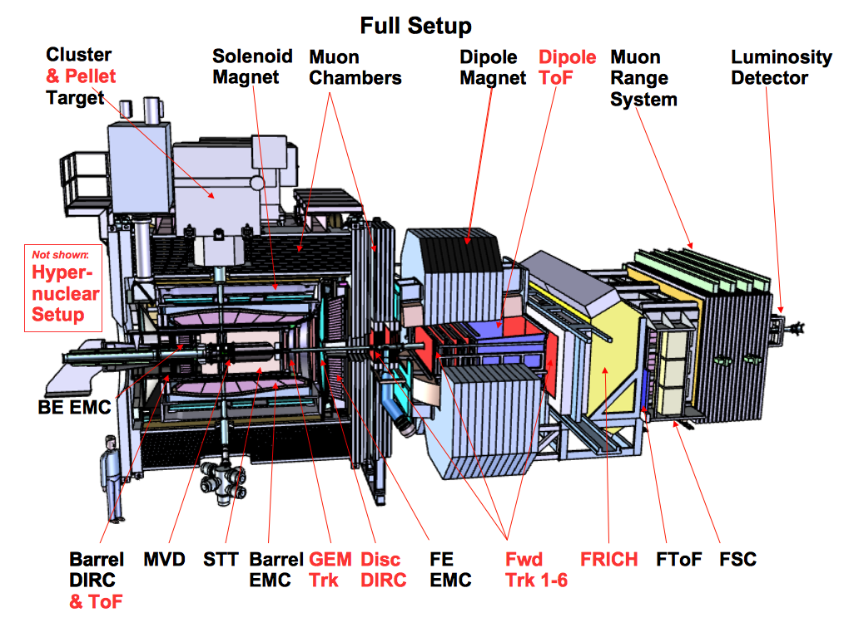
2. The antiproton facility at P2
GEM
& TOF

Slide 14
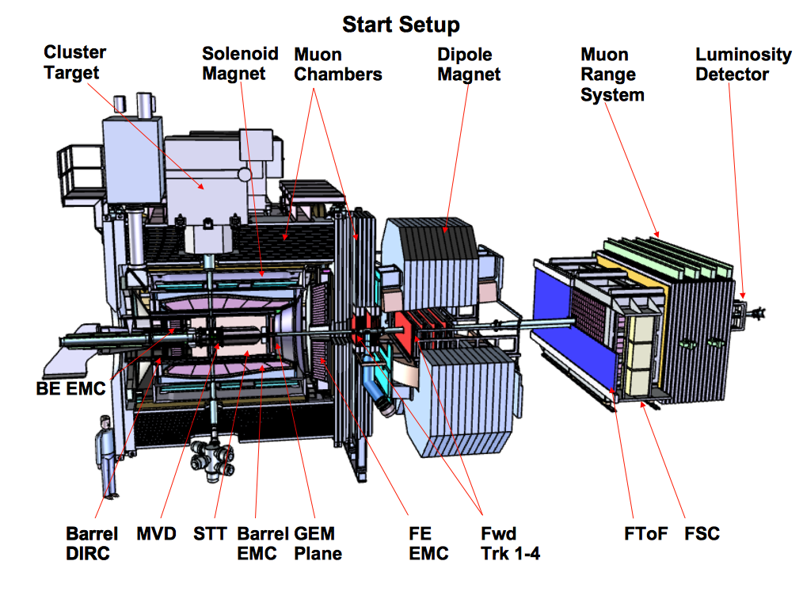
2. The antiproton facility at P1
& TOF

Slide 15
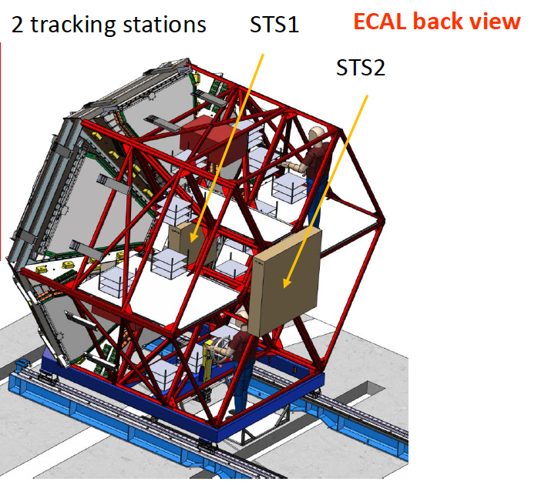
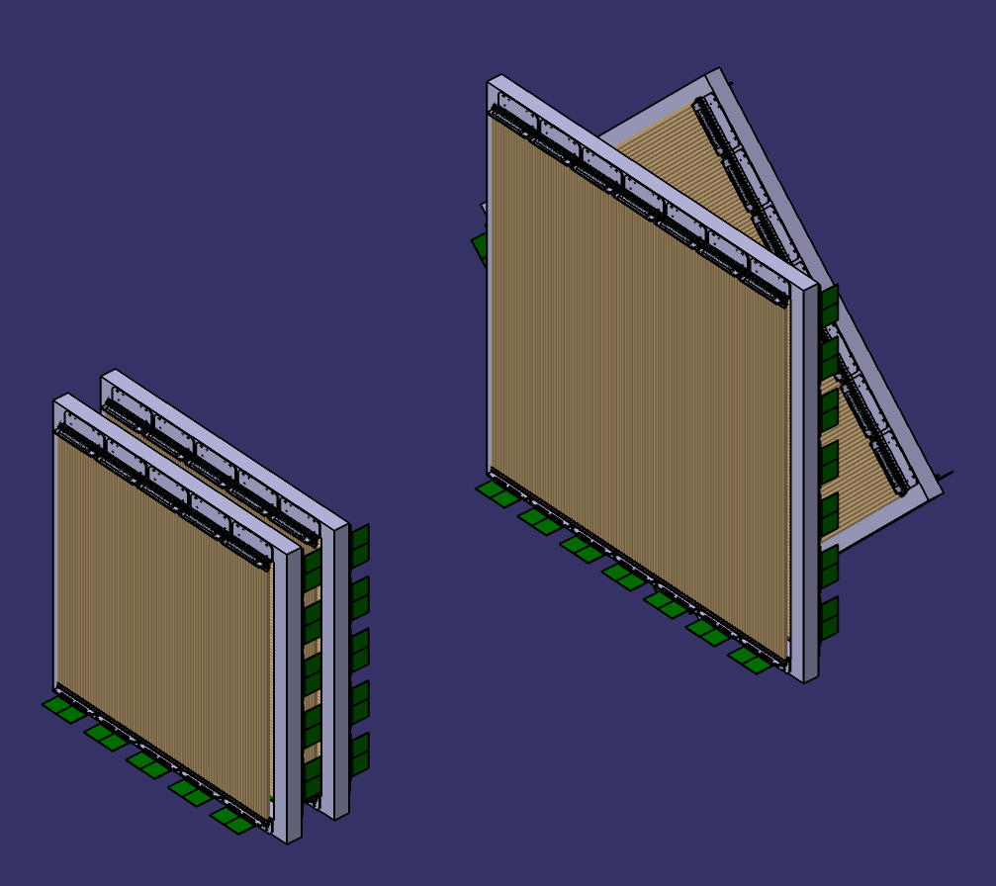
2. The antiproton facility at P1
p p(A) →Y (any hyperon) X →Λe+e- X
PANDA pre-series and prototype detectors for STS1/2
HADES measures the dileptons & mesons
PANDA Straw Trackers for the baryon (Θ<7˚) STS1: 640 tubes (use later as FT3/4) STS2: 900 tubes (use later as FT5/6) (4 double layers each)
76 cm
Special tracking session on Tuesday at 16:30

Slide 16
3. Physics potential of PANDA at P1
Physics goals and foreseen impact of P1 program
What do we want to achieve at P1?
What will be the impact in our understanding of QCD or in technology?
Selected flagships at “phase one”
Feasibility studies via comprehensive MC simulations
Heart of the paper, discussion today!

Slide 17
High profile P1 projects?
strangeness d.o.f.
Hyperon structure: spectroscopy and Dalitz decays
Hyperon production observables: xsecs, spin, …
charm d.o.f.
Charmonium-like spectroscopy…
…X(3872) line shape and decays
…Charged Z-states spectroscopy
… Open-charm production??
light-quark systems
Nucleon structure: EMFF in time-like regime
Form factors in unphysical regime via pi⁰ production?
Light-meson spectroscopy: glueballs, etc.??? Requires PWA!

Slide 18
4. Summary and long-term perspectives
Connection P1 to long-term PANDA program (P2 and P3)
Hyperon structure and dynamics →|S|=3 hyperons, hypernuclei, hyperfine splitting in |S|=3 atom, hyperon CP tests, charm hyperons, …
Charm structure and dynamics → charmonium-like high spin states, open-charm spectroscopy/weak sector, charmonium-nucleon interaction, …
Nucleon EMFFs at low q² → high q² EMFFs, TMDs, GPDs, TDAs, …
…
Overall impact of PANDA physics program

Slide 19
The “writing” process
Bottom-up approach
Role of physics convenors:
leading the drafting of document
cross-refereeing
Role of TAG:
advisory and refereeing
Simulations:
Settle on PandaRoot release
MC production: where, how much, coordinated?
Regular (monthly) meetings: eZuce, face-to-face at CMs

Slide 20
Addendum 9 update on procedure
Request from CB for a concise PubRule
Editorial committee (EC): Albrecht, Elisabetta, Karin, and Mamen: many thanks for your valuable input and excellent work!!
10th of October: first draft of EC to PubCom, revised draft on 20th of October, request by PC for submission to CB (cc to PhysCom)
31th of October: submission to chair of CB, internal note on forum for CB members posted on 11th of November
Comments received so-far from GSI group, update by PC
This CB meeting: notifying and request for further comments
March ’17: formal vote during CB on concise PubRule

