Slide 1

Tune measurements at SIS-18
Thanks to EUCard X-Ring for funding!
Rahul Singh
Beam Instrumentation
GSI

Slide 2
Outline
Introduction -> Beam signals
Schottky monitor
Network Analyzer -> Beam transfer function -> PLL
Broadband oversampling ADC system -> TOPOS
Diode based peak detector/ AM demodulator -> BBQ
Comparison and summary

Slide 3
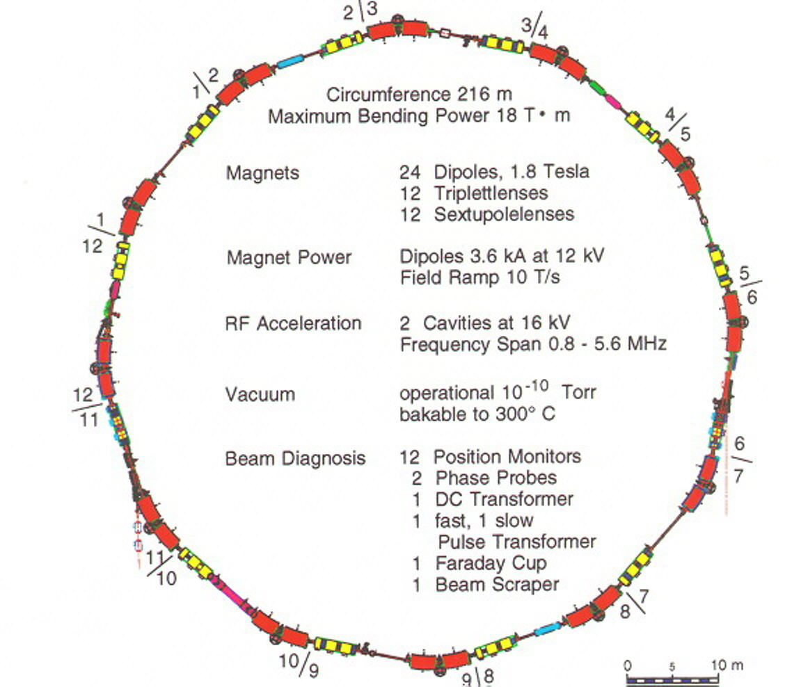
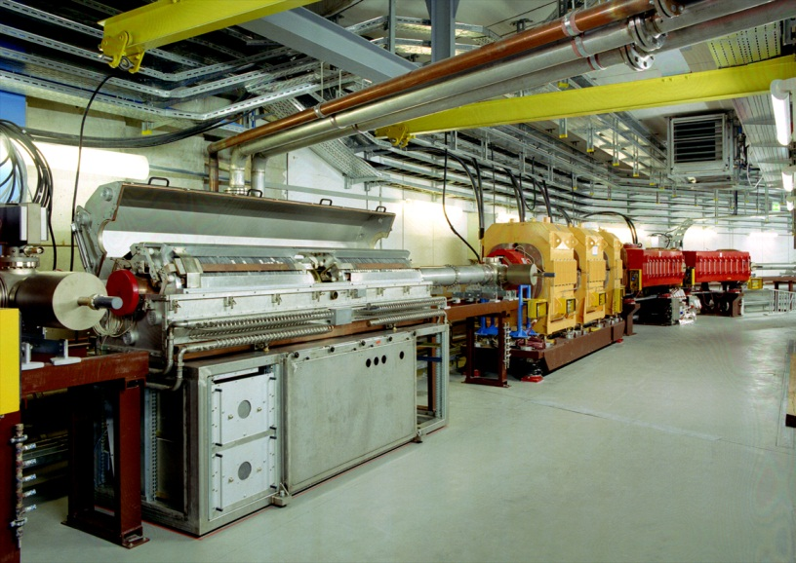
GSI Heavy Ion Synchrotron SIS-18 (Bρ=18 Tm): Overview
Dipole, quadrupole,
rf cavity 0.8 < f < 5 MHz
acceleration
acceleration
Important parameters of SIS18
Important parameters of SIS-18
Ion range (Z) | 1 → 92 (p to U)
Circumference | 216 m
Injection type | Horizontal multi-turn
Energy range | 11 MeV/u → 2 GeV/u
Ramp duration | 0.1 → 1.5 s
Acc. RF | 0.8 → 5 MHz
Harmonic | 4 (= # bunches)
Bunching factor | 0.4 → 0.08
Tune h/v | 4.17-4.3 / 3.27
Trans. size σ_{h} / σ_{v} | ≈ 10 / 5 mm injection
injec-
tion
injec-
tion
extrac-
tion
extrac-
tion
Upcoming FAIR:
SIS18 used as booster
high intensities up to ‘space charge limit’
precise control of beam parameter for emittance conservation & low losses
electron cooling
acceleration
BPMs: 12 regular + 5 for special purpose
+ stripline exciter

Slide 4
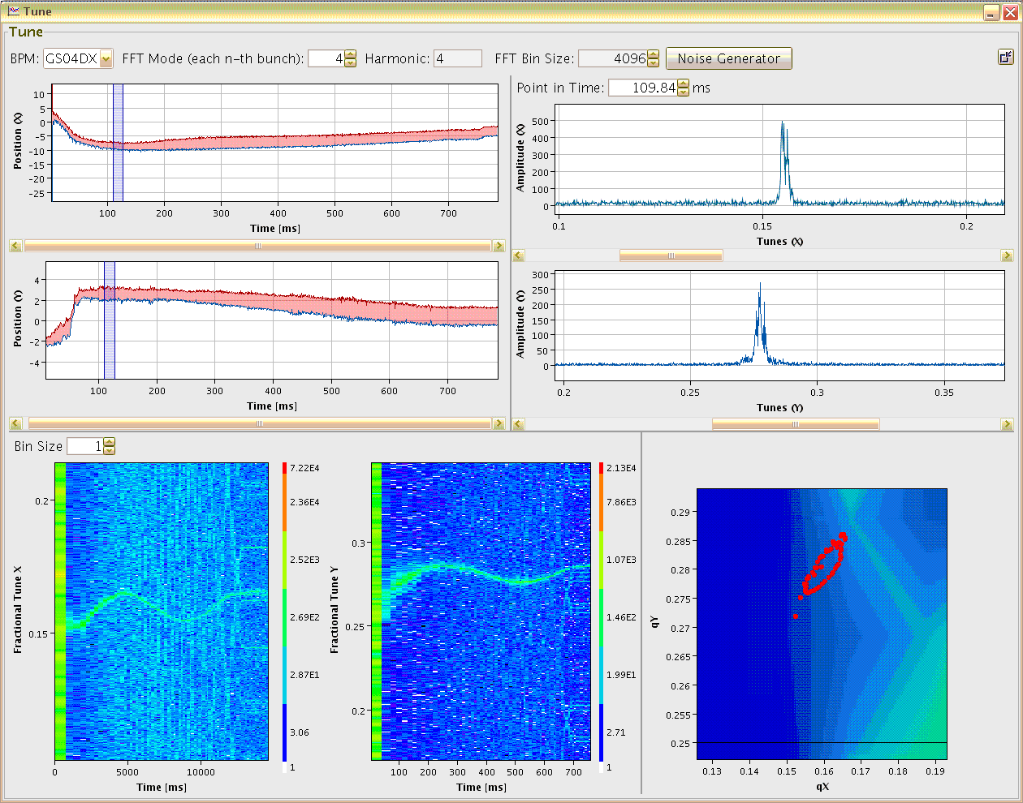
Tune determination at SIS18: Online display in control room
5 mm
Online display for
tune measurement
during acceleration
Excitation with
band-limited noise
Time resolution:
4096 turns ≈ 20 – 4.5 ms
Variation during ramp:
triplett to duplett focusing
Result:
Online display for user
Sufficient signal strength
with moderate excitation
Minor emittance growth
Maximum Position Variation
Tune at fixed time
0.05
5 mm
horizontal
horizontal
0
200
time [ms]
500
700
2 mm
horizontal tune
0.05
2 mm
vertical
vertical
0
200
time [ms]
500
700
vertical tune
Tune versus time
Working Diagram
horizontal
vertical
vert. Q_{y}
hori. frac. tune Q_{x}
vert. frac. tune Q_{y}
δ Q_{x} ≈ 0.015
δ Q_{y} ≈ 0.020
Beam parameter:
10¹⁰ Ar¹⁸⁺ , 11 → 300 MeV/u
within 0.7 s
tune variation by
imperfect focusing ramp
Position of maximum in spectrum
hori. Q_{x}
time [ms]
time [ms]
P. Kowina et al., Proc. BIW’10; R. Haseitl et al., Proc. DIPAC’11, G. Jansa et al., Proc. ICALEPCS’09

Slide 5
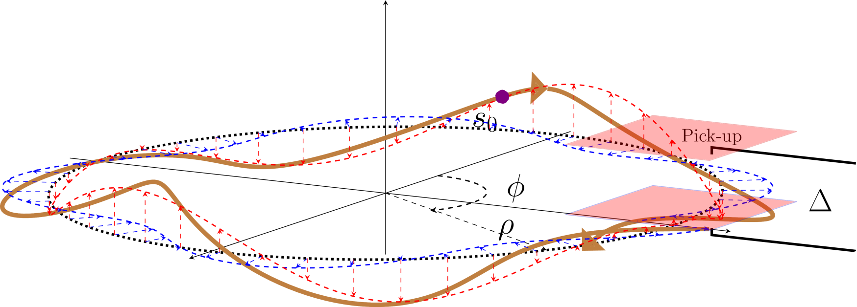

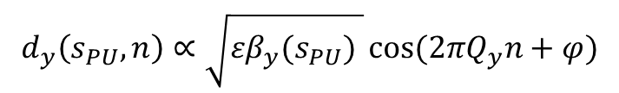
Betatron Tune
QF
QD
QF
QD
The oscillations at the pick-up on every $n^{th}$ turn
Periodic focusing and defocusing due to magnetic lenses lead to transverse oscillations
Number of transverse oscillations per turn is called tune
$$d_{y}\left(s_{PU},n\right)∝\sqrt{εβ_{y}(s_{PU}) }\cos{(2πQ_{y}n+φ})$$
$ε=$ emittance, $d_{y}\left(s_{PU}\right)=$ dipole moment,
$β_{y}=$lattice beta function

Slide 6
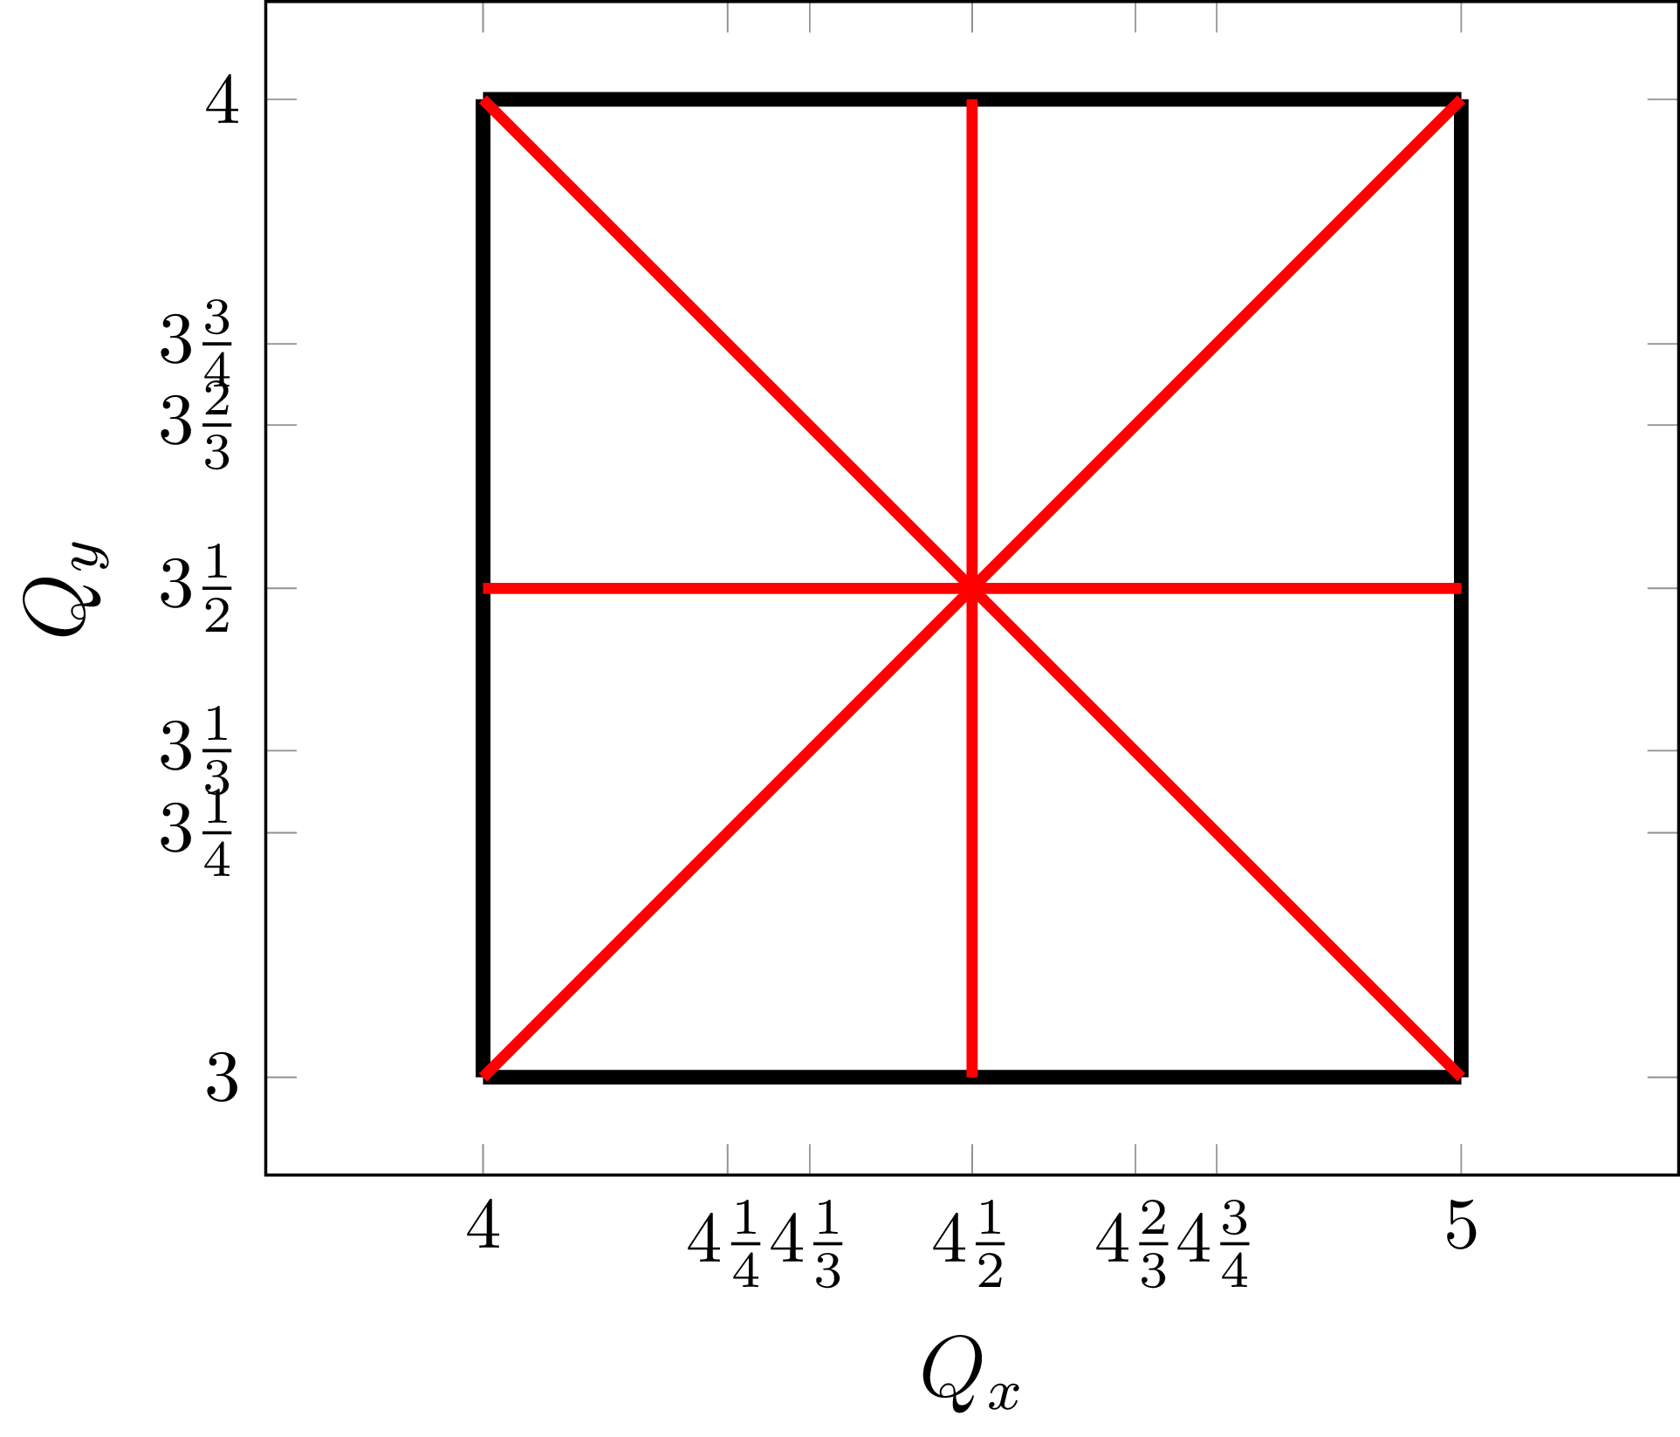
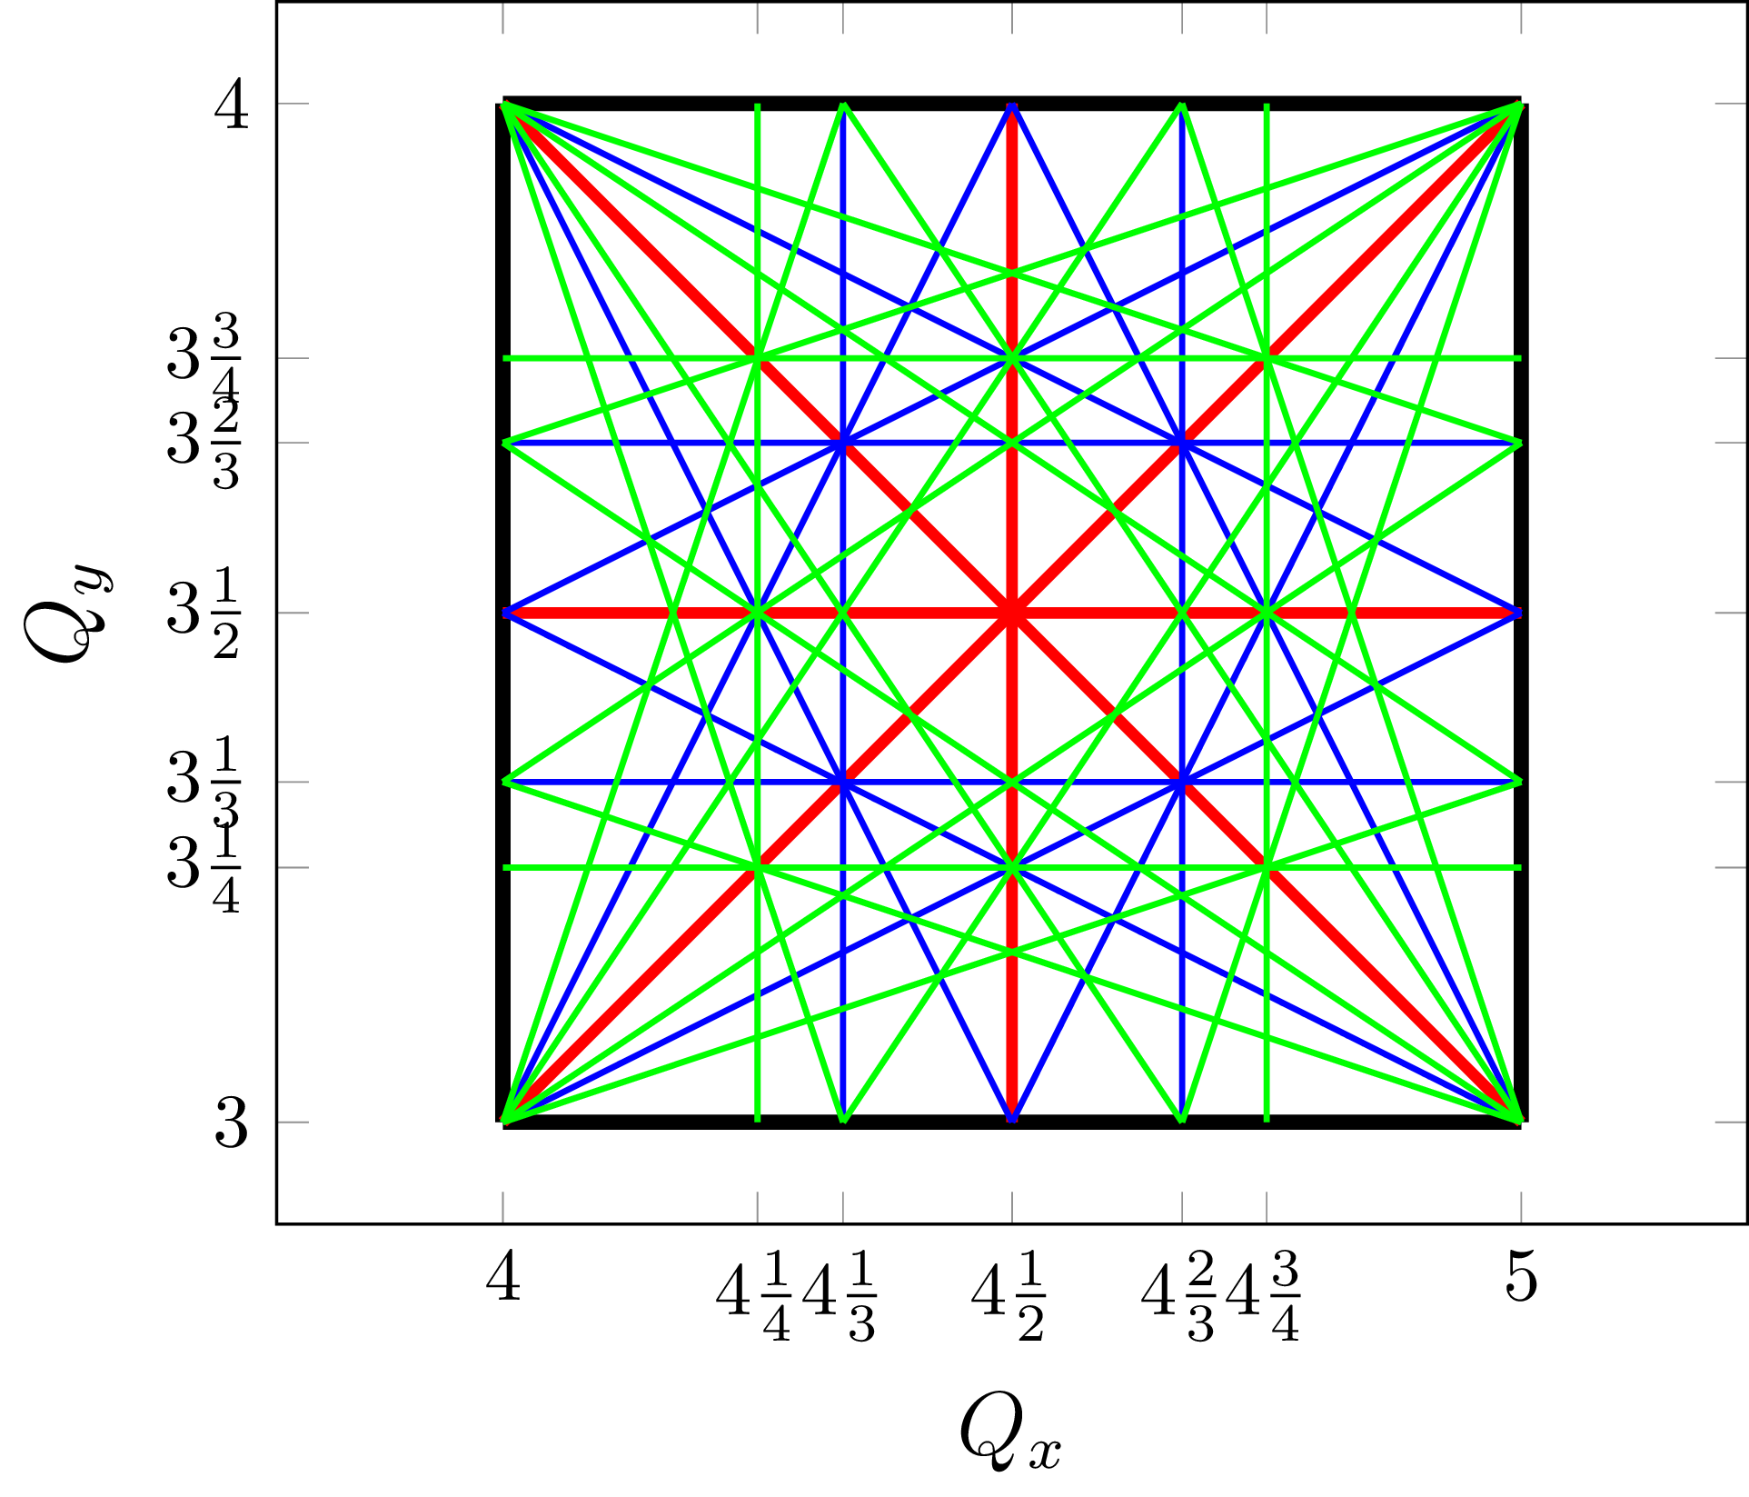
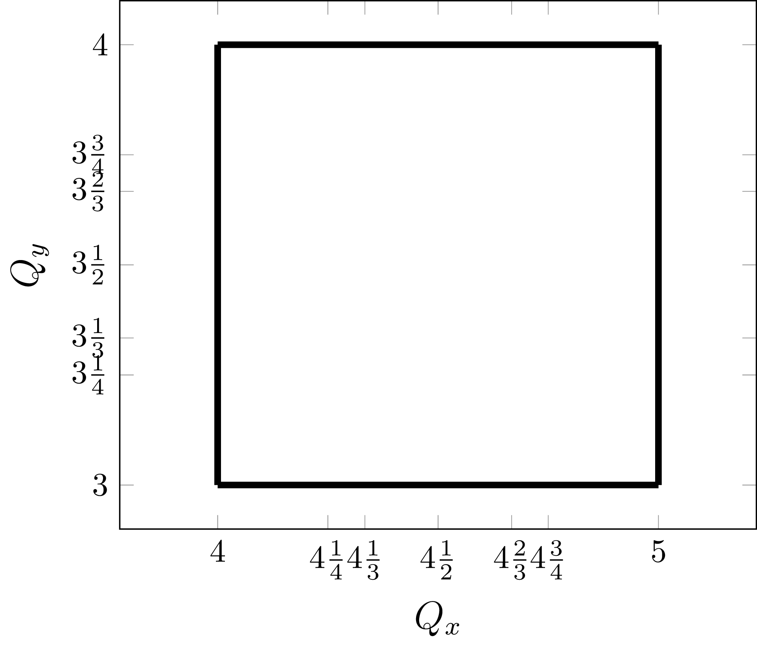
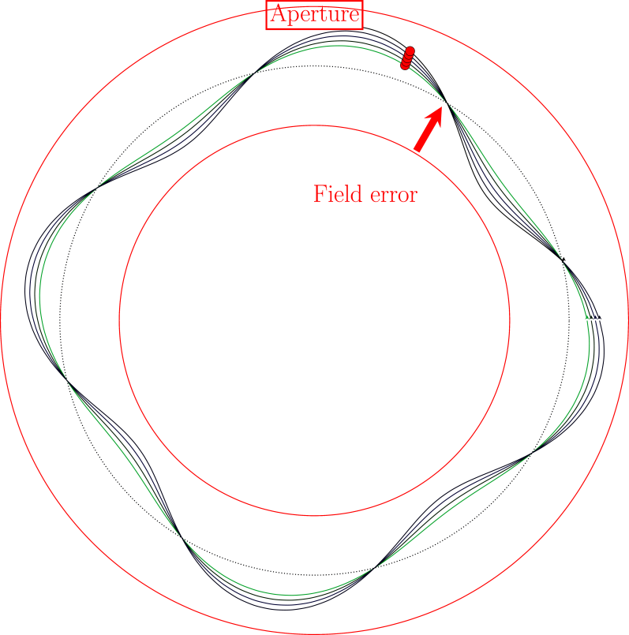
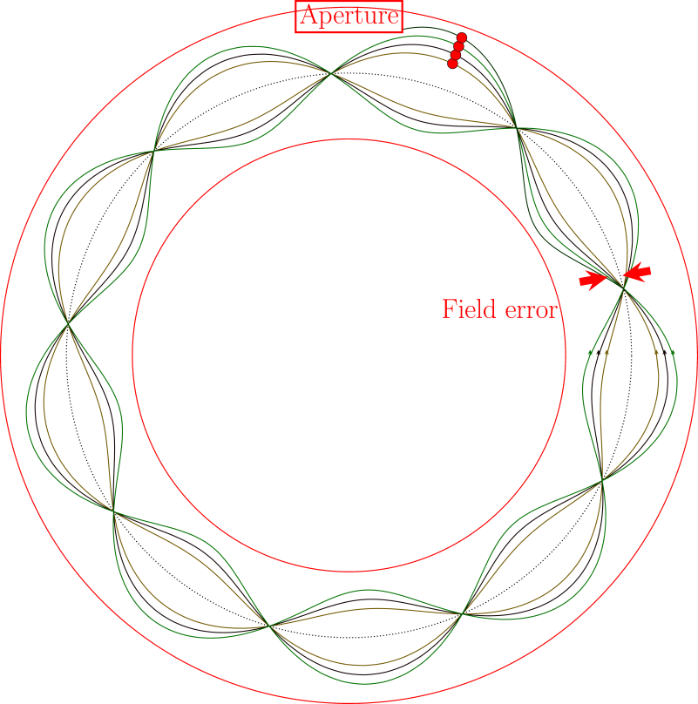


Resonances, coupling and chromaticity
Structural resonances
Magnet errors drive the resonances, therefore some tune values (bands) are forbidden
Coupling between the planes
The magnets have tilts with respect to axis of reference, cause coupling between the planes
Chromaticity
Different focusing for different energies
$$\frac{ΔQ_{ }}{Q_{0}}=ξ_{ }\frac{∆p}{p_{0}}$$
Working point
$$lQ_{x}{+mQ}_{y}=p$$
$where \left|l\right|+\left|m\right|$ is the order of resonance
Notes:
All particles undergo betatron motion,
Betatron oscillations must not superimpose in-phase on themselves after few revolution periods.
In-phase superposition of betatron oscillations leads to a resonant amplitude build-up.
Real life is more complex than that:
two motion planes, horizontal and vertical;
coupling between the planes;
oscillation amplitude in each plane changes from one location to another according to a function (so called β-function);
betatron motion with larger amplitudes is nonlinear.
What are the restrictions? Certain betatron tune values and thus certain magnet focussing configurations are forbidden. For example, If the particle returns exactly to the same position in same phase, any small disturbance (dipole power supply) will immediately throw the beam out of pipe in few turns. Cant work with these values. Similarly, for half integers, quadrupoles creates problems, and the stop band proportional to the field erros. one third integers, the strength of these resonances depend on the nature of errors in the lattice.
We can plot this on the so called resonance diagram together for both planes. The tune in both planes define the “working point”

Slide 7
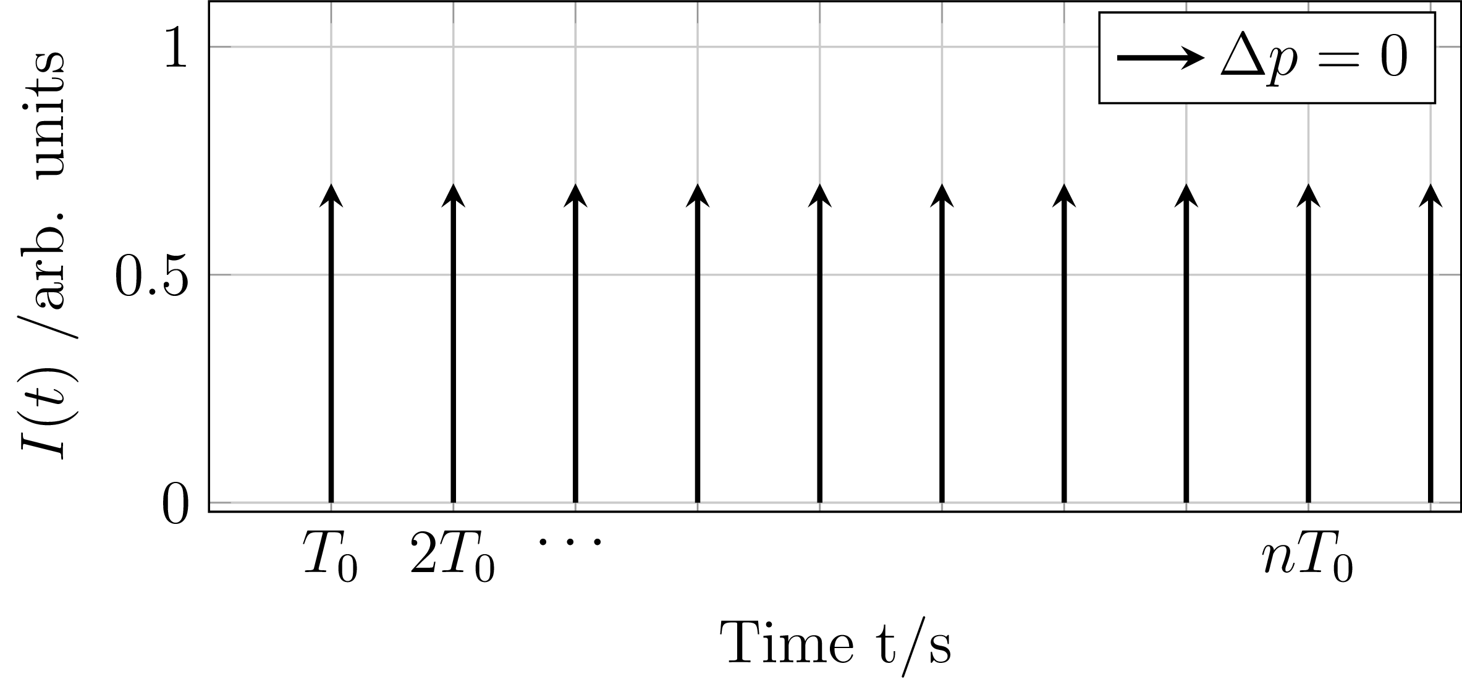
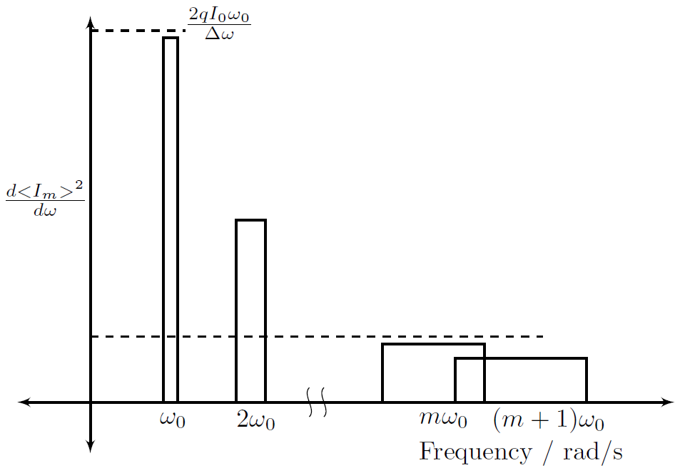
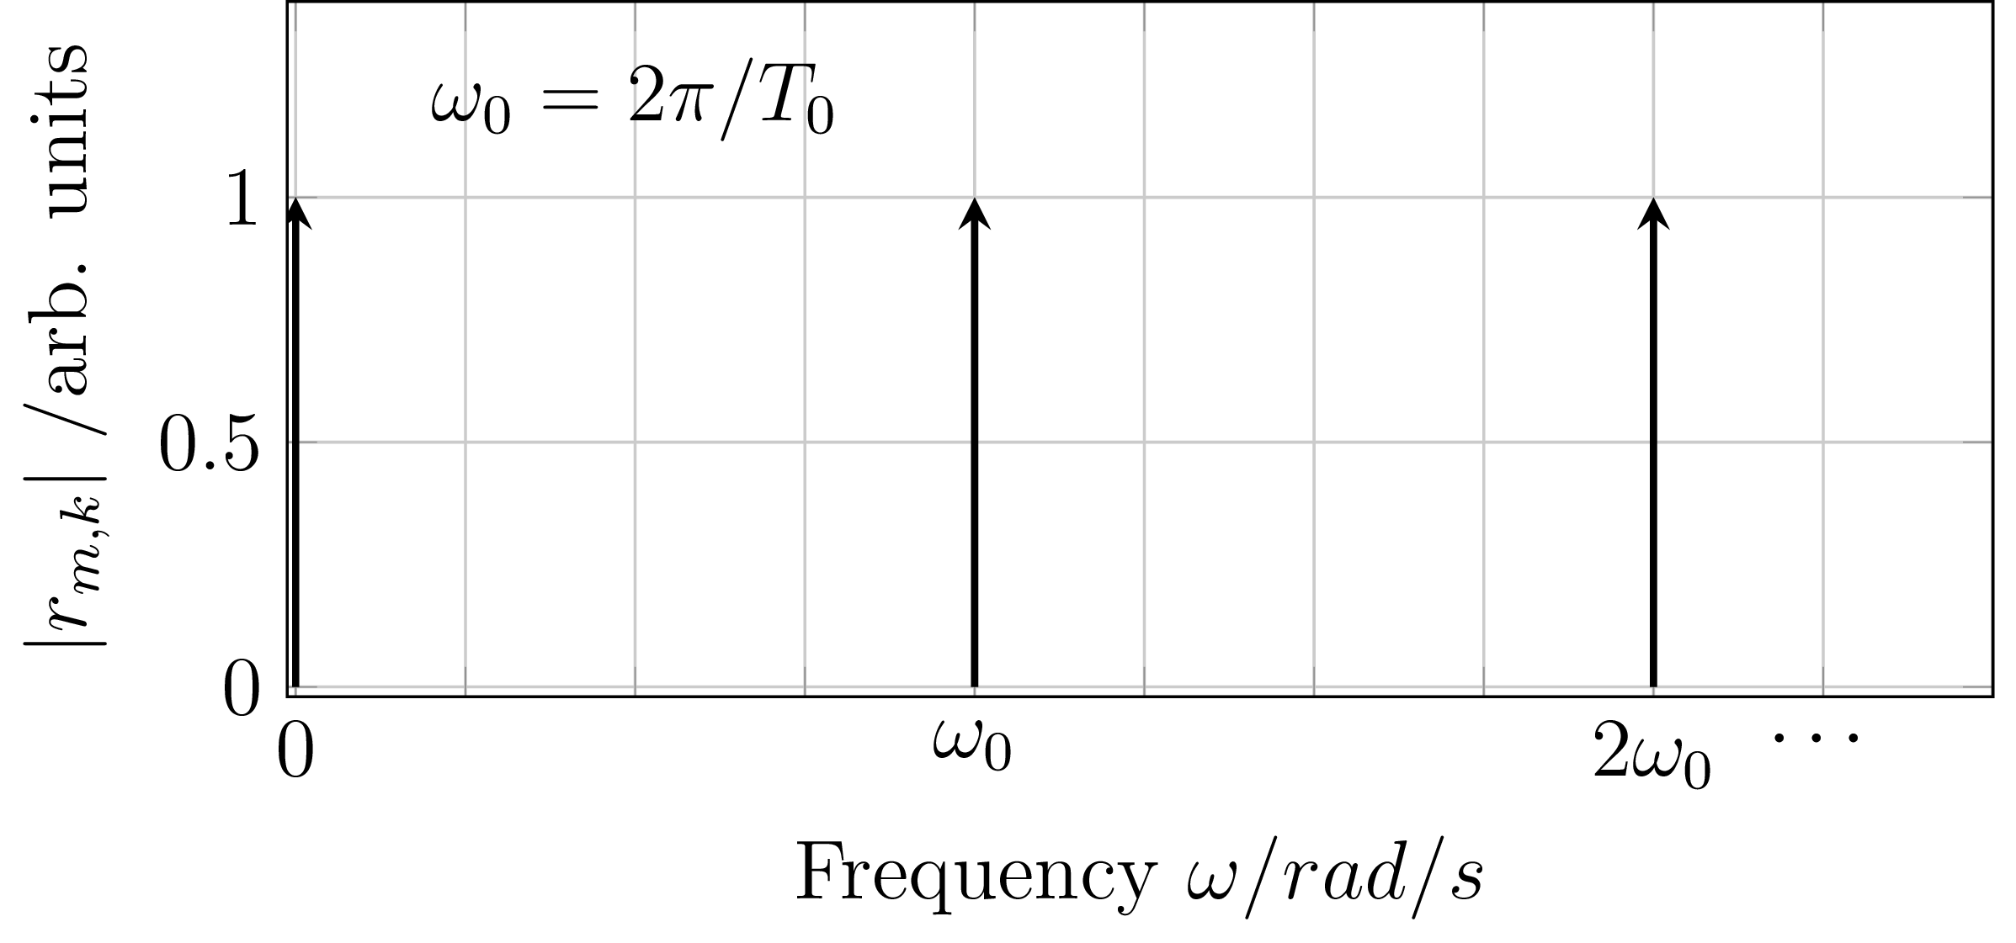


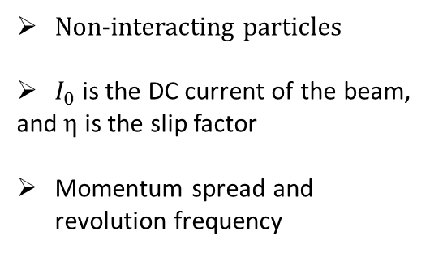







Longitudinal beam spectrum: Coasting beam
$$∆p≠0$$
$$Σ$$
$$∆p=0$$
$I\left(t\right)∝δ(t−{nT}_{0})$
$$∆p≠0$$
$I\left(t\right)∝δ(t−{n(T}_{0}+∆T))$
Area same under each band
Non-interacting particles
$I_{0}$ is the DC current of the beam,
and $η$ is the slip factor
Momentum spread and revolution frequency
$$At m∆ω>ω_{0}$$
Shot noise: $2qI_{0}$
$$\frac{Δp}{p_{0}}=\frac{∆ω}{{m\left|η\right|ω}_{0}}$$

Slide 8
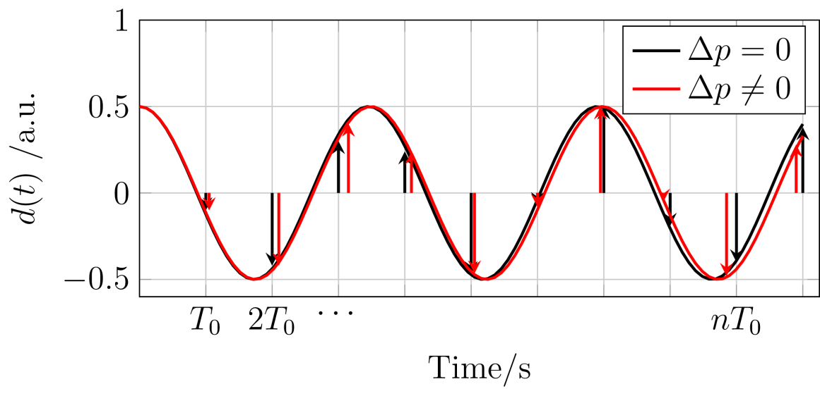
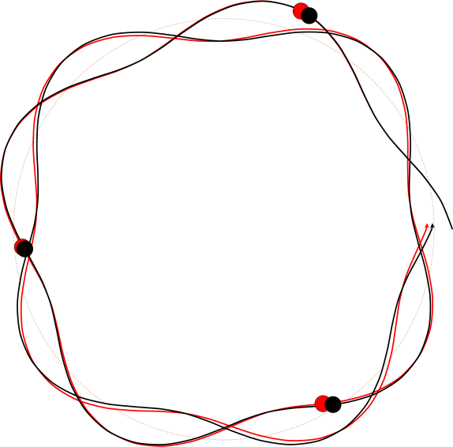
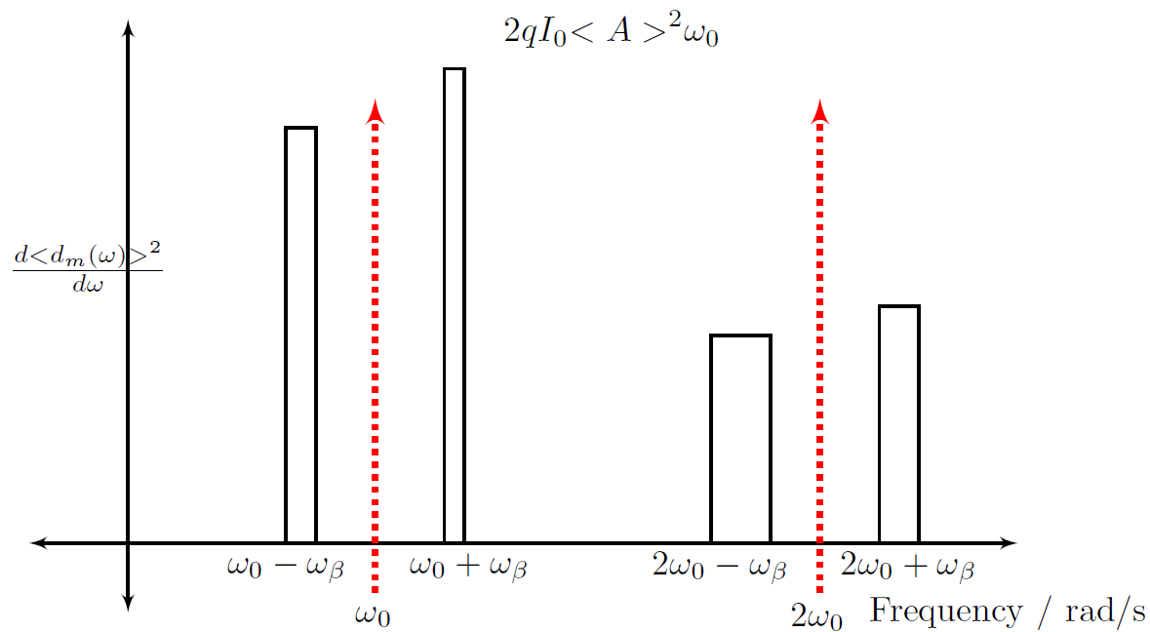


Transverse beam spectrum: Coasting beam
$$Δ$$
$$d_{ }\left(t\right)∝ x_{ }\left(t\right){∙I}_{ }\left(t\right)$$
Simple AM modulation of the longitudinal spectrum
The difference in width of sidebands provide chromaticity
The ratio of powers in longitudinal and transverse spectra can provide beam width

Slide 9
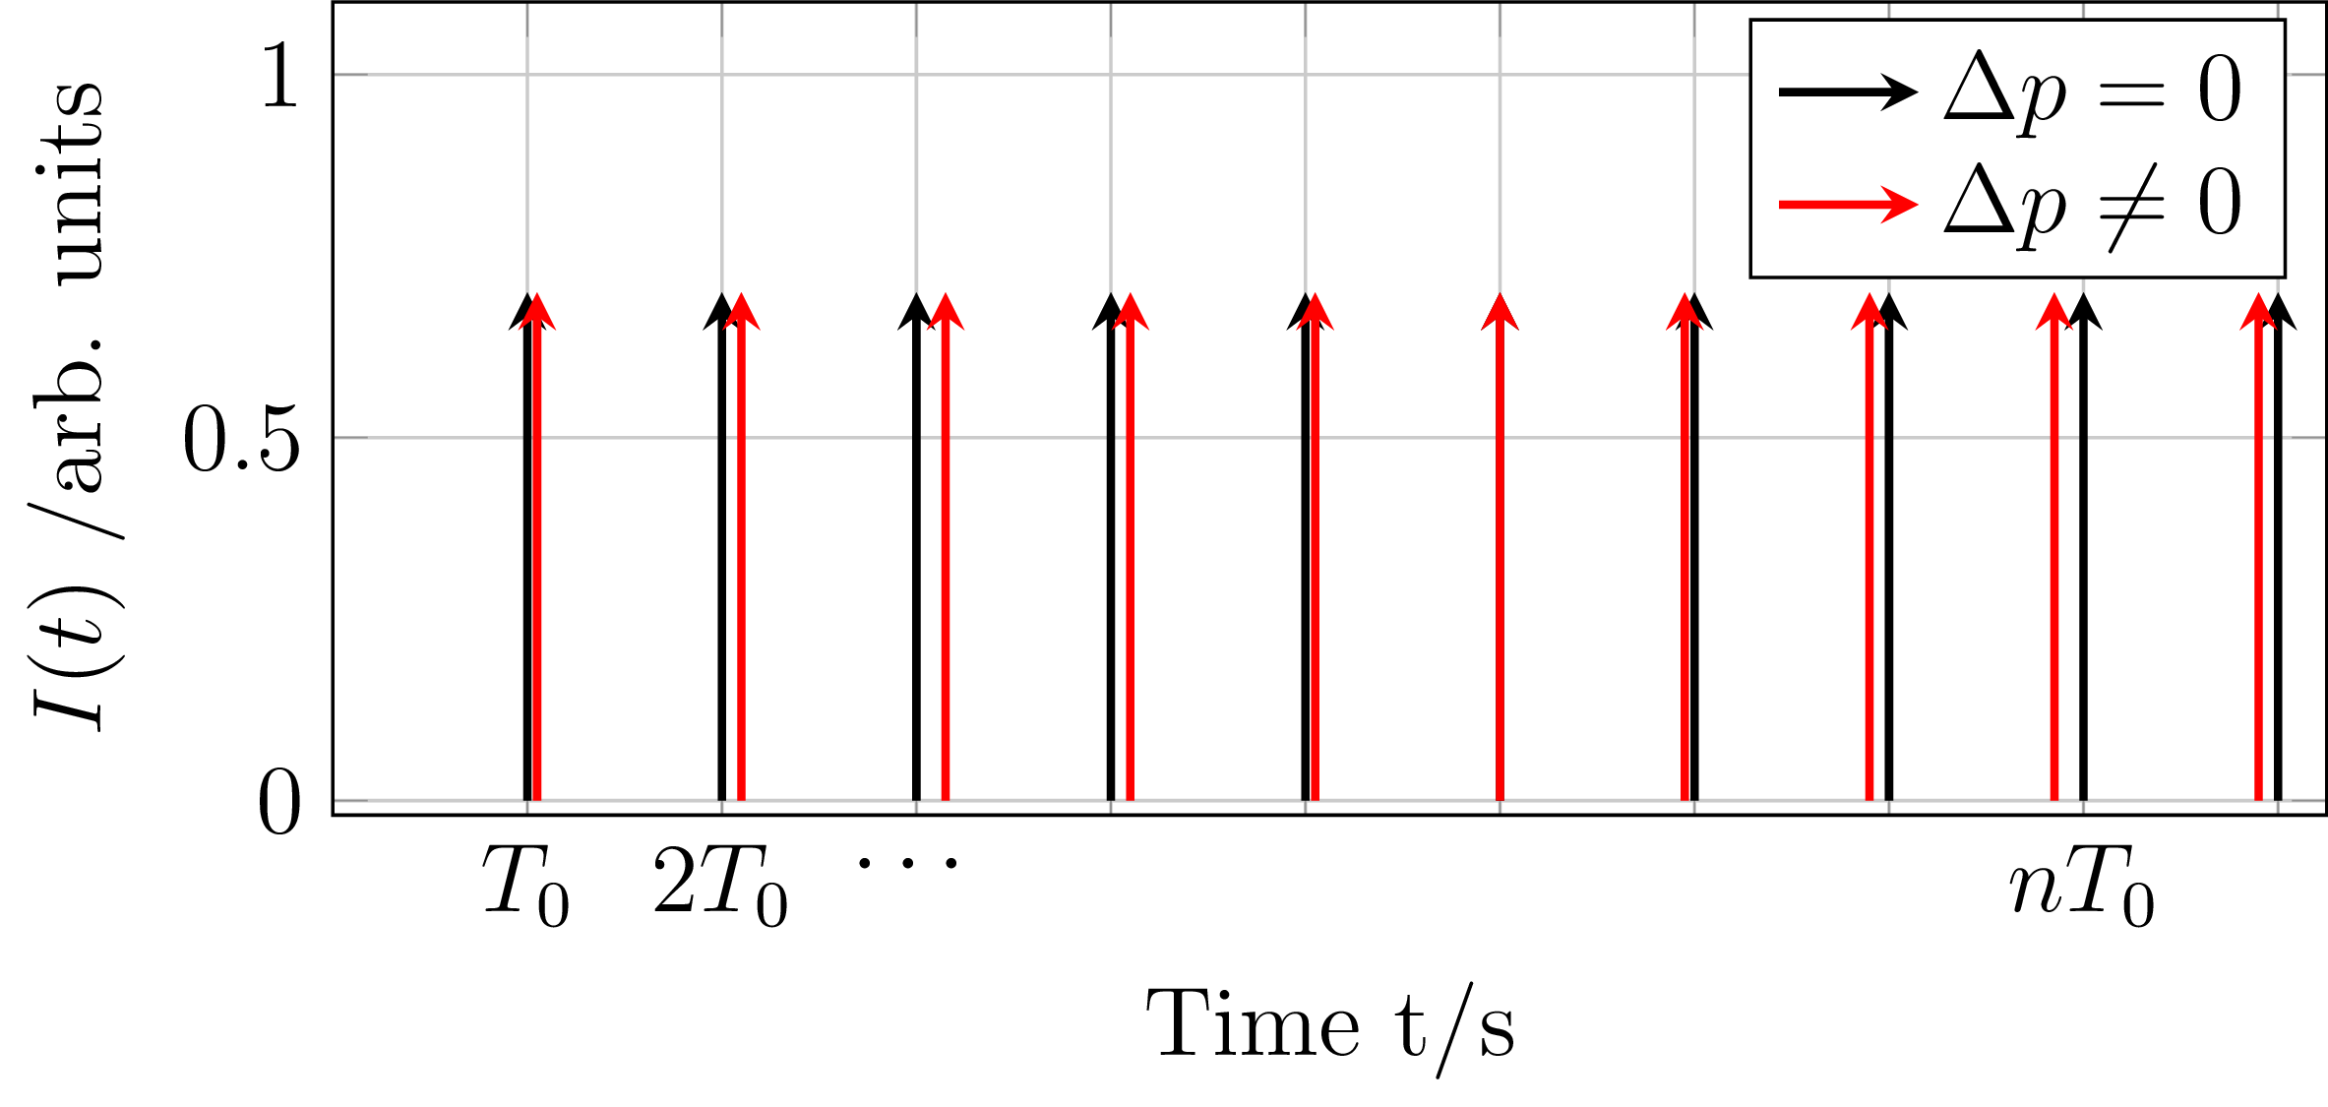
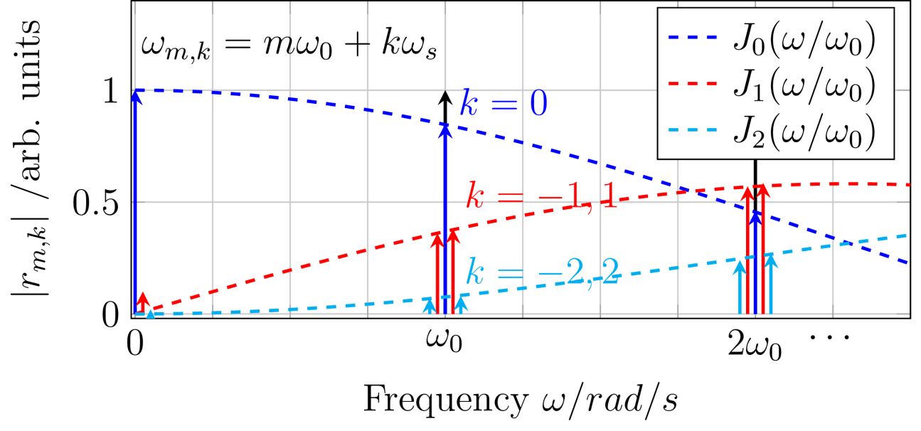








Longitudinal beam spectrum: Bunched beam
$$Σ$$
$I\left(t\right)∝δ(t−{nT}_{0})$
$I\left(t\right)∝δ(t−{nT}_{0}−θ_{ }\left(t\right))$
${θ_{m}}_{ }∝\frac{Δp}{p_{0}}$
$$θ_{ }\left(t\right)={θ_{m}}_{ }\sin{(ω_{s}t + φ_{ })}$$
Frequency modulation with index $h=(mηω_{0}\frac{Δp}{p_{0}})/ω_{s}$
Synchrotron frequency
Frequency
$$ω_{m,k}^{}=mω_{0}+kω_{s}$$
Bessel‘s
function
Amplitude
$r_{m,k}^{}=qω_{0}{ J}_{k}(mθ_{m}$)
Phase
$$α_{m,k}^{}=−kφ$$
Width of synchrotron sidebands given by synchrotron frequency spread!

Slide 10
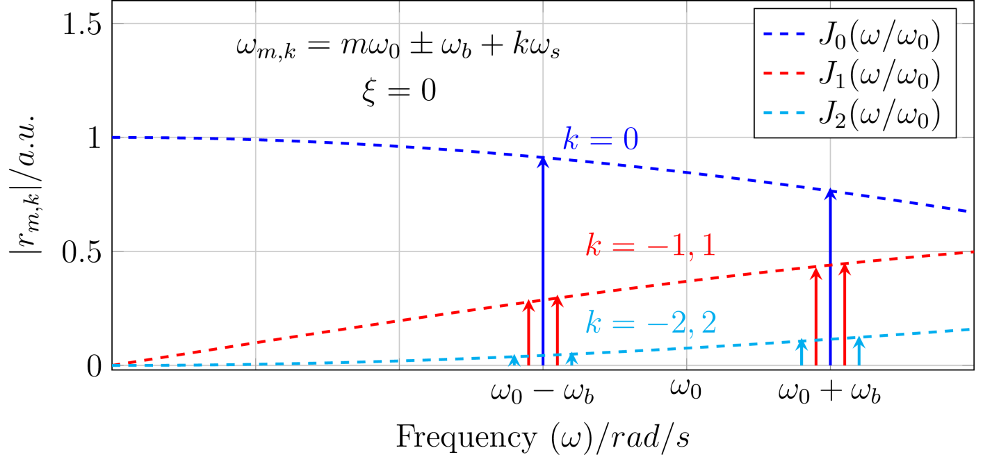
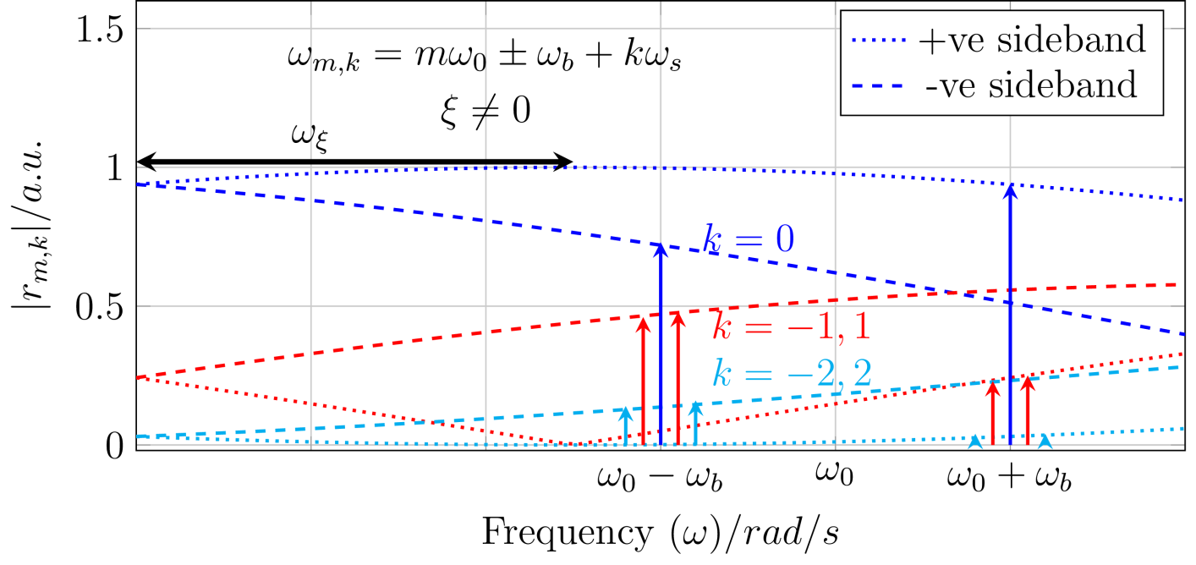




Transverse beam spectrum: Bunched beam
Dipole moment d(t) comprises betatron = amplitude x(t) & synchrotron = frequency I(t) modulation
$$Δ$$
$$d_{ }\left(t\right)∝ x_{ }\left(t\right){∙I}_{ }\left(t\right)$$
Frequency of harmonics m & mode k
Sideband amplitude given by
Bessel-function ${ J}_{k}$ of order k
Envelope shifted!
$$ω_{ξ}={\frac{ξ}{η}Q_{0}ω_{0}}_{ }$$
ω_{b} betatron freq, ω₀ rev. freq, and a bunch length,
Finite chromaticity ξ modifies sideband’s heights !

Slide 11
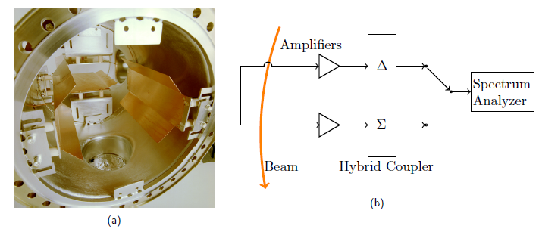
Schottky signal monitor
Schottky@ESR - > SIS ones are 70 cm long
50 Ohm terminating impedance to avoid impedance mismatch and reflections -> Higher low pass cut off ~ 20 MHz
Sum signal used for longitudinal diagnostics, momentum spread, synchrotron frequency spread etc.
Difference signal used for tune and chromaticity

Slide 12
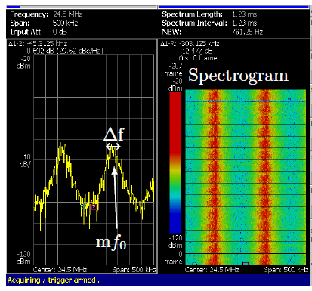
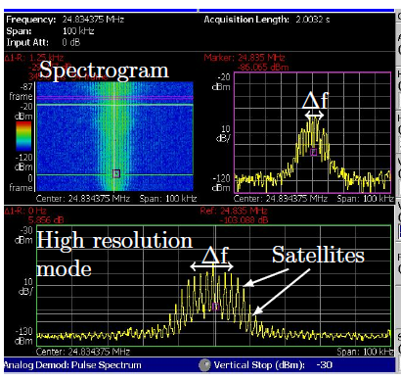
Longitudinal Schottky spectrum
Coasting Beam Spectrum
Bunched Beam Spectrum
A realtime spectrum analyser with 14-bit ADC used for the measurements
Does the envelope of bunched beam spectrum correspond to beam momentum spread?

Slide 13
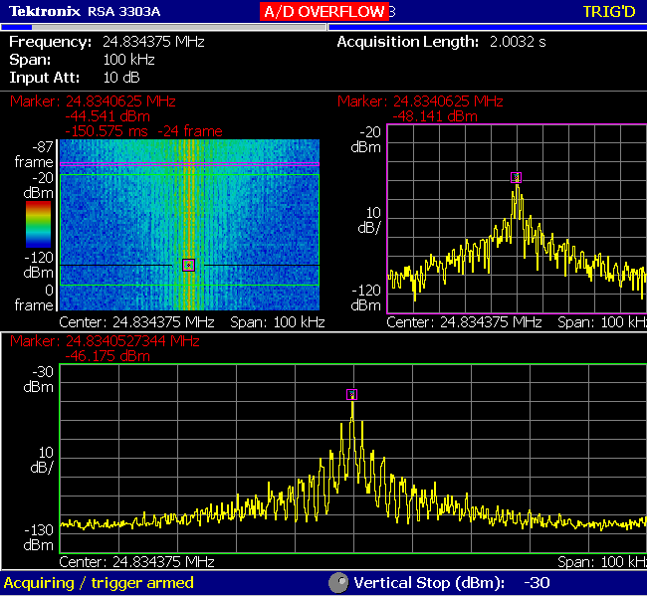
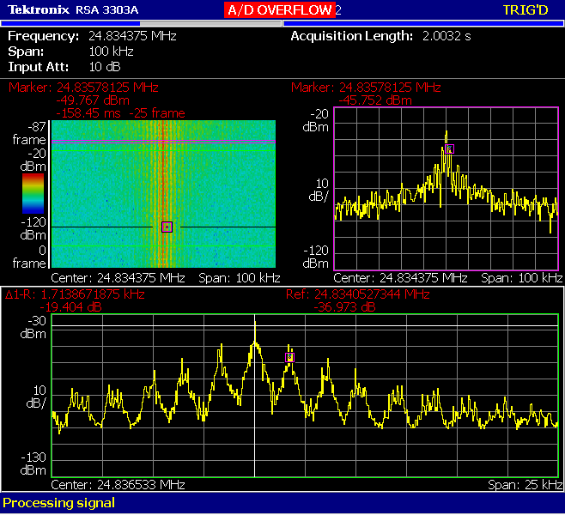
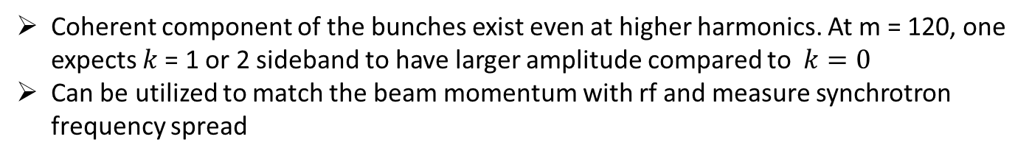

Longitudinal Schottky spectrum
Coherent
peak
$$k∆ω_{s}$$
Coherent component of the bunches exist even at higher harmonics. At m = 120, one expects $k$= 1 or 2 sideband to have larger amplitude compared to $k=0$
Can be utilized to match the beam momentum with rf and measure synchrotron frequency spread

Slide 14
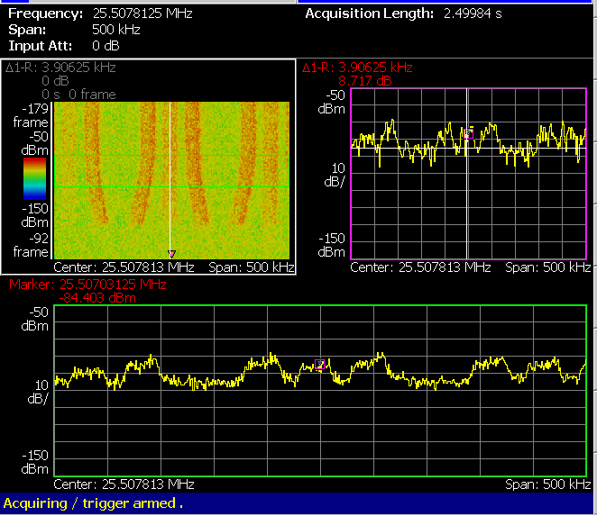
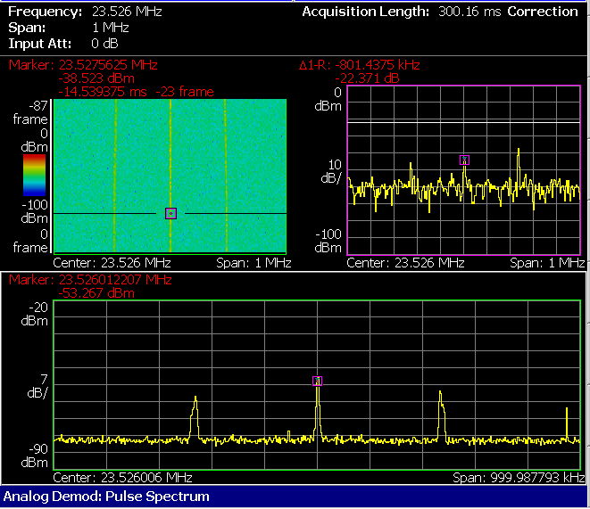
Transverse Schottky spectrum : Coasting beam
Injection
Extraction Flat-top
For coasting beams: Tune and chromaticity are regularly derived from transverse Schottky spectra
Transverse Schottky difficult to interpret at high space charge and signal often too low at lower intensities (Ref: Paret et al. Kornilov et al.)
Hopeless during acceleration

Slide 15
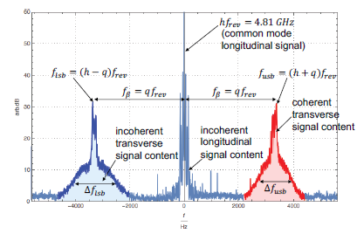
Transverse Schottky spectrum: Bunched beam
M. Wendt et al. Proc. of IBIC 2016.
Simulations of Kornilov et al. mentioned that the envelope of the sidebands for bunched beam reflect the coasting beam envelope. However practical usage not clear.
The measured Chromaticities from transverse Schottky of bunched were verified with the RF modulation method. (Private communication with M. Wendt)

Slide 16
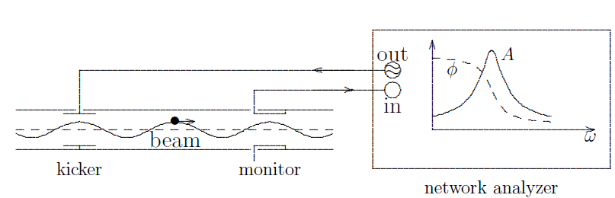
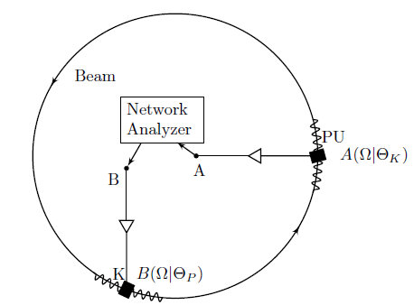
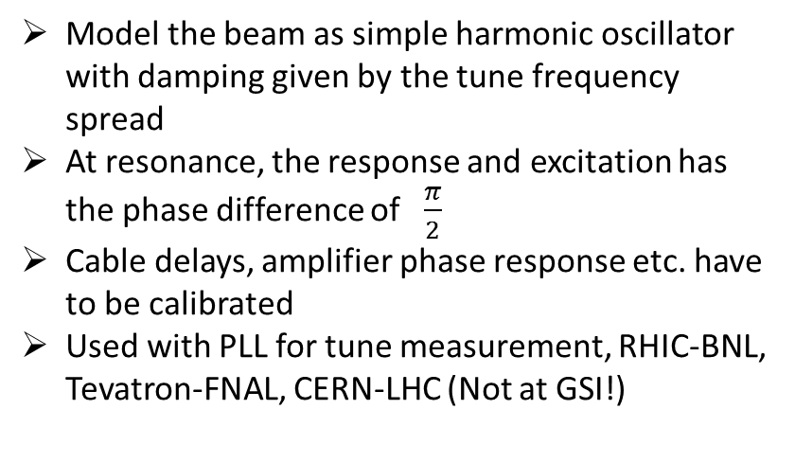
Beam transfer function
A. Hofmann: Landau Damping -> Proc. of CAS 2006
Model the beam as simple harmonic oscillator with damping given by the tune frequency spread
At resonance, the response and excitation has the phase difference of $\frac{π}{2}$
Cable delays, amplifier phase response etc. have to be calibrated
Used with PLL for tune measurement, RHIC-BNL, Tevatron-FNAL, CERN-LHC (Not at GSI!)

Slide 17
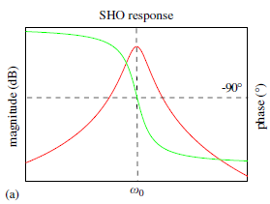
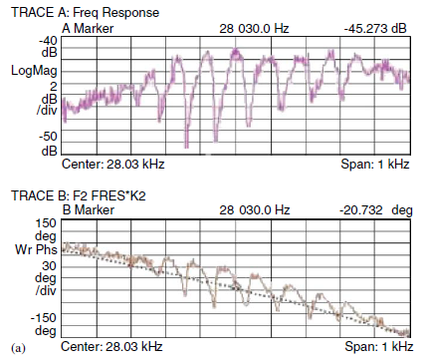
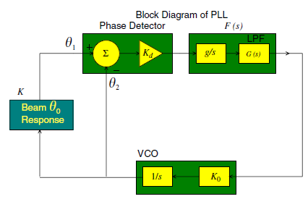
Tune measurement using PLL
Reality
Gives precise tune measurement when it works and follows tune -> Feedback
It is a closed loop: can lock to a sideband without one noticing
Problems seen with fast changing tune and/or high intensity modification of spectra
FFT
Tune
C.Y. Tan, Tune tracking with a PLL in the Tevatron, NIM-A

Slide 18
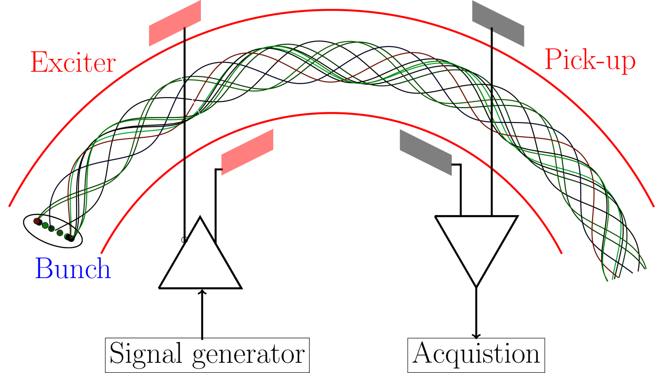
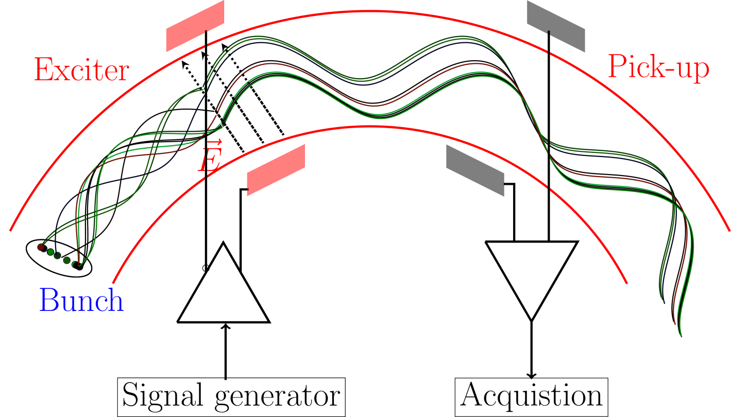
Basic technique of tune measurement
Add a coherent velocity (in phase component) on top of incoherent transverse velocities - > By beam excitation
Frequency response of kicker/exciter
Excitation types: Kick, Sweep, Noise
Excitation power
Frequency response of pick-up
Low-noise amplifiers : Resolution
Fast and robust processing
Notes:
Beam with several particles with randomly distributed phases and amplitude will give only very small fluctuations due to finite number of particles (schottky fluctuations) proportional to sqrt(N)
Beam excitation aligns the particle phases, and allows to measure center-of-mass before the beam decohores due to finite spread in frequency. Thus regular excitation needed. Types of excitation were studied as part of this work, Kick excitation (a wide band, or single time impulse excitation), requires high power, and significantly dilutes the phase space.
Chirp excitation, slow method, difficult to use in day to day operations, BTF excitation, to study the amplitude and phase response of the beam.
A compromise of the both the above methods, band limited (or pseudo random noise) for regular excitation without significant blow-up, usable along the ramp.

Slide 19
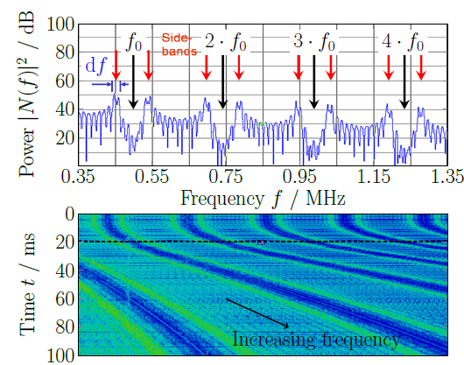
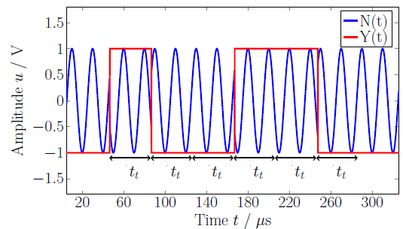
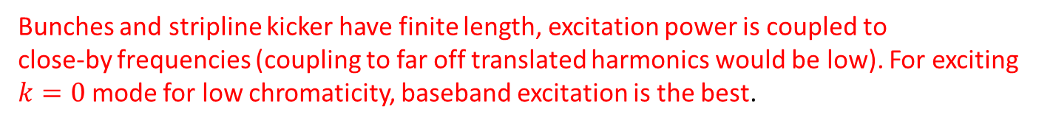
Beam excitation
Kick : Wideband excitation -> All modes are excited initially. Suitable for ramp.
Frequency Sweep : Long term behavior similar to kick excitation: Individual modes can be excited and studied. Usage in BTF.
Band limited noise : Adjustable band around the set-tune frequency. Standard method of exciting beam for tune measurements at GSI. (HIMAC and GSI)
Bunches and stripline kicker have finite length, excitation power is coupled to
close-by frequencies (coupling to far off translated harmonics would be low). For exciting $k=0$ mode for low chromaticity, baseband excitation is the best.

Slide 20
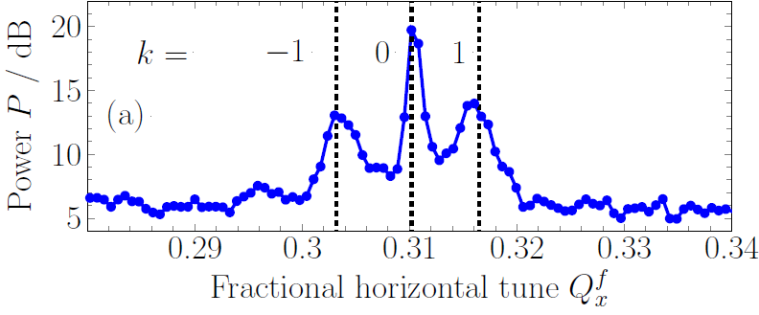
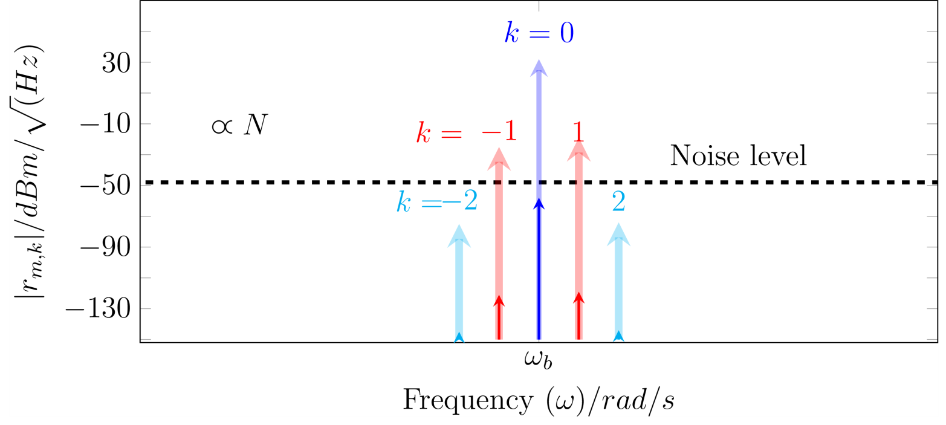
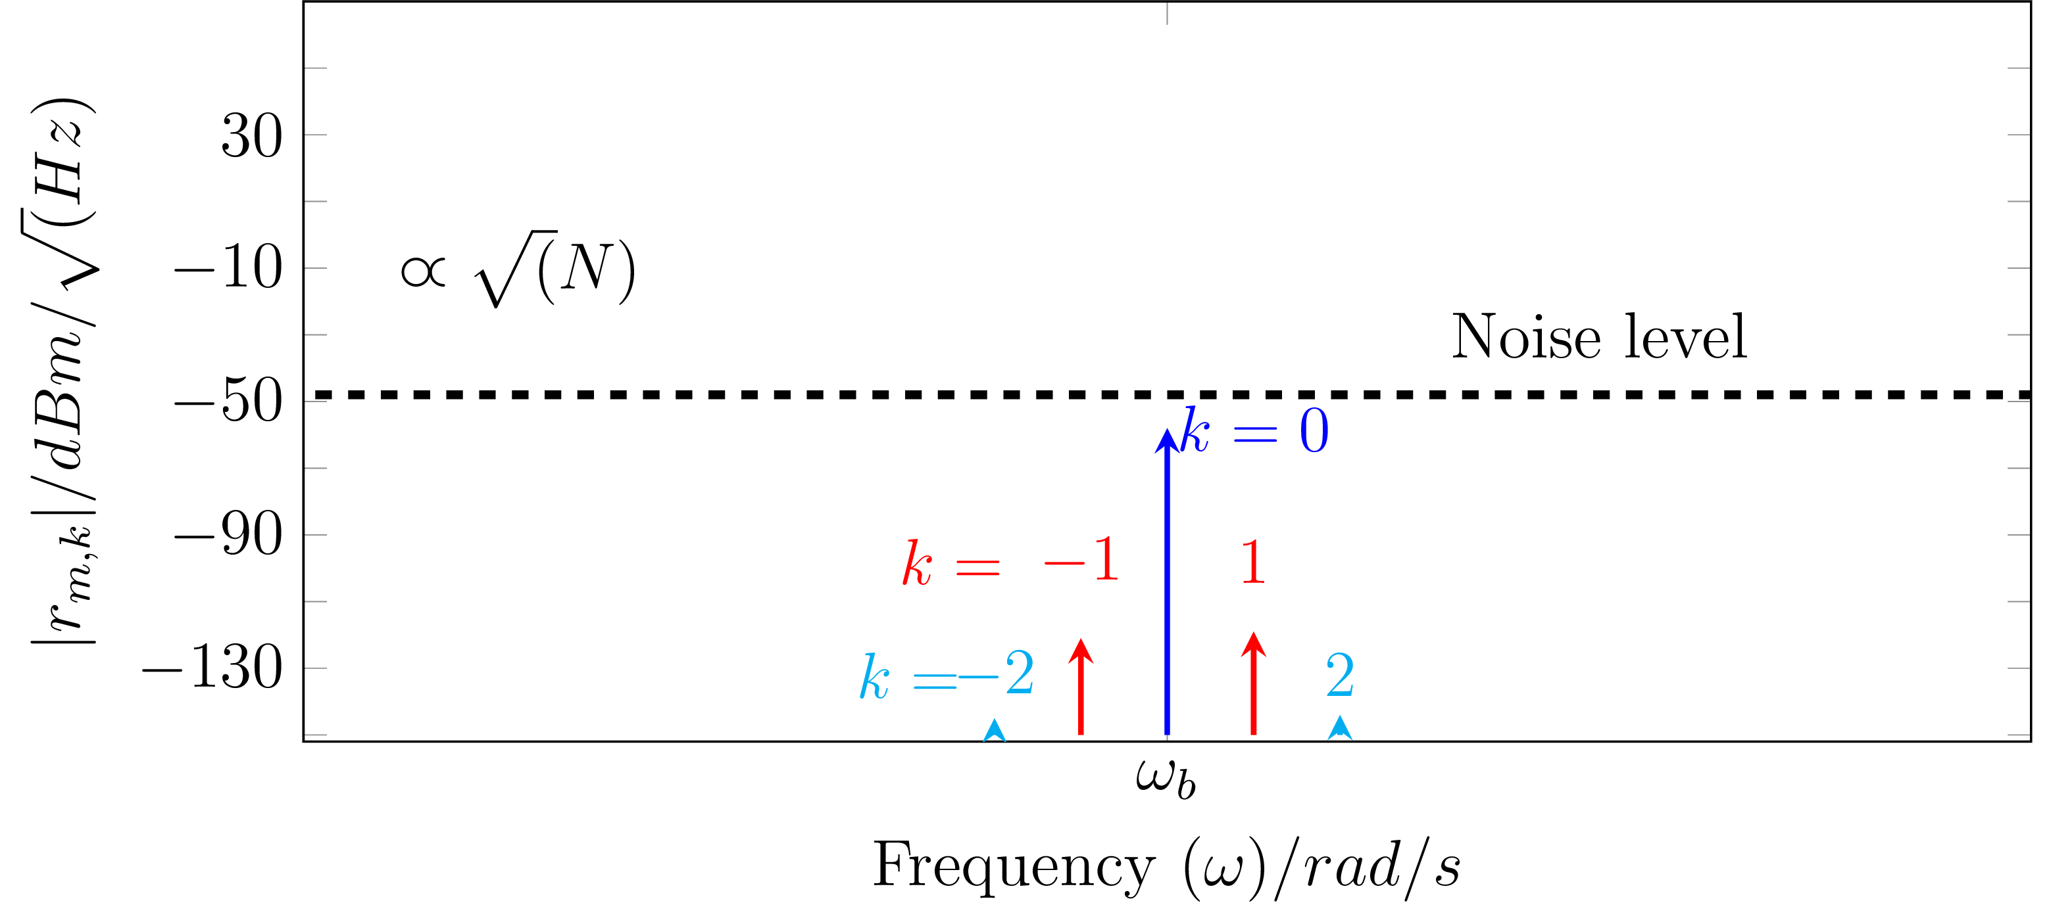

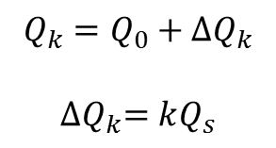

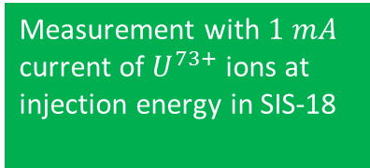

Baseband tune spectra : Bunched beam
Head-tail modes
Measurement with $1 mA$ current of $U^{73+}$ ions at injection energy in SIS-18
For baseband, $m=0$
$$ω_{k}=ω_{b}+kω_{s}$$
Normalizing by rev. freq. ($ω_{0}$)
Excitation
$$Q_{k}=Q_{0}+{∆Q}_{k}$$
$${∆Q}_{k}=kQ_{s}$$
Baseband
Excitation

Slide 21
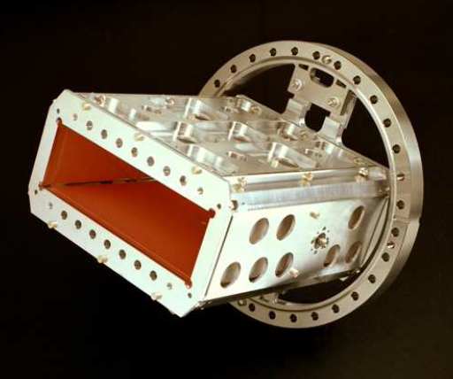
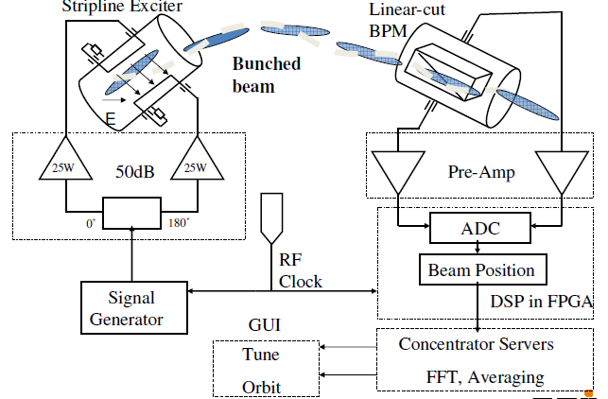
Tune, Orbit & POsition System TOPOS → Oversampling
General functionality:
The beam is excited by band-limited noise or sweep
Broadband amplification & oversampling of bunches
Position value for each bunch
Fourier transformation gives the non-integer tune Q ^{f}
Linear cut BPM:
Size: 200 x 70 mm², length 260 mm
Position sensitivity:
S_{x} = 0.8 %/mm, S_{y} = 2.0 %/mm
Digital Electronics
(LIBERA from I-Tech):
ADC with 125 MSa/s
10 effective bits
FPGA: position evaluation etc.
Remark: For FAIR-SIS100 12 eff. bits ADC
Different excitations:
noise or sweep
R. Singh (GSI) et al., Proc. HB’10, U. Springer et al., Proc. DIPAC’09

Slide 22

Tune, Orbit & POsition System TOPOS → Oversampling
General functionality:
The beam is excited by band-limited noise or sweep
Broadband amplification & oversampling of bunches
Position value for each bunch
Fourier transformation gives the non-integer tune Q ^{f}
Example: One turn = 4 bunches @ 35 MeV/u
U_{right}
U_{left}
Steps for digital processing:
Baseline restoration
Integration of bunches
⇒ position for each bunch
Tune: FFT on position of
same bunch turn-by-turn i.e.1 of 4 per turn
From raw data: bunching factor,
ω_{synch} & head-tail bunch shape
Different excitations:
noise or sweep
R. Singh (GSI) et al., Proc. HB’10, U. Springer et al., Proc. DIPAC’09

Slide 23


Analog peak detection /AM demodulator => BBQ
The beam is excited to betatron oscillation by band-limited noise or chirp:
The beam dipole moment is determined by analog manner via peak detector
Filtering of base-band component delivers the non-integer tune Q ^{f}
System designed by M. Gasior (CERN) and honored by Faraday Cup Award, see e.g. BIW’12
‘Quadrupolar’ BPM:
Size: 200 x 70 mm², length 210 mm
Position sensitivity:
S_{x} = 1.4 %/mm, S_{y} = 2.1 %/mm
Different excitations:
noise or sweep
or DAQ: ADC + FFT calc
BBQ design: M. Gasior BIW’12; GSI measurements; R. Singh (GSI) et al., Proc. HB’12 and DIPAC’13

Slide 24


Analog peak detection /AM demodulator => BBQ
The beam is excited to betatron oscillation by band-limited noise or chirp:
The beam dipole moment is determined by analog manner via peak detector
Filtering of base-band component delivers the non-integer tune Q ^{f}
System designed by M. Gasior (CERN) and honored by Faraday Cup Award, see e.g. BIW’12
Steps of analog processing:
Peak detection
Amplification of the difference
Filtering
Feeding to spectrum analyzer or DAQ
⇒ weighted folding of spectrum to baseband
BBQ design: M. Gasior BIW’12; GSI measurements; R. Singh (GSI) et al., Proc. HB’12 and DIPAC’13

Slide 25



Comparison BBQ versus TOPOS
BBQ:
Peak detection using analog circuit
i.e. no further treatment possible
High dynamic range
Result: tune with higher sensitivity
⇒ ‘Easy-to-use’ device
k = 0
vertical
Ni⁷⁺ beam:
11 MeV/u
2 ⋅ 10¹⁰ ions
BBQ spectrum
k = 1
TOPOS spectrum
k = -1
TOPOS:
Oversampled digitization of the BPM signals
Full time domain information
Versatile data processing possible
e.g. picking 1 of 4 bunches, filtering ...
Results: Position, tune, longitudinal profile
synchrotron frequency ω_{s}
⇒ versatile due to full information stored
Remark: Improved algorithms in preparation
based on linear regression fit
Same raw data but different algorithms
tradition: integration & y ∝ Δ/Σ
(presented data)
Amplitude
novel: linear fit Δ_{i} versus Σ_{i}
5 x higher signal-to-background + higher resolution
+ better common mode suppression
R. Singh et al., IBIC’15
Notes:
TOPOS is the position and orbit measurement system, and tune is calculated from the FFT of the position across the whole cycle, when the beam excitation is also applied. The technical system, and implementation in FPGA and huge data acquisition was part of a separate 3-4 year project which was almost completed when I joined.
My initial contribution to the TOPOS was to use it, and face problems in its operation. Over the period of time, I understood the problem areas in the algorithm, and came up with an alternate position calculation algorithm, thus I will briefly explain it.
Compare the baseline restoration algorithm to the regression fit, pros and cons.
Another contribution was to understand the noise sources in the BPM.

Slide 26
Conclusion
Typical tune measurement systems were discussed.
Tune measurement systems at GSI and their comparison.
Systems should be chosen according the beam conditions and measurement requirement.
As always a trade-off between flexibility, simplicity and reliability.
Acknowledgment : Colleagues at BI@GSI!
Questions??

