Slide 1
Ion Pump design for improved speed at low pressure
M.Audi , C.Paolini - Agilent Technologies
Beam Dynamics meets Vacuum
KIT , March 2017

Slide 2
Scope of the work
Ion pumps are normally used at low pressure , 10⁻⁸ mbar ( 10⁻⁶ Pa ) and below.
Existing ion pumps have maximum pumping speed in the 10⁻⁶ mbar (10⁻⁴ Pa ) range.
Analyze influence of design parameters on pumping speed of an ion pump.
Experimental test of elements with different parameteres in different operating conditions.
Goal is to optimize these parameters in order to :
-Improve the overall pumping speed
-More specifically, improve it at lower pressures.

Slide 3
Ion Pumps main pumping principle ( for getterable gases )
Penning Cell , crossed B and V act as an electron trap
Electrons ionizes gas molecules through collisions
Ions are created in order to bombard the Titanium cathode
Even if some ions diffuse into the cathode, this is not the main pumping effect
Ion Bombardment causes Sputtering of chemically active Titanium film on the anode
Neutral Gas molecules stick to the Titanium film (chemisorption) and are buried in the anode
This is the main pumping effect and the only stable one
Ion pumps do not pump ions by diffusion into the cathode , but pump neutral molecules by chemisorption by the sputtered cathode material on the anode

Slide 4
Ion Pump pumping speed
The amount of gas pumped is proportional to the amount of sputtered cathode material.
This is proportional to the number of ions bombarding the cathode with sufficient energy to create sputtering .
Q ( mbar l / s ) = h I ( A )
S (l/s) = Q (mbar l / s) / P ( mbar ) = h I / P
I/P , discharge intensity , must be maximized to maximize S
I/P = f ( V , B , cell d , .........)
I = k P ^{n} where usually 1< n < 1.2
I/P , and therefore S , increase with p ( up to 10 ^{– 5} mbar )
n close to 1 to obtain constant I/P ( I/P = k ) and therefore S
n depends again on V , B , cell d

Slide 5
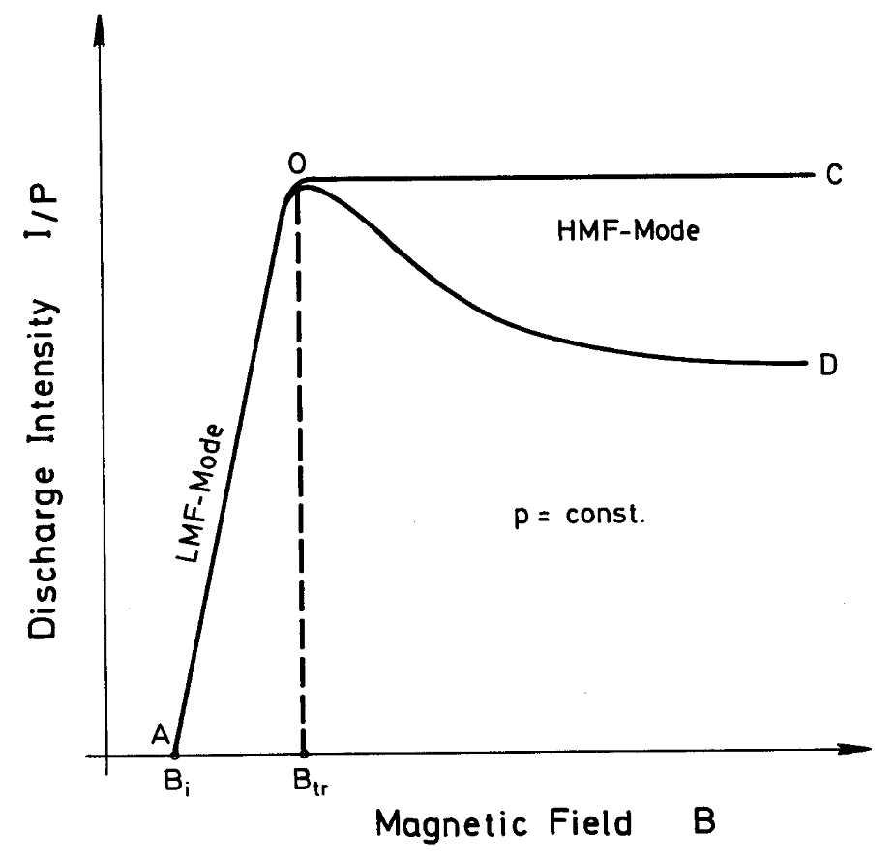
Discharge intensity in Low Magnetic Field and High Magnetic Field modes
Low pressure
High pressure
20 mm dia cell
P (mbar) | @ 7 kV | @ 5 kV | @ 3 kV
1,00E-06 | 1256 | 1061 | 823
1,00E-07 | 1409 | 1191 | 922
1,00E-08 | 1580 | 1336 | 1035
1,00E-09 | 1774 | 1499 | 1161
Notes:
The highest ion pumping speed is achieved in HMF mode and also in LMF mode the speed increases with the magnetic field strength (proportional to B^2).
This is a typical diagram of the discharge intensity dependence on the magnetic field at constant pressure.
The branch AO is characteristic for the LMF mode. At low pressures (p <1E-7 Torr) the HMF mode (branch OC) shows an almost constant discharge intensity. For high pressure (p>1°-7 Torr) the HMF mode is given by the curve OD.
After this introduction, we easily understand how complex is the physics of an ion pump and how difficult can be to predict (and sometimes also to measure) the pumping speed of an ion pump.

Slide 6
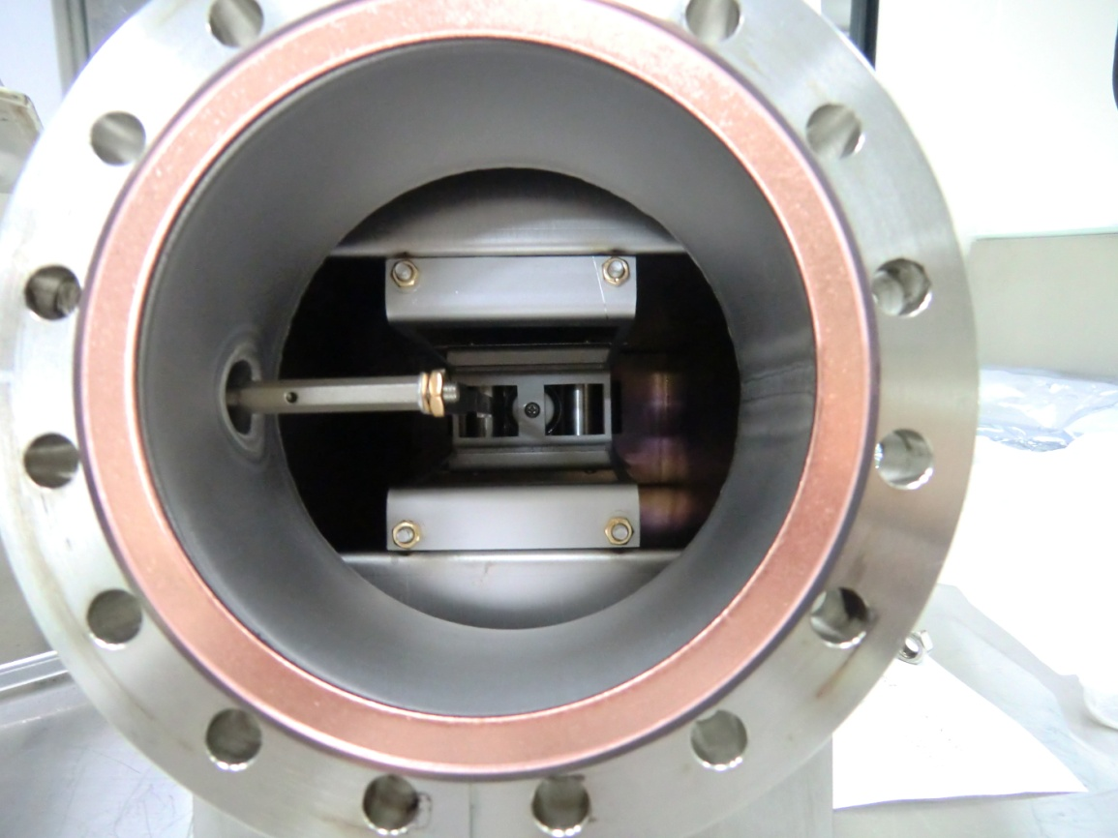
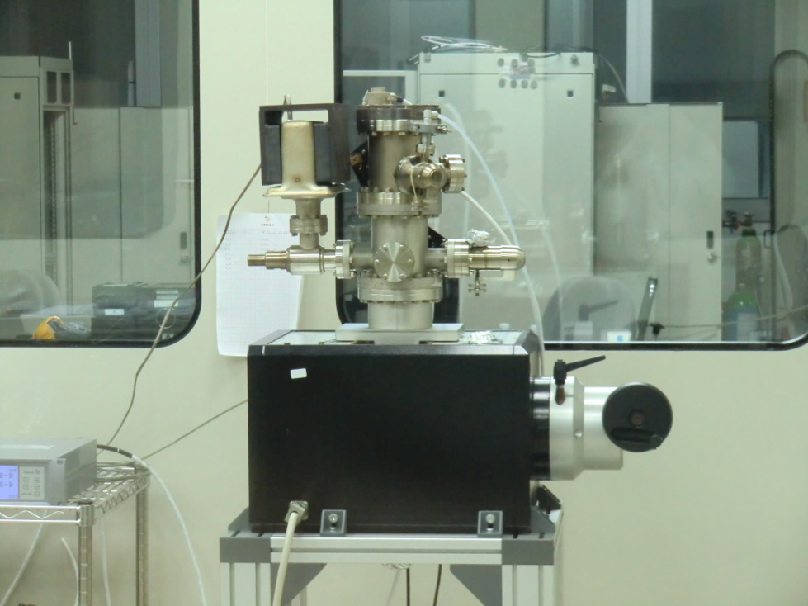
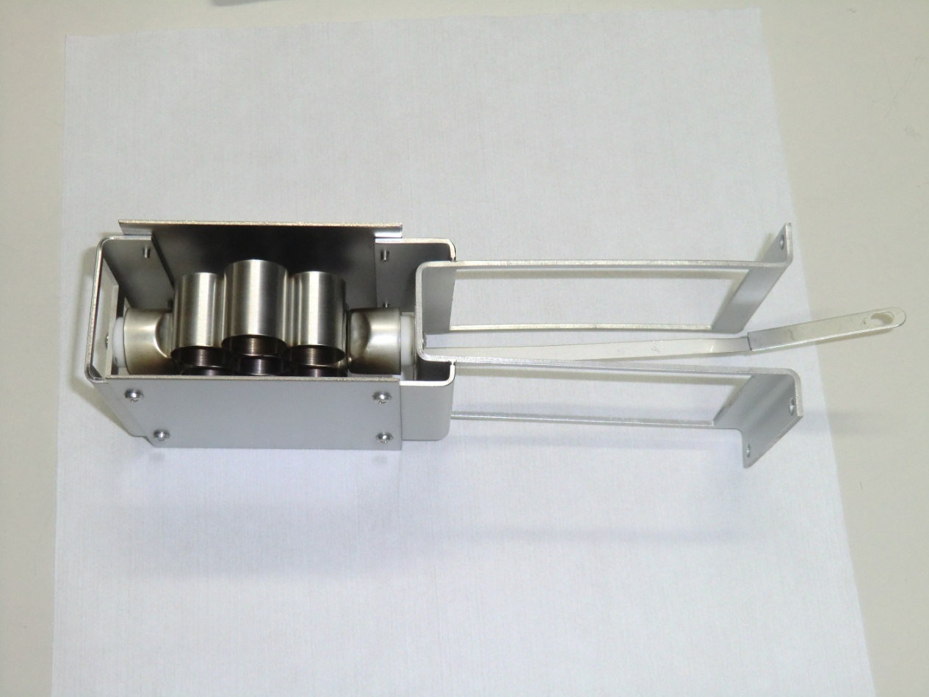
I/P measurements - Experimental set up
Vacuum chamber: UHV gauge, variable leak valve, independent ion pump
Electromagnet poles
“special” ion pump body with HV feedthrough
Ion Pump element to be tested
Roughing Valve

Slide 7
Fixed Cell Diameter , variable B

Slide 8
Fixed Cell Diameter, variable B

Slide 9
Fixed Cell Diameter, variable B

Slide 10
Fixed B, variable Cell diameter

Slide 11
Fixed B, variable Cell diameter

Slide 12
Fixed B, variable Cell diameter

Slide 13
Pump Parameter Design
Optimum Magnetic Field for I/P 1400 / 1600 Gauss
Present Ion Pumps work with 1100/1200 Gauss, obtainable with commercially available magnets and conventional design
Optimum cell diameter 20 to 24 mm
Dia , mm | Area , mm2 | No of Cells
16 | 201 | 75
20 | 314 | 48
24 | 452 | 33
28 | 615 | 24
Present Ion Pumps have cells from 15 to 25 mm diameter
We have to work on Magnetic Field

Slide 14
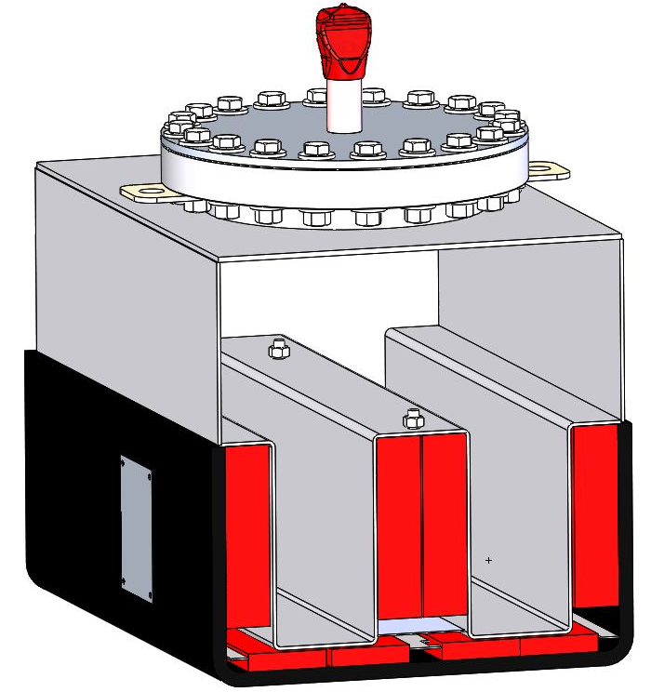
Ion Pump Magnetic field
Conventional, 150 L/S
New design

Slide 15
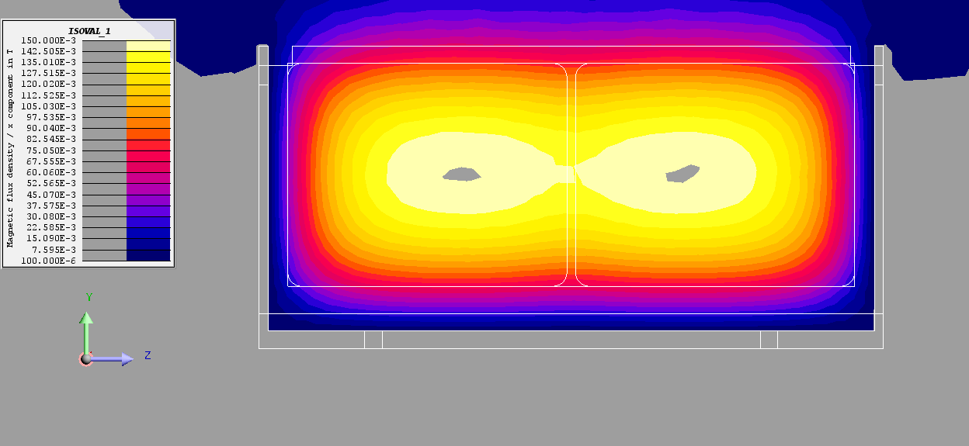
Ion Pump Magnetic field
Conventional
Red 900 G
Orange 1000 G
Yellow 1250 G
Grey > 1500 G
New design

Slide 16
Pumping speed after saturation , DIODE , N₂
NEW VIP200
Convent VIP150

Slide 17
Vacuum Firing processed
VIP 200 bodies
Vacuum Furnace
@ 950°C , 10 E-5 mbar
Pump internal components
Notes:
Decided to applied the vacuum firing to all surface in the ion pump that are exposed to vacuum in order to reduce order of magnitudes the outgassing rate.
Vacuum furnaces is in the 10-5 mbar range @ 950°C
You can see the pump bodies and some internal parts of the pumps (in this case some anodes of the elements) ready to be «treated under vacuum, firing»
This process is perfromed before pump assembly and following internal outgassing process: You might probably know that Agilent has a unique «outgassing» process for all the manufactured pumps which consist in a automatic baking at 450°C base èressure dependant(10-8 mbar).

Slide 18
Vacuum Firing Process
VIP200 baking process cycle
Standard VIP baking process cycle
2hr30’’
4 hrs
Pressure Temperature
Lower pressure achieved at the end of the baking procedure (approx. a decade lower)

Slide 19
Summary
I/P values have been measured for a wide range of Ion Pumps key design parameters such as V , B , cell dimensions
The influence of B on I/P has been experimentally measured , and a value higher than the one used in existing ion pumps has been proved to be necessary to improve the performances, especially at lower pressures.
With optimized design parameters it is possible to design an ion pump with the highest pumping speed per unit volume ( 200 L/S in the same dimensions of conventional 150 L/S ).
Even more important, the maximum pumping speed of 200 L/S is reached in the 10 ⁻⁸ mbar (10 ⁻⁶ Pa ) range, where a conventional 150 L/S usually provides 120 L/S.
Vacuum firing process of all the surfaces exposed to vacuum allows to reach a lower ultimate pressure

Slide 20
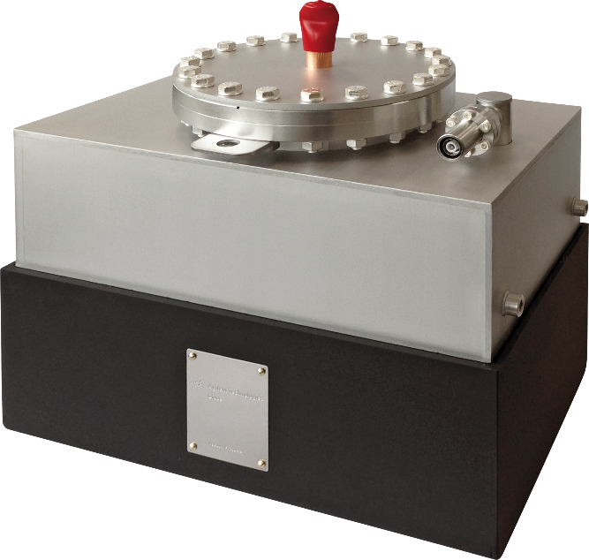
New Agilent VIP200
eXtreme High Vacuum Performance
The first ion pump with maximum pumping speed at low pressure

