Slide 1
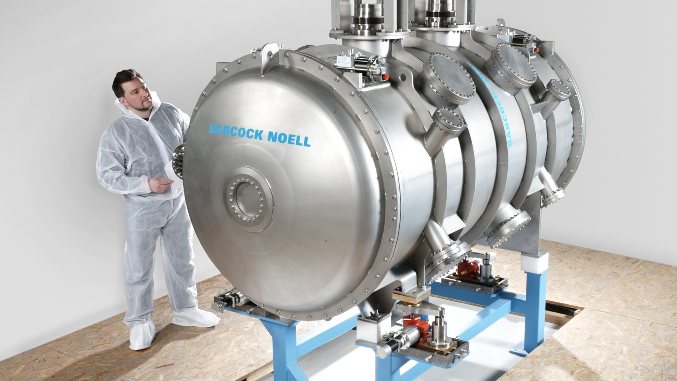

Challenges of vacuum chambers with adjustable gap for SC undulators
Beam Dynamics meets Vacuum, Collimators and Surfaces 08-10 March 2017
C. Boffo, Th. Gerhard, M. Turenne, W. Walter; Babcock Noell GmbH
S. Casalbuoni, A. Cecilia, S. Gerstl, A. Grau, T Holubek, C. Meuter, D. Saez de Jauregui, R. Voutta; Karlsruhe Institute for Technology

Slide 2
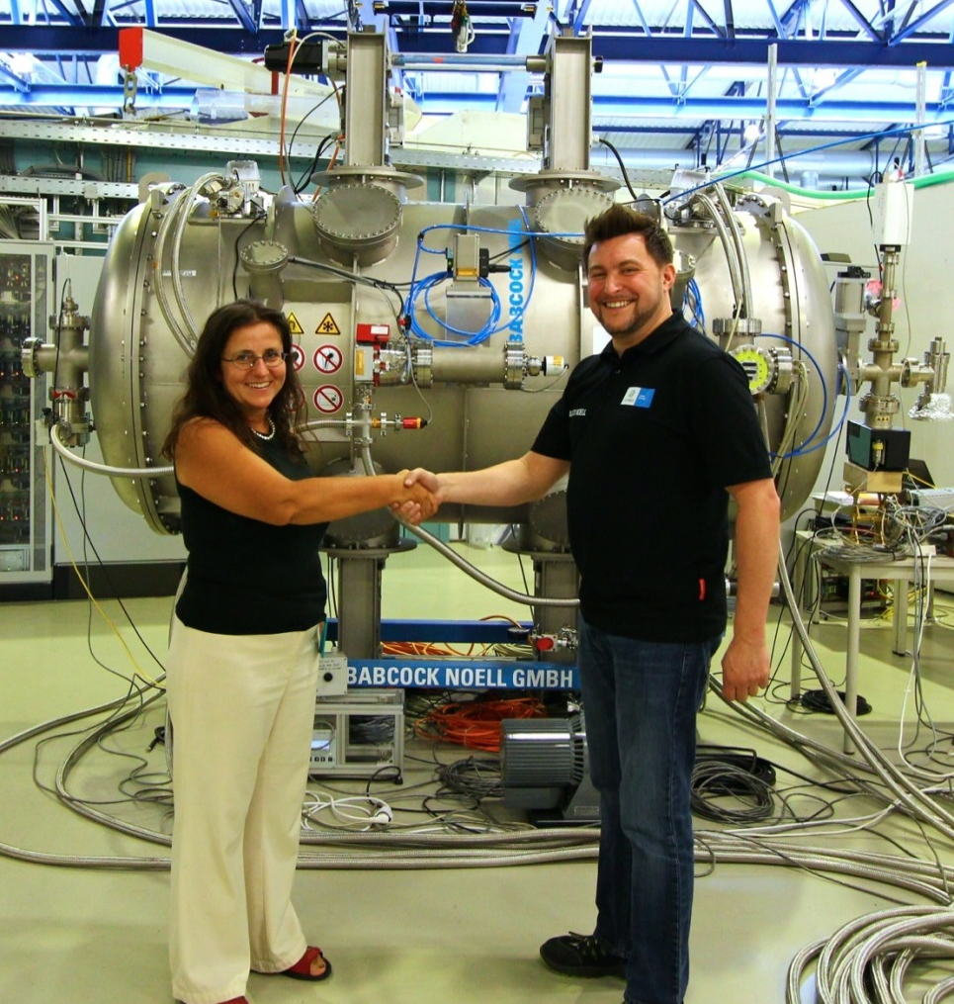

Outline
Undulators and SCUs
SCU15 and SCu20
Requirements for the vacuum chamber
Technological solutions
Summary
C. Boffo Beam Dynamics meets Vacuum etc. 8-10 Match 2017

Slide 3
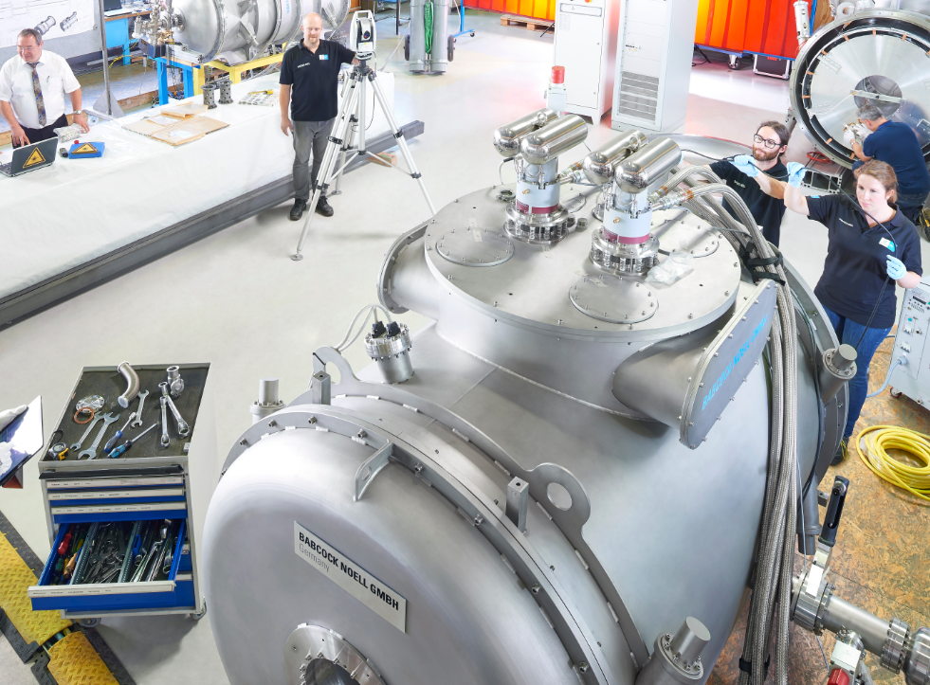
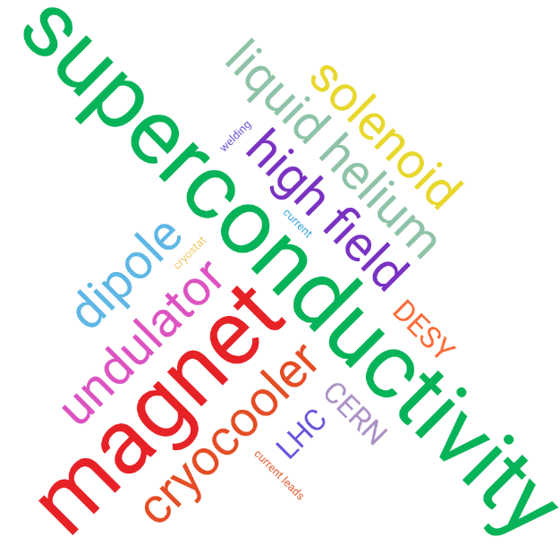
Babcock Noell GmbH
Your best partner of cutting edge development
C. Boffo Beam Dynamics meets Vacuum etc. 8-10 Match 2017

Slide 4

Undulators
Evolution of the spieces
Classical PM
In vacuum PM
Cryo PM
Superconducting
Vacuum chamber
Vacuum chamber
Vacuum chamber
PM
SC
PM
PM
Vacuum chamber
Vacuum chamber
PM
PM
SC
PM
Room temperature (stabilized)
Strongest possible PM
Gap adjustment to modify B
Room temperature
Magnets get closer B increase
Gap adjustment to modify B
Temperature ~100 K
Magnets get cooled B increase
Gap adjustment to modify B
Temperature ~4 K
Higher fields with SC
C. Boffo Beam Dynamics meets Vacuum etc. 8-10 Match 2017

Slide 5
Undulators
Motivation
Slide courtesy of KIT
C. Boffo Beam Dynamics meets Vacuum etc. 8-10 Match 2017

Slide 6
SCUs
Main parameters
Iron formers
NbTi superconductor
Tight tolerances <50 um on key dimensions
Movable gap
Cold corrector coils for minimization of field integrals
Conduction-cooling design
 | SCU15 | SCU20 | Units
Period length | 15 | 20 | mm
Full periods | 100.5 | 75.5
Max field on axis 7 mm gap | 0.73 | 1.18 | T
Nominal current | 150 | 390 | A
Ramp to nominal current | 450 | 300 | s
Operating gap | 7 | 7 | mm
Injection gap | 15 | 15 | mm
Beam heat load | 4 | 4 | W
Design temperature | 4.2 | 4.2 | K
C. Boffo Beam Dynamics meets Vacuum etc. 8-10 Match 2017

Slide 7
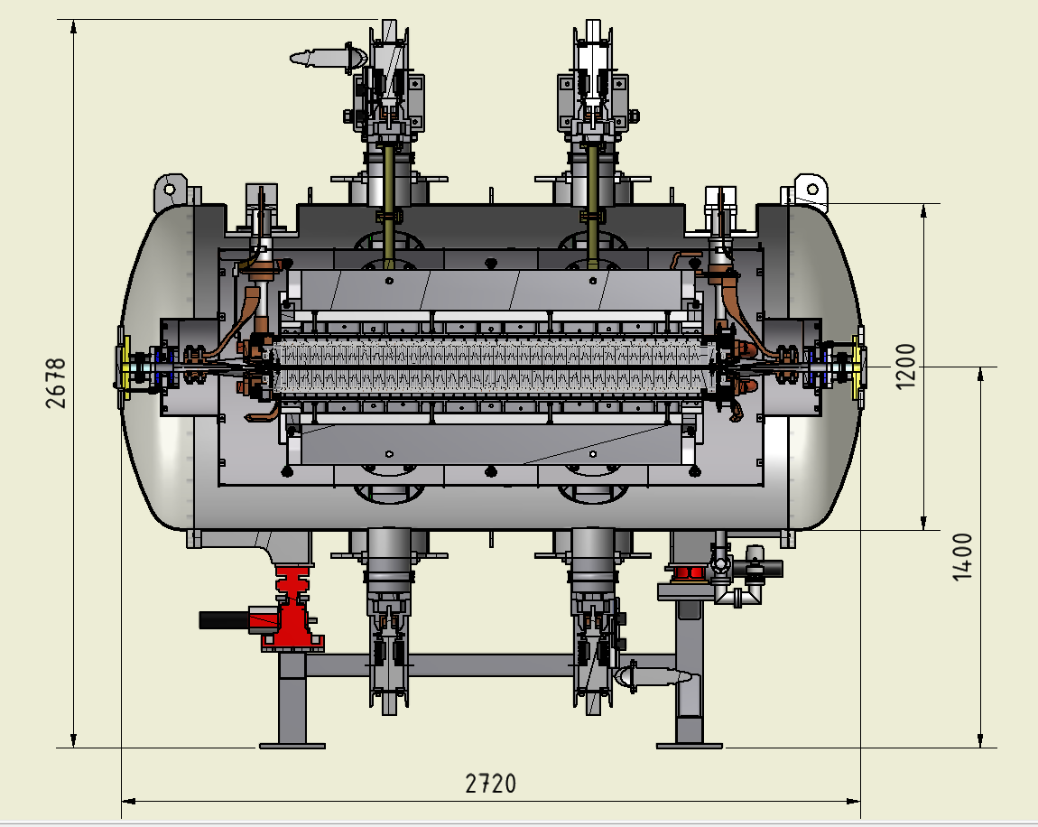
SCU15
The device
Mover system
Cryocoolers
RF bellow
Coils
Cryostat
Beam pipe
Adjusting feet
Thermal shield
C. Boffo Beam Dynamics meets Vacuum etc. 8-10 Match 2017

Slide 8
Requirements for the vacuum chamber
A dream project for an engineer
Thermal
    Beam heat load of 4W (plus conductive and radiative loads) would require at least 3 cryoccolers to operate at 4.2K
    Provide cooling along the vacuum chamber
    Minimize length of warm to cold transition (impact on active length of undulator)
Mechanical
    Minimize thickness (reduce difference between magnetic and beam gap)
    Flat center area of at least 300 mm ( magnet width to minimize magnetic roll off)
    Sustain differential pressures in both directions of 1 bar (during installation or failure)
    Movable gap between 7 and 15 mm (flexible elements are required)
    Taper between 7 mm to standard 32 mm warm ANKA beam pipe height
Beam
    Internal copper coating to reduce surface resistance
    Integration of cold BPM
    Integration of cold RF bellows (compensation for cooldown shrinkage)
C. Boffo Beam Dynamics meets Vacuum etc. 8-10 Match 2017

Slide 9
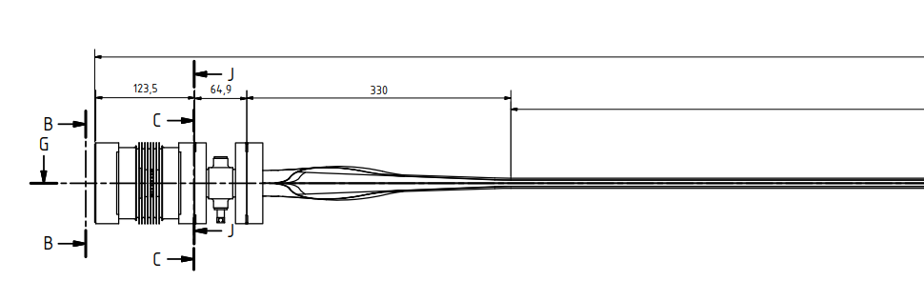
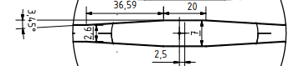
First generation vacuum chamber
Concept
RF Bellow
Cooling circuit A
Magnet
Cooling circuit B
Magnet
GAP
Liner
Beam
Magnet
Magnet
BPM
50 K
10 K
Minimization of difference between beams stay clear 7 mm and magnet gap 8 mm
Formed 0.3 mm 316L foil as chamber (leaves 0.2 mm distance to magnet)
Only 20 mm center straight with smooth angle to provide space for cooling
Cooling provided by copper elements soft soldered to the foil
Beam shifted 2.5 mm toward inside of chamber to reduce beam heat load
Lateral spring elements to provide flexibility to open and close gap
RF bellow sustain temperature gardients between 300 and 50 K
C. Boffo Beam Dynamics meets Vacuum etc. 8-10 Match 2017

Slide 10
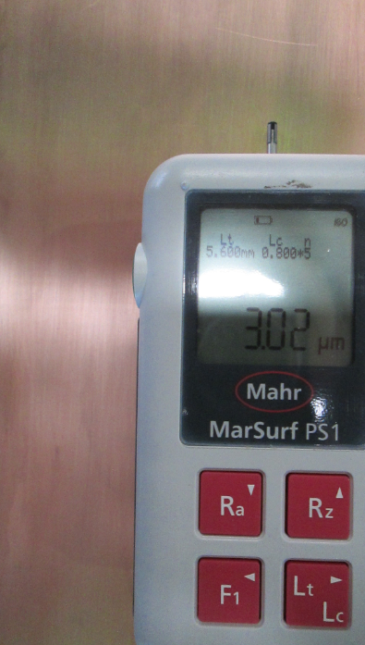
SCU15 vacuum chamber
Technological development
Forming of stainless steel foils with high precision and small angles (elastic limit)
Coating of internal and external surfaces with galvanic deposited copper (measured RRR 190)
Laser welding of the chamber
Soft soldering of cooling elements
Ultrasonic cleaning of the full chamber (Al, SST316L and Copper)
Bake out at 120 C for 12 hours
C. Boffo Beam Dynamics meets Vacuum etc. 8-10 Match 2017

Slide 11
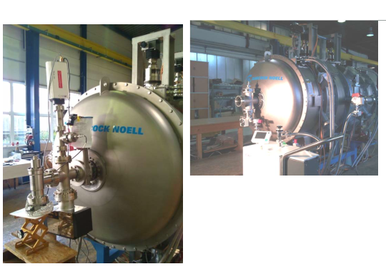
SCU15 vacuum chamber
Qualification and performance
Vacuum <5*E-10 mbar static
<5*E-9 mbar dynamic
Leak rate < 5*E-10 mbar l s
S. Casalbuoni et al., Superconducting Undulator Workshop, Didcot, UK, 2014
C. Boffo Beam Dynamics meets Vacuum etc. 8-10 Match 2017

Slide 12
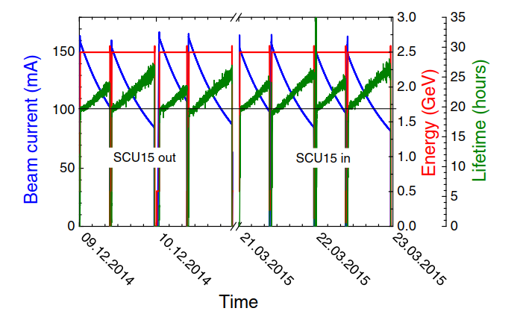
Operation in the ANKA ring
Beam lifetime
Beam lifetime not affected with SCU15 in the ring and in operation.
S.Casalbuoni et al., ASC2016
C. Boffo Beam Dynamics meets Vacuum etc. 8-10 Match 2017

Slide 13
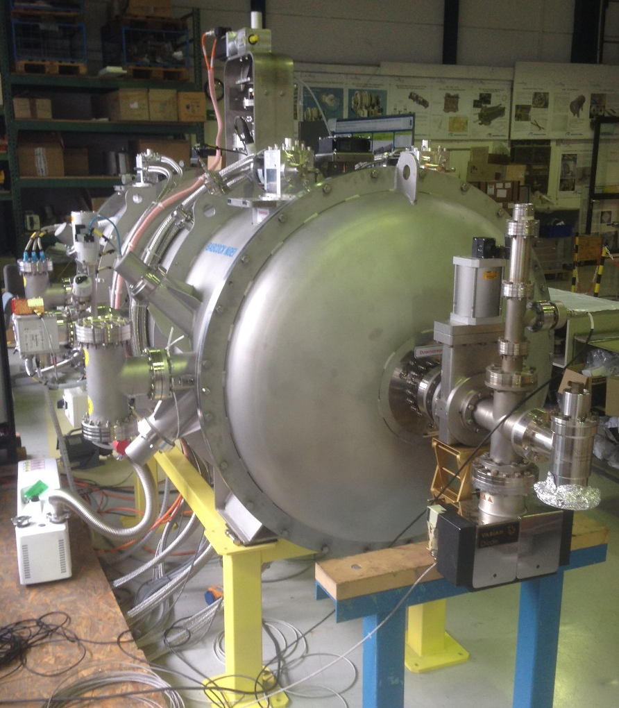
SCU20 vacuum chamber
Improvements and results
Position of the 50 K temperature level after the taper
Magnets width reduced so that the vacuum chamber cross section can be reduced
Taper inside cryostat 7 mm to 15 mm and outside cryostat from 15 mm to 32 mm (reduced heat load)
RF bellow does not see temperature gradient
No cold BPM
Vacuum <5*E-10 mbar
Leak rate < 1*E-10 mbar l s
C. Boffo Beam Dynamics meets Vacuum etc. 8-10 Match 2017

Slide 14
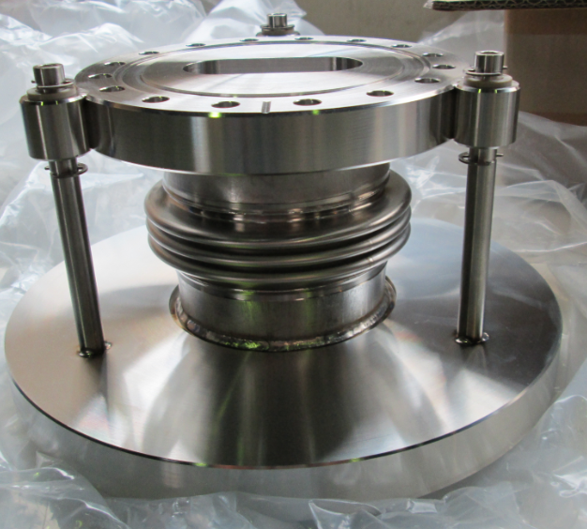
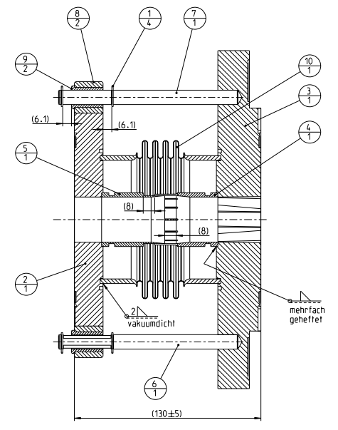
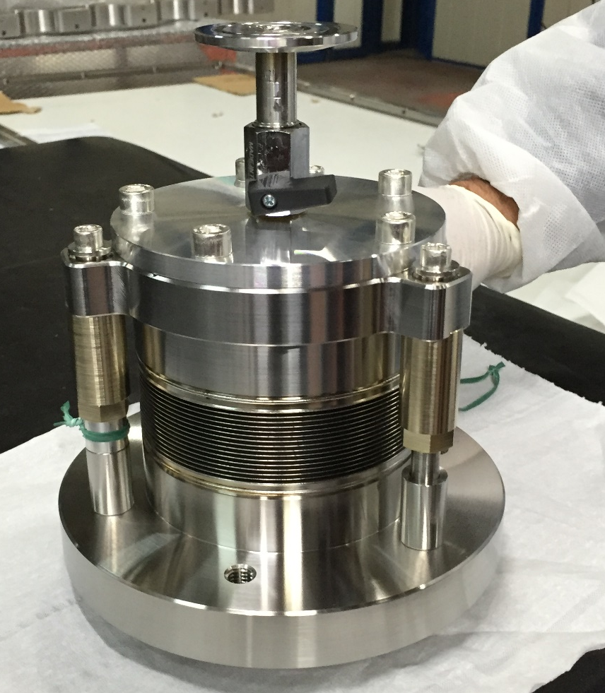
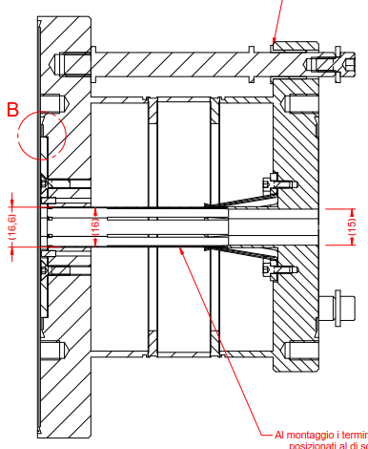
RF Bellows
Design comparison
Warm
Cold
Cold
Warm
support
Clips
Fingers
Bellow
CF75
CF100
C. Boffo Beam Dynamics meets Vacuum etc. 8-10 Match 2017

Slide 15
Summary
Designing a flexible vacuum chamber for superconducting undulators is challenging
SCU15 demonstrated that the required performance can be achieved
Design improvements for the SCU20 vacuum chamber focused on manufacturability and reproducibility
C. Boffo Beam Dynamics meets Vacuum etc. 8-10 Match 2017

Slide 16
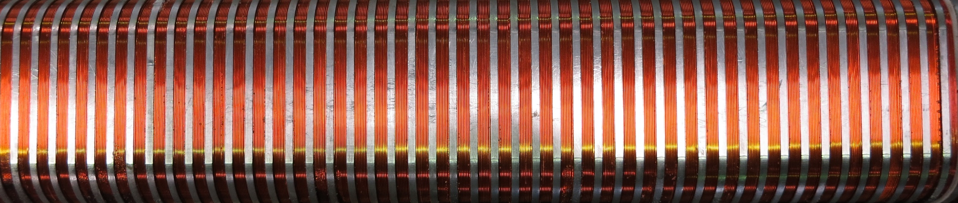
Thank you for your attention
If you want the best insertion device
for your light source
CONTACT US
We will deliver your SCU in 24 months

