Slide 1
Beam Dynamics Meets Vacuum, Collimations and surfaces.
The Vacuum System of MAXIV
Eshraq Al-Dmour,
MAX IV laboratory
9th March 2017
On behalf of the vacuum team

Slide 2
Contents
Facility layout
Vacuum system layout.
NEG-coating R&D at CERN,
Installation procedure,
Vacuum commissioning status.
Conclusion

Slide 3
MAX IV facility

Slide 4
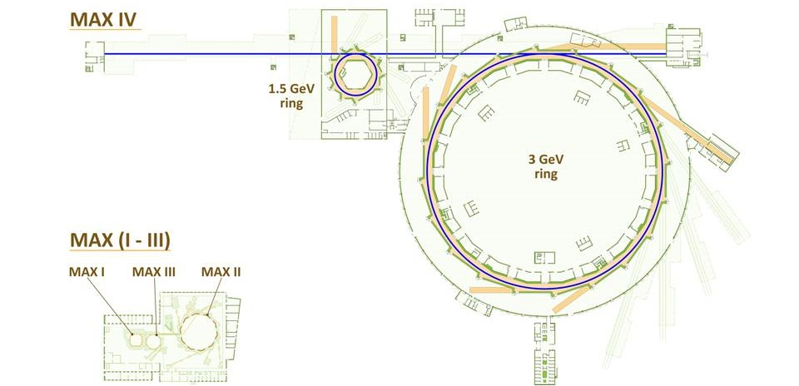
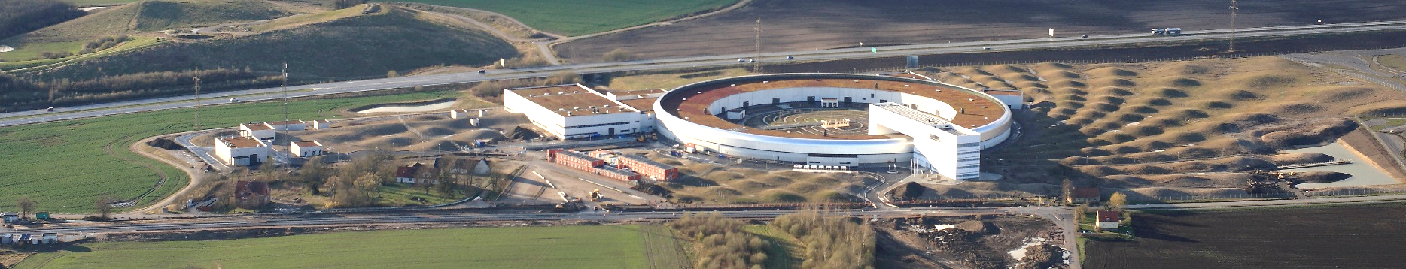
MAX IV layout
Max IV - Synchrotron light source facility in Lund, Sweden.
Linac (300 m)
Short pulse facility
3 GeV ring
(528 m)
1.5 GeV
ring (96 m)
Small aperture,
all NEG-coated
Conventional
design
Commissioning started:
August 2015
Commissioning started:
September 2016
https://www.maxlab.lu.se/maxiv

Slide 5
MAX IV, 1.5 GeV storage ring vacuum system layout

Slide 6
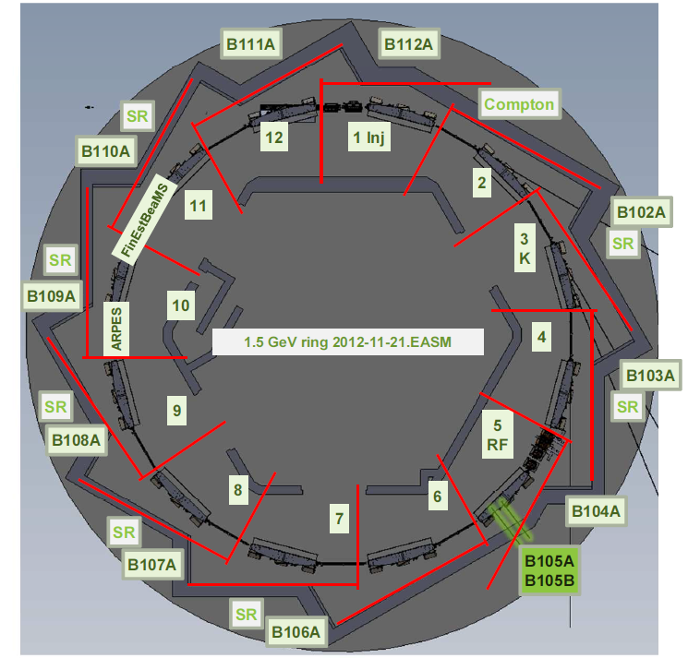
1.5 GeV storage ring layout
96m circumference
12 DBA.
12 straight sections of which, all for ID, except:
  Ach. 1: injection
  Ach. 5: RF straight Ach. 3: inj. Kicker +ID

Slide 7
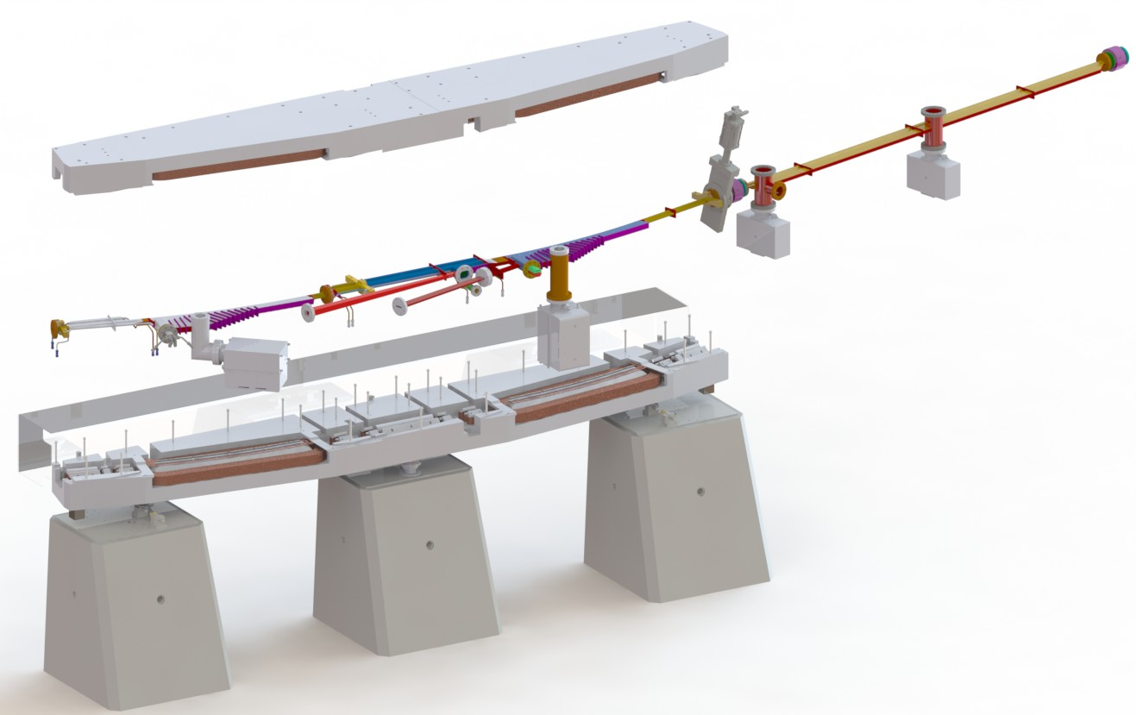
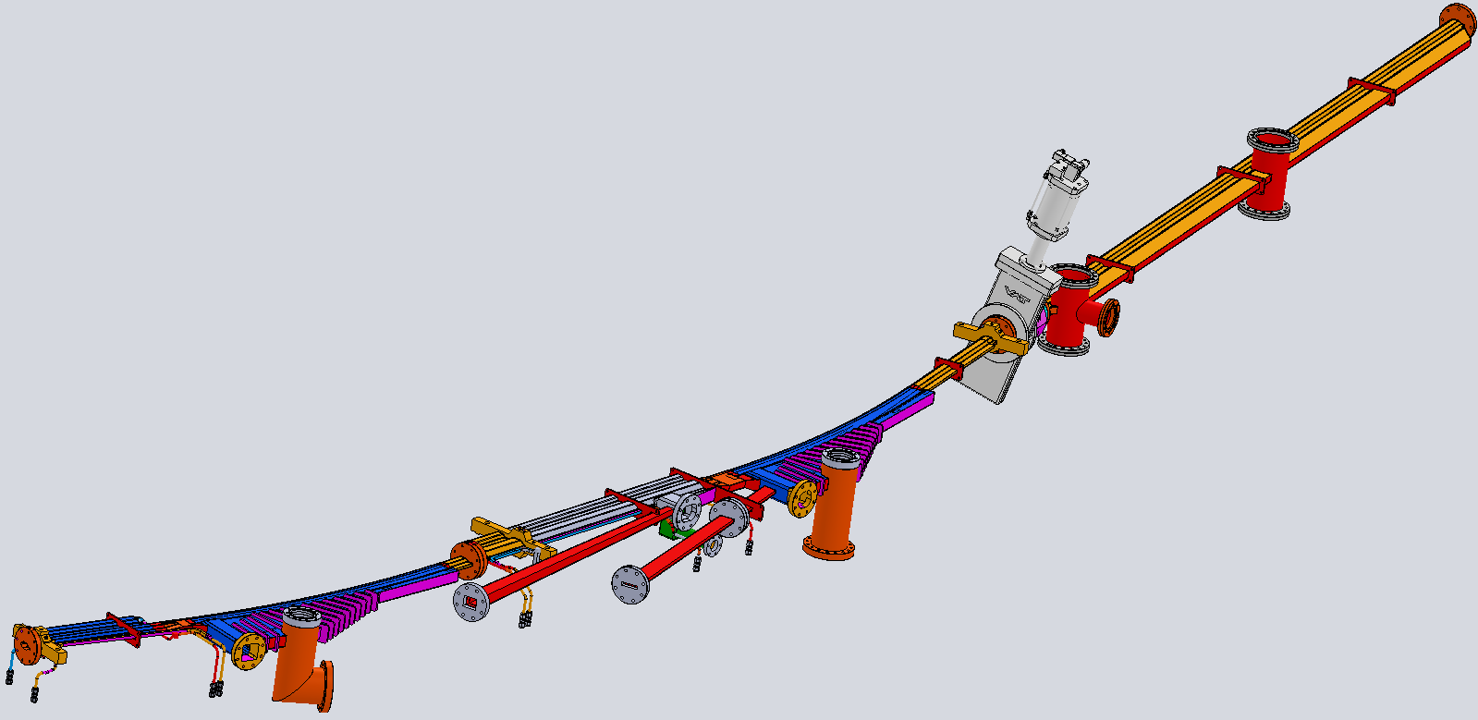
1.5 GeV storage ring vacuum system
Conventional vacuum system:
  St. steel VC with lumped and distributed absorbers.
  Ion pumps, TSP and NEG strips.
One achromat.

Slide 8
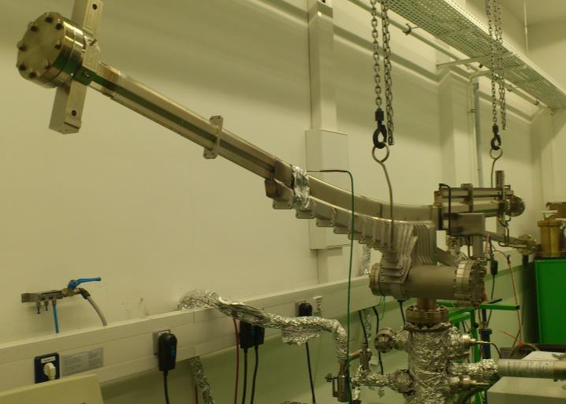
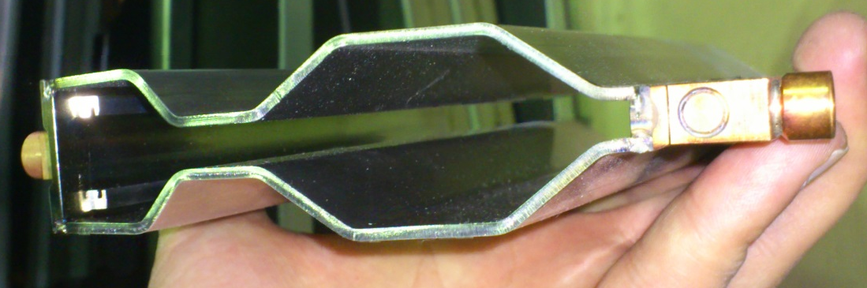
1.5 GeV storage ring vacuum system
Vacuum chamber during the testing.
20 mm

Slide 9
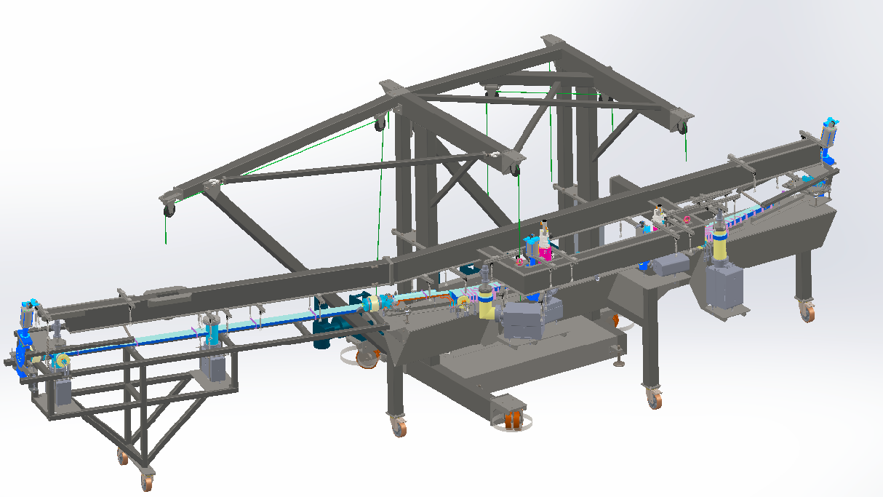
1.5 GeV storage ring vacuum system
  Installation.
Strong-back
Assembly tables

Slide 10
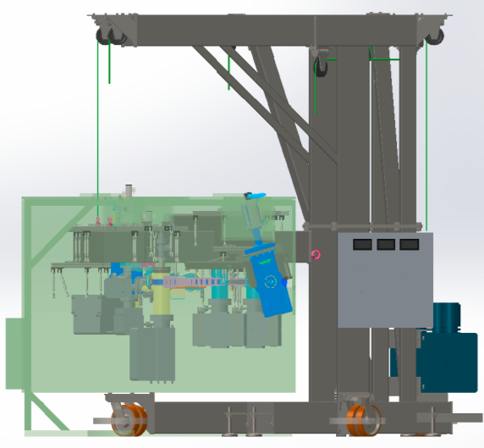
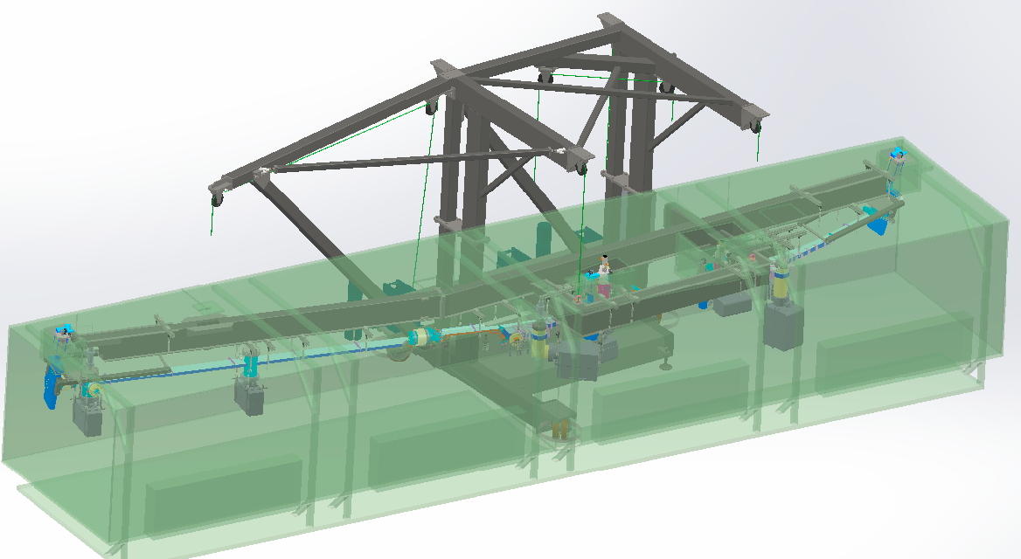
1.5 GeV storage ring vacuum system
  Installation.
Bakeout oven

Slide 11
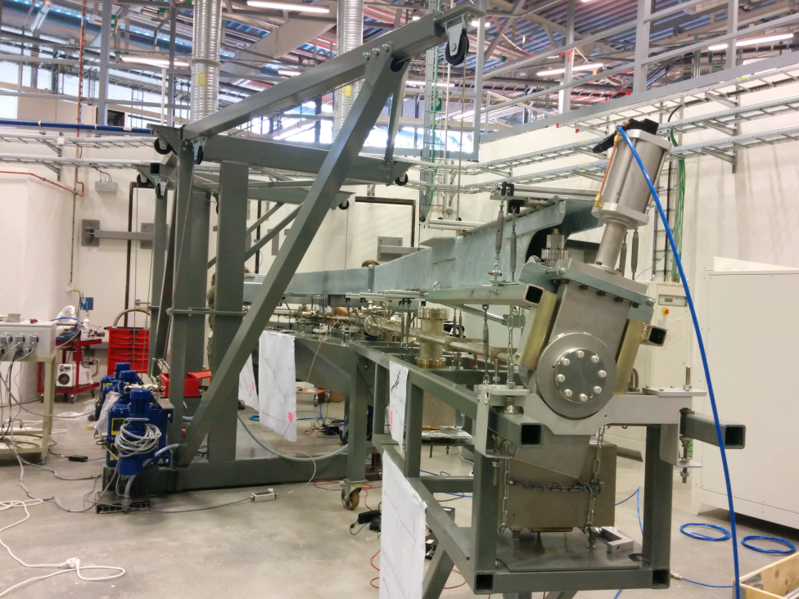
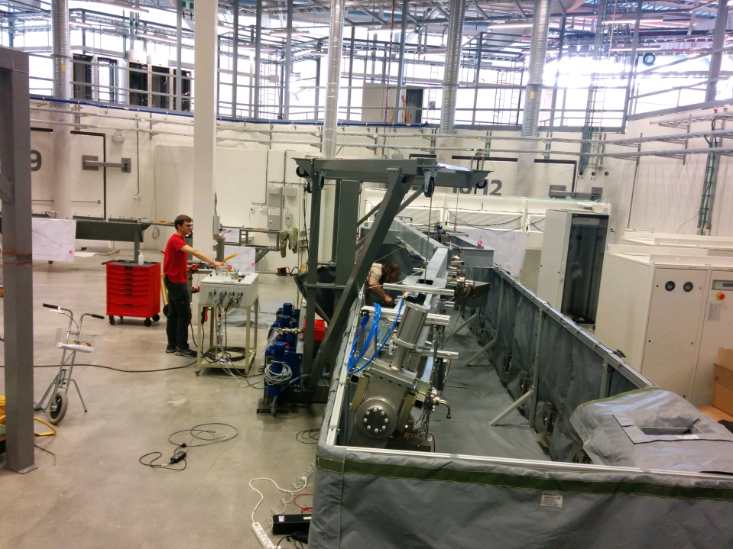
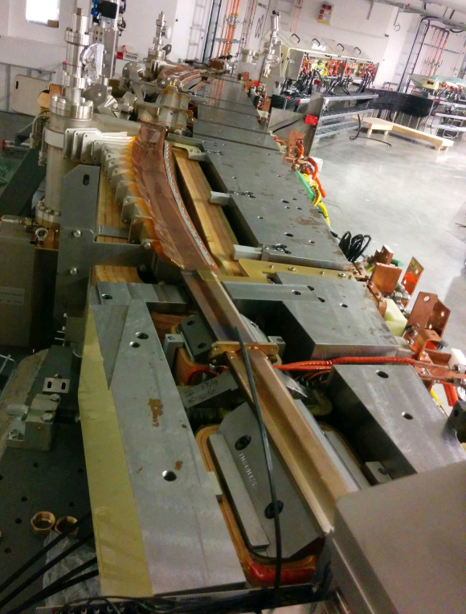
1.5 GeV storage ring vacuum system

Slide 12
MAX IV, 3 GeV storage ring vacuum system.

Slide 13
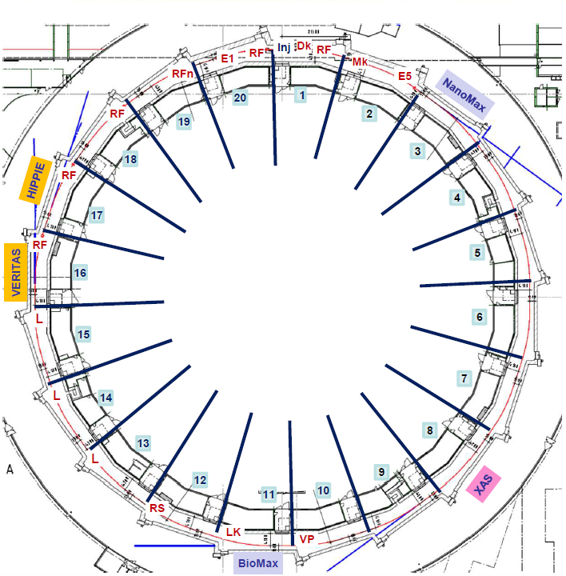
3 GeV ring layout
Emittance measurement
Injection
Circumference 528 m,
20 achromats,
19 straight sections for IDs
  Legend:
  Dk: Dipole kicker (S1)
  Mk: Multipole kicker (L)
  LK: Longitudinal kicker (S2)
  VP: Vertical pinger (S2)
      L=long straight,
      S=short straight,
100 MHz RF cavities
Landau cavities
Installed Insertion Devices:
2 In vacuum undulators (2 m long)
NanoMAX IVU18
BioMAX IVU18
2 EPU (4 m long, min gap 11 mm)
VERITAS EPU48
HIPPIE EPU53
Balder
1 In vac. Wiggler (2.4 m long)
BALDER IVW50

Slide 14
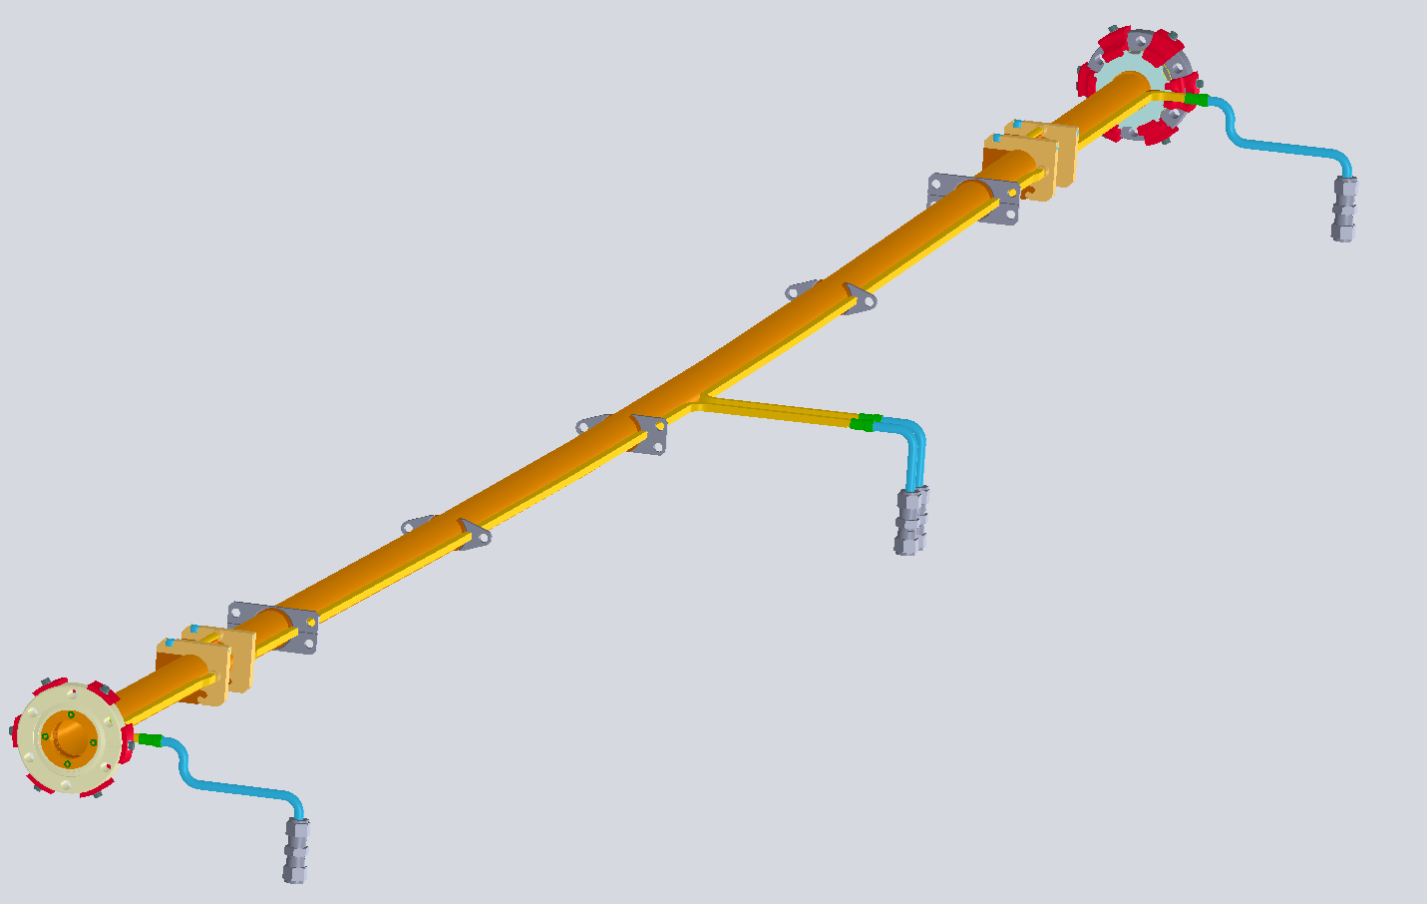
Standard vacuum chamber geometry
One achromat
VC5
Beam direction
Welded bellows
VC5 chamber
Chamber body
Material: OFS copper
Inside diameter: 22 mm,
Total length: 2.5 m,
Bent part
Arc length: 1 m,
Bending angle: 3⁰,
Bending radius: 19 m.
NEG-coated.
Beam direction
Cooling for corrector
Ribs
Welded bellows
Bent part
Distributed cooling
Cooling for corrector

Slide 15
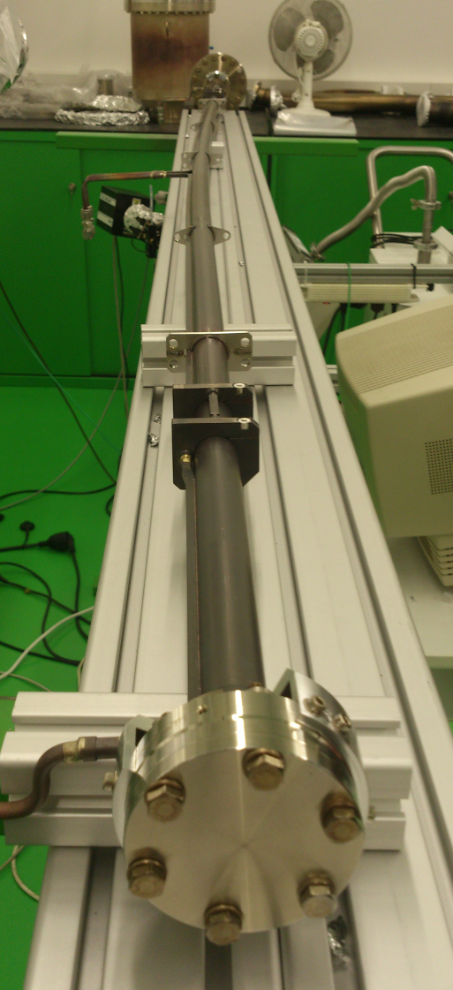
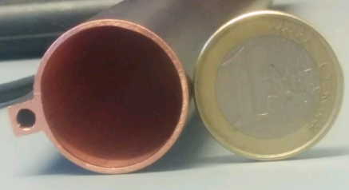
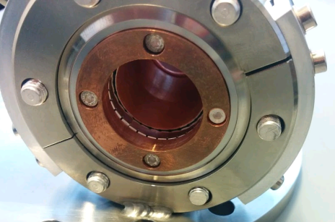
General vacuum chamber geometry
Ribs
Cooling for corrector area
Distributed cooling
Beam direction
Chamber body
Welded bellows

Slide 16
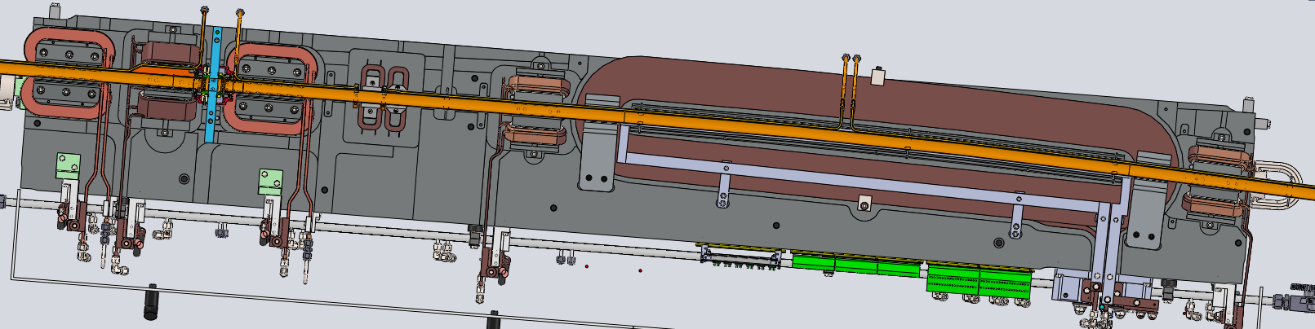
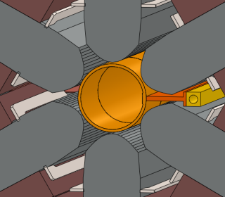
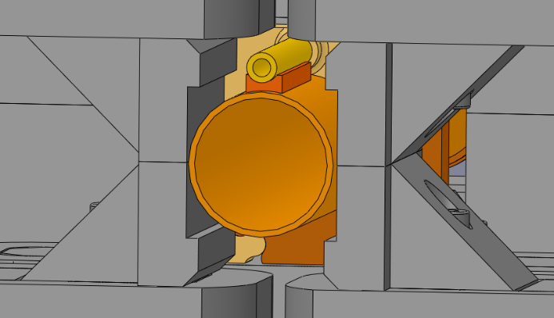
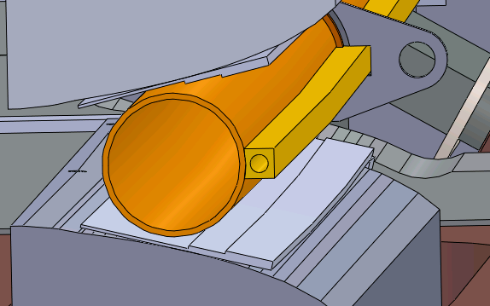
3 GeV magnet layout
One achromat
Photon beam
- Total length ~26 m,
- 4.5 m straight section (L)
Beam direction
U2, VC4
Sextupole
25mm
Corrector
Dipole
Ø22 (ID)
Ø25
Chamber ID 22mm
Magnet apertures Ø25mm
Min. clearance with the iron 0.5 mm, min. clearance with the coils 2 mm.

Slide 17
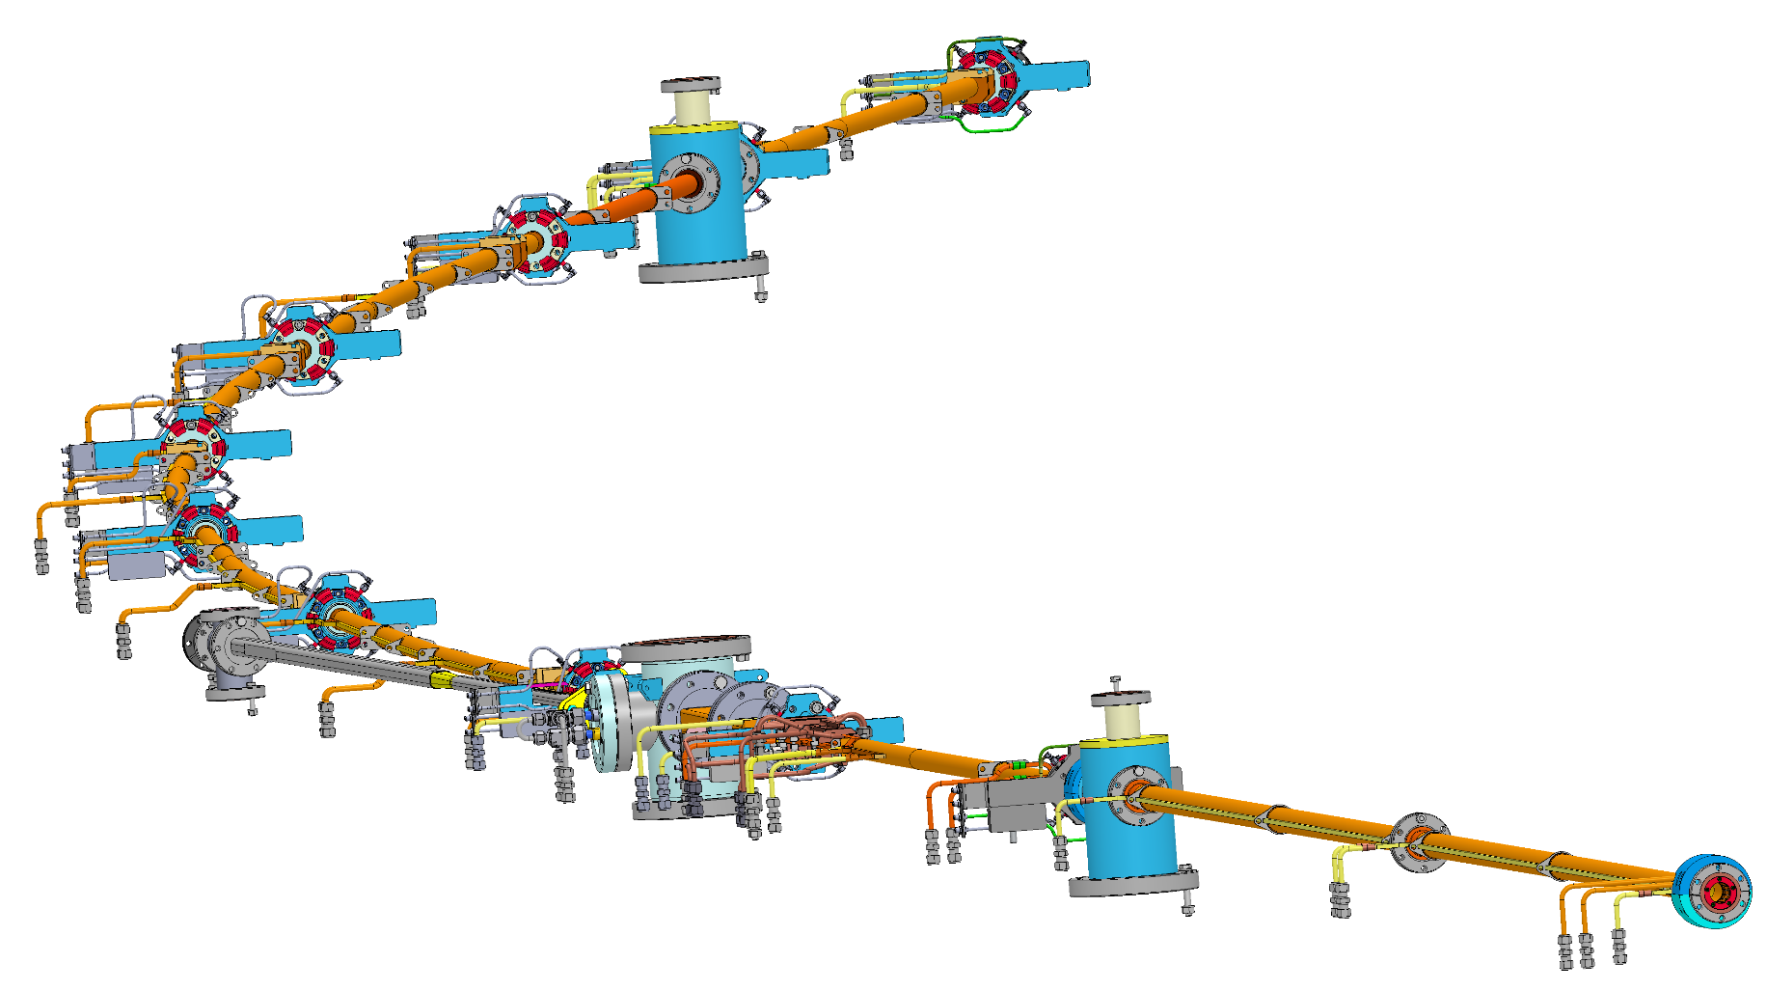
Vacuum achromat layout
One achromat
Beam direction
Penning gauge (S2)
One achromat
Length: ~26m
VC9
VC8
In each achromat:
10 BPMs,
3 pumping ports (with ion pumps) and 1 pump in FE,
1 crotch absorber,
3 gate valves.
VC7
VC6
Extractor gauge (S1)
VC5
VC4
Photon beam
VC3
Electron beam
VC1
VC2
VC10

Slide 18
NEG-coating R&D at CERN
To validate the coating feasibility 3 main stages of NEG (Ti, Zr, V) coating validation by magnetron sputtering in collaboration with CERN were undertaken. (R&D duration ~2 years).
Define and perform initial surface treatment of OFS copper substrate.
Validate compatibility of NEG-coating (adhesion, thickness, activation behavior):
a). on etched OFS copper.
b). on wire-eroded surfaces and used brazing alloys.
3. NEG-coating validation of compact vacuum chamber geometries:
a). Coating and testing of small diameter, bent tubes.
b). Establish coating procedure/technology and coat chambers
of complex geometry.

Slide 19
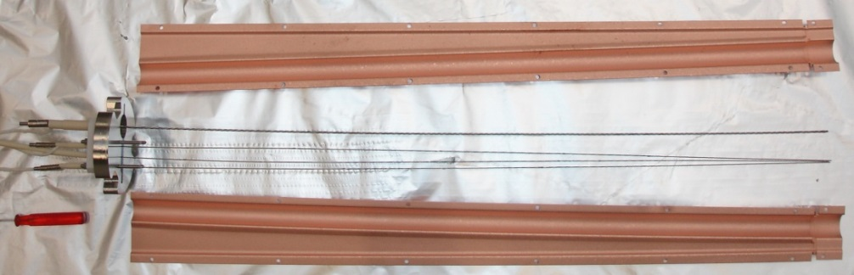
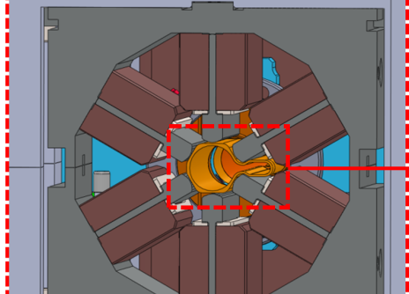

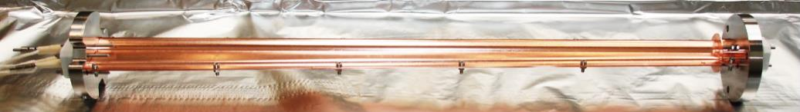
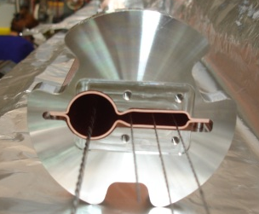
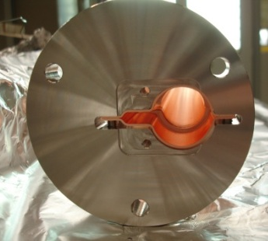
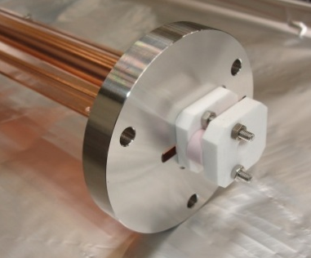
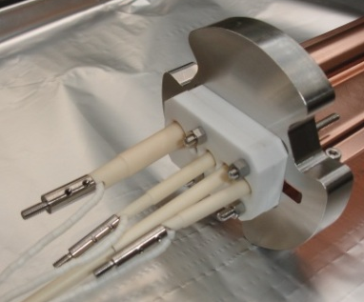
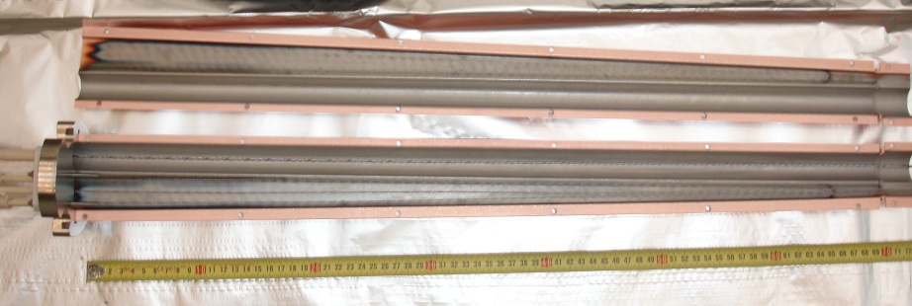
NEG coating: R&D at CERN
Example: Develop coating procedure for chambers with small antechamber –(vertical aperture from 5 to 7 mm).
Aperture limiting sextupole
Chamber exit
Chamber entrance
0.75 m
Ø22
Ø25
7
Prototype made at CERN in two halves to be able to inspect the coating quality.
3
5
Chamber exit
Chamber entrance

Slide 20
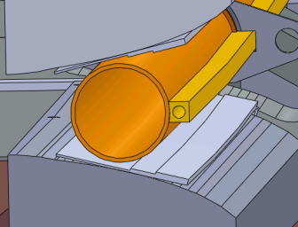
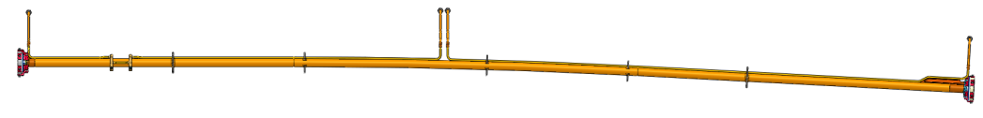

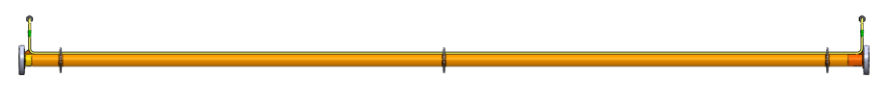
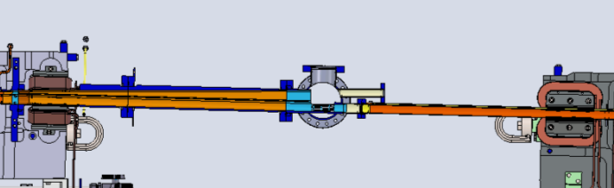
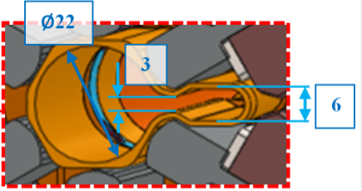
NEG-coating series production
Beam direction
3 GeV - 1 achromat (~26m)
One achromat
Photon beam
VC10
VC2
VC4
Main vacuum chamber types:
1. Standard bent vacuum chambers (VC4) - 1.5⁰ and 3⁰ bends,
Industry (70% length wise)
2.8 m (VC4)
Ø22 mm
3⁰
Ø22
2. Straight vacuum (VC10) chambers,
Collaboration with ESRF (15%)
17.2 mm
2 m (VC10B)
BPM
3. Special/complicated vacuum chambers.
VC2
Photon beam
Collaboration with CERN (15%)
Electron beam

Slide 21
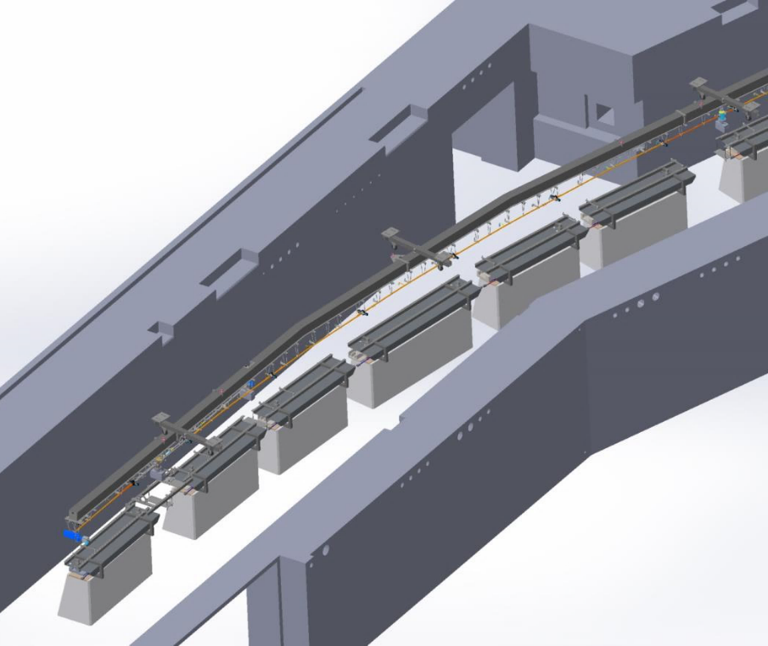
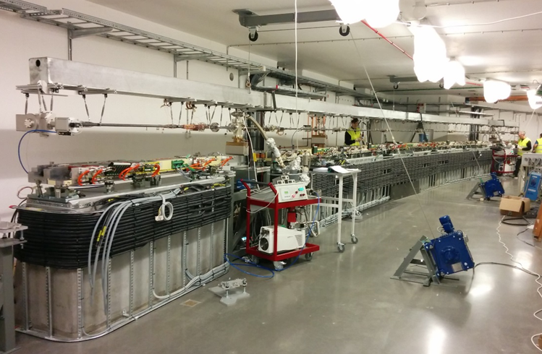
Installation procedure
Ring installation was tested and rehearsed by installing and activating
1 mockup achromat in summer 2014.
Actual installation started in November 2014, ended June 2015
Installation done with help from Budker Institute
Strongback
7 magnet blocks
on concrete girders
7 magnet blocks
on concrete girders

Slide 22
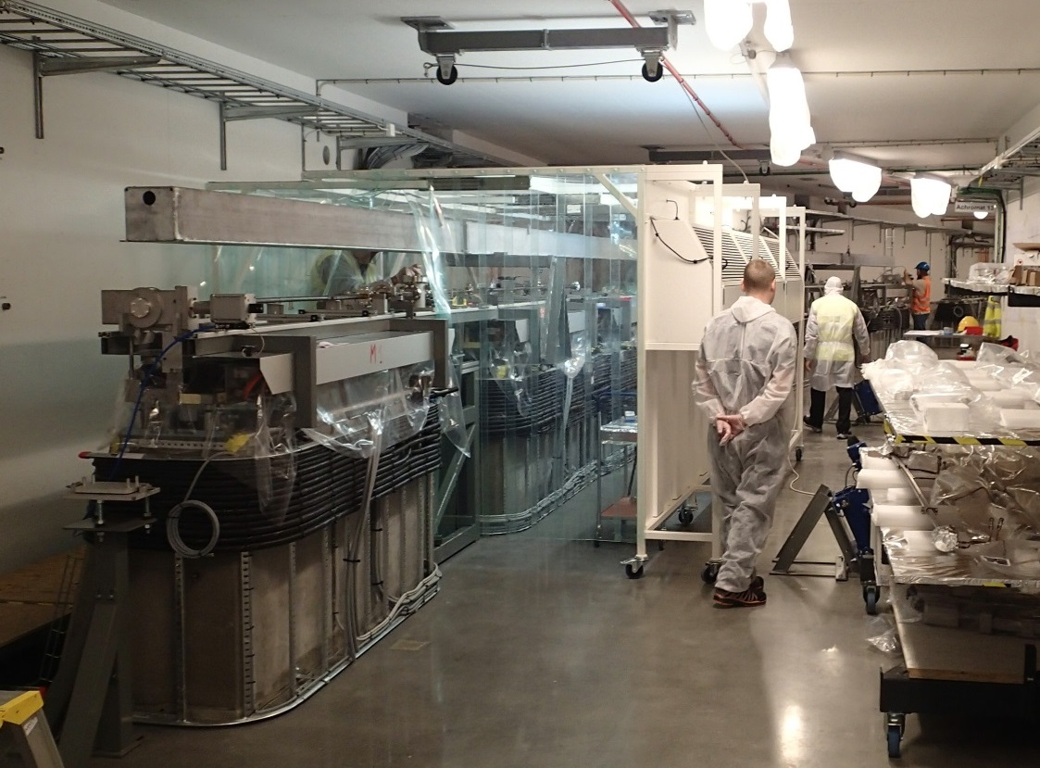
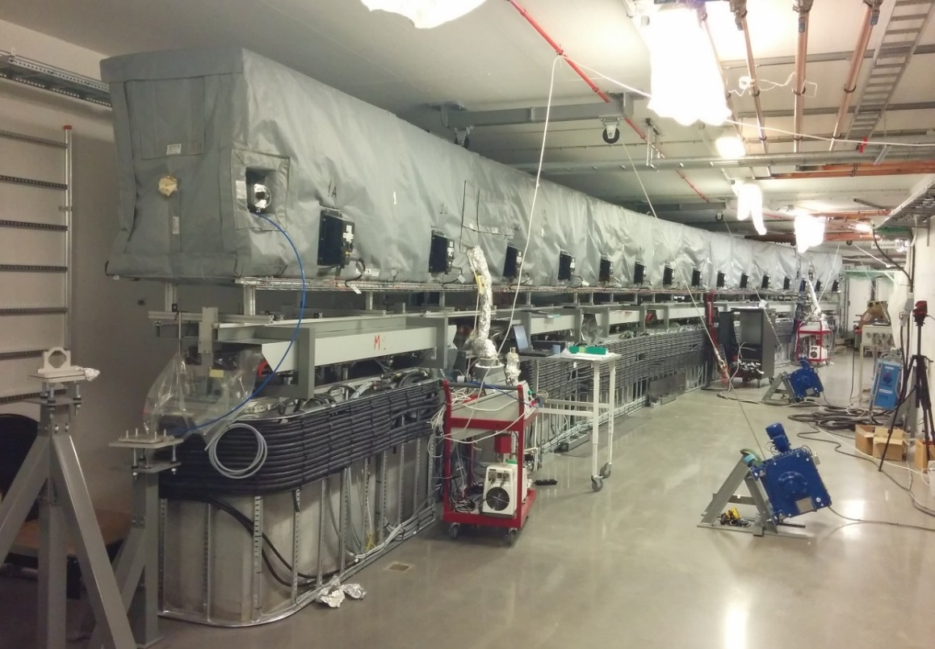
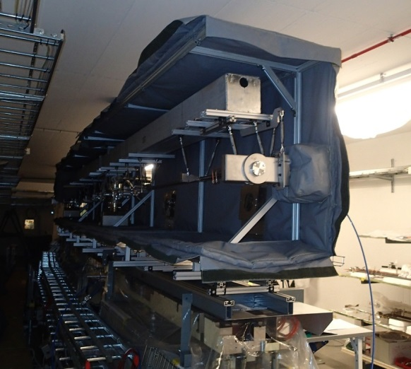
Installation procedure
Assembly in-situ (above magnets),
Pump down and testing,
Lifting,
Bake out (1 day), activation (1 day),

Slide 23
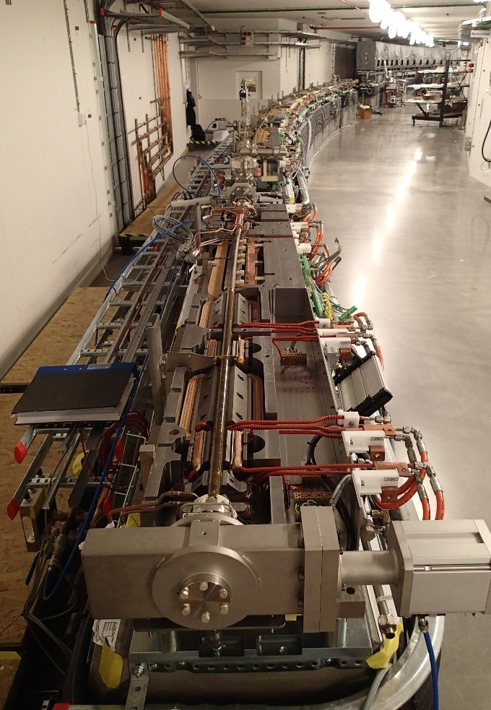
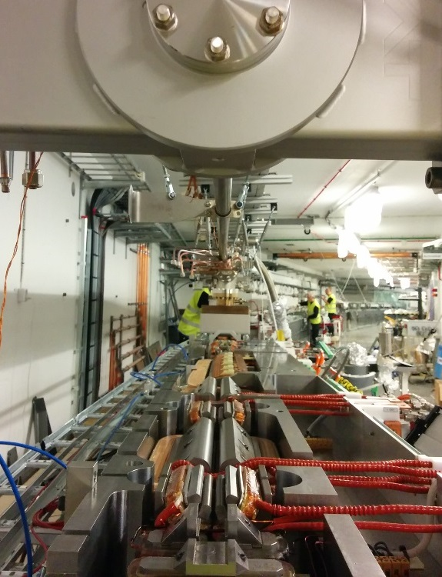
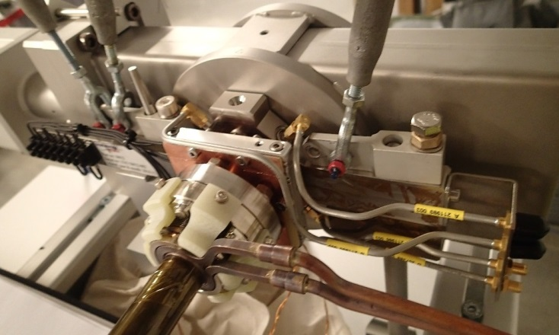
Installation procedure
Lowering to the bottom magnet half,
Installation of final equipment (supports, BPM cables),
Lowering to magnet block.

Slide 24
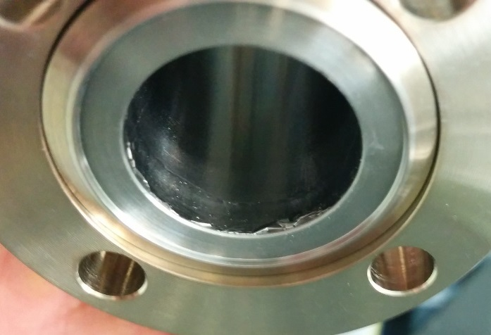
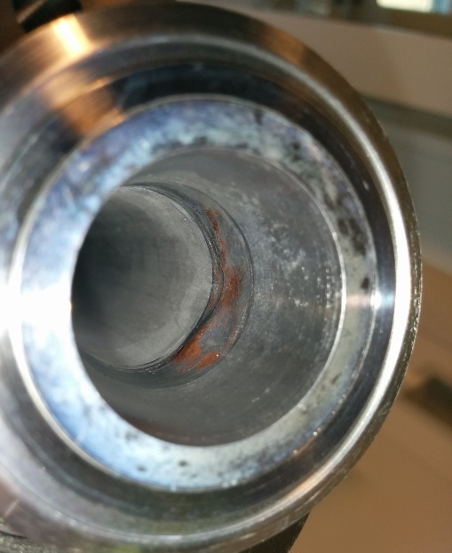
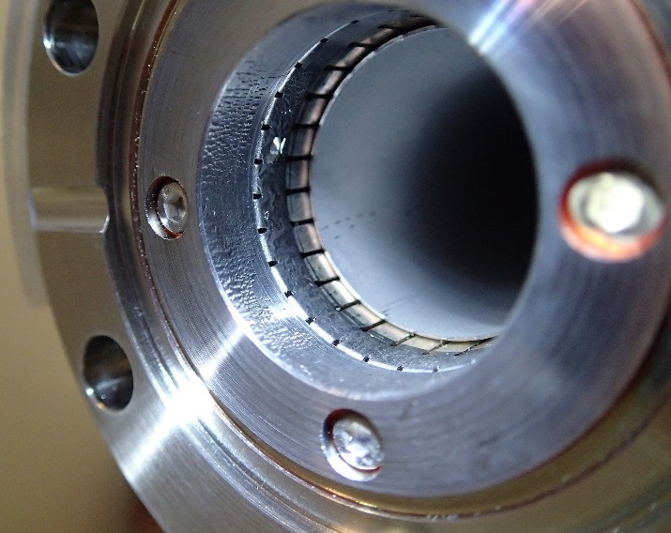
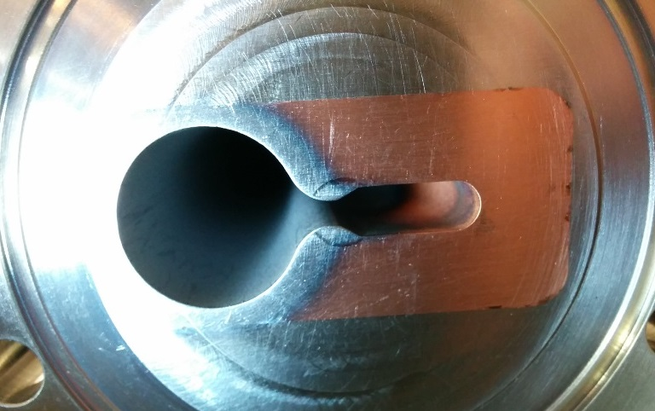
Coating non-conformities
All the chambers were inspected at site before installation.
Peeling-off
Observed peeling-off:
At RF fingers Cu-Be insert and Cu end piece. RF fingers and Cu end were not shielded properly during coating.
Solution: new pieces ordered and replaced (without coating).
Peeling-off at the edge of stainless VC. Chamber not aproved for installation.
peeling-off
Uncoated areas:
Few cm^2 uncoated, in complex chambers.
Uncoated areas
Peeling-off at RF fingers and
Copper end piece

Slide 25
Commissioning
3 GeV ring

Slide 26
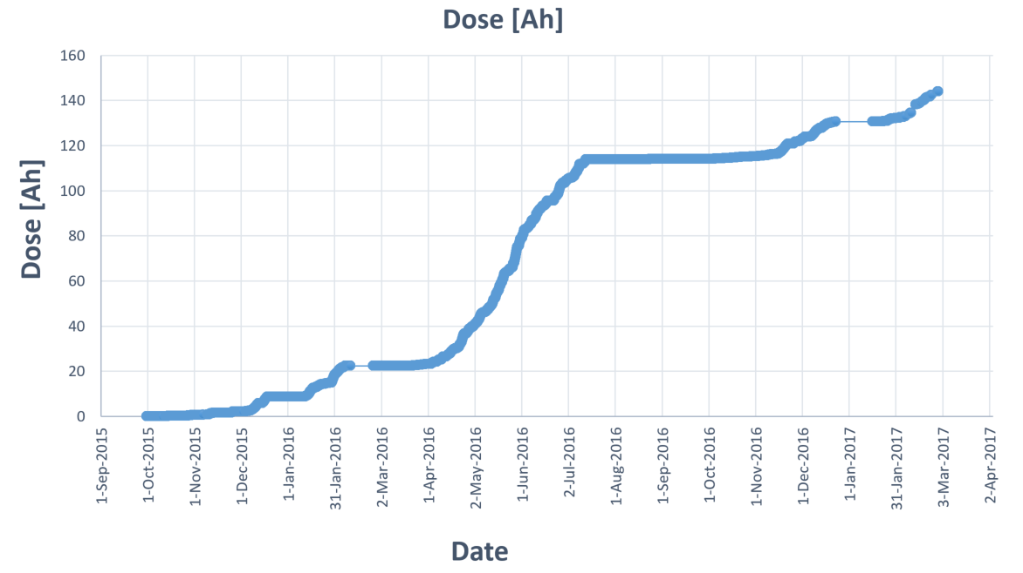
Commissioning progress
3 GeV storage ring commissioning started in August 2015
Average base pressure:
Gauges 2e-10 mbar,
Ion pumps in 8e-11 mbar range.
Accumulated beam dose:
140 Ah.
First shut down
1st shutdown March 2016:
2 in-vacuum undulators,
second shut down
2nd shutdown August 2016:
2 EPU chambers (8x36mm),
In-vacum wiggler.

Slide 27
Pressure vs beam current vs dose
Beam direction
Extractor gauge
Pressures at dose 16 Ah and 95 Ah,
during beam ramp up.
(pressure recorded by extractor gauge at not NEG coated crotch absorber in S1)

Slide 28
Pressure in one achromat vs beam current
Beam direction
Pressures at dose 95 Ah, during beam ramp up, recorded at different positions along achromat (L, S1, S2)
Legend:
Pressure at S1 (ion pump)*
Pressure at S1 (extractor gauge)
Pressure at S2 (penning gauge)
Pressure at S2 (ion pump)
Pressure at L (ion pump)
* Pressure at S1 (Ion pump) probably due to electrical effect

Slide 29
Vacuum conditioning curve
Beam direction
Extractor gauge
Normalized average pressure vs beam dose,
recorded in S1 uncoated crotch absorber, and S2 NEG-coated
Penning gauge
Legend:
Pressure at S1 (extractor gauge)
Pressure at S2 (penning gauge)

Slide 30
Vacuum conditioning curve
ALBA: Raquel Monge, privet communication.
Diamond: M P Cox et al, Commissioning of the diamond light source storage ring vacuum system, Journal of Physics: Conference Series 100 (2008) 092011
Soleil: J.C. Besson, et al COMMISSIONING & OPERATION OF SOLEIL, WAO 2007. PSI - Scientific and Technical Report 2003 / Volume VI
SLS: L. Schulz et al, STATUS REPORT OF THE SLS STORAGE RING VACUUM SYSTEM: EXPERIENCE AFTER TWO YEARS OF OPERATION
ASP: E. Al-Dmour, VACUUM PERFORMANCE IN THE MOST RECENT THIRD GENERATION SYNCHROTRON LIGHT SOURCES, EPAC08.

Slide 31
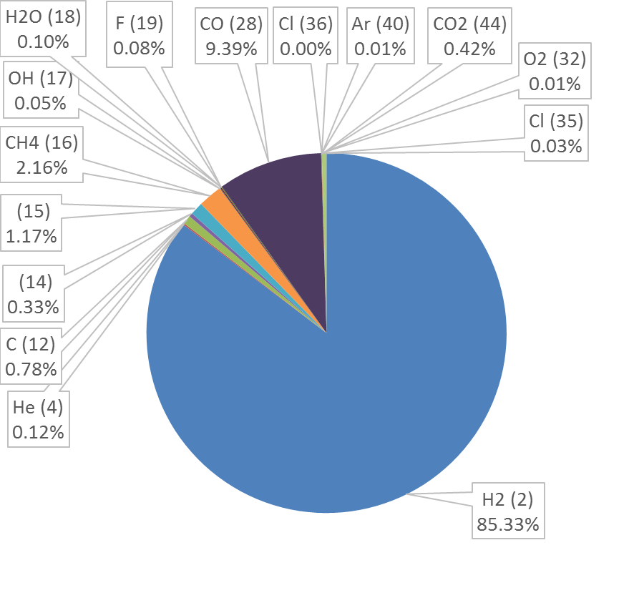
Residual gas spectrum
Residual gas spectrum at 140 mA beam current
Main residual gasses:
Hydrogen 85.33 %,
Carbon monoxide 9.39 %
Carbon dioxide 0.42 %
Methane 2.16-1.17 %
* Mass 16 and 19 is most likely due to intrinsic degassing of the gas spectrometer.

Slide 32

Lifetime evolution
Maximum stored beam current 198 mA

Slide 33


Scraper measurements
Mean lifetime vs vertical scraper distance from the beam center (Done at beam dose 140 Ah)
Total average pressure along the beam path
(contribution from all gasses based on the RGA spectra Z² =5.77)
Mean lifetime, τ (h)
Scraper position from beam center, y (mm)
At 70 mA (dose 140 Ah):
Elastic beam lifetime τ_{elastic} = 163 h
Inelastic beam lifetime τ_{inelastic} = 104 h
Touschek lifetime τ_{Touschek} = 63 h
Pressure as seen by the beam 7.3e-09 mbar

Slide 34
Commissioning
1.5 GeV ring

Slide 35

Commissioning progress
1.5 GeV storage ring commissioning started in Sep. 2016

Slide 36

Vacuum conditioning curve

Slide 37

Lifetime evolution

Slide 38



Problems
Beam direction
RF cavity (S2) venting due to broken high power feedthrough during conditioining (with closed valves). Now cavity is removed from the ring and dummy chamber placed as could not be run with high power anymore. Now awaits conditioning outside the ring. Also pick up loops ceramic parts had leaks.
Hot spots in proximity of crotch absorber (S1), and in the slit between chamber and antechamber, miss-positioning of the crotch chamber, chamber deformation.
Hot spot
Photon beam
e-

Slide 39
Conclusion
MAXIV 3GeV ring vacuum design, production and installation was a challange, it is the first fully NEG coated machine.
NEG coating increased the complexity of the design, production and the installation.
R&D in NEG coating was essential in making a successful production and performance of the chambers.
MAXIV 3GeV ring is under commissioning, with the first users are expecting on April 2017.
The vacuum conditioning is following similar behavior to that of similar machines which used conventional vacuum design.

Slide 40


Thanks for your attention
Acknowledgments:
Jonny Ahlbäck, Marek Grabski, Chiara Pasquino (CERN), Esa Paju, Michael Gilg, Jens Sundberg, Åke Andersson, Pedro F. Tavares.
Collaborators: CERN, ALBA, ESRF, BINP, Soleil.

