Slide 1
Dynamic Vacuum Challenges for Heavy Ion Accelerators
Markus Bender

Slide 2
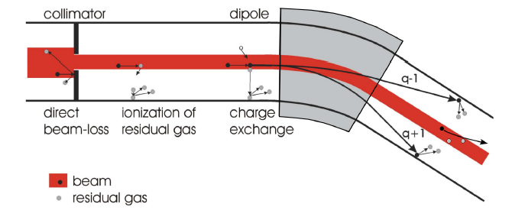
Swift heavy ion-induced desorption
Dynamic vacuum

Slide 3
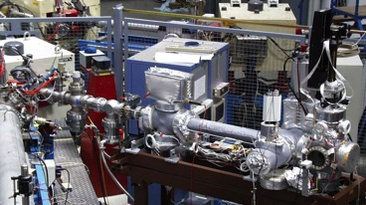
Desorption yield measurements
IP
ion gauge
ion gauge
RGA
collimator
from
accelerator
current
transformer
conductance
10⁻⁷ mbar
sector valve
TMP
TMP
TSP
sample holder
10⁻⁸ mbar
10⁻¹⁰ mbar
desorption yield out of
pressure increase:
(short single pulse, no pumping)
time dependent:
(continuous bombardment)
Experiments by: M. Bender, A. Krämer,
H. Kollmus (GSI), E. Mahner (CERN) 2003

Slide 4
What we measure...
1.4 MeV/u C²⁺ ⇒ Al, perpendicular incidence
scrubbing
Continuous bombardment
1Hz, 9⋅10¹⁰ ions/pulse
total pressure increase [mbar]
Single shot
9⋅10¹⁰ ions/pulse
time [min]

Slide 5
Review of heavy-ion induced desorption data
PRST-AB 11, 104801 (2008)
Courtesy Edgar Mahner
Notes:
We wanted to investigate the material that was irradiated to find a relation between the amount and composition of desorbed gas and the material.

Slide 6
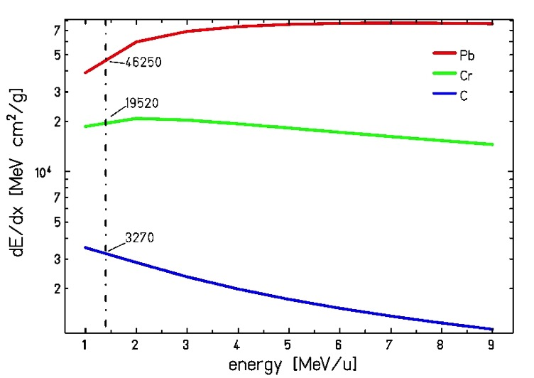
Scaling: Electronic Energy Loss
C, Cr and Pb -> stainless steel, calculated using the CMEE library
n_{eff} [mol./ion]
measurement
1900
300
10
dE/dx
[MeV cm²/g]
46250
19520
3270
(dE/dx)²
normalized
1900
338
9.5
Pb
Cr
C
H. Kollmus, M. Bender, E. Mahner, et al., JVST A 27 (2009)

Slide 7
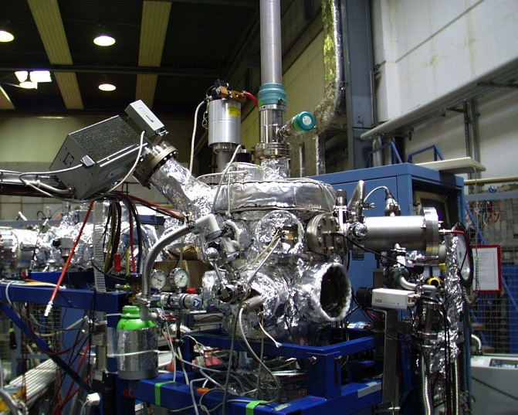
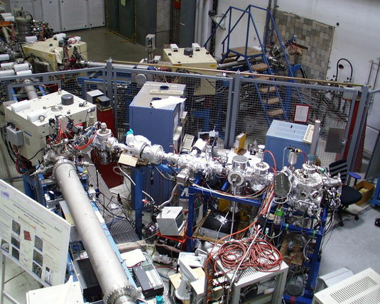
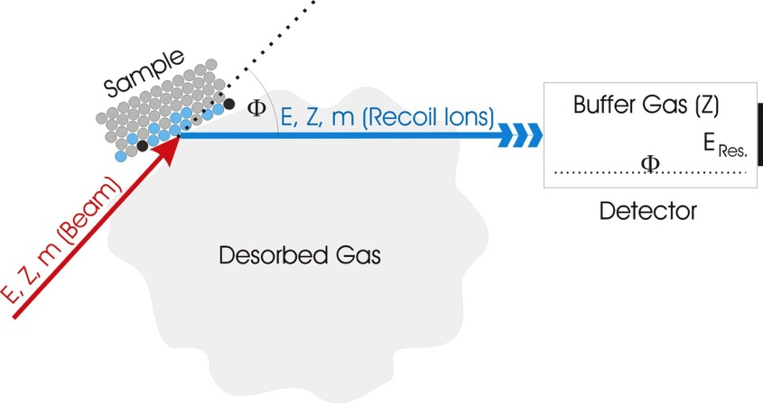
Material Investigation with ERDA
Sample Characterization
Feed Through
RGA
Detector
Beam
à
Desorption Yield Measurement
Faraday Cup
element-specific depth profiling up to ~ 1μm resolution few nm
→ How are the target properties correlated to the desorption?
(surface property, bulk purity, oxidation...)
Xe
Sputter
Source

Slide 8
Contents of Stainless Steel
0 nm
180 nm
O

Slide 9
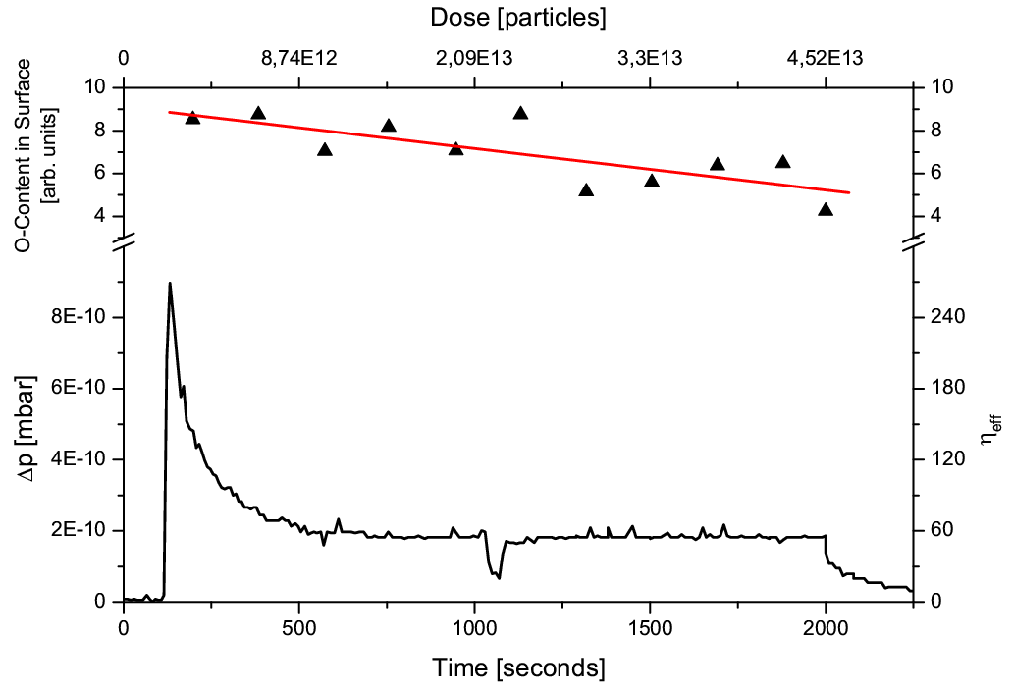
Desorbed Gas ≠ sputtered Oxide Layer
fluence [particles/cm²]
oxide layer
6.5E14 mol/cm² ~ 1ML
desorption
H. Kollmus, M. Bender, W. Assmann, et al., Vacuum 82 (2008)

Slide 10
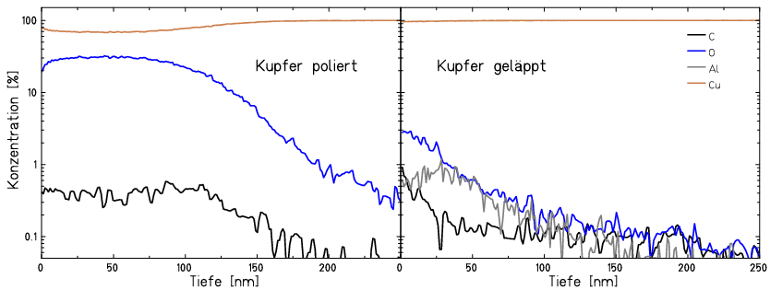
Material Dependence
oxidized copper
metallic copper
+ acid treatment
concentration [%]
depth [nm]
depth [nm]
Cu₂O → insulator:
poor el. & th. conductivity
η~1530 (Proj: 1.4MeV/u Xe)
Cu → conductor:
free electrons moderate energy load
η~350 (Proj: 1.4MeV/u Xe) mainly H₂
mainly CO, H₂, CO₂ for both samples
M. Bender, H. Kollmus, W. Assmann, Nucl. Inst. Meth. B 256 (2007)

Slide 11
Oxidation Prevention
Gold coating
  no oxide layer (noble metal)
  diffusion into copper
  high energy loss dE/dx
  measured yields: η ≲ 200 (1.4 MeV/u Xe)
Rhodium coating
  no oxide layer (noble metal)
  less diffusion
  lower energy loss dE/dx
  measured yields: ≳ 1000 (1.4 MeV/u Xe)

Slide 12
Summary of Experimental Results
Desorbed gas is not the sputtered impurities of the material
Desorbed gas is always CO, CO₂ and H₂
  Also the contents of the residual gas
Link to the substrate
  Insulators (Cu₂O) desorb more than conductors
Higher temperature bakeout of loss regions reduces desorption
  At 350°C highest CO desorption
Thermal moderated surface process with link to the substrate
  Desorption = release of weakly bound surface adsorbats
  Transient overheated spot drives the release
  (dE/dx)²-scaling

Slide 13
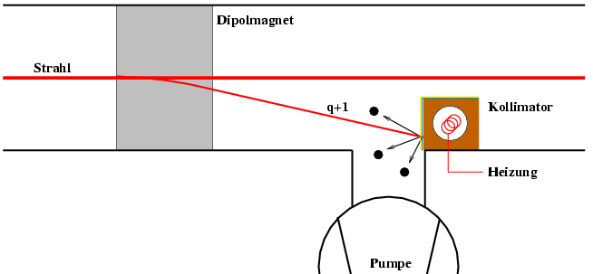
“Cure” for the dynamic vacuum
beam loss collimator
  Gold coated OFHC-copper
    Ni diffusion barrier
  in-situ bake out of the loss sections minimize the desorption
    while cooling down from the UHV bake out collimator is kept at higher temperature
dipole
beam
collimator
heater
pump

Slide 14
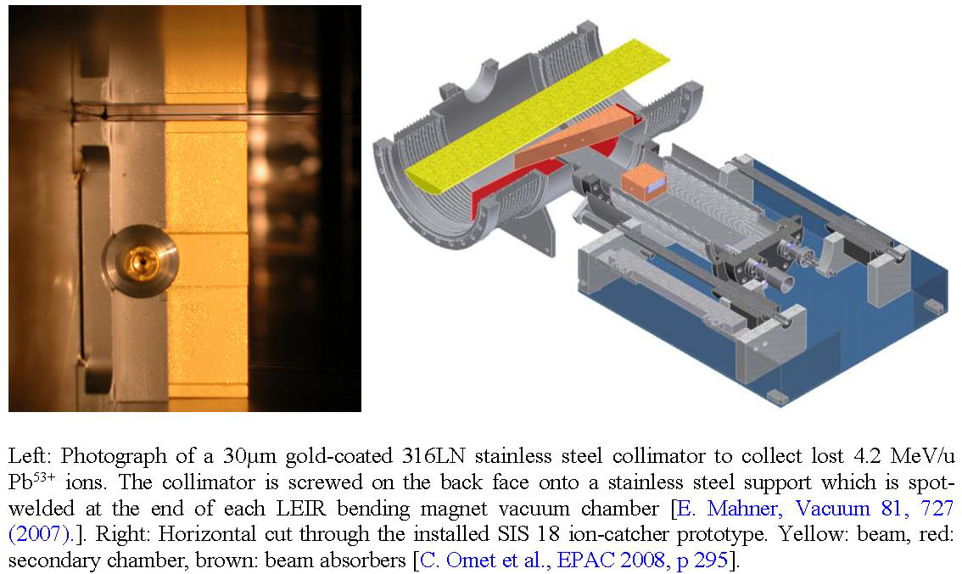
”Cure“ for the dynamic vacuum

Slide 15
Idea of thermal moderated Desorption
How can 1 ion trigger the desorption of some 100 gas molecules?
projectile ion loses energy
(mainly to the electronic system)
inelastic
Thermal
Spike Modell
nuclear collisions
electrons carry energy away
from the ion track
the hot electrons transfer the energy
to the lattice by e-p coupling
thermal desorption due to
enhanced surface temperature

Slide 16
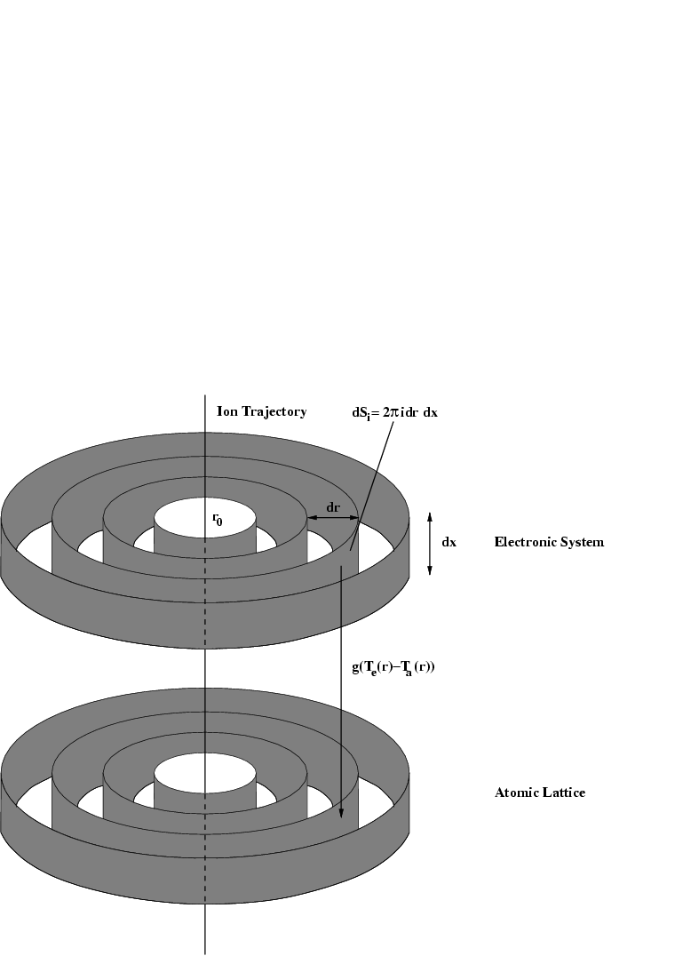
The inelastic Thermal Spike Model
Electronic Subsystem:
Lattice System:
Solving the equations: radial time dependant temperature distribution

Slide 17
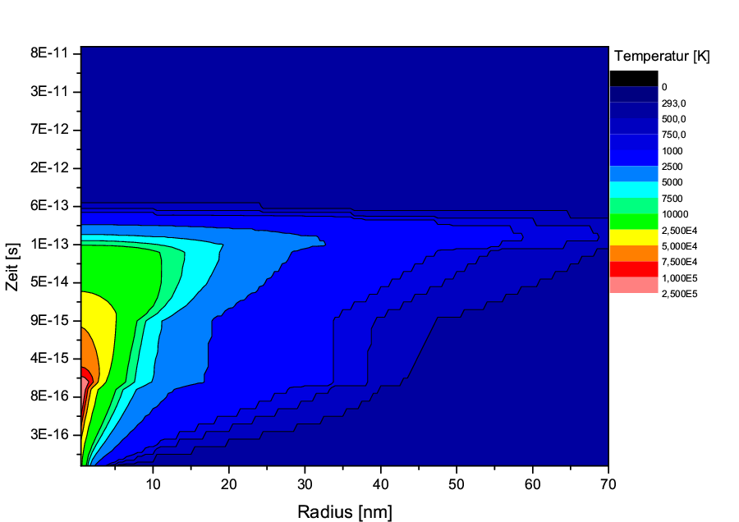
Temperature of the Electrons
(1.4MeV/u Xe→Cu)
temperature [K]
time [s]
radius [nm]

Slide 18
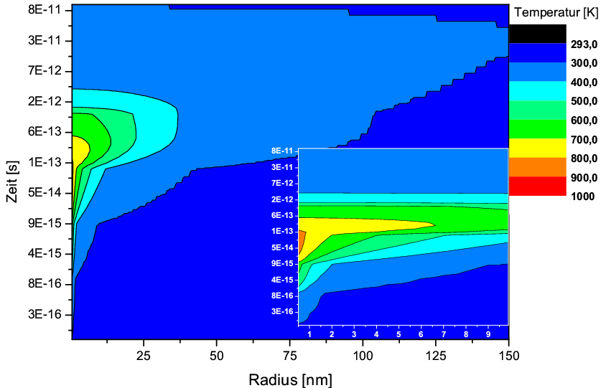
Temperature of the Lattice
(1.4MeV/u Xe→Cu)
temperature [K]
time [s]
radius [nm]

Slide 19
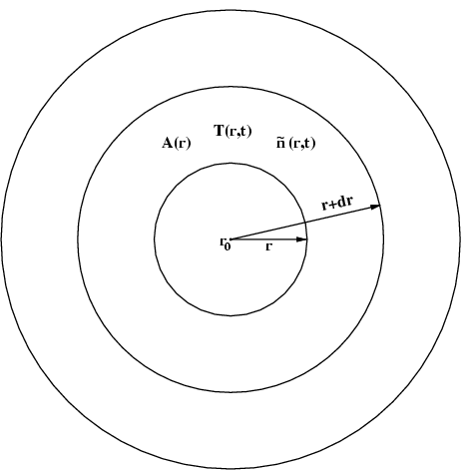
Thermal Desorption
M. Bender, H. Kollmus, M. Toulemonde, et al., Nucl. Inst. Meth. B 267 (2009)

Slide 20
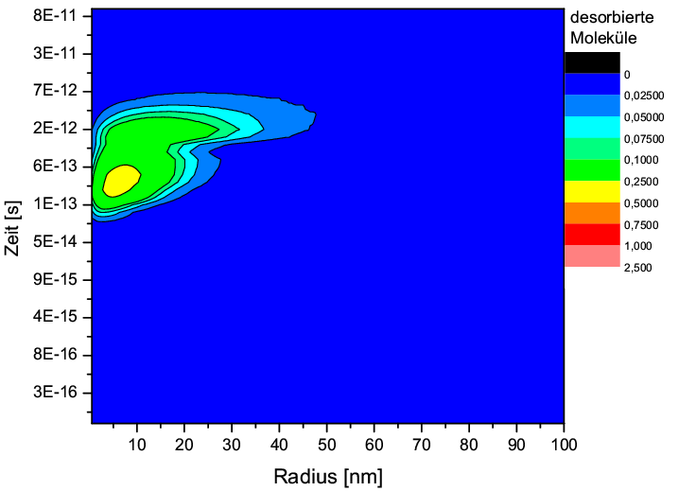
Desorbed Molcules
(1.4MeV/u Xe→Cu)
desorbed molecules
time [s]
radial function, integral over 2π
radius [nm]

Slide 21
Some Numbers
Collision System | experimental value | model value 1 ML; 0,4 eV; 1,5 e ⁻
1,4 MeV/u Xe → Cu | 290...360 | 185
1,4 MeV/u Xe → Au | 90 | 165
1,4 MeV/u Xe → Rh | 1285 | 3400
1,4 MeV/u Xe → Cu₂O | 1530 | 10000
1,4 MeV/u C → Cu | 10 | 5
1,4 MeV/u Cr → Cu | 150 | 40
1,4 MeV/u Pb → Cu | 800 | 525
4,2 MeV/u Pb → Au | 800 | 675
M. Bender, H. Kollmus, M. Toulemonde, et al., Nucl. Inst. Meth. B 267 (2009)

Slide 22
High Intensity on Targets
Spiral2: 5e14 ions per second (S³ @ FISIC)
even with lowest desorption yields (100) and high pumping speed (some 1000 l/s) the system will break down within seconds
AND THE DESORBED GAS WILL BE ACTIVATED!
How to minimize the desorption yield?

Slide 23
Latest Experiments Ca on Au-Ni-Cu
η = 37500→

Slide 24
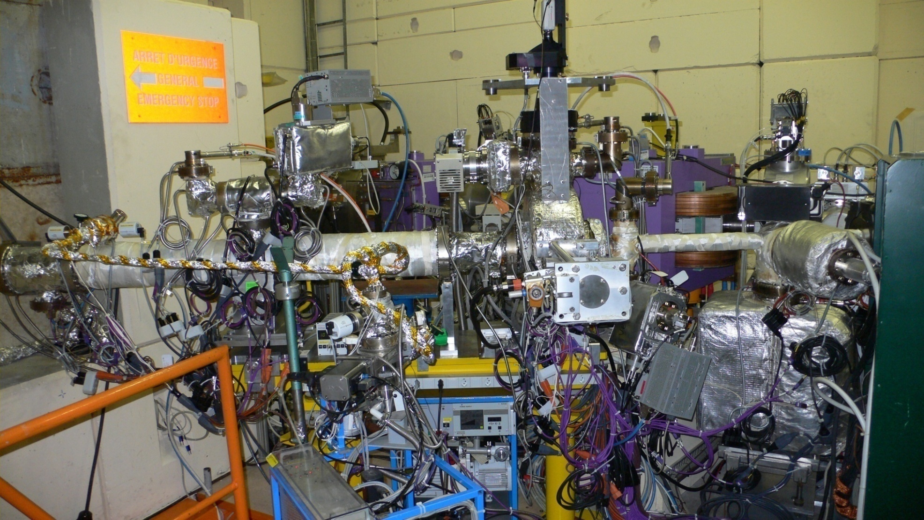
LINAC 3 cryogenic target experiment 2009
27.9.2009
  Bakeable UHV system with 2 RGA's, 2 BAG's, gas injection system, MTV, linac beam control
  Cryogenic target assembly developed
  Static pressure: low 10⁻¹¹ Torr
Courtesy Edgar Mahner

Slide 25
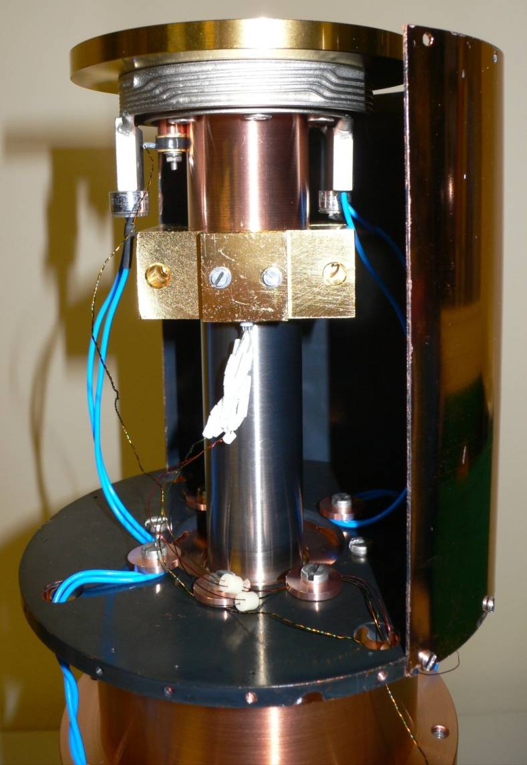
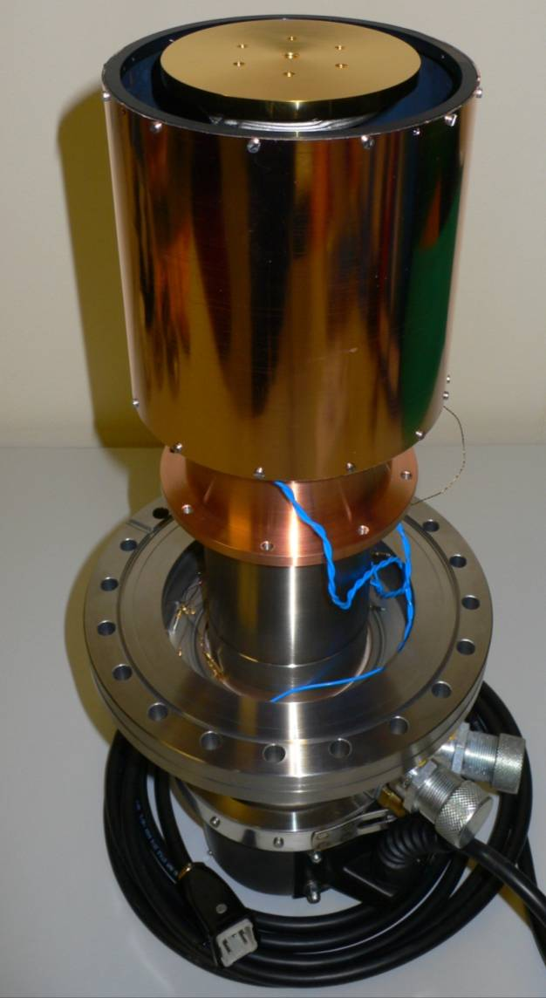
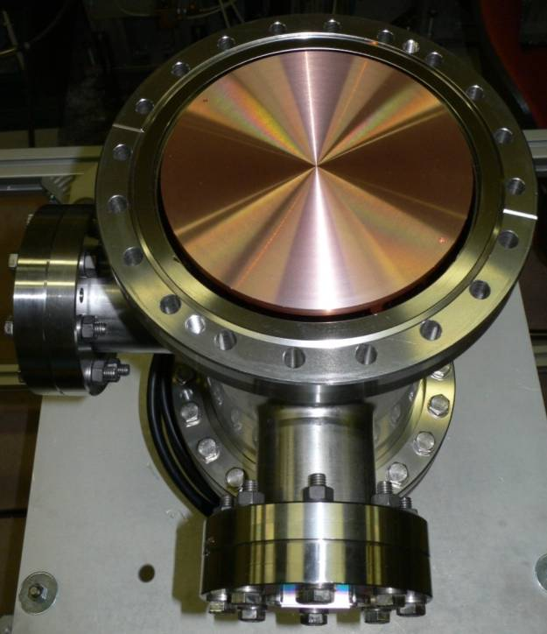
LINAC 3 cryogenic target assembly 2009
E. M. et al. PRST-AB 14, 050102 (2011)
4.9.2009
Assembly with bare Cu target and instrumentation feedthroughs
Ions: Pb⁵⁴⁺ @ 4.2 MeVu,
Impact angle: θ = 0°
Intensity: 1.1-1.5×10⁹ ions/pulse
Targets: bare Cu, Au/Cu
Target temp.: 300, 77, 6.3 K
3.9.2009
3.9.2009
Cryogenic targets: ∅ 141 mm, mounted on a cold-head, 2 samples tested: bare Cu and Au/Cu
Temperature control: 3 sensors (PT100, RhFe, Si diode) + 2 heaters (25 W)
Cu radiation shield: electro-polished outside, coated inside. Lowest target temperature achieved: 6.3 K
Courtesy Edgar Mahner

Slide 26
LINAC 3 pressure rises and desorption yields
Au/Cu target at 300, 77, 6.3 K
Pb⁵⁴⁺ (4.2 MeV/u), Θ = 0°
E. M. et al. PRST-AB 14, 050102 (2011)
Courtesy Edgar Mahner

Slide 27
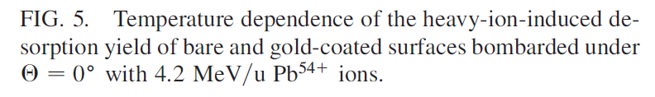
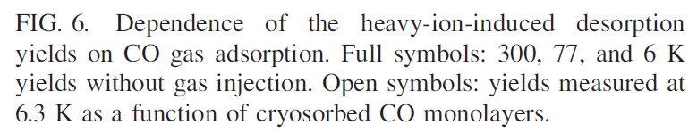
LINAC 3 temperature and CO gas adsorption
Desorption yields for Au/Cu and Cu
Experiments have shown, for the first time, that the heavy-ion induced desorption yield is temperature-dependent.
10 ML
1 ML
Both targets have a factor of ≈18 lower desorption yield at 6.3 K compared to the 300 K value.
E. M., L. Evans, D. Küchler, R. Scrivens, M. Bender, H. Kollmus, D. Severin, M. Wengenroth, PRST-AB 14, 050102 (2011)
Courtesy Edgar Mahner

Slide 28
“Our Expectation": 1 Monolayer
T: Cryo

Slide 29
“Our Expectation": few Monolayers
T: Cryo

Slide 30
“Our Expectation": many Monolayers
?
K (Ice), C (Ice), ...
T: Cryo

Slide 31
Conclusion and Outlook
Ion-induced desorption is still a topic in new accelerator facilities
Dedicated studies needed:
  Cryogenic surfaces (coverage, temperature,...)
  Room temperature (contribution of diffusion from unbaked targets)
Surface and bulk investigations needed
  → ERDA for concentration of light elements
  → XPS for oxides / carbides
Enhance existing model to cryogenic temperatures and diffusion

Slide 32
Conclusion and Outlook
Vaccum diagnostic
Cooled apperture
Electron-gun
Sample →
Flange or window
Cooling /Heating
keV-sputter-gun
Bypass-
valve
UHV-Pump
IZ, TSP
Turbo pump

Slide 33
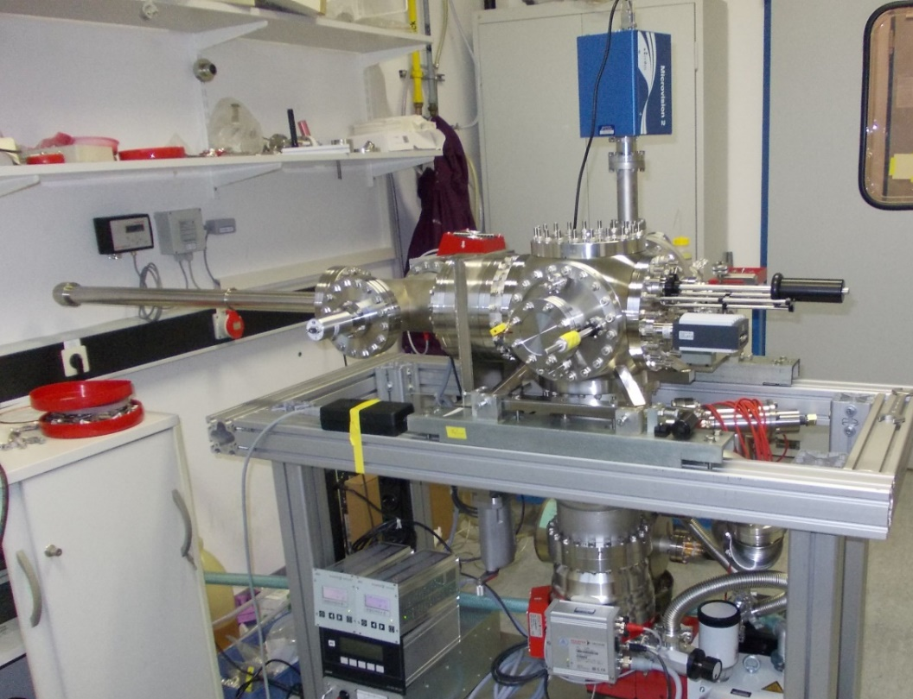
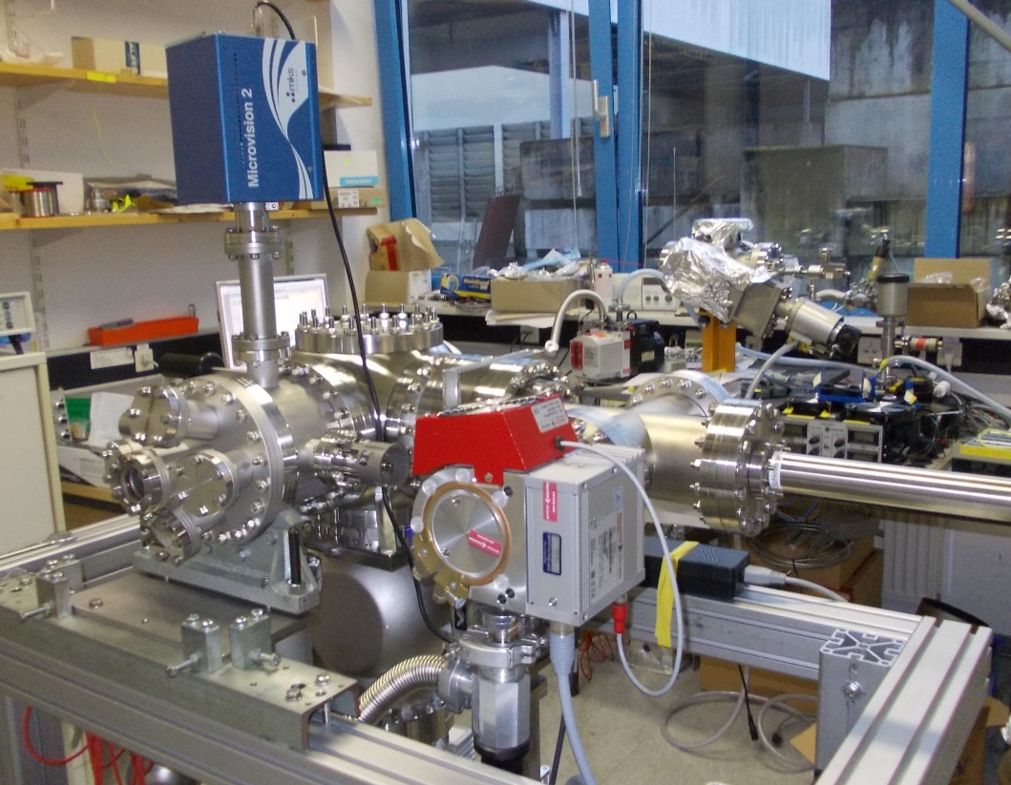
Conclusion and Outlook

Slide 34
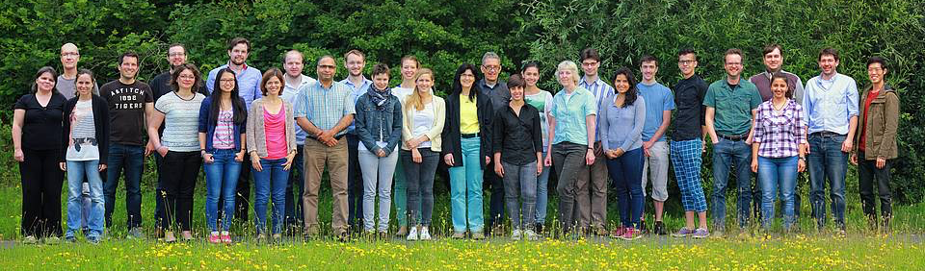
Acknowledgement
GSI: H. Kollmus, A. Warth, L. Bozyk, D. Severin, C. Trautmann, A. Gumberidze
CERN: E. Mahner
IRFU: M. Authier, O. Cloue, A. Drouard
INSP: E. Lamour, S. Mace, C. Prigent, D. Vernhet, S. Steydli
CIMAP: P. Rousseau, M. Toulemonde
GANIL: C. Stodel, R. Levallois
LMU: W. Assmann
HSRM: F. Völklein

