Slide 1
Dynamic vacuum and beam loss challenges at GSI and FAIR
C. Omet
Dpty. Subproject Leader SIS100 / SIS18
Workshop Beam dynamics meets vacuum /KIT
08/03/2017

Slide 2
Content
Dynamic vacuum and beam loss challenges at GSI/FAIR
GSI: SIS18
  Phenomena
  Recipe
  Measurements
  Software tools
FAIR: SIS18 + SIS100
  Recipe
  Forecast

Slide 3
Common statements
For protons:
  Electron clouds can lead to beam dynamics (and vice versa).
For heavy ions:
  Dynamic vacuum ~ beam loss ≠ beam dynamics.
  No non-linear transverse or longitudinal movement of particles in the bucket in the usual definition.
  Beam dynamics can lead to dynamic vacuum effects.
  No (or seldom) electron clouds.
Static beam life time:
  Defined only for 1 particle in the machine.
  Contra-intuitive, as one needs many particles to measure the beam life time correct.
Dynamic beam life time:
  Governed by dynamic (vacuum or other) effects.

Slide 4
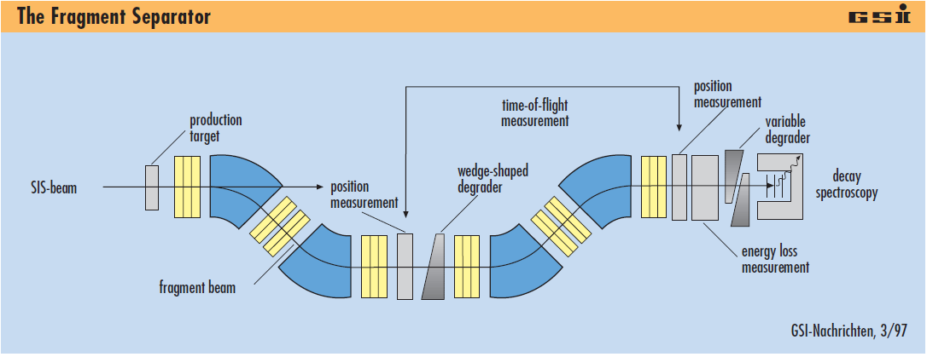
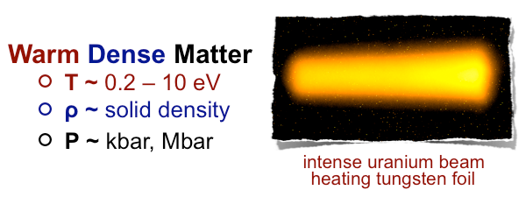
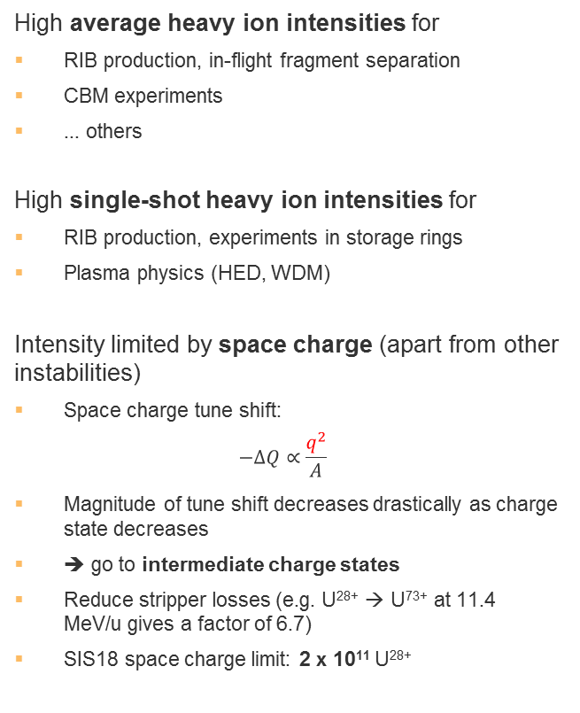
Physics case:
Ultimate Heavy ion intensity
High average heavy ion intensities for
RIB production, in-flight fragment separation
CBM experiments
... others
High single-shot heavy ion intensities for
RIB production, experiments in storage rings
Plasma physics (HED, WDM)
Intensity limited by space charge (apart from other instabilities)
Space charge tune shift:
$$−ΔQ∝\frac{q^{2}}{A}$$
Magnitude of tune shift decreases drastically as charge state decreases
➔ go to intermediate charge states
Reduce stripper losses (e.g. U²⁸⁺ → U⁷³⁺ at 11.4 MeV/u gives a factor of 6.7)
SIS18 space charge limit: 2 x 10¹¹ U²⁸⁺
Why so low?
Institute | Machine | Planned Intensity | Achieved Intensity | Ion species
BNL | AGS Booster |  | 5 x 10 ⁹ | Au³²⁺
CERN | LEIR |  | 9 x 10 ⁸ | Pb⁵⁴⁺
JINR | NICA Booster | 4 x 10 ⁹ |  | Au³²⁺
GSI | SIS18 | 1.5 x 10¹¹ | 3.2 x 10¹⁰ | U²⁸⁺
FAIR | SIS100 | 6 x 10¹¹ |  | U²⁸⁺
Achieved / planned intermediate charge states heavy ion intensities

Slide 5
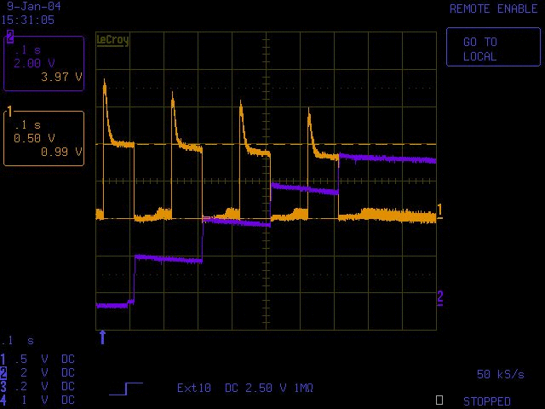
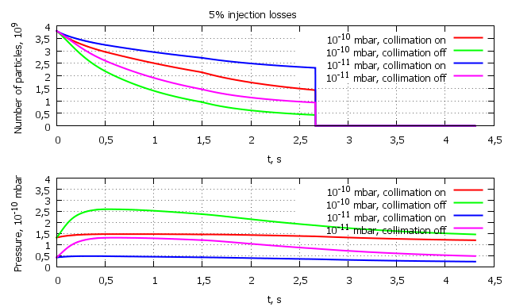
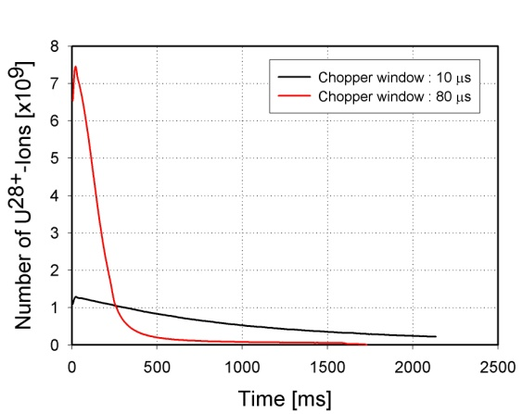
Intermediate Charge State Operation and Beam Loss: Other accelerators
AGS booster (measured)
Intermediate charge state operation suffers from severe charge exchange loss. Ionization beam loss is by far the dominating loss process and begins much earlier the space charge and current dependent effects.
NICA booster (predicted)
SIS18 (measured in 2001)
Space charge limit: 2x10¹¹

Slide 6
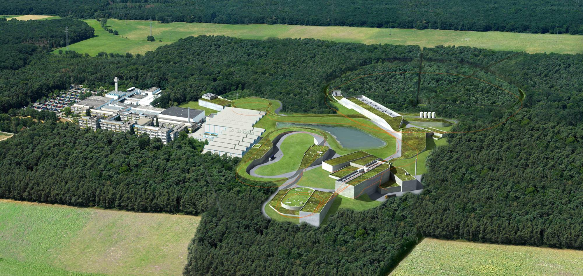
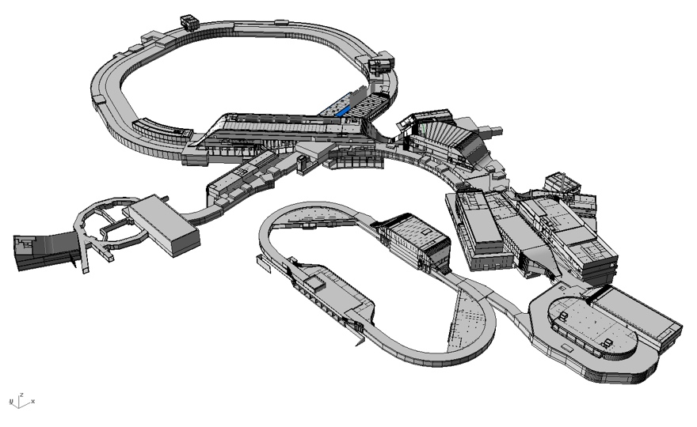
SIS100 - Heavy Ion Beams for FAIR
SIS100 beam parameters:
Every ion from p to U
U²⁸⁺ -ions for RIB production:
  5x10¹¹ / cycle
  Rep. rate: 0.5 Hz
  Energy: 400–2715 MeV/u

Slide 7
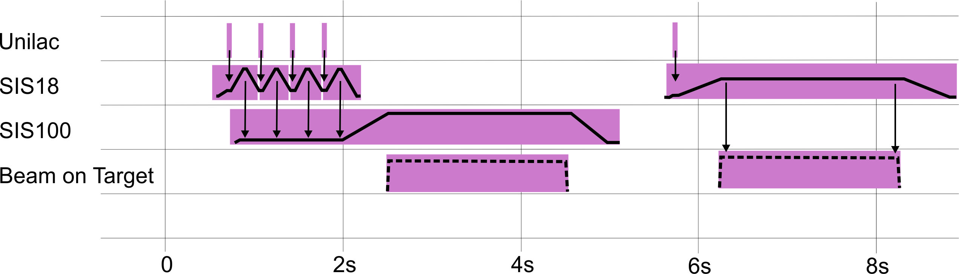
Intensity Requirements in SIS18 for FAIR
FAIR stage | Today | Stage 0 (Existing Facility after upgrade) | Stage 1 (Existing Facilty supplies Super FRS, CR, [HESR]) | Stage 2 (SIS100 Booster)
Reference Ion | U⁷³⁺ | U⁷³⁺ | U⁷³⁺ | U²⁸⁺
Maximum Energy | 1 GeV/u | 1 GeV/u | 1 GeV/u | 0.2 GeV/u
Maximum Intensity | 4x10⁹ | 2x10¹⁰ | 2x10¹⁰ | 1.5x10¹¹
Repetition Rate | 0.3 - 1 Hz | 1 Hz | 1 Hz | 2.7 Hz
SIS100:
5x10¹¹ U²⁸⁺ ions per cycle
3x10¹¹ U²⁸⁺ ions per second

Slide 8
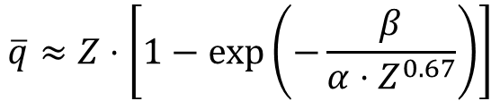
Equilibrium charge state:
Qualitative understanding
$$\overline{q}≈Z⋅\left[1−\exp\left(−\frac{β}{α⋅Z^{0.67}}\right)\right]$$
2015 intensities!
Ion | Charge state after gasstripper @ 1.4 MeV/u @11.4 MeV/u | q_equ (SIS18 in, 11.4 MeV/u) | q_equ SIS18 out ([MeV/u]) | q_equ SIS100 out ([GeV/u])
p | 1+ | 1+ | 1+ (4000) | 1+ (28.8)
Ne | 7+ 10+ | 10+ | 10+ (1150) 10+ (1990) | 10+ (9.5) 10+ (13.9)
Ar | 10+ 18+ | 17+ | 18+ (710) 18+ (1670) | 18+ (6.6) 18+ (12.6)
Kr | 16+ 34+ | 31+ | 36+ (500) 36+ (1650) | 36+ (4.9) 36+ (12.0)
Xe | 21+ 48+ | 42+ | 54+ (360) 54+ (1310) | 54+ (4.0) 54+ (10.1)
Ta | 24+ 61+ | 51+ | 72+ (260) 73+ (1170) | 73+ (3.2) 73+ (9.2)
Au | 24+ 64+ | 54+ | 78+ (220) 79+ (1110) | 79+ (2.8) 79+ (8.9)
U | 28+ 73+ | 59+ | 90+ (196) 92+ (1020) | 92+ (2.7) 92+ (8.3)
Charge exchange cross sections increase for projectile charge states farther from equilibrium charge states
No problems for light ions → proton machines are “easy”!
Problems for heavy ions → corresponds to reality!

Slide 9
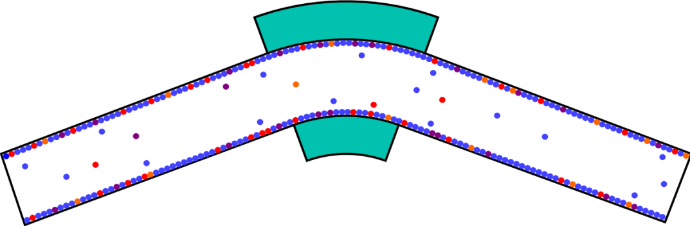
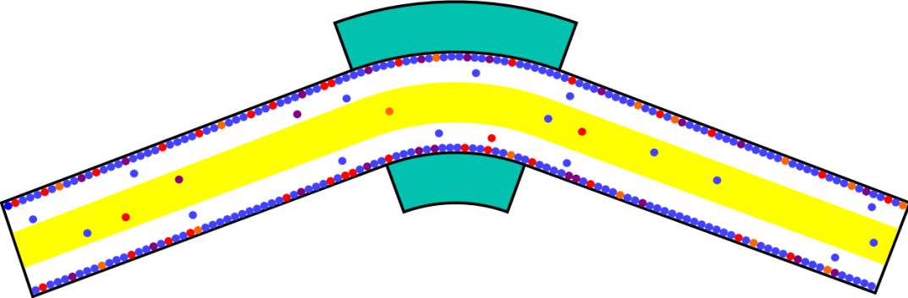
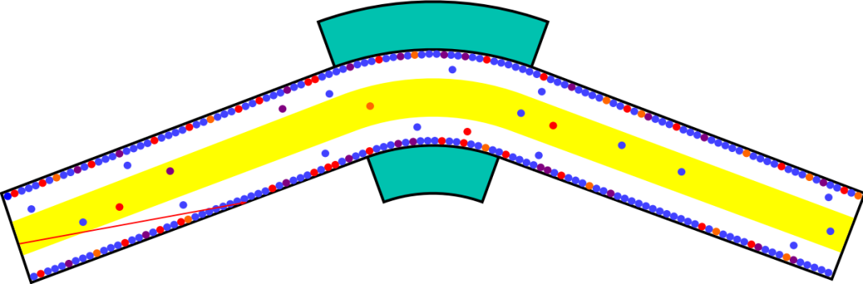
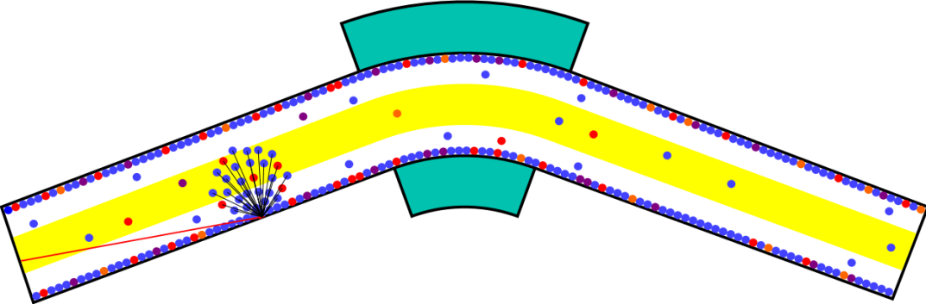
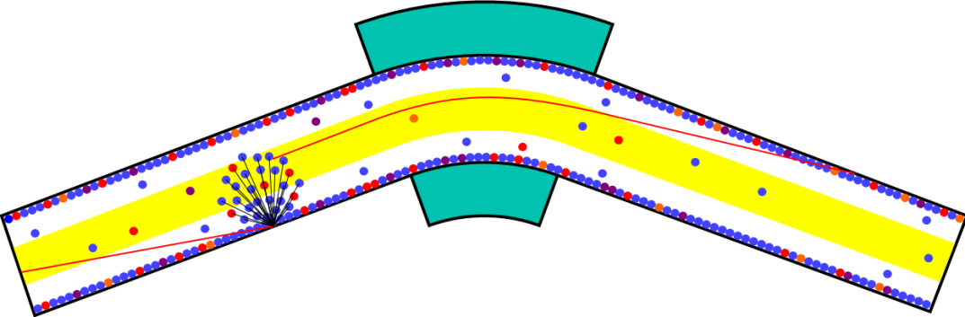
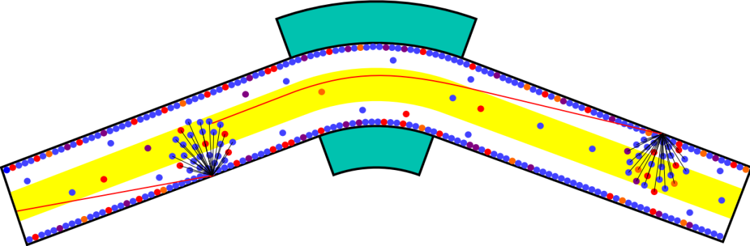
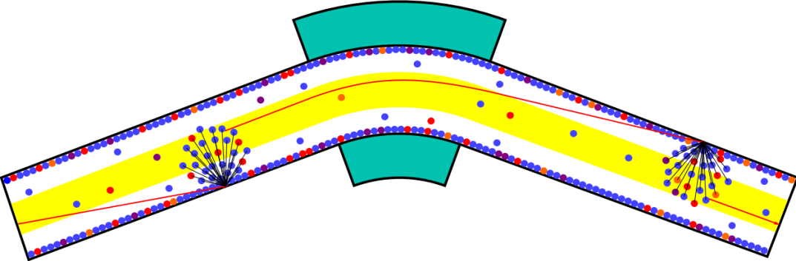
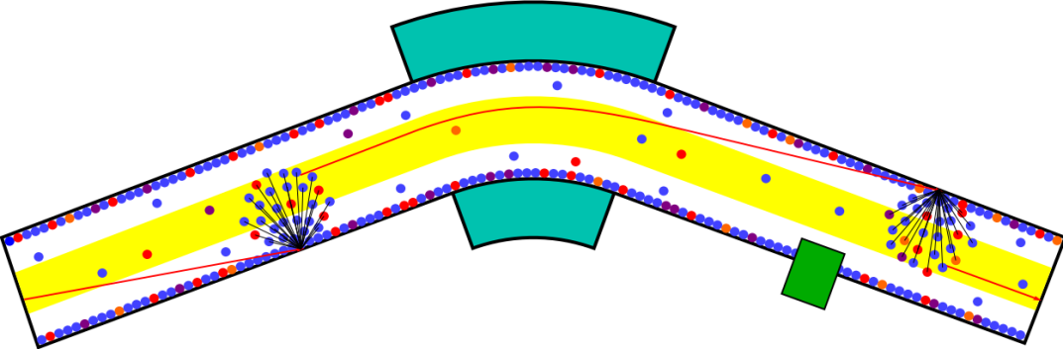
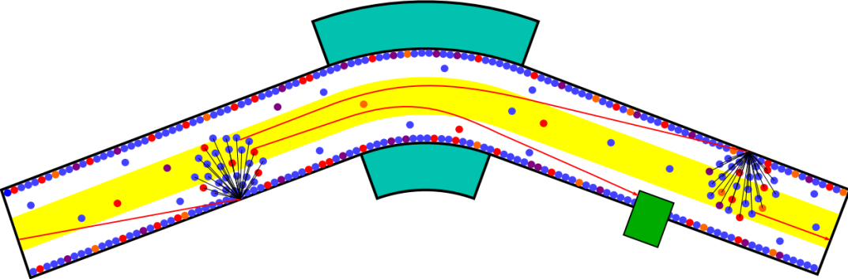

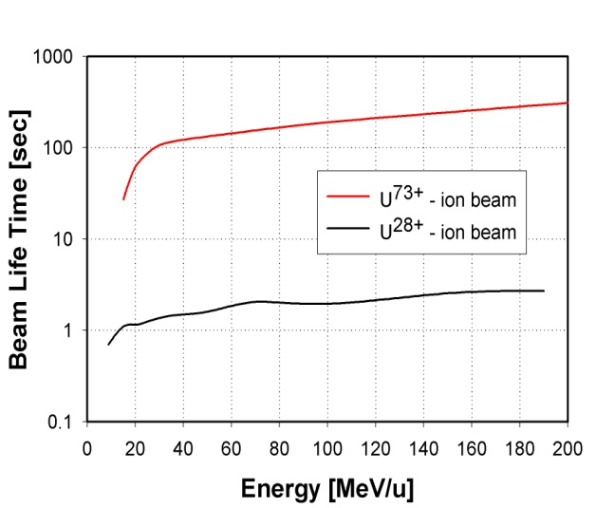
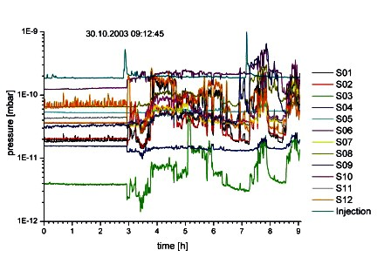
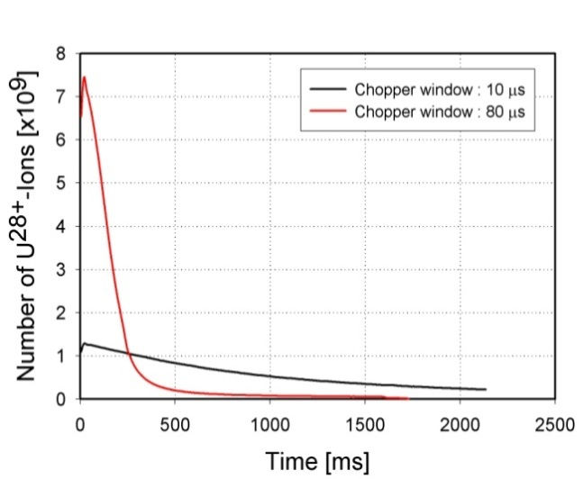
Ionization Beam Loss and Dynamic Vacuum
adsorbed
residual gas
dipole
electron capture
desorption
desorption
electron loss
beam loss
further
charge exchange
s.c. limit: 2x10¹¹
Main issues of the SIS18 Booster operation:
Life time of U²⁸⁺ is significantly lower than of U^{73+.}
Life time of U²⁸⁺ depends strongly on the residual gas pressure.
Ion induced gas desorption (η≈20 000) increases the local pressure.
Beam losses increase with intensity (dynamic vacuum).

Slide 10
High Intensity, Low Charge State
Heavy Ion Operation
Main issue: Dynamic vacuum
  Projectile electron stripping or capture by residual gas interaction
  Direct ion loss behind dispersive elements
  Ion impact stimulated desorption (multipacting factor η=25000): Local pressure rise
SIS18 serves as a test facility
for the development of
  new accelerator concepts
  new technologies and
  the understanding
  - to overcome vacuum instabilities and ionization beam loss during high intensity heavy ion operation.
adsorbed
residual gas
dipole
electron capture
desorption
desorption
electron loss
Avalanche!
beam loss
further
charge exchange
collimator / ion catcher

Slide 11
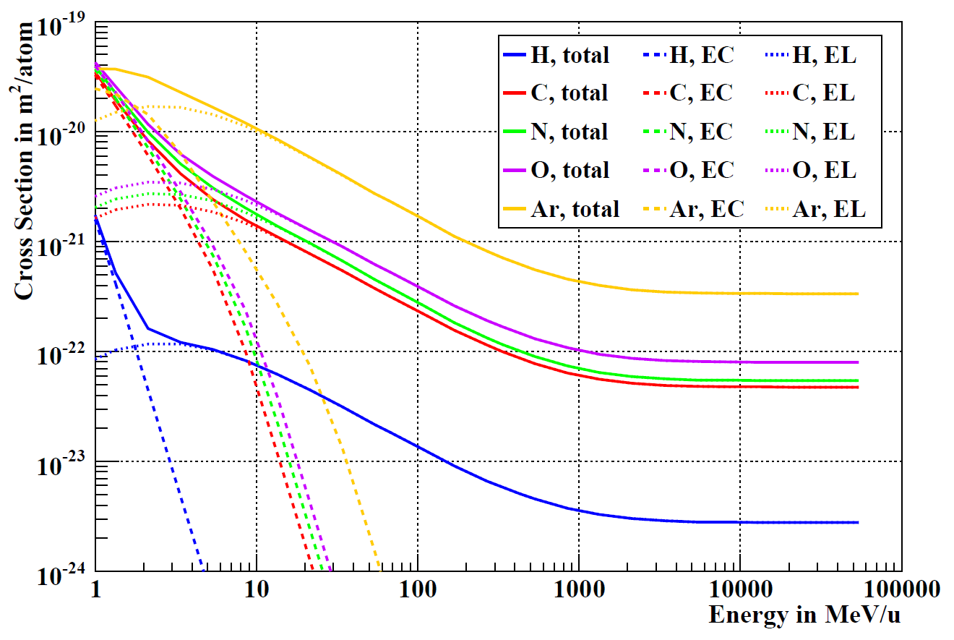
Ionization and e⁻-capture cross sections
(plot is for U²⁸⁺ projectiles)
EL = Electron loss (ionization)
EC = Electron capture
Former injection energy SIS18
New injection energy SIS18
Injection energy of SIS100

Slide 12
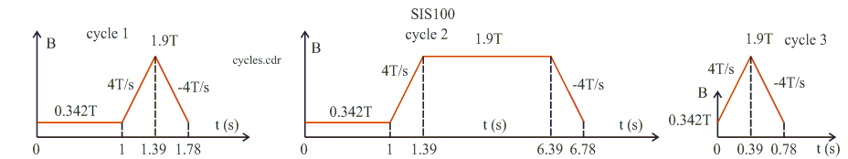
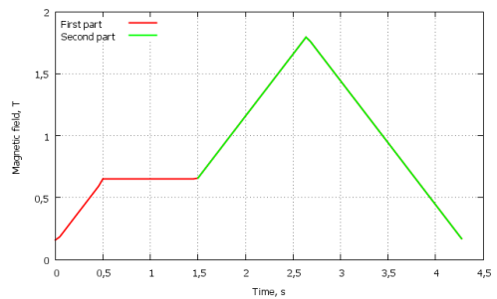
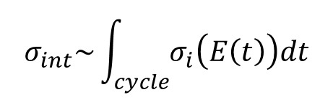
Machine Cycles and Integral Cross Section
SIS100 cycles
NICA booster cycle
Integral cross section for e⁻-capture or e⁻-loss depends on the specific machine cycle.
$$σ_{int}\sim \int_{cycle}{σ_{i}\left(E\left(t\right)\right)dt}$$
LEIR cycle

Slide 13
Strength of Charge Exchange and Dynamic Vacuum
Charge exchange loss and dynamic vacuum scale with : [N x σ_{int} ] x f_{rep}
Machine | Institute | Ion species | Total integ. cross section σ_{int} | Number of ions per cycle | N x σ_{int} | f_{rep} [Hz] | N * σ_{int} * f_{rep}
AGS Booster | BNL | Au³¹⁺ | 4.5x10⁻²¹ | 5x10 ⁹ | 2.2x10⁻¹¹ | 5.00 | 1.1x10⁻¹⁰
LEIR | CERN | Pb⁵⁴⁺ | 5.5x10⁻²⁰ | 1x10 ⁹ | 5.5x10⁻¹¹ | 0.25 | 1.4x10⁻¹¹
NICA Booster | JINR | Au³²⁺ | 4.9x10⁻²¹ | 4x10 ⁹ | 1.9x10⁻¹¹ | 0.25 | 4.7x10⁻¹²
SIS18 | GSI | U²⁸⁺ | 8.7x10⁻²² | 1.5x10¹¹ | 1.3x10⁻¹⁰ | 3.00 | 3.9x10⁻¹⁰
SIS100 | FAIR | U²⁸⁺ | 1.8x10⁻²¹ | 6x10¹¹ | 1.1x10⁻ ⁹ | 0.50 | 5.5x10⁻¹⁰
Figure of merit

Slide 14
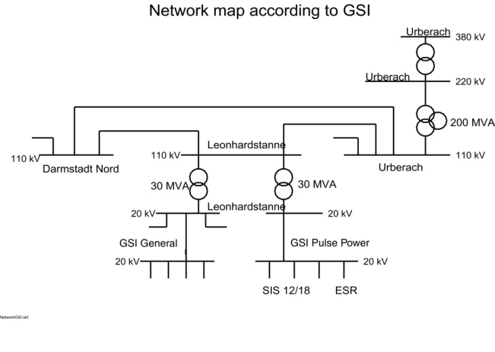
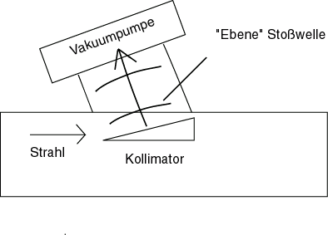
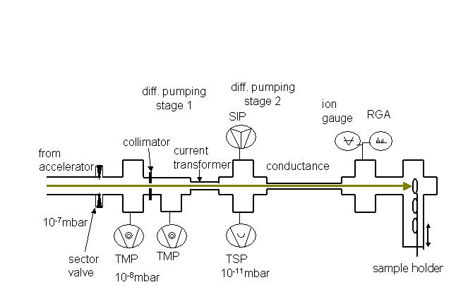
SIS18 Pressure Stabilization - Recipe
Short cycle times and short sequences
  SIS18: 10 T/s – 4 batch sequence for SIS100 injection
  New power grid connection, power converters and RF system
Enhance pumping power (UHV upgrade)
  NEG-coating - local and distributed
  new magnet chambers, improved bake out system
Localizing beam loss and control/suppression of desorption gases
  Catcher system, Lattice design
  Materials with low desorption yields
  η-Teststand, ERDA measurements
Minimum „effective“ initial beam loss
  Halo collimation in TK to SIS18
cryo pump
increased pressure
ion beam
wedge collimator
  see presentation of M. Bender

Slide 15
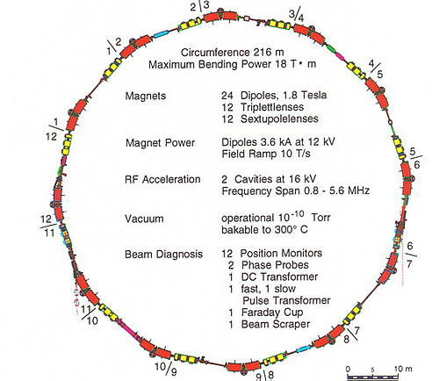
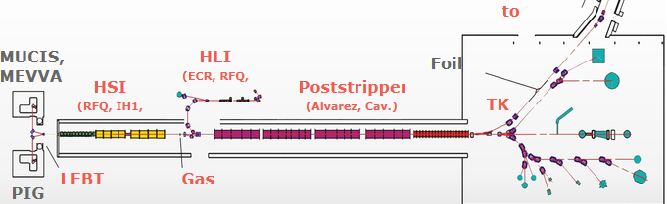
SIS100 Booster:
SIS18 Upgrade program
SIS18 goal intensity for booster SIS100 operation:
2.5 x 10¹¹ U²⁸⁺ per cycle, 100 MeV/u (FAIR CDR)
1.25 x 10¹¹ U²⁸⁺ per cycle, 200 MeV/u (real world compatible numbers)
SIS18 Upgrade program launched in 2003:
Injection septum for higher injection energies
Enhanced UHV system for p<10⁻¹¹ mbar (e.g. NEG coated vacuum chambers)
Collimator system with low-desorption yield surface
Enhanced ramp rate (4 → 10 T/s)
  Power grid connection (110 kV)
  New dipole power converters
  h=2 MA acceleration cavities (0.5 MHz - 50 kV)
... many other small upgrades (Multiturn injection, ...)
UNILAC currents are quite demanding, too!
15 mA U²⁸⁺ necessary to achieve desired intensities
Accelerating structure is partly 45 years old (eroded surfaces, bad vacuum seals, old RF senders,...)

Slide 16
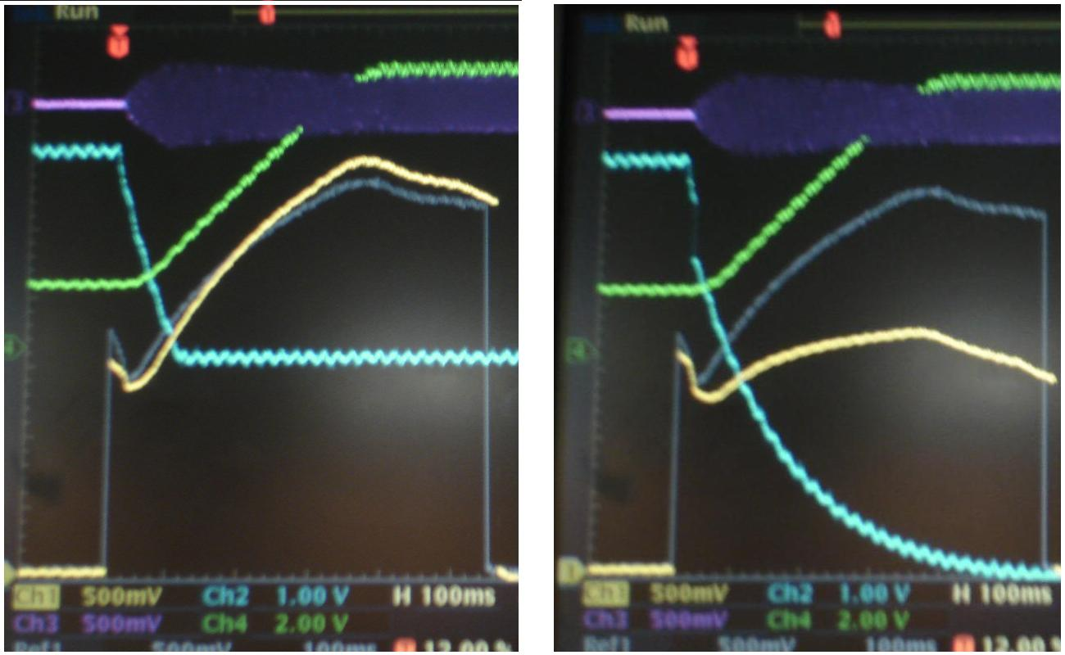
SIS18: Minimization of Initital Pressure Bumps
Injection of a MW heavy ion beam.
Ionization beam loss
High voltage break down
Gas desorption in the injection channel of the injection septum results in HV breakdowns; those generate even higher local pressure bumps and ionize a large fraction of the beam after injection.
Any HV breakdown interrupts the low charge state operation for many seconds.
Stronger pumping is needed in the injection septum.
NEG panels have been installed under the electrostatic septum; afterwards, there was a big progress in beam life time.

Slide 17
Required UNILAC Beam
UNILAC beam parameters for FAIR booster mode have been calculated for an optimized MTI process for a SIS18 acceptance of 150 x 50 mm mrad (see table).
  Velocity of reduction of orbit bump and beam emittance.
  Small beam emittance can be artificially generated by means of the collimation system in the transfer channel.
Beams with smaller emittance and lower current can be injected over a longer time, leading to the same final intensity in SIS18. Sharp edge beam generated by imaging optics for the tight injection channel.
Generation of beams with low transverse emittances and brilliant cores.
Shifting beam loss from inside SIS18 into the transfer channel.
slow reduction
fast reduction
ε_{x} / mm mrad | I / mA | t / µs | B (norm.) mA / (mm mrad)
3 | 10 | 140 | 3.3 (21)
5 | 15 | 80 | 3.0 (19)
7 | 16 | 75 | 2.3 (15)
10 | 20 | 60 | 2.0 (13)
Cutting of tails in the transfer channel (TK).
The SIS18 acceptance should be 200 x 50 mm mrad. Acceptance limited so far by closed orbit errors ?

Slide 18
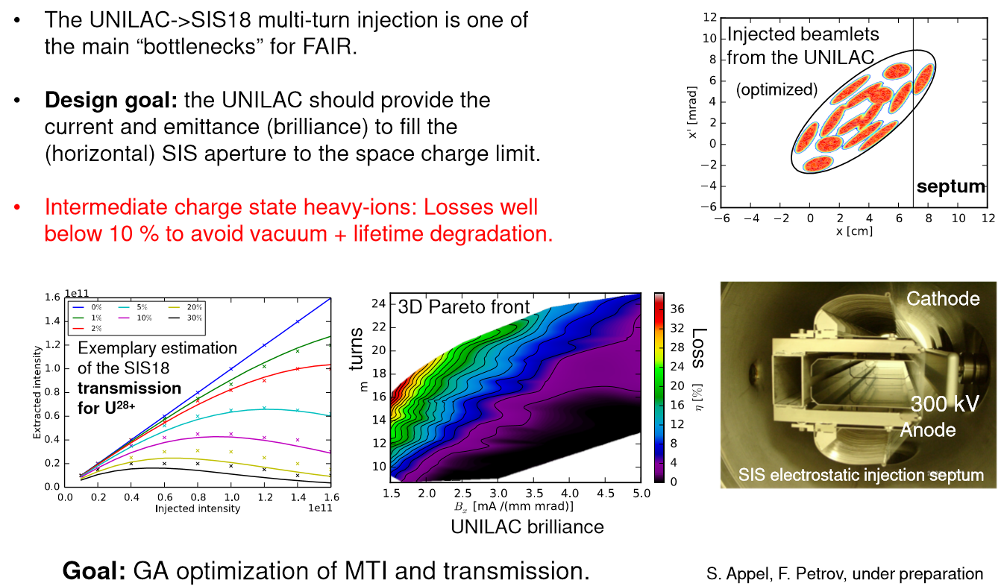
SIS18 future:
Optimization of MTI

Slide 19
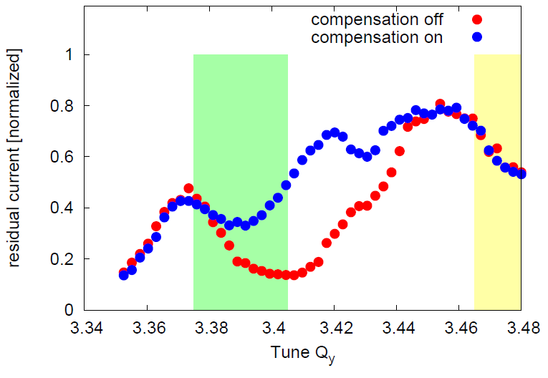
SIS18 high current working point
Resonance scan after 2014 realignment.
ΔI/I
Present standard working point
Q_{x,y} = (4.28; 3.29)
Good results for higher currents with
Q_{x,y} = (4.17; 3.29)
Planned final high current working point
Q_{x,y} = (4.14; 3.6)
  Compensation of different resonances necessary:
  Q_{y} = 3.33; 3.5
  Q_{x} – Q_{y} = 1
  2Q_{x} – Q_{y} = 1
Resonance correction system installed (skew quads, sextupoles, octupoles).
Proof of principle machine experiments in SIS18 showed successful partial compensation of single resonances.
0,1
0.08
0.06
0.04
0.02
0
Bunched beam, 1 s storage, 3rd order resonance partially compensated.
G. Franchetti et. al.

Slide 20
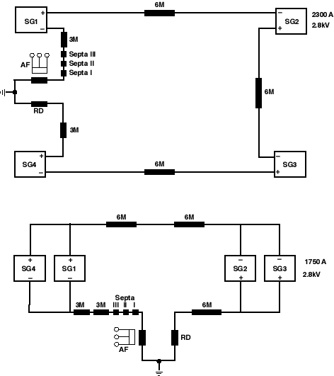
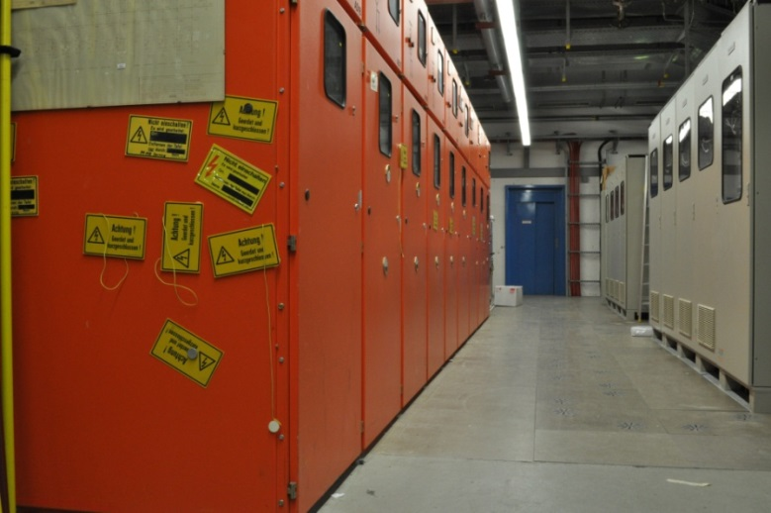
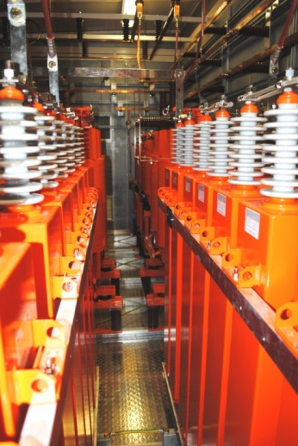
Power Converter and Fast Ramping
High average beam intensity requires fast short cycle times with fast ramping.
  Shortening of cycle time (intermediate charge states)
  Higher repetition rate (booster operation 2.7 Hz)
  Increased average intensity (x 2-9)
Present Operation:
  dB/dt = 1.3 T/s – 0.3 Hz
  P_{max} = 19 MW
Dipole power converter upgrade is near to be finished (final measurement with new FAIR power grid will be done 2018).
  dB/dt = 10 T/s – 2.7 Hz
  P_{max} = 39 MW

Slide 21
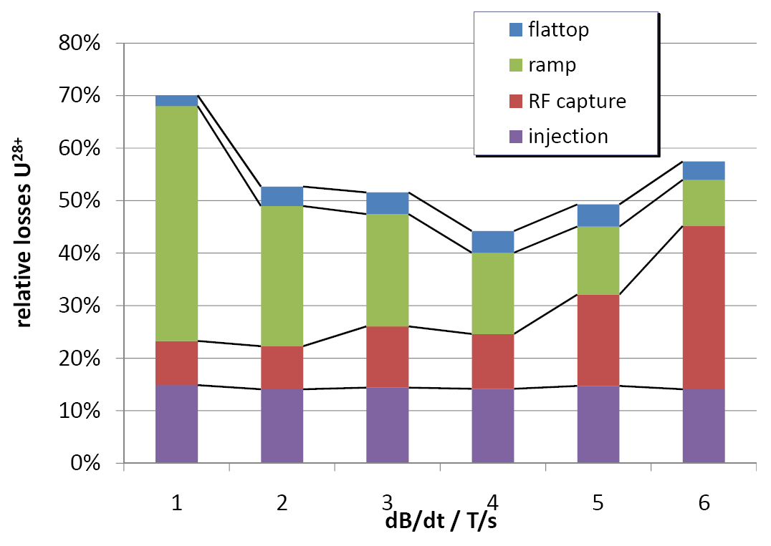
U²⁸⁺ - Beam Loss at High Ramp Rates
Total (integrated) Ionization loss decreases with higher ramp rates.
RF capture loss increases with higher ramp rate.
Fractional loss of different mechanisms during fast ramping

Slide 22
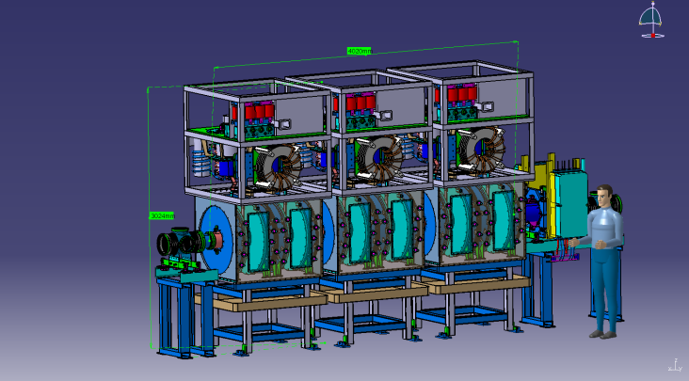
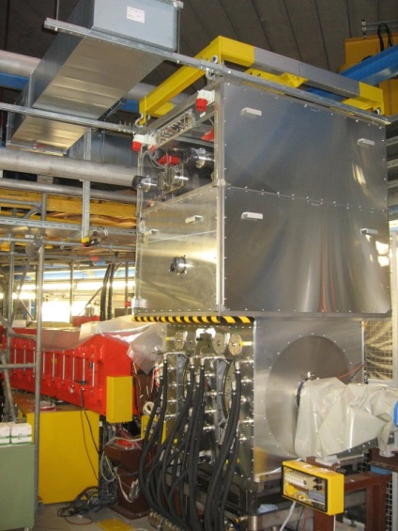
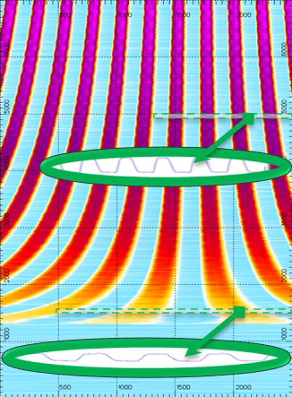
New h=2 Acceleration System
Sufficient RF voltage for fast ramping with low charge state heavy ions
  2.0x10¹⁰ U⁷³⁺ acceleration with 4 T/s.
  1.5x10¹¹ U²⁸⁺ acceleration with 10 T/s.
50 kV (0.5 – 50 kV)
  High power requirements,
  Additional space provided in tunnel,
  Sufficient bucket area for minimum loss (30% safety).
Two harmonic acceleration:
  Flat bunch profile (high Bf) for lower inc. tune shift:
  h=4 (existing cavities) and
  h=2 (new cavities).
Compatible with SIS100 RF cycles.
Ion Bunch Shape
before manipulation
after manipulation
during dual harmonic RF

Slide 23
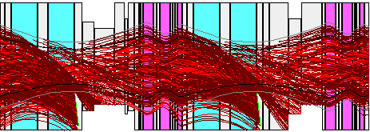
SIS18 Charge Catcher System
Ionization beam loss in section 11,12
Beam loss distribution U²⁹⁺
Developed for heaviest ions (highest ionization cross sections)
Triplet / doublet structure is suitable but: bending power of dipoles to high
Limited catching efficiency depending on emittance (65%)

Slide 24
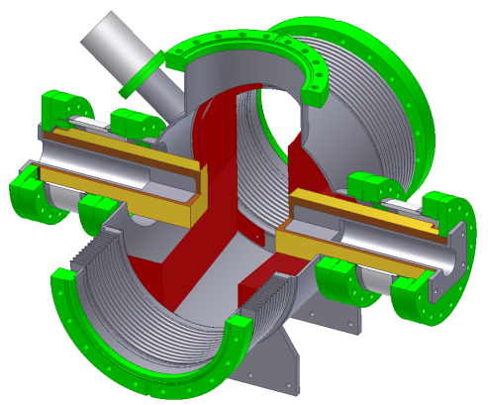
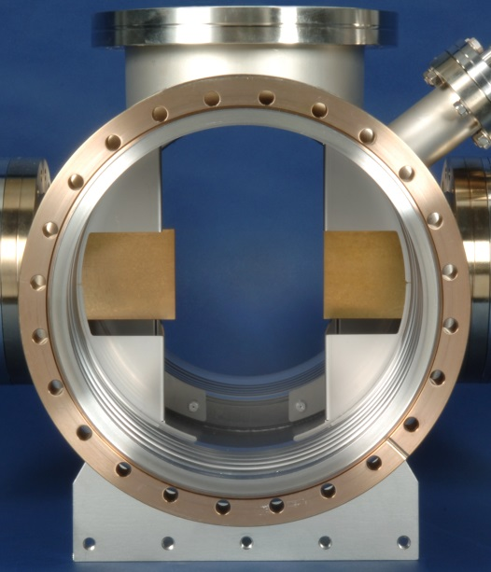
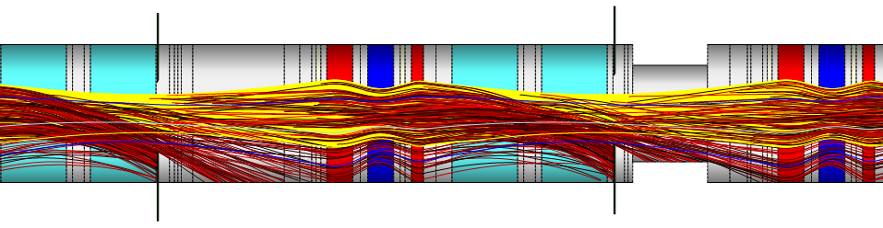
SIS18 Charge Catcher System - Technology
Goals:
Minimization of desorption gas production.
Capture and removal of desorbed gases (stabilization
of the dynamic pressure).
Design:
Block shaped beam stopper made of low desorption
yield material (Cu block, Au surface).
Secondary, NEG coated chamber for confinement of desorption gases.
Integration of UHV diagnostics and ion current measurement (online charge exchange rate measured).
Two prototypes successfully tested in 2007:
  Significantly reduced desorption yield.
  Installation of 10 charge catchers completed.

Slide 25
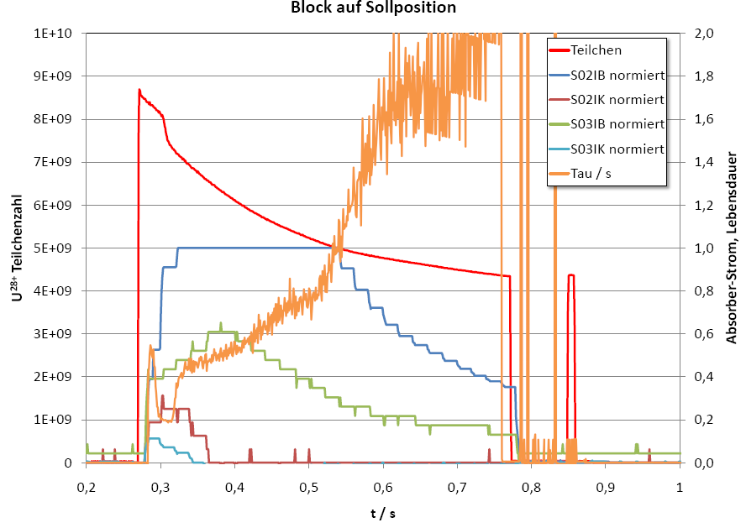
SIS18 Measurement of Ionisation and Capture Loss
I_{K}
U²⁷⁺
U²⁹⁺
I_{B}
S02I_{B}
(dynamic) beam lifetime
S03I_{B}
S02/3I_{K}
particle number
2008: First real measurement of lost ions by current onto the ion catchers!

Slide 26
Static and Dynamic Residual Gas Spectrum
Residual gas
component
Relative amount for outgassing
Relative amount for desorption
Hydrogen
88 %
40 %
Nitrogen
0 %
0 %
Oxygen
0 %
0 %
Argon
1 %
0 %
Water
4 %
0 %
Carbonmonoxide
2 %
25 %
Carbondioxide
1 %
10 %
Methan
4 %
25 %

Slide 27
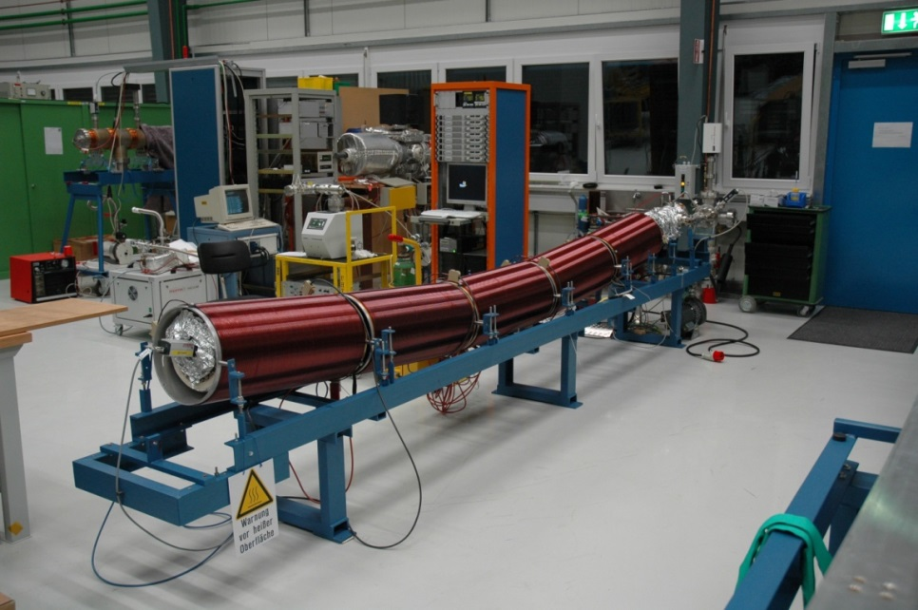
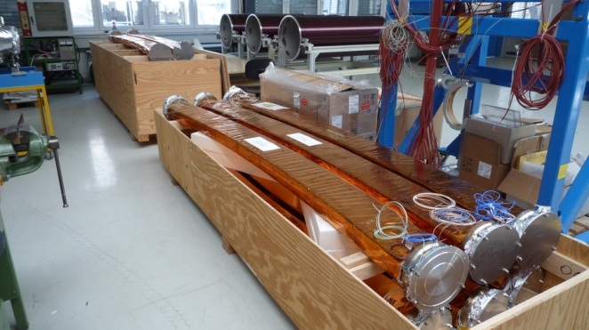
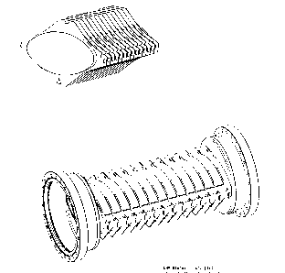
UHV system upgrade
Goals:
Generation of static pressures p₀ < 5x10⁻¹² mbar and
Average pumping speed increase by a factor of 100
Stabilization of dynamic pressure p(t)_{max}<10⁻⁹ mbar.
Removal of contamination from heavy residual gas components (e.g. Ar).
Replacement of all dipole- and quadrupole chambers by new, NEG coated chambers.
Improved bake-out system for operation up to 300°C.
More and more NEG coated standard chambers.
NEG panels in injection- and extraction septa.
Open issues:
Outgassing of kicker ferrite cores.
Extraction septa still to be studied (installation of NEG panels?).

Slide 28
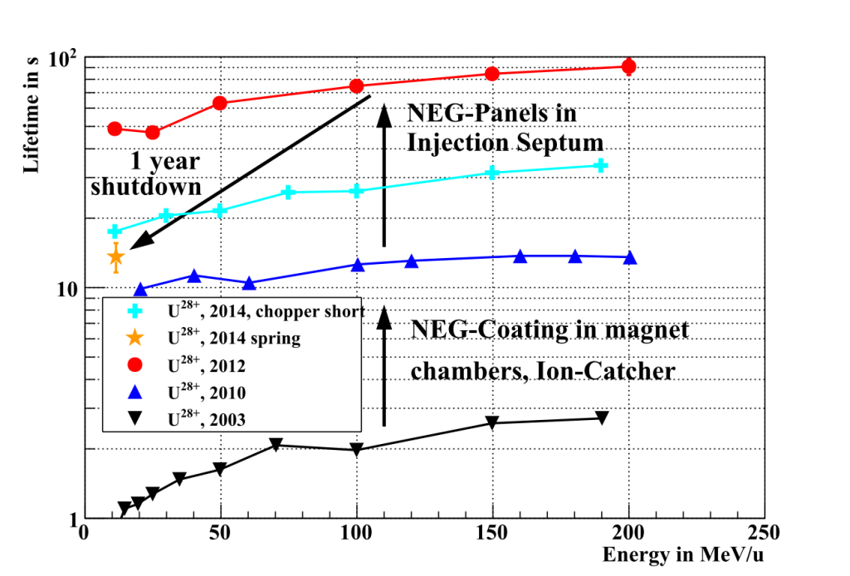

SIS18 Beam Lifetime Status (intermediate charge state heavy ions)
As a result of the various upgrade stages, the beam lifetime could be continuously increased.
  NEG coating of the dipole and quadrupole chambers,
  Ion Catchers,
  NEG panels in the injection septum.
After installation of NEG panels in the injection septum:
  A perfect agreement has been achieved between the measured and calculated beam lifetime and its energy dependence.
2016:
5.2 s
@ 5.7 MeV/u
Notes:
28

Slide 29


SIS18 upgrade:
Intensity world record
World Intensity Record for Low Charge State Heavy Ions
  3.2 x 10¹⁰ U²⁸⁺ accelerated and extracted successfully
  Achieved after partial completing the upgrade program (no h=2 cavities, ramping only with 4 T/s)
  Remember: Space charge limit is 2 x 10¹¹ U²⁸⁺ → still a factor of 6 in (extracted!) intensity is missing...
UNILAC upgrade does its job, too (11/2014):
  7 mA after stripping U⁴⁺ to U²⁸⁺
  pulsed gas stripper
  ... a factor of 2 still missing...
2001 FAIR conceptual design report (FAIR proposal)

Slide 30


Dynamic Vacuum – STRAHLSIM Code
Linear beam optics
  Loss patterns due to charge change
  Collimation efficiency
  Reads and writes many formats (AML, MIRKO, MAD-X, WinAGILE)
Static Vacuum
  p0, Seff, Vacuum-conductances, NEG coating, cryogenic surfaces,
  Static residual gas components
  Dynamic (Source of beam losses)
  Synchrotron cycle
  S_{eff,cold/NEG}(p, T): analytic model, incl. saturation
  Systematic losses (injection, RF capture)
  Projectile ionisation and capture σ(E, Δq,Z) from Shevelko, Olson
  Coulomb scattering, Target ionisation, Intra beam scattering
  Spacially resolved pressure profile
  Ion stimulated desorption
  Desorption rate η scaling with energy (dE/dx)²
  Beam scrubbing included
Benchmarked with many machine experiments (and at other accelerators)

Slide 31




STRAHLSIM: Multi-Cycle and Long Term Studies
Multi-cycle studies
The pressure at the end of the first cycle is the pressure at the beginning of the second cycle > Relaxation of the peak pressure over many cycles.
Modulation of the intensity in the SIS18 booster cycles may lead to higher average intensities in SIS100.
Pumping power of NEG depends on number of monolayers (decrease by half an order of magnitude per monolayer).
Beam scrubbing reduced desorption yield.
Ionization loss during stacking and acceleration in SIS18 and SIS100
Long term studies
Accumulated ions over months
Number of monolayers over months
Pressure over months

Slide 32
2nd Generation of STRAHLSIM Code
Spatial and time resolved simulation of dynamic vacuum and charge exchange beam loss.
Better modelling of localized effects (no conductivity averaging over the circumference).
Self determined static vacuum depending on the UHV system and machine layout.
Long term stability (transmission) and NEG saturation depends on the beam scrubbing.
NEG saturation with beam scrubbing
NEG saturation without beam scrubbing
Latest simulations show stabilization of start pressure after 3 weeks of continous 3 Hz operation.

Slide 33

Present SIS18 Machine Performance Status
The graph “extracted intensity” over “injected intensity” shows the limit of the machine performance determined by the technical development status of the machine.
Measured data (dots) and STRAHLSIM extrapolation for higher number of injected ions.
A linear dependence indicates that the extracted beam intensity is
  not yet defined by dynamic vacuum effects in the synchrotron and
  still depending on the injected (UNILAC) beam current.
Saturation by dynamic vacuum effects limited the maximum number of extracted ions
  in the year 2007 to 7x10⁹ ions,
  for the present situation to 5x10¹⁰ ions (extrapolated, limited by UNILAC current).

Slide 34

SIS18 Booster Operation for FAIR
Results of STRAHLSIM simulations for the desired SIS18 booster operation with different (uncontrolled) initial beam loss.

Slide 35
SIS18 Machine Development Issues and Goals
Development of low charge state, heavy ion operation:
Benchmarking of loss profiles as a function of energy with STRAHSIM predictions (transmission through cycle / extracted versus injected number of ions).
Life time measurements for various charge states U²⁷⁺ - U^{40+.} Comparison with cross sections.
Identification of remaining sections/devices with high UHV pressure.
Commissioning of fast ramped mode (10 T/s up to 18 Tm) and benchmarking with expectations.
Optimization of MTI, beam halo collimation in transfer channel minimization of uncontrolled initial beam loss.
Slow extraction of low charge state, heavy ion beams.

Slide 36


SIS100
Overall status:
More than 60% of the overall SIS100 cost book value is contracted.
Delivery of SIS100 series components started in 2017.
All large series (long lead items) are contracted.
SIS100 is entering the „hot phase“!

Slide 37




SIS100:
Lattice design criterias
Length: 5 x SIS18 length (= 1 083.6 m)
Reference ion operation: U²⁸⁺
  Localize beam ionization losses
  Control vacuum pressure
Secondary ion: Protons
  Variable $γ_{t}$-optics by multiple quadrupole families
  Fixed $γ_{t}$-optics utilizing fast $γ_{t}$-jump quadrupoles
RF system
  Room temperature cavities, dispersion free straight sections
  State-of-the-art bunch manipulations: Bunch merging & compression, Barrier buckets
Versatile extraction modes
  Fast bipolar Kicker system (internal emergency dump)
  Slow extraction: KO-excited beam, resonant extraction
Laser Cooling
Acceleration
Acceleration
Bunch
compression
SIS100
SIS300
Transfer
SIS100  SIS300
Extraction →
to Experiments
→ Injection
from SIS18
Images courtesy of M. Konradt / J. Falenski

Slide 38


SIS100:
Main Parameters – a versatile machine
Circumference: 1083.6 m
  (5 x length of SIS18)
Superperiodicity: 6
Cells per period: 14
Focusing structure: Doublet
108 Dipoles (superferric)
  1.9 T, 4 T/s
  Nominal current: 13.1 kA
168 Quadrupoles (superferric)
  27.8 T/m
  Nominal current: 10.5 kA
Extraction modes:
  Fast, 1...8 bunches
  Slow, KO-Extraction up to 10 s
Acceleration for every ion from protons to uranium
  Variable quadrupole powering for $γ_{tr}$ shifting or $γ_{tr}$-jump
Item | RIB (U²⁸⁺) | CBM (U⁹²⁺) | Protons for pbar
Magnetic rigidity $B⋅ρ$ [Tm] | 18 ... 100 | 14.3 ... 100 | 16.2 ... 100
Repetition rate $f_{rep}$ [Hz] | 0.45 | 0.1 | 0.36
Energy range $E$[GeV/u] | 0.2 ... 2.7 | 1.0 ... 10.6 | 4.0 ... 28.8
Relativistic $γ$ | 1.2 ... 3.9 | 2.0 ... 12.4 | 5.3 ... 31.9
Transition energy $γ_{tr}$ | 15.5 | 14.3 | 18.3 (45*)
Tune $ν_{x,y}$ | 18.9/18.8 | 17.3/17.8 | 10.4/10.3 / (21.8/17.7*)
Number of ions per cycle $N$ | 5 x 10¹¹ | 1.5 x 10¹⁰ | 2 x 10¹³
Number of ions per second [1/s] | 2.25 x 10¹¹ | 1.5 x 10 ⁹ | 7.2 x 10¹²
Number of bunches $n$ | 8 | 2 | 4
Harmonics number $h$ | 10 | 10 | 10 → 5
RF frequency $f$ [MHz] | 1.56...2.67 | 2.41...2.76 | 1.36... 1.38
Extracted bunch form | 8 | “DC” | 1 (70 ns)
Stored beam energy $E_{beam}$ [kJ] | 51.5 | 6.1 | 93.0
Emittance @ inj. $ε_{x,y}$ [mm mrad] | 35 x 12 | 15 x 5 | 12 x 5
Emittance @ extr. $ε_{x,y}$ [mm mrad] | 6.3 x 0.9 | 2.2 x 0.5 | 2.0 x 0.7

Slide 39



SIS100:
Lattice design optimization
Several (>100) different lattices have been tried out for the given charge exchange process.
  Optimization criterion: Collimation efficiency for U²⁸⁺ → U²⁹⁺.
  Tool: STRAHLSIM (ion optics code + dynamic vacuum)
Surprise #1: Common FODO structure: only ~60 % reachable
Surprise #2: SIS100 Conceptual Design Report (CDR) lattice: 97% reachable, but with too low acceptance

Slide 40


SIS100:
Lattice design (I)
SIS100 ion catcher system optimized for U²⁸⁺ → U²⁹⁺
  >99% catching efficiency
  all charge exchange loss is controlled by cryocatcher
Double ionization U²⁸⁺ → U³⁰⁺
  ~70% catching efficiency
  30% of double ionized ions is lost in the quadrupole before cryocatcher

Slide 41


SIS100:
Lattice design (II)
Doublet focusing structure: up to 100% reachable with focusing order DF
  First called “storage mode lattice” because many U²⁹⁺ particles survived one complete turn.
  Dipoles act as a charge state separator when bending angle per cell is chosen correctly.
  Quadrupoles are stronger than obviously necessary (over-focussing) to assure survival of beam until it reaches the collimator (which gives other problems → protons).
U²⁹⁺ loss positions are nicely peaked at the position of the collimators
Dynamic vacuum calculations early showed that in spite of the very well controlled losses, a huge pumping speed will be required
  Cold vacuum chambers
  SC magnets
  Adsorption pumps
  Good starting pressure (when some monolayers will freeze out on cold surfaces, pumping is degraded).

Slide 42




SIS100:
FoS and Series of Superconducting Dipole Magnets
(109 pieces required)
1.9 T, 4 T/s fast ramped superferric design (8 turns)
13.1 kA nominal, 1 Hz operation
Low loss yoke design
FoS (First of Series) successfully tested warm and cold.
Series production by BNG (Germany) started.
Coil head of pre-series dipole magnet
Notes:
42
1

Slide 43



SIS100:
Cryocatcher
Pre-Series Cryocatcher
Cryocatcher block, low-desorption coated, at shield temperature (50K)
Vacuum chamber copper plated on the outside for thermal conductance, at 4K
Residual vacuum pressure: < 10⁻¹¹ mbar in every operation case!
Pre-Series Cryocatcher has been tested at cold and functions properly.
FoS (First of Series) is currently built at TRINOS.
Notes:
43
1

Slide 44





SIS100:
Thin-walled LHe-cooled Dipole & Quadrupole Chambers
see presentation of S. Wilfert
Dipole chambers (108 pieces required)
Pre-series and series chambers ordered.
0,3 mm thickness (eddy currents!), special stainless steel Bö P506.
FOS chamber is produced and delivered, chamber cooling has been re-iterated.
Quadrupole chambers
185 elliptical, 6 star-shaped (extraction)
0,3 mm thickness, special stainless steel Bö P506.
Manufacturing design completed.
Tendering will start in 2017

Slide 45


SIS100:
Special Cryo-Adsorption Pump´s
Installation between two dipole magnets
SIS100 Adsorption Pumps
78 pieces
Essential for pumping of hydrogen (which is not pumped by cold surfaces).
FoS (First of Series) Adsorption pump has been delivered and tested at GSI, with outstanding pumping characteristics.
Series production released.
see presentation of S. Wilfert

Slide 46
Summary
GSI / SIS18:
Six major upgrades (big investments) are nearly completed for SIS18 booster operation with high intensity, intermediate charge state heavy ions. Some “minor" issues, especially related to initial systematic beam loss have to be addressed. Dynamic vacuum simulations indicate that a successful completion of these minor measures is a precondition for the booster operation.
Major progress has been achieved in understanding of the dynamic vacuum, gas desorption, beam loss by charge changes and influence of saturating Cryo/NEG surfaces and beam scrubbing effects.
Major progress has already been achieved in the unique acceleration of high intensity, intermediate charge state heavy ions. 3.2x10¹⁰ U-ions per cycle have been accelerated.
The present SIS18 machine performance should enable acceleration of 5x10¹⁰ U-ions per cycle. For FAIR, a factor of 6 in intensity per cycle and a factor of 12 in intensity per second is missing.
FAIR / SIS100:
Lattice design was specially tailored for operation with low charge state heavy ions.
Vacuum pressure is forecasted to be a dynamic, but only to an extent which does not have a big impact on intensity.

Slide 47
End
Special thanks go to:
  Subproject SIS100 / SIS18
  L. Bozyk, M. Bender, H. Kollmus
  GSI vacuum dpt.
  GSI beam diagnostics dpt.
Questions?

Slide 48


Injection System Upgrade
Septum for 280 kV
Increased acceptance
Injection of U²⁸⁺ at reference energy
Protection of septum electrodes (1.5 MW beam power)
Position and profile verification
Aim for reduced gas production

Slide 49
Observations relevant for MTI at High Currents
The linac longitudinal emittance, grows with increasing beam current
  (measured at the beginning of the transfer channel and after injection into SIS)
  for SIS18: the coasting beam momentum spread depends on the current
The linac center energy, changes with increasing emittance (beam loading in buncher cavities ?)
  for SIS18: the Rf frequency must be tunes according to the current
The horizontal tune for highest injection efficiency changes with increasing current
  for SIS18: the tune (PC) has to be changed for different beam current (set-values)
The center beam energy is slowed down after injection into SIS18 by resistive wall imp.
  for SIS18: fast capture (2ms and acceleration start)
Debunching may be improved by a more effective debuncher cavity at the end of UNILAC
At operation with TK stripper (injection of highly charged ions), the center energy changes according to the degradation of the stripper thickness.

Slide 50

2nd Generation STRAHLSIM: UHV in SIS18
Longitudinal pressure profile in SIS18 with measurements (dots).

Slide 51


Intermediate Charge States for FAIR
FAIR intensity goals can only be reached by lowering the charge states.
Incoherent tune shift limits the maximum intensity in SIS18.
$−ΔQ∝\frac{Z^{2}}{A}$
  Poststripper charge states will be used, e.g.: Ar¹⁸⁺ → Ar¹⁰⁺ or U⁷³⁺ → U²⁸⁺
  No stripping loss (charge spectrum) in the transfer channel (gives a factor of 6.7 in U intensity)!

Slide 52

Injection of a Sharp Edge Beam
2. Image plane
(Backside injection septum)
1. Image plane
(Injection channel)
Imaging optical system
Object plane (Three Collimators)
Imaging system from the collimators up to the injection channel and the backside of the septum.

Slide 53






SIS100:
Proton Operation
SIS100 faces same problem as PS and AGS:
How to escape transition?
SIS100 optimized for heavy ions
  Charge separator function for dynamic vacuum
  Strong focusing, large chromaticities
  Acceptance limitation due to collimators
SIS100 high γ_{t} scheme
  Q_{h}=21.8 and lattice distortion to yield γ_{t}=45
  Achieved by splitting F quads in two families
  Challenges:
    Control of irregular optics
    Large chromatic tune spread ΔQ_{n} = ±0.25
    Non-linear α-buckets due to small η₀ = 5·10⁻⁴
SIS100 γ_{t} jump scheme
  Q_{h}=10.4 to yield γ_{t}=9 and large dispersion
  Integration of 12 jump quads (6 π-doublets)
  Challenges:
    Control of optics during jump
    Small momentum acceptance δ ≤ 5·10⁻³
 | SIS100 | PS | AGS
#protons/cycle | 2·10¹³ | 2·10¹³ | 10¹⁴
Circumference [m] | 1083.6 | 628.3 | 807.0
Lattice type | Dublet | AG | AG
Gamma range | 5.3 – 32.0 | 2.5 – 29.0 | 2.7 – 27.0
Gamma transition | 15.5 | 6.1 | 8.5
Q_{h} /Q_{v} | 18.9/18.8 | 6.2/6.3 | 8.8/8.7
Q_{h,v}/L [1/100m] | 1.7 | 1.0 | 1.1
C_{h}/C_{v} (nat.) | -22.6/-22.6 | -5.0/-6.3 | -9.0/-9.0
Optics for high γ_{t} scheme
α-bucket in high γ_{t} scheme
fixed point
A_{n}=26 eVs
ε_{n}=12 eVs
Optics for γ_{t} jump scheme
Jump quadrupole
Q₁
Q₂
Δμ_{x} ≈ π

Slide 54

Transverse Emittance Transfer
Controlled fill-up of the vertical acceptance (partial emittance transfer).
  Enhanced MT injection efficiency.
  Enhanced space charge limit.
Transverse exchange of emittance (hor.>vert.) via a short excitation of the linear coupling resonance.
  Develpment of a fast pulsed (skew) quadrupole ( 10 -100 μs).
Precondition:
  Controlled injection with conservation of the vertical linac emittance.
Design model of a fast pulsed quadrupole

