Slide 1
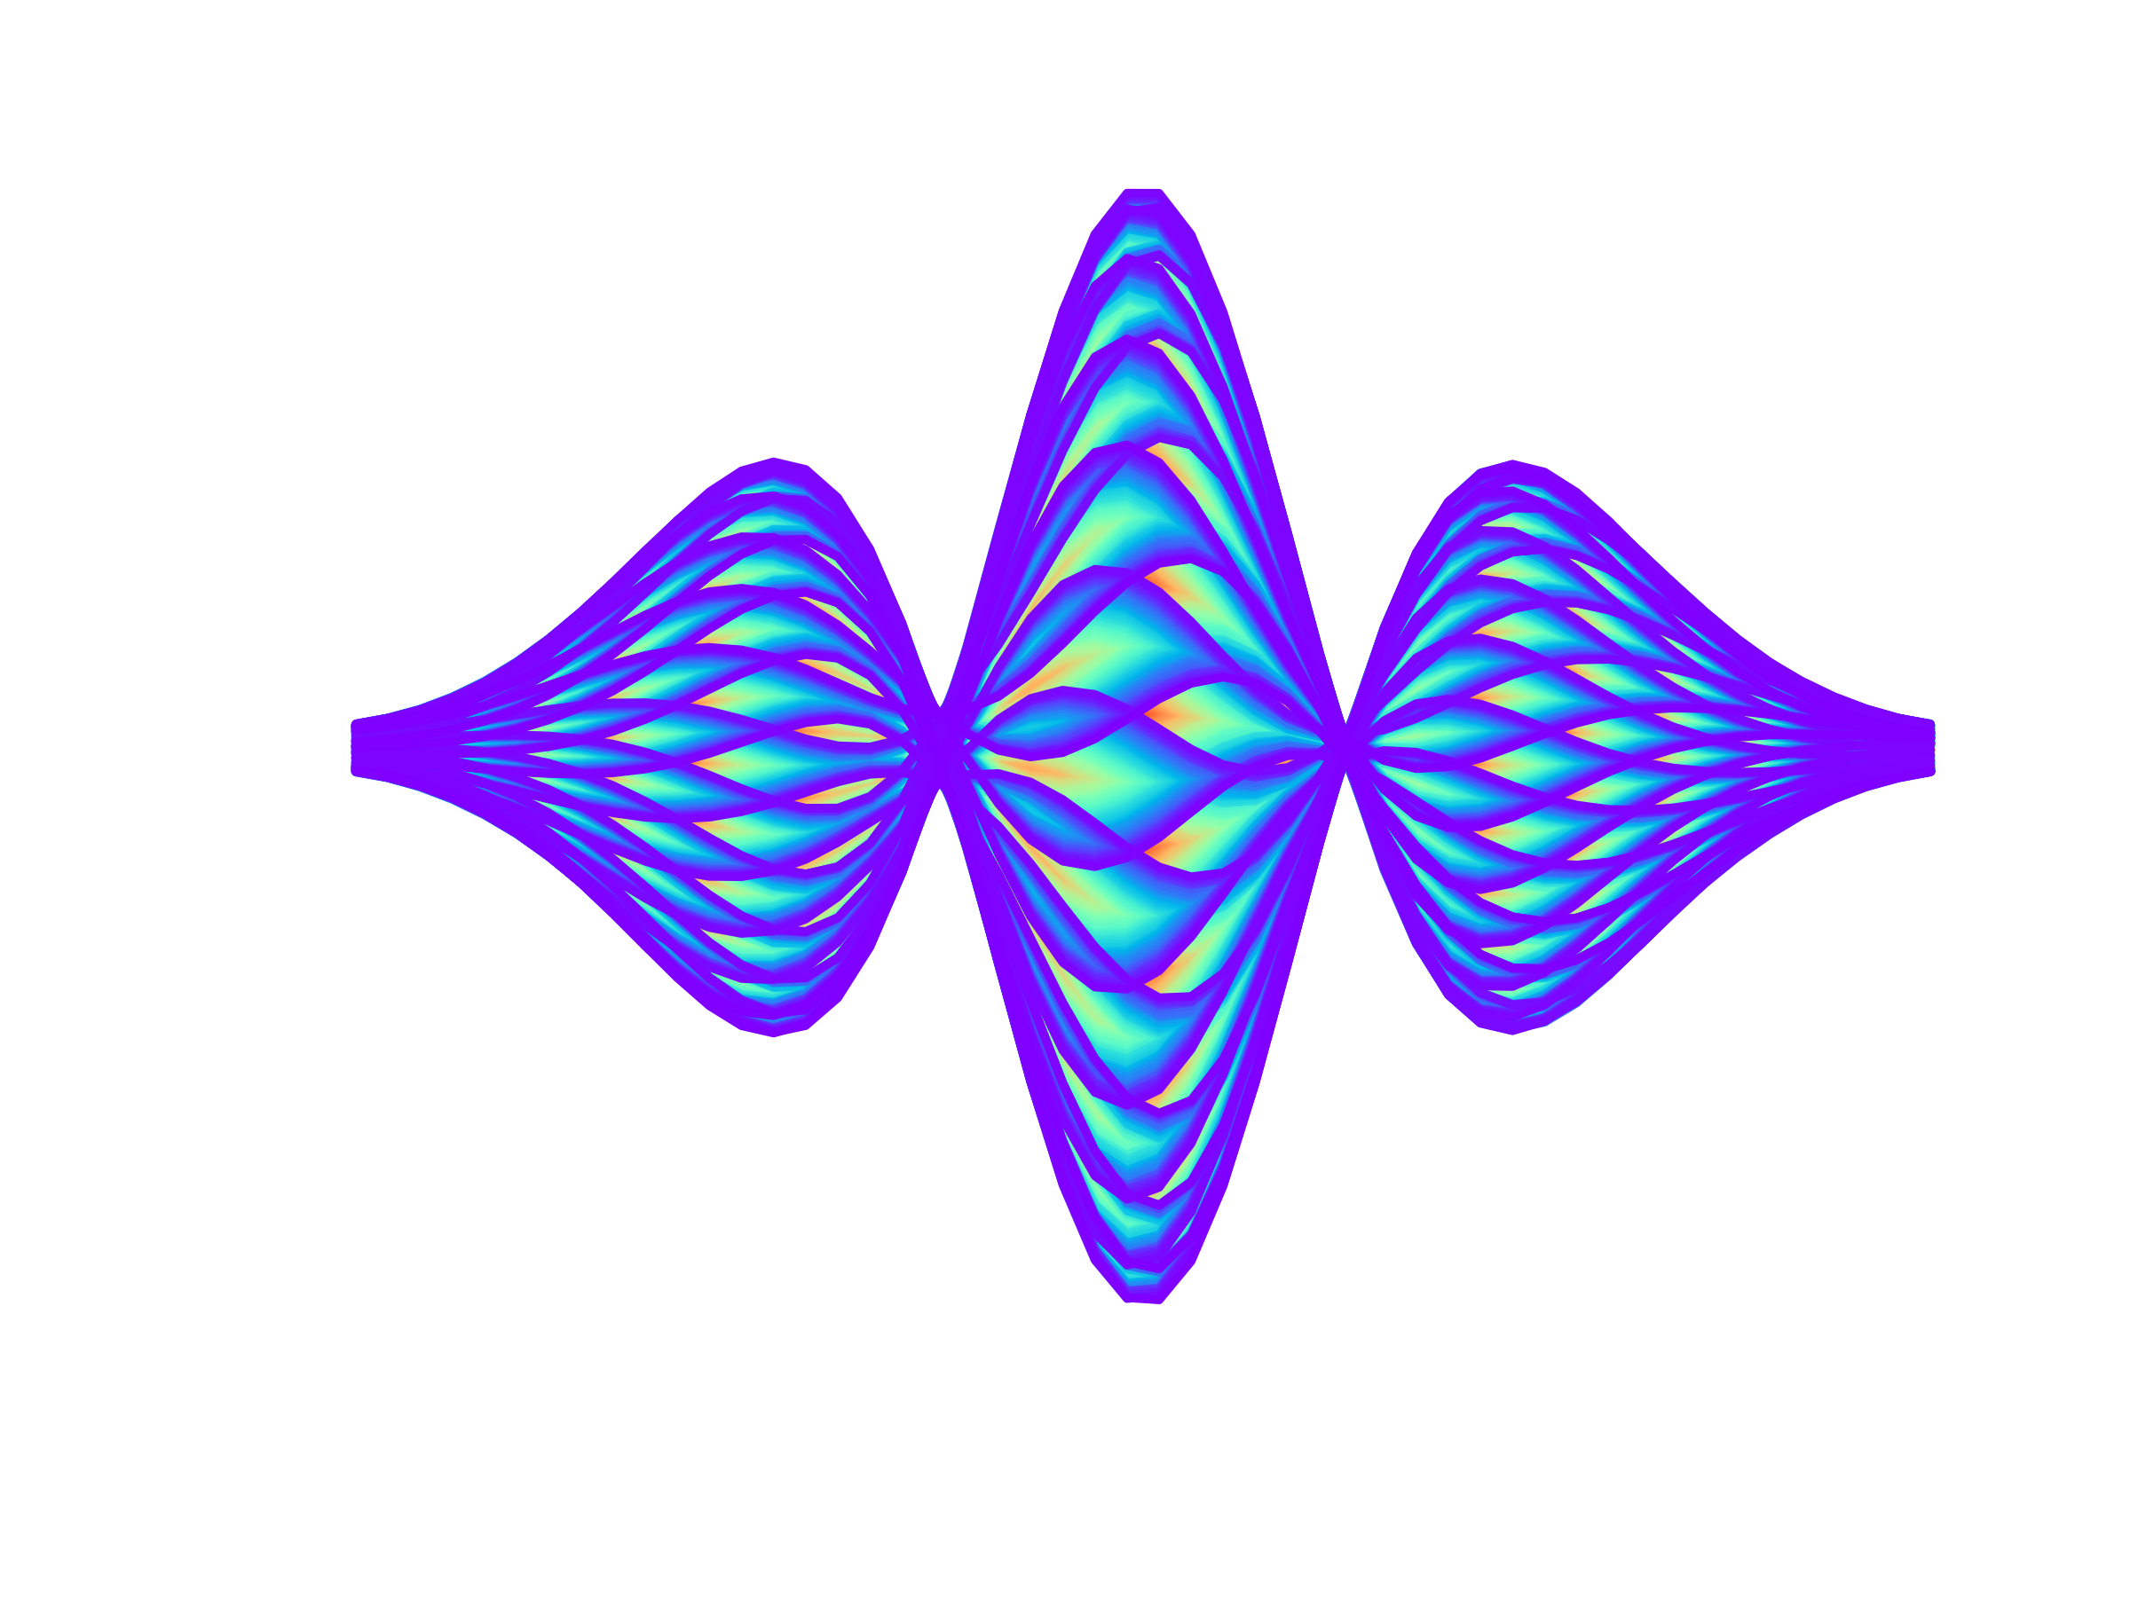


Impact of Impedance effects
on beam chamber specifications
Elias.Metral@cern.ch
Tel.: 00 41 75 411 4809
http://emetral.web.cern.ch/emetral/
Elias Métral
BE/ABP-HSC (Collective/Coherent Effects)

Slide 2
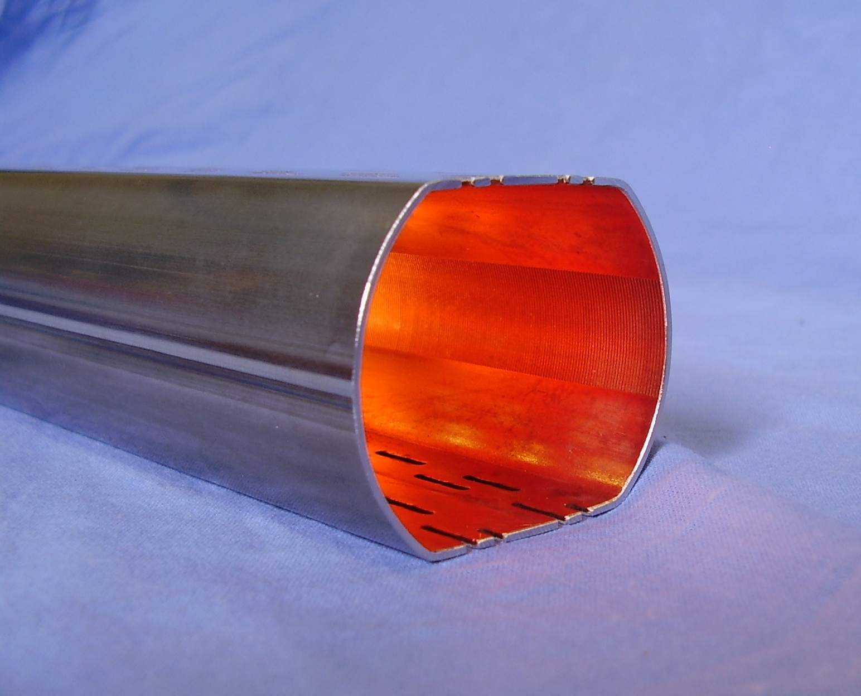
INTRODUCTION: THE LHC BEAM CHAMBER

Slide 3
INTRODUCTION: THE LHC BEAM CHAMBER
Beam screen tube (Stainless-Steel: SS)

Slide 4
INTRODUCTION: THE LHC BEAM CHAMBER
Beam screen tube (Stainless-Steel: SS)
Copper coating

Slide 5
INTRODUCTION: THE LHC BEAM CHAMBER
Beam screen tube (Stainless-Steel: SS)
Copper coating
Longitudinal weld

Slide 6
INTRODUCTION: THE LHC BEAM CHAMBER
Beam screen tube (Stainless-Steel: SS)
Copper coating
Longitudinal weld
Pumping slots

Slide 7
INTRODUCTION: THE LHC BEAM CHAMBER
Beam screen tube (Stainless-Steel: SS)
Copper coating
Saw teeth
Longitudinal weld
Pumping slots

Slide 8
INTRODUCTION: THE LHC BEAM CHAMBER
Beam screen tube (Stainless-Steel: SS)
Copper coating
2 b
Saw teeth
Longitudinal weld
Pumping slots

Slide 9
INTRODUCTION: THE IMPEDANCE

Slide 10
INTRODUCTION: THE IMPEDANCE
Change in
geometry or electrical conductivity

Slide 11
INTRODUCTION: THE IMPEDANCE
Change in
geometry or electrical conductivity
Wake field = Electromagnetic field generated by the beam interacting with its surroundings (vacuum pipe, etc.)

Slide 12
INTRODUCTION: THE IMPEDANCE
Change in
geometry or electrical conductivity
Wake field = Electromagnetic field generated by the beam interacting with its surroundings (vacuum pipe, etc.)
  Power loss

Slide 13
INTRODUCTION: THE IMPEDANCE
Change in
geometry or electrical conductivity
Wake field = Electromagnetic field generated by the beam interacting with its surroundings (vacuum pipe, etc.)
  Power loss
  Beam instabilities

Slide 14
INTRODUCTION: THE IMPEDANCE
Change in
geometry or electrical conductivity
Wake field = Electromagnetic field generated by the beam interacting with its surroundings (vacuum pipe, etc.)
  Power loss
  Beam instabilities
Impedance = Fourier transform of the wake field (wake function)

Slide 15
INTRODUCTION: THE IMPEDANCE
2 fundamental approximations behind the “conventional impedances / wakes”

Slide 16
INTRODUCTION: THE IMPEDANCE
2 fundamental approximations behind the “conventional impedances / wakes”
  Rigid-beam approximation =>

Slide 17
INTRODUCTION: THE IMPEDANCE
2 fundamental approximations behind the “conventional impedances / wakes”
  Rigid-beam approximation =>
  Impulse approximation =>
Wake potential

Slide 18
INTRODUCTION: THE IMPEDANCE
Longitudinal case
Longitudinal wake function

Slide 19
INTRODUCTION: THE IMPEDANCE
Longitudinal case
Transverse case is more complicated
  Conventional definition
Longitudinal wake function
Transverse wake function

Slide 20
INTRODUCTION: THE IMPEDANCE
Longitudinal case
Transverse case is more complicated
  Conventional definition
  … but several terms need to be added to correctly describe the beam dynamics
Longitudinal wake function
Transverse wake function

Slide 21
INTRODUCTION: THE IMPEDANCE
Longitudinal case
Transverse case is more complicated
  Conventional definition
  … but several terms need to be added to correctly describe the beam dynamics
Longitudinal wake function
Transverse wake function
Driving (or dipolar) wake

Slide 22
INTRODUCTION: THE IMPEDANCE
Longitudinal case
Transverse case is more complicated
  Conventional definition
  … but several terms need to be added to correctly describe the beam dynamics
Longitudinal wake function
Transverse wake function
Detuning (or quadrupolar) wake
Driving (or dipolar) wake

Slide 23
INTRODUCTION: THE IMPEDANCE
Longitudinal case
Transverse case is more complicated
  Conventional definition
  … but several terms need to be added to correctly describe the beam dynamics
Longitudinal wake function
Transverse wake function
Detuning (or quadrupolar) wake
Angular wake => Fast damping in VEPP-2 and BEP
Driving (or dipolar) wake

Slide 24
INTRODUCTION: THE IMPEDANCE
  The impedance is a complex function of frequency and at least 5 contributions are needed to correctly characterized an equipment
    Longitudinal impedance
    Horizontal dipolar/driving impedance
    Vertical dipolar/driving impedance
    Horizontal quadrupolar/detuning impedance
    Vertical quadrupolar/detuning impedance
In case of non axi-symmetric vacuum chambers (assuming that the particles are travelling at the speed of light => Assumption made in this talk)

Slide 25
CONTENTS
Frequency range of interest
Copper coating: why and which thickness?
Effect of transverse damper
Effects of other coatings (e.g. a-C) or surface treatments (e.g. LESS) to fight against e-cloud
Effect of HTS coating
Longitudinal weld
Pumping slots
Conclusions
  a-C = amorphous carbon
  LESS = Laser treatment of the surface
  HTS = High Temperature Superconductor

Slide 26
FREQUENCY RANGE OF INTEREST
  Cut-off frequency (above which modes are propagating)
    N.A. for LHC: b ≈ 2 cm => f_{cut-off} ≈ 5 GHz

Slide 27
FREQUENCY RANGE OF INTEREST
  Cut-off frequency (above which modes are propagating)
    N.A. for LHC: b ≈ 2 cm => f_{cut-off} ≈ 5 GHz
  Lower limit => First Unstable (transverse) Betatron Line:
    N.A. for LHC: (1 - 0.31) × 11245 ≈ 8 kHz

Slide 28
FREQUENCY RANGE OF INTEREST
  Bunch length and bunch spectrum
    N.A. for LHC: τ_{b} (4 σ) ≈ 1 ns

Slide 29
FREQUENCY RANGE OF INTEREST
  Bunch length and bunch spectrum
    N.A. for LHC: τ_{b} (4 σ) ≈ 1 ns
  Some higher-order modes can also be excited and lead to longitudinal and/or transverse instabilities
Power spectrum
Extends up to ~ ± 1 / τ_{b}
f

Slide 30
FREQUENCY RANGE OF INTEREST
  Bunch length and bunch spectrum
    N.A. for LHC: τ_{b} (4 σ) ≈ 1 ns
  Some higher-order modes can also be excited and lead to longitudinal and/or transverse instabilities
  => For LHC: from 8 kHz to few GHz
Power spectrum
Extends up to ~ ± 1 / τ_{b}
f

Slide 31
COPPER COATING: WHY AND WHICH THICKNESS?
  Keep the resistivity as low as possible for 3 reasons

Slide 32
COPPER COATING: WHY AND WHICH THICKNESS?
  Keep the resistivity as low as possible for 3 reasons
    Power loss => High-frequency

Slide 33
COPPER COATING: WHY AND WHICH THICKNESS?
  Keep the resistivity as low as possible for 3 reasons
    Power loss => High-frequency
    Transverse Coupled-Bunch (Resistive-Wall) Instability: TCBI => Low-frequency

Slide 34
COPPER COATING: WHY AND WHICH THICKNESS?
  Keep the resistivity as low as possible for 3 reasons
    Power loss => High-frequency
    Transverse Coupled-Bunch (Resistive-Wall) Instability: TCBI => Low-frequency
    Transverse Mode-Coupling Instability: TMCI => High-frequency

Slide 35
COPPER COATING: WHY AND WHICH THICKNESS?
  1) Power loss => Due to real part of the longitudinal impedance

Slide 36
COPPER COATING: WHY AND WHICH THICKNESS?
  1) Power loss => Due to real part of the longitudinal impedance
Euler gamma function

Slide 37
COPPER COATING: WHY AND WHICH THICKNESS?
  1) Power loss => Due to real part of the longitudinal impedance
    For SS for instance, the power loss would be ~ 30 times more
    Thickness of Cu (20 K, 7 TeV) coating => 1 (few) μm enough

Slide 38
COPPER COATING: WHY AND WHICH THICKNESS?
  1) Power loss => Due to real part of the longitudinal impedance
    For SS for instance, the power loss would be ~ 30 times more
    Thickness of Cu (20 K, 7 TeV) coating => 1 (few) μm enough

Slide 39
COPPER COATING: WHY AND WHICH THICKNESS?
  1) Power loss => Due to real part of the longitudinal impedance
    For SS for instance, the power loss would be ~ 30 times more
    Thickness of Cu (20 K, 7 TeV) coating => 1 (few) μm enough
Power loss and TMCI

Slide 40
COPPER COATING: WHY AND WHICH THICKNESS?
  1) Power loss => Due to real part of the longitudinal impedance
    For SS for instance, the power loss would be ~ 30 times more
    Thickness of Cu (20 K, 7 TeV) coating => 1 (few) μm enough
TCBI
Power loss and TMCI

Slide 41
COPPER COATING: WHY AND WHICH THICKNESS?
  2) TCBI => Due to real part of the transverse impedance

Slide 42
COPPER COATING: WHY AND WHICH THICKNESS?
  2) TCBI => Due to real part of the transverse impedance
Instability rise-time
(in the thick-wall regime)

Slide 43
COPPER COATING: WHY AND WHICH THICKNESS?
  2) TCBI => Due to real part of the transverse impedance
    Previous plot reveals why in this case few tens / hundreds of μm are needed (at low frequency, IF we are in the thick-wall regime)
    This thick-wall regime is for instance not the case with the LHC collimators…
Instability rise-time
(in the thick-wall regime)

Slide 44
LHC beam pipe: round, 20 mm radius, 1 m long
Im
Re
Copper: ρ = 17 nΩm

Slide 45
LHC beam pipe: round, 20 mm radius, 1 m long
Re
Im
Graphite: ρ = 10 μΩm
Copper: ρ = 17 nΩm

Slide 46
LHC beam pipe: round, 2 mm radius, 1 m long
Re
Im
Copper: ρ = 17 nΩm

Slide 47
LHC beam pipe: round, 2 mm radius, 1 m long
Graphite: ρ = 10 μΩm
Copper: ρ = 17 nΩm
Re
Im

Slide 48
LHC beam pipe: round, 1 m long
Im
Graphite: ρ = 10 μΩm,
b = 2 mm
Re
Copper: ρ = 17 nΩm,
b = 20 mm

Slide 49
LHC beam pipe: round, 1 m long
Im
Graphite: ρ = 10 μΩm,
b = 2 mm
Re
Copper: ρ = 17 nΩm,
b = 20 mm

Slide 50
LHC beam pipe: round, 1 m long
Im
Graphite: ρ = 10 μΩm,
b = 2 mm
Re
Copper: ρ = 17 nΩm,
b = 20 mm

Slide 51
LHC beam pipe: round, 1 m long
Im
Graphite: ρ = 10 μΩm,
b = 2 mm
When Re = Im
=> Classical thick-wall regime
Re
Copper: ρ = 17 nΩm,
b = 20 mm

Slide 52
SS beam pipe with 20 mm radius
and 0 μm copper coating (room temp.)
Re
Im

Slide 53
SS beam pipe with 20 mm radius
and 1 μm copper coating (room temp.)
Re
Im

Slide 54
SS beam pipe with 20 mm radius
and 5 μm copper coating (room temp.)
Re
Im

Slide 55
SS beam pipe with 20 mm radius
and 10 μm copper coating (room temp.)
Re
Im

Slide 56
SS beam pipe with 20 mm radius
and 50 μm copper coating (room temp.)
Re
Im

Slide 57
SS beam pipe with 20 mm radius
and 1000 μm = 1 mm copper coating (room temp.)
Re
Im

Slide 58
Graphite beam pipe with 2 mm radius
and 0 μm copper coating (room temp.)
Re
Im

Slide 59
Graphite beam pipe with 2 mm radius
and 1 μm copper coating (room temp.)
Re
Im

Slide 60
Graphite beam pipe with 2 mm radius
and 5 μm copper coating (room temp.)
Re
Im

Slide 61
Graphite beam pipe with 2 mm radius
and 10 μm copper coating (room temp.)
Re
Im

Slide 62
Graphite beam pipe with 2 mm radius
and 50 μm copper coating (room temp.)
Re
Im

Slide 63
Copper (room temp.) beam pipe with 20 mm radius
and 0 μm graphite coating
Re
Im

Slide 64
Copper (room temp.) beam pipe with 20 mm radius
and 1 μm graphite coating
Re
Im

Slide 65
Copper (room temp.) beam pipe with 20 mm radius
and 5 μm graphite coating
Re
Im

Slide 66
Copper (room temp.) beam pipe with 20 mm radius
and 10 μm graphite coating
Re
Im

Slide 67
Copper (room temp.) beam pipe with 20 mm radius
and 50 μm graphite coating
Re
Im

Slide 68
COPPER COATING: WHY AND WHICH THICKNESS?
  3) TMCI => (Mainly) due to imaginary part of the transverse impedance

Slide 69
COPPER COATING: WHY AND WHICH THICKNESS?
  3) TMCI => (Mainly) due to imaginary part of the transverse impedance
    Example case (~ LHC)
[a.u.]
[a.u.]

Slide 70
COPPER COATING: WHY AND WHICH THICKNESS?
  3) TMCI => (Mainly) due to imaginary part of the transverse impedance
    Example case (~ LHC)
[a.u.]
Mode-coupling between modes 0 and -1
[a.u.]

Slide 71
COPPER COATING: WHY AND WHICH THICKNESS?
  3) TMCI => (Mainly) due to imaginary part of the transverse impedance
    Example case (~ LHC)
    Approximation to find the
    threshold => When tune
    shift of mode 0 is ~ - Q_{s}
From Sacherer formula

Slide 72
COPPER COATING: WHY AND WHICH THICKNESS?
  3) TMCI => (Mainly) due to imaginary part of the transverse impedance
    Example case (~ LHC)
    Approximation to find the
    threshold => When tune
    shift of mode 0 is ~ - Q_{s}
Weighted by the bunch spectrum (mode 0), which also depends on bunch length…
1.15E11 p/b

Slide 73
EFFECT OF THE (RESISTIVE) TRANSVERSE DAMPER
  A (bunch by bunch) resistive transverse damper is usually used to damp the TCBI => IF instability rise-time is longer than ~ 10 turns

Slide 74
EFFECT OF THE (RESISTIVE) TRANSVERSE DAMPER
  A (bunch by bunch) resistive transverse damper is usually used to damp the TCBI => IF instability rise-time is longer than ~ 10 turns
  Depending on Q’ (chromaticity) and the transverse damper gain, a certain amount of non-linearities (Landau octupoles) is also needed to stabilize the single-bunch instabilities by Landau damping

Slide 75
EFFECT OF THE (RESISTIVE) TRANSVERSE DAMPER
  A (bunch by bunch) resistive transverse damper is usually used to damp the TCBI => IF instability rise-time is longer than ~ 10 turns
  Depending on Q’ (chromaticity) and the transverse damper gain, a certain amount of non-linearities (Landau octupoles) is also needed to stabilize the single-bunch instabilities by Landau damping
  Recent studies revealed that for Q’ = 0 the resistive transverse damper is destabilising (for the single bunch) and shed a light on the physical mechanism

Slide 76
EFFECT OF THE (RESISTIVE) TRANSVERSE DAMPER
  Destabilising effect of the resistive transverse damper (in red below)
[a.u.]
[a.u.]

Slide 77
EFFECT OF THE (RESISTIVE) TRANSVERSE DAMPER
  Destabilising effect of the resistive transverse damper (in red below)
    This is the interaction between modes - 1 and 0 through the damper which creates the instability
[a.u.]
[a.u.]

Slide 78
EFFECT OF THE (RESISTIVE) TRANSVERSE DAMPER
  Destabilising effect of the resistive transverse damper (in red below)
    This is the interaction between modes - 1 and 0 through the damper which creates the instability
    The “coupling” between the 2 modes pushes apart the instability growth rates and as the lowest one is 0, it becomes negative
[a.u.]
[a.u.]

Slide 79
EFFECT OF THE (RESISTIVE) TRANSVERSE DAMPER
    Considering only the 2 modes 0 and - 1 yields
  N_{b}
[a.u.]

Slide 80
EFFECT OF THE (RESISTIVE) TRANSVERSE DAMPER
  N_{b}
[a.u.]

Slide 81
EFFECT OF THE (RESISTIVE) TRANSVERSE DAMPER
  N_{b}
[a.u.]

Slide 82
EFFECT OF THE (RESISTIVE) TRANSVERSE DAMPER
  N_{b}
[a.u.]

Slide 83
EFFECT OF THE (RESISTIVE) TRANSVERSE DAMPER
  N_{b}
[a.u.]

Slide 84
EFFECT OF THE (RESISTIVE) TRANSVERSE DAMPER
  The consequences on the Landau damping are currently under investigation (as the assumption of independent modes cannot be made anymore)

Slide 85
EFFECT OF THE (RESISTIVE) TRANSVERSE DAMPER
  The consequences on the Landau damping are currently under investigation (as the assumption of independent modes cannot be made anymore)
  However, with a sufficiently strong (and low noise) transverse damper, the TCBI (low frequency) should not be a problem anymore => Particular attention should be paid to the high frequency (single-bunch) regime

Slide 86
COATING (e.g. a-C) OR SURFACE TREATMENT (e.g. LESS)
TO FIGHT AGAINST E-CLOUD

Slide 87
COATING (e.g. a-C) OR SURFACE TREATMENT (e.g. LESS)
TO FIGHT AGAINST E-CLOUD
  This will increase the resistivity (or roughness) at high frequency => Mainly the imaginary parts of the longitudinal and transverse impedances

Slide 88
COATING (e.g. a-C) OR SURFACE TREATMENT (e.g. LESS)
TO FIGHT AGAINST E-CLOUD
  This will increase the resistivity (or roughness) at high frequency => Mainly the imaginary parts of the longitudinal and transverse impedances
    Increase of imaginary part of longitudinal impedance at high frequency => More critical for the loss of longitudinal Landau damping

Slide 89
COATING (e.g. a-C) OR SURFACE TREATMENT (e.g. LESS)
TO FIGHT AGAINST E-CLOUD
  This will increase the resistivity (or roughness) at high frequency => Mainly the imaginary parts of the longitudinal and transverse impedances
    Increase of imaginary part of longitudinal impedance at high frequency => More critical for the loss of longitudinal Landau damping
35640
16 MV
n = f / f_{rev}
Weighted by the
bunch spectrum

Slide 90
COATING (e.g. a-C) OR SURFACE TREATMENT (e.g. LESS)
TO FIGHT AGAINST E-CLOUD
    Increase of imaginary part of transverse impedance at high frequency => More critical for TMCI

Slide 91
COATING (e.g. a-C) OR SURFACE TREATMENT (e.g. LESS)
TO FIGHT AGAINST E-CLOUD
    Increase of imaginary part of transverse impedance at high frequency => More critical for TMCI
      Example case of FCC-hh, where laser treatment was proposed as baseline for SEY reduction

Slide 92
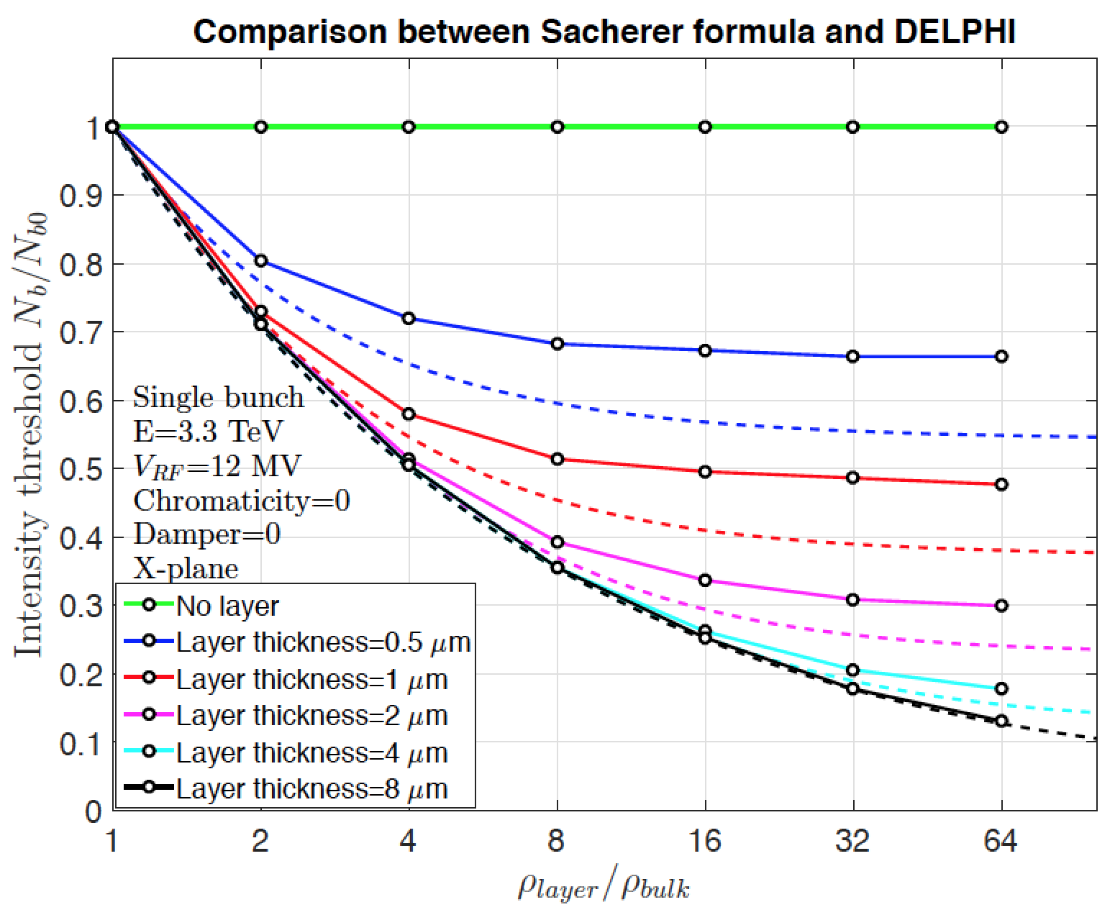
COATING (e.g. a-C) OR SURFACE TREATMENT (e.g. LESS)
TO FIGHT AGAINST E-CLOUD
    Increase of imaginary part of transverse impedance at high frequency => More critical for TMCI
      Example case of FCC-hh, where laser treatment was proposed as baseline for SEY reduction
Dotted line
Sergey Arsenyev

Slide 93
COATING (e.g. a-C) OR SURFACE TREATMENT (e.g. LESS)
TO FIGHT AGAINST E-CLOUD
    Increase of imaginary part of transverse impedance at high frequency => More critical for TMCI
      Example case of FCC-hh, where laser treatment was proposed as baseline for SEY reduction
      => Measurements at low temperature and high magnetic field are required (and planned)
Dotted line
Sergey Arsenyev

Slide 94
HTS COATING for FCC-hh: YBCO (from Sergio Calatroni)

Slide 95
HTS COATING for FCC-hh: YBCO (from Sergio Calatroni)
1
Vs. copper at injection
Re
Im
10⁹

Slide 96
HTS COATING for FCC-hh: YBCO (from Sergio Calatroni)
1
Vs. copper at injection
Re
Im
10⁹
    Much better at low and intermediate frequencies

Slide 97
HTS COATING for FCC-hh: YBCO (from Sergio Calatroni)
1
Vs. copper at injection
Re
Im
10⁹
    Much better at low and intermediate frequencies
    Pay attention to higher frequencies as it could impact TMCI

Slide 98
Longitudinal weld

Slide 99
Longitudinal weld
Increased factor deduced from 3D CST simulations with 50 μm of copper on top of SS and assuming a 2 mm high weld in SS

Slide 100
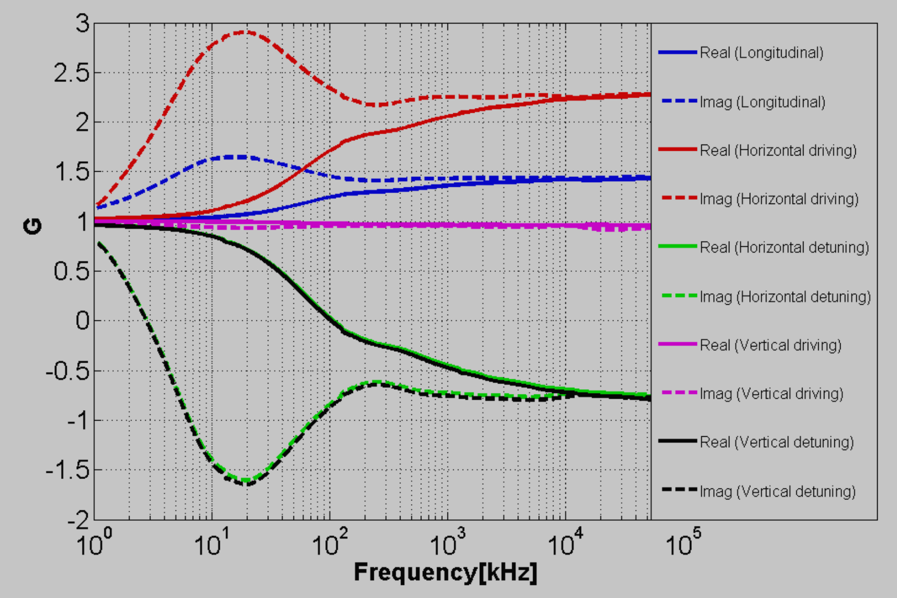
Longitudinal weld
Increased factor deduced from 3D CST simulations with 50 μm of copper on top of SS and assuming a 2 mm high weld in SS
Carlo Zannini

Slide 101
Longitudinal weld
Effect on the power loss

Slide 102
Longitudinal weld
Effect on the power loss
=>

Slide 103
Longitudinal weld
Effect on the power loss
    => The estimated increase of the power loss by ~ 50% is in agreement with the previous simulations (high frequency effect)
=>

Slide 104
Pumping slots

Slide 105
Pumping slots
Fraction of surface covered by the holes
  In the arcs: η = 4.0%
  In the LSS: η = 1.8% to 2.6% (depends on screen Φ)

Slide 106
Pumping slots
Fraction of surface covered by the holes
  In the arcs: η = 4.0%
  In the LSS: η = 1.8% to 2.6% (depends on screen Φ)
This will mainly increase the imaginary part of the longitudinal and transverse impedances (=> TMCI)
Total length covered
by the holes

Slide 107
Pumping slots
Fraction of surface covered by the holes
  In the arcs: η = 4.0%
  In the LSS: η = 1.8% to 2.6% (depends on screen Φ)
This will mainly increase the imaginary part of the longitudinal and transverse impedances (=> TMCI)
  Recommendations => Minimize the numerator and maximize the denominator… + Optimize the shape of the slots to minimize the perturbation of the induced current: elongated and rounded
Total length covered
by the holes

Slide 108
Pumping slots
Fraction of surface covered by the holes
  In the arcs: η = 4.0%
  In the LSS: η = 1.8% to 2.6% (depends on screen Φ)
This will mainly increase the imaginary part of the longitudinal and transverse impedances (=> TMCI)
  Recommendations => Minimize the numerator and maximize the denominator… + Optimize the shape of the slots to minimize the perturbation of the induced current: elongated and rounded
In addition, some trapped modes could be created => Randomization of the slots lengths (between 6,7,8,9,10 mm with average at 8 mm) + randomization of the slot spacing
Total length covered
by the holes

Slide 109
Conclusions

Slide 110
Conclusions
Impact of impedance effects on beam chamber specification is relatively well understood

Slide 111
Conclusions
Impact of impedance effects on beam chamber specification is relatively well understood
Next challenges might come from the correct characterization (vs. frequency) of some coatings or surface treatment

Slide 112
Conclusions
Impact of impedance effects on beam chamber specification is relatively well understood
Next challenges might come from the correct characterization (vs. frequency) of some coatings or surface treatment
The transitions between the beam pipes and any equipment should also be optimized (to be as smooth as possible => Famous 15 deg for LHC but depends on the particular case), as well as robust designs when RF fingers are involved (for longitudinal and/or transverse displacements)

Slide 113
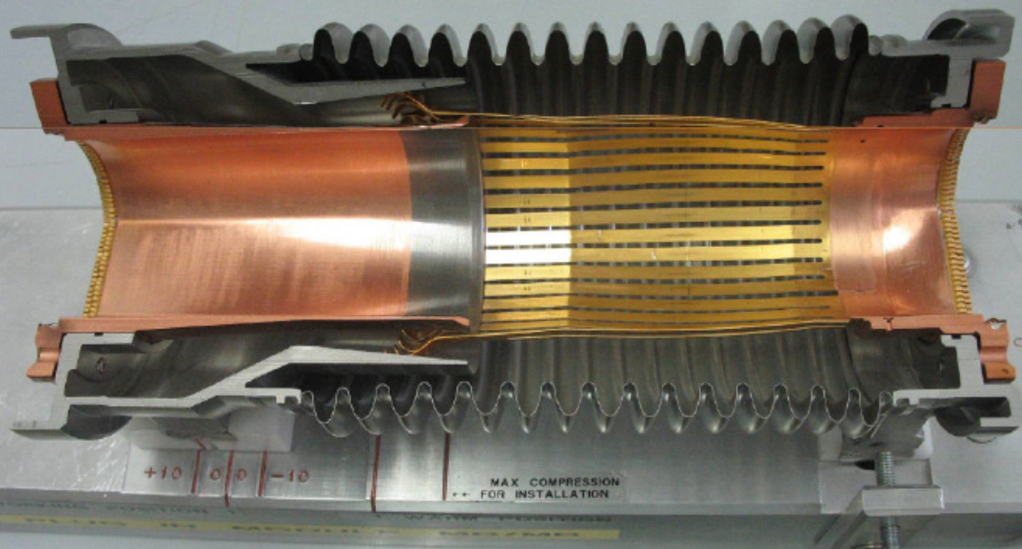
Conclusions
Impact of impedance effects on beam chamber specification is relatively well understood
Next challenges might come from the correct characterization (vs. frequency) of some coatings or surface treatment
The transitions between the beam pipes and any equipment should also be optimized (to be as smooth as possible => Famous 15 deg for LHC but depends on the particular case), as well as robust designs when RF fingers are involved (for longitudinal and/or transverse displacements)
Example of RF fingers:
PIMs = Plug-In Modules

Slide 114
Many thanks for your attention!

Slide 115
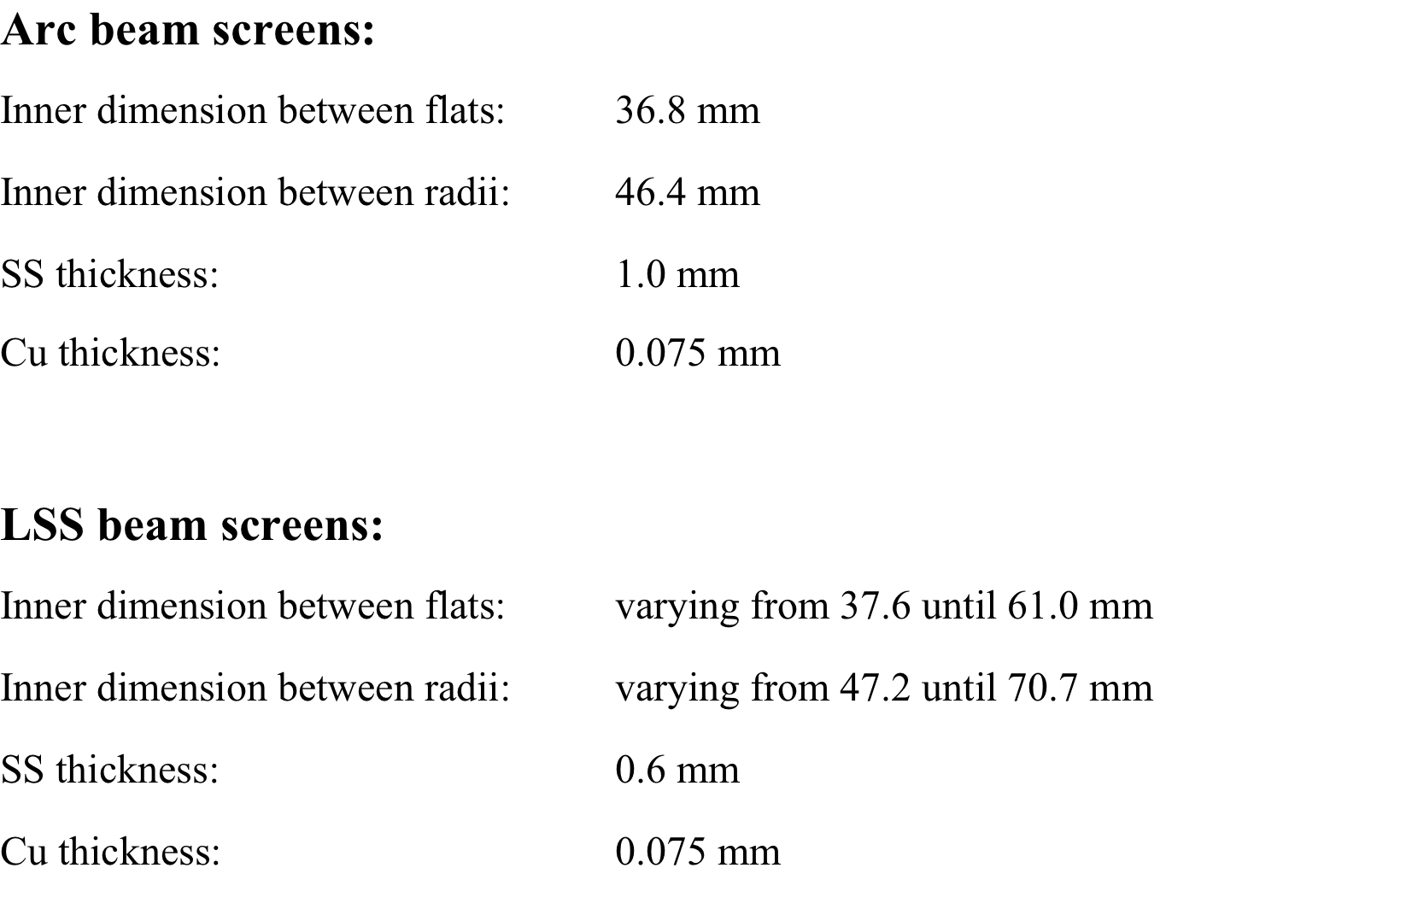
APPENDIX A: LHC BEAM SCREENS
Courtesy of N. Kos

Slide 116
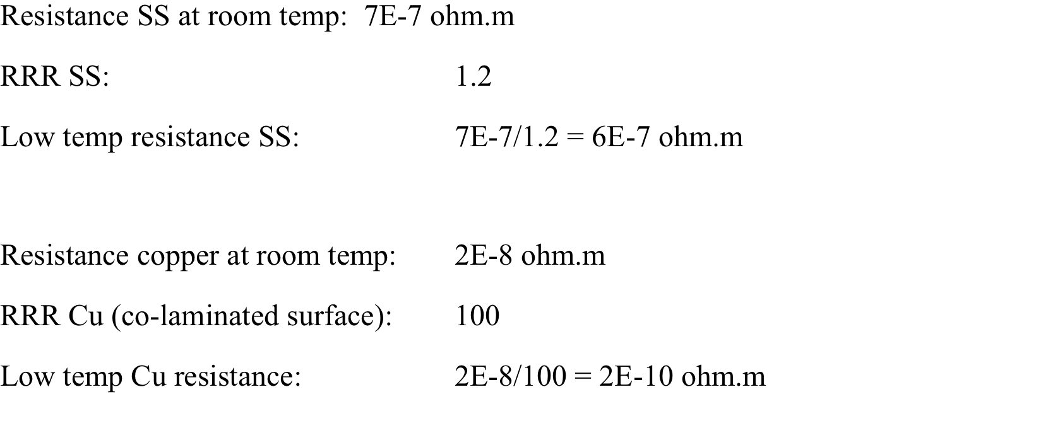
Courtesy of N. Kos

Slide 117
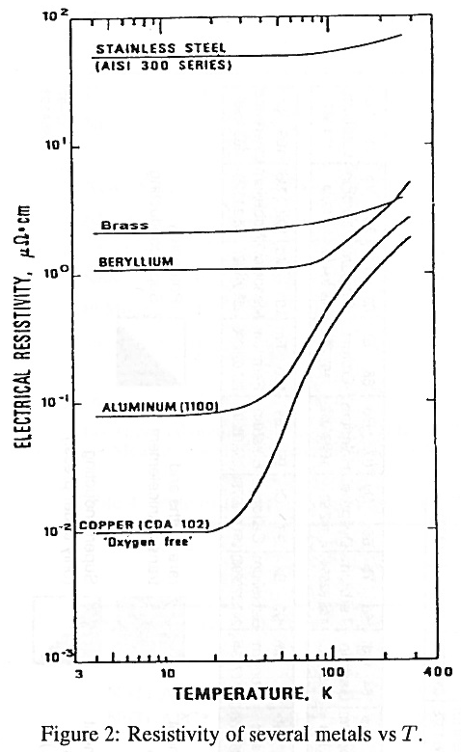
APPENDIX B: RRR (Residual Resistivity Ratio)
  Reduction of the resistivity with temperature => The resistivity decreases with temperature towards a minimum (determined by purity) and the RRR is defined as the ratio of the DC resistivity at room temperature to its cold-DC lower limit
  “Handbook of Accelerator Physics and Engineering”, 2nd Printing, Edited by A.W. Chao and M. Tigner, p. 368

Slide 118
APPENDIX C: MAGNETO-RESISTANCE
  Increase of the resistivity with magnetic field => Kohler’s rule
0.535 T
8.33 T
20 T

Slide 119
APPENDIX D: PUMPING HOLES
The parameters for the current beam screen are
  Length of the slots: L = 6,7,8,9 and 10 mm => Laverage = 8 mm
  Width of the slots:
    In the arcs: W = 1.5 mm
    In the LSS: W = 1.0 mm
  Beam screen thickness:
    In the arcs: T = 1 mm SS + 0.075 mm Cu = 1.075 mm
    In the LSS: T = 0.6 mm SS + 0.075 mm Cu = 0.675 mm

