Slide 2
Research on high temperature superconducting (HTS) coatings for the FCC
Sergio Calatroni – CERN
In collaboration with: CNR-SPIN and TU-Wien // ALBA, ICMAB and IFAE

Slide 3
Outline
The FCC-hh
Basics of beam dynamics & impedances
Surface impedance – normal metals
Surface impedance – superconductors
Surface impedance – superconductors in B field
Case for Tl-1223 and Y-123

Slide 4


Future Circular Collider Study

Slide 5

FCC-hh: pushing the energy frontier
The name of the game of a hadron collider is energy reach
Compared to the LHC:
Factor ~6 in energy → E_{cms} 100 TeV pp
Factor ~3 in radius → ρ_{bending} 100 km
Factor ~2 in field → B_{dipole} 16 T
Factor ~144 in synchrotron radiation power → E⁴ρ⁻²
$$E∝B_{dipole}{×ρ}_{bending}$$

Slide 6

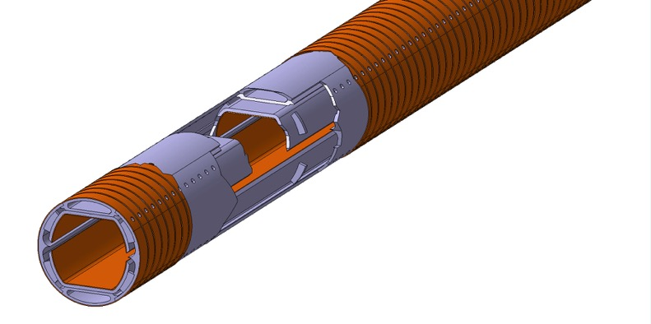
Synchrotron radiation/beam screen
High synchrotron radiation load (SR) of protons @ 50 TeV:
~30 W/m/beam (@16 T)
5 MW total in arcs (LHC <0.2W/m)
New type of ante-chamber
absorption of synchrotron radiation
avoids photo-electrons, helps vacuum
Taking into account vacuum requirements, overall cryogenic efficiency and power consumption of the accelerator, the synchrotron radiation has to be absorbed at 50 K
Copper coating as in the LHC
… it might not be good enough for the FCC-hh
Courtesy: C. Garion

Slide 7
Impedance basics
Image charges flow on the surface of the beampipe and produce wakefields
The wakefields potential is proportional to surface impedance
Power dissipation from wakes is where is a summation of over the bunch frequency spectrum
Wakefields have an effect on beam stability, in particular the transverse plane
Risetime of resistive-wall instability depends on the surface impedance
with at the frequency of the unstable mode
Transverse mode-coupled impedance (TMCI) limits the maximum
bunch intensity, also linked to the surface impedance

Slide 8
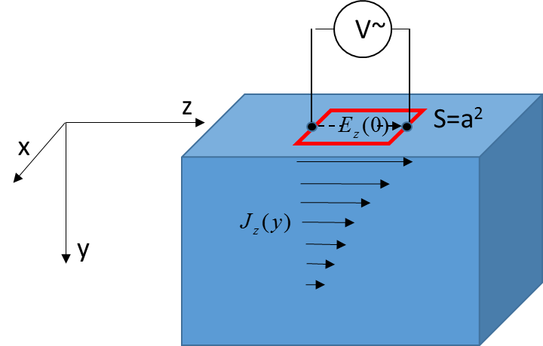
Normal metals in the local limit
V_{dc}
S=a²
d

Slide 9
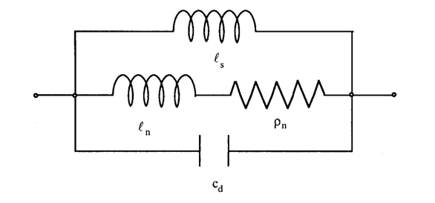
Two-fluids model
Normal metals:
Perfect metals:
Superconductors:
Frequency independent
Density of “super-electrons”

Slide 10
Superconductors in the local limit
When
From BCS theory, for

Slide 11
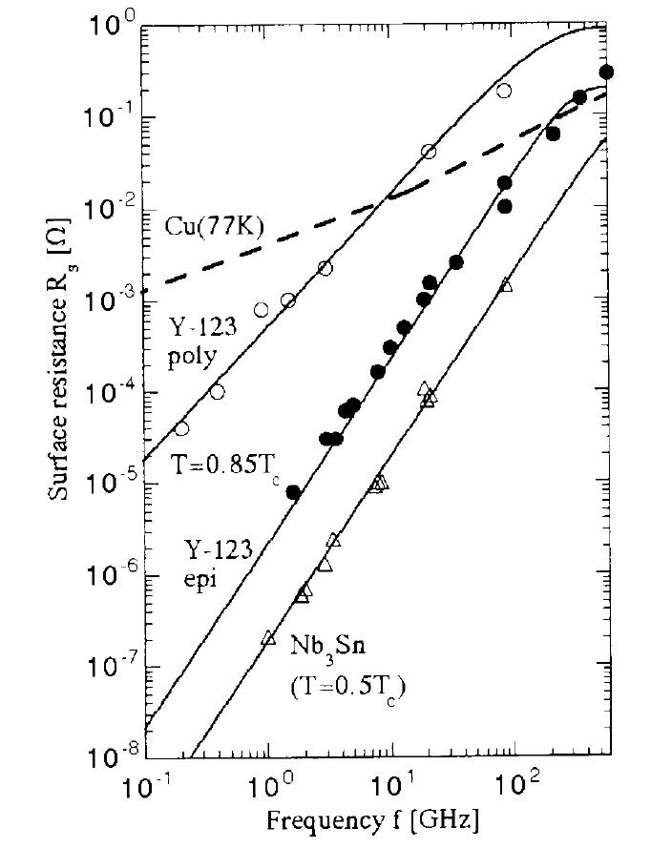
Expected performance
Surface resistance at zero H_{rf} and zero B_{ext}
Tc ~100 K
Tc ~120 K
Sundaresan et al. , IEEE TRANS. APPL. SUPERCOND. 13 (2003) 2913
HTS can have surface resistance lower than Cu
at T< 77 K and 0 T
f < 10 GHz
M. Hein, “High-Temperature Superconductor Thin Films at Microwave Frequencies”, Springer

Slide 12
From: Ruggero Vaglio

Slide 13
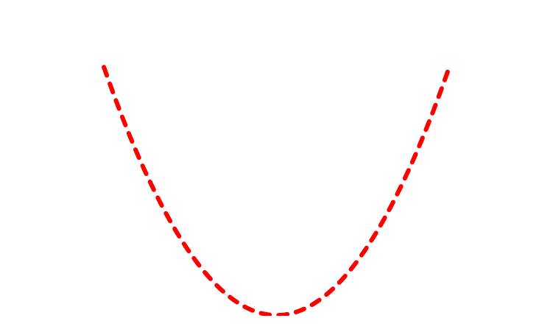
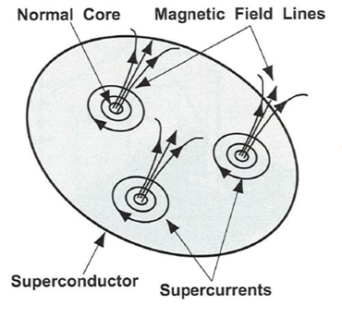
Fluxon motion in RF
At B₀>>B_{c1} repulsion forces between fluxon lines are higher with respect to the pinning forces. The fluxon array feels a periodic force of the form:
d
Gittleman and Rosenblum:
Phys Rev. Lett. 16, 734 (1966)
J. Appl. Phys. 39, 2617(1968)
If (small amplitude oscillations)

Slide 14
Fluxon motion in RF
with
The rigid fluxon lattice behaves as an harmonic damped oscillator
if m=0
Marcon, Fastampa, Giura, Silva:
Phys Rev. B, 43, 2940 (1991)
Solving for v₀:
“depinning frequency”
with

Slide 15
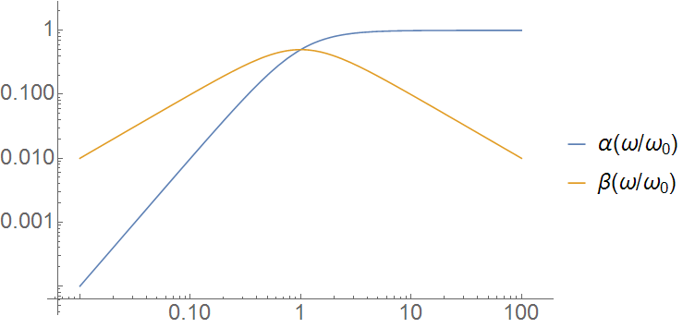
Surface impedance: effect of magnetic flux
For HTS the effect of a field B>>B_{c1} is dominating over intrinsic properties
S. Calatroni, R. Vaglio submited to IEEE Trans. Appl. Supercond.
Depinning frequency ν₀ 1÷100 GHz from literature on HTS.

Slide 16
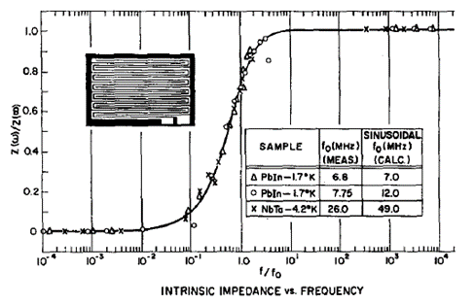
Surface resistance: effect of magnetic flux
Flux flow regime
No flux flow
Flux flow and dissipation depend on pinning strength and frequency
Properties can be calculated in principle on the basis of standard DC transport measurments

Slide 17
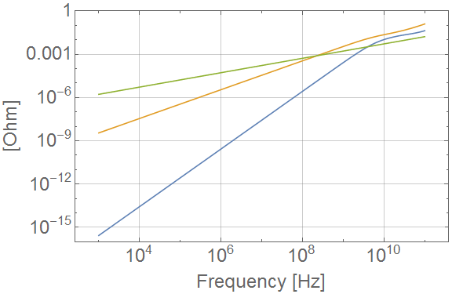
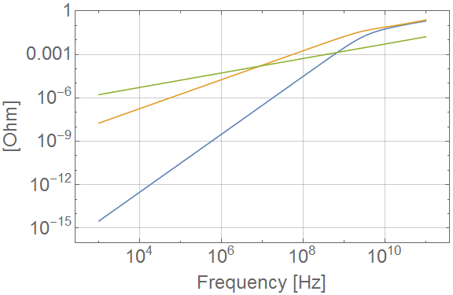
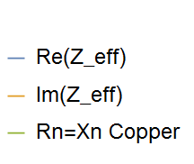
Surface resistance: effect of magnetic flux
Surface impedance Z of YBCO compared to Cu at 50 K
1.06 T magnetic field
16 T magnetic field
ν₀ = 5.8 GHz at 1.06T, ν₀ = 2.9 GHz at 16T
B_{c2} = 65 T
ρ = 50 µΩcm
Transport measurements: J. Fleiter and A. Ballarino, “Parameterization of the critical surface of REBCO conductors”, priv. comm. And https://edms.cern.ch/document/1426239/2

Slide 18
HTS films requirements for beam screen: FCC
Instantaneous current at a fixed point
8-cm bunch frequency spectrum
Beam screen of ~30mm diameter.
Assuming a film thickness / skin depth of 1 µm the HTS material should have a critical current density
Jc of about 25 kA/cm² (2.5x10⁸ A/m²) at 50 K and 16T
In this conditions it must have a
surface impedance better than copper in the needed frequency range

Slide 19
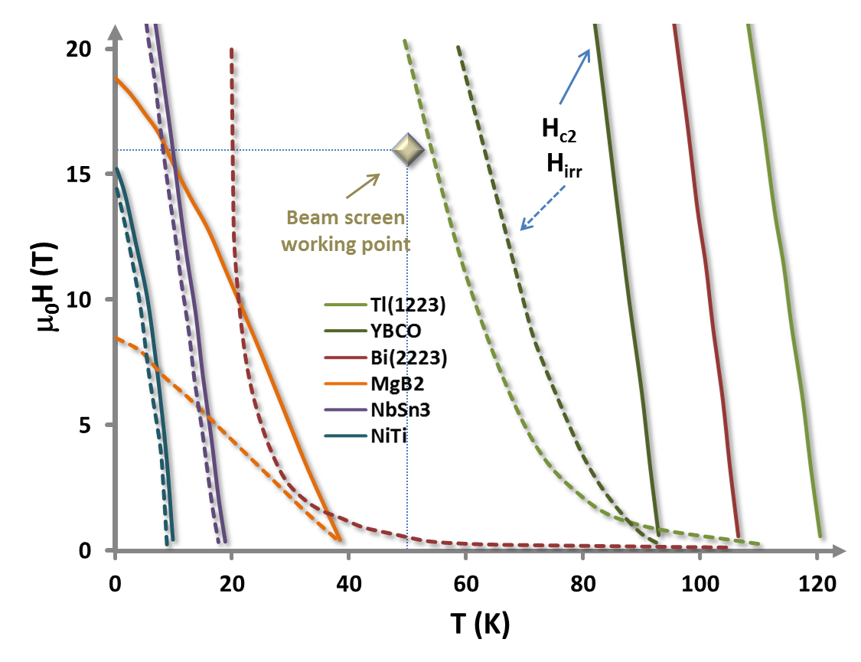
Material choices
Data from:
Nature 414, 368-377 (15 November 2001)
High-Tc superconducting materials for electric power applications
David Larbalestier, Alex Gurevich, D. Matthew Feldmann & Anatoly Polyanskii
Superconductor Science and Technology, Volume 11, Number 8
Synthesis and properties of fluorine-doped Tl(1223): bulk materials and Ag-sheathed tapes
E Bellingeri, R E Gladyshevskii, F Marti, M Dhallé and R Flükiger
Courtesy: E. Bellingeri

Slide 20
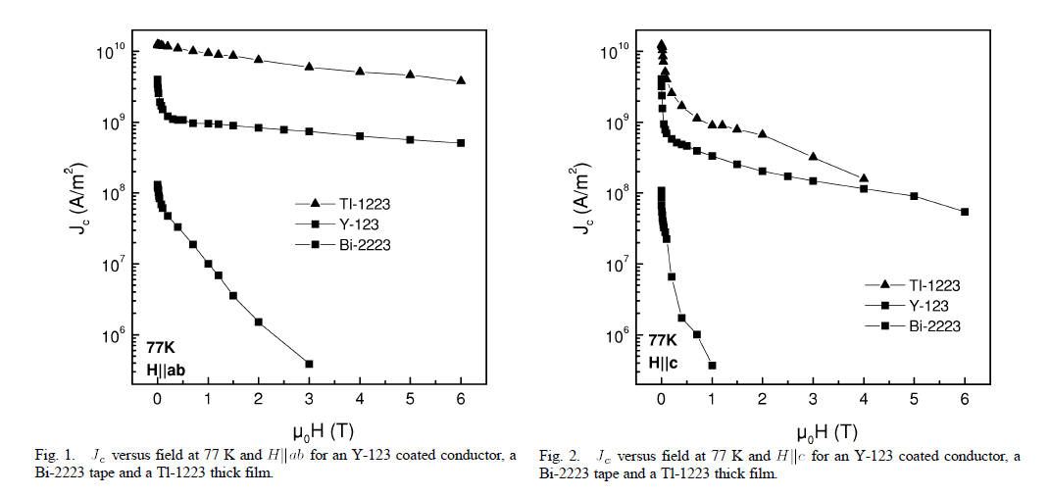
Comparison: Y-123, Bi-2223, Tl-1223
Susanne Tönies, Harald W. Weber, Gerhard Gritzner, Oliver Heiml, and Mario H. Eder,
IEEE TRANSACTIONS ON APPLIED SUPERCONDUCTIVITY, VOL. 13, NO. 2, JUNE 2003

Slide 21
Comparison table
 | YBCO | Tl1223
PROs | Safe Very high Jc Very high steep Hirr Proven technology on tapes (IBAD, …) | High Tc High Jc High Hirr Very tolerant for out stoichiometry Substrate-tolerant (Ag coating)
CONs | Strong weak link problems Lower Tc Very sensitive to stoichimetry Substrate is critical | Toxic Weak link?
Courtesy: E. Bellingeri

Slide 22
Challenges for HTS coatings
YBCO and Tl-based HTS are the only possible candidates
How to obtain good quality HTS inside tube geometry
  Considerable experience exists in coated tape production for YBCO, scalability to tubes is extremely challenging
  Tl-based HTS has characteristics similar to YBCO, and should allow full scalability to tubes thanks to electrodeposition on silver (coated) substrates

Slide 23
Collaboration on Tl-based HTS
CERN has started a Collaboration with CNR-SPIN and TU Wien in the frame of the FCC to develop Tl-based coatings
Scope of the collaboration is focussed on identifying a coating process scalable to the full beam screen
FCC frame allows for fundamental R&D on materials with possible outcomes outside the primary goal (e.g. coated conductors for magnets)

Slide 24
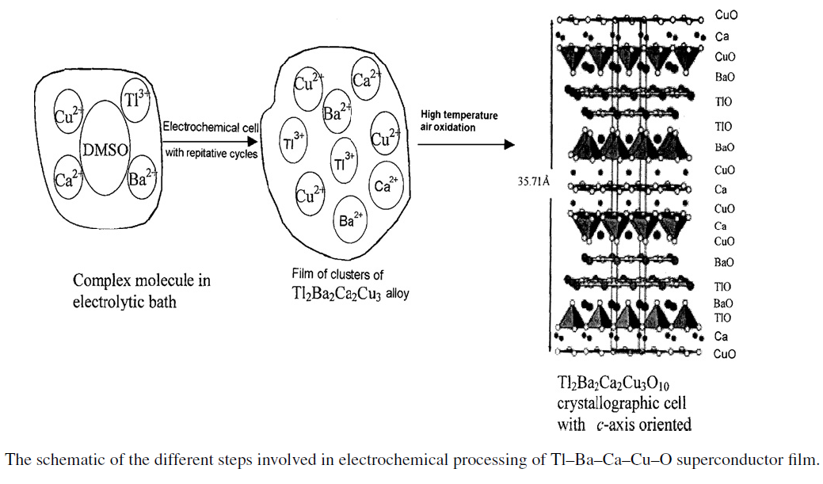
WP highlights (future work)
WP2 (CNR-SPIN): explore precursors preparation, produce policrystalline films and identify suitable production route for thick Tl-HTS films
Courtesy: E. Bellingeri

Slide 25
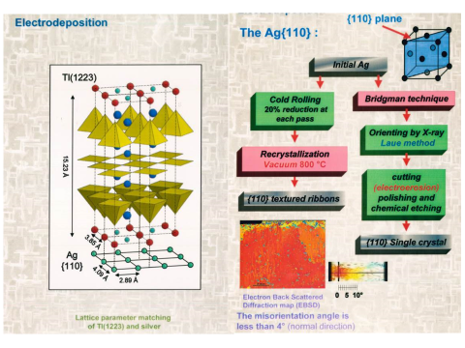
c-axis texture on untextured Ag

Slide 26
Collaboration on YBCO-based HTS
CERN has signed a Collaboration with ICMAB, IFAE and ALBA (Barcelona) in the frame of the FCC to develop a beam screen design based on Coated-Conductors (HTS tapes)
Scope of the collaboration is focussed on identifying ways of using existing high-performance HTS tapes for manufacturing the beam screen
Three-years time-frame to address all manufacturing questions and their impact on SC properties
Development of an RF test station for samples in high magnetic field

Slide 27
Barcelona proposal
Courtesy: T. Puig, F. Perez

Slide 28
Outlook
Strong motivation for HTS coatings for FCC beam screens, with potential of drastically reducing beam impedance.
Tl-1223:
  Promising performance, might open up >100 K temperature window
  Scalable coating -> R&D with CNR-SPIN and TU Wien
YBCO:
  Proven performance
  Challenging to coat inside beam screens, need forming technology -> R&D with ICMAB-ALBA-IFAE
Coating properties need extensive experimental validation, for any specific coating process.

Slide 30
Transverse impedance
F. Sacherer in: Proceedings of the First Course of the International School of Particle Accelerators, CERN 77-13, p. 198

Slide 31
Tl_{x}Ba₂Ca_{y}Cu_{y+1}O_{z}
Site | Tl_{x} | Ba₂ | Ca_{y} | Cu_{y+1} | O_{z}
Stoichiometry | X=1 o 2 | 2 | Y=0,1,2 | Y+1=1,2,3 | Z=5…10
Substitution | Pb,Bi,Cu,Hg | Sr | Tl | NONE | F

Slide 32
Y-123 vs Tl-2212

Slide 33
Non-linearities

