Slide 1





Beam Dynamics and Vacuum Issues in FCC
Frank Zimmermann, CERN
EuCARD-2 XRING workshop, KIT, 8 March 2017
on behalf of the FCC design study team
many thanks to Michael Benedikt, Roberto Cimino, Stephane Fartoukh, Roberto Kersevan, Mayro Migliorati, Daniel Schulte,..
LHC
PS
FCC
SPS
Work supported by the European Commission under Capacities 7th Framework Programme project EuCARD-2, grant agreement 312453, and the HORIZON 2020 project EuroCirCol, grant agreement 654305, as well as by the German BMBF

Slide 2


colliders and discoveries
Standard Model
Particles and forces
A. Ballarino
powerful instruments for discovery and precision measurement
Notes:
New slide from Davide.
Showing that conductor development is launched at international level, Russia, Japan, (Korea and Europe in preparation)
Underline importance of that development as main cost driver for the hadron collider machine.

Slide 3
many open questions remain
    Standard Model describes known matter, i.e. 5% of the universe!
    what is dark matter?
    what is dark energy?
    why is there more matter than antimatter?
    why do the masses differ by more than 13 orders of magnitude?
    do fundamental forces unify in single field theory?
    what about gravity?
    is there a “world equation – theory of everything”? …
Known Matter 4.9%
Dark Matter 26.8%
Dark Energy 68.3%
galaxy rotation curves, 1933 - Zwicky
K. Borras
Notes:
New slide from Davide.
Showing that conductor development is launched at international level, Russia, Japan, (Korea and Europe in preparation)
Underline importance of that development as main cost driver for the hadron collider machine.

Slide 4

energy frontier in the 21st century
very large circular hadron collider - only feasible approach to reach 100 TeV c.m. collision energy in coming decades
access to new particles (direct production) in few-TeV to 30 TeV mass range, far beyond LHC reach
much-increased rates for phenomena in sub-TeV mass range → much increased precision w.r.t. LHC
M. Mangano
hadron collider energy reach
Cf. LHC: factor ~4 in radius, factor ~2 in field → O(10) in E_{cms}
$$E∝B_{dipole}{×ρ}_{bending}$$

Slide 5

Future Circular Collider Study
Goal: CDR for European Strategy Update 2018/19
International FCC collaboration (CERN as host lab) to study:
pp-collider (FCC-hh) → main emphasis, defining infrastructure requirements
80-100 km tunnel infrastructure in Geneva area, site specific
e⁺e⁻ collider (FCC-ee), as a possible first step
p-e (FCC-he) option, integration one IP, FCC-hh & ERL
HE-LHC with FCC-hh technology
HE-LHC
~16 T ⇒ 100 TeV pp in 100 km
suggested
in 2010

Slide 6
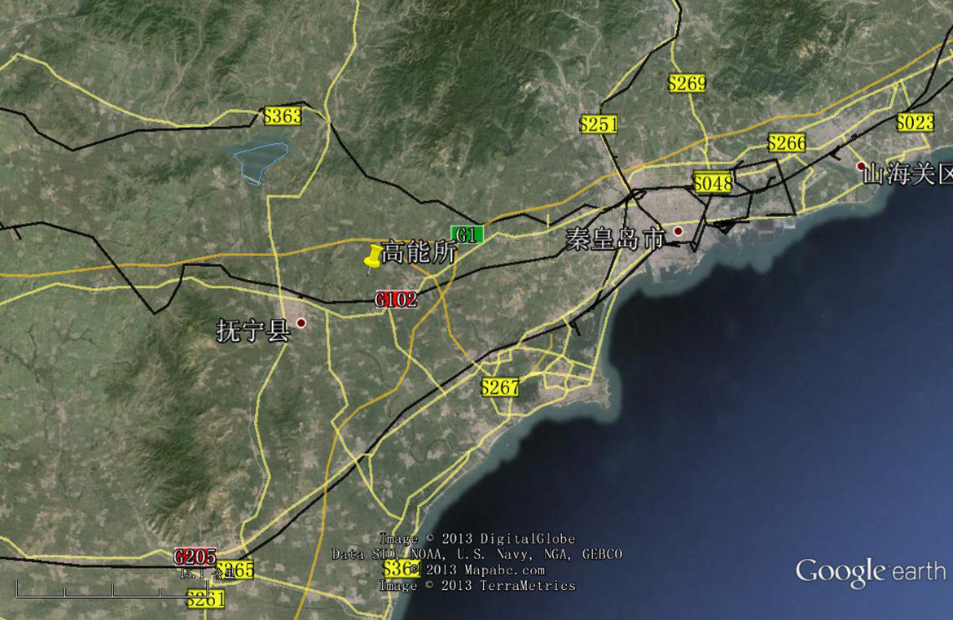
CepC/SppC study (CAS-IHEP) 100 km (new baseline!) , e⁺e⁻ collisions ~2028; pp collisions ~2042
Qinhuangdao (秦皇岛）
CepC, SppC
50 km
100 km
easy access
300 km east
from Beijing
3 h by car
1 h by train
“Chinese Toscana”
Yifang Wang

Slide 7
alternative CEPC sites
M. Koratzinos, HongKong

Slide 8
CERN Circular Colliders & FCC
1980
1985
1990
1995
2000
2005
2010
2015
2020
2025
2030
2035
2040
Constr.
Physics
LEP
Design
Proto
Construction
Physics
LHC – operation run 2
HL-LHC - ongoing project
Design
Construction
Physics
~20 years
FCC – design study
Design
Proto
Construction
Physics
must advance fast now to be ready for the period 2035 – 2040
milestone: CDR by end 2018 for next update of European Strategy

Slide 9
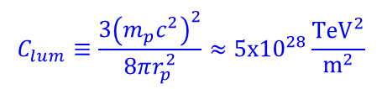
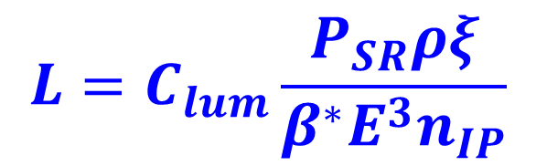
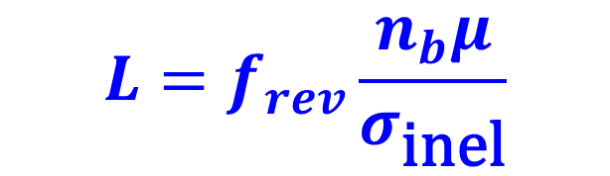
hh peak luminosity scaling
FCC-hh vs LHC:
beam-beam tune shift
limited hadron collider:
x700
x4
$$L=C_{lum}\frac{P_{SR}ρξ}{β^{∗}E^{3}n_{IP}}$$
$$C_{lum}≡\frac{3{\left(m_{p}c^{2}\right)}^{2}}{8πr_{p}^{2}}≈5x{10}^{28}\frac{{\text{TeV}}^{2}}{{\text{m}}^{2}}$$
with
x8
x1 or x5?
x5?
event pile-up limited
hadron collider:
$$L=f_{rev}\frac{n_{b}μ}{σ_{\text{inel}}}$$
shorter bunch spacing would help!!
(e.g. 25→ 5 ns increases n_{b} 5x!)

Slide 10
hadron collider parameters (pp)
parameter | FCC-hh |  |  | HE-LHC | (HL) LHC
collision energy cms [TeV] | 100 |  |  | 25 | 14
dipole field [T] | 16 |  |  | 16 | 8.3
circumference [km] | 100 |  |  | 27 | 27
beam current [A] | 0.5 |  |  | 1.27 | (1.12) 0.58
bunch intensity [10¹¹] | 1 (0.2) | 1 (0.2) |  | 2.5 | (2.2) 1.15
bunch spacing [ns] | 25 (5) | 25 (5) |  | 25 (5) | 25
IP β*_{x,y} [m] | 1.1 | 0.3 |  | 0.25 | (0.15) 0.55
luminosity/IP [10³⁴ cm⁻²s⁻¹] | 5 | 30 |  | 34 | (5) 1
peak #events/bunch crossing | 170 | 1020 (204) |  | 1070 (214) | (135) 27
stored energy/beam [GJ] | 8.4 |  |  | 1.4 | (0.7) 0.36
synchrotron rad. [W/m/beam] | 30 |  |  | 4.1 | (0.35) 0.18
transv. emit. damping time [h] | 1.1 |  |  | 4.5 | 25.8
initial proton burn off time [h] | 17.0 |  | 3.4 | 2.3 | (15) 40

Slide 11
FCC-hh as A-A collider
 | Pb-Pb | Pb-p
beam energy [TeV] | 4100 | 50
c.m. energy/nucleon pair [TeV] | 39.4 | 62.8
no. bunches / beam | 2072 | 2072
IP beta function [m] | 1.1 | 1.1
long. emit. rad. damping time [h] | 0.24 | 0.5
initial luminosity [10²⁷ cm⁻²s⁻¹] | 24.5 | 2052
peak luminosity [10²⁷ cm⁻²s⁻¹] | 57.8 | 9918
based on existing LHC complex; fast radiation damping; secondary beams from IP require dedicated collimators,…
M. Schaumann, “Potential performance for Pb-Pb, p-Pb, and p-p collisions in a future circular collider, Phys. Rev. ST Accel. Beams 18, 091002 (2015).
A. Dainese et al., “Heavy ions at the Future Circular Collider,” contribution to forthcoming CERN Report on Physics at FCC-hh, http://arxiv.org/abs/1605.01389 .
J. Jowett, M. Schaumann

Slide 12
FCC-hh layout
NEW LAYOUT NOV. 2016

Slide 13
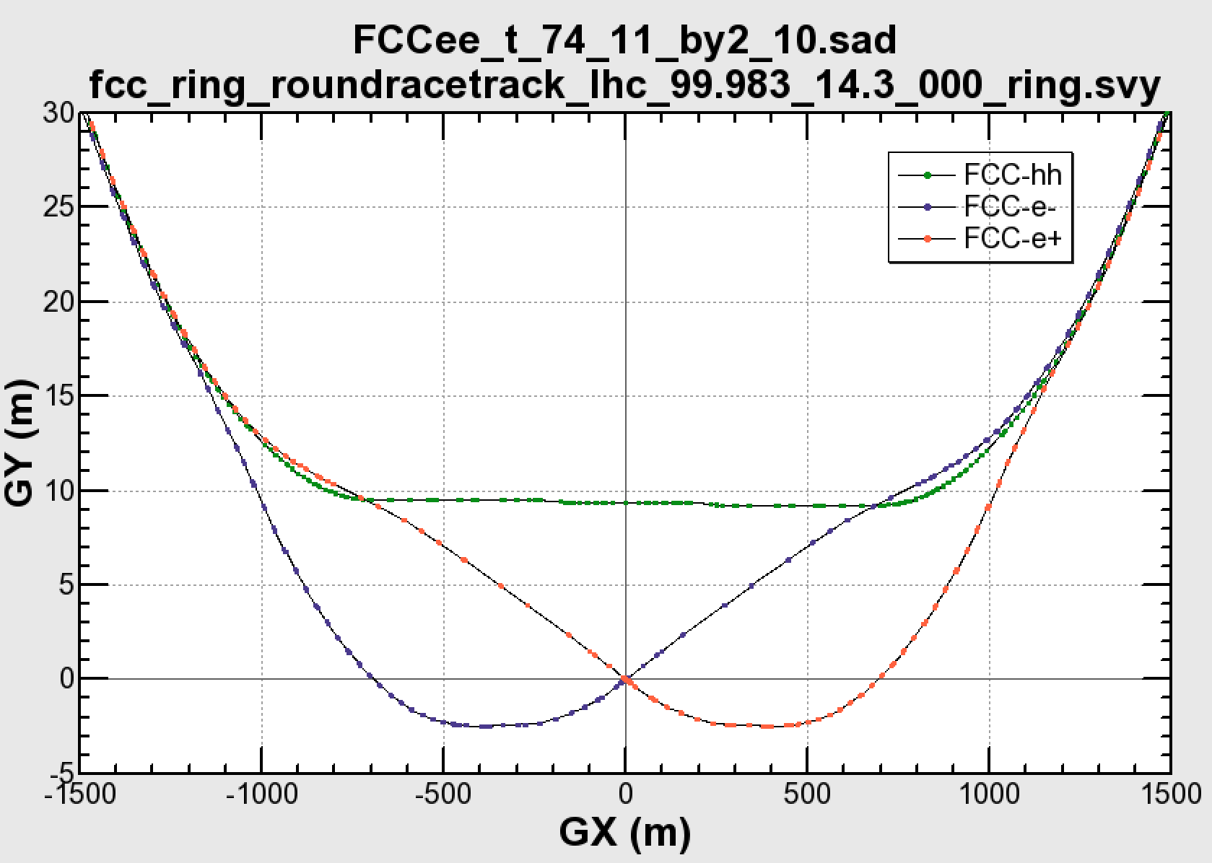

common layouts for hh & ee
FCC-ee 1, FCC-ee 2,
FCC-ee booster (FCC-hh footprint)
11.9 m
IP
30 mrad
FCC-hh/
ee Booster
FCC-hh
layout
9.4 m
0.6 m
Lepton beams must cross over through the common RF to enter the IP from inside.
Only a half of each ring is filled with bunches.
Common
RF (tt)
Common
RF (tt)
Max. separation of 3(4) rings is about 12 m:
wider tunnel or two tunnels are necessary around the IPs, for ±1.2 km.
2 main IPs in A, G for both machines
asymmetric IR optic/geometry for ee to limit synchrotron radiation to detector
IP
K. Oide
Notes:
Check with Katsunobu to have latest layout.
Check with detector people if 9 m offset is acceptable for ee detector

Slide 14
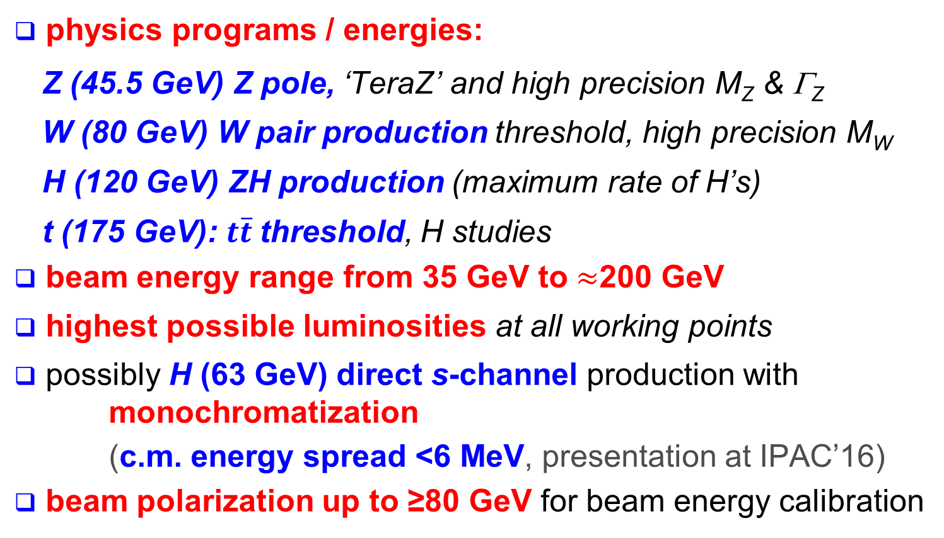
FCC-ee scope
A. Blondel, J. Ellis, C. Grojean, P. Janot,
et al.
physics programs / energies:
  Z (45.5 GeV) Z pole, ‘TeraZ’ and high precision M_{Z} & Γ_{Z}
  W (80 GeV) W pair production threshold, high precision M_{W}
  H (120 GeV) ZH production (maximum rate of H’s)
  t (175 GeV): $t\overline{t}$threshold, H studies
beam energy range from 35 GeV to $≈$200 GeV
highest possible luminosities at all working points
possibly H (63 GeV) direct s-channel production with monochromatization
  (c.m. energy spread <6 MeV, presentation at IPAC’16)
beam polarization up to ≥80 GeV for beam energy calibration
JHEP 01 (2014) 164
possible 1st step of ~100 TeV hadron collider (FCC-hh)

Slide 15
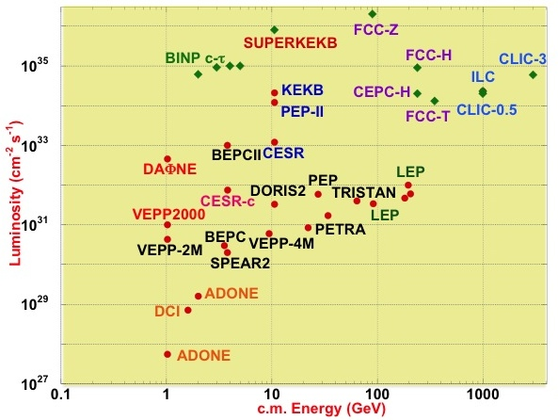
FCC-ee & CEPC exploit lessons & recipes from past & present e⁺e⁻ and pp colliders
FCC-ee
LEP:
high energy
SR effects
B-factories:
KEKB & PEP-II:
high beam
currents
top-up injection
DAΦNE: crab waist
Super B-factories
S-KEKB: low β_{y}*
KEKB: e⁺ source
HERA, LEP, RHIC:
spin
gymnastics
combining successful ingredients of recent colliders → extremely high luminosity at high energies
Marica Biagini 2016

Slide 16
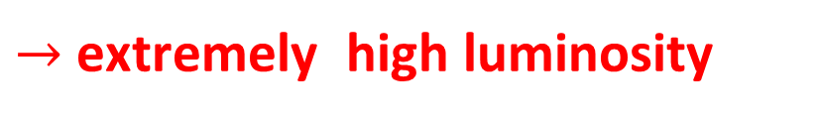
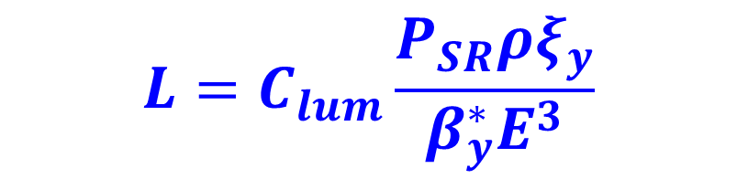
ee luminosity scaling
FCC-ee vs LEP:
x4.5
x4
x1.5-2
$$L=C_{lum}\frac{P_{SR}ρξ_{y}}{β_{y}^{∗}E^{3}}$$
<x2
x1/25-1/50
$→$extremely high luminosity

Slide 17
FCC-ee key parameters
parameter | FCC-ee |  |  |  |  |  | CEPC | LEP2
energy/beam [GeV] | 45 |  |  | 120 | 175 |  | 120 | 105
bunches/beam | 30180 | 91500 |  | 770 | 78 |  | 50 | 4
beam current [mA] | 1450 |  |  | 30 | 6.6 |  | 19.2 | 3
luminosity/IP x 10³⁴ cm⁻²s⁻¹ | 207 | 90 |  | 5.1 | 1.3 |  | 2.0 | 0.0012
energy loss/turn [GeV] | 0.03 |  |  | 1.67 | 7.55 |  | 1.67 | 3.34
synchrotron power [MW] | 100 |  |  |  |  |  | 64 | 22
RF voltage [GV] | 0.4 |  | 0.2 | 3.0 |  | 10 | 2.1 | 3.5
rms bunch length (SR,+BS) [mm] | 1.2, 6.7 |  | 1.6, 3.8 | 2.0, 2.4 |  | 2.1, 2.5 | 2.7, 2.9 | 12, 12
rms emittance ε_{x,y} [nm, pm] | 0.2, 1 |  | 0.1, 1 | 0.6, 1 |  | 1.3, 2.5 | 1.3, 4.0 | 22, 250
longit. damping time [turns] | 1320 |  |  | 72 |  | 23 | 72 | 31
crossing angle [mrad] | 30 |  |  | 30 |  | 30 | 33 | 0
beam lifetime [min] | 94 |  | 185 | 67 |  | 57 | 110 | 434

Slide 18
dynamics, vacuum & material issues for FCC
high level of synchrotron radiation (SR)
FCC-hh: 5 MW in cold environment, E_{γ}~4 keV, cryogenics power, vacuum, impedance
HE-:LHC: 170 kW in cold environment, E_{γ}~0.3 keV, vacuum, impedance, aperture
FCC-ee: 100 MW, E_{γ}~1 MeV, high total power, high photon energies, detector background, impedance
performance - electron cloud / impedance / vacuum
  NEG coating? HTS coating?
cost-efficient construction
  vacuum chambers, thin-film Nb/Cu SC cavities
machine protection
  collision debris, collimation

Slide 19
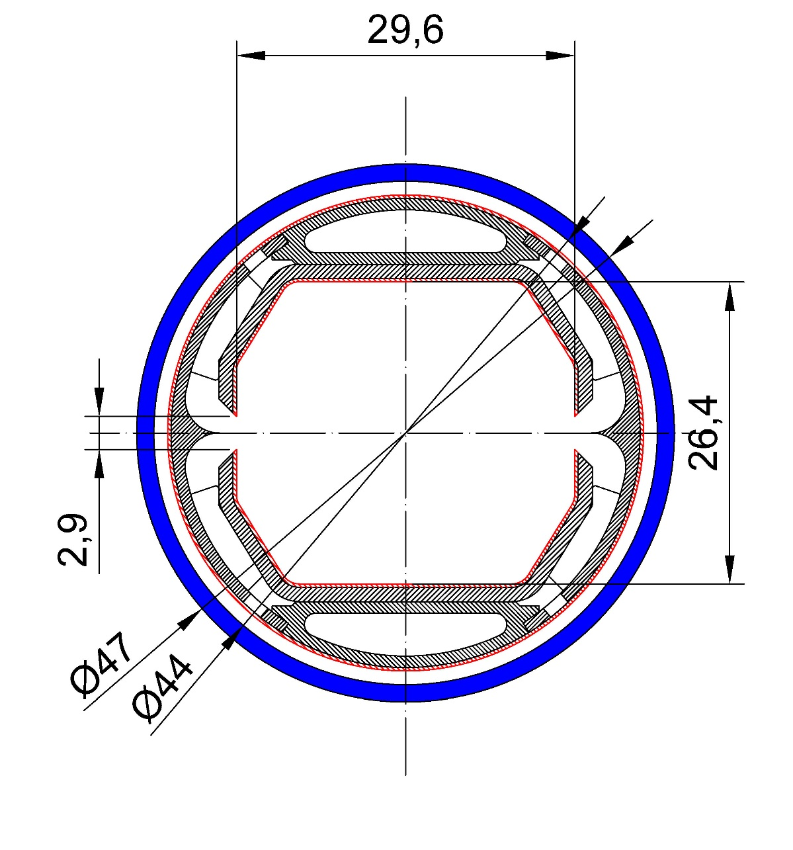
FCC-hh cryo -vacuum system
R. Kersevan,
C. Garion,
O. Boine-Frankenheim,
V. Kornilov,
F. Petrov,
et al.
FCC-hh: ≈5 MW SR power
emitted in cold arcs
beam screen at 40—60 K
(LHC at 5—20 K) → better Carnot efficiency;
but higher resistance → res. wall instability
slits & wedge capture and hide photons → no
photoelectrons in beam pipe proper
surface treatment to reduce SEY?
R. Kersevan et al.

Slide 20
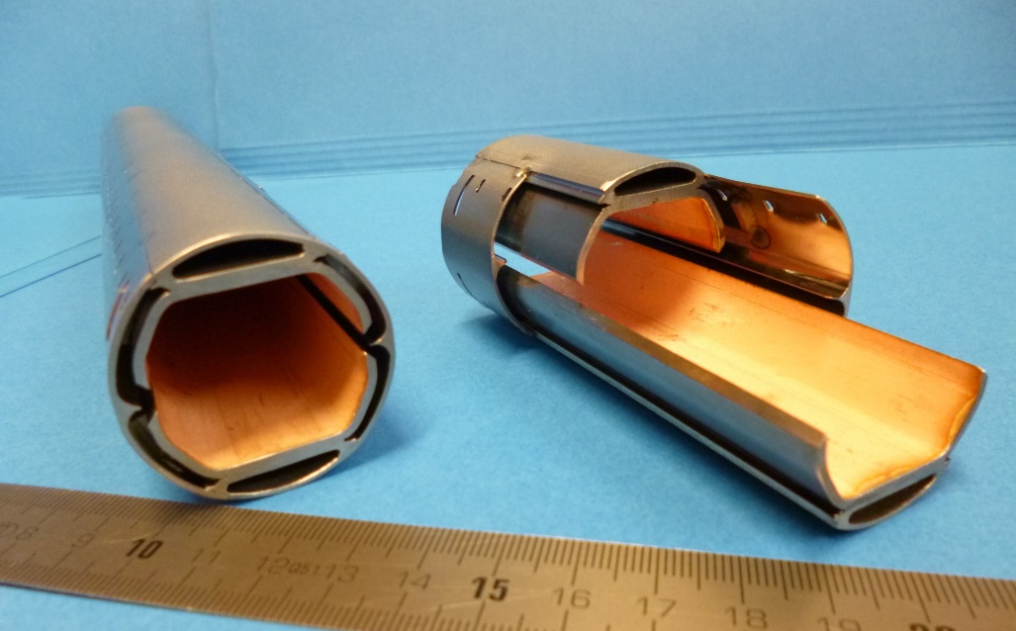
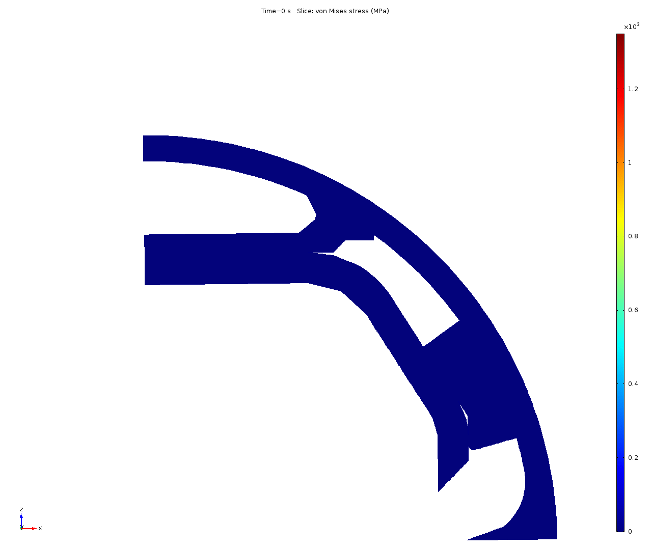
FCC-hh cryo-vacuum system
FCC-hh beam screen prototypes
beam tests at KIT ANKA
R. Kersevan et al.
simulation of quench behaviour
F. Perez & CIEMAT team, et al.

Slide 21
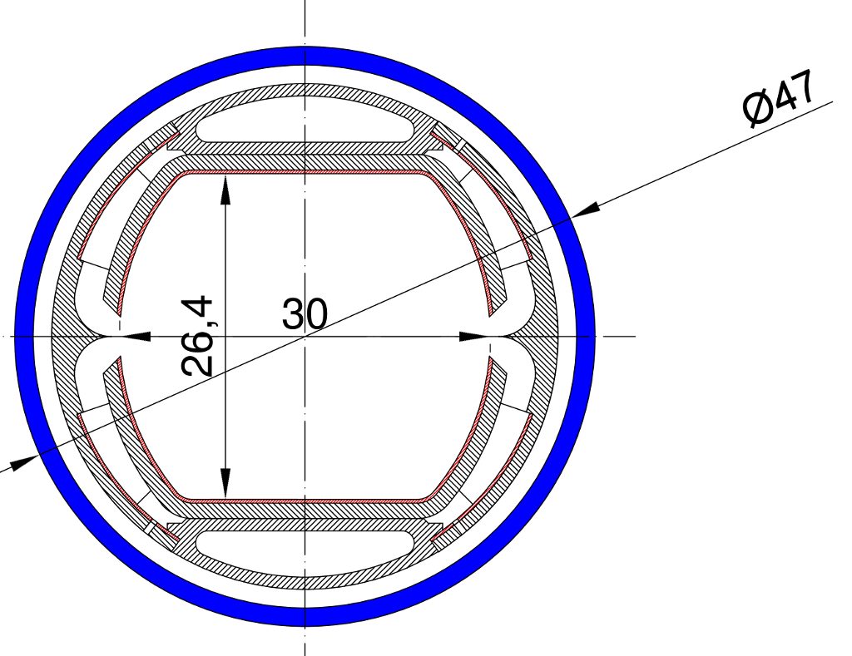
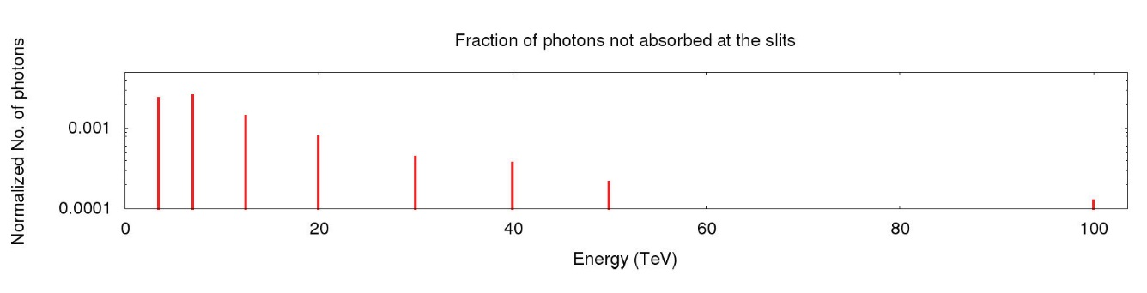
absorption of synchrotron radiation
Synrad
G. Guillermo
40 %
1 %
vertical orbit
error tolerance:
approx. 1 mm
(slot height 3 mm)
0.6 %
slot height 5 mm
G. Guillermo,
D. Sagan,
F. Zimmermann, IPAC16 (2016)
beam energy

Slide 22
FCC-hh beam-screen temperature
total
cryo
power
picked 50 K for efficiency and beam stability
but for 4.5 K magnets can also consider 110 K
Ph. Lebrun
L. Tavian
V. Baglin
based on LHC screen
300MW
200MW
100MW
D. Schulte

Slide 23
SR mitigation – dreams & challenges
shaping the beam
DC beam does not radiate
suppression of shot noise to reduce radiation demonstrated at SLAC NLCTA, D. Ratner et al., PRST-AB 18, 050703 (2015)
1 D crystalline beam (acceleration by induction acceleration?)
tailoring the boundary
large bending radius + small chamber size provide shielding - effect seen at RHIC (published 2008)
HTS coating for small chamber?
hollow plasma channel shield? other ideas?
guiding the SR photons to warmer place(s)
proposal by R. Cimino

Slide 24
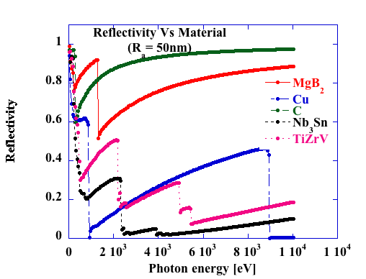
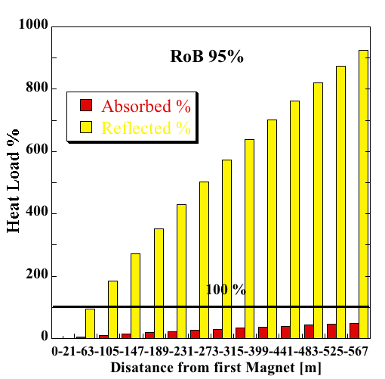
ex. Reflectivity of Beam screen (RoB)
<50% on last
magnet
20 nm C coating might greatly reduce heat load at cryogenic temperature
R. Cimino

Slide 25
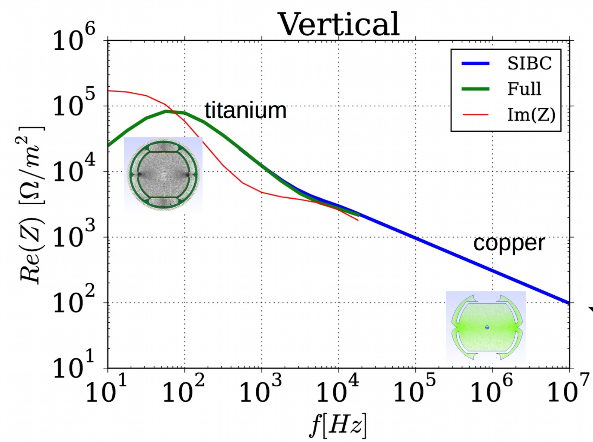
FCC-hh b.s. impedance
O. Boine-Frankenheim et al.
Beam pipe
Material | Cu, Ti
Cu thickness [μm] | 300
Betatron side-bands
are at 1 kHz
SIBC impedance is valid down to 100 Hz and sufficient for FCC estimations.
High-frequency part requires 3D
simulations
At 3 TeV: resitive wall instability $≈100$ turns -> feedback (+ octupoles) required !

Slide 26
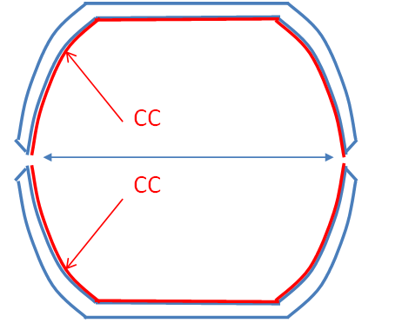
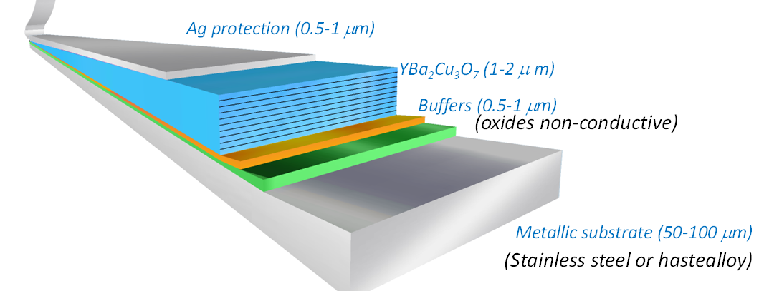
HTS coating of beam screen?
goals: - drastically lower FCC-hh beam impedance
- allowing for higher beam-screen temperature
candidate materials:
Tl-1223 (promising performance, opens up >100 K temperature window, scalable coating, R&D with CNR-SPIN and TU-Vienna)
YBCO (proven performance, requires forming technology, R&D with ICMAB-ALBA-IFAE)
CC: coated conductor
HTS can have surface resistance lower than Cu
at T< 77 K and
f < 10 GHz
S. Calatroni

Slide 27
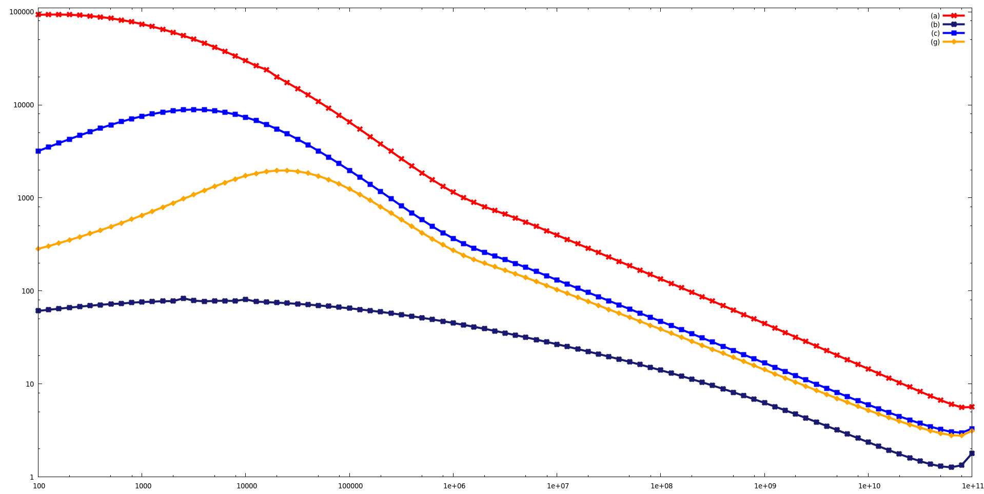
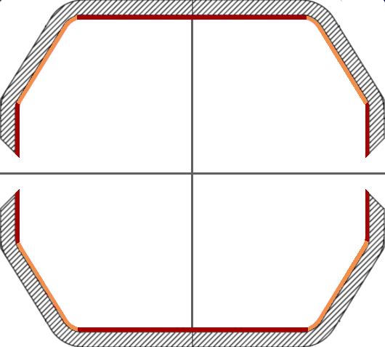
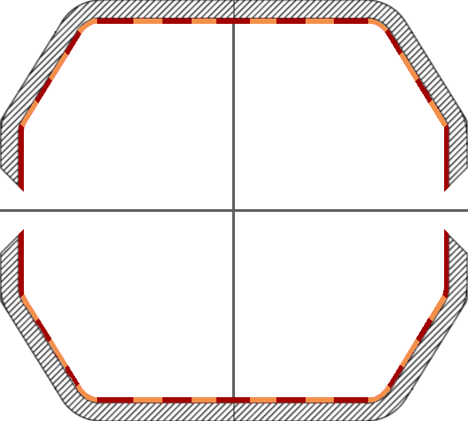

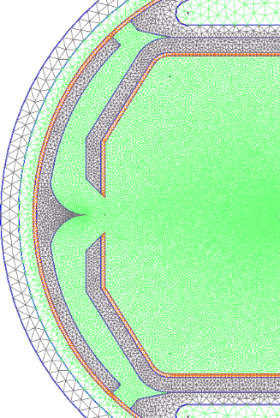












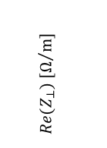






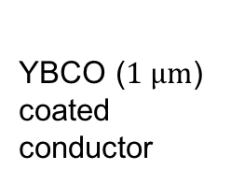
$K$)
HTS coating (YBCO, 𝑻_{𝒄}=𝟗𝟕 K)
O. Boine-Frankenheim et al.
YBCO: Yttrium Barium Copper Oxide
$${10}^{5}$$
Cu
YBCO
Wide tape
2mm tapes
YBCO ($1 μm$)
coated
conductor
Cu
YBCO
$${10}^{4}$$
A (partially) HTS coated pipe would more or
less cancel the screen’s impedance contribution.
- two collaborations (S. Calatroni): YBCO/Tl-1223
- frequency, temperature, B-field dependance
- field distortion and hysteresis
- effect on SEY and photoelectron yield
$${10}^{3}$$
$$Re(Z_{⊥}) [Ω/m]$$
$${10}^{2}$$
$${10}^{1}$$
HTS
coating
antechamber
$${10}^{0}$$
$${10}^{2}$$
$${10}^{3}$$
$${10}^{4}$$
$${10}^{5}$$
$${10}^{6}$$
$${10}^{7}$$
$${10}^{8}$$
$${10}^{9}$$
$${10}^{10}$$
$${10}^{11}$$
f $[Hz]$

Slide 28
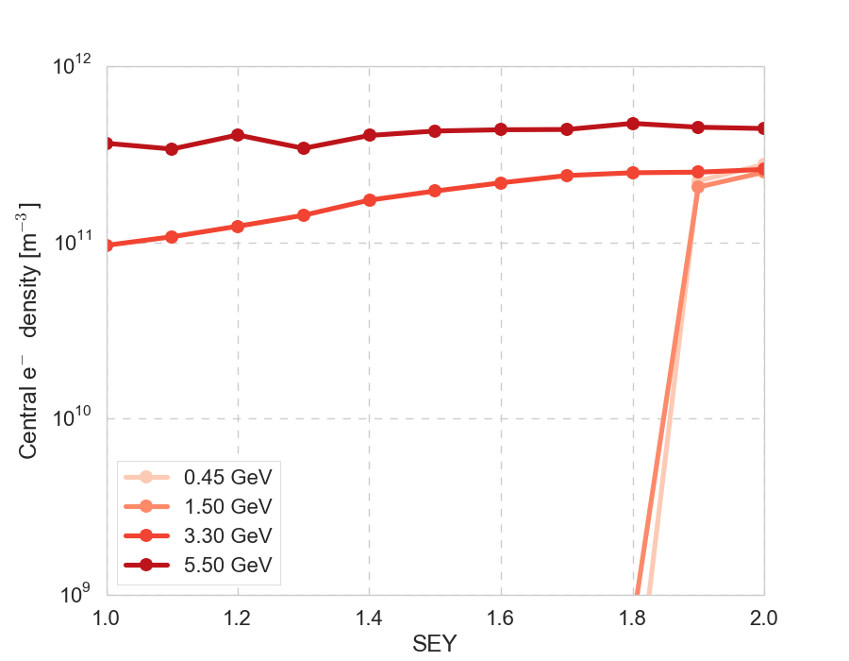
FCC-hh e-cloud instability
O. Boine-Frankenheim et al.
K. Ohmi et al, IPAC2015
3 TeV: ρ_{e,th} = 4.4 x 10¹⁰ m⁻³
50 TeV: ρ_{e,th} = 5.7 x 10¹¹ m⁻³
so far, the slits/absorbers were not included
in the e-cloud simulations !
L . Mether, FCC week, Rom (2016)
buildup simulations (pyCloud) indicate:
to run the machine without electron cloud and heat loads, sufficiently low SEY is required (<1.8 already OK), but
photoelectrons may be dangerous even for SEY ≤ 1, if no mitigation
build up in drift/dipoles

Slide 29
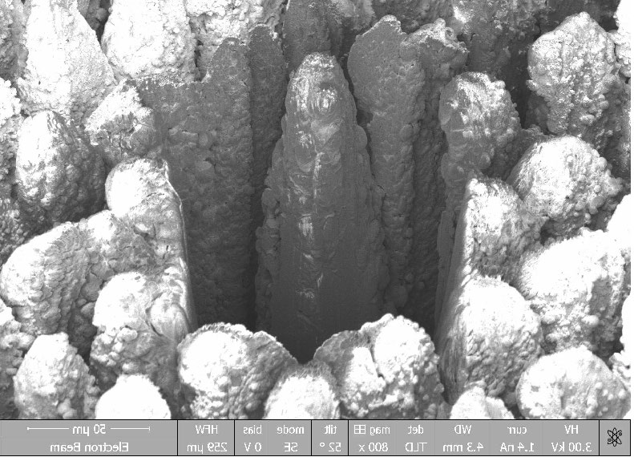
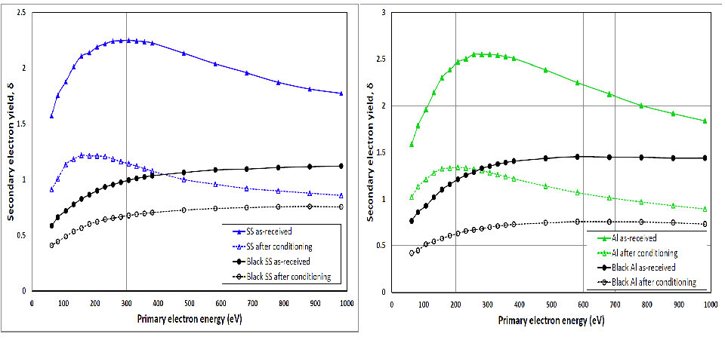
e-Cloud Mitigation by Laser Ablation
Surface Engineering (LASE) ? …
LASE on a metal surface is a very viable solution for reducing the δ < 0.6.
• even the initial (unconditioned) δ = 0.93 for SS is low enough to suppress e-cloud in, e.g., the SPS, HL-LHC, or FCC, etc.
• SEY is reduced by a combination of two geometrical effects
• surface resistance measurements: shallow groove type with superimposed nano-sphere is preferable solution
O. Malyshev,
R. Valizadeh,
et al.

Slide 30
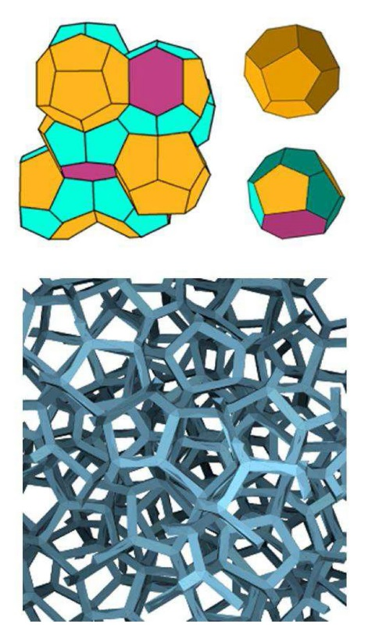
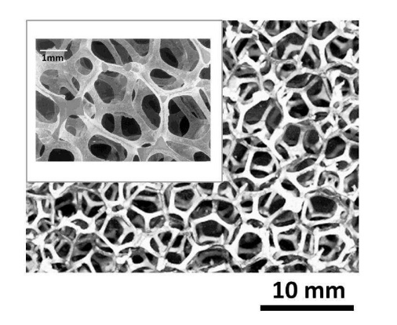
or open-cell metallic foams?
a typical open-cell metallic foam structure
Wearie-Phelan honeycomb cell (top left),
its constituent polyhedra (top right) and its
numerically simulated reticulated foam
low secondary emission yield
resisting eddy-current induced stresses
good pumping properties
but potentially much larger impedance than solid metals
(→ HTS coated foams, or backing beam screen slits with metallic foams?)
S. Petracca, et al.

Slide 31
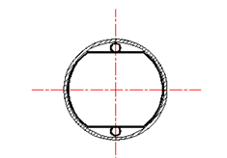
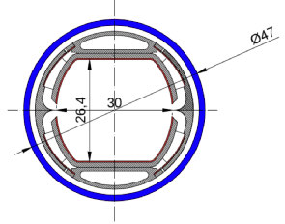
HE-LHC beam-screen options
scaled LHC beam screen
with pumping slots,
and sawtooth structure
FCC-hh beam screen
pumping slots shielded,
much reduced # photoelectrons
experiencing beam field
14
19
(1) b = 14 mm, T=20 K
(2) b = 14 mm, T=50 K
(3) b = 13.2 mm, T=50 K

Slide 32
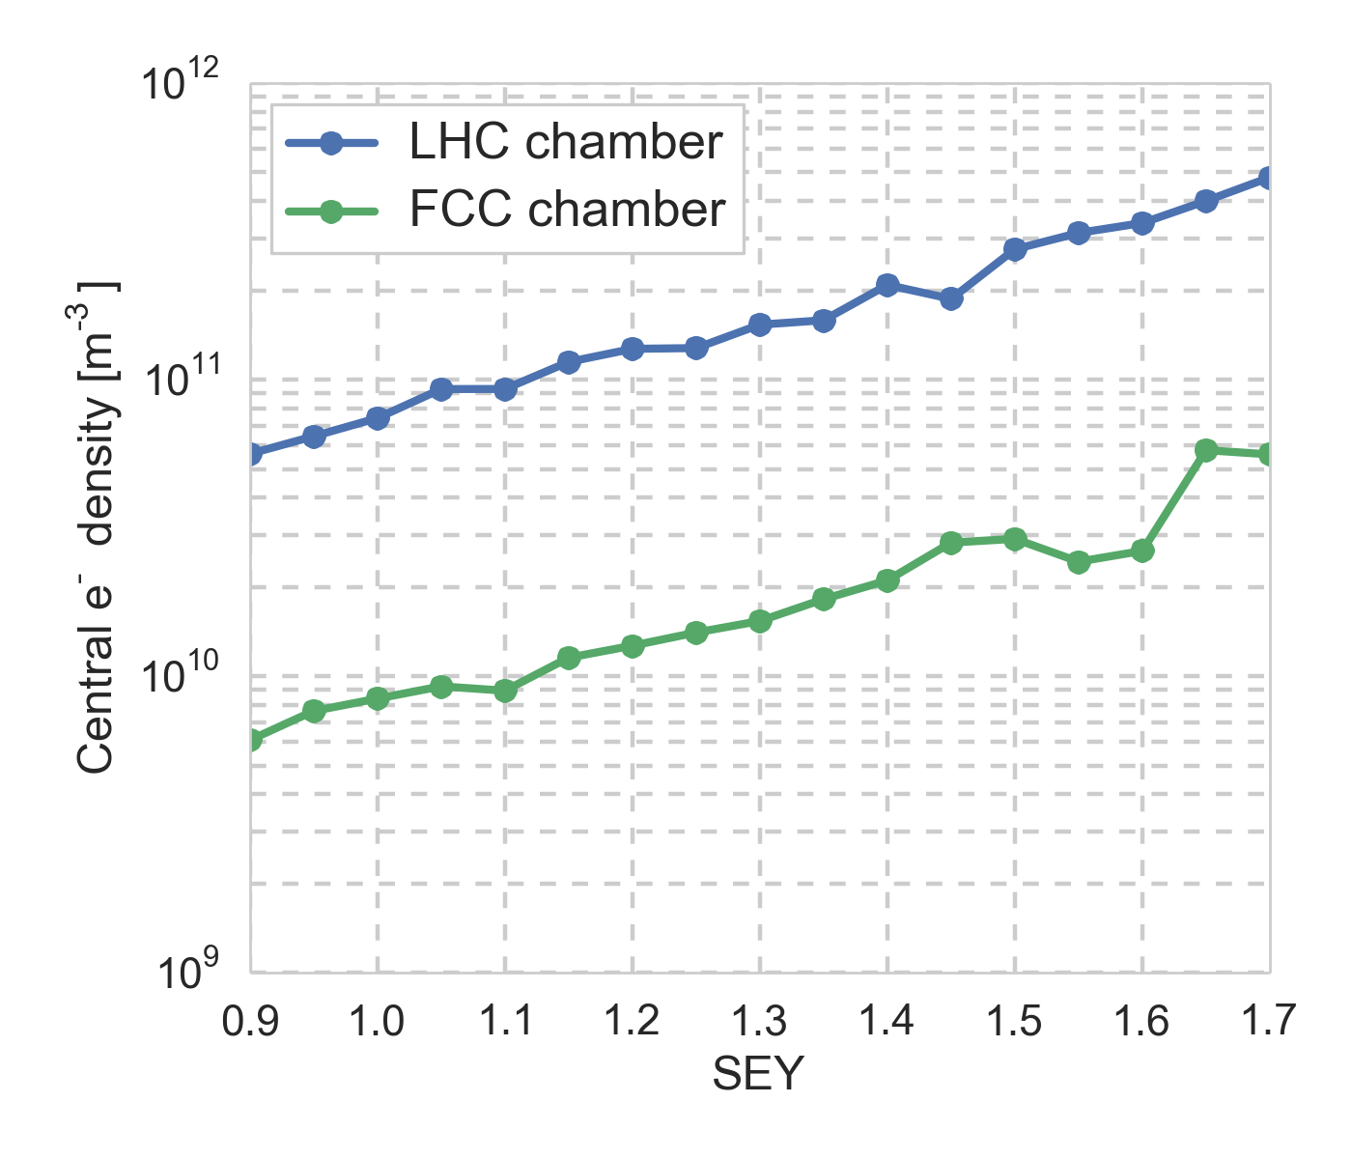
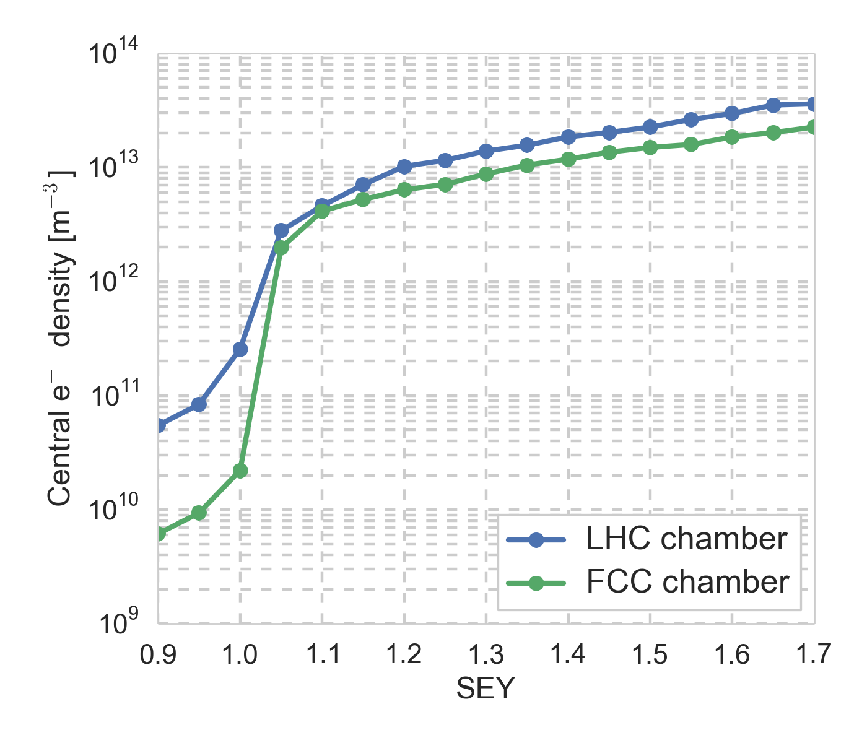
HE-LHC e-cloud build up
25 ns beam
5 ns beam
L. Mether
→
FCC type chamber efficient,
5 ns requires very low SEY
e-cloud inst. threshold |  | 25ns inj | 5ns inj
formula | ρ_{e,th}(m⁻³) | 1.4x10¹¹ | 1.4x10¹¹
simulation with B | ρ_{e,th}(m⁻³) | 3x10¹¹ | 3-4x10¹¹
simulation wo B | ρ_{e,th}(m⁻³) | 1-2x10¹¹ | 1-2x10¹¹
K. Ohmi

Slide 33
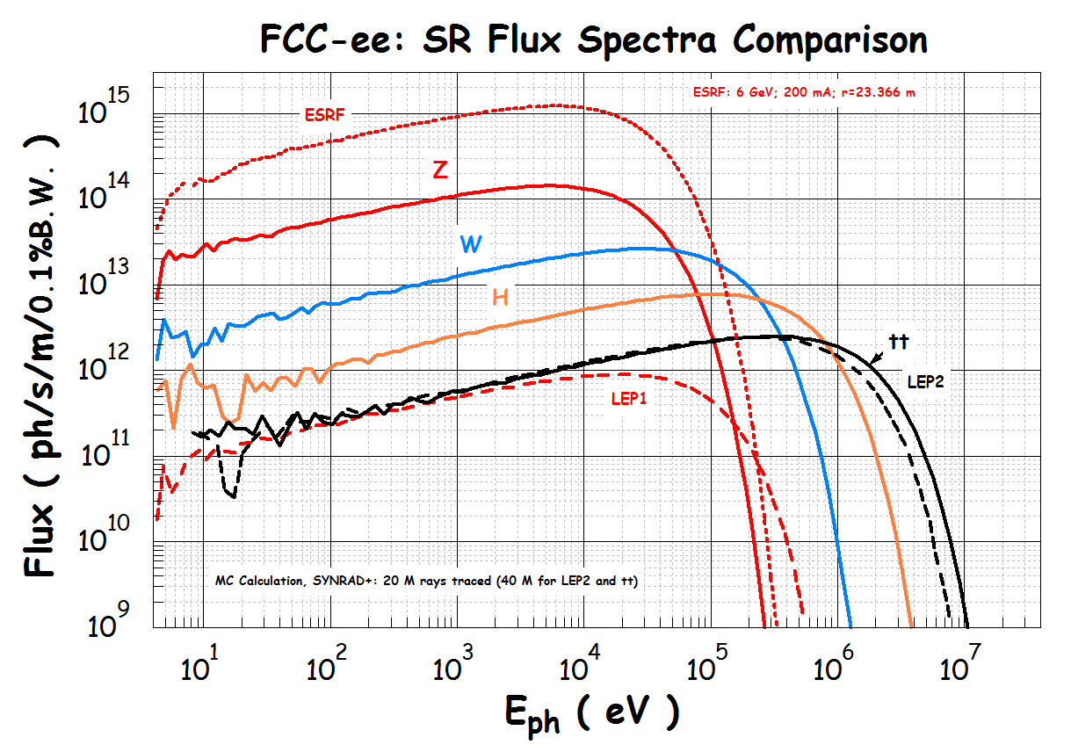
SR flux spectra for FCC-ee
R. Kersevan

Slide 34
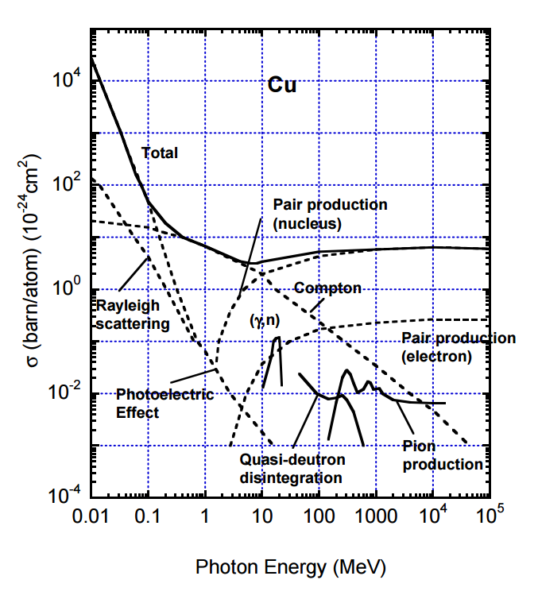
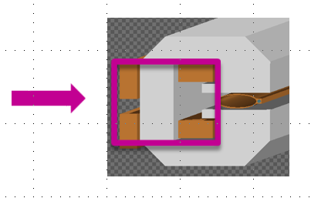
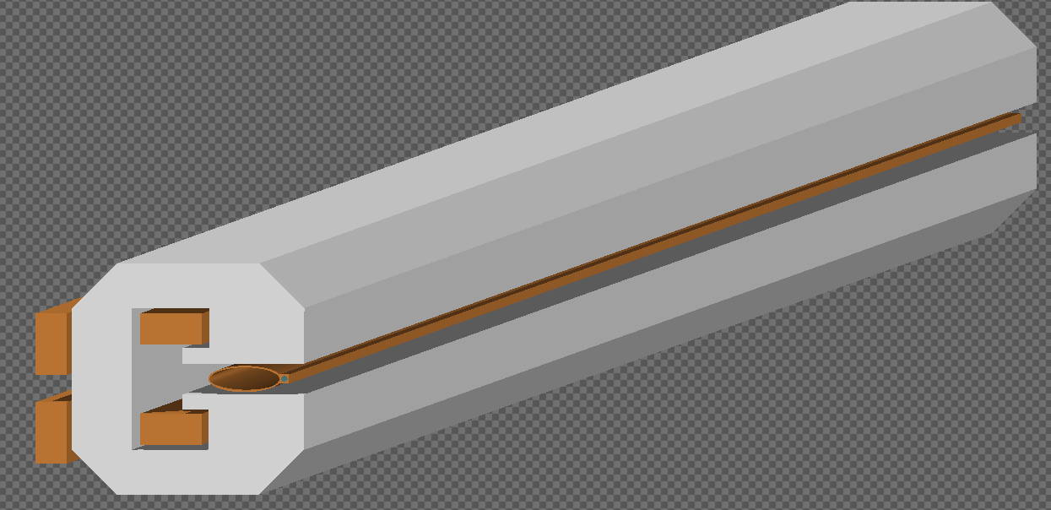
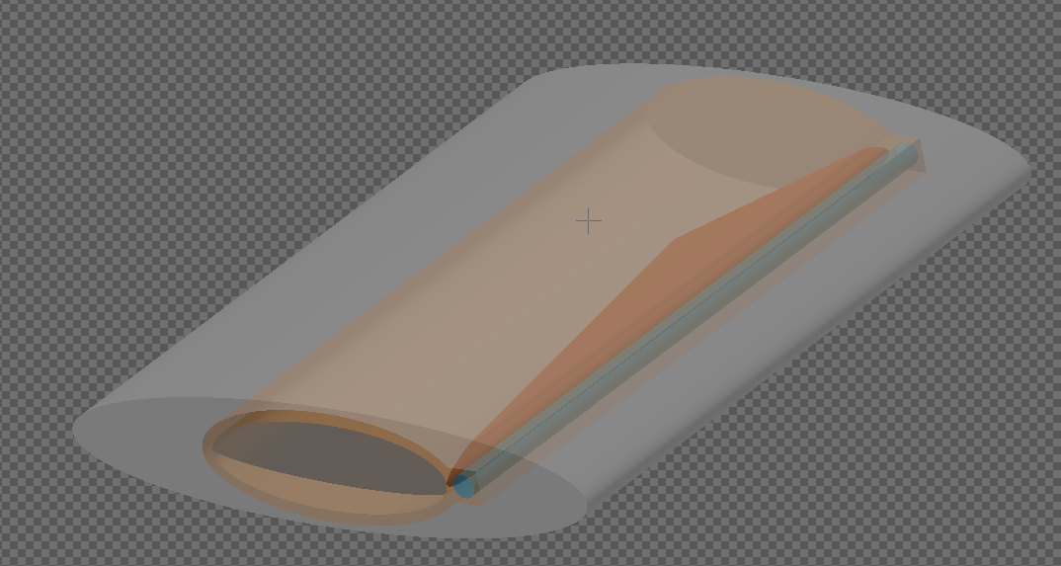
SR shielding for FCC-ee
Ref.: “Impact of synchrotron radiation in lepton collider arcs”,
F. Cerutti et al., FCC Kick-off Meeting, Univ. Geneva, Feb 2014
10.5 m dipole
Iron + plastic
24 cm absorber
25 mm
Lead
F. Cerutti, L. Lari., R. Kersevan

Slide 35
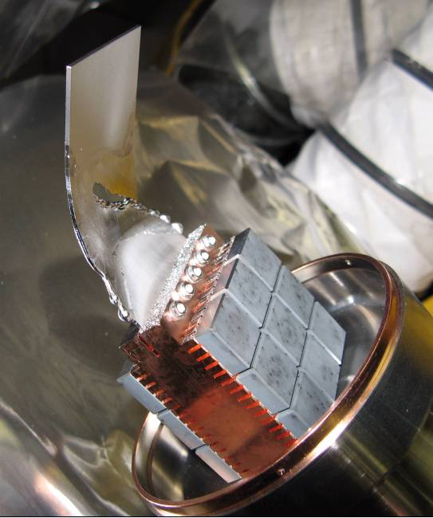
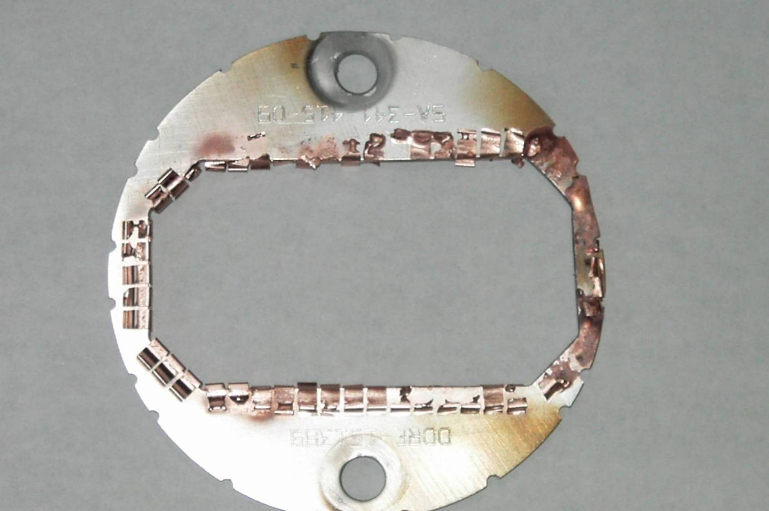
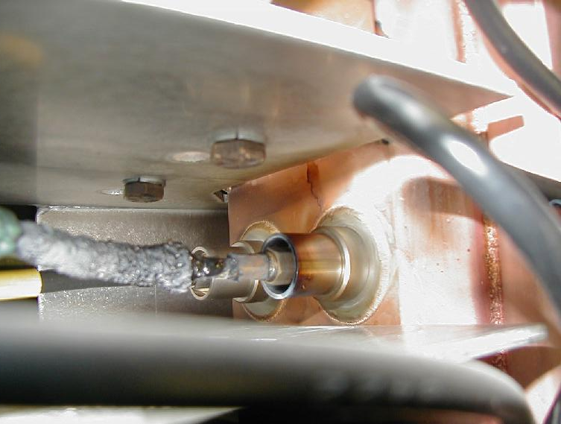
HOM heating due to small gaps at PEP-II
damaged spoiler, RF shield, BPMs,…
A. Novokhatski

Slide 36
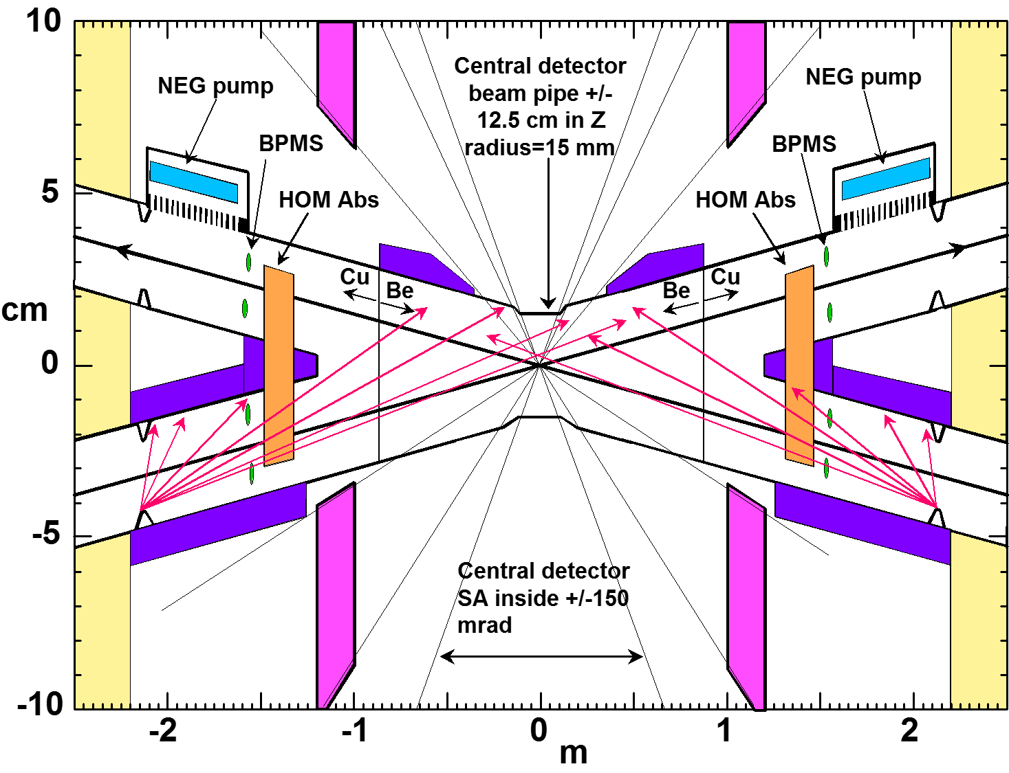
FCC-ee IR: HOMs, SR, vacuum
M. Sullivan

Slide 37
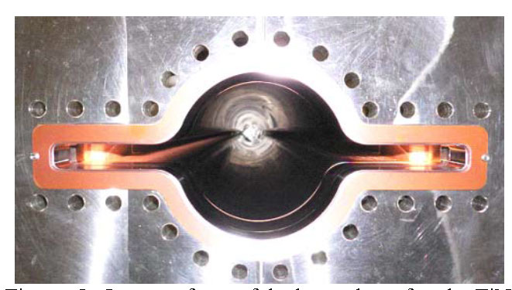
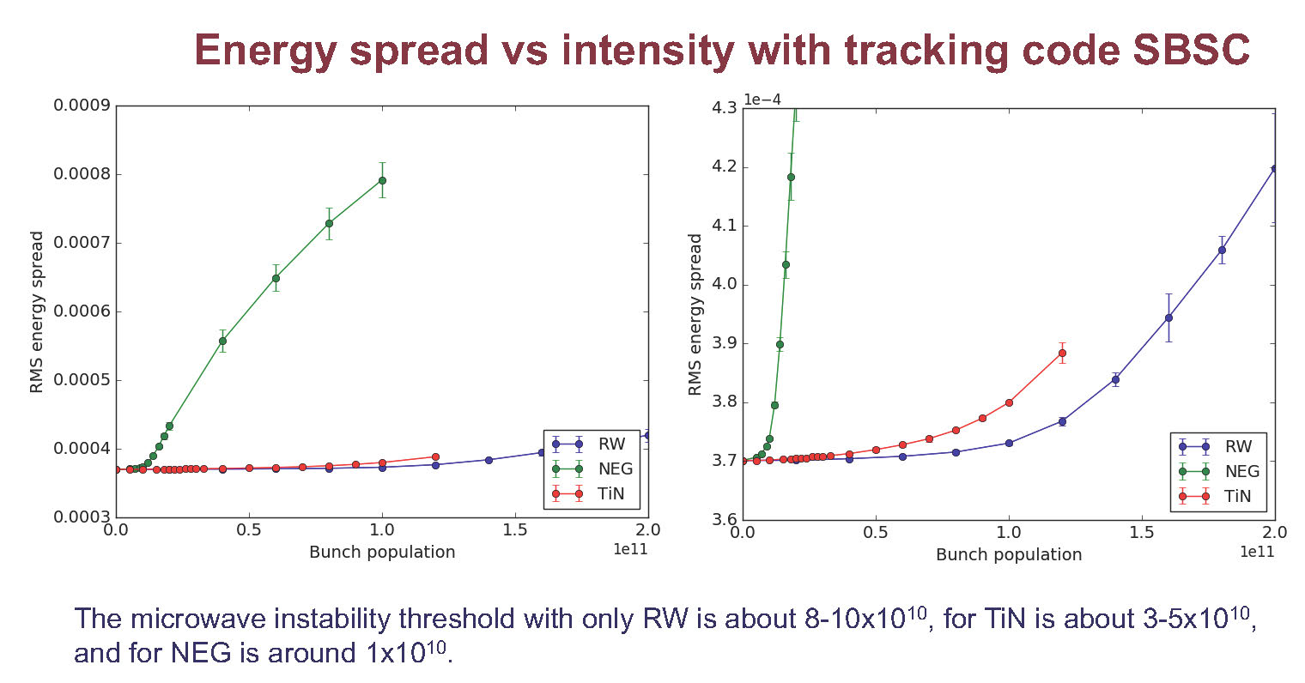
FCC-ee NEG effect
TiN coated beam duct for KEKB
NEG coating greatly increases
longitudinal impedance
→ microwave instability
1 μm NEG
→ disaster
0.2 μm TiN
Perhaps
acceptable
M. Migliorati

Slide 38
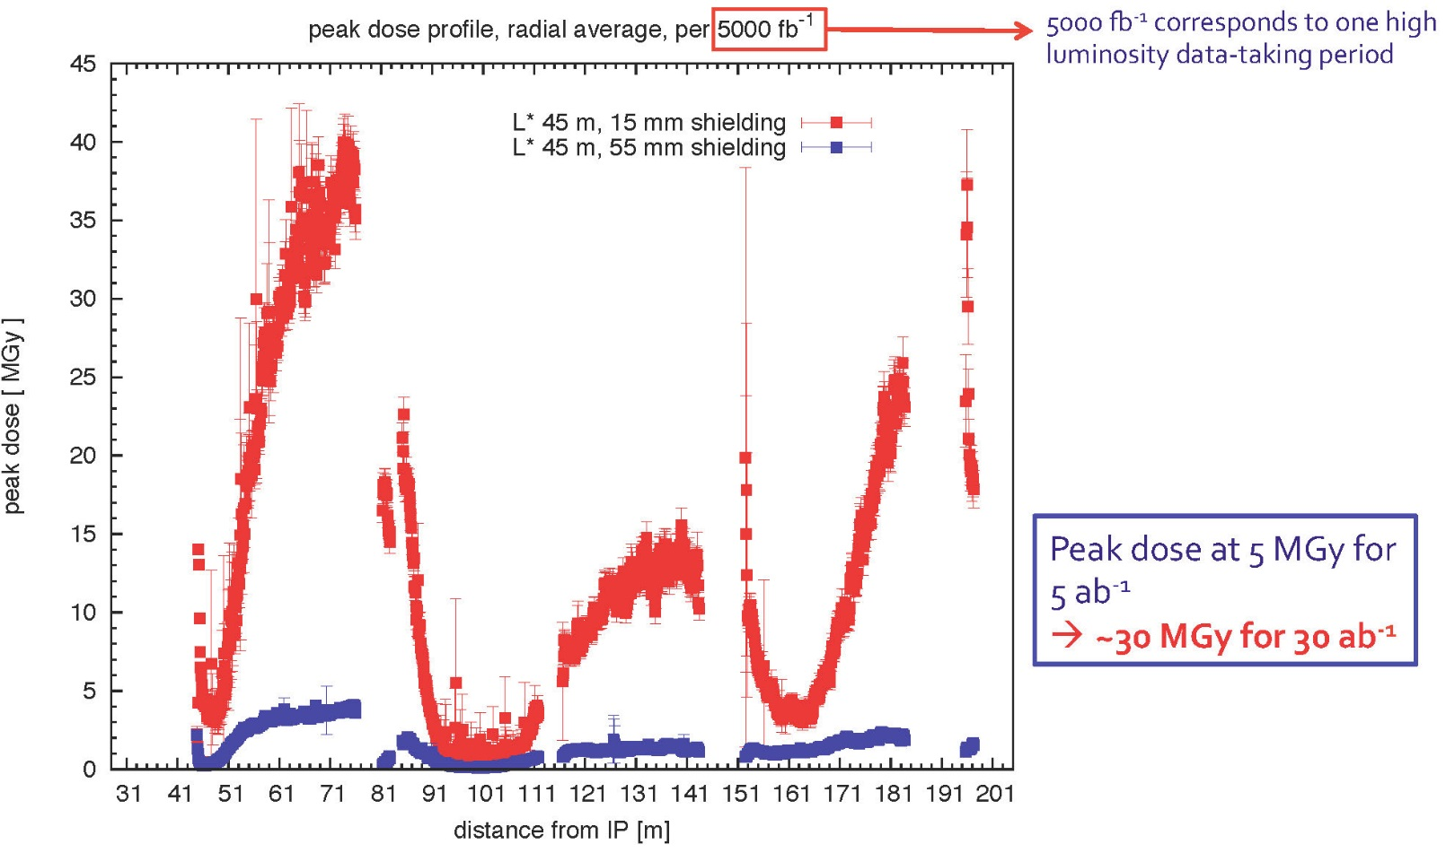
FCC-hh BDS & MDI
interaction region
beam delivery
System (BDS)
machine
detector interface
(MDI)
issue:
collision debris
hitting final
quadrupoles
radiation dose for final quadrupoles
I. Besana, F. Cerutti, D. Schulte, A. Seryi, et al.
Notes:
Add one slide showing optics, possibly with some smaller plots on insertions?
Detailed optimisation on optics of each insertion within overall defined boundaries.

Slide 39
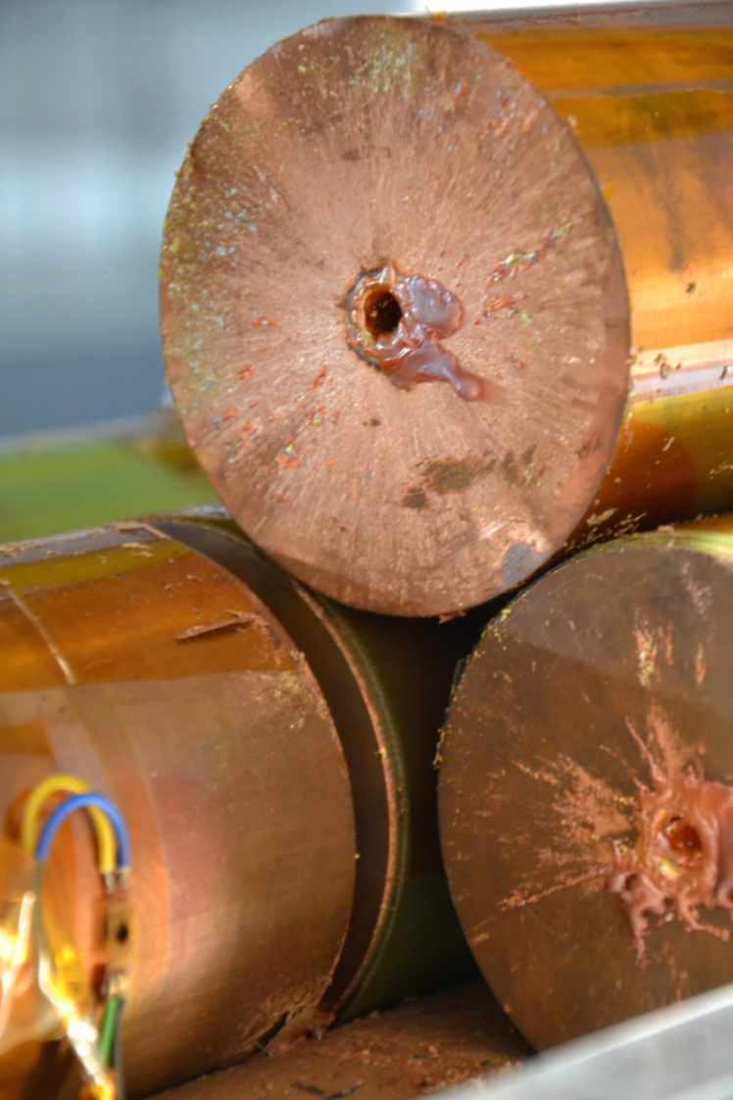

FCC-hh machine protection
contributions: beam screen (BS) & cold bore (BS heat radiation)
stored energy 8.4 GJ per beam
  at least one order of magnitude higher than for LHC, equivalent to A380 (560 t) at nominal speed (850 km/h).
  collimation, control of beam losses and radiation effects (shielding) are of prime importance.
  injection, beam transfer and beam dump all critical
D. Schulte
damage of a beam with an energy of 2 MJ
all machine protection issues to be addressed early on

Slide 40
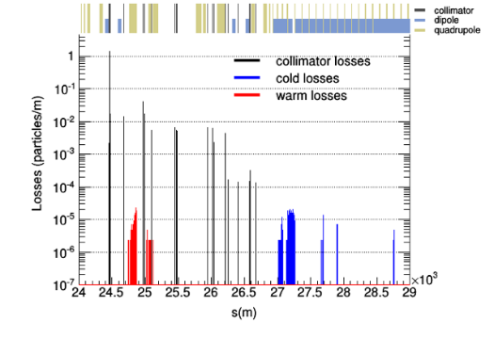
FCC-hh collimation
collimators should avoid quenches of SC magnets (efficiency) and protect the machine in case of sudden failures (robustness)
first FCC efficiency studies
high losses in dispersion suppressor
heat load on primary collimators close to the limit
operational robustness improvements:
  - crystal collimation?
  - hollow electron lens?
M. Fiascaris,
J. Molson,
S. Redaelli,
D. Schulte

Slide 41
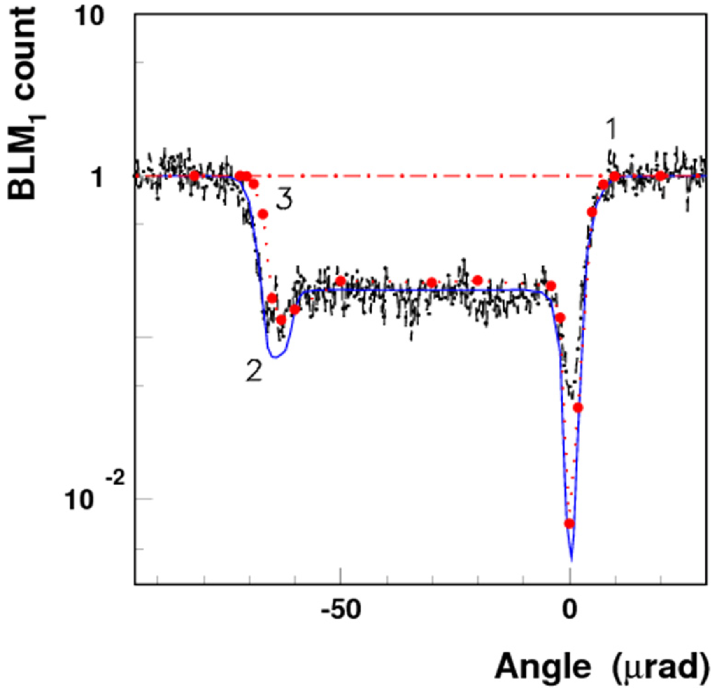

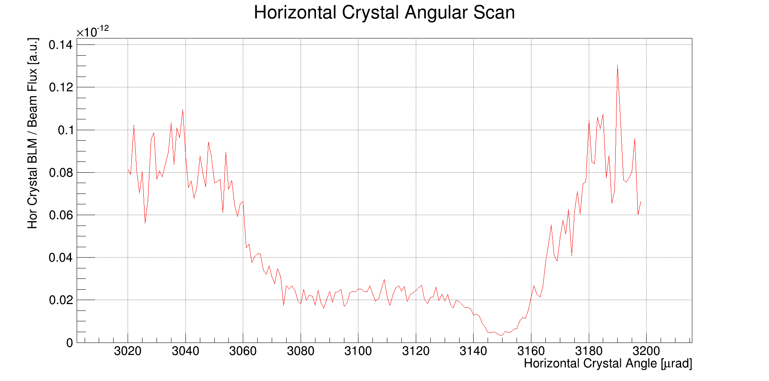

1st LHC crystal channelling at 6.5 TeV
S. Redaelli et al.
Beam core
Phys.Lett. B758 (2016) 129-133
Halo
Crystal
(2)
(1)
Collimator
important: achieved required angular control of <1 μrad (A. Masi et al.)
Measurement
Simulation model 1
Simulation model 2
(1) angular scan: strong reduction of local losses in channeling compared to amorphous
(2) linear collimator scan: measures the profile of the channeled halo.
Loss rates in amorphous
Beam core
Channeled halo
Offset at collimator
Beam losses at crystal [ a.u. ]
Reduced losses in channeling
Losses at collimator [ a.u. ]
~1/30
Example:
scan at 450GeV
Example:
scan at 6.5TeV
Crystal angle [ μrad ]
Secondary collimator position [ mm ]

Slide 42


hollow e-lens for beam-halo collimation
sketch of the e-lens equipment to be installed in LHC
prototype of e-gun for hollow beam (Fermilab)
L. Rossi, V. Shiltsev, et al.

Slide 43





in-situ repairs?
T. Torims
laser cladding
monorail
prototypes
R&D at space agencies
M. Di Castro

Slide 44
EU program ‘EuroCirCol’
European Union Horizon 2020 program
Support for FCC study
Grant agreement 654305
3 MEURO co-funding
Scope:
FCC hadron collider
Optics Design
Cryo vacuum design
16 T dipole design, construction folder for demonstrator magnets
Notes:
New slide from Davide.
Showing that conductor development is launched at international level, Russia, Japan, (Korea and Europe in preparation)
Underline importance of that development as main cost driver for the hadron collider machine.

Slide 45






16 T dipole options and plans
Cos-theta
Common coils
Swiss contribution
via PSI
Canted
Cos-theta
Blocks
down-selection of options end 2016 for detailed design work
model production 2018 - 2022
prototype production 2023 - 2025
M. Benedikt
Notes:
New slide from Davide.
Showing that conductor development is launched at international level, Russia, Japan, (Korea and Europe in preparation)
Underline importance of that development as main cost driver for the hadron collider machine.

Slide 46


US Magnet Development Program
S. Gourlay
Under Goal 1:
16 T cos theta dipole design
16 T canted cos theta (CCT) design

Slide 47


R&D on Superconducting Septa
hybrid system: short overall length with high robustness & availability
SuShi concept:
SC shield creates a
field-free region inside strong dipole field
superconductor
3 candidate technologies:
NbTi/Nb/Cu multilayer sheet
HTS tape
Bulk MgB₂
M. Atanasov, D. Barna

Slide 48

RF system R&D lines
400 MHz single-cell cavities preferred for hh and ee-Z (few MeV/m)
baseline Nb/Cu @4.5 K, development with synergies to HL-LHC, HE-LHC
R&D: power coupling 1 MW/cell, HOM power handling (damper, cryomodule)
hh
Z
W
≈ 16 cells per beam
≈ 100 per beam
(+ 100 for booster ring)
≈ 210 per beam
(+ 210 for booster ring)
400 or 800 MHz multi-cell cavities preferred for ee-ZH, ee-tt and ee-WW
baseline options 400 MHz Nb/Cu @4.5 K, ◄▬► 800 MHz bulk Nb system @2K
R&D: High Q₀ cavities, coating, long-term: Nb₃Sn like components
W
H
t
≈ 200 per beam
(+ 200 for booster)
≈ 800 per beam
(+ 800 for booster)
≈ common 2600 cells for both beams
(+ 2600 for booster)
Notes:
New slide from Olivier
Common design for hadron and lepton low energy-high currecnt system
Synergies HL-LHC, HE LHC, FCC-hh, FCC-ee Z pole

Slide 49
collaboration & industry relations
102
Institutes
20
Companies
30
Countries

Slide 50


First FCC Week
Conference
Washington DC
23-27 March 2015
http://cern.ch/fccw2016
468
Participants
168
Institutes
http://cern.ch/fccw2015
24
Countries

Slide 51
some conclusions
FCC colliders offer plenty of R&D possibilities for vacuum, surfaces, and material plus their interactions with lepton and hadron beams
a few highlights:
  synchrotron radiation for hh & ee
  machine protection against damage, Pb & W masks,…
  cost-efficient designs (various coatings: TiN, NEG, a-C, HTS, Nb/Cu,…), and surface treatments (LASE)
  cost-effective production (additive manufacturing)
  novel approaches: e-lenses, foams, crystals, total photon reflection …
material properties matter! – SEY, conductivity, SR shielding, nuclear & el.-magn. stopping power, cost, efficiency,…

