Slide 1
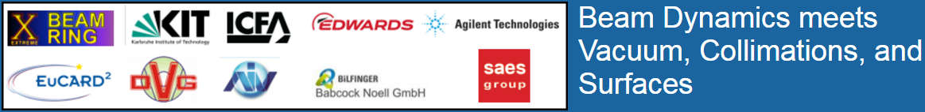

Slide 2
Future Circular Collider Study
Goal: CDR For the European Strategy Update 2018-2019
International FCC collaboration
(CERN as host lab) to study:
• pp-collider (FCC-hh)
→ main emphasis, defining infrastructure requirements
16 T → 100 TeV pp in 100 km
• 80-100 km tunnel infrastructure in Geneva area, site specific
• e+e- collider (FCC-ee), as potential first step
• p-e (FCC-he) option, integration one IP, FCC-hh & ERL
• HE-LHC with FCC-hh technology

Slide 3
Future Circular Collider Study
The FCC study is necessary to propose a credible project for the period after the exploitation of the High-Luminosity LHC, i.e. 2035-2040.

Slide 4
Future Circular Collider Study
Feasibility study of the new tunnel: FCC fits in CERN area
Injection options:
SPS → LHC → FCC
Injection energy 3.3 TeV from LHC
SPS (upgraded) → FCC
Injection at 1.5 TeV from SPS equipped with fast-cycling SC magnets, 6-7 T, 1 T/s ramp.

Slide 5
FCC-hh Parameters

Slide 6
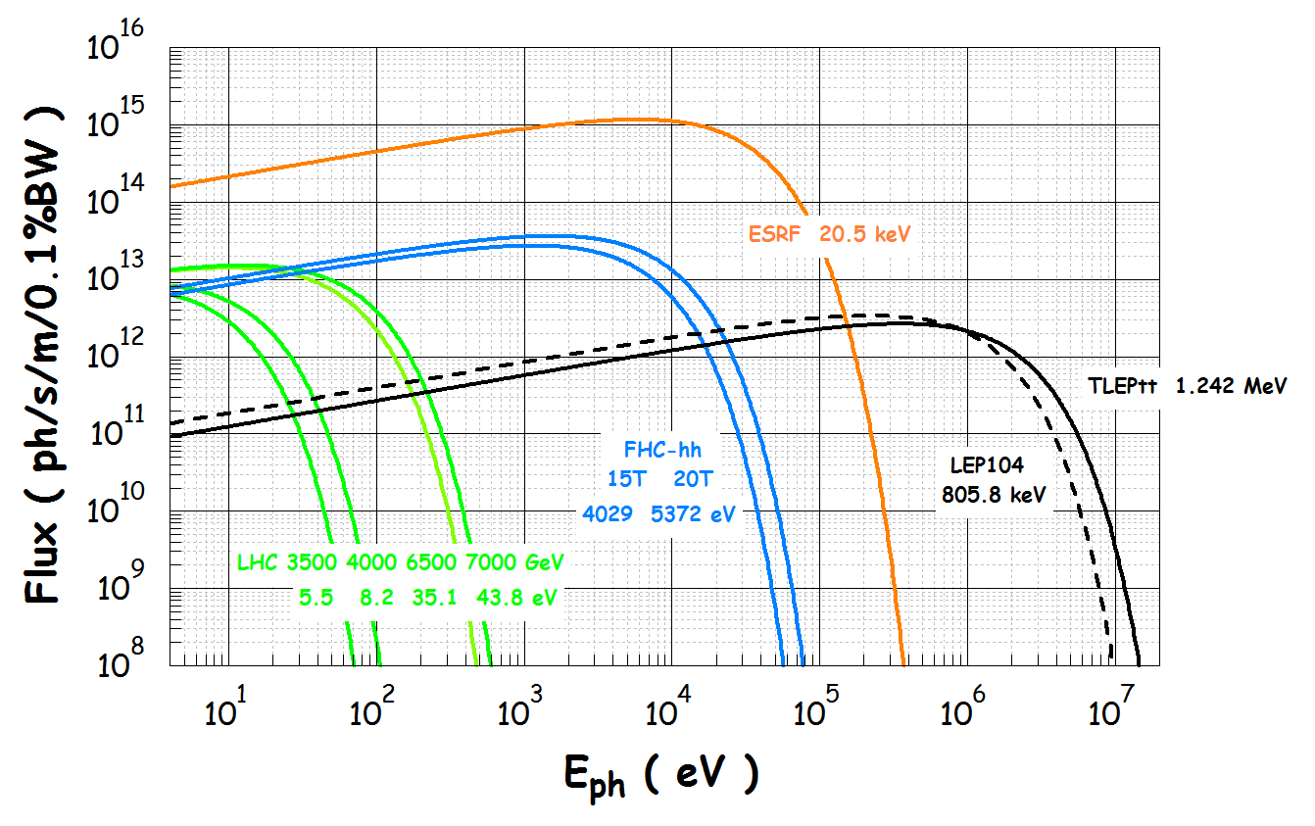

Slide 7
Minimum power (Carnot) needed to remove 1 W from a cold surface.
Typical efficiency with respect to Carnot cycle : 0.3
Per T_{w} = 300 K
For low T:
Cold mass 1.9 K
1.8K – 166 W
Beam
Cold bore
4.5K - 65.7 W
20K – 14 W
77K - 2.9 W
2
5
10
300
Temperature of the cold surface [K]

Slide 8
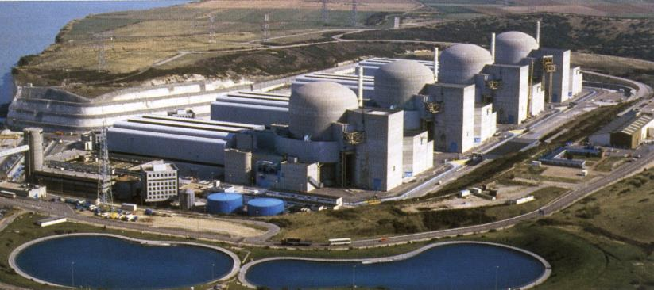
What does it mean to transfer 30 W/m from 1.9 K to 300 K in FCC?
$$P_{w}=30\frac{W}{m}∙\frac{300}{1.9}∙\frac{1}{0.3}∙2∙85000 m≈3 GW→≈5GW_{el}$$
Paluel (F) Nuclear Power Plant 5.5 GW

Slide 9
The required beam gas density is ~5 times lower that the one for the LHC: from 10¹⁵ to 2x10¹⁴

Slide 10
Beam screen temperature:
To have saturated vapour density much lower or much higher than 2x10¹⁴ m⁻³, the temperature ranges 20-40, 60-100, 120-200 should be avoided.
To reduce resistive impedance, temperature lower than 60 K are required.
The chosen temperature is around 50 K for copper co-laminated stainless steed beam screens.
Cu
Ph. Lebrun, L. Tavian, V. Baglin

Slide 11
The FCC-hh beam screen model
As a consequence of the higher SR power density:
The mass flow of gas in the cooling channel must be increased. The diameter of the channel has to be increased to avoid too high pressure drop.
The beam screen temperature must be increased in the range 40 to 60 K, as compared to the 5 to 20 K in LHC, to reduce the needed cryogenic power. The higher temperatures have large repercussions on the vacuum due to higher equilibrium vapour pressures.
There is an increased photo-desorption due to an higher number of photons (x6 above cut-off at 4 eV). Higher effective pumping speed is needed.
In addition, from the early design, we want to integrate an ecloud suppressor method.
Consequence: The present LHC beam cannot be adapted/copied to the FCC-hh.

Slide 12
FCC-hh beam screen geometry evolution
Improved heat transfer
Increased He cooling channel
Cold thermal sprayed copper coating on the outer side
Lower impedance
Symmetrical design
Pumping holes hidden by the screen
Better heat transfer
Cold thermal sprayed copper coating on the outer side
Improved pumping
Larger pumping holes (no impedance constraint)
Easier manufacturing
Polygonal shape of the screen
March 2015
May 2015
August 2015
January 2016

Slide 13
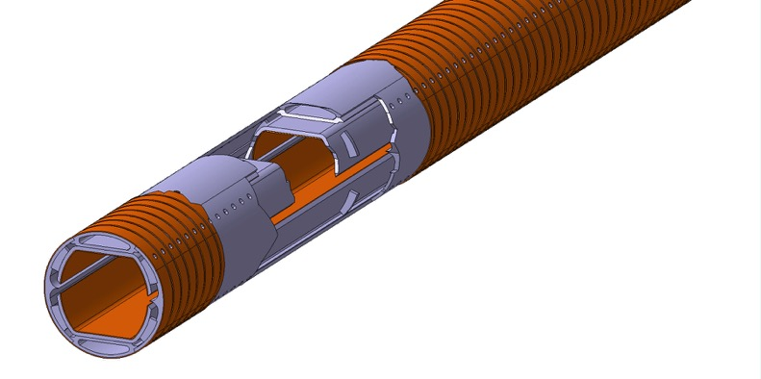
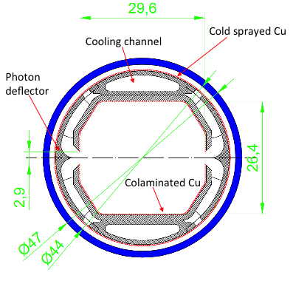
April 2016

Slide 14
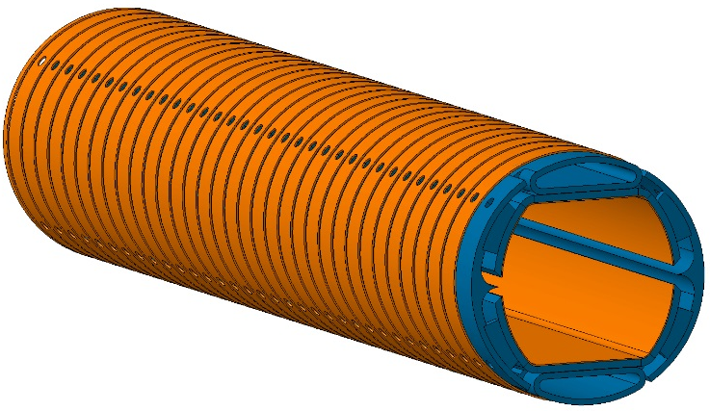
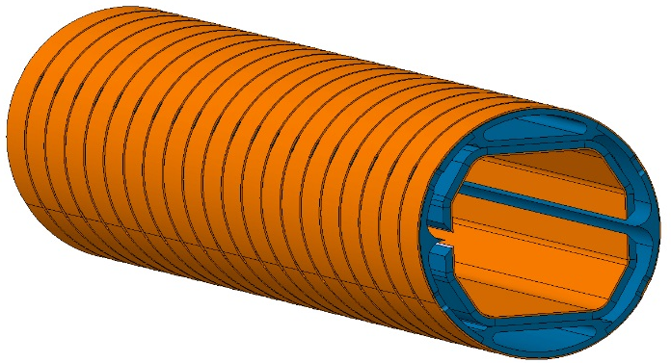
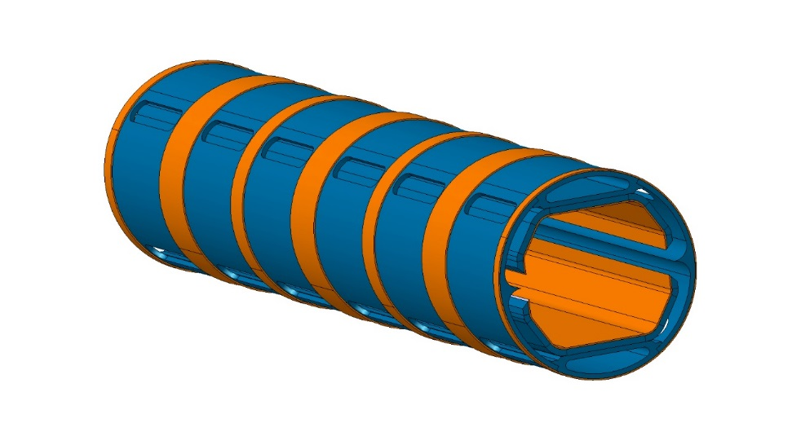
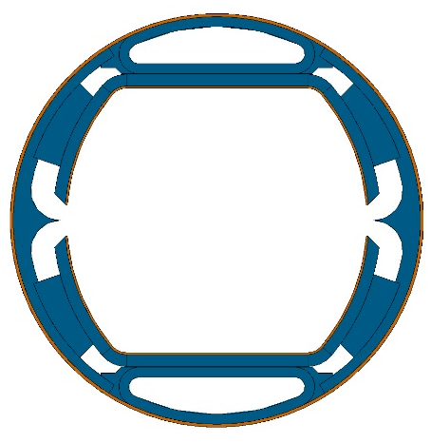
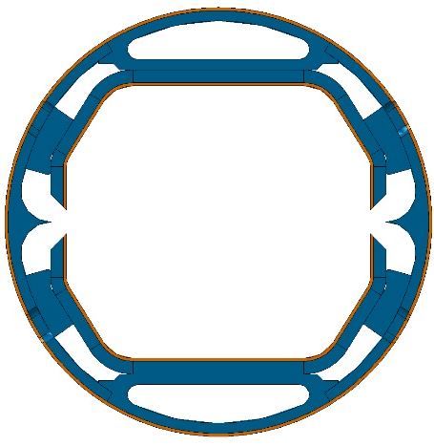
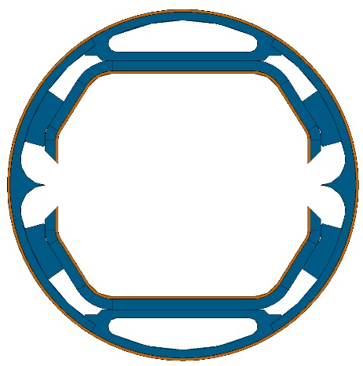
Orsay 09/2015
3rd WP4 meeting
Geneva 06/2016
4th WP4 meeting
Barcelona 11/2016
5th WP4 meeting
GOALS
Improve pumping speed
Optimize thermal and mechanical behaviour

Slide 15
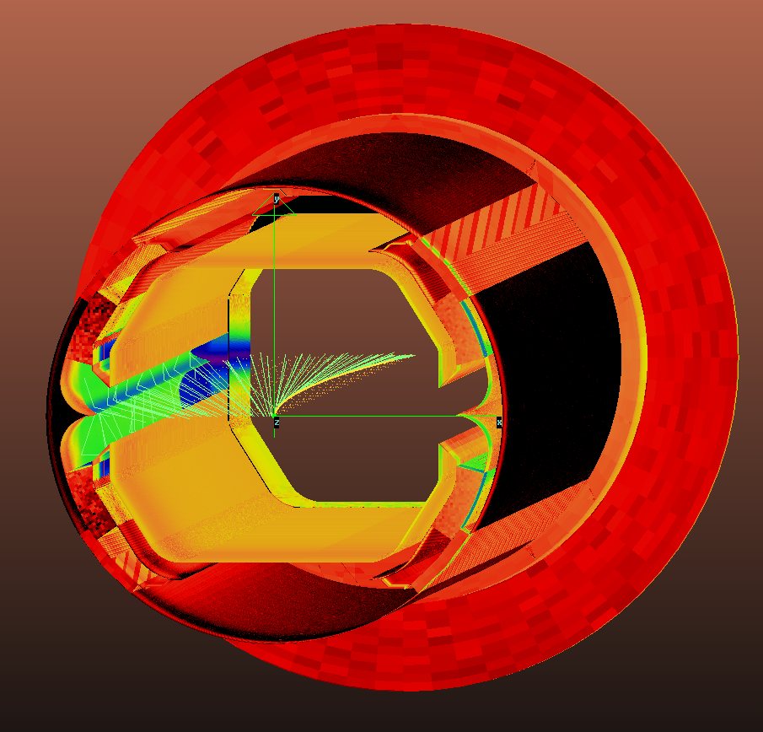

Synchrotron light distribution, including absorber: Power
SYNRAD+ ray-tracing simulation code
W/cm²
% of Total BM Power, 502W
Ribs
32.9%
Reflectors
29.3%
Cold bore
0.007%
Inner copper
6.56%
End absorber
12.6%
Drift space
8.1%
68% of the incident power is reflected on the reflector
Credit: I. Bellafont, ALBA, EuroCirCol Meeting, 7/11/2016, Barcelona

Slide 16
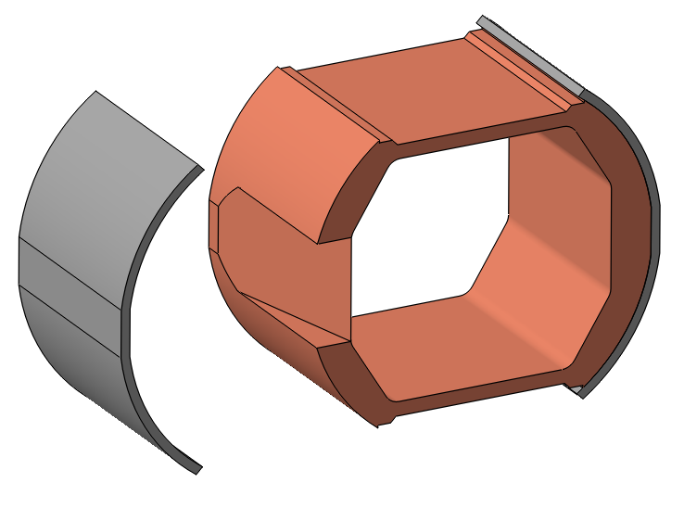
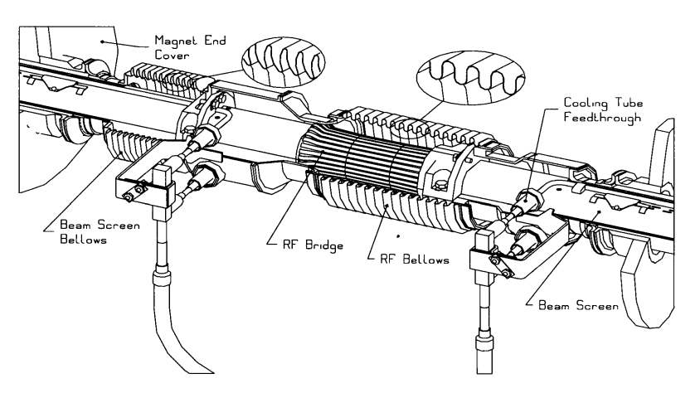
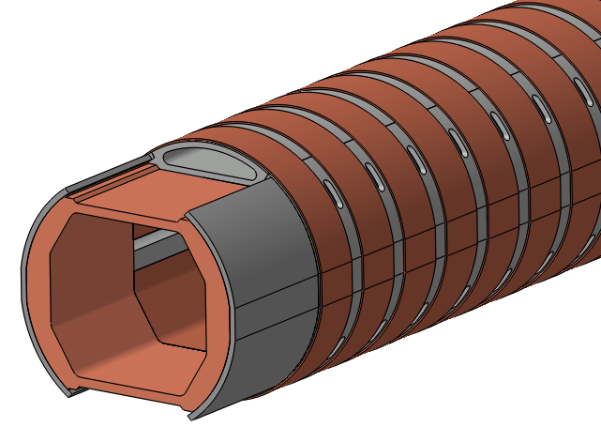
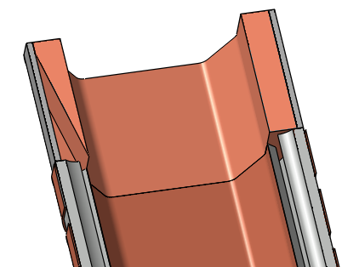
Synchrotron light distribution, including absorber: Power
END-RADIATION ABSORBER
Present LHC Interconnect
S. steel, welded to the BS and brazed to the Cu
Possible absorber location
22mm long, 12.8º slope
Beam direction
Credit: I. Bellafont, ALBA, EuroCirCol Meeting, 7/11/2016, Barcelona

Slide 17
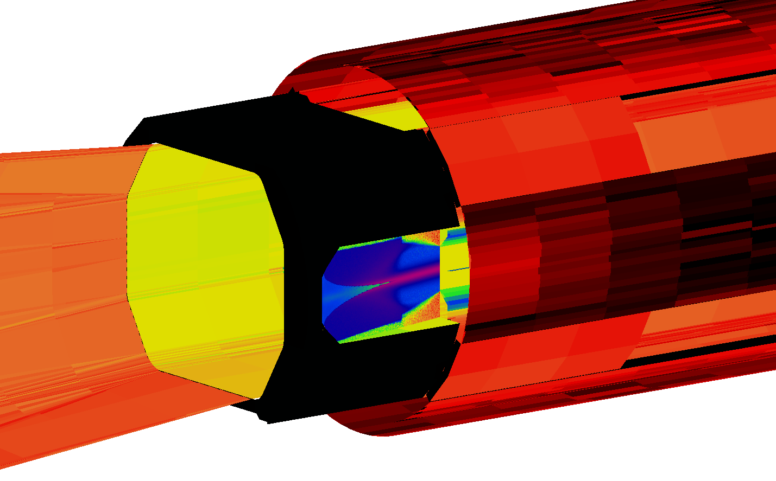

Synchrotron light distribution, including absorber: Power
END-RADIATION ABSORBER
W/cm²
For an ideal beam, this end absorber can reduce the maximum power density more than 4 times on the slope area, reducing the possibility to have a thermomechanical failure
61 W (12.6% Tot.P.)
800W/cm² max`
Beam direction
$$K\left(T\right)=\frac{T_{c}}{T_{H−}T_{C}}$$
Redirecting as much SR as possible to the absorber, not only the cooling efficiency improves, the total outgassing is also decreased. It can be done changing the reflector’s shape or reducing its roughness
Carnot efficiency of refrigerators
Credit: I. Bellafont, ALBA, EuroCirCol Meeting, 7/11/2016, Barcelona

Slide 18
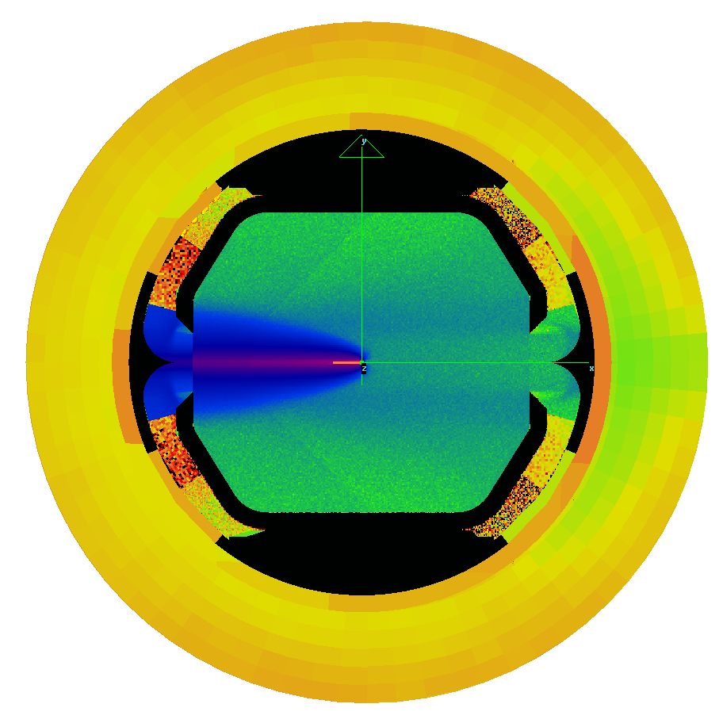

Synchrotron light distribution, including absorber: Flux
Photons/s/cm²
% of Total BM Flux, 2.1E18 ph/s
Ribs
29.6%
Reflectors
21.4%
Cold bore
0.27%
Inner copper
4.9%
End absorber
12.8%
Drift space
5.9%
78% of the incident flux is reflected by the reflector
Credit: I. Bellafont, ALBA, EuroCirCol Meeting, 7/11/2016, Barcelona

Slide 19
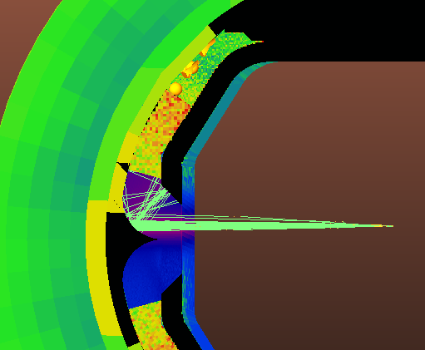

Synchrotron light distribution, including absorber: Flux
MISALIGNMENT STUDY
To perform an approach to the real geometry conditions, a misalignment study has been carried out, moving the beam 1mm upwards
The leaked power is slightly lower, while the molecular density is slightly higher
The radiation is directed forward with a narrower angle, increasing the power on the end absorber.
W/cm²
Aligned
Misaligned
Stretching the sharp point of the reflector can produce the same effect in ideal conditions
Molecular density @72h
9.88·10¹³ H₂/m³
9.93·10¹³ H₂/m³
Cold bore power
0.034 W
0.032 W
Absorber power
63 W
86 W
Inner copper power
3.3 W
3.7 W
Ribs power
165 W
73 W
Credit: I. Bellafont, ALBA, EuroCirCol Meeting, 7/11/2016, Barcelona

Slide 20
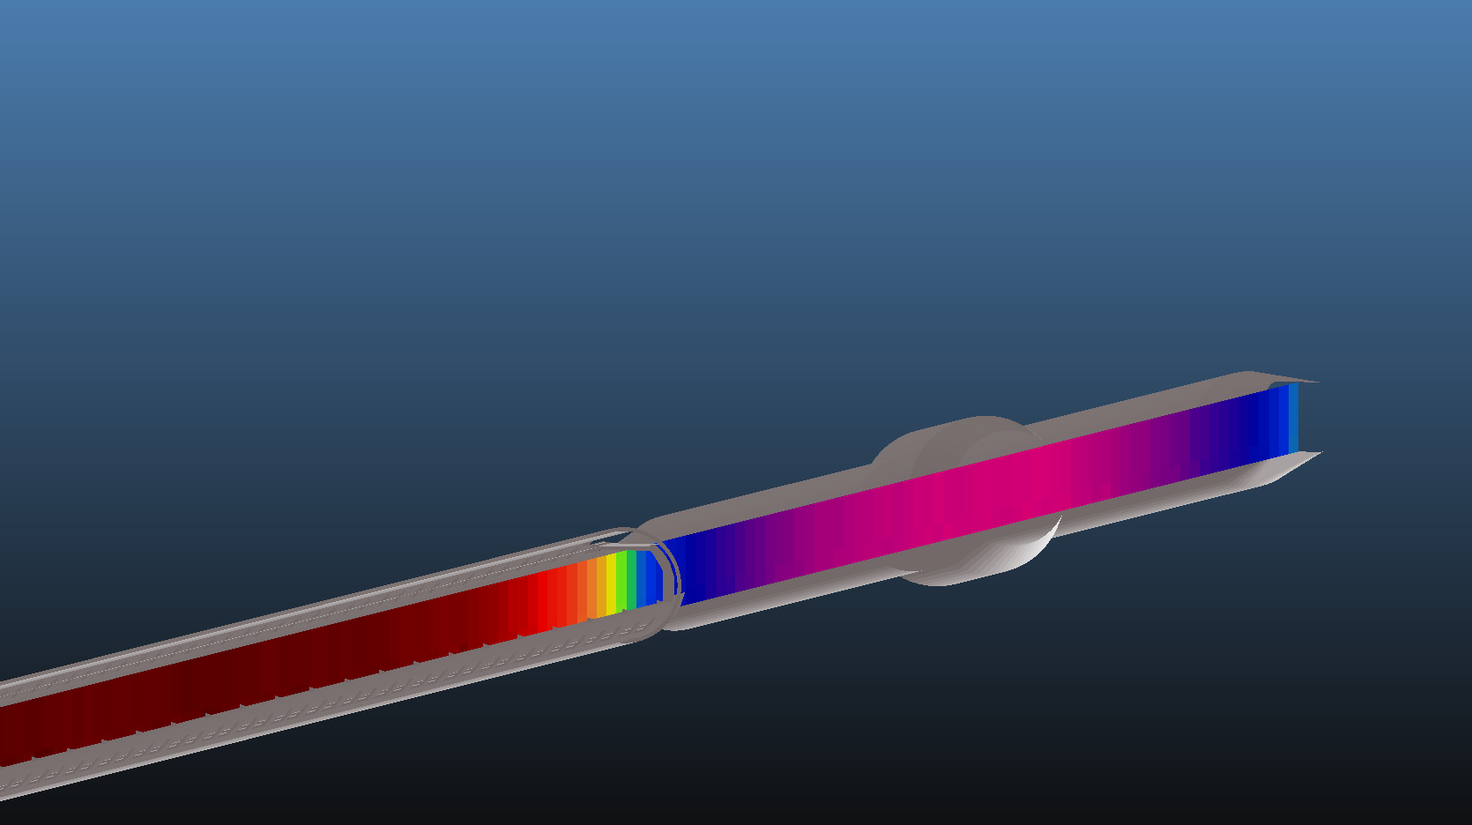
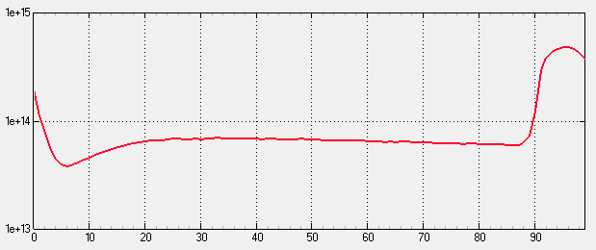
Gas density distribution: Molflow+ Simulations
Main slot aperture
Pumping Holes length
Holes area coverage
Reflector roughness
5mm outwards
10mm
67.6 %
σ/T = 0.0032
Temperatures
Molecular density
profile; only PSD H₂
Ribs
60K
Drift space between dipoles
1.43m
1.5 m-long Drift
Main reflector
60K
14.3 m-long Dipole
Cold bore
1.9K
Inner copper
47K
End absorber
100K
Other areas
50K
Beam direction
Outgassing per BM
Bending magnet 14.3m
4.97·10⁻⁶ mbar·l/s
Average arc density
9.88·10¹³ H₂/m³
PSD data
Average arc pressure
6.56 ·10⁻¹⁰ mbar
Bk. 316 SS H₂ 293K 4 keV
Conditioning Time
72h
Credit: I. Bellafont, ALBA, EuroCirCol Meeting, 7/11/2016, Barcelona

Slide 21
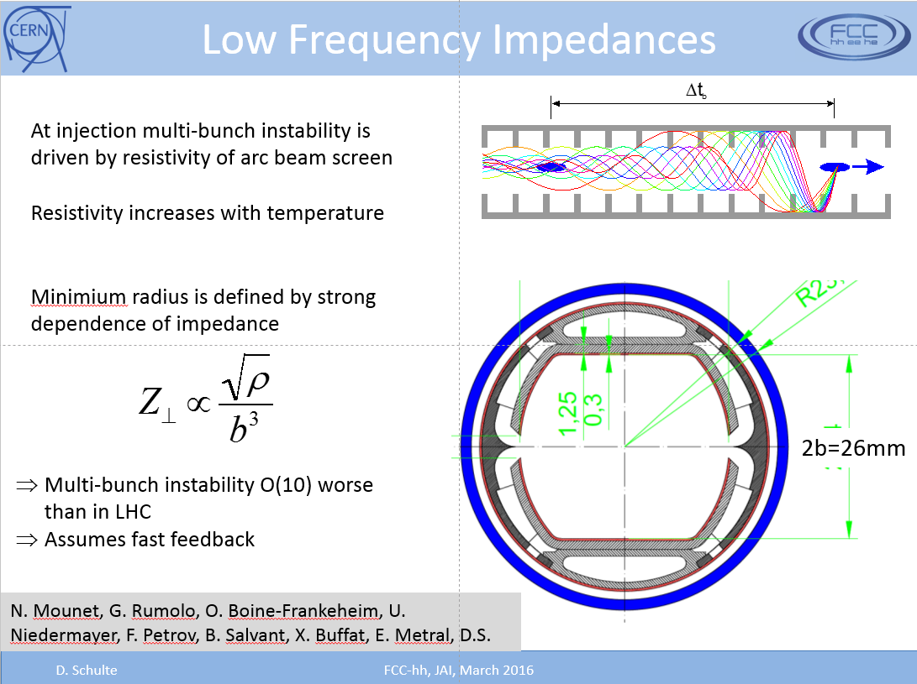

Slide 22
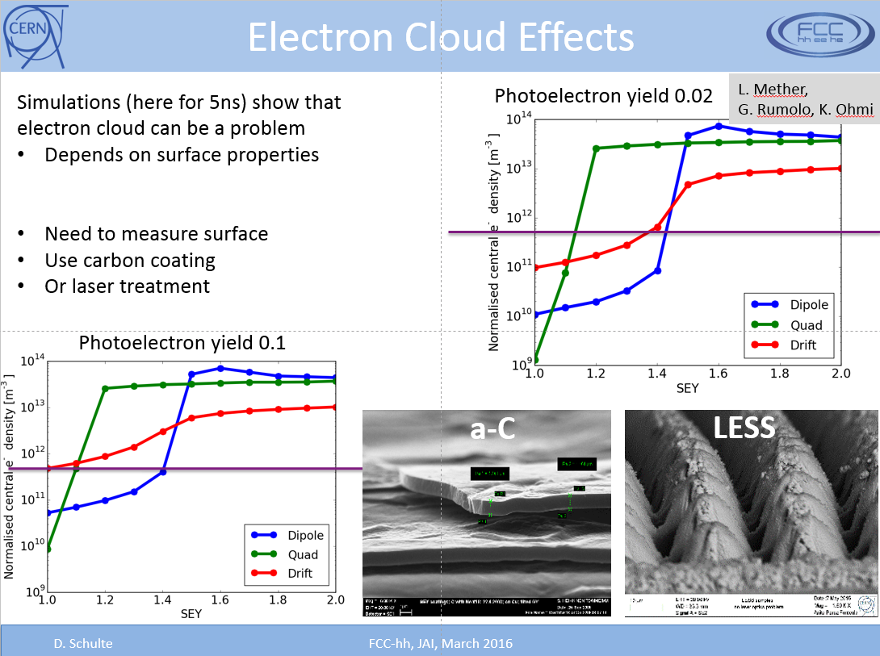

Slide 23
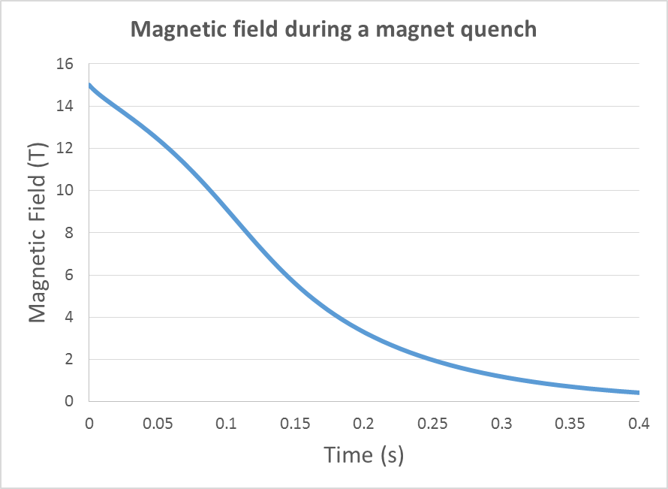
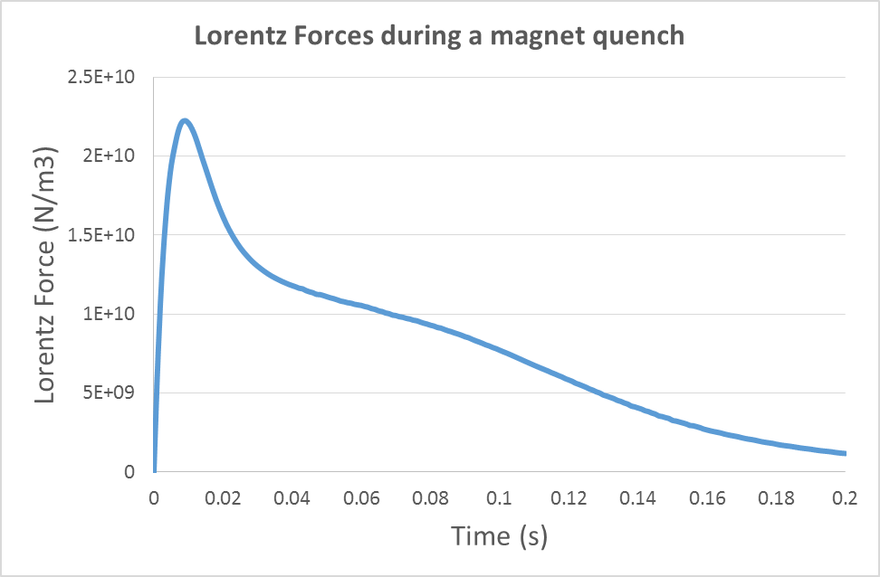
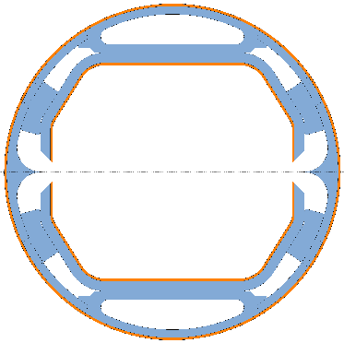







Mechanical Design
Magnet quench
$$B_{z}(t)$$
$$j_{y}$$
z
$$j_{y}$$
y
x
Variation of magnetic field at quench produces currents all along the beam screen.
These currents produce Lorentz forces that have to be correctly withstood by the beam screen.
This 3D simulation has been carried out taking into account ‘Joule effect’ coupling magnetic field and temperatures ($ρC_{p}\frac{∂T}{∂t}−∇\left(k∇T\right)=Q_{e}=JE$).
$$F_{L}=\frac{B^{′}\left(t\right)}{ρ(T)}xB(t)$$
$$F_{L}$$
$$F_{L}$$
Electric current, $j_{y} (A/m^{2})$
z
x

Slide 24
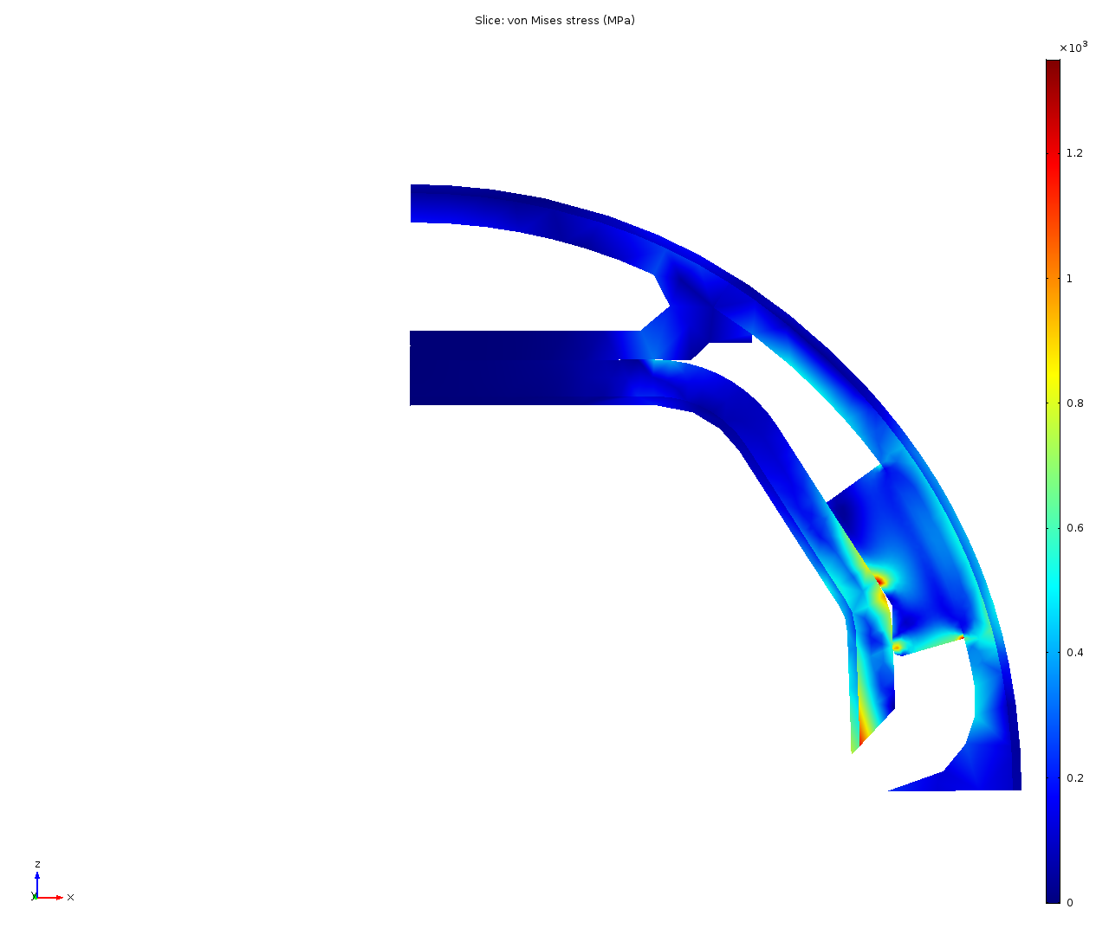
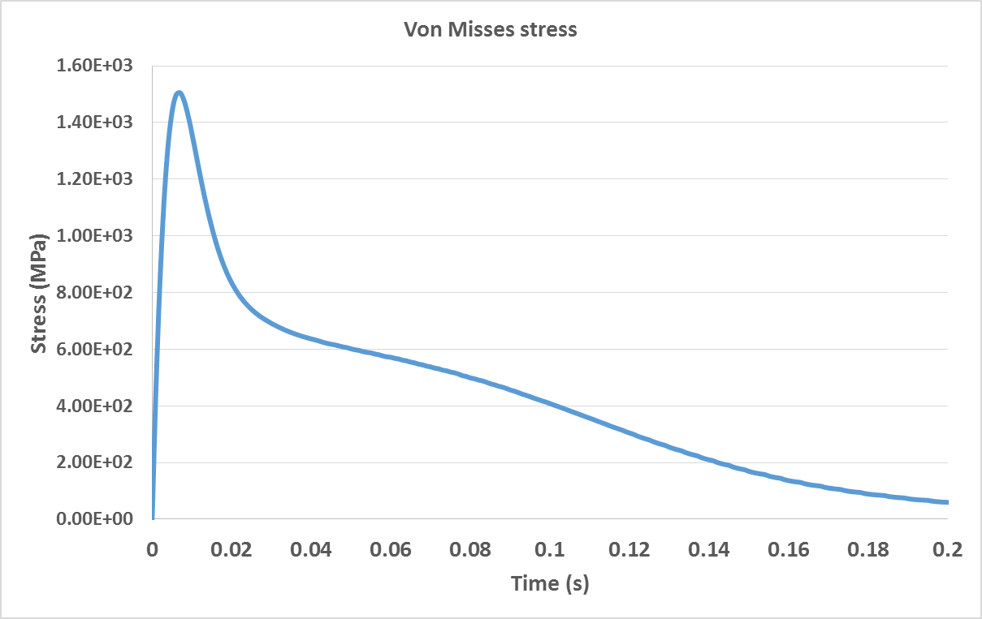
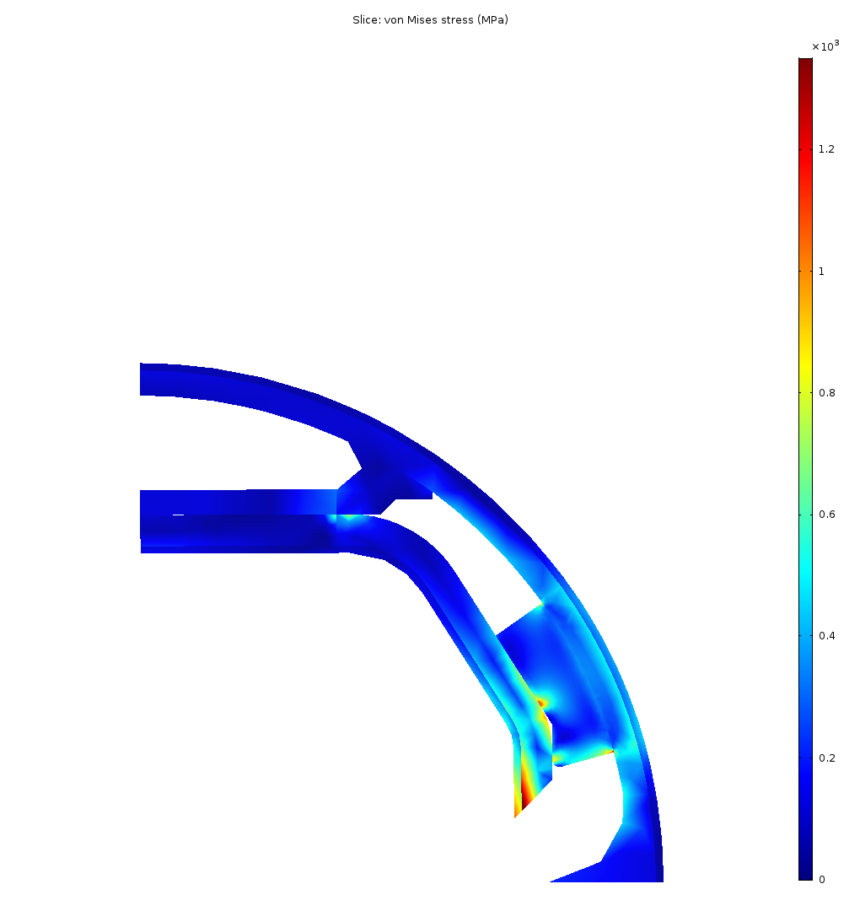
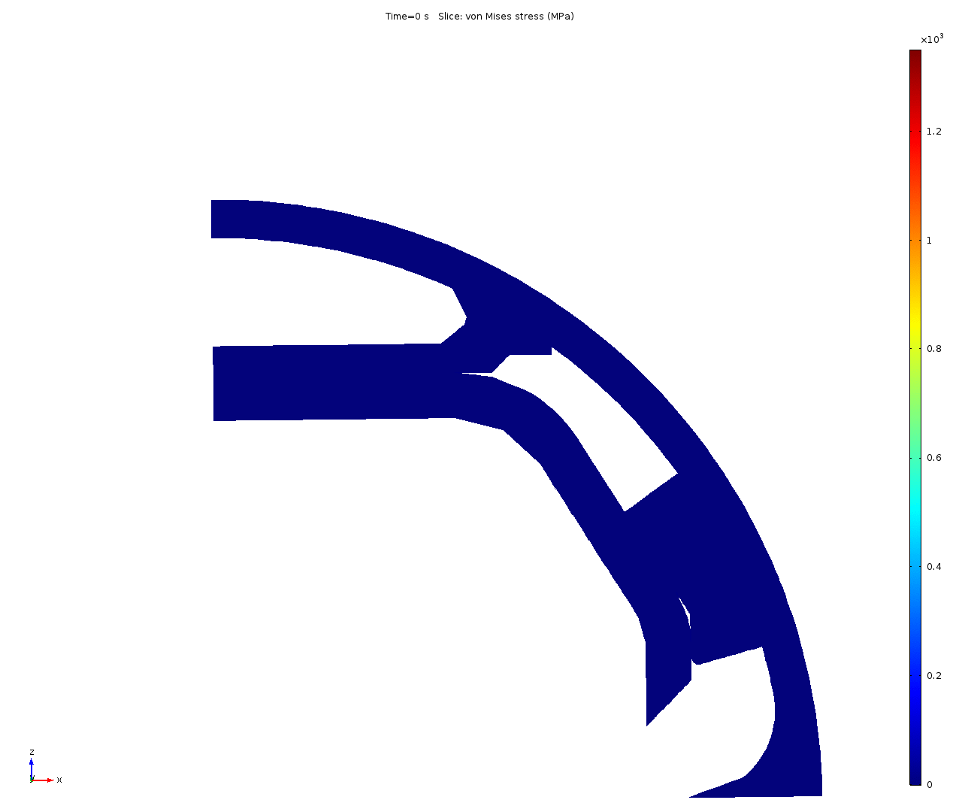
Mechanical Design
Stress analysis
Max stress: 1500 MPa
The maximum stress reached at highest Lorentz force (0.008 secs) is 1500 MPa (Yield strength at 50 K: 1350 MPa), so the material will plastify during magnet quench.
Max displacement: 0.467 mm

Slide 25
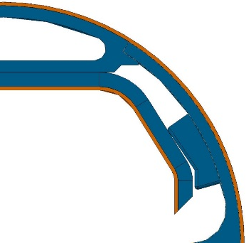
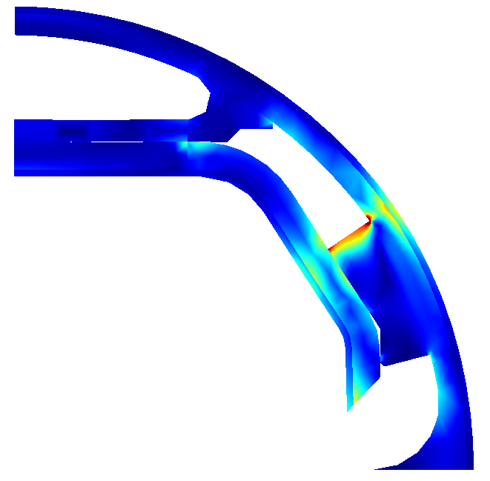
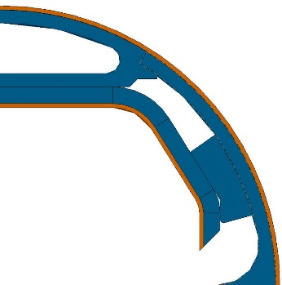

Latest news
Design evolution
Behaviour during a magnet quench
0 mm gap
1300
0.2 mm gap
Design optimisation
Design optimisation
Present design
Present design
0
Von Mises Stress (MPa)
Design modification
→ Significant improvement by the design modification and potentially easier to manufacture
Design modification

Slide 26
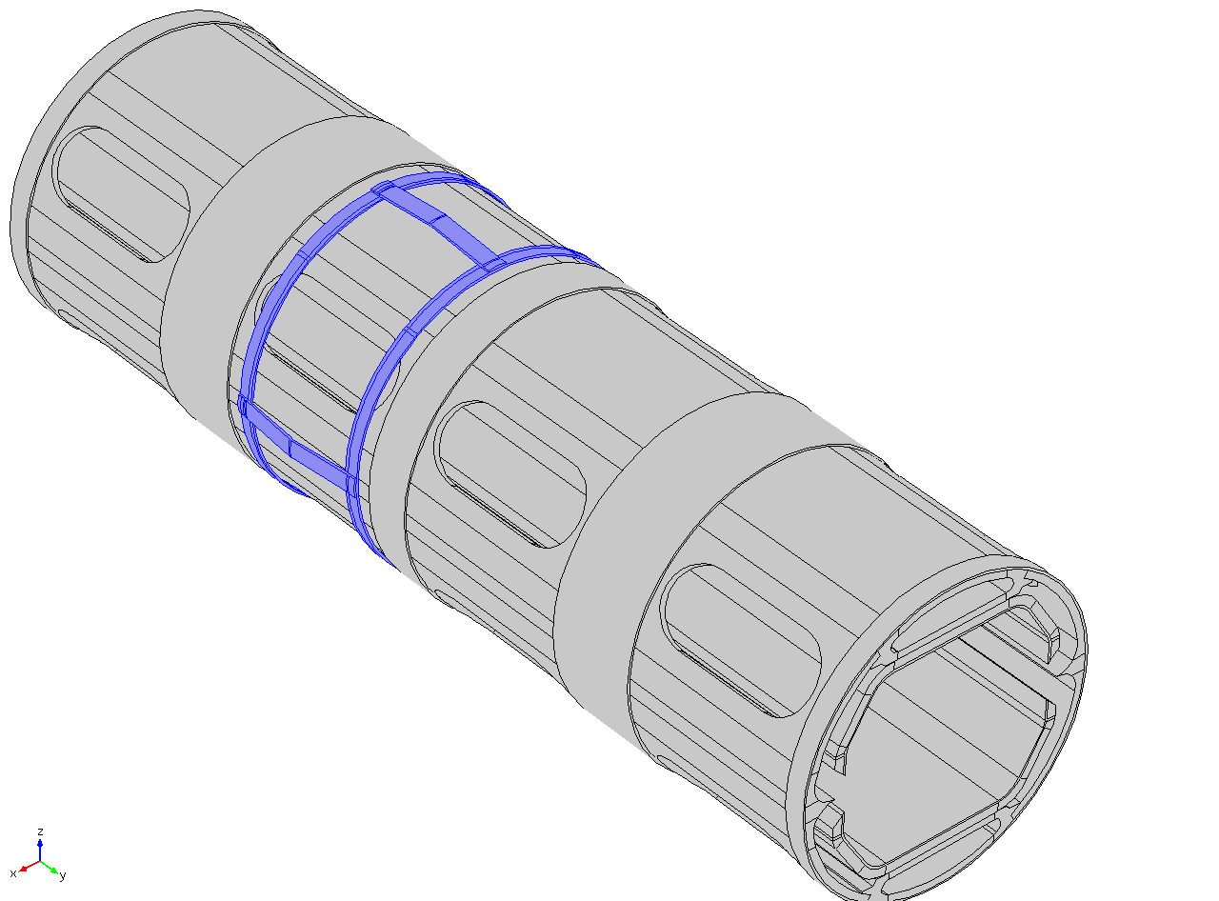
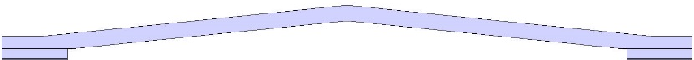
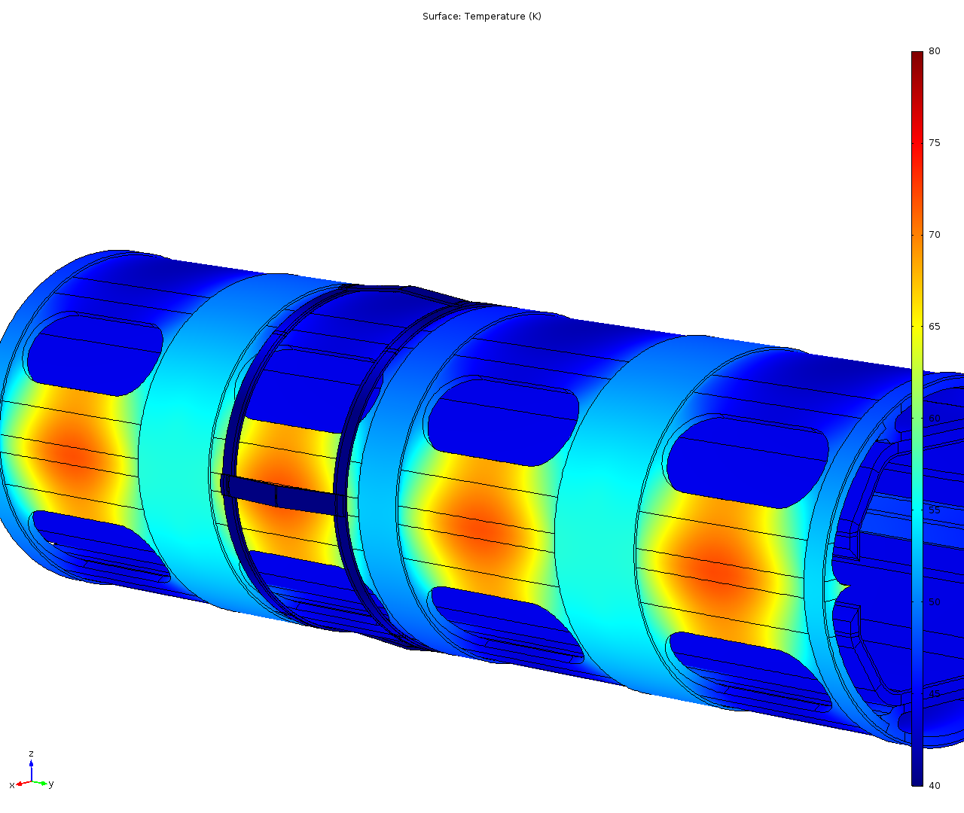
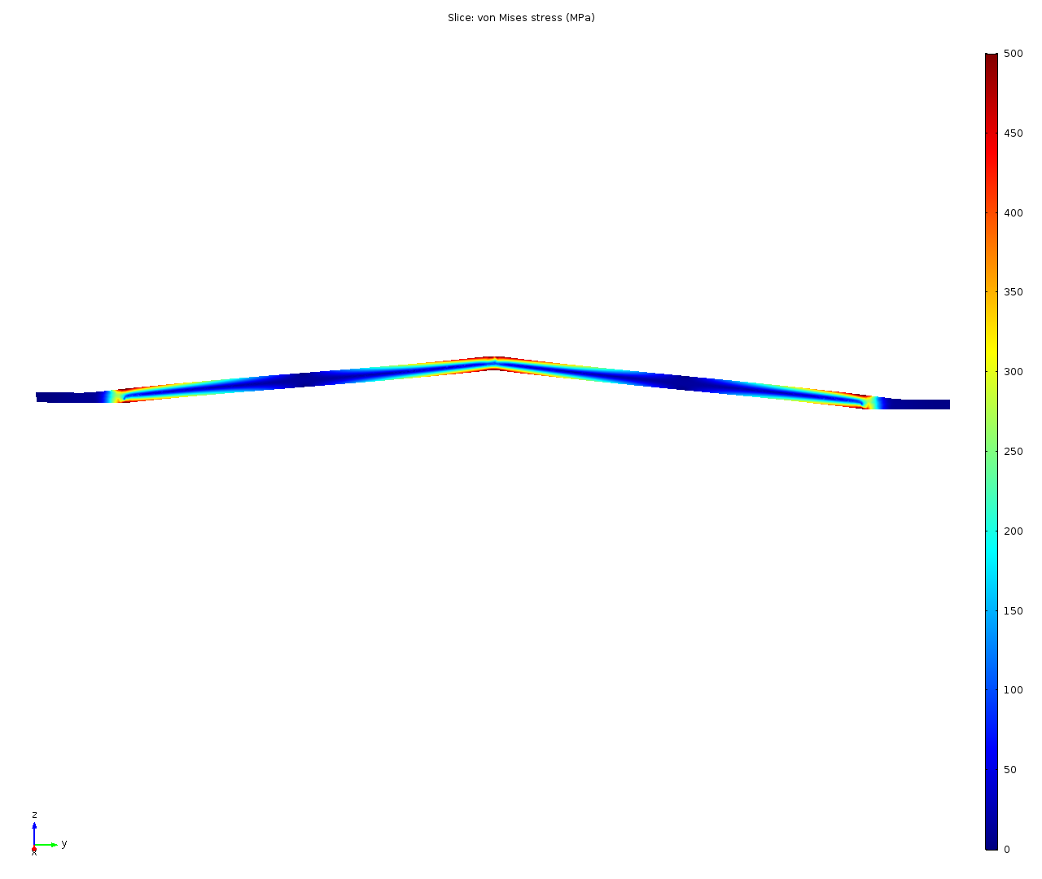
Beam screen development (2)
Design of the supporting system ongoing
21 mm
0.3 mm thick
1.7 mm height
(→ pre-stress 0.2 mm)
Thermal analysis
Welding points (4 per ring)
Mechanical analysis
0.2 mm displacement
Contact pressure: ~ 360 MPa
Contact force: ~ 11 N
Temperature profile
Total heat load transferred:
~ 0.03 W/support
0
500
Von Mises stress
Mechanical behaviour acceptable
Preliminary design promising

Slide 27
Thermal load to cold bore
4
1
Nuclear scattering: 46 mW/m
2
Synchrotron radiation: 2.4 mW/m
3
1.5 mm
5
3
Thermal radiation: 2.33 mW/m
2
4
Beam screen supports: 49 mW/m
6
5
Image currents
4
4
6
Electron cloud effect
1
Max power allowed: 100 mW/m
Total thermal load transferred to cold bore: 99.73 mW/m

Slide 28


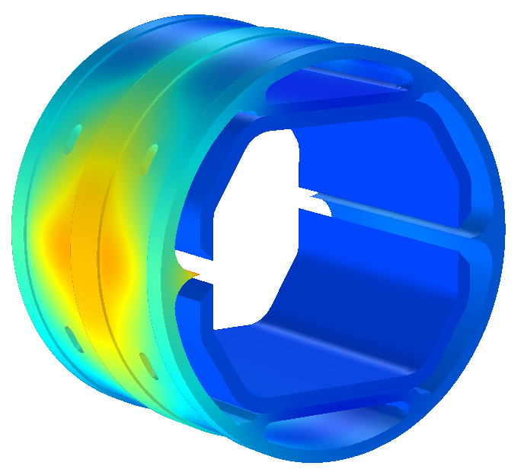
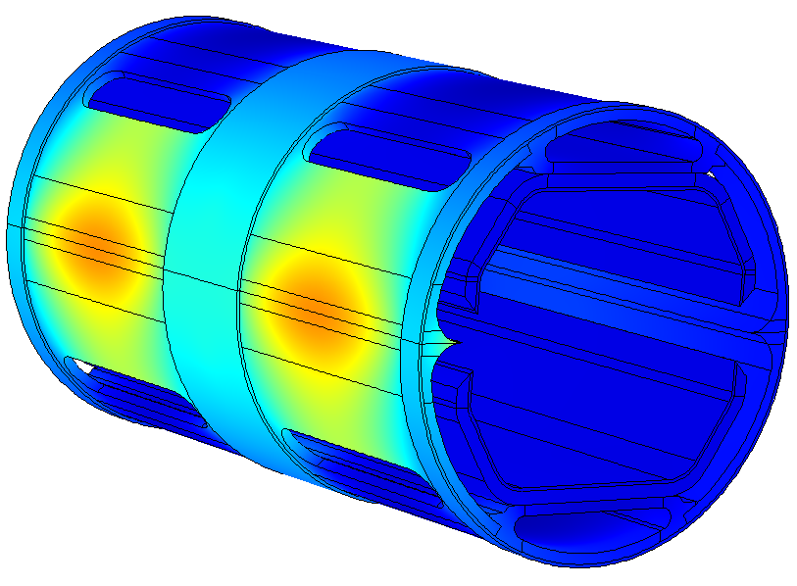
BS comparative
Amount of copper reduced 70%.
Change on deflector gap produces higher Lorentz forces and lower inertia moment, so that, stresses are higher.
1500 MPa
1250 MPa
Inner copper layer temperature reduced 3K thanks to the isolation produced by bigger pumping slots.
47 K
44 K

Slide 29
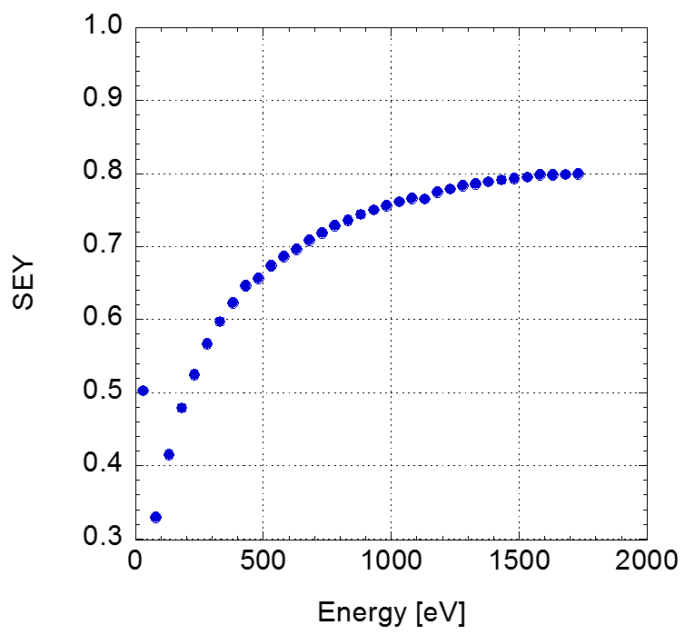
Ecloud mitigation integrated in the design: Present baseline
Laser treatment, just above the ablation threshold, of the top and bottom beam screen surfaces (ASTeC-STFC and Dundee University).
The morphology of the surface is strongly modified
20 μm
Very low SEY is achieved
Studies in progress:
Morphology optimisation
Impedance
Dust generation
Effect of magnetic field
Very efficient to reduce photon reflectivity

Slide 30
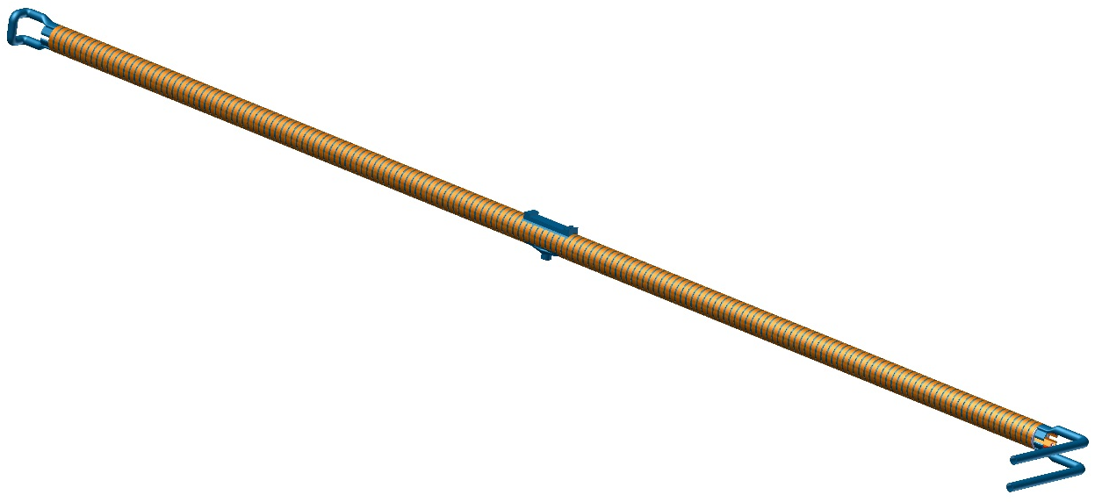
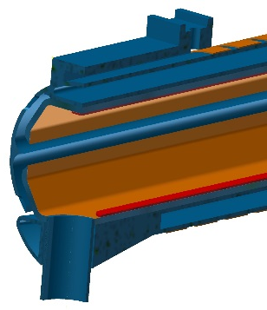
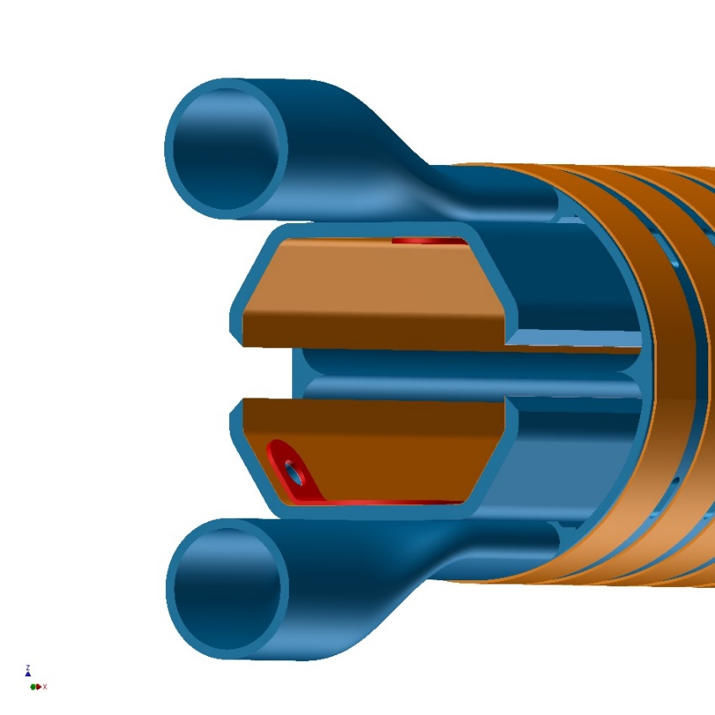
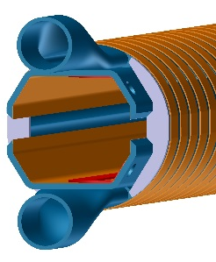
Configuration
The retained configuration for the first prototype is based on the version presented at the FCC week in April 2016.
Fixed point
Chimney for pressure measurement
Internal electrode:
Copper, 6 mm wide
Ceramic insulation
Cooling circuit
Beam screen wall:
304L, 1.5 mm
copper electrodeposition, 0.05 mm
End plate at both extremities
External copper rings:
~ 6 mm * 0.5 mm
Pitch: 11 mm
Probably no coating in the middle of the beam screen
Reflector: 304
Cooling channel: 316L
Slit height: 5 mm

Slide 31
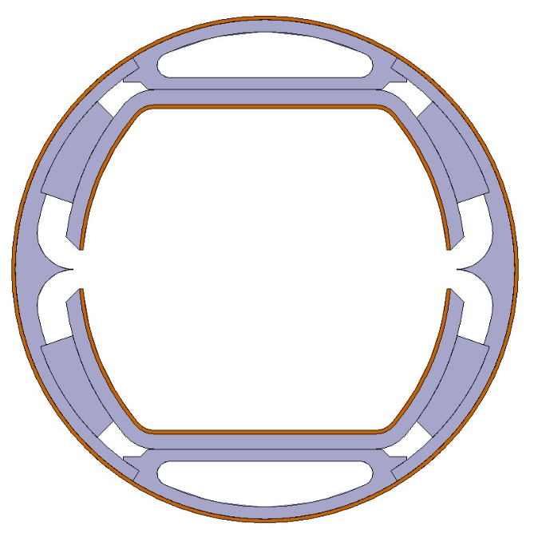
Prototypes
Series vs prototype #1
Sub-component manufacturing:
Series
1st prototype
Beam screen wall:
P506, 1.25 mm
copper colamination, 0.3 mm
Beam screen wall:
304L, 1. 5 mm
copper electrodeposition, 0.05 mm
Reinforcement:
304L
EDM or water jet cutting
Reinforcement:
P506
punching
Reflector:
304,
Machined + forming + finishing
Cooling channel:
P506 stainless steel
Extruded
Reflector:
P506 stainless steel
Extruded + finishing
Cooling channel:
316L,
3D printed + machined

Slide 32
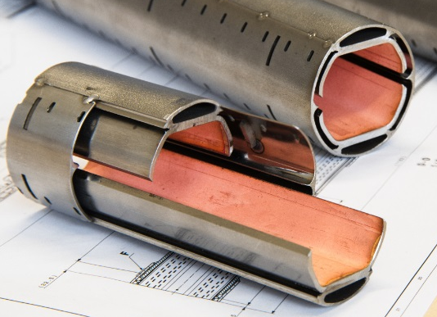
Manufacturing procedure: prototypes
Assembly:
~ 40 cm long
Transition and special central pieces
Cooling channel
Powder
3D printing
Machining
Welding
Welding
Machining
Beam screen wall
Sheet
Forming
Machining
Welding
Cu Coating
Machining
Coating
Welding
Reflector
Flat bar
Heat treatment
Machining
polishing
Forming
Cutting
Deburring
Forming
Machining
Welding
Machining (FP)
Reinforcement
Sheet
Cutting
Deburring
Coating
End plate
Sheet
Cutting
Deburring

Slide 33
Key technologies
Technology |  | Risk | Mitigation
3D printing |  | Leak | Leak tests of 100% of 3D printed parts
 |  | Deformation | Minimize the machining Dedicated tooling during welding
Laser cutting and welding |  | Metal projection | Tooling
 |  | Deformation | Tooling Additional forming
Sheet metal working and machining |  | Precision | Heat treatment Dedicated tooling
Coating | Electrodeposition | Peel off | Apply known procedures
 | Plasma and cold spray |  | Tests on dedicated representative samples
 |  |  | Thermal shock cycles

Slide 34
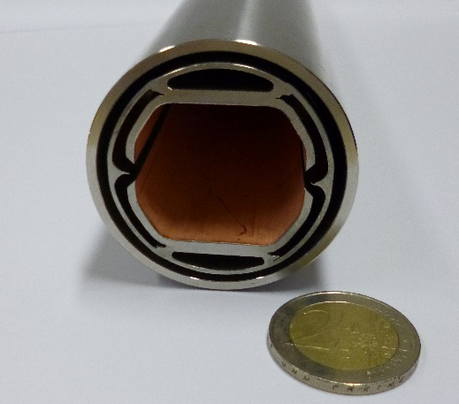
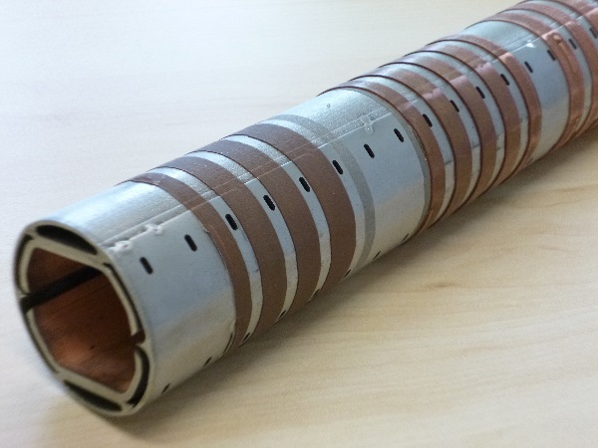
Key technology validation
Main technologies have been validated by the production of two 30 cm long prototypes.
Different surface preparations have been assessed for the copper cold spray.
Production of a 30 cm prototype
Copper cold sprayed strips on beam screen short prototype

Slide 35
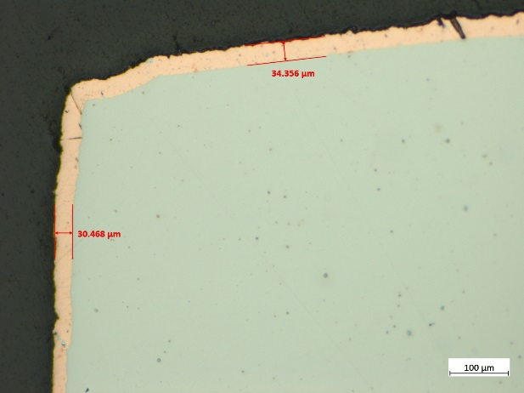


Key technology validation
Uniformity of the copper electrodeposition has been assessed along the 2 m long prototype.
The internal electrode has been produced by plasma and cold spray coating. Electrical insulation has been validated after thermal shock cycles (77K-~400K).
All 3D printed parts for the cooling channel have been leak tested at reception.
Ceramic
Aluminium
Copper
A few 3D printed parts
Measurements of the electrodeposited copper thickness
Electrode obtained by plasma and cold spray

Slide 36





Last news: 2 m long beam screen prototype manufacturing
Beam screen assembly before tack welding
Beam screen assembly after tack welding
Next steps:
Cold sprayed copper rings
Fixed point machining
Instrumentation (temperature sensor) installation
Beam screen assembly after welding (today)

Slide 37
Long prototype to be installed at Anka
(see also other presentation by R. Kersevan)
Assembly:
~ 40 cm long
Transition and special central pieces
Cooling channel
Powder
3D printing
Machining
Welding
Welding
Beam screen wall
Sheet
Forming
Coating
Machining
Welding
Reflector
Flat bar
Machining
Forming
Cutting
polishing
Reinforcement
Sheet
Cutting
Welding
Coating

Slide 38
Conclusions
A beam screen (BS) design capable of handling the ~30 W/m SR power generated by the 50 TeV protons in the FCC-hh has been conceived and designed;
A large number of ray-tracing montecarlo simulations, with realistic energy-, angle-, and material-dependent photon reflectivities have been carried out: they have allowed us to maximize the capture efficiency of the intense photon flux, and reduce the residual gas density along the path of the proton beam;
The effect of vertical misalignments between the orbit and the longitudinal slots has also been studied, and should not pose major problems, neither for the gas density nor for the SR power dissipation. This also includes the case of the SR fan generated at lower energies, which is wider vertically and can miss, in part, the opening of the slot (not discussed here, see FCC-hh General Meetings’ indico page)
A still open issue is the reliable calculation of the impedance generated by the presence of the double slot and, behind each slot, the evenly-spaced reinforcing ribs and pumping slots: randomizing their size and spacing seems difficult for this BS!
Ideally, the impedance of such an arrangement should be measured at cold temperatures (40-60 K);
Three 2m-long prototypes of the double-slot BS geometry are in an advanced stage of fabrication: the first one will be soon installed on a dipole radiation beam port of the 2.5 GeV ANKA light source, at KIT (see dedicated presentation, this workshop).
It will then be followed by a second one with integrated clearing electrodes, and a third one with laser-ablated surfaces.

Slide 39
Acknowledgments
A large part of this presentation has been prepared by Paolo Chiggiato, head of CERN-TE-VSC;
Studies, CAD work, MC simulations, Thermal calculations, and more… have been carried out by C. Garion, J. Fernandez Topham, M. Gil Costa, I. Bellafont, R. Kersevan, with support from M. Ady for SYNRAD+ and Molflow+ code upgrades
Thank you for your attention ☺

