Slide 2

The HL-LHC vacuum
& beam dynamics
V. Baglin
CERN TE-VSC, Geneva
https://indico.gsi.de/conferenceDisplay.py?confId=5393

Slide 3
Outline
Introduction
Vacuum Stability
Operating temperature
Impedance
Vacuum conditioning and beam scrubbing
Summary

Slide 4
1. Introduction

Slide 5
LHC Current Parameters
 | Design |  | Commissioning
 | Nominal | Ultimate | 2010 | 2011 (Fill 2256) | 2012 (Fill 3250) | 2015 (Fill 4569) | 2016 (Fill 5045)
Energy [TeV] | 7 |  | 3.5 | 3.5 | 4 | 6.5 | 6.5
Luminosity [x10³⁴ cm⁻².s⁻¹] | 1.0 | 2.3 | 0.02 | 0.36 | 0.75 | 0.6 | 1.0
Int. Luminosity [fb⁻¹/year] | 80 | 120 | 0.0 | 5.9 | 23.3 | 4.2 | 16
Current [mA] | 584 | 860 | 80 | 362 | 420 | 468 | 447
Proton per bunch [x10¹¹] | 1.15 | 1.7 | 1.2 | 1.45 | 1.6 | 1.15 | 1.19
Number of bunches | 2808 |  | 368 | 1380 | 1378 | 2244 | 2076
Bunch spacing [ns] | 25 |  | 150 (75-50)* | 50 (25)* | 50 (25)* | 25 | 25
Normalised emittance [μm.rad] | 3.75 |  | ~ 3 | ~ 2.3 | ~ 2.2 | ~ 3 | ~ 3
β * [m] | 0.55 |  | 3.5 | 1 | 0.6 | 0.8 | 0.4
Total crossing angle [μrad] | 285 |  | 240 | 240 | 290 | 290 | 185
Critical energy [eV] | 44.1 |  | 5.5 |  | 8.2 | 35.3 | 35.3
Photon flux [ph/m/s] | 1 10¹⁷ | 1.5 10¹⁷ | 0.06 10¹⁷ | 0.3 10¹⁷ | 0.4 10¹⁷ | 0.8 10¹⁷ | 0.8 10¹⁷
SR power [W/m] | 0.22 | 0.33 | 0.002 | 0.01 | 0.02 | 0.13 | 0.13
Photon dose [ph/m/year] | 1 10²⁴ | 1.5 10²⁴ | 1 10²¹ | 0.1 10²⁴ | 0.3 10²⁴ | 0.1 10²⁴ | 0.2 10²⁴
Beam dose per year [A.h] | 2800 | 4100 | 3 | 314 | 569 | 126 | 255
* During MD periods

Slide 6

HL-LHC Project
  The HL-LHC Project is a program which consists of multiplying by ~ 5 the LHC luminosity with an objective of 3 000 fb⁻¹ accumulated in the mid 2030ies.
  For this purpose, the optics, the matching section and the inner triplet around ATLAS and CMS are completely rebuilt and shall be ready for operation by ~ 2026.
 | LHC Design |  |  | HL-LHC
 | Nominal |  | Ultimate | Nominal
Energy [TeV] | 7
Luminosity [x10³⁴ cm⁻².s⁻¹] | 1.0 | 2.3 |  | 5*
Current [mA] | 584 | 860 |  | 1090
Proton per bunch [x10¹¹] | 1.15 | 1.7 |  | 2.2
Number of bunches | 2808 |  |  | 2736
Bunch spacing [ns] | 25
Minimum β* [m] | 0.55 |  |  | 0.15
Noramlized emittance [μm] | 3.75 |  |  | 2.5
* Levelled luminosity
BD meets VC&S at KIT, Karlsruhe, 8-10 March , 2017

Slide 7
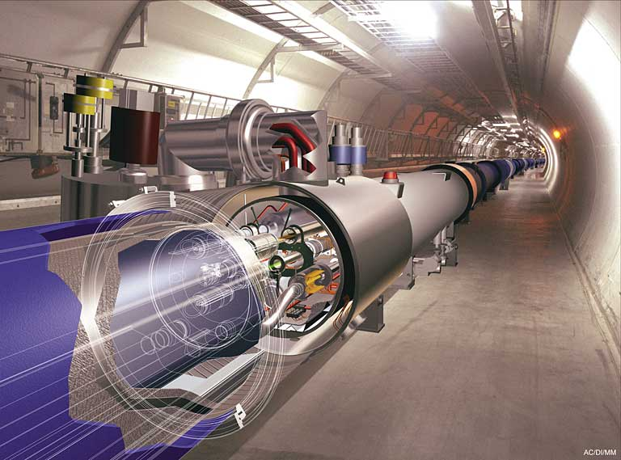
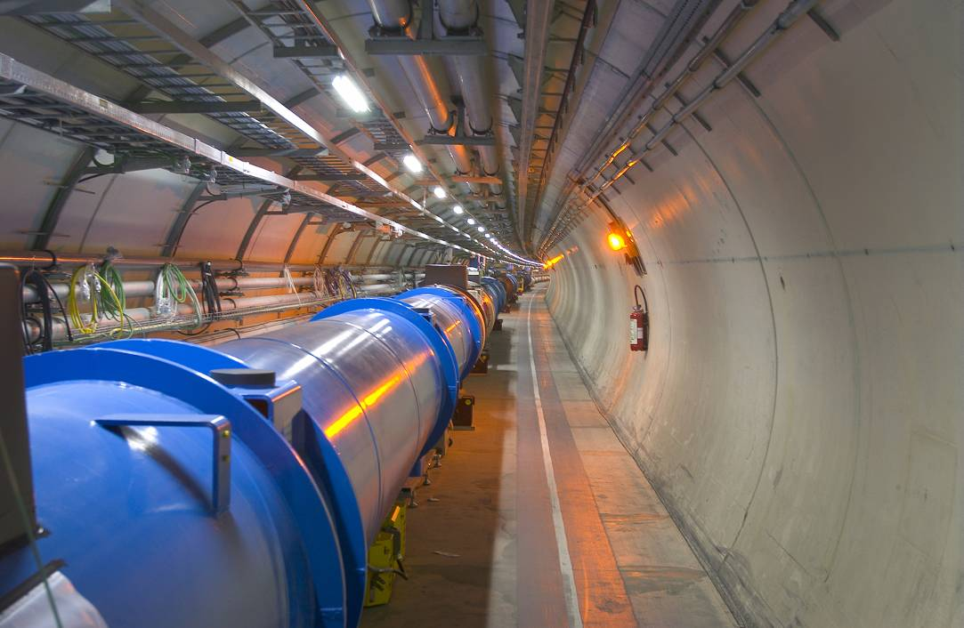
LHC : Superconducting Technology
Cryogenic vacuum system inside the arc
A beam screen is housed inside the cold bore held at 1.9 K

Slide 8
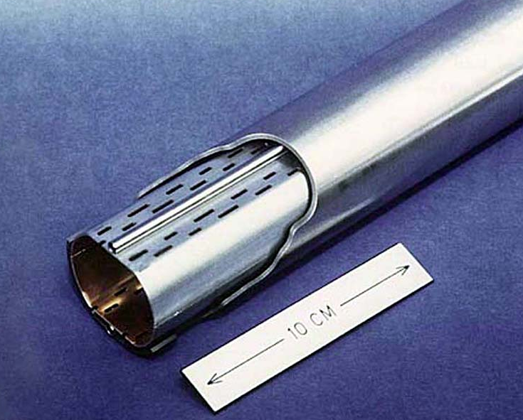
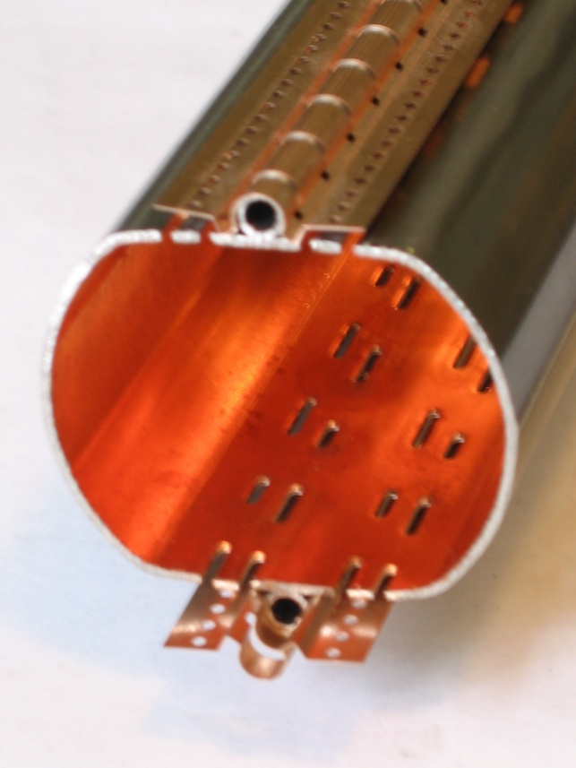
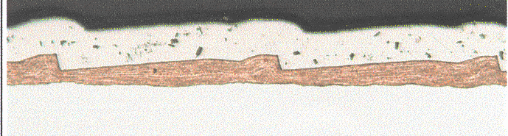
Beam Screen Design
Sawteeth are provided in the LHC beam screen to reduce the photoelectron yield and the forward reflectivity
In dipoles, electron shield are clamped to protect the cold bore from electron cloud heat load
~ 40 μm
Courtesy N. Kos CERN TE/VSC
~ 500 μm
BD meets VC&S at KIT, Karlsruhe, 8-10 March , 2017

Slide 9
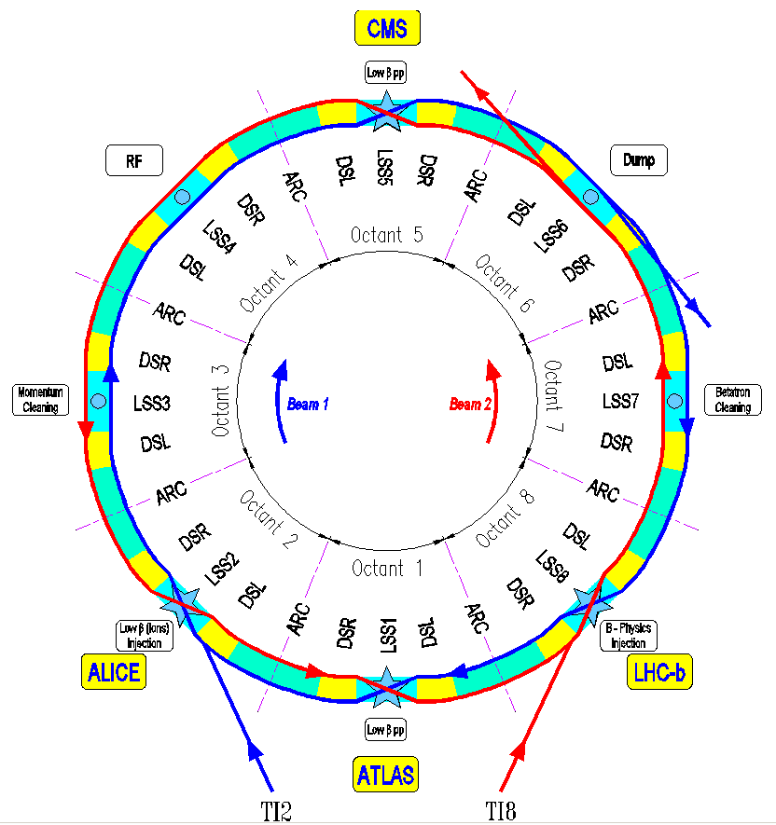
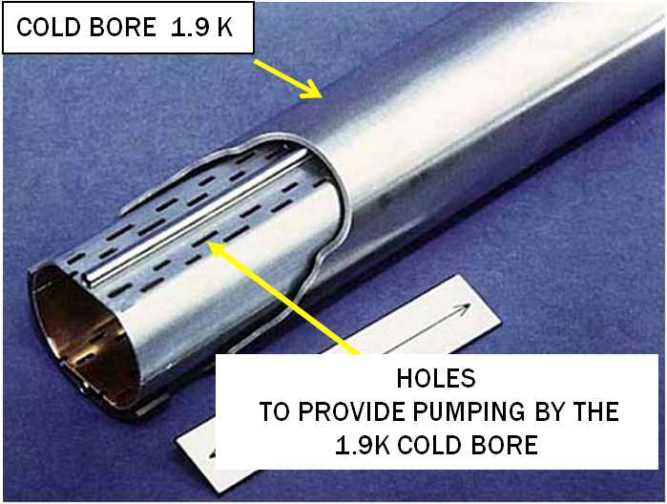
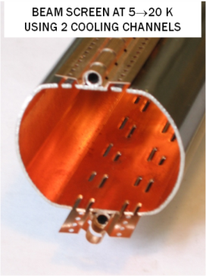
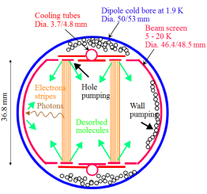
Cryogenic Beam Vacuum
2 independent beam pipes per arc: 8 arcs of 2.8 km each
BD meets VC&S at KIT, Karlsruhe, 8-10 March , 2017

Slide 10
Arc : Some Numbers
Item | Total
Vacuum sectors (cryogenic) | 16
Vacuum sector valves | 32
Roughing valves (arc) | 844
Ion pumps | 0
Bayard Alpert gauges | 0
Penning gauges (arc) | 108
Pirani gauges | 108
Item | Length (m)
Unbaked Arc @ cryo T | ~ 45 000
BD meets VC&S at KIT, Karlsruhe, 8-10 March , 2017

Slide 11
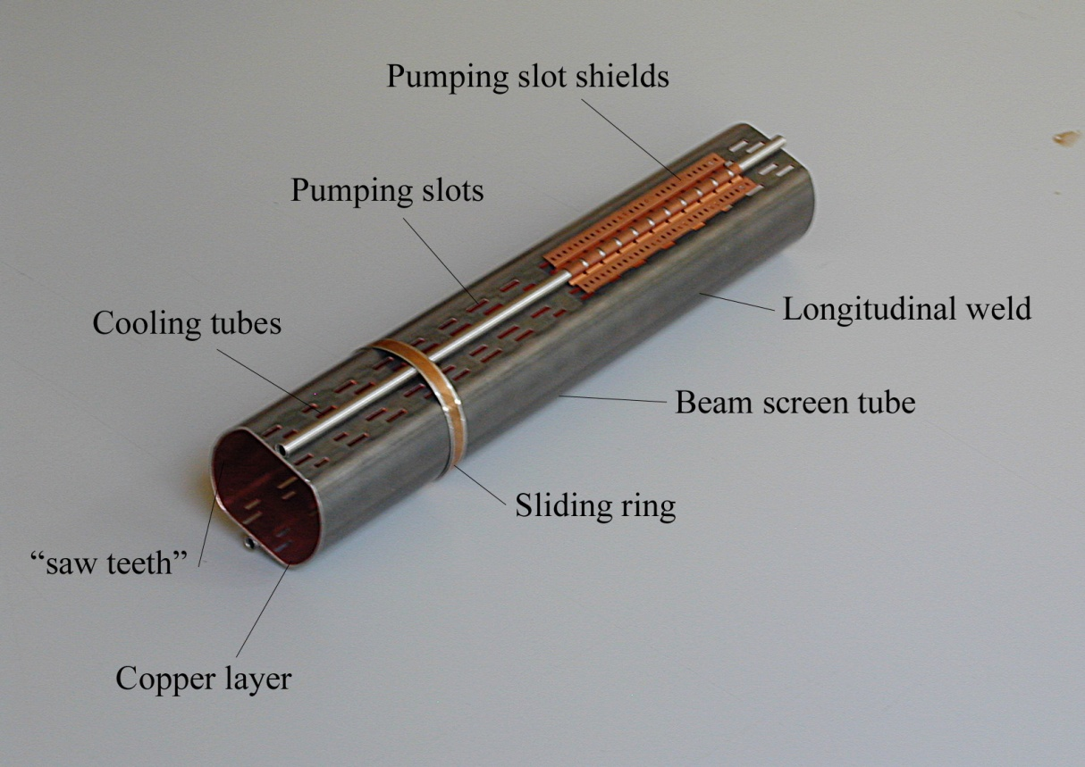
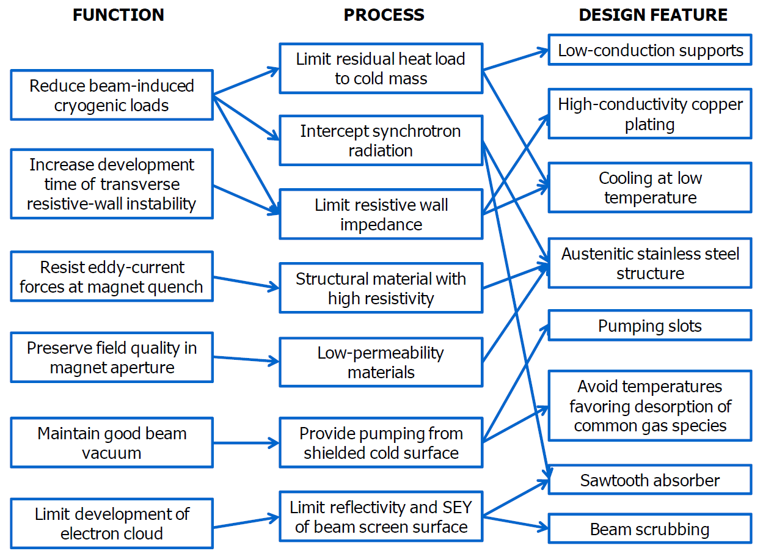
New System: LHC Beam Screen
An innovative and complex system, produced length ~50 km!
Intercept the heat load induced by the circulating beam
Operate between 5 and 20 K
Pumping holes to control the gas density
Functional design map of beam screen
Courtesy N. Kos CERN TE/VSC
P. Lebrun et al.
CERN ATS 2013-006
BD meets VC&S at KIT, Karlsruhe, 8-10 March , 2017

Slide 12
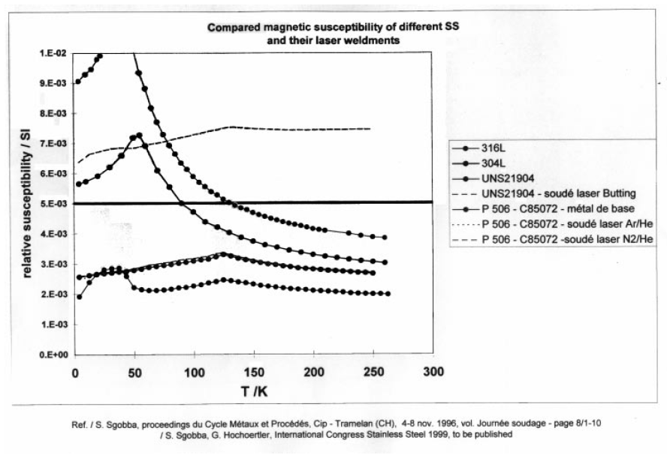
Magnetic susceptibility < 0.005
Stainless steel to provide mechanical robustness against quench forces: 1 mm thick
Low permeability to preserve field quality
BD meets VC&S at KIT, Karlsruhe, 8-10 March , 2017

Slide 13
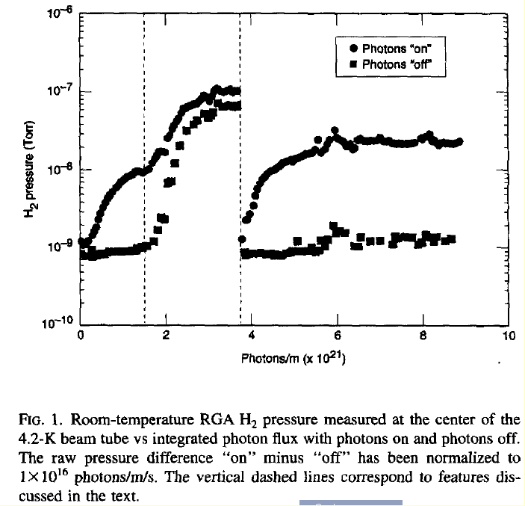
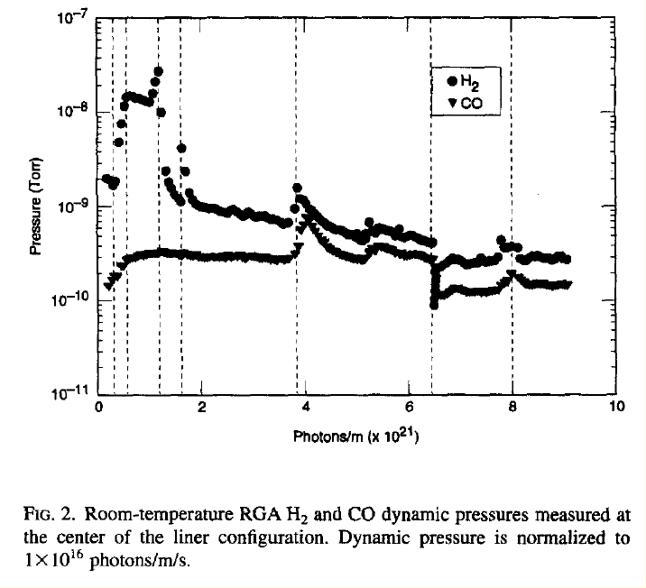


Why a Perforated Beam Screen ?
SSC studies in 1994
No perforations
With perforations
V.V. Anashin et al. J. Vac. Sci.Technol. A. 12(5) , Sep/Oct 194
A perforated beam screen allows to control the gas density
BD meets VC&S at KIT, Karlsruhe, 8-10 March , 2017

Slide 14




Gas density & surface coverage equations
V.V. Anashin et al. J. Vac. Sci.Technol. A. 12(5) , Sep/Oct 194
with:
n gas density, s surface coverage, V volume per unit length, A_{w} surface per unit length, A_{c}D axial diffusion term of molecules, σ sticking probability, S ideal speed per unit length, C beam screen holes pumping speed per unit length, tm sojourn time of physisorbed molecule, η desorption yield of chemisorbed molecules, η’ recycling desorption yield of physisorbed molecules,
Infinitely long tube (A_{c}D=0), without beam screen (C=0) and quasi static conditions:
Increase with the surface
coverage
BD meets VC&S at KIT, Karlsruhe, 8-10 March , 2017

Slide 15
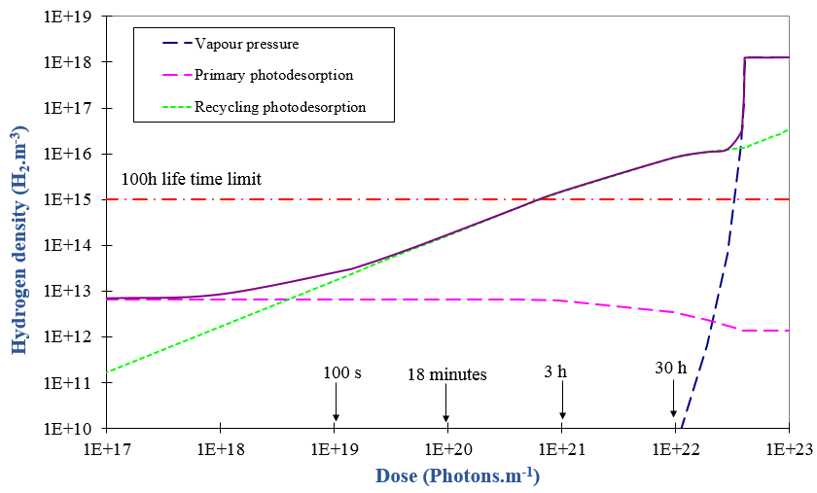
Cryosorbing tube without holes
BD meets VC&S at KIT, Karlsruhe, 8-10 March , 2017

Slide 16
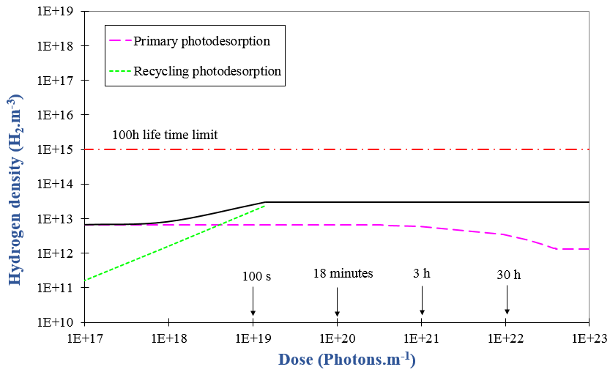
Perforated beam screen
Infinitely long tube (A_{c}D=0), with a beam screen (C≠0) and quasi static conditions:
Equilibrium pressure
Equilibrium coverage
A perforated beam screen allows to control the gas density
BD meets VC&S at KIT, Karlsruhe, 8-10 March , 2017

Slide 17
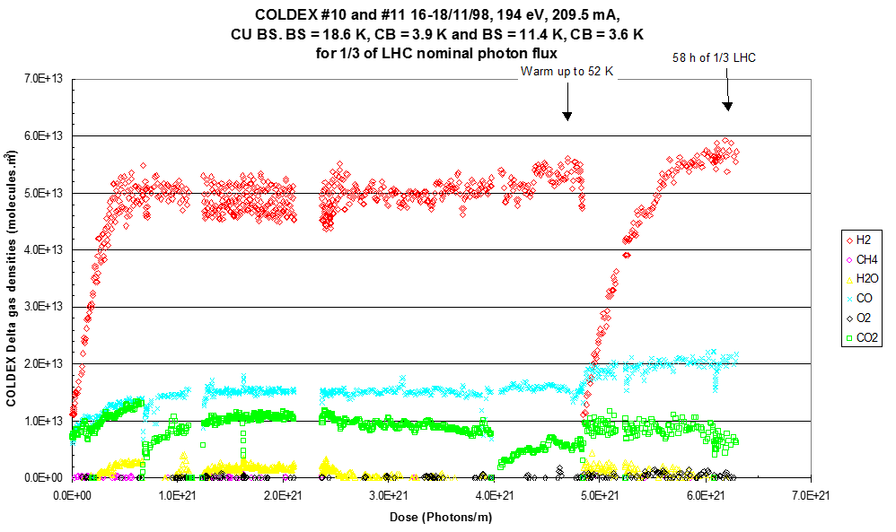
Fit to measured data at 10 K with 194 eV crit. energy
η = 2.6 10⁻⁴ H₂/ph
η' = 0.08 H₂/ph/monolayer
σ= 0.08
V. Baglin et al, Proc. EPAC 00, Vienna, 2000
BD meets VC&S at KIT, Karlsruhe, 8-10 March , 2017

Slide 18
LHC Vacuum System Principle
Molecular desorption stimulated by photon, electron and ion bombardment
Desorbed molecules are pumped on the beam vacuum chamber
100 h beam life time (nuclear scattering) equivalent to ~ 10¹⁵ H₂/m³ (10⁻⁸ Torr H₂ at 300 K)
In cryogenic elements
Molecular physisorption onto cryogenic surfaces
(weak binding energy)
Molecules with a low recycling yield
are first physisorbed onto the beam screen
(CH₄, H₂O, CO, CO₂) and then onto the
cold bore
H₂ is physisorbed onto the cold bore
BD meets VC&S at KIT, Karlsruhe, 8-10 March , 2017
BD meets VC&S at KIT, Karlsruhe, 8-10 March , 2017

Slide 19
2. Vacuum stability

Slide 20
Vacuum Stability
Reduction of the net pumping speed
Pressure instability during beam stacking in the ISR.
Simple beam tube without beam screen
In both cases, when the beam current approach the critical current, the pressure increases to infinity
With a perforated beam screen, C
ISD yields, sticking coefficient, identification of ion sources, cross sections production of ions, are of primary importance
BD meets VC&S at KIT, Karlsruhe, 8-10 March , 2017

Slide 21
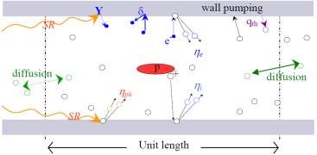
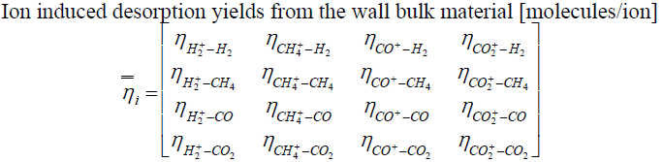
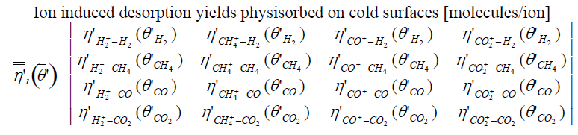
Vacuum Stability
Perforated beam screens are preferred to simple beam tube: more margin against instability
The desorption of several type of gas species induced by ions, requires the use of dedicated code to study the multigas-system:
O. Gröbner, ISR-VA/76-5
W.C. Turner. J. Vac. Sci.Technol. A. 14(4) , Jul/Aug 1996
O.B. Malyshev, A. Rossi, EPAC 2000, Vienna, Austria
A. Rossi, VASCO code, LHC project note 341
Experimental parameters are needed to complete the inputs for computing tools
BD meets VC&S at KIT, Karlsruhe, 8-10 March , 2017

Slide 22
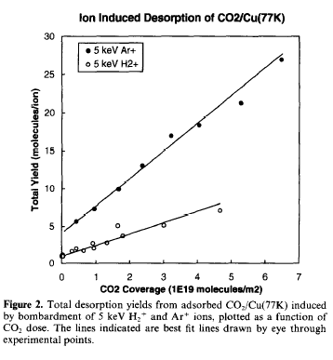
At Cryogenic Temperature
Desorption of physisorbed gas
H₂⁺, 3.2 K
N. Hilleret, R. Calder, IVC, 1977
η’_{H2} ~ 2000
η’_{CO2} ~ 2
@ 5 keV and 1 monolayer
J. Barnard et al., Vacuum 47 (4), 347, (1996)
BD meets VC&S at KIT, Karlsruhe, 8-10 March , 2017

Slide 23
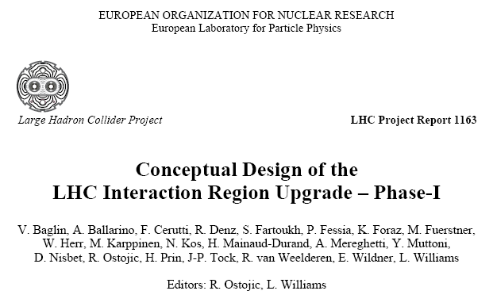
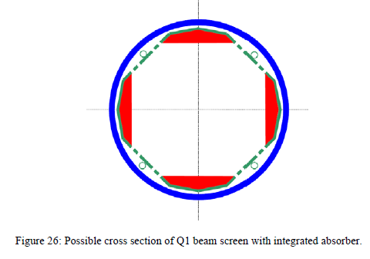
LHC Phase 1: 2-3 10³⁴ Hz/cm²
Preliminary study to HL-LHC
LHC ITs were identify from the beginning of the project to be “burned” by the collision debris
Dated in 2008
15 cm diameter bore
BS design:
  Intercept 4 W/m from collision debris
  Perforated beam screen
BD meets VC&S at KIT, Karlsruhe, 8-10 March , 2017

Slide 24
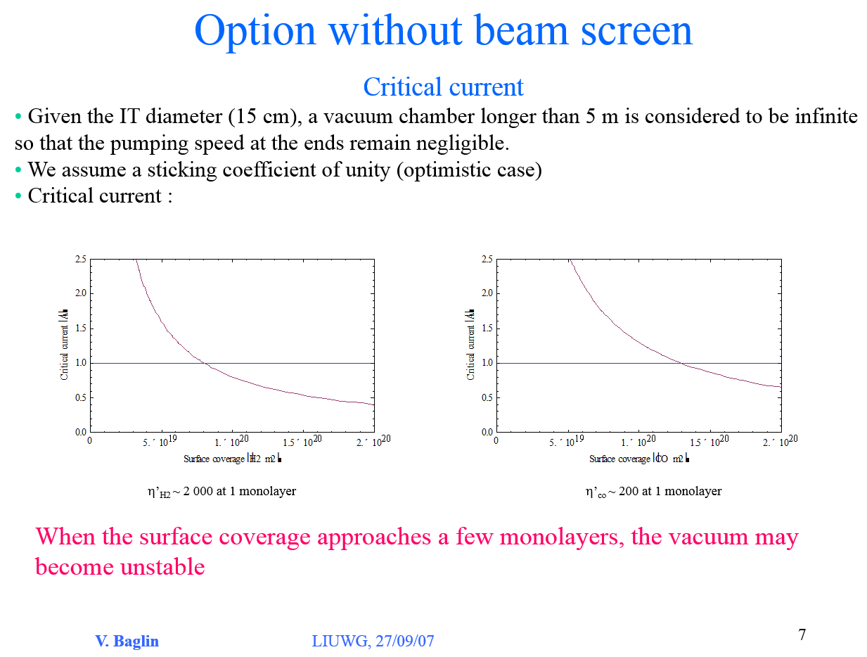
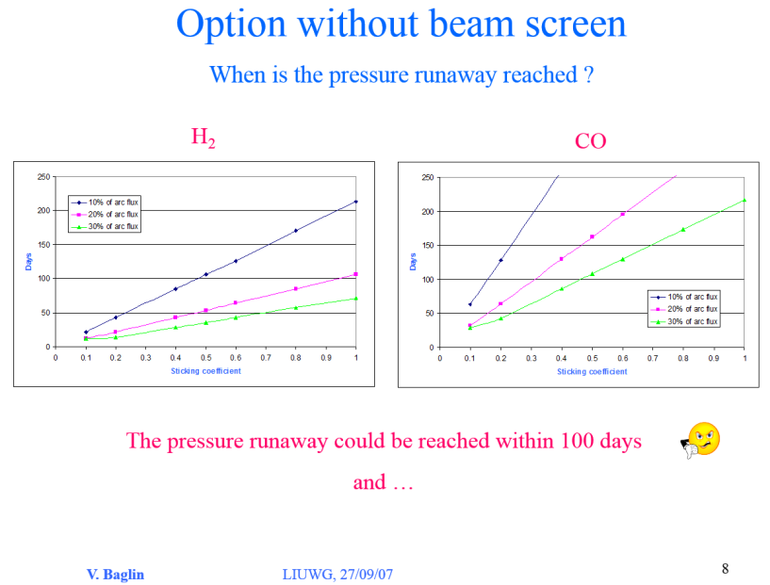
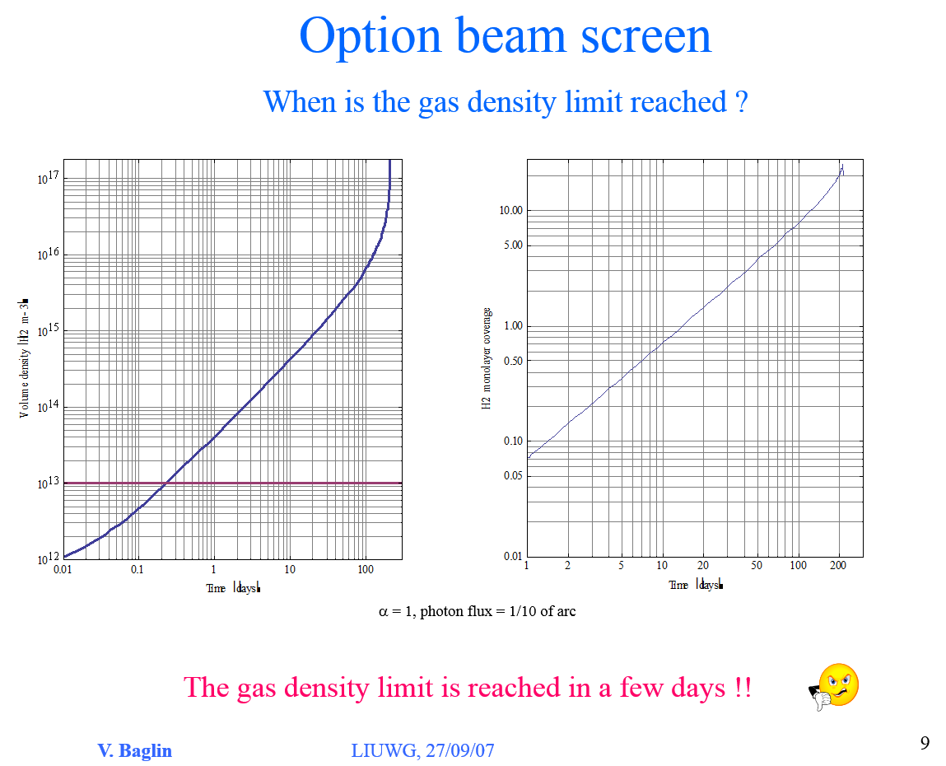
LHC Phase 1: 2-3 10³⁴ Hz/cm²
Despite the large bore diameter (15 cm), the vacuum system is not stable. A pressure runaway could be reached with 100 days
Despite the large pumping speed, the gas density limit is reached within a few days
➔Operating without a perforated beam screen is not viable
BD meets VC&S at KIT, Karlsruhe, 8-10 March , 2017

Slide 25
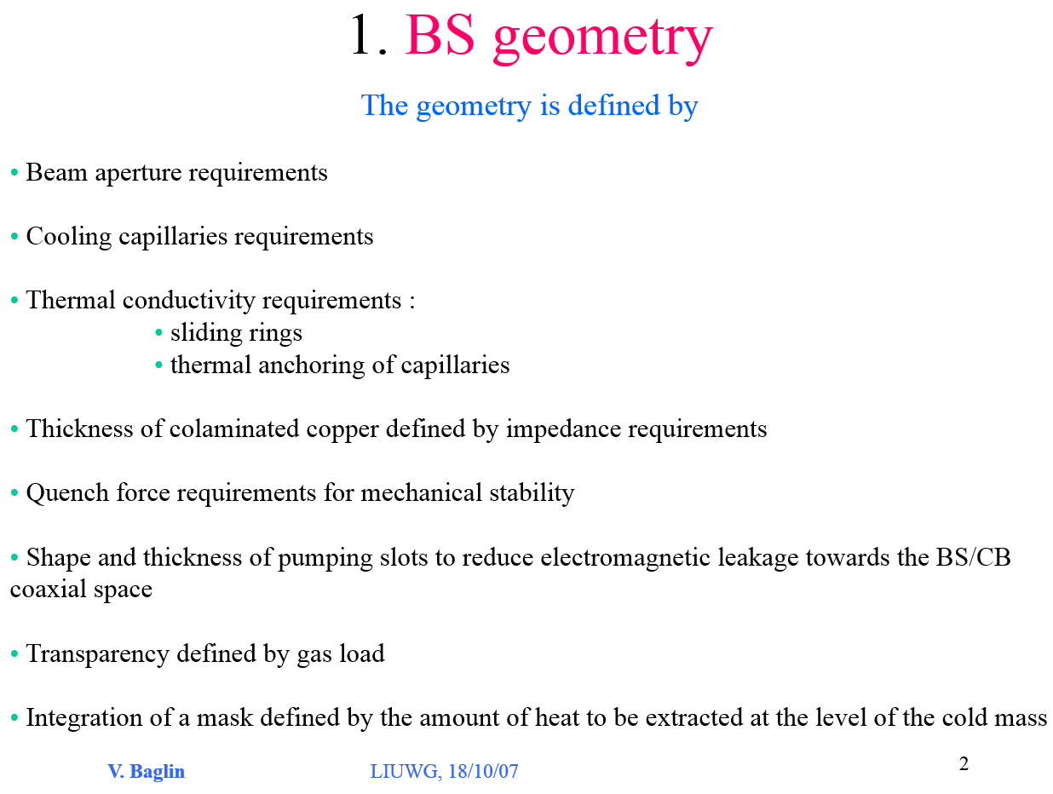
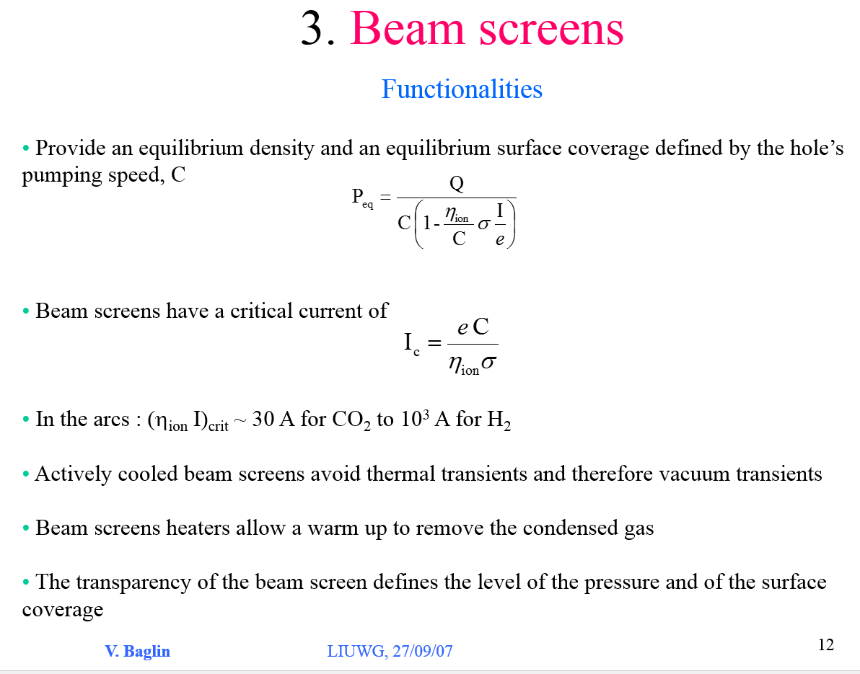
LHC Phase 1: 2-3 10³⁴ Hz/cm²
A perforated beam screen brings vacuum stability, allows to control the gas density and provide the possibility for a mask to intercept the collision debris at a high temperature optimising the cryogenic budget and protecting the cold mass
BD meets VC&S at KIT, Karlsruhe, 8-10 March , 2017

Slide 26
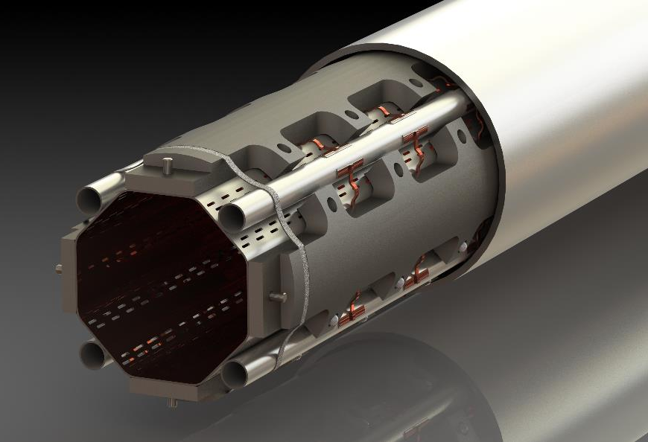

HL-LHC: a-C coated shielded beam screen
Cooling tube
Thermal link
Cold bore
4mm thick 316LN
Tungsten absorber:
Heat load15-25 W/m
Sliding ring
Cu colaminated
on P506
Elastic supporting system
Pumping slots
Courtesy C. Garion TE-VSC
Q1 beam screen / cold bore assembly
BD meets VC&S at KIT, Karlsruhe, 8-10 March , 2017

Slide 27
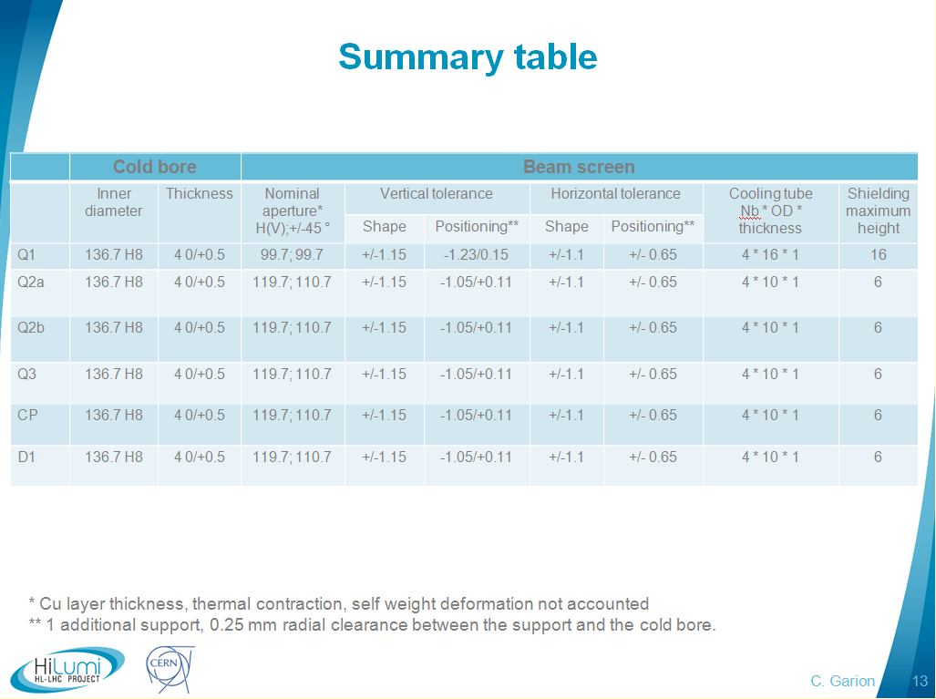
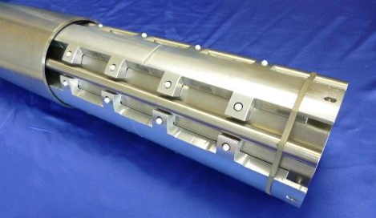
HL-LHC: Beam aperture
Coil aperture: 150 mm
Taking into account shielding, cooling tube, cold bore and beam screen, the available aperture is:
a) 99.7/99.7 for 16 mm thick shielding
b) 119.7/119.7 for 6 mm thick shielding
Vacuum stability and cold mass protection cost an aperture reduction of 33% & 22%
Courtesy C. Garion TE-VSC
BD meets VC&S at KIT, Karlsruhe, 8-10 March , 2017

Slide 28
3. Operating temperature

Slide 29
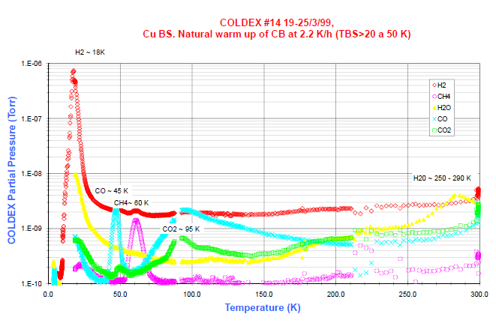
A Natural Warm Up of a St. Steel Cold Bore
BD meets VC&S at KIT, Karlsruhe, 8-10 March , 2017

Slide 30
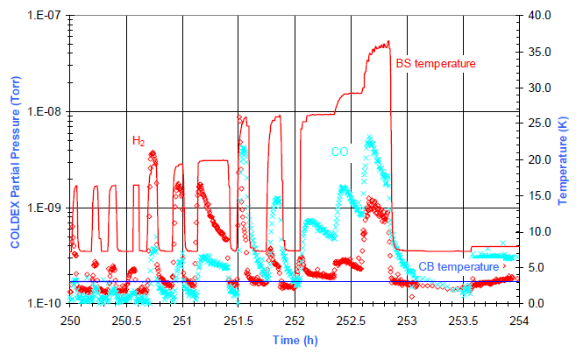
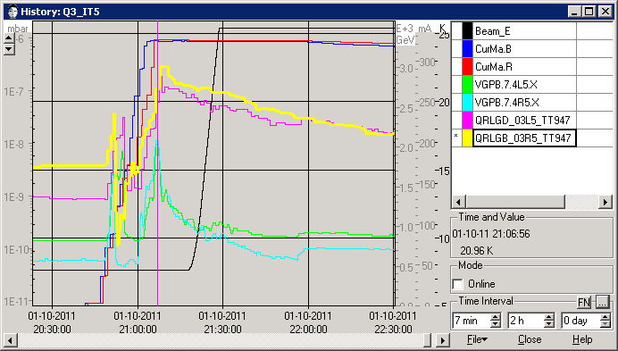
Vacuum Transients: T Oscillations
Transients are due to an excess of physisorbed gas onto the beam screen
Transients level are a function of the gas species, the local pumping speed, the temperature, the driving mechanism (temperature excursion, electron cloud, synchrotron radiation, ion bombardment, particle loss …)
Appropriate cooling scenario with decoupling between cold bore and beam screen with the possibility of BS warming up to 80 K have been implemented in the LHC base line
In a LHC-type mock –up (T driven)
In LHC (T driven)
V. Baglin et al, Proc. EPAC 02, Paris 2002
Fill 2177, 1st October 2011
Beam screen heaters in LHC are used to flush the gas towards the cold bore
BD meets VC&S at KIT, Karlsruhe, 8-10 March , 2017

Slide 31
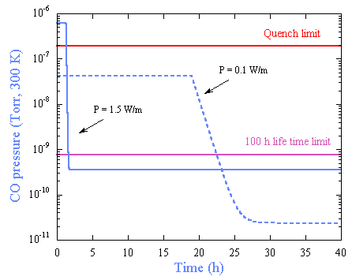
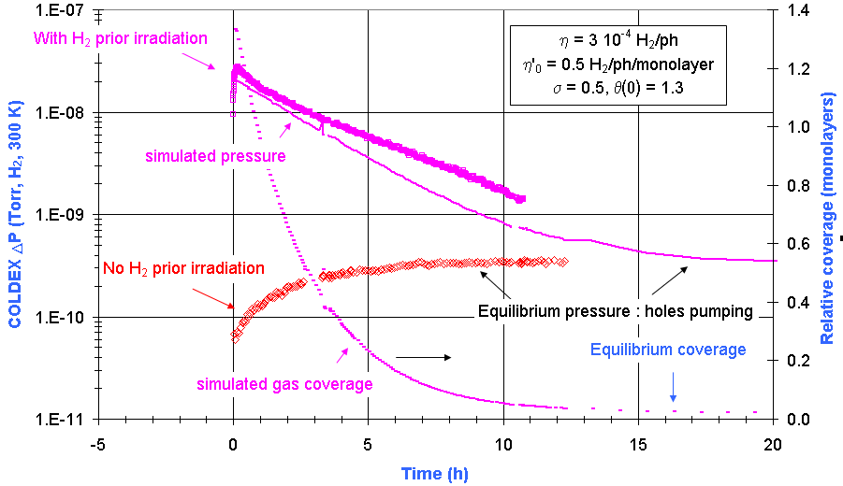
Vacuum Transients: SR and Electron Cloud Driven
Transients are due to an excess of physisorbed gas onto the beam screen.
For mitigation: beam screen’s surface must be bared i.e. free of physisorbed molecules.
In a LHC-type mock –up (SR driven)
V. Baglin, Proc. of LHC Project Workshop 2004, Chamonix, France
Physisorbed gas can be redistributed e.g. after a magnet quench.
This might have consequences on the pressure level and also heat load onto the cryogenic system.
BS heaters are installed to flush the gas towards the CB.
V. Baglin, Proc. of LHC Project Workshop 2004, Chamonix, France
Beam screen heaters in LHC are used to flush the gas towards the cold bore
BD meets VC&S at KIT, Karlsruhe, 8-10 March , 2017

Slide 32
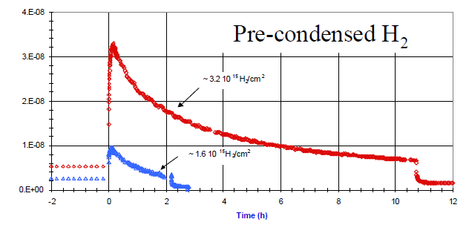
BS covered with an “excess” amount of coverage
V. Baglin, Proc. of EPAC 2002, Paris, France
Recycling of an excessive coverage of H₂ leads to a transient pressure spike
A new equilibrium pressure is reached after several hours of photon irradiation
BD meets VC&S at KIT, Karlsruhe, 8-10 March , 2017

Slide 33
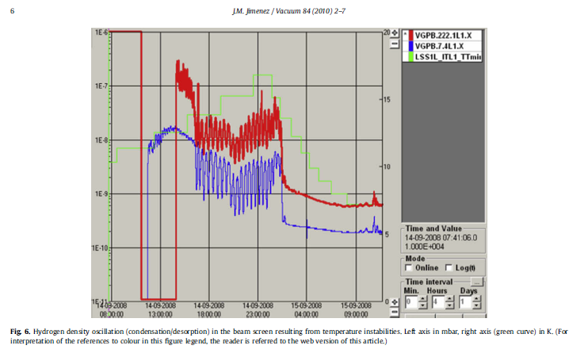
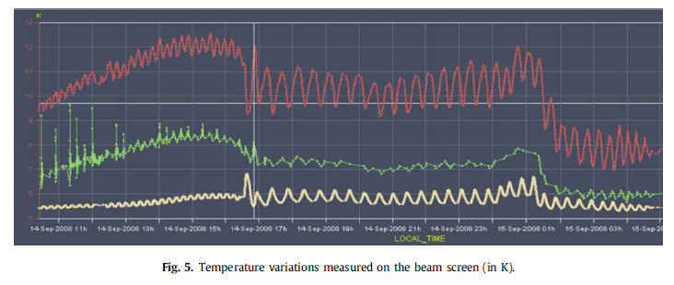
Examples of LHC pressure transients
JM Jiménez, Vacuum 84(2009)2-7
Temperature oscillations of +/- 1 K
Pressure excursions of a few 10⁻⁸ mbar when operating at particular temperature
Identification of desorption temperature is needed
Feed forward technique to control BS temperature is needed
BD meets VC&S at KIT, Karlsruhe, 8-10 March , 2017

Slide 34
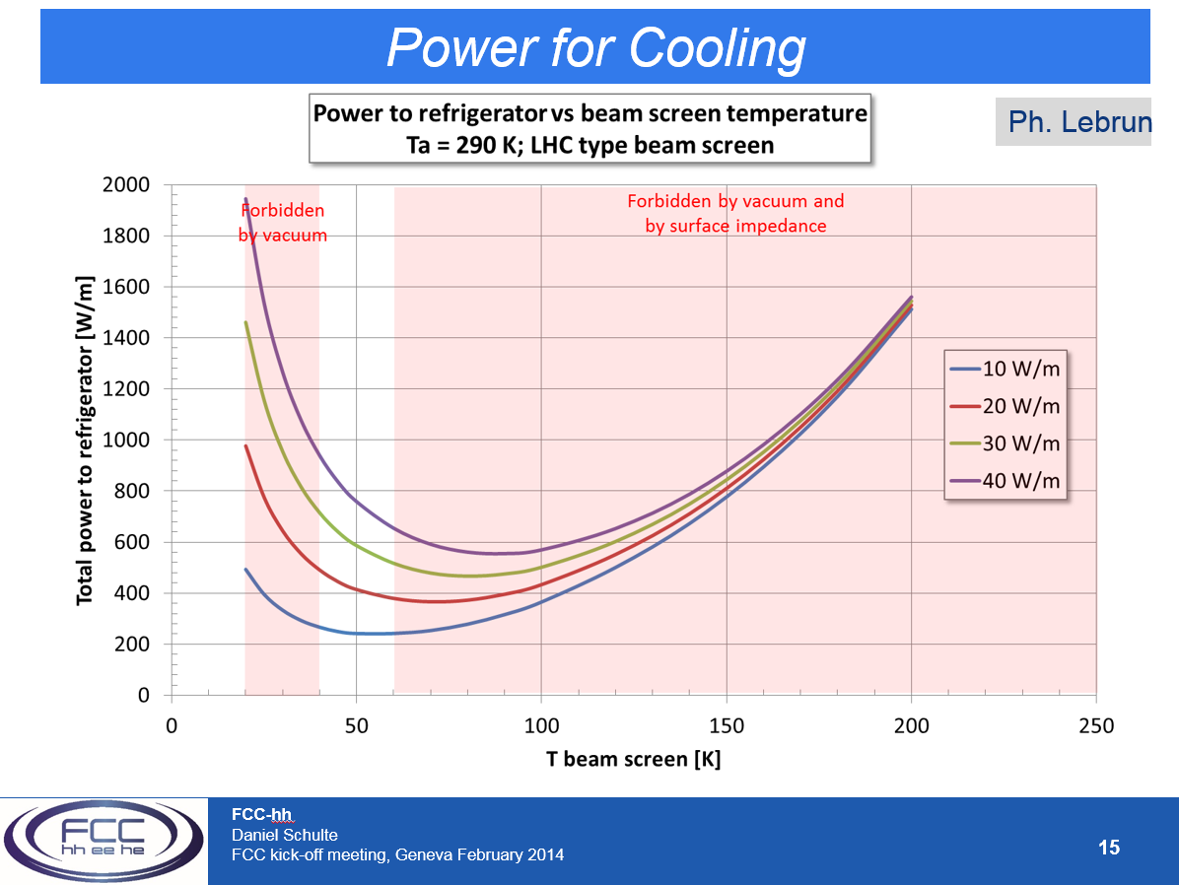
FCC Kick-Off Feb 2014:
Operating temperature of the FCC-hh beam screen
Based on preliminary considerations
P. Lebrun et al.
CERN ATS 2013-006
But at 100K the impedance is about twice as high as at 50K
Choose 50K
Need 100MW for cooling
BD meets VC&S at KIT, Karlsruhe, 8-10 March , 2017

Slide 35
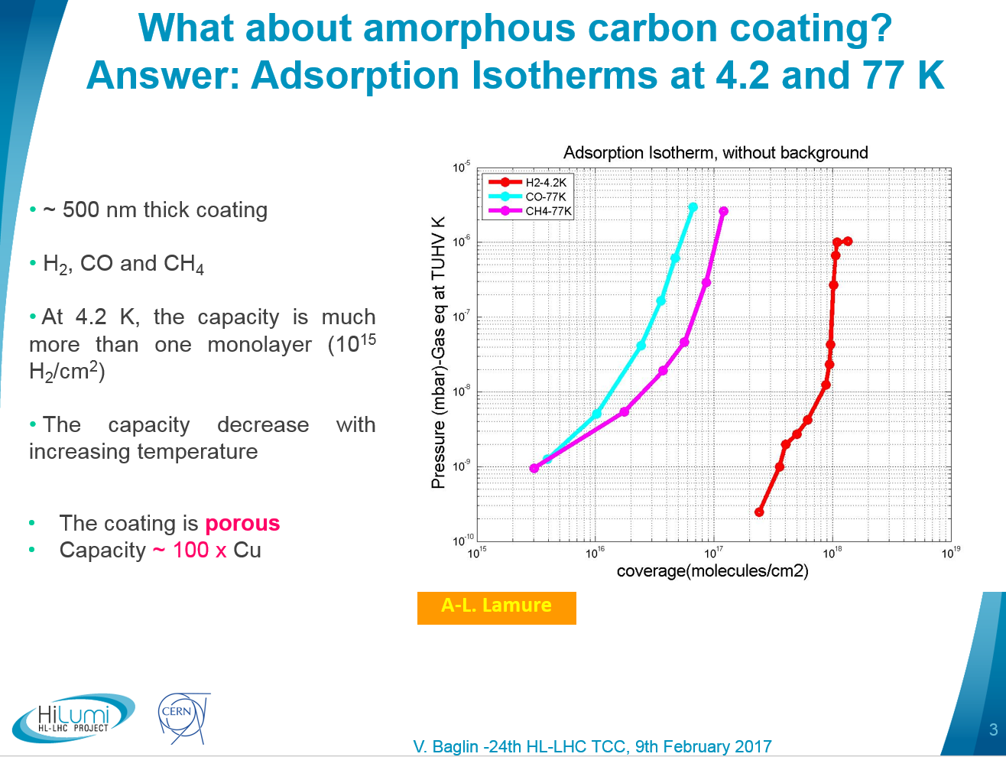
HL-LHC with a-C coating
Impact of the surface material and roughness
BD meets VC&S at KIT, Karlsruhe, 8-10 March , 2017

Slide 36
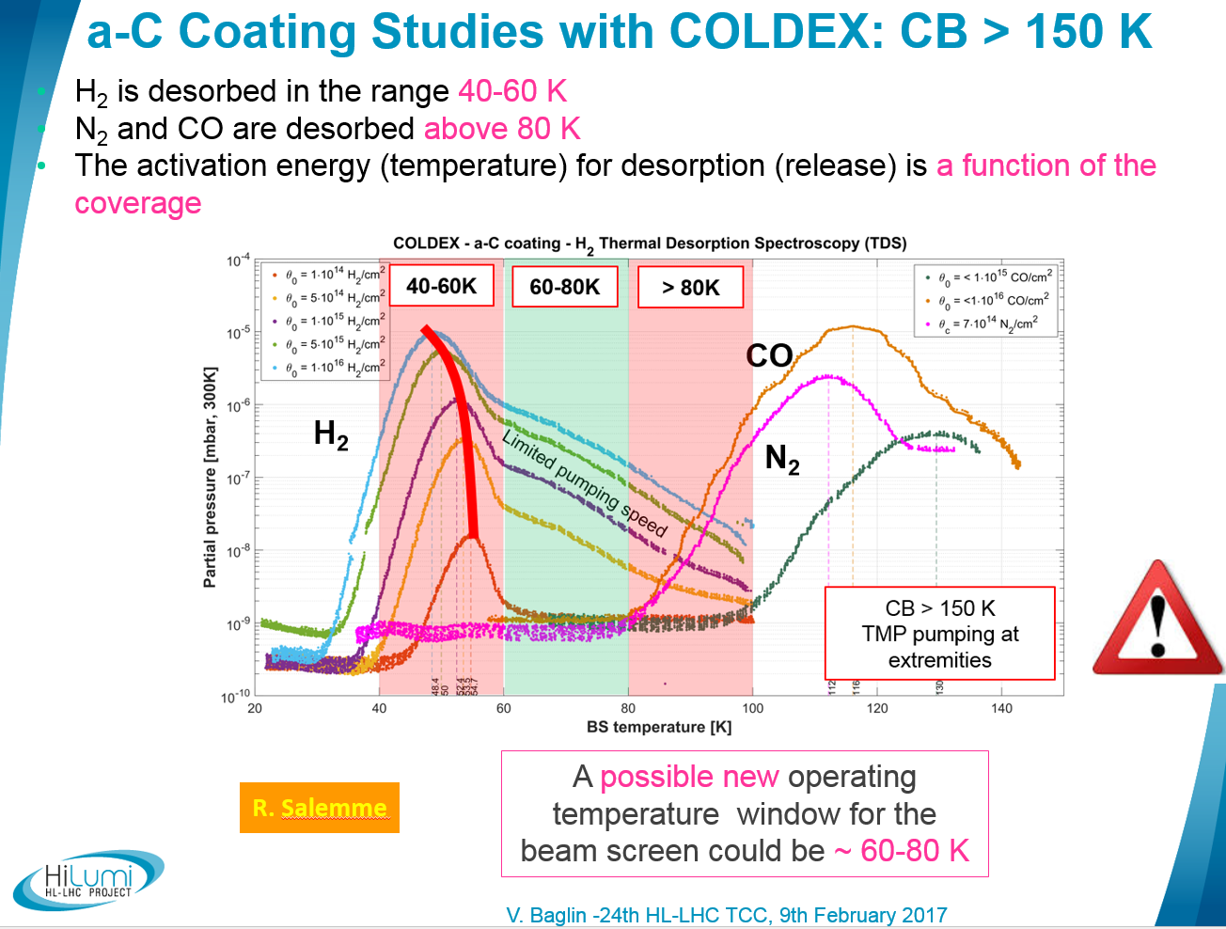
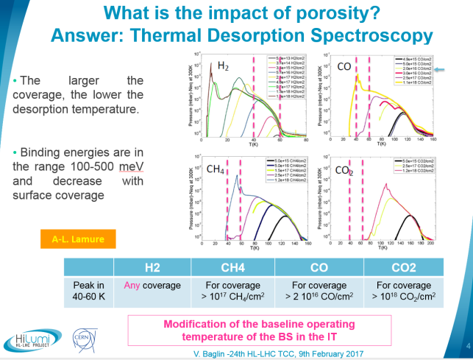
HL-LHC with a-C coating
HL-LHC base line:
  Beam screens at 5-20 in the matching sections
  Beam screens at 60-80 K in the Inner Triplets of the high luminosity insertions
BD meets VC&S at KIT, Karlsruhe, 8-10 March , 2017

Slide 37
4. Impedance

Slide 38

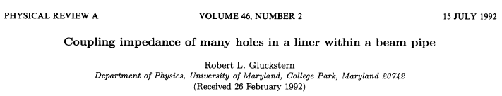
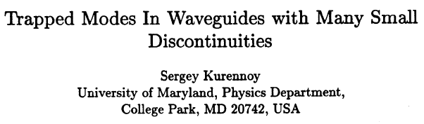
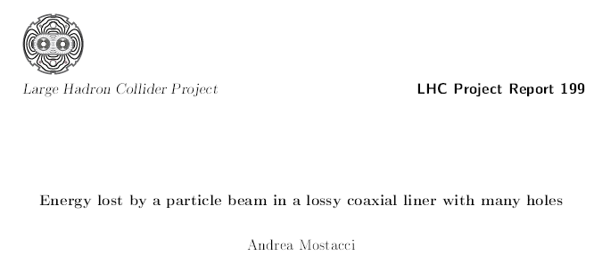
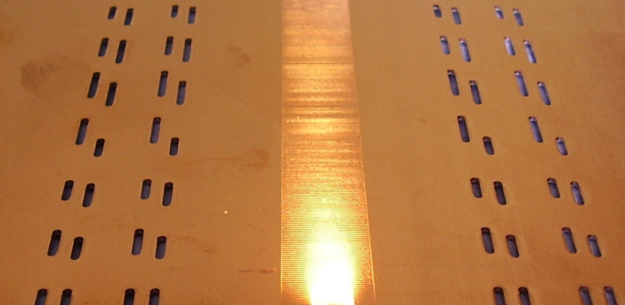
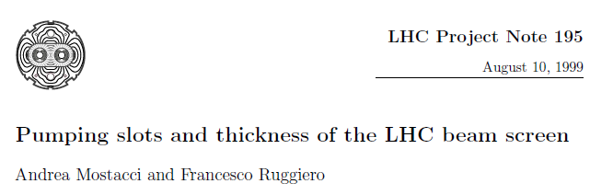
Holes - Shape - Distance - Coaxial space - Power
Impedance is reduced by elongating the hole parallel to the axis of the pipe
  ➔ Pumping slots
Coupling is minimised providing the axial spacing of the holes is not uniform within an accuracy of 1%
Trapped modes produces sharp resonance peaks
  ➔ Randomisation of the holes distribution and length is needed
Power loss ~ P₀ exp (-T/W)
P₀ ~ W⁴
4.4 % transparency
Slot: Width, W= 1.5 , length = 8 +/-2
Longitudinally spaced by 16 +/- 2 between the axes of the slots
Wall thickness, T = 1 mm
BD meets VC&S at KIT, Karlsruhe, 8-10 March , 2017

Slide 39
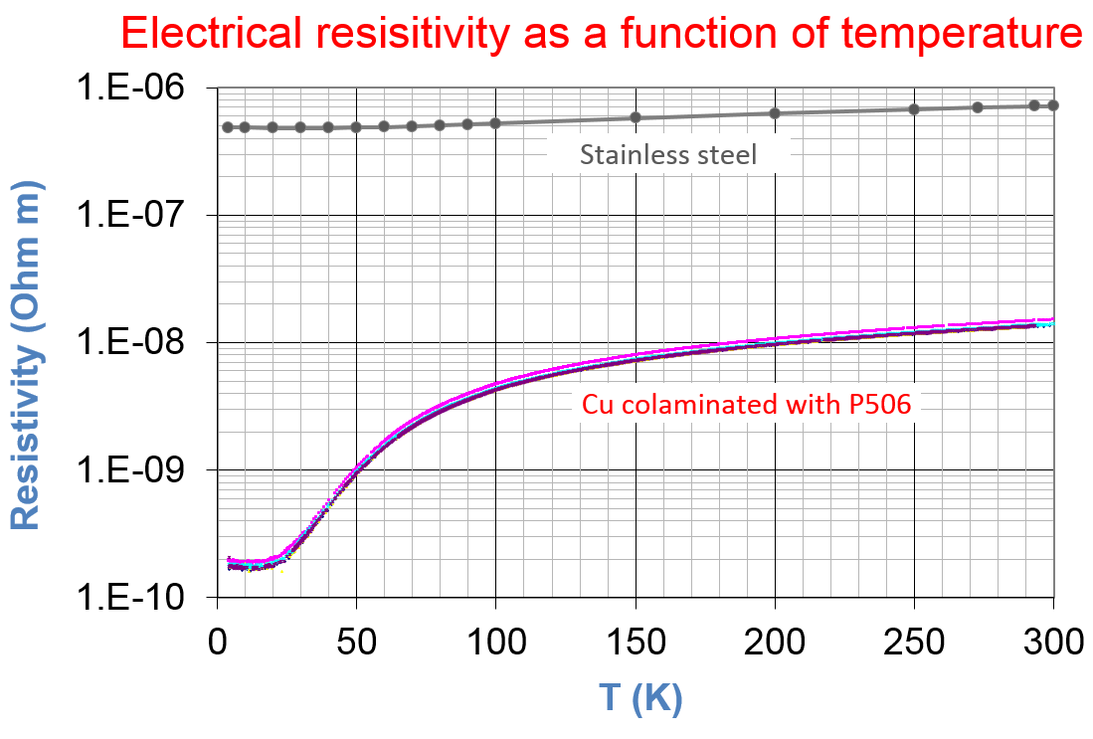
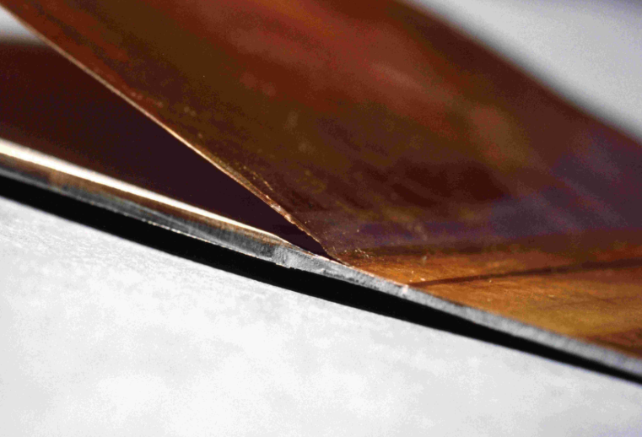
Cu Resistivity
Design: R_{S} = ρ/t = 3.6 10⁻⁶ Ohm at 4.2 K and 50 μm
Produced:
  R_{S} = 2.4 10⁻⁶ Ohm at 4.2 K and 75 μm
  R_{s} is constant in the range 5 – 20 K
  R_{273K} / R_{4.2K} = 72
Courtesy N. Kos TE-VSC
BD meets VC&S at KIT, Karlsruhe, 8-10 March , 2017

Slide 40



HL-LHC a-C coating in IT
a-C coating has a very large resistivity:
ρ ~ 3 10⁻⁵ Ohm m at 300 K
so R = 60 Ohm for 500 nm thick layer
Preliminary study
It is shown that the a-C coating has an impact only on the imaginary part of the impedance above 1 MHz
Since a-C coating is located only in the inner triplets or the LSS1&5 of HL-LHC, the impact on the impedance in expected to be negligible
BD meets VC&S at KIT, Karlsruhe, 8-10 March , 2017

Slide 41
5. Vacuum conditioning
and beam scrubbing

Slide 42


LHC: Cleaning Effect under SR Dose
Arc extremity’s vacuum gauges : unbaked Cu and cryogenic beam screen
Reduction by 2 orders of magnitude since October 2010 till Dec 2012
2 trends :
Room temperature
Cryogenic temperature
V. Baglin, Vacuum 138(2017)112-119
Inside the arc, at 5-20 K, deltaP < 10⁻¹⁰ mbar (i.e. below detection limit)
The photodesorption yield at cryogenic temperature is estimated to be < 10⁻⁴ molecules/photon
BD meets VC&S at KIT, Karlsruhe, 8-10 March , 2017

Slide 43


LHC Evolution of Surface Properties with Scrubbing
V. Baglin, Vacuum 138(2017)112-119
From the heat load measurements and the simulations, the maximum secondary electron yield can be estimated.
δ_{max} values span in the range 1.3 – 1.4
Electron cloud threshold, δ_{max} :
  ~ 1.3 in dipole fields
  ~ 1.1 in quadrupolar fields
One order of magnitude reduction of the dynamic pressure while increasing beam intensities up to 470 mA
<P_{arc}> ~ 4 10⁻⁹ mbar since the end of the 2015 Run
Design value ~ 10⁻⁸ mbar at 300K i.e.
10¹⁵ H_{2eq}/m³ which correspond to 100h life time
BD meets VC&S at KIT, Karlsruhe, 8-10 March , 2017

Slide 44

HL-LHC: a-C coating to mitigate multipacting
BD meets VC&S at KIT, Karlsruhe, 8-10 March , 2017

Slide 45

a-C coating performances studies with COLDEX
No dynamic pressure larger than 10⁻⁹ mbar due to ESD is observed for:
  bare surface
  surface coverages of:
    ~3 10¹⁶ H₂/cm² , ~2 10¹⁶ CO/cm^{2,} ~3 10¹⁶ CO₂/cm²
Measured dynamic heat load are within:
  0.2 +/- 0.1 W/m for all studied cases
No multipacting electron activity is measured above 0.1 nA
δ_{max} < 1.1
SEY ≤ 1.1
2015 detection limit
2016 detection limit
R. Salemme, PhD Thesis
BD meets VC&S at KIT, Karlsruhe, 8-10 March , 2017

Slide 46



HL-LHC: aC coating
In-situ bakeout at 120ºC
M. Ady
KEK Collaboration:
  4 KeV critical energy (x100 LHC)
  Desorption yields of a-C coating larger than stainless steel
  Conditioning with beam
Several monolayers of gas are available for desorption
BD meets VC&S at KIT, Karlsruhe, 8-10 March , 2017

Slide 47

HL-LHC a-C coating
Long pumping time are needed before cool down to deplete the surface
BD meets VC&S at KIT, Karlsruhe, 8-10 March , 2017

Slide 48

HL-LHC: Vacuum Conditioning
Vacuum conditioning due to SR is expected to take place within 2400 A.h
10⁻¹⁰ mbar
R. Kersevan. Proc of IPAC 2015, Richmond, USA
BD meets VC&S at KIT, Karlsruhe, 8-10 March , 2017

Slide 49
6. Summary

Slide 50
Summary
There is a strong interplay between beam dynamics and the HL-LHC vacuum system:
  For the insertion of a beam screen with the associated reduction of beam aperture
  For the definition of the beam screen perforation
  For the definition of the surface material to optimise impedance & mitigate multipacting
  For the definition of the operating temperature
  During the machine commissioning period to allow a conditioning time
BD meets VC&S at KIT, Karlsruhe, 8-10 March , 2017

Slide 51
Thank you for your attention !!!
BD meets VC&S at KIT, Karlsruhe, 8-10 March , 2017

Slide 53
Back up slides

Slide 54

Saturated Vapor Pressure
Pressure over liquid or gas phase (many monolayers condensed)
Follows the Clausius-Clapeyron equation: Log P_{sat} = A – B/T

Slide 55

Electrical resisitivity
O. Gröbner

Slide 56




LHC Multipacting: Influence of Beam Structure
Bunch intensity:
a threshold effect
Beam intensity:
pressure linearity
G. Bregliozzi et al., IPAC San Sebastian, 2011
Time separation:
Non-linearity
VGI.134.7L1.B
VGPB.237.7R1.B
BD meets VC&S at KIT, Karlsruhe, 8-10 March , 2017

