Slide 1
Residual gas and surfaces in vacuum specification for particle accelerators
Dr. Oleg B. Malyshev
Senior Scientist
ASTeC Vacuum Science Group
(oleg.malyshev@stfc.ac.uk)

Slide 2
Outline
Introduction
Vacuum specifications
Vacuum vessel
Beam induced vacuum processes
Homeless problems
Conclusions

Slide 3
Introduction
Vacuum (from Latin “vacua”) means empty
  In practice, gas density n = 0 particles/m³ is an unreachable
    There is always some number of particles in any volume:
      Vacuum ≠ 0
      n > 0 particles/m³
In the gas dynamics, Vacuum is the gas state when P < 1 bar
  as soon as gas from a closed volume is pumped out all that remains is called ‘vacuum’
  this is a realistic approach and a real science
Vacuum is a problem for many applications and researchers and it is a subject of two scientific disciplines:
  Rarefied Gas Dynamics (a bit more academic field, focused on theory and applied fluid dynamics, gas flows, heat transfer)
  Vacuum Science and Technology (a bit more practical, very interdisciplinary, focused on the implementation).

Slide 4
For a particle accelerator, vacuum is just a tool or a required condition
The accelerator scientists would prefer not to have to bother with it
and would like the vacuum scientists and engineers to design a vacuum system where
  The pressure is zero
  The vacuum pumps and gauges take up no space
  The cost is trivial
  But… it’s too far from that all!

Slide 5
‘Typical’ vacuum specification for particle accelerators
All need Vacuum to a greater or lesser extent e.g.
  10⁻⁵ – 10⁻⁶ mbar in small linacs, Van de Graafs
  10⁻⁷ – 10⁻⁸ mbar in proton synchrotrons
  10⁻⁹ – 10⁻¹⁰ mbar in synchrotron light sources
  10⁻¹¹ – 10⁻¹² mbar in antiproton accumulation rings

Slide 6
Vacuum required in the particle accelerators
High energy particles collide with residual gas molecules that results in:
loss of particles,
the beam quality degradation.
H₂O
H₂
Beam
CO
CH₄
CO₂
CO₂
H₂
CH₄
CO
Gas ionisation and space charge, instabilities
Bremsstrahlung radiation, safety
Residual activation

Slide 7
What vacuum is required in storage rings
The beam current I decays with time t as:
where τ is the total beam lifetime given by the beam lifetime τ_{beam} due to different Quantum, Touschek, particle lifetime, etc.,
and gas lifetime defined as:
☞ i.e. there must be: τ_{gas} > τ_{beam}

Slide 8
Main criteria for ‘good vacuum’ for the accelerators
τ_{gas} > τ_{beam} (for storage rings);
The beam loss rate due to a beam-gas interaction is tolerable (for linacs);
The beam properties (ex.: emittance) aren’t affected by a beam-gas interaction;
The detector operation isn’t affected by a beam-gas interaction debries;
Residual radiation of vacuum chamber and equipment in an accelerator tunnel due to a beam-gas interaction is tolerable;
Radiation safety criteria during accelerator operation is met.

Slide 9
Accelerator Vacuum Specification
From such considerations, the accelerator physicist will calculate the permissible beam-gas interactions to give the desired performance of the accelerator
For this a basic design (lattice and apertures) will be required
The vacuum specification will then (ideally) be
  a set of number densities of likely gas species at all points around the machine
  Specify when these spec. should be reached in respect to a machine lifetime (ex. after 100 A⋅hr, after 1st year of operation, etc.)
  Specify locations where these spec. should be met:
    average or maximum value for the sector, ring, section;
    specific local pressure at specified component(s)

Slide 10
Examples of vacuum specification for a high energy particle accelerators and components
100 h vacuum life time at I = 560 mA after 100 Ah conditioning (for DLS);
P(N₂ eqv) = 10⁻⁸ mbar after bakeout and a week of pumping (for a buster);
n(H₂ eqv) = 10¹⁵ m⁻³ after 2 years conditioning (for the LHC);
The Ga-As photocathode vacuum chamber between the photocathode and 1st dipole magnet:
  total pressure P_{tot} < 10⁻¹² mbar
  and partial pressure for oxygen containing gases such as CO, CO₂, H₂O, O₂: P_{g} < 10⁻¹⁵ mbar.

Slide 11
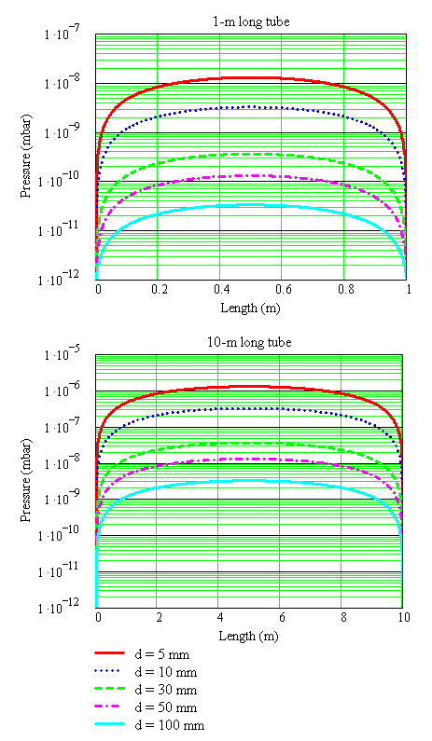
Could an Accelerator Be Built in Space?
V. Anashin’s task for students at BINP
A 1-m and 10-m long circular beam ‘vacuum’ chamber with a diameter d somewhere in space where the pressure is 10⁻¹² mbar (i.e. 2.5⋅10⁷ molecules/cm³).
For thermal desorption only:
η_{t} = 10⁻¹¹ mbar⋅l/(s⋅cm²).
To fulfil the vacuum requirements for circular accelerators would be not an easy task even in Space!!!

Slide 12
Accelerator in the space
If there is no vacuum chamber
  the beam will see magnets, absorbers, beam instrumentation…
  And will require the beam chamber (beam screen) with smooth walls
    Example: in-vacuum undulators
I.e. a beam screen (vacuum chamber) walls is required not only for vacuum

Slide 13
Vacuum vessel
Interface and barrier between atmosphere and vacuum
Source of gas
Source of electrons and ions
Electric properties (wall resistance, surface impedance, image current)
Magnetic properties
Optic properties (absorb or reflect photons)
It has a wall thickness (takes a space)
It has a temperature
vacuum
atmosphere

Slide 14
Beam size and a vacuum chamber
Vacuum chamber could not follow the changing beam shape,
An ideal vacuum chamber should have
  a simple cross section and
  a minimum number of in size variation

Slide 15
Transition in shapes
or
α
Required maximum angle for transitions and tapering

Slide 16
Pumping ports, holes and slots
A simple pumping port
A pumping port with a mesh with slots
A pumping port with a mesh with holes
A pumping port with a mesh with slots

Slide 17
Accelerator Vacuum Design
The task of the vacuum scientist/engineer is then to
  design the containment system and any specialist mechanical items (e.g. scrapers, shutters, beam diagnostic devices)
  calculate the size, number, position and types of the vacuum pumps necessary to achieve the specified number densities (or pressures)
    for this a reasonable mechanical design/layout is required
  determine the necessary vacuum diagnostics
  define the required treatments of vacuum chamber and its component

Slide 18
Why is meeting a vacuum specification not a simple process?
Some things are not well defined
  Pumping speeds
  Outgassing/desorption properties of materials
  Vacuum chamber shape
  Accuracy of vacuum diagnostics
It is difficult to get enough pumping to where it is required
There are often conflicting requirements between different disciplines, e.g. apertures, wakefield.
Vacuum calculations are difficult and time consuming
A good technical solution may be too expensive
Several design iterations are usually required to reach a satisfactory compromise

Slide 19
Beam induced vacuum processes

Slide 20
Synchrotron radiation and vacuum chamber walls
SR photons can be adsorbed or reflected
Photon stimulated desorption (PSD) is one of the most important sources of gas in the presence of SR.
Gas molecules may desorb from a surface when and where photoelectrons leave and arrive at a surface
PSD and PEY depends on:
Choice of material
Cleaning procedure
History of material
Surface treatments
Pumping time
Additionally it depends on
Energy of photons
Photon flux
Integral photon dose
Temperature
H₂O
CO
H₂
e⁻
γ
e⁻
CO₂
γ
H₂
CH₄

Slide 21
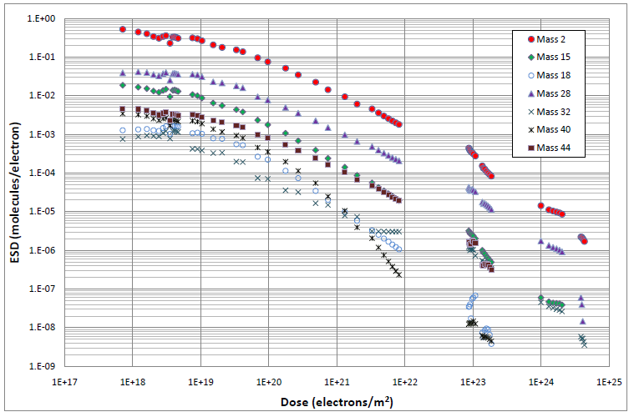
ESD
Electron stimulated desorption (ESD) can be a significant gas source in a vacuum system in a number of cases when the electrons bombard the surface.
The same as thermal desorption and PSD, ESD depends on:
Choice of material
Cleaning procedure
History of material
Pumping time
Additionally it depends on:
Energy of electrons impacting the surface
Electron flux to the surface
Integral electron dose
Temperature

Slide 22
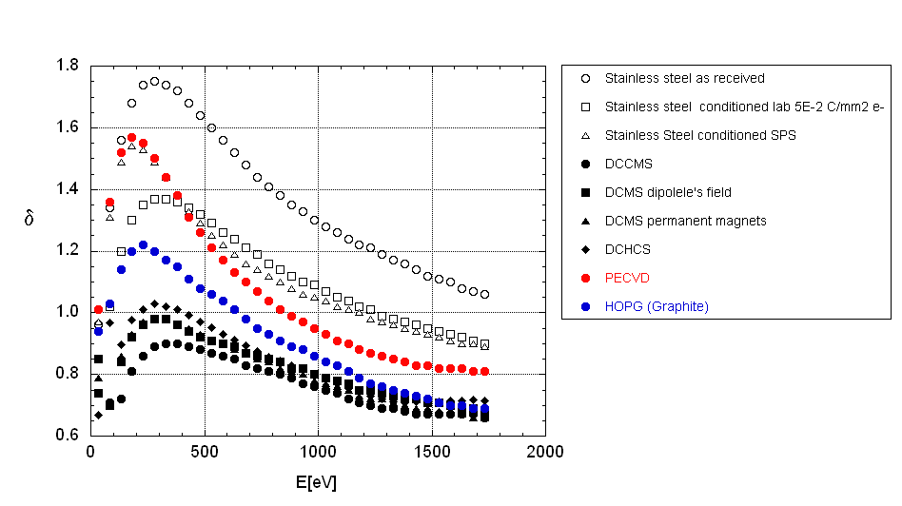
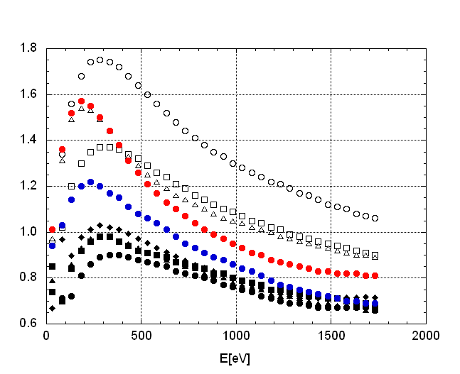
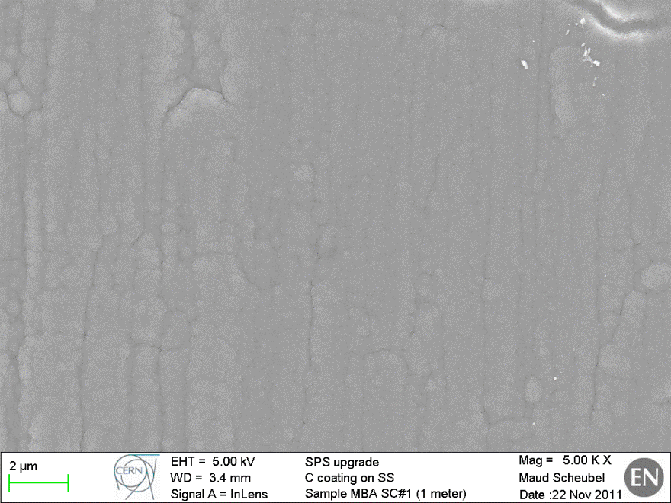
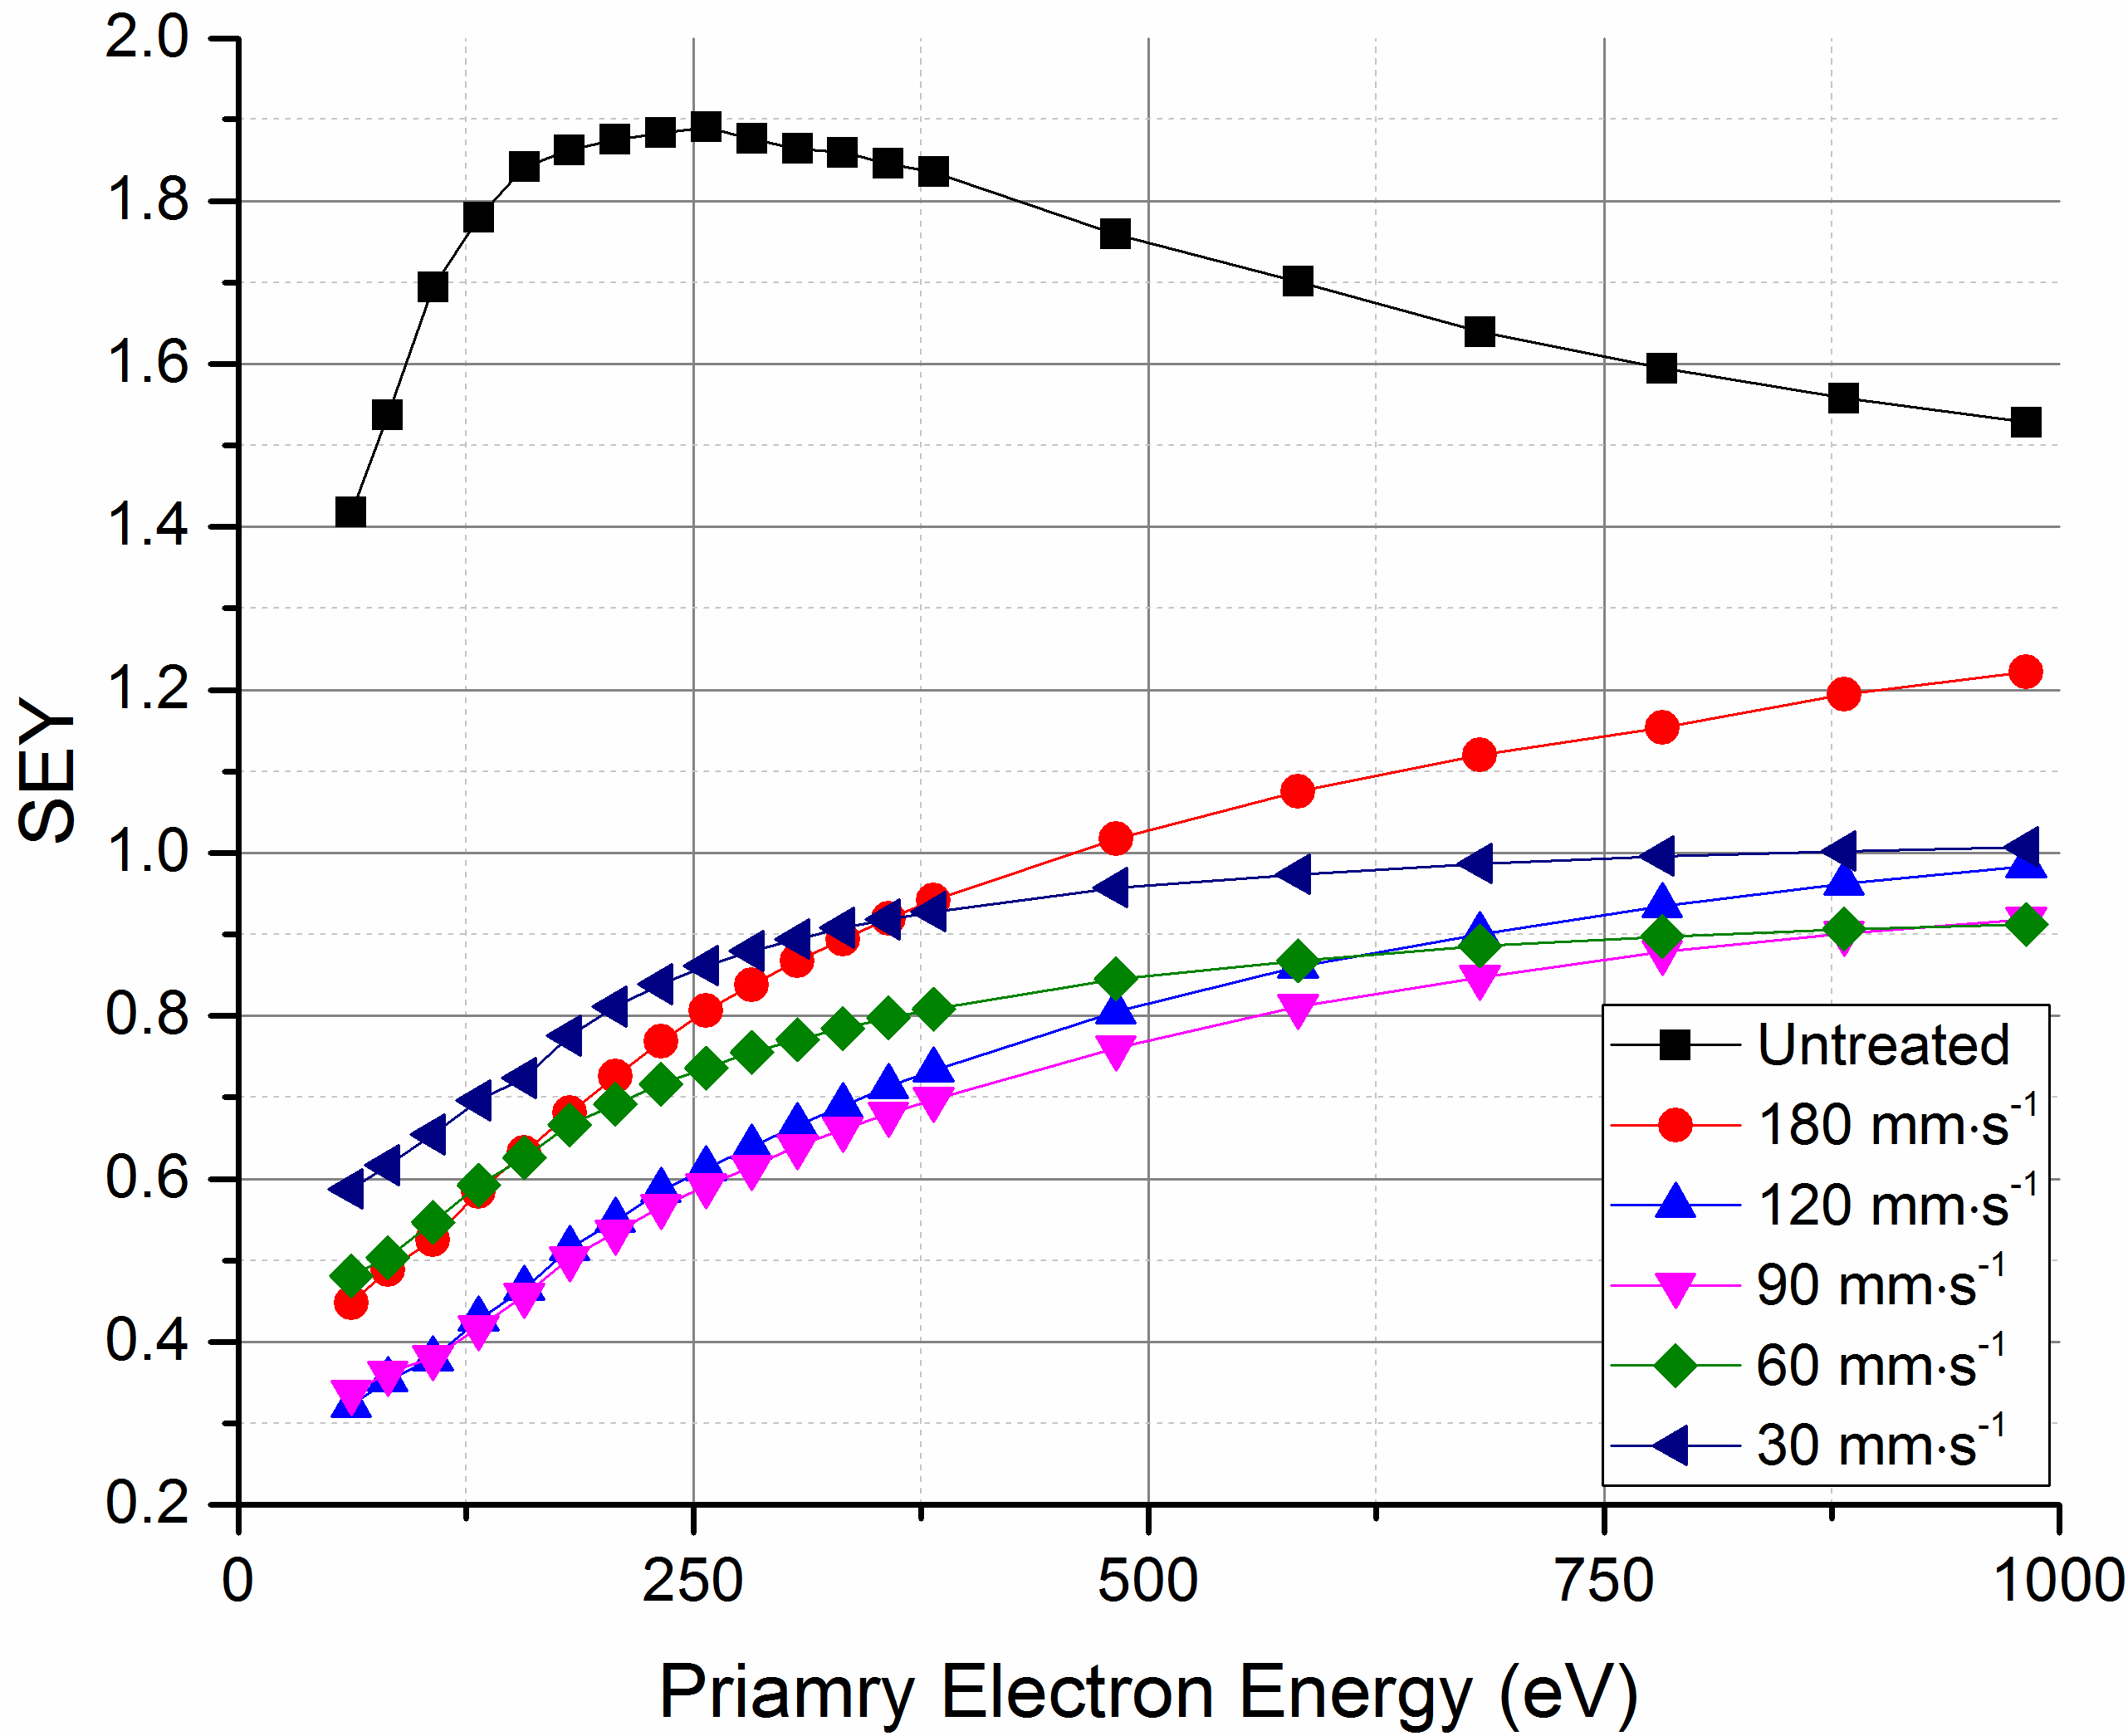
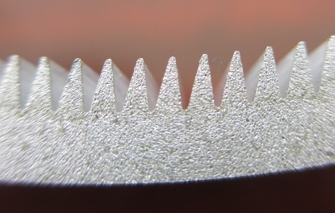
SEY
Low SEY material
Low SEY coating
Roughen surface
Special shape of vacuum chamber
  An antechamber allows reducing PEY
Laser treated surface
Normal
coating
Grooved surface

Slide 23
Sources of Gas in a Vacuum System: ISD
Ion stimulated desorption (ISD) can be a significant gas source in a vacuum system where the ion beam bombards the surface. There is very little data, most work has been done at CERN.
The same as thermal desorption, PSD and ESD, the ISD depends on: choice of material, cleaning procedure, history of material and pumping time.
It is also depends on:
Mass, charge and energy of ions impacting the surface
Ion flux to the surface
Integral ion dose
Temperature

Slide 24
Two concepts of the ideal vacuum chamber
Traditional:
surface which outgasses as little as possible (‘nil’ ideally)
surface which does not pump otherwise that surface is contaminated over time
Results in
Surface cleaning, conditioning, coatings
Vacuum firing, ex-situ baling
Baking in-situ to up to 300°C
Separate pumps
‘New’ (C. Benvenuti, CERN, ~1998):
surface which outgasses as little as possible (‘nil’ ideally)
a surface which does pump, however, will not be contaminated due to a very low outgassing rate
Results in
NEG coated surface
There should be no un-coated parts
Activating (baking) in-situ at 150-180°C
Small pumps for C_{x}H_{y} and noble gases

Slide 25
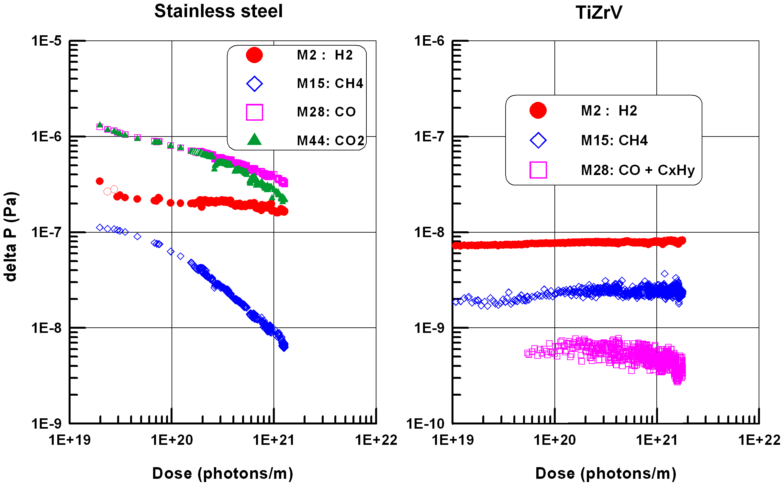
NEG coated vacuum chamber under SR
Dynamic pressure rise for the Stainless Steel (baked at 300°C for 24 hrs) and TiZrV coated vacuum chambers (activated at 190°C for 24 hrs)

Slide 26
What the NEG coating does
Reduces gas desorption:
  A pure metal film ~1-μm thick without contaminants.
  A barrier for molecules from the bulk of vacuum chamber.
Increases distributed pumping speed, S:
  A sorbing surface on whole vacuum chamber surface
  S = α⋅A⋅v/4;
where α – sticking probability,
A – surface area,
v – mean molecular velocity
Vacuum NEG Subsurface Bulk
Coating Layers

Slide 27
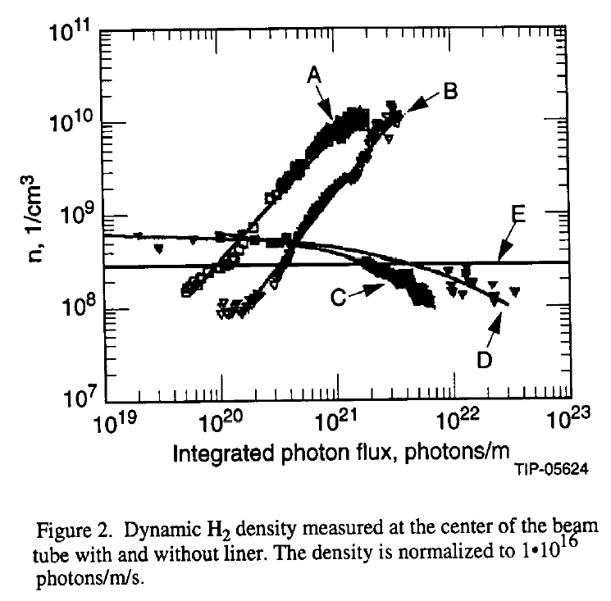
Vacuum Chamber at Low Temperature: PSD and Recycling
A and B are vacuum chamber without a liner
SR
C and D are experiments with a liner with pumping holes
E is the beam lifetime limit
SR
☞ Low temperature does not necessary provides good vacuum in a vacuum chamber!

Slide 28
Vacuum Chamber at Low Temperature: Molecular Cracking
  There are four main photodesorbed gases in a cryogenic vacuum chamber: H₂, CH₄, CO and CO₂, and two of them (CH₄ and CO₂) can be cracked by photons, :
and
The additional amount of H₂, CO and O₂ appears in a
vacuum chamber due to photo-cracking of CH₄ and CO₂.
The efficiency of photo-cracking of CH₄ and CO₂ is about
10 times higher then CH₄ and CO₂ desorption from their cryosorbant!

Slide 29
‘Homeless’ problems
Sometimes a new problem has not clear assignment to traditional sub-field in accelerator science
Such ‘grey zone’ problems are often assigned to vacuum

Slide 30
Ion trapping instability with the negatively charged beams
Residual gas molecules are ionised by the beam
The positively charged ions build up an ion cloud along the negatively charged beam path
The ions cause the ion induced beam instability
Mitigation:
  Better pumping system
  Ion collectors
Calculation of required vacuum are expected from accelerator scientists
CO₂
beam
+
+
+
+
+
+
+
H₂
+
−
+
+
+
+
+
+
CO
CH₄

Slide 31
BIEM and e-cloud
Beam induced electron multipacting (BIEM) and build up of electron cloud (e-cloud) are significant problems in a vacuum chamber with a positive charged beam:
Free electrons appear in vacuum chamber due to photoemission and electron from a beam induced gas ionisation
These free electrons is accelerated towards the first positively charged bunch;
when the bunch passes the accelerated electron moves with accumulated energy up to hundreds of eV towards the opposite wall and strikes it, this causes:
  ESD, which results in a pressure rise
  Secondary electrons are then accelerated by the next bunch
  An electron cloud space charge can increase the beam emittance
CO
e⁻
H₂O
e⁻
e⁻
e⁻
e⁻
e⁻
+
+
+
e⁻
e⁻
e⁻
e⁻
e⁻
e⁻
H₂
CO₂
e⁻
e⁻
CH₄
e⁻

Slide 32
Sources of electrons and their mitigation techniques
Photo-electrons
  Geometrical: antechamber or other means of reduction or localisation of direct and reflected photons
  Surface treatment, conditioning, coatings
Secondary electrons
  Passive means:
  Active means:
Gas ionisation
  Surface treatment and conditioning
  Low outgassing coating
  Better pumping
Low SEY coatings (ex.: NEG or TiN)
Grooves on vacuum chamber
Laser treated surfaces
Biased electrodes
Solenoidal magnetic field
Beam train parameters (charge and bunch spacing)

Slide 33
Ion Induced Pressure Instability
When the positive charged beam particles colliding with residual gas molecules ionise them, these ions are accelerated towards the vacuum chamber wall. This causes ion induced gas desorption, the pressure rises and more molecules will be ionised, accelerated and bombard the wall…
where
Q = gas desorption,
S_{eff} = effective pumping speed,
χ = ion induced desorption yield
σ = ionisation cross section,
I = beam current.
When I → I_{c} (or )
then gas density (pressure) increases dramatically!

Slide 34
Critical current
Critical current, I_{c}, is a current when pressure (or gas density) increases dramatically.
Mathematically, if
34

Slide 35
Heavy Ion Induced Pressure Instability
The heavy ion beam particles colliding with residual gas molecules may lose or trap an electron and be lost in the bending magnet. These very high energy ions or neutrals bombard the vacuum chamber wall which results in a very high desorption yield (up to a few thousands molecules per ion). This causes further gas desorption, resulting in a pressure rise and more lost beam particles bombarding the wall…
A⁺
H₂O
H₂
A⁺
A⁺
Aº
CO
< --- Dipole --- > | < --------------------- Straight ----------------------------- >

Slide 36
Surface resistance, beam impedance
Choice of material
Roughness
Surface coating (Cu, TiN, NEG)
Surface treatment (polishing, etching, laser treatment)
Special vacuum components (valves, bellows, pump and gauge ports)
RF frequency

Slide 37
Uncertainties in Calculation of Vacuum System
“Vacuum is not exact science”
A.G. Mathewson
Desorption yields may differ (factor 2 or even more) for vacuum components made of the same material after exactly the same cleaning procedure and treatments
Mechanical tolerances may result in a difference between estimated and real vacuum conductance
Results of Experiments: 10-20% accuracy for all gauges at UHV
Approximations: extending of experimental results on a few order of magnitude, - it is just a reasonable guess!
Pumping speed is also approximation: up to +60% of nominal pumping speed after baking but -30% to -50% at UHV

Slide 38
Vacuum Chamber at Low Temperature: P and n!
  Pressure and gas density :
  Two vessels at temperatures T₁ and T₂: T₁ > T₂
Viscous regime:
Molecular regime:
T₁
P₁
n₁
T₂
P₂
n₂
and

Slide 39
Conclusions
Vacuum specifications require:
  Gas density
    Total and partial
    Average and local
    After specified conditioning time
    Consider uncertainties
  Vacuum beam chamber
    Dimensions
    Material
    Properties
  Grey zone problems to be solved together
    Ion trapping and e-cloud, ion induced instability…

