Slide 1
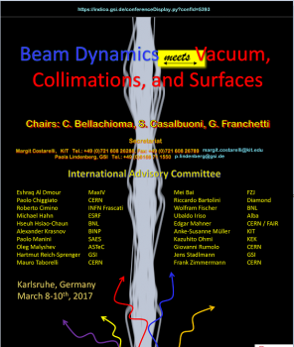
Beam Dynamics and Vacuum Challenges in Present Light Sources and Future Low-Emittance Rings
8-10 March 2017, Karlsruhe
Karlsruhe Institute of Technology Campus
Ryutaro Nagaoka (Synchrotron SOLEIL)

Slide 2
Content:
1. Introduction: Goals and Performance of Ring-Based LSs (Light Sources) and Associated Issues
2. Specific issues encountered and studies made in present LS rings
3. Future trends and issues in DLSR (Diffraction Limited Storage Rings)
4. Conclusions
Acknowledgement :
RN thanks Christian Herbeaux, Thierry Moreno, Frank Wien, Matthieu Refrégiers, the colleagues in the accelerator physics group of SOLEIL and Alex Chao (currently at SOLEIL) for their help and discussions in preparing this presentation.
Beam dynamics & vacuum challenges in present light sources …
Beam Dynamics Meets Vacuum, KIT, 8-10 March 2017 2/20

Slide 3
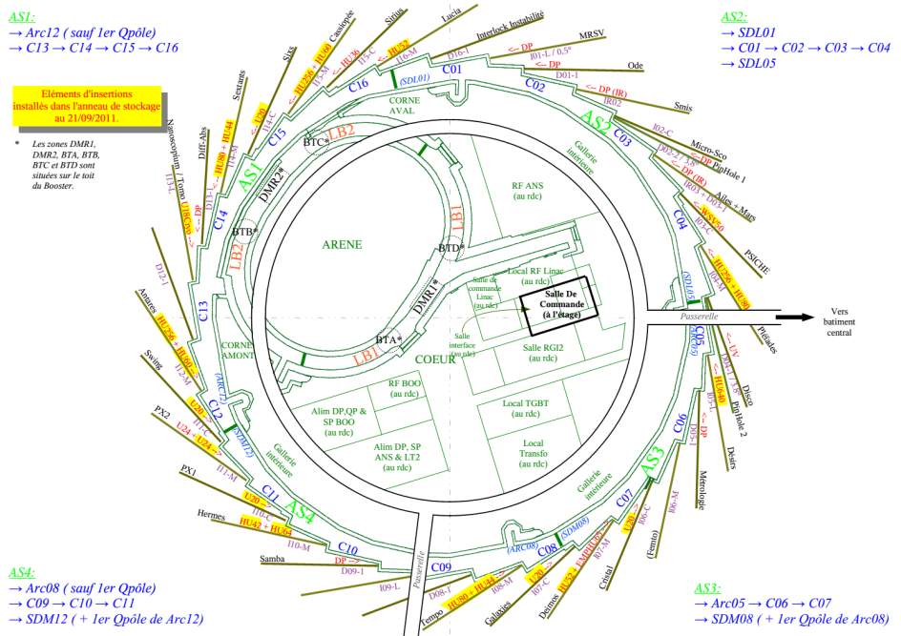
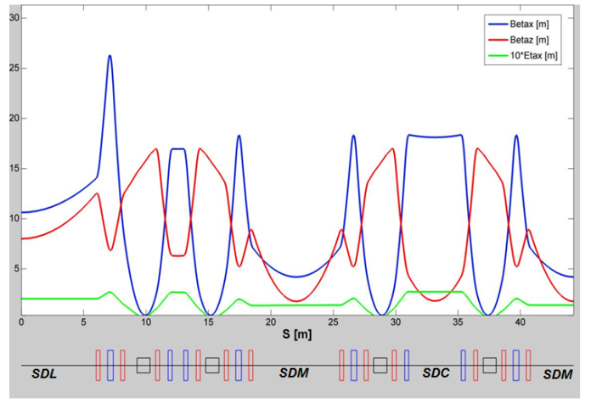
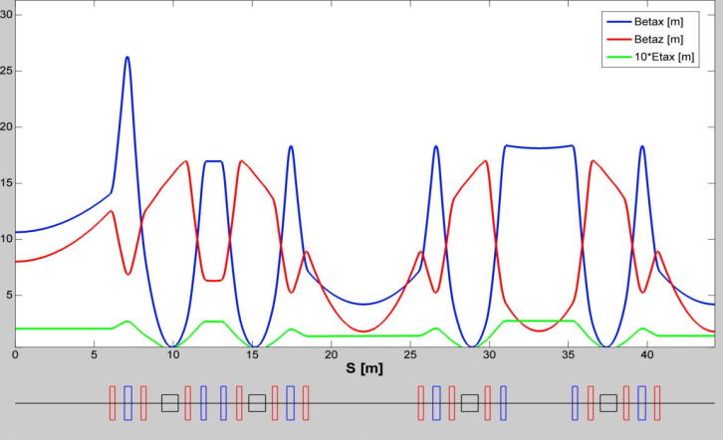
1. Introduction
Goals and the target performance of LS (Light Source) storage rings:
Constant delivery of a high quality, intense and stable photon beam to a large number of beamlines
Currently running 3rd generation LSs:
Many free straights for IDs (Insertion Devices). IDs and dipoles used for photon beamlines.
Ring magnet lattice elaborated to provide a low emittance electron beam with a large ratio (free straight sections)/ circumference
24 straights (4×12 m + 12× 7 m + 8× 3.6 m) over 354 m of circumference, i.e. 45% availability at SOLEIL, in a DB lattice
29 beamlines (22 IDs + 7 dipoles) at SOLEIL
Beam dynamics & vacuum challenges in present light sources …
Beam Dynamics Meets Vacuum, KIT, 8-10 March 2017 3/20
SDL
SDM
SDC
SDM

Slide 4
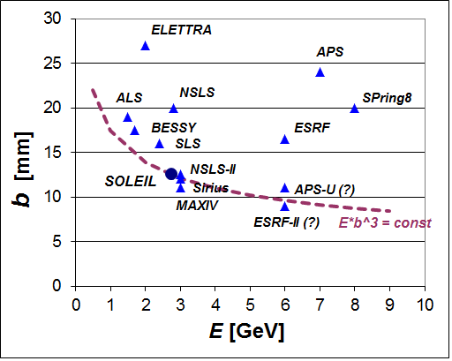
High quality and intense photon beams: Often characterized in terms of
I : Beam current, ε_{u} : Transverse emittance
⇒ Two major axis in increasing Brilliance:
1) Lowering of transverse beam emittance:
• Optimal ring structure : DBA, TBA lattice with many straight sections, strong focusing everywhere, high number of periodicity
• Chain of consequences:
Low emittance → Strong focusing → Smaller bore radii → Narrower VC aperture → Higher impedance (Resistive-Wall & Broadband) → Lower vacuum conductivity → Special vacuum technology (NEG, …)
• Presently a big global wave for 3GLS → DLSR (Diffraction Limited Storage Rings or 4GLS)
Vertical half aperture versus energy for several light source rings
Beam dynamics & vacuum challenges in present light sources …
Beam Dynamics Meets Vacuum, KIT, 8-10 March 2017 4/20

Slide 5
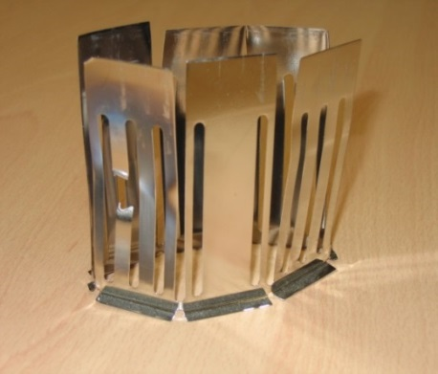
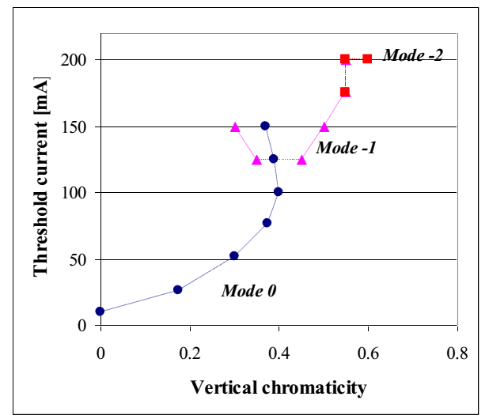
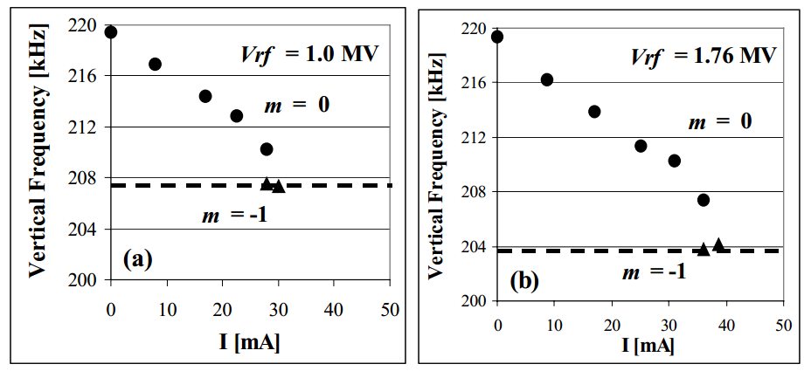
2) Raising beam intensity (single and multibunch) & its issues:
• Along with reduced VC aperture and lower beam emittance, enhanced sensitivity to collective beam instability (microwave, TMCI, headtail, resistive-wall, …) and beam-induced VC heating
• Enhanced SR (Synchrotron Radiation) power hitting and heating VC (normally proportional to the total beam current)
• Enhanced Touschek scattering and IBS (Intra Beam Scattering) + Reduced VC aperture → particle losses → beam lifetime drops
• Enhanced beam-ion interactions and instabilities
Ion trapping, FBII (Fast Beam-Ion Instability)
Melted RF finger at SOLEIL, Courtesy N. Béchu
Measured vertical RW instability thresholds versus chromaticity in the uniform filling at the ESRF
TMCI measured at ELETTRA (J.L. Revol et al.,EPAC2000,Vienna)
Beam dynamics & vacuum challenges in present light sources …
Beam Dynamics Meets Vacuum, KIT, 8-10 March 2017 5/20

Slide 6
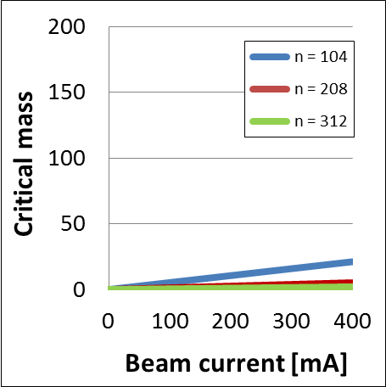
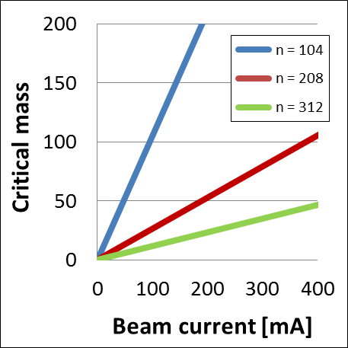
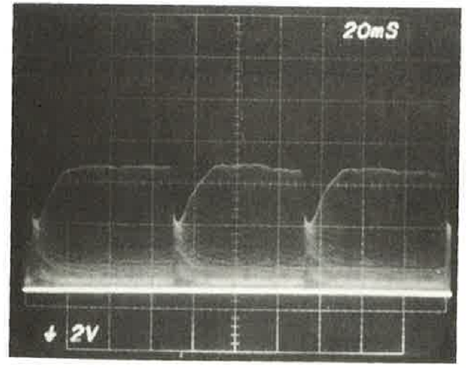
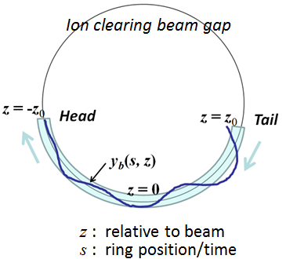
• Beam-ion interactions: Ions are created due to collision of electrons with residual gases:
- Ions trapped in electrons’ electro-static potential could render an electron beam unstable.
- For low-emittance rings, ions are less likely to be trapped due to higher critical mass.
- For modern and future rings storing a high intensity and low emittance beam, a “single pass” interaction between the two beams may become strong enough to jeopardise the performance.
Calculated with ε_{x} = 4 nm (left) and 0.2 nm (right) with SOLEIL parameters (1% coupling)
Beam pulsation observed at KEK-Photon Factory due to trapped ions (S. Sakanaka, OHO 1986)
• This type of two-beam interaction, named “Fast Beam-Ion Instability (FBII)” resembles “beam breakup in linacs” and does not involve ion trapping, and an ion clearing beam gap may not be helpful.
(Raubenheimer and Zimmermann, Phys. Rev. E52, 5487, 1995)
Beam dynamics & vacuum challenges in present light sources …
Beam Dynamics Meets Vacuum, KIT, 8-10 March 2017 6/20

Slide 7
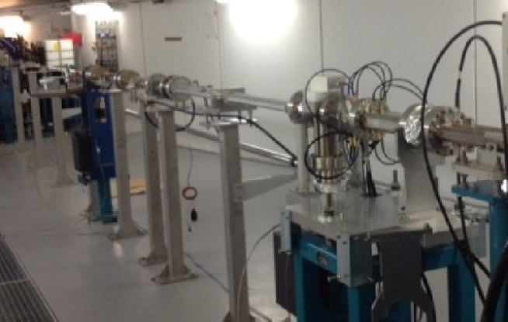
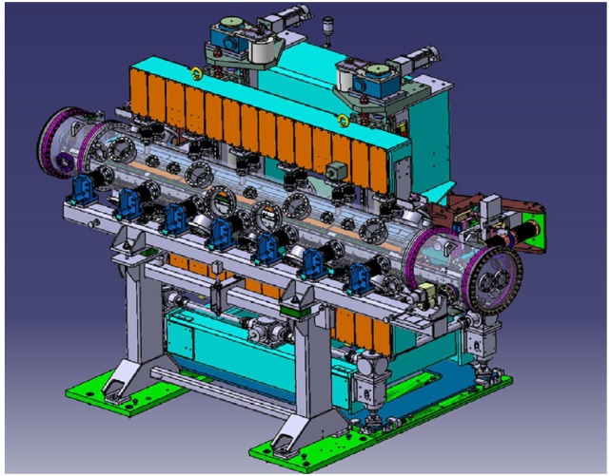
• Impact of low gap IDs on beam dynamics, vacuum and VCs:
- Vertically narrow flat geometry for chamber cross section → Source of large asymmetry in beam dynamics between the two transverse planes
- Increased RW (Resistive-Wall) and geometric impedance due respectively to low-gap section chambers and taper transitions
- In-vacuum undulators and wigglers (minimal gap ~5 mm)
⋅ Development of variable tapers associates mechanical and beam dynamics challenges
⋅ Vacuum conditioning of large volume objects not trivial
⋅ Considered to be one of the likely sources for heat-induced FBII at SOLEIL
Low gap chamber in a 12 m long straight section in SOLEIL
Cryogenic in-vacuum undulator developed at SOLEIL
Three type of vacuum chambers at SOLEIL
Beam dynamics & vacuum challenges in present light sources …
Beam Dynamics Meets Vacuum, KIT, 8-10 March 2017 7/20

Slide 8
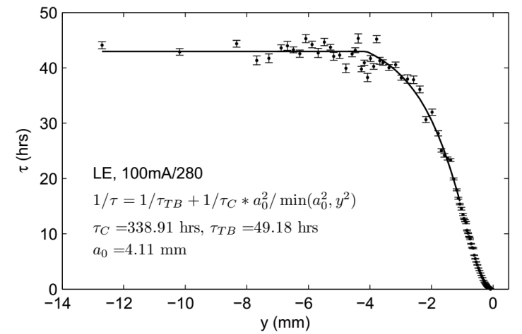
3) Beam stability requirement in terms of;
- Intensity
- Position and beam sizes over both short and long period
Machine operation in its ideal (golden) machine setting
Excellent orbit correction system with reliable BPMs (positioning/thermal stability)
Excellent machine thermal stability
Top-up is essential for both constant beam intensity and machine thermal stability
Even with top-up, always better to have good beam lifetime
Need of Ultra-High Vacuum (UHV) with not too constrained VC apertures
ID gaps closed to small aperture → Beam injection losses, ID magnet damage,
Importance of H/V scrapers and constant knowledge of limiting physical aperture in the ring
4) Delivery of different modes of operation
- Beam filling: Uniform, hybrid, 8-bunch, single bunch, …
- Different optics: Low-alpha, …
→ Enhanced sensitivity to VC and vacuum related issues in some modes
Measurement of beam lifetime as a function of the scraper position (Huang, Corbette, SLAC-PUB-14397)
Beam dynamics & vacuum challenges in present light sources …
Beam Dynamics Meets Vacuum, KIT, 8-10 March 2017 8/20

Slide 9
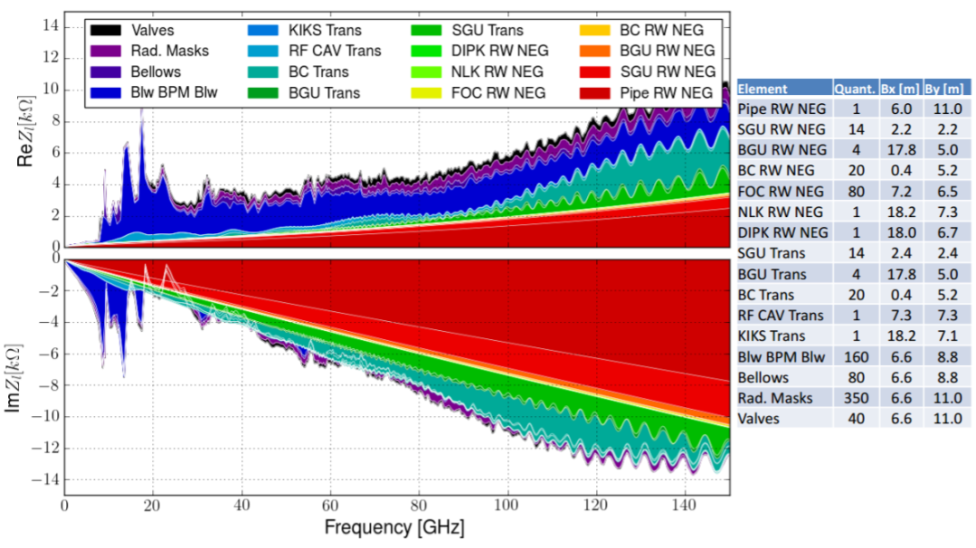
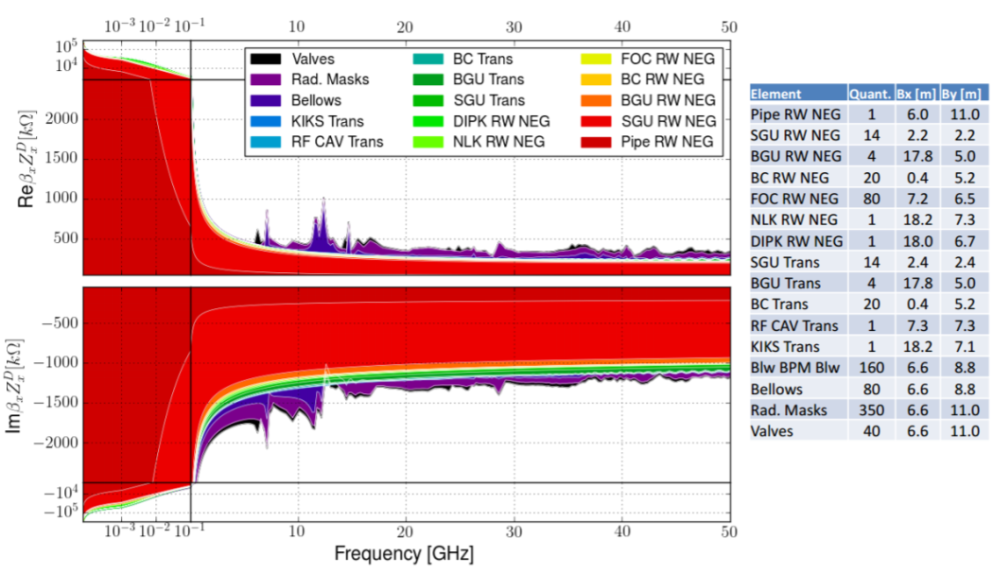
2. Specific issues encountered and studied in present LS rings
Piecewise 3D numerical evaluations of the vacuum chamber impedance
- Carried out by many labs (BESSY, ESRF, APS, SPring-8, SOLEIL, DIAMOND, NSLS-II, ALBA, MAXIV, SIRIUS, …) using 3D Electro-Magnetic field solvers such as CST-microwave studio, GdfidL, …
- Results are often used to simulate the beam instabilities
- In several cases, these studies allowed detecting beam dynamics/heating issues in advance and giving feedback to improve the original vacuum component designs
Impedance budget obtained for (the future machine) SIRIUS (left: longitudinal, right: horizontal) (F.-E. De Sà, LER2016)
- For modern LS rings, the contribution of resistive-wall dominates due to the much reduced VC aperture, and the imaginary part gets enhanced if NEG is in addition coated on the chambers
Beam dynamics & vacuum challenges in present light sources …
Beam Dynamics Meets Vacuum, KIT, 8-10 March 2017 9/20

Slide 10
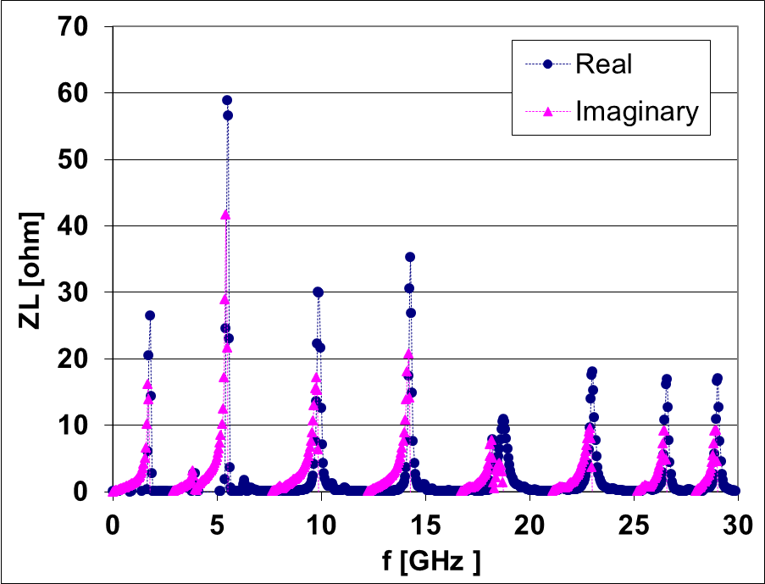
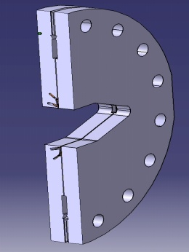
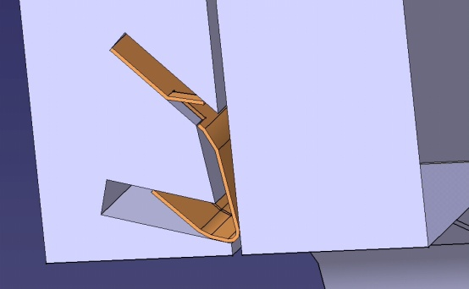
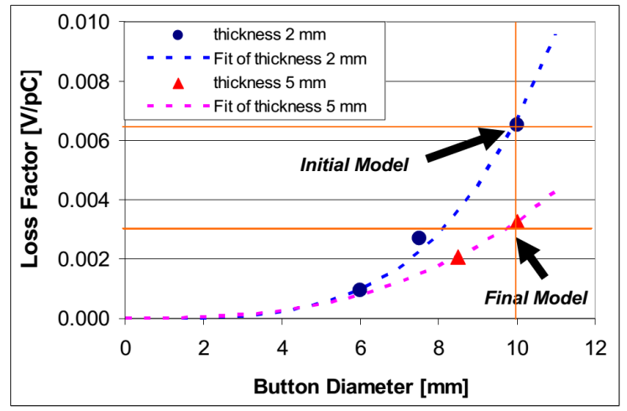
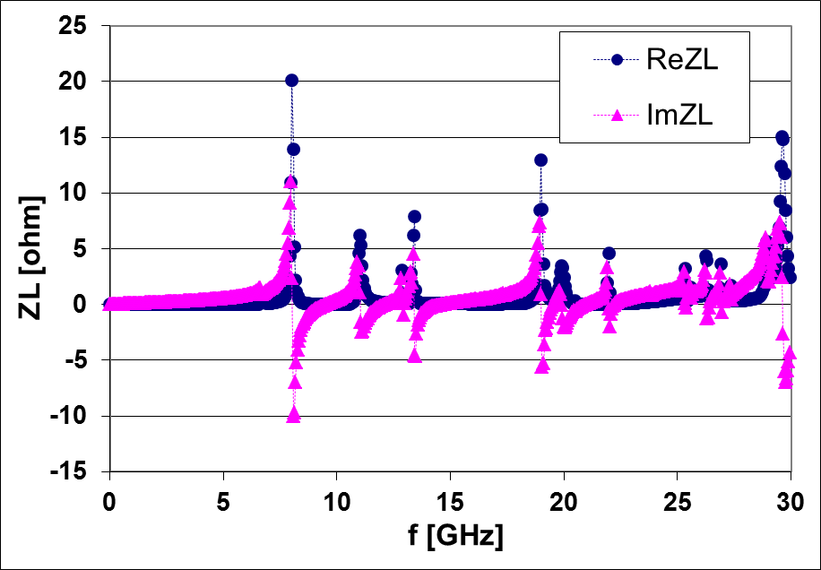
2) Some examples of the impact of vacuum chamber impedance
• SOLEIL flange
RF Shielding foil helps drastically suppress the flange impedance, but its possible mis-positioning may induce serious heating.
• SOLEIL BPM
- Malfunctioning of BPM button electrodes encountered are likely due to the heating due to the trapped mode at ~8 GHz.
(R. Nagaoka et al., EPAC 2006, Edinburgh)
Beam dynamics & vacuum challenges in present light sources …
Beam Dynamics Meets Vacuum, KIT, 8-10 March 2017 10/20

Slide 11
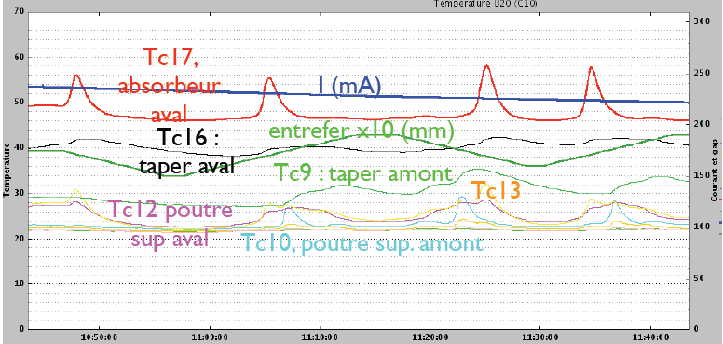
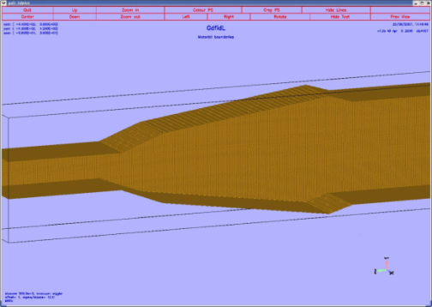
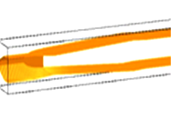
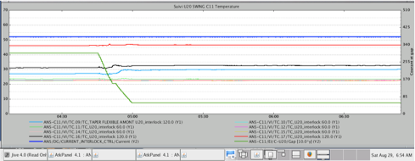
• SOLEIL in-vacuum ID tapers
300
60
50
200
40
30
100
20
10
Beam current
ID Gap
Temperatures
In-vacuum taper structure: Initial (above). Improved (below)
Monitoring of heating in a taper with the 1st design (above) and absence of heating with the improved design (below)
- Initial tapers creating a cavity structure when the ID gap was opened had a serious problem of beam-induced heating → Had to be taken out and be replaced.
- New tapers greatly improved the heating issues. They could still occasionally exhibit heating problems when their expected movements are affected by mechanical defects.
Beam dynamics & vacuum challenges in present light sources …
Beam Dynamics Meets Vacuum, KIT, 8-10 March 2017 11/20

Slide 12
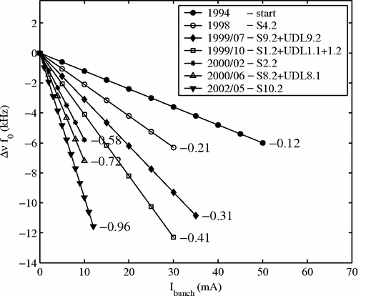
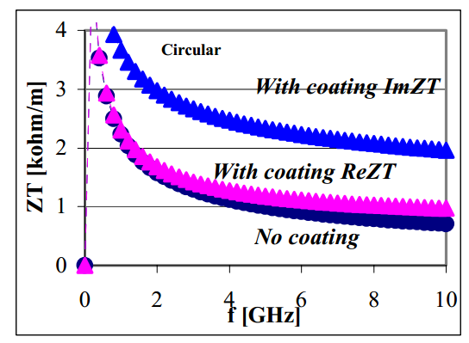
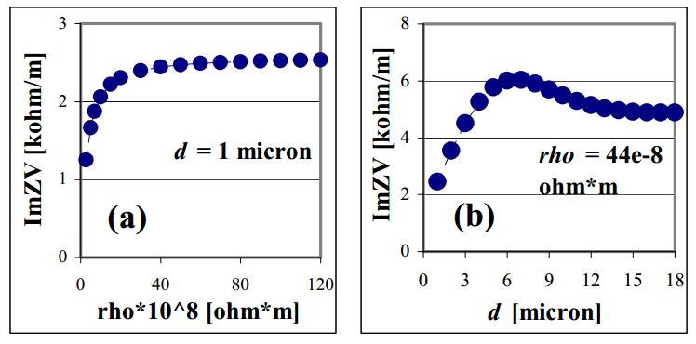
3) Impact of NEG coating in LSs
• NEG coating, which turned out to be very effective in pumping the residual gases without pumping ports, is more and more used in ring-based LSs.
• SOLEIL is the 1st LS that has as much as nearly half of the entire chamber NEG coated.
• Observation made at Elettra, however, had raised some concerns on the impedance.
E. Karantzoulis et al., PRSTAB 6, 030703
• Analytical studies made showed an increase in ImZ by a factor ~2, but had to assume high resistivity & coating thickness to explain quantitatively the Elettra result
R. Nagaoka, EPAC 2004, Lucern
• For future DLSRs, NEG coating is expected to be an indispensable technology.
Beam dynamics & vacuum challenges in present light sources …
Beam Dynamics Meets Vacuum, KIT, 8-10 March 2017 12/20

Slide 13
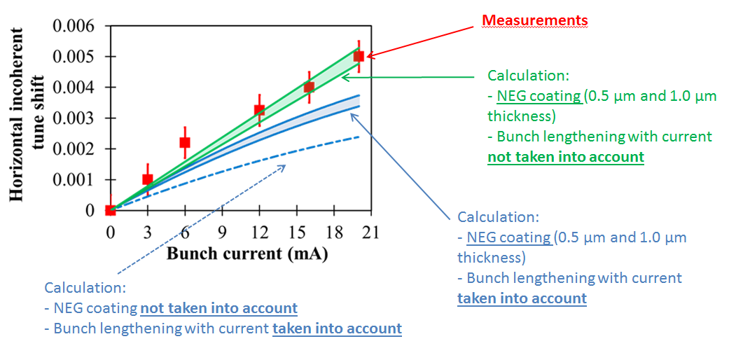
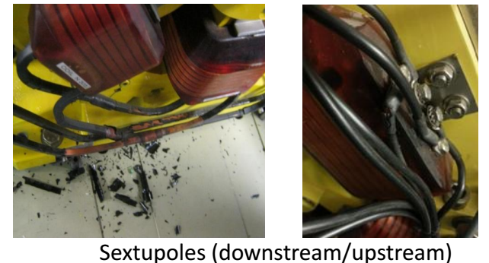
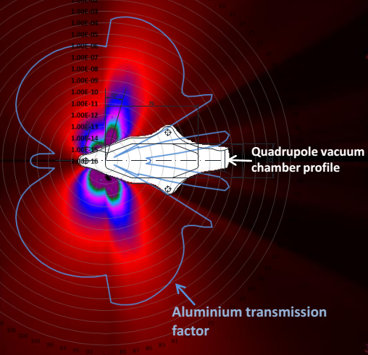
• At SOLEIL, the effect of NEG coating was also confirmed to contribute non-negligibly in the incoherent tune shifts arising from VC cross section asymmetry:
(P. Brunelle et al., PRAB 19,044401 (2016))
• Damages of cables etc. were found to arise from fluorescence X-rays due to NEG coated VCs at SOLEIL:
(N. Hubert et al., “Radiation damages and characterization in the SOLEIL storage ring”, IBIC 2013)
Beam dynamics & vacuum challenges in present light sources …
Beam Dynamics Meets Vacuum, KIT, 8-10 March 2017 13/20

Slide 14
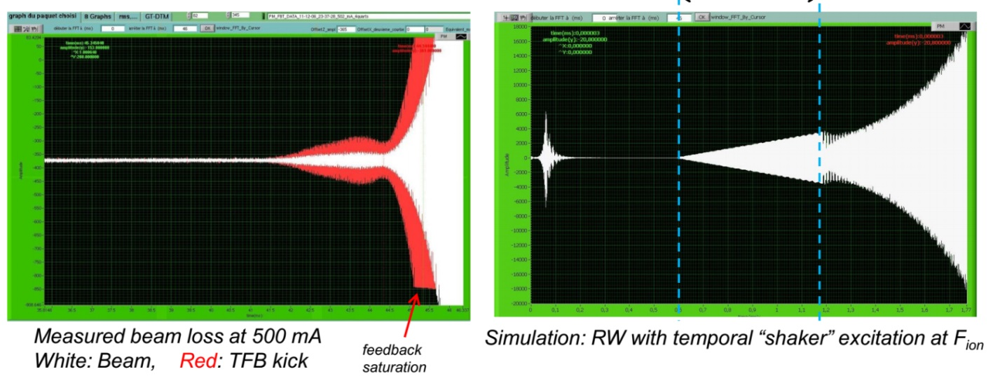
4) FBII arising from local out-gassing due to beam-induced heating of VCs:
• At SOLEIL, transverse bunch-by-bunch feedback is routinely used to suppress resistive-wall (RW) instability.
• However, depending upon the beam filling and intensity, beam-induced heating could trigger FBII via outgassing and leads to total beam losses.
• Usually the beam is lost some 10 minutes after reaching the final current (500 mA)
• The above interval of time as well as the total beam loss due to FBII remained as a big puzzle
Experimental and numerical analyses lead us to conclude that over the time interval, the local pressure keeps rising up to the point when feedback hits its limit and becomes destructive
(R. Nagaoka et al., TWIICE, SOLEIL 2014)
Beam dynamics & vacuum challenges in present light sources …
Beam Dynamics Meets Vacuum, KIT, 8-10 March 2017 14/20

Slide 15
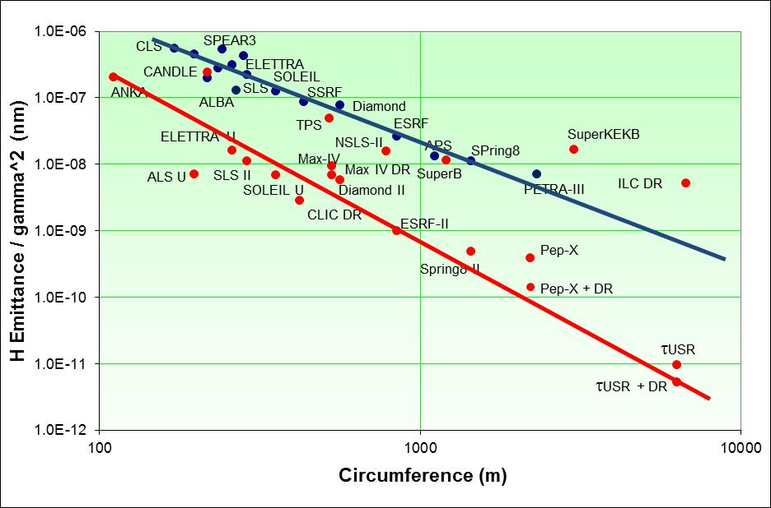
3. Future trends and issues in DLSRs
• A global wave today to construct (or re-construct) ring-based LSs having the horizontal emittance ε_{H} by tens of factors below the “nm⋅rad” range
Basic principle used:
E: Beam energy, θ: Bending angle
→ MBA (Multiple Bend Achromat) instead of DBA, TBA
Courtesy R. Bartolini
• Especially for machine “upgrades”, the resultant ring configuration tends to be extremely dense, and keeping the original photon sources becomes non-trivial
Comparison between ESRF and ESRF-EBS, (M. Hahn, 3eme Rencontres Nationales du Réseau Technologies du Vide, Oct. 2016)
Beam dynamics & vacuum challenges in present light sources …
Beam Dynamics Meets Vacuum, KIT, 8-10 March 2017 15/20

Slide 16
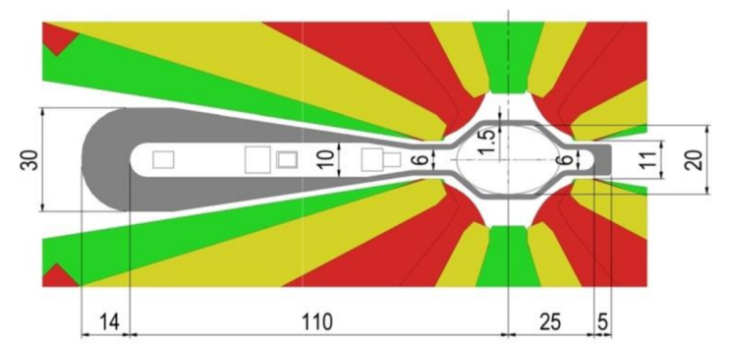
• In addition to the need of strong quadrupoles, sextupoles, and octupoles, non-standard magnets such as,
- Dipoles with transverse and/or longitudinal gradient
- Antibends (outward dipolar deflection) and their integration in focusing quadrupoles
are found useful in further lowering ε_{H} and/or gaining space
(from P. Raimondi, LERD2015, April 2015)
For ESRF-EBS, the imposed 11mm stay clear from pole to pole for all magnets optimized for synchrotron radiation handling
(from P. Raimondi, LER2016, Oct. 2016)
Beam dynamics & vacuum challenges in present light sources …
Beam Dynamics Meets Vacuum, KIT, 8-10 March 2017 16/20

Slide 17
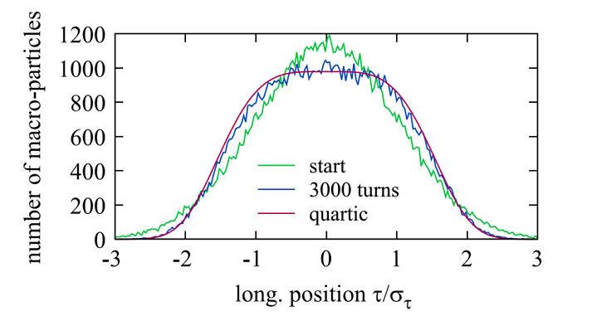
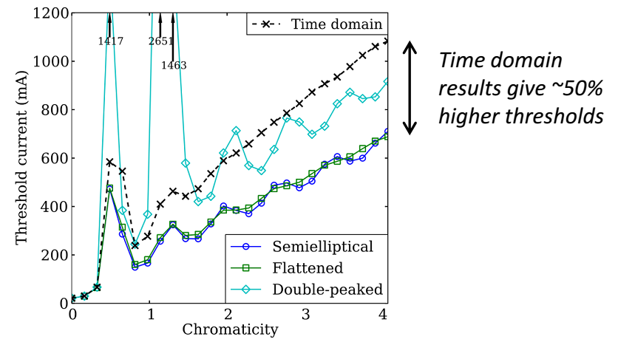
• Challenges on vacuum systems:
- VC designs compatible with magnet poles, photon extraction and beam stay clear conditions
- Integration of pumping ports, photon absorbers, collimators and crotches
- Detailed evaluation of vacuum profiles along the ring
→ NEG coating must be a very helpful method for DLSRs with the given constraints above
• Challenges on beam dynamics:
- Beam injection and storage (off-axis, on-axis, beam swap-out methods, longitudinal injection, use of MIKs (NLKs), …
- Fine machine tuning to achieve the expected ultra-low-emittance
- Fighting against Touschek scattering, IBS, collective instability, beam-ion instability and beam-induced heating due to increased machine impedance (especially RW)
→ Bunch lengthening with harmonic cavities is considered to be a helpful mitigating method
Simulation of passive harmonic cavity potential with multibunch tracking (mbtrack) (G. Skripka et al., NIM A806 (2016) 221–230)
Studies on the impact of harmonic cavity lengthening on transverse head-tail instability (F. Cullinan et al., PRAB 19,124401 (2016))
Beam dynamics & vacuum challenges in present light sources …
Beam Dynamics Meets Vacuum, KIT, 8-10 March 2017 17/20

Slide 18
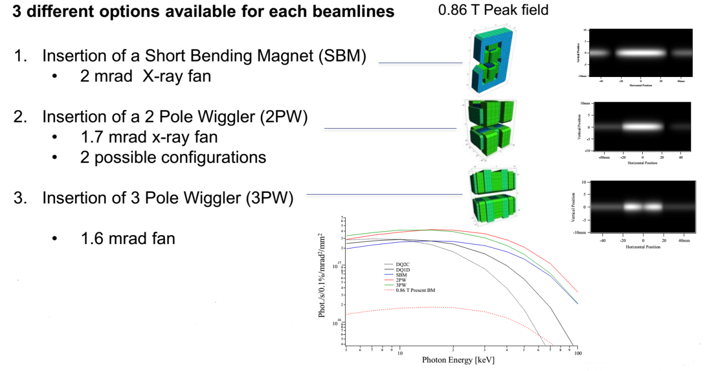
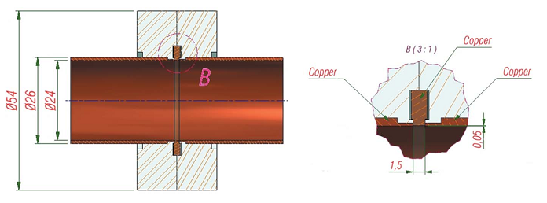
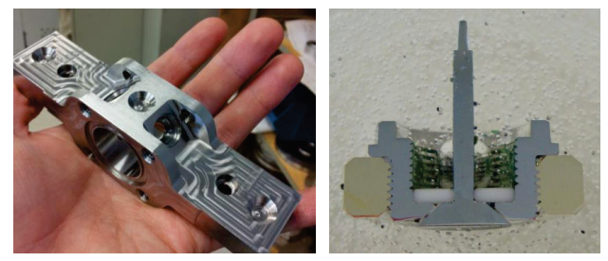
• Some specific hardware development in future DLSRs:
- Lowering of the dipole fields preferred for DLSRs raises a problem for dipole beamlines → Very short few-pole wigglers are being developed at the ESRF and APS, to be inserted in the lattice
- Innovative designs of new vacuum components with reduced coupling impedance are being made
Alternative short devices being developed at the ESRF for dipole beamlines (J. Chavanne, LER2016)
Bell-shaped BPM button developed at SIRIUS (A.R.D Rodrigues et al., IPAC2015)
“Zero-impedance” flange developed at SIRIUS (R.M. Seraphim et al., IPAC2015)
Beam dynamics & vacuum challenges in present light sources …
Beam Dynamics Meets Vacuum, KIT, 8-10 March 2017 18/20

Slide 19
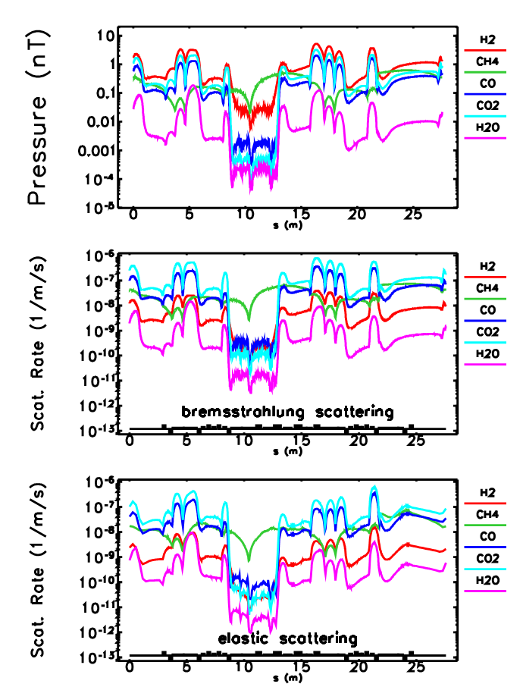
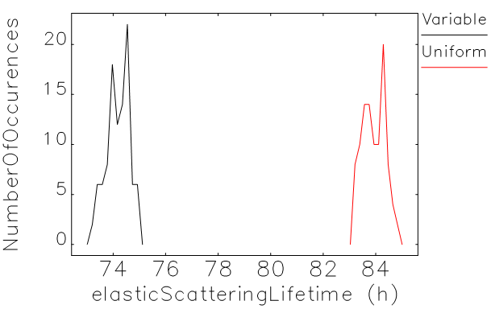
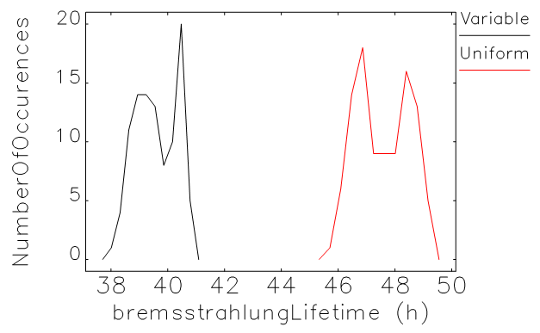
• Advanced numerical evaluation of gas scattering lifetimes combining the position dependent electron dynamics and vacuum profiles :
(M. Borland et al., IPAC2015)
Elastic and Bremsstrahlung scattering lifetimes are computed using species-specific gas pressure profiles computed with Synrad+ and Molflow+ and local transverse/momentum apertures (DA and LMA) calculated by elegant
10~20% over-estimations found with the standard approach
Comparisons with the standard approach over 100 simulated machines
→ Benchmarking of the method with a real machine (pressure) is planned
Beam dynamics & vacuum challenges in present light sources …
Beam Dynamics Meets Vacuum, KIT, 8-10 March 2017 19/20

Slide 20
4. Summary
There are clear reasons for which the beam dynamics are bound to meet vacuum chamber and vacuum issues as we continue to raise the performance of the ring-based light sources.
Mastering the vacuum and vacuum chamber issues is one of the keys in achieving our target machine performance.
• The low emittance lattice is making the vacuum chambers and components more and more miniature, both transversely and longitudinally, making their designs and vacuum pumping difficult with classical pumps.
• Vacuum pumping with NEG coating on the other hand is becoming increasingly attractive for the future machines.
• Beam dynamics studies, both for single particle and collective instability, fully taking into account aperture limitations, local gas pressure and species, and the impedance aspect of vacuum chambers, are becoming increasingly important in assuring the designed performance of today’s and future light sources.
Beam dynamics & vacuum challenges in present light sources …
Beam Dynamics Meets Vacuum, KIT, 8-10 March 2017 20/20

