Slide 1

Basics of beam dynamics and vacuum
Giovanni Rumolo
Many thanks to H. Bartosik, G. Iadarola, L. Mether, A. Huschauer, K. Li, A. Oeftiger, E. Koukovini-Platia, N. Mounet, C. Zannini
Beam Dynamics meets Vacuum, Surfaces and Collimation, in Karlsruhe, Germany, 8-10 March, 2017

Slide 2
Outline
Introduction
Effect of vacuum quality on beam lifetime and emittance preservation
  Elastic and inelastic collisions
  Vacuum instability
  Local pressure degradation
Electron and ion effects
  Electron cloud build up, effects and mitigations
  Ion trapping and accumulation
  Fast beam ion instability
Conclusions

Slide 3
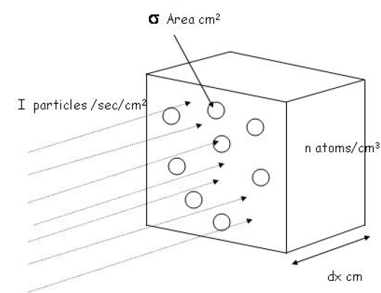
Introduction
The performance reach of accelerators and storage rings crucially depends on the vacuum system
Beam particles interact (mainly electromagnetically) with the molecules of the rest gas in the vacuum chamber
  Single and multiple interactions cause energy loss, scattering and/or change of charge state, resulting in increase of oscillation amplitude or particle loss
  The observables are reduced beam lifetime and/or dilution of phase space, i.e. emittance growth
  Gas ionization may trigger avalanche multiplication processes

Slide 4
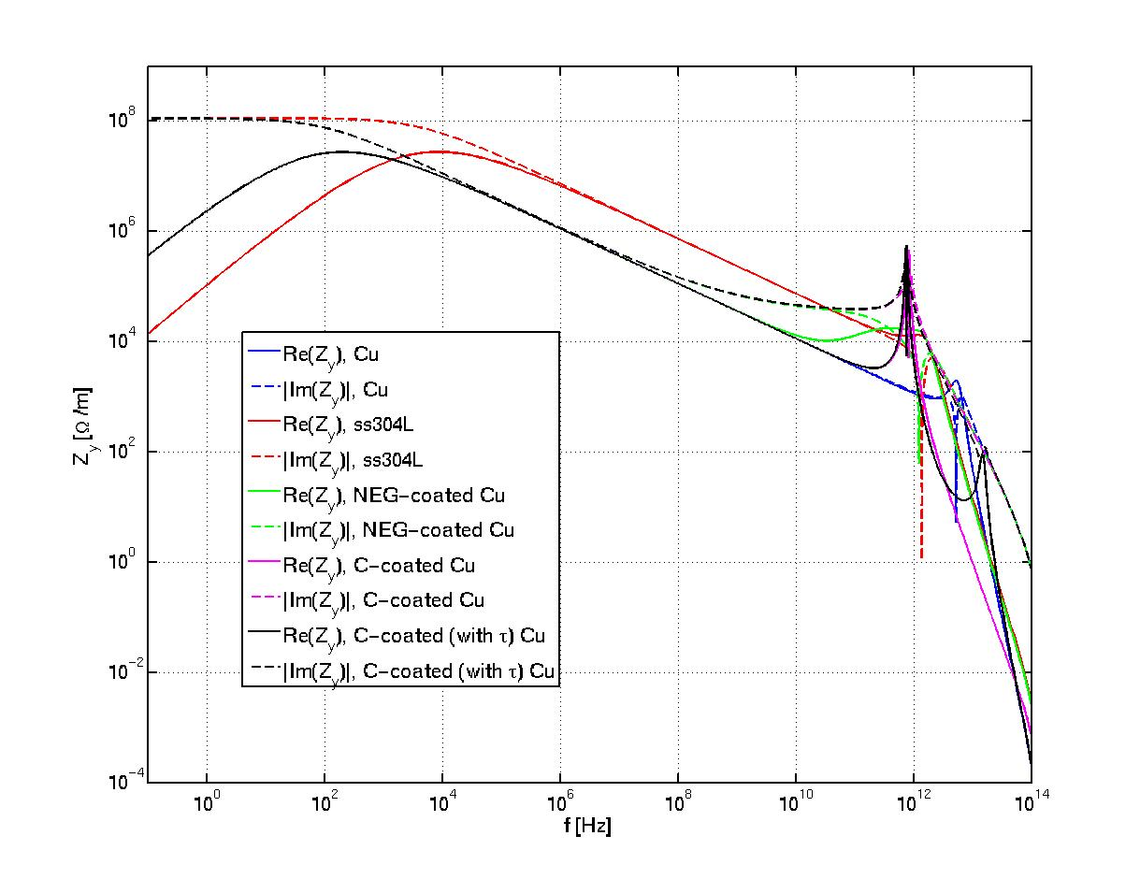
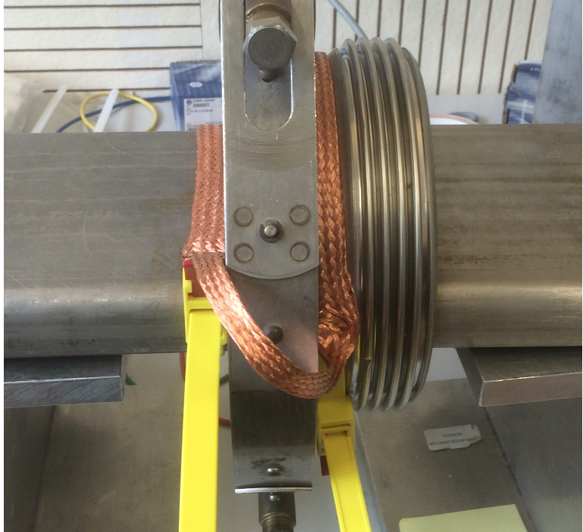
Introduction
The performance reach of accelerators and storage rings crucially depends on the vacuum system
The vacuum system plays an important role for beam stability
  Finite conductivity of the material(s), shape, coating of the vacuum chamber determine the main component of the resistive wall impedance of a machine
  Transitions between pipes, flanges, bellows, pumping ports, valves are other important contributors to the global machine impedance
  The machine impedance needs to be kept below a certain budget to allow operation at the desired intensity

Slide 5
Introduction
The performance reach of accelerators and storage rings crucially depends on the vacuum system
The vacuum system plays an important role for beam stability
  Finite conductivity of the material(s), shape, coating of the vacuum chamber determine the main component of the resistive wall impedance of a machine
  Transitions between pipes, flanges, bellows, pumping ports, valves are other important contributors to the global machine impedance
  The machine impedance needs to be kept below a certain budget to allow operation at the desired intensity
Talk of E. Métral this afternoon

Slide 6
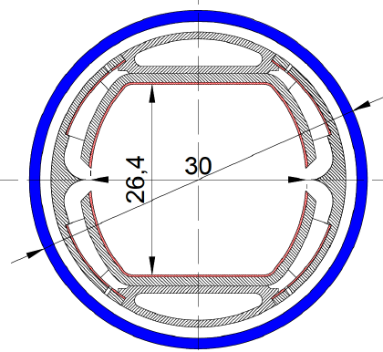
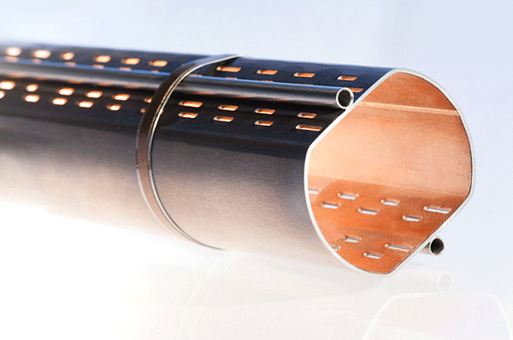
Introduction
The performance reach of accelerators and storage rings crucially depends on the vacuum system
The vacuum chamber also affects beam stability and lifetime otherwise
  Surface properties at the inner wall of the vacuum chamber, in particular desorption and electron yields, are critical
    High desorption yields can lead to pressure runaway
    High electron yields can lead to electron cloud formation
  Distributed pumping from surface/design (e.g. NEG coating, pumping holes)
  Shape optimisation for photon absorption (antechambers, slits)
e⁻
beam

Slide 7
Introduction
The performance reach of accelerators and storage rings crucially depends on the vacuum system
The vacuum chamber also affects beam stability and lifetime otherwise
  Surface properties at the inner wall of the vacuum chamber, in particular desorption and electron yields, are critical
    High desorption yields can lead to pressure runaway
    High electron yields can lead to electron cloud formation
  Distributed pumping from surface/design (e.g. NEG coating, pumping holes)
  Shape optimisation for photon absorption (antechambers, slits)
e⁻
beam
Talks of V. Baglin, R. Kersevan, R. Cimino, S. Calatroni, F. Zimmermann, M. Bender, F. Cullinan, G. Iadarola, etc.

Slide 8
Interaction of beam with residual gas
Beam particles (leptons, hadrons) – projectile – can interact with residual gas molecules – target – in different manners
  Elastic collisions: mainly Coulomb interactions with no important energy loss but with transverse scattering.
  Inelastic collisions: many types, always associated with important energy transfer and/or particles change and creation
    Bremsstrahlung, or emission of electromagnetic radiation from deceleration, especially important for electrons
    Target ionization
    Electron capture or loss (only for ions)
    Nuclear reactions
All these interactions lead to beam particle loss or emittance growth

Slide 9
Interaction of beam with residual gas
Assuming that every beam particle undergoing a collision is lost, the rate of loss of N particles moving with speed βc and going through a layer dx of gas with density n_{g} can be calculated from
where σ is the cross section associated to the type of collision and depends on the target and projectile particle types, charge states and energies

Slide 10
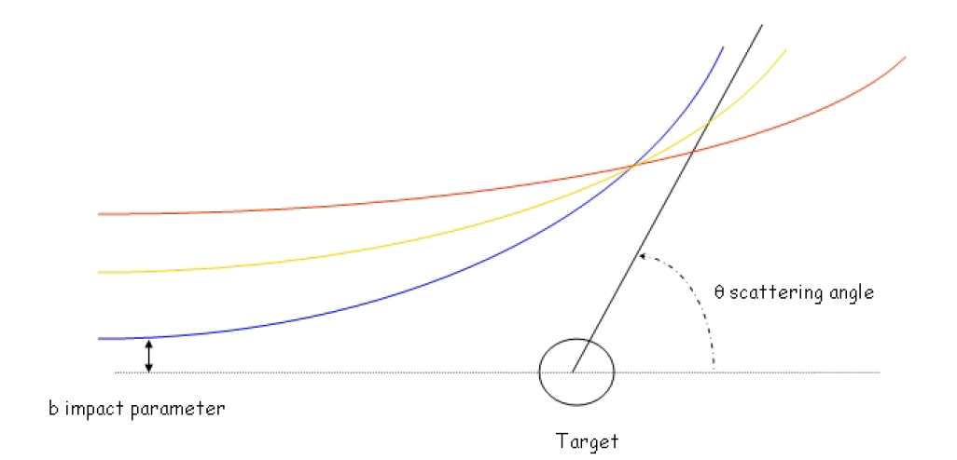
Elastic scattering
Coulomb interactions between beam particles (Z_{p}, A_{p}) and nuclei (Z_{t}, A_{t}) cause scattering with cross section given by the formula
θ₀ is defined as the scattering angle above which the particle is lost
Notes:
r_p^2 (Z_p/A_p)^2 → r_e^2 for leptons

Slide 11
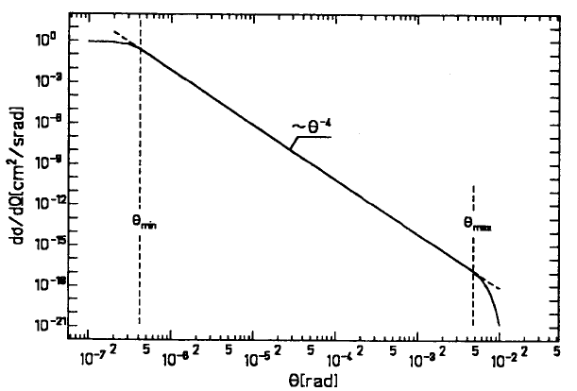
Elastic scattering
Deviations from the (sin θ/2)⁻⁴ dependence of the cross section for
  Low impact parameter or large scattering angle, because of strong interaction between projectile and the nucleus of the target
  Large impact parameter or small scattering angle, because of the shielding effect of the electrons
Notes:
Evidently very relevant for heavy ions (low energy) and leptons (Z_p/A_p = 1836)

Slide 12
Elastic scattering
Deviations from the (sin θ/2)⁻⁴ dependence of the cross section for
  Low impact parameter or large scattering angle, because of strong interaction between projectile and the nucleus of the target
  Large impact parameter or small scattering angle, because of the shielding effect of the electrons
Multiple Coulomb collisions with small scattering angle (below θ₀) result into emittance growth with rate
Notes:
Evidently very relevant for heavy ions (low energy) and leptons (Z_p/A_p = 1836)

Slide 13
Bremsstrahlung
The electromagnetic interaction of charged particles with the residual gas particles also causes photon emission and significant energy loss
  Specially important for light particles (electrons, positrons)
  Photons of all energies are emitted (only limited by the kinetic energy E of the emitting particles), only events with emission of photons having energy above the machine energy acceptance ε_{m} result in particle loss
Notes:
Evidently very relevant for heavy ions (low energy) and leptons (Z_p/A_p = 1836)

Slide 14
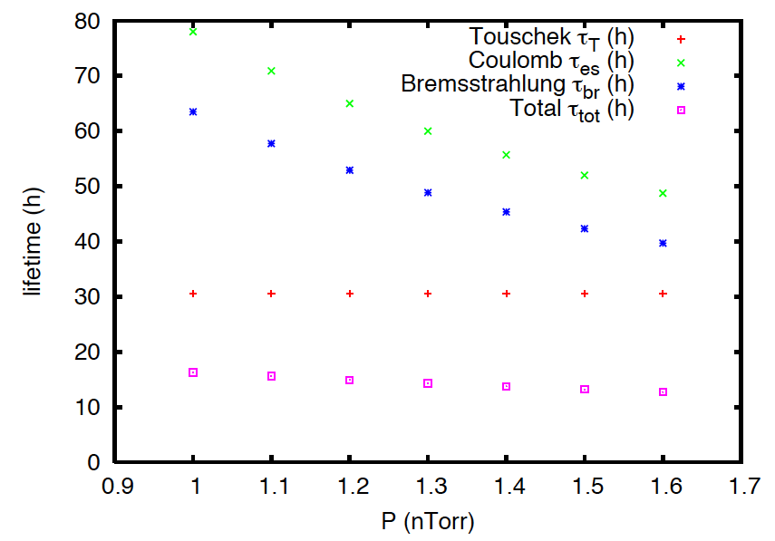
Lifetime calculation for a light source
The lifetime for a light source is generally determined by elastic scattering, bremsstrahlung and IBS or Touschek effect (which are both scattering between particles within the bunch).
  Ex. Calculations of ALBA lifetime during design (2005) in unbaked vacuum (x-axis is partial pressure of CO)
Talks of R. Nagaoka, U. Iriso
Notes:
Evidently very relevant for heavy ions (low energy) and leptons (Z_p/A_p = 1836)

Slide 15
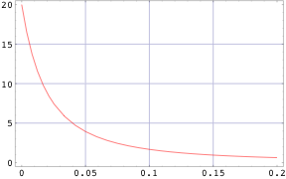
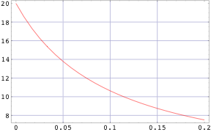
Charge exchange processes
Electron capture or loss (projectile): Ions circulating in an accelerator ring can acquire one electron, or lose one (if they are not fully stripped)
  Cross sections are complicated functions of projectile mass, energy and charge state as well as target atomic number. The evaluation relies on experimental values and extrapolated scaling laws applicable in certain ranges of mass numbers or energies (to be found in literature)
Ar¹⁰⁺
U²⁸⁺
Stripping
Stripping
σ_{L} (Mbarn)
σ_{L} (Mbarn)
t (s)
t (s)
Example: Evolution of the stripping cross section over the SIS18 ramp for two different types of ions
Notes:
Evidently very relevant for heavy ions (low energy) and leptons (Z_p/A_p = 1836)

Slide 16
Charge exchange processes
Electron capture or loss (projectile): Ions circulating in an accelerator ring can acquire one electron, or lose one (if they are not fully stripped)
  Cross sections are complicated functions of projectile mass, energy and charge state as well as target atomic number. The evaluation relies on experimental values and extrapolated scaling laws applicable in certain ranges of mass numbers or energies (to be found in literature)
  Qualitatively, electron capture and loss occur with maximum probability for projectile velocities close to the typical electron velocity of the target atom
  Multiple capture or loss usually much less likely
  These processes lead to particle loss usually at clearly defined hot spots (downstream from dipoles, momentum acceptance locations) and (local) vacuum degradation from wall desorption
Notes:
Evidently very relevant for heavy ions (low energy) and leptons (Z_p/A_p = 1836)

Slide 17
Target ionization
Target ionization: Particles circulating in an accelerator ring can ionize molecules of the residual gas (ion-electron pair formation)
  Cross sections are complicated functions of projectile mass, energy and charge state as well as target atomic number. Formulae available (for single charge projectile and extensible to multiple charge)

Slide 18
Target ionization
Target ionization: Particles circulating in an accelerator ring can ionize molecules of the residual gas (ion-electron pair formation)
  Cross sections are complicated functions of projectile mass, energy and charge state as well as target atomic number. Formulae available (for single charge projectile and extensible to multiple charge)
  Ions from residual gas ionisation can be
    accelerated and lost to the wall in machines operating with positively charged particles, desorbing molecules and causing vacuum degradation
    trapped around electron (or H⁻, or antiproton) beams and accumulate
  Electrons from residual gas can be accelerated and impact the wall with high enough energy as to create secondary emission and electron multiplication (usually in machines operating with positively charged particles)
  Energy loss from beam particles during ionization usually negligible

Slide 19
Vacuum quality and stability
Outgassing stimulated by ions, electrons or photons plays a crucial role in the vacuum quality (beam lifetime) of accelerators and storage rings
  Photon induced gas desorption is particularly important for light sources, which produce large amounts of synchrotron radiation
    Outgassing, however, determines dynamic pressure but does not feed back into producing more photons
  Gas desorption induced by beam generated ions and electron clouds is the main mechanism for beam induced outgassing in proton machines
  Ion losses from charge exchange processes are usually the dominant cause for gas desorption in heavy ion machines (especially those running with not fully stripped ions)
Pumping time
Dynamic term depending on beam intensity, pressure, cross sections, desorption yields → Can cause instability if larger than pumping term!
Static pressure
Notes:
In general, the set made of the equation of lifetime and that of pressure evolution need to be solved together (numerically) to predict correctly pressure evolution and beam lifetime over the cycling or storage time of a machine.

Slide 20
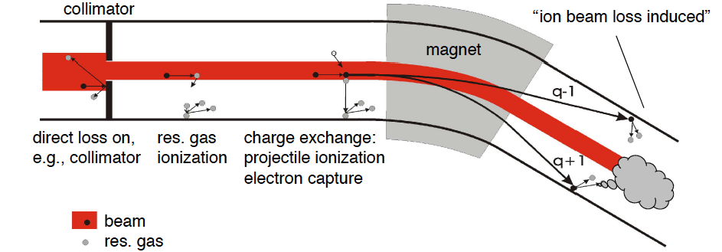
Vacuum quality and stability
Example: Outgassing in SIS18 (GSI) is dominated by residual gas ionization and electron capture/loss for operation with U²⁸⁺
Vacuum instability sets in when:
Desorption coeff for beam ions lost to the wall (~MeV/u, grazing) ~10⁴
Desorption coeff for rest gas ions repelled to the wall (~10 eV, perpendicular) ~10

Slide 21
Vacuum quality and stability
Example: Outgassing in SIS18 (GSI) is dominated by residual gas ionization and electron capture/loss for operation with U²⁸⁺
Vacuum instability sets in when:
Cross section for electron stripping or capture ~10 Mbarn at injection
Cross section for rest gas ionization ~10⁴ Mbarn at injection

Slide 22
Vacuum quality and stability
Example: Outgassing in SIS18 (GSI) is dominated by residual gas ionization and electron capture/loss for operation with U²⁸⁺
Cures: Collimation system to concentrate losses, improved pumping speed (NEG coating), reduced desorption yields, fast cycling (compatibly with bucket acceptance limited on the ramp by RF power)
Talks of O. Malyshev, C. Omet, M. Bender, V. Kornilov

Slide 23
Local pressure vs. average pressure
The average pressure determines beam lifetime and emittance growth
Pressure bumps, i.e. locations with high values of pressure, can exist
  Unwanted aperture restrictions (e.g. obstacles), small leaks
    Particles would be additionally lost at the location defined by the betatron oscillation initiated by scattering at the location of pressure bump → Degraded lifetime
  Outgassing elements
    Usually due to electron cloud (dynamic with cycling) or heating (slow evolution)
    Ferrite kickers: Bad vacuum may cause flashovers, or if it is sign of heating, the ferrite may heat up beyond Curie point
    Movable collimators (e.g. injection protection device in LHC), heating may compromise alignment precision
  Ionization profile monitors: in this case the local pressure increase is wanted for diagnostic purpose, but may reduce beam lifetime
  Voluntary (controlled) pressure bumps in some regions to study fast beam ion instabilities and parameter dependence
In some locations, it is desired to keep the pressure especially low, e.g. around the experiments of a collider to minimise background

Slide 24
Electron cloud formation in a vacuum pipe
Generation of electrons inside the vacuum chamber
(primary, or seed, electrons)
Residual gas ionization
Desorption from the losses on the wall
Photoelectrons from synchrotron radiation

Slide 25
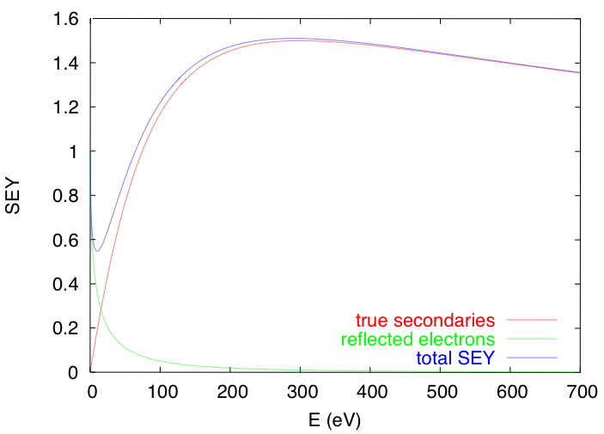
Electron cloud formation in a vacuum pipe
Generation of electrons inside the vacuum chamber
(primary, or seed, electrons)
Acceleration of primary electrons in the beam field
Secondary electron production when hitting the wall
θ
E
secondaries
elastically reflected

Slide 26
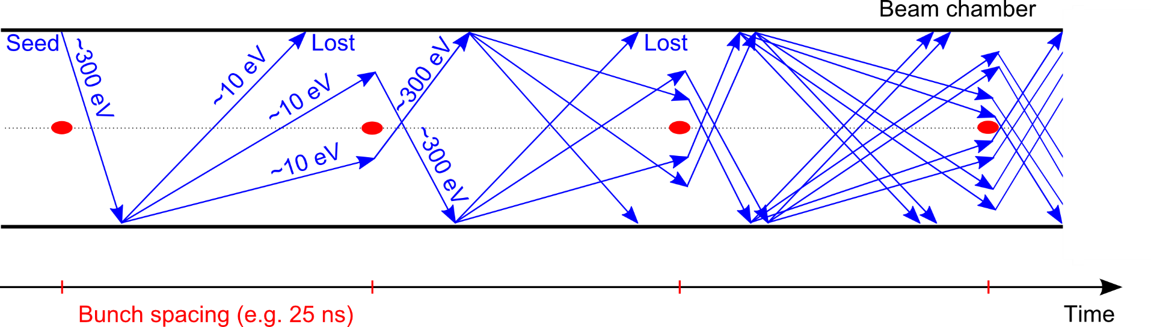
Electron cloud formation in a vacuum pipe
Generation of electrons inside the vacuum chamber
(primary, or seed, electrons)
Acceleration of primary electrons in the beam field
Secondary electron production when hitting the wall
Avalanche electron multiplication

Slide 27
Electron cloud formation in a vacuum pipe
Generation of electrons inside the vacuum chamber
(primary, or seed, electrons)
Acceleration of primary electrons in the beam field
Secondary electron production when hitting the wall
Avalanche electron multiplication
After the passage of several bunches, the electron distribution inside the chamber reaches a stationary state (electron cloud)

Slide 28
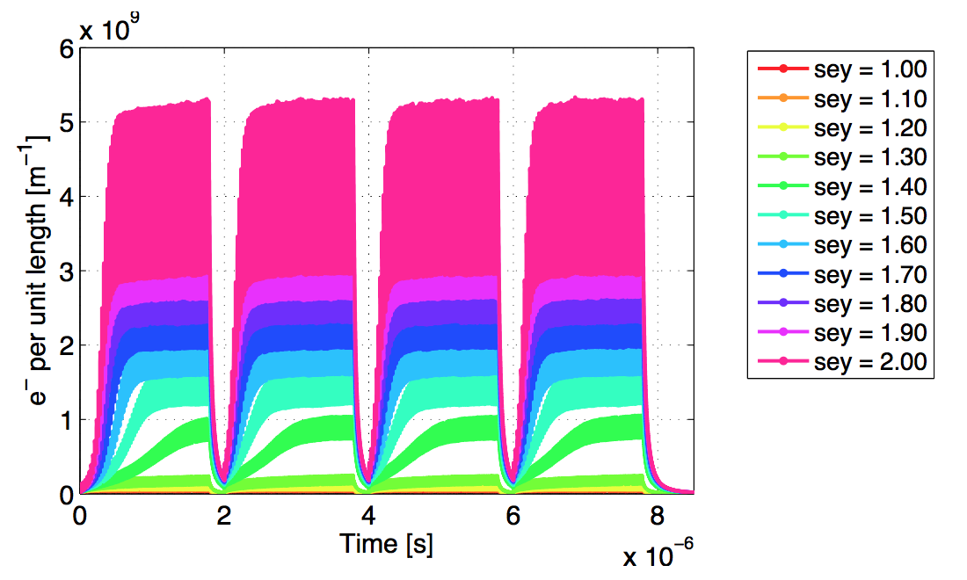
Electron cloud formation in a vacuum pipe
Generation of electrons inside the vacuum chamber
(primary, or seed, electrons)
Acceleration of primary electrons in the beam field
Secondary electron production when hitting the wall
Avalanche electron multiplication
After the passage of several bunches, the electron distribution inside the chamber reaches a stationary state (electron cloud)

Slide 29
Electron cloud formation in a vacuum pipe
Generation of electrons inside the vacuum chamber
(primary, or seed, electrons)
Acceleration of primary electrons in the beam field
Secondary electron production when hitting the wall
Avalanche electron multiplication
After the passage of several bunches, the electron distribution inside the chamber reaches a stationary state (electron cloud)
→ Several effects associated

Slide 30
Effects of the electron cloud
The presence of an e-cloud inside an accelerator ring is revealed by several typical signatures
Fast pressure rise, outgassing
Additional heat load
Baseline shift of the pick-up electrode signal
Tune shift along the bunch train
Coherent instability
  Single bunch effect affecting the last bunches of a train
  Coupled bunch effect
Beam size blow-up and emittance growth
Luminosity loss in colliders
Energy loss measured through the synchronous phase shift
Active monitoring: signal on dedicated electron detectors (e.g. strip monitors) and retarding field analysers
Machine observables
Beam observables

Slide 31
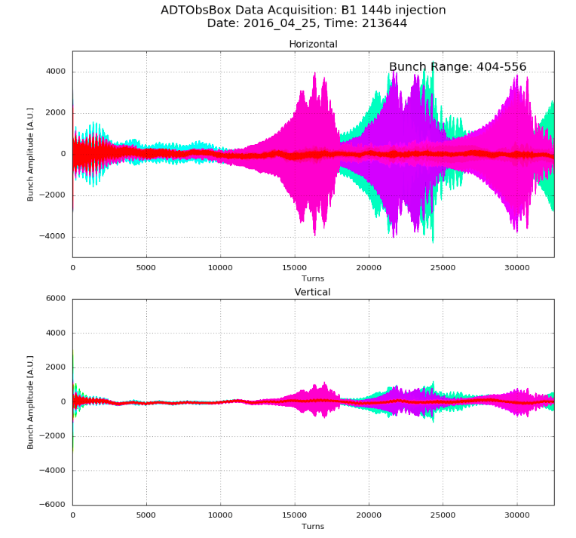
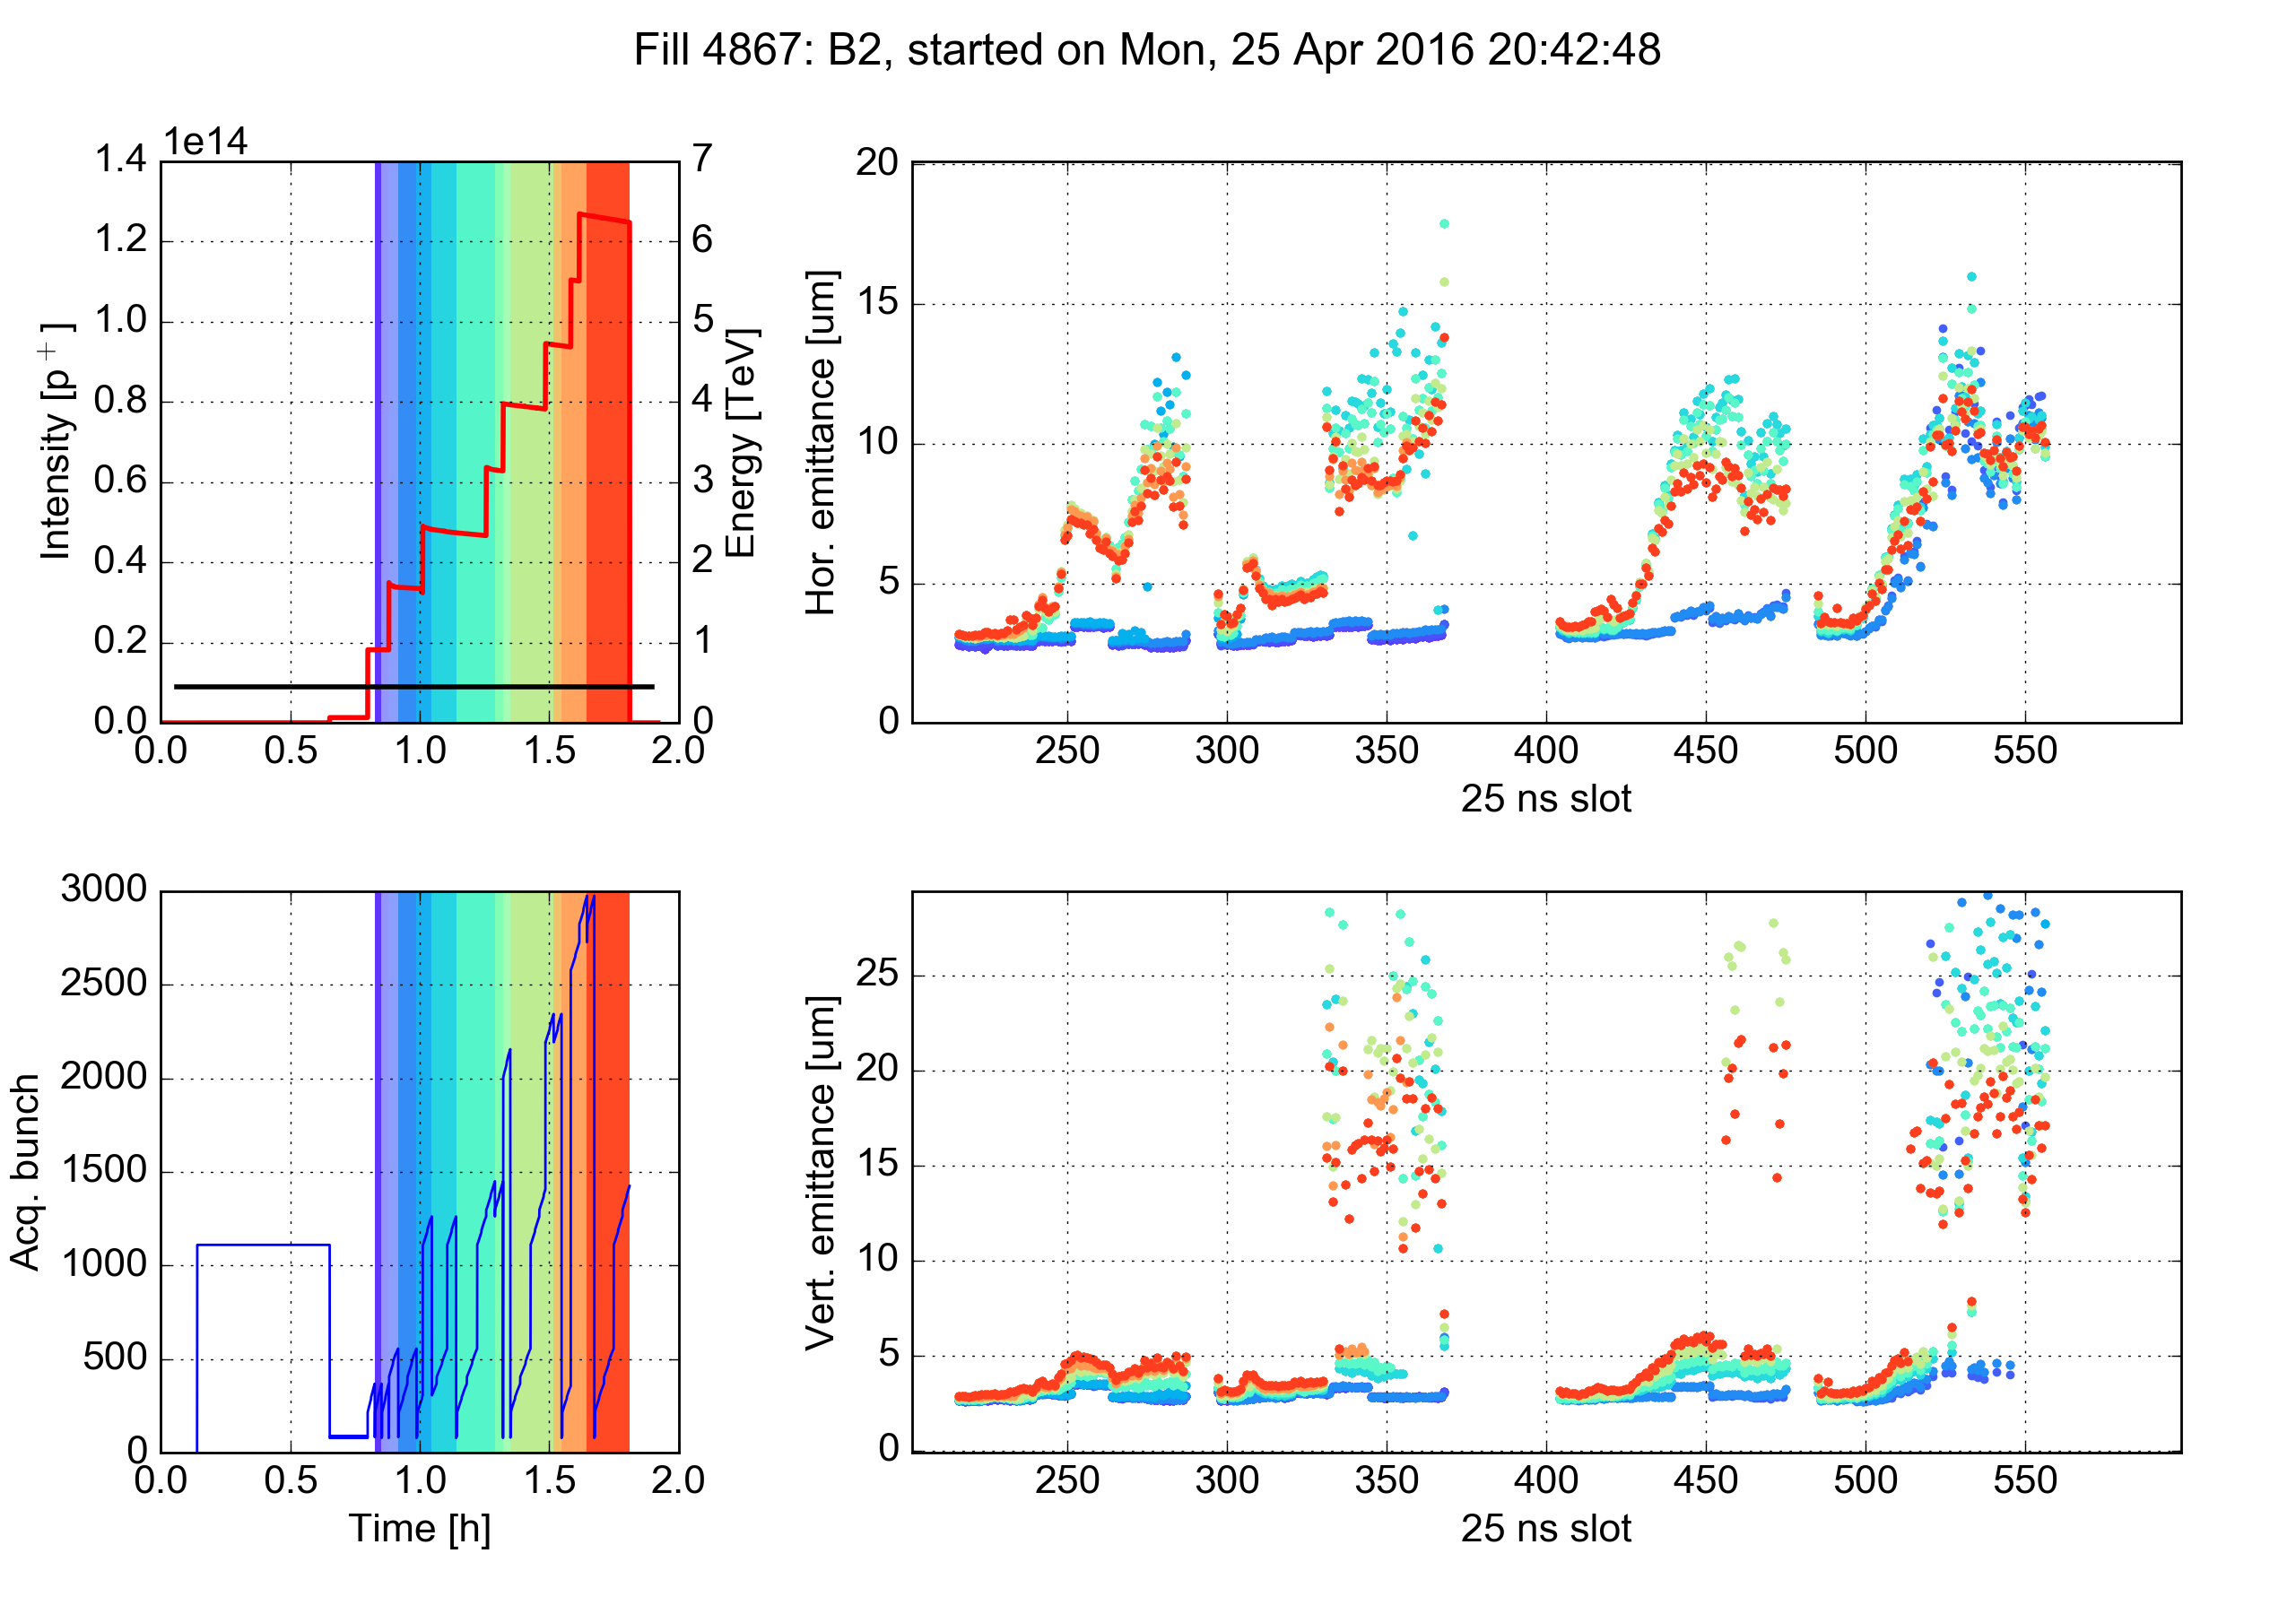
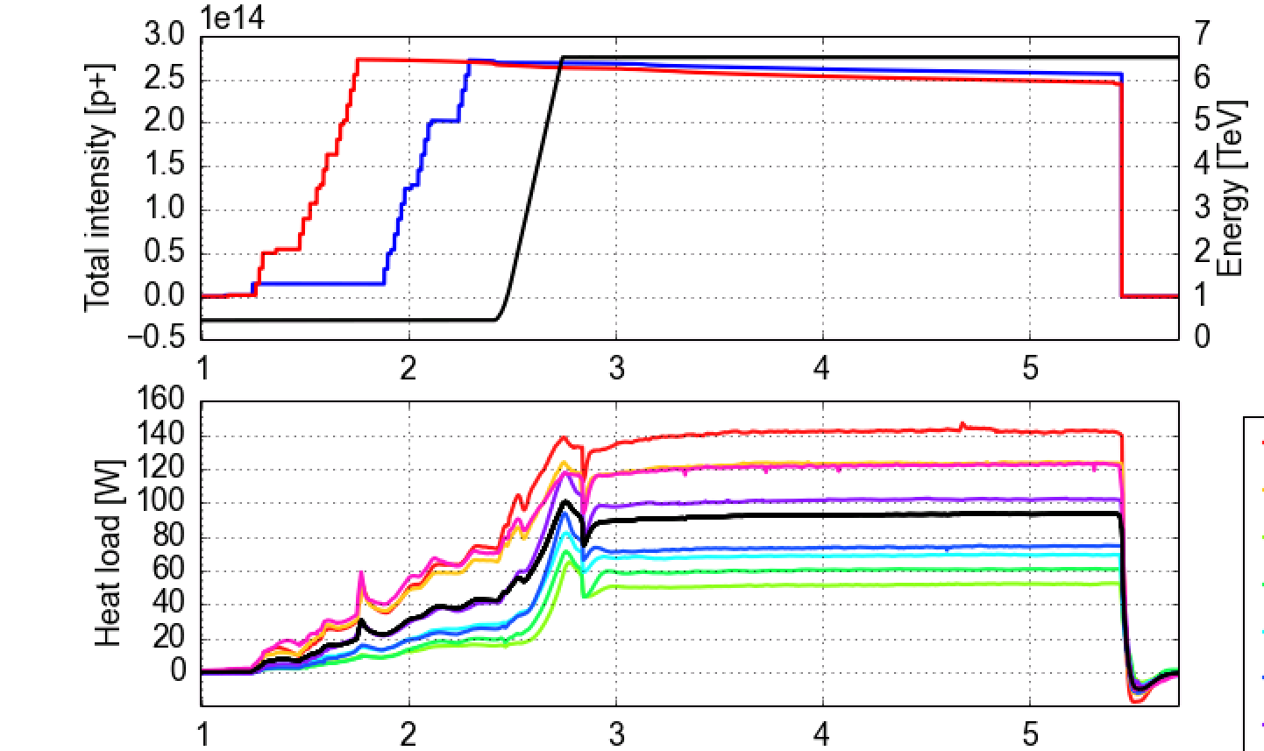
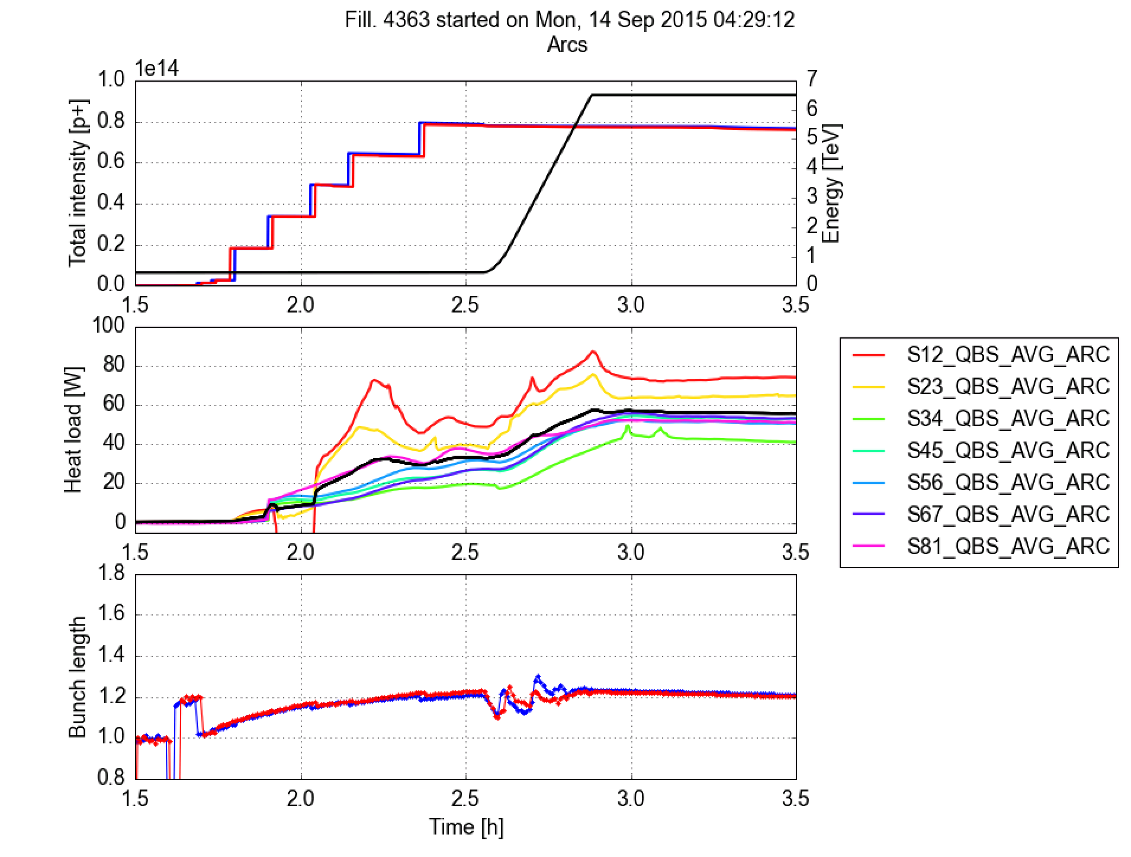
Example: Observations in LHC
Notes:
Existing models reproduce satisfactorily machine observations and hold significant predictive power. However, much room for refinement and improvement, talk by Gianni

Slide 32
Example: Observations in LHC
More details in G. Iadarola’s presentation, including description of the simulation models
Notes:
Existing models reproduce satisfactorily machine observations and hold significant predictive power. However, much room for refinement and improvement, talk by Gianni

Slide 33
Suppression/mitigation techniques
Machine scrubbing
  Limited by scrubbing curve of the surface and SEY threshold
  Can be helped by using “scrubbing” beams that enhance the e-cloud
Active elements
  Clearing electrodes
  Solenoids
  Feedback system against instabilities (needs wide band)
Surface coating or treatment
  Coating with intrinsically low SEY material (with low activation temperature, e.g. NEG, or requiring no activation, e.g. a-C)
  Surface shaping/roughening by machining (e.g. grooves)
  Laser treatment of surface
Run with low e-cloud filling patterns
  At the expense of the number of bunches in the machine (e.g. 50 ns or 8b+4e in LHC)
Notes:
Solutions might increase impedance or outgassing

Slide 34
Ion accumulation in a vacuum pipe
Generation of ions inside the vacuum chamber
Residual gas ionization
Desorption from the losses on the wall
Ion emission from synchrotron radiation

Slide 35
Ion accumulation in a vacuum pipe
Generation of ions inside the vacuum chamber
Ion motion in the beam field
Possible trapping around the beam depending on ion mass and beam properties (bunch size, intensity, spacing)

Slide 36
Ion accumulation in a vacuum pipe
Generation of ions inside the vacuum chamber
Ion motion in the beam field
Possible trapping around the beam depending on ion mass and beam properties (bunch size, intensity, spacing)
Ion of mass A
T_{b}

Slide 37
Trapping condition
Example: CLIC Damping Rings
CO, N₂
H₂O

Slide 38
Ion accumulation in a vacuum pipe
Generation of ions inside the vacuum chamber
Ion motion in the beam field
Possible trapping around the beam depending on ion mass and beam properties (bunch size, intensity, spacing)
After the passage of several bunches, ion density can affect beam motion → Tune shift along the train & coherent beam instability

Slide 39
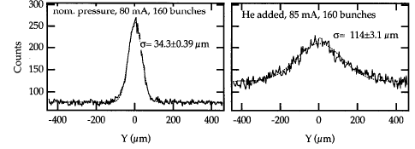
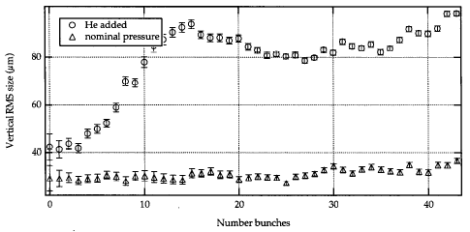
Observations
Fast beam ion instabilities observed in ALS (see below) PLS, SOLEIL, BESSY II, ELETTRA, ALBA, Cesr-TA
ALS: Under injection of additional He, the fast beam ion instability affects later bunches in the train and causes emittance growth

Slide 40
Observations
Fast beam ion instabilities observed in ALS (see below) PLS, SOLEIL, BESSY II, ELETTRA, ALBA, Cesr-TA
Usually the fast beam ion instability is observed in electron rings
  During commissioning/start up (chamber not yet conditioned, bad vacuum, feedback system not yet operational)
  Because of some local pressure rise (e.g. due to impedance heating)
  Artificially induced by injecting gas into the vacuum chamber and raising the pressure by more than one order of magnitude (for studies)
Analytical models and simulation tools have been developed
  Observations usually less severe than predictions, as if some stabilizing effects are not included in existing models → more benchmark with dedicated experiments needed
  Instrumental to produce vacuum specifications of future machines

Slide 41
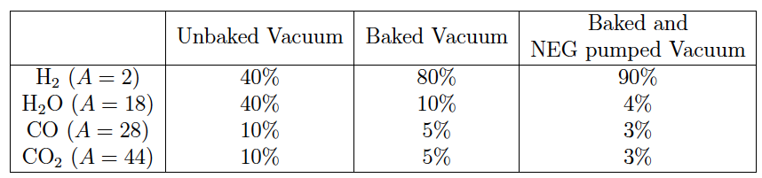
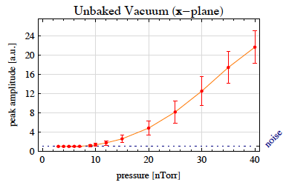
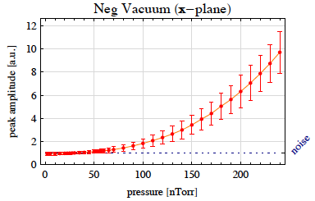
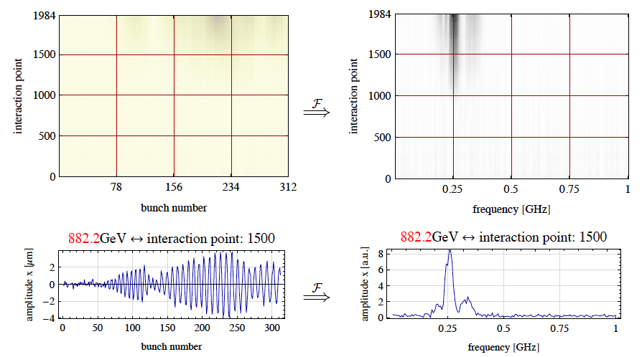
Example: Vacuum specification for CLIC main linac
Fast beam ion instability sets in for total pressures above 10 nTorr in unbaked vacuum and above 60 nTorr in NEG vacuum
Notes:
H₂ not trapped for most of the linac and therefore not contributing to instability

Slide 42
Summary and conclusions
The design of the vacuum system of an accelerator is crucial due to
  Collisions of beam particles with residual gas
  Impedance of vacuum chamber(s) and equipment
  Interactions of stray particles with the inner surface of the vacuum chamber
Beam can be affected in terms of
  Lifetime degradation and emittance growth from collisions
  Vacuum instability with poor lifetime and possible interlock of operation
  Beam instabilities and loss due to the impedance
  Beam instabilities and loss due to e-cloud and ion accumulation
  Equipment can be also affected and limit performance, e.g. kicker flashovers from poor vacuum, heat load from e-cloud in cold systems, etc.
Different types of machines are dominated by different effects, e.g.
  Light sources: elastic and inelastic scattering, ion trapping & instability
  Heavy ion machines: charge exchange, gas ionization, vacuum instability, e-cloud
  Proton machines: e-cloud

Slide 43
Thank you for your attention

Slide 44
References (I)
Lifetime, cross-section and activation, P. Grafström, CAS, CERN-2007-003, p. 213
Beam residual gas interaction, S. P. Møller, CAS, CERN 99-05, p. 155
Interaction of stored ion beams with the residual gas, B. Franzke, CAS, CERN 92-01, p. 100
Single beam lifetime, A. Wrulich, CAS, CERN 94-01, p. 409
Lifetime issues in ALBA, G. Rumolo and M. Muñoz, AAD-SR-BD-AN-0072
Dynamic outgassing, O. Gröbner, CAS, CERN 99-05, p. 127
A theory of the beam loss-induced vacuum instability applied to the heavy-ion synchrotron SIS18, E. Mustafin et al., NIM A 510 (2003) 199-205
Estimations of beam lifetime in the SIS18, G. Rumolo et al., Proc. of ICFA Advanced Beam Dynamics Workshop HB2004, Bensheim, Germany, 18 – 22 October, 2004

Slide 45
References (II)
SIS18 Operation for FAIR, P. Spiller, MAC meeting, 11 September 2011
Electron clouds, G. Rumolo and G. Iadarola, Proc. of CAS on Intensity Limitations in Particle beams, 2015
Review on two stream instabilities in accelerators, G. Rumolo, TWIICE, Topical Workshop on Instabilities, Impedances and Collective Effects, Synchrotron SOLEIL, 16-17 January, 2014
Numerical modeling of fast beam ion instabilities, L. Mether, G. Iadarola, G. Rumolo, Proc. of ICFA Advanced Beam Dynamics Workshop HB2016, Malmö, Sweden, 3 – 8 July, 2016
First observations of a fast beam ion instability, J. Byrd, A. Chao, S. Heifets, et al., Phys. Rev. Lett. 79 (1997), 79-82
Fast Beam-ion Instabilities in CLIC Main Linac Vacuum Specifications, A. Oeftiger and G. Rumolo, CERN-OPEN-2011-050, CLIC-Note-930 (2011)

Slide 46
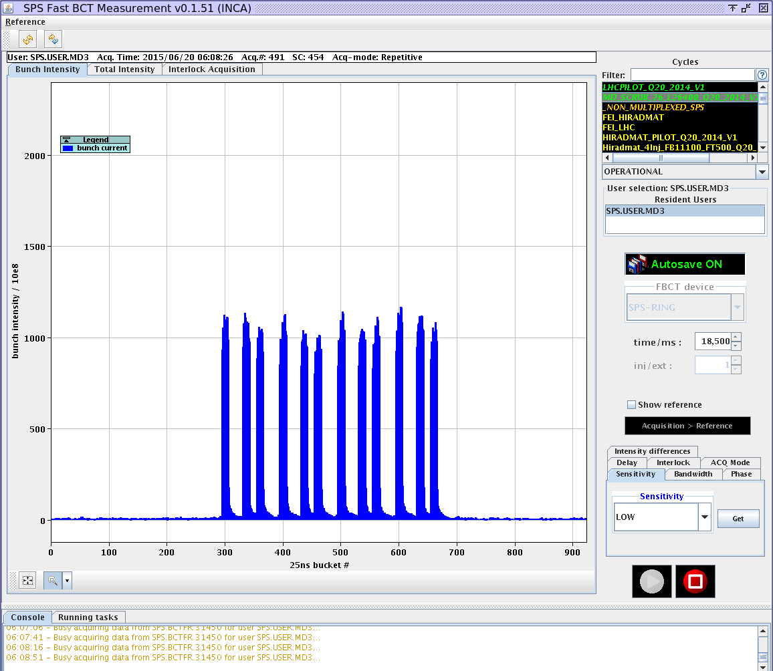
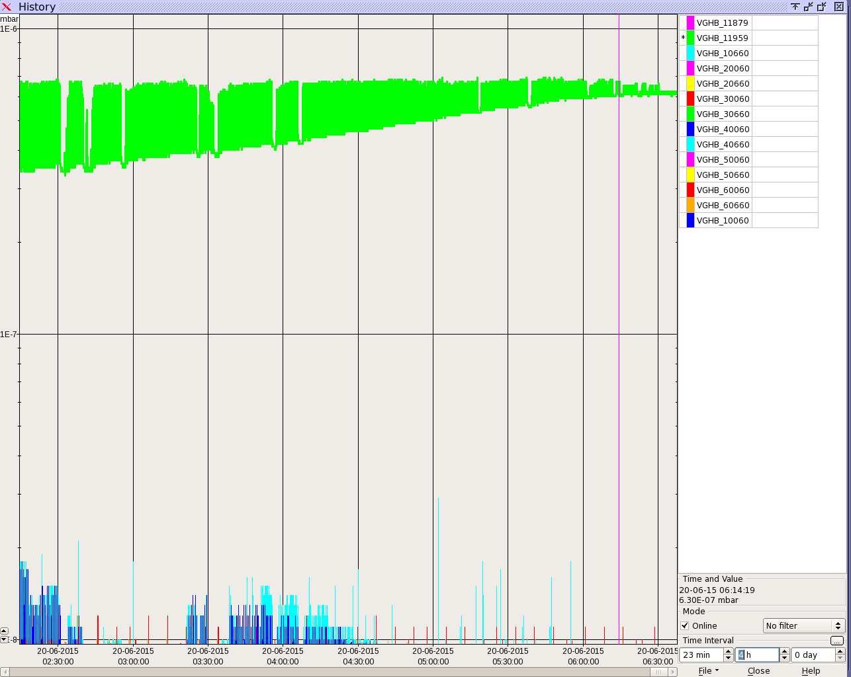
Example: Outgassing of SPS injection kicker
Pressure interlock value
Exercise of “beam induced bake out”

Slide 47
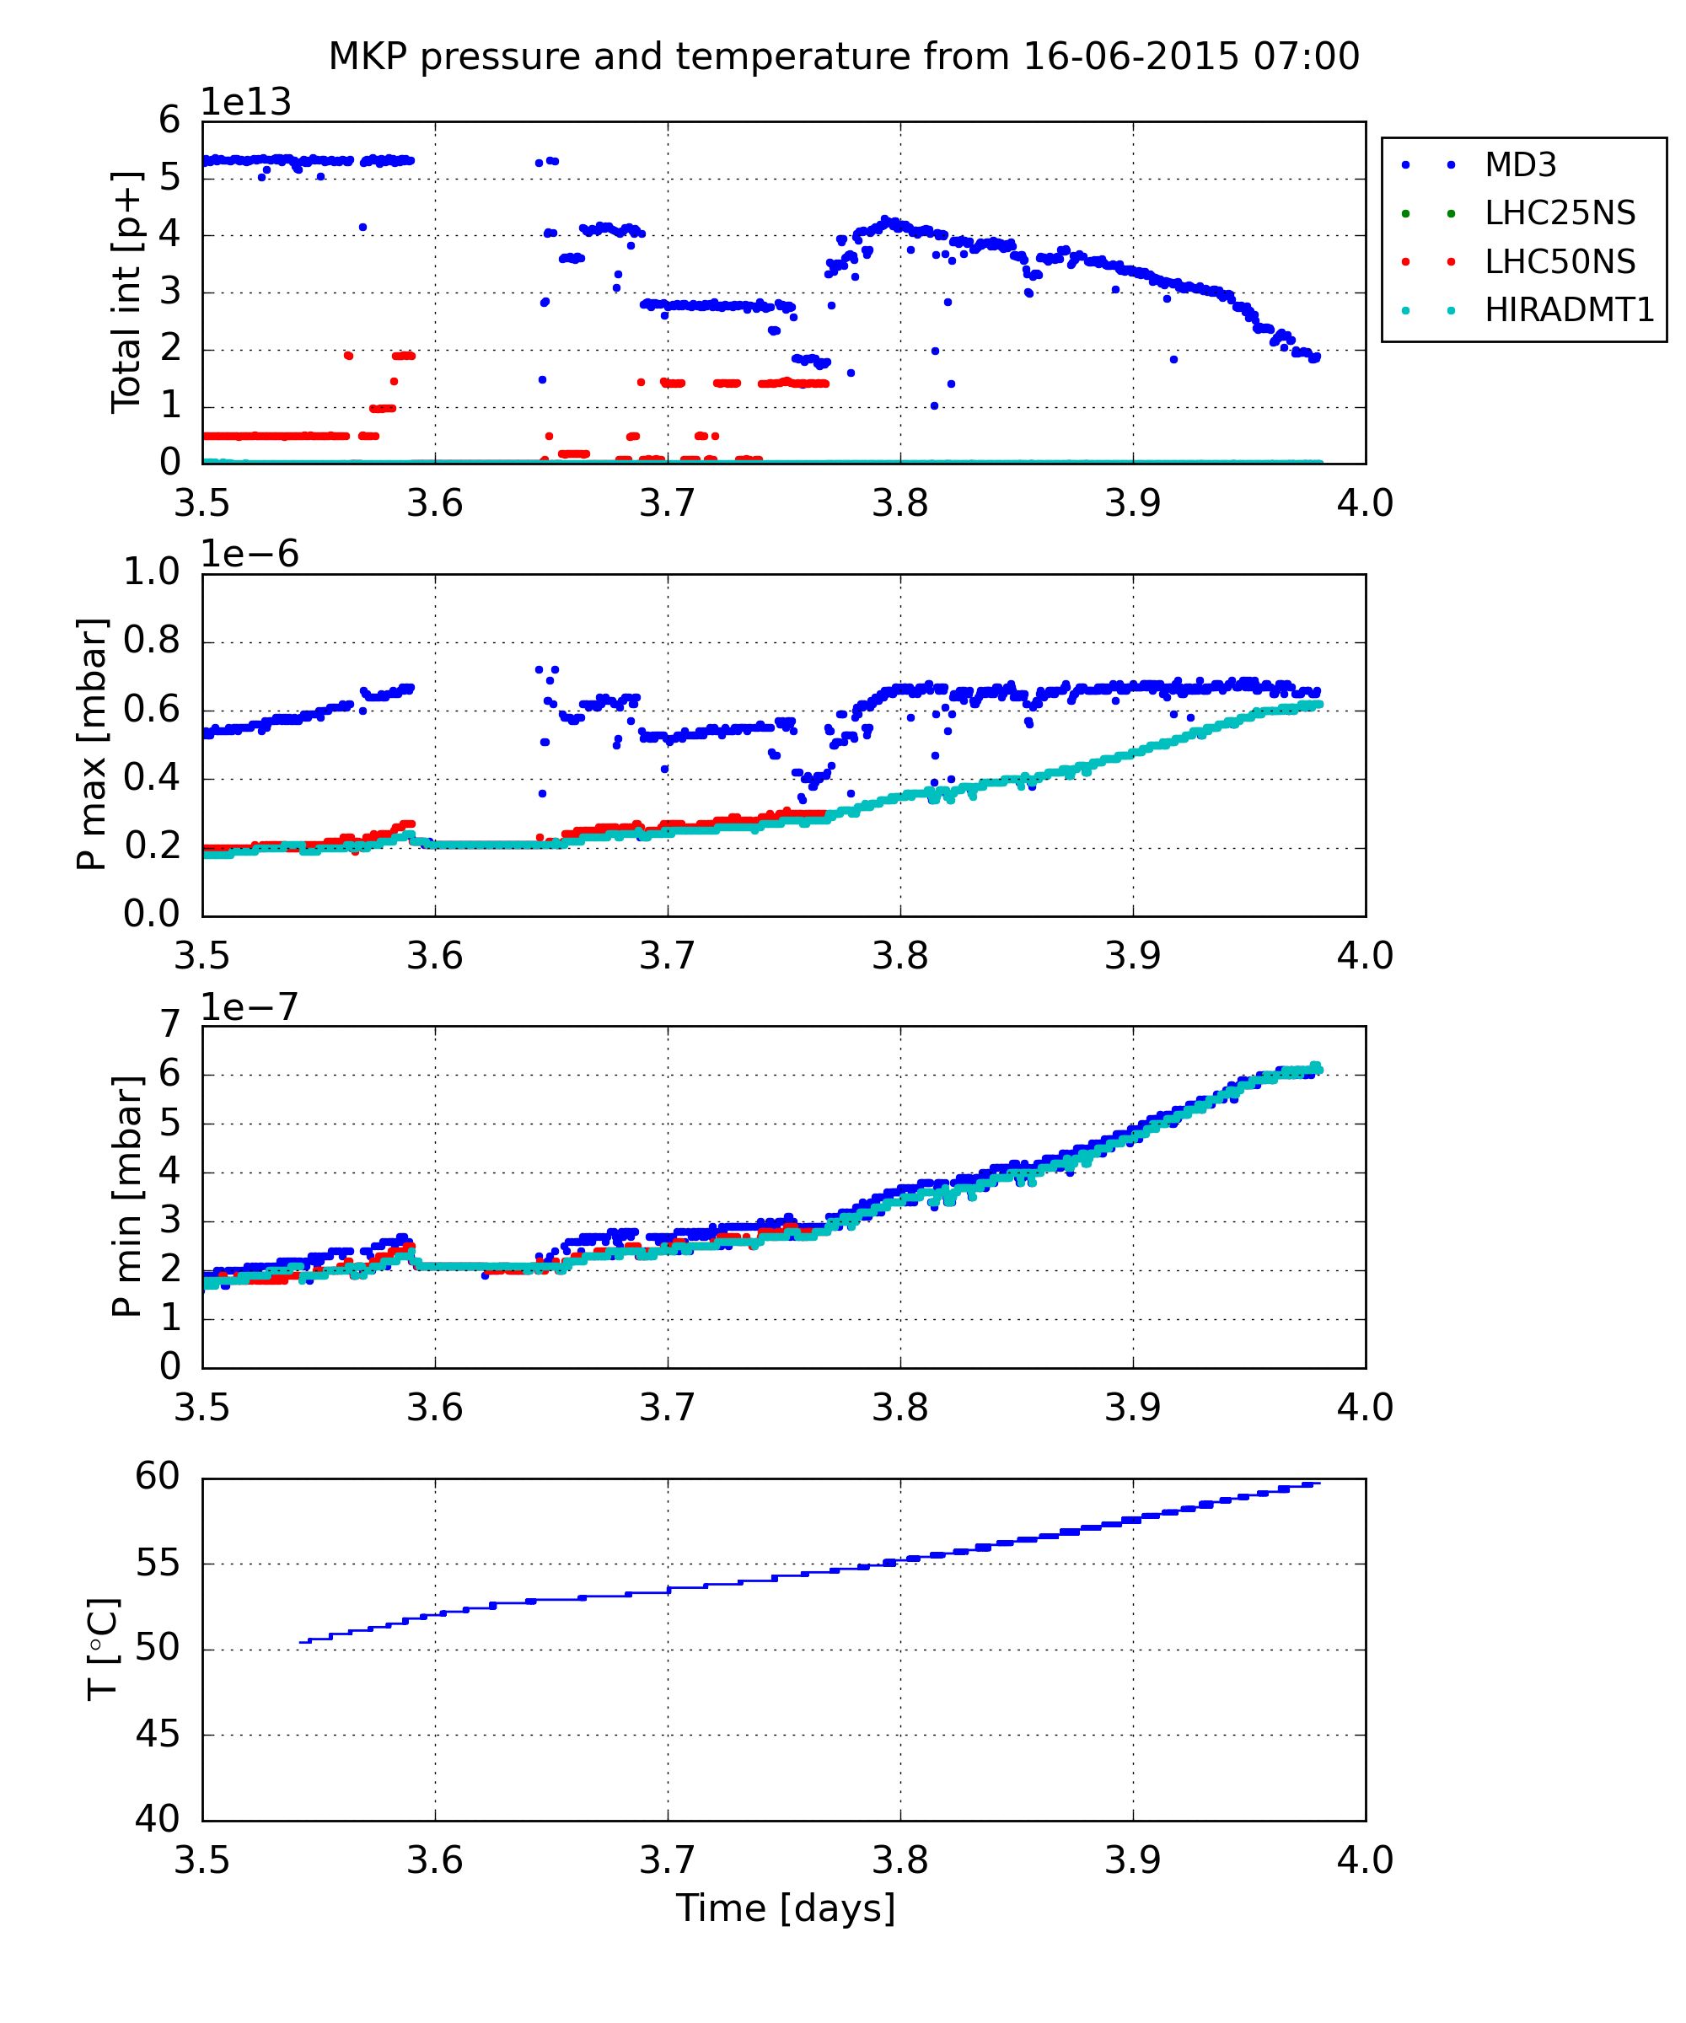
Example: Outgassing of SPS injection kicker
Pressure interlock value
Exercise of “beam induced bake out”

Slide 48
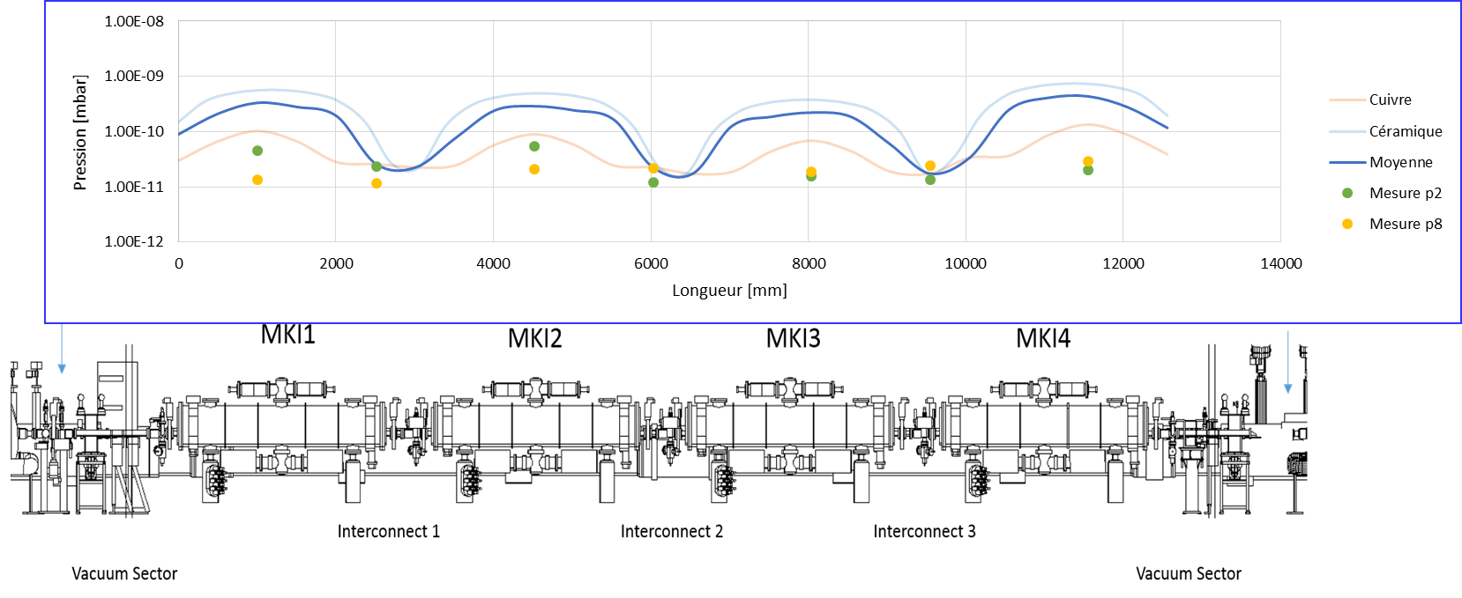
Example: Outgassing of LHC injection kicker
LHC Beam Vacuum Evolution during 2015 Machine Operation,
C. Yin-Vallgren and G. Bregliozzi, Electron cloud meeting #29, 8 April 2016

Slide 49
Example: Outgassing of LHC injection kicker

Slide 50
Example: photoelectrons
cross sectional view (x,y)
view from above (x,s)
When the synchrotron radiation hits the beam pipe
  partly it produces electron emission within a 1/γ angle from the point where it impinges
  partly it is reflected inside the pipe and hits at different locations, too, producing electrons with a more complex azimuthal distribution.

Slide 51
Secondary electron emission
When electrons hit the pipe wall, they do not just disappear…..
  High energy electrons easily survive and actually multiply through secondary electron emission
  Low energy electrons tend to survive long because they are likely to be elastically reflected.
Secondary electron emission is governed by the curve below
θ
E_{p}
secondaries
elastically reflected

Slide 52
Transverse beam instability
Single bunch mechanism
y
s
A beam going through an electron cloud focuses the electrons (pinch), so that the central density of electrons changes along the bunch
Since electrons are drawn toward the bunch local centroid, this is the mechanism that can couple head and tail of a bunch
While the bunch is perfectly centered on the pipe axis, the pinch also happens symmetrically and no coherent kick is generated along the bunch

Slide 53
Transverse beam instability
Single bunch mechanism
If the head of the bunch is slightly displaced by an amount Δy_{head} , an asymmetric pinch will take place, resulting into a net kick felt by the bunch tail Δy’_{tail}

Slide 54
Transverse beam instability
Single bunch mechanism
After several turns (passages through the electron cloud), the “perturbation” in the head motion transfers to the bunch tail, and its amplitude may grow under some conditions

Slide 55
Transverse beam instability
Single bunch mechanism
y
s
After a number of turns much larger than the synchrotron period, the unstable coherent motion has propagated to the whole bunch
Intra-bunch motion
Emittance blow up

Slide 56
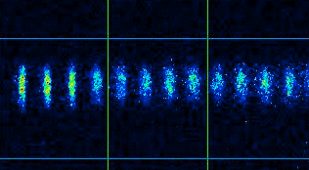
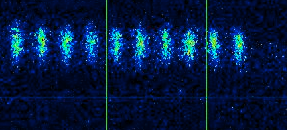
Observations (I)
Blow up at KEK-LER
Vertical beam size blow up observed with a streak camera
Train head
Train tail
The electron cloud causes beam size blow up (through instability and incoherent effects) that manifests itself at the tail of the bunch train
From K. Ohmi, K. Oide, F. Zimmermann, et al.

Slide 57
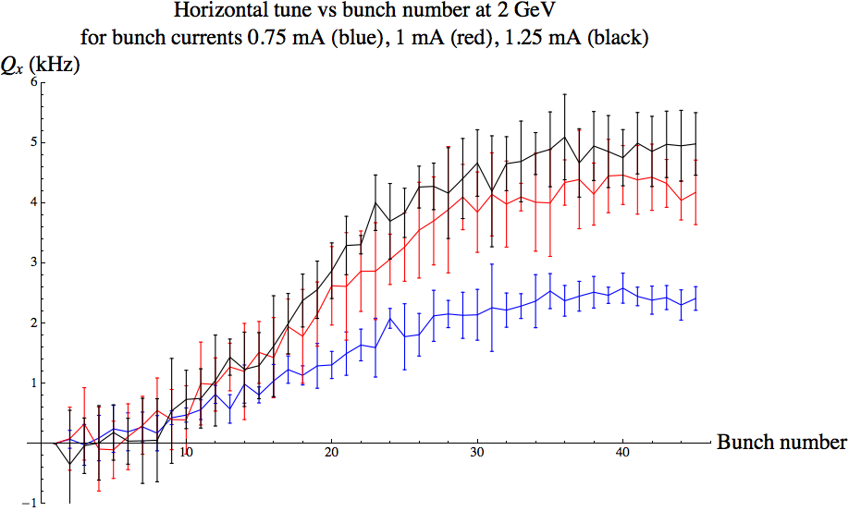
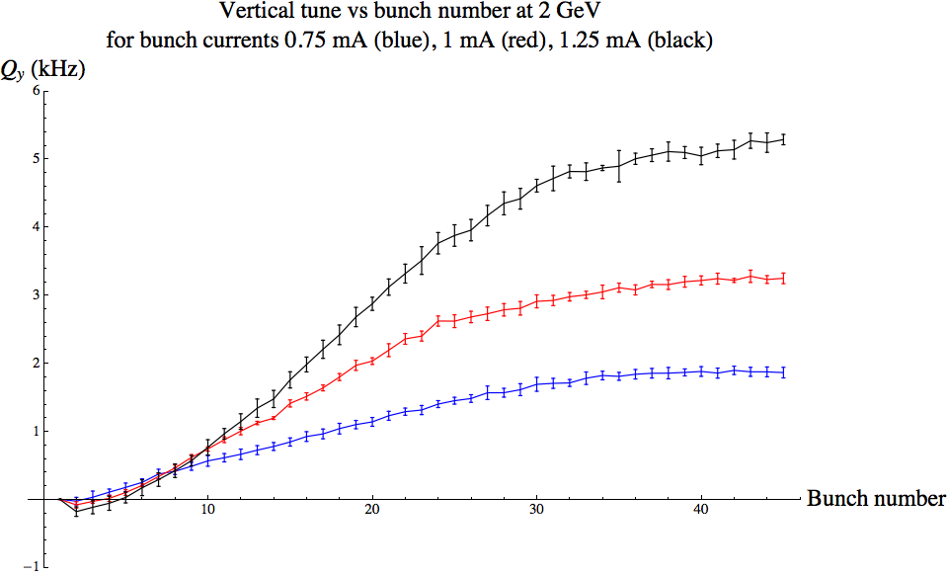
Observations (II)
Tune shift at Cesr-TA
Horizontal and vertical tune shifts along a 46 bunch train in Cesr-TA (Cornell facility presently used for electron cloud studies) taken during a positron run
Dependence on the beam current is shown, clearly pointing to stronger electron cloud for higher currents.
From M. Palmer, J. Crittenden, G. Dugan, et al.

Slide 58
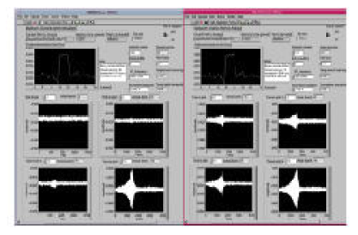
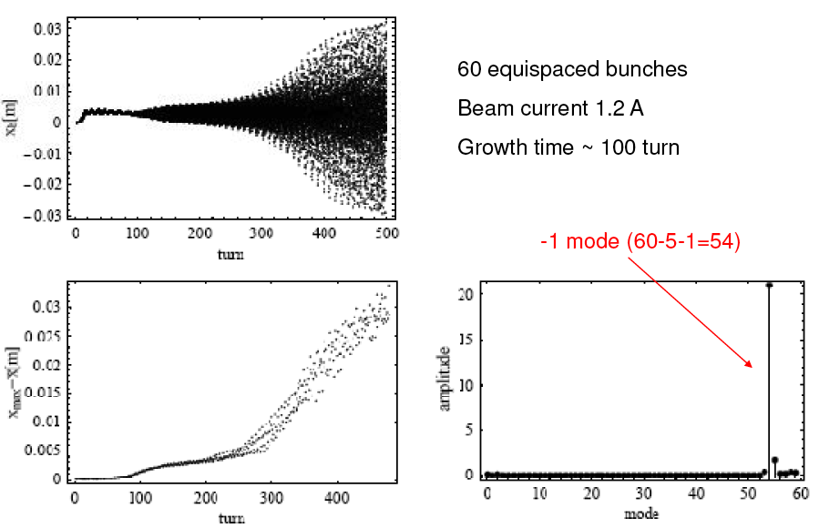
Observations (III)
Instabilities in DaΦne
Coupled bunch instability data from DAFNE (only positron ring) have been compared with PEI-M simulations
Very good agreement found, it confirms that the observed horizontal instability is caused by electron cloud
Horizontal instability on mode -1
From T. Demma (LER Workshop 2010)

Slide 59
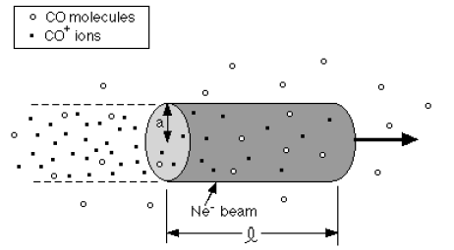
Example: Residual gas ionization
The number of electron/ion pairs created per unit length (λ=dN_{ion}/ds = dN_{el}/ds)
Scattering ionization (depends on cross section of ionization process)
Field ionization, first bunch (only when beam electric field is above threshold)

Slide 60
Trapping condition
(Gaussian beams)
Ion of mass A
Kick from the passing bunch
Section i

Slide 61
Trapping condition
(Gaussian beams)
Ion of mass A
T_{b}
Section i+1
Section i
Transport through the drift space between bunches

Slide 62
Trapping condition
(Gaussian beams)

Slide 63
Transverse Fast Beam Ion Instability
The ions accumulate along one bunch train
Head and tail of the train are coupled through the ions (both in linear and circular machines).

Slide 64
Transverse Fast Beam Ion Instability
The ions keep memory of the offset of the generating bunch and transfer this information to the following bunches.
The driven oscillation is expected to be at a main frequency related to the ion oscillation frequency.

Slide 65
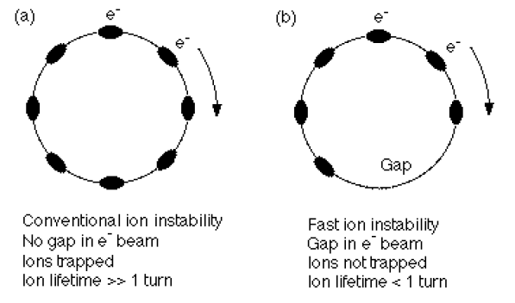
Transverse Beam Ion Instability
In circular machines two possible regimes exist:
  Bunches are uniformly distributed around the machines ➔ no clearing gap, classical beam ion instability
  Bunches are distributed in one (or more) train(s) with a long enough gap for ion clearing ➔ The instability develops over one train length, fast beam ion instability

Slide 66
Theory and simulations
Detailed theory of fast beam ion instability in several references, e.g.
  “Fast beam-ion instability. I. Linear theory and simulations”, T.O. Raubenheimer, F. Zimmermann, Phys. Rev. E 52, 5, 5487
  “Fast beam-ion instability. II. Effect of ion decoherence”, G. V. Stupakov, T.O. Raubenheimer, F. Zimmermann, Phys. Rev. E 52, 5, 5499
  A. Chao, Notes on “Fast Ion Instabilities”, in USPAS lectures on Advanced Concepts in Accelerator Physics
Macroparticle simulation tools developed from 1995 onwards
  Weak-strong → E.g. “Simulation study of Fast Beam Ion Instability”, X. L. Zhang, et al., Proc. of APAC98, “Fast Beam Ion Instability simulations in the TESLA electron damping ring and the FEL beam transfer line”, C. Montag, Proc. of PAC01, “Simulation of the Beam-Ion Instability in the electron damping ring of ILC”, L. Wang et al., Proc. of PAC07
  Strong-strong with analytical field calculations → “Fast beam-ion instability. I. Linear theory and simulations”, T.O. Raubenheimer, F. Zimmermann, Phys. Rev. E 52, 5, 5487
  Self-consistent strong-strong model with PIC, acceleration, tunneling ionization, multi-species → FASTION code, “Fast Ion Instability in the CLIC transfer line and main Linac”, G. Rumolo et al., Proc. of EPAC08

Slide 67
Simulations: the CLIC Main Linac
Along the 20 km, a coherent instability develops due to 20 nTorr of H₂O
A characteristic frequency of 250 MHz can be identified

Slide 68
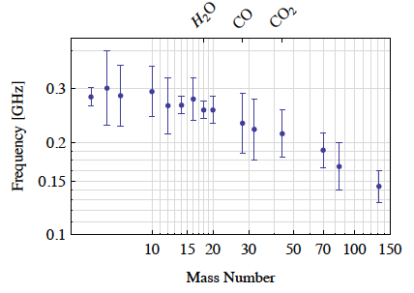
Simulations: the CLIC Main Linac
Along the 20 km, a coherent instability develops due to 20 nTorr of H₂O
A characteristic frequency of 250 MHz can be identified

Slide 69
Simulations: the CLIC Main Linac
Not only level of vacuum is important, but also its composition
Usually H₂ is not trapped and ions are lost due to overfocusing, therefore it does not contribute to the instability

Slide 70
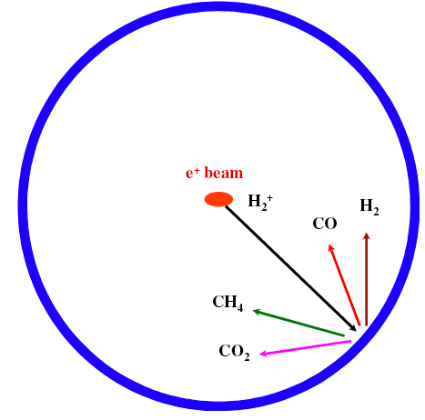
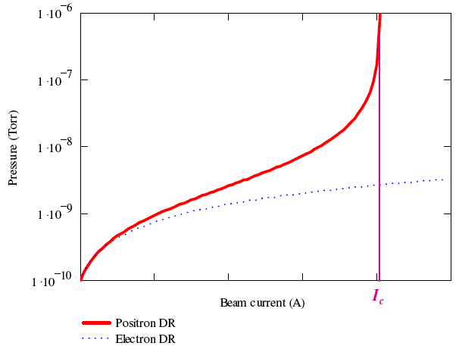
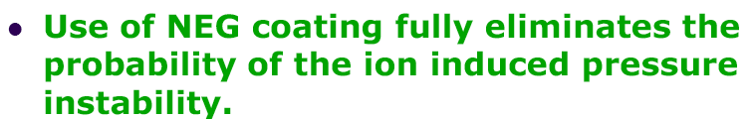
Two-stream phenomena
Ion effects in positron rings
Ions from gas ionization can also cause trouble in the positron DRs
When lost to the chamber walls, they produce more molecules according to their energy and the wall desorption yield
Consequently, more ions are produced and the process can lead to an ion induced pressure instability
From O. Malyshev, LER2010

Slide 71
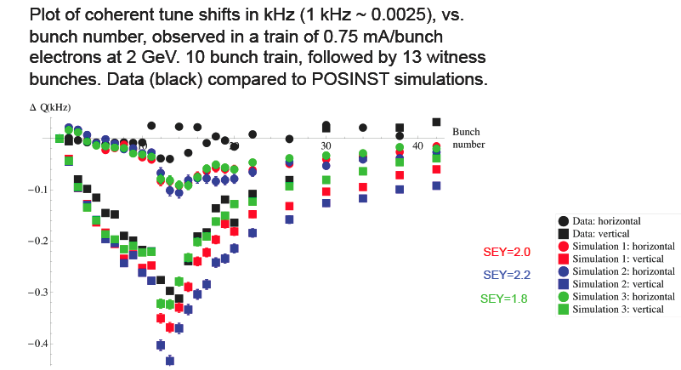
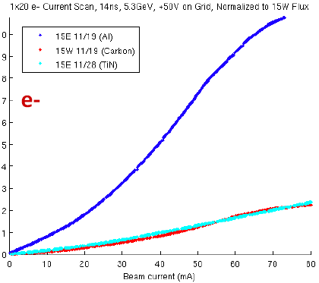
Two-stream phenomena
Electrons in electron machines
There is experimental evidence of electron cloud formation also in rings running with electrons
  An anomalous heat load was observed in the ANKA superconducting wiggler, possibly ascribed to electron cloud (?)
  Both tune shift and RFA measurements taken at Cesr-TA with electrons circulating in the machine, demonstrate the existence of electron accumulation.
Measurements from RFAs in 3 different test chambers

