Slide 1
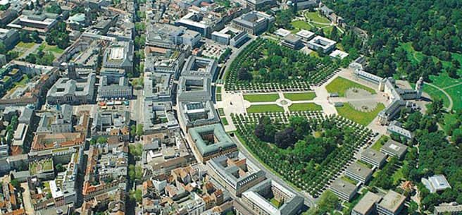
Secondary electron yield of surfaces: laboratory measurements, influence of temperature and magnetic field
M.Taborelli, for TE-VSC, CERN

Slide 2
measurements
The secondary electron yield: SEY
number of emitted electrons (secondary)
SEY=
number of impinging electrons (primary)
N
2.5
Primary e-
2.3
Cu as rec.
2.1
δmax
1.9
secondaries
1.7
SEY
1.5
1.3
1.1
Emax
0.9
0.7
N.Hilleret
0.5
0 500 1000 1500 2000 2500 3000
Primary Energy [eV]
δ_{max} or SEYmax = maximum value as a function of primary energy
E_{max} = primary energy of the maximum
The electrons in that energy range escape from depth of less than 20 nm: SEY depends on surface properties

Slide 3
measurements
Measurement of SEY of surfaces
electron gun
electron gun
collector
Gun is closer to sample:
better adapted for low Ep
Currents are not all measured simultaneously
I_{p}
A
I_{p}
+ -
I_{c}
I_{c}
Sample
Sample
Faraday cup
+ -
+ -
I_{p} = I_{s} + I_{c}
δ = I_{c} / (I_{s} + I_{c})
I_{p} with Faraday cup
δ = 1-I_{s}/I_{p}
I_{s}
A
I_{s}
A
sometimes I_{p} is measured just by polarising the sample positive: in this way the elastic electrons are lost

Slide 4
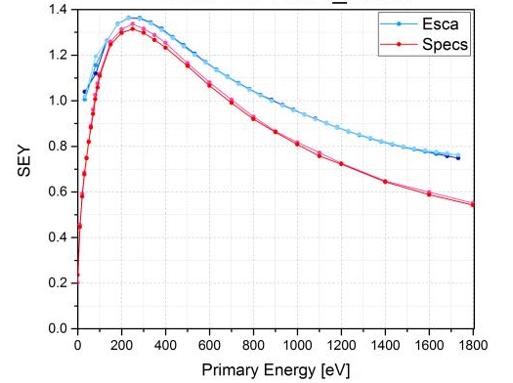
measurements
Accuracy and precision
Precision (reproducibility) is high, better than 0.05 (see the two red curves)
Accuracy with respect to the absolute SEY is lower and systems of different geometry give values of +/- 0.1 on SEYmax
Coll
Fara
Systems give sligthly different results depending on configuration….

Slide 5
measurements
Keep a low dose!
Measurements done at low dose (below 10⁻⁶ C/mm²) to avoid conditioning of the surface: very important for as-received air exposed samples
2.6
2.4
2.2
2.0
1.8
1.6
1.4
1.2
1.0
OFE copper
V.Baglin et al. LHC project report 472
1e-8 1e-7 1e-6 1e-5 1e-4 1e-3 1e-2
Dose [C/mm²]
A low dose is mandatory to measure the SEY of insulators (charging)

Slide 6
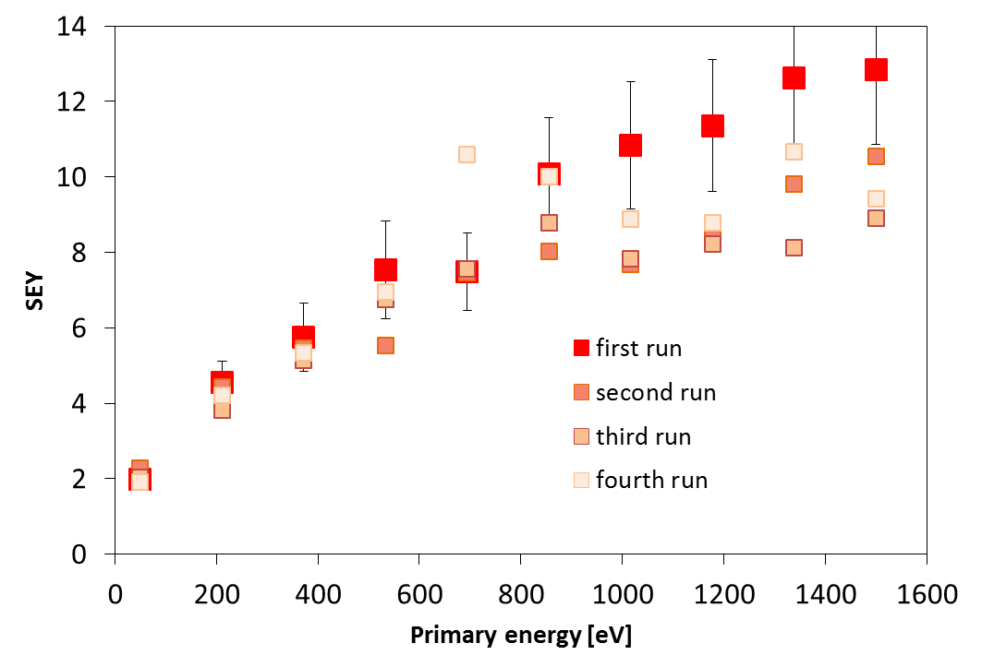
measurements
Pulsed: example of alumina
Pulsed measurements
1e-13 C/mm²/point
5μs/pulse
Neutralization with 5eV beam for 60s
Charging after the first curve perturbs the following measurements

Slide 7
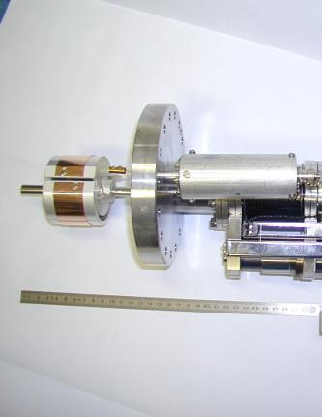
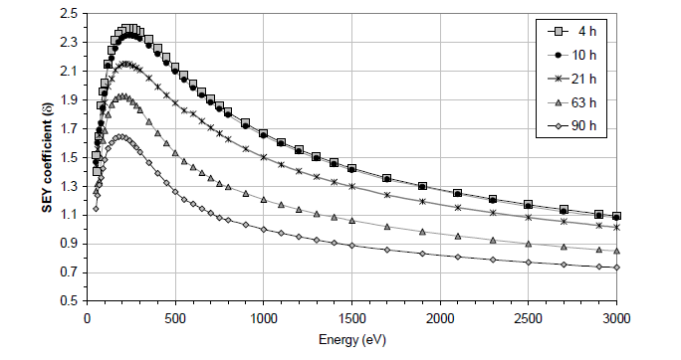
measurements
In situ I: SEY measurements in the SPS accelerator
Rotatable sample system in line of sight of SPS beam; operated remotely
Copper conditioning
Hours of LHC beam operation
LHC-Project Report 632, 2003 J.M.Jimenez et al

Slide 8
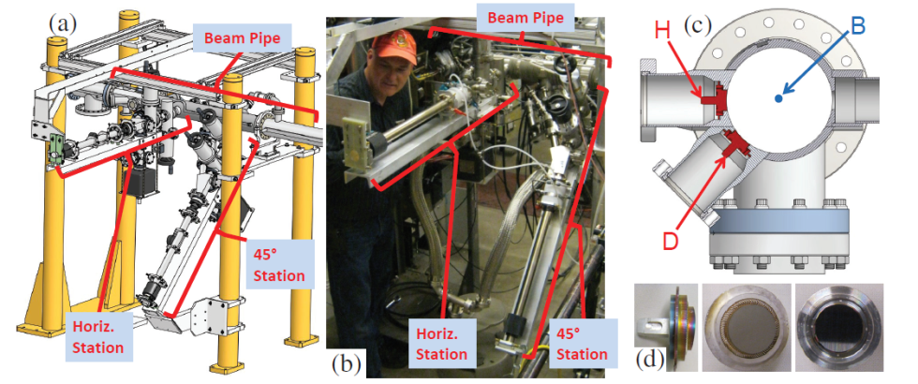
measurements
In situ II: Samples exposed and transferred in UHV
CESR-TA Cornell: W.Hartung at al IPAC2013, Shanghai, 3493
See also: M.Pivi et al SLAC-pub-14000, 2010

Slide 9
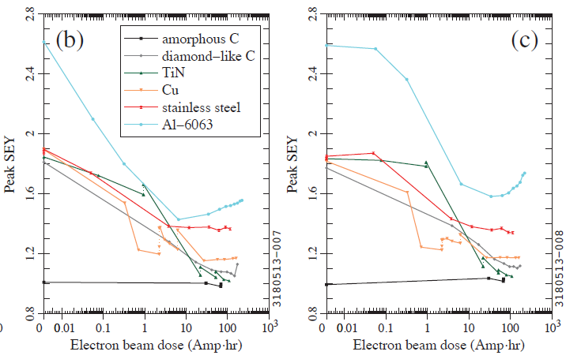
measurements
In situ II: CESRTA system, conditioning monitoring
SEY of samples measured in situ before and after conditioning
CESR-TA Cornell: W.Hartung at al IPAC2013, Shanghai, 3493
The SEY of several samples as a function of operation time in positions where only e-cloud impinges and other where e-cloud and synchrotron radiation impinge

Slide 10
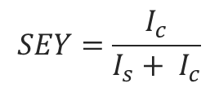
Example of a setup for cold SEY
temperature
Cold head facing an e-gun collector system in RT UHV chamber
$$SEY=\frac{I_{c}}{I_{s}+ I_{c}}$$
collector
e-gun
Ic
Is
From RT down to 6K
P in low 10⁻⁹ mbar (H₂ > H₂O > CO > CO₂)
Suitable for measurements at primary energy above 80 eV, dose < 10⁻⁷ C/mm² for full curve

Slide 11
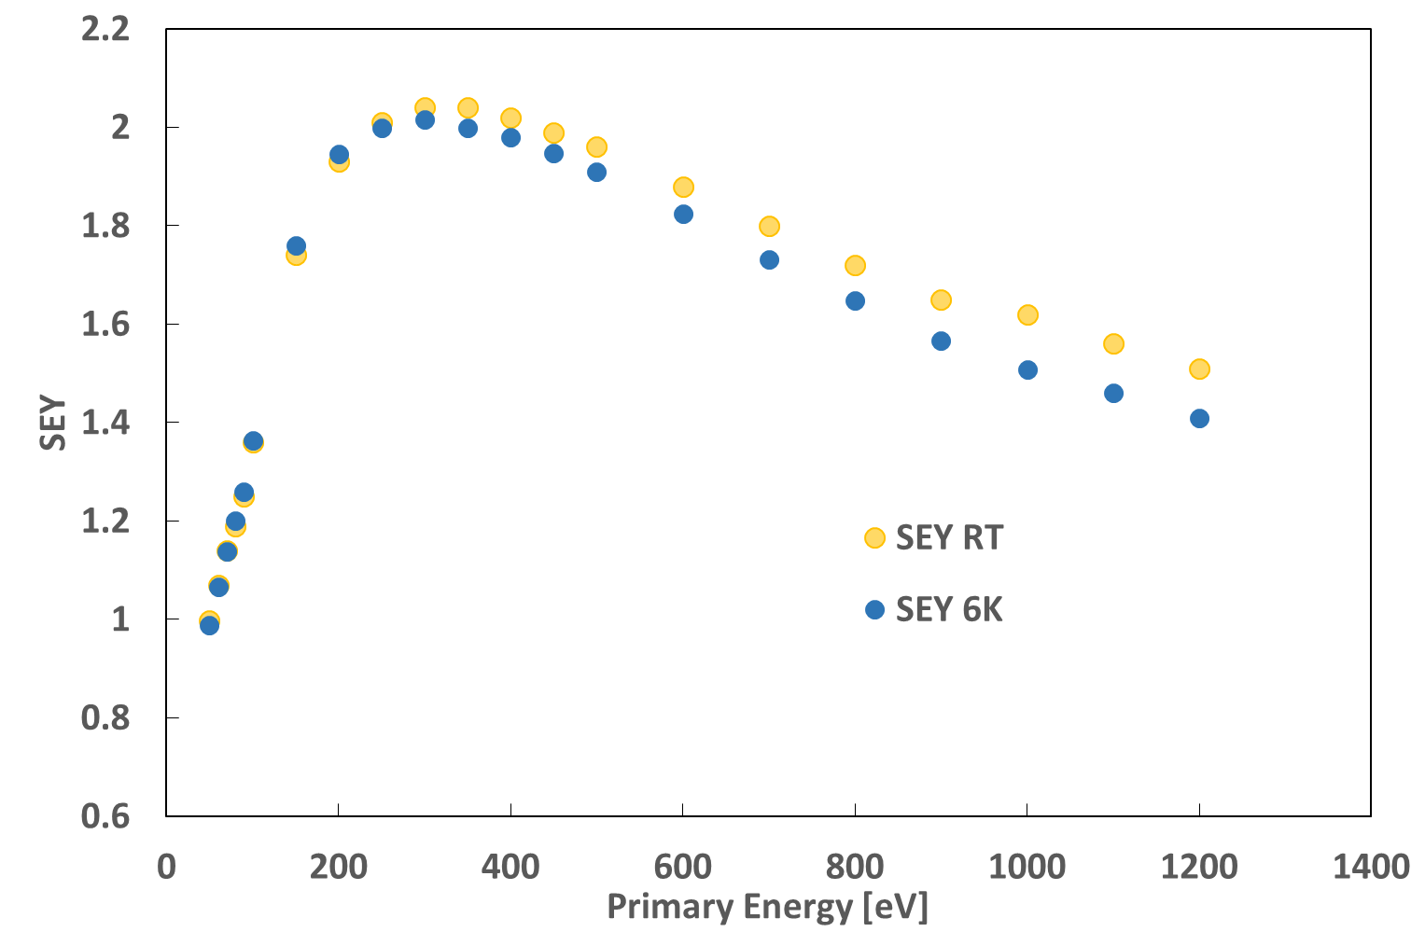
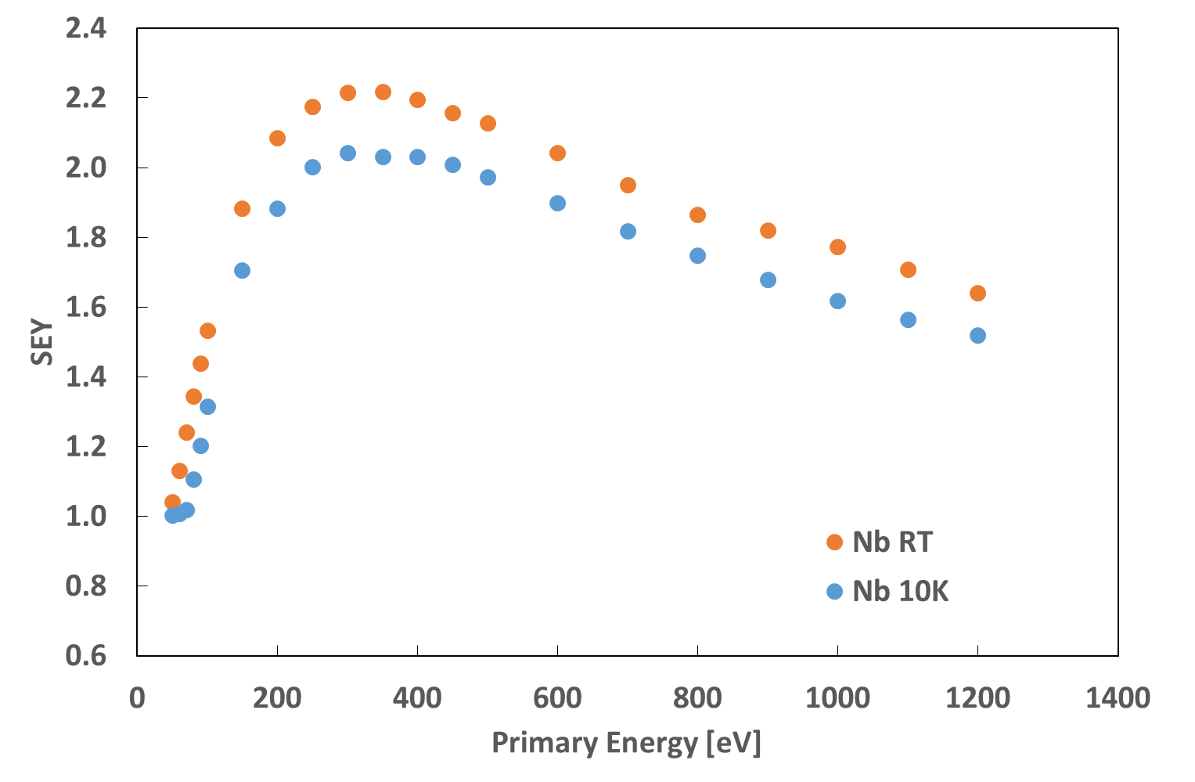
temperature
Intrinsic temperature dependence of SEY?
There is no or weak intrinsic T dependence of SEY for an as received metal surface:
Copper OFE
Nb
The slight SEY decrease at low T is possibly due to the influence of adsorbates upon cooling (same for ion induced yield H.Rothard et al PRB30, 9224,1988 )

Slide 12
temperature
Why is the temperature effect so weak?
Production of secondary:
The excitations involved to generate secondary electrons are of the order of eV (to overcome the work function)
E
25meV=KT<< ΔE=1-10 eV
Transport:
The excitations limitng the mean free path in metals at several eV above E_{F} is dominated by electron-electron interaction (phonons are less important) and the DOS occupancy changes only marginally in the practical temperature range
…what about insulators?
Vac. level
EF
KT

Slide 13
temperature
Intrinsic T dependence of insulators
The SEY decreases with T:
→ generally explained by the reduction of escape of secondaries which is limited by e-phonon scattering → at high T there are more phonons → more scattering →shorter mfp → lower SEY
NaCl
MgO
SEY
RT
SEY
740C
M. V. Gomoyunova, J. Tech. Phys. 28, 2473, (1958) , in J. Cazaux JAP 89, 8265 (2001)
J.B.Johnson et al, Phys Rev. 91, 582 (1953)

Slide 14
temperature
Condensed water on cold copper surface
Low temperatures provoke condensation:
V.Baglin et al. Proc Chamonix X, p130, 2000
2.4
2.2
2.0
1.8
1.6
1.4
1.2
1.0
0.8
as rec
45 ML
65 ML
200ML
SEY
SEYmax
0 500 1000 1500 2000 2500
The curve saturates at about 150ML….the mfp of escaping secondary electrons is very large (larger than for metals, and also larger than for CO, CO₂ etc)

Slide 15
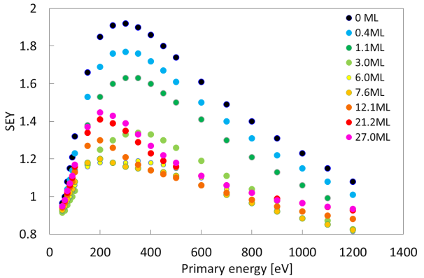
temperature
Condensed layers: CO on OFE copper
6K
CO adsorption lowers the SEY of as-received copper at any coverage
Emax decreases at high coverage

Slide 16
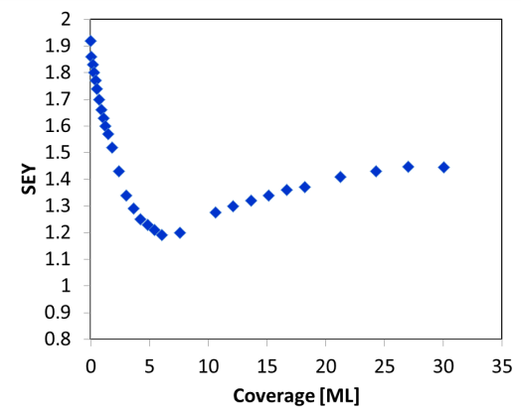
temperature
Condensed layers: CO on OFE copper
Cumulative CO physisorption on Cu OFE
Not monotonic: cannot be explained as a sum of CO and Cu SEY
Saturation at 25ML, much lower coverage than water → smaller escape depth
6K
The SEY of CO is the lowest compared to H₂O , CO₂, CH₄, N₂

Slide 17


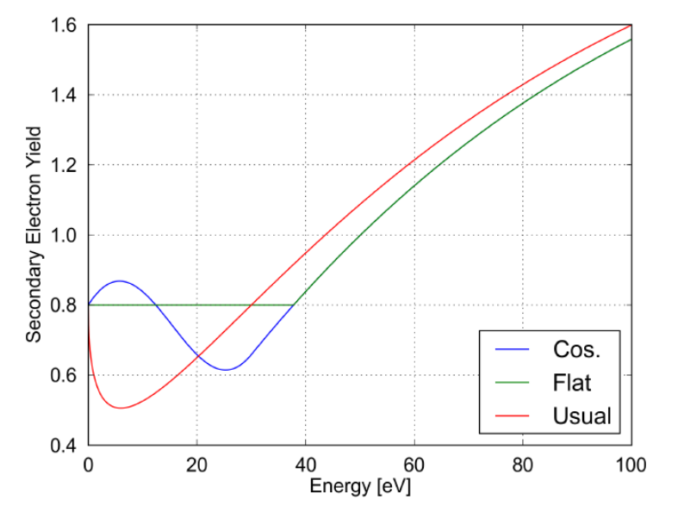
Low Ep
Low primary energy: motivation for the measurements
The low energy part influences the e-cloud threshold :
Simulation for LHC beam in the arcs, 72 bpi and 288 bpi at nominal intensity
SEY= δelas + δtrue
Courtesy G.Iadarola, PhD Thesis
Courtesy G.Iadarola, PhD Thesis
Courtesy G.Iadarola, PhD Thesis
R0
Primary energy [eV]
δmax
max

Slide 18
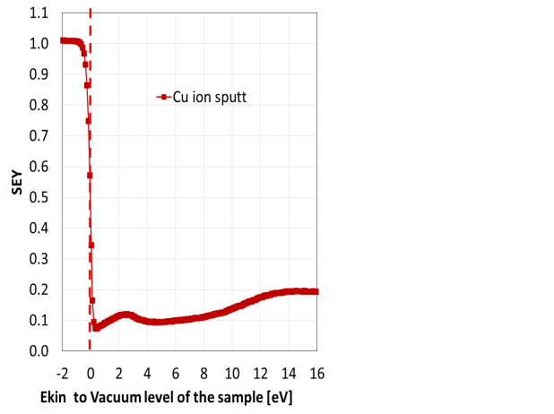
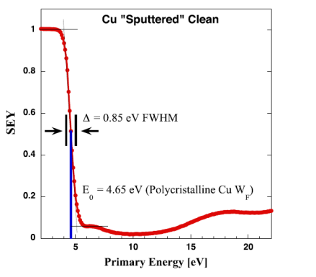
Low Ep
Can we measure the SEY at low primary energy?
Yes, by retarding (- bias on the sample), sacrifying some angular accuracy
Polycrystalline copper
Cimino et al, Phys. Rev. ST Accel. Beams 18, 051002, 2015

Slide 19
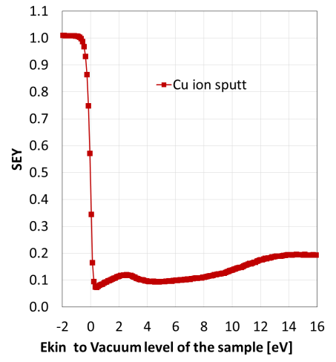
Low Ep
More in detail: what is the energy scale
WF difference
sample-filament+ gun error
E_{F}^{f}
Φ^{s}
E_{F}^{f}
3.0V
E_{F}^{f}
0.8V
E_{F}^{s}
E_{F}^{f}
0.5V
Vgun= 3 V
Vgun= 0.5 V
Vgun= 0.8 V
Vgun=0
To get a meaningful energy scale one must take into account the difference of WF between gun and sample and a possible error in gun voltage. Calibrate by a sample with known Φs

Slide 20
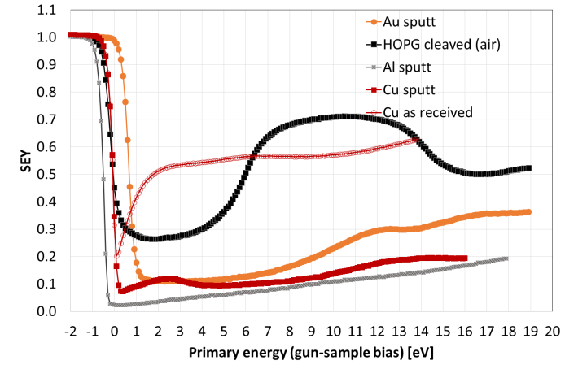
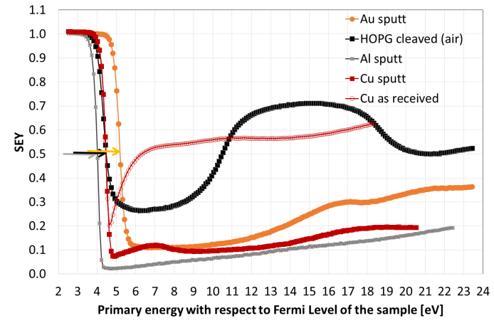
Low Ep
Energy scale and WF
In collaboration with A.Bellissimo (UniRoma3)
Assume for Au:
Φ=5.2eV
Get:
ΦAl =4.0 eV
ΦCu= 4.4 eV
ΦHOPG=4.4eV
The structures (dips) are possibly at threshold of inelastic processes
in competition with elastic scattering (H.E.Farnsworth 1928, p41-57)

Slide 21
B-field
Effect of magnetic field
measurements?

Slide 22
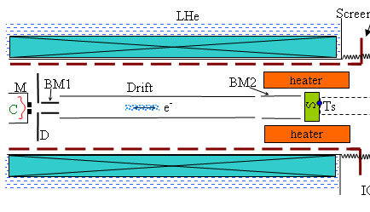
B-field
Charge measured by displacement current:
A.Krasnov et al. Proc DIPAC2011, p236
The charge is measured by integrating the displacement currents: this does not need a collector or Faraday cup!

Slide 23
Incidence and transport: static uniform magnetic field perpendicular to a flat surface, like in a dipole
B-field
An electron arriving to the surface with an angle β will keep its angle of incidence with respect to the surface normal
V_{II}
The B field modifies only the direction of V||, but not its length: the V vector remains on a cone
V⊥
β
B
No change of angle of incidence: on a flat surface no change of SEY is expected
The electron travels for the length of a mfp λ → collision time τ
It reaches a depth V⊥τ independent of B

Slide 24
In the material: effect of static magnetic field on the secondary electrons transport and cascade
B-field
The B-field in the solid does not change |V||| and V⊥ : no change of depth of the cascade
Is the angle change due to B relevant before a scattering event? How long is λ ?
→ slowest escaping electrons
→ V⊥ → E_{FERMI}+WF > 5eV inside
λ≅ 8 nm
V|| : low V|| give the smallest Larmor radius:
When is r_{L} ≅ λ?
V⊥in
V⊥out
WF
E_{FERMI}
inside
outside
V⊥
B⊥

Slide 25
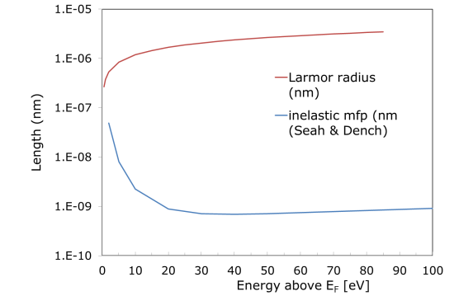
Comparison of Larmor radius and electron mean free path
B-field
5eV
at 9T
V||
V⊥
V⊥ corresponds to 5eV and an inelastic mean free path of 8nm
V|| giving an r_{L} of about 8nm corresponding to an energy of 0.0005eV….
Those values of V||/V⊥ are electrons travelling within 0.5 deg from the normal to the surface, → no major effect is expected from their change of trajectory

Slide 26
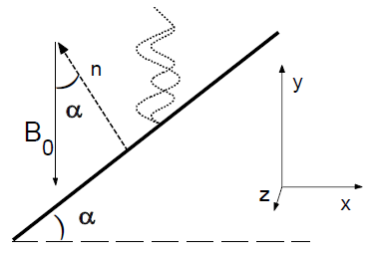
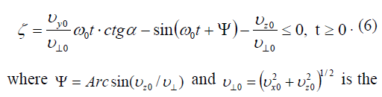
B-field
Rough surfaces and electron trapping
L.Wang et al. SLAC-PUB 12001, 2006
Secondary electrons emitted from a rough surface (grooves) with B field normal to surface will hit the surface again:
Condition for hitting:
The condition is independent of the field B!
It depends on the initial direction Vy, Vz ….
The steeper the surface the better it is

Slide 27
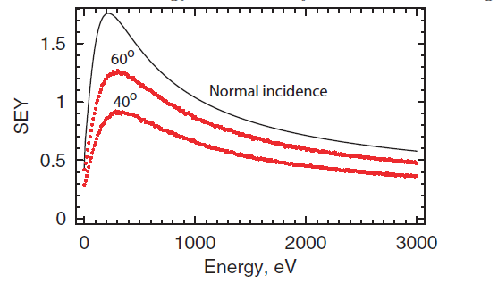
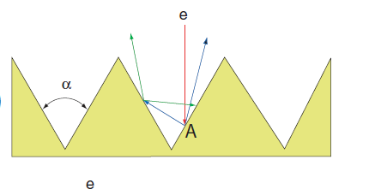
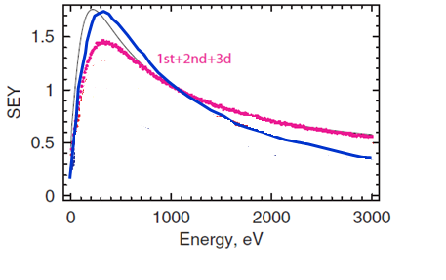
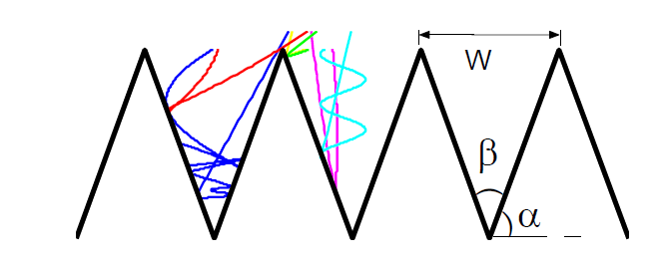
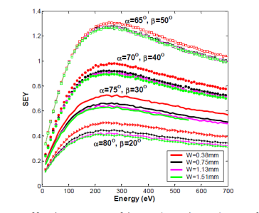
The effect of B on a rough surface
B-field
Published simulations do not perfectly agree (both with a flat surface with SEY=1.75): not clear if the field reduces the performance
β
flat
0.2T
M.Pivi et al SLAC-PUB 13020, 2007
40º
Normal incidence
No B
β
60º
1.4
1.2
1
0.8
0.6
0.4
0.2
0
Normal incidence
«effective SEY»: ratio of all electrons impinging and leaving in e-cloud
0.2T
L.Wang
SLAC-PUB-12641
July 2007
New simulations in progress by N.Fil, ONERA Toulouse

Slide 28

THANK YOU
THANK YOU AND…
SEE YOU IN GENEVA IN 2018

Slide 29
Effect of magnetoresistance:
In magnetoresistance the conduction electrons at Fermi level are involved, therefore we expect a stronger effect:
Electrons are slower and the respective Larmor radius is smaller than for secondaries
The mean free path is much longer than for secondaries
Very pure copper,
mfp about 30 μm
For copper the effect scales with H/ρ₀
It nicely illustrates the mean free path influence (or RRR)
J.Phys.Chem Solids
11, 37, 1959
H x S (MGauss)
S=R(273K)/R(4.2K)
(PRB 23, 483, 1981)
Beam screen copper has RRR~100, therefore we expect and effect of about Δρ/ρ₀ ~2

Slide 30
Multipacting test bench
Lab characterization
This enables to evaluate the performance in a situation more similar to the effect of the beam
Reflected power
SPS dipole
No reflected power (= no multipacting) in the coated dipoles with the available input power (tested up to 2 Tesla)
Easy to achieve multipacting in the non-coated dipole (even after prolonged conditioning).

Slide 31
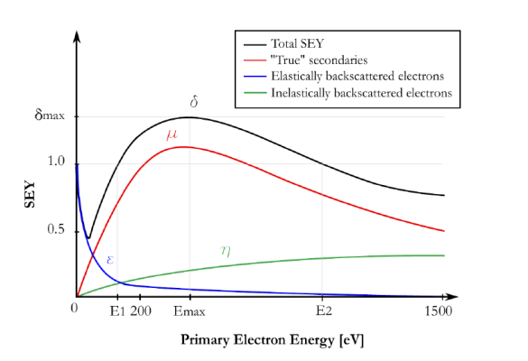
The secondary electrons
Conceptually one can distinguish in principle different contributions to the electrons scattered by a surface.
NB: We measure in general the total yield and call it secondary electron yield
__ total SEY
__ true secondaries
__ elastically backscattered
__ inelastically backscattered
true
secondaries
elastic
N(Es) , EDC
1
SEY
Auger
backscattered
From F.Perez et al
50eV
0 E1 200 E2 1500
Secondary electron Energy
Primary electron Energy (eV)

Slide 32
secondaries
Why does the curve have a maximum?
All materials display a curve with a maximum (Emax) as a function of primary energy
primary
beam
p
SEY
Average escape depth of secondary electrons
primary energy
Remark on angle!
Important for multipacting RF crossing 1 and for SEY

Slide 33
SEY and roughness
Effect well known
H.Bruining 1938
Simulation J.Kawata et al J. Phys. Soc. Jpn. 63, pp. 795-806 (1994)
The secondary electrons cannot escape from high aspect ratio roughness
The effect is purely geometric and is scale invariant (for a size above the mfp of electrons)

Slide 34
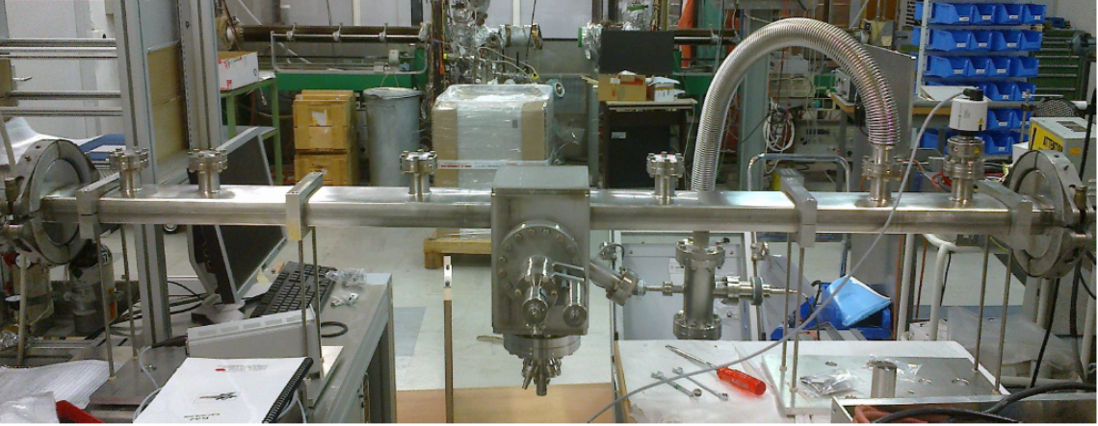
Setup in BA5
MBB profile
(no magnetic field)
sample
measured
spot
e-gun
Measurement done during the technical stop (the electronics must be brought in the tunnel)

Slide 35
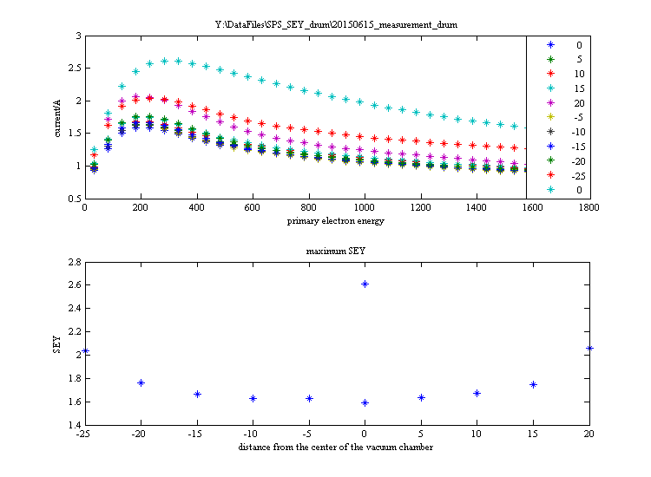
SEY vs position, transverse to the beam
-25 0 +20 mm
bottom
(not facing the beam)
before installation in SPS
SEY
Primary energy [eV]

Slide 36
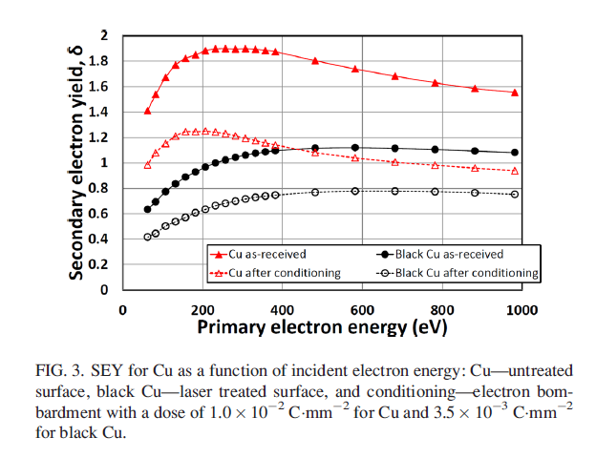
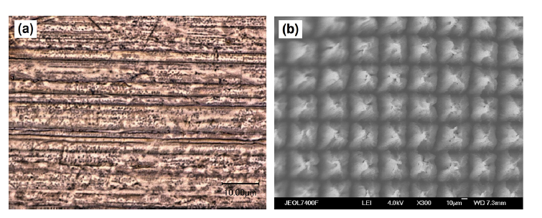
Mitigation
Microscopic roughness: laser treated surface
Cu as-rec.
Cu treated
R.Valizadeh et al. APL 105, 231605 (2014)
Laser structured surfaces: the SEY reduction is due to the micro-roughness
Under study as candidate for LHC triplets and FCC
20 μm
sample: A.Abdolvand Uni Dundee

Slide 37
Test with the SPS proton beam in e-cloud monitors
B-field 1.2KGauss
vacuum chamber
Coated liner
SPS
proton
beam
80 cm
e-cloud current
48 strips spaced 1.25 mm
The B-field of 1.2kGauss corresponds to the field of the SPS dipoles at injection energy (26 GeV)

Slide 38
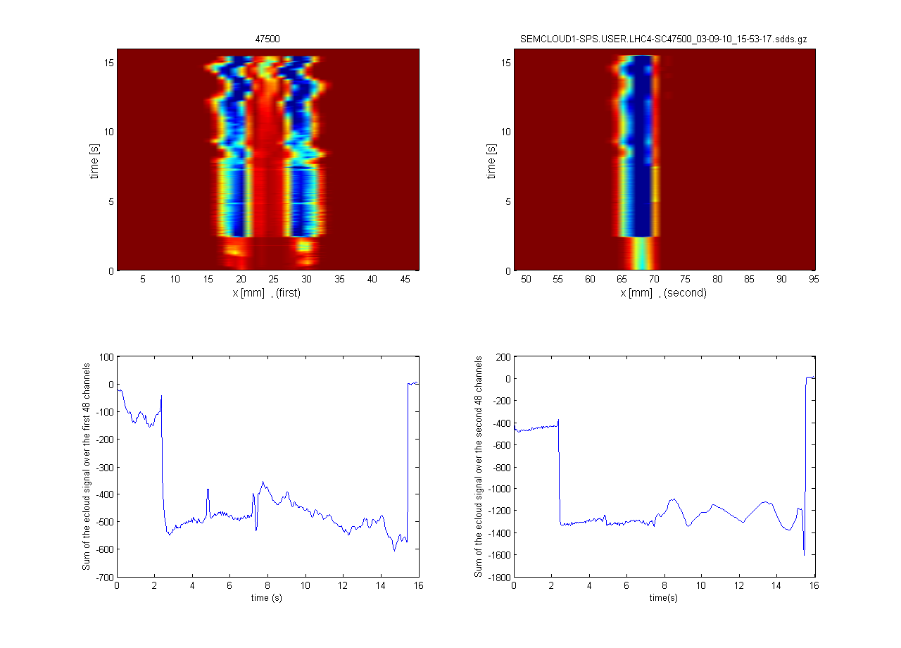
Test with proton beam in e-cloud monitors
Installed all in all 6 a-C coated liners; LHC type beams (26GeV and 450GeV, up to 1.8 x10¹¹ p/b x 72 b, 25 ns spacing) did not show e-cloud
one installed in 2008 without loss of performance up to 2015 (exposed to 1 year venting during LS1)
samples extracted after operation did not show significant SEY increase
Inner
Example:
StSt
StSt
StSt
a-C
Time [s]
Time [s]
uncoated
uncoated
uncoated
coated
ECM with SPS dipole
beam pipe
cross section
coating

