Slide 1

e-cloud issues and experience from LHC
G. Iadarola, P. Dijkstal, G. Rumolo
Thanks to:
M. Barnes, R. Cimino, E. Metral, L. Mether, A. Romano
Beam Dynamics Meets Vacuum Collimation and Surfaces – Karlsruhe, 2017

Slide 2
Outline
e-cloud buildup: basics and main ingredients
  Secondary Electron Yield
  Effect of bunch spacing and applied magnetic field
Impact on machine performance
  Heat load
  Beam instabilities
  Local vacuum degradation
Sensitivity of e-cloud buildup process on surface properties
  “Shape” of the SEY curve
  Energy spectrum of secondary electrons

Slide 3
Outline
e-cloud buildup: basics and main ingredients
  Secondary Electron Yield
  Effect of bunch spacing and applied magnetic field
Impact on machine performance
  Heat load
  Beam instabilities
  Local vacuum degradation
Sensitivity of e-cloud buildup process on surface properties
  “Shape” of the SEY curve
  Energy spectrum of secondary electrons

Slide 4
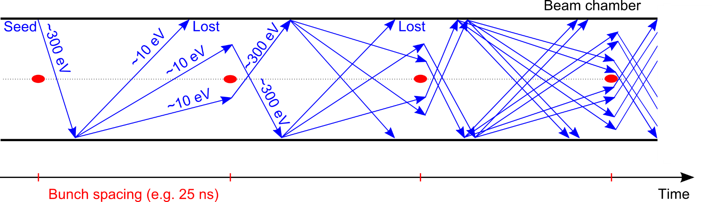

The e-cloud buildup mechanism
    e⁻ is emitted (photoelectric effect)
    Secondary Electron Emission can drive an avalanche multiplication effect filling the beam chamber with an electron cloud
    Proton bunch
    Secondary Electron Emission
Something like this…

Slide 5
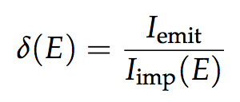
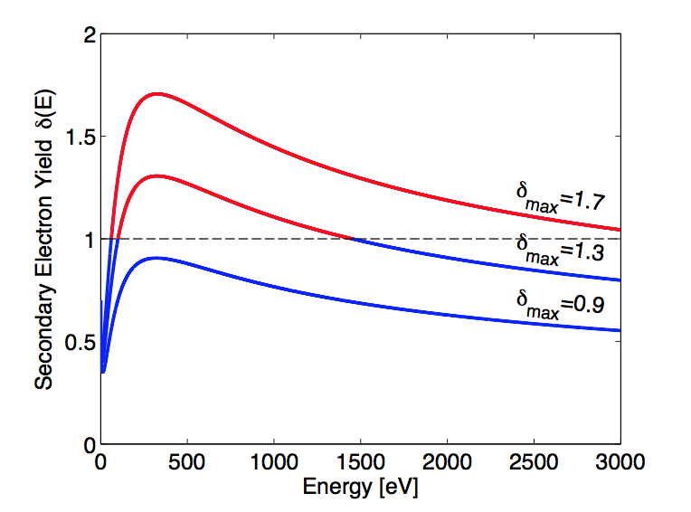
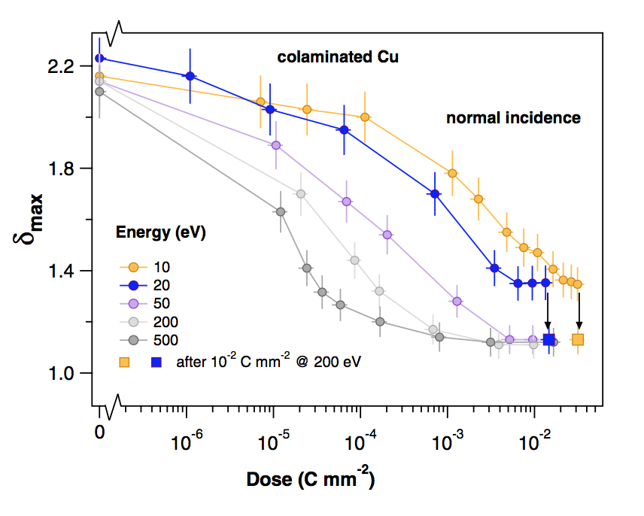
Main ingredients: surface properties
  The main quantity involved is the the Secondary Electron Yield (SEY), defined as as:
Ratio between emitted and impacting electron current as a function of the energy of the impinging electrons
It depends on surface chemical properties
It depends on the history of the surface, in particular on accumulated electron dose
  To a certain extent the e-cloud cures itself → beam induced scrubbing
R. Cimino et al. Phys. Rev. Lett. 109, 064801 – 2012

Slide 6
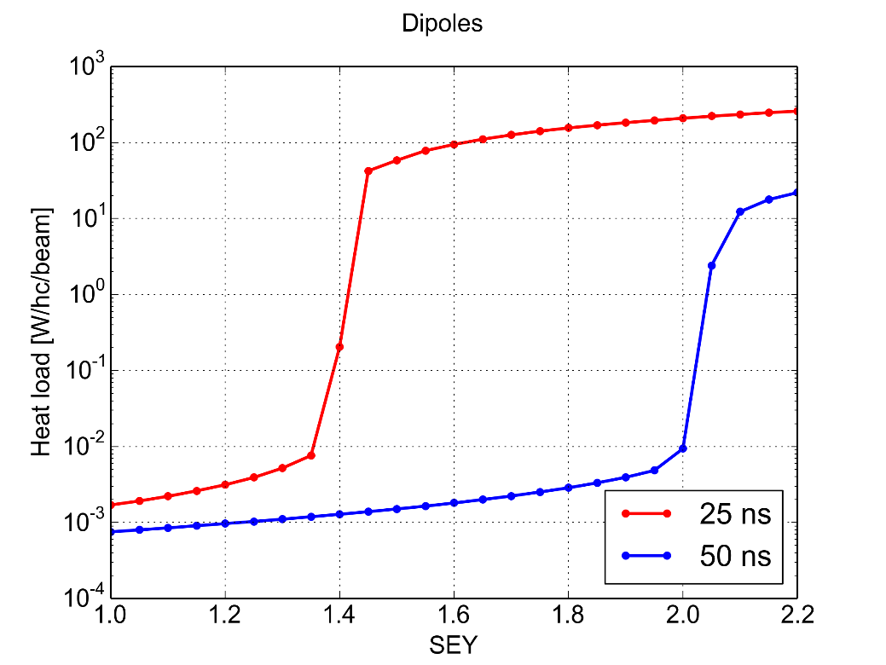
Main ingredients: bunch spacing
PyECLOUD simulations – LHC arc dipole
The bunch spacing determines how many electrons survive between consecutive bunch passages
Significant impact on multipacting threshold, i.e. SEY above which avalanche multiplication (multipacting) is triggered
Multipacting
Multipact.
Accumulation of primary e⁻
Accumulation of primary e⁻
Maximum Secondary Electron Yield (δ_{max})

Slide 7
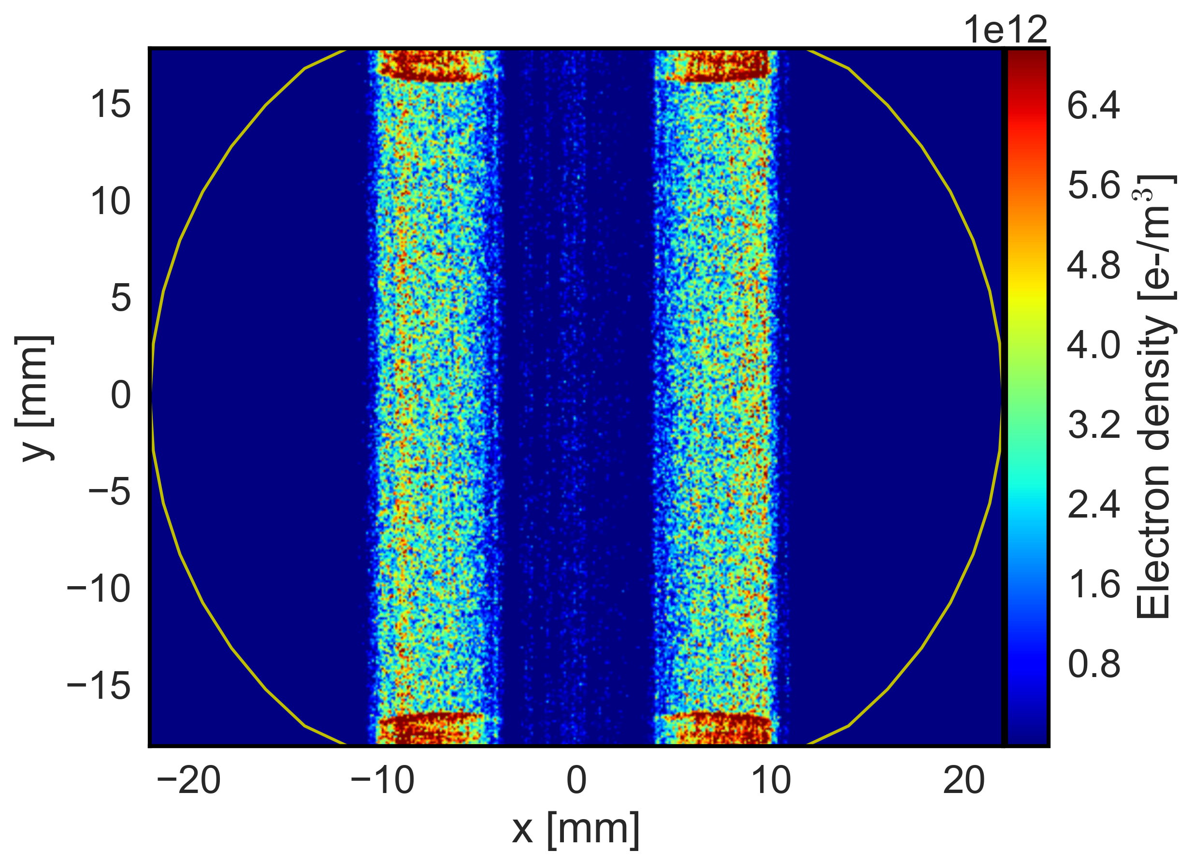
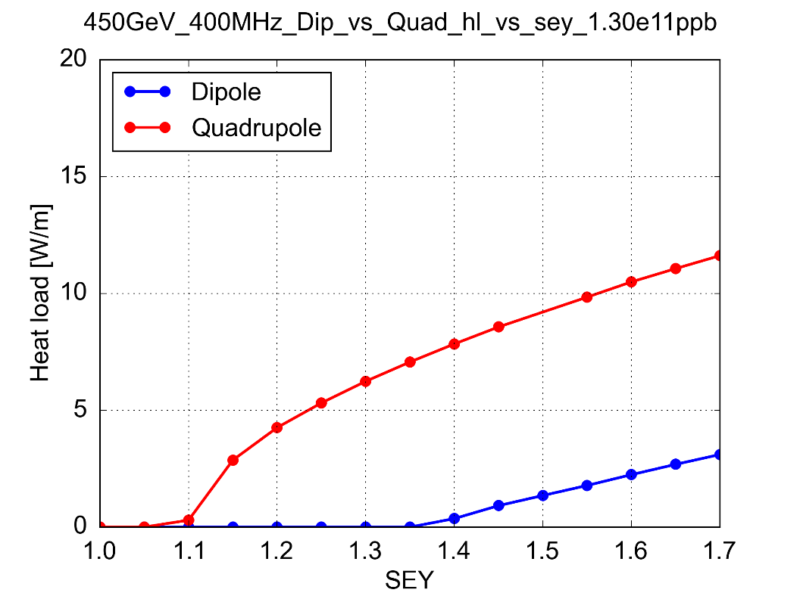
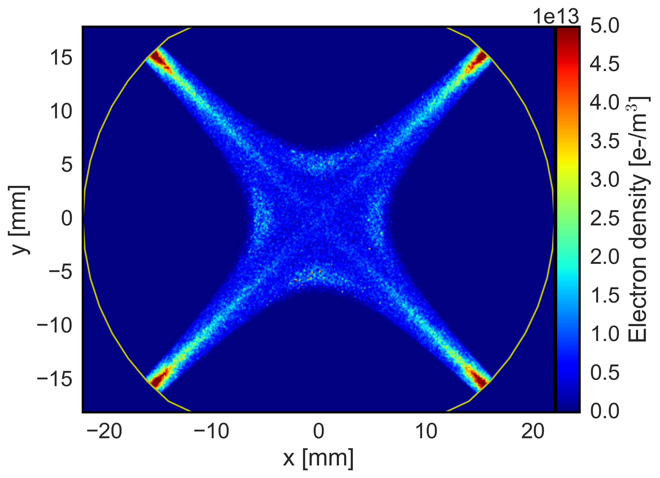
Main ingredients: magnetic fields
LHC Arc Dipole
Electron trajectories are strongly influenced by externally applied magnetic fields
Electrons spin around the field lines
In quadrupole magnets magnetic trapping can occur with electrons surviving several bunch passages being accelerated up to a few keV
  Much stronger heat loads compared to dipoles
LHC Arc Quadrupole
Maximum Secondary Electron Yield (δ_{max})

Slide 8
Outline
e-cloud buildup: basics and main ingredients
  Secondary Electron Yield
  Effect of bunch spacing and applied magnetic field
Impact on machine performance
  Heat load
  Beam instabilities
  Local vacuum degradation
Sensitivity of e-cloud buildup process on surface properties
  “Shape” of the SEY curve
  Energy spectrum of secondary electrons

Slide 9
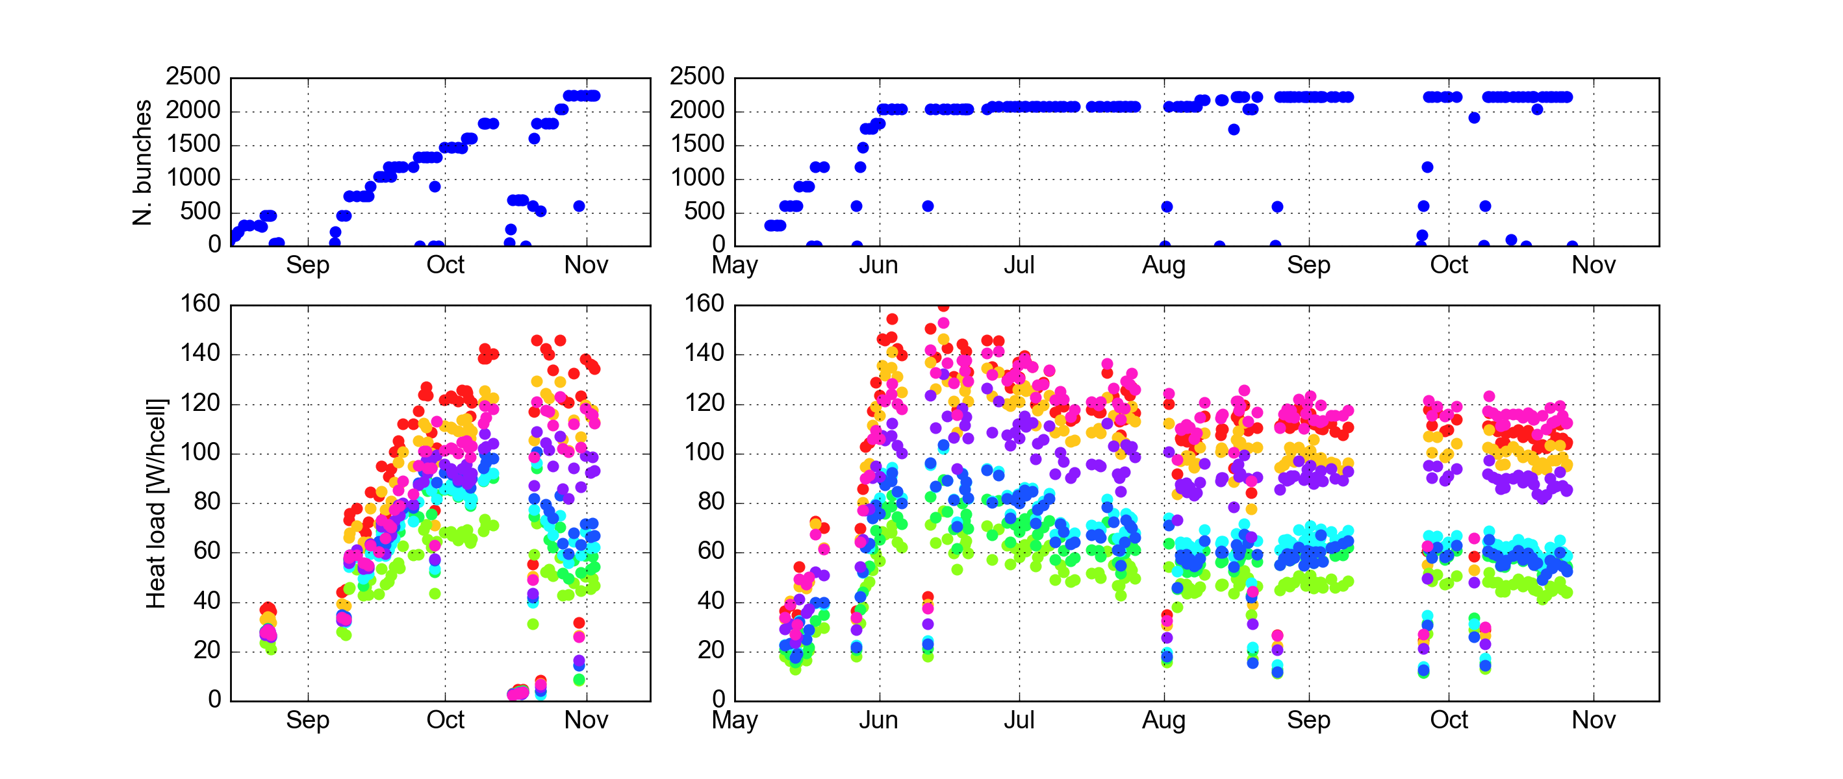
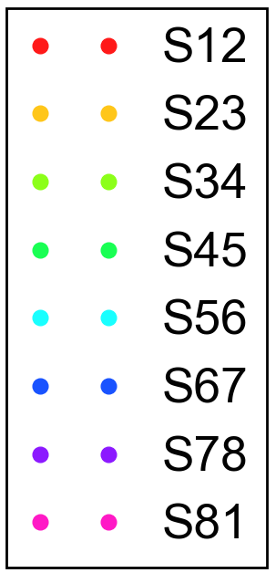
Impact on machine performance: heat loads
  The LHC started physics operation with the nominal bunch spacing of 25 ns in 2015
  e-cloud much stronger than with 50 ns spacing (even after 2 weeks dedicated to scrubbing at injection energy)
  Strong heat loads measured on the beam screens of the superconducting magnets
2015
2016
2x72b
72b
4x36b
72b
2x48b
Train
type

Slide 10
Impact on machine performance: heat loads
  The LHC started physics operation with the nominal bunch spacing of 25 ns in 2015
  e-cloud much stronger than with 50 ns spacing (even after 2 weeks dedicated to scrubbing at injection energy)
  Strong heat loads measured on the beam screens of the superconducting magnets
2015
2016
  Difficult to control beam screen temperature during transients (injection, ramp, beam dump)
  Slow intensity ramp-up needed to learn how to cope with these effects
  Mitigated with a dedicated feedforward loop using models to predict heat loads from measured beam parameters and automatically regulating the beam screen cooling system
2x72b
72b
4x36b
72b
2x48b
Train
type

Slide 11
Impact on machine performance: heat loads
  The LHC started physics operation with the nominal bunch spacing of 25 ns in 2015
  e-cloud much stronger than with 50 ns spacing (even after 2 weeks dedicated to scrubbing at injection energy)
  Strong heat loads measured on the beam screens of the superconducting magnets
2015
2016
2x72b
72b
4x36b
72b
2x48b
Train
type
  Heat loads got close to the available cooling capacity (160 W/hcell)
  Number of bunches could be gradually increased to 2244 thanks to parasitic scrubbing and to optimization of the filling pattern

Slide 12
Impact on machine performance: heat loads
  The LHC started physics operation with the nominal bunch spacing of 25 ns in 2015
  e-cloud much stronger than with 50 ns spacing (even after 2 weeks dedicated to scrubbing at injection energy)
  Strong heat loads measured on the beam screens of the superconducting magnets
2015
2016
  Thanks to scrubbing accumulated in 2015 and to the optimized cryo feed-forward intensity ramp-up in 2016 could be much faster
2x72b
72b
4x36b
72b
2x48b
Train
type

Slide 13
Impact on machine performance: heat loads
  The LHC started physics operation with the nominal bunch spacing of 25 ns in 2015
  e-cloud much stronger than with 50 ns spacing (even after 2 weeks dedicated to scrubbing at injection energy)
  Strong heat loads measured on the beam screens of the superconducting magnets
2015
2016
2x72b
72b
4x36b
72b
2x48b
Train
type
  Some margin gained thanks to parasitic scrubbing, but number of bunches could not be increased due to other problems in the injectors

Slide 14
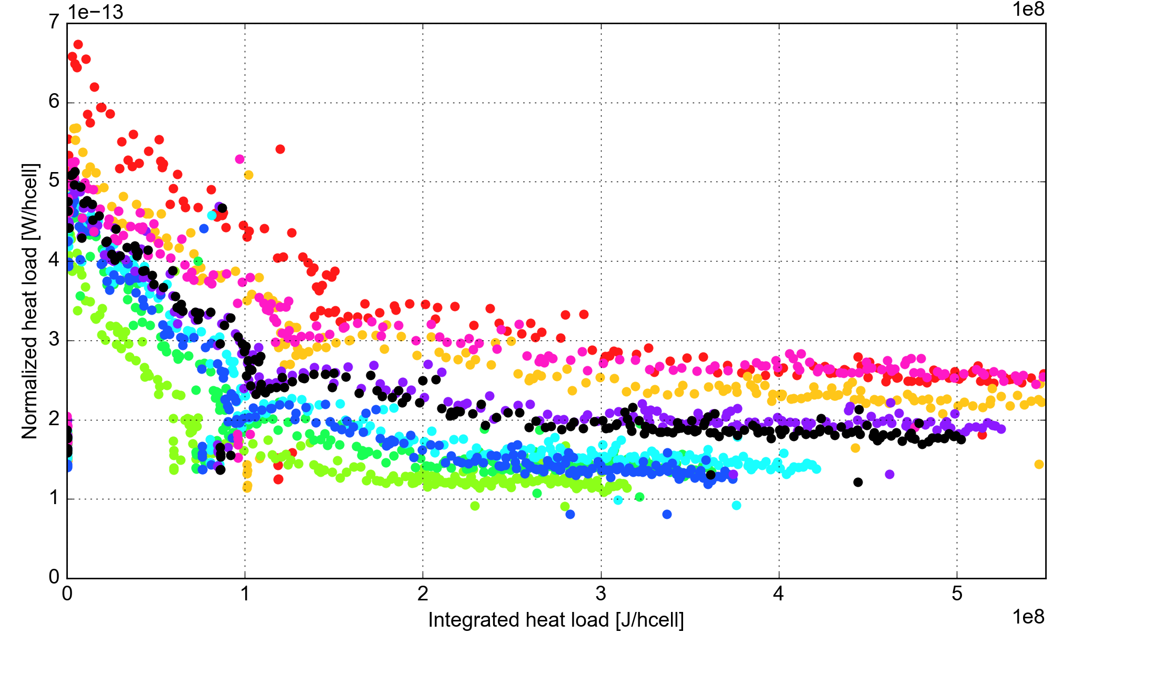
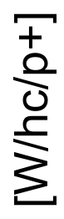
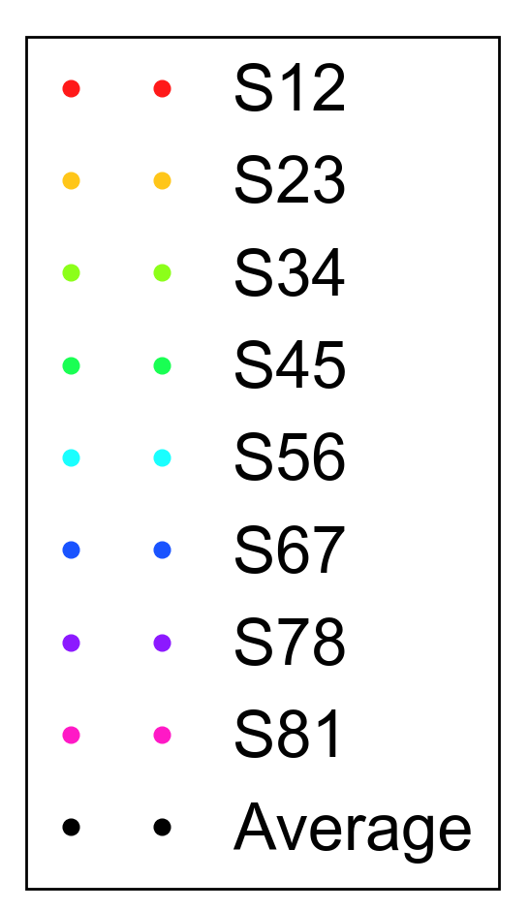
Impact on machine performance: heat loads
  Scrubbing effect clearly visible when normalizing heat loads to beam intensity
  Saturating at different levels for different sectors of the machine (origin under investigation…)

Slide 15
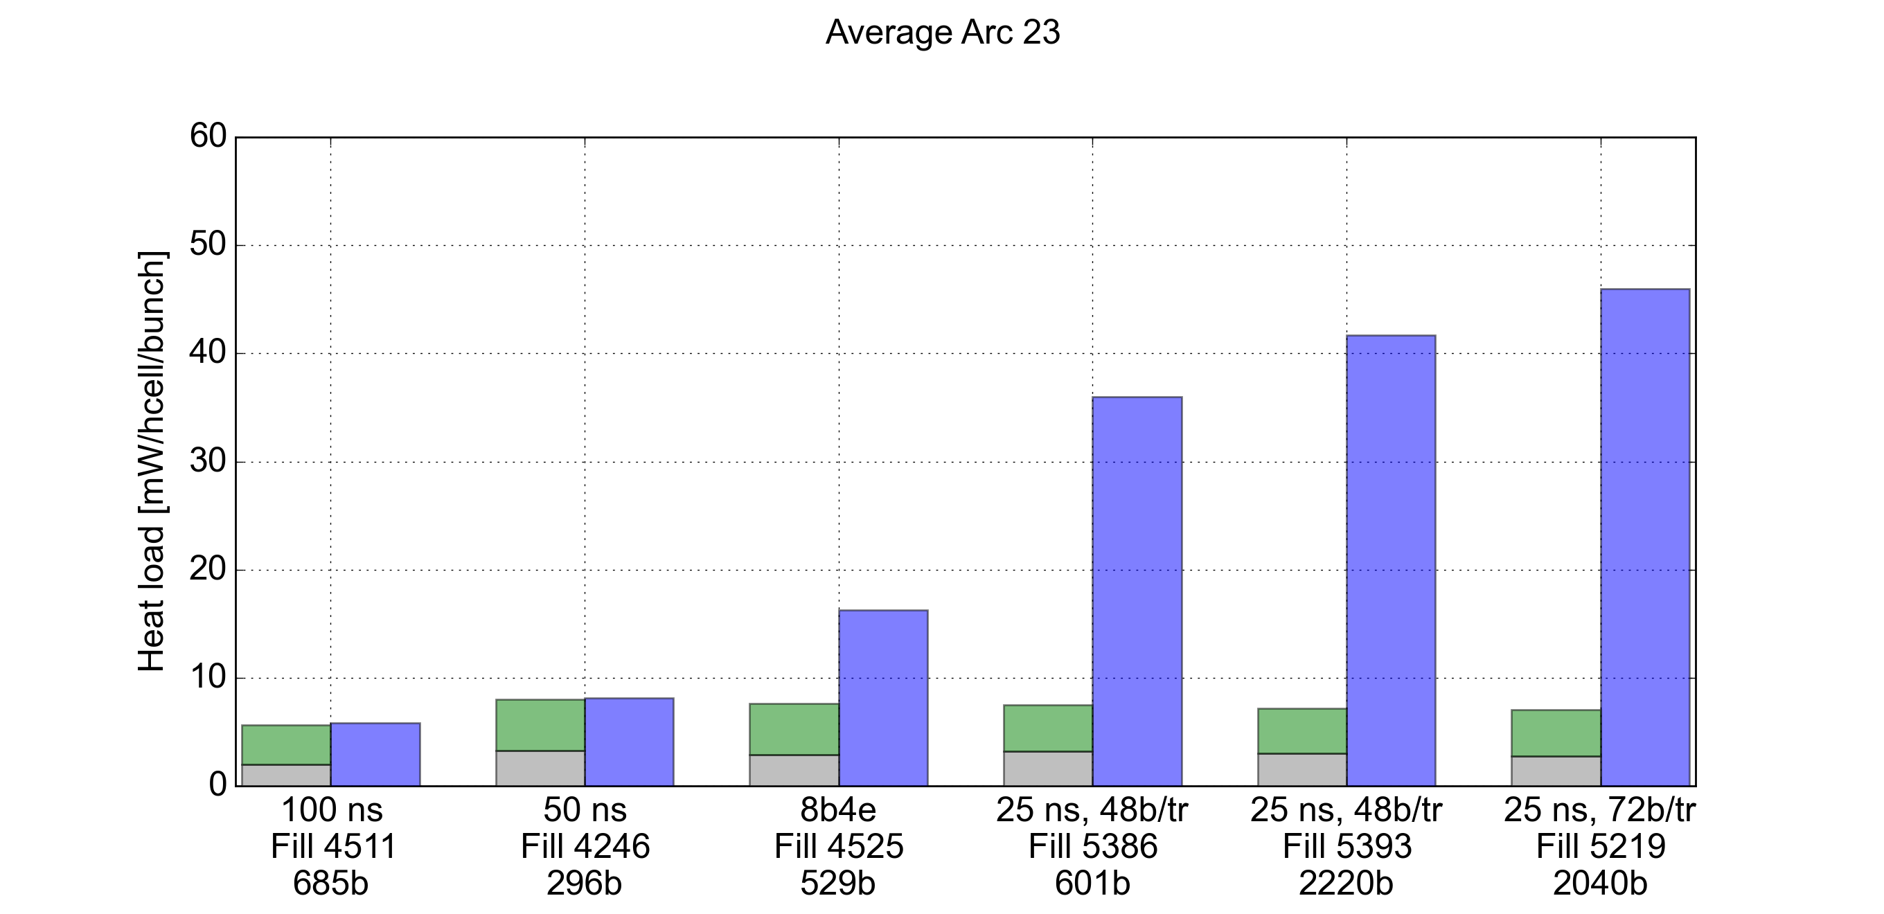
Impact on machine performance: heat loads
  As expected we have a very strong dependence of the heat loads on the bunch spacing
Arc 23 – 6.5 TeV
Synchrotron Radiation
Impedance (R.W.)
Measured

Slide 16
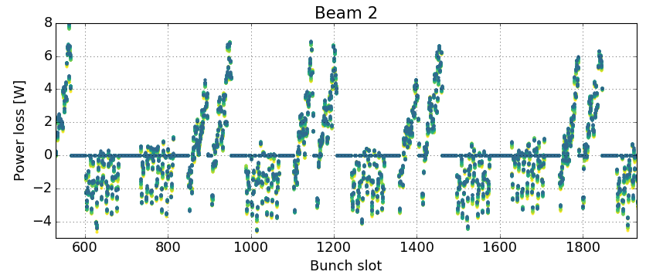
Impact on machine performance: heat loads
  e-cloud signature clearly visible on bunch-by-bunch energy loss (measured from RF stable phase shift)
  Filling schemes with short 25ns trains (8 bunches) interleaved with 125 ns gaps significantly mitigate the buildup (but with ~30% less bunches)
8b+4e
25 ns
8b+4e
25 ns

Slide 17
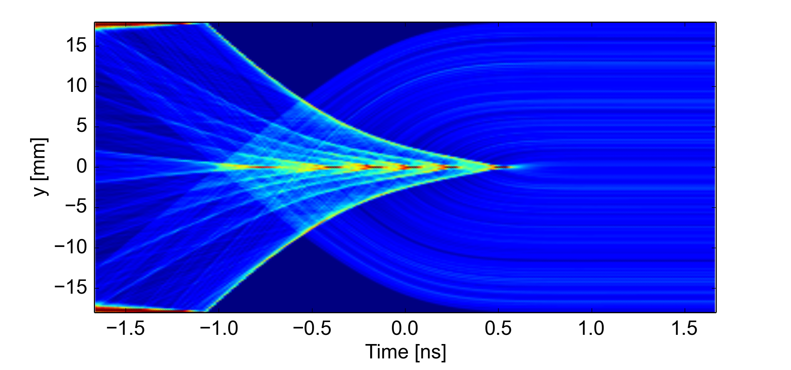
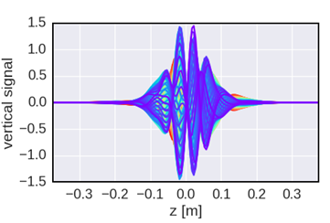
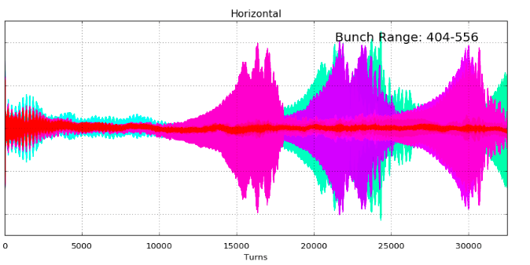
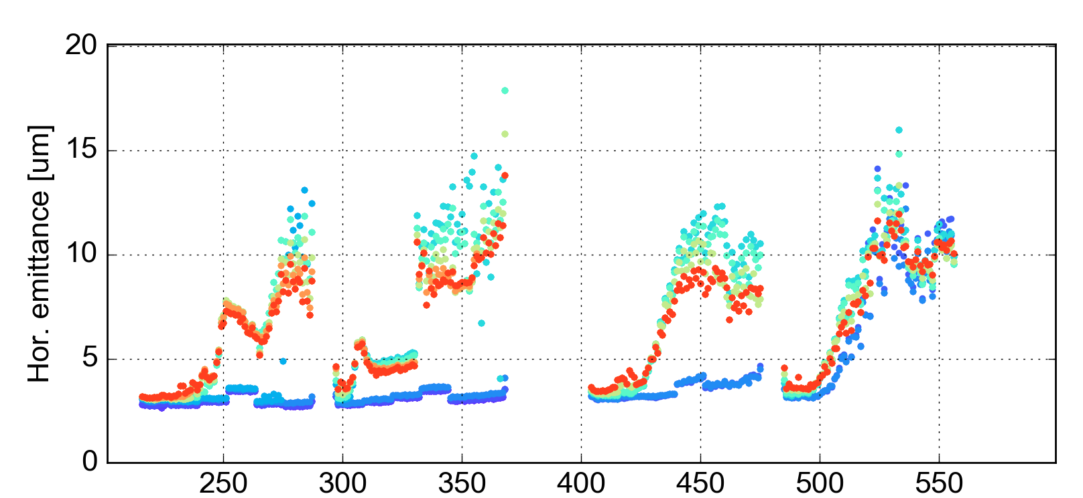
Impact on machine performance: beam instabilities
The electrons are attracted by the proton bunches and “fly” through the beam
This can induce strong coherent oscillations within the bunch → transverse instability
Electron density during a bunch passage
e-cloud driven instability
Simulation
Simulation
Measurements (2016)
Measurements (2016)
Bunch position (a.u.)
Courtesy L. Carver

Slide 18
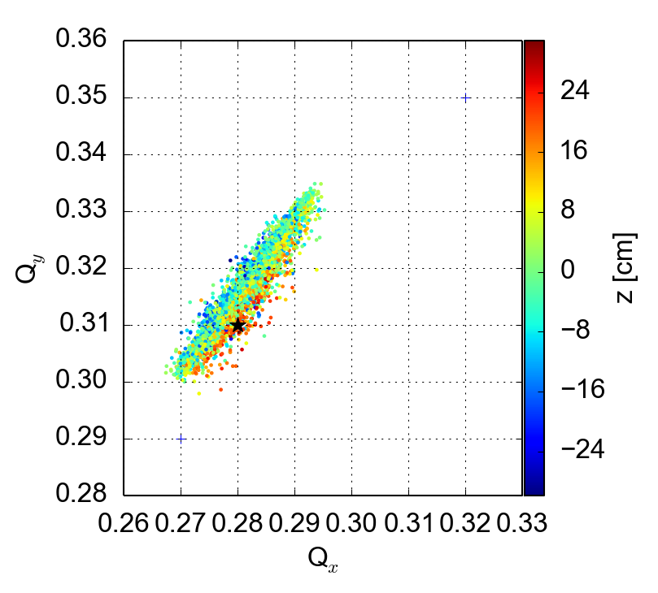
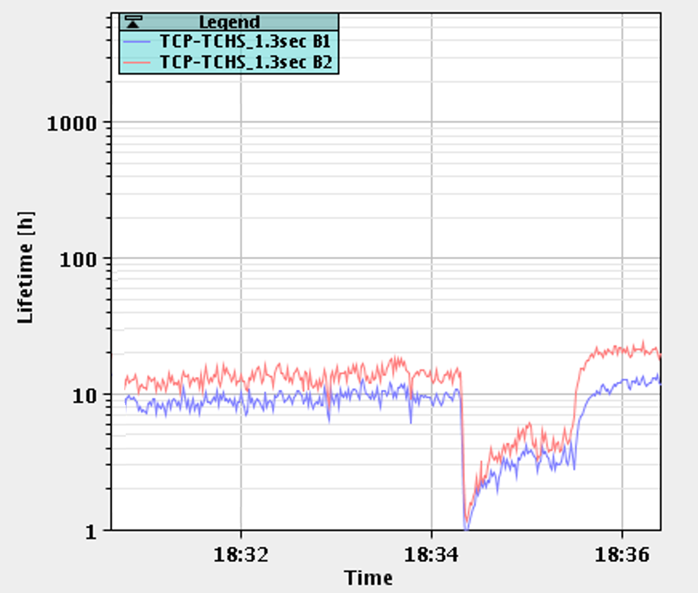
Impact on machine performance: beam instabilities
We had to learn how to run the machine in the presence of the e-cloud
Tricky to ensure beam stability at injection (e-cloud in quadrupoles identified as a major source of the instability). To preserve transverse emittance we operate with:
  Transverse feedback: high gain, maximum achievable bandwidth
  High chromaticity (Q’_{HV}=20)
  High octupole settings (ΔQ_{RMS} = 1.5 x 10⁻³)
Changed tunes at injection to better accommodate large tune footprint from Q’, octupoles and e-cloud
Octupole knob at -1.5
Q’=15/20, 5 x 10¹¹ e/m³
Q’v=15
Qv=.305
Q’v=15
Qv=.300
Q’v=10
Qv=.305
(.28, .31)
(.27, .295)
Courtesy A. Romano

Slide 19
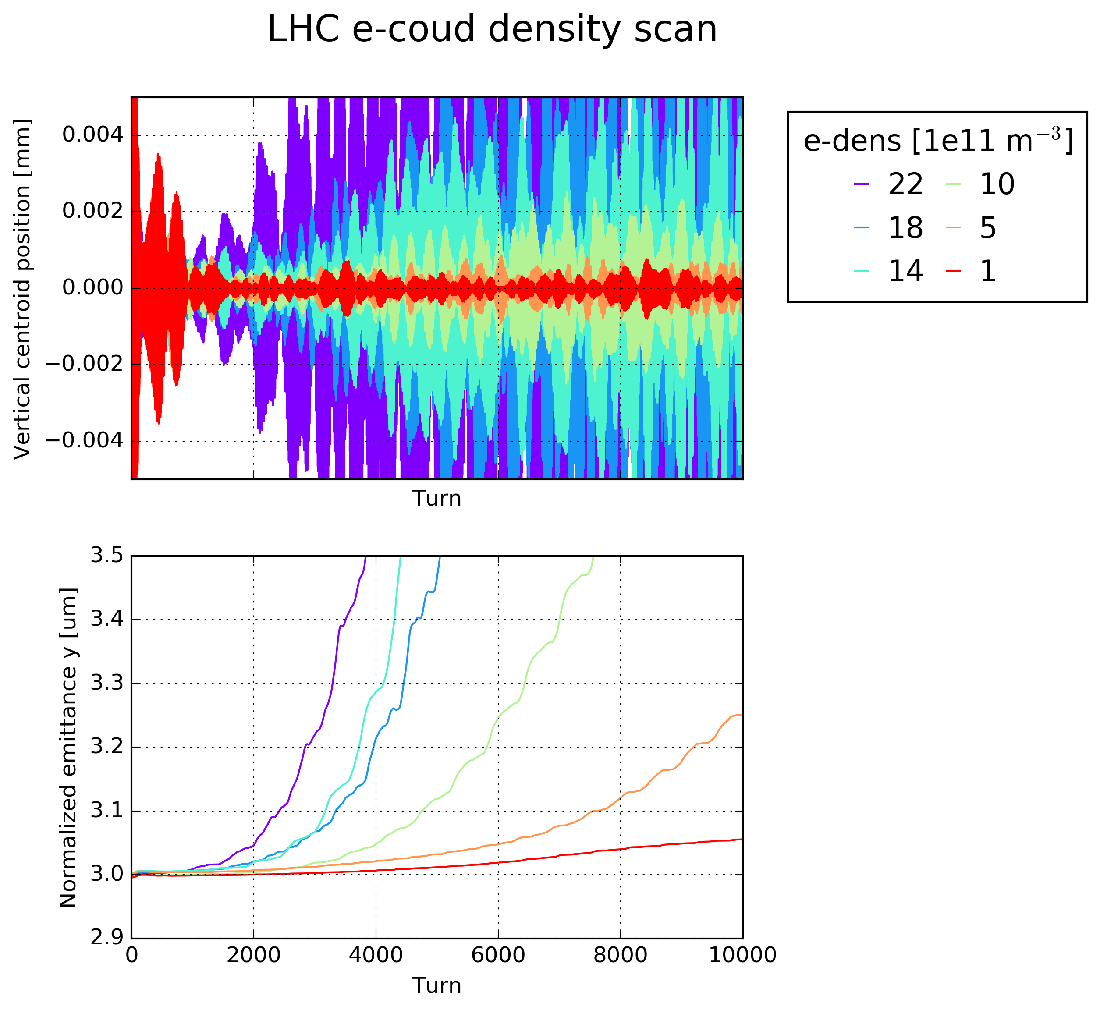
Impact on machine performance: beam instabilities
Intense work ongoing to be able to simulate these kind of instabilities
In space: small beam (~100 μm) in a big chamber (4 cm)
In time: 1 ns for the e⁻ motion, 1 to 10 s for instability development
Multi-scale problem:
Recent work at CERN focused on increasing the performance of our simulation tools:
  Introduced multi-grid Particle in Cell solver
  Exploit parallel computing through a new parallelization layer (PyPARIS)
Allowed gaining new insight on scenarios that were previously inaccessible (e.g. 10k turn simulations for LHC at 7 TeV)

Slide 20
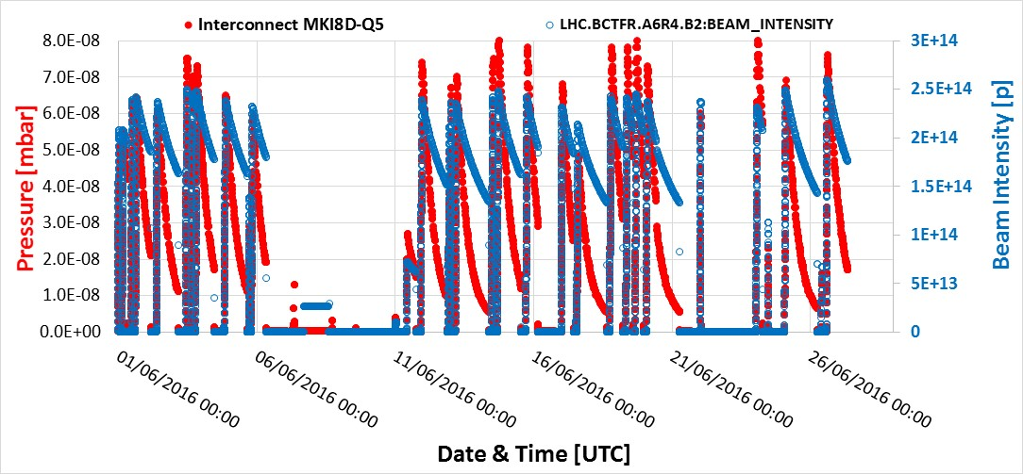
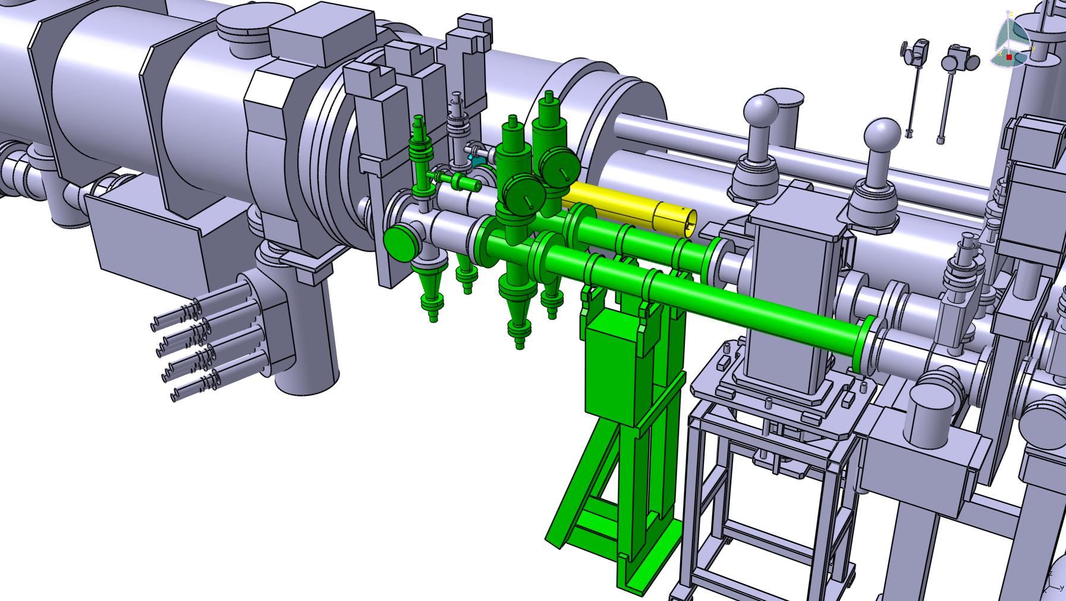
Impact on machine performance: vacuum degradation
Even with 25 ns spacing (e-cloud developing large fraction of the machine) no significant beam degradation from beam-gas interaction is observed (thanks to efficient pumping – see talk by V. Baglin)
Nevertheless localized pressure increase due to e-cloud can still limit the performance:
Example: pressure in one of the injection kicker areas rising to the maximum acceptable to pulse the kicker
  This limited bunch intensity to ~1.1e11 in 2016
  Additional pumping modules added for the 2017 Run (starting in May)
Injection interlock
Courtesy M. Barnes

Slide 21
Outline
e-cloud buildup: basics and main ingredients
  Secondary Electron Yield
  Effect of bunch spacing and applied magnetic field
Impact on machine performance
  Heat load
  Beam instabilities
  Local vacuum degradation
Sensitivity of e-cloud buildup process on surface properties
  “Shape” of the SEY curve
  Energy spectrum of secondary electrons

Slide 22
Simulation of the e-cloud formation
Main steps involved in the simulation (e.g. in PyECLOUD)
t=t+Δt
Ionization of the residual gas
Photoemission from synchrotron radiation
Generate seed e⁻
Evaluate the electric field of beam at each MP location
Evaluate the electric field from the electrons
Compute MP motion (t->t+Δt)
Interaction with the surface:
Detect impacts and generate secondary electrons

Slide 23
Simulation of the e-cloud formation
Main steps involved in the simulation (e.g. in PyECLOUD)
t=t+Δt
Generate seed e⁻
Evaluate the electric field of beam at each MP location
“Standard electrodynamics”
Maxwell’s and Newton’s equations
Well estabilished numeric techniques from plasma physics (Particle In Cell, Boris tracking)
Evaluate the electric field from the electrons
Compute MP motion (t->t+Δt)
Interaction with the surface:
Detect impacts and generate secondary electrons

Slide 24
Simulation of the e-cloud formation
Main steps involved in the simulation (e.g. in PyECLOUD)
t=t+Δt
Generate seed e⁻
Evaluate the electric field of beam at each MP location
Evaluate the electric field from the electrons
Compute MP motion (t->t+Δt)
Not much can be deduced from fundamental laws
Use empirical models obtained by fitting analytic expressions on lab measurement data (see next slides…)
Interaction with the surface:
Detect impacts and generate secondary electrons

Slide 25
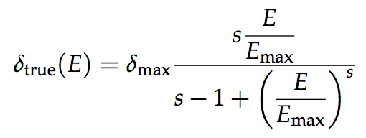
Secondary emission modeling
In ECLOUD and PyECLOUD the Secondary Electron Yield has the following expression (obtained in [1] fitting experimental data):
For LHC beam screens we keep fixed:
E_{max} = 332 eV
s = 1.35
while we assume that δ_{max} changes with scrubbing
Elastic interactions are treated separately
For the surface community:
Is this fit consistent with more recent measurements?
Can we assume that parameters E_{max} and s do not change with surface conditioning?
Do they depend on temperature, magnetic field, physisorbed gases?
Sensitivity of e-cloud buildup on these parameters will be shown in the next slides

Slide 26
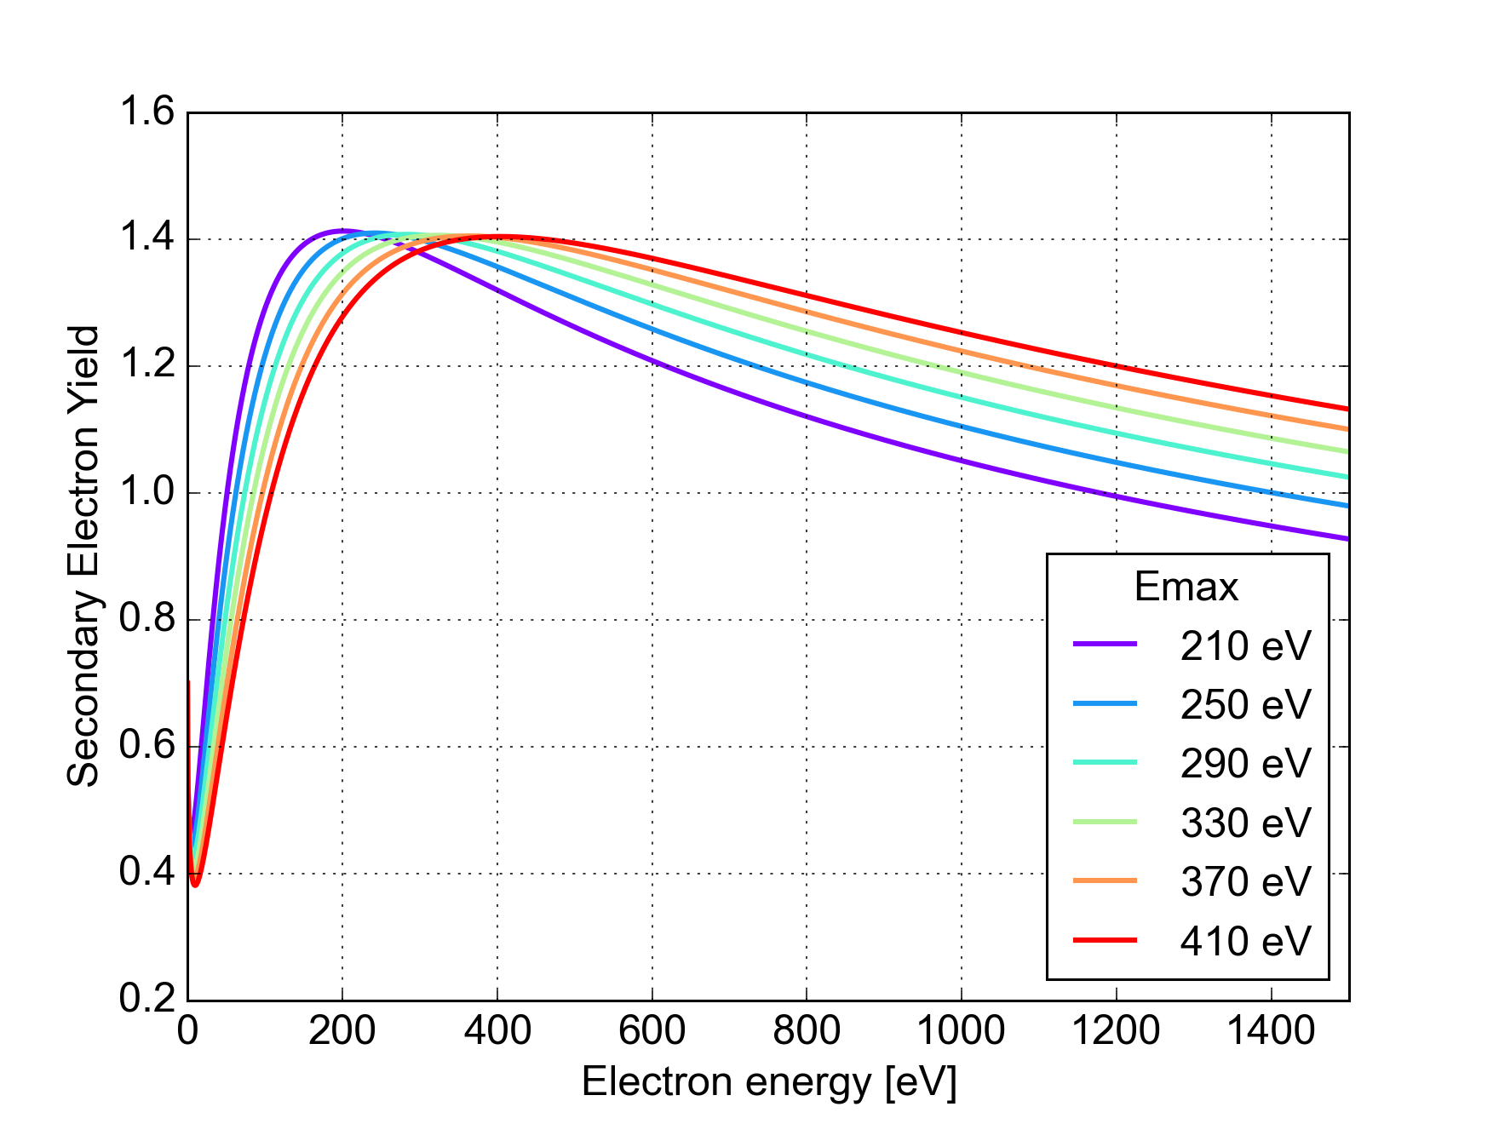
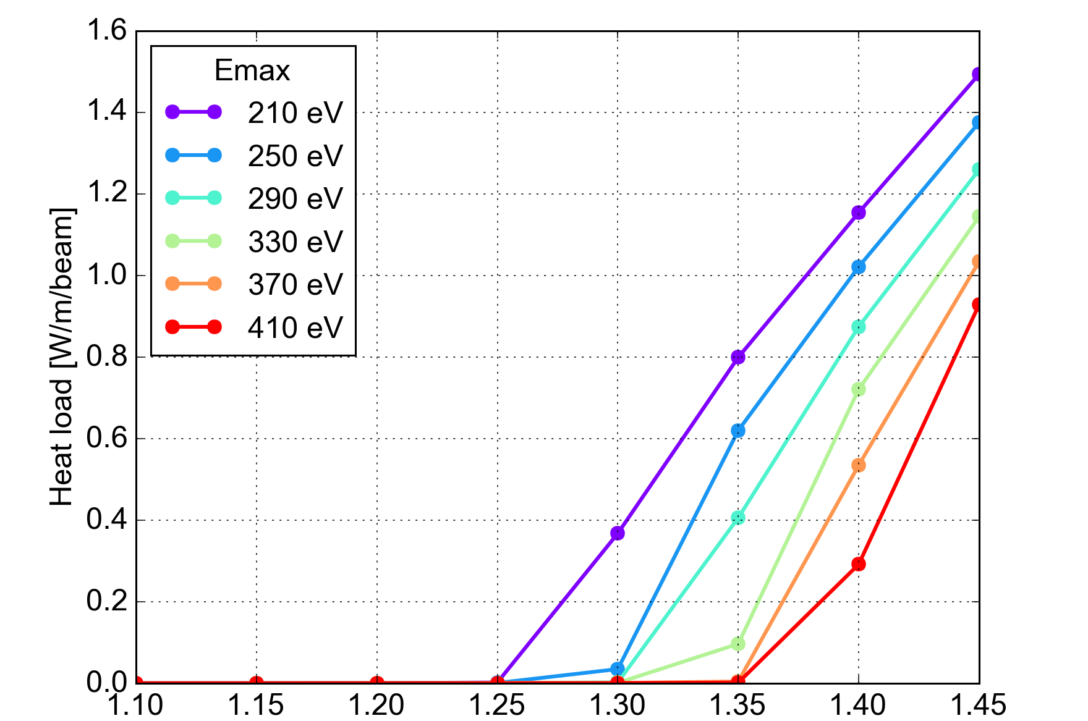
Sensitivity to surface properties: effect of E_{max}
This parameter changes the position of the maximum and also the decay at higher electron energy
The effect can be significant, visible on the heat loads
Maximum Secondary Electron Yield (δ_{max})

Slide 27
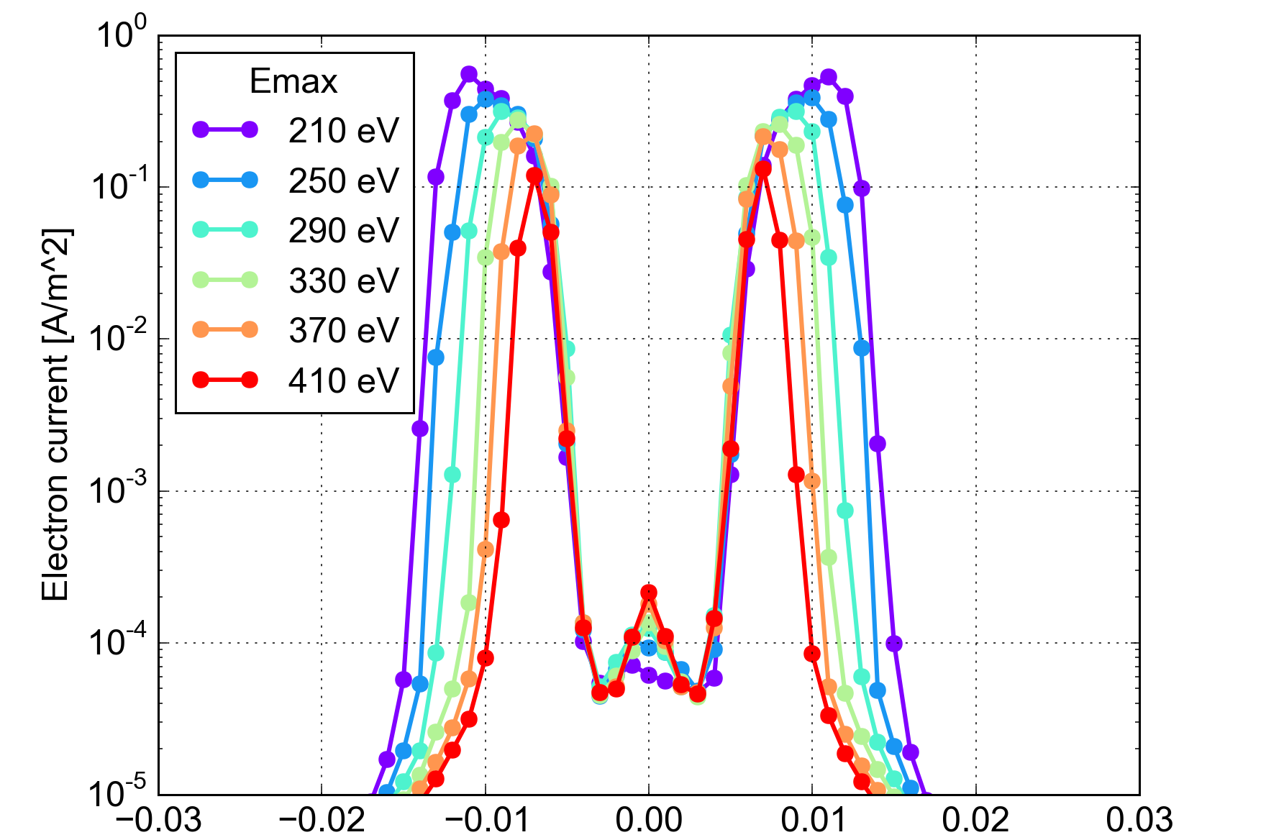
Sensitivity to surface properties: effect of E_{max}
This parameter changes the position of the maximum and also the decay at higher electron energy
The effect can be significant, visible on the heat loads and on the distribution of the electrons in the beam pipes
Horizontal position [m]

Slide 28
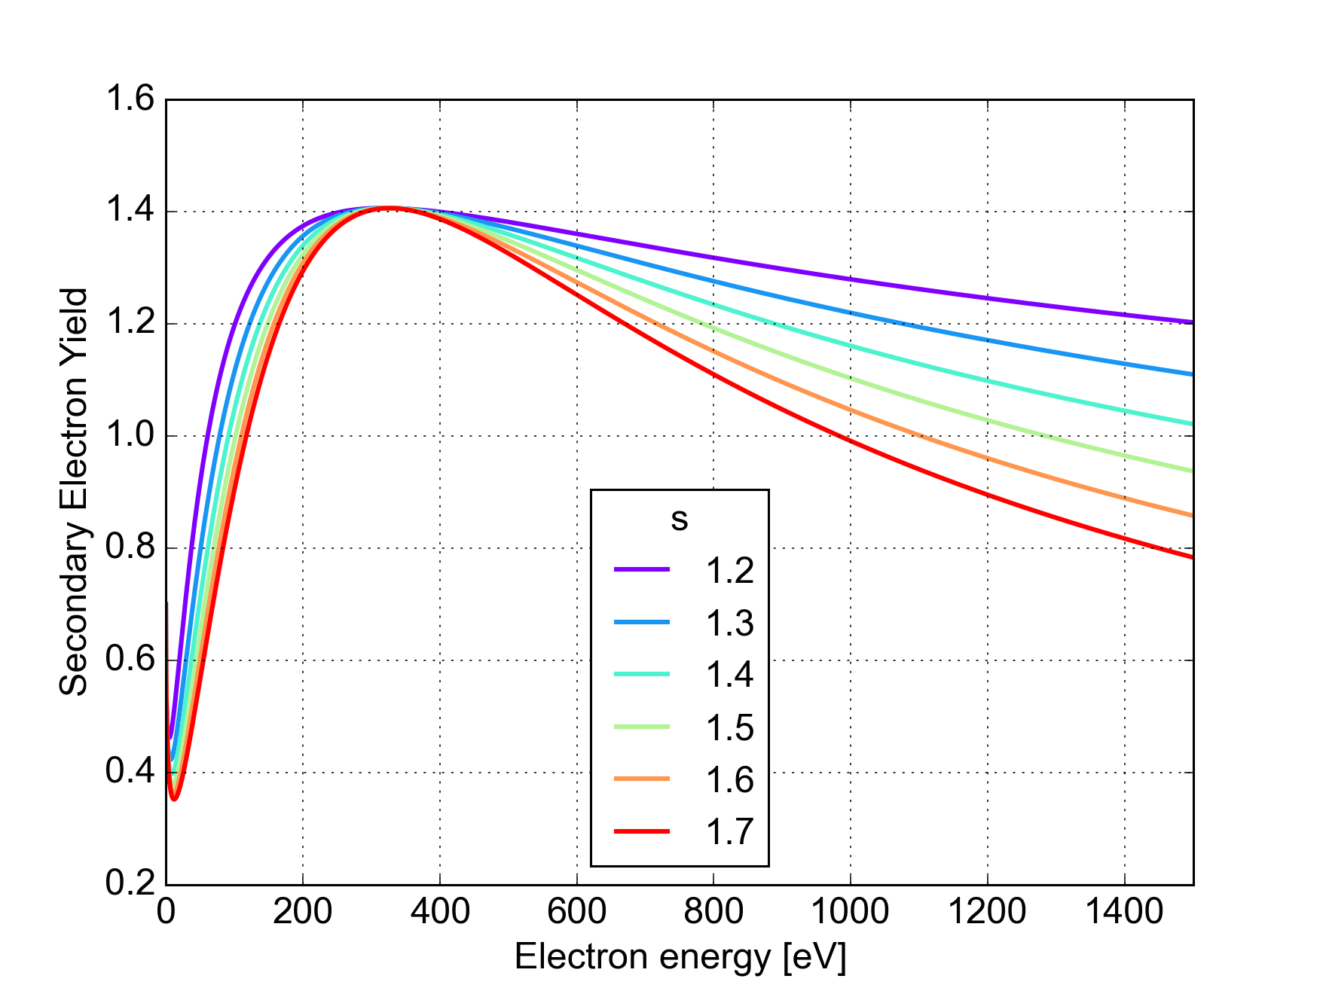
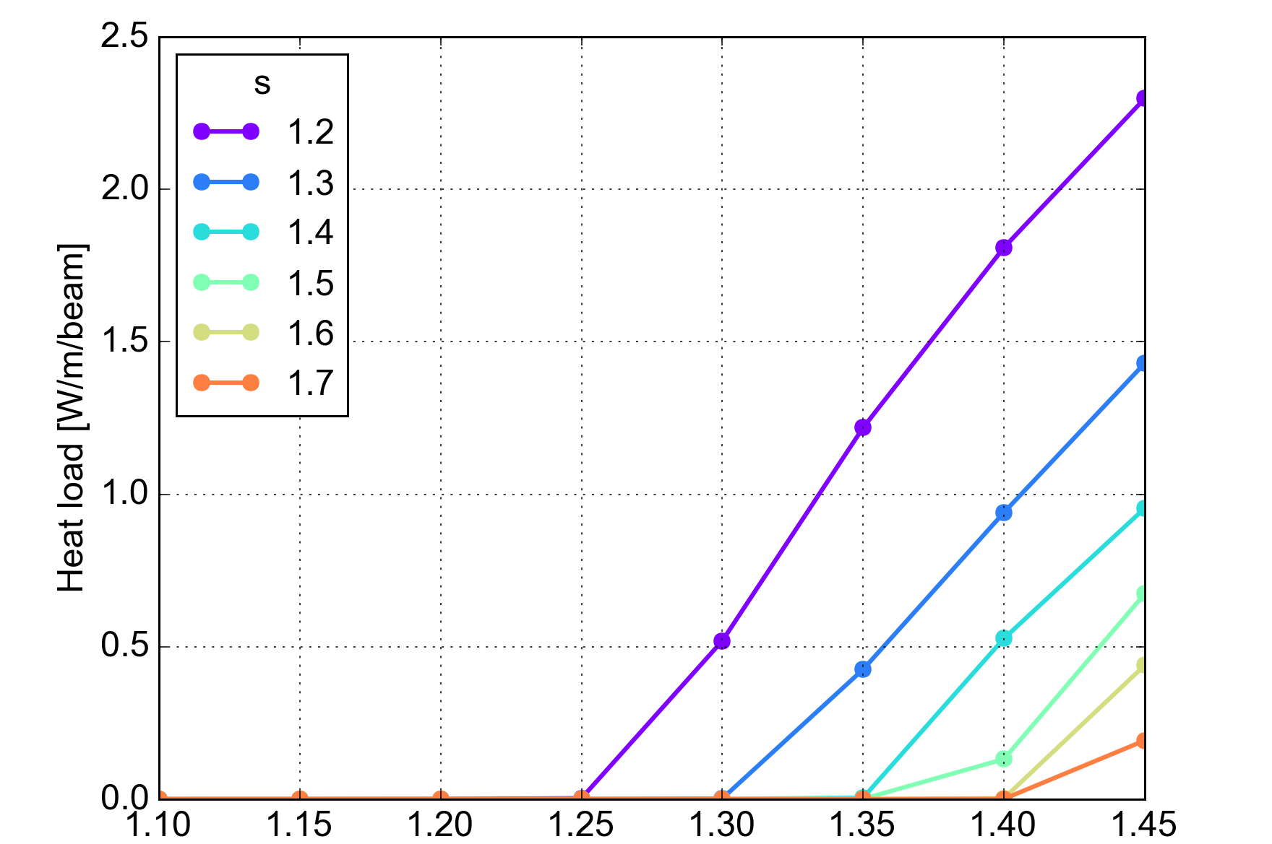
Sensitivity to surface properties: effect of s
This parameter mainly changes the decay of the curve for high electron energy
Also here the effect can be very strong…
Maximum Secondary Electron Yield (δ_{max})

Slide 29
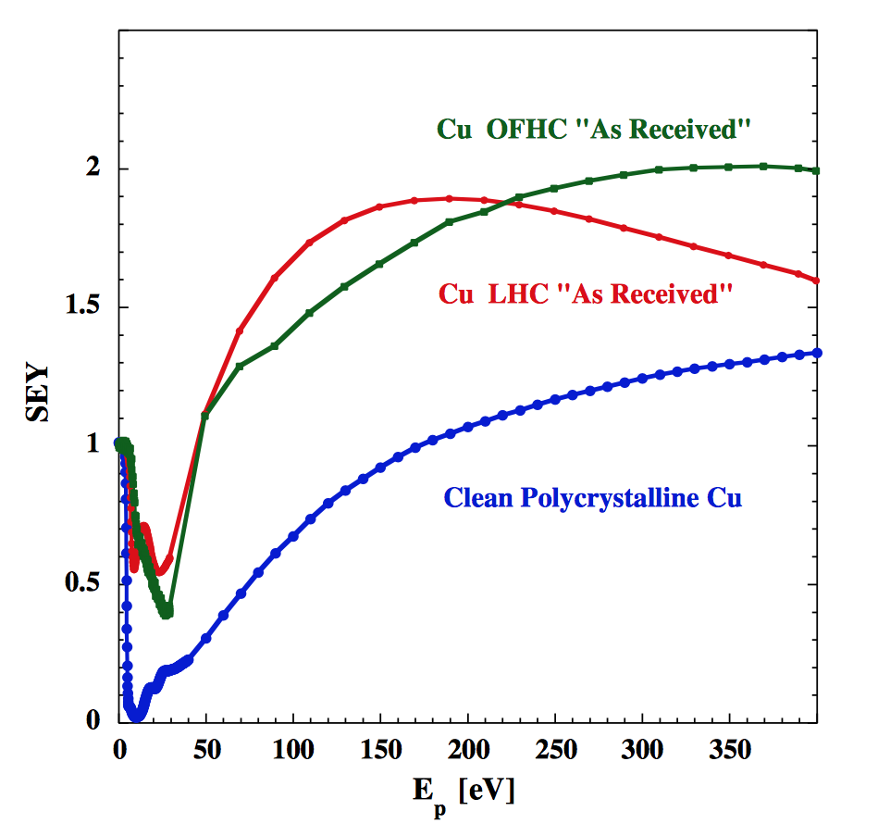
Sensitivity to surface properties: low energy SEY
Behavior at low energy plays a very important role in the e-cloud buildup
  Determines with which probability elections will survive between subsequent bunch passages
R. Cimino et al., PRSTAB 18, 051002 (2015)

Slide 30
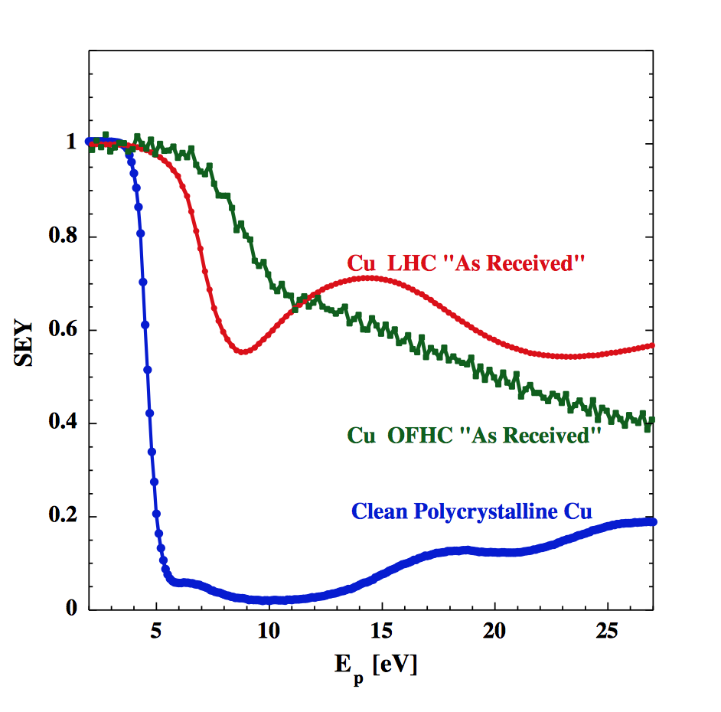
Sensitivity to surface properties: low energy SEY
Behavior at low energy plays a very important role in the e-cloud buildup
  Determines with which probability elections will survive between subsequent bunch passages
R. Cimino et al., PRSTAB 18, 051002 (2015)

Slide 31
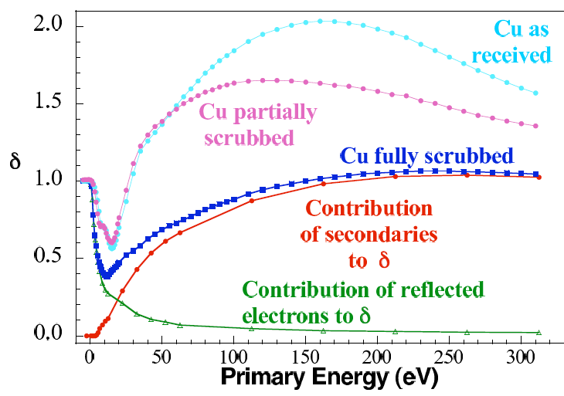
Sensitivity to surface properties: low energy SEY
Behavior at low energy plays a very important role in the e-cloud buildup
  Determines with which probability elections will survive between subsequent bunch passages
Experiments seem to indicate that this part of the curve evolves with scrubbing
  Characterizing this effect vs dose would significantly improve our understanding on scrubbing
R. Cimino et al. Phys. Rev. Lett. 93, 014801 - 2004

Slide 32
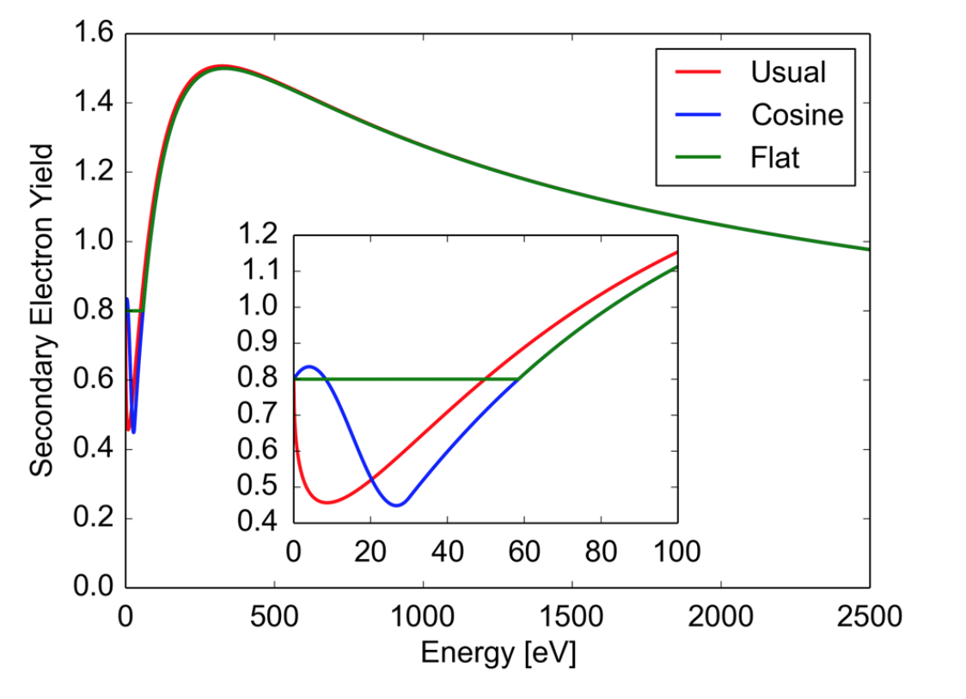
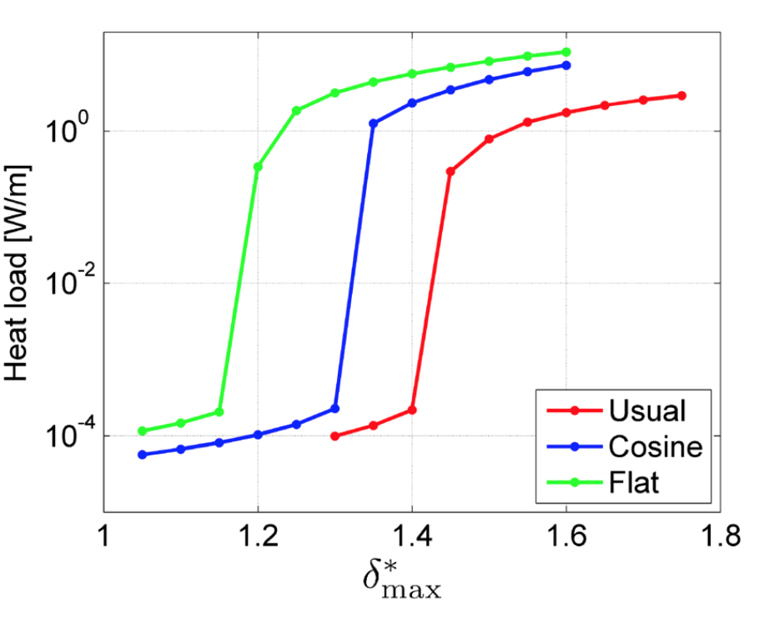
Sensitivity to surface properties: low energy SEY
A small simulation experiment confirms that the effect can be very strong

Slide 33
Sensitivity to surface properties: energy of secondary e⁻
There is more than just the SEY curve:
The energy of the secondary e⁻ determines their probability of being absorbed before the following bunch passage
PyECLOUD (as ECLOUD) implements distribution measured at CERN by N. Hilleret et al.
Significant impact on multipacting threshold and heat load values

Slide 34
Sensitivity to surface properties
… and there are many other aspects that could be a significant impact:
Dependence on the angle of impact
Angular distribution of emitted electrons
Dependence of all these properties on accumulated dose, temperature, magnetic field
Other relevant differences to be taken into account when applying lab measurements to accelerator conditions?
My dream:
A database of SEY curves (for different material, accumulated scrubbing and other relevant parameters) to be plugged in the simulator directly (without necessarily fitting the entire curve)
Data needs with good resolution at low energy and to extend up to 1-2 keV (at least for simulation of buildup in quadrupoles)

Slide 35
Thanks for your attention!

