Slide 1
The 70 MeV H- Transfer Line at ISIS
Bryan Jones
ISIS Beam Physics Operations Leader
Contributions from – Denis Cherepkov (Design Engineering), Sunil Patel (Vacuum Section)
Beam Dynamics meets Vacuum, Collimations and Surfaces Workshop, March 2017

Slide 2
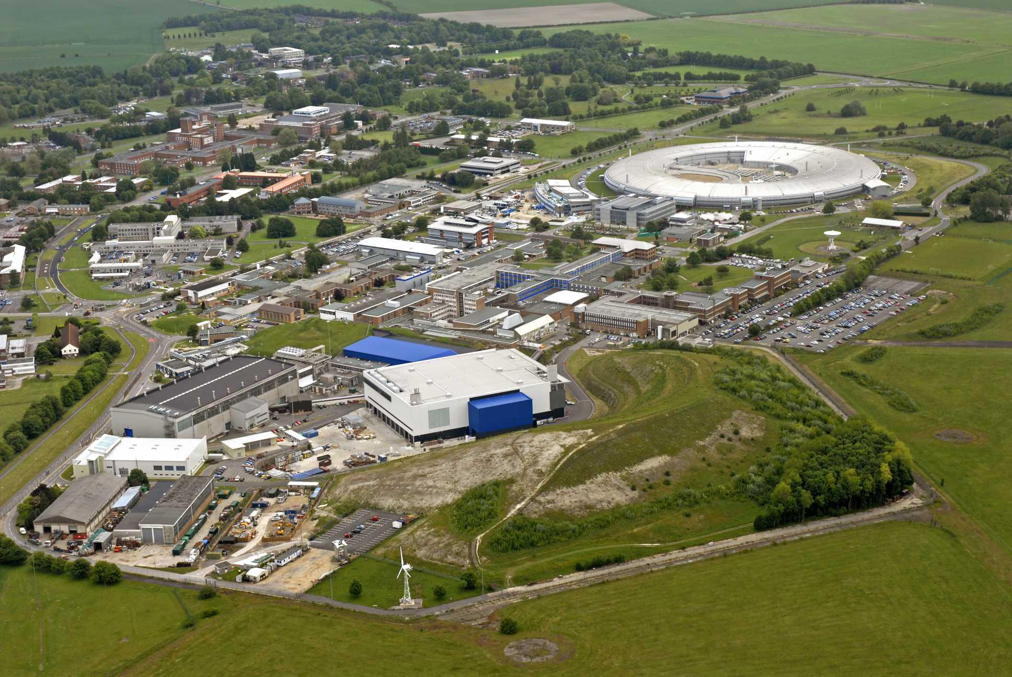
ISIS Spallation Neutron Source Rutherford Appleton Laboratory, UK
Notes:
ISIS is located at RAL near Oxford in the UK.
It is the central laboratory for the UK’s STFC and is home to high-power laser, computing and space facilities, the Diamond 3rd gen light source and the ISIS Neutron Source.

Slide 3
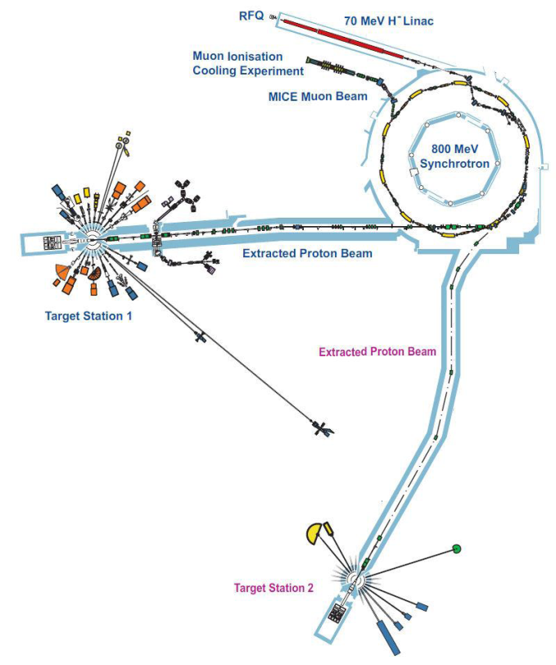
ISIS
Notes:
From above we see the linac hall, synchrotron mound and two target halls.
The first target station and accelerator buildings were built in the 60s for a previous machine, NIMROD.
ISIS began operations in 1985 and added this second target station in 2008.
Inside these buildings we have a 665 keV RFQ and 70 MeV, 4-tank DTL which feed the 800 MeV 50 Hz RCS.

Slide 4
ISIS
Accelerators:
RFQ: 665 keV H⁻
Linac: 70 MeV H–, 25 mA, 200 μs, 50 pps
Synchrotron: 800 MeV proton, 50 Hz
h=2, 6 fundamental and 4 second harmonic RF cavities
Targets:
W (Ta coated) : Neutrons
Graphite : Muons
Instruments:
TS-1: 20 TS-2: 7 Muon: 6
~£35M/year budget
~350 permanent staff
Notes:
The injector produces 200us long bunches of 70MeV H- ions at 50Hz with a peak current of 25mA.
The 160m circumference ring accelerates up to 3x10¹³ ppp in 2 bunches using 6 fundamental and 4 relatively new second harmonic cavities.
Beam is fed to the original TS-1 which has an intermediate muon target, and the newer TS-2.
ISIS is a well established facility which has operated for >30 years and has a large, global user community.

Slide 5
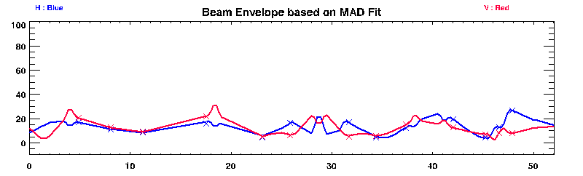
Injection Line – ‘HEDS’
70 MeV H–, 25 mA, 200 μs, 50 pps
52 m beamline
4-inch (~100mm) OD aluminium vacuum tube
Notes:
The injection line or High Energy Drift Space is a 52m long beamline mostly consisting of 4-inch OD aluminium tube.
There is a set of steering magnets to align the beam from the linac, large horizontal bending magnets to move the beam to the inside of the ring and into the injection region.
We have 13 flying-wire profile monitors and several beam toroids.

Slide 6
Beamline Design
Design Pressure
5x10⁻⁷ mbar
Aluminium flight tubes
Low atomic number, low activation
Viton seals, increased maintenance
Graphite beam absorbers
Outer radii of main bending magnets
Collect partially stripped H⁰
Notes:
Aluminium flight tubes were originally used as their low-Z means low activation. However they necessitate the use of rubber o-rings to seal joints. These decay over time/beam and need replacement every 12-18 months.
The main dipoles contain 15mm thick graphite beam absorbers, in-vacuum, along their outer radii to collect lost beam.

Slide 7
Vacuum Performance
Beamline volume ~500 litres
3 turbo pumps (Leybold TurboVac 361)
Backed with scroll pumps (Edwards nXDS10)
Vacuum gauges at each pump
Pfeiffer pirani (TPR010) and cold cathode penning (IKR050)
Typical operating range:
1->10x10⁻⁷ mbar
Up to 3x10⁻⁶ under leak conditions
Interlocks trip at 5x10⁻⁶
Notes:
The beamline has a total volume of around 500 litres which is typically operated at 1 -> 10e-7 mbar.
Vacuum is produced by 3 turbo pumps with gauges at each pump.
We have operated at pressure up to 3e-6 mbar with considerable increased beam loss.
Hardware will trip off at 5e-6.

Slide 8
Beam Losses
Residual Gas Stripping
$Loss=ρ.σ.φ.l$
Field Stripping
$P\left(t\right)=e^{−t/(γτ)} τ=\left(\frac{a}{E}\right)e^{\left(\frac{b}{E}\right)}$
Intrabeam Stripping
100 mW
5 mW
10 μW
Notes:
This slides summarises the relevant beam loss mechanisms and their effect on the ISIS HEDS.
Residual gas interaction is the dominant effect leading to the loss of ~0.1W of beam along the HEDS.
The effect is directly proportional to the gas density and beam intensity.
The magnets can cause stripping, the probability of stripping is dependant on the beam energy. For ISIS this causes ~5mW of lost beam.
The interaction of the H- particles on each other can cause stripping dependant on the bunch intensity and size. For ISIS this is a very small effect.

Slide 9
Stage 1 Upgrade
Section in synchrotron hall replaced with steel vessels and diamond-edge aluminium seals in 2004
Increased activation but potentially better vacuum, increased reliability and less maintenance.
Success – no failures since installation
Notes:
In 2004 after a period of lost time due to HEDS vacuum leaks the decision was made to replace the synchrotron side of the beamline with steel vessels and use metal-to-metal seals.
This led to increased activation but this is mitigated by an improved vacuum level and reduced maintenance/repair work.
The project was successful in that we have had no failures of the Al seals during user runs since

Slide 10
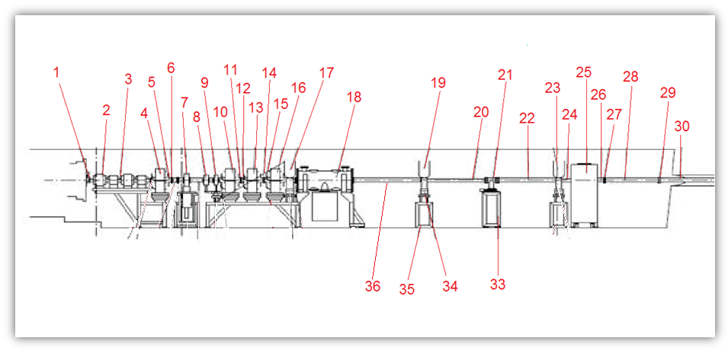
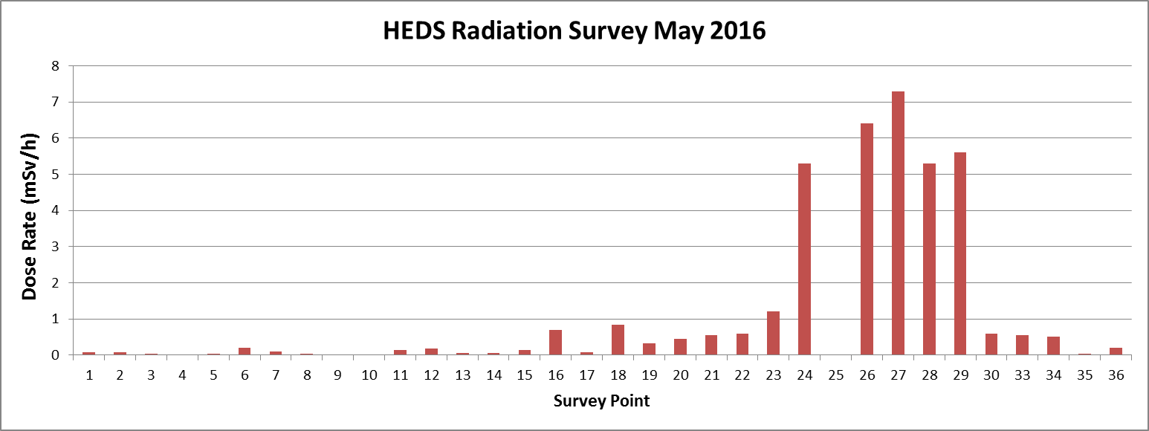
Radiation Survey
Steel
Aluminium
Notes:
However, as expected we see a factor of 10 increase in residual activation in the stainless steel sections. This survey was made in May last year 4 hours after beam operation stopped.
Item 25 is a beam stop used when setting up linac beam so we expect to see activation here but the transition between steel and aluminium at points 29/30 show the effect well.
Since this section of the beamline is in a small tunnel we cannot afford to have a factor of 10 increase in dose rate all along the line.

Slide 11
Next Upgrade
Considered:
Steel vessels – radiation not ALARP, tunnel location
‘Soft’ Al Conflat seals – prefer V-clamps
Friction welded steel flanges – no supplier
Notes:
Our current project on the beamline is to upgrade the section just before this beamstop.
Several solutions were considered for this section,
We felt the increased activation could not be mitigated sufficiently to use steel vessels in this section.
We looked at soft aluminium conflat seals but we prefer to use quick-release V-band clamp to reduce working time in active areas.
Denis also looked into using aluminium tubes with friction welded steel flanges to allow the use of Al seals but could not find a supplier.

Slide 12
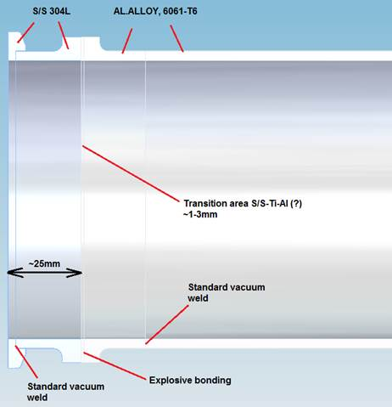
Explosion Welded Flanges
Atlas Technologies & Meyer Tools
25mm Stainless flange to allow use of standard aluminium seals
Amount of active steel minimised
However steel is in working area
Notes:
However we have found 2 suppliers that can provide explosion welded steel flanges, both suppliers are US based and we would be interested to know of any EU/UK based alternatives.
25 mm rings of steel and Al are explosion welded together then welded to an Al tube using standard techniques.
This solution minimises the amount of steel in the beamline though it should be noted the steel is in the working area for changing seals.

Slide 13
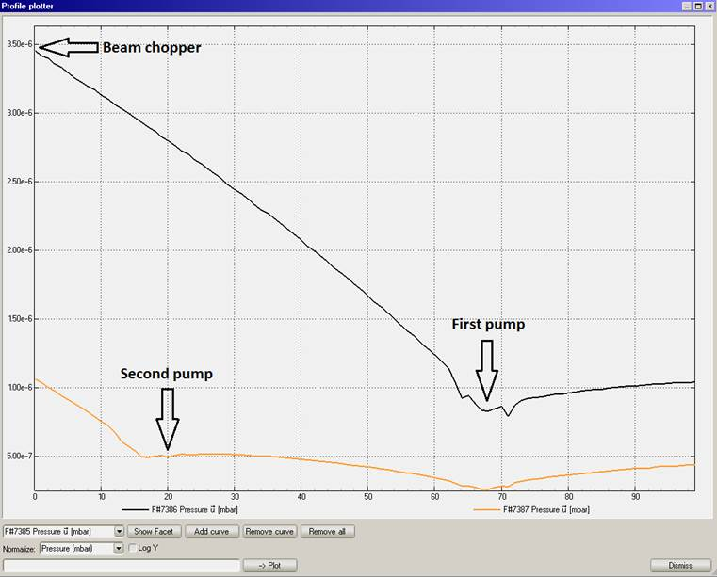
Molflow+ Simulation
Outgasing =3E-9 mbar.l/sec/cm²
Pumping = 345 l/s per pump
Pressure (mbar)
s(m)
Notes:
Whilst doing this upgrade we will add an additional vacuum pump which should give us a factor of 5-6 reduction in pressure as shown by this Molflow simulation.
The corresponding reduction in stripping losses help mitigate the use of steel.

Slide 14
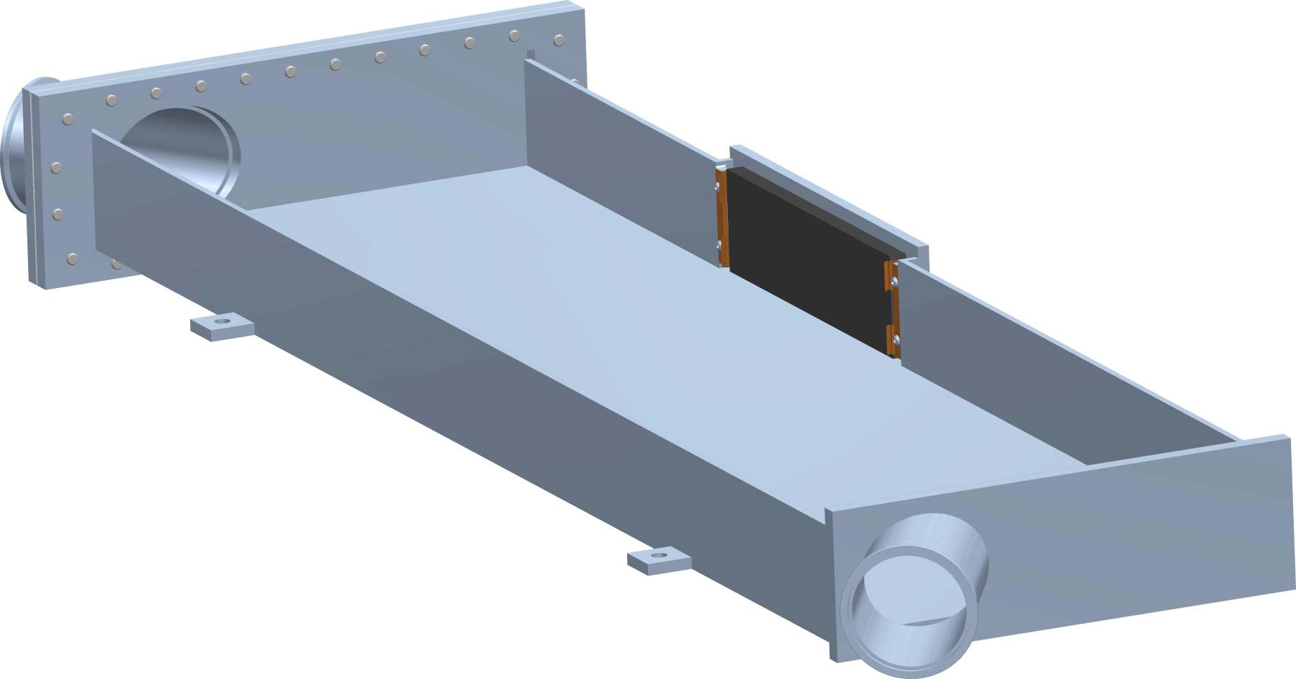
Beam Absorbers
15mm internal graphite absorbers
H⁰
5x10¹⁰ particles/s
H⁻
Notes:
Finally we have 15mm graphite blocks installed inside the vacuum vessels of a large horizontal bending magnets to absorb H0 atoms which will not be deflected.
Details of the design process and aim of these absorbers has been lost so we have had to take a fresh look at the situation to plan replacement.

Slide 15
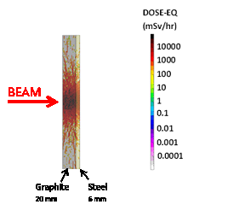
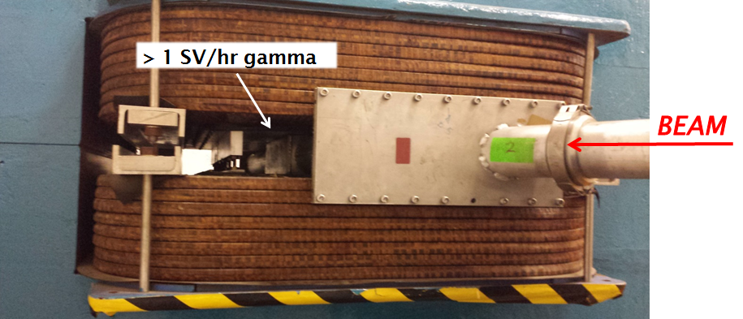
Activation
FLUKA Simulation – 1 user cycle
 | On-contact Equivalent Dose (msV/hr)
Graphite Thickness (mm) | 0 Seconds | 1 Day | 1 Week
0 | 401 | 189 | 120
10 | 308 | 134 | 91
15 | 251 | 81 | 57
20 | 193 | 43 | 33
Notes:
We made a simple FLUKA model and simulated 1 user cycle of ISIS beam with the estimated loss levels I showed earlier. The results are shown in the table, we expect a ~50 mSv/hr after 1 week.
To benchmark these results we planned to make a measurement before/after a user run. What we found was that even after several months cool-down the outside face of the vessel emits over 1 Sv/hr.

Slide 16
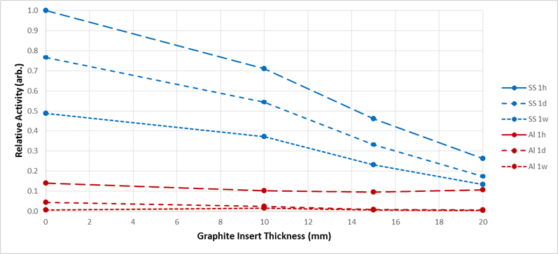
Options
Thicker absorber?
Outgassing
Aluminium vessels?
Activate magnet
Dump line?
New magnet
Notes:
So we are considering our options carefully for this project.
We really need thicker absorbers but this will mean more outgassing and longer pump down time. However, we don’t see a need to have the graphite in vacuum anyway.
We could use aluminium vessels, as shown here aluminium gives a lower activation level than steel+20mm graphite. But the beam would just be absorbed in the magnet yoke/coils.
Ideally we will build a dedicated dump line with appropriate shielding but this will probably mean building a new magnet.

Slide 17
Summary
70 MeV beamline operated well for 30+ years
Was aluminium, now 50% steel
Original rubber seals -> aluminium
Explosion welded Al/SS vacuum vessels to be tested
In-vacuum beam absorbers used in dipoles
Significant residual activation
Upgrade plan to be decided

Slide 18
Conclusions
Good vacuum especially important for ion beam transport due to stripping cross-sections
Need to balance material activation, reliability and maintenance needs to minimise staff dose
Long straight sections of H- beamline may need dump/absorber

Slide 19
Thank You

