Slide 1
Ξ Spectroscopy and the PANDA ‚Start Setup‘
Dec 6, 2016 | Albrecht Gillitzer
LIX PANDA Collaboration Meeting, GSI Darmstadt, 5-9 Dec 2016

Slide 2
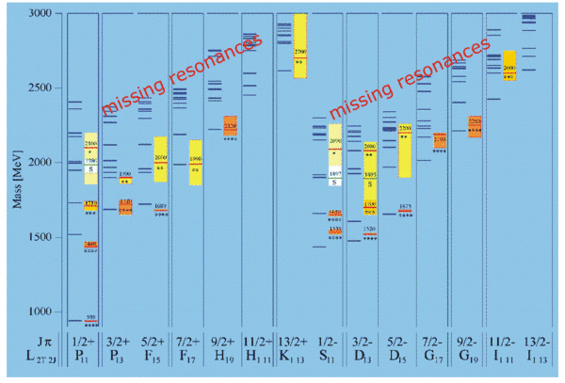
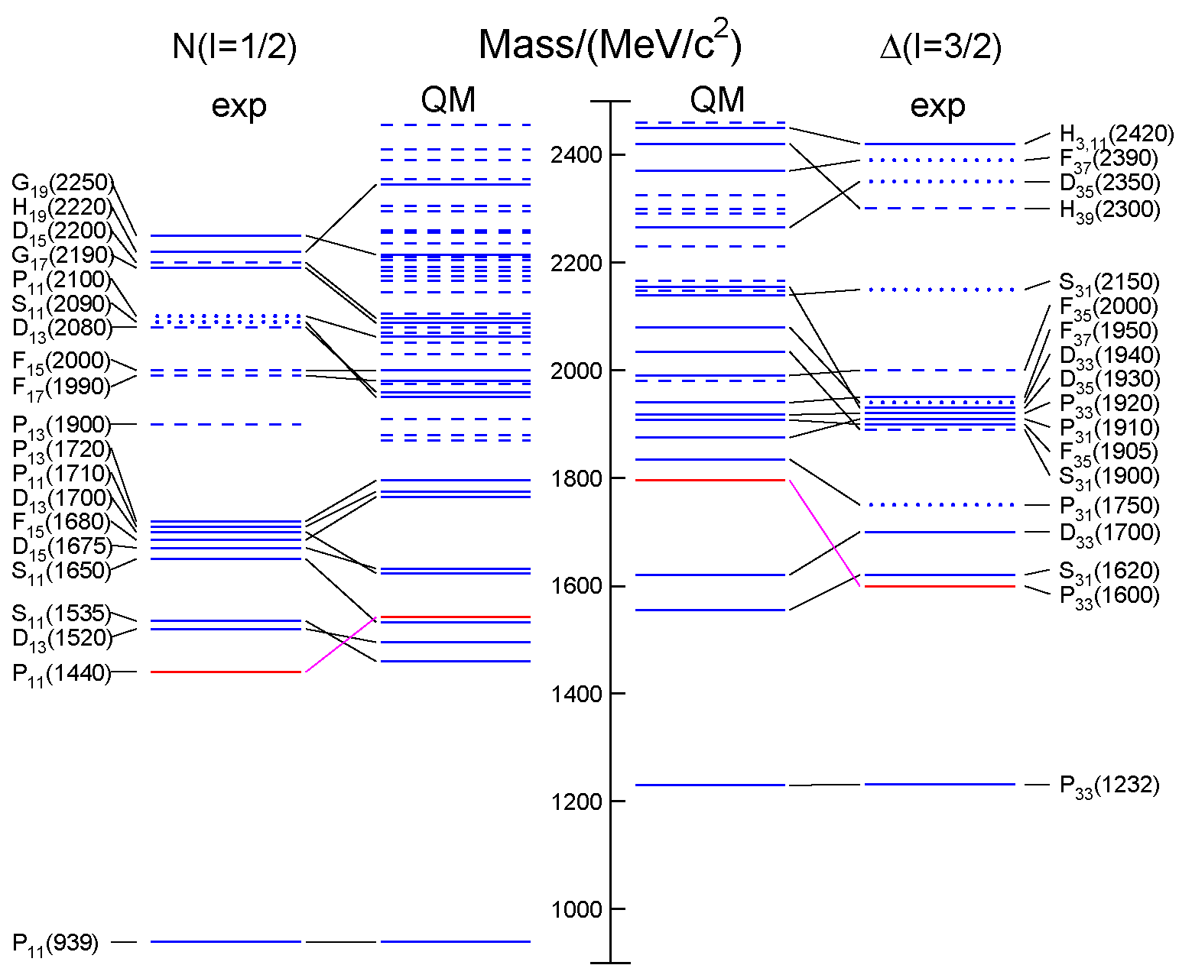
Open Questions
Missing resonances
Wrong masses, wrong sequence
Relevant degrees of freedom?
3-quark?
quark-diquark?
meson-baryon dynamics
from RPP 2014 / QM: S. Capstick, W. Roberts

Slide 3
Strange Partners
Approximate SU(3) flavor symmetry
N* & Δ states have partners in the strange sector
focus on Ξ and Ω
Ξ: as many states as N* & Δ together ⁽¹⁾
Ω: as many states as Δ
scrutinize our understanding of the baryon excitation pattern
⁽¹⁾ in case of SU(3) symmetry !

Slide 4
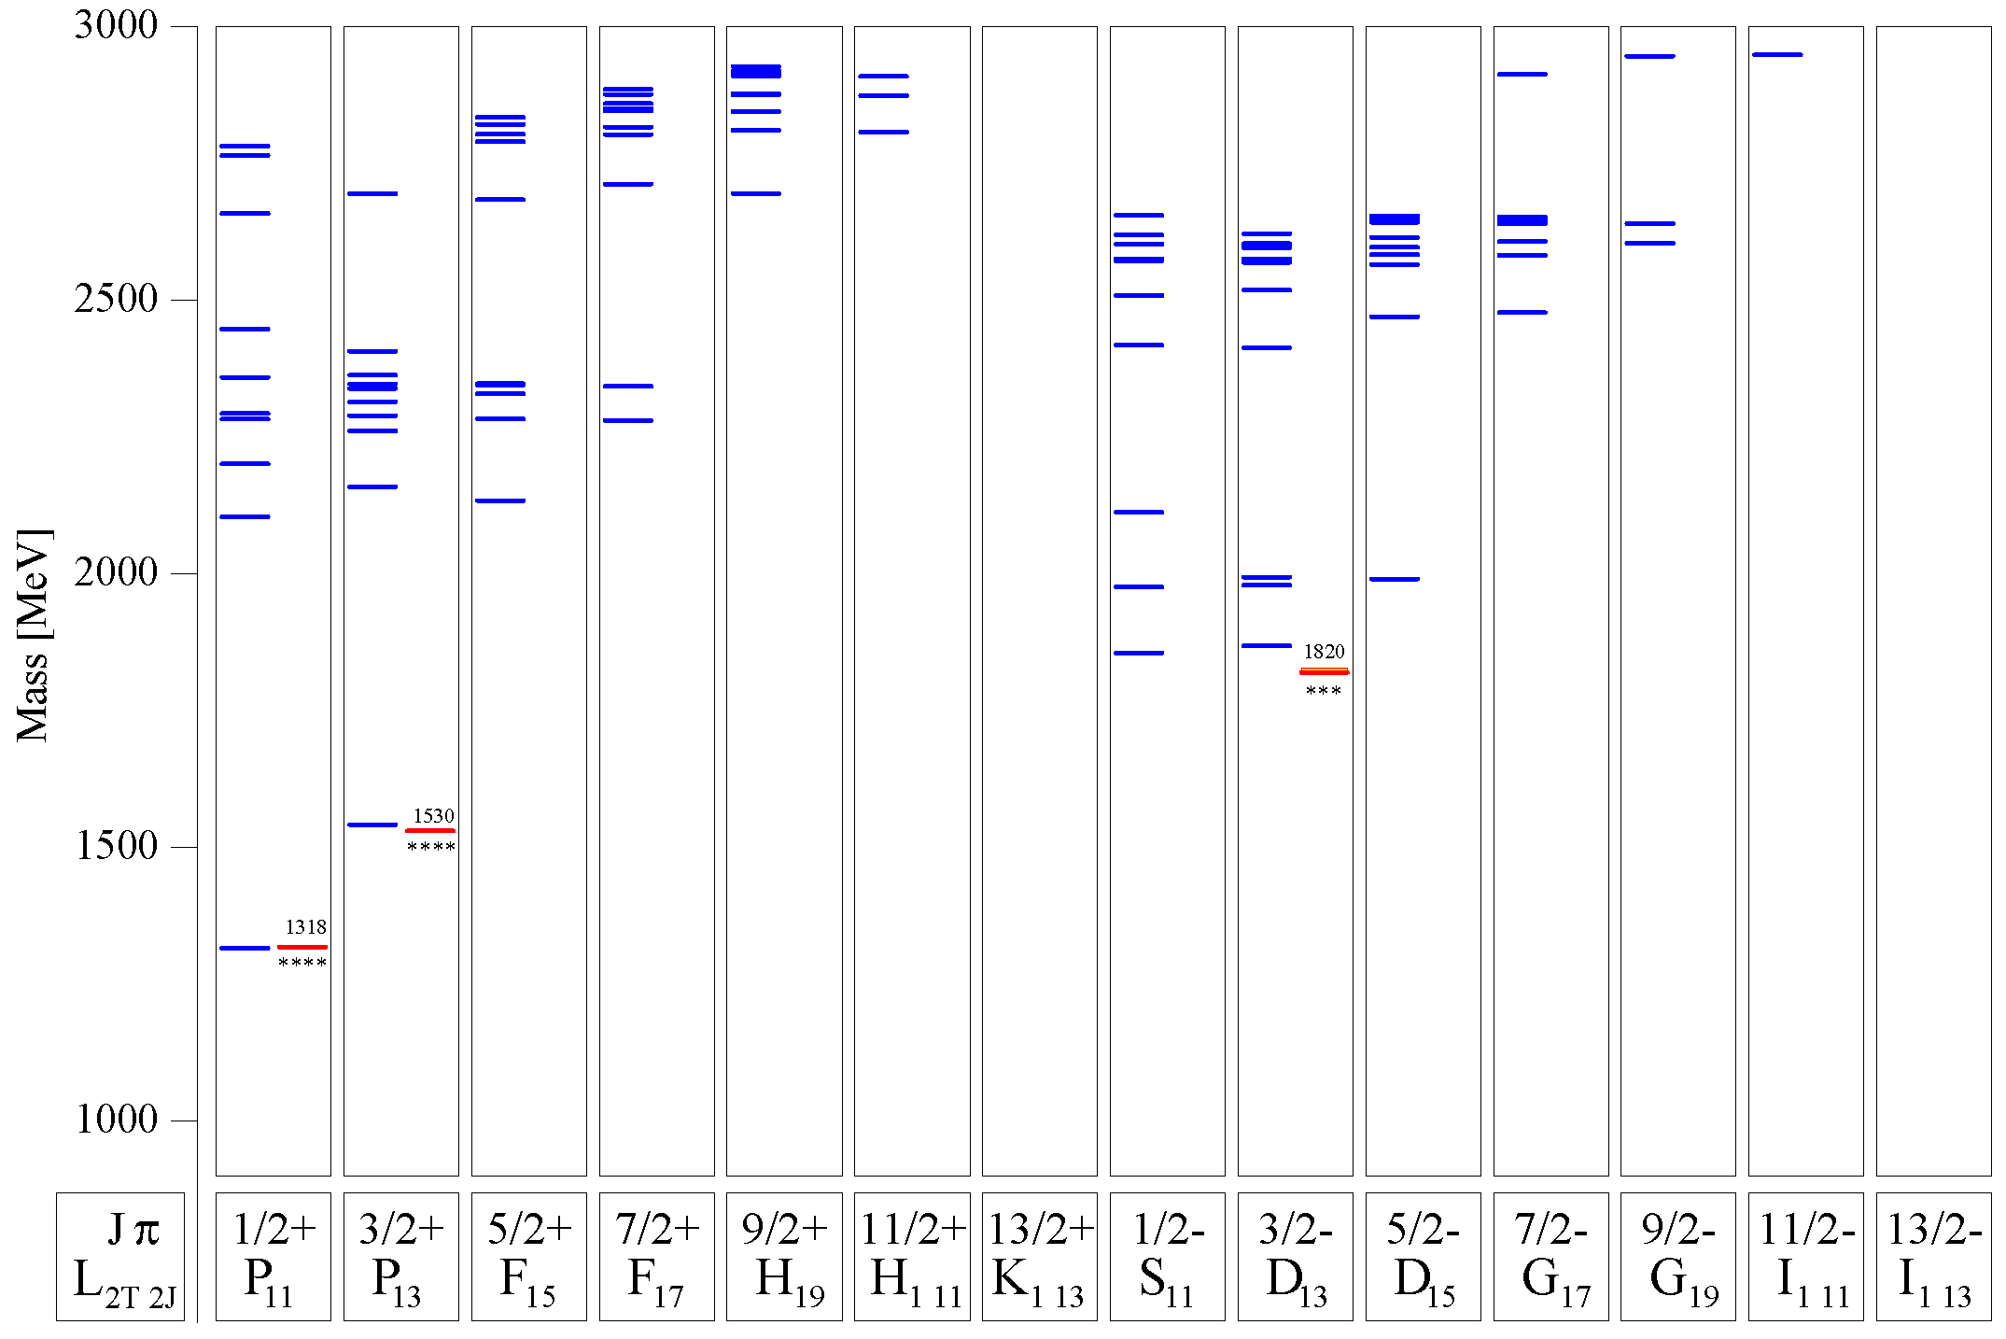
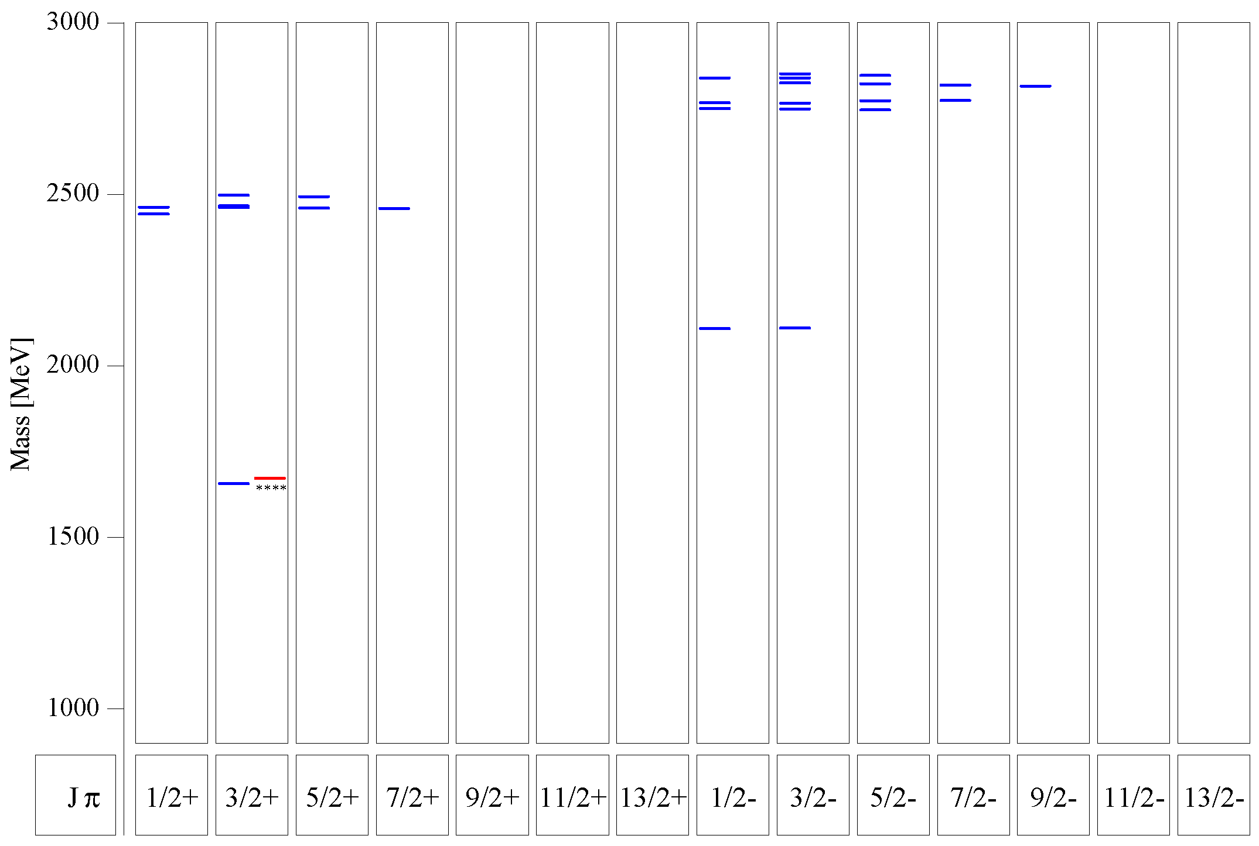
Quark Model for Ξ & Ω
Ξ:
many states predicted below 3 GeV
compare 1/2⁺ and 1/2⁻ excitation
Ω:
several states predicted between 2 GeV and 3 GeV
compare 3/2⁺ and 3/2⁻ excitation
Ξ
U. Löring et al., EPJA 10 (2001) 447
Ω
s.a.: M. Pervin, W. Roberts, PRC 77 (2008) 025202

Slide 5
Most Promising: Study Ξ Resonances
very little known ←→ rather high cross section
find missing resonances
determine branching to various decay modes:
$Ξπ, Ξπ^{+}π^{−}, Ξπ^{0}π^{0}, ΛK^{−}, Σ\overline{K}, Ξη, Ξηπ, Ξη^{′}, Ξω, Ξφ, …$
determine J^{P} quantum numbers if possible
recent progress:
PAWIAN now includes baryons
strategy:
select $\overline{p}$ momentum to produce a specific resonance close to threshold

Slide 6
Proposed Version of the PANDA ‚Start Setup‘
Day-1 master macros as basis for the physics simulation and analysis studies:
Cluster Jet Target
No GEM planes → need MVD or STT_{stereo} for p_{z}
No Disc DIRC → no K/π separation
FTS planes 1 2 3 4 (no 5 6 ) → poor p resolution
No RICH
How does this affect Hyperon Spectroscopy & Hyperon Spin Physics?

Slide 7
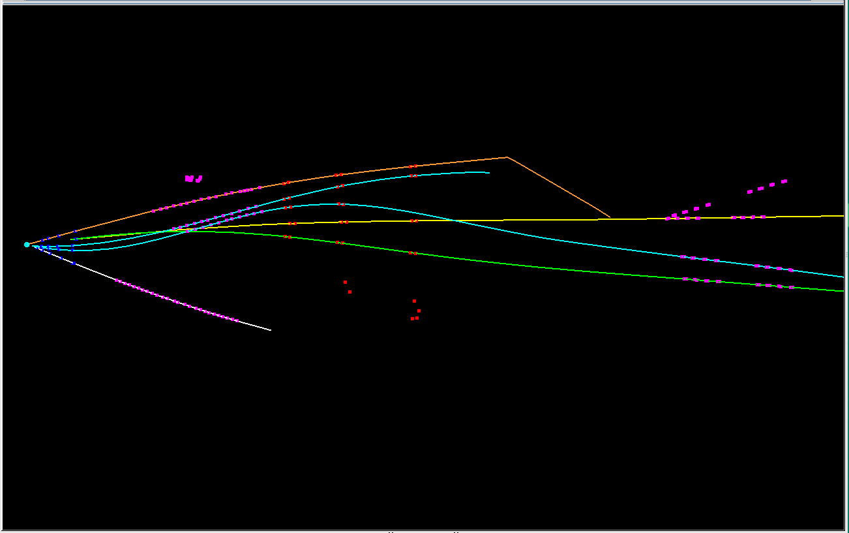
event #15
GEM
STT
K⁻
FTS
π⁺
MVD
p
π⁺
π⁻
_
p
1 baryon in FTS, 2 mesons in FTS, 1 decay outside MVD

Slide 8
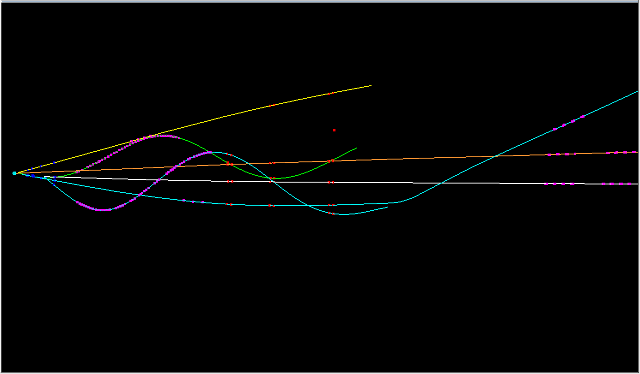
event #34
GEM
p
STT
π⁺
FTS
MVD
π⁻
K⁻
_
p
π⁺
1 baryon in FTS, both baryons in GEM, 2 mesons in FTS, 1 decay outside MVD

Slide 9
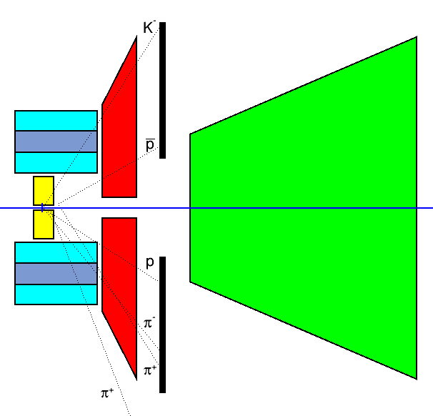
Fast Geometric Analysis: now with Helix Tracks
EvtGen events
4.1 GeV $\overline{p}p→{\overline{Ξ}}^{+}ΛK^{−}$
$\overline{p}π^{+}π^{+}p{π^{−}K}^{−}$final state
simplified geometry of MVD, STT, GEM, FTS
plot xy hit distribution for particles at different z

Slide 10
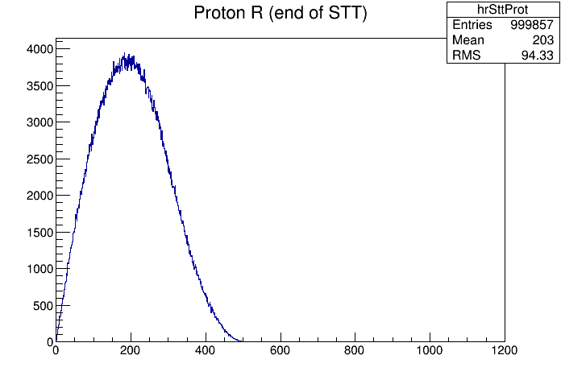
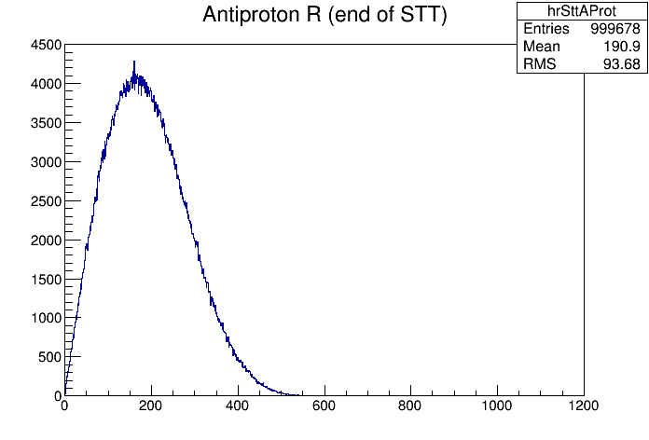
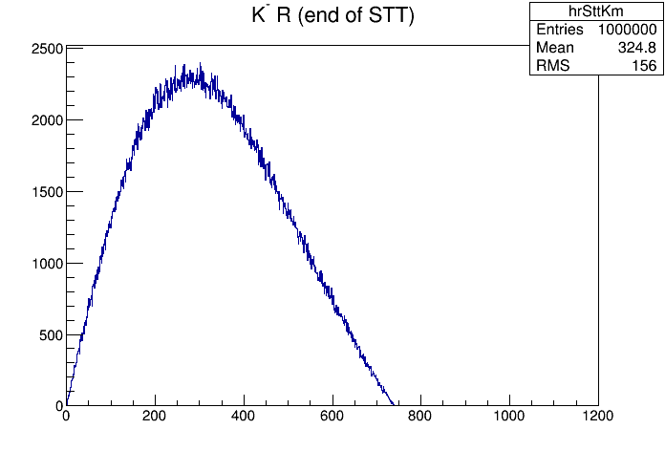
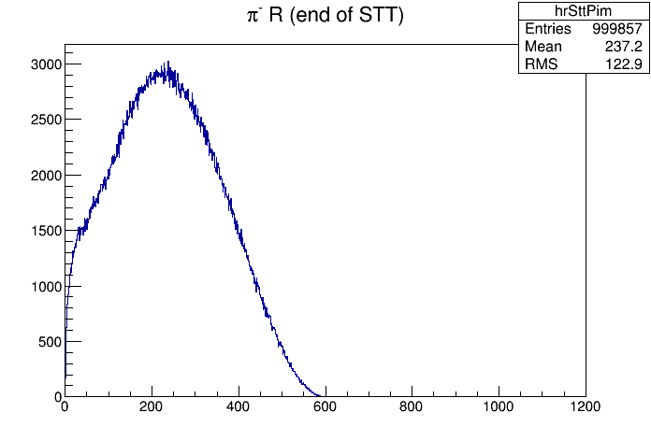
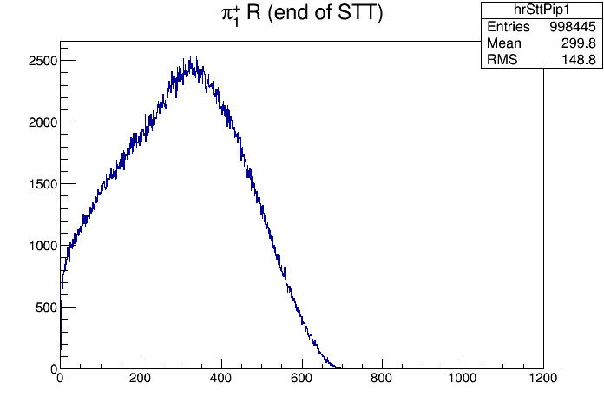
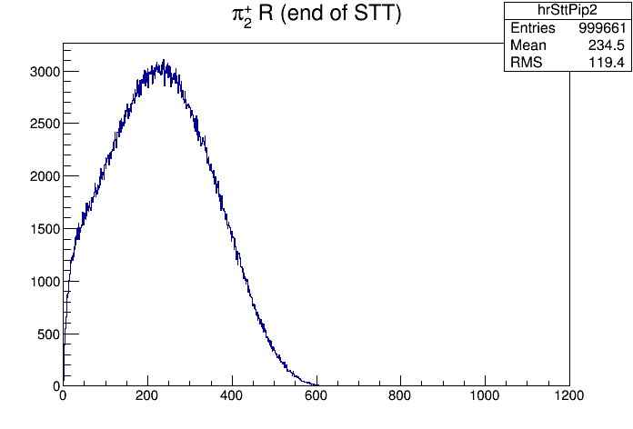
Radial Distribution at STT End Plane, Helix Tracks

Slide 11
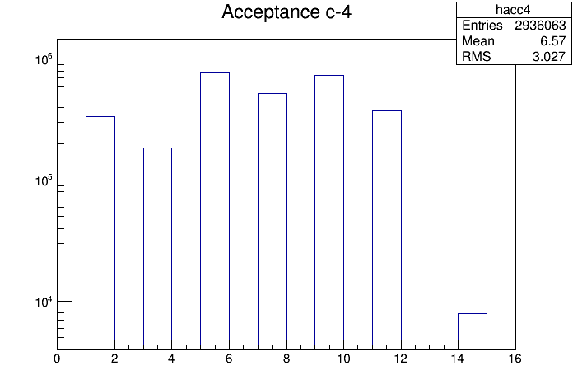
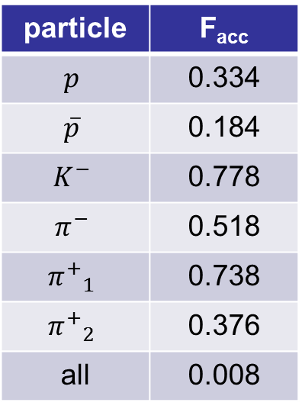
R_{STT} > 331 || (R_{MVD-70} > 10) && (R_{STT} > 190)
particle | F_{acc}
$$p$$ | 0.334
$$\overline{p}$$ | 0.184
$$K^{−}$$ | 0.778
$$π^{−}$$ | 0.518
$${π^{+}}_{1}$$ | 0.738
$${π^{+}}_{2}$$ | 0.376
all | 0.008
_
p
p
K⁻
π⁻
π⁺
π⁺
all
₁
₂
i.e. hitting STT stereo layers or (hitting 2nd-last MVD disc and STT 2 double layers)

Slide 12
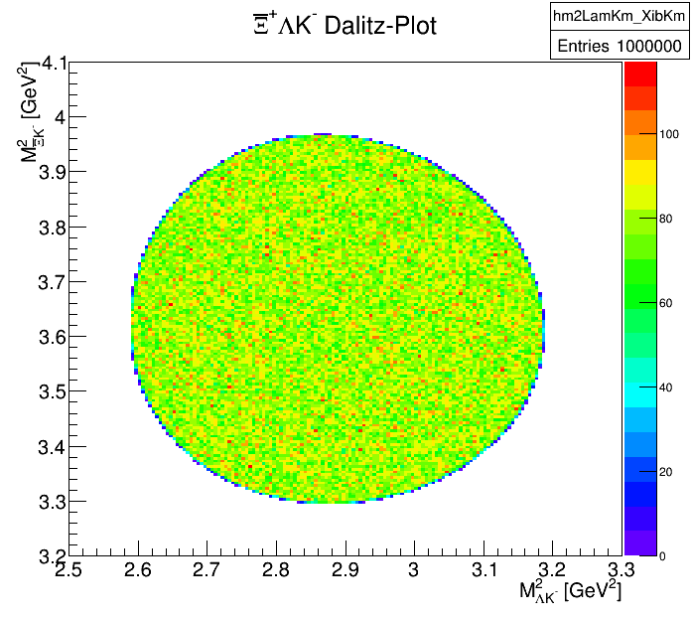
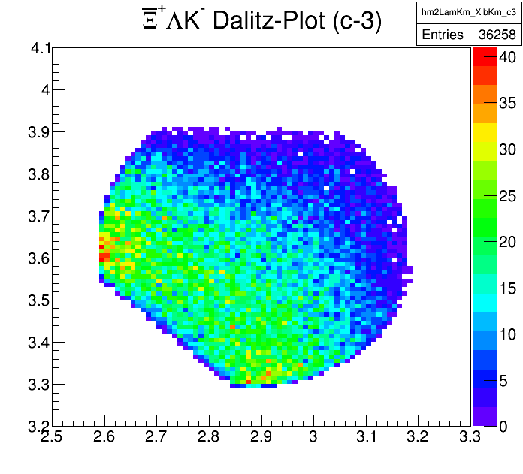
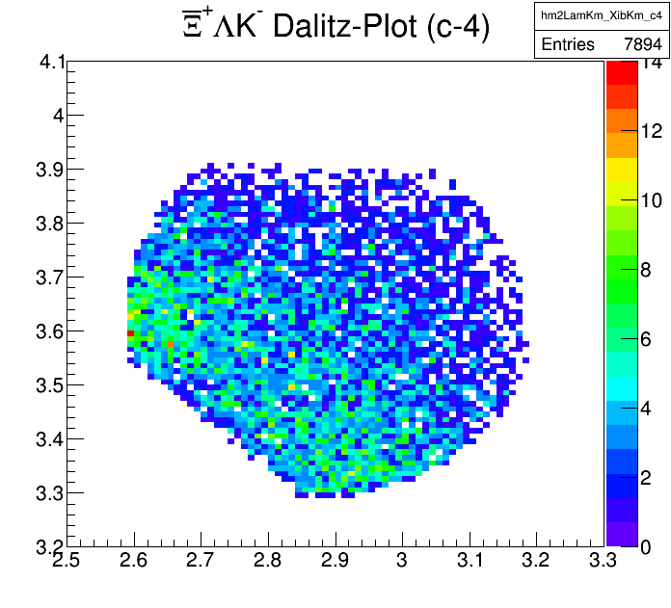
Effect on Ξ⁺ΛK⁻ Dalitz Plot
_

Slide 13
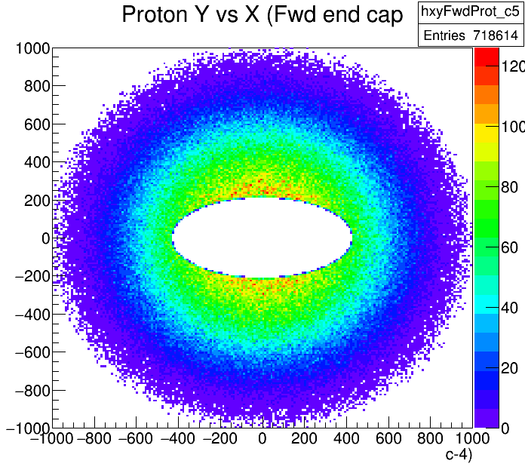
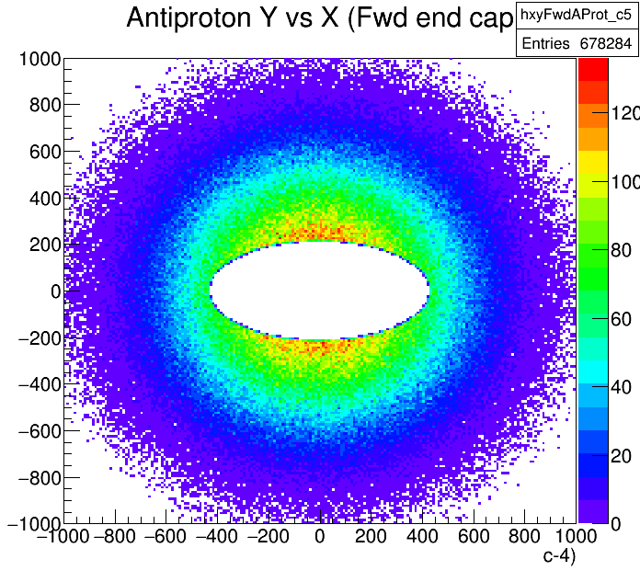
Acceptence of Target Spectrometer
xy hit distribution on Target Spectrometer forward end cap:

Slide 14
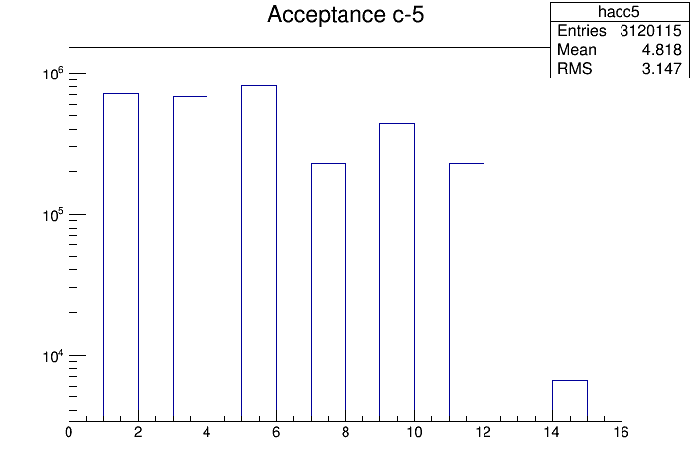
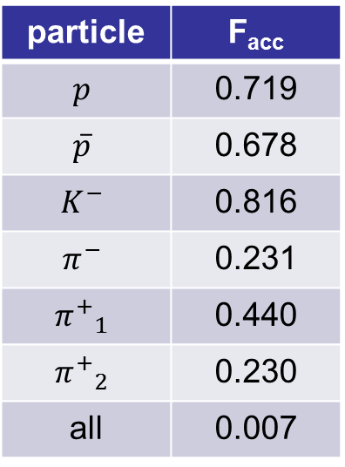
XY_{FwdEndCap} inside TS acceptance
particle | F_{acc}
$$p$$ | 0.719
$$\overline{p}$$ | 0.678
$$K^{−}$$ | 0.816
$$π^{−}$$ | 0.231
$${π^{+}}_{1}$$ | 0.440
$${π^{+}}_{2}$$ | 0.230
all | 0.007
_
p
p
K⁻
π⁻
π⁺
π⁺
all
₁
₂

Slide 15
Conclusion
Hyperon spectroscopy is an important topic in hadron physics which deserves more attention
PANDA is the ideal instrument for a comprehensive Ξ and Ω spectroscopy program
A large part of the program can already be pursued at reduced luminosity
However: for these studies the GEM detector and the FTS, including a detector behind the dipole, are required

