Slide 1
PANDA Phase 0 Experiment: Straw Trackers at HADES
6-Dec-2016 | Peter Wintz (FZ Jülich)
59. PANDA CM, FAIR, Dec-6th, 2016

Slide 2
Outline – Phase 0 Straw Trackers
Overview
Straw stations at HADES
Deliverables for PANDA day-1

Slide 3
Overview: Phase 0 Experiment
Idea to include straw trackers in experiment program before PANDA starts
Upgrade HADES with two new Forward Straw Tracker stations: STS1, STS2
Test straw trackers and readout system under experiment condition
Same (similar) straw module design as PANDA-FT, later use in PANDA
Phase 0 experiment starts (end) 2018 with first beam at SIS 18
Physics program: radiative hyperon decays, .. also part of PANDA program
STS1/2 tasks: small polar-angle (baryon) track reconstruction (θ < 6.5°)
HADES measures dileptons and mesons
Involved PANDA/HADES groups: Cracow, Julich, Orsay ..
Synergies: Straws + FE-ASIC (PANDA), TRB3/DAQ (HADES)

Slide 4
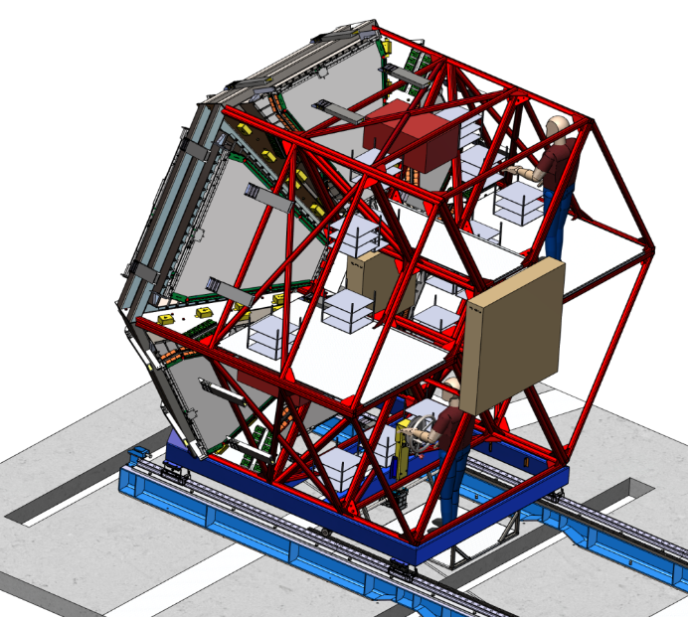
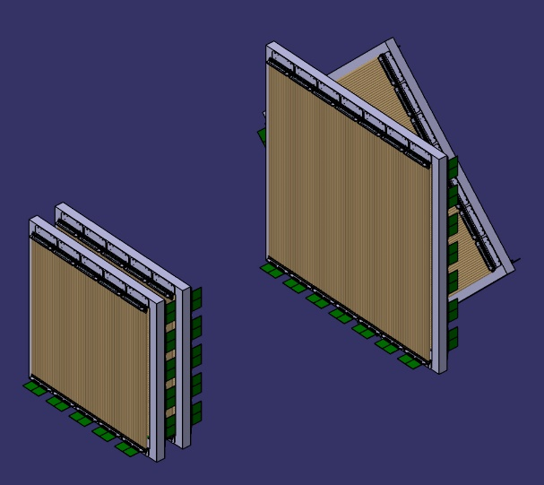
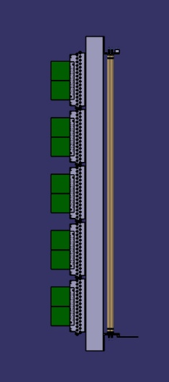
Phase-0 Straw Trackers STS at HADES
STS1: 4 double layers, angles 0°, 90°, 0°, 90°
  640 straws, 4x5 modules a 2x16 straws
  Same straw length (77 cm) as FT 4
  ~ 77 x 77 cm² active area, beam hole ~ 8 x 8 cm²
STS2: 4 double layers, angles 0°, 90°, +45°, -45°
  896 straws, 4x7 modules
  Same straw tube length (125 cm) as FT 5,6
  ~ 113 x 113 cm² active area, beam hole ~16 x 16 cm²
2 tracking
stations
STS1
STS2
STS2
STS1
160 cm

Slide 5
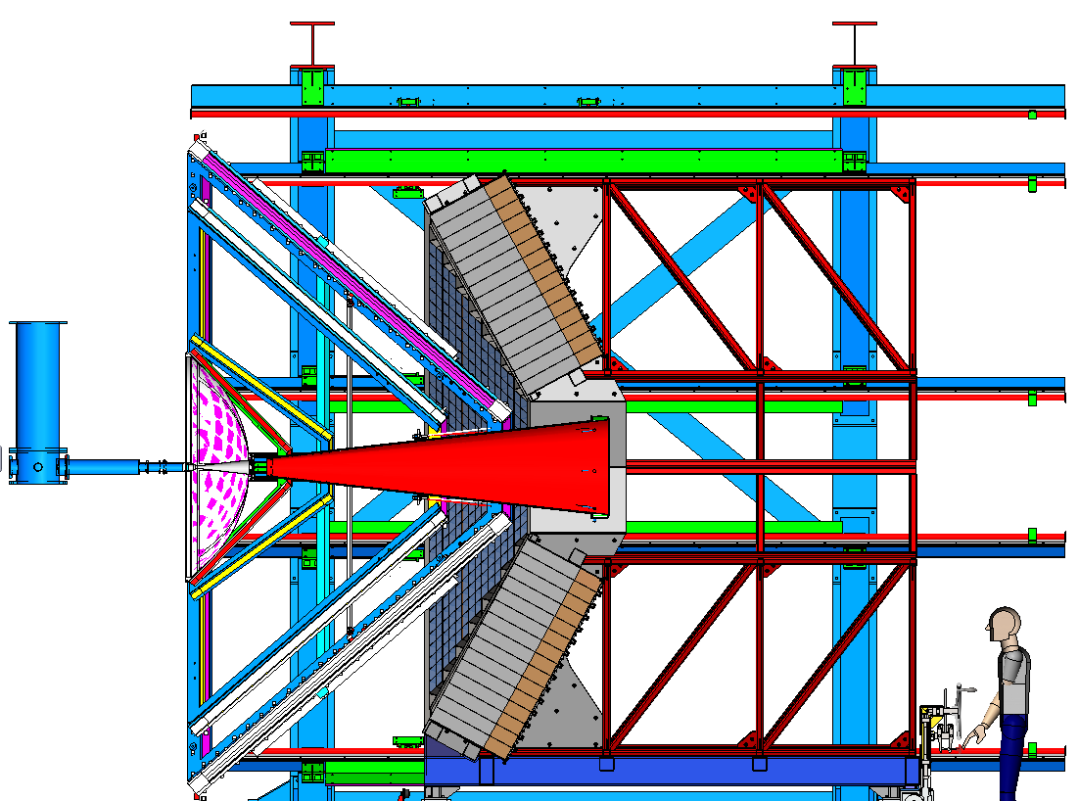
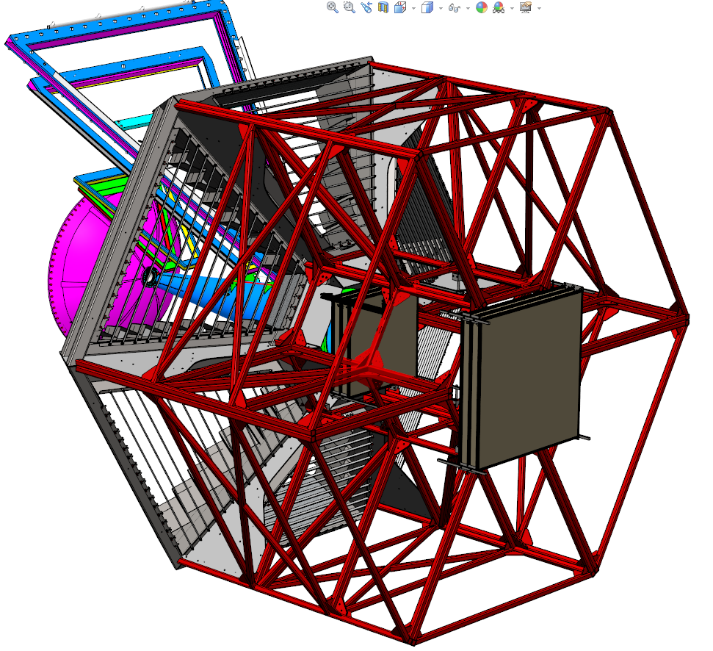
STS – Mounting to HADES ECAL Frame
From P. Salabura & J. Smyrski

Slide 6
STS Roadmap
Timelines for phase 0 program:
  2017 STS construction,
  2018 installation at HADES, end 2018 first beam at SIS18
  2018-2020 experiment
Work packages:
  STS1 with Julich straws (STT materials), FT module adaption (front-end)
  STS2 with Krakow straws, full FT 5/6 module design
  Mech. frames for STS1+2 by Krakow, Orsay, ..
  FE-ASIC/TRB3 readout from STT pre-series system (available 2018)
Julich straw series productions
  Straw productions for STT will end 2017/18
  Insert short production cycle for STS1 (640 straws) in 2017

Slide 7
Phase 0 Deliverables for Day-1
Full PANDA-FT system test in experiment environment at HADES
Readout system set up, calibration & data analysis methods (PID)
Student education with experiment program (i.e. hyperon decays)
Cost & time efficient test program scenario (2017-2020)
Full funding and work package plan set up
Exploitation of synergies (STT/FT) and PANDA/HADES
Full FT design proof: straw modules, mech. frame, FE-ASIC / TRB3 readout
Can serve as final test for PANDA-FT
Later use of STS2 modules in FT 5 or 6 (~ 25%)
Later use of STS1 modules in FT 4 (~35%)

Slide 8
Thank you
for
your attention

