Slide 1
Specific Topic:
PANDA Forward Tracking at Day-1
6-Dec-2016 | Peter Wintz (FZ Jülich)
59. PANDA CM, FAIR, Dec-6th, 2016

Slide 2
Tracking Detectors at Day-1 (2023)
PANDA-TS: MVD + STT, no GEM stations
PANDA-FT not all 6 stations
Requirements from (hyperon) physics program
Simulation and pattern recognition aspects
Identify best suited FT setup with available resources
FT 1- 4
FT 1/2 + FT 5/6
Reduced stations FT5/6

Slide 3
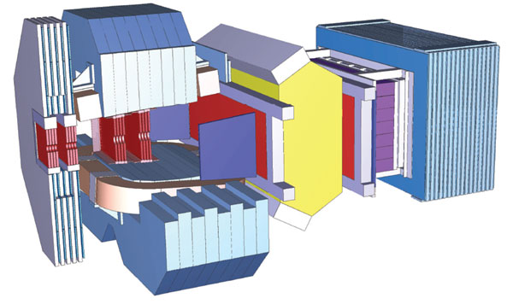
FT Station Numbers
Station | Width | Height | Modules | Straws
1 | 1338 | 640 | 4x10 | 1152
2 | 1338 | 640 | 4x10 | 1152
3 | 1782 | 690 | 4x12 | 1536
4 | 2105 | 767 | 4x14 | 1792
5 | 3923 | 1200 | 4x27 | 3296
6 | 3923 | 1200 | 4x27 | 3296
1-4 |  |  |  | 5632
1,2 + 5,6 |  |  |  | 8896
1-6 |  |  |  | 12224
45%
75%
numbers from TDR draft

Slide 4
Session Outline
Straw trackers for phase 0 (2017-2020)
FT layout options at day-1 (2023)
Requirements from hyperon physics program
Simulation and pattern recognition aspects

