Slide 1










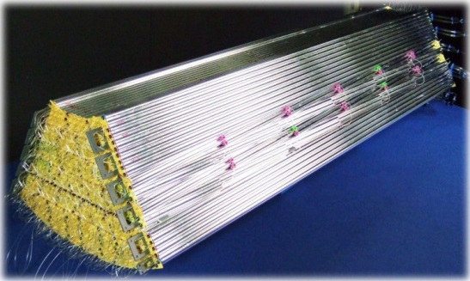
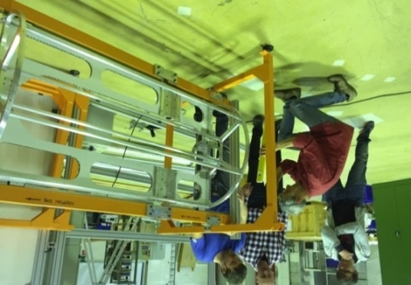
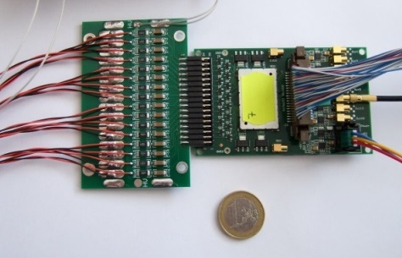
STT Status & News
Peter Wintz (FZ Jülich) for the STT group
59. PANDA CM, FAIR, Dec-6th, 2016

Slide 2
Outline: STT Status & News
Timelines
Electronic Readout
Beam test campaign in 2016

Slide 3
Status & Timelines
Beam test campaign in 2016 at COSY completed last week
    New beam test area set up, straw test systems for both readouts
    Measure broad dE/dx range with proton & deuterons at COSY
Readout workshop in Krakow fixed to Jan-30/31, 2017
    https://indico.gsi.de/conferenceDisplay.py?confId=5290
    Define decision process for final STT readout, TC involvement
    Aim for readout decision by Q1/2018
Request for next beam time, earliest for Q4/2017, beam program definition
Pre-series system test set up (one STT sector) in Q4/2017
Straw productions in Julich will end 2017/18

Slide 4
Status Electronic Readout
STT with readout of drift time and dE/dx for PID, two readout solutions
FE-ASIC / TRB (drift time and time-over-threshold for dE/dx information)
    Pre-series system set up ongoing (700 ch)
    All components specified and available: ASICs, FEBs, TRB3 system
    Currently (automatic) bonding of >100 ASICs by company, QA issue
    dE/dx separation power by time-over-threshold demonstrated (s. below)
    Time-over-thresh resolution studies ongoing
Amp/ADC - FPGA (pulse shape sampling for drift time and dE/dx)
    System design done (integrated amplifier / ADC backend)
    In-beam prototype test last week (16ch board, 3x diff. amplifier gains)
    Work flow plan set up, pre-series system scheduled for Q3-2017
    Straw setup to be repaired (~ 6-7 years old)

Slide 5
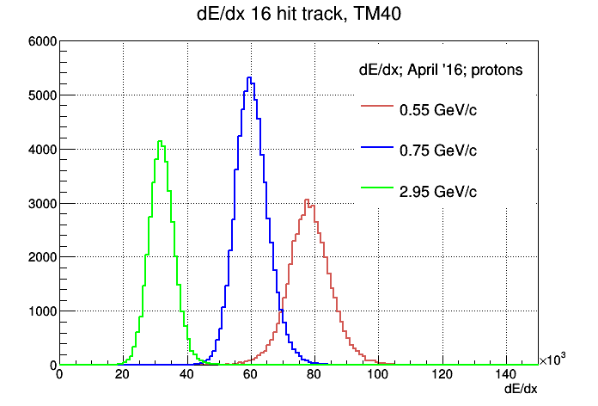
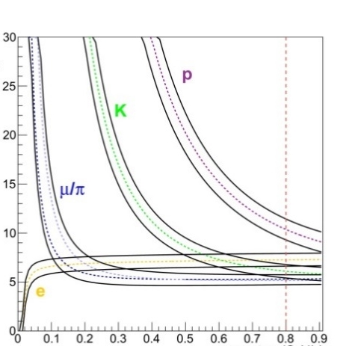
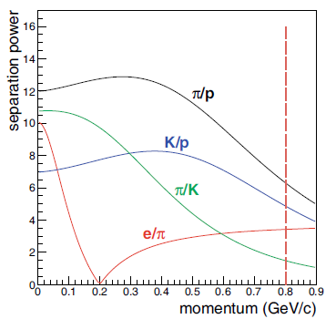
dE/dx - Readout Result (Prelim.)
Krzysztof Pysz (IFJ Krakow)
Beam test campaign in 2016 (Apr/Dec)
9 days proton beam: 3.0, 1.0, 0.75, 0.55 GeV/c
6 days deuteron beam: 1.5, 0.75, 0.6 GeV/c
600 MeV/c deuterons with 10mrad straggling
Measured dE/dx range: ~ 5 .. 30 keV/cm (@ 2bar)
Low noise level, same thresholds (in Apr/Dec)
Measured dE/dx by FADC (40% truncation) for proton beam
3 GeV/c
Pawel Strzempek
(JU Krakow)
Separation power
(1 GeV/c)
dE/dx (arb. units)
750 MeV/c
550 MeV/c
Momentum (GeV/c)
Momentum (GeV/c)
Simulation of PID separation power for STT by simulated dE/dx (PANDA-STT TDR)
Measured time-over-threshold (drifttime correct., 20% trunc.) for proton beams of diff. momenta

Slide 6
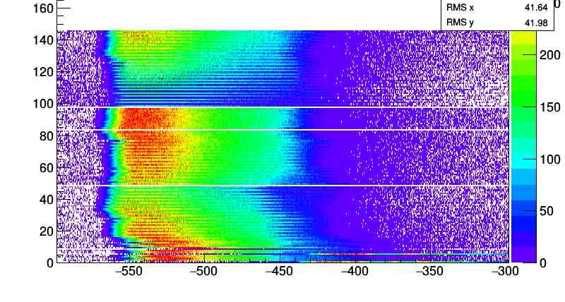
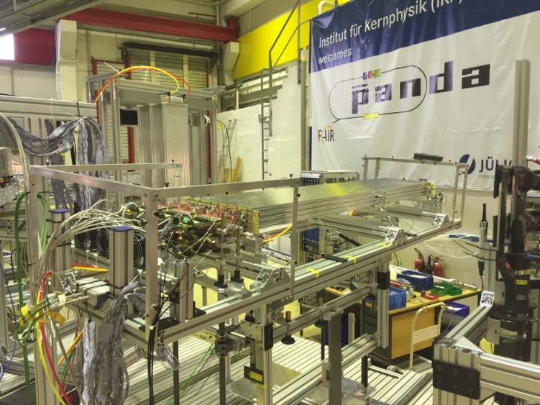
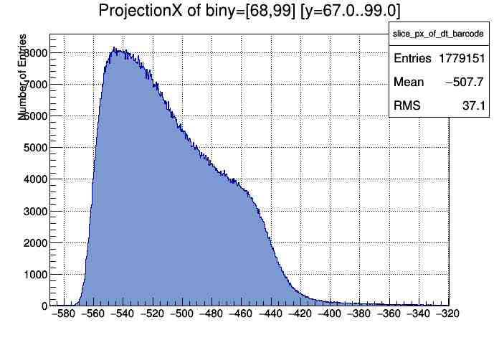
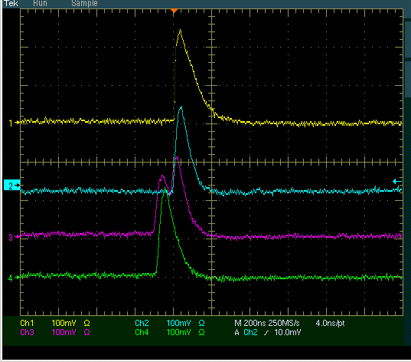
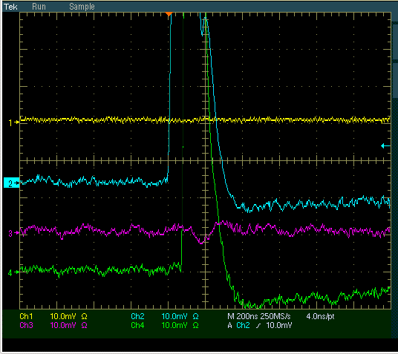
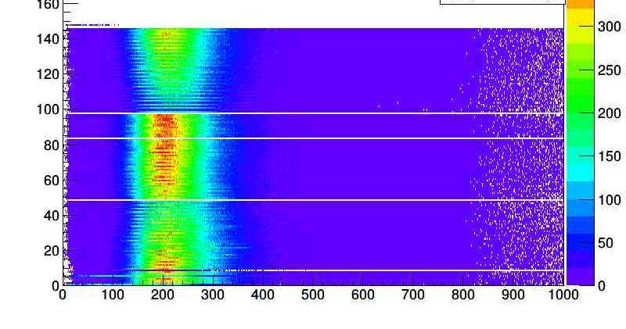
ASIC/TRB – Readout Status
(Raw Spectra from April 2016 Beam Time)
In-beam position of straw setup with
FE-ASIC boards (beam from the right)
beam spot area
ASIC analog output
signals (in-beam),
NL <5mV (stable),
min. thresh. at 10mV
TDC time (top) and time-over-threshold (below) vs channel

Slide 7
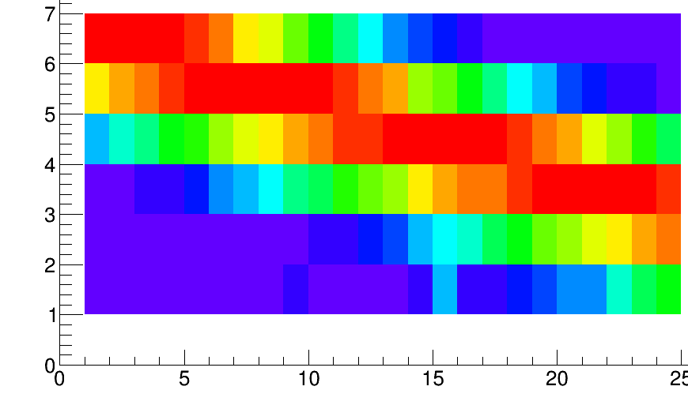
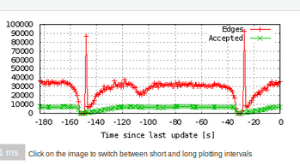
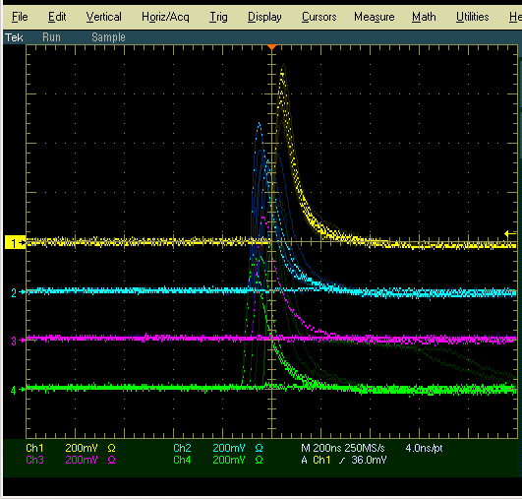
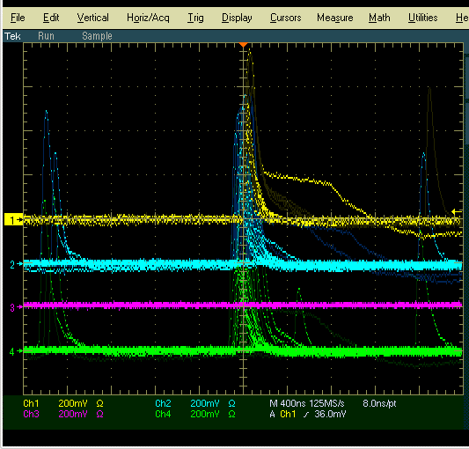
Snapshots Beamtime Nov/Dec 2016
TRB3-DAQ, cts rate for 1.5 GeV/c beam, trigger (red), readout rate (green)
COSY beam extraction cycle 2min (spike intensities on detectors)
Hitmap (6x24 straws), ~ 2x2 cm² spot
600 MeV/c deuteron beam
dE/dx > 8x MIPS
FE-ASIC analog outs on scope
Some tail cancellation limit seen
(i.e. yellow waveform)
beam

Slide 8
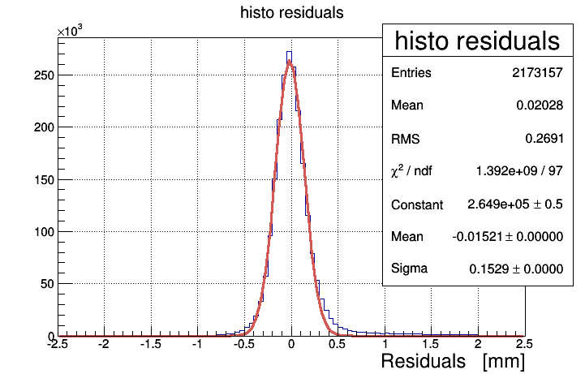
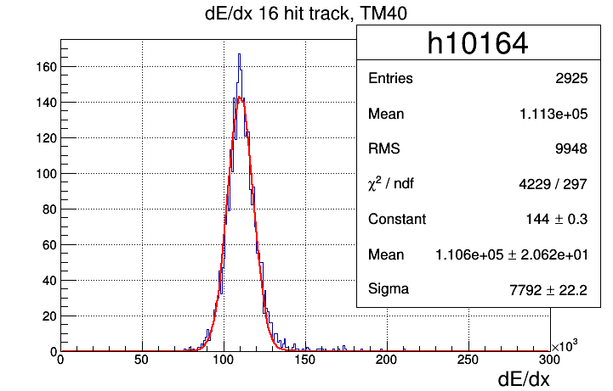
Snapshots Beamtime Nov/Dec 2016
FADC prototype readout
Pre-liminary results (Krzysztof Pysz, Krakow)
Results for 750 MeV/c deuteron
    ~ 153µm spatial resolution (top fig.)
    ~ 7% dE/dx resolution (lower fig.)
Data analysis of 16ch Amp/ADC testboard
in progress
Straw setup to be improved/repaired

Slide 9
Thank you
for
your attention

