Slide 1
FairMQ for Online Reconstruction
An example on PANDA test beam data
| Tobias Stockmanns on behalf of the PANDA collaboration

Slide 2
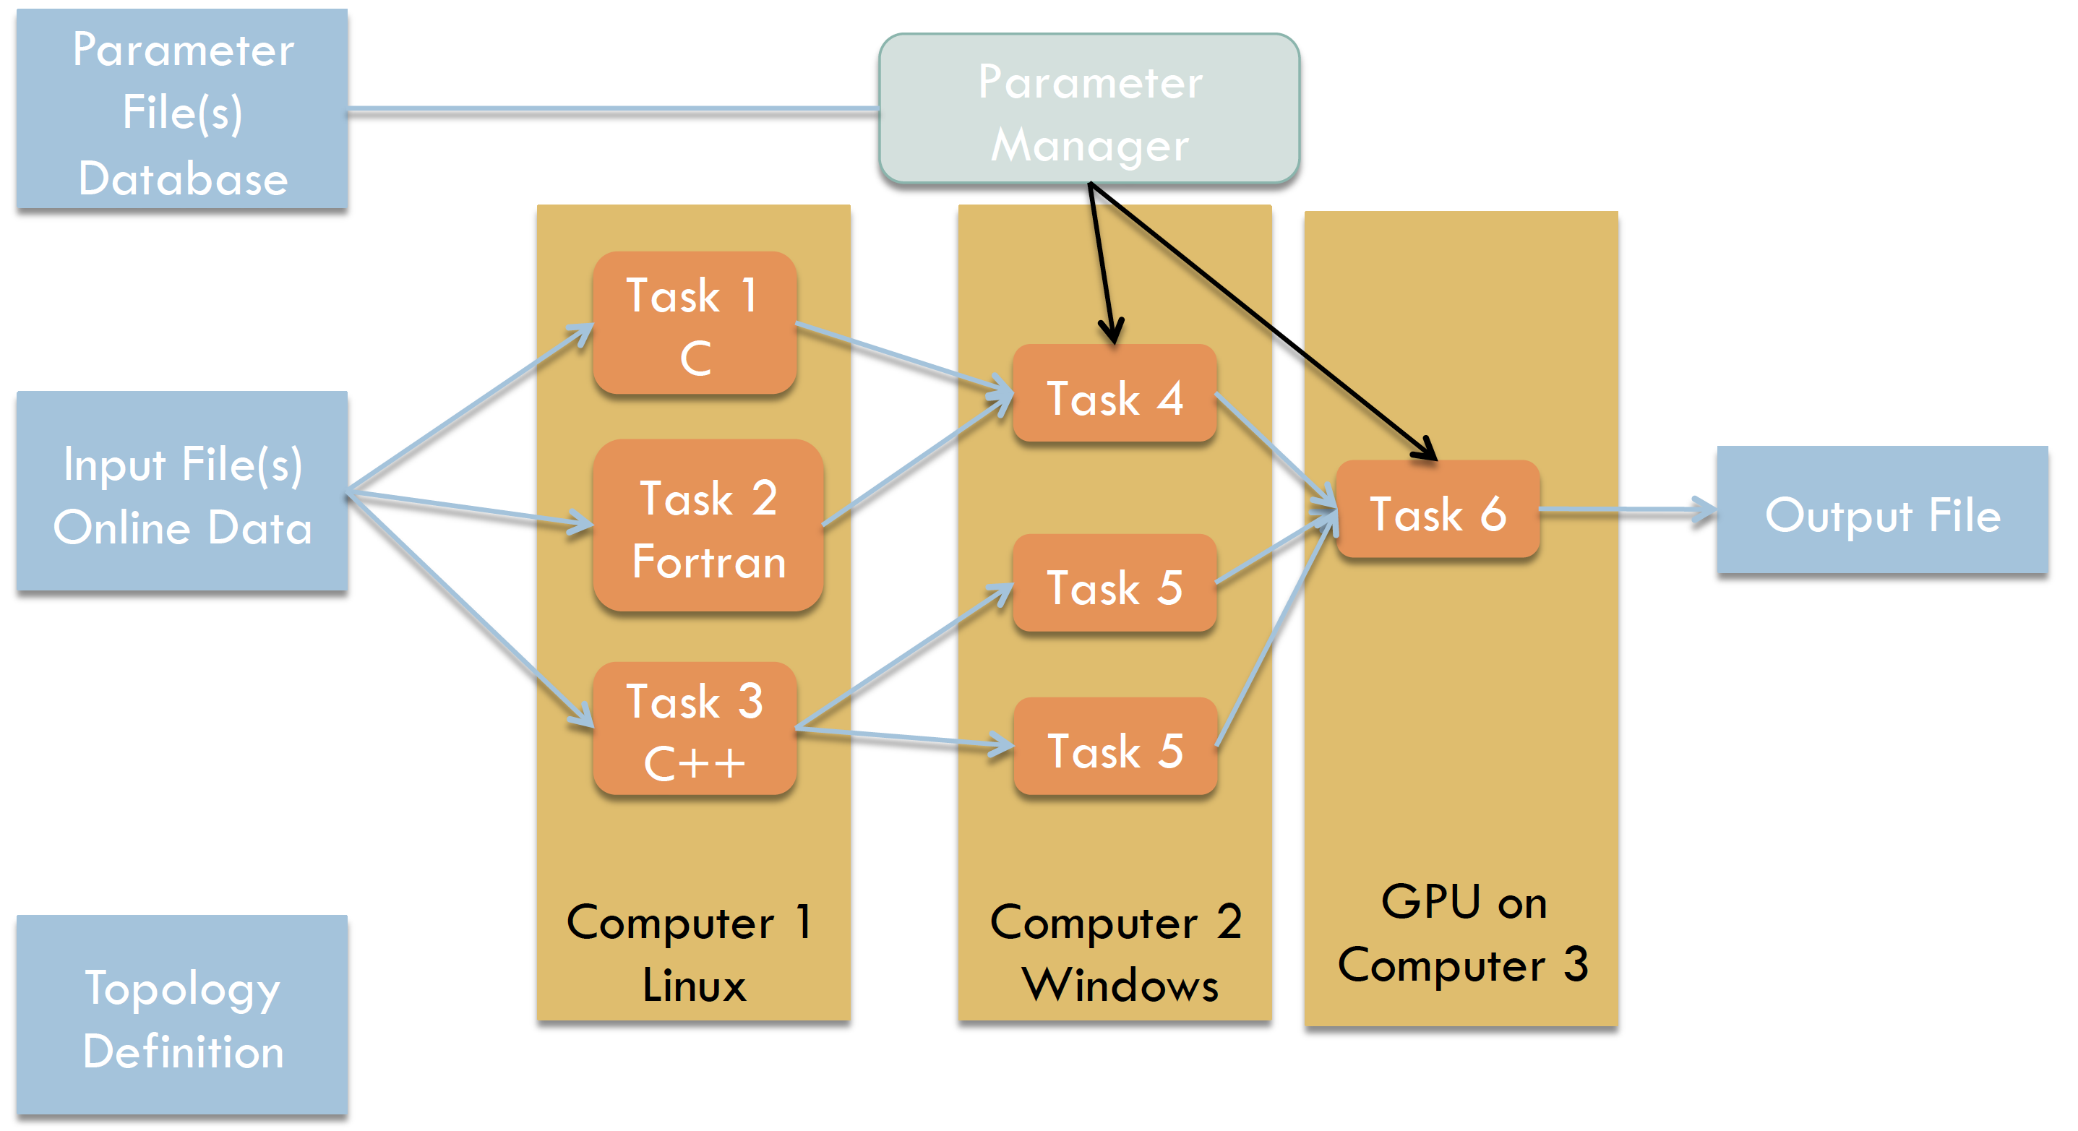
FairMQ
FairMQ: Message Queue

Slide 3
Test of FairMQ with Real Data
Parallel readout of 4 pixel detectors
Readout done by 4 FPGA boards sending their data to two PCs
On the PC bitstream converted into raw data
Raw data send via FairMQ to a FileSink
| Tobias Stockmanns

Slide 4
Idea
Use MQ to completely process TB data online
Processing steps:
Convert raw data into Digis
Sort by time stamp
Build “event”
Find cluster
Convert Digis into Hits
Combine data stream of all four ASICs
Build global event
Find Tracks
Fit Tracks
4 x Single FE

Slide 5
Single Front-End
Online
Sorter
Online
Raw Data Sampler
Raw to Digi
Dupli-cator
Distri-butor
Sorter
Merger
Digi to Hit
TB Data
File Sink
Sorter
File handling
Data processing
Data handling
Online monitoring

Slide 6
Distributor

Slide 7
Data after sorting

Slide 8
Multiple Front-Ends
Online
Sorter
Raw Data Sampler
Raw to Digi
Dupli-cator
Distri-butor
Sorter
Merger
Digi to Hit
TB Data
File Sink
Sorter
Online
Online
Online
Sorter
Raw Data Sampler
Raw to Digi
Dupli-cator
Distri-butor
Sorter
Merger
Digi to Hit
TB Data
File Sink
Sorter
Event Builder
Track Finder/Fitter
File
Sink
Online
Sorter
Raw Data Sampler
Raw to Digi
Dupli-cator
Distri-butor
Sorter
Merger
Digi to Hit
TB Data
File Sink
Sorter
Online
Sorter
Raw Data Sampler
Raw to Digi
Dupli-cator
Distri-butor
Sorter
Merger
Digi to Hit
TB Data
File Sink
Sorter

Slide 9
Event Builder
Time Stamps
FE 1
FE 2
FE 3
FE 4
Data of each FE sorted in time

Slide 10
Event Builder
FE 1
FE 2
FE 3
FE 4
Take first in stack

Slide 11
Event Builder
FE 1
x
FE 2
FE 3
FE 4
Take first in stack
Take earliest

Slide 12
Event Builder
FE 1
x
FE 2
FE 3
x
FE 4
Take first in stack
Take earliest
Search for matching hits

Slide 13
Event Builder
FE 1
x
FE 2
FE 3
x
FE 4
Take first in stack
Take earliest
Search for matching hits
Write out those in one event

Slide 14
Event Builder
FE 1
FE 2
FE 3
FE 4
Fill empty positions with next hits

Slide 15
Event Builder
FE 1
FE 2
FE 3
FE 4
Fill empty positions with next hits
Repeat selection

Slide 16
Event Builder
FE 1
FE 2
FE 3
FE 4
Fill empty positions with next hits
Repeat selection

Slide 17
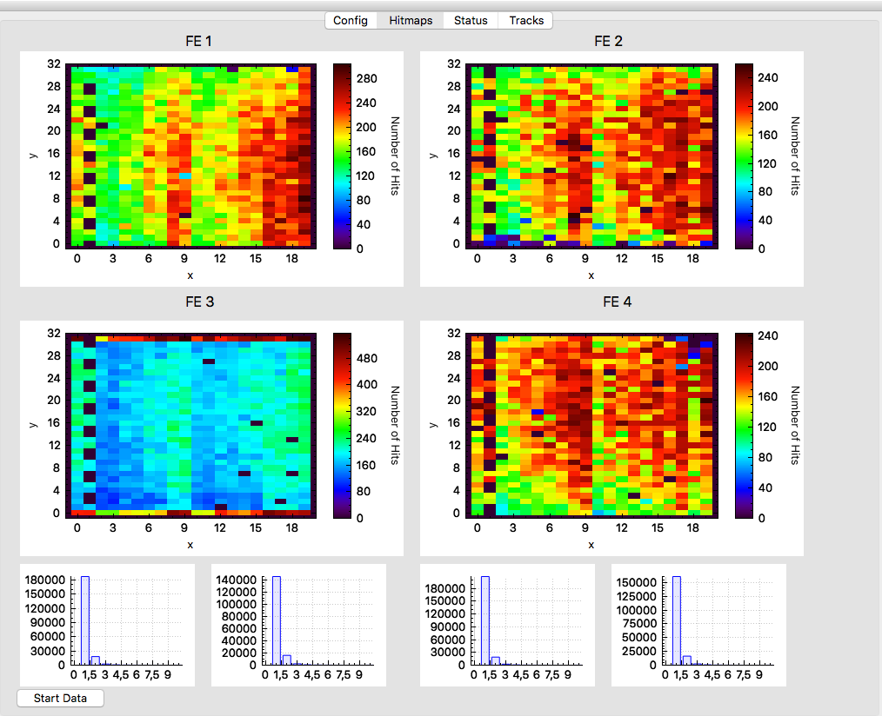
Online Monitoring
running on 6 PC
4 for each FE
1 for tracking
1 for control

Slide 18
Online Monitoring
Hitmap
Running on 6 PC
4 for each FE
1 for tracking
1 for control
Cluster finder

Slide 19
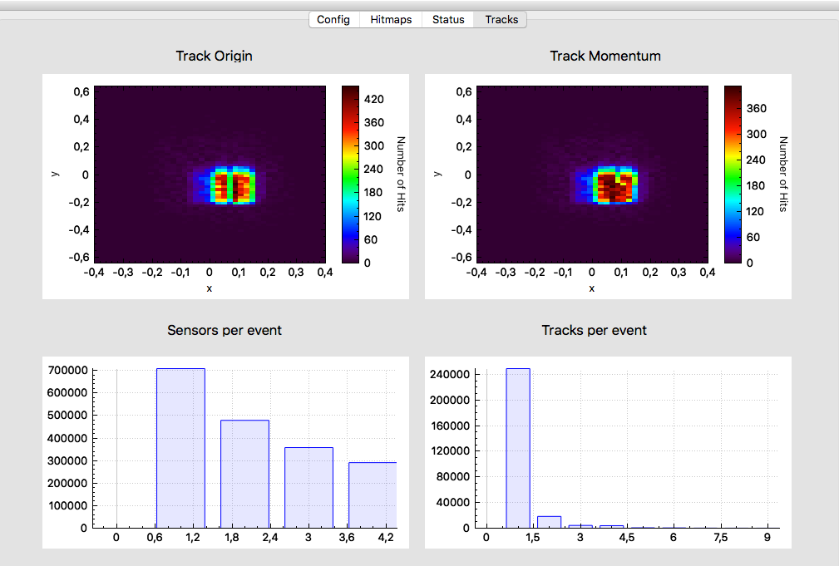
Online Monitoring
Track fitter
Event builder
Track
finder

Slide 20
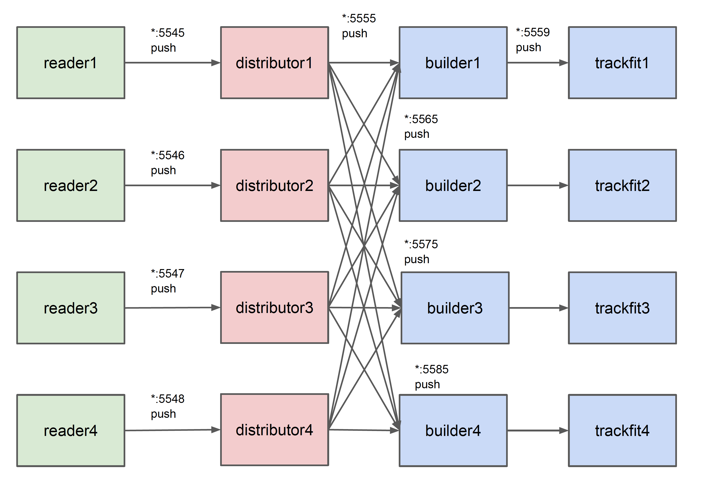
Parallelization of Event Builder
FE 1
Time 1
FE 2
Time 2
FE 3
Time 3
FE 4
Time 4

Slide 21
Summary
Online reconstruction of test beam data is running
Status information during data taking from
Digis
Cluster
Data integrity
Event building
Tracking
Event building bottleneck
Improving speed by parallelization
Faster algorithm

Slide 22
Distributor

Slide 23
Distributor
threshold

Slide 24
Distributor
offset
threshold

Slide 25
Distributor
offset
threshold

