Slide 1

Micro Vertex Detector of PANDA
Strip Detector
PANDA MVD
Detector Construction and Design

Slide 2
Overview
Design Strip Part
  Half Shell (new prototype needed)
  Stave (BL 4 prototype)
  Service lines (going on)
  Strip Disc (going on)
  Manufacture of the parts
  BL 4- Stave with cooling module as Prototype ready for test
  Disc Support for Readout electronics (going on)
  Manufacturing of Disc support structure (going on)
  Quality controls new X-ray machine at ZEA-1
  Thermal hydraulic investigation and tests
  Thermal hydraulic Test at ZEA-1 (test facility ready for use)
  Investigation of cooling pipes (going on)
  FEM Validation
  Half shell deformation - 1. valuation (going on)
  Stave deformation (going on)
  Strip Disc deformation (going on)
  Pixel Disk attachment (going on)
Full Scale Model

Slide 3
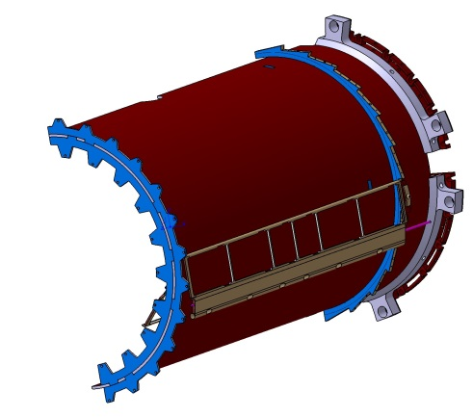
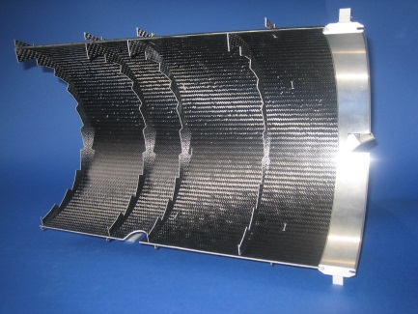
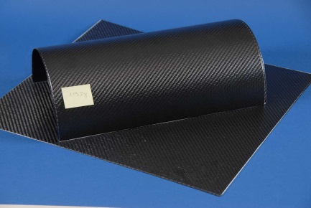
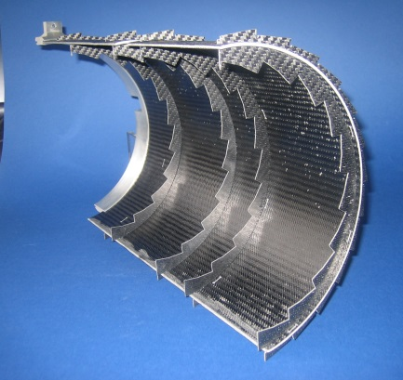
Support Structures- Strip Barrel Half Shell
1. Prototyp
Semi-finished-products
Half Shell

Slide 4
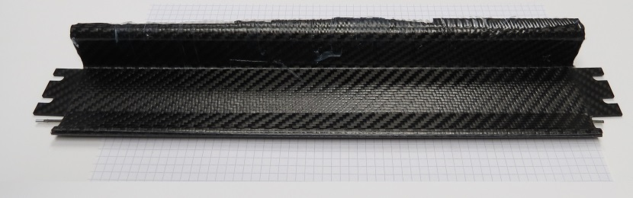
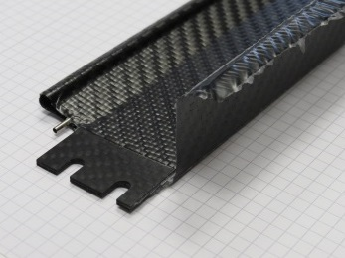
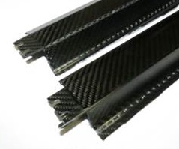
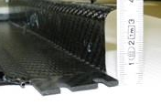
Stave – BL4
Inlay – 2mm CFK
Prototyp – BL4 – Nov. 2016 from IKV
Edge processing
Deformation / rotation – 1mm

Slide 5
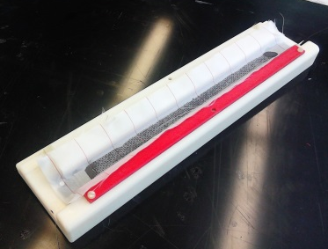
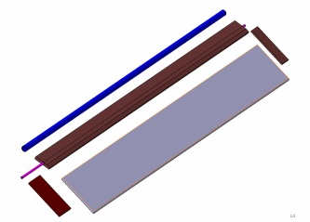
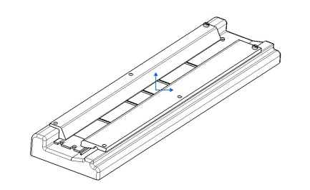
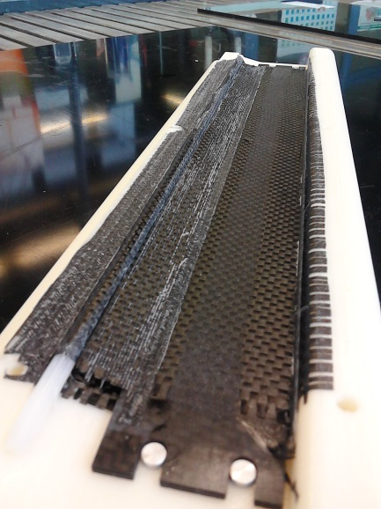
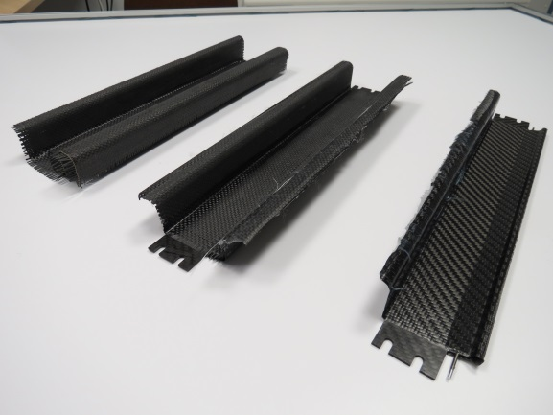
Stave – BL4 - Hand- lay- up
Tool
Hand- lay- up
Single components
Hand- lay- up vs. Prepreg
Cable channel
with round stock

Slide 6
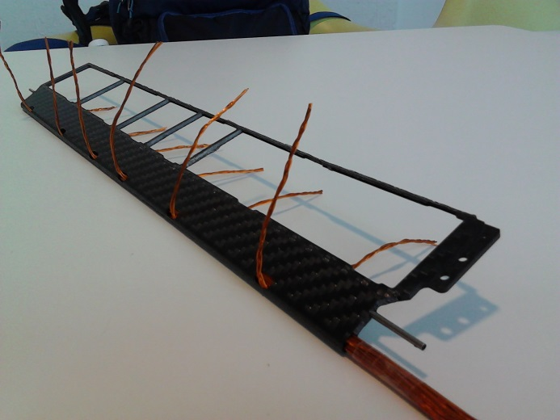
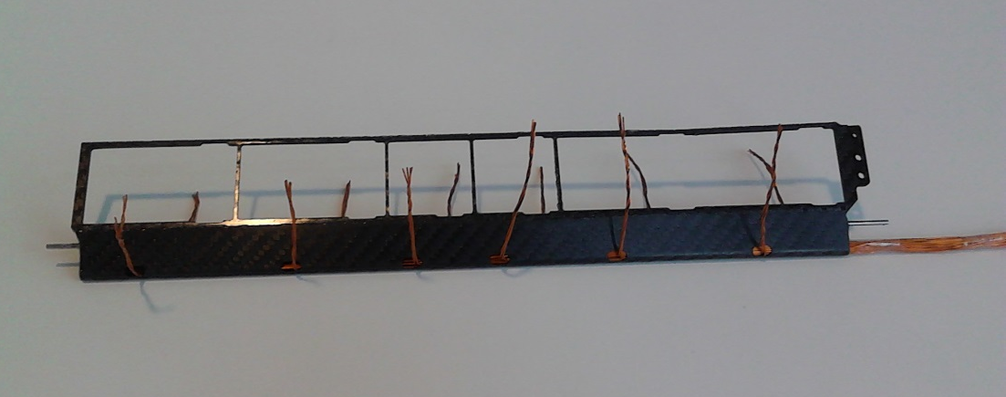
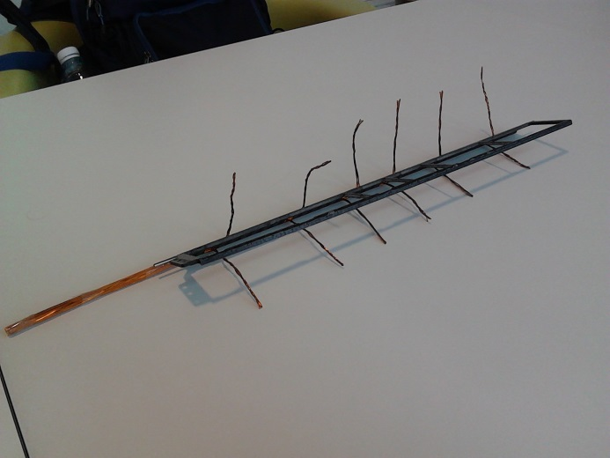
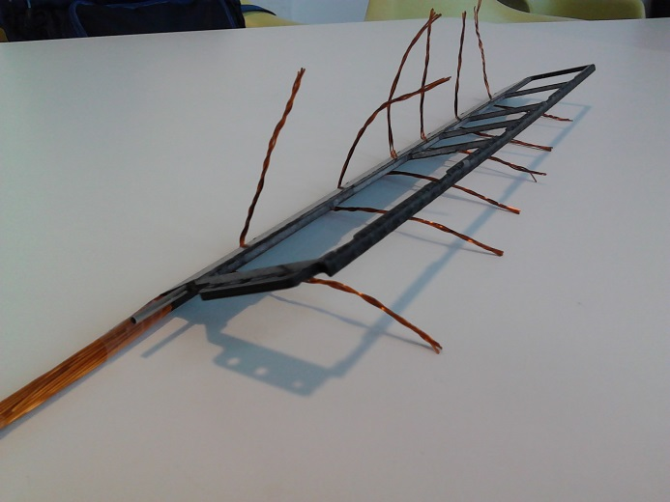
Stave – BL4 With Cable

Slide 7
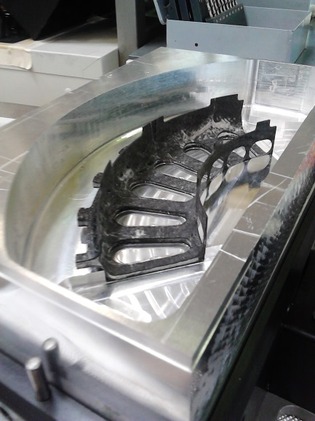
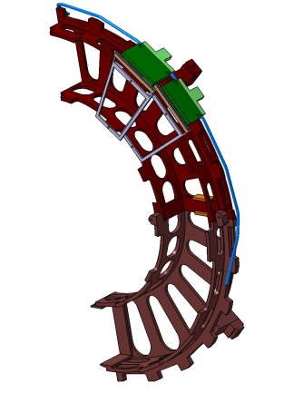
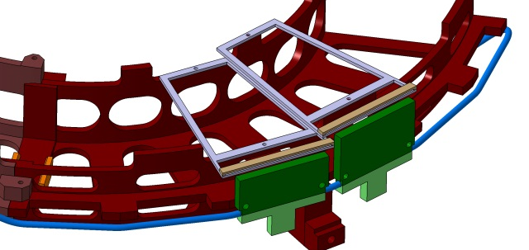
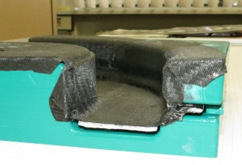
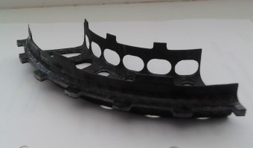
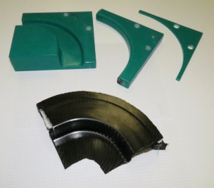
Strip Disk
Workshop
Half Disk
Variant long
Variant short
Tool and 2.Prototyp
2. Prototyp - Prepreg
1. Prototyp - hand- lay- up

Slide 8
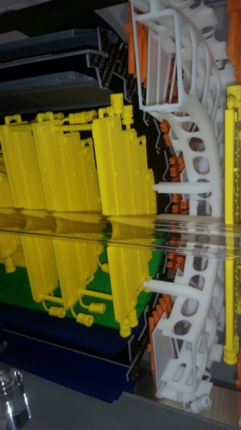
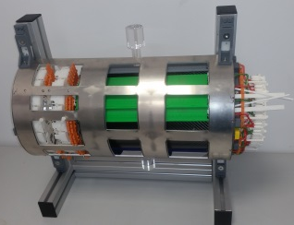
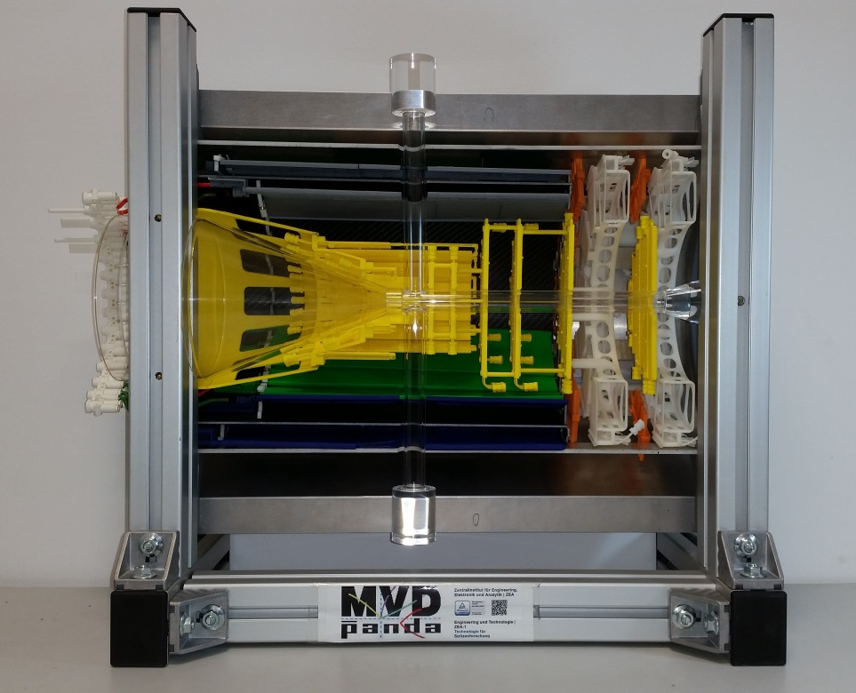
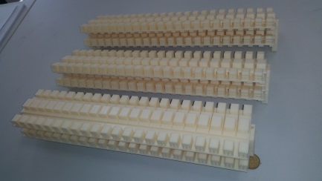
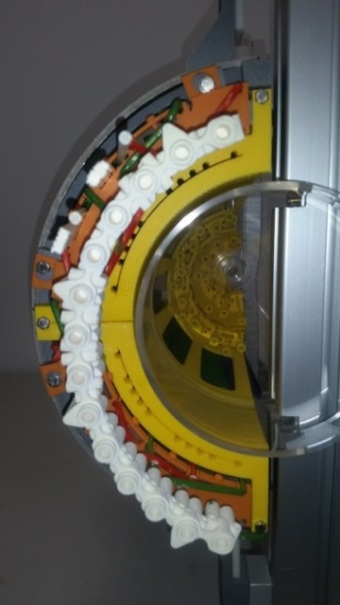
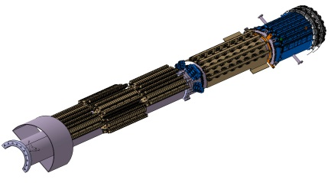
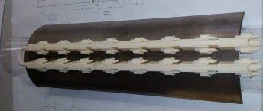
Full Scale Model

Slide 9
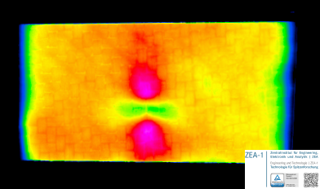
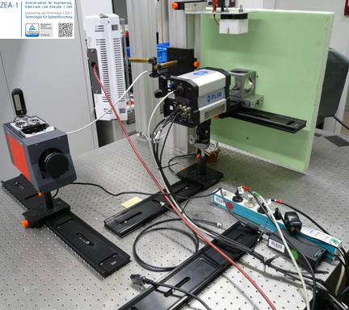
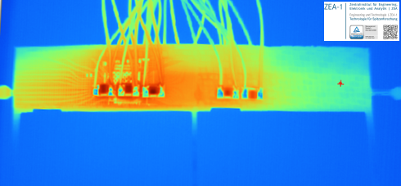
Test Facility (Thermography)
FLIR SC6000, ImageIR 8300 thermography cameras with cooled detectors
picture resolution 640x512
thermal resolution better than 20mK
Different exaction sources for active thermography
fiber crack in a composite cfk/foam plate
heat distribution on the surface of a stave

Slide 10
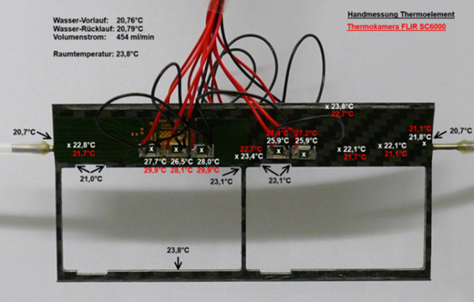
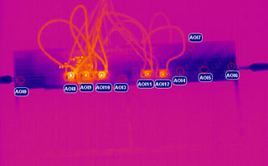
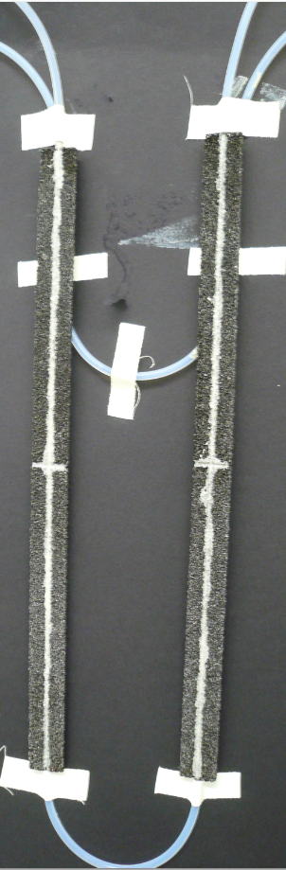
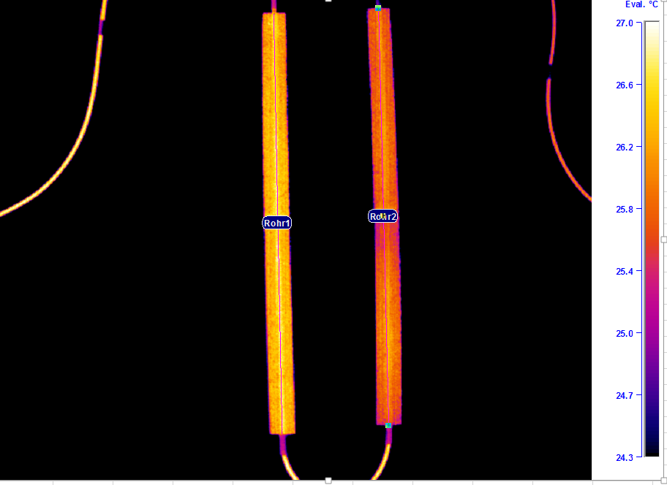
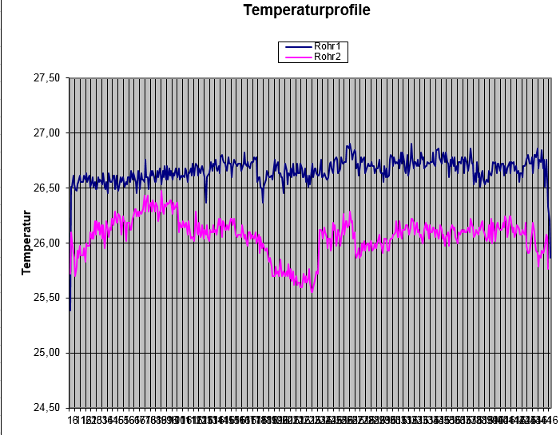
Test Facility (Thermography)
Water inlet temperature ~30°
Water inlet temperature ~23°
sharp temperature separation between Carbon Foam and Rohacell

Slide 11
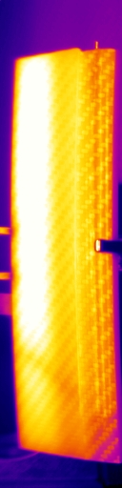
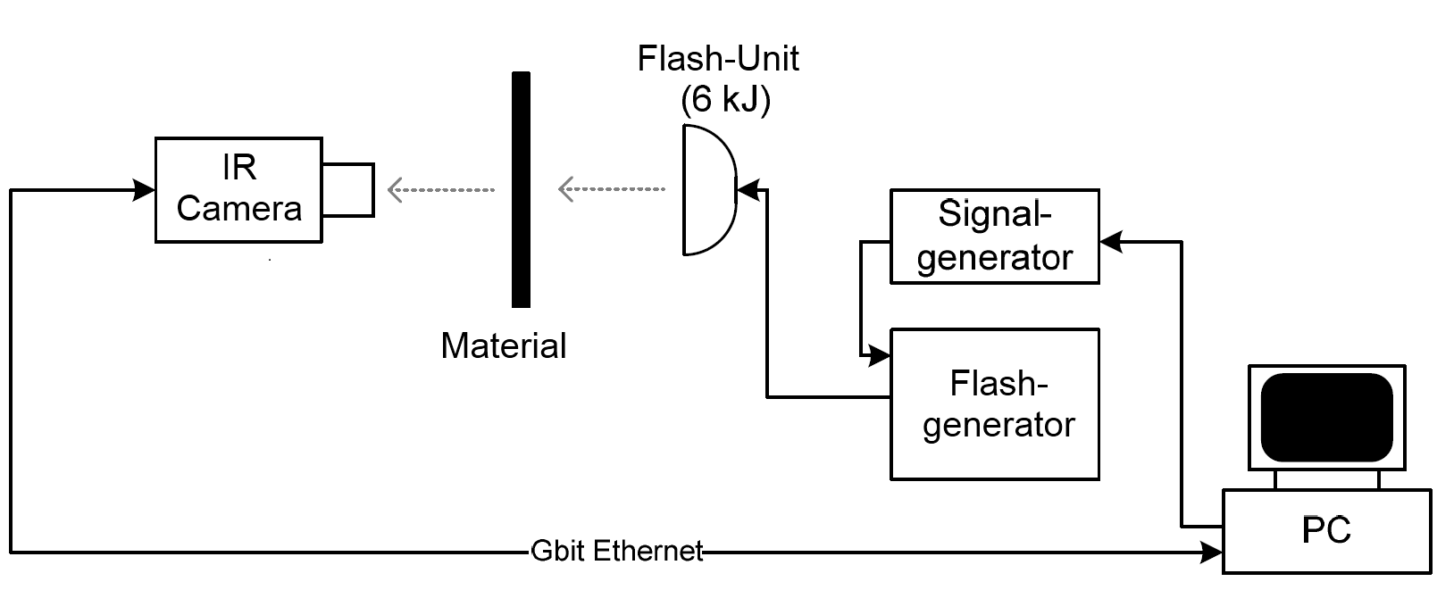
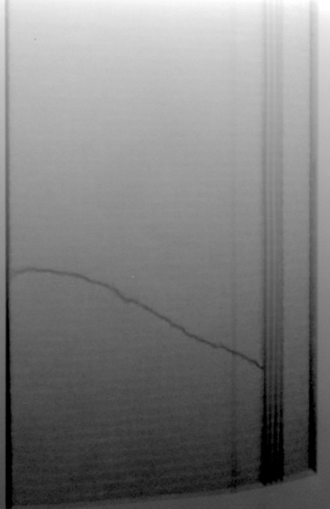
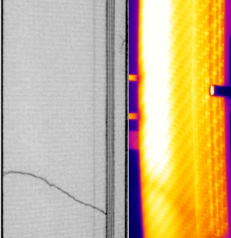
Test Facility Active Thermography
Studies to determine the quality control (delamination) for the production of CFRP (carbon fiber-reinforced polymer

Slide 12
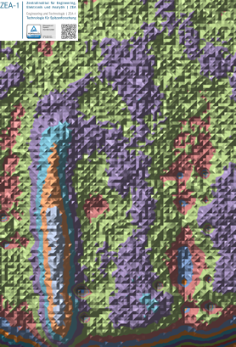
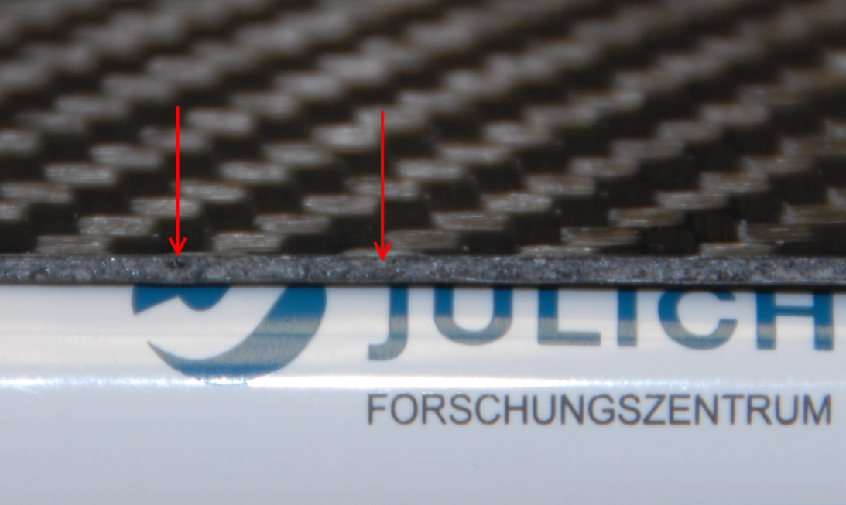
Test Facility Active Thermography
development of a "thermal wave algorithm" using active thermal imaging to analyze the structure of the staves
$20mm$ long, $0,5mm$ in diameter
passage
steel needle
1
2
1
2

Slide 13
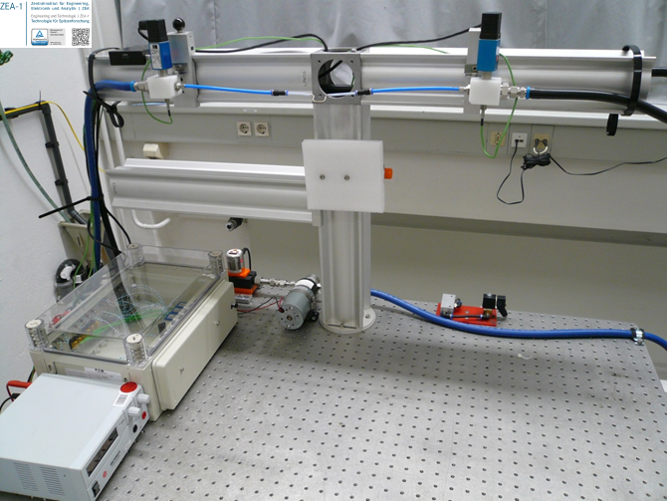
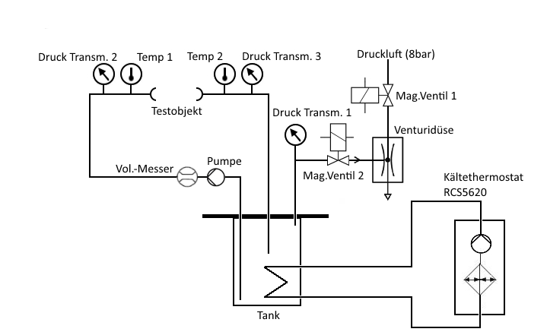
Test Facility Hydraulic
pressure sensor
variable distance
temperatur sensor
volume flow sensor
air pump
water pump
data aquisition
Pump control

Slide 14
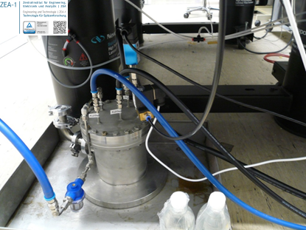
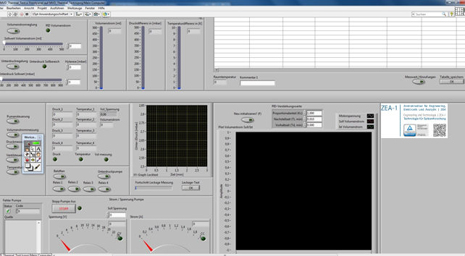
Test Facility Hydraulic
Pressure range$−1000 mbar⋯+1000$mbar
Volume flow $0⋯500\frac{ml}{min}$
Cooling water temperature $5⋯25°C$
Low pressure m$ode −800mbar⋯0$mbar
Variable PID controlled
volume flow
Standardized measurement
cycles for quality assurance
Labview software
Experiment control

Slide 15
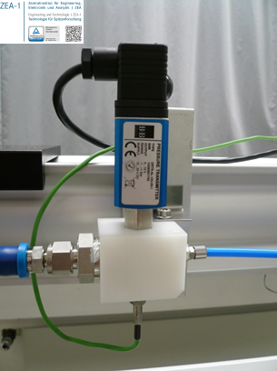
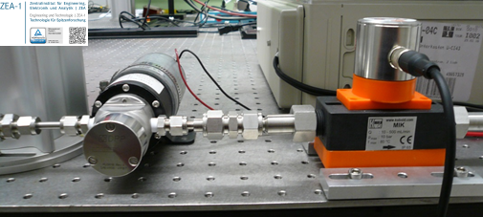


Test Facility Measurement accuracy
Pressure sensor $−1000mbar⋯1000mbar$
temperature coefficient$<±0,3\frac{mbar}{K}$
Linearity error$<±4mbar$
Volume flow Sensor $10⋯500\frac{ml}{min}$
repeat accuracy$±5ml/min$
accuracy$±10ml/min$
K-Type thermocouple
Deviation class 1
Iterative calibrated pressure and volume flow sensors. Documentation according to ISO 9001

Slide 16


Test Facility Quality Assurance Process
quality assurance
MVD-Stave
hydraulic
thermal
Testing of the hydraulic specifications
Check with active thermography :
delamination, resin allocation, faulty glueing, CFC or foam fractures
Further development of the automatic test procedure
Documentation
Calibration of flow and pressure sensors
Maintenance of the calibration facility
Testing of the thermal coupling between the cooling and the mecanical structure
Documentation

Slide 17


Cable Dimension BL4
pair name | d[mm] forward | d[mm] backward | I [A] | length [mm]
N-FEA-1 | 0,15 | 1 | 1,1 | 31
N-FEA-2 | 0,25 | 1 | 1,1 | 91
N-FEA-3 | 0,25 | 1 | 1,1 | 139
N-FEA-4 | 0,3 | 1 | 1,1 | 174
N-FEA-5 | 0,3 | 1 | 1,1 | 222
N-FEA-6 | 0,35 | 1 | 1,1 | 282
N-FED-1 | 0,15 | 0,75 | 0,6 | 31
N-FED-2 | 0,15 | 0,75 | 0,6 | 91
N-FED-3 | 0,25 | 0,75 | 0,6 | 139
N-FED-4 | 0,25 | 0,75 | 0,6 | 174
N-FED-5 | 0,25 | 0,75 | 0,6 | 222
N-FED-6 | 0,25 | 0,75 | 0,6 | 282
P-FEA-1 | 0,15 | 1,3 | 1,93 | 31
P-FEA-2 | 0,25 | 1,3 | 1,93 | 91
P-FEA-3s | 0,25 | 1 | 1,1 | 139
P-FEA-4s | 0,3 | 1 | 1,1 | 174
P-FEA-5 | 0,4 | 1,3 | 1,93 | 222
P-FEA-6 | 0,45 | 1,3 | 1,93 | 282
P-FED-1 | 0,15 | 1 | 1,3 | 31
P-FED-2 | 0,25 | 1 | 1,3 | 91
P-FED-3s | 0,25 | 0,75 | 0,85 | 139
P-FED-4s | 0,25 | 0,75 | 0,85 | 174
P-FED-5 | 0,35 | 1 | 1,3 | 222
P-FED-6 | 0,4 | 1 | 1,3 | 282
Connector, designed by ZEA-2

Slide 18

Thermal Investigation
Front 1
Front 2
Back 1
Back 2
The current density is too high for the choosen cable diameter

Slide 19




Cable diameter
Laying up the cable diameter in dependence on DIN 46435, DIN VDE 0298-4
pair name | d[mm] forward | I [A] | d [mm] calculated forward
N-FEA-1 | 0,15 | 1,1 | 0,63
N-FEA-2 | 0,25 | 1,1 | 0,63
N-FEA-3 | 0,25 | 1,1 | 0,63
N-FEA-4 | 0,3 | 1,1 | 0,63
N-FEA-5 | 0,3 | 1,1 | 0,63
N-FEA-6 | 0,35 | 1,1 | 0,63
N-FED-1 | 0,15 | 0,6 | 0,5
N-FED-2 | 0,15 | 0,6 | 0,5
N-FED-3 | 0,25 | 0,6 | 0,5
N-FED-4 | 0,25 | 0,6 | 0,5
N-FED-5 | 0,25 | 0,6 | 0,5
N-FED-6 | 0,25 | 0,6 | 0,5
P-FEA-1 | 0,15 | 1,93 | 0,85
P-FEA-2 | 0,25 | 1,93 | 0,85
P-FEA-3s | 0,25 | 1,1 | 0,63
P-FEA-4s | 0,3 | 1,1 | 0,63
P-FEA-5 | 0,4 | 1,93 | 0,85
P-FEA-6 | 0,45 | 1,93 | 0,85
P-FED-1 | 0,15 | 1,3 | 0,75
P-FED-2 | 0,25 | 1,3 | 0,75
P-FED-3s | 0,25 | 0,85 | 0,5
P-FED-4s | 0,25 | 0,85 | 0,5
P-FED-5 | 0,35 | 1,3 | 0,75
P-FED-6 | 0,4 | 1,3 | 0,75
5,1g CU per Stave → 22,6g CU per Stave
First try: we used the lowest calculated diameter (=biggest old diameter) for all cables to test the connectors
= 13,2g CU per stave
$$R=\sqrt{n∙r²∙η}$$
$η$ = 0,79
n = 48
r = cable diameter
R = diameter cable channel
n = number of cable
$η$ = packing ratio
For comparison:
Backward cable: 326g CU per meter and stave (BL4)

Slide 20


Redesign Cable Channel
old concept:
carbon prepack laminated around a semi-manufactured carbon tube
new concept:
laminating the carbon prepack around a metal rod. After the manufacturing process the material is cooled, so that the shrunken rod can be removed
Doubling of the cross-sectional area
saving of material

Slide 21


Thermal Testing Power Connector

Slide 22


Next Steps
Examination thermal behavior BL4 staves
connected to the cooling system,
equiped with cables inside,
flexible pcb,
connectors,
dummy electronic/sensors.
→ Help is needed!
Who determines the new cable diameter and material?
Who is looking for the (final) connectors?
Who is designing the Flex PCB, when can we get it?
What is the (final) power consumption of the electronic?
Who are the contact persons?
Who needs BL4-Prototypes and when?

Slide 23


Retirement of Vincenzo Fracassi
Thank you very much Enzo!

