Slide 1

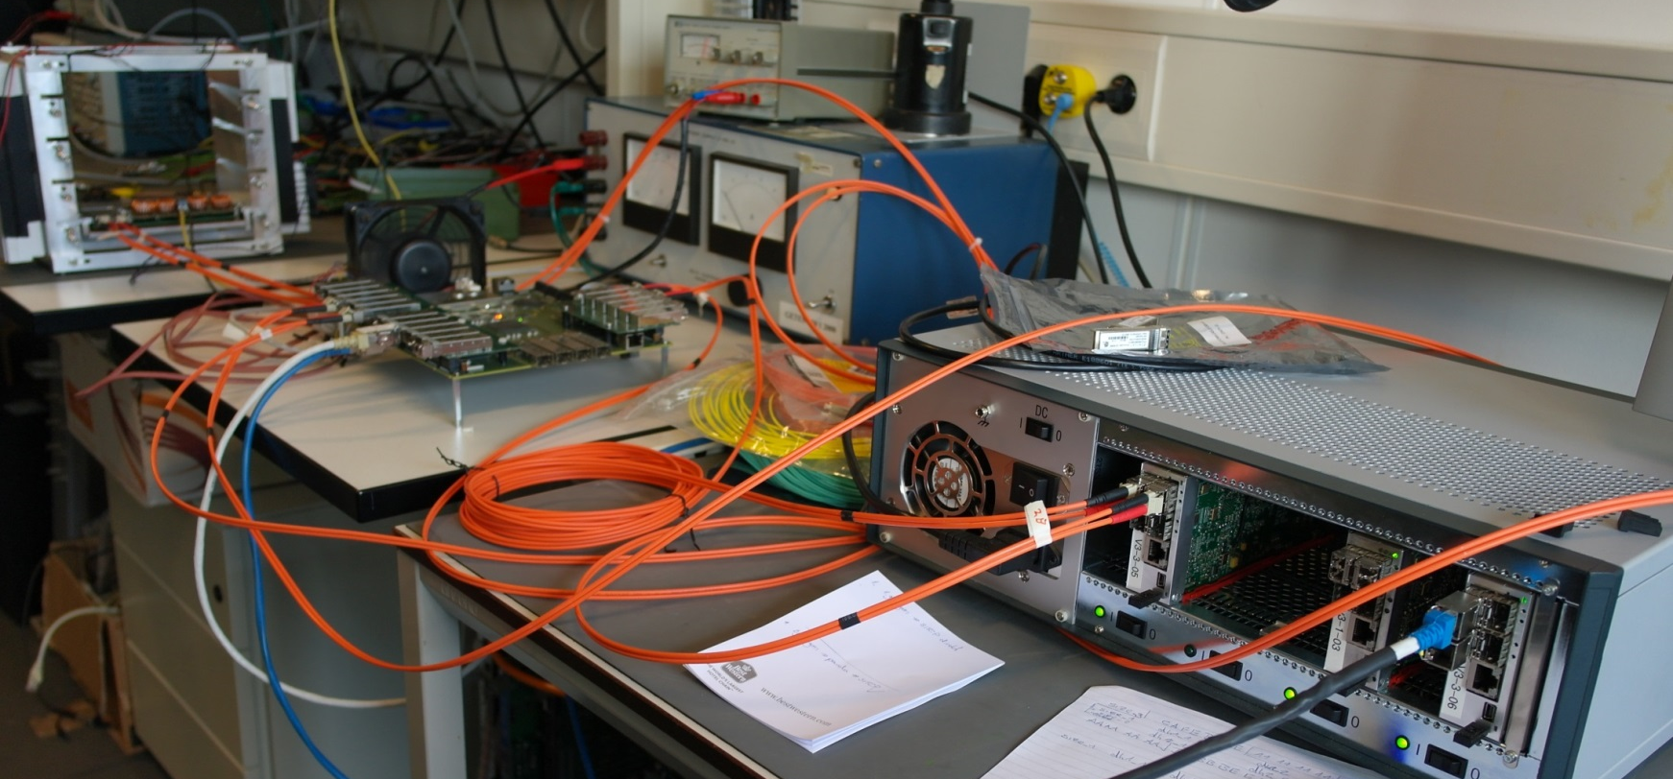
M. Tiemens
The hardware implementation of the cluster finding algorithm and the Burst Building Network

Slide 2
M. Tiemens
| 2
Recap
Map
EMC
Data
Concentrator

Slide 3








M. Tiemens
| 3
Distributed Cluster Finding
$$γ$$
$$h_{c}$$
$$π^{0}$$
$$π^{0}$$
1
Form preclusters:
$$p$$
$$\overline{p}$$
$$η_{c}$$
$$η$$
5000 events @200 kHz
2
Merge preclusters:
(if needed)
3
(Set properties of completed clusters)

Slide 4
M. Tiemens
| 4
Distributed Cluster Finding
$$γ$$
Relative nr of events reconstructed:
Default:
Online:
Distributed:
$$h_{c}$$
$$π^{0}$$
29.4%
28.7%
$$π^{0}$$
23.9%
$$p$$
$$\overline{p}$$
$$η_{c}$$
$$η$$
CPU processing time (relative to Default):
Default:
Online:
Distributed:
5000 events @200 kHz
1
1.19
0.93 (0.05 + 0.88)

Slide 5
M. Tiemens
| 5
VHDL Implementation Test Setup
Kintex 7 Test Board
Compute Node
DC
SFP
SFP
DC
SFP
SFP
DC
SFP
SFP
DC
SFP
SFP
Gb Ethernet
Data
(4 DC’s)
PC
USB

Slide 6
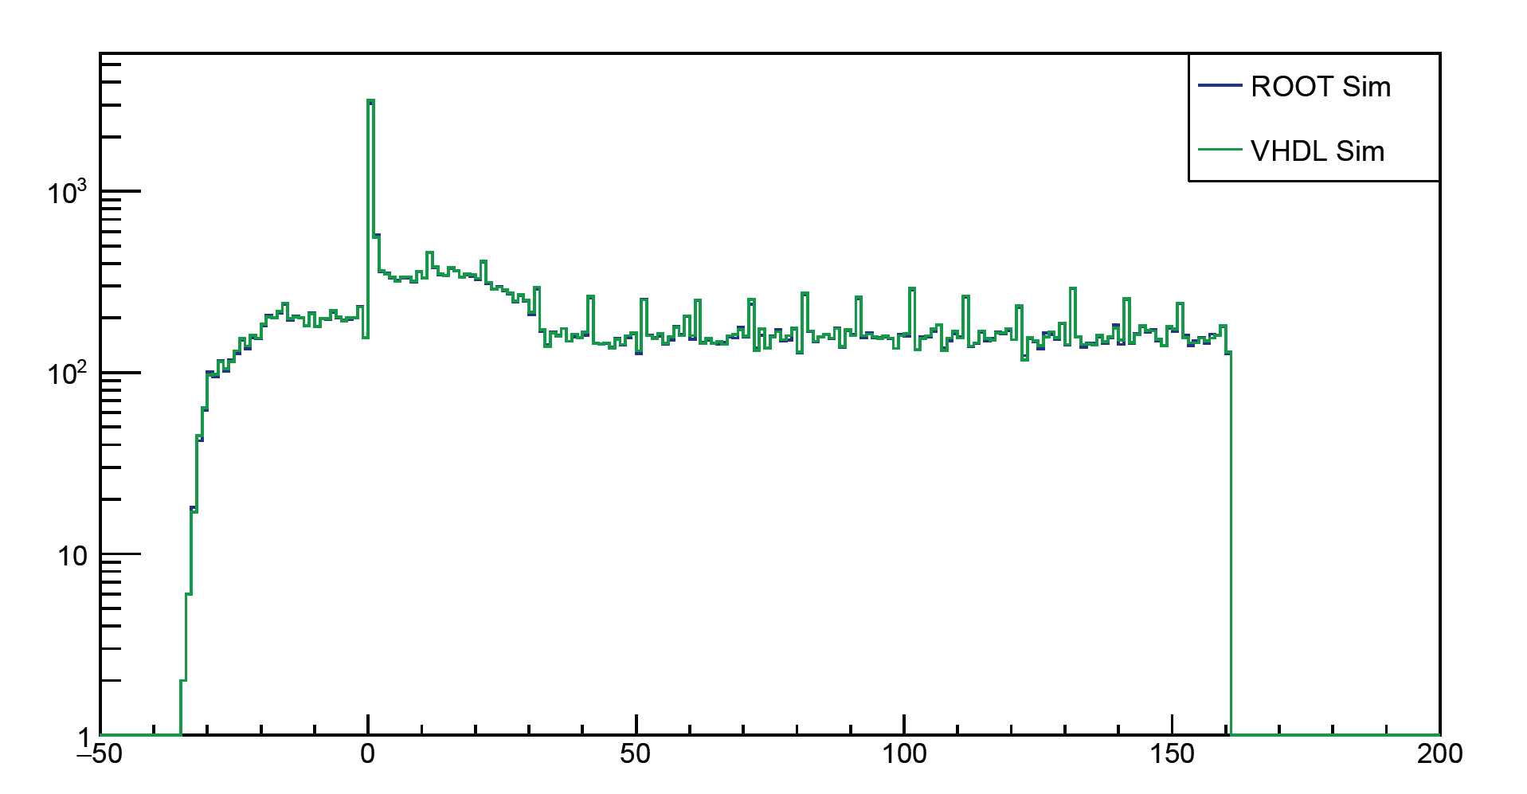
M. Tiemens
| 6
Comparison Between PandaRoot and VHDL
Kintex 7 Test Board
Compute Node
DC
SFP
SFP
DC
SFP
SFP
DC
SFP
SFP
DC
SFP
SFP
Gb Ethernet
Data
(4 DC’s)
PC
USB
Mapped X-position

Slide 7
M. Tiemens
| 7
Data Structure
64-bit words
PRECLUSTER1 | X | Y | D | t | NR_OF_HITS
X, Y : Position in 2D Map
D : Diameter of Precluster
t : Time
E : Energy
HIT1 | t | E | ch. nr
HIT2 | t | E | ch. nr
…
CLUSTER1 | x | y | z | t | E | NR_OF_HITS
HIT1 | t | E | ch. nr
HIT2 | t | E | ch. nr
…

Slide 8
M. Tiemens
| 8
What if a Photon Hits the Edge?
Detection:
EDGE
Energy-weighted position is close to edge of map
Options:
1
Discard these clusters
2
Apply correction factor to E
3
Use complicated neighbour relation to edge of other map

Slide 9

M. Tiemens
| 9
All right, so what does this all mean for the data flow, and the processing thereof?

Slide 10
M. Tiemens
| 10
Data Collection
EMC
BwEndcap + Barrel | # | Rate /device (Gbps) | Total rate (Gbps) |  | FwEndcap | # | Rate/device (Gbps) | Total rate (Gbps)
SADCs <10 kHz | 572 | 0.05 | 28.6 |  | SADCs 300 kHz | 217 | 1.2 | 260.4
SADCs >10, <50 kHz | 512 | 0.27 | 138.24
SADCs >50 kHz | 112 | 0.6 | 67.2
Total | 1196 |  | 234.04 |  |  | 217 |  | 260.4

Slide 11
M. Tiemens
| 11
BwEndcap Barrel
FwEndcap
1196 digitisers
Total rate: 234 Gbps
217 digitisers
Total rate: 260 Gbps
0101
0101
0101
0101
0101
BwEndcap + Barrel | # | Rate /device (Gbps) | Total rate (Gbps) |  | FwEndcap | # | Rate/device (Gbps) | Total rate (Gbps)
SADCs <10 kHz | 572 | 0.05 | 28.6 |  | SADCs 300 kHz | 217 | 1.2 | 260.4
SADCs >10, <50 kHz | 512 | 0.27 | 138.24
SADCs >50 kHz | 112 | 0.6 | 67.2
Total | 1196 |  | 234.04 |  |  | 217 |  | 260.4
3 → 1
16 inputs
25 Data Concentrators
Total rate: 468 Gbps
Assuming worst case where each hit becomes a cluster
14 Data Concentrators
Total rate: 520 Gbps

Slide 12
M. Tiemens
| 12
Output Produced by Data Concentrators (DCs)
14 Data Concentrators
Total rate: 520 Gbps
25 Data Concentrators
Total rate: 468 Gbps
50 optical links
@10 Gbps
42 optical links
@12 Gbps
1196 digitisers
Total rate: 234 Gbps
217 digitisers
Total rate: 260 Gbps
0101
0101
0101
0101
0101
3 → 1
Now what?

Slide 13
M. Tiemens
| 13
Processing the DC Output
14 Data Concentrators
Total rate: 520 Gbps
3 Options for the BBN*:
25 Data Concentrators
Total rate: 468 Gbps
1
Throw everything into one big data collection network, which may or may not do more advanced processing (at least collect and sort data).
50 optical links
@10 Gbps
42 optical links
@12 Gbps
2
Do some data merging, then do 1.
Now what?
3
Collect everything in a switch, and let one big FPGA board do the rest.
*Burst Building Network, PANDA’s data collection and processing network

Slide 14
M. Tiemens
| 14
Processing the DC Output
1
14 Data Concentrators
Total rate: 520 Gbps
3 Options for the BBN*:
25 Data Concentrators
Total rate: 468 Gbps
1
Throw everything into one big data collection network, which may or may not do more advanced processing (at least collect and sort data).
50 optical links
@10 Gbps
42 optical links
@12 Gbps
Switch
2
Do some data merging, then do 1.
63 optical links @16 Gbps
Smart Network
3
+ Merge preclusters
+ Kick low-E clusters*
Collect everything in a switch, and let one big FPGA board do the rest.

Sort
1
2
3
Repeat until entire EMC covered

Slide 15
M. Tiemens
| 15
Topology of the Network
Sort
Merge Preclusters
Kick Low-E Clusters*
1
63 optical links @16 Gbps
508 Gbps (if 1+2+3)
1 Tbps (if 0 or 1)
32 Optical links (if 1+2+3)
63 Optical links (if 0 or 1)

Slide 16
M. Tiemens
| 16
Topology of the Network
1
Procedure (after sorting):
Make timebunches:
Send 1st n timebunches to n FPGAs on 1st CN
Send 2nd n timebunches to n FPGAs on 2nd CN
Etc until mth CN, then send to 1st CN again and repeat from 2.
Network
32 links
/63 links
Compute Nodes

Slide 17
M. Tiemens
| 17
Topology of the Network
Processing the DC Output
3 Options for the BBN:
Procedure (after sorting):
Make timebunches:
Send 1st n timebunches to n FPGAs on 1st CN
Send 2nd n timebunches to n FPGAs on 2nd CN
Etc until mth CN, then send to 1st CN again and repeat from 2.
Network
1
Throw everything into one big data collection network, which may or may not do more advanced processing (at least collect and sort data).
32 links
/63 links
2
Do some data merging, then do 1.
3
Collect everything in a switch, and let one big FPGA board do the rest.
Compute Nodes

Slide 18
M. Tiemens
| 18
Processing the DC Output
2
14 Data Concentrators
Total rate: 520 Gbps
3 Options for the BBN:
25 Data Concentrators
Total rate: 468 Gbps
1
Throw everything into one big data collection network, which may or may not do more advanced processing (at least collect and sort data).
2 per device
50 optical links
@10 Gbps
3 per device
42 optical links
@12 Gbps
Combine data from 4 DCs
Combine data from 3 DCs
2
8 inputs
8 outputs
9 inputs
7 outputs
Do some data merging, then do 1.
3
Collect everything in a switch, and let one big FPGA board do the rest.
7 Network DCs
Total rate: 293 Gbps
19 optical links
@16 Gbps
5 Network DCs
Total rate: 325 Gbps
21 optical links
@16 Gbps
(Uncombined: 63 links @988 Gbps)

Slide 19
M. Tiemens
| 19
Processing the DC Output
14 Data Concentrators
Total rate: 520 Gbps
3 Options for the BBN:
25 Data Concentrators
Total rate: 468 Gbps
1
Throw everything into one big data collection network, which may or may not do more advanced processing (at least collect and sort data).
2 per device
50 optical links
@10 Gbps
3 per device
42 optical links
@12 Gbps
Combine data from 4 DCs
Combine data from 3 DCs
2
8 inputs
8 outputs
9 inputs
7 outputs
Do some data merging, then do 1.
3
Collect everything in a switch, and let one big FPGA board do the rest.
7 Network DCs
Total rate: 293 Gbps
19 optical links
@16 Gbps
5 Network DCs
Total rate: 325 Gbps
21 optical links
@16 Gbps

Slide 20
M. Tiemens
| 20
Processing the DC Output
3
14 Data Concentrators
Total rate: 520 Gbps
3 Options for the BBN:
25 Data Concentrators
Total rate: 468 Gbps
1
Throw everything into one big data collection network, which may or may not do more advanced processing (at least collect and sort data).
50 optical links
@10 Gbps
42 optical links
@12 Gbps
32 Gbps Switch
2
Do some data merging, then do 1.
31 optical links
@32 Gbps
VU31P:
Overflow if VU35P occupied
3
Collect everything in a switch, and let one big FPGA board do the rest.
Xilinx UltraScale+ VU35P (64x 32Gbps transceivers)
16 optical links
@32 Gbps

Slide 21
M. Tiemens
| 21
Processing the DC Output
3
14 Data Concentrators
Total rate: 520 Gbps
25 Data Concentrators
Total rate: 468 Gbps
50 optical links
@10 Gbps
42 optical links
@12 Gbps
32 Gbps Switch
31 optical links
@32 Gbps
VU31P:
Overflow if VU35P occupied
32 Gbps Switch
Xilinx UltraScale+ VU35P (64x 32Gbps transceivers)
32 Optical links
@16 Gbps
16 optical links
@32 Gbps

Slide 22
M. Tiemens
| 22
Summary and Outlook
1
Hardware implementation of clustering has been made:
a
Results agree with PandaRoot sim.
b
→ Check with FPGA specifications to explore possibilities.
2
Several options for the BBN are being explored.
Recommendation:
1
Use Option 3 (big FPGA board).
2
If not possible (see 1b), use Option 2 (do data merging, then feed to BBN).

Slide 23
M. Tiemens
| 23
Open Question to Collaboration:
What do other subsystems require of the BBN?

