Slide 1
APD News

Slide 2
Motivation
Background/Motivation:
2 main different kinds of dark current distribution observed during screening of APDs after gamma irradiation
Assumption: Difference originates from different voltage conditions under irradiation
Test irradiation study performed depending on dose:
Irradiation of several APDs w/o HV applied @ different gamma doses

Slide 3
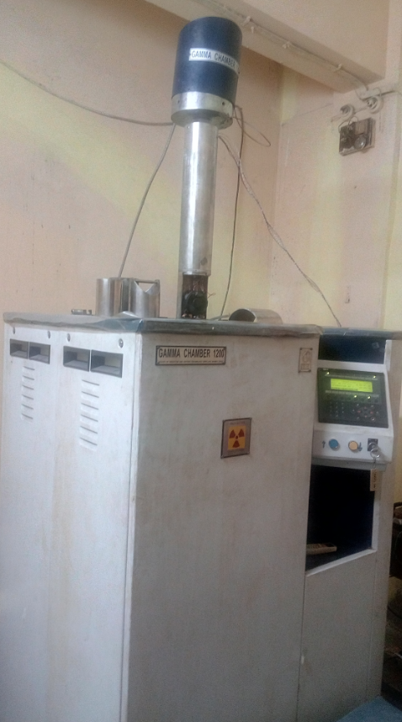
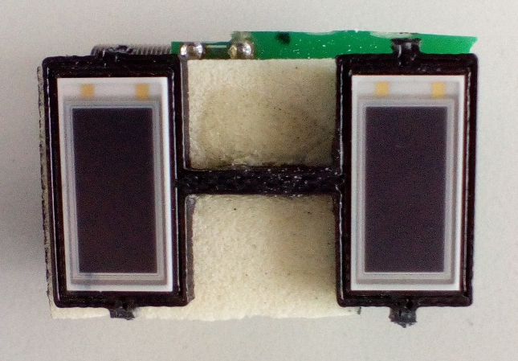
Setup in India
APD sample number | Dose [Gy] | y/n
1 | 20 | n
2 | 50 | n
3 | 100 | y
4 | 200 | y
5 | 500 | y
6 | 1000 | y
7 | 1500 | y
8 | 2200 | y
9 | 3750 | n
10 | 5000 | n
Gamma Irradiation @ VECC, India
Setup of one sample
Sample consists of:
One APD unconnected
One APD connected,
to be biased under
irradiation (M =100)
both APDs matched in
terms of bias, breakdown,
etc…
Supported by Vinod Singh Negi and Ajit Kumar

Slide 4
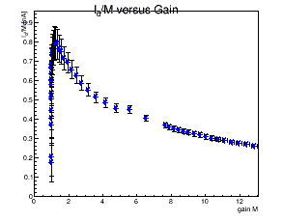
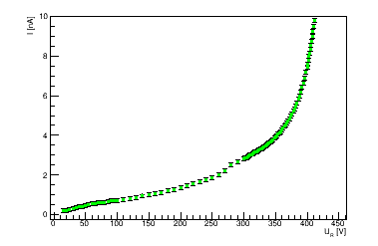
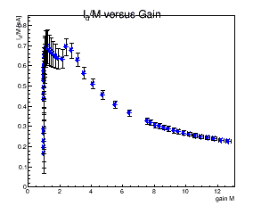
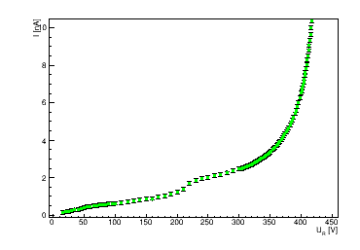
Bias voltages/corresponding gain values
Dark current
unbiased
Corresponding
gain value
Not connected under irradiation
example: D* = 100 Gy
measured after gamma irradiation @ T = 20°C,
without annealing
biased
Corresponding
gain value
M = 100
under irradiation

Slide 5
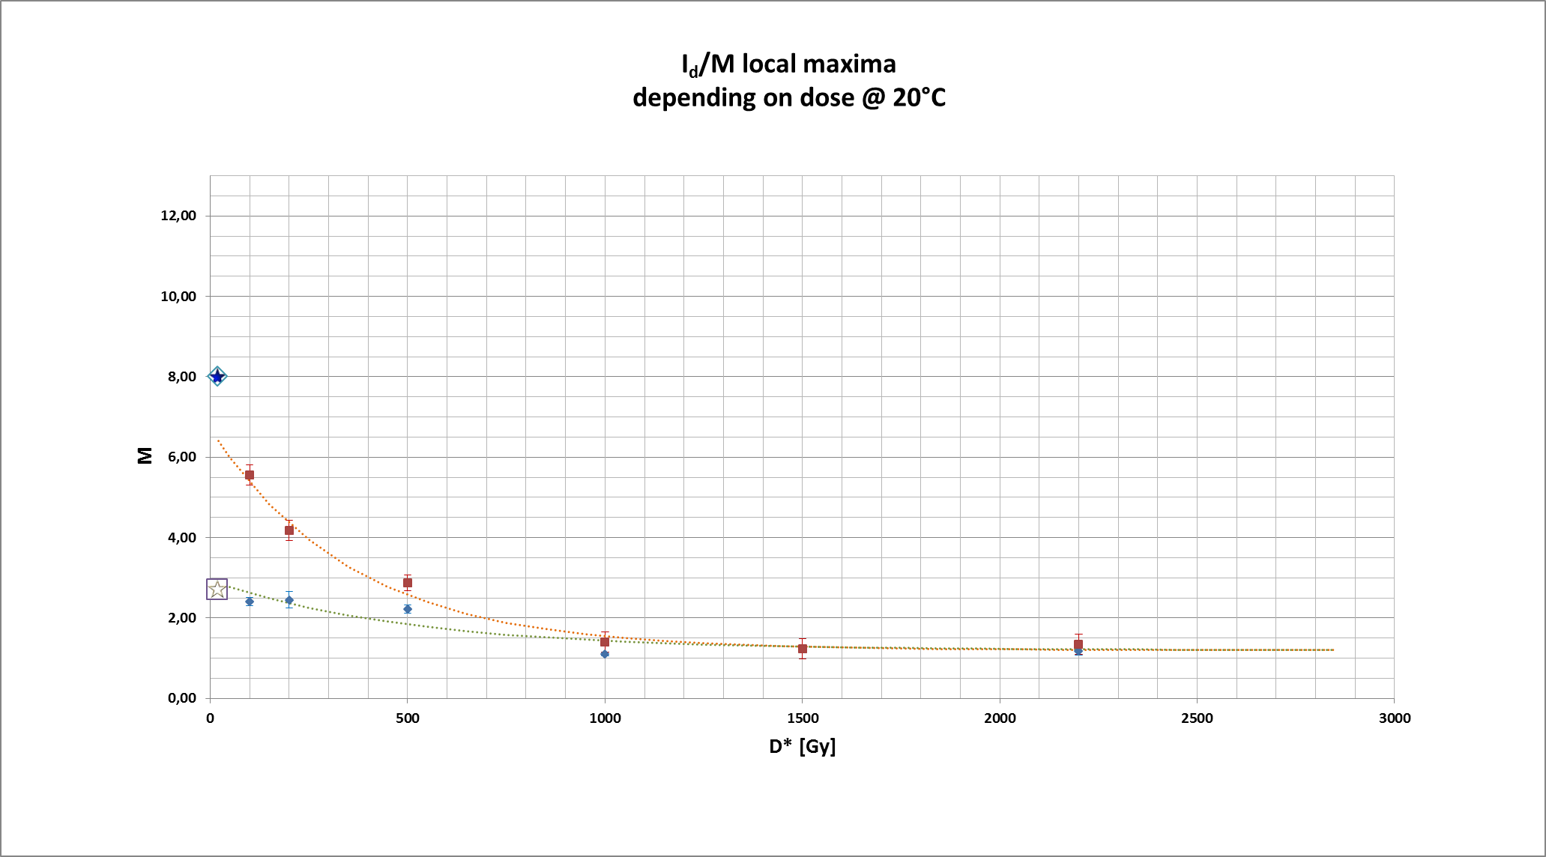



Local maxima locations
depending on dose
Results of characterization @ T = 20°C
after irradiation, before thermal annealing
Unbiased / no connection under irradiation
M = 100 under irradiation
Preliminary

Slide 6
Summary & Outlook
Summary:
Different dark current behavior observed originates from different bias voltage applications during irradiation
Irradiation setup @ Giessen has been modified and repaired (see last CM report of Hans in September)
Application of individual bias voltages (i.e. M = 100) for each APD possible and functional now
Outlook:
Analysis of ‘India data’ ongoing:
Influence of bias voltage application under irradiation on changes in QE, C and M(λ): to be investigated
Thanks to:
Bochum colleagues: for setup of new HV control system of the existing irradiation setup (mainly Tobias) & for providing us with the necessary devices for R & D purposes (Fritz-Herbert)
Indian CBM colleagues: for opportunity/support and realization of gamma irradiation study on such a short time scale (i.a. Vinod & Ajit)

