Slide 1
STT update
Artur Cebulla (FZ Jülich) for the STT group
LVIII. PANDA CM Mainz, MEC session, Ded-05th, 2016

Slide 2
STT update
DIRC STT issue/Solution approach
STT internal services
STT external services

Slide 3
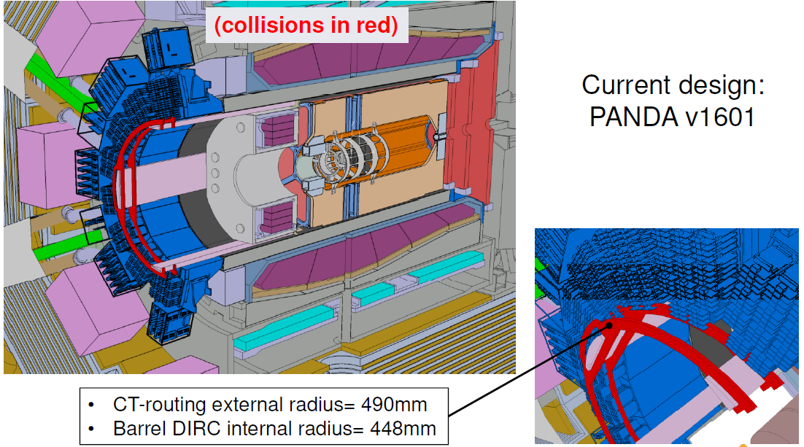
DIRC/STT issue

Slide 4
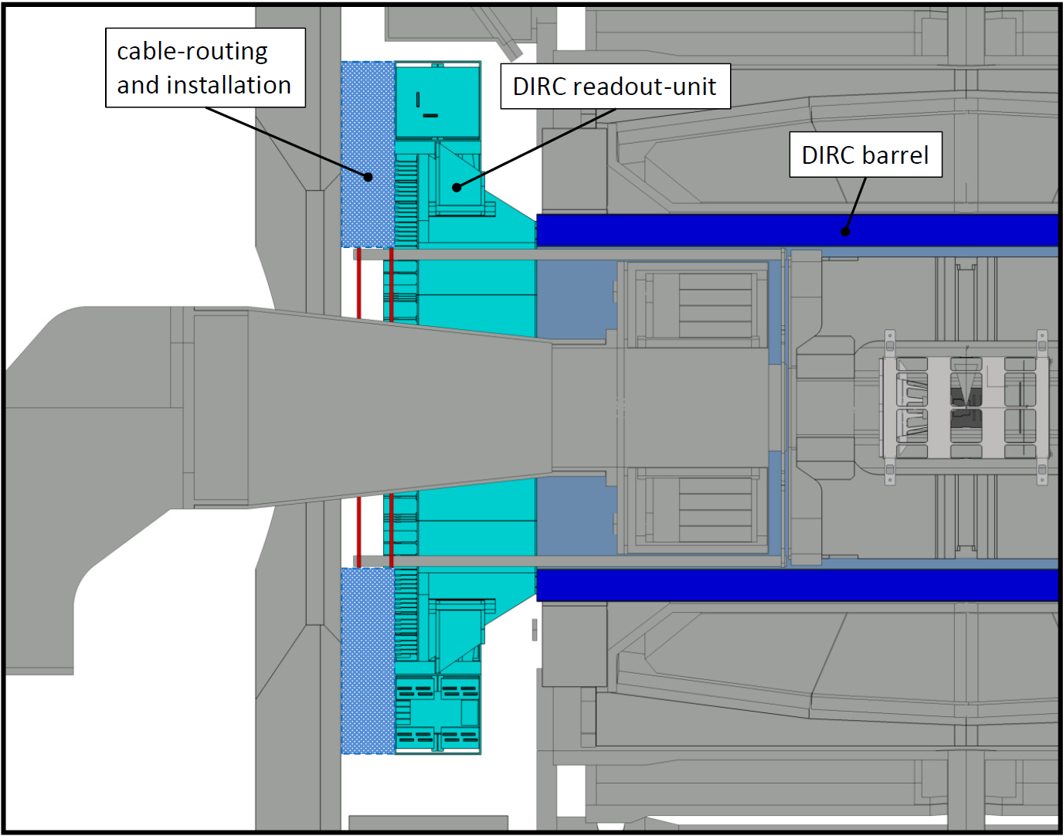
DIRC/STT issue
STT Frame/Support

Slide 5
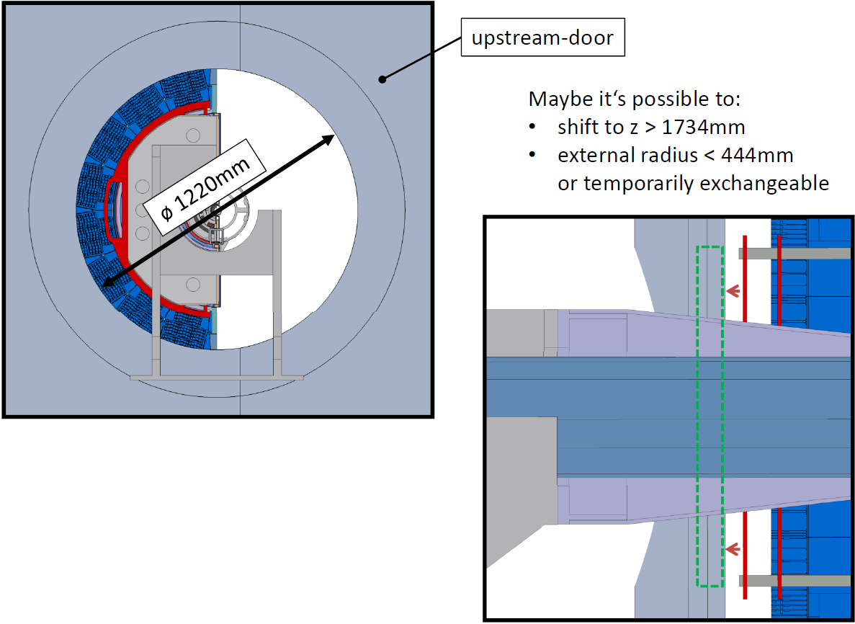
Solution approach
I. Support structure

Slide 6
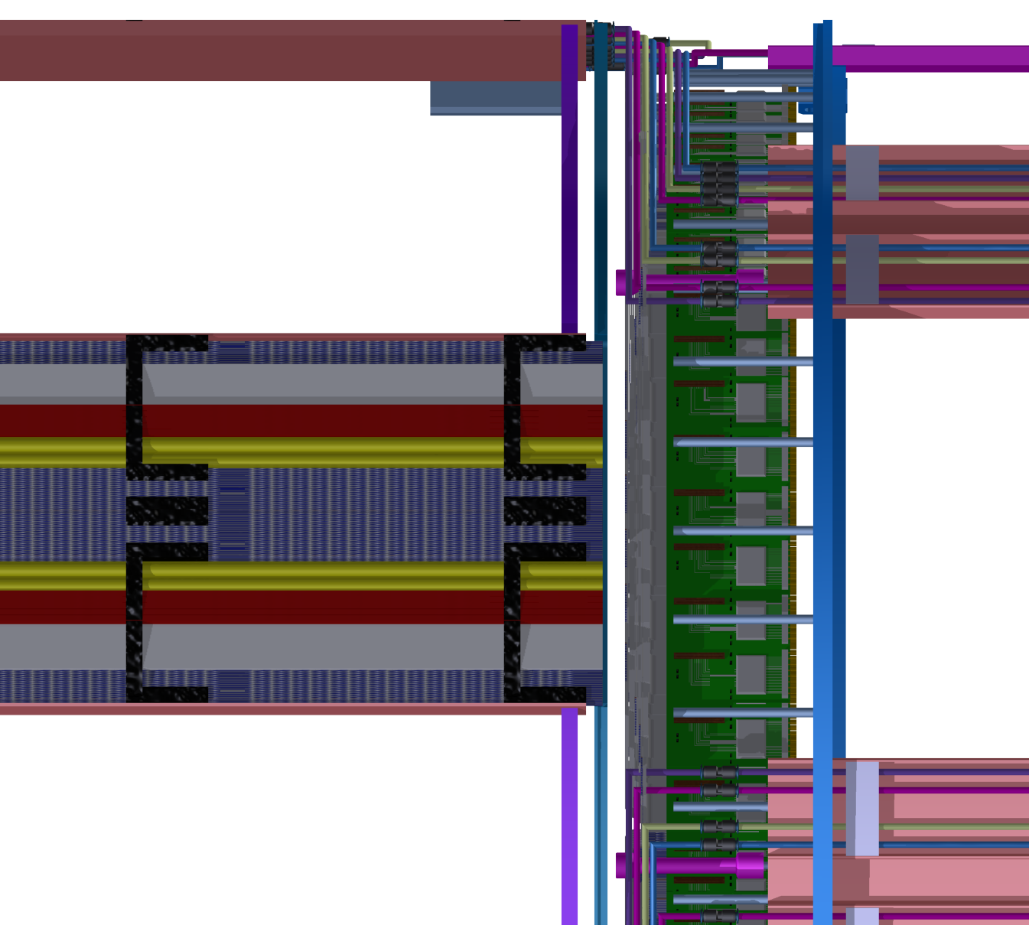
Solution approach
II. Readout cablemanagment

Slide 7
Solution approach
Support structure
  Shift in z – door direction
Readout cablemanagment
  Shift supportring in z direction

Slide 8
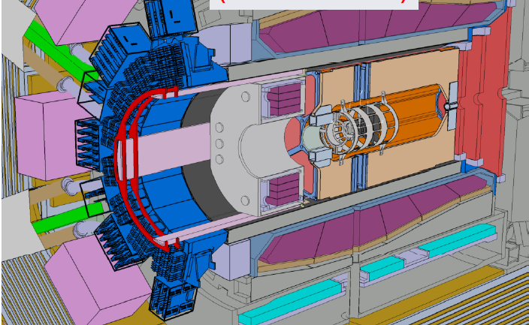
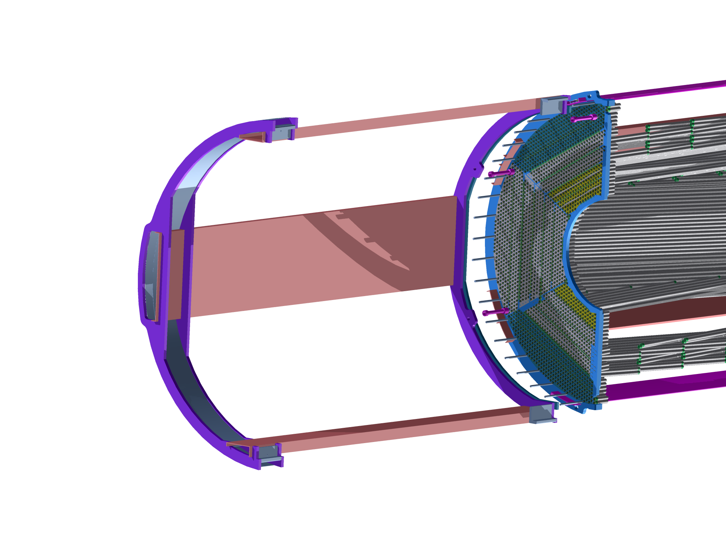
STT issue

Slide 9
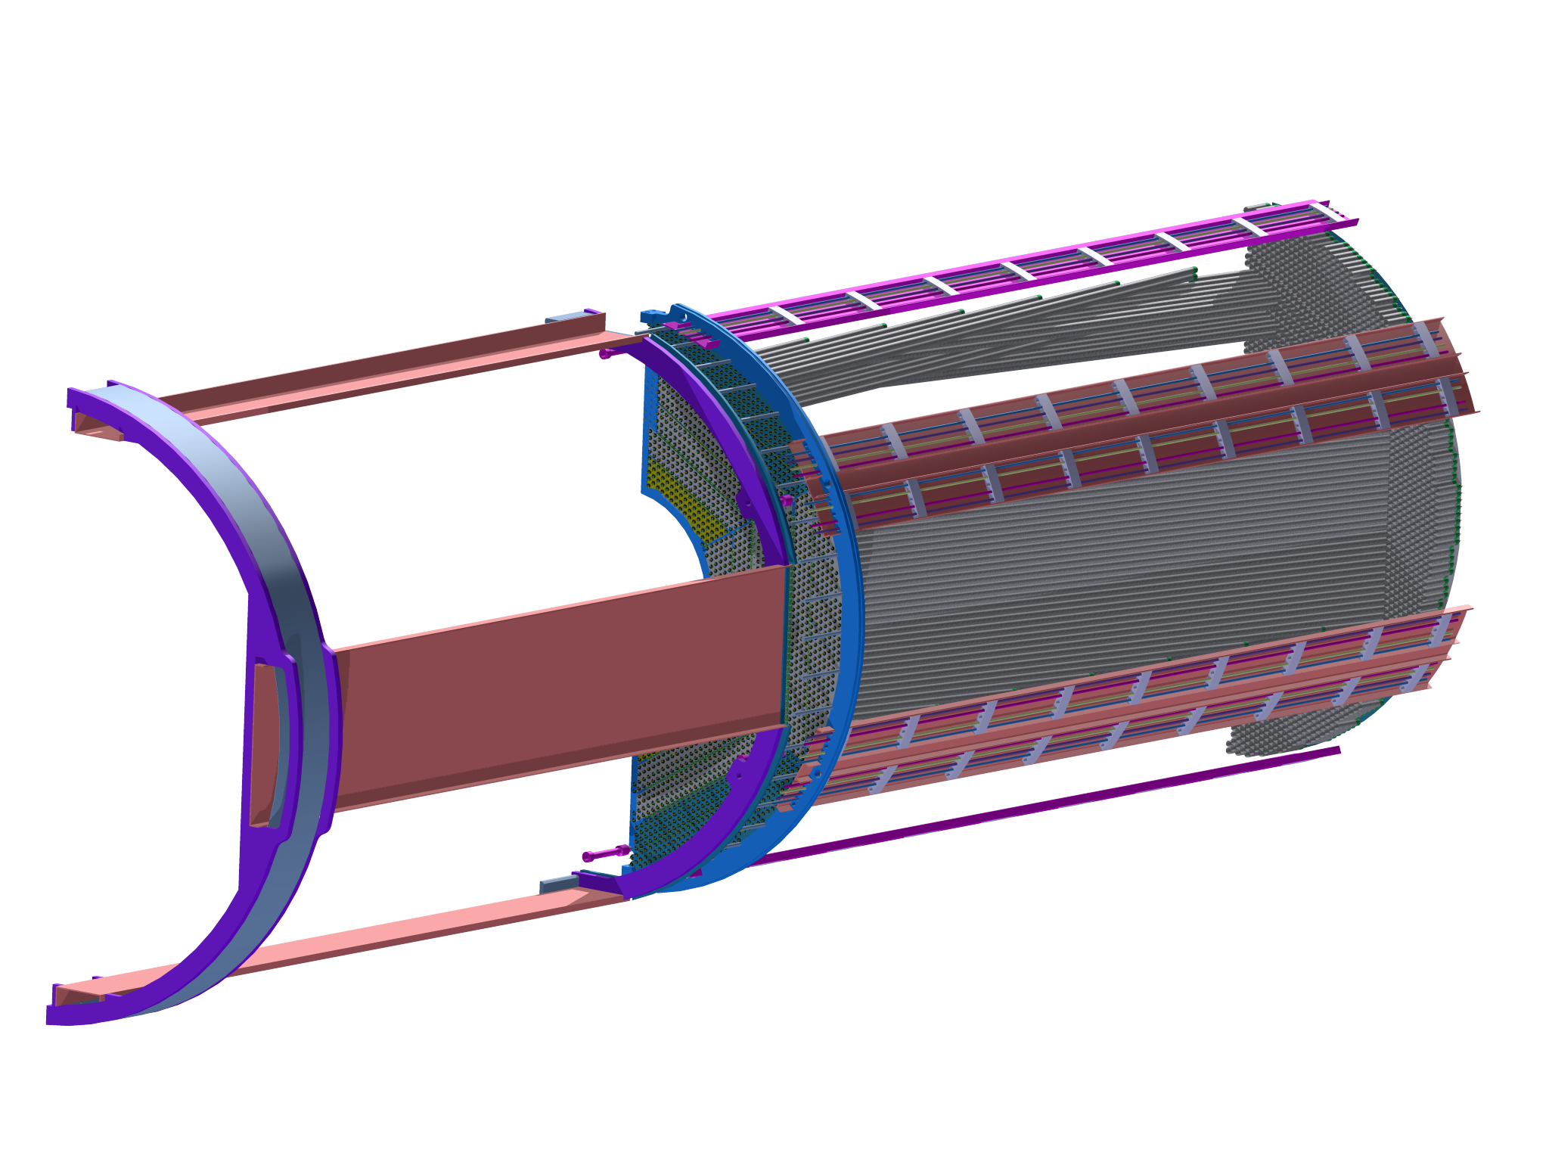
STT interal services
Insertion services

Slide 10
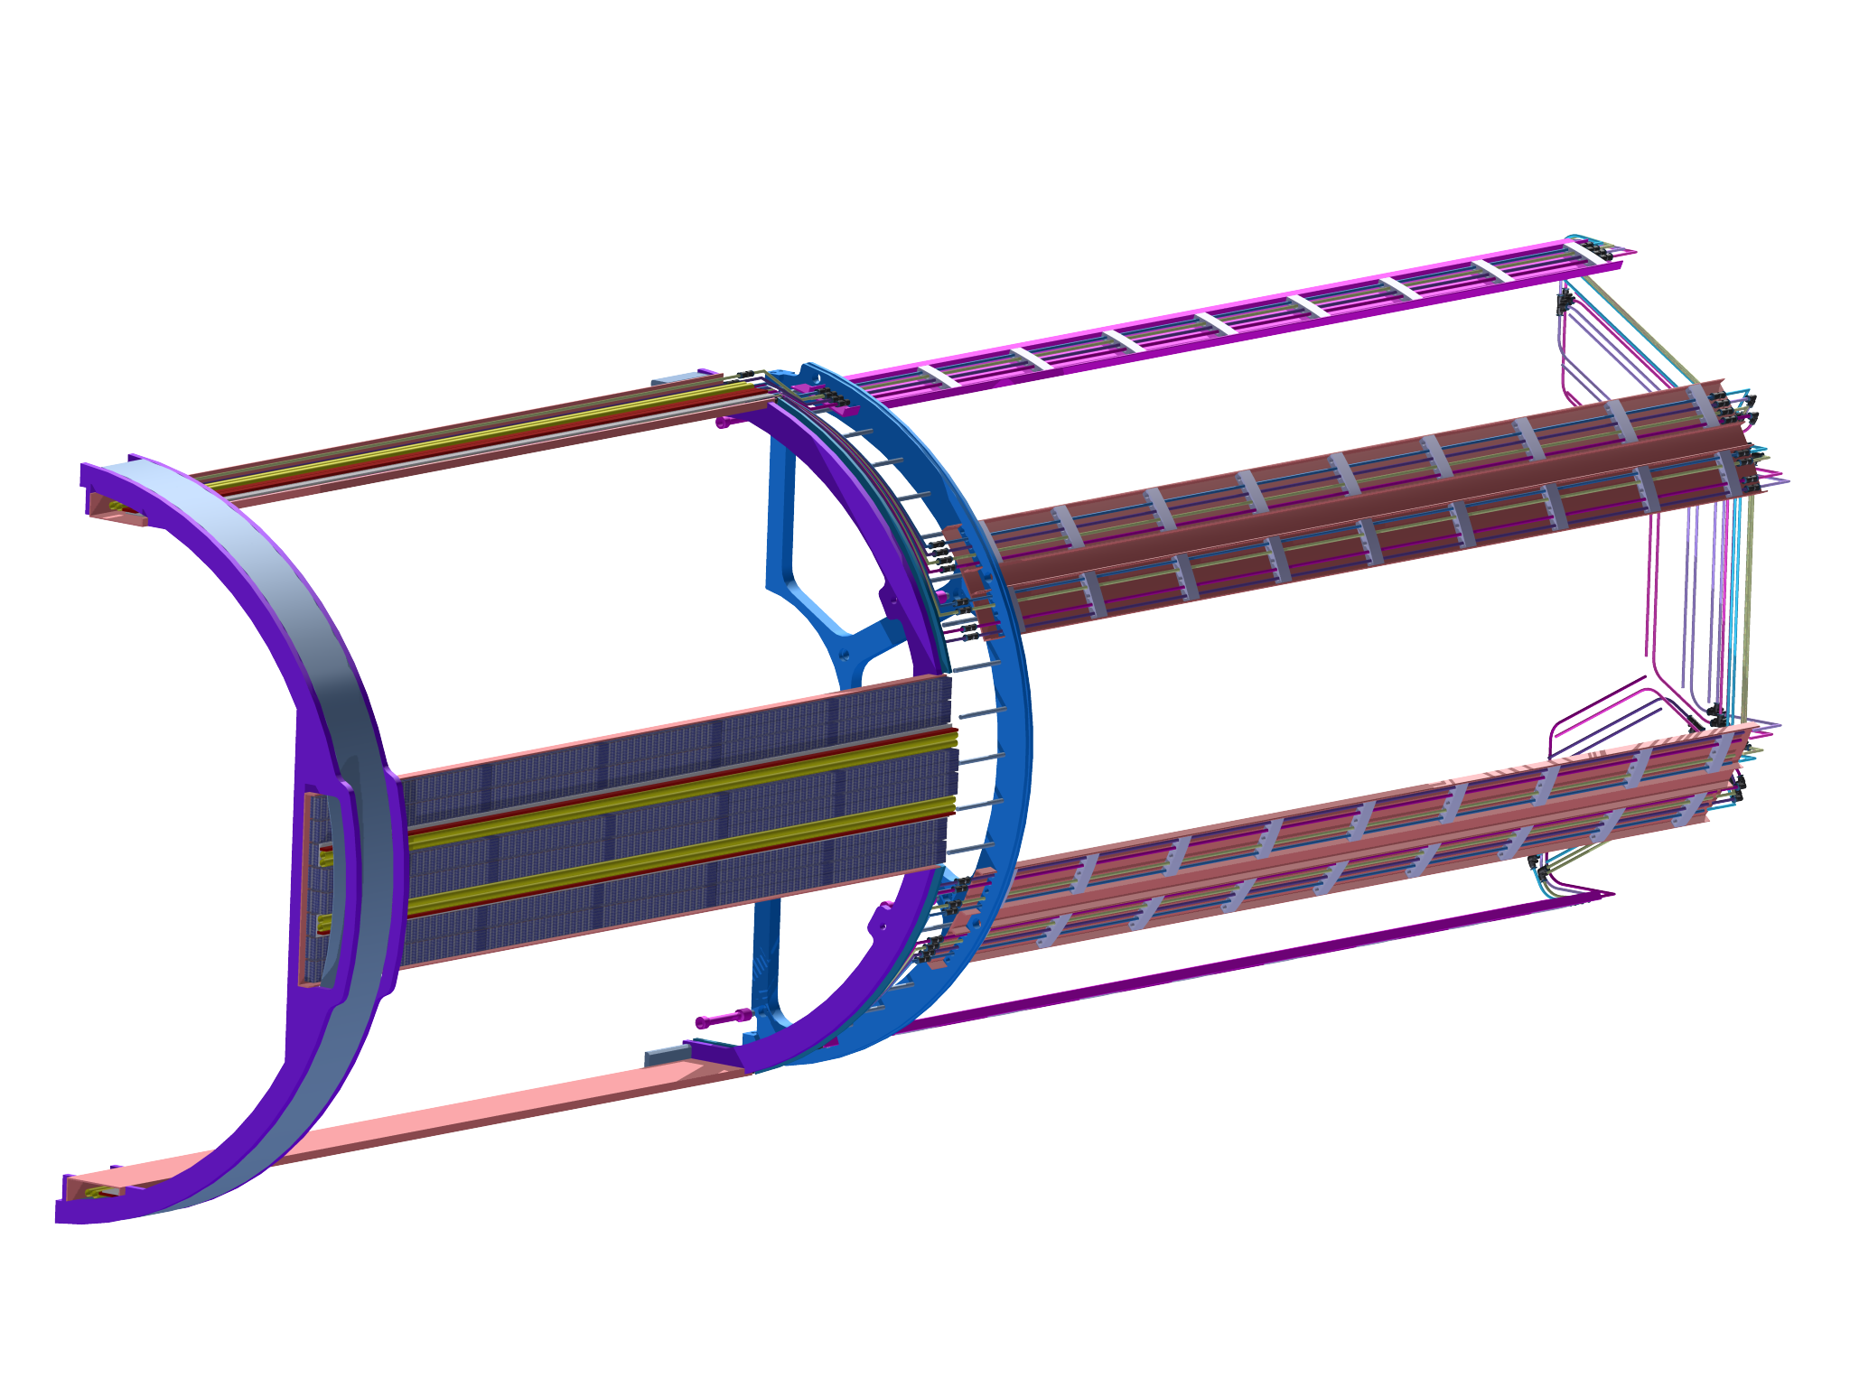
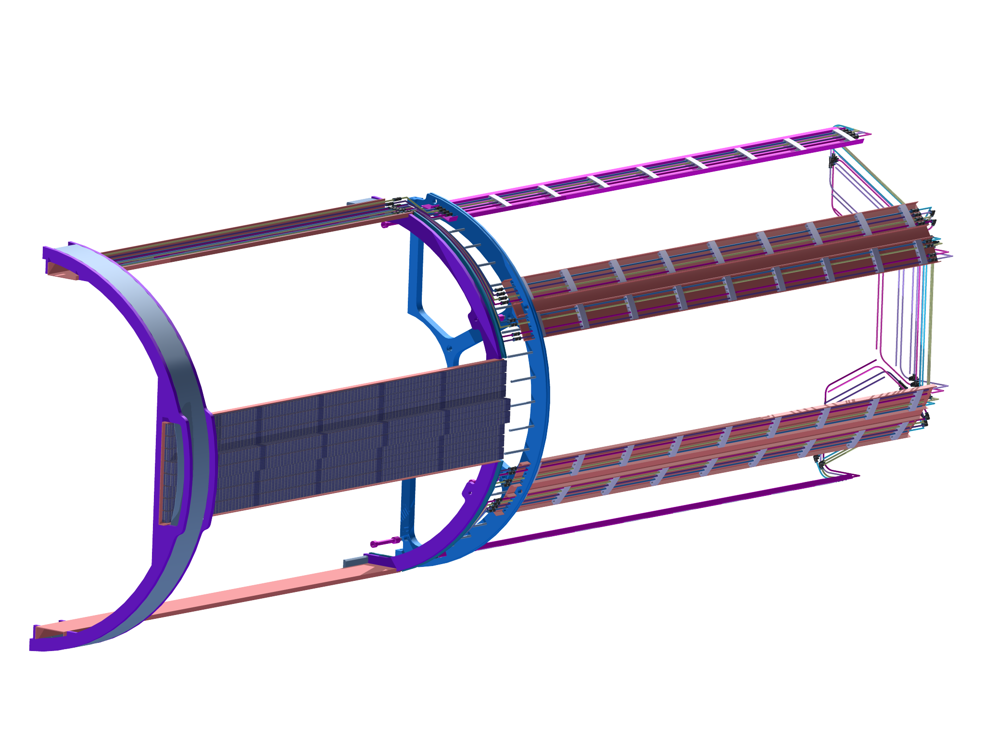
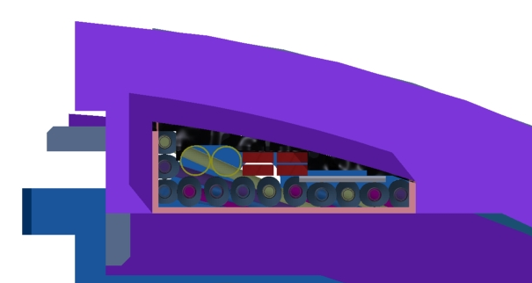
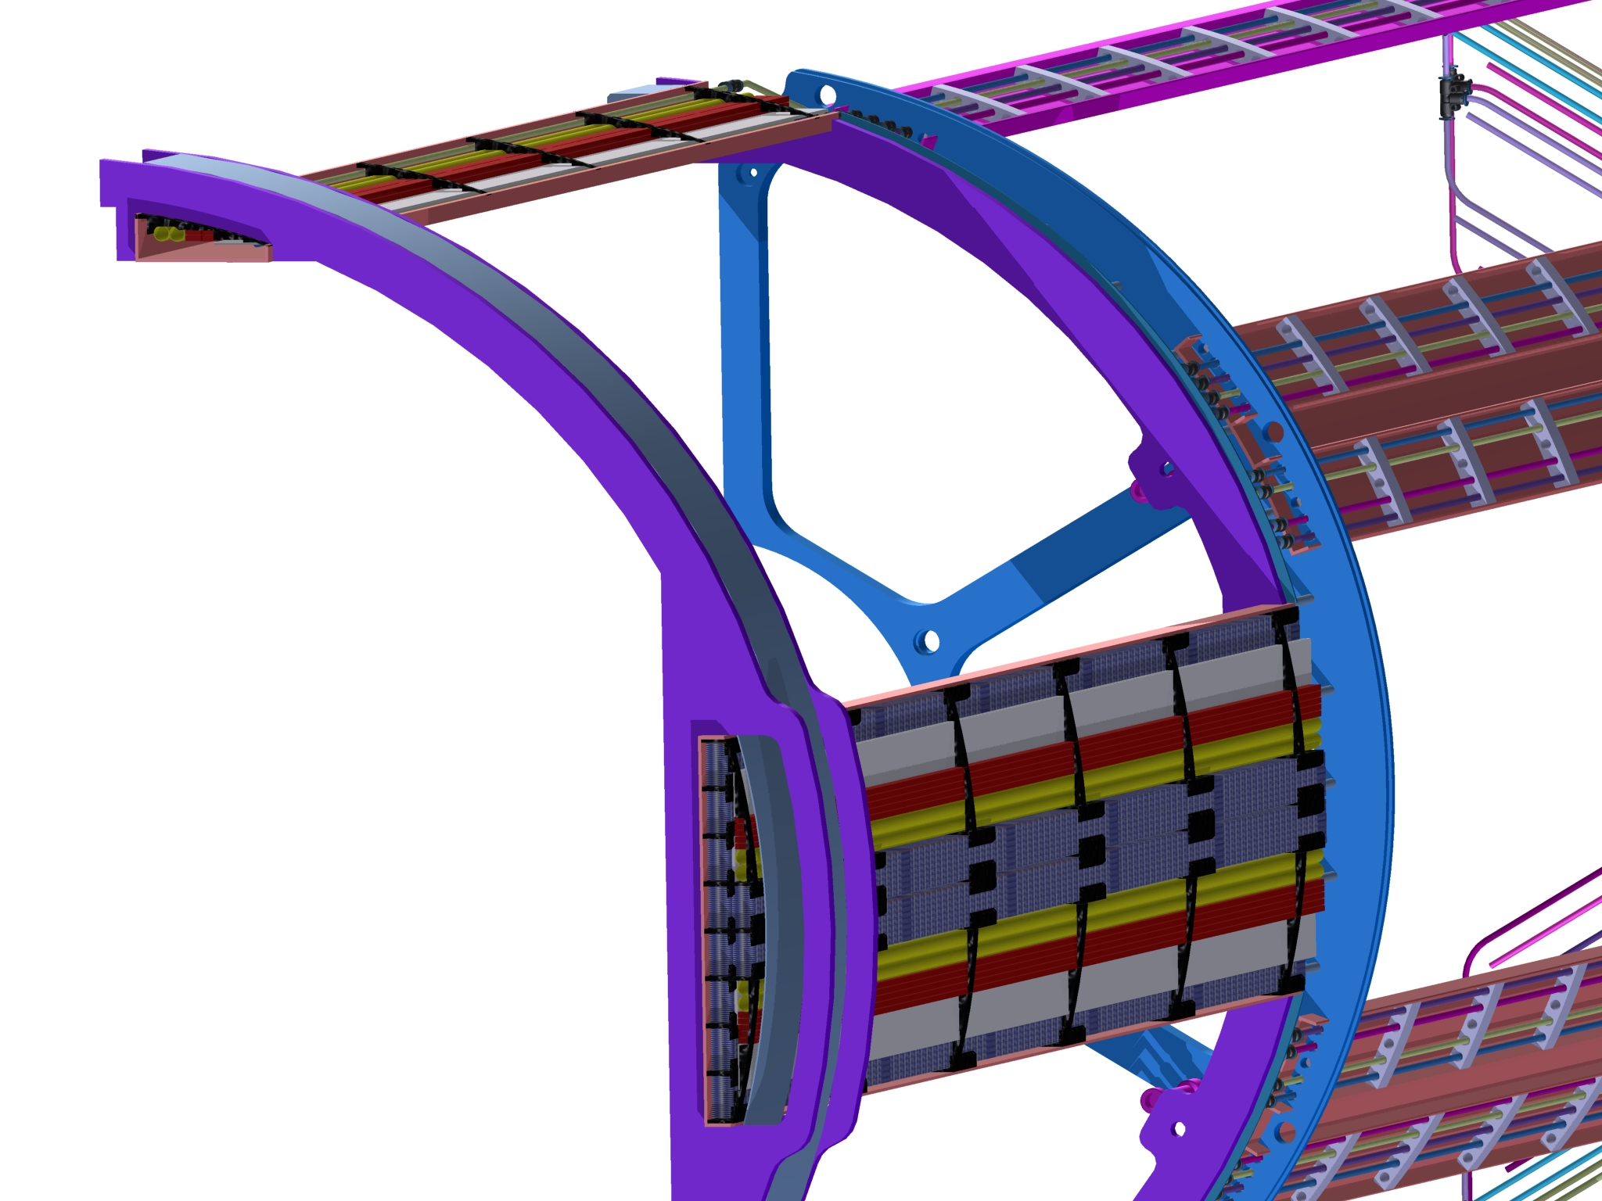
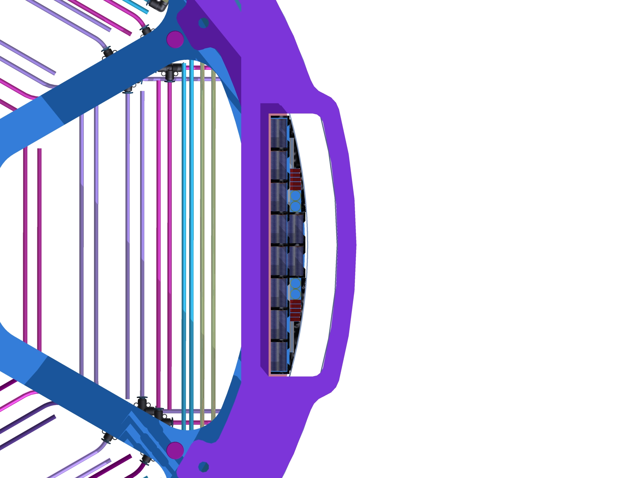
STT internal services

Slide 11
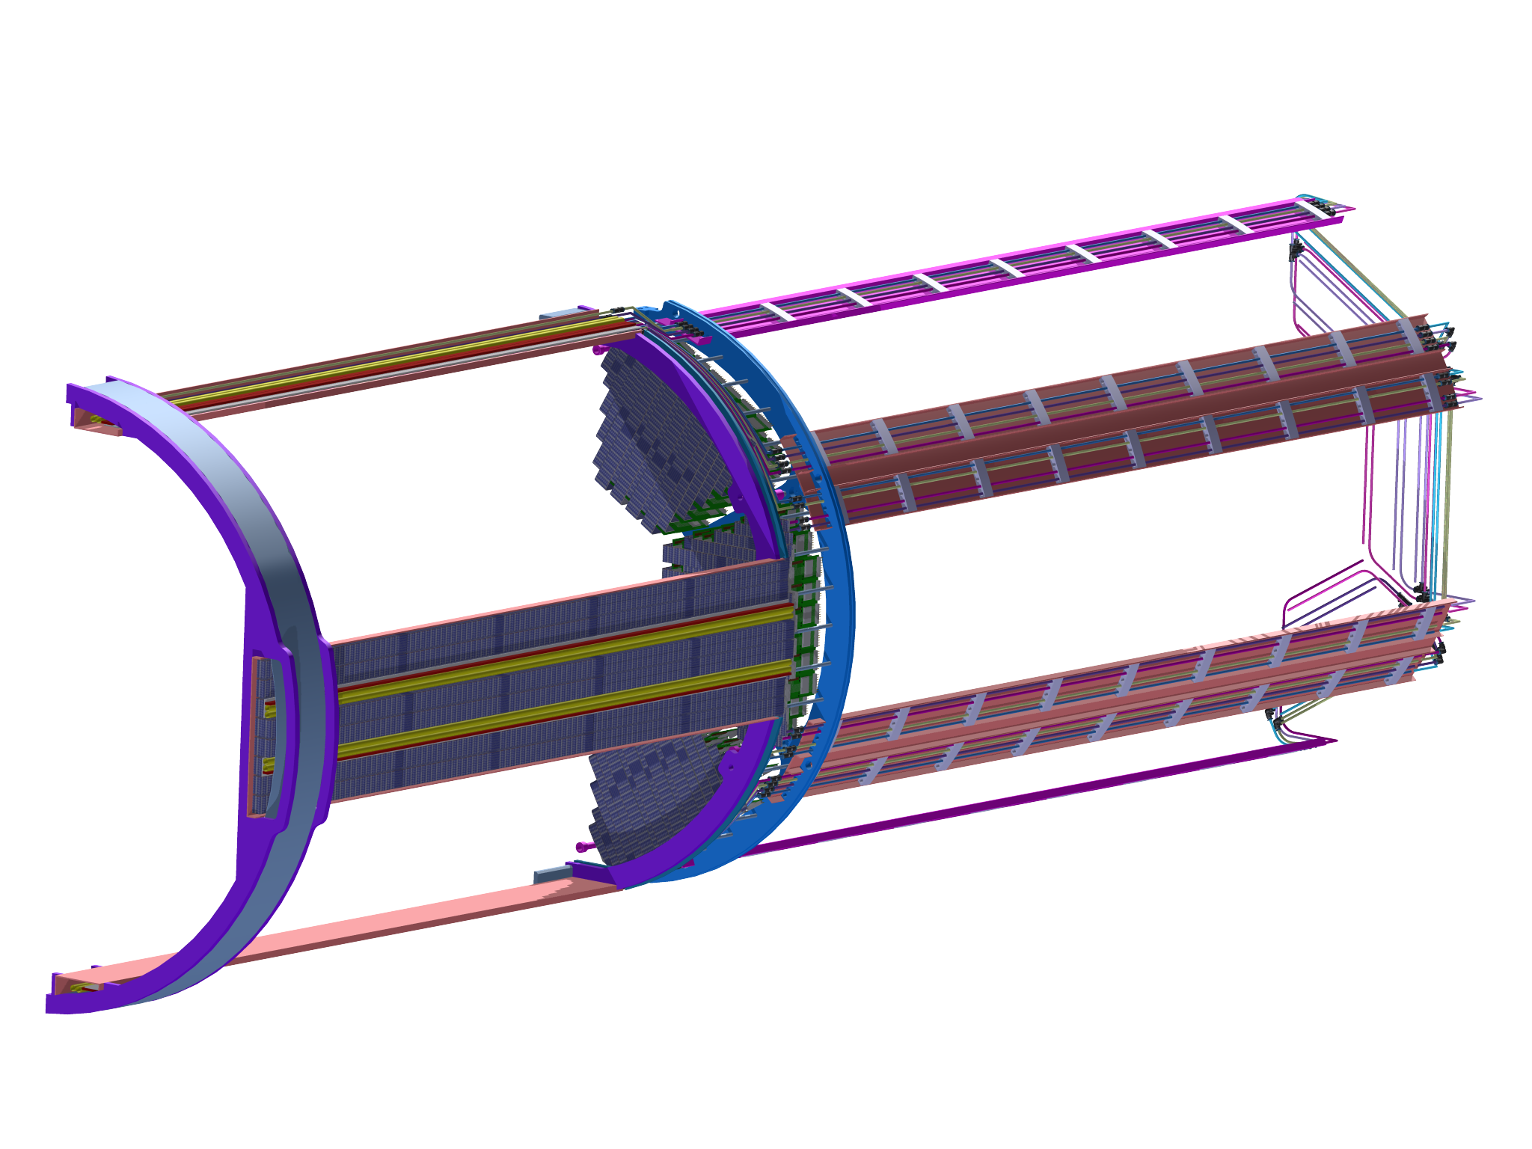
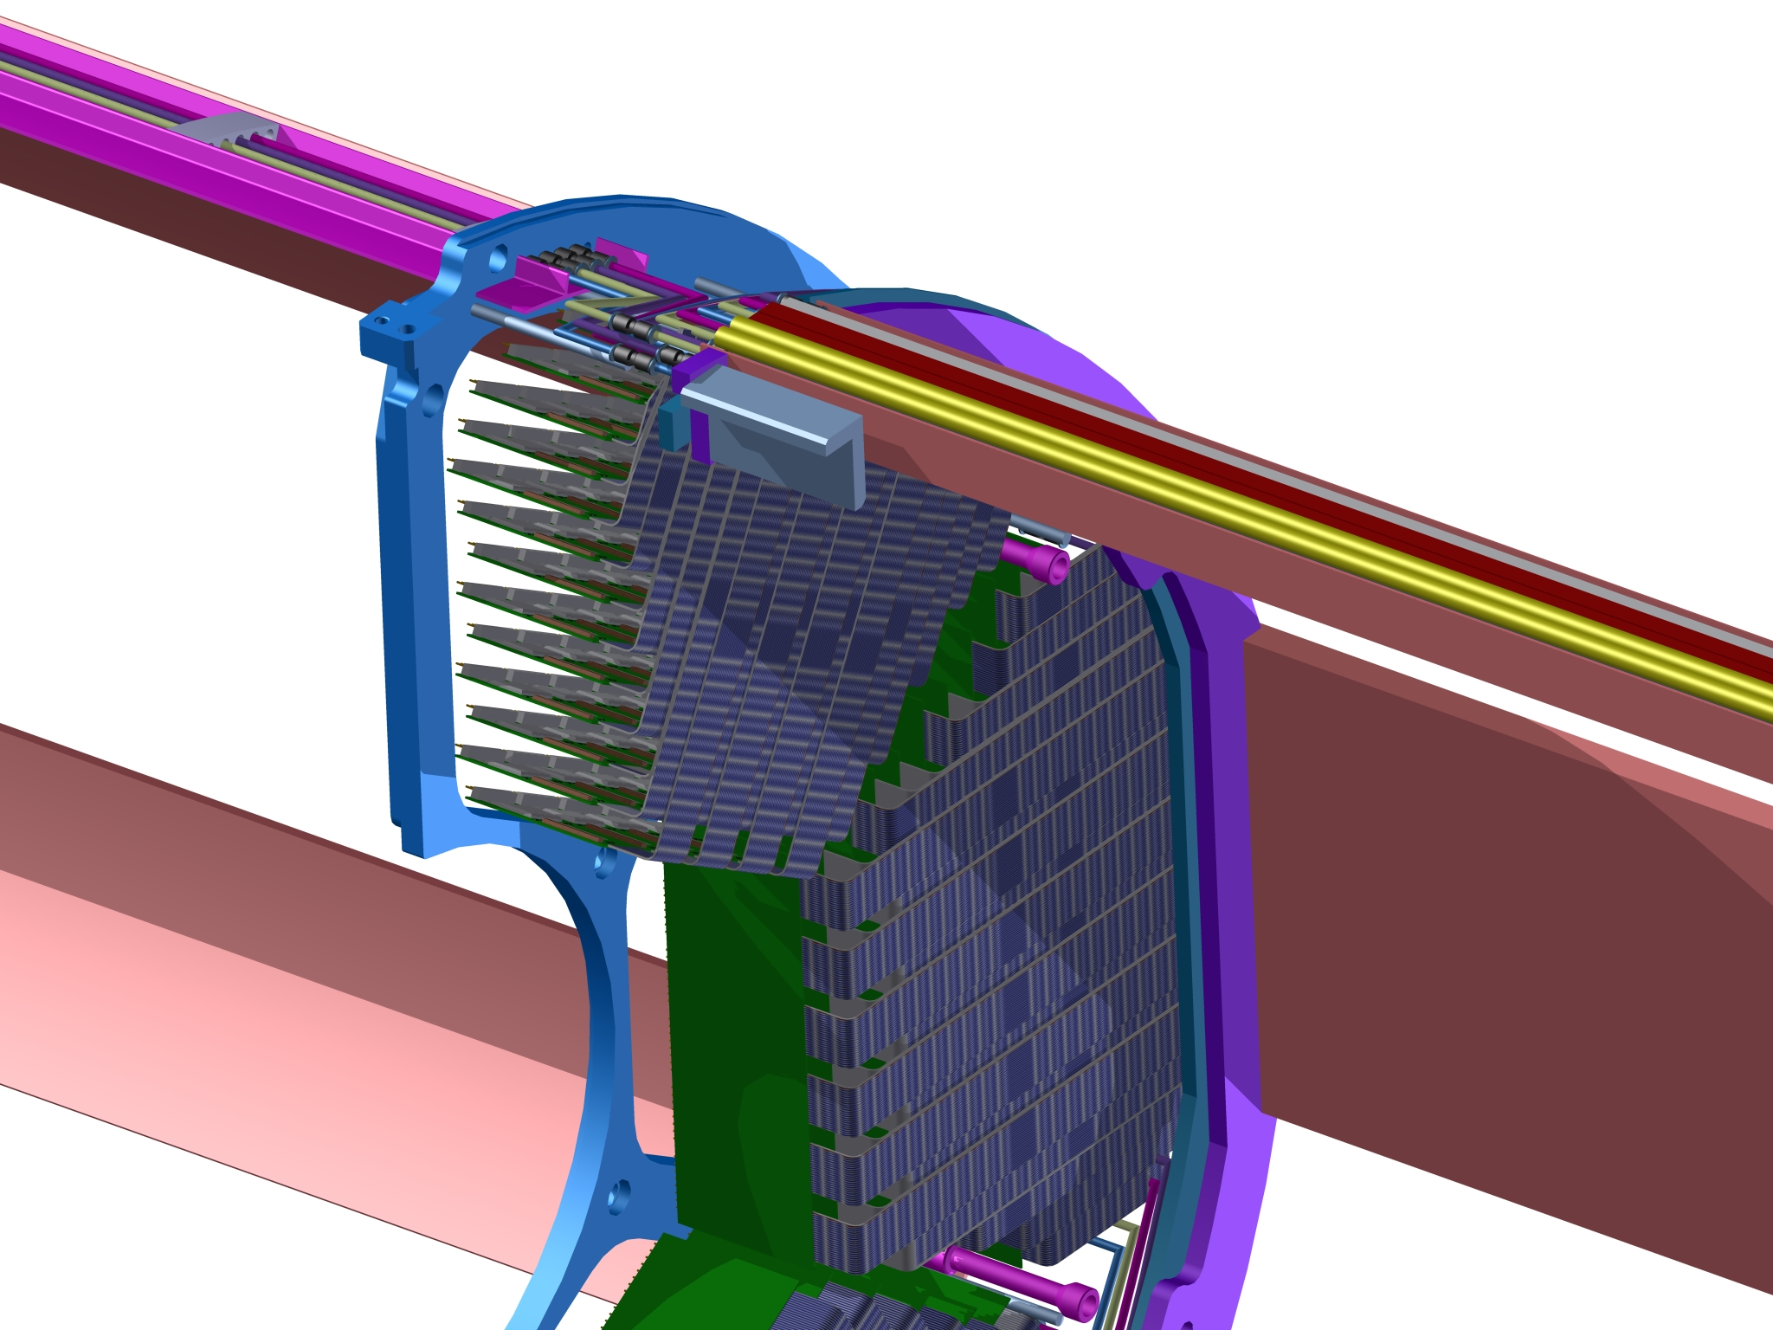
STT internal services
Insertion of readout boards

Slide 12
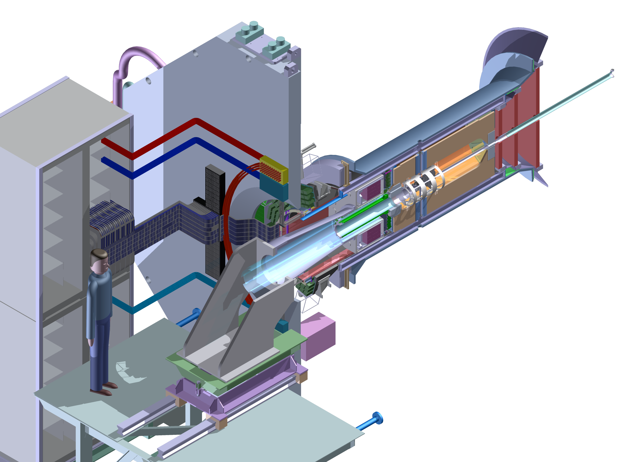
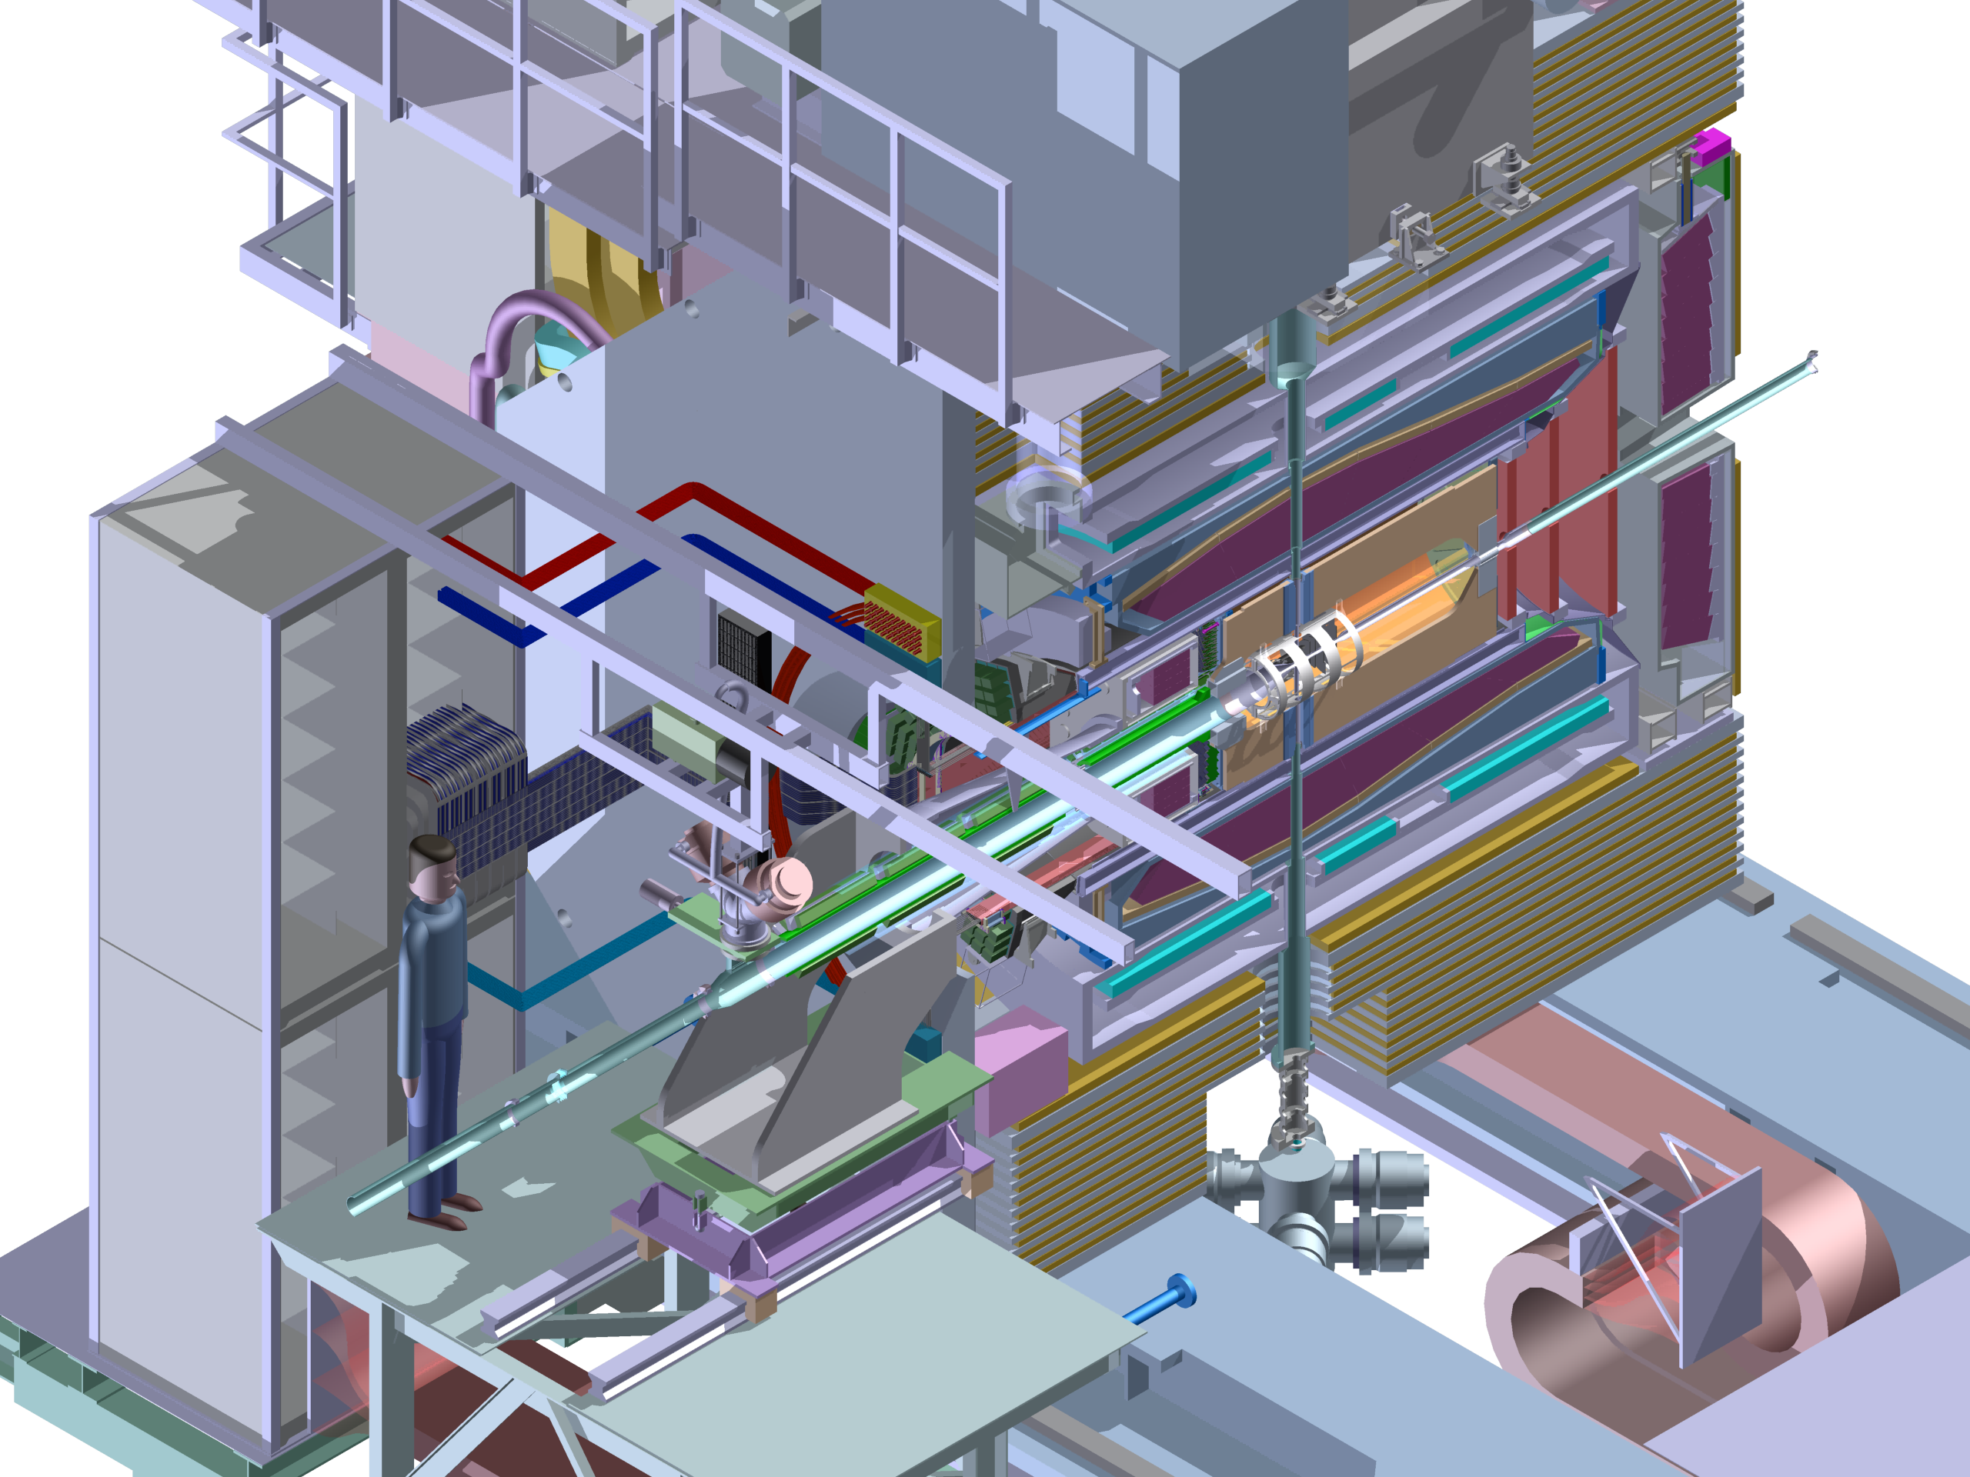
STT external services

Slide 13
STT external services
Two readout electronic solutions
Both are in work
2 Racks L/R @ the door

Slide 14
Thank you for your
attention

