Slide 1
Operational Experience with the Ionization Beam Profile Monitor at COSY
22. May 2017 | Christian Böhme, I. Bekman, K. Reimers, V. Kamerdzhiev | IKP-4

Slide 2
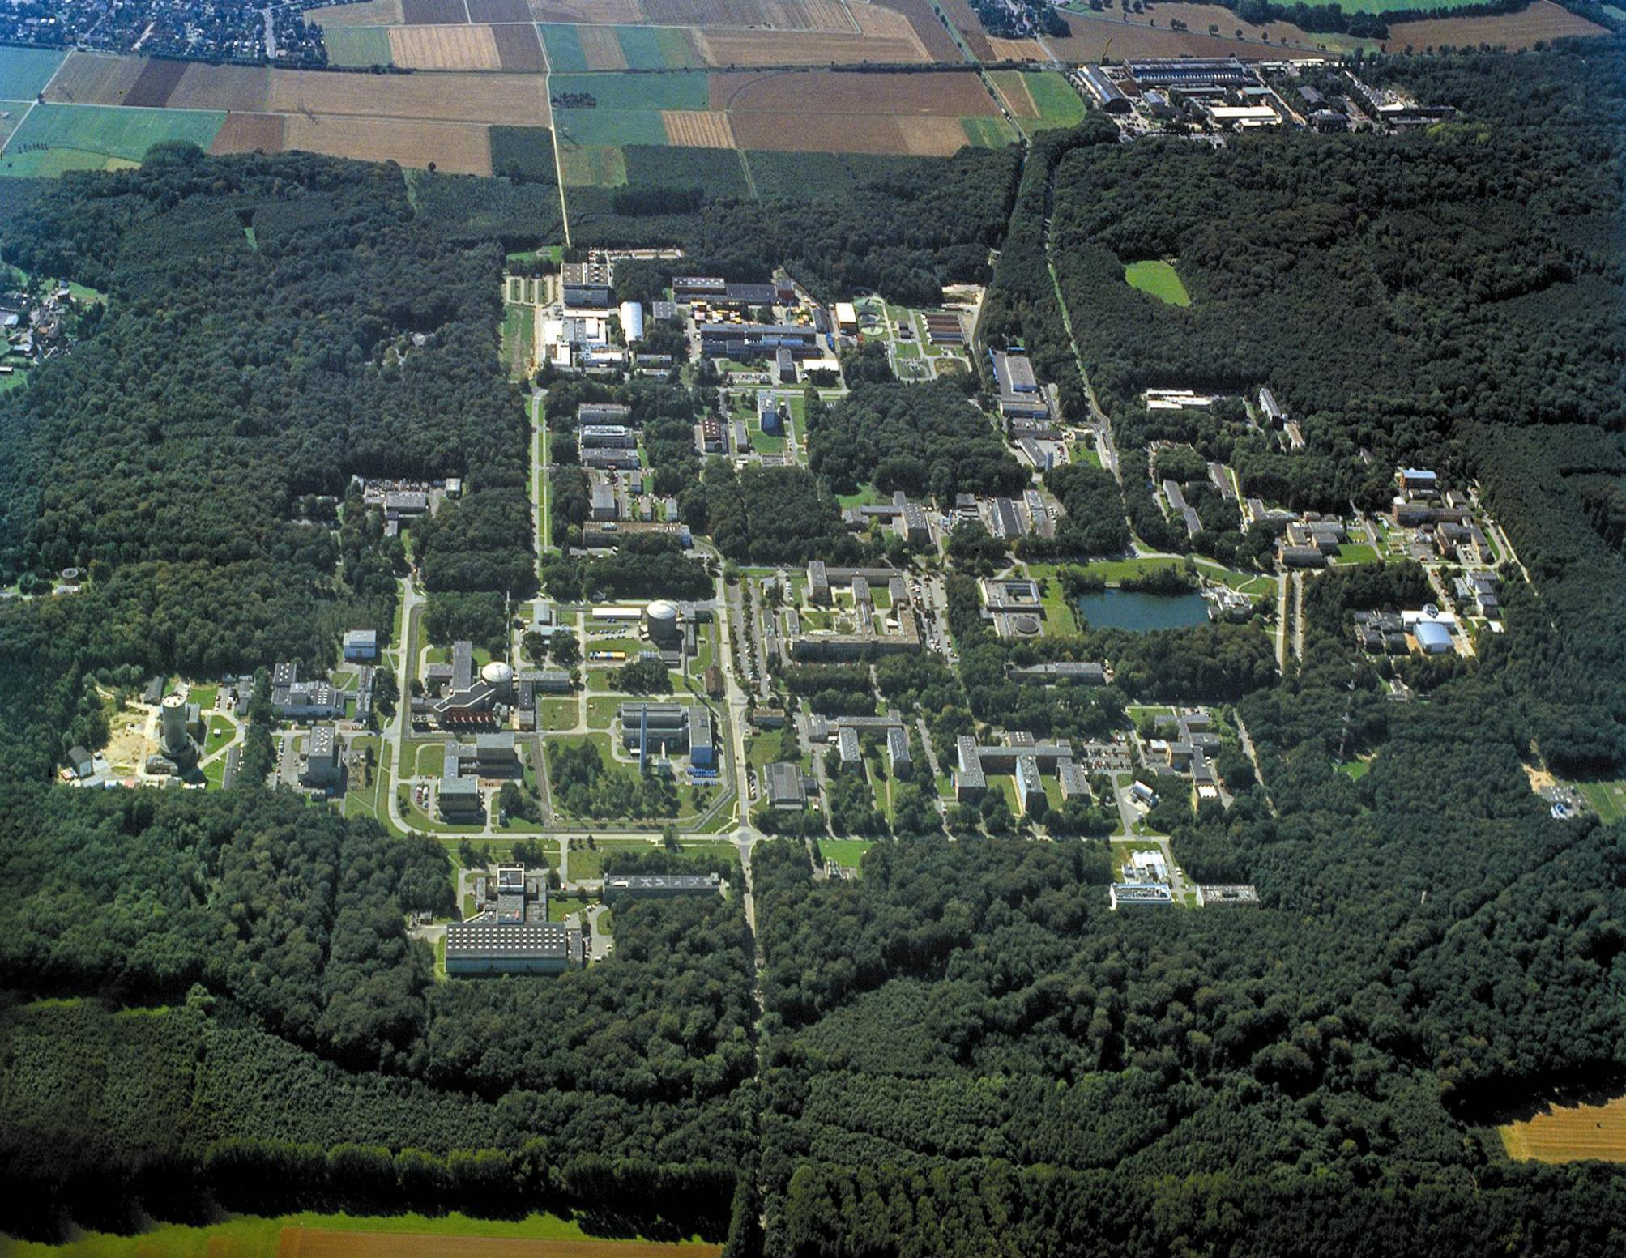
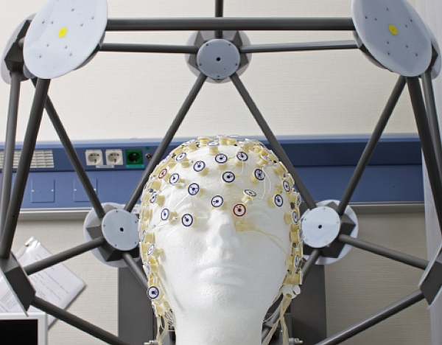

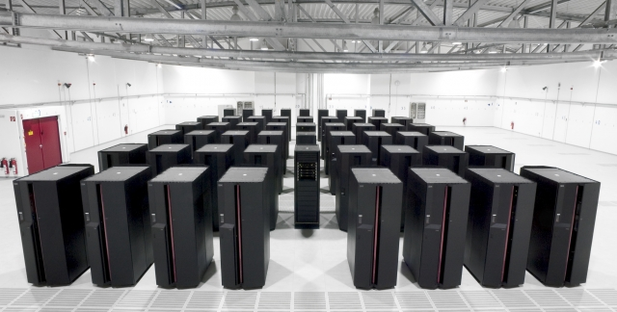
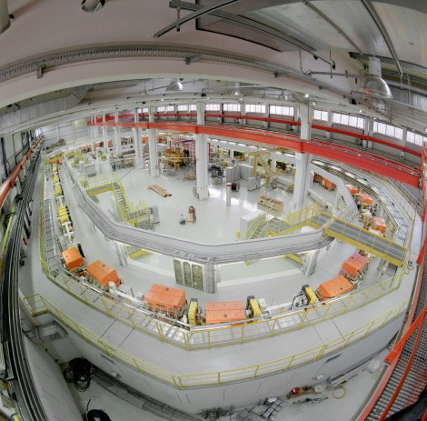
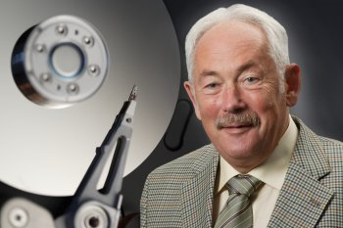
Deep Brain Pacemaker
Supercomputer
COSY
Prof. Grünberg, Nobel Prize Physics 2007
Bilder: Forschungszentrum Jülich GmbH

Slide 3
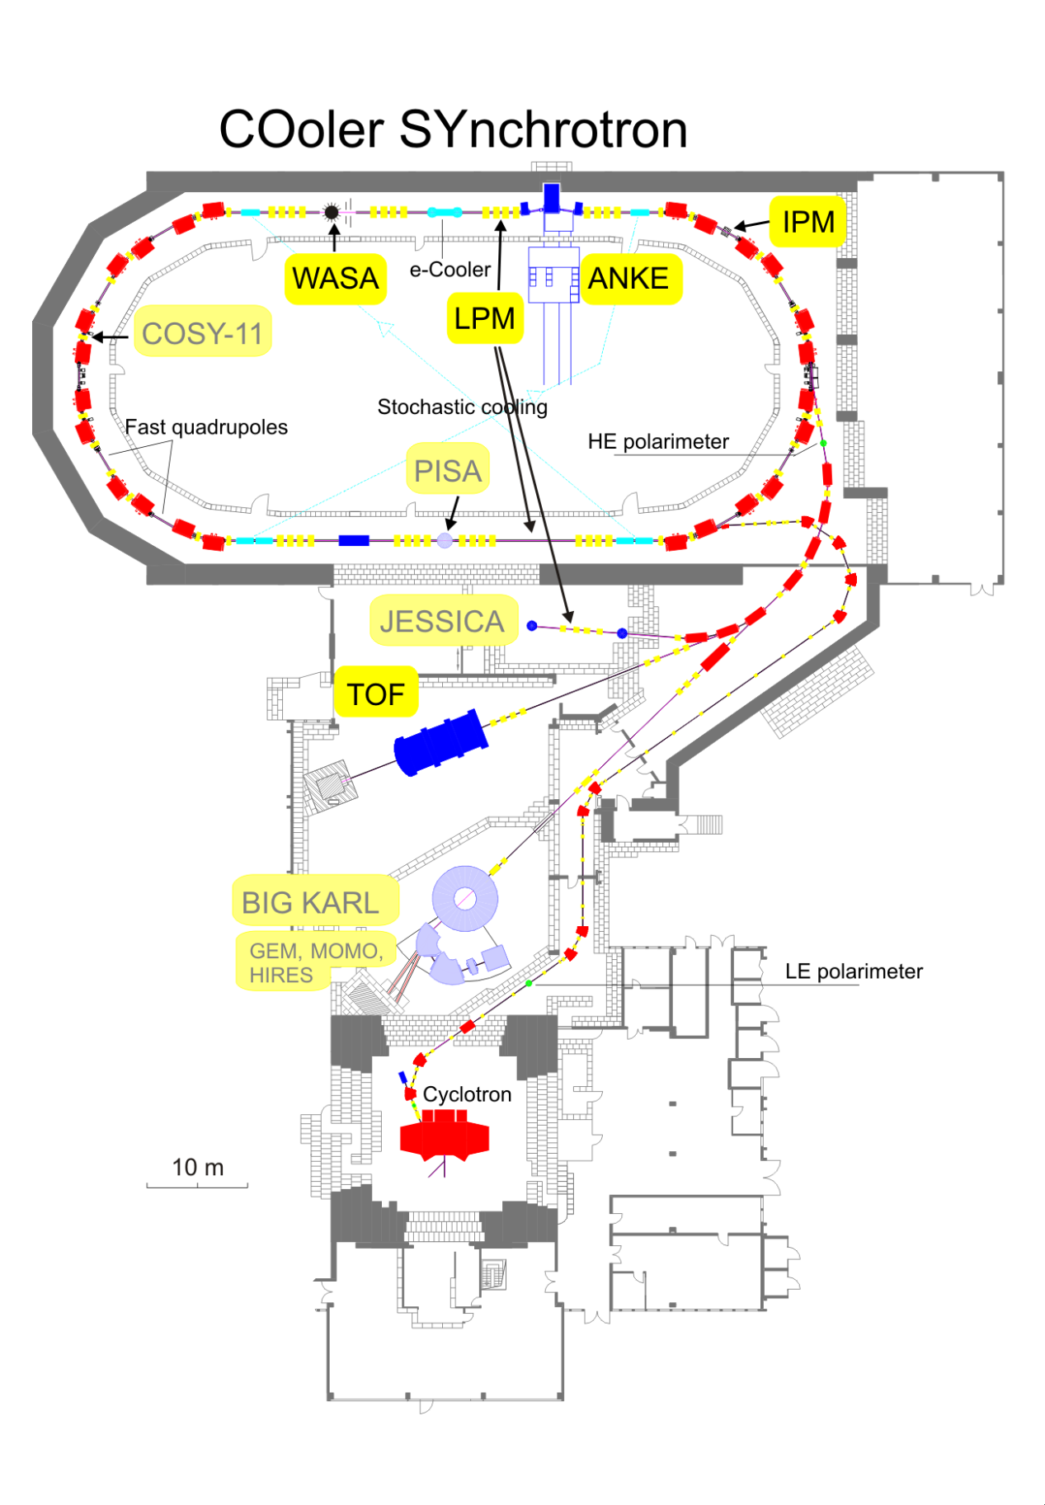
COoler SYnchrotron (COSY):
184 m circumference
Protons and Deuterons
Polarized or un-polarized
¹H⁺: 275 MeV/c - 3,65 GeV/c
Stochastic and electron cooling
2 e⁻ cooler: 100 keV and 2 MeV
Typ. amount of stored particles: 10¹⁰
Internal experiments and 3 external
beam lines
H⁻ stripping injection
Build from 1989, commissioned 1993
Picture: Dietrich, J. and Mohos, I., PRAMANA - journal of physics 59 (2002), 1007

Slide 4
IPM – short history
IPM using Wegde & Strip anode (decommissioned 2009)
Prototype test for FAIR
Initial Installation 2007
Readout requirements from FAIR and COSY different
  FAIR recording high speed (200 fps) and load later for processing over shared 100 Mbit network
  COSY online processing and low speed (1-10 fps), separate network (10 GBit)
Software in LabView
Optical readout using FireWire cameras (~5 m max cable length)
Triggered frame acquisition planned

Slide 5
Initial Setup
Tunnel
Eye
Control Room
Fire Wire
Processing
PXI
PC
10 GBit
Picture Acquisition
(PXI System from GSI)
Situation Now:
FireWire Cameras are replaced with GigE Cameras
PXI System replaced by PC
Principle architecture kept
  PC in eye quite old, still running under Windows XP and Labview 8.6

Slide 6
IPM Architecture
UV Lamp (Calibration)
Vacuum
Air
+V₀
Multichannel Power Supply
Vacuum
Ions
-V₀
Electrons
Air

Slide 7
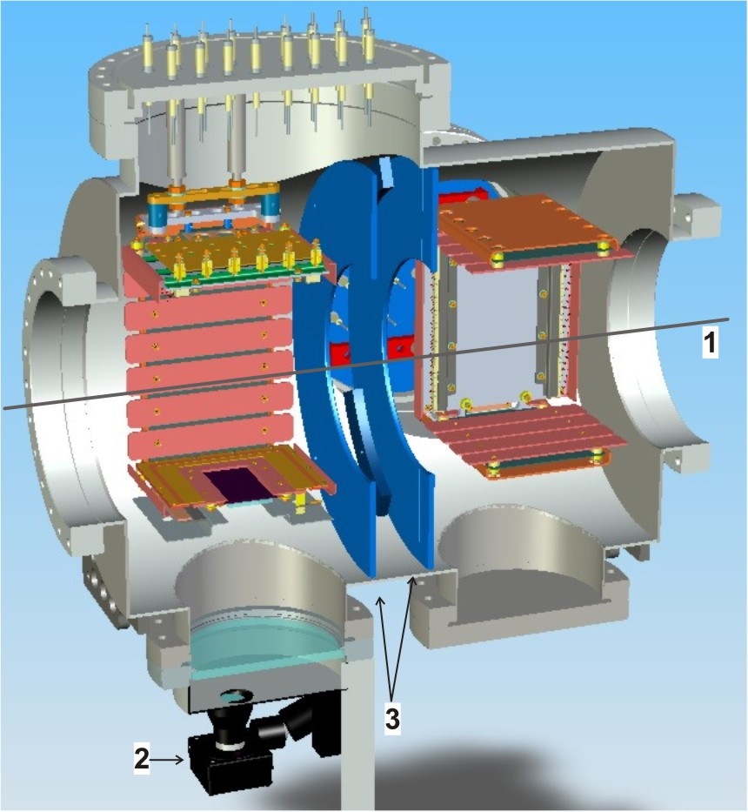
IPM Design
1: Beam
2: Camera
3: E-Field minimizing apreture
Picture by T. Giacomini, GSI

Slide 8
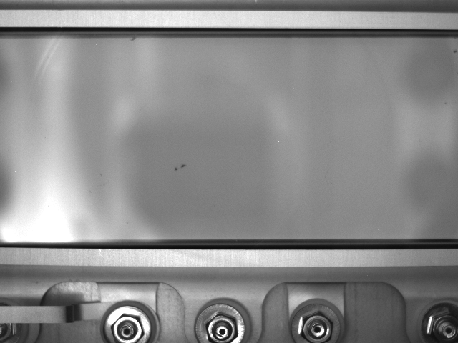
Camera View

Slide 10
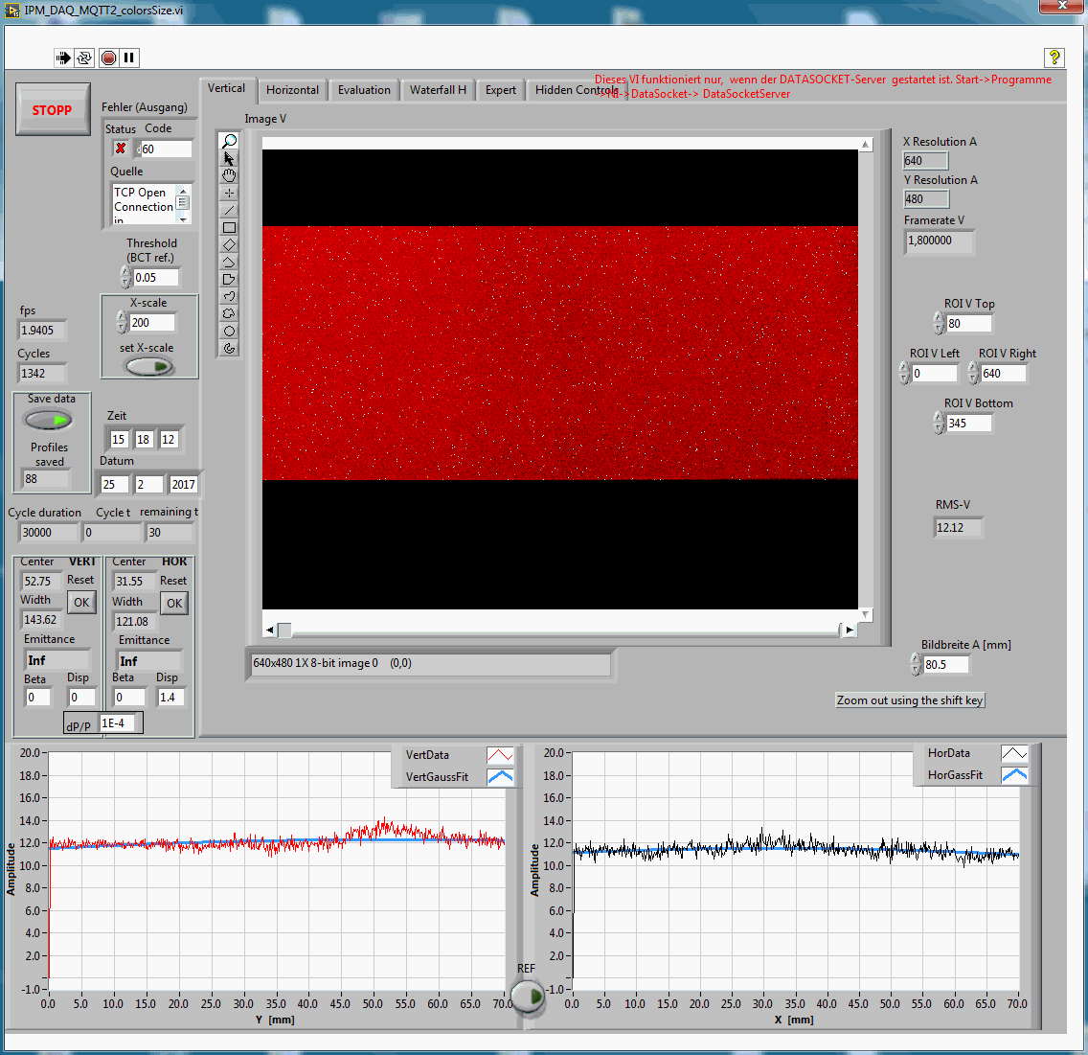
Sensivity measurement using UV Lamp

Slide 11
MCP Degredation Correction

Slide 12
Beam Current vs. time
Gaussian fit parameters vs. time
Raw data and gaussian fit

Slide 13
HV Control

Slide 14
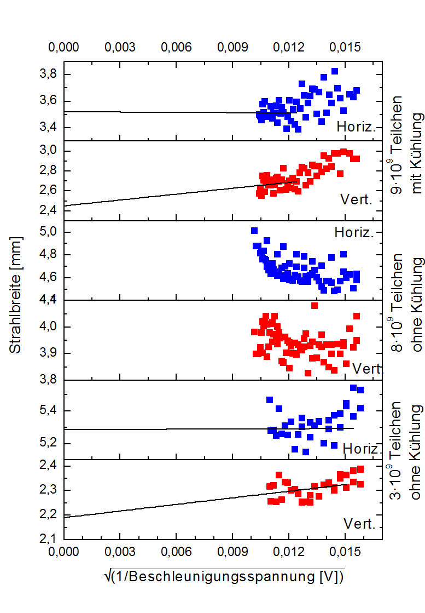
Calibration
K. Wittenburg, PKTR Note No. 70, DESY (1991)
Measure the beam width with different E-field voltages
Extrapolate to infinite voltage
In our case above ±2500 V the error in beam width is less than 5%

Slide 15
Long Term Camera Degradation
If the measurement software is closed the accumulated color values are saved
Black is 0, white 255
This should give an indication of dead (white) pixels
It is assumed that there is no beam picture any longer (HV off)
Single points might deviate
Replacement

Slide 16
Long Term MCP degredation

Slide 17
Gaussian Fit
Beam parameters are mainly described by the parameters of an Gaussian fit
Gaussian fit not always correct
Upper picture: oscillating beam
(exp. Time 100 ms range)
Lower P: Cooling

Slide 18
Problems
Phosphor defects
Unsymmetrical
Effects

Slide 19
Problems
Phosphor defects
  Reason known, solution possible
Camera defects
  Can be measured and mapped out
  Last GigE-cameras lasted ~6 years
Unsymmetrical effects
  Occur not all the time
    No reflections
  Is beam-dependent (no beam, no effect)
  Charge-up effects?

Slide 20
Why isn‘t it fully automized yet?
HV control program
  Automatized control of the HV at channel plates, for having a signal not to low or high (damage of CP), but also not changing all the time
Vacuum control connection
  Emergency shut-of if vacuum level is to high

Slide 21
Future Plans
Major software upgrade planned
  New control-PC should take over calculations, new software
  Publishing results over EPICS
  Possibility to integrate in CSS
  Therefore development on old system was reduced
Frame trigger pulse implementation

