Slide 1


Experimental perspectives for the study of QCD matter at high net-baryon densities
Volker Friese
GSI Darmstadt
XII Quark Confinement and the Hadron Spectrum
Thessaloniki, 3 September 2016

Slide 2
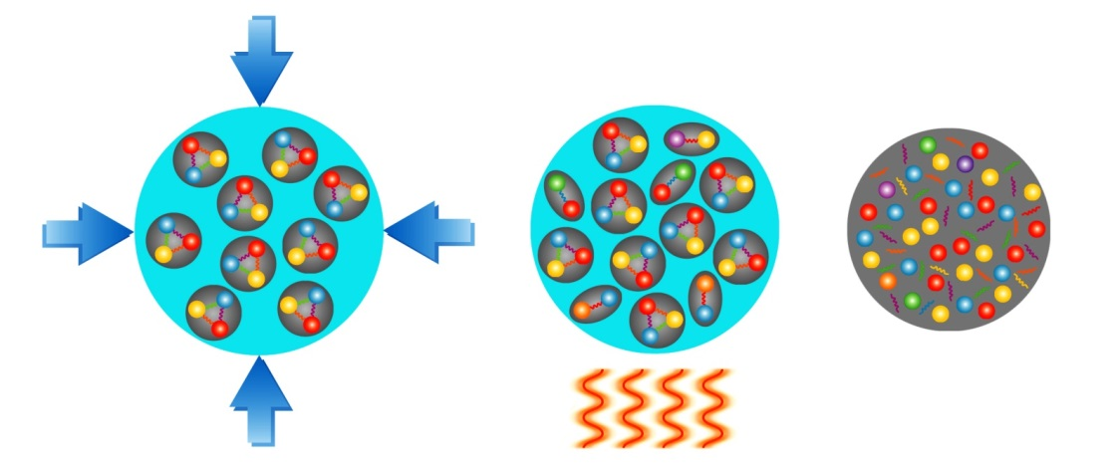
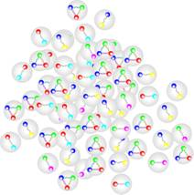
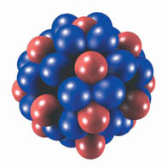
Phases of QCD Matter
T
early universe
QGP
heating
hadron gas
neutron stars
ρ₀
ρ
compression

Slide 3
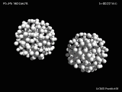
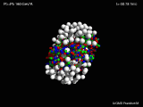
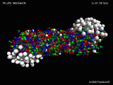
Extreme matter in the laboratory
In high-energy collisions of heavy nuclei, matter at high energy densities (hot and dense) is created – for a very short time and in a very limited volume.
Control parameters:
Collision energy
System size (ion species / collision centrality)

Slide 4
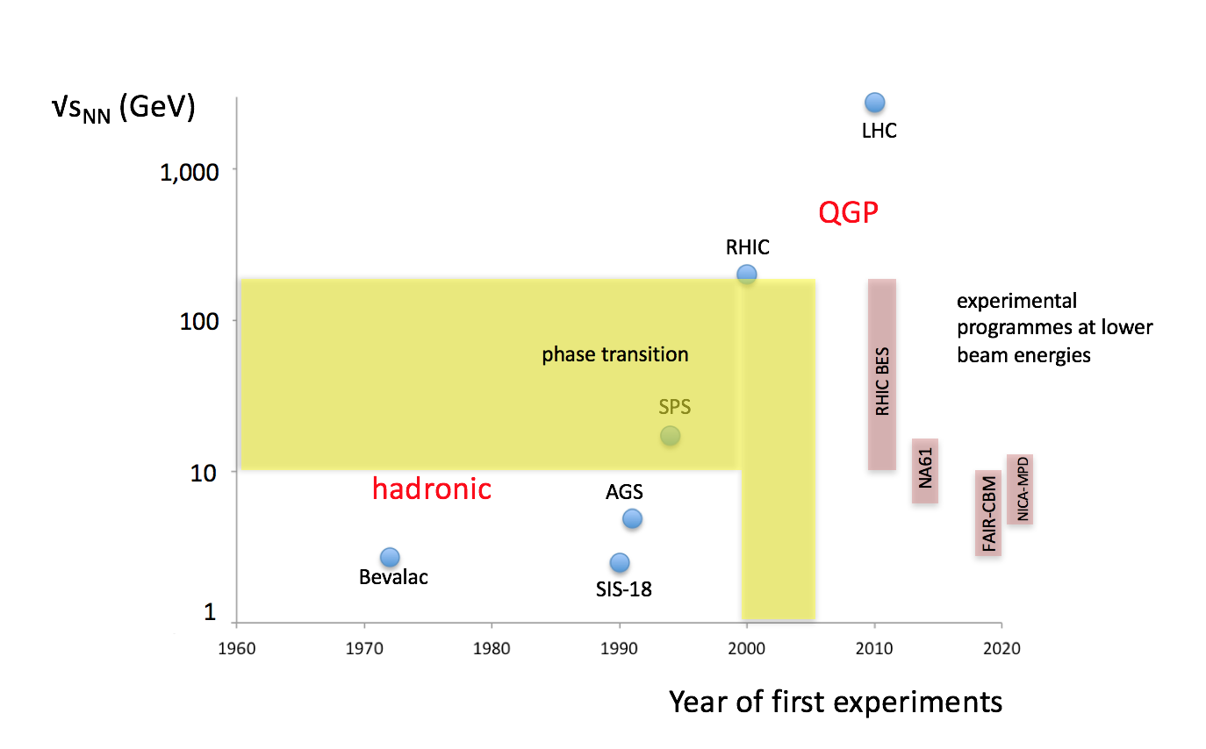
A Brief History of Experimental Heavy-Ion Physics
studying QGP properties

Slide 5
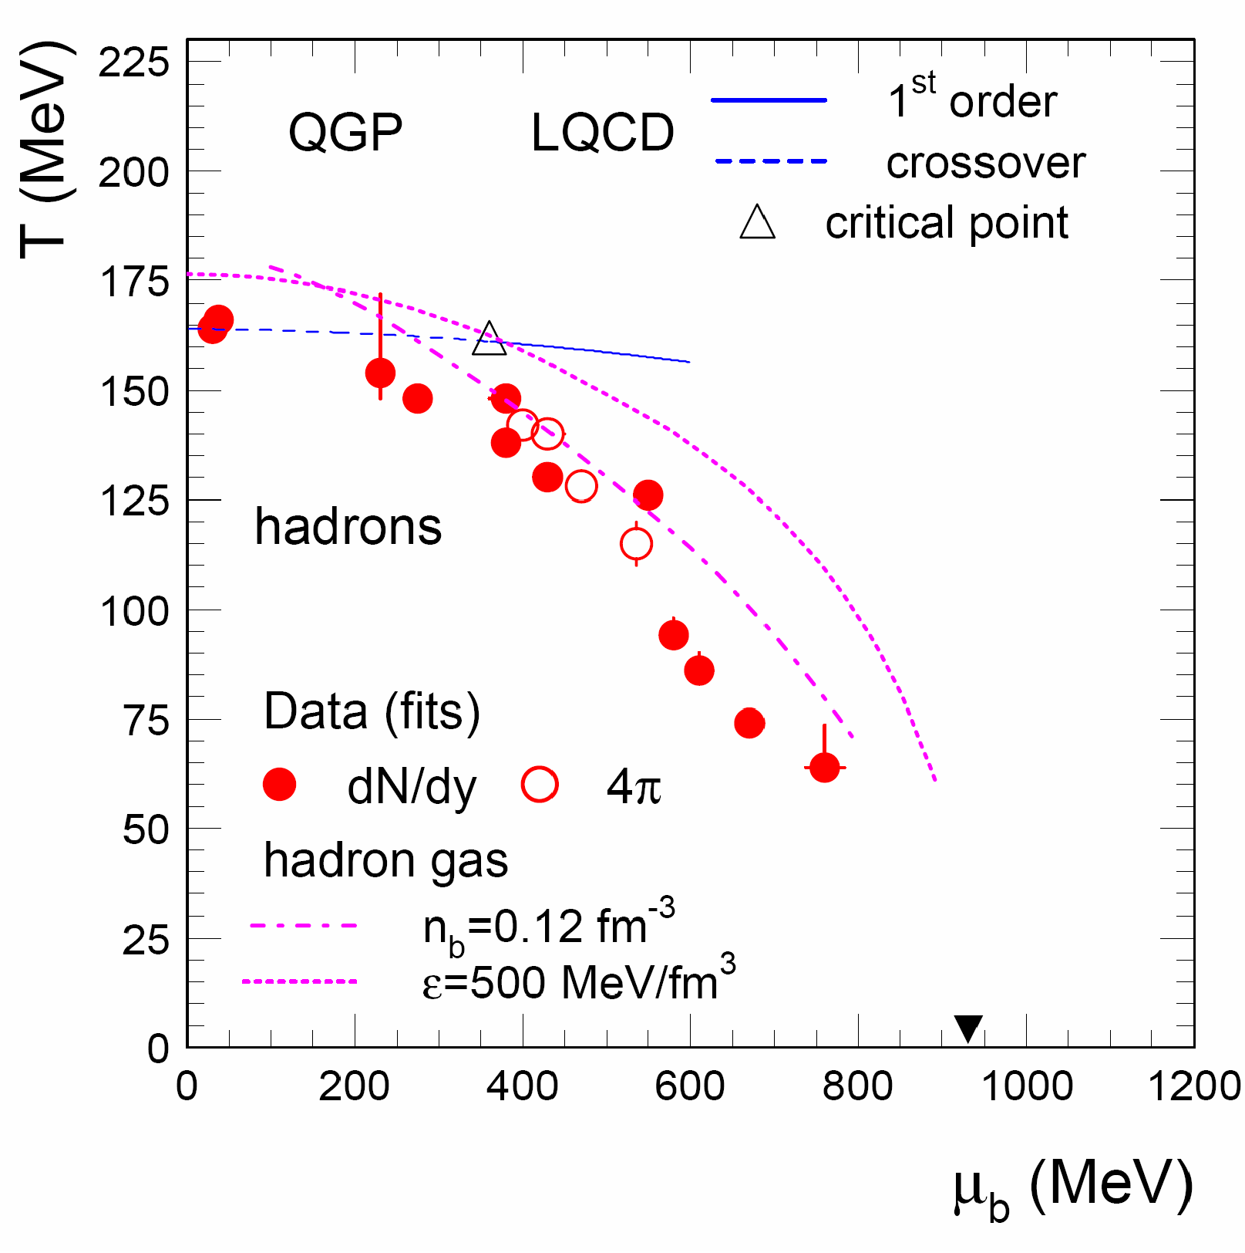
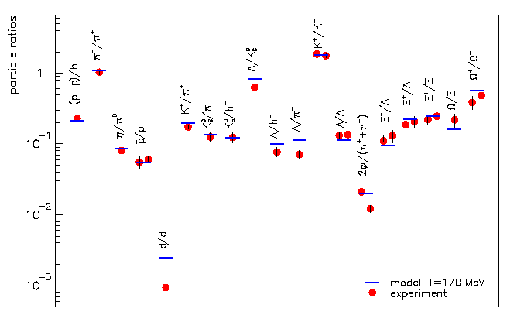
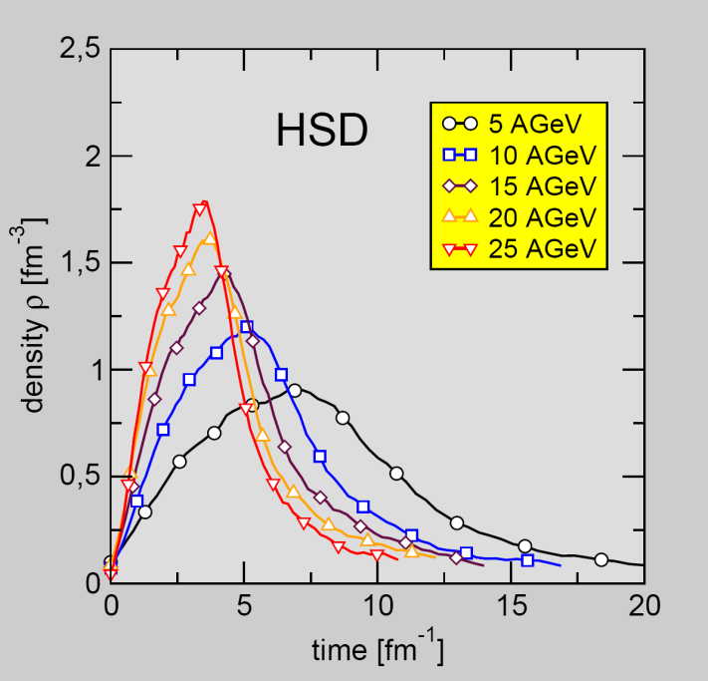
Experimental Access to the Phase Diagram
The hadronic final state resembles a hadron gas in equilibrium.
Moderate collision energies probe the high-density region of the phase diagram.
Microscopic models confirm to reach a high-density state with medium energies.

Slide 6
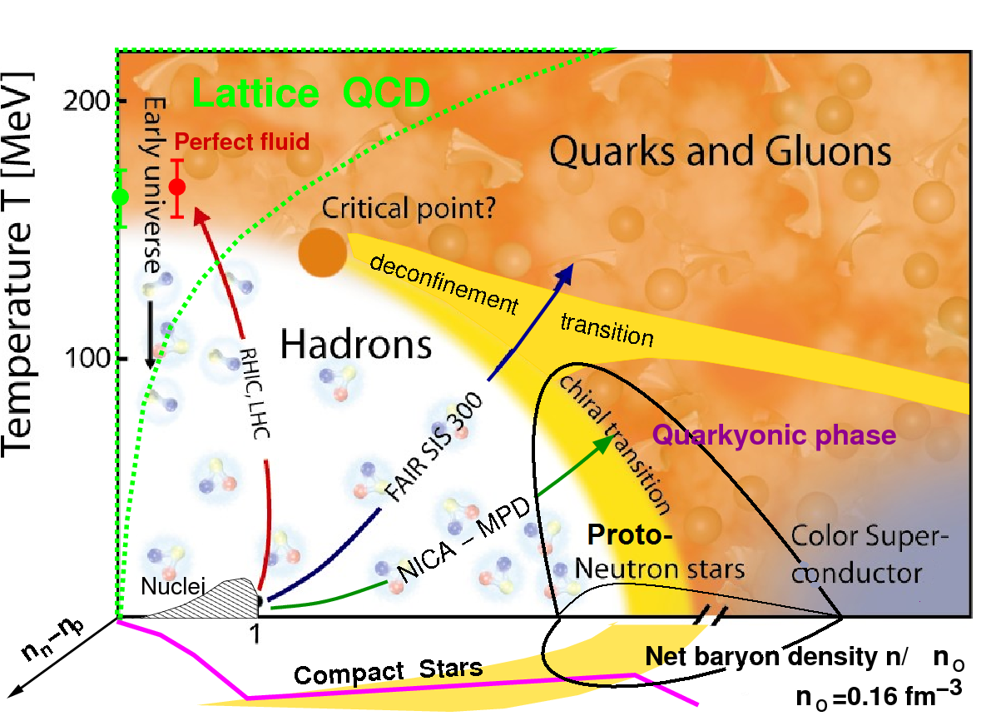
The Phase Diagram Might Be Complex....
Landmarks:
Cross-over at low densities,
first-order (?) transition at high densities,
both separated by a critical point.
Chiral transition /
quarkyonic matter ?
Exotic phases at extreme densities
Diagram: Courtesy A. Sorin
Key questions:
Is there a critical point, and if yes, where?
Where is deconfinement first reached?
Is there a first-order phase transition?
Is there a difference between chiral and deconfinement transition?
... left open by previous experiments at AGS and SPS

Slide 7
A New Round of Experiments
Paradigm: detection of QCD “landmarks” by systematic studies of indicative observables as function of collision energy (“beam energy scan”) (and of system size)
  Started with NA49 (SPS), continued by STAR (RHIC)
  Looking for discontinuities / irregularities in the excitation functions
  With proper “baseline” measurements (p+p, p+A)
At existing accelerators with existing experiments
With new, next-generation experiments at upcoming facilities
  improved sensitivity (rate, precision)
  capable to measure rare observables not accessible before

Slide 8
Experimental Handles
Fluctuations: expected near the critical point
Flow: access to the equation-of-state
Strangeness: equilibration as signal for phase transition
Lepton pairs: thermal radiation as thermometer -> caloric curve
Charm: probe of the early collision stage
Experimental knowledge on these below top SPS energies is scarce (limited to bulk probes, limited in statistics), or missing.
Future experiments must improve the data situation decisively!

Slide 9
Strangeness
One of the ”classical” observables:
strangeness enhancement / canonical suppression
Strangeness yields from are well described by the statistical model: strong argument for phase transition (no hadronic mechanism to equilibrate e.g. Omega)
Following this: measuring strange baryon abundances at lower energies.
  Down to which collision energies does the hadron gas model hold?
Model fits describe data at lower SPS and at AGS
  But with a limited amount of particle species
  Data on multi-strange baryons are scarce

Slide 10
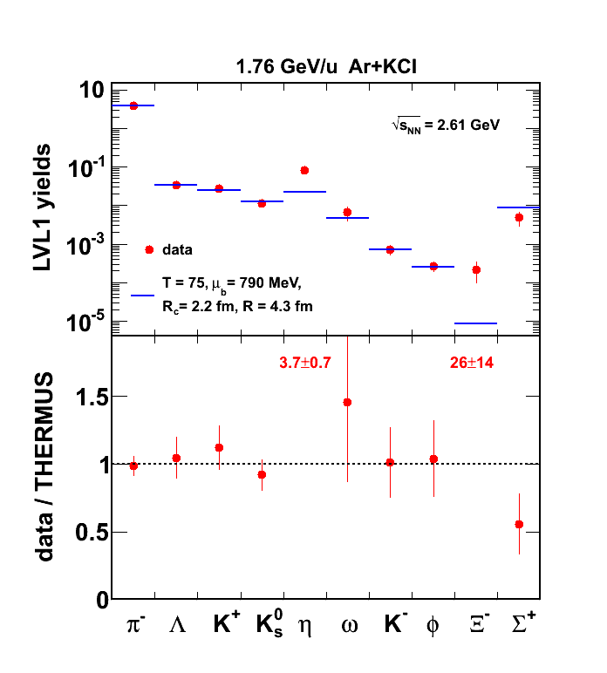

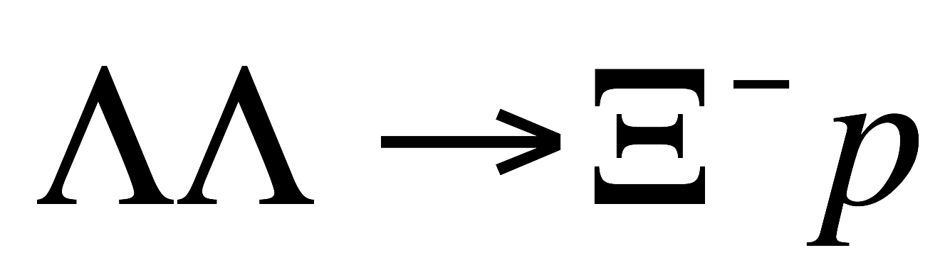

Breakdown of strangeness thermalisation?
HADES
HADES result for Xi⁻ at SIS-18 (1.76A GeV): Xi⁻ yield is off by an order of magnitude from the statistical model.
N.b.: This is deep sub-threshold. Production through multi-step processes
R. Holzmann, CBM Physics Workshop, April 2010

Slide 11
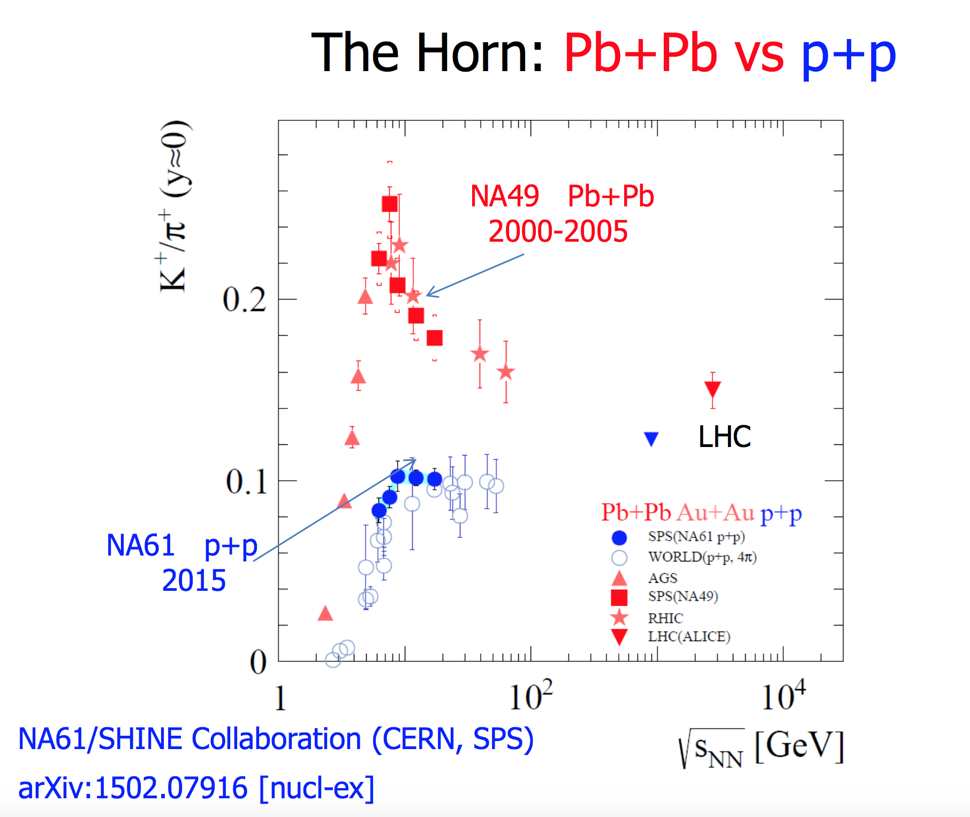
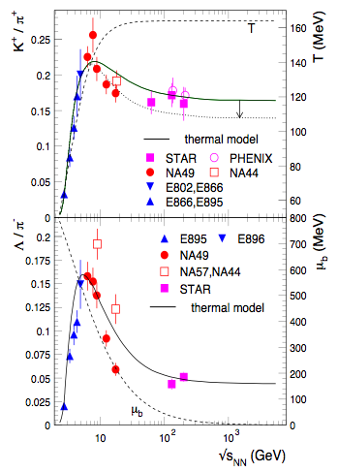
Strangeness: The „horn“, again
Statistical model: broad maximum at ≈ 30A GeV (interplay of T and μ_{b})
No satisfactory description of the K/pi energy dependence, but
Improvement when including high-mass resonances
A. Andronic, P. Braun-Munzinger und J. Stachel, Phys. Lett. B 673 (2009) 142

Slide 12
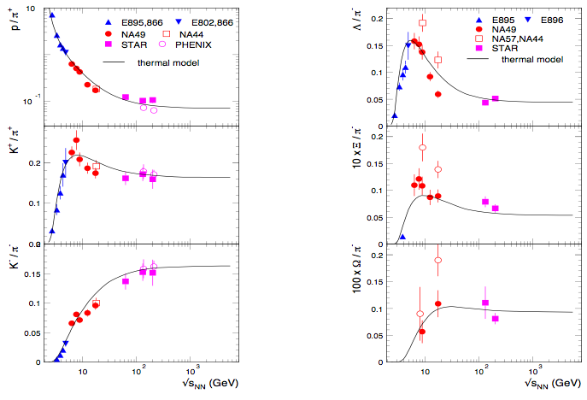
The need for data on multi-strange baryons
A long-lasting debate: pure hadronic description or signal of drastic change in matter properties?
Data on multi-strange baryons will be decisive!
“Onset” scenario: effect is due to increase in strangeness; sharp maximum at same location as K/pi; size of peak increases with strangeness content
Hadron Gas Model: effect is due to net-baryon density; broad maximum; size of maximum decreases with strangeness content; position of maximum shifts

Slide 13
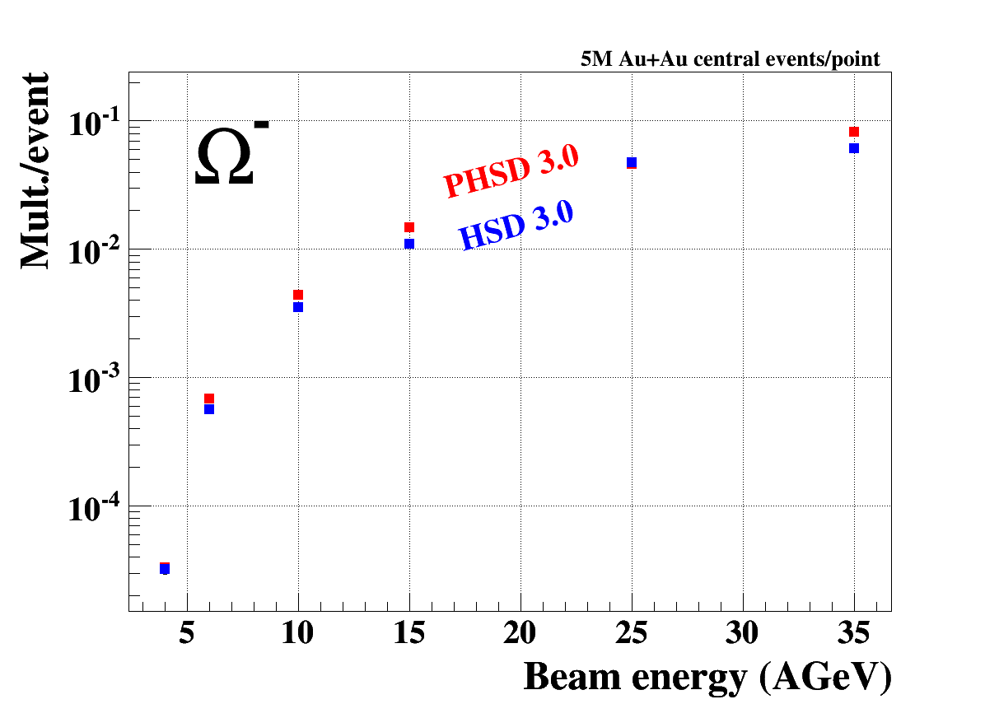
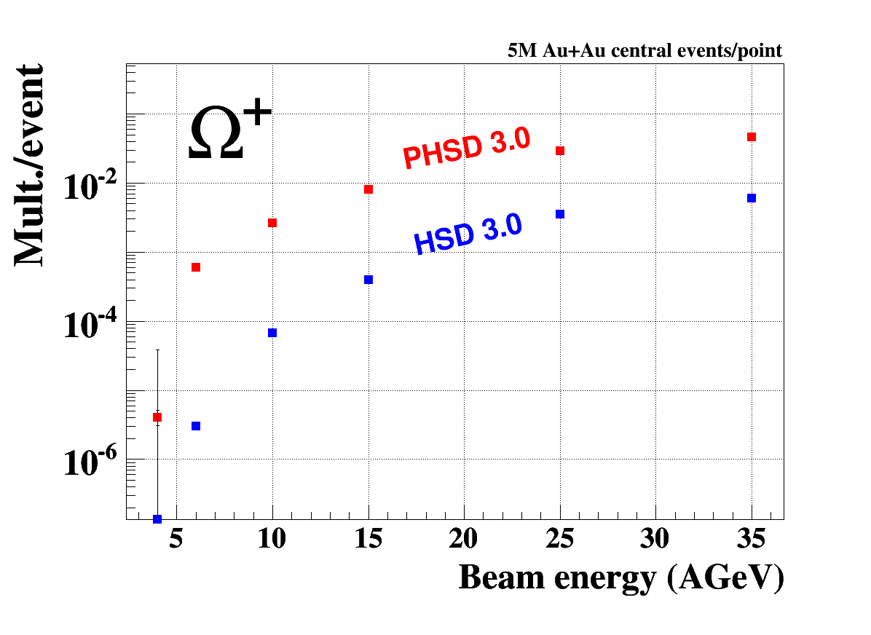
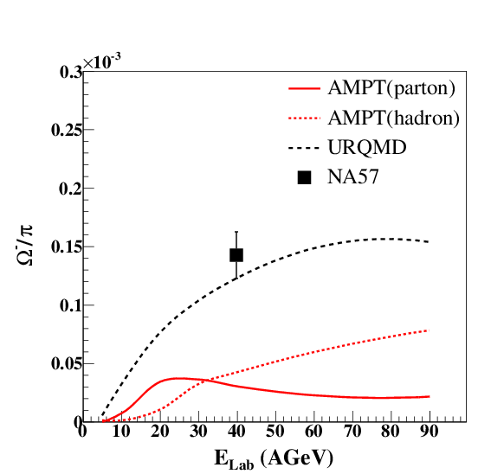
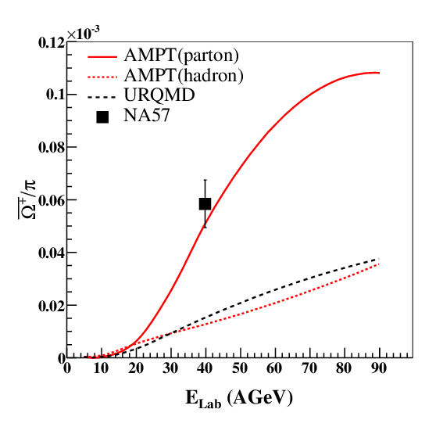
Strange anti-baryons at FAIR/NICA energies
HSD / pHSD
AMPT
Microscopic models (including partonic production) predict the anti-hyperons to be very sensitive to partonic production mechanisms (hyperons much less)

Slide 14
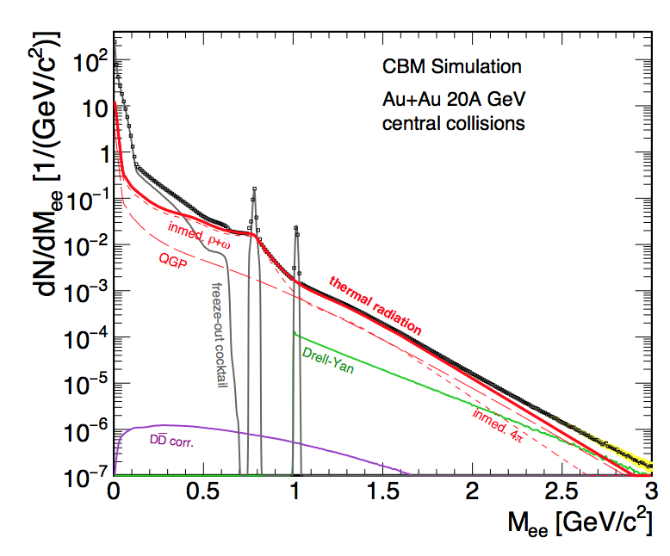
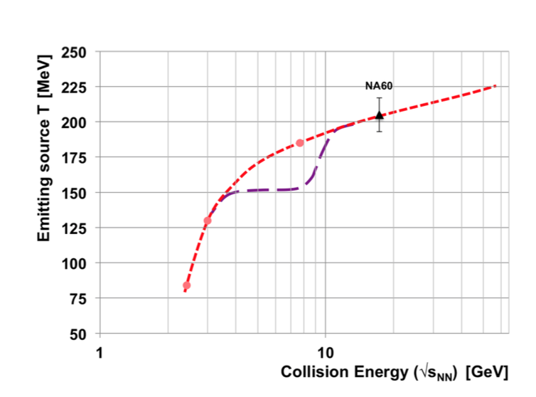
Lepton Pairs: The Intermediate Mass Region
Between φ and J/ψ: no hadronic sources
  processes: Drell-Yan, thermal radiation (QGP / hadron gas)
Apparent temperature of excess yield (through transverse spectra) as function of mass:
  rise for m < 1 GeV: hadronic sources, radial flow
  constant for m > 1 GeV: early source with low flow -> direct radiation from the QGP?
Calls for systematic investigation at lower energies!
  dream: measure the caloric curve, and see non-monotonic behaviour

Slide 15
Charm in Heavy-Ion Collisions
Unlike lighter quarks, m_{c} >> T
  thermal production of charm negligible
  production of charm in first-chance N-N collisions
  charm probes the produced medium
    c quark diffusion in QGP
    D meson / J/ψ propagation in hadronic medium
courtesy R. Rapp

Slide 16
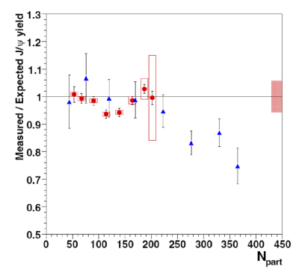
Charmonium Suppression: The QGP Signal
R. Arnaldi et al. (NA60), Nucl. Phys. A 830 (2009) 345c
Dissociation of charmonium states by free colour charges in a deconfined medium
observed at SPS (NA50) for very central Pb+Pb collisions (not in In+In / NA60)
need to control additional effects:
  absorption in cold nuclear (spectator) matter -> p+A
  absorption in hot hadronic (co-mover) matter
  regeneration: only at high collision energies (RHIC, LHC)

Slide 17
Charmonium Below Top SPS Energy
Can an „onset“ of charmonium suppression be observed below top SPS energy (160A GeV)?
N_{ccbar} << 1: re-generation negligible
Many questions:
  how do quarkonia interact with normal hadrons?
  what is the effect of nuclear matter on the binding of c-cbar to charmonia?
  how is the overall c-cbar production rate modified in dense matter?
H. Satz, Heavy-Flavour Workshop, 24 May 2014

Slide 18
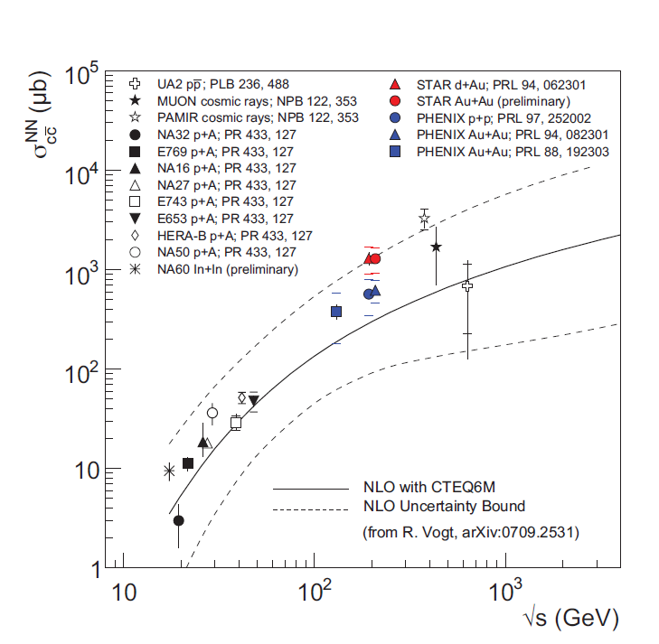
Charm Cross Section
For the interpretation of charmonium data, the total c-cbar production cross section is required: need to measure also open charm.
  cave: near threshold, N_{J/ψ} << N_{D} not necessarily true
Charm cross section close to threshold is experimentally unknown below √s = 20 GeV even in elementary reactions (let alone A+A)!
pQCD calculations also come with large uncertainties.

Slide 19
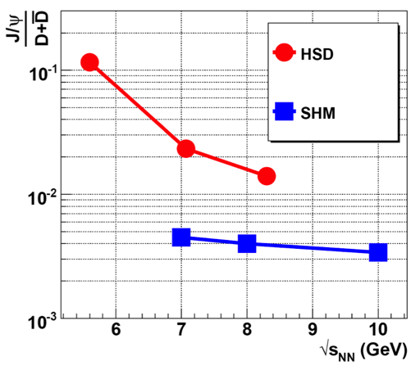
The Sensitivity of Charm
Model predictions (hadronic / partonic) differ significantly: charm production near threshold is sensitive to the production scenario!
Particularly promising: ratio hidden to open charm (reduces uncertainty due to c-cbar cross section).

Slide 20
Experimental Landscape
Running experiments
  STAR-BES (RHIC)
  NA61 (SPS)
  HADES (SIS-18)
At future facilities (under way)
  CBM @ FAIR (+ HADES @ FAIR)
  MPD @ NICA (+ BM@N)
Future plans (not yet approved)
  NA60+ (SPS)
  Heavy-ion programme at J-PARC

Slide 21
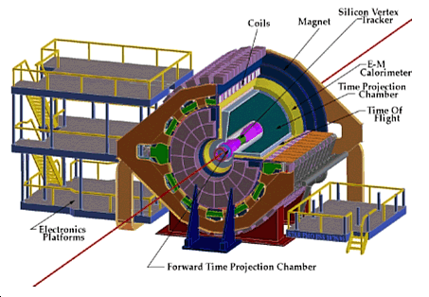
RHIC Beam Energy Scan
STAR (and PHENIX) experiments @ RHIC
emphasis on search for the critical point through event-by-event fluctuations
phase 1: 2010 – 2014
phase 2 planned for 2019 – 2020, with upgrades in machine (electron cooling) and detector (iTPC)
R. Nouicer, Saturday 9:45

Slide 22
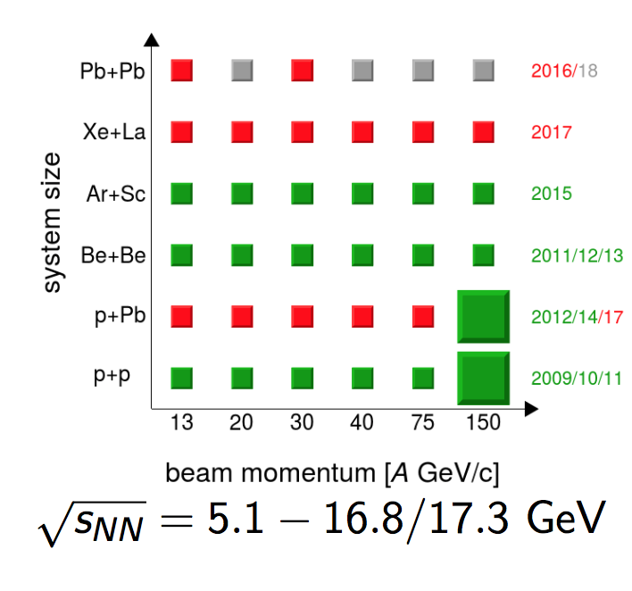
NA61
upgrade of the NA49 detector at CERN-SPS; recently first ion data
2-d scan: beam energy and system size
hadron spectra and yields, event-by-event fluctuations
large acceptance, moderate yields
upgrade with vertex detector under way (access to open charm at highest energy)
E. Andronov, Friday 18:30
G. Feofilov, Thursday 17:12

Slide 23
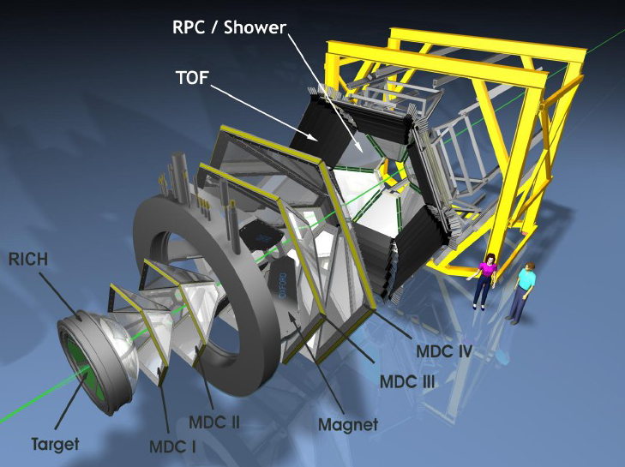
HADES
Fixed-target di-electron spectrometer
In operation at GSI SIS-18
Proton, pion and ion induced reactions at 1A – 2A GeV (for ions)
Up to 50 kHZ event rate
Observables: Low-mass lepton pairs and strange hadrons

Slide 24
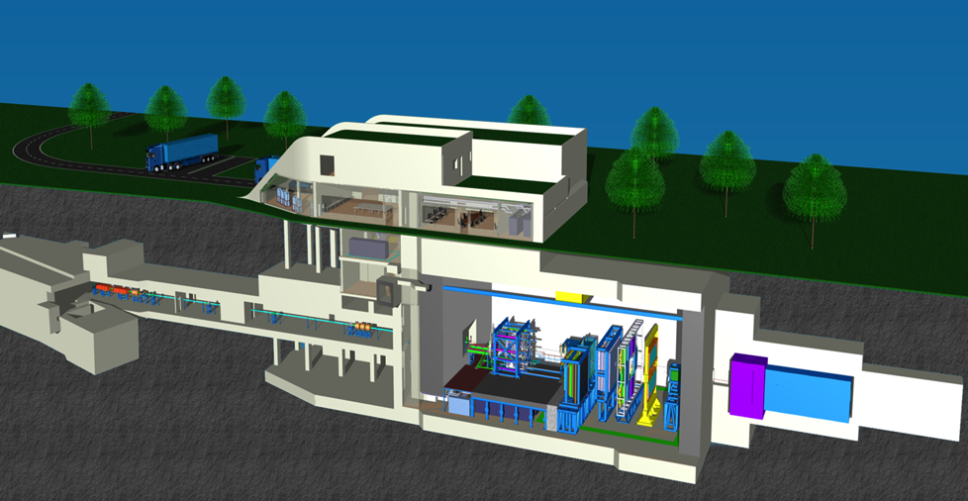
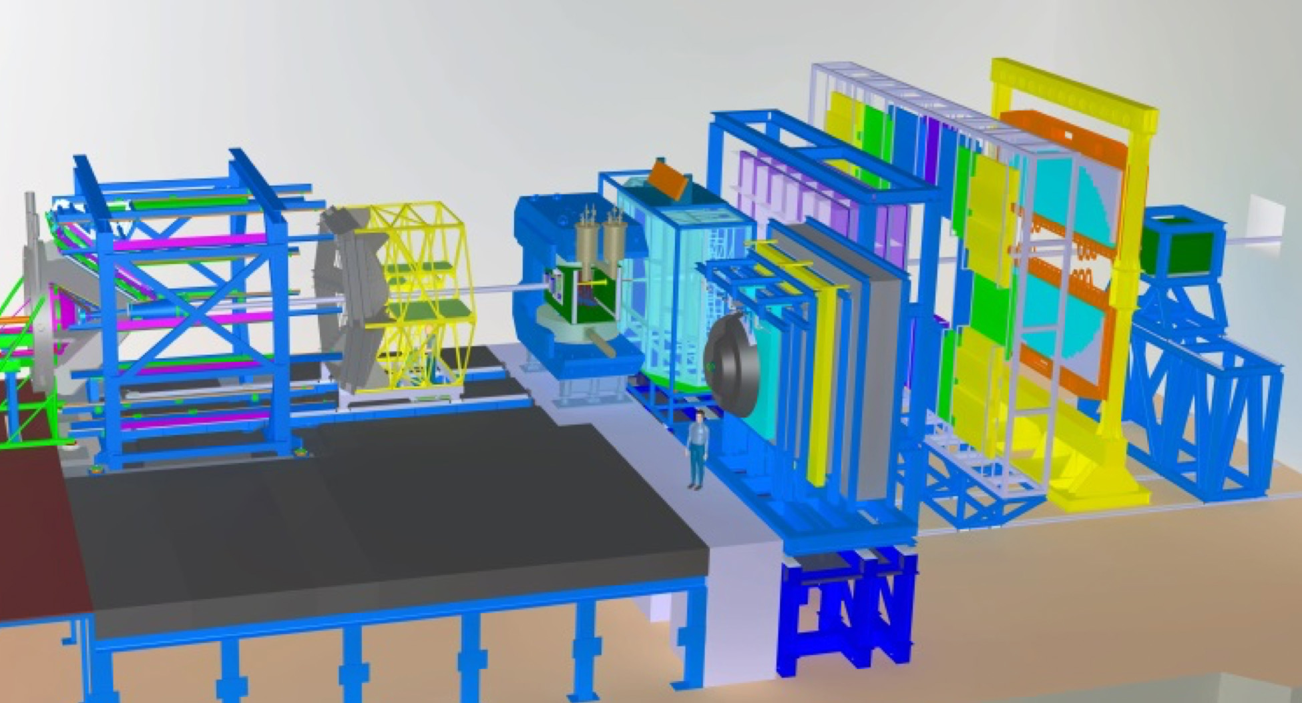
CBM
next-generation fixed-target experiment at the FAIR centre, Darmstadt (under construction)
hadron, lepton (electron + muons) and photon detector with large acceptance
beam energy range 2A – 45A GeV ( - 14 AGeV at SIS-100)
very ambitious goals for interaction rate (> 1 MHz): sensitivity to extremely rare observables (anti-hyperons, charmonium, open charm)
FAIR nuclear collision programme includes HADES at the new beam line (medium-size ions up to 6A GeV)
operation from 2021/2022 on
FAIR: K. Peters, Saturday 8:45
CBM: I. Vassiliev, Thursday 16:06

Slide 25
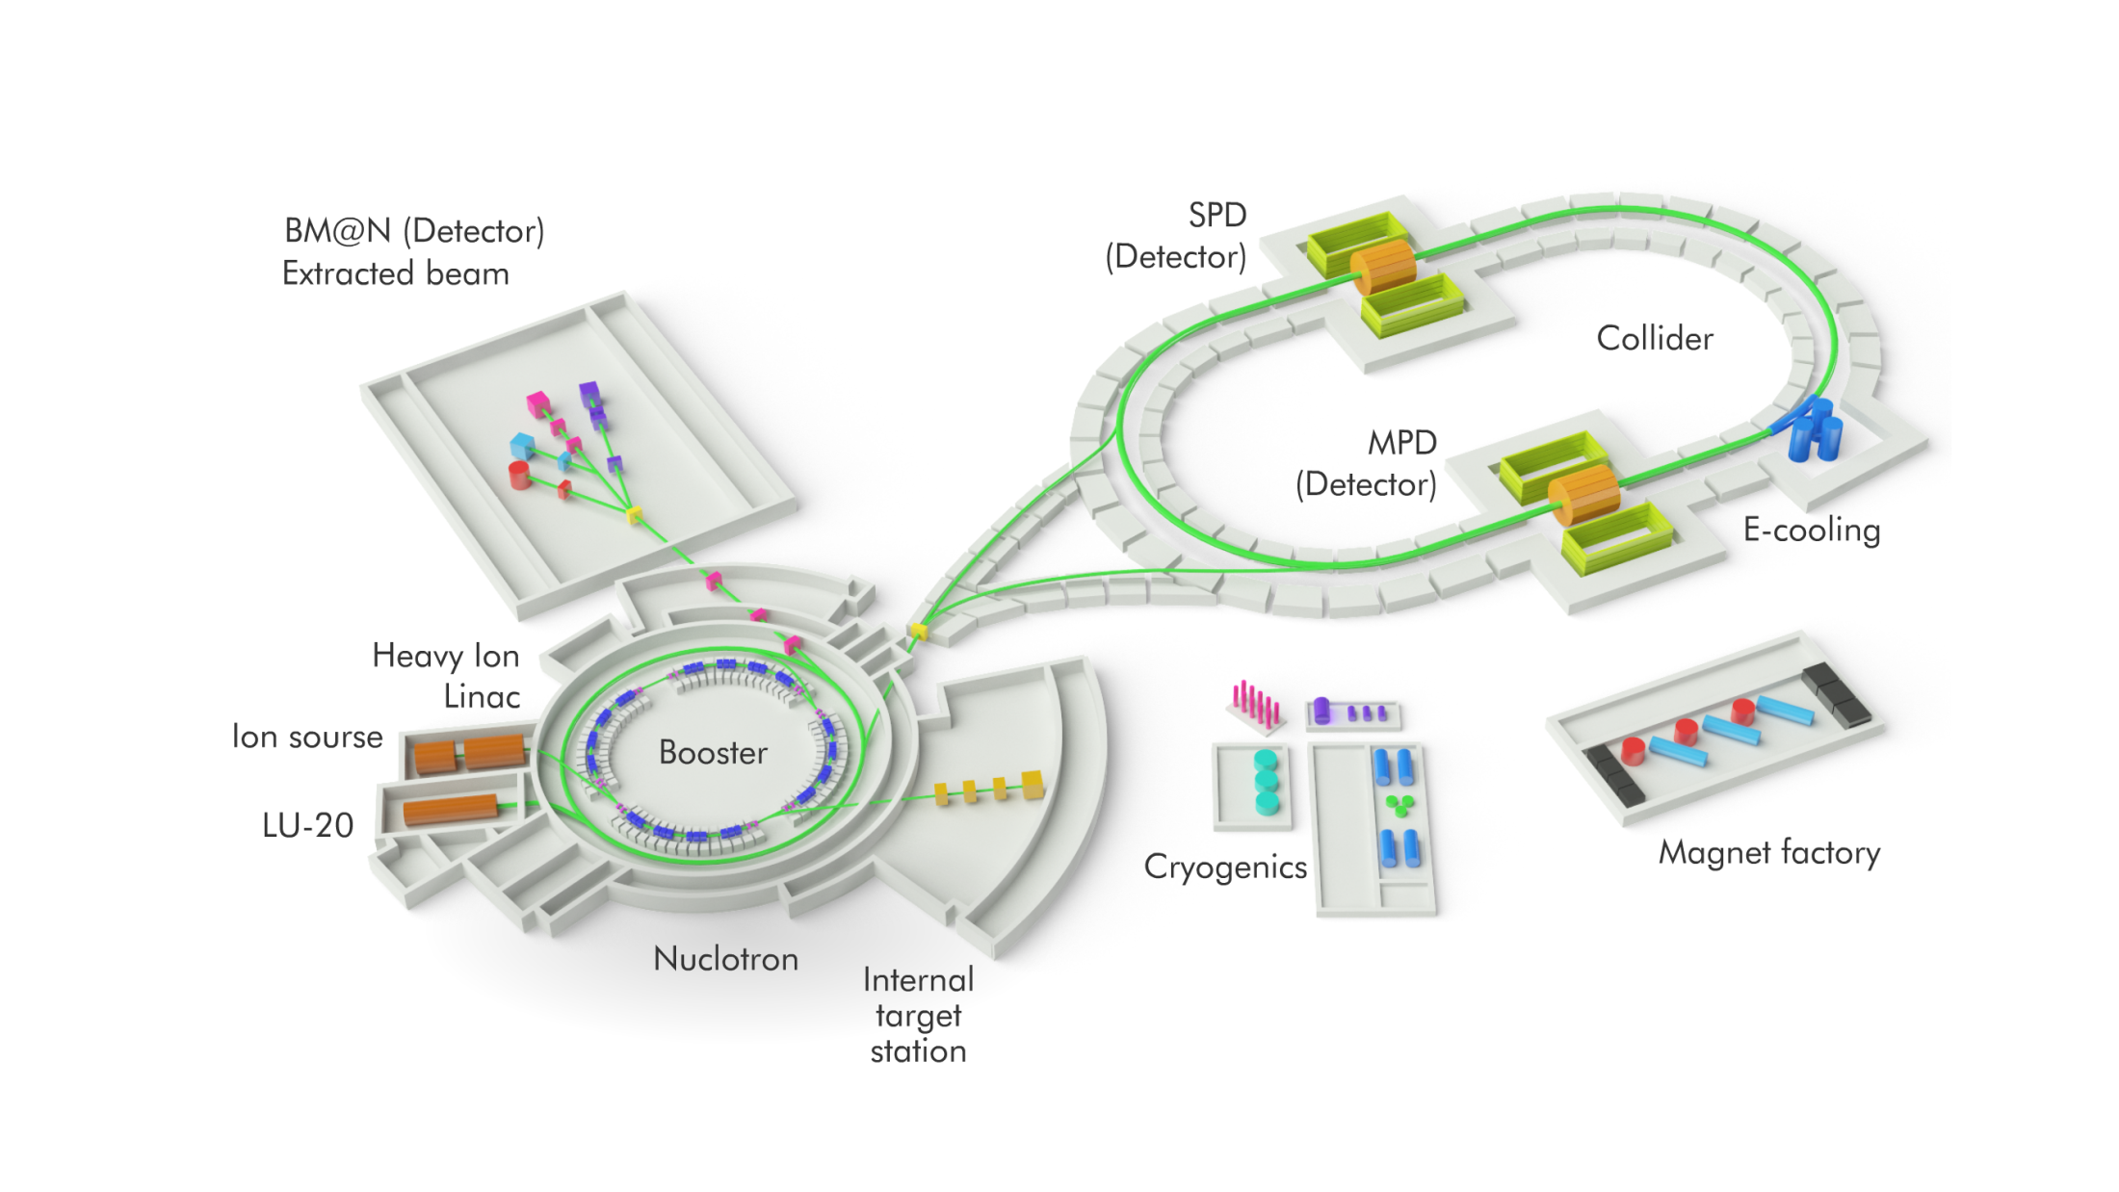
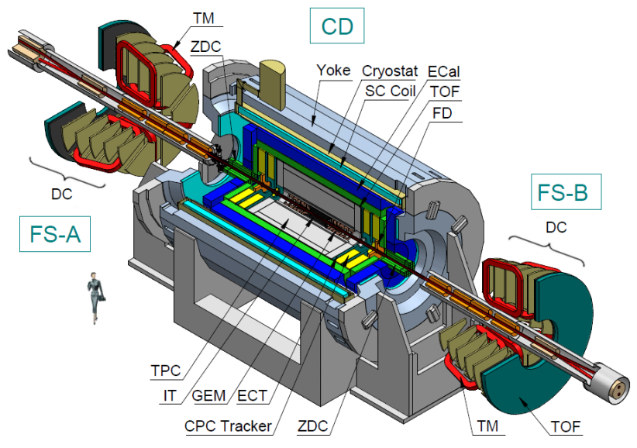
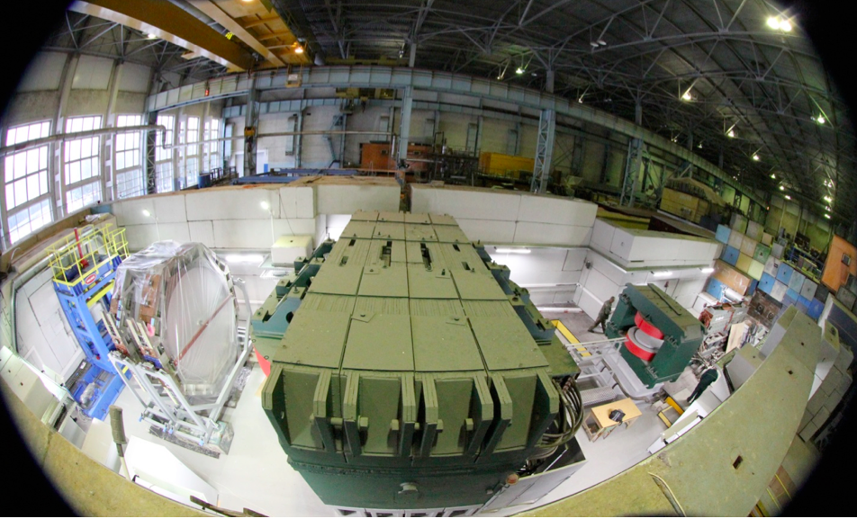
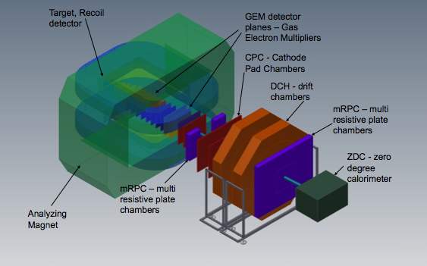
MPD / NICA
MPD:
Collider experiment,
sqrt(s_{NN}) = 4 – 11 GeV
Interaction rate up to 8 kHZ(depending on energy)
Hadron and lepton measurements
Time line (staged): 2019 - 2013
O. Rogachevsky, Saturday 11:00
BM@N:
Fixed-target,
E_{beam} = 1A – 4.5A GeV from Nuclotron
Interaction rates up to 50 kHz
Measurement of hadrons
Time line: light ion beams 2017, heavy ion beams 2019

Slide 26
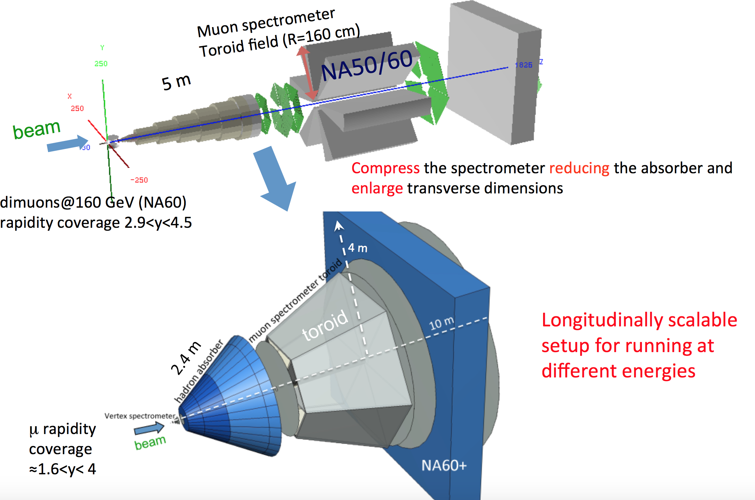
Perspectives: NA60+
Courtesy G. Usai
Plan for a di-muon experiment at SPS
Idea: follow the concept of NA60 (two spectrometers) with a compacted setup
Intermediate-mass di-muons and charmonia
Status: forming collaboration, Letter of Intent in the next years)

Slide 27
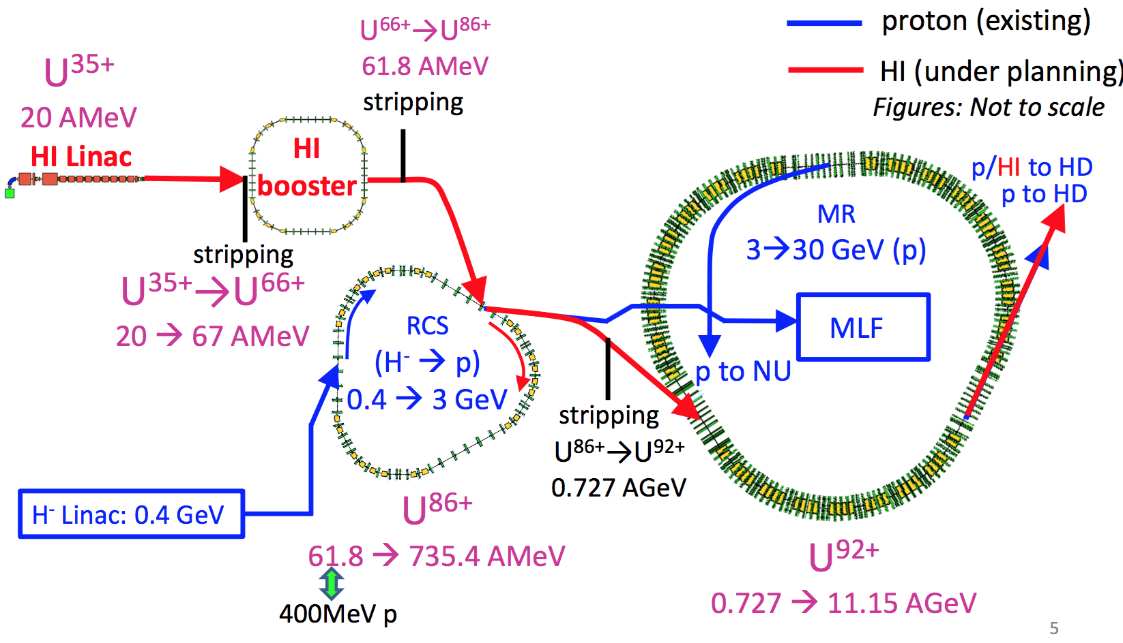
Perspectives: Plans at J-PARC
Additional ion acceleration scheme
Extracted beams for fixed-target experiments
Energy: 1A – 19A GeV
Extreme rates (4 x 10¹¹ / cycle)

Slide 28
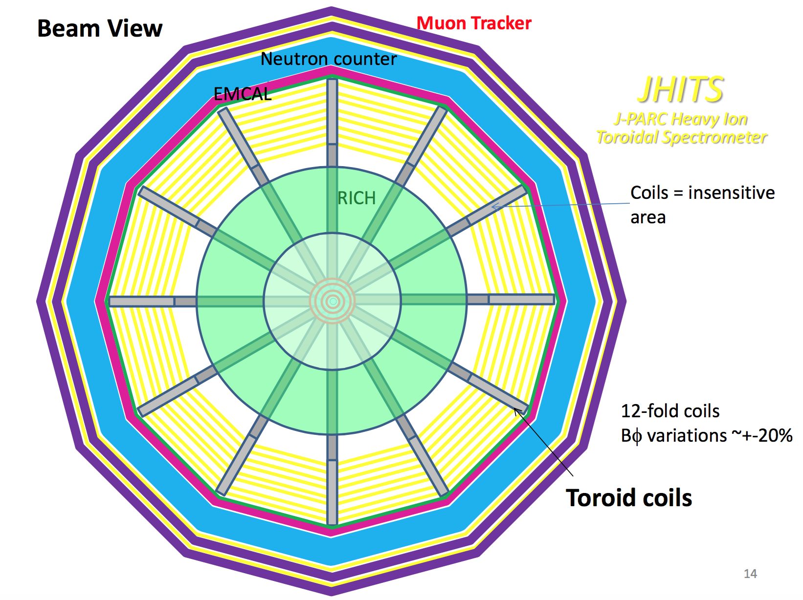
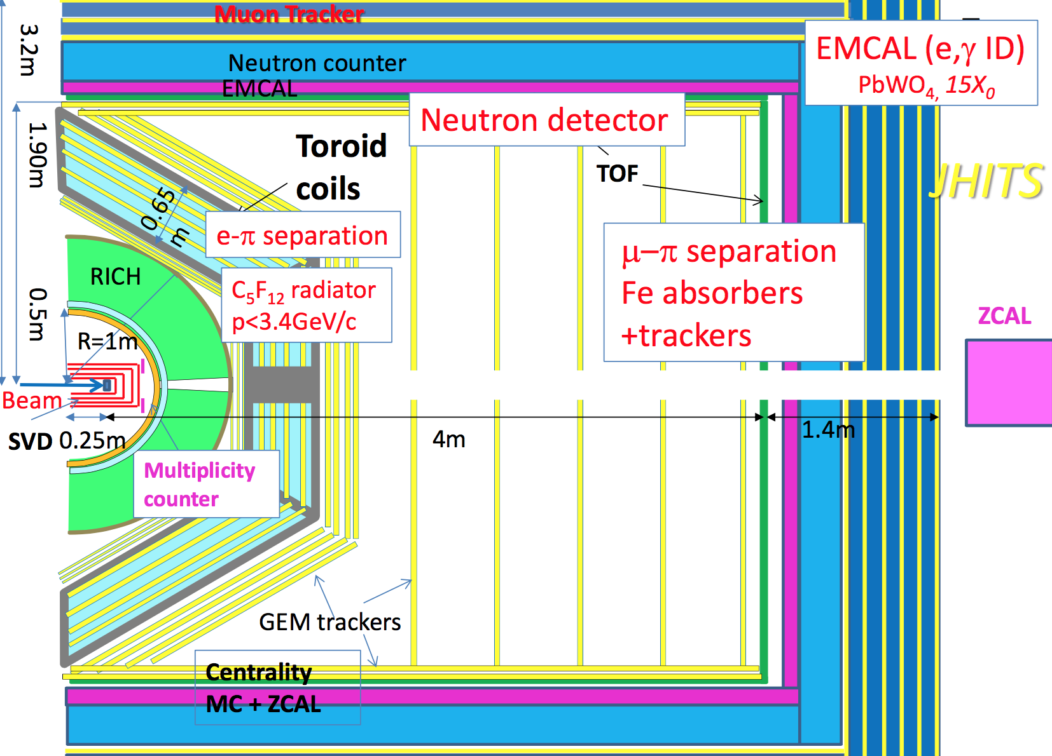
J-PARC: Ideas on a HI Detector
H. Sako, Reimei workshop 2016
Toroidal Spectrometer
Interaction rates up to 10 MHz
Measurement of hadrons, electrons, muons and neutral probes
Status: conceptual; White Paper 2016; goal: start within the next ten years

Slide 29
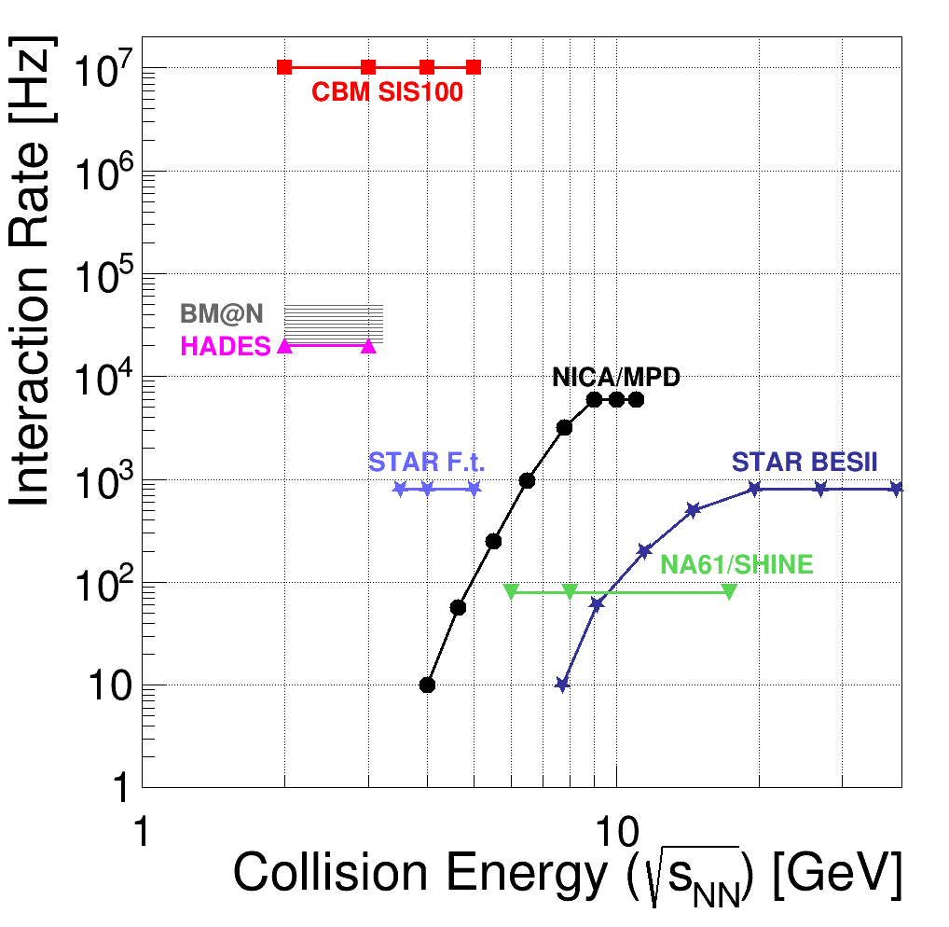
Comparison: Rates
SIS300

Slide 30
Comparison: Observables
restrictions: by rate and/or by instrumentation
charmonium
CBM
open charm
CBM
NA61
anti-hyperons
BES
CBM
NA61
IM dileptons
CBM
LM dileptons
CBM
NICA
bulk flow,
strangeness,
fluctuations
BES
CBM
NA61
BM@N
NICA

Slide 31
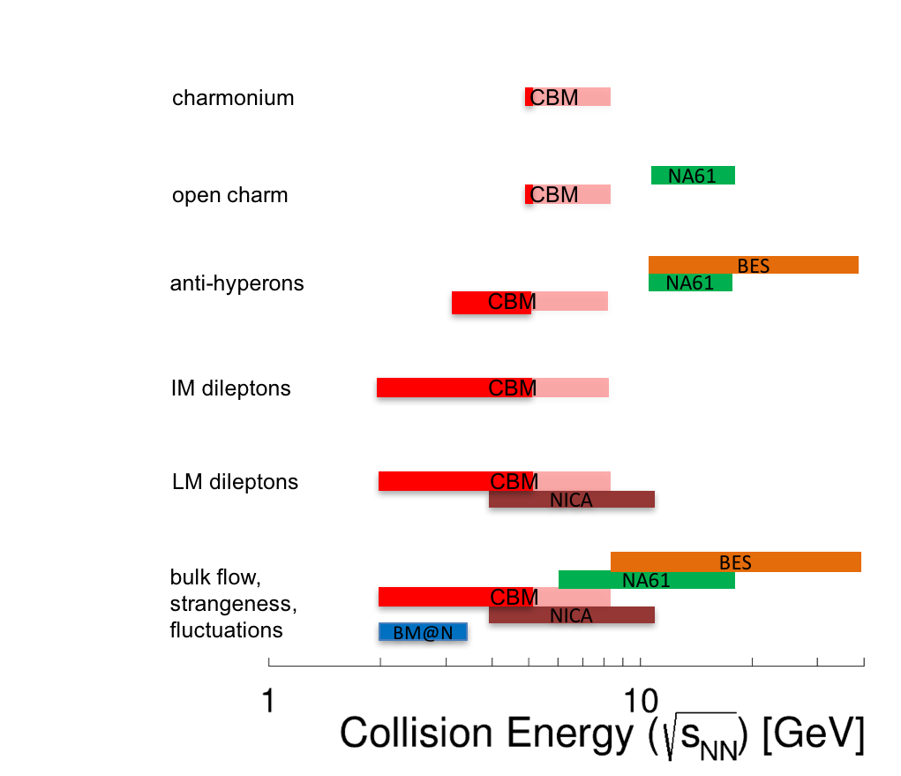
(A Short) Summary
If the intended experiment programmes and their timelines become true: starting from the early 2020s, a wealth of data will decisively improve our knowledge on the QCD phase diagram at high net-baryon densities.
In junction with the continuing experiments at highest energies (LHC and RHIC), the field promises to be vibrant for the next decade and more.

