Slide 1


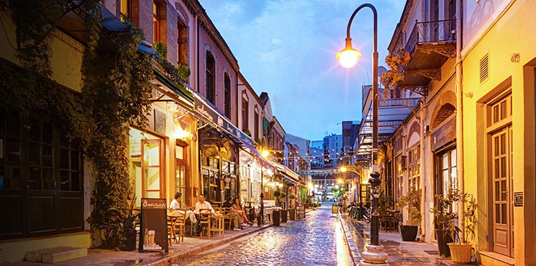
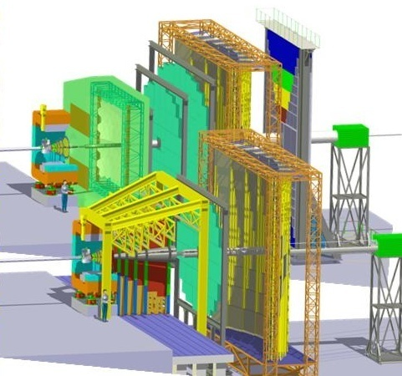
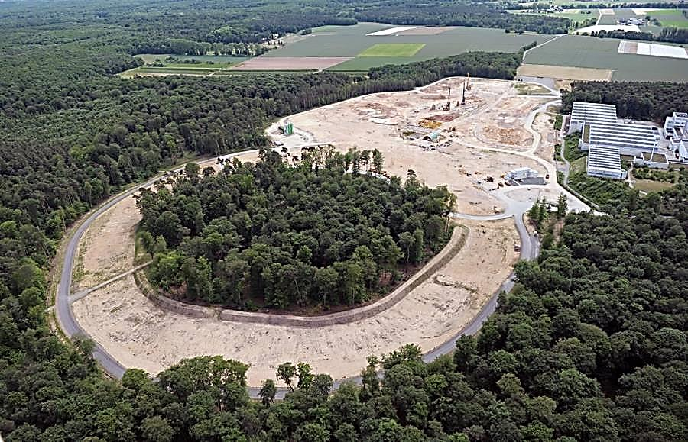
The Compressed Baryonic Matter Experiment at FAIR
Iouri Vassiliev for the CBM Collaboration
TOF
ECAL
TRD
RICH
STS
PSD
FAIR construction site
MUCH
Thessaloniki September 1 2016
1
Notes:
1
1
1
1

Slide 2

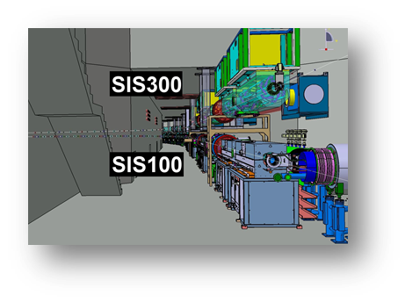
Facility for Antiproton & Ion Research
SIS100/300
Tunnel planning completed.
Application for tunnel
construction permit
submitted end of 2015
p-Linac
SIS18
CBM
FAIR strategy:
FAIR construction along the beam.
FAIR Day-1 experiment in 2022: CBM
Cave planning completed.
Application for construction
permit to be submitted 2016
FAIR beams:
10⁹/s Au up to 11 GeV/u
10⁹/s C, Ca, ... up to 14 GeV/u
10¹¹/s p up to 29 GeV
FAIR phase 1
FAIR phase 2
100 m

Slide 3
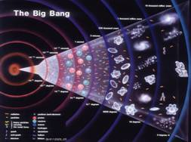
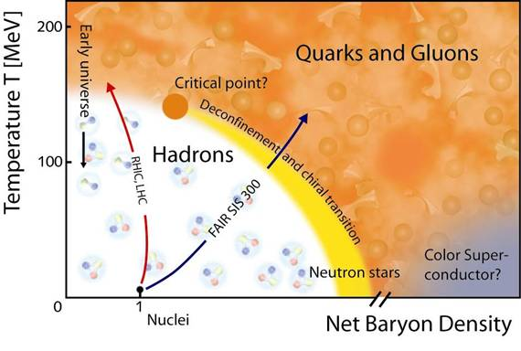
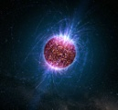
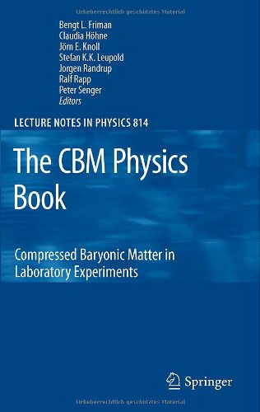
Physics case:
Exploring the QCD phase diagram
The equation-of-state at high ρ_{B}
collective flow of hadrons
particle production at threshold energies: open charm, multi-strange hyperons
Deconfinement phase transition at high ρ_{B}
excitation function and flow of strangeness (K, Λ, Σ, Ξ, Ω) and
charm (J/ψ, ψ', D⁰, D_{s}, D±, Λ_{c})
charmonium suppression, for J/ψ and ψ
QCD critical endpoint
excitation function of event-by-event fluctuations (K/π, ... Ξ/ π, Ω/ π)
Onset of chiral symmetry restoration at high ρ_{B}
in-medium modifications of hadrons (ρ,ω,φ →e⁺e⁻(μ⁺μ⁻))
LHC
RHIC
SPS-CERN
CBM
3
Notes:
3
3
3

Slide 4


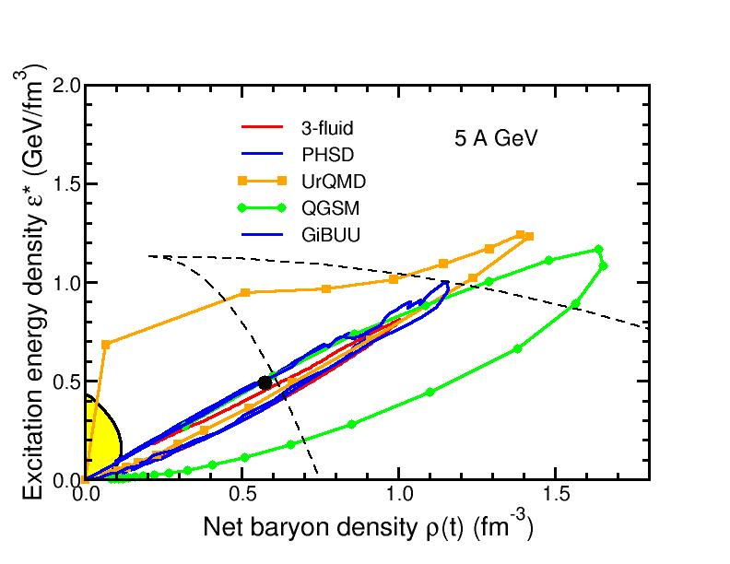
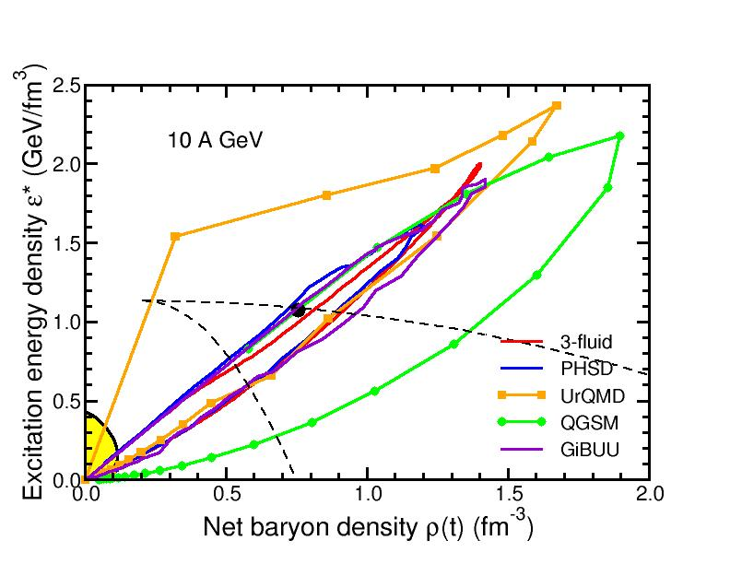
Baryon densities in central Au+Au collisions
I.C. Arsene et al., Phys. Rev. C 75, 24902 (2007)
5 A GeV
10 A GeV
8 ρ₀
5 ρ₀
phase
coexistence

Slide 5
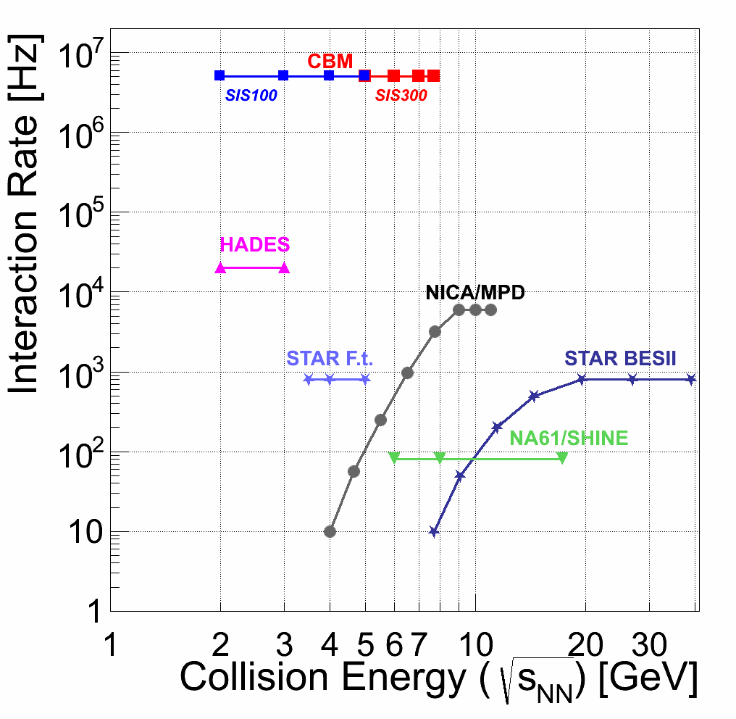
Experiments exploring dense QCD matter
high
net-baryon densities
CBM:
world record
rate capability
determination of (displaced) vertices with high resolution
(≈ 50 μm)
identification of leptons and hadrons
fast and radiation hard detectors
self-triggered readout electronics
high speed data acquisition and
online event selection
powerful computing farm 4-d tracking*
software triggers

Slide 6
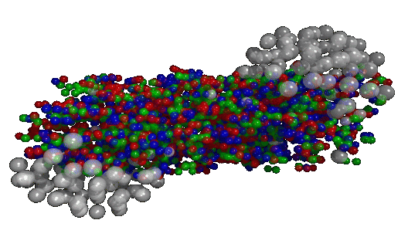
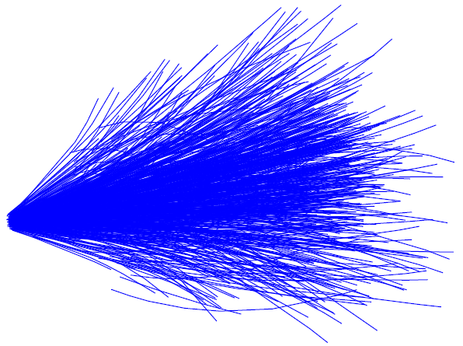
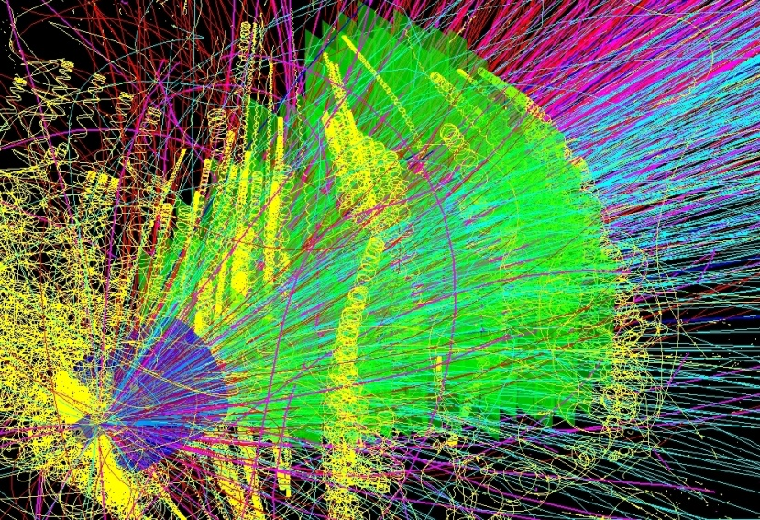

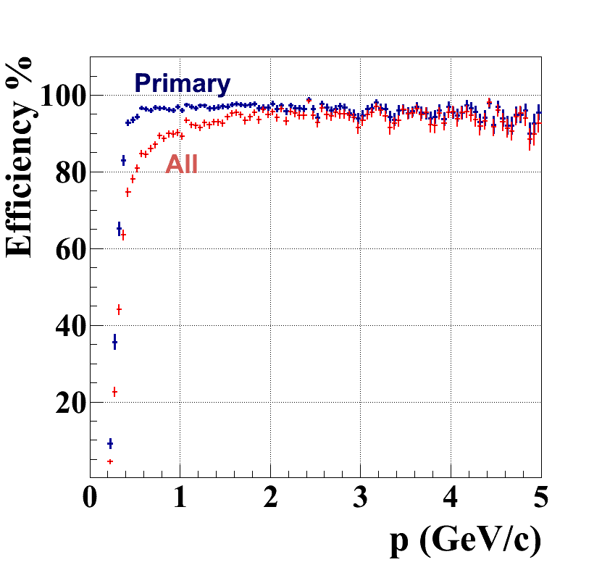
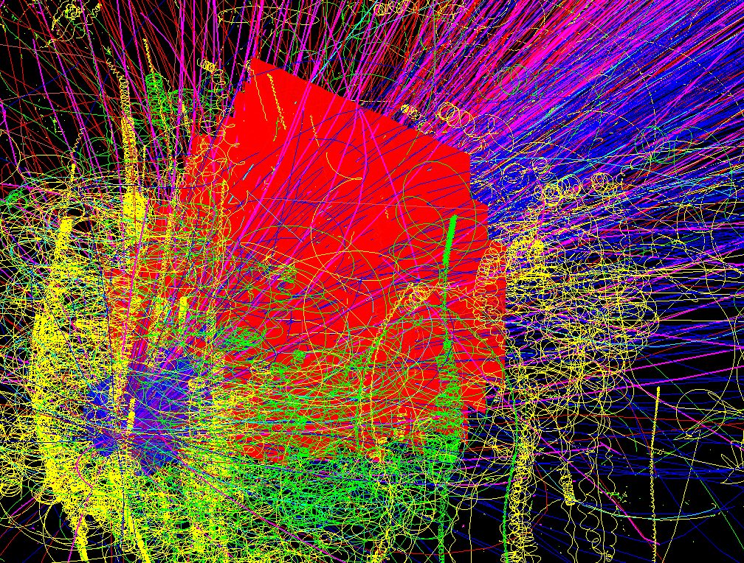
SIS-300: central Au + Au (UrQMD or PHSD) events
Simulation and reconstruction
UrQMD
simulation
~700 π
160 p
53 K
32 Λ
27 K_{S}⁰
0.44 Ξ⁻
0.018 Ω⁻
reconstruction
simulation
~700 π
174 p
42 K
30 Λ
24 K_{S}⁰
2.4 Ξ⁻
0.005 Ω⁻
CA track finder
low p tracks !
648 recstructed tracks
Ref. prim. eff = 96%
All set eff = 87%
dp/p = 1.2%
central: 82 (TF) + 16 (PF) ms/core
mbias : 10 (TF) + 2 (PF) ms/core
up to 80 cores/CPU
Notes:
6
6

Slide 7
CBM First Level Event Selection (FLES)
The FLES package is
vectorized, parallelized, portable and scalable up to 3 200 cores
Talk by I.Kisel
Example:
Full track reconstruction including KF particle analysis of multi-strange
(anti) hyperons for min. bias Au+Au collisions at 25 A GeV.
Single node with up to 80 cores
100 nodes with 32 cores each
220 k events/s !
HPC cluster at
ITEP Moscow
7

Slide 8
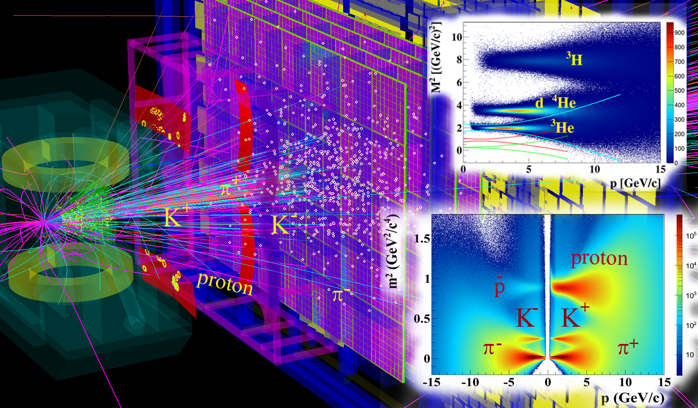
Particle identification with CBM :
Ni+Ni 15 AGeV
123 π
53 p
6 K⁺
1.6 K⁻
4 Λ
7.5 K_{S}⁰
0.4 Ξ⁻
Central event: 40 (TF) + 7 (PF) ms/core with MVD!
(~ 2 faster w/o MVD)

Slide 9
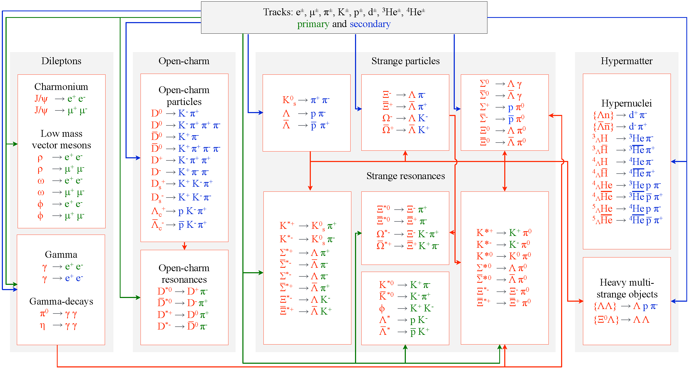
KF Particle Finder for the CBM Experiment
+ ALICE, STAR, PANDA, NA61

Slide 10
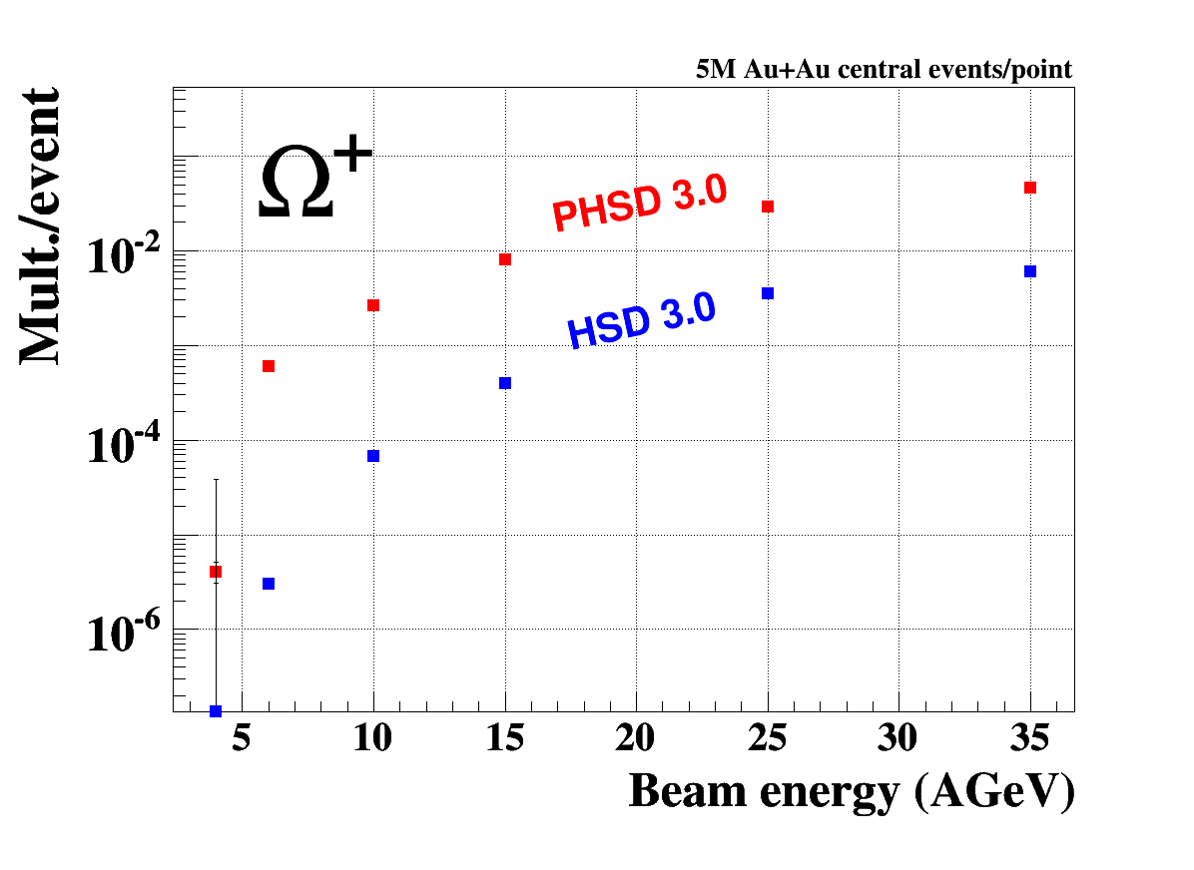
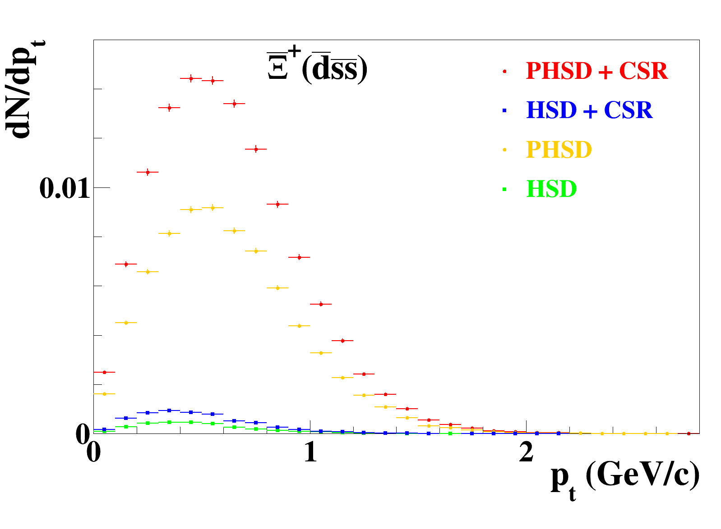
QGP and CSR signatures at FAIR energies:
Multi-strange antibaryons
E.Bratkovskaya
fias.uni-frankfurt.de/~brat/PHSD/index1.html
PHSD 3.3 Au + Au @ 10 AGeV
QGP
5M events/point
preliminary
Most of the Ω+ produced by QGP @ FAIR energy!?
CSR increase yield of MS Antibaryons !?

Slide 11
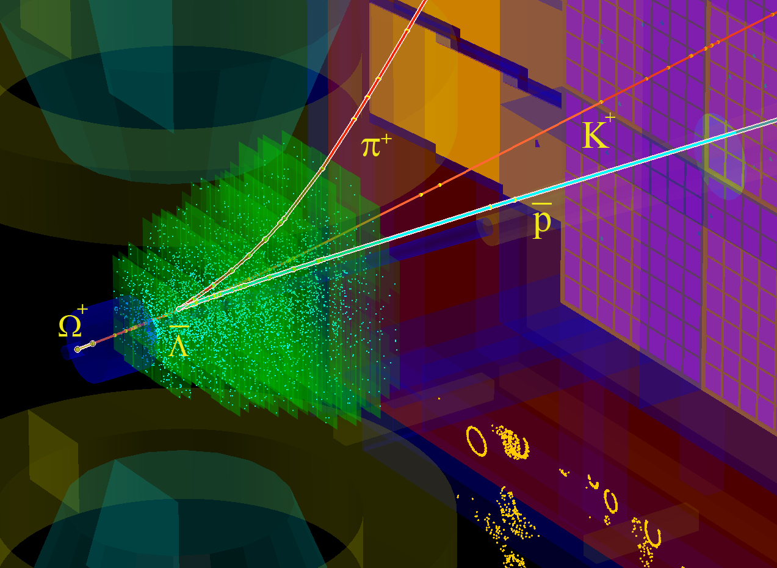
KF Particle Finder with ToF track ID: Au+Au @ 10AGeV SIS100
165 π
170 p
26 K
15 Λ
20 K_{S}⁰
0.3 Ξ⁻
pv

Slide 12
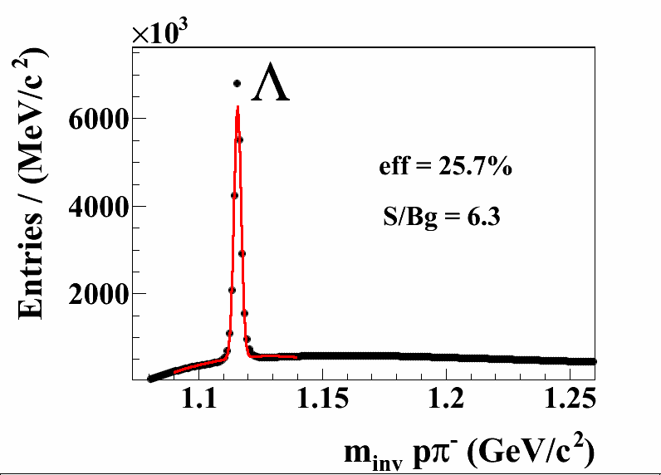
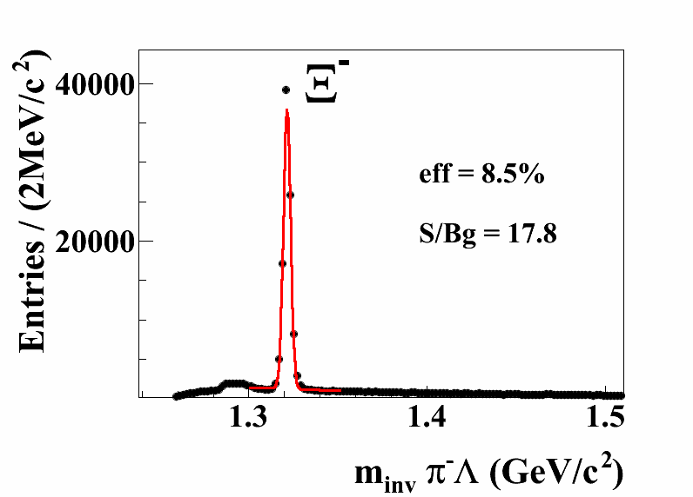
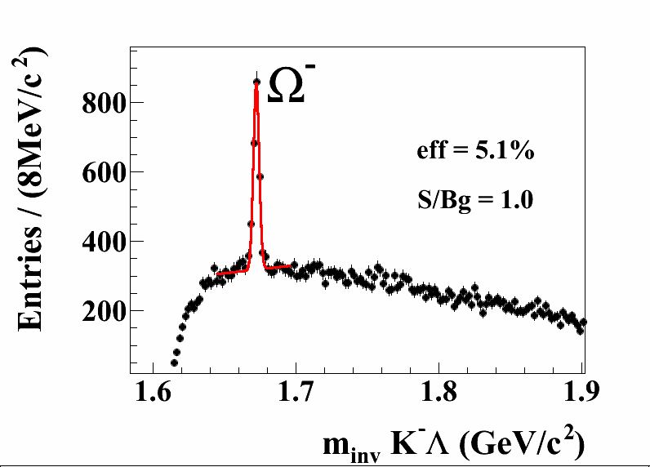
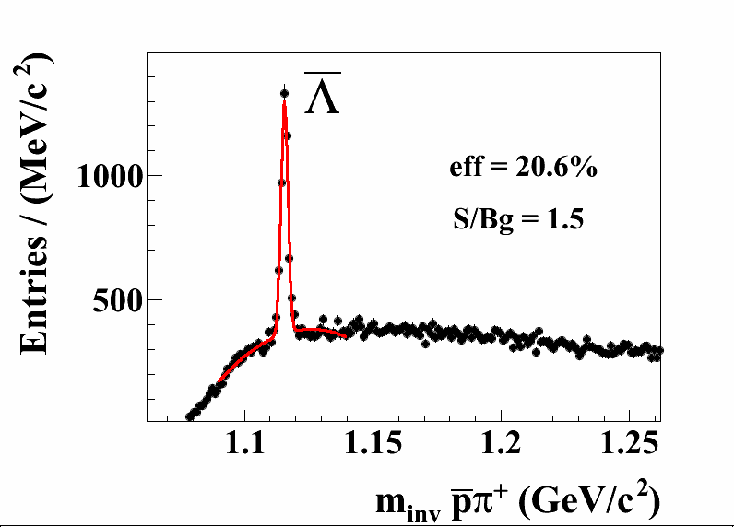
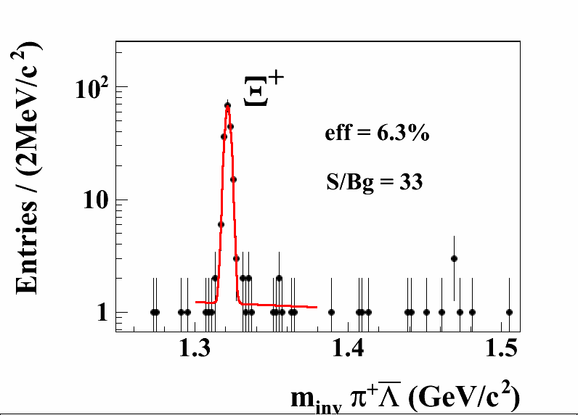
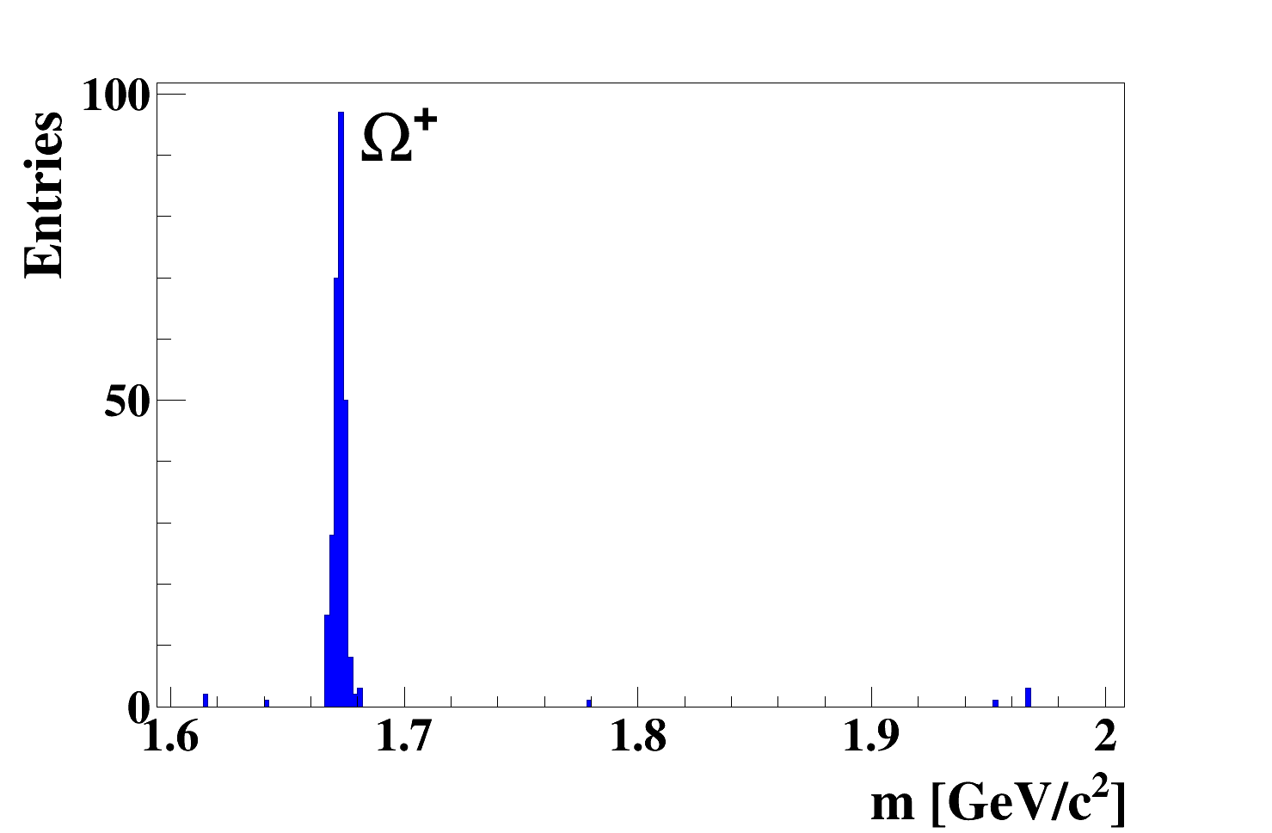

UrQMD
Au+Au 10 AGeV 5M central events
eff =2.3%
12

Slide 13
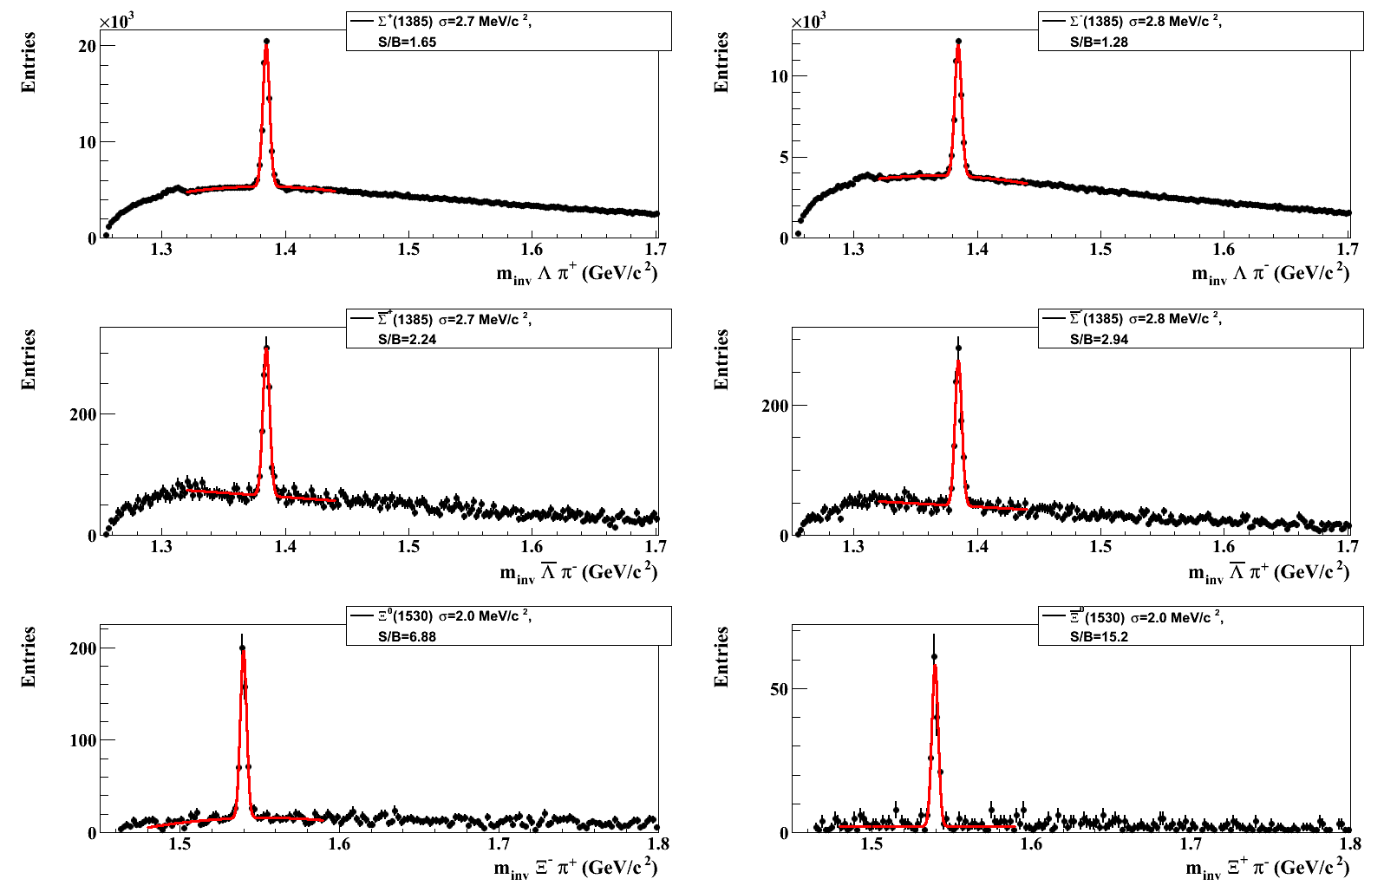
p+C 25 GeV 50M central events
UrQMD
Σ^{*+}
Σ^{*-}
width 36 MeV/c² (pdg)
Σ^{*+}
Σ^{*-}
Ξ^{*0}
Ξ^{*0}
width 9 MeV/c²

Slide 14
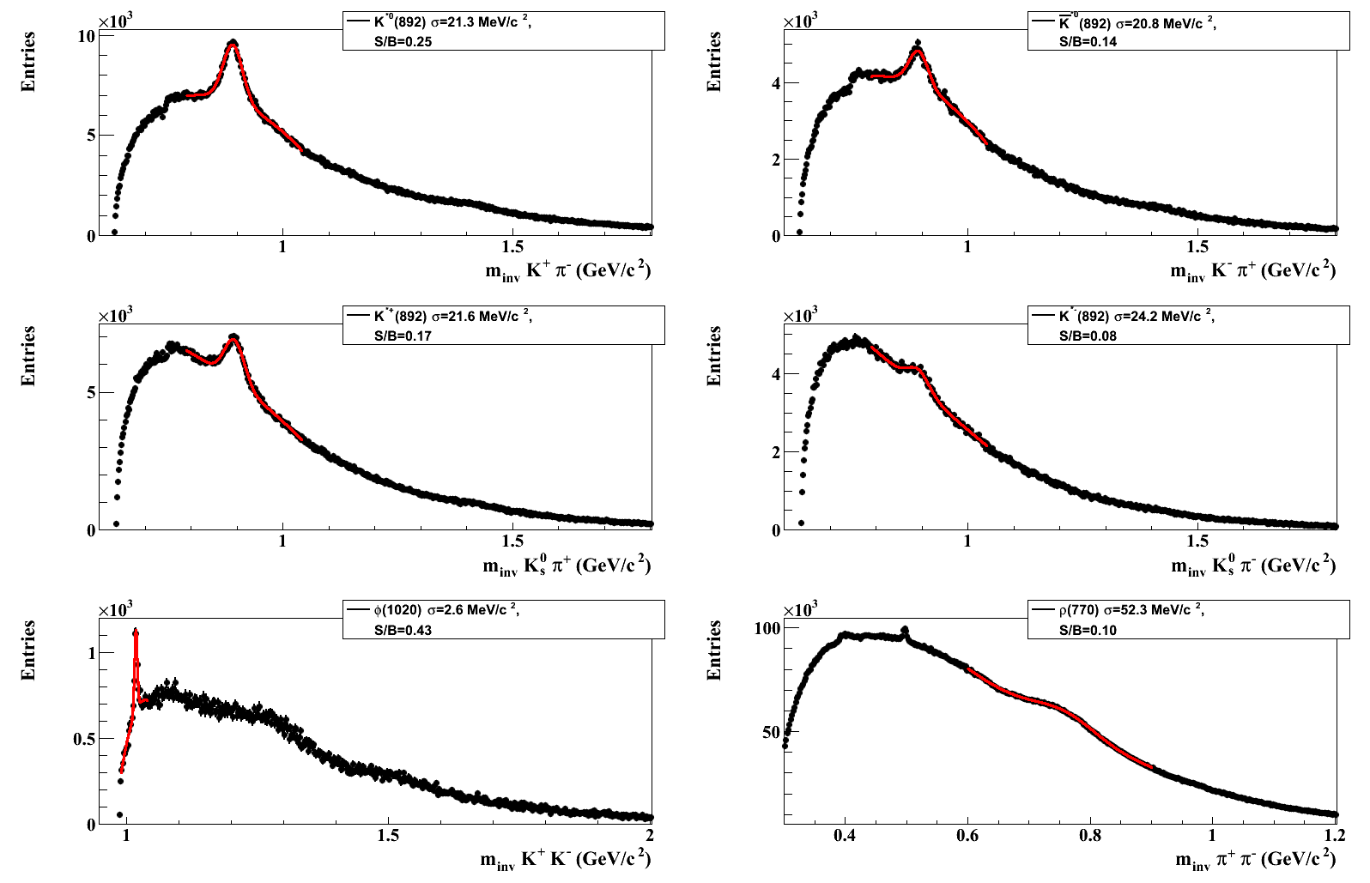
p+C 25 GeV 50M central events
UrQMD
K^{*0}
K^{*0}
σ ~ 50 MeV/c² (pdg)
K^{*+}
K^{*-}
f₂ 1270
f₀ 1370
Κ⁰_{s}
ρ→π⁺π⁻
f₀ 1500
φ→Κ⁺Κ⁻
η→π⁺π⁻π⁰

Slide 15
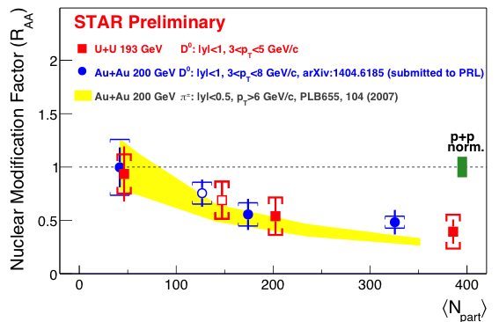
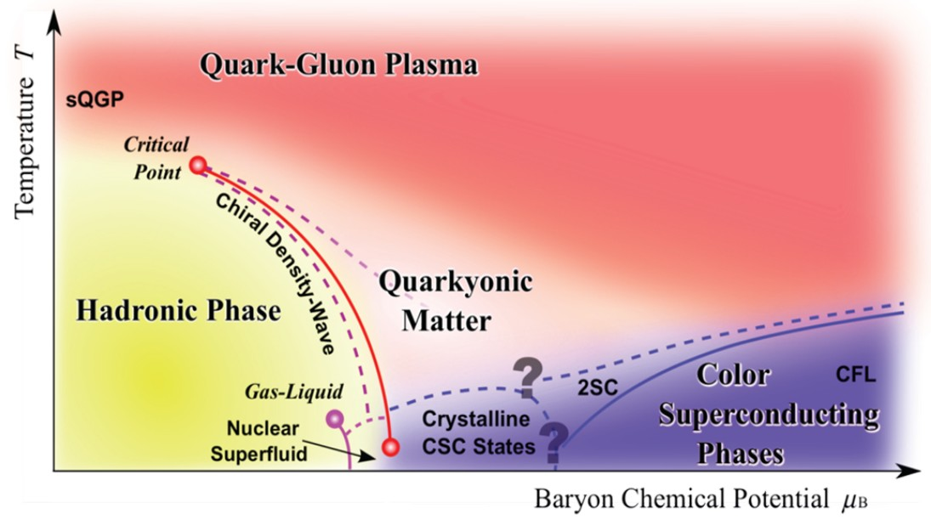
Open charm physics case:
SIS-100
What is the production mechanism of charm quarks at threshold beam energies?
How does open and hidden charm propagate in cold and in hot nuclear
matter?
SIS-300
Is there a phase transition from hadronic to quark-gluon matter, or a region of phase coexistence? (excitation function and flow of charm)
J/ψ and open charm suppression measured
charm in A+A near threshold: terra incognita
high discovery potential, e.g. in-medium modifications of D mesons
Open Charm

Slide 16
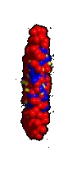
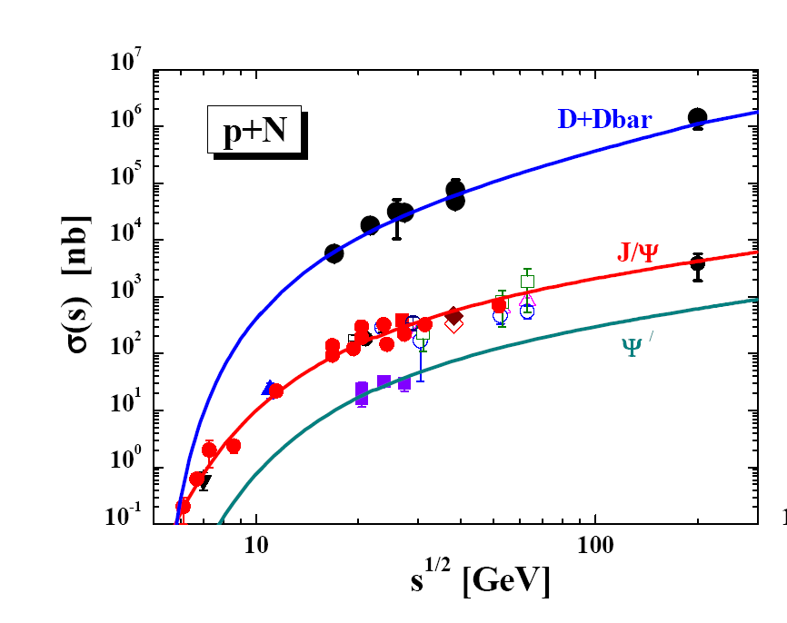
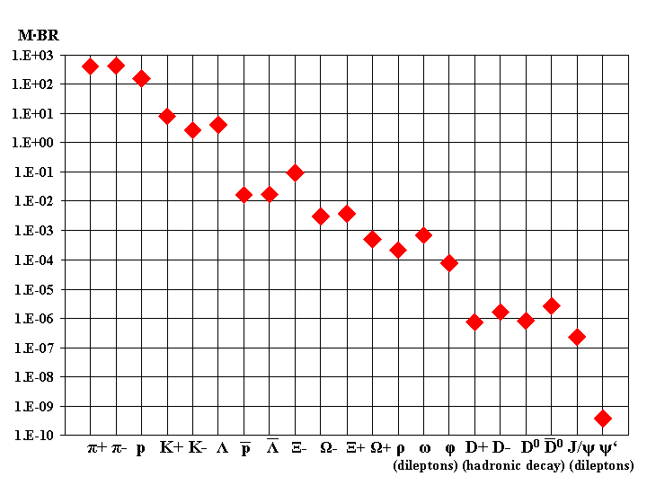
Challenge for open charm measurements at FAIR energies
D⁰, D⁺, D_{s}⁺ , Λ_{c} , D*
J/ψ, Ψ′
SIS-100
SIS-300
SIS-300
D⁰+D⁰bar (2010)
V. N. Riadovikov, PHYSICS OF ATOMIC
NUCLEI Vol. 73 No. 9 2010
A.Andronic,Thermal model
Privat communication
SPS Pb+Pb 30 A GeV
Lines: HSD-Input (2007)
D⁰, D⁺, Λ_{c}, J/ψ
p + p →J /ψ + p + p 11.2 GeV
p + n →Λ_{c} + D⁻ + p 12.0 GeV
p + p →D⁺ + D⁻ + p + p 14.9 GeV
Lynnik et al., Nucl. Phys. A 786 (2007) 183

Slide 17
Open charm decay topology
χ²_{topo}
D⁺
K⁻
χ²_{prim 1}
PV
π⁺
χ²_{prim 2}
π⁺
χ²_{geo}
L
Target plane
χ²_{prim 3}
cτ = 60…312 μm !

Slide 18
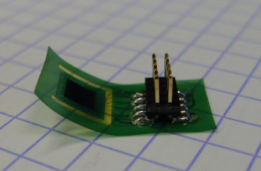
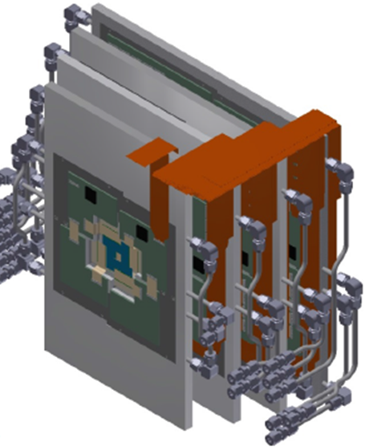
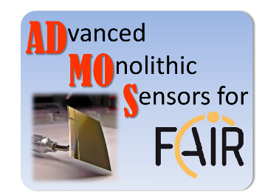
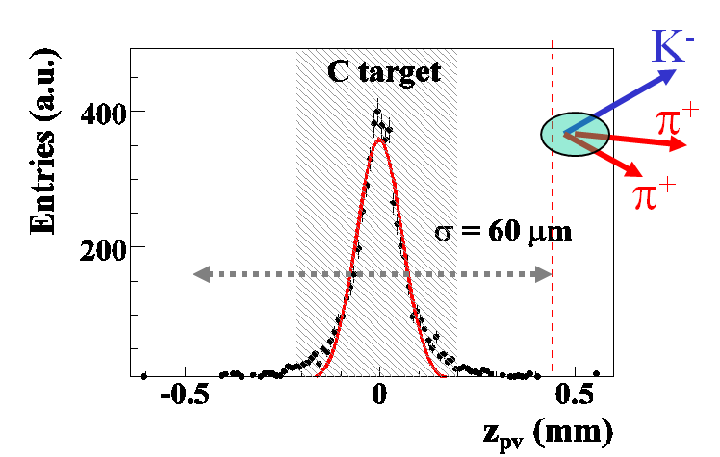
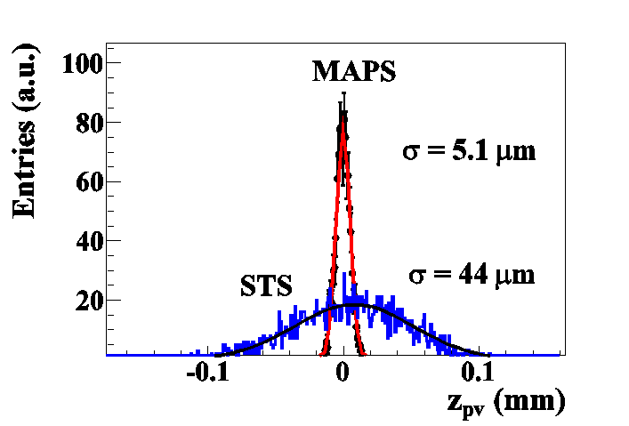
Primary vertex reconstruction in CBM
Monolithic Active Pixel Sensors
(MAPS, also CMOS-Sensors)
Invented by industry (digital camera)
Modified for charged particle detection since 1999 by IPHC Strasbourg
Installed at STAR
Also foreseen for ALICE…
Talk by Philipp Klaus
4.5 tracks central
1 track mbias
450 tracks central
100 tracks mbias
Notes:
18

Slide 19
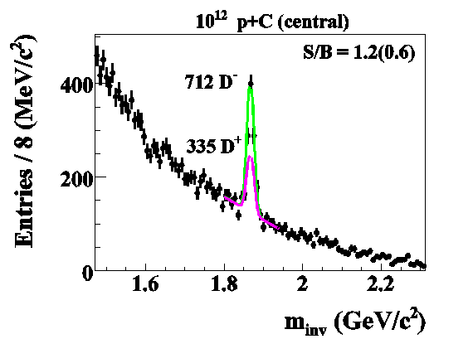
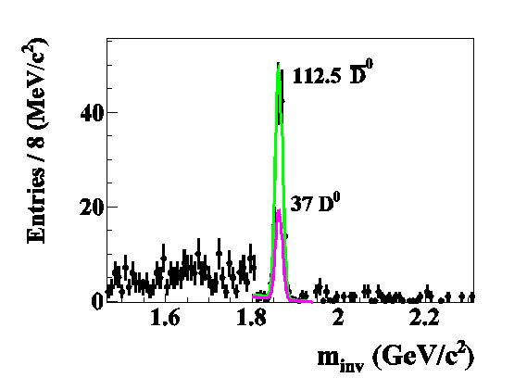
CBM performance at SIS-100: D-meson reconstruction in p-C collisions at 30GeV
D⁺ → K⁻ π⁺π⁺
D⁰ → K⁻ π⁻π⁺π⁺
10¹² central events
M^{D+} _{HSD}=2.7⋅10⁻⁸
BR = 0.095
M^{D0} _{HSD} = 2.9(8.8)⋅10⁻⁸
BR = 7.7%
Eff = 1.7%
eff = 13.2 %
In 10 weeks: 18k D± and 3k D⁰ at 10 MHz IR
with PV BG suppressed 10-30 times!

Slide 20
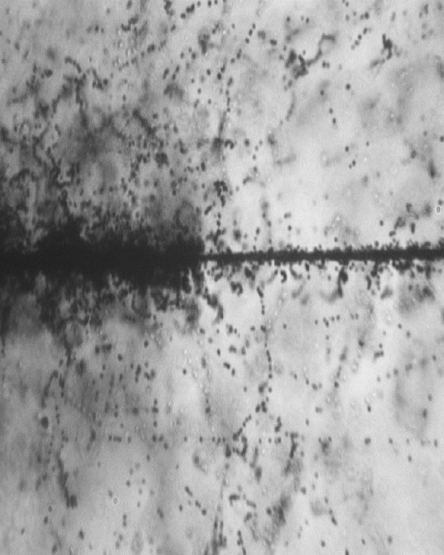
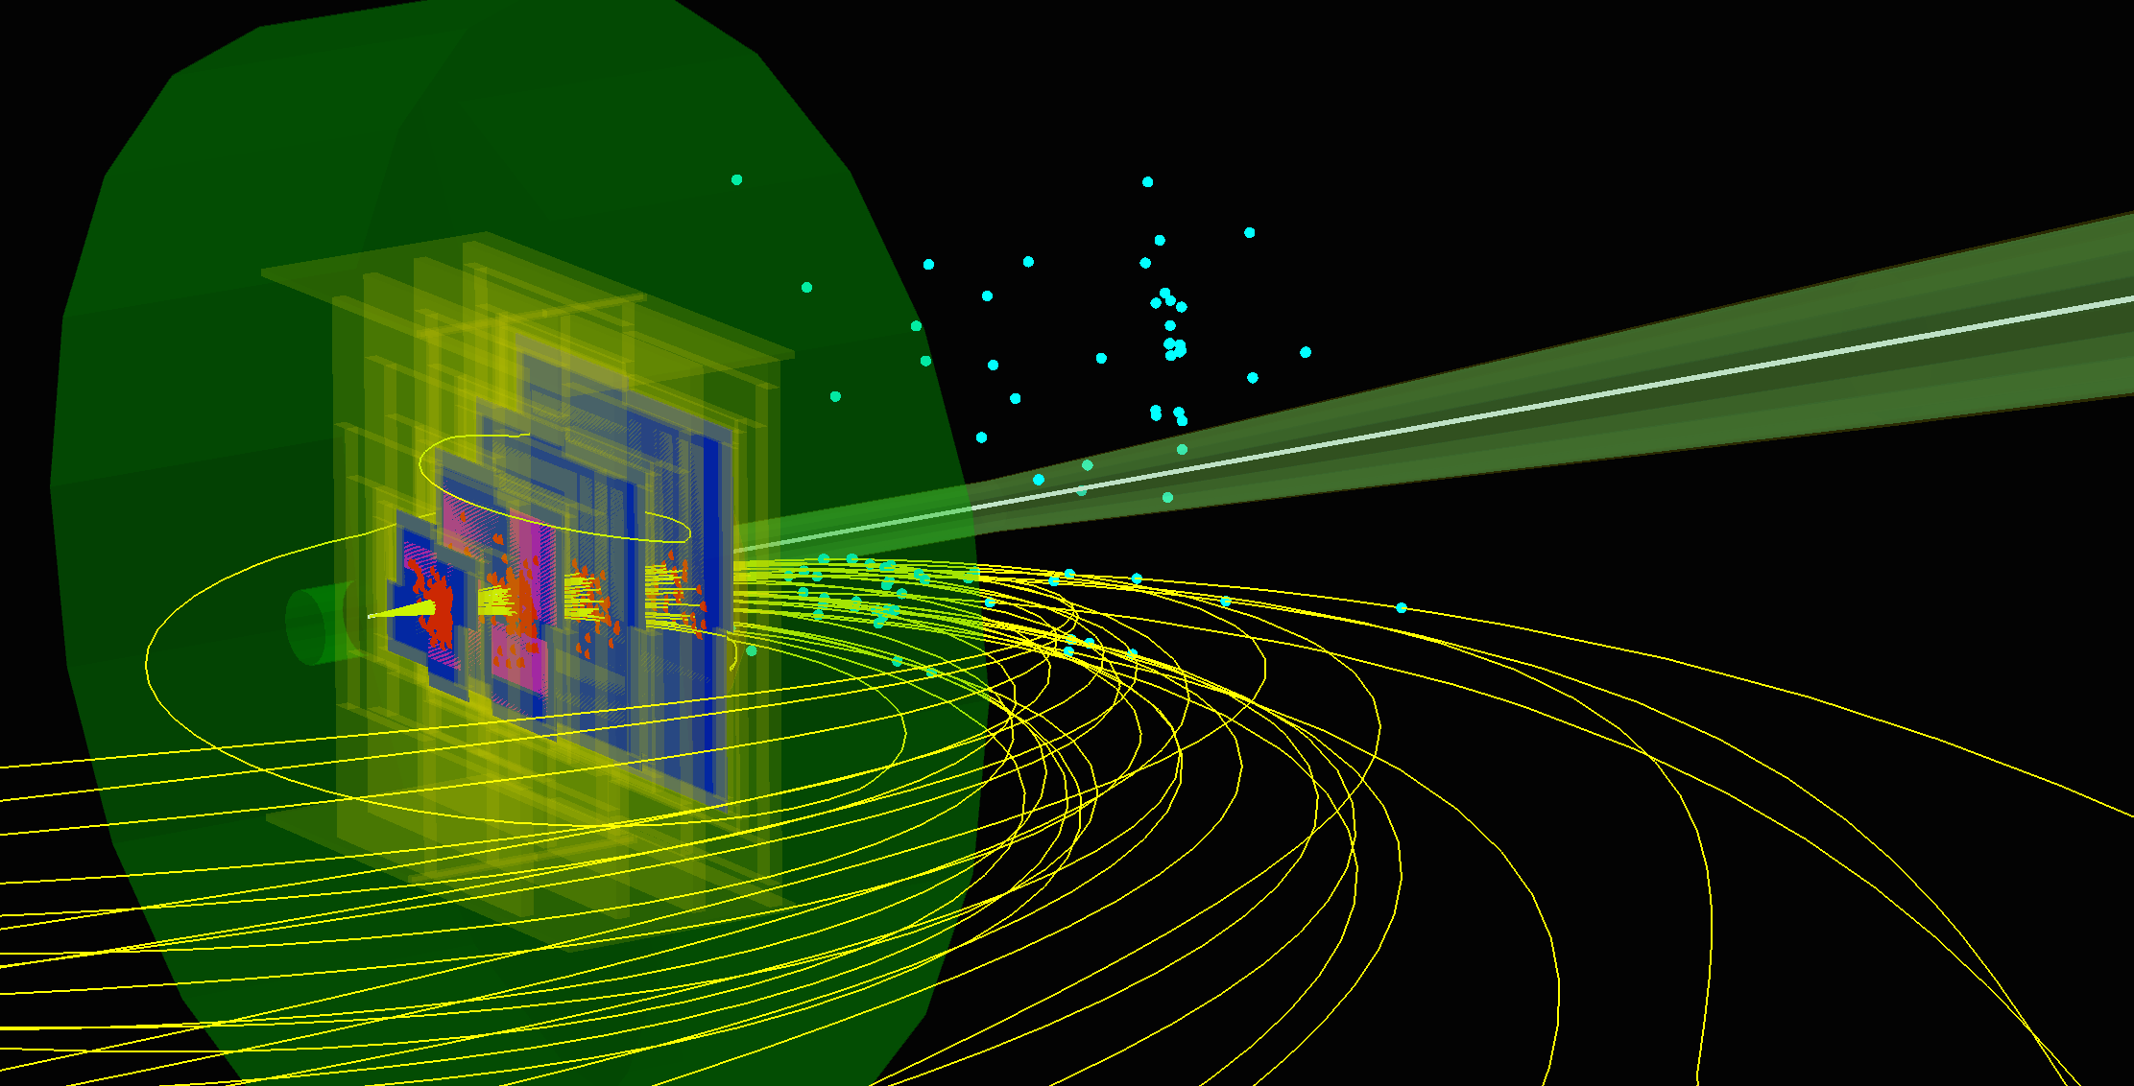
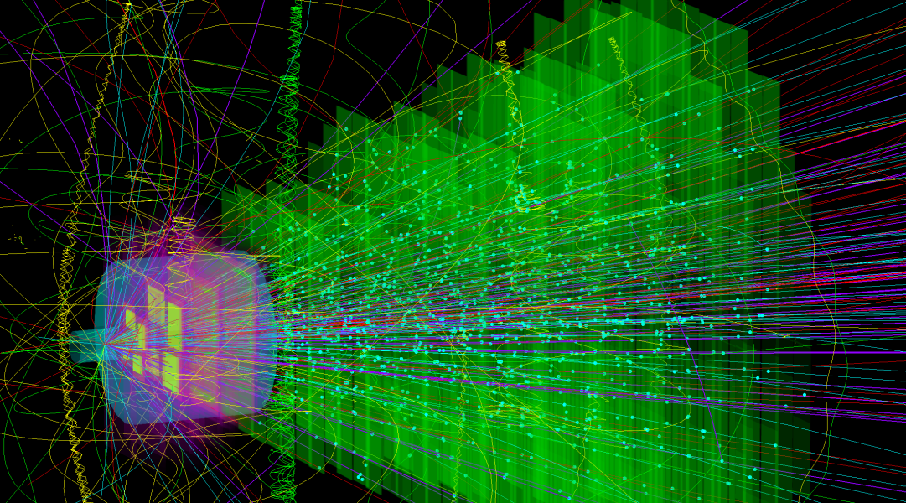
CBM performance at SIS-100: D-meson
analysis package for Ni+Ni @ 15 AGeV
10.7 GeV Au ion
P.Zarubin
IR: 0.1MHz = 300 Ni ions, p > 70 MeV, t = 30 μs
δ-electrons
Simulation 5M
Ni+Ni 15AGeV
central
Simulation 5M
D⁰ T = 150 MeV
E _{beam} = 15GeV
Simulation 1k
Ni+Ni 15AGeV
mbias
Reconstruction 5M events Global Tracking
central Ni+Ni @ 15 AGeV
123 π
53 p
6 K⁺
1.6 K⁻
4 Λ
7.5 K_{S}⁰
0.4 Ξ⁻
Simulation 1k
3ions Ni beam on 400μm Ni target
MVD
STS
_{EbE}
_{ME}
Analysis 5B
mixed event
Analysis 5M
event by event

Slide 21
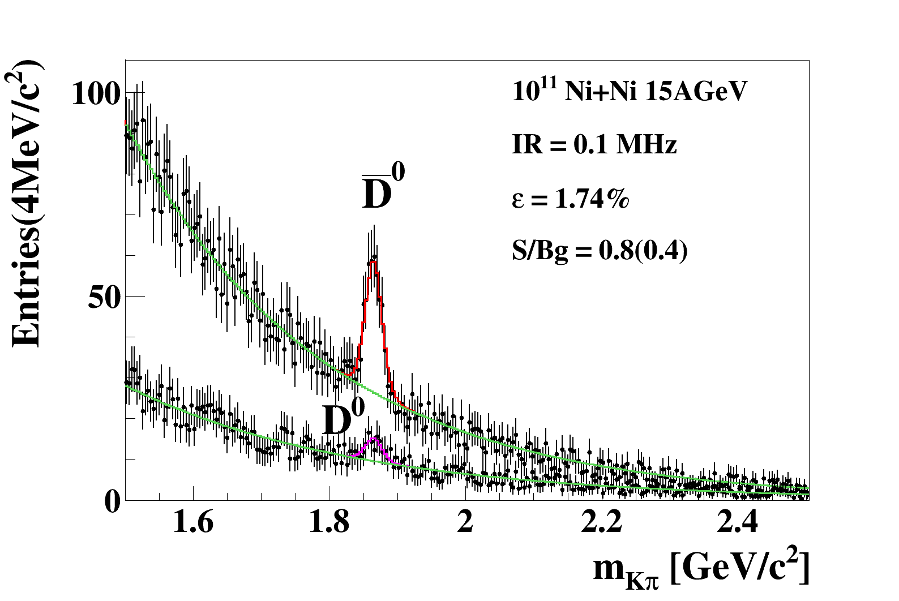
CBM performance at SIS-100: D-meson reconstruction
in Ni+Ni collisions at 15 AGeV
M: D⁰ 6.5 E⁻⁷ , D⁰ 3.8 E⁻⁶
Thermal (J. Cleymans) model by V.Vovchenko
BR: pdg 2015
In 10 weeks: 1620 D⁰ at 0.3MHz IR

Slide 22
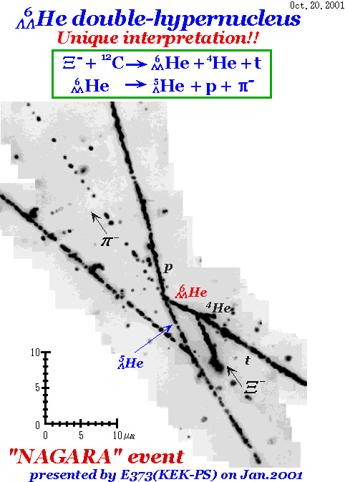
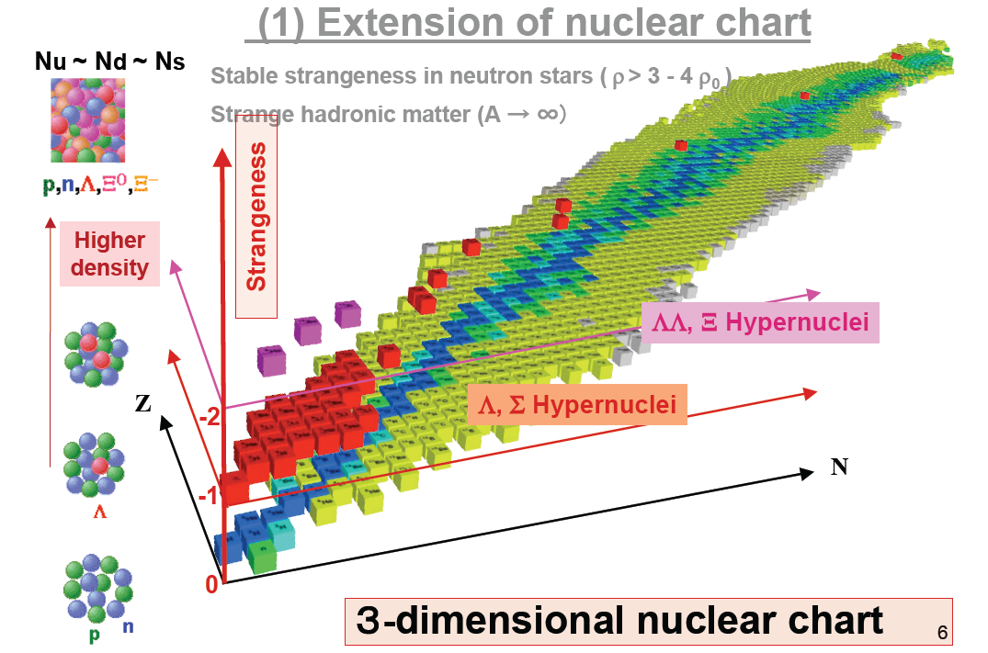
How far can we extend the chart of nuclei towards
the third (strange) dimension by producing single
and double hypernuclei?
Does strange matter exist
in the form of heavy multi-strange objects?
CBM
Au+Au
Ω
Hypernuclei @ CBM ?
-3
T. Bressani (2009)
new physics items:
search for H particle
neutron star composition
are there S=-2 deeply bound K(bar) states?
challenges:
(abundant) production of ΛΛ-hypernuclei is very difficult (CBM!)
identification of produced hypersystems is problematic (CBM!)
complicated topology is good for CBM

Slide 23
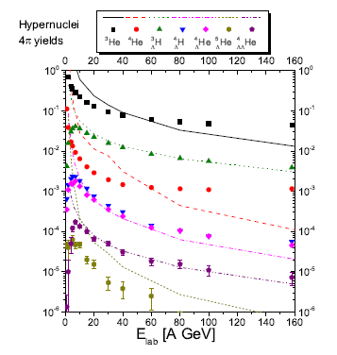
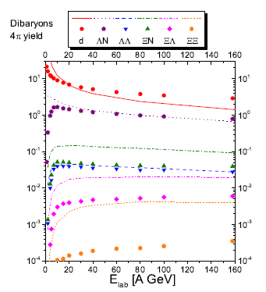
Hypernuclei, dibaryon and antinuclei production in high energy heavy ion
collisions: Thermal production vs. Coalescence
J. Steinheimer, K. Gudima, A. Botvina, I. Mishustin, M. Bleicher, H. Stöcker
Phys. Lett. B714, 85, (2012)
Lines: UrQMD + thermal hydrodynamics, symbols: DCM + coalescence

Slide 24
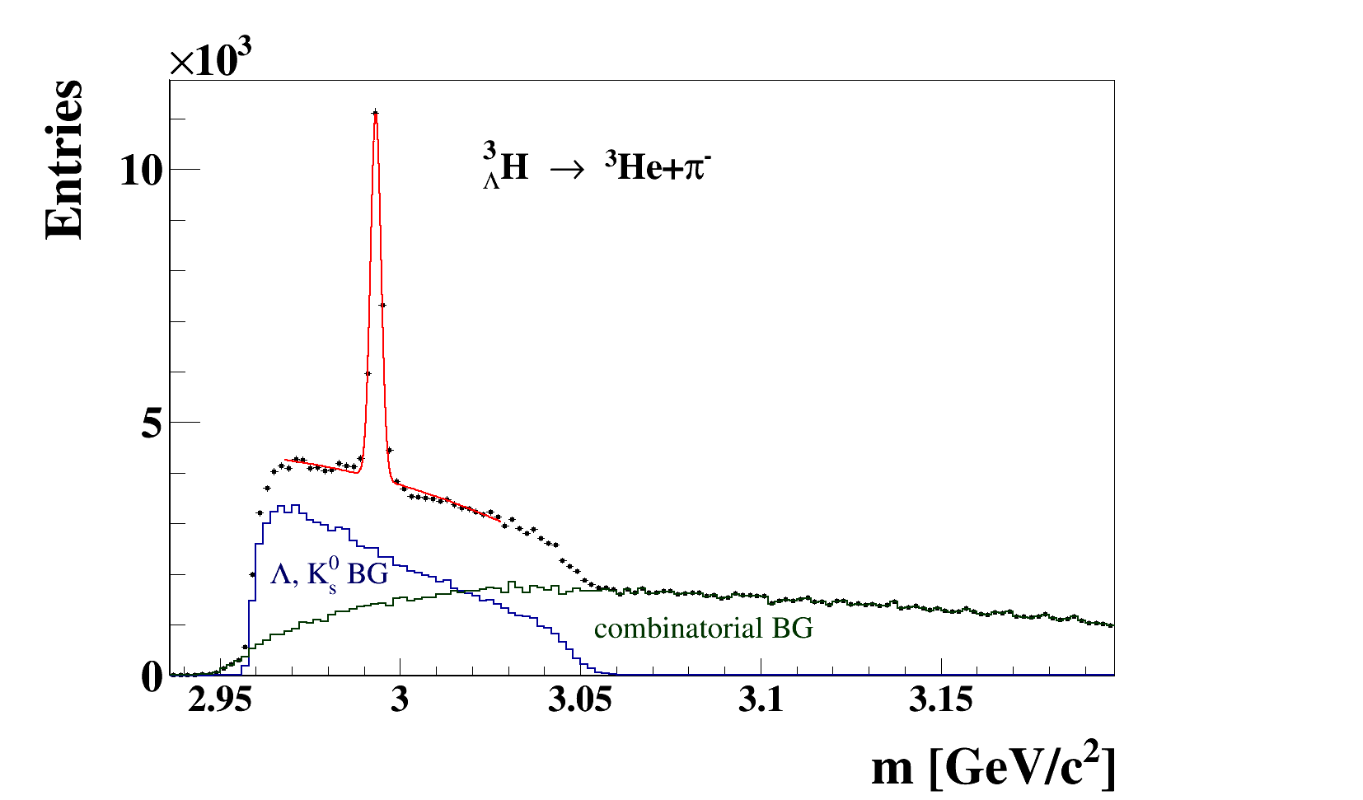


UrQMD
Au+Au 10 AGeV 5M central events
Extended KFParticle Finder ³_{Λ}H
5 seconds of data taking!
STAR 2010
eff = 19.2%
= 1.7 MeV
S/B ~ 1.5
BR from H. Kamada et al., Phys. Rev., Ser. C 57, 1595 (1998)
24

Slide 25





UrQMD
Au+Au 10 AGeV 5M central events
Extended KFParticle Finder ⁴_{Λ}He
Σ⁻ → nπ⁻
BG
Ξ⁻
K⁻
π⁻
Σ⁺ → nπ⁺
eff = 14.7%
= 1.6 MeV
S/B ~ 50
BR ~ 0.2
STS + MVD
BG
K⁺
π⁺
Σ⁺ → pπ⁰
π⁺
BG
K⁺
3 prong detached vertex is good signature of ⁴_{Λ}He decay
25

Slide 26


The CBM Collaboration: 60 institutions, 530 members
Croatia:
Split Univ.
China:
CCNU Wuhan
Tsinghua Univ.
USTC Hefei
CTGU Yichang
Czech Republic:
CAS, Rez
Techn. Univ.Prague
France:
IPHC Strasbourg
Hungary:
KFKI Budapest
Budapest Univ.
Germany:
Darmstadt TU
FAIR
Frankfurt Univ. IKF
Frankfurt Univ. FIAS Frankfurt Univ. ICS
GSI Darmstadt
Giessen Univ.
Heidelberg Univ. P.I.
Heidelberg Univ. ZITI
HZ Dresden-Rossendorf
KIT Karlsruhe
Münster Univ.
Tübingen Univ.
Wuppertal Univ.
ZIB Berlin
Russia:
IHEP Protvino
INR Troitzk
ITEP Moscow
Kurchatov Inst., Moscow
LHEP, JINR Dubna
LIT, JINR Dubna
MEPHI Moscow
Obninsk Univ.
PNPI Gatchina
SINP MSU, Moscow
St. Petersburg Polytech. Univ.
Ioffe Phys.-Tech. Inst. St. Pb.
Ukraine:
T. Shevchenko Univ. Kiev
Kiev Inst. Nucl. Research
India:
Aligarh Muslim Univ.
Bose Inst. Kolkata
Panjab Univ.
Rajasthan Univ.
Univ. of Jammu
Univ. of Kashmir
Univ. of Calcutta
B.H. Univ. Varanasi
VECC Kolkata
IOP Bhubaneswar
IIT Kharagpur
IIT Indore
Gauhati Univ.
Korea:
Pusan Nat. Univ.
Poland:
AGH Krakow
Jag. Univ. Krakow
Silesia Univ. Katowice
Warsaw Univ.
Warsaw TU
Romania:
NIPNE Bucharest
Univ. Bucharest
26th CBM Collaboration meeting in Prague, CZ
14 -18 Sept. 2015

Slide 27
Summary:
CBM detector is an excellent device for high statistic measurement of strange and multi-strange hyperons with huge discovery potential of hypernuclei and hypothetic heavy multi-strange objects, a tool to measure open charm at threshold beam energies.
CBM detector will cower the high net-baryon density and moderate temperatures region of the QCD phase diagram.

Slide 29


Slide 30
Electrons in CBM at SIS100
Measurement parallel to hadrons:
Au+Au at 4 energies (4, 6, 8, 10 A GeV) at 100 kHz
central Au+Au at 8 A GeV
8 A GeV:
2×10⁶ ω in 2 weeks
(100k events)
Simulation:
Signal yields from HSD
Background from UrQMD

Slide 31


Muons in CBM at SIS100
Running scenario:
Au+Au at 4 energies (4, 6, 8, 10 A GeV) up to 1 MHz
Simulation: Signal yields from HSD, Background from UrQMD
central Au+Au at 4 A GeV
central Au+Au at 8 A GeV
2×10⁵ ω in 2 weeks
(approx. NA60 statistics)
2×10⁶ ω in 2 weeks
ω
ω
η
φ
η
ρ
ρ
φ

Slide 32
Expected particle yields Au+Au @ 10 AGeV
Particle (mass MeV/c²) | Multi- plicity 6 AGeV | Multi- plicity 10 AGeV | decay mode | BR | ε (%) | yield (s⁻¹) 6AGeV | yield (s⁻¹) 10AGeV | yield in 10 weeks 6AGeV | yield in 10 weeks 10 AGeV | IR MHz
Λ (1115) | 4.6·10⁻⁴ | 0.034 | pπ⁺ | 0.64 | 11 | 1.1 | 81.3 | 6.6·10⁶ | 2.2·10⁸ | 10
Ξ⁻ (1321) | 0.054 | 0.222 | Λπ⁻ | 1 | 6 | 3.2·10³ | 1.3·10⁴ | 1.9·10¹⁰ | 7.8·10¹⁰ | 10
Ξ⁺ (1321) | 3.0·10⁻⁵ | 5.4·10⁻⁴ | Λπ⁺ | 1 | 3.3 | 9.9·10⁻¹ | 17.8 | 5.9·10⁶ | 1.1·10⁸ | 10
Ω⁻ (1672) | 5.8·10⁻⁴ | 5.6·10⁻³ | ΛK⁻ | 0.68 | 5 | 17 | 164 | 1.0·10⁸ | 9.6·10⁸ | 10
Ω⁺ (1672) | - | 7·10⁻⁵ | ΛK⁺ | 0.68 | 3 | - | 0.86 | 0 | 5.2·10⁶ | 10
³ _{Λ}H (2993) | 4.2·10⁻² | 3.8·10⁻² | ³Heπ⁻ | 0.25 | 19.2 | 2·10³ | 1.8·10³ | 1.2·10¹⁰ | 1.1·10¹⁰ | 10
⁴_{Λ}He (3930) | 2.4·10⁻³ | 1.9·10⁻³ | ³Hepπ⁻ | 0.32 | 14.7 | 110 | 87 | 6.6·10⁸ | 5.2·10⁸ | 10

Slide 33

SIS-100 Ni+Ni @ 15 AGeV D⁰ embedded, QA-plots:
z < 5mm cut
χ²_{topo}
σ_{z} ~ 40μm
STS D⁰ reconstruction efficiency: ε =18.5 %
ε ^{D0} ToF Embedded δ 100 kHz 3 mbias pile up = 1.74 %

Slide 34

UrQMD
Au+Au 10 AGeV 5M central events
Extended KFParticle Finder (Λ,N)_{bound}
5 seconds of data taking!
eff = 28.9%
= 1.6 MeV
BR ~ 0.2
UrQMD output do not contain deuterons
~ 5.6 d/event expected (no secondary d’s)!
34

Slide 35
Functionality of KF Particle
Functions | CBM | ALICE | PANDA | STAR
Construction of mother particles | + | + | + | +
Addition and subtraction of the daughter particle to (from) the mother particle | + | + | + | +
+= and -= operators | + | + | + | +
Accessors to the physical parameters (mass, momentum, decay length, lifetime, rapidity, etc) | + | + | + | +
Transport: to an arbitrary point, to the decay and production points, to another particle, to a vertex, on the certain distance | + | + | + | +
Calculation of a distance: to a point, to a particle, to a vertex | + | + | + | +
Calculation of a deviation: from a point, from a particle, from a vertex | + | + | + | +
Calculation of the angle between particles | + | + | + | +
Constraints: on mass, on a production point, on a decay length | + | + | + | +
KF Particle Finder | + | + | + | +
Exactly the same package in all four experiments: CBM, ALICE, PANDA and STAR
Allows to reconstruct open charm decays

Slide 36
Expected statistics for open charm mesons in
Ni+Ni collisions at 15AGeV (SIS-100)
 | D⁰+D⁰ | D⁺+D⁻ | D_{s}⁺ | Λ_{c}⁺
decay channel | K⁻π⁺ | K⁻π⁺ π⁺ | K⁻K⁺ π⁺ | p K⁻π⁺
M_{SM (J.Cleymans)} | 4.5·10⁻⁶ | 2.2·10⁻⁶ | 1.1·10⁻⁶ | 3.6·10⁻⁶
BR(%) | 3.8 | 9.5 | 5.3 | 5.0
geo. acc.(%) | 30 | 40 | 33 | 70
z-resolution (μm) | 40 | 48 | 50 | 60
total eff. (%) | 1.8 | 2.3 | 0.5 | 0.05
σ_{m} (MeV/c²) | 12 | ~12 | ~12 | ~12
S/B_{2σ} | 0.8/0.4 | - | - | -
Yield/10 weeks, 0.3 MHz IR | 1620 | 2620 | 160 | 50
Notes:
36

Slide 37



SIS-300 Open charm (Au+Au @ 25 AGeV) 0.1 MHz z-vertex reconstruction
0.1 MHz

Slide 38


CBM physics program III (P.Senger)
Motivation:
No data at FAIR energies
Strange matter
Hypernuclei, strange dibaryons and massive strange objects
Production of hypernuclei via coalescence
of hyperons and light nuclei
A. Andronic et al., Phys. Lett. B697 (2011) 203
H. Stöcker et al., Nucl. Phys. A 827 (2009) 624c

