Slide 1
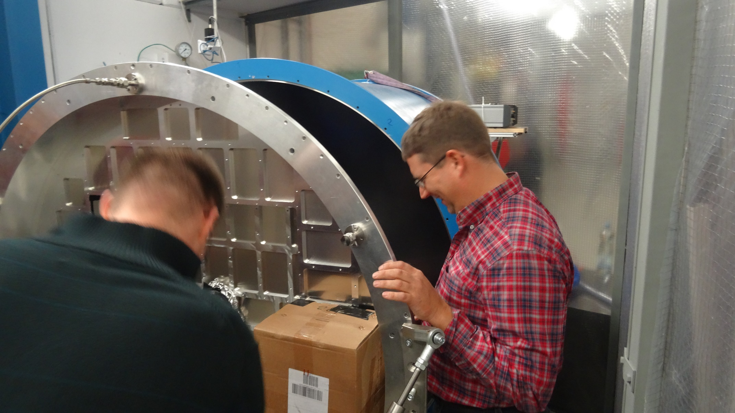
Readout 21.09.16

Slide 2
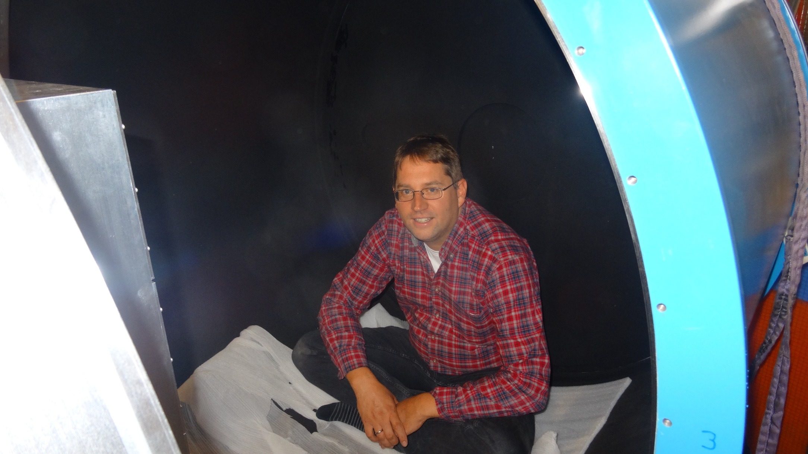
Readout 21.09.16
Checking for photon leaks

Slide 3
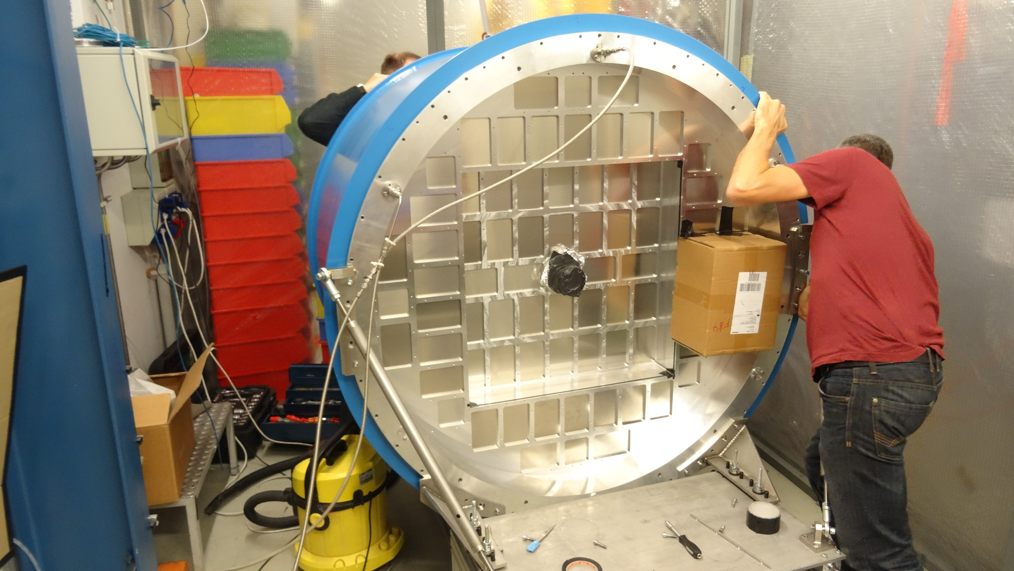
Readout 21.09.16

Slide 4
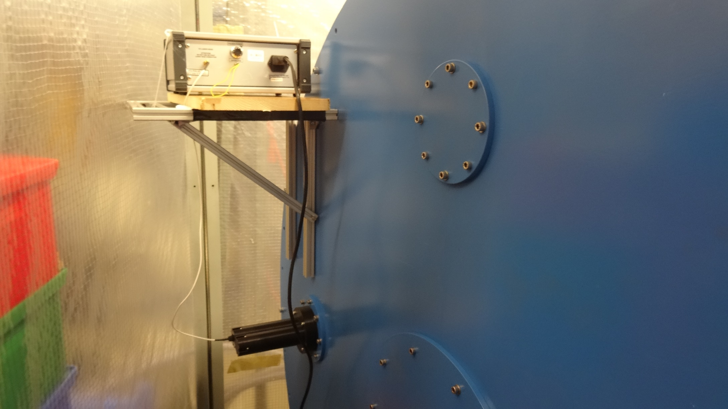
Readout 21.09.16
Light source at rear flange

Slide 5
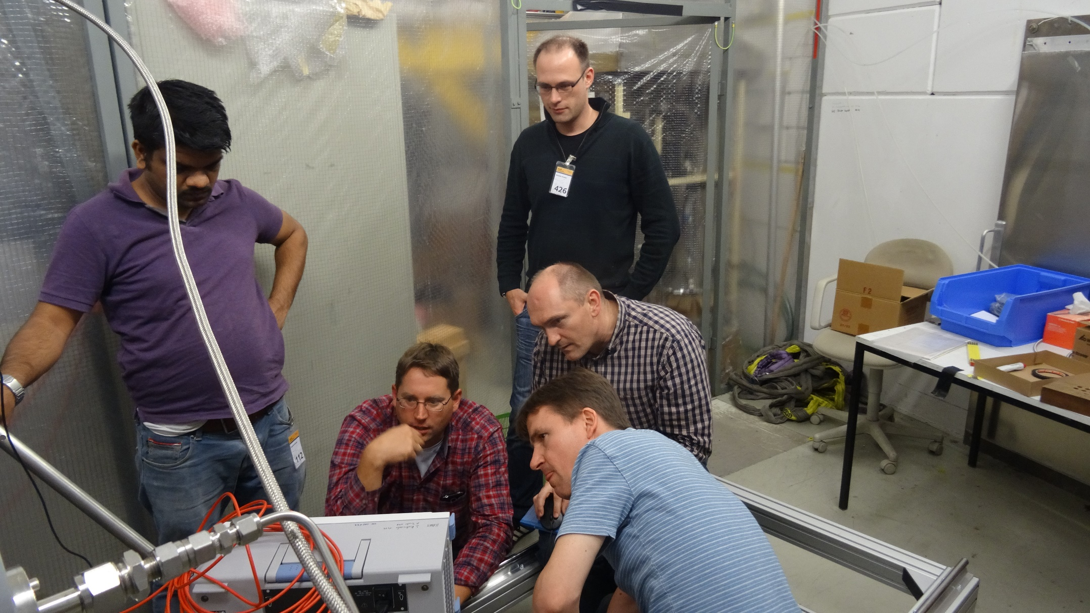
Readout 21.09.16
1 scope + 5 experts

Slide 6
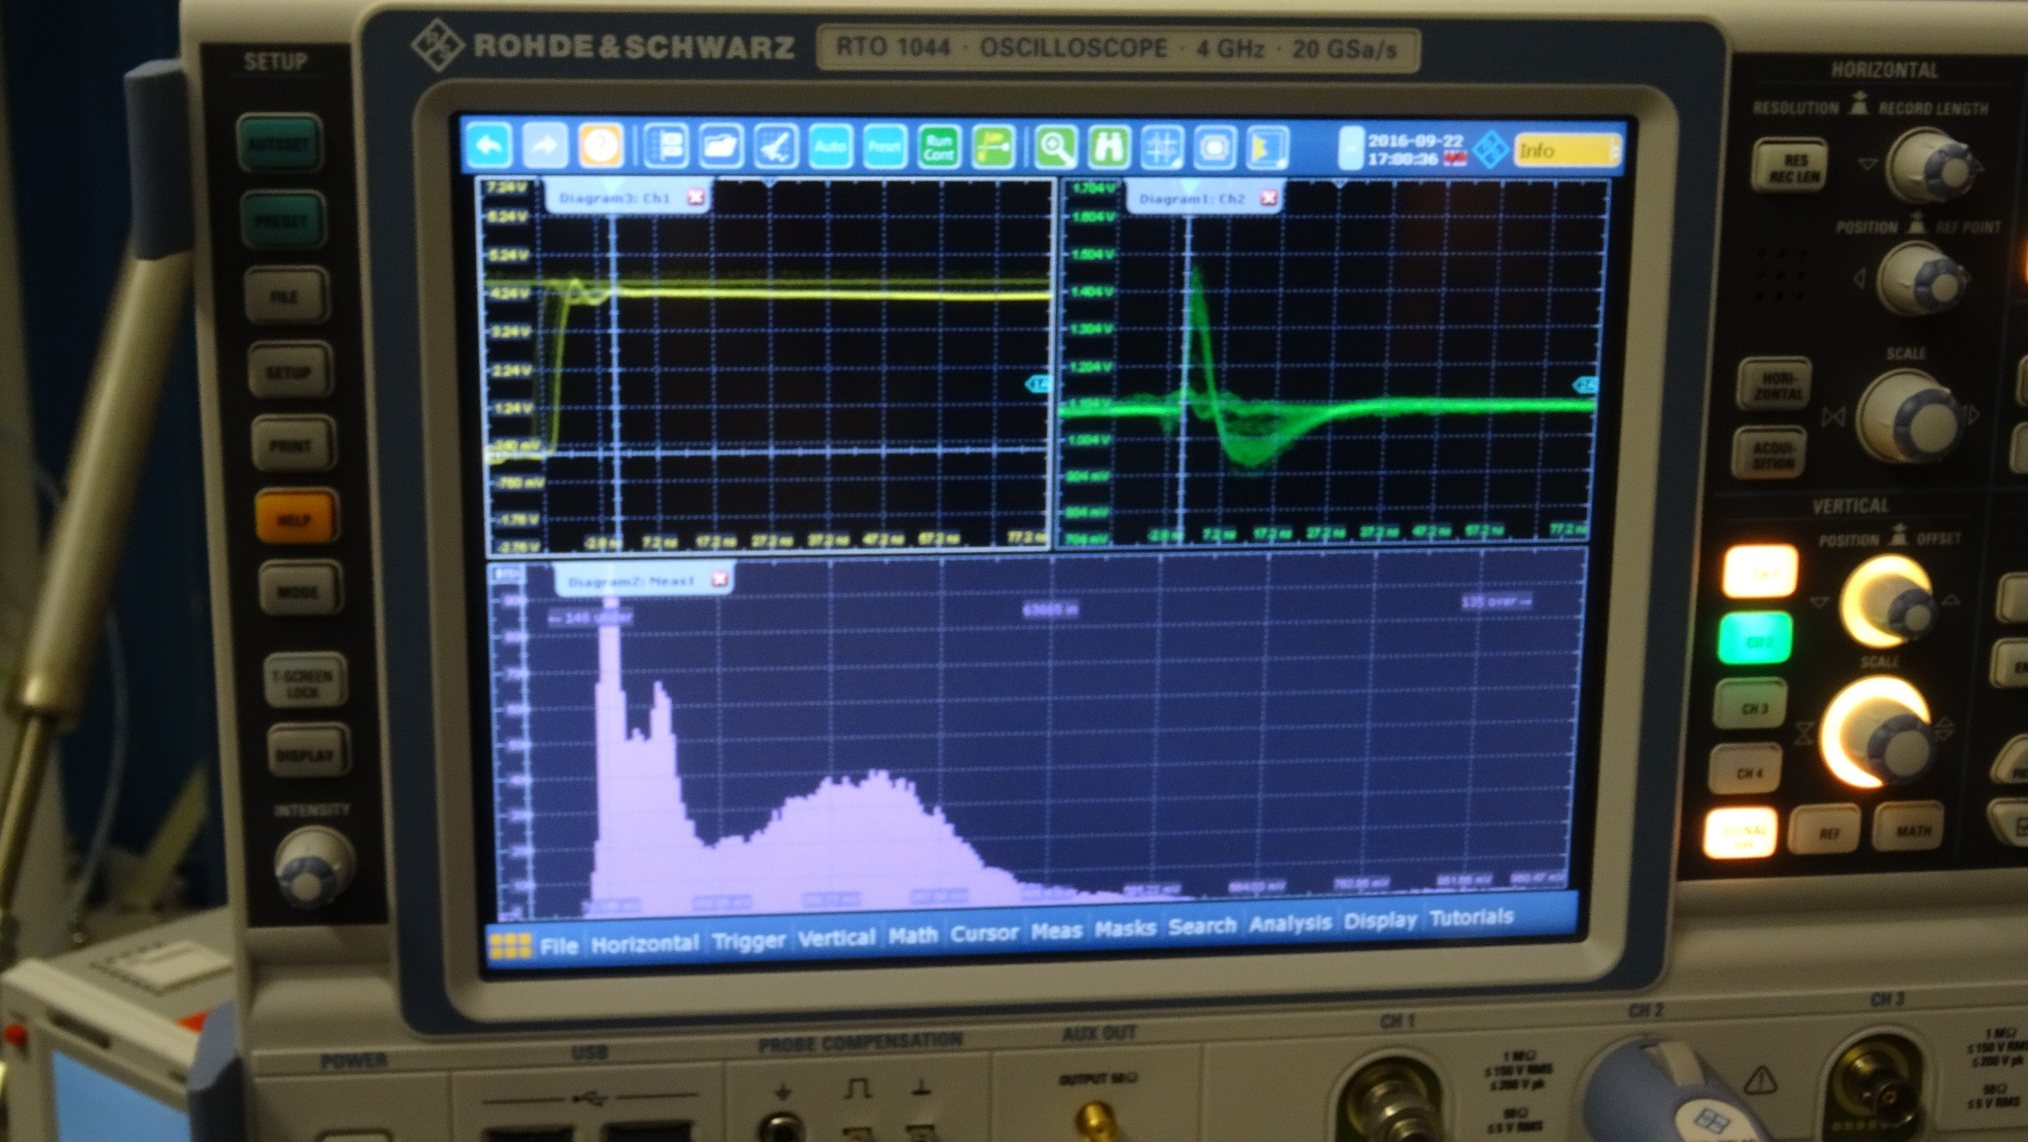
Readout 21.09.16
First photon signals

Slide 7
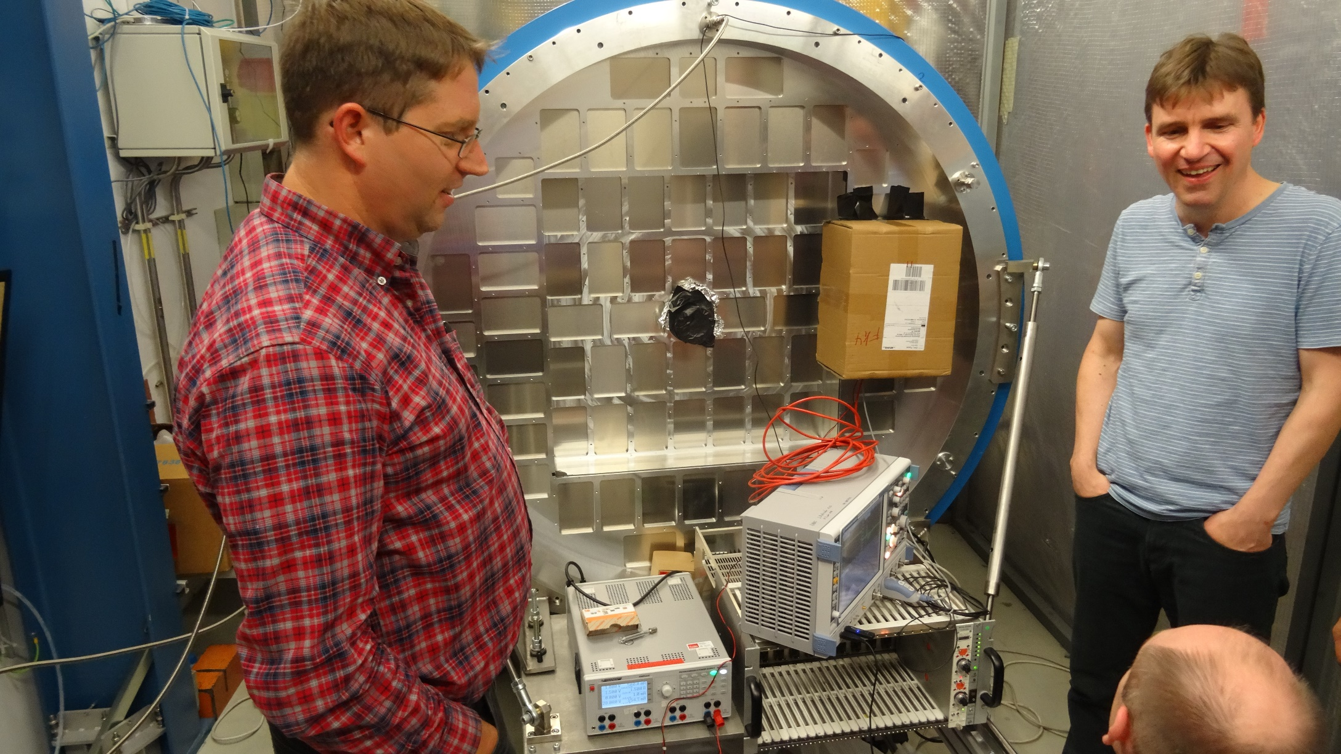
Readout 21.09.16
w/o words

Slide 8
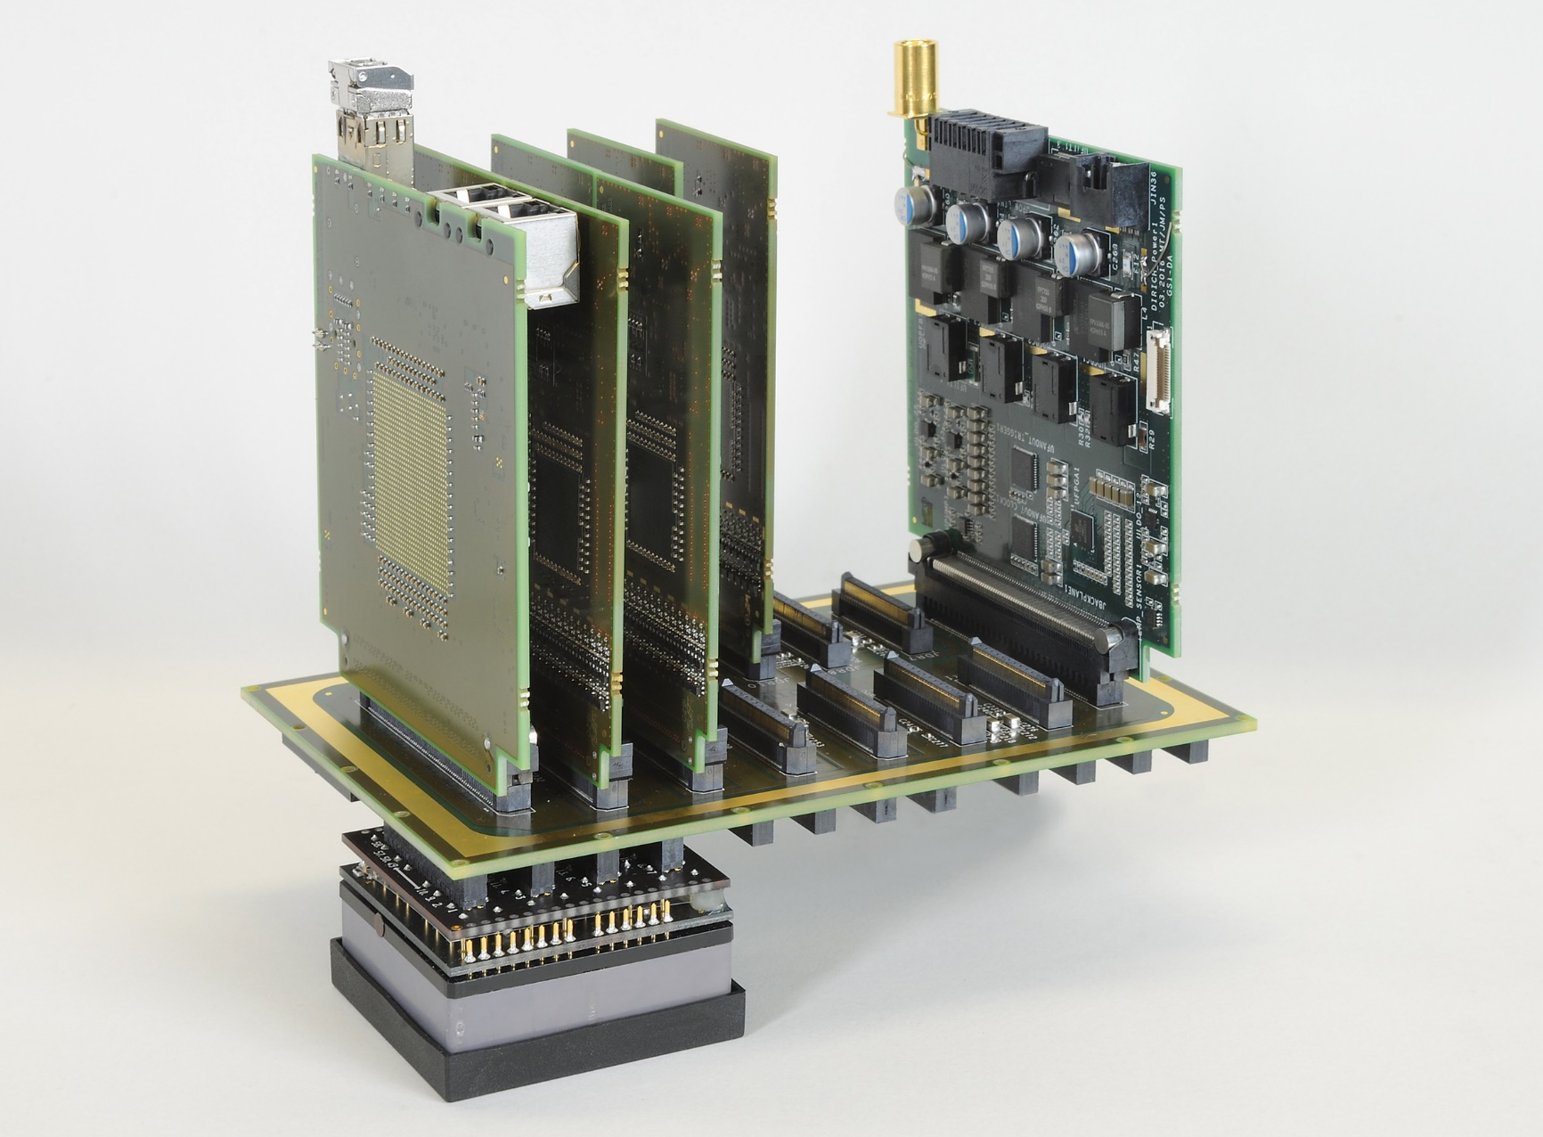
Readout 21.09.16
Side view
DiRICH
HV & LV
supply
Concentrator
Backplane
MAPMT

Slide 9
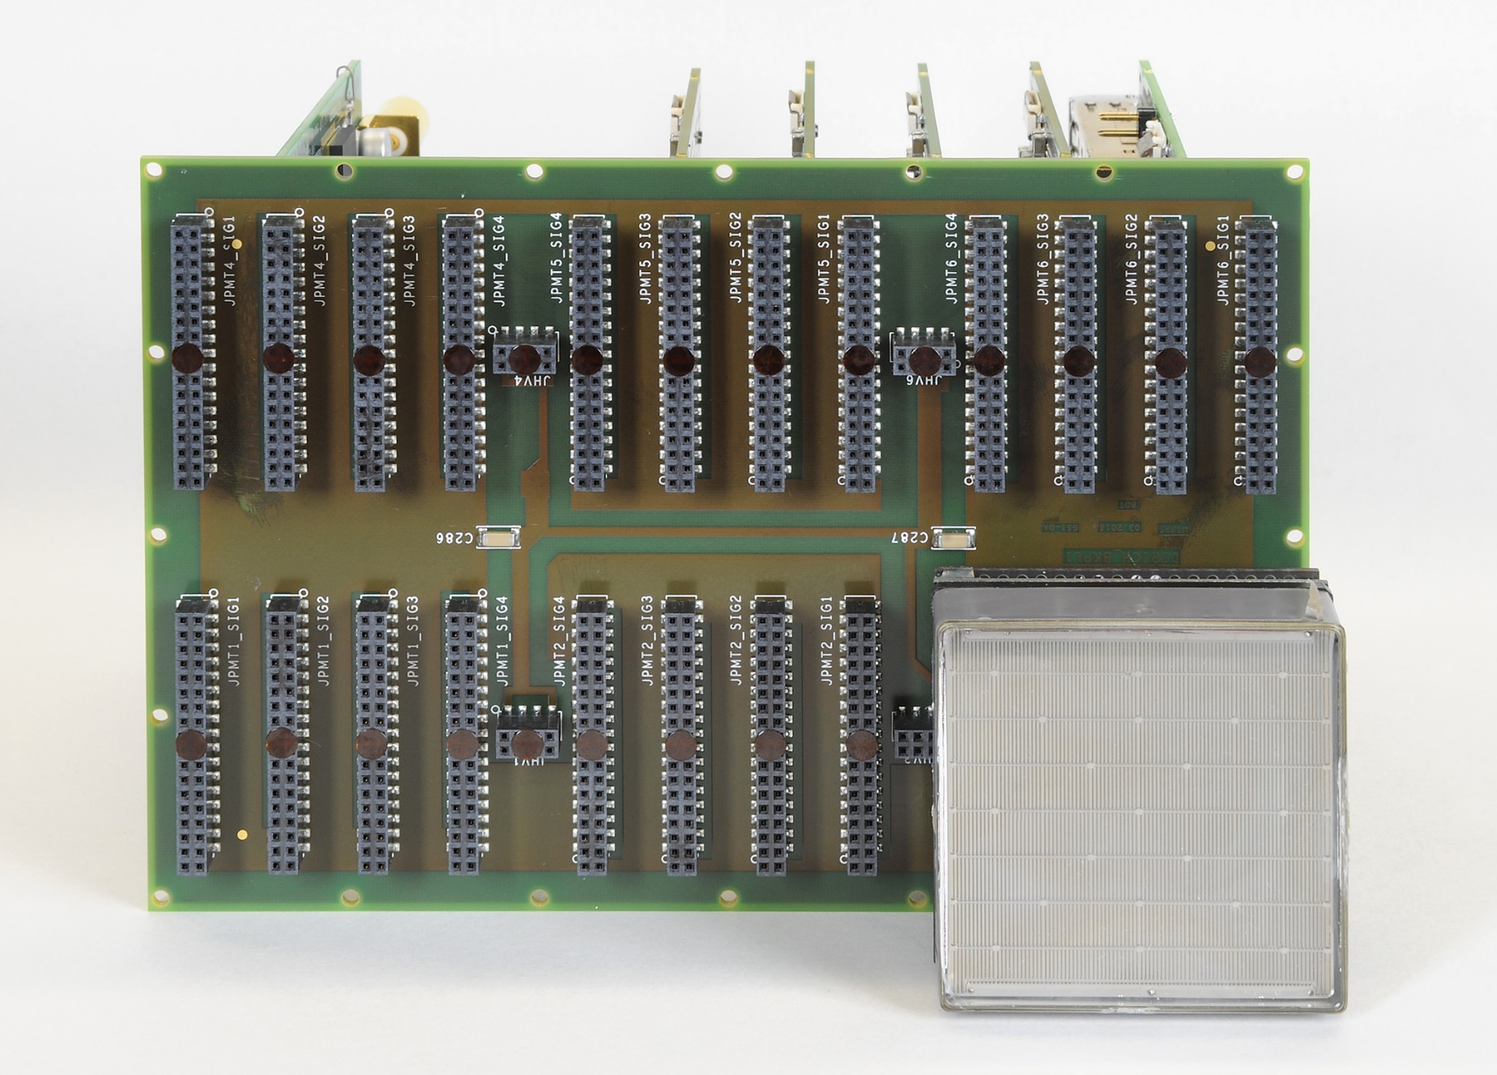
Readout 21.09.16
Front (MAPMT) side view
HV & LV
supply
DiRICH
Concentrator
MAPMT
Backplane

