Slide 1
ELI–NP: New Frontiers in Nuclear Physics with High Power lasers and Brilliant Gamma Beams
Sydney Gales for the ELI-NP team
Nuclear Physics Long Range Plan 2017 town meeting -Darmstadt Jan 11-13

Slide 2
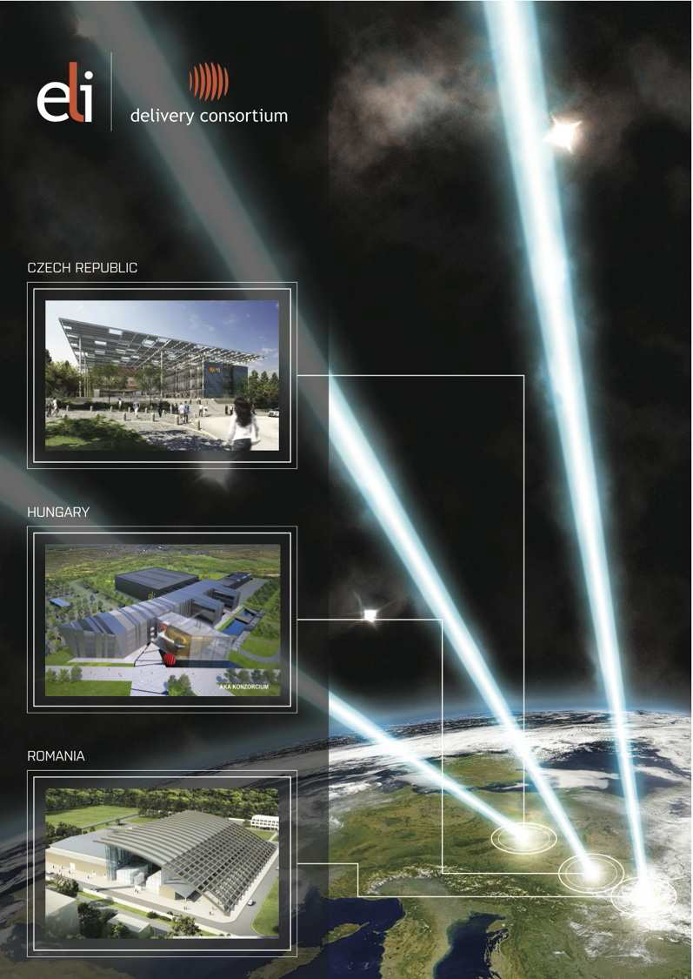
What is ELI?
Extreme Light Infrastructure
  ELI will be
  The world’s first international laser
  research infrastructure, providing
  unique science and research opportunities
  for international users
  A distributed research infrastructure
  based initially on 3 facilities in CZ, HU and RO
  The first ESFRI project to be implemented
  in the new EU Member States EU13
  Pioneering a novel funding model:
  combining structural funds (ERDF)
  for the implementation and member contributions
  to an ERIC for the operation
Sydney Gales ELI-NP Nuclear Physics Long Range Plan 2017-Darmstadt Jan 11-13

Slide 3
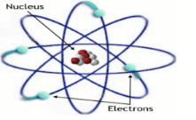
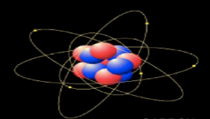
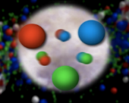

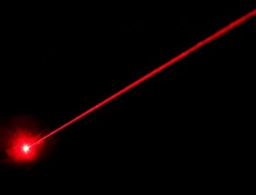
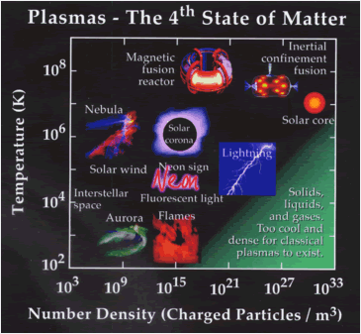
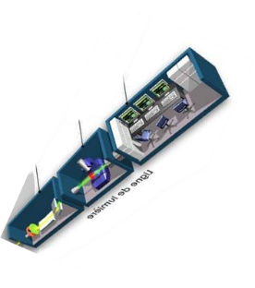
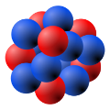
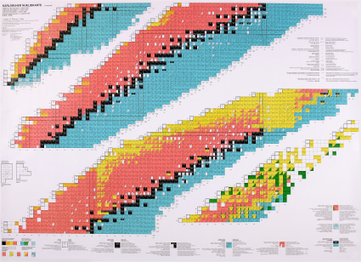


ELI-NP
Explore matter and its constituents : from atom to vacuum with new powerful probes at the frontiers of existing technologies
High Power lasers and High energy and brilliant gamma beams
1) Ultra-short High power laser pulse(25fs) 2 X1O PW, 1/mn
Femto -scale
Laser
Collisions (GeV)electron-(eV) laser ph
3
2) GAMMA beams high flux , monochromatic, Γ ~qqs10^{–3} , E= 0.2-19 MeV
Sydney Gales ELI-NP Nuclear Physics Long Range Plan 2017-Darmstadt Jan 11-13

Slide 4
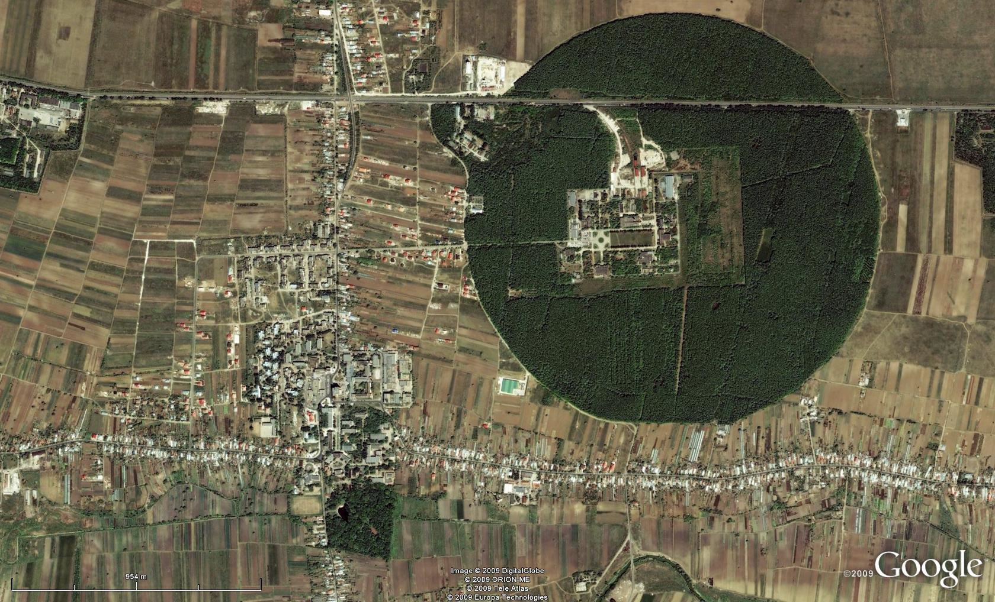
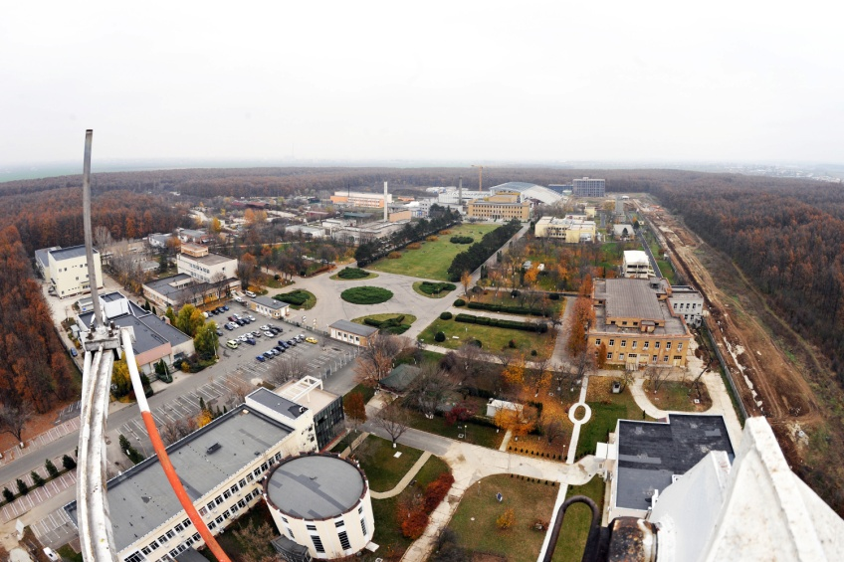
Bucharest-Magurele
National Physics Institutes
Structural Funds approved in Sept. 2012
Start construction June 2013
Projected completion date: mid-2019
Full facility operation +1-2 years
Full budget approved in Dec 2015 by EU 310 M€
Staff hiring in progress 2013- 15 members
To day about 140 ---- towards 240 in 2018
Management 6+ Support Staff 28(legal, finance, HR)
R&D (research,Eng,Tech) 104 ,e,g. Senior junior, postdocs, PhD, Engineers and Physicists, Technicians
Romania 65%, EU 15%, Asia,15%, USA,Can, others 5%
NUCLEAR
Tandem acc. Cyclotrons
γ – Irradiator
Adv. Detectors
Biophysics
Environmental Phys.
Radioisotopes
BUCHAREST
ring rail/road
ELI-NP
ELI-NP
Lasers
Plasma
Optoelectronics
Material Physics
Theoretical Physics
Particle Physics
Sydney Gales ELI-NP Nuclear Physics Long Range Plan 2017-Darmstadt Jan 11-13

Slide 5
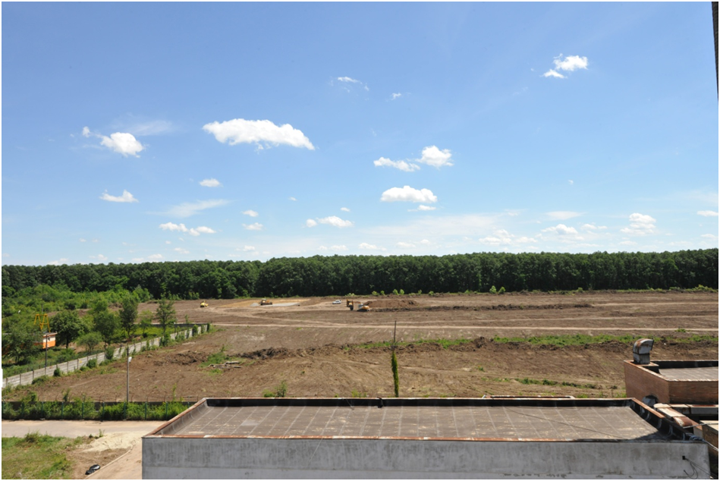
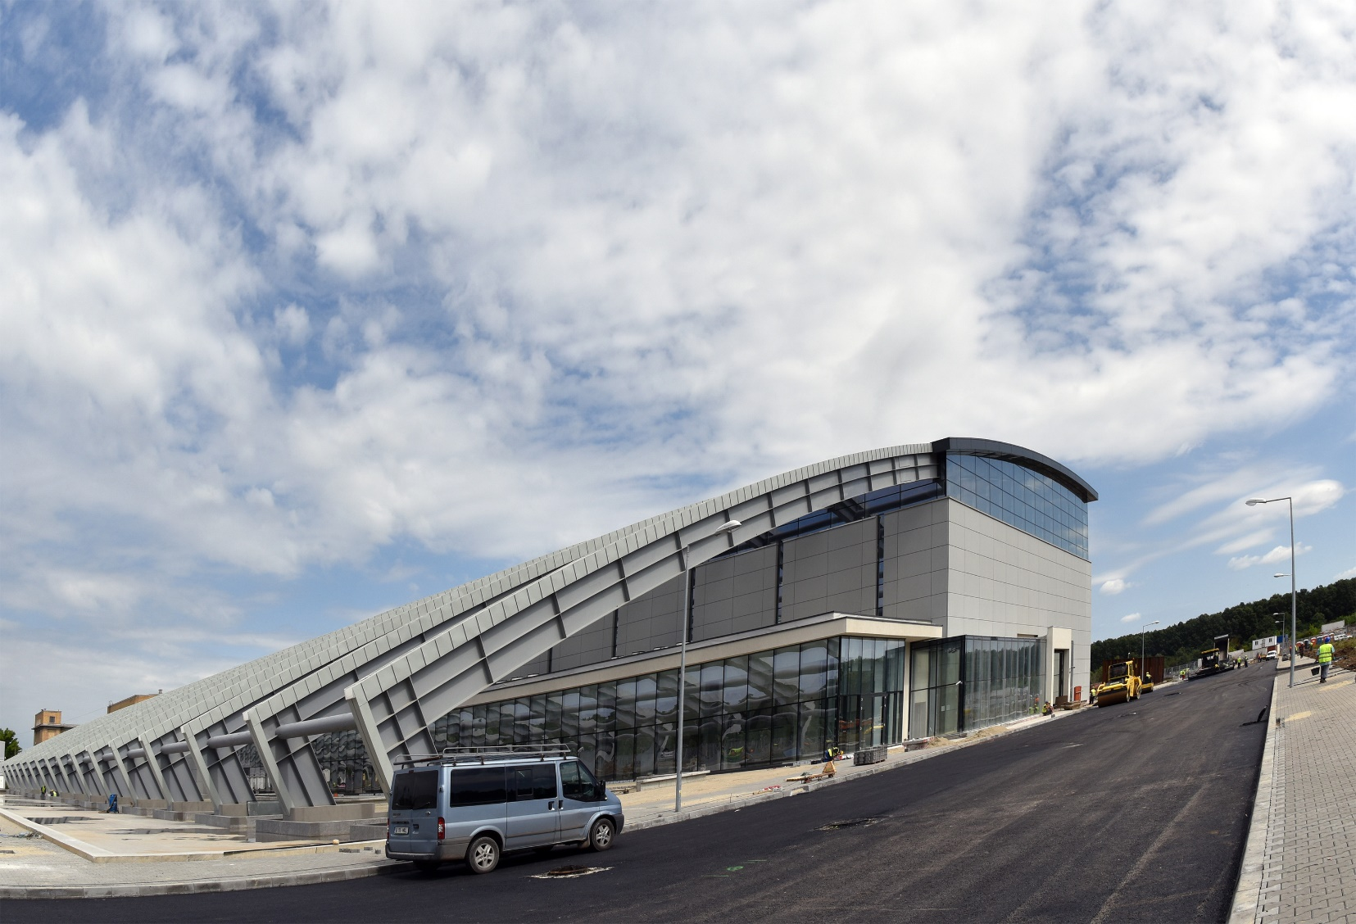
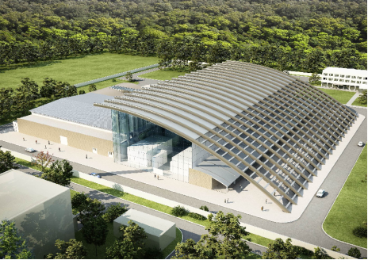
ELI-NP: Civil engineering completed
Buildings, 33000 m² total
Building Lasers ,Linac and experiment halls
Restaurant-Cafeteria
Guest house
Physics building offices, meeting rooms ,…
Experiences – 7000 m²
8 expts halls for gamma, laser, and combined
gamma + laser research activities
Architect project
May 28, 2013
July 2016
Sydney Gales ELI-NP Nuclear Physics Long Range Plan 2017-Darmstadt Jan 11-13

Slide 6
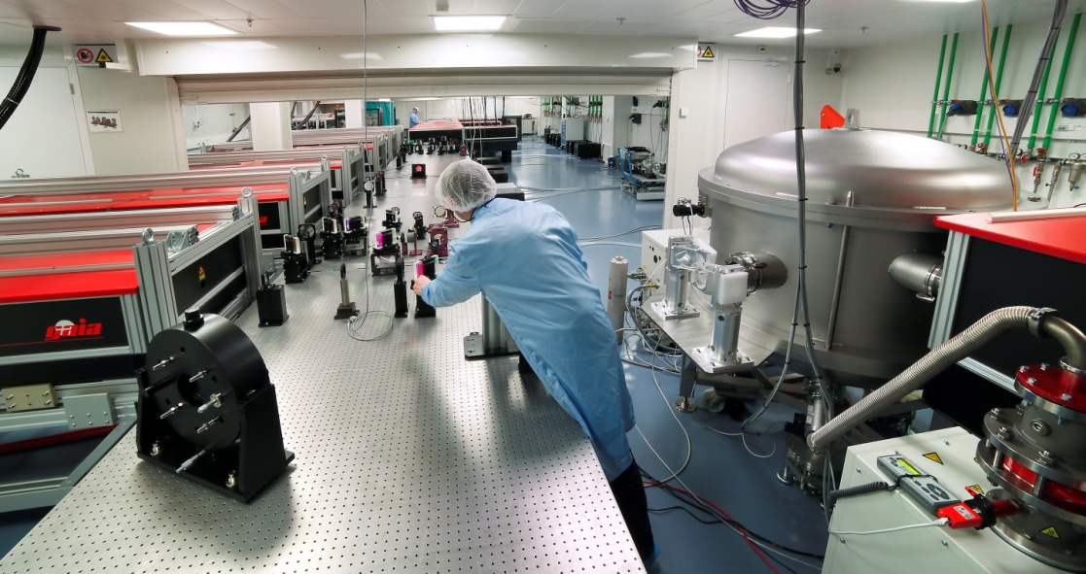
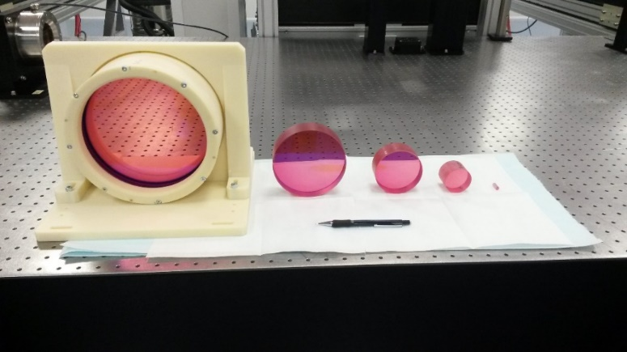
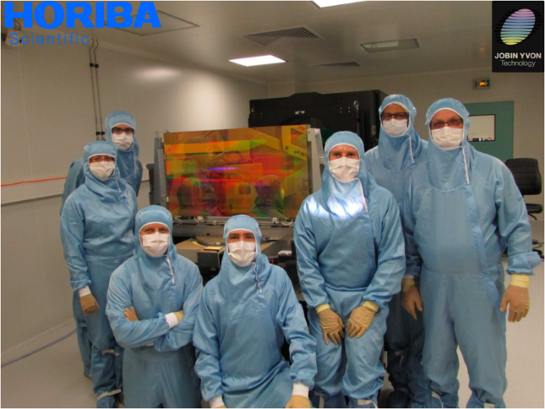
High Power Laser System
Each component has been tested on time at Thales
HPLS First arm 1,37PW ,21fs, 1Hz achieved Nov 2015
Towards 10 PW
Couple of technical issues
have been solved
First large diffractive grating for 10PW compressor produced (new!)
20cm useful aperture Ti:Sa crystal available (world record)

Slide 7
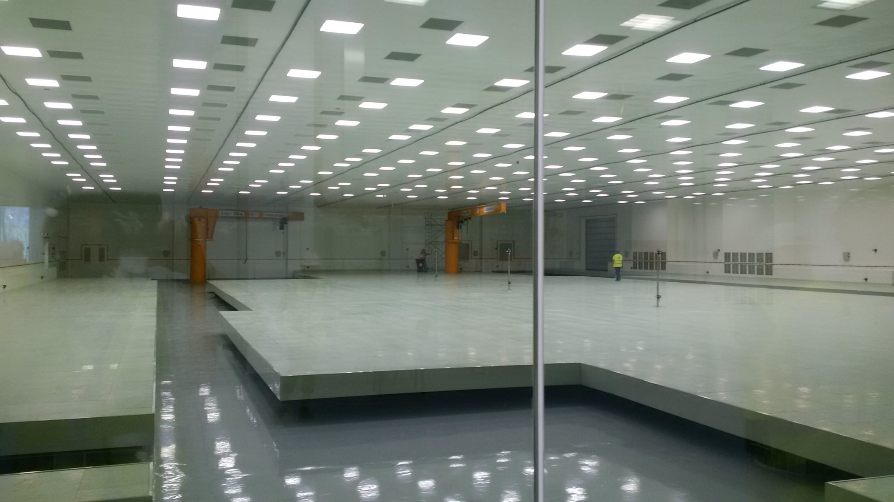
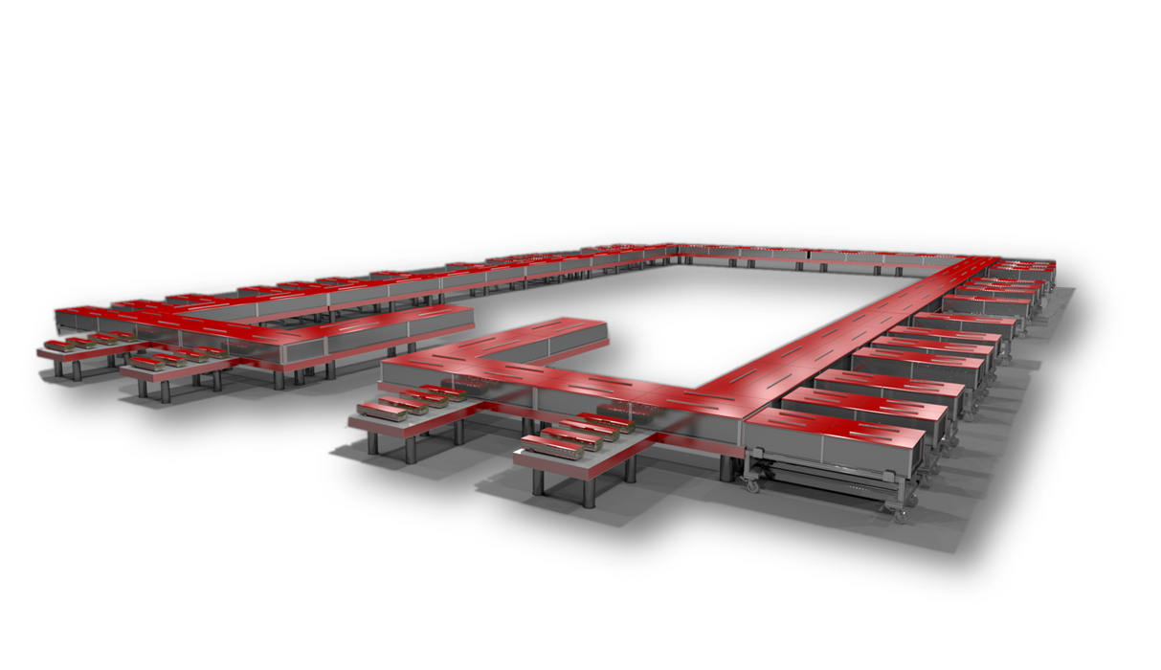
Highest Intensity Laser System
Large Clean Room Ready
Thales started the implementation last month.
2 x 0.1 PW 10Hz
2 x 1 PW 1 Hz
2 x 10 PW 0.1 Hz
Hybrid double CPA configuration
  CPA 1 for beam stability
  XPW for contrast and spectrum enhancement
  OPCPA for contrast enhancement
  New high energy pump laser
  CPA 2 for energy and energy stability
Sydney Gales ELI-NP Nuclear Physics Long Range Plan 2017-Darmstadt Jan 1 1-13
Notes:
Here you can see a very large clean room in our ELI-NP building. The laser system can deliver 200J of light energy within 20 times 10 to the minus 15th seconds, namely 20 femtosecond. In order to push this energy within this very short time, the intensity of the laser light can reach 10 times 10 to the 15th watt namely petawatt peak intensity. If we focus this laser light into a few micron spot by using focusing mirror, the laser intensity per square cm can reach 10 the 23 Watt per square cm.
We will start this laser implementation this Dec.

Slide 8
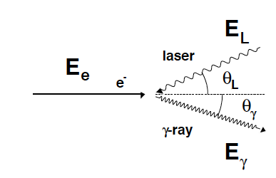
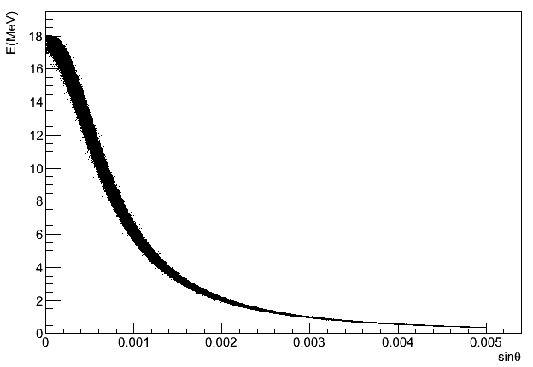
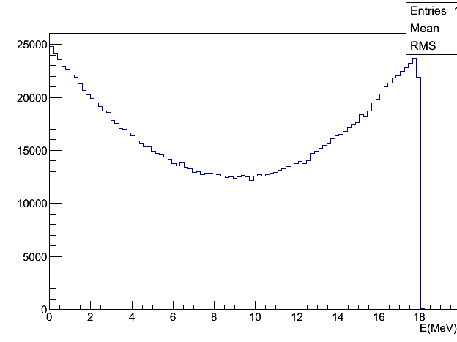
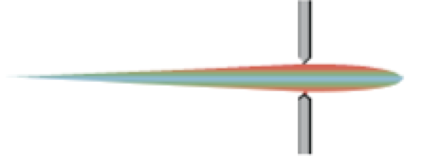
Gamma Beam System – Basic Concepts
Gamma–rays from Inverse Compton Scattering
eV
photon scattering on ultra relativistic electrons (γ ≫ 1)
”Photon accelerator”
GeV
Strong forward focusing
Angular dependence of the photon energy
Compton
edge
γ = 10³ → Δθ ~ 1 mrad
dN/dE
… but low cross section ~ 10^{–25} cm²
Sydney Gales ELI-NP Nuclear Physics Long Range Plan 2017-Darmstadt Jan 1 1-13

Slide 9
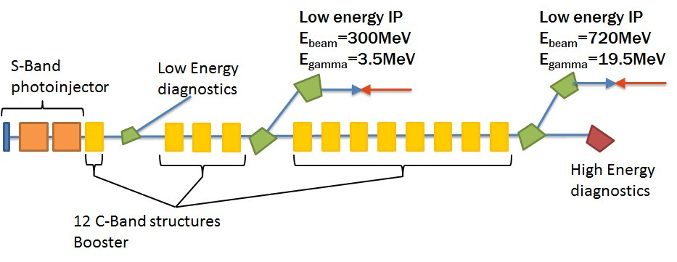
ELI–NP Gamma Beam System
Goal : building of the most advanced Gamma Beam System in the world
Solution : a collider based on the most advanced components: electron accelerator and lasers
EuroGammas Consortium
Istituto Nazionale di Fisica Nucleare, INFN Italy, CNRS France,Research Institutes and HighTech Companies from 8 Countries
Energy (MeV) | 0.2 – 19.5
Bandwidth rms (%) | ≤ 0.5%
photons/sec within FWHM bdw. | ≤ 8.3∙10⁸
Source rms size (mm) | 10 – 30
Linear polarization (%) | > 99
Macro rep. rate (Hz) | 100
# pulses per macro pulse | 32
Pulse–to–pulse separation (nsec) | 16
ELI-NP
Sydney Gales ELI-NP Nuclear Physics Long Range Plan 2017-Darmstadt Jan 11-13

Slide 10
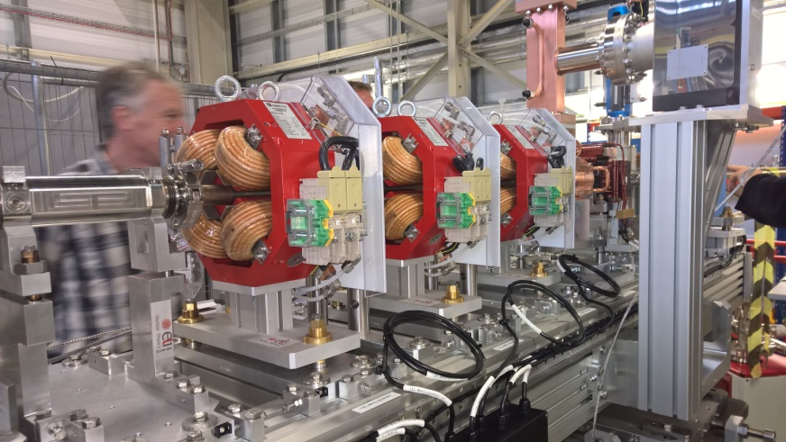
Gamma Beam System construction well underway
RF Photoinjector @Frascati
Accelerator modules
C-Band acc
Sydney Gales ELI-NP Nuclear Physics Long Range Plan 2017-Darmstadt Jan 11-13

Slide 11
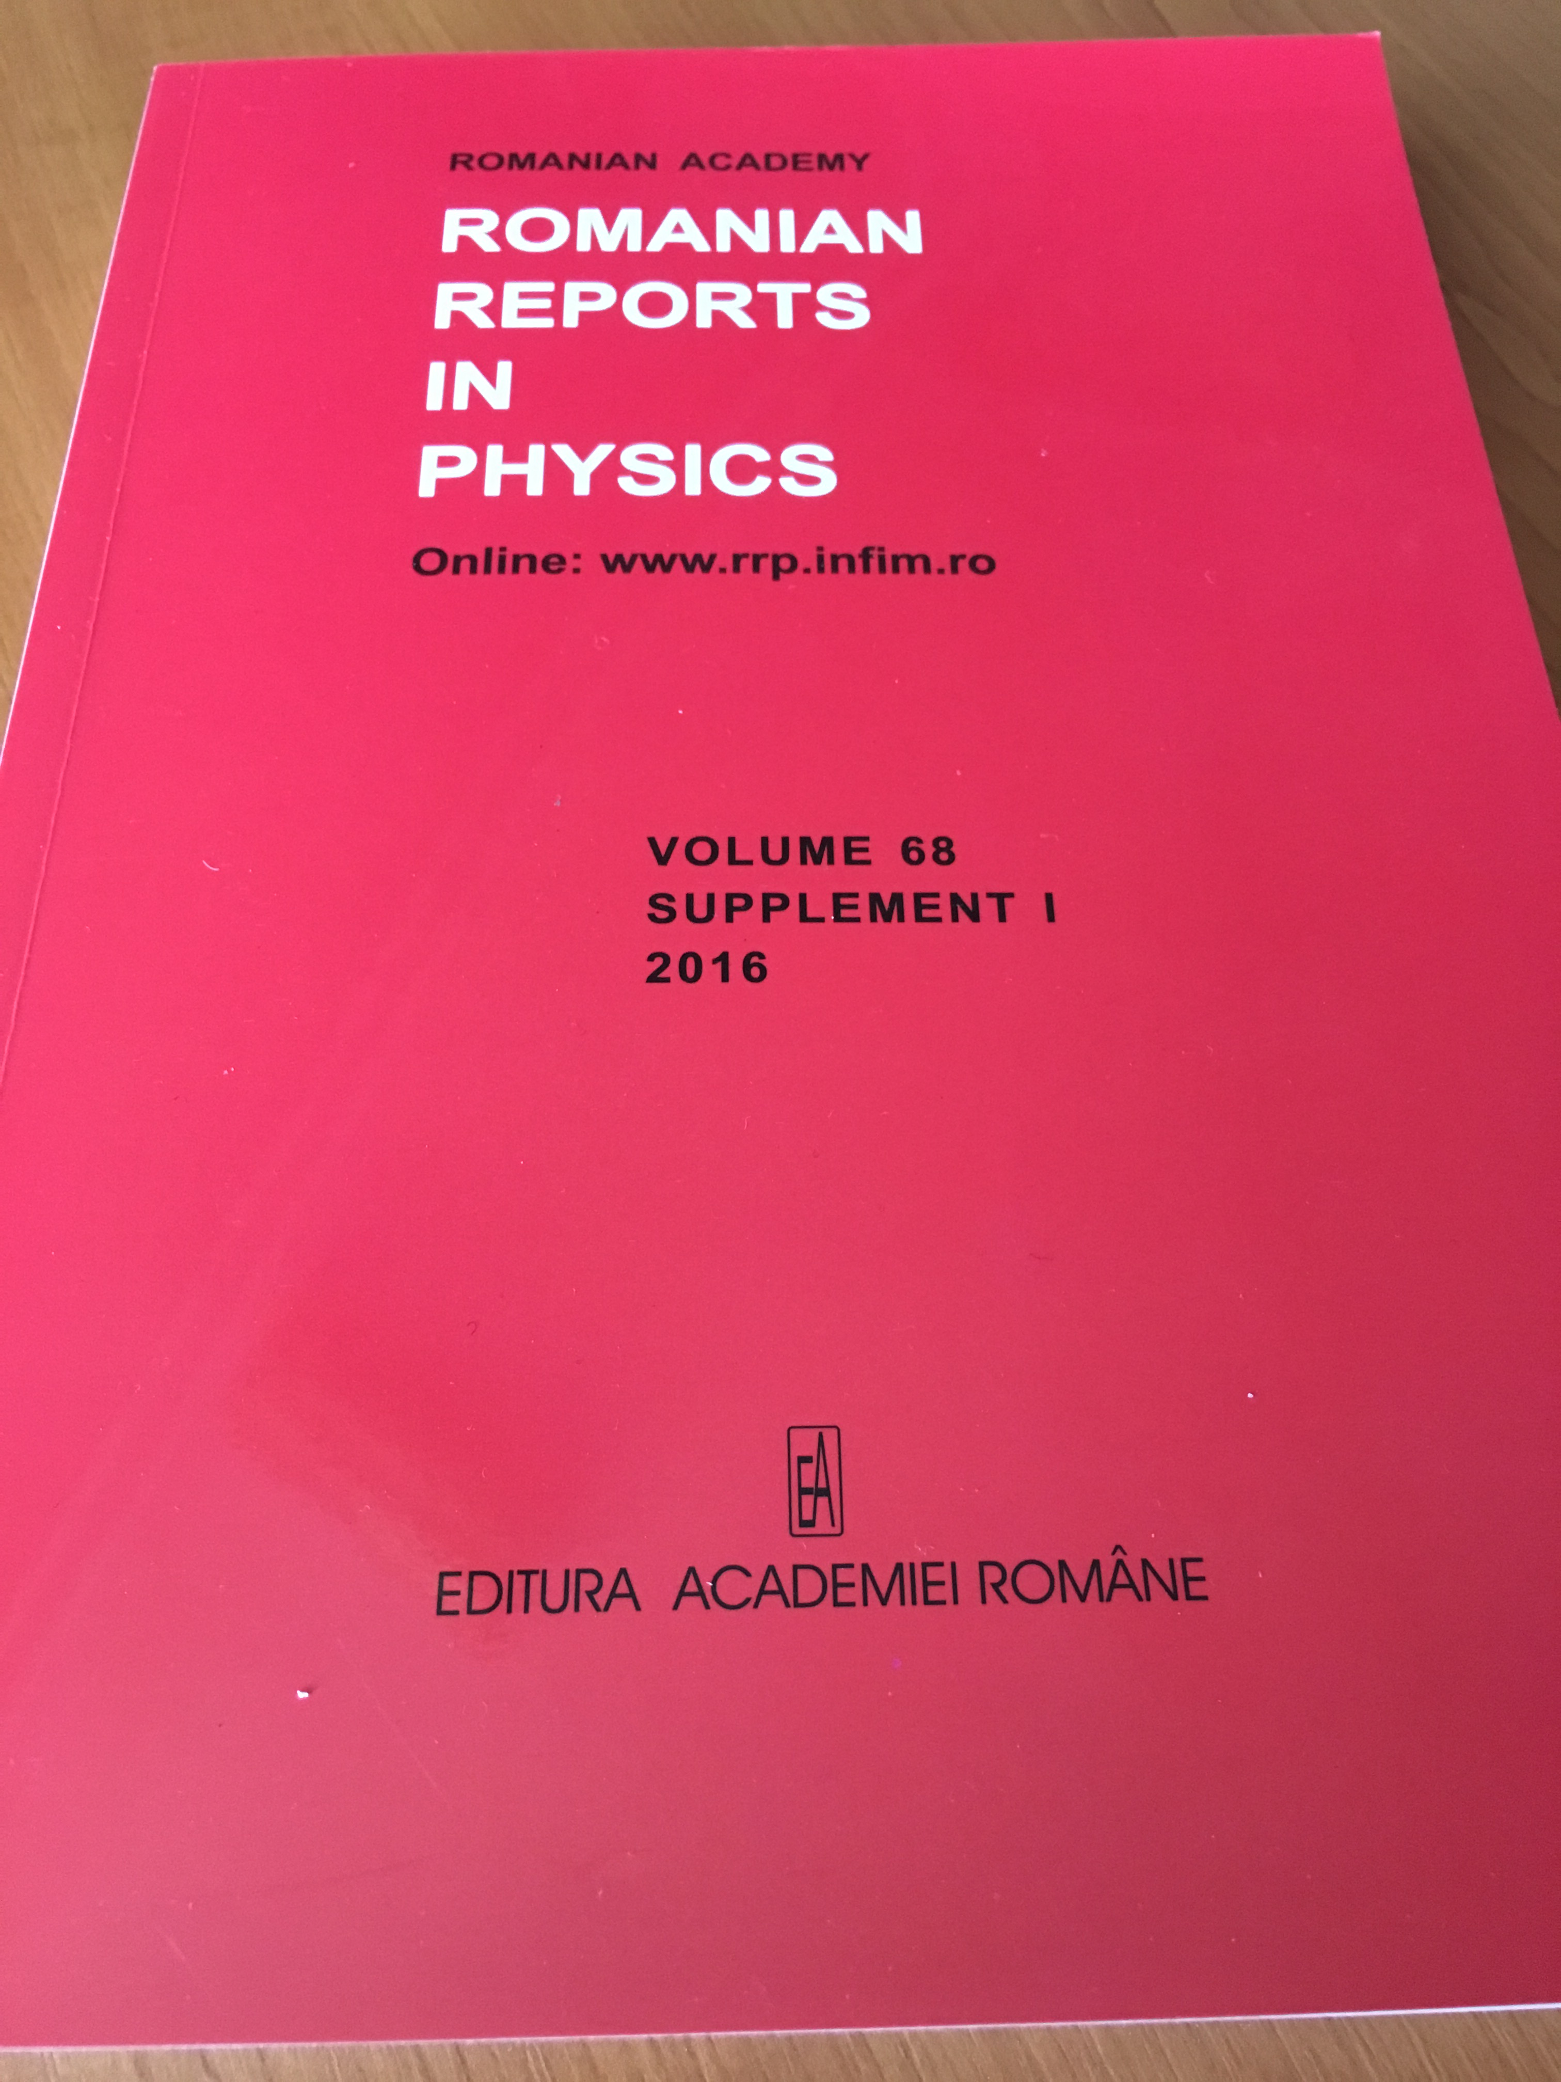

ELI-NP Scientific Program and Instruments
TDR’s for Experiments completed and published
>30 MoU’s and about 20 research contracts with major Laser and NP labs and Institutions (EU and Worldwide)
Experiments with High Power Laser System
- Laser-driven nuclear physics
High-field QED experiments
Materials in extreme environments for energy,
accelerators and space applications
Monitoring and control systems for experiments
Experiments with Gamma Beam System
Nuclear resonance fluorescence experiments
Gamma above neutron threshold
Photo-fission experiments
Charged-particle detection
Positron production by gamma beam
Gamma-beam industrial applications
Radioisotopes production for medical applications
Gamma-beam delivery and diagnostics
Combined laser-gamma experiments
International Working groups
3 international workshops in 2013-2014 and 2015
(more than 150 part)
http://www.rrp.infim.ro/
Sydney Gales ELI-NP Nuclear Physics Long Range Plan 2017-Darmstadt Jan 11-13

Slide 12
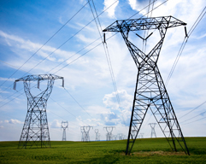

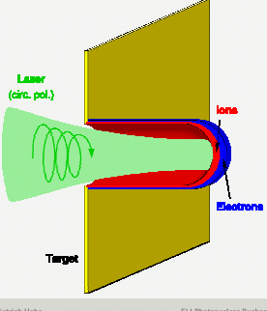


10PW, is 10000 times the world grid power
(10⁻¹⁵ secondes)
Laser Driven Nuclear Physics
The Pressure of
Light?
I = 10²³ w/cm²
10 millions Eiffel Towers
on the tip of your finger!
GIGANTIC TSUNAMI !!
field ~ TV/m
E_{e} ~ Ten’s of GeV
E_{ion} ≤ 150 MeV/u
charge ~ 10’s of pC
DE/E ~ 1-2% (e⁻)
~ 10-20% (ion)
e~10⁻⁵ mm mrad
Electrons are expelled from the target due to the chock wave induced by the powerful laser .Heavy ions are accelerated in the field created by the electrons
Bunches of e- and ions at solid state densities 10²⁴ e/cm³

Slide 13
Nuclear reactions in Plasma
(using Laser)
interesting for astrophysics of light element nucleosynthesis (bare nuclei reactions as in stars)
nucleosynthesis of heavy element
lifetime changes (of isomer?) in the plasma and inverse electron capture
p an d beams
created by LASER
Photonuclear neutron generation
(I. Pomerantz)
Sydney Gales ELI-NP Nuclear Physics Long Range Plan 2017-Darmstadt Jan 11-13

Slide 14
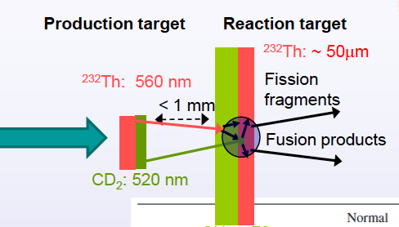
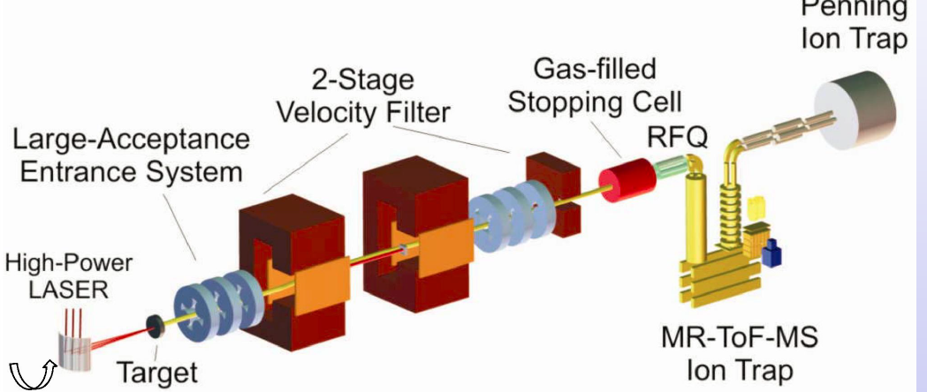
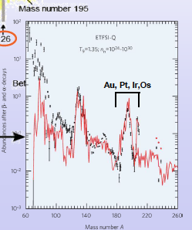
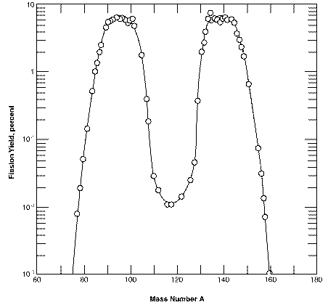
Laser driven Fission-Fusion (Flagship expt)
P.Thirof ,F.Negoita et al
selection and separation
N= 126 waiting point
bottleneck for nucleosynthesis
of actinides
Mass distribution of fission of ²³²Th
<A_{L>} ~ 91, ΔA_{L} ~ 14 amu (FWHM)
ΔAL ~ 22 amu (10%)
<Z_{L}> ~ 37.5 (Rb,Sr)
F_{L}
F_{H}
Fusion of (light) fission products :
F_{L} + F_{L} => (A~200, Z~70, N ~ 126)
Sydney Gales ELI-NP Nuclear Physics Long Range Plan 2017-Darmstadt Jan11-13

Slide 15
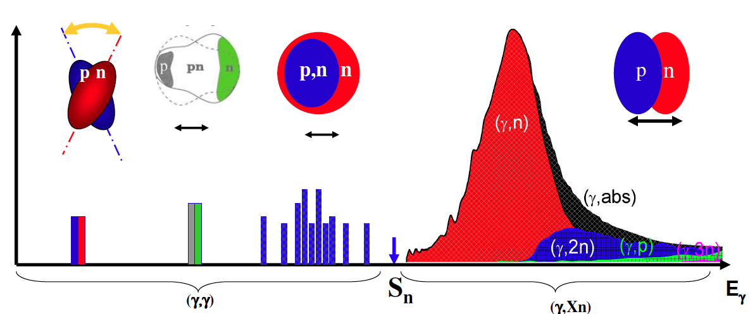

Experiments with high-brilliance gamma beams at ELI-NP
Electromagnetic dipole response of nuclei
NRF
GDR
Availability frontier
p-nuclei and actinides
γ
From Norbert Pietralla
Sensitivity frontier
weak channels
Nuclear Resonance Fluorescence (NRF)
Giant/Pigmy Resonances (GANT) ; Decay channels
Photonuclear reactions (γ,n), (γ,p), (γ,α) and Astrophysics
Photofission (γ,ff)
Precision frontier
high statistics
Sydney Gales ELI-NP Nuclear Physics Long Range Plan 2017-Darmstadt Jan 11-13

Slide 16
Main Detector arrays under construction ,prototypes ready
8 m
2 m
E8
The footprints of all GBS experiments at ELI-NP are fixed
ELIGANT-GN
LaBr3+ Liq Scint
ELIADE-Ge Clover
5 m
1.5 m
Sydney Gales ELI-NP Nuclear Physics Long Range Plan 2017-Darmstadt Jan 11-13

Slide 17
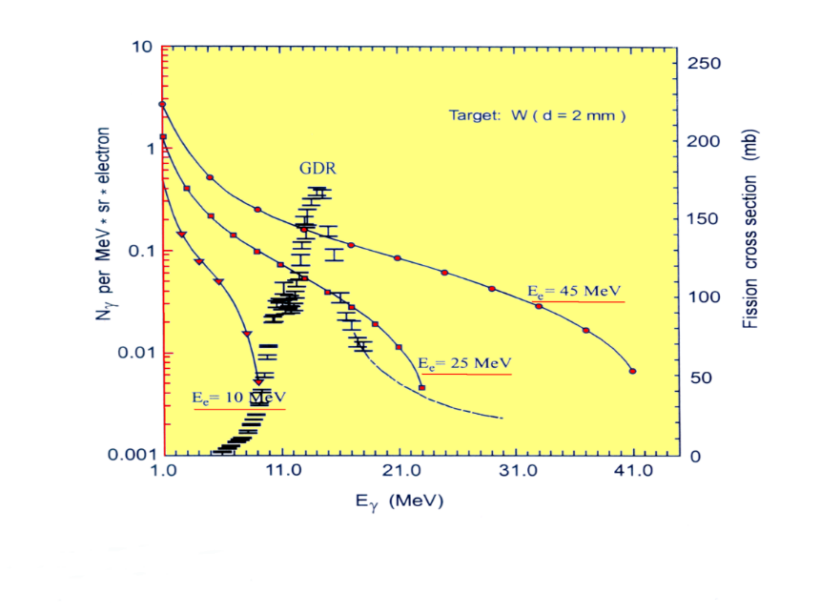

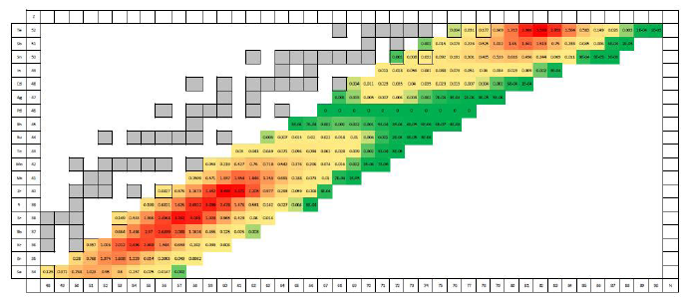
Rom. Rep. Phys. 68, S621 (2016)
IGISOL facility at ELI-NP
Production of fission fragments at ELI-NP
double-chamber CSC
P. Constantin et al, NIM B 378, 78 (2016), ibid (2016) submitted
beam extraction
RF carpets
Laval nozzles
target assembly
DC electrodes
Fast , refractory
segmented anode
Studies of gas-flow dynamics funded by the Romanian Science Agency
Work in collaboration with GSI, Darmstadt and University of Giessen
An unique niche!
Refractory element Short lifetime
Sydney Gales ELI-NP Nuclear Physics Long Range Plan 2017-Darmstadt Jan 11-13

Slide 18
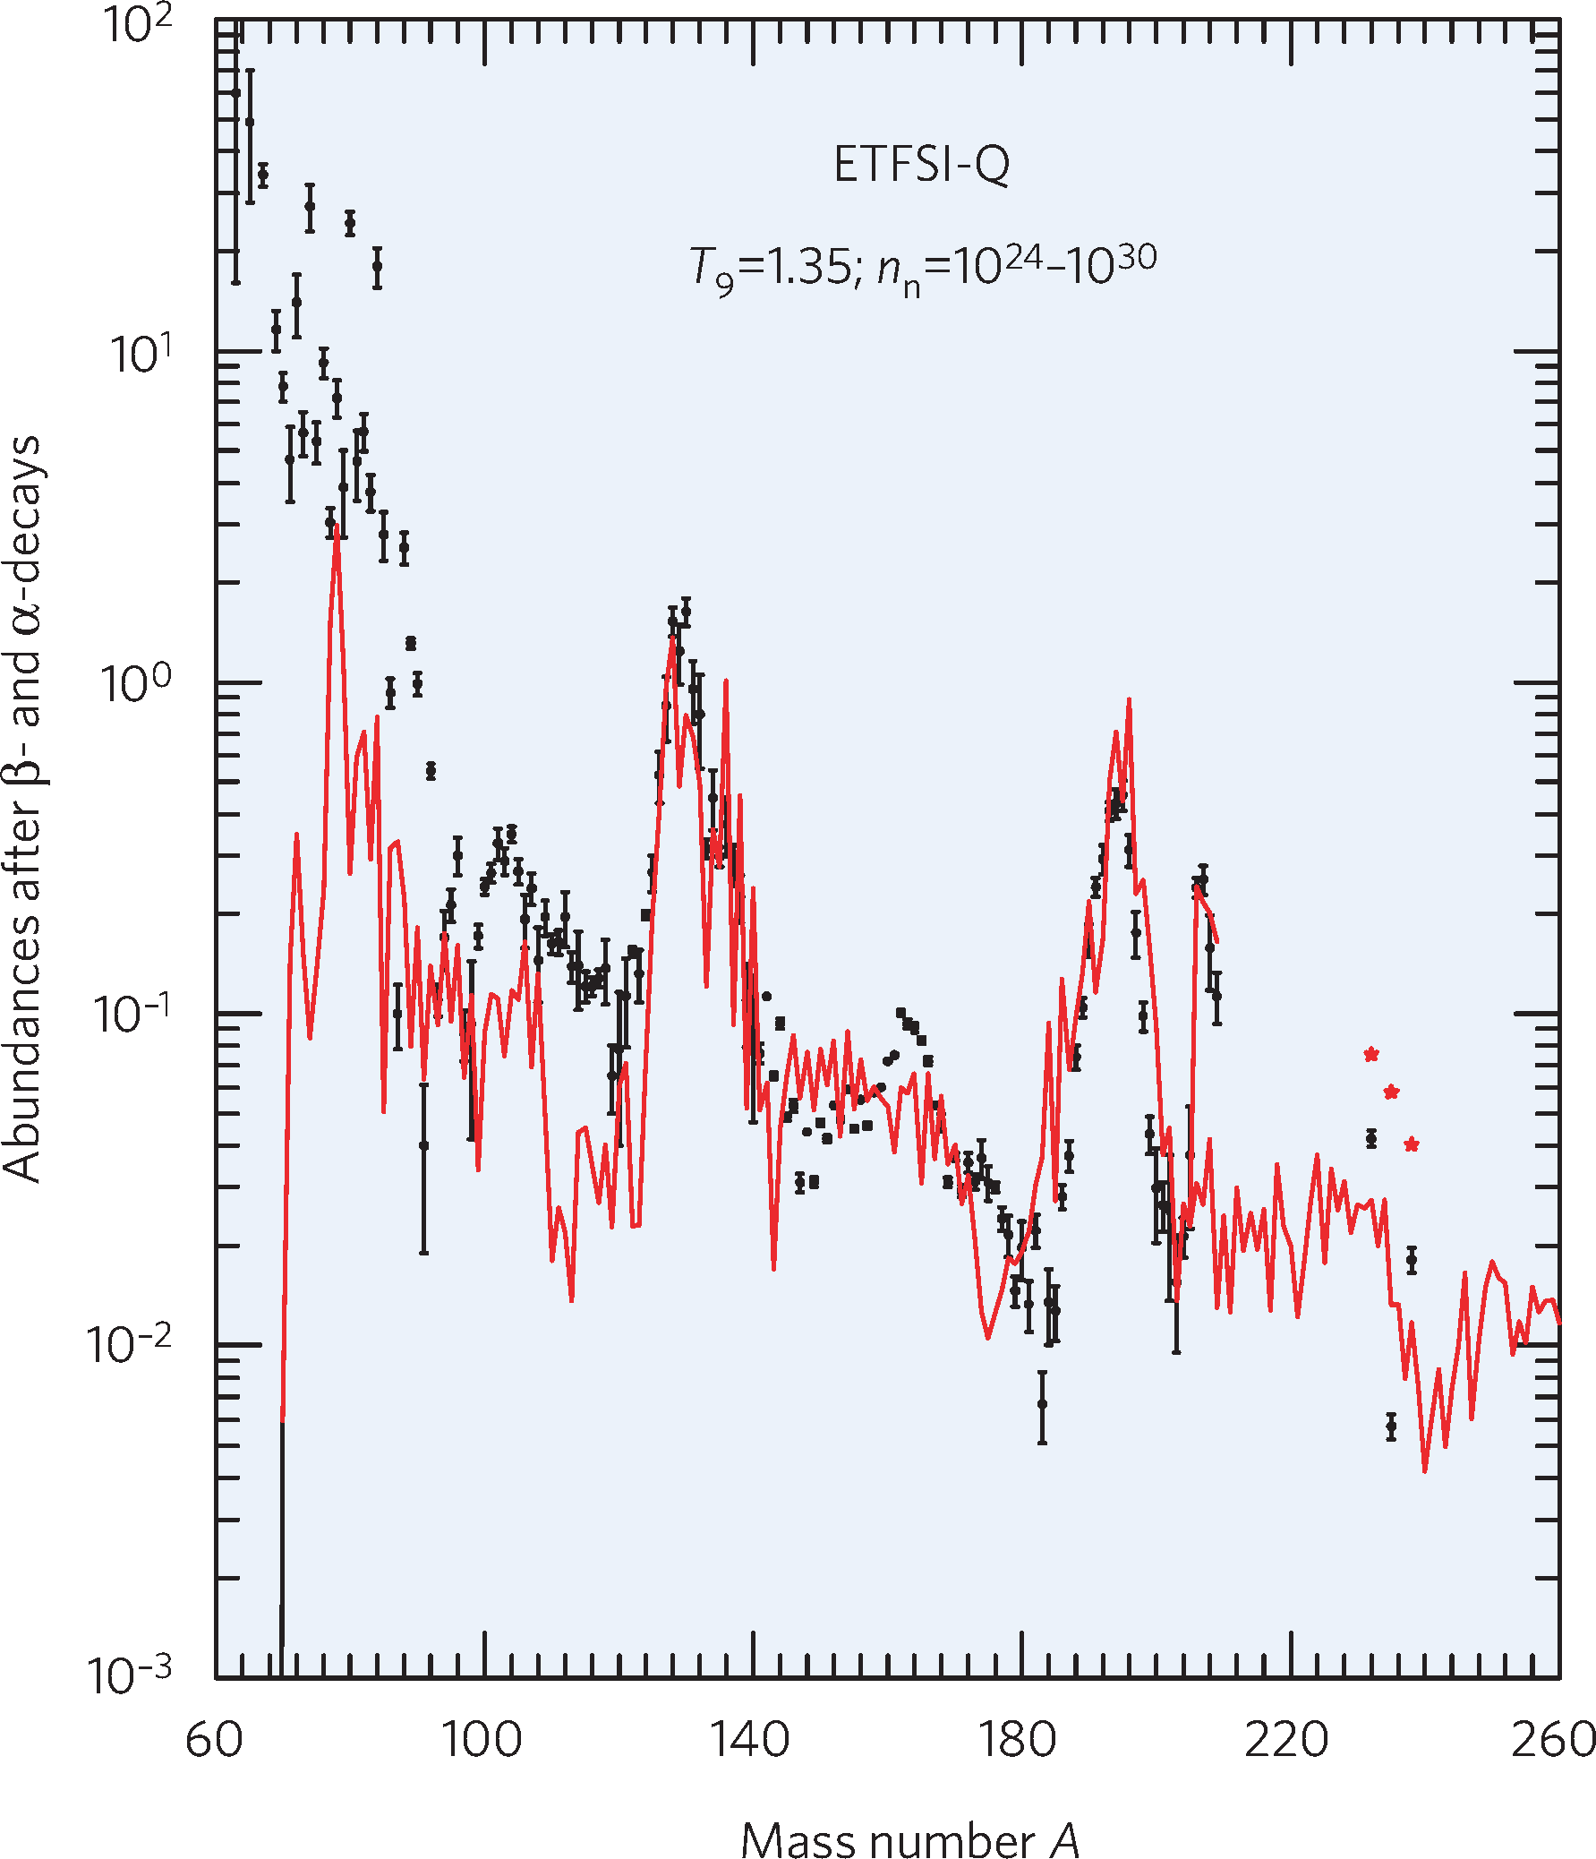

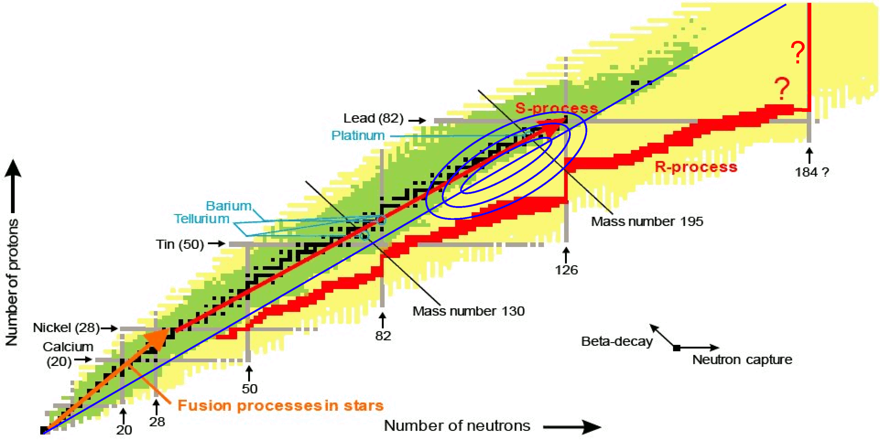
Astrophysics
Isotopic distribution in the Universe a central question for Astrophysics
s Process: (γ, n) reactions
p process (γ, p) and (γ, α) Reactions; key reaction γ+¹⁶O ¹²C+α
r process: N=126, understanding nucleosynthesis of actinides
-
Sydney Gales ELI-NP Nuclear Physics Long Range Plan 2017-Darmstadt Jan 11-13

Slide 19
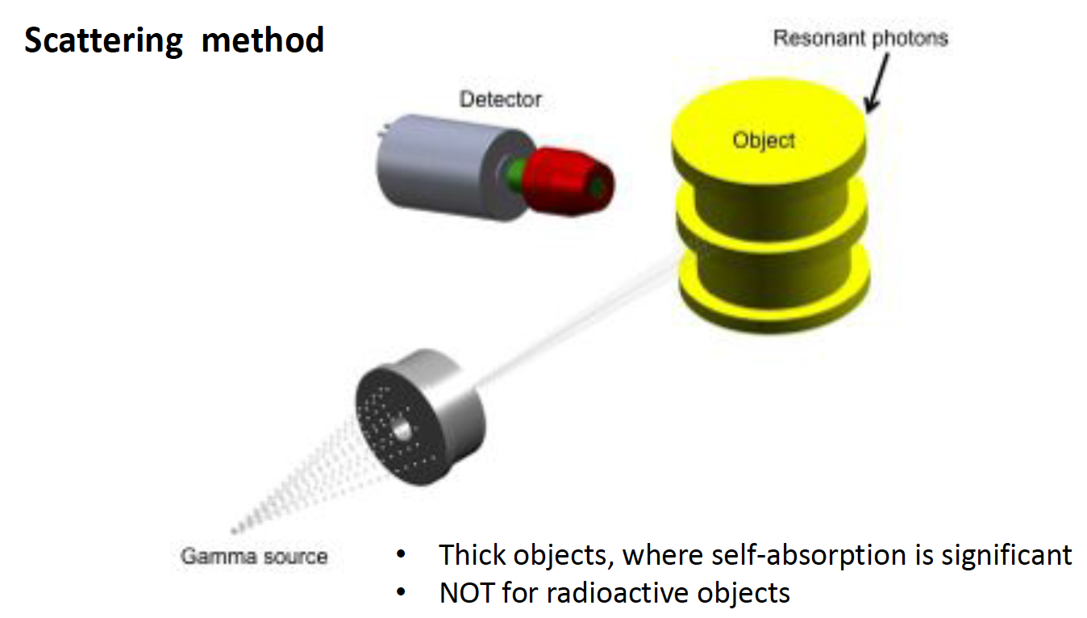
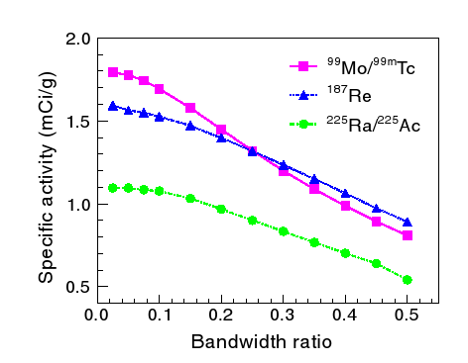
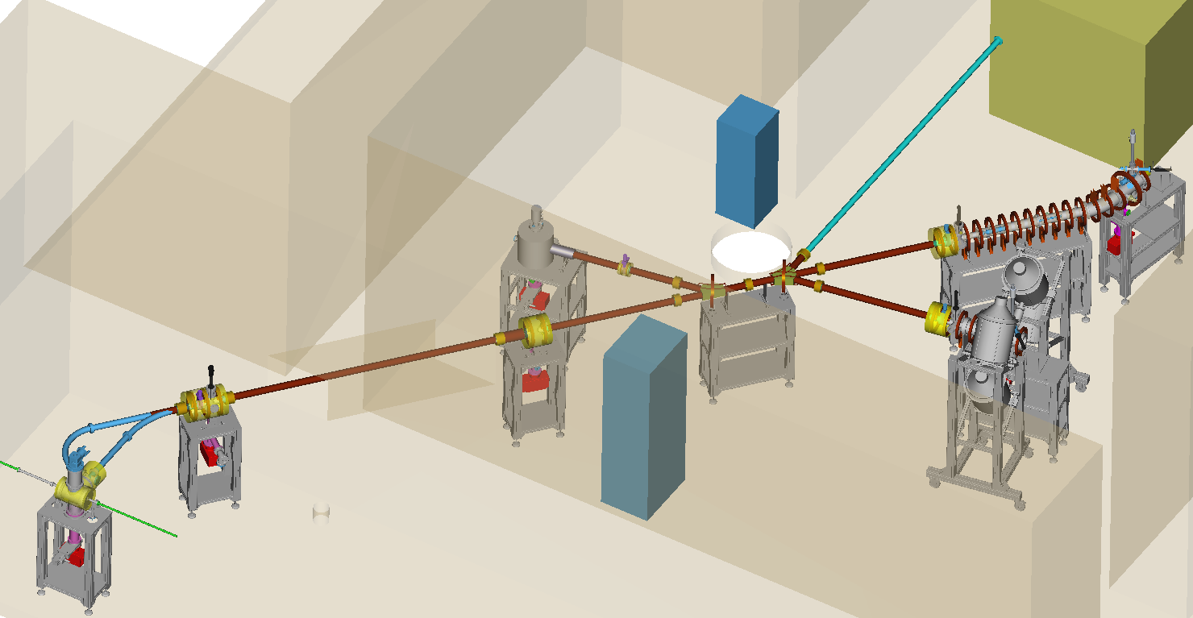
Applications of Gamma Beams
Industrial tomography
material inspection: nuclear waste
food contaminations
Medical radioisotopes at ELI-NP
Rom. Rep. Phys. 68, S799 (2016)
^{195m}Pt: In chemotherapy of tumors
it can be used to exclude ”non responding” patients from unnecessary chemotherapy and optimizing the dose of all chemotherapy
feasibility study: Wen Luo et al.,
Appl. Phys. B 122, 8 (2016)
Positron beams for material science at ELI-NP
ELI-NP Positron Laboratory
Rom. Rep. Phys. 68, S735 (2016)
Converter
γ-beam

Slide 20

New horizons with ELI-NP
Fission-fusion
Inverse capture reactions
s and p and r-processes
NRF, Dipole Response, GR&PDR
Level density ….
Gamma Imaging
Material Science
Medical Isotopes
Astrophysics
Nuclear Physics
Nuclear Security
Fusion Reactor Eng.
Cancer Therapy
Very attractive science and large discovery potential at reach at the interface of High power laser , plasma , accelerator and nuclear physics
“Go East”
Sydney Gales ELI-NP Nuclear Physics Long Range Plan 2017-Darmstadt Jan 11-13

Slide 21
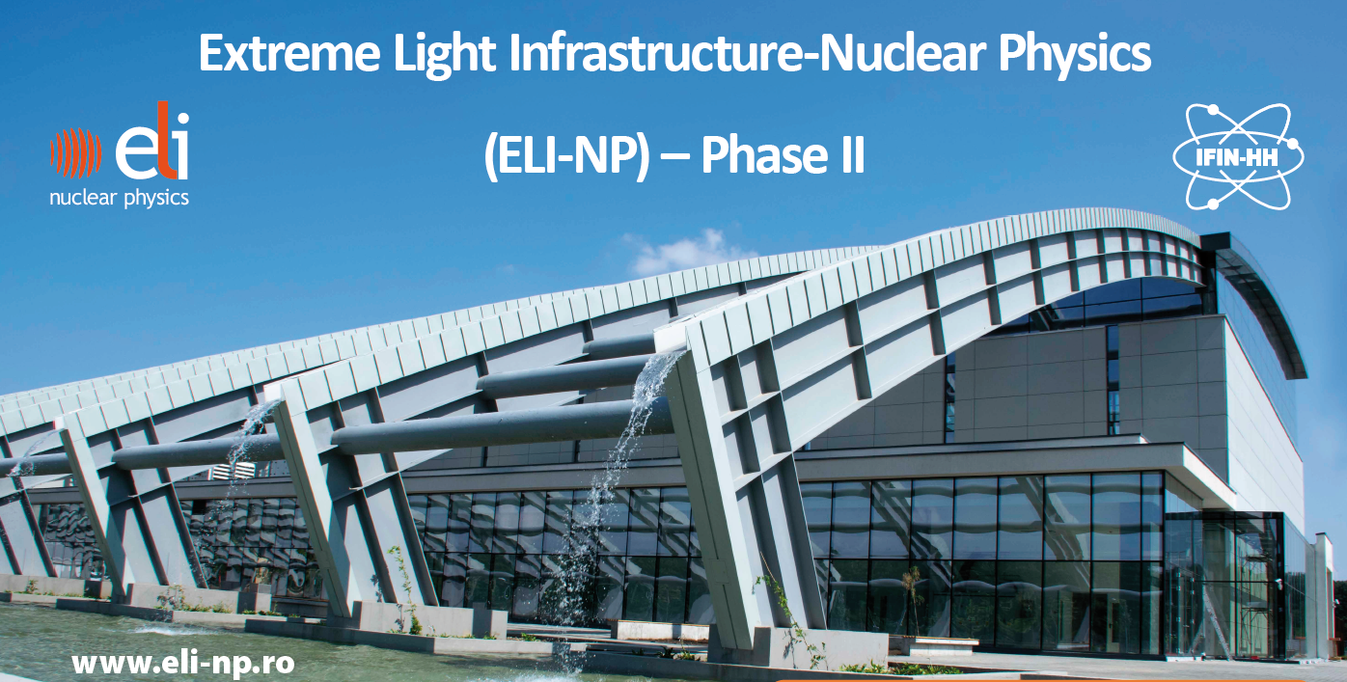
Thanks to ELI-NP team
Thank you for your patience!
Sydney Gales ELI-NP Nuclear Physics Long Range Plan 2017-Darmstadt Jan 11-13

Slide 22

ELI: Extreme Light Infrastructure
World Roadmap for High Power Lasers
At focal point of the laser(microns)
E= 9x10⁶ MV/cm for an intensity of 10²³W/cm2
30 GeV e- acceleration within few mm
1TeV
10²⁵W~ 10%Solar Power on 1cm2
1GeV
ELI
Naked U ions
Gev e-
1MeV
1eV
G. Mourou, T. Tajima, Science 331,41 (2011)

Slide 23
Proton >200 MeV is possible.
Predicted proton energy for LP and CP I=10²² W/cm2, 0.2 µm CH₂ target
(Psikal et al J Phys Conf 2016)
Sydney Gales ELI-NP Nuclear Physics Long Range Plan 2017-Darmstadt Jan11-13

Slide 24
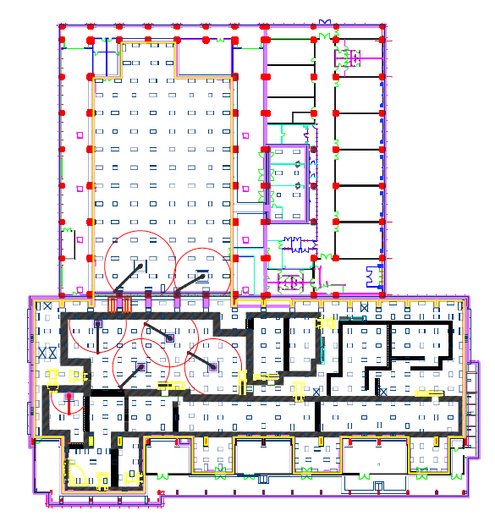
ELI–NP –Building Status
accelerator
bays
HPLS
A – A
Laboratories
A
laser
rooms
basement
anti–vibration
mounts
Experiments
Platform supported on dampers
GBS
Anti–vibration platform
±1 μm @ < 10 Hz
A
Sydney Gales ELI-NP Nuclear Physics Long Range Plan 2017-Darmstadt Jan11-13

Slide 25

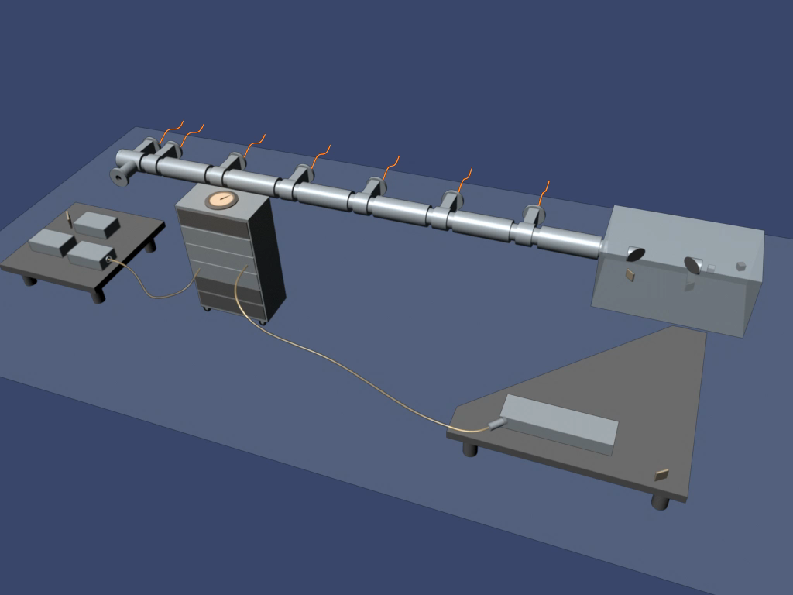
Gamma Beam Specifications (GBS)
Energy (MeV) | 0.2 – 19.5
Spectral Density (ph/s∙eV) | 0.8 – 4∙10⁴
Bandwidth rms (%) | ≤ 0.5%
# photons per shot within FWHM bdw. | ≤ 2.6∙10⁵
# photons/sec within FWHM bdw. | ≤ 8.3∙10⁸
Source rms size (mm) | 10 – 30
Source rms divergence (mrad) | 25 – 200
Peak brilliance (N_{ph}/sec∙mm²∙mrad²∙0.1%) | 10²⁰ – 10²³
Radiation pulse length rms (ps) | 0.7 – 1.5
Linear polarization (%) | > 99
Macro rep. rate (Hz) | 100
# pulses per macro pulse | 32
Pulse–to–pulse separation (nsec) | 16
Electron Linac up to 720 MeV
e- injection
Courtesy of C. Barty
γ-Beam
Laser-Photo cathode
Collisions
e-photons
Yag Laser
E_{e} ~ 300 MeV E_{γ} < 3.5 MeV
E_{L} ~ 2.4 eV (green)
J-class 100Hz
E_{e} ~ 720 MeV E_{γ} < 20 MeV
ELI-NP, the Nuclear Physics Pillar of ELI, is building an advanced Compton Source (Gamma Beam System) aiming at making a substantial step forward in γ-ray beam performances
Sydney Gales ELI-NP Nuclear Physics Long Range Plan 2017-Darmstadt Jan11-13

Slide 26
Sydney Gales ELI-NP Nuclear Physics Long Range Plan 2017-Darmstadt Jan11-13

Slide 27
Fission – Fusion Mechanism
Mass distribution
in Th fission
F_{L}
F_{H}
Sydney Gales ELI-NP Nuclear Physics Long Range Plan 2017-Darmstadt Jan11-13

Slide 28
ELI-NP Gamma beam production
Compton backscattering:
E_{γ} =4γ_{e}² E_{L}
E_{e}=720 MeV => γ_{e}~ 700 => E_{γ} ~20 MeV
but very weak cross section: 6.6 10⁻²⁵ cm²
        Therefore for a powerful γ beam, one needs:
                - high intensity electron beams
                - very brilliant optical photon beams
                - very small collision volume
                - very high repetition frequency
‘Photon accelerator’
Sydney Gales ELI-NP Nuclear Physics Long Range Plan 2017-Darmstadt Jan11-13

Slide 29
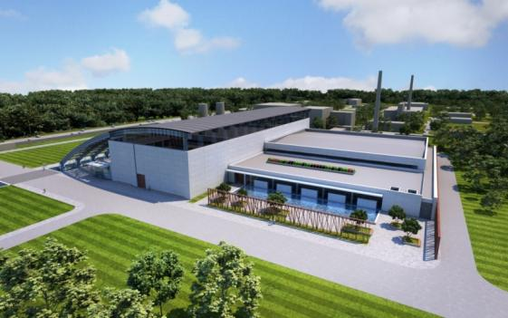
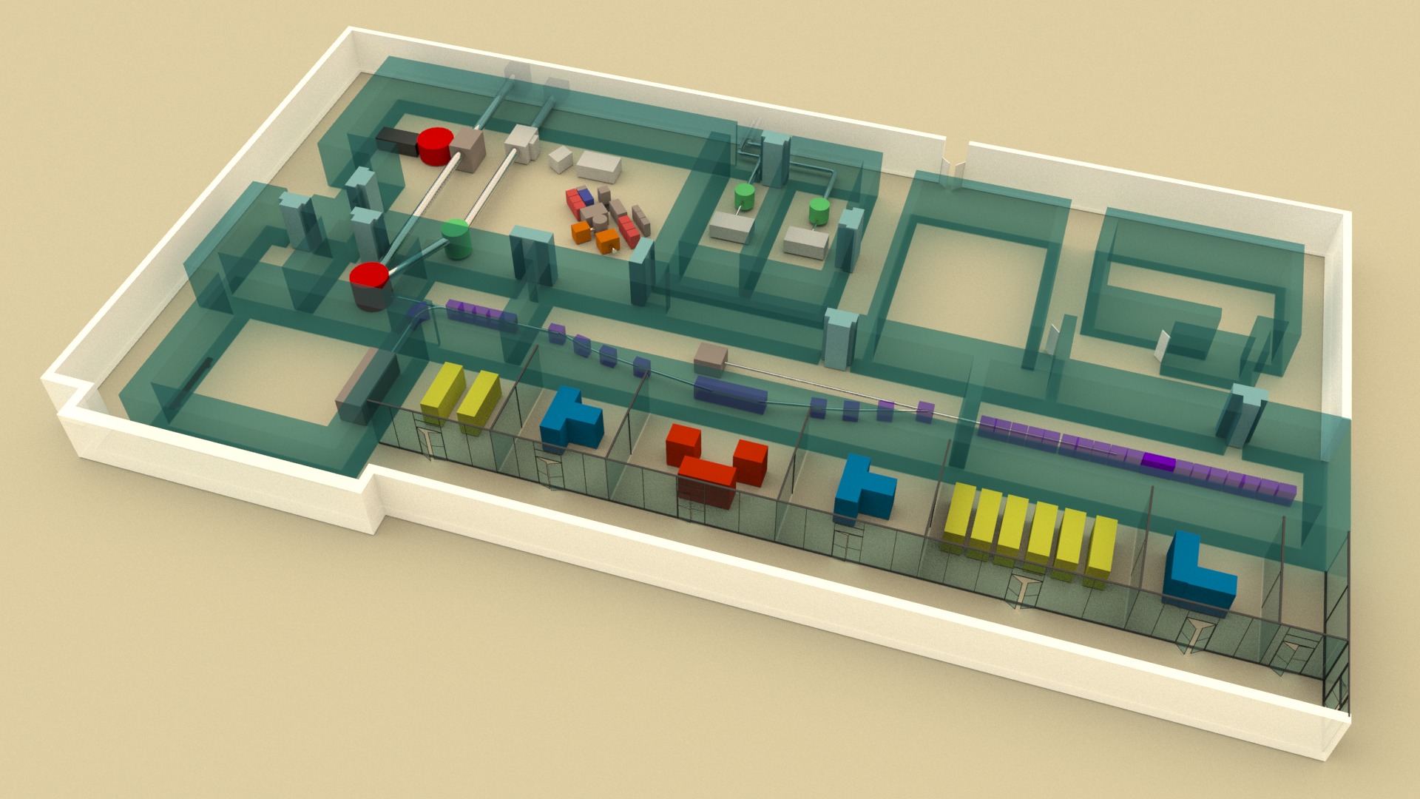
ELI–NP Experiment Building
HP Lasers
E6 10PW
E1 10PW
E5 1PW @ 1 Hz
E4 0.1PW @ 10 Hz
Experiments
8 experimental
areas
E7,2X10PW
E3 Positron
source
E8,Gamma
Nuclear reactions
E2,NRF
E7,QED High field
gamma + electrons
7000 m²
Sydney Gales ELI-NP Nuclear Physics Long Range Plan 2017-Darmstadt Jan11-13

Slide 30
Human Resources
Technical Staff (18)
Eng. Staff (18)
PhD students (50)
Jr. researchers (107)
Senior researchers (20)
Head of Res. Activities (5)
2013
2014
2015
2016
2017
2018
2019
Sydney Gales ELI-NP Nuclear Physics Long Range Plan 2017-Darmstadt Jan11-13

