Slide 1

Long Range Plan
WG3: Nuclear Structure and Reaction Dynamics
Elias Khan and John Simpson

Slide 2
WG3: Members
Conveners: Elias Khan (Orsay), John Simpson (Daresbury)
NuPECC Liaisons: Adam Maj, Faical Azaiez and Ari Jokinen
Carlo Barbieri (Surrey) Alison Bruce (Brighton) Emmanuel Clement (Ganil) Zsolt Dombradi (ATOMKI) Christoph Düllmann (Mainz) Antoine Drouart (Saclay) Bogdan Fornal (IFJ PAN Kraków) Christian Forssén (Göteborg) Martin Freer (Birmingham) Angela Gargano (Napoli) Georgi Giorgiev (Orsay) Paul Greenlees (Jyväskylä) Stéphane Grévy (CENBG Bordeaux) Magne Guttormsen (Oslo) Andrea Jungclaus (Madrid) Nasser Kalantar (KVI-CART) Alexander Karpov (Dubna) Valerie Lapoux (Saclay) | Silvia Leoni (Milano) Antonio Moro (Sevilla) Gerda Neyens (Leuven) Alexandre Obertelli (Saclay) Norbert Pietralla (TU Darmstadt) Ricardo Raabe (Leuven) Maurycy Rejmund GANIL) Karsten Riisager (Aarhus) Takenhiko Saito (GSI) Herve Savajols (Ganil) Christoph Scneidenberger (GSI) Achim Schwenk (TU Darmstadt) Haik Simon (GSI) Vittorio Soma (Saclay) Suzana Szilner (Zagreb) Calin Alexandra Ur (Bucharest) Giuseppe Verde (IPN Orsay and Catania)

Slide 3
WG3 Subgroups (SG)
Nuclear Theory (Christian Forssen and Achim Schwenk)
  Gargano, Moro, Soma
Nuclear structure (Alexandre Obertelli)
  Barbieri, Bruce, Clement, Drouart, Dullman, Dombradi, Fornal, Forssen, Freer, Gargano, Greenlees, Guttormsen, Grevy, Jungclaus, Kalantar, Karpov, Lapoux, Leoni, Moro, Neyens, Raabe, Rejmund, Pietralla, Raabe, Rejmund, Riisager, Saito, Savajols, Schwenk, Scheidenberger,Ur
Reaction Dynamics (Antonio Moro)
  Karpov, Szilner, Ur
The Nuclear Equation of State (Giuseppe Verde)
  Forssen, Guttormsen, Leoni, Kalantar, Schwenk, Ur,
Facilities and instrumentation (Stéphane Grevy)
  Kalandar, Leoni, Riisager, Scheidenberger, Simon, Szilner, Ur, Verde

Slide 4
WG3: Timescale
First phone conference December 2015, sub-groups formed, meetings, phone confs, email….
Sub groups prepared drafts December 2015 to June 2016
Sub group Meeting at Orsay for Nuclear Structure, 5/4/16
28 attendees, 12 labs, 10 countries
First plans WP3 presented by Adam Maj to NuPECC April 2016
May 2016 first draft of full document
Presented to NuPECC (JS) Uppsala in June, (EK) Vienna in October
Iteration with sub-group leaders and teams ongoing
Input still welcome, latest document includes comments from last week

Slide 5
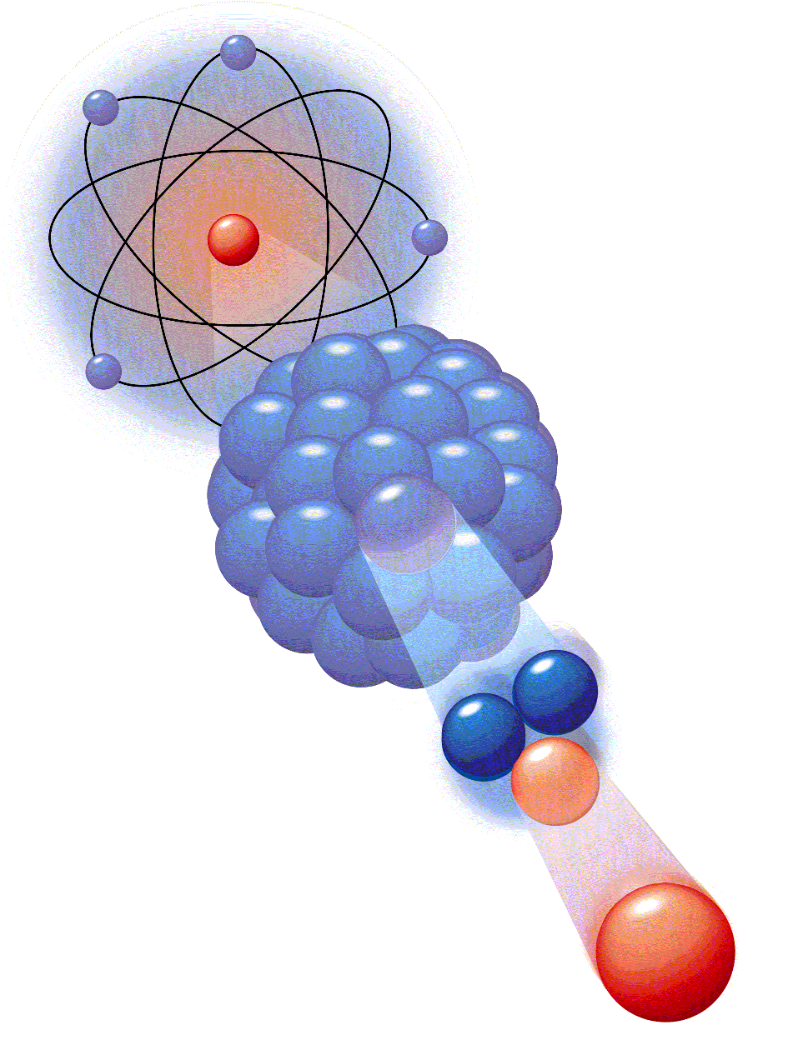
Introduction
Understanding of nuclear structure from the strong interaction
Unified understanding of all nuclei (structure, reactions)
Rich variety of phenomena
Very diverse field

Slide 6
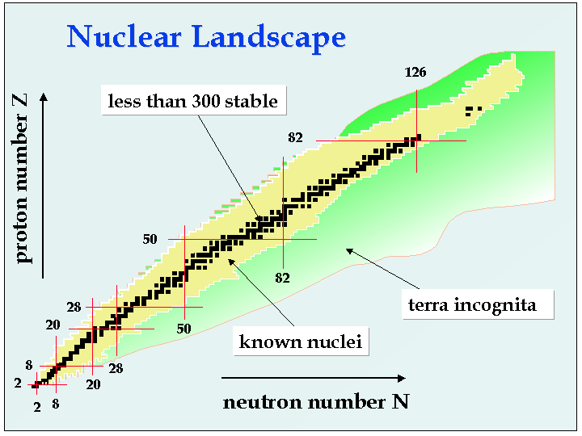
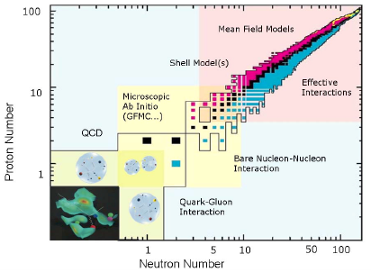
The Nuclear Arena

Slide 7
Introduction
Understanding of nuclear structure from the strong interaction
Rich variety of phenomena
Very diverse field
Need for facilities and instrumentation

Slide 8
Introduction
Key Questions
How does the nuclear chart emerge from fundamental interactions?
How does nuclear structure evolve across the nuclear landscape and what shapes can nuclei adopt?
How does the structure change with temperature and angular momentum?
How to unify nuclear structure and reaction approaches?
How complex are nuclear excitations?
How do correlations appear in dilute neutron matter, both in structure and reactions?
What is the density and isospin dependence of the nuclear equation of state?

Slide 9
WG3: Main Chapters of the draft
Introduction
Nuclear Theory
Nuclear Structure
Reaction Dynamics
The Nuclear Equation of State
Facilities and Instrumentation
(Summary and open issues – each section)
Recommendations

Slide 10
SG1: Nuclear Theory
Section headings
How does the nuclear chart emerge from the underlying interactions ?
Achieving a unified description of all nuclei
Towards consistent reaction theory
Computational challenges to reach the scientific goals of nuclear physics
The precision era of nuclear physics
Training the next generation of researchers in nuclear physics

Slide 11
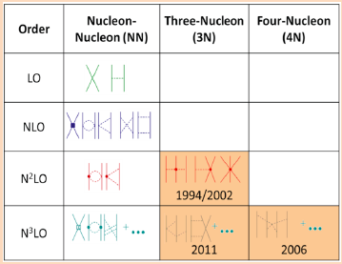
Chiral EFT for nuclear forces
Box Example.
Chiral EFT for nuclear forces
The contributions to two-, three- and four-nucleon interactions at successive orders in chiral EFT are shown diagrammatically. The interaction between nucleons (solid lines) is mediated by the exchange of pions (dashed lines), the Goldstone bosons of QCD, which are responsible for the long-range part of strong interactions. The short-range parts of nuclear forces are developed in a general series of contact interactions.
Many-body forces are highlighted including the year they were derived. Three-nucleon (3N) forces, which emerge naturally in EFTs, enter at next-to-next-to-leading order (N²LO). Moreover, EFTs lead to a hierarchy among many-body interactions.
Nuclear structure evolved
Nuclear forces based on QCD to solve many body problem with controlled uncertainties
EFT reduce the complexity of the underlying QCD theory to the relevant degrees of freedom in a systematic way
Towards heavy systems

Slide 12
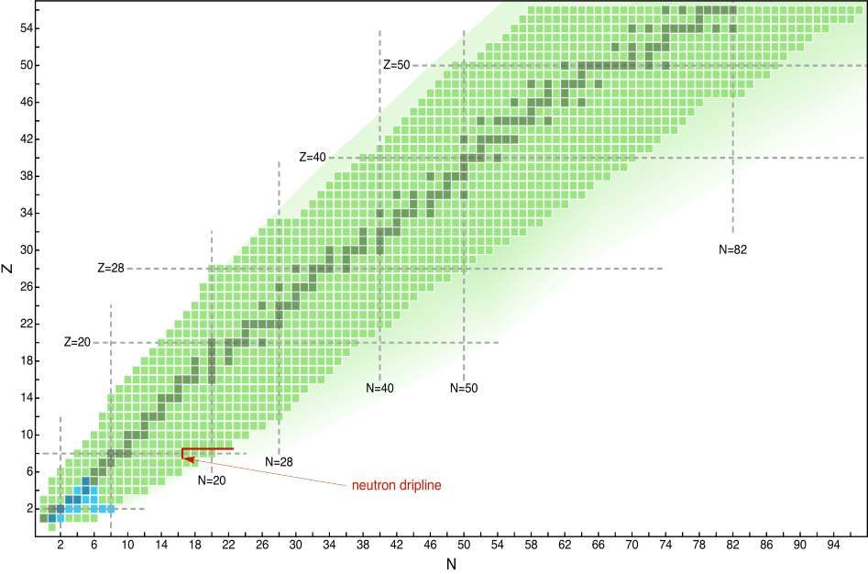
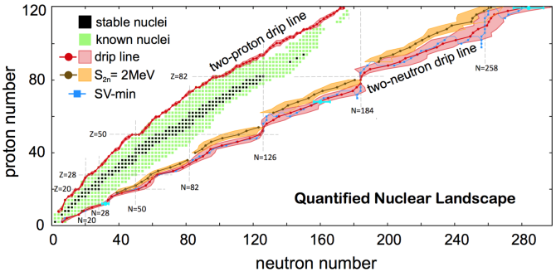
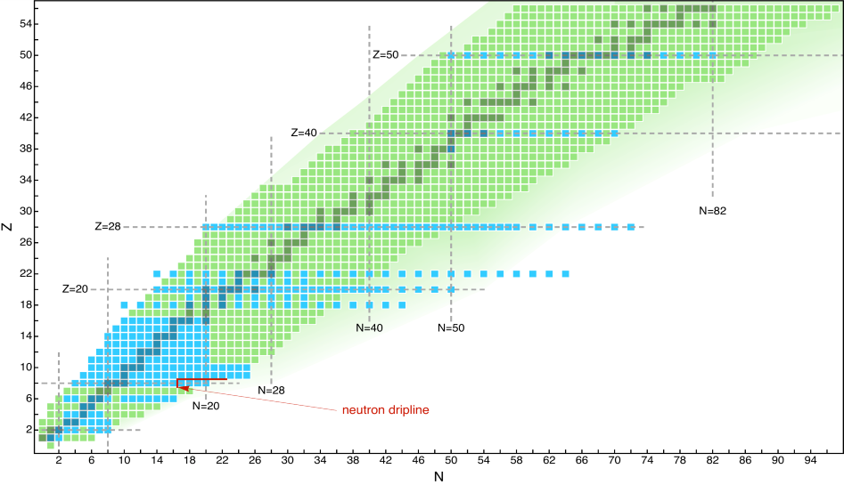
Achieving a unified description of all nuclei
Increased reach of ab initio methods
How does the nuclear chart emerge from the underlying interactions?
50
2005
Nuclear structure theory has evolved into a field with
a systematic theoretical foundation
new and advanced few- and many-body methods with controlled uncertainties
40
30
Z
20
10
Ab initio
2
50
2015
40
Z
30
EDF calculations
20
10
2
2
10
20
30
40
50
60
70
80
90
N

Slide 13
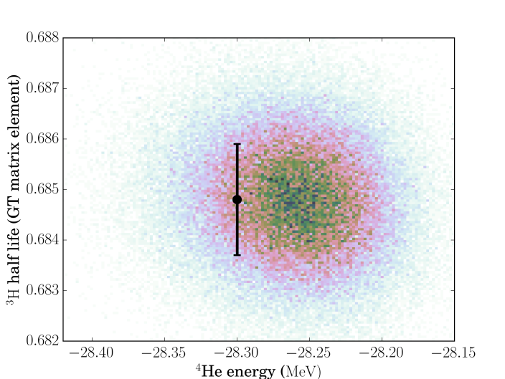
The precision era of nuclear theory
Effective field theories enable quantified systematic uncertainties.
This enables:
to infer the significance of a disagreement between experiment and theory
to identify new relevant experiments
to provide critical nuclear physics input for tests of fundamental symmetries

Slide 14
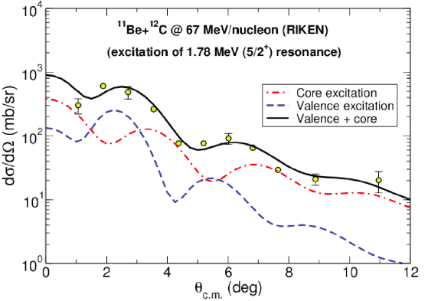
Towards a consistent reaction theory
Advances in reaction theory
Resonant breakup on the halo ¹¹Be nucleus: halo vs. core excitation mechanism

Slide 15
Nuclear Theory
(Summary and open issues)
We recommend continued efforts to
increase the precision and to extend few-
and many-body methods to new regions
of the nuclear chart
We recommend focused research on constructing improved nuclear EDFs and
large-scale SM methods; exploring new regions, advancing novel derivations of effective interactions and consistent operators, and the inclusion of the continuum
Towards consistent reaction theory
We recommend increased efforts in nuclear reaction theory to meet new experimental demands
Training the next generation of
Researchers in nuclear physics
Computational challenges to reach the scientific goals of nuclear physics
We recommend that methods in Europe be pursued that establish the successful TALENT graduate training initiative on a continuous basis.
Sustained progress in nuclear theory requires:
developing new methods and new ideas
supported by employing the most
advanced computational tools and the training of a very diverse workforce.

Slide 16
SG2: Nuclear structure
Section headings
Which novel few-body data will constrain our understanding of nuclear forces?
  Hypernuclei
  Resonances in neutron-rich nuclei
  Electroweak interactions
How does the shell structure evolve across the nuclear landscape?
  Exploration towards the drip lines
  Comprehensive spectroscopy
  Heavy and superheavy Elements
How complex are nuclear excitations?
  Coupling between nucleons and core-excitations
  Giant resonances
What shape can nuclei take?
  Quadrupole, octupole, triaxial, SD, HD, Jacobi
How do neutron halos and skins evolve across the nuclear chart?
  Haloes, neutron skins
How do nucleon correlations appear in dilute neutron matter?
How does nuclear structure change with temperature?

Slide 17
How does the shell structure evolve across the nuclear landscape?
  Exploration towards the drip lines
Box Example.
Structure of Ca isotopes
Standard magic numbers, well established for stable nuclei, fade away in neutron-rich systems where new ones may appear. How do we determine them? A shell closure cannot be established from a single experimental signature but rather has to emerge from the concurrence of several features, e.g. in energies of the lowest 2⁺ excited state, two-nucleon separation energies and charge radii isotopic shifts. Hence, different experiments are typically necessary to assess the evolution of magic numbers, as testified by recent studies of neutron-rich calcium isotopes. Penning-trap measurements at TRIUMF and ISOLDE have extended our knowledge of nuclear masses up to ⁵⁴Ca (central panel) and pointed to the appearance of a new magic number at N=32. More recently, charge radii obtained via laser spectroscopy at ISOLDE (lower panel) weakened this conclusion. In parallel, the measurement of the lowest 2⁺ excited state in ⁵⁴Ca at RIKEN (upper panel) has opened the same debate on N=34.
Ab initio calculations (coloured curves) start accessing medium-mass isotopic chains systematically. Comparisons between these calculations and current and future experiments in the region (e.g. up to ⁵⁶Ca) will help unveil how such magic numbers emerge from underlying complex nucleon dynamics.
RIB facilities will enable other regions of shell closures in heavier systems

Slide 18
How complex are nuclear excitations?
Box Example.
Pygmy Resonances
In neutron-rich systems, the neutron excess is expected to form a skin, often assumed to oscillate outside the proton-neutron core: this results in a concentration of E1 strength in the region around the particle binding energy (< 10 MeV) - the Pygmy Dipole Resonance (PDR). Experiments are ongoing for few exotic nuclei above separation-energy threshold, using advanced and complex setups at fragmentation facilities, while stable systems, below threshold, have been largely investigated by different probes – from photons, high energy protons and alphas and heavy ions at intermediate energies. A quite complex nature of pygmy states has been evidenced, as in the case of ¹²⁴Sn where isoscalar and isovector states seem to co-exist in the same energy region, and the character of these excitations appears to be hybrid, with mixture of compressional or non-collective character.
New experiments are envisaged to better clarify the features of the low-lying dipole strength with neutron excess and the existence of pygmy states of other multipolarities, E2 in particular. At ISOL facilities, inelastic scattering at 10-15 MeV/u in inverse kinematics will shed light on the nature of the pygmy resonance below particle threshold, while exclusive measurements based on the detection of high resolution γ rays and particle decay at intense gamma-beam facilities, such as ELI-NP, will pin down the fine structure of the entire resonance response in stable systems, shedding light on damping mechanisms.
γ−decay spectra from the pygmy resonance in ¹²⁴Sn, as measured with α scattering at 34 MeV/A (top, KVI data), heavy ion at 20 MeV/A (middle, AGATA at LNL) and γ scattering (bottom, Darmstadt data). Coloured histograms give the strength resolved in individual transitions, with energy-integrated relative intensities (insets).

Slide 19
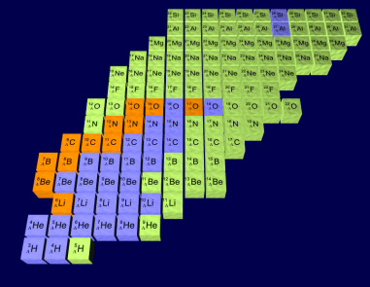
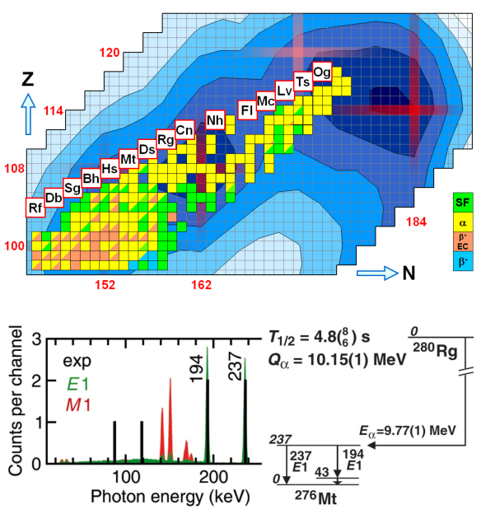
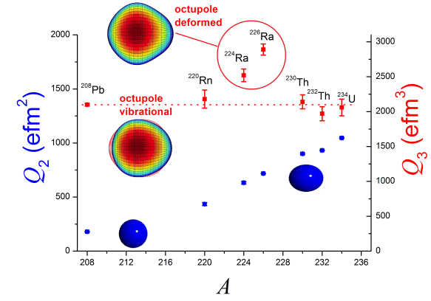
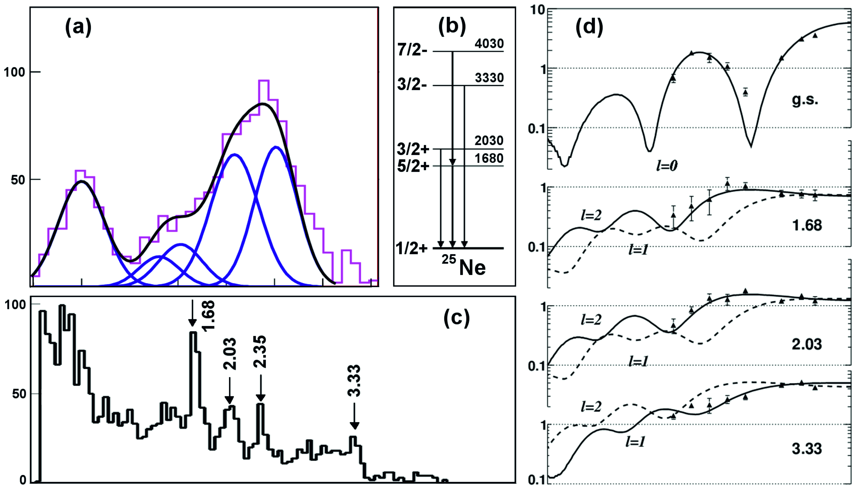
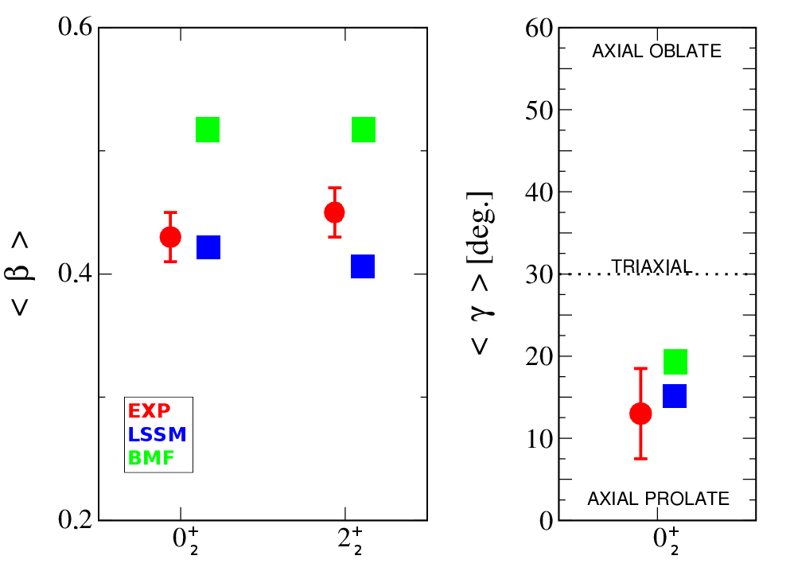
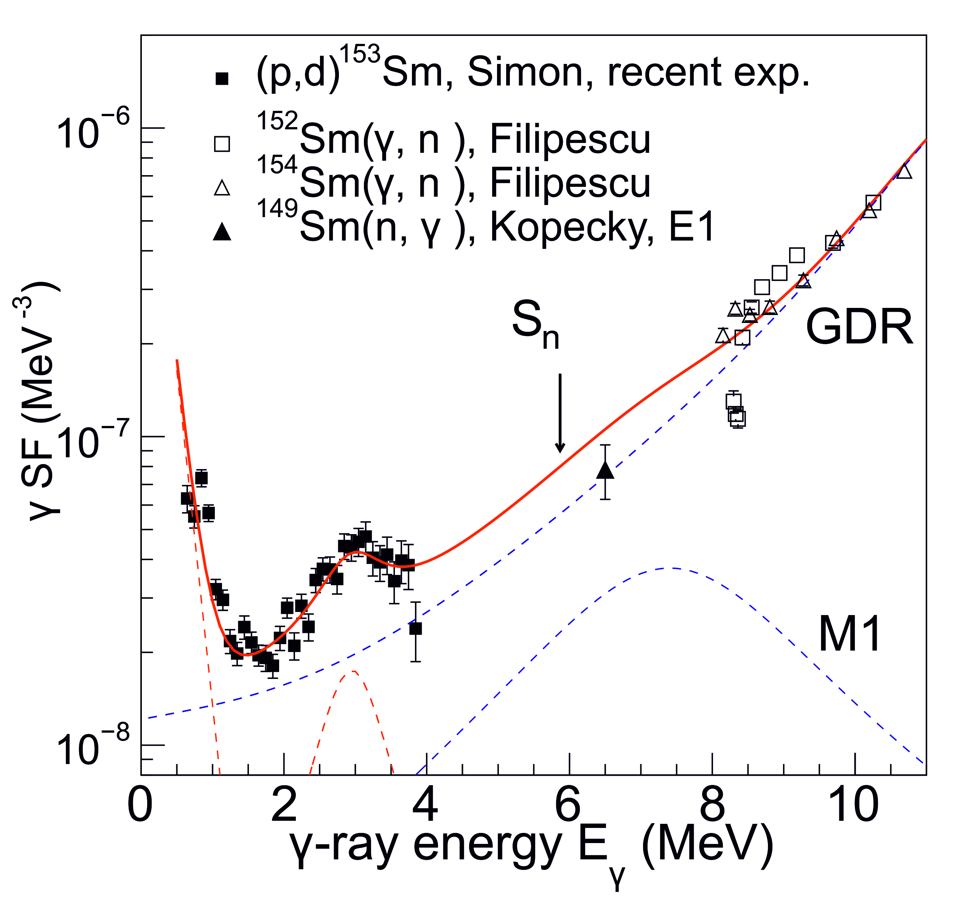
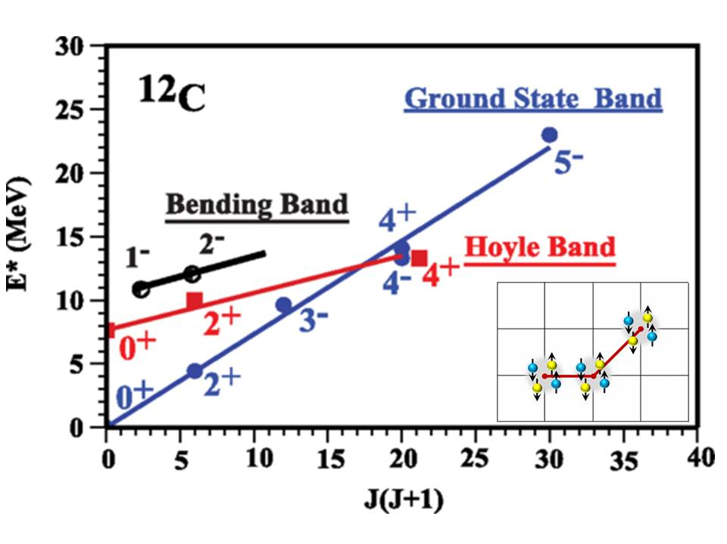
Topics (selected)
Hypernuclei
SHE
Shapes Rn
Transfer reactions,
particle-γ spec ²⁵Ne
Shapes ⁴²Ca, triaxial-SD
γ strength function
Hoyle band

Slide 20
Nuclear Structure
(Summary and open issues)
Nuclear structure involves exploring the very limits of matter –
Isospin N/Z (neutron-rich), Mass (SHE), Temperature and Spin
Rich field
Requires state-of-the-art facilities and instrumentation
Completion of radioactive beam facilities
(FAIR, HIE-ISOLDE, SPES, SPIRAL 2 (EURISOL DF)
Strong support for exiting stable beam facilities
Strong support smaller scale facilities across
Storage rings (FAIR, HIE-ISOLDE)
AGATA

Slide 21
SG3: Reaction Dynamics
Section headings
Investigation of correlations by means of transfer and knockout reactions
Modelling fusion
Interfacing structure with reaction observables
Accessing structures beyond the proton/neutron driplines
Accessing extreme deformations and rare fission modes

Slide 22
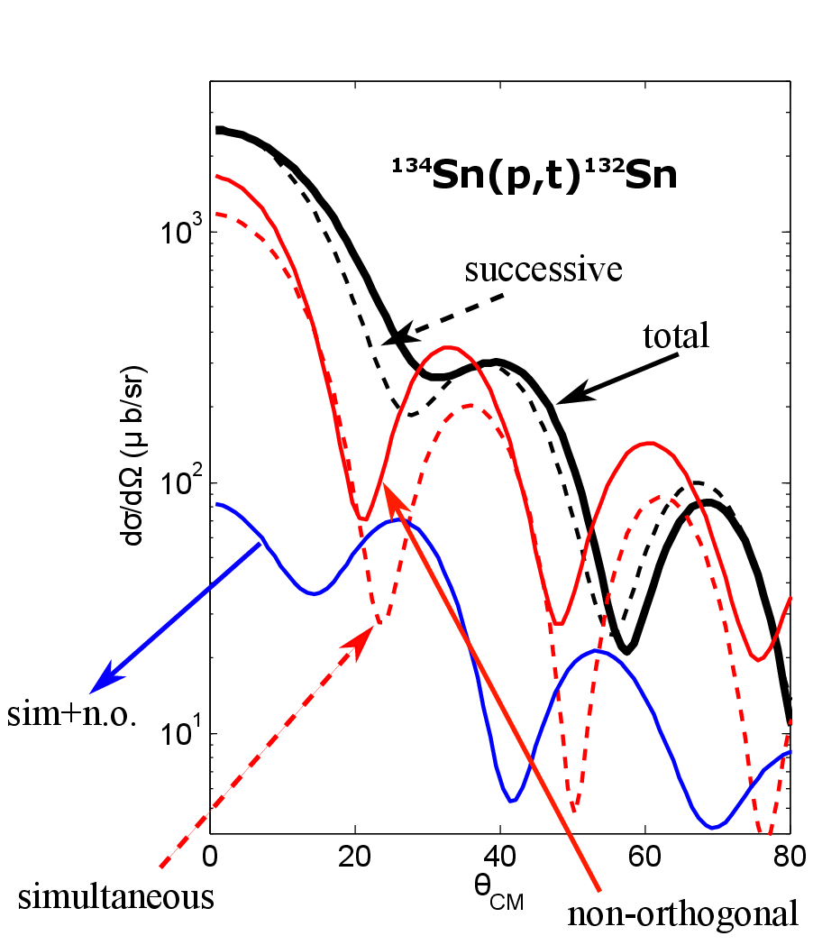
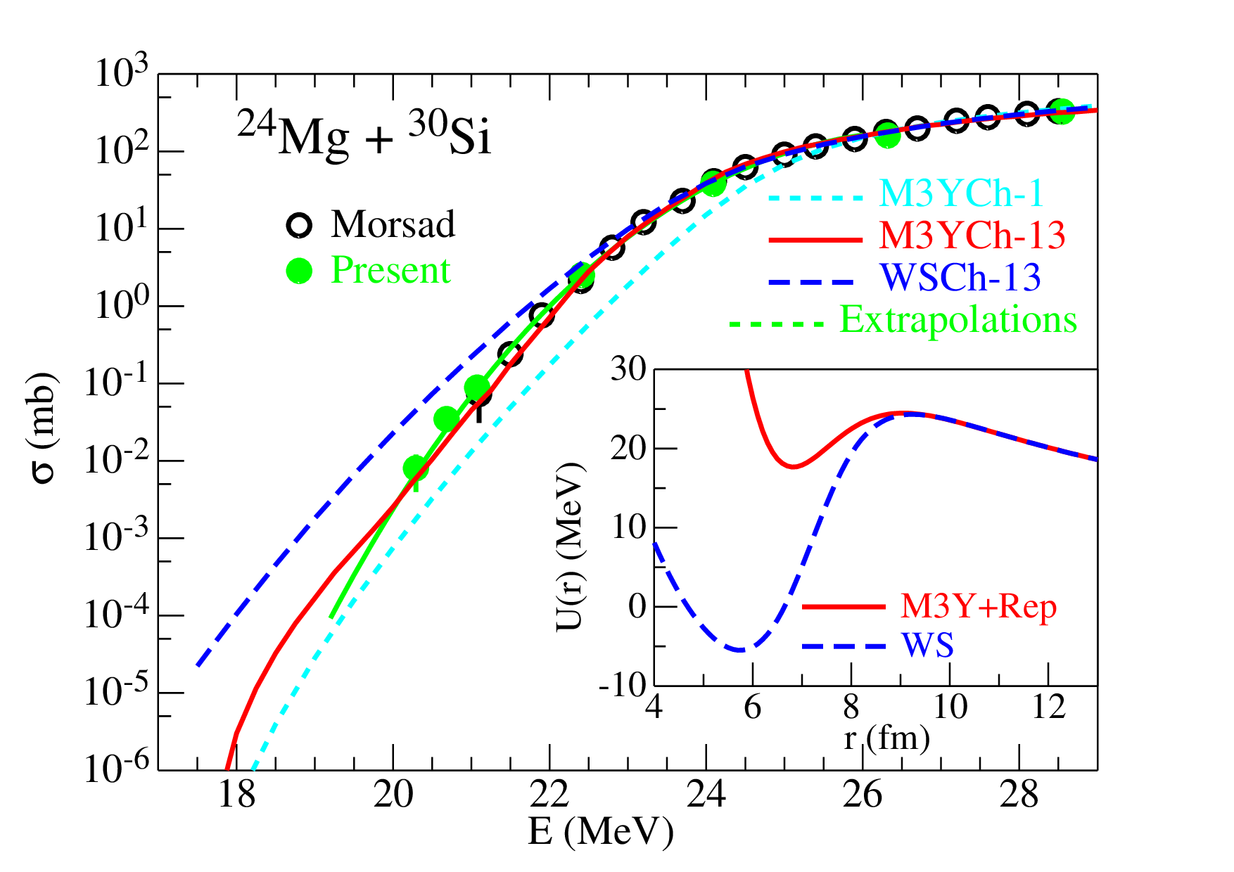
Box 6 Example.
Investigation of correlations by means of transfer and knockout reactions
Modelling fusion
2 particles transfer
The comparison of experimental absolute cross sections with a suitable microscopic reaction theory provides insights on nucleon-nucleon correlations
It will be important to investigate how and to what extent these structure properties influence the evolution of the collision of two nuclei, keeping in mind the importance of the connection between reaction and structure aspects.
The complicated scenario unveiled by recent near-barrier exclusive breakup measurements calls for a better understanding of the processes responsible for the fusion hindrance, and their mutual influence.
To improve our understanding of the heavy-ion fusion hindrance at extreme low energies
Benefit from new generation of detectors array

Slide 23
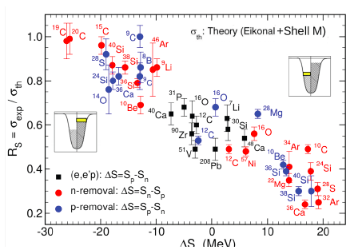
Towards the solution of the spectroscopic factor puzzle
Box Example.

Slide 24
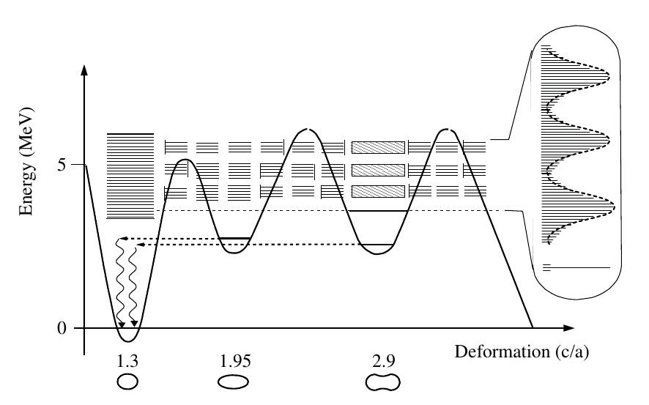
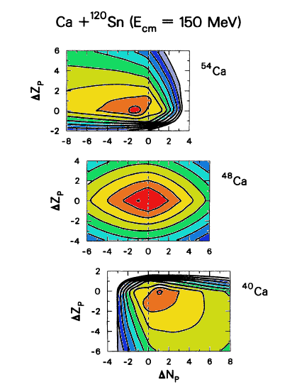
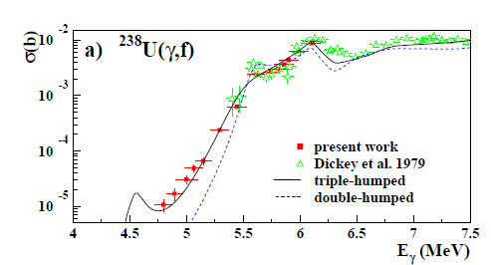
Accessing structures beyond the proton/neutron driplines
Accessing extreme deformation and rare fission modes
Many nuclear reactions produce nuclei beyond the proton or nucleon driplines: transfer, knockout, quasi-free breakup processes, fission, etc.
One of the promising tools for the production of the neutron-rich heavy nuclei is the use of the multinucleon transfer reactions at energies close to the Coulomb barrier.
Studies of the 2nd and 3rd minimum of the fission barrier
Photofission cross section measurements, rare fission modes, ternary fission
(γ,f) experiment at HIγS: Csige et al., Phys. Rev. C 87, 044321 (2013)

Slide 25
SG3: Reaction dynamics
(Summary and open issues)
Better understand incomplete fusion and fusion suppression in weakly bound nuclei
Improve description nucleus-nucleus potential in fusion
Better understanding of HI fusion hindrance at low energy
Microscopic time dep. models for fusion, fission and deep inelastic (HPC)
Better description of the coupling among reaction channels
Collective excitations and particle correlations in reaction models
Describe the third minimum in fission barrier

Slide 26
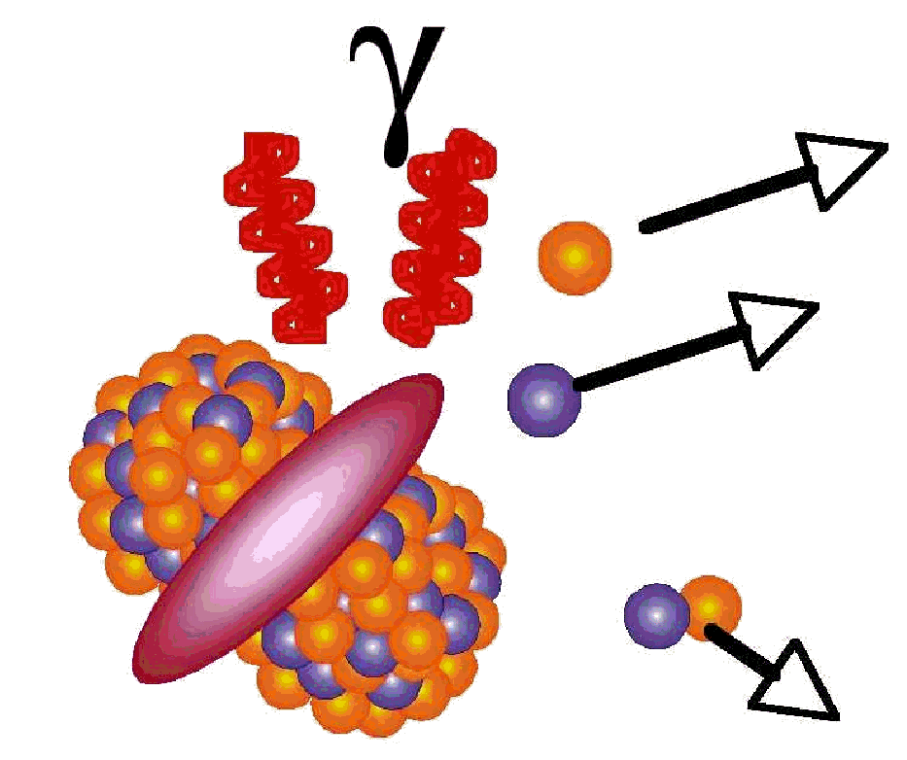
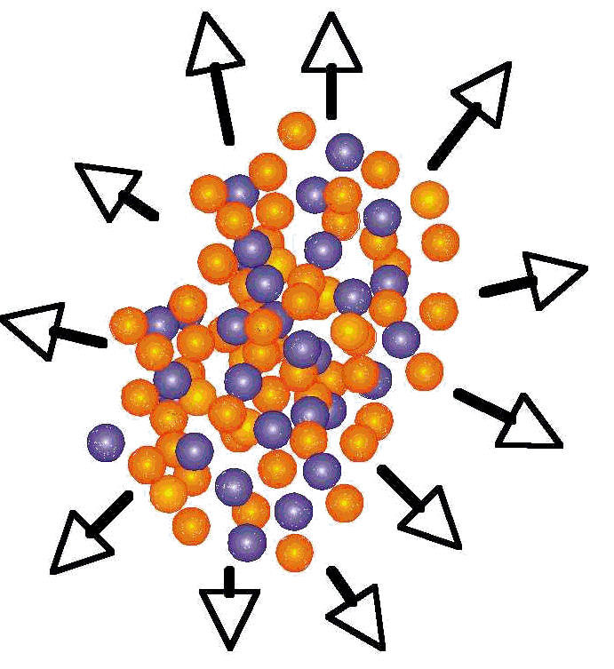
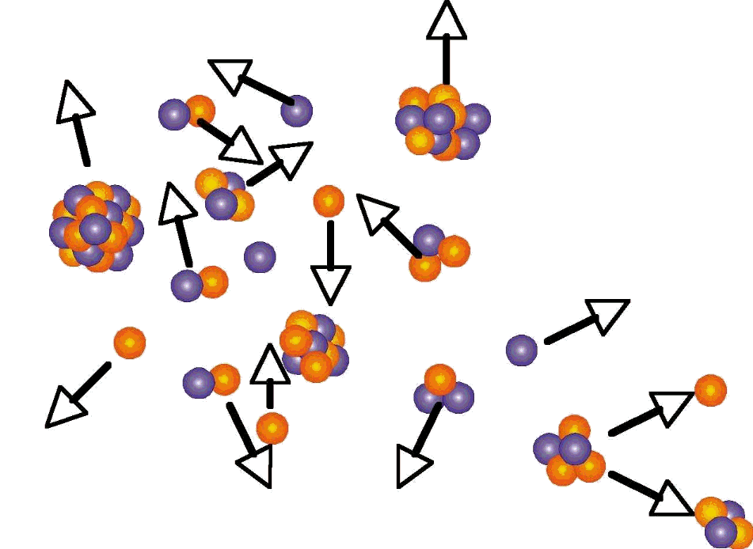
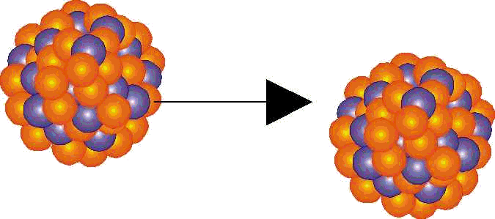
SG4: The Nuclear Equation of State
(key questions)
Section headings
Introduction to the EoS
  E(T, ρ)
  Key role in reaction mechanisms, collective excitations, astrophysics…
The density dependence of the symmetry energy:
  Incompressibility
  Symmetry energy
  Investigations around saturation densities
  Investigations away from saturation densities: heavy ion collisions
  Sub-saturation densities
  Supra-saturation densities
  Status of symmetry energy investigations
  heavy ion collisions
Projectile
Target
Secondary decays
Pre-equilibrium, stopping, compression
Fragmentation
Flow, expansion

Slide 27
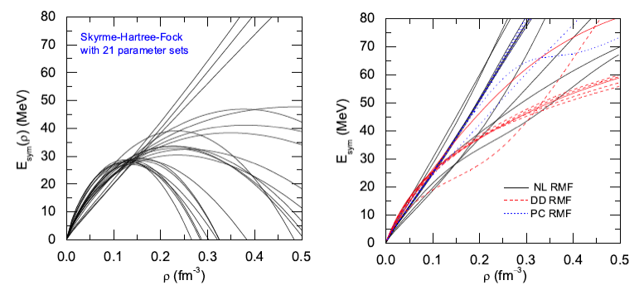
EoS of asymmetric nuclear matter
Asymmetry term
B.A. Li et al., Phys. Rep. 464, 113 (2008)
Stiff
E_{sym}(MeV)
E_{sym}(MeV)
Soft
Esym enhanced in reactions with large N/Z asymmetries (due to δ²)

Slide 28
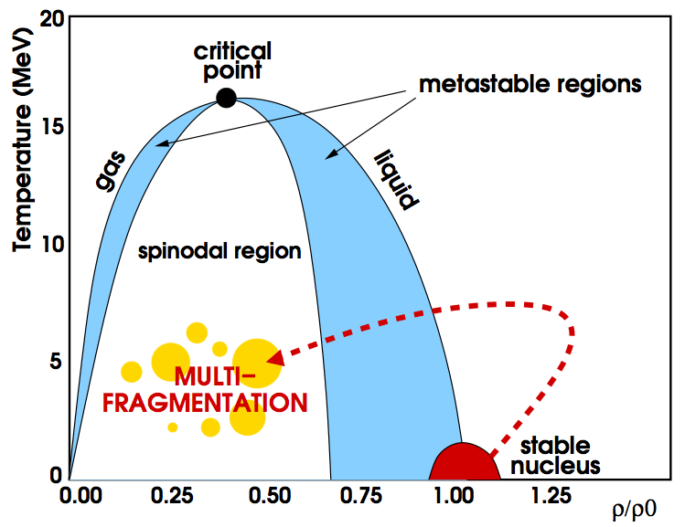
Exciting nuclear matter with HIC
Increasing excitation to induce signature of boson condensation ?
⁴⁰Ca+⁴⁰Ca E/A=35 MeV, peripheral
The path to multifragmentation
INDRA+VAMOS
Bosons (d and α) at higher density than Fermions (p)

Slide 29
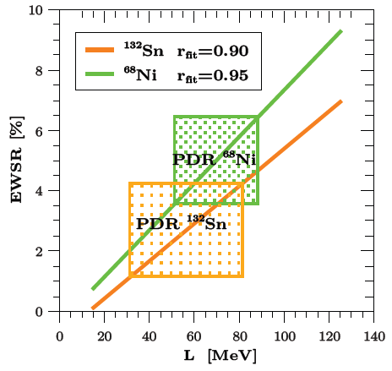
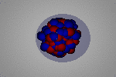
E_{sym} studies with Pygmy Dipole Resonance
Collective oscillation of neutron skin against the Core ? → Esym around saturation density
M.B. Tsang, NN2012
L=65.1±15.5 MeV
S_{o}=32.3±1.3 MeV
+ dipole polarisability, IAS, GDR, PREX comp.
GMR
dR_{np} (²⁰⁸Pb)= 0.20±0.02 fm

Slide 30
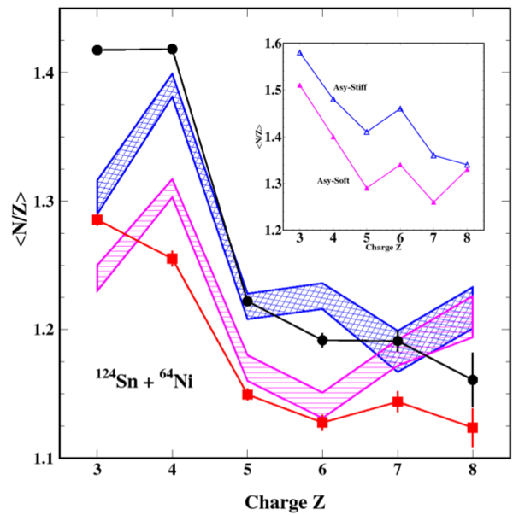
Isospin chronology and E_{sym}(ρ)
N/Z content of neck fragment (dynamical fast emission)
SMF Simulations vs Experimental data
Dynamical - Neck
N/Z content of statistical emission by PLF and TLF
Statistical
PLF:
TLF:
Constrain the density dependence of the symmetry energy
Neck:

Slide 31
SG4: The Nuclear Equation of State
(summary and open issues)
Charged particle production: a) increase solid angle coverage of new generation arrays such as FAZIA: high isotopic resolution over wide dynamic range (Z=1-30) up to ΔΩ≈2π
Neutron production: focus on detectors with large solid angle, high efficiency, high angular resolution
Structure and clustering evolution with density: focus on high angular resolution studies with particle-particle correlations (need position sensitive detectors with large solid angle coverage)
EoS and symmetry energy in synergy with astrophysical constraints and theory
Transport model: need to resolve disagreements between different approaches → comparisons to experimental data need to be solid reducing drastically model dependencies
Above saturation densities (E/A>200MeV): GSI/FAIR energies will allow achieving densities up to ρ≈ρ₀ → encourage the study of probes of symmetry energy from production yield ratios n/p (with NeuLAND), π⁺/π⁻ and K⁺/K⁰

Slide 32
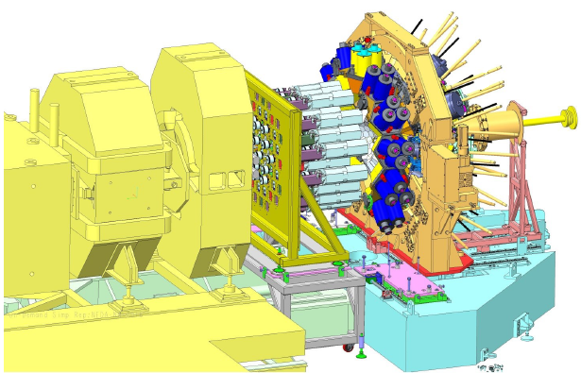
SG5: Facilities and Instrumentation
Accelerator/Reactor facilities
RIB Facilities
Stable Ion Beam and others techniques
Instrumentation
Separators, spectrometers and associated detection for the identification
Detectors for structure and dynamic studies
  Gamma detectors
  Particle detectors
  Neutron detectors
  Active targets
  Hadron spectrometers
Storage rings
Traps and Lasers
Technical Innovations

Slide 33
SG5: Facilities and instrumentation (recommendations)
Radioactive beams (ISOL and in flight):
The urgent completion of FAIR, the Super-FRS and NUSTAR@FAIR, are of utmost importance for the community.
EURISOL is the long term goal that will ensure unique physics opportunities. In the meantime it is important that the development of the existing intermediate major facilities (Spiral2, HIE-ISOLDE and SPES) in the framework of the EURISOL-DF are supported.
A large variety of state-of-the-art instrumentation has to be constructed for their optimal exploitation
Stable beams
Strong support for existing stable beam facilities (ENSAR2 TNA)
Very high-intensity stable-ion beams from the high-power LINAG of the SPIRAL2, the new super-conducting cw-linac under construction at GSI and the Dubna SHE factory are of high importance, especially for out of beam studies of extremely rare nuclei, such as SHE’s.
The long-term goal for a new dedicated high-intensity stable ion beam facility in Europe is recommended as an important future project. See ECOS report.
Other smaller scale facilities, often university based, have to be supported for their specific programmes, for the development of new instruments and also for providing education and training of next generation researchers.

Slide 34
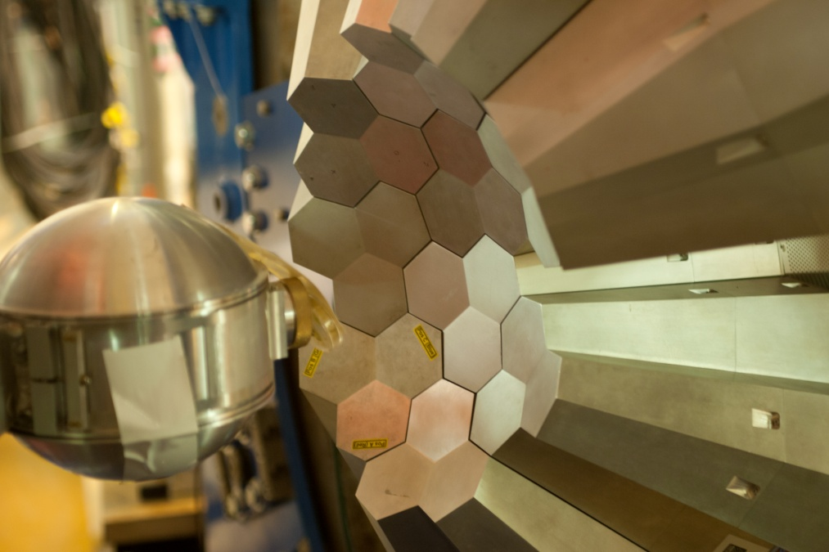
SG5: Facilities and instrumentation (recommendations)
Instrumentation
  One of the strength of the European community is the development of powerful detectors. This must continue.
  The flagship major international project is the gamma detector AGATA that has been used since 2010 at LNL, GSI and GANIL. The timely completion of the full AGATA spectrometer is of highest importance to address the exciting science programme at both the stable and radioactive beam facilities.

Slide 35
WG3: Key recommendations
We recommend to develop efforts towards a universal description of nuclear structure to provide bridges between the ab-initio, shell model and EDF methods.
The exciting science program for nuclear structure, reactions and equation of state requires the development of stable and radioactive facilities. We recommend the urgent completion of FAIR and the development of the major facilities within EURISOL-DF.
The urgent completion of FAIR, the Super-FRS and NUSTAR@FAIR, are of utmost importance for the community. In the interim period it is vital that a high-level research programme and use of the new detectors for FAIR at GSI continues using the existing beams and facilities.
A strength of the European community is the development of powerful detectors and instrumentation. The timely completion of the full AGATA spectrometer is of
highest importance to address the exciting science program at both the stable and radioactive beam facilities.

Slide 36
Thanks
All contributors and sub group leaders who have prepared the document and slides for this presentation
Comments, questions, suggestions, help!

Slide 37


Slide 38
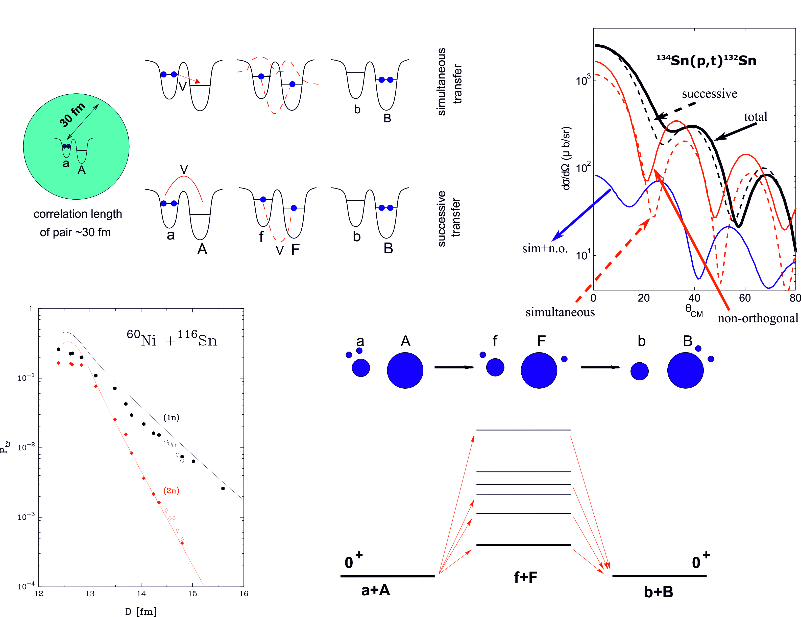
Box Example.
Two-particles transfer reaction
and pairing correlations
Notes:
Two particle transfer description is known to be a difficult topic
However, present approaches are now able to take into account both sequential and simultaneous 2 particles transfer processes.
Examples are given for (p,t) on ¹³²Sn and the ⁶⁰Ni+¹¹⁶Sn reaction.

