Slide 1



NuPECC Town
Meeting
13 January 2017

Slide 2
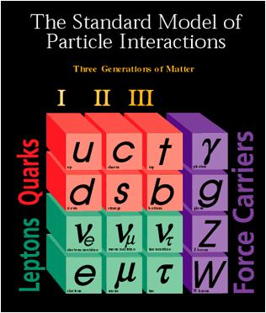
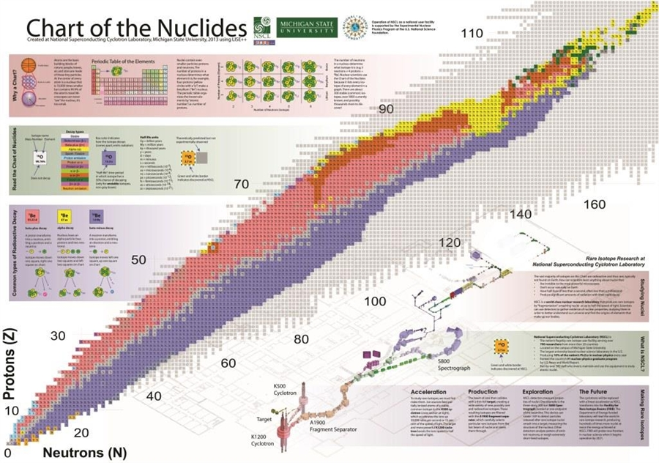
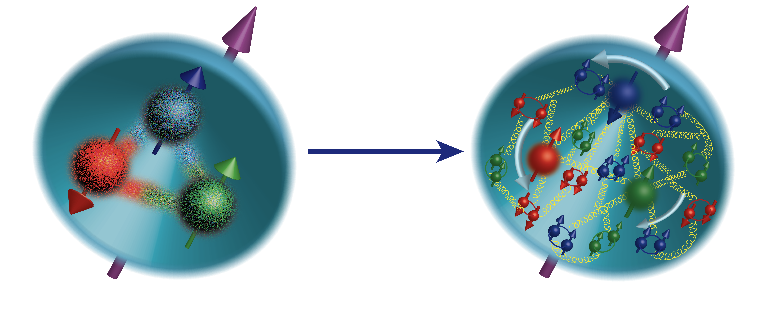
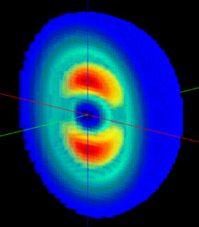
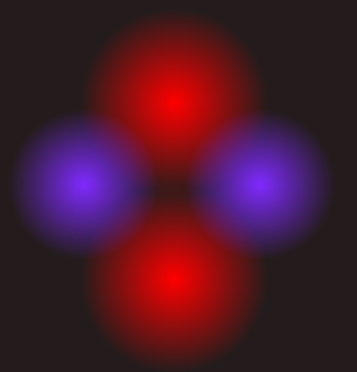
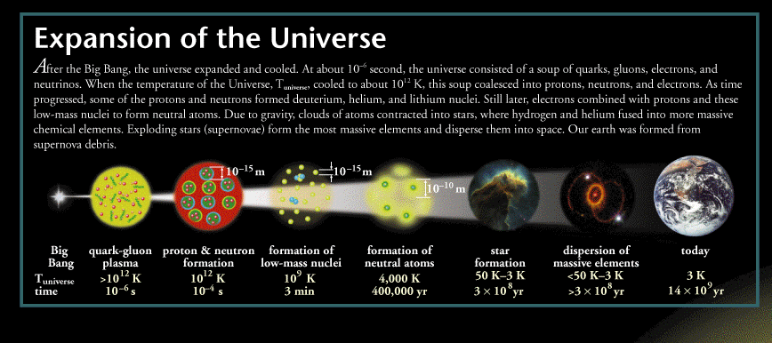
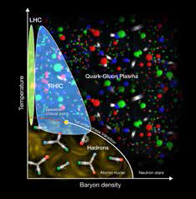
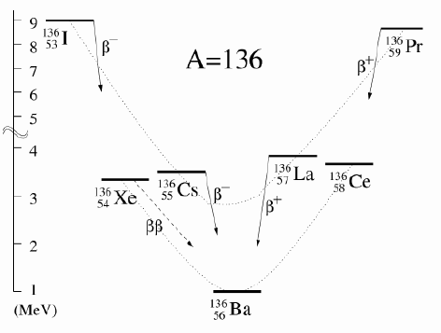
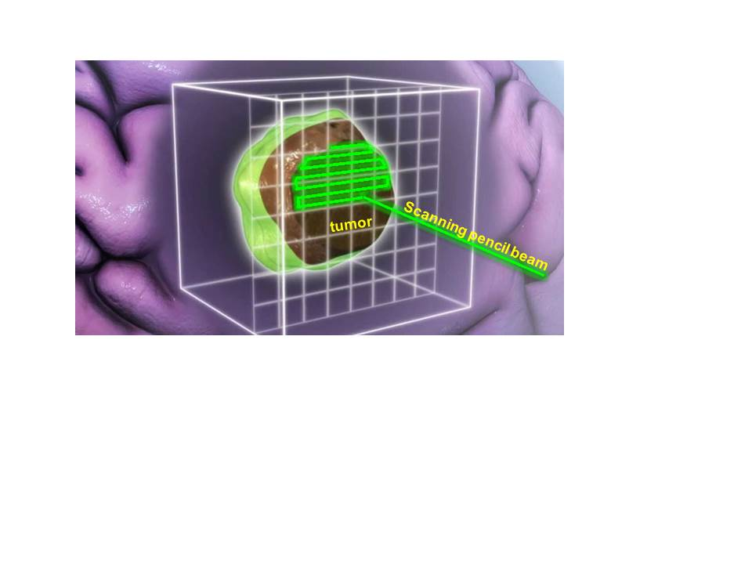

Will
21st Century Nuclear Science:
Probing nuclear matter in all Its forms & exploring their potential for applications
Where in the universe, and how, were the heavy elements formed? How do supernovae explode?
How are the properties of protons and neutrons, and the force between them, built up from quarks, antiquarks and gluons? What is the mechanism by which these fundamental particles materialize as hadrons?
Where are the limits of nuclear existence, and what is the structure of nuclei near those limits?
What is the nature of the different phases of nuclear matter through which the universe has evolved?
Do nucleons and all nuclei, viewed at near light speed, appear as walls of gluons with universal properties?
How can the properties of nuclei be used to reveal the fundamental processes that produced an imbalance between matter and antimatter in our universe?
How are the nuclear building blocks manifested in the internal structure of compact stellar objects, like neutron stars?
How can technologies developed for basic nuclear physics research be adapted to address society’s needs?

Slide 3
FY07 LRP Recommendations are being implemented!
These were made after a period, 2001-2006, of little major construction.
Complete JLAB 12 GeV - almost complete
Build FRIB - now well underway
Targeted program in fundamental symmetries
- underway
Upgrade RHIC - completed at 1/7 the anticipated
cost
Resources for R&D for EIC – steps forward
Initiatives in theory, gamma-ray tracking and Accelerator R&D - major progress, theory topical collaborations, GRETINA

Slide 4
2015 Recommendations – in brief
The exact text is important!
Recommendations
  Follow the 2007 LRP
  Lead a ton-scale neutrinoless double beta decay experiment
  Build an Electron Ion Collider after FRIB construction is compete
  Increase investment in small and mid scale projects and initiatives
Initiatives
  Theory and Theory Computing
  R&D for the EIC and neutrinoless double beta decay
Workforce, Education and Outreach

Slide 5
We rely on off-shore facilities
Higher energy relativistic heavy ions – LHC
Multi-GeV energy hadron beams – J-PARC, FAIR, CERN
Higher energy radioactive beams – RIBF, GSI, FAIR
ISOL radioactive beams – TRIUMF, ISOLDE, SPIRAL
To a large part, neutrons and neutrinos from reactors
Lower energy electron beams – Mainz
High resolution transfer reactions with stable beams – RCNP, MLL
In some cases, U.S. scientists are users of these facilities. In others, we count on experiments at these facilities to provide complementary information.

Slide 6
RECOMMENDATION I
The progress achieved under the guidance of the 2007 Long Range Plan has reinforced U.S. world leadership in nuclear science. The highest priority in this 2015 Plan is to capitalize on the investments made.
With the imminent completion of the CEBAF 12-GeV Upgrade, its forefront program of using electrons to unfold the quark and gluon structure of hadrons and nuclei and to probe the Standard Model must be realized.
Expeditiously completing the Facility for Rare Isotope Beams (FRIB) construction is essential. Initiating its scientific program will revolutionize our understanding of nuclei and their role in the cosmos.
The targeted program of fundamental symmetries and neutrino research that opens new doors to physics beyond the Standard Model must be sustained.
The upgraded RHIC facility provides unique capabilities that must be utilized to explore the properties and phases of quark and gluon matter in the high temperatures of the early universe and to explore the spin structure of the proton.
Realizing world-leading nuclear science also requires robust support of experimental and theoretical research at universities and national laboratories and operating our two low-energy national user facilities —ATLAS and NSCL— each with their unique capabilities and scientific instrumentation.
The ordering of these four bullets follows the priority ordering of the 2007 plan.

Slide 7
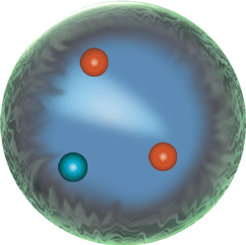
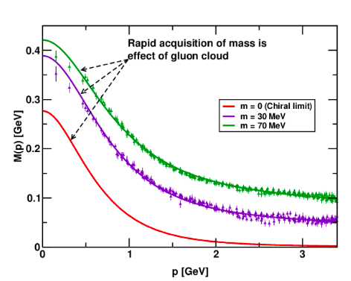
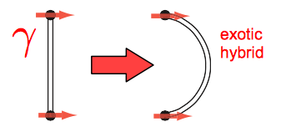
The CEBAF 12 GeV Era
The upgraded CEBAF has the ideal beam properties to learn about the dynamics of the valence quarks that determine the quantum numbers of strongly interacting particles.
We have learned this dynamics is strongly influenced by the mechanism that develops mass in QCD, dynamical chiral symmetry breaking.
We have a firm theoretical framework to measure the correlations between quark momentum and transverse position, 3D imaging.
We will search for particles where the glue helps determine the quantum numbers.

Slide 8
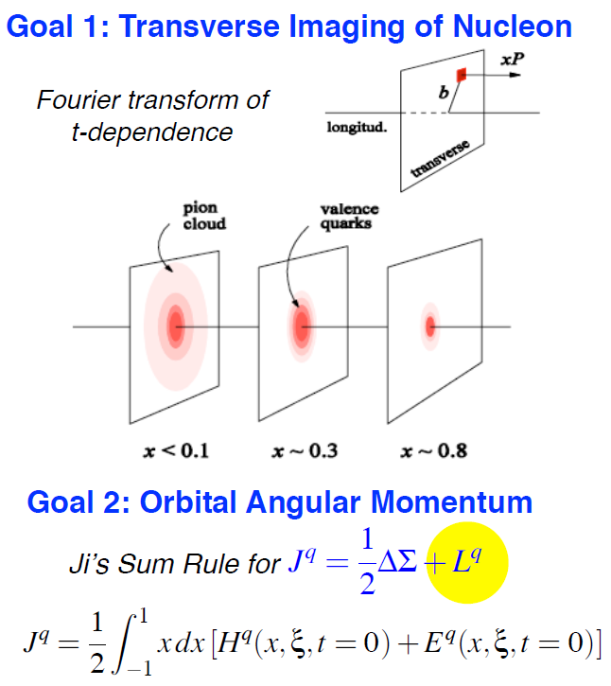
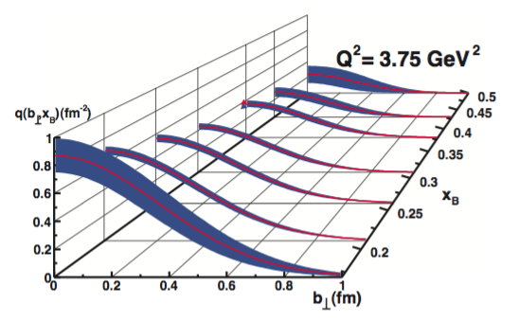
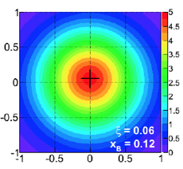
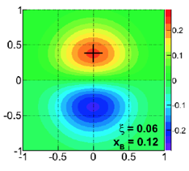
Three Dimensional Images of the Proton
The proton’s transverse profile as function of the impact parameter b
Distortions induced by spin direction
N polarization
b_{y}
CLAS12 with help from Halls A & C
b_{x} (fm)
GPD H and E
GPD E only

Slide 9
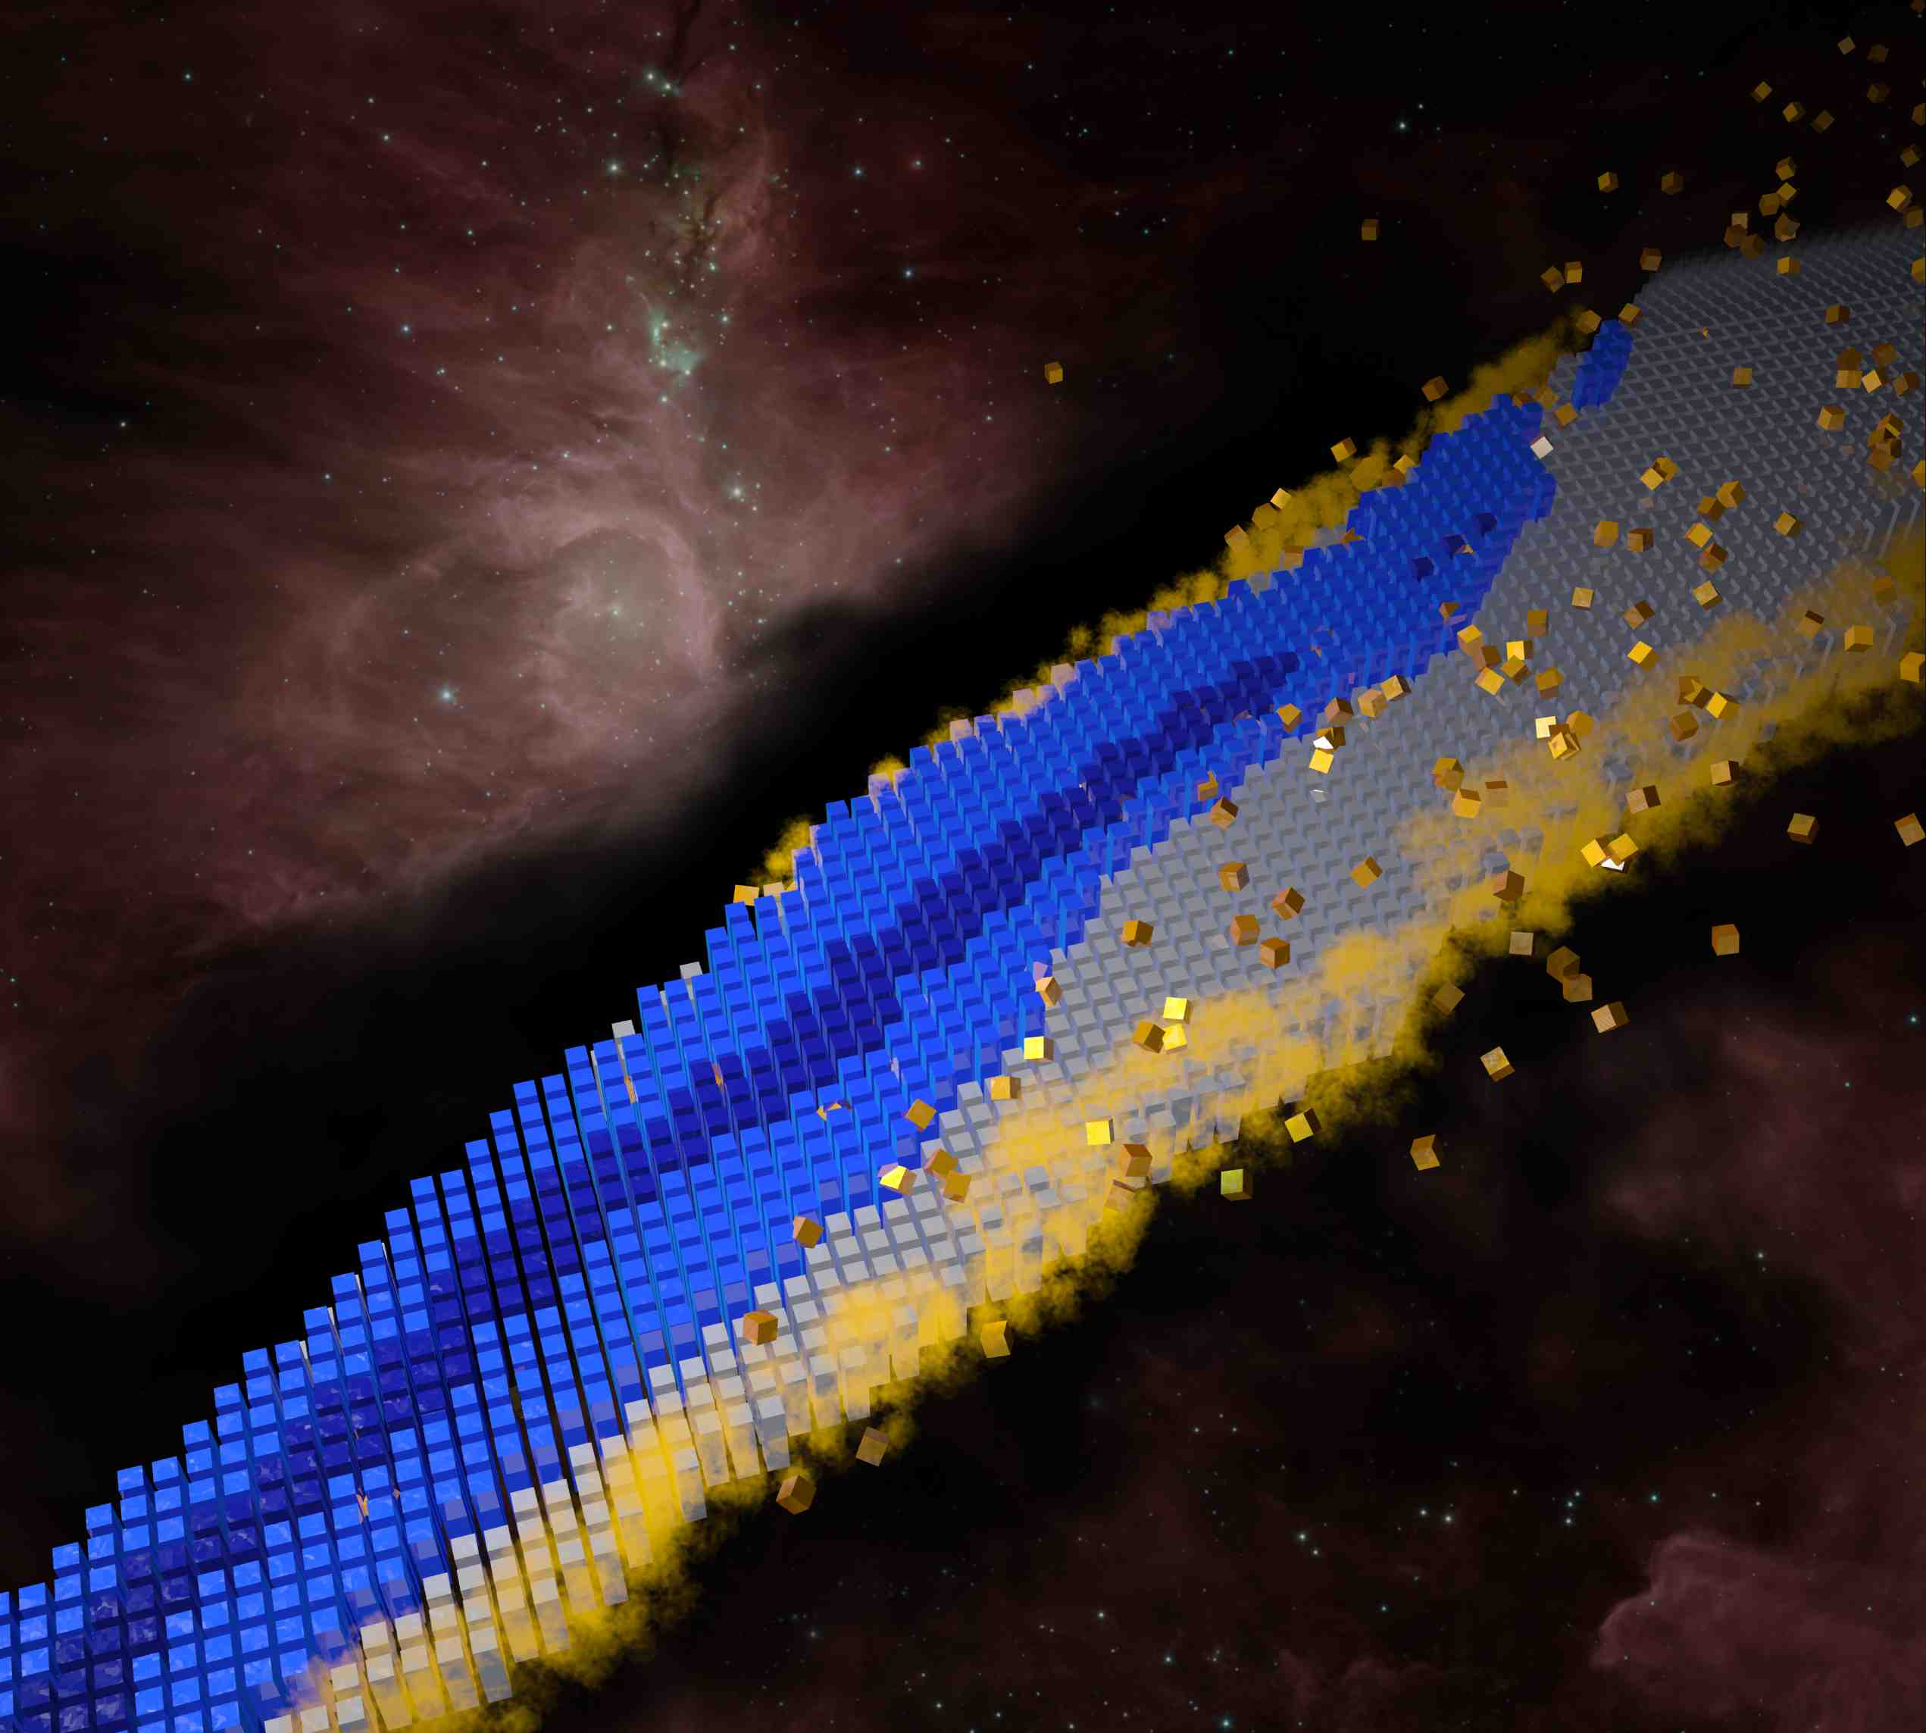
The FRIB ERA
The Nuclear Landscape and the Big Questions
Where do nuclei and elements come from?
How are nuclei organized?
What are practical and scientific uses of nuclei?
BOTTOM LINE
Revolution due to major advances in accelerator technology, experimental techniques, analytic theory, and computing. This has led to a shift from phenomenological picture to nuclear theory grounded in the Standard Model. Today, we are constructing a roadmap that will lead to a predictive theory of nuclei.
To Understand, Predict, and Use…
Notes:
http://www.astro.ucla.edu/~wright/BBNS.html

Slide 10
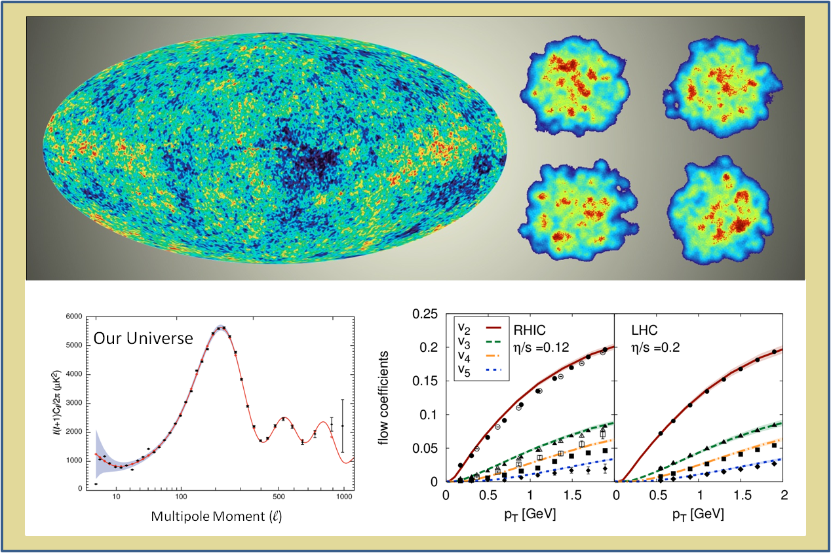
RHIC and the LHC
The Big Bang vs Lots of Little Bangs
In both cases the measurements at later time reveal the fluctuations in the initial conditions which are remarkably preserved during the expansion.

Slide 11
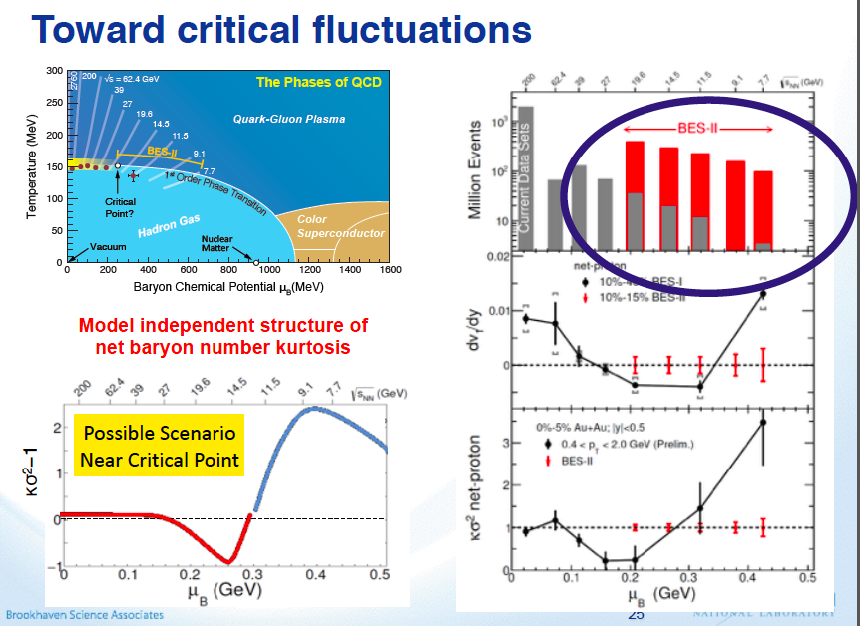

Slide 12
RECOMMENDATION II
The excess of matter over antimatter in the universe is one of the most compelling mysteries in all of science. The observation of neutrinoless double beta decay in nuclei would immediately demonstrate that neutrinos are their own antiparticles and would have profound implications for our understanding of the matter-antimatter mystery.
We recommend the timely development and deployment of a U.S.-led ton-scale neutrinoless double beta decay experiment.
A ton-scale instrument designed to search for this as-yet unseen nuclear decay will provide the most powerful test of the particle-antiparticle nature of neutrinos ever performed. With recent experimental breakthroughs pioneered by U.S. physicists and the availability of deep underground laboratories, we are poised to make a major discovery.
This recommendation flows out of the targeted investments of the third bullet in Recommendation I. It must be part of a broader program that includes U.S. participation in complementary experimental efforts leveraging international investments together with enhanced theoretical efforts to enable full realization of this opportunity.
Expected to be an international effort with possible international siting

Slide 13
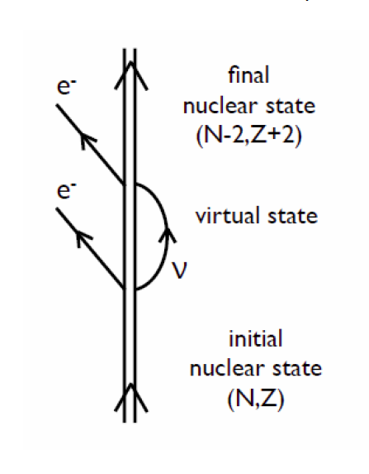
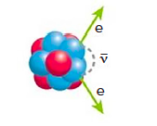
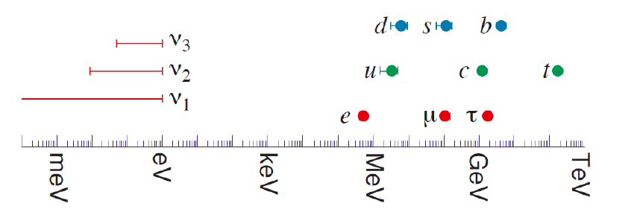
Neutrinoless Double Beta Decay
Observation of Neutrinoless
Double Beta Decay would
Demonstrate the lepton number is not conserved
Prove that a neutrino is an elementary Majorana particle, that is, its own antiparticle.
Suggest that a new mechanism for mass generation, not the Higgs mechanism, is at work.
Provide evidence for one of the key ingredients that could explain the preponderance of matter over antimatter in the universe, leptogenesis.

Slide 14
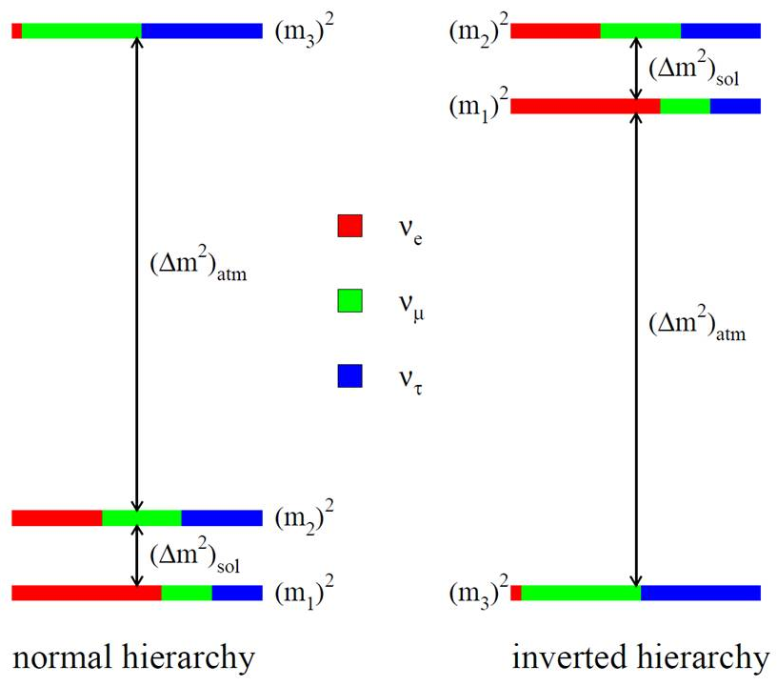
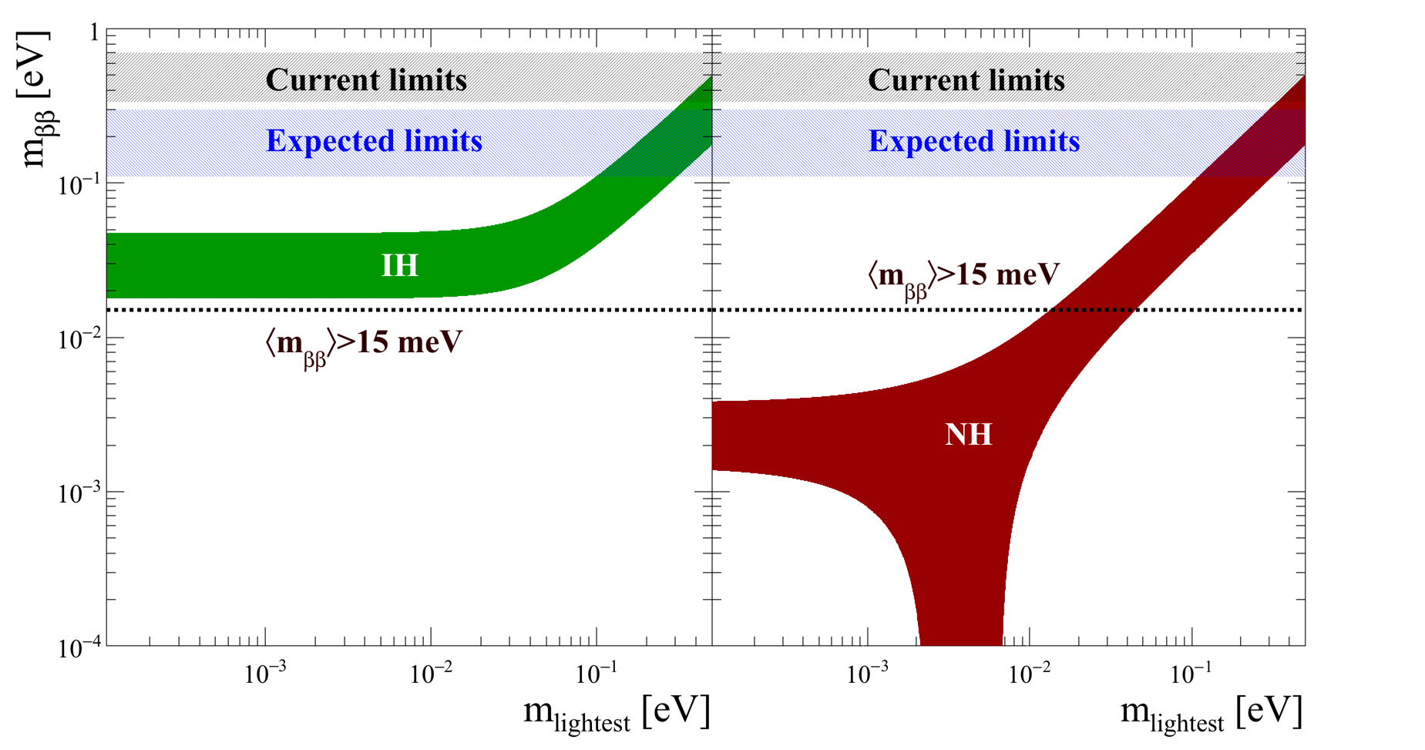
In the light neutrino exchange mechanism the decay rate depends directly on a weighted sum of the masses of light neutrinos. With data from neutrino oscillations which only measure mass differences, we know the expected weighted sum, subject to knowing the mass of the lightest neutrino and which hierarchy is realized in nature.
Goal of ton-scale experiments

Slide 15
Other Information on Neutrino Masses
Direct measurement in nuclear beta decay: KATRIN aiming for 200 meV
Long-Baseline Neutrino Oscillations (HEP): NOVA expects 3 sigma determination of hierarchy in three years
  First data release of T2K and Nova provide 1-2 sigma hints of normal hierarchy
  In both cases only a few events and requires excellent control of backgrounds
Cosmology:
  Current limit: Planck + BAO: < 230 meV implies m_{ββ} < 90 meV
  CMB-S4 + DESI project < 15 meV (early 2020’s)
These constraints rely on an underlying set of simplifying model assumptions
[scale invariance, flatness, w = -1, etc.]. This introduces a level of theoretical
model (systematic) uncertainty. Laboratory complementarity is essential.
eV sterile neutrinos also can increase the weighted mass sum
We need to have double beta decay results on the same time scale as these complementary results. Tension between them can point to other well motivated neutrinoless double beta decay mechanisms or issues in cosmology.

Slide 16
RECOMMENDATION III
Gluons, the carriers of the strong force, bind the quarks together inside nucleons and nuclei and generate nearly all of the visible mass in the universe. Despite their importance, fundamental questions remain about the role of gluons in nucleons and nuclei. These questions can only be answered with a powerful new Electron Ion Collider (EIC), providing unprecedented precision and versatility. The realization of this instrument is enabled by recent advances in accelerator technology.
We recommend a high-energy high-luminosity polarized Electron Ion Collider as the highest priority for new facility construction following the completion of FRIB.
The EIC will, for the first time, precisely image gluons in nucleons and nuclei. It will definitively reveal the origin of the nucleon spin and will explore a new Quantum Chromodynamics (QCD) frontier of ultra-dense gluon fields, with the potential to discover a new form of gluon matter predicted to be common to all nuclei. This science will be made possible by the EIC’s unique capabilities for collisions of polarized electrons with polarized protons, polarized light ions, and heavy nuclei at high luminosity.

Slide 17
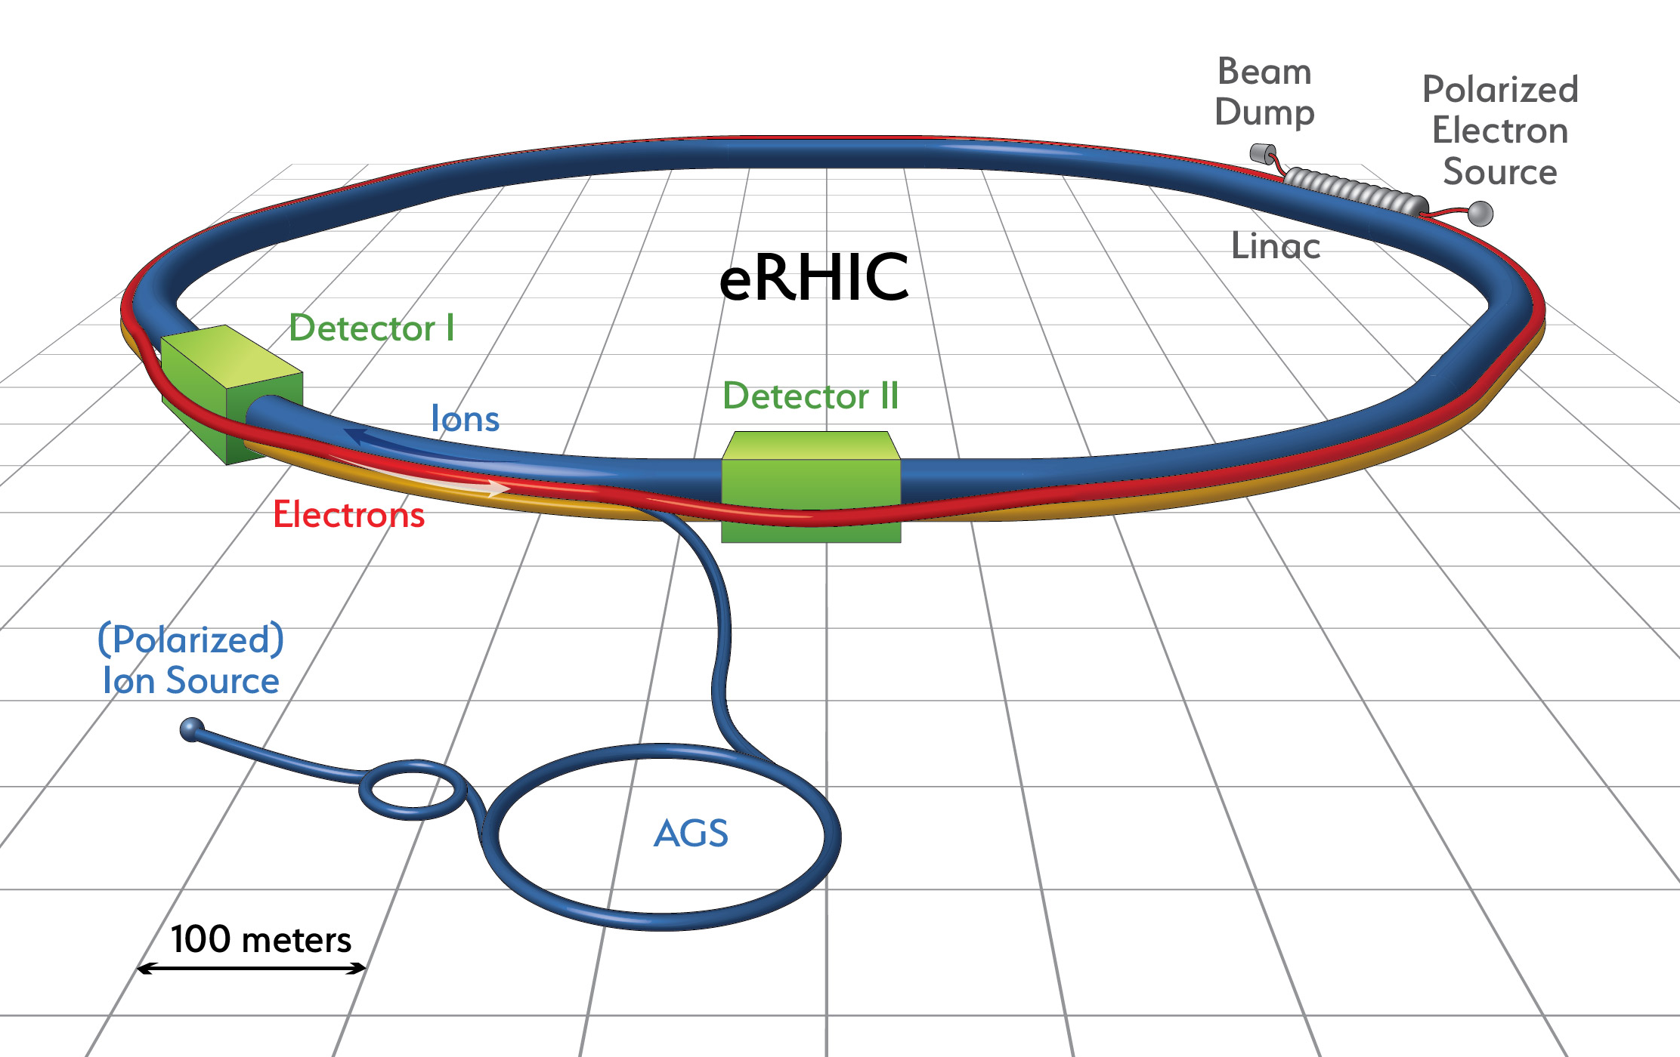
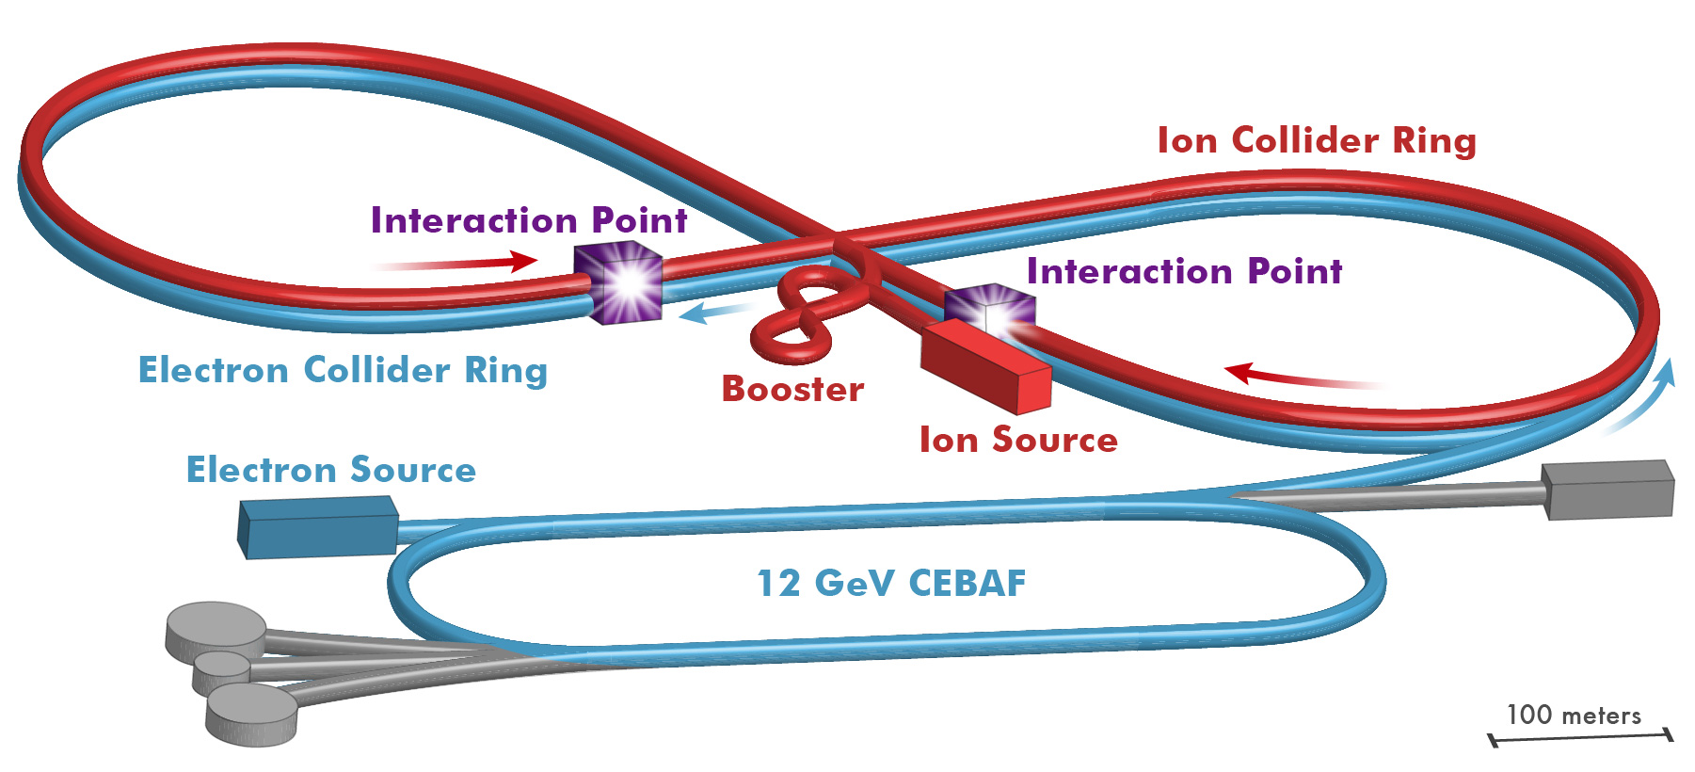
The Electron Ion Collider
Two options of realization!
For e-N collisions at the EIC:
Polarized beams: e, p, d/³He
e beam 5-10(20) GeV
Luminosity L_{ep} ~ 10³³⁻³⁴ cm⁻²sec⁻¹
  100-1000 times HERA
20-100 (140) GeV Variable CoM
LINAC-Ring
Ring-Ring
For e-A collisions at the EIC:
Wide range in nuclei
Luminosity per nucleon same as e-p
Variable center of mass energy
Not to scale
JLEIC
Ring-Ring
World’s first
Polarized electron-proton/light ion
and electron-Nucleus collider
Both designs use DOE’s significant investments in infrastructure
Ed. A. Deshpande, Z.-E. Meziani, J.-W. Qiu
Notes:
Contrast with HERA could be made more explicit. Table/column presentation.

Slide 18
EIC Distinct from (the past) HERA
Luminosity 100-1000 times that of HERA
  Enable 3D tomography of gluons and sea quarks in protons
Polarized protons and light nuclear beams
  Critical to all spin physics related studies, including precise knowledge of gluon’s spin & angular momentum contributions from partons to the nucleon’s spin
Nuclear beams of all A (p→U)
  To study gluon density at saturation scale and to search for coherent effects like the color glass condensate and test its universality
Center mass variability with minimal loss of luminosity
  Critical to study onset of interesting QCD phenomena
Detector & IR designs mindful of “Lessons learned from HERA”
  No bends in e-beam, maximal forward acceptance….

Slide 19
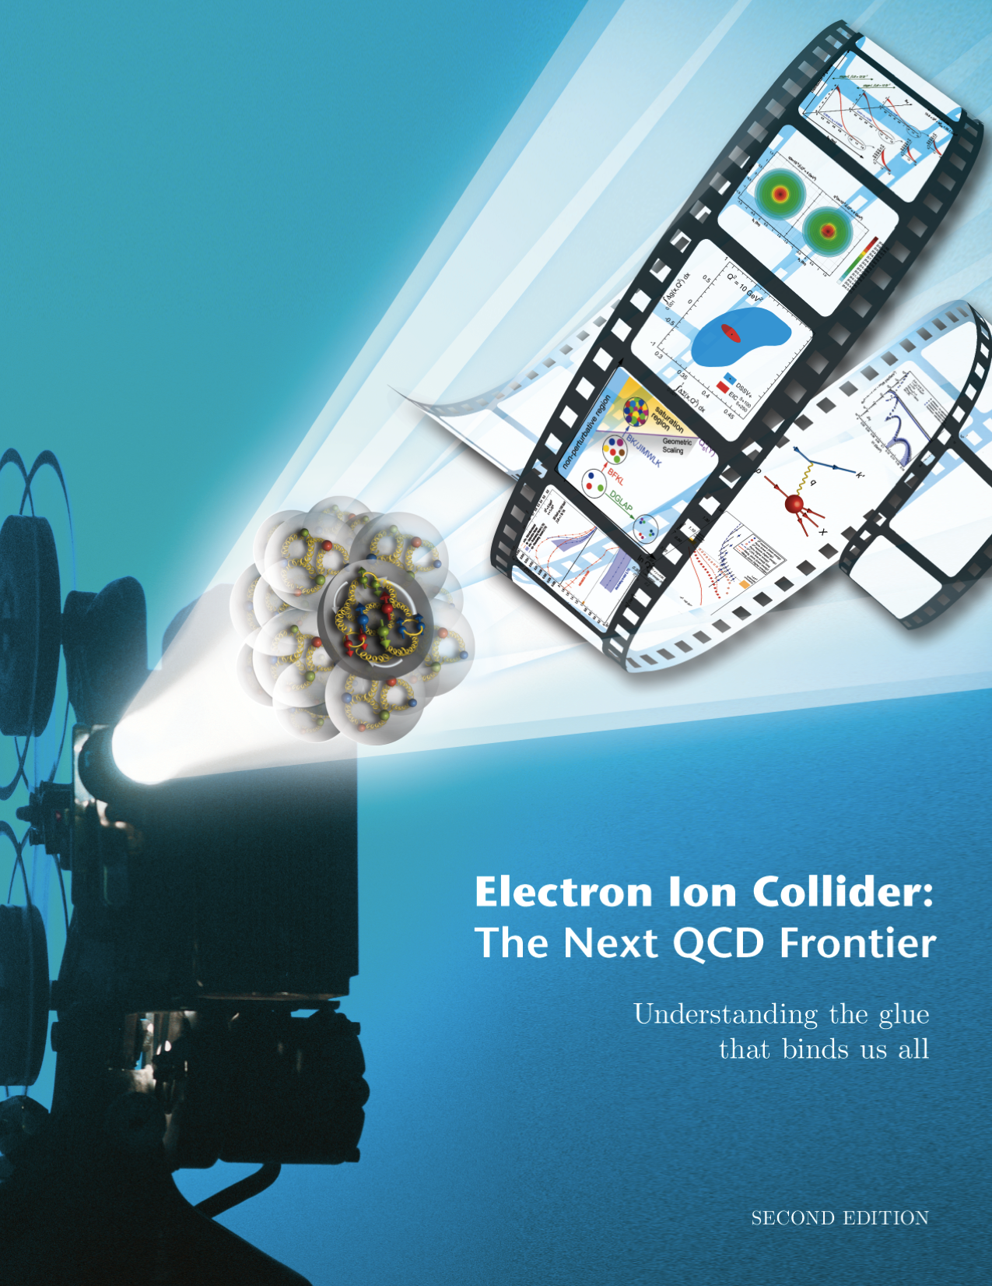
3-Dimensional Imaging Quarks and Gluons
W(x,b_{T},k_{T})
Momentum
space
Coordinate
space
∫d²b_{T}
∫ d²k_{T}
f(x,k_{T})
f(x,b_{T})
Quarks
Gluons
Spin-dependent 3D momentum space
images from semi-inclusive scattering
Spin-dependent 2D (transverse spatial) + 1D (longitudinal momentum) coordinate space images from exclusive scattering
Position r X Momentum p → Orbital Motion of Partons
➔ Directly comparable with Lattice QCD Calculations

Slide 20
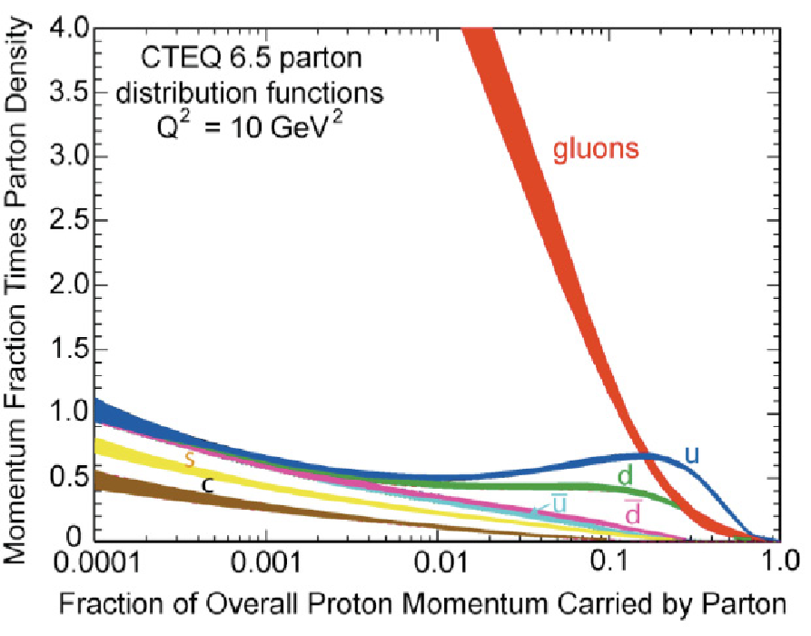
What do we learn from low-x studies?
What tames the low-x rise?
New evolution eqn.s @ low x & moderate Q²
Saturation Scale Q_{S}(x) where gluon emission and recombination comparable
gluon
emission
gluon recombination
Resolution
=
At Q_{S}
1/Energy
First observation of gluon recombination effects in nuclei:
➔leading to a collective gluonic system!
First observation of g-g recombination in different nuclei
Is this a universal property?
Is the Color Glass Condensate the correct effective theory?
Notes:
Color Glass Condensate mentioned for the first time here!

Slide 21
Physics with nuclei….
How do gluons and sea quarks contribute to the nucleon-nucleon force?
Are gluons distributions broader than quark distributions in nuclei?
How does the nuclear environment affect the distributions of quarks and gluons and their interactions inside nuclei?
Color correlations within nuclei
How does nuclear matter respond to fast moving color charge passing through it? (hadronization…. confinment?)
➔ How does a jet propagate through a nucleus (new?)

Slide 22

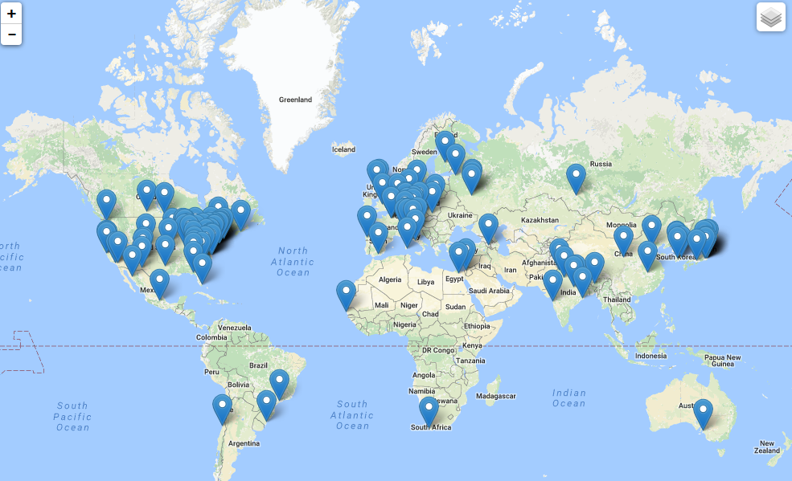
The EIC Users Group: EICUG.ORG
(no students included as of yet)
670 collaborators, 28 countries, 150 institutions... (December, 2016)
Map of institution’s locations

Slide 23
The Path Forward for the EIC
National Academy of Science Review of the EIC
  Report due around end of 2017
  NuPECC LRP support for the science would be very valuable.
Accelerator R&D program ~7$M/year in FY17
Generic Detector R&D program ~$1.3M/year
There is a real opportunity for international sources to make a big impact on the physics goals and scope.

Slide 24
RECOMMENDATION IV
We recommend increasing investment in small-scale and mid-scale projects and initiatives that enable forefront research at universities and laboratories.
Innovative research and initiatives in instrumentation, computation, and theory play a major role in U.S. leadership in nuclear science and are crucial to capitalize on recent investments. The NSF competitive instrumentation funding mechanisms, such as the Major Research Instrumentation (MRI) program and the Mathematical & Physical Sciences mid-scale research initiative, are essential to enable university researchers to respond nimbly to opportunities for scientific discovery. Similarly, DOE-supported research and development (R&D) and Major Items of Equipment (MIE) at universities and national laboratories are vital to maximize the potential for discovery as opportunities emerge.
One of the first examples of an increase in mid-scale project funding was the LHC upgrades

Slide 25
The Role of the NSAC Long Range Plan in Projects
NSAC is asked to identify scientific opportunities and a level of resources necessary to achieve these. The recommendations express priorities. But, except for the largest-scale facilities, projects named in this report are given as examples to carry out the science. The funding agencies have well-established procedures to evaluate the scientific value and the cost and technical effectiveness of individual projects. There is a long-standing basis of trust that if NSAC identifies the opportunities, the agencies will do their best to address these, even under the constraints of budget challenges.

Slide 26
A: Theory Initiative
Advances in theory underpin the goal that we truly understand how nuclei and strongly interacting matter in all its forms behave and can predict their behavior in new settings.
To meet the challenges and realize the full scientific potential of current and future experiments, we require new investments in theoretical and computational nuclear physics.
We recommend new investments in computational nuclear theory that exploit the U.S. leadership in high-performance computing. These investments include a timely enhancement of the nuclear physics contribution to the Scientific Discovery through Advanced Computing program and complementary efforts as well as the deployment of the necessary capacity computing.
We recommend the establishment of a national FRIB theory alliance. This alliance will enhance the field through the national FRIB theory fellow program and tenure-track bridge positions at universities and national laboratories across the U.S.
We recommend the expansion of the successful Topical Collaborations initiative to a steady-state level of five Topical Collaborations, each selected by a competitive peer-review process.

Slide 27
B: Initiative for Detector and Accelerator Research and Development
U.S. leadership in nuclear physics requires tools and techniques that are state-of-the-art or beyond. Targeted detector and accelerator R&D for the search for neutrinoless double beta decay and for the Electron Ion Collider is critical to ensure that these exciting scientific opportunities can be fully realized.
We recommend vigorous detector and accelerator R&D in support of the neutrinoless double beta decay program and the Electron Ion Collider.

Slide 28
Workforce, Education, and Outreach
A workforce trained in cutting-edge nuclear science is a vital resource for the Nation.
Our Nation needs a highly trained workforce in nuclear science to pursue research, develop technology, and ensure national security. Meeting this need relies critically on recruiting and educating early career scientists.
We recommend that the NSF and DOE take the following steps.
Enhance programs, such as the NSF-supported Research Experience for Undergraduates (REU) program, the DOE-supported Science Undergraduate Laboratory Internships (SULI), and the DOE-supported Summer School in Nuclear and Radiochemistry, that introduce undergraduate students to career opportunities in nuclear science.
Support educational initiatives and advanced summer schools, such as the National Nuclear Physics Summer School, designed to enhance graduate student and postdoctoral instruction.
Support the creation of a prestigious fellowship program designed to enhance the visibility of outstanding postdoctoral researchers across the field of nuclear science.

Slide 29
Budgets
It is well recognized that resources are always limited, and hard choices have been made concerning parts of the program that could not go forward in a realistic budget scenario. For example, the 2013 NSAC report Implementing the 2007 Long Range Plan responded to a more constrained budget picture than was originally expected. The resulting focused plan has been widely supported by the community, the Administration and the Congress. This 2015 Long Range Plan also involves hard choices to go forward with constrained budget scenarios.

Slide 30
Project Sequencing
FY15-18 as in 2013 Implementation Plan and consistent with the FY16 President’s budget request
Ton-scale neutrinoless double beta decay starts near end of the decade after FRIB peak.
  Need for demonstration projects to show what they can do and need for more R&D
  A standing NSAC subcommittee is providing advice.
EIC construction after completion of FRIB construction.
  Time scale set, in part, by exciting physics at current facilities, by R&D required, and, in part, to avoid the need for large sudden budget increase.
  Significant redirection from existing facilities when construction begins

Slide 31
Other Budget Priorities
Increased small-scale and mid-scale projects including theory computing. This was temporarily sacrificed in 2013 implementation plan to start construction program.
Increased research funding. It has fallen over the past few years to less than 30% of total in 2015 in DOE-NP.

Slide 32
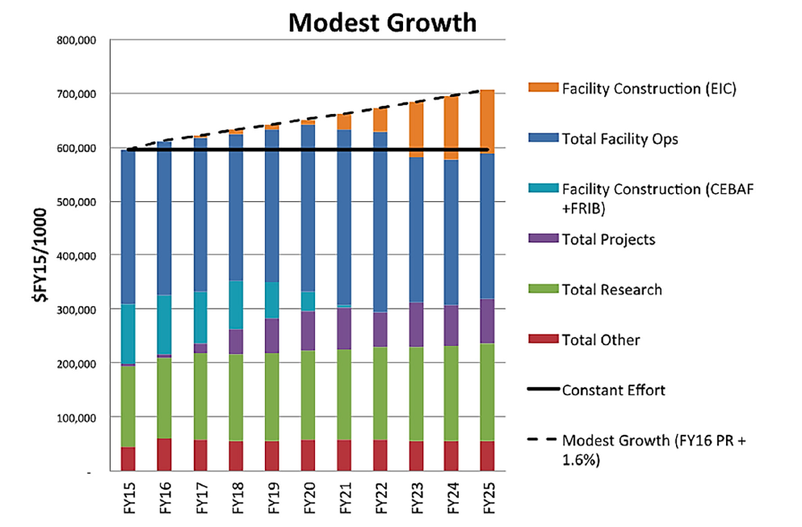
DOE Budget Projections
This is comparable to NP budget growth from 2007 to 2015

Slide 33
Is This Realistic?
DOE NP Budget history Since the 2007 LRP
Since 2007, the real growth has been larger than this!

Slide 34
NSF Nuclear Physics Budget
FRIB begins operation at the mid-point of this LRP and NSCL transitions from NSF stewardship. Before the transition , NSCL will remain the premier national user facility for rare isotope research in the U.S., with unique rare isotope reacceleration capabilities following fast beam fragmentation.
We project increasing mid-scale funding at NSF and believe NP can compete well across the Physics Division for new initiatives. This is essential to ensure NSF-supported scientists have the resources to lead significant initiatives. We did not specifically associate any one initiative with NSF except as significant partners/leaders in neutrinoless double beta decay and neutron EDM where they already play important roles.
We project a total NSF nuclear physics funding increasing slightly each year in line with the modest growth scenario.

Slide 35
Summary
Nuclear Physics has an exciting science program world wide.
There are broader impacts to technology and medicine as well as other sciences such as astrophysics, HEP, material science and chemistry.
New powerful world leading tools are coming on-line and being constructed in the U.S.
We see two important major U.S. initiatives for the future.
There is always budget uncertainty. Thus far for 2017 we are operating on a “continuing resolution” and there is a transition in the leadership of the federal government. Historically, the average level of growth needed has been maintained.
We want to work in an international context to maximize the impact of resources.
International participation can have a big impact on the these plans.

Slide 36
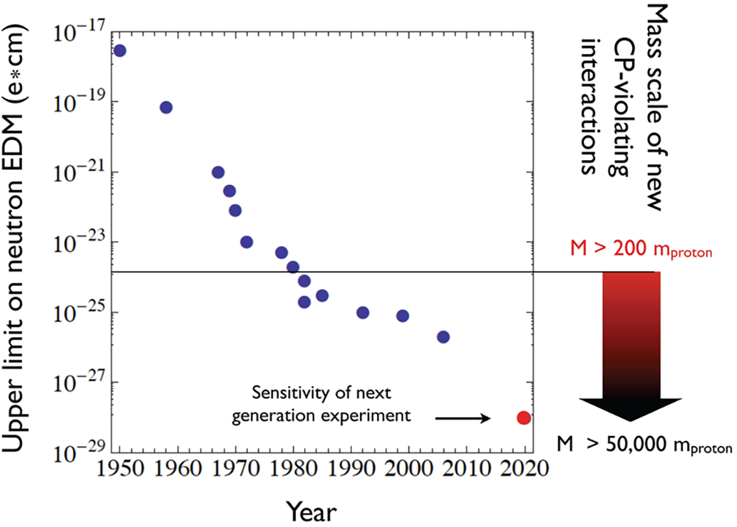
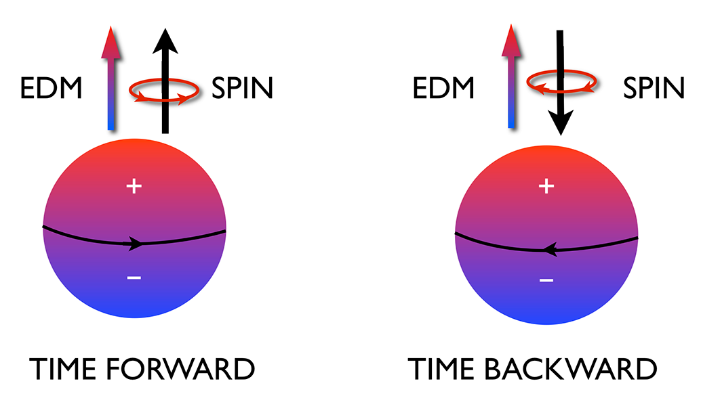
Fundamental Symmetries - Example
Search for CP Violation in Electric Dipole Moments
There is a full court press searching for new mechanisms for CP violation to explain the matter/antimatter asymmetry of the universe. A measurement of an electric dipole moment of the neutron is one of the most sensitive of these searches. The U.S. effort is jointly funded by NSF and DOE and will use the fundamental physics neutron beam line at the SNS.
Reversing time reverses the relative direction of the spin and EDM. By the CPT theorem, this is CP violating

Slide 37
Neutrinoless Double Beta Decay Context
We are aiming for U.S. leadership of the most promising ton-scale experiment, and expecting significant international and interagency collaboration. For the highest cost options, we only projected about 60% funding from U.S.
If a positive result is seen, it needs to be confirmed on another isotope and with another technique. We expect secondary U.S. involvement in at least one other international effort would go ahead with a similar time scale.
Total integrated U.S. budgets for two projects ~ $250M in $FY15
Ongoing NSAC Subcommittee activities

Slide 38
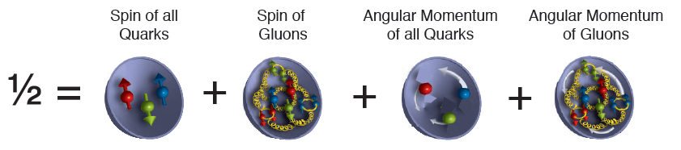
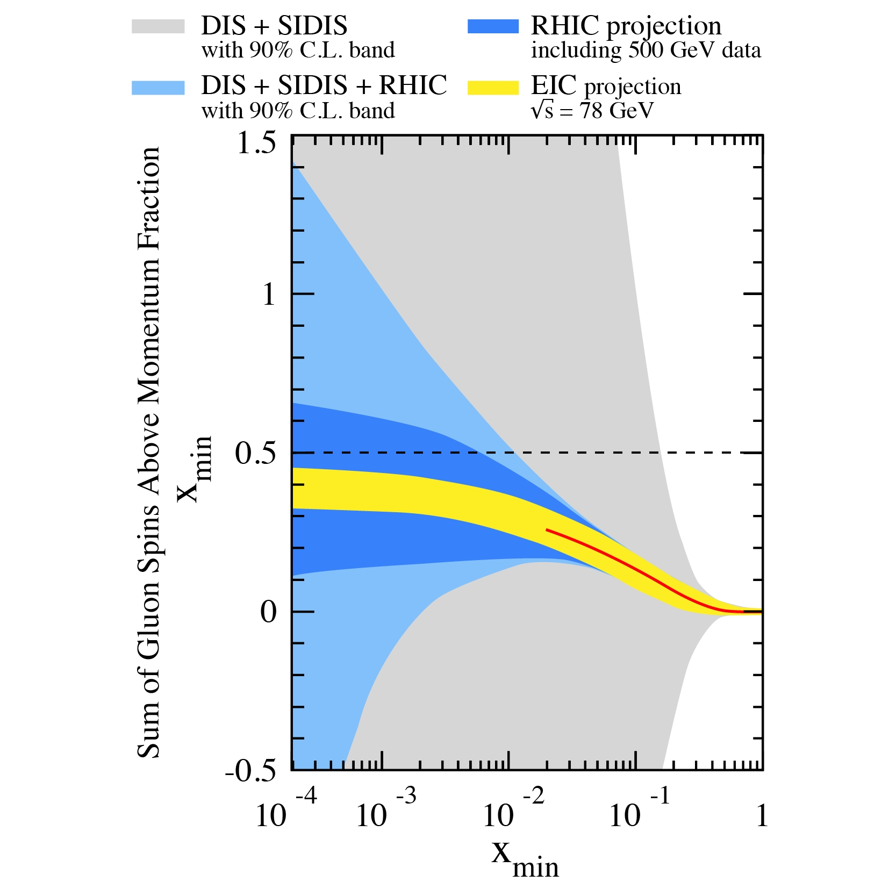
Why isn’t the Spin Settled by JLAB and RHIC?
Done
CEBAF
EIC
Valuable
Information
from RHIC
Requires EIC to fully answer

