Slide 1
Status Report on Barrel Mechanics
Andrey Ryazantsev
on behalf of the IHEP-Protvino group

Slide 2
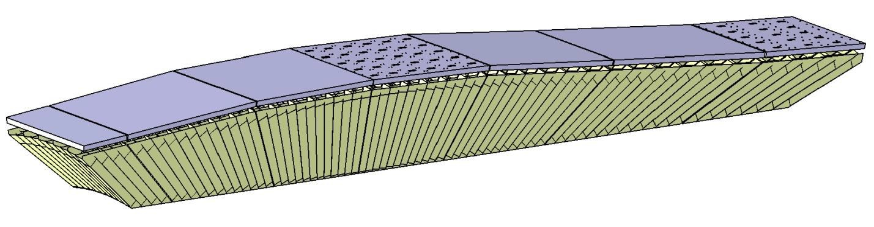
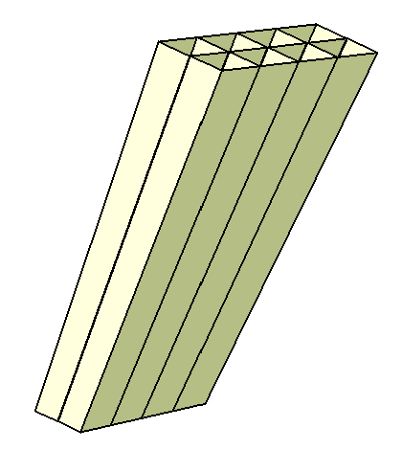
Crystals modular support structure
Super Module types
#1 #2 #3 #4 #5 #6 #7
(1 module) (3 different modules in each) ( 2 different modules)
Beam
Proto 120
7(-) 6(-) 5(-) 4(-) 3(-) 2(-) 1(-) 1(+) 2(+) 3(+) 4(+) 5(+) 6(+) 7(+) 8(+) 9(+) 10(+) 11(+)
18 different types of the single carbon fiber alveoli units of 2×4 cells [2×3 cells for 11(+)]
(5 units / module)

Slide 3
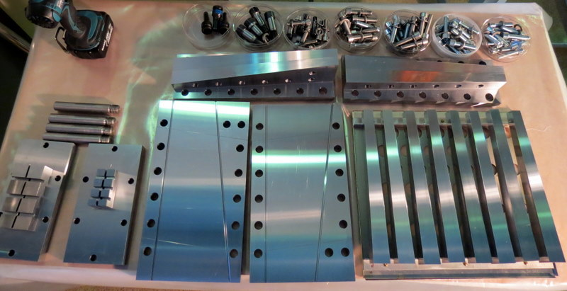
Mold for single alveoli production
18 different types of molds were designed at IHEP and produced by subcontractor
All pieces were made of special quality steel; flatness ~5 µm; 20 µm of the dimensions accuracy
Input control at IHEP was made with CMM before assembling

Slide 4
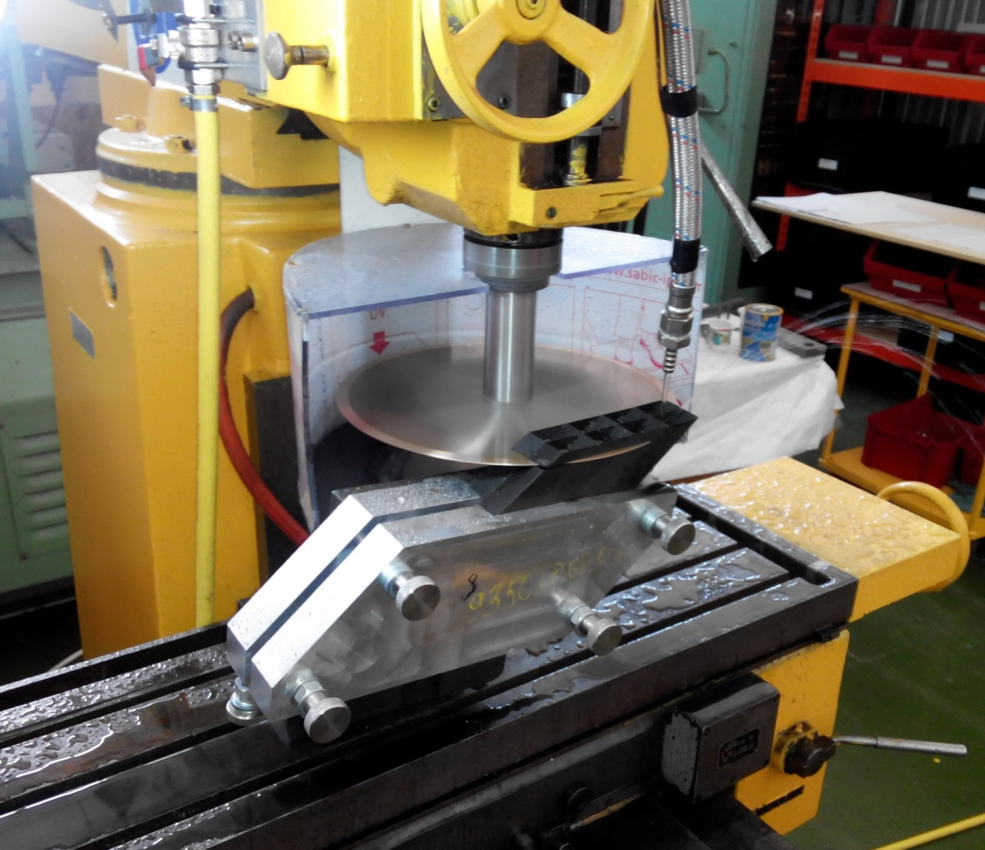
Tools for single alveoli units precise cutting
Cutting tools of 18 different types were designed at IHEP and produced by subcontractor

Slide 5
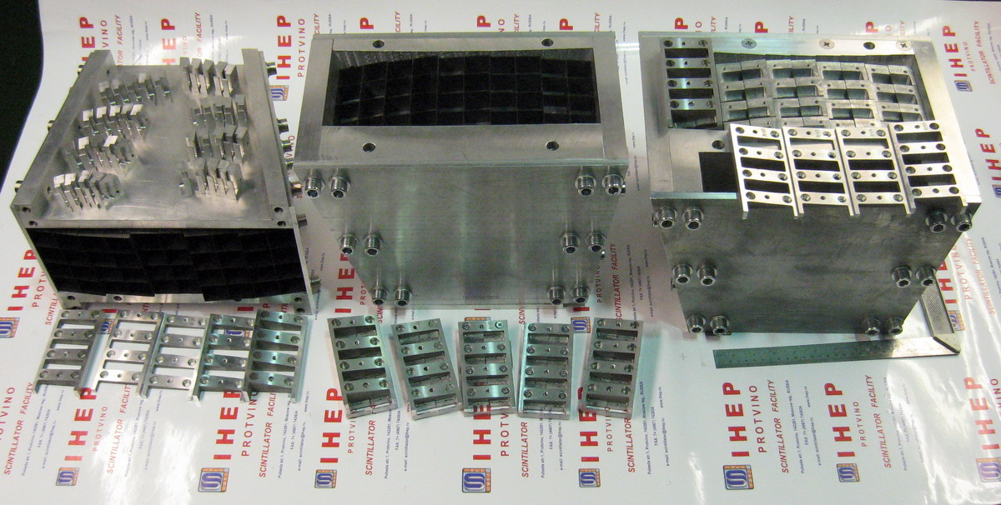
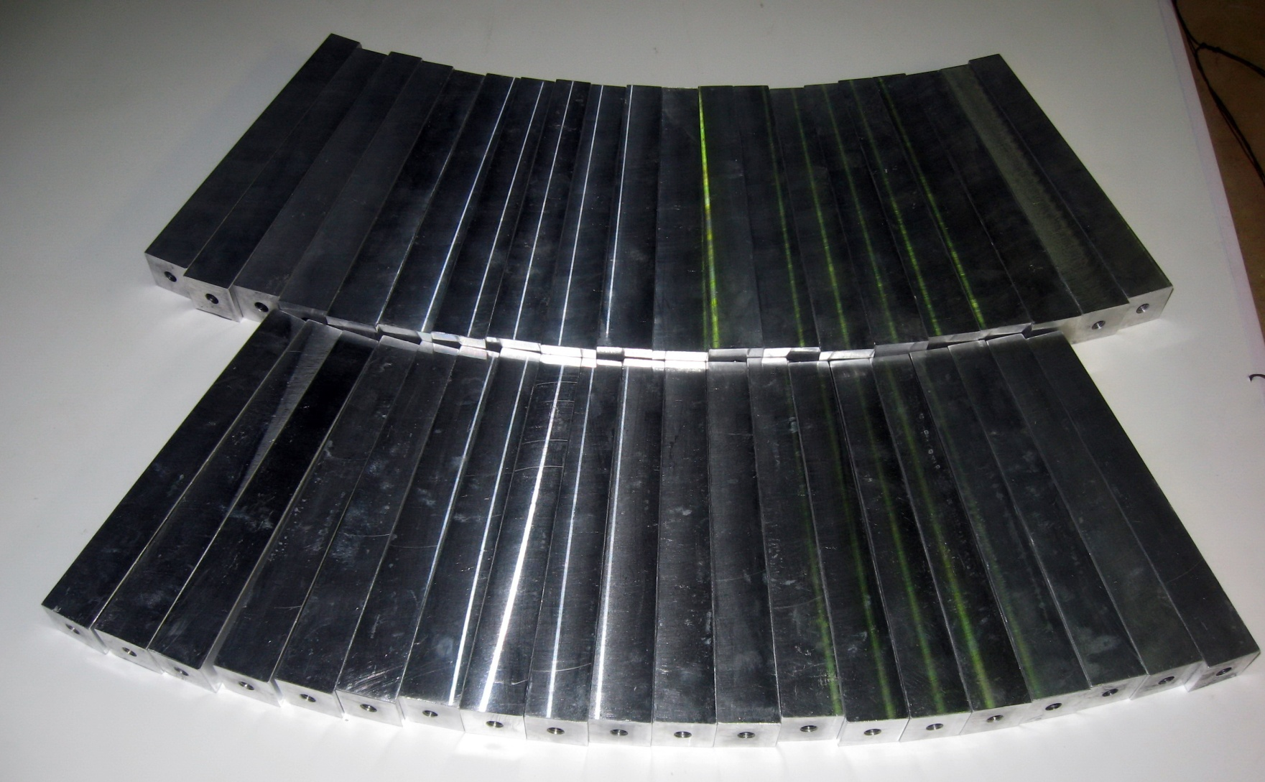
Assembly devices, rear inserts, intermediate plates, dummy crystals
18 different types of high precision assembly devices to glue alveoli packs and assemble modules
were designed at IHEP and produced by subcontractor (input control is made at IHEP with CMM)
Rear inserts
Dummy crystals
Intermediate plates

Slide 6
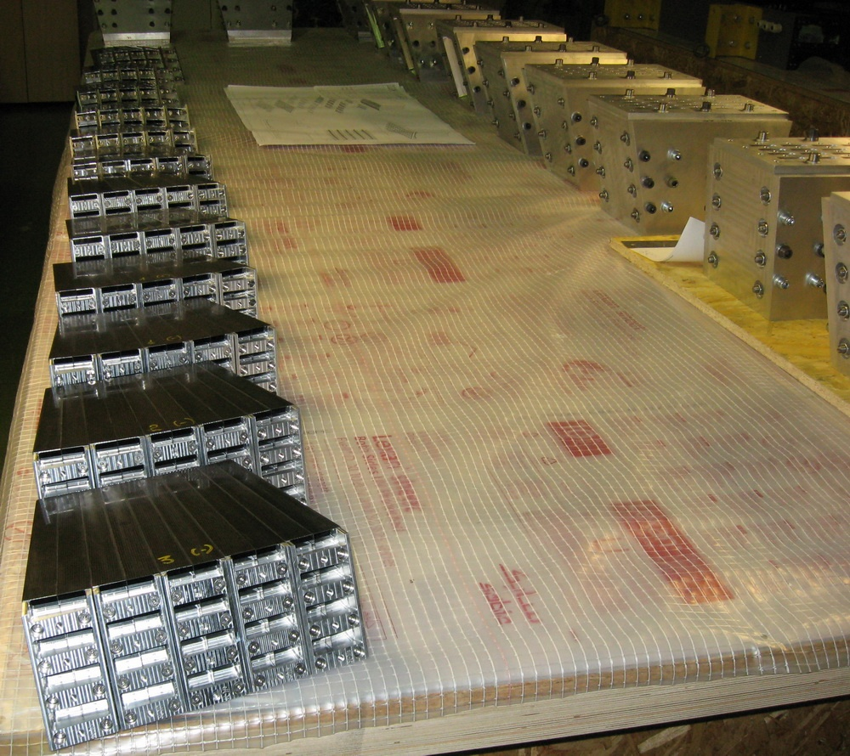
12 alveoli packs with rear inserts and intermediate plates and 12 assembly devices

Slide 7
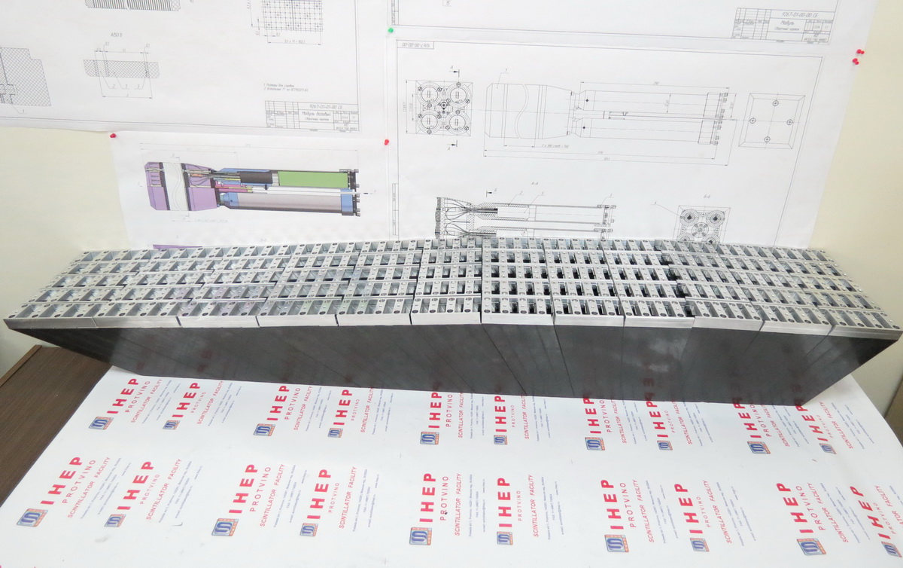
12 modules of crystals support structure
9(+) 8(+) 7(+)
6(+) 5(+) 4(+)
3(+) 2(+) 1(+)
1(-) 2(-) 3(-)
Delivered in May

Slide 8
Major milestones for the EMC Barrel Mechanics
Pending…
Delivered without tools
Production in progress
!!!

Slide 9
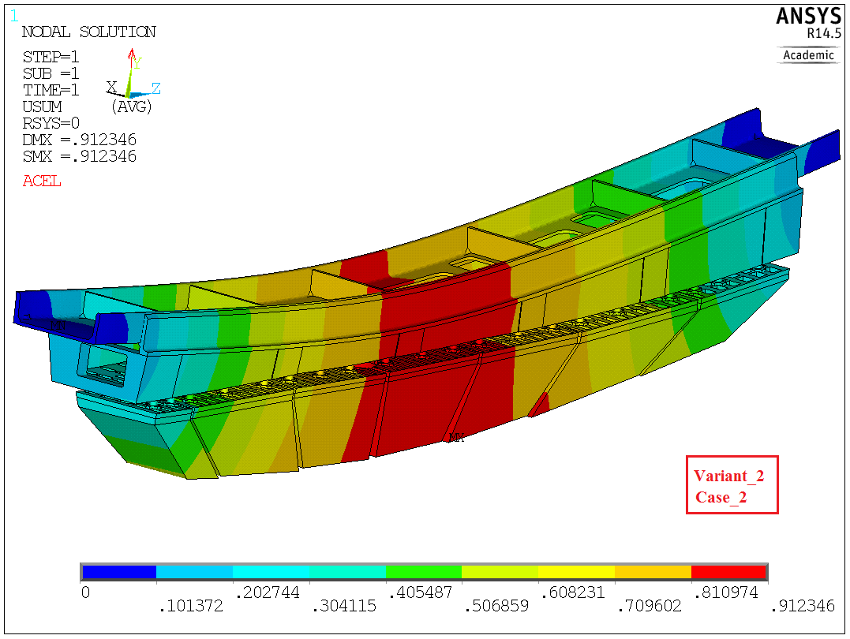
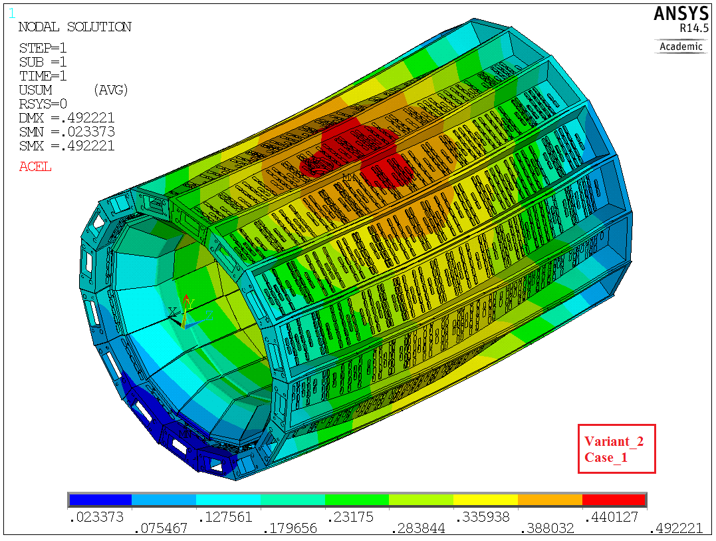
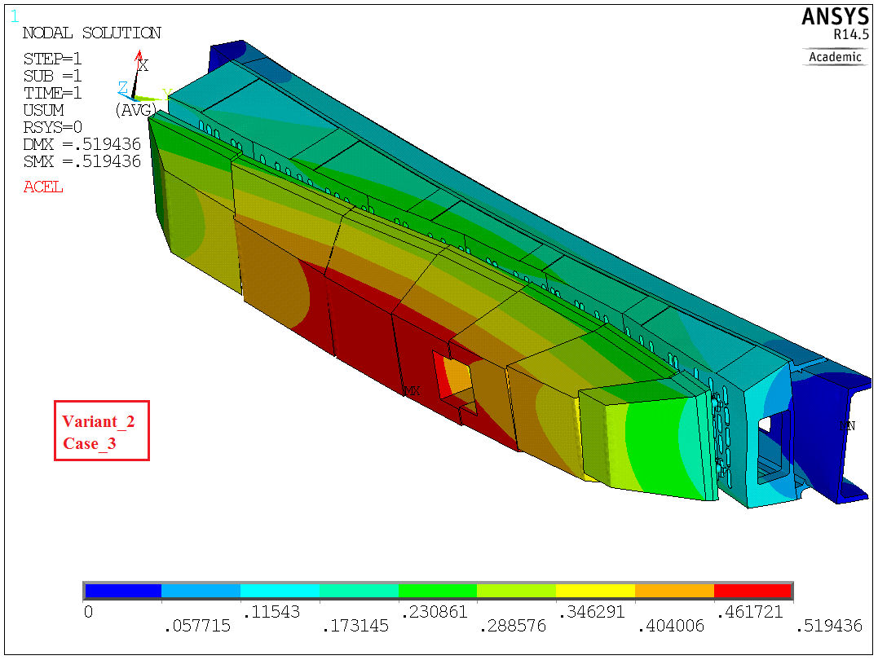
Finite elements analysis (by A. Ryabov)
 | Case_1 | Case_2 | Case_3
Variant_0 (Initial design - September, 2014) | 0.45 | 1.00 | 0.55
Variant_1 (Increased openings in the beam) | 0.51 | 1.02 | 0.58
Variant_2 (Support feet are shorter by 10 mm) | 0.49 | 0.91 | 0.52
Variant_3 (Support feet are longer by 10 mm) | 0.51 | 1.12 | 0.63
Cryostat, support rings and beam covers are not shown

Slide 10
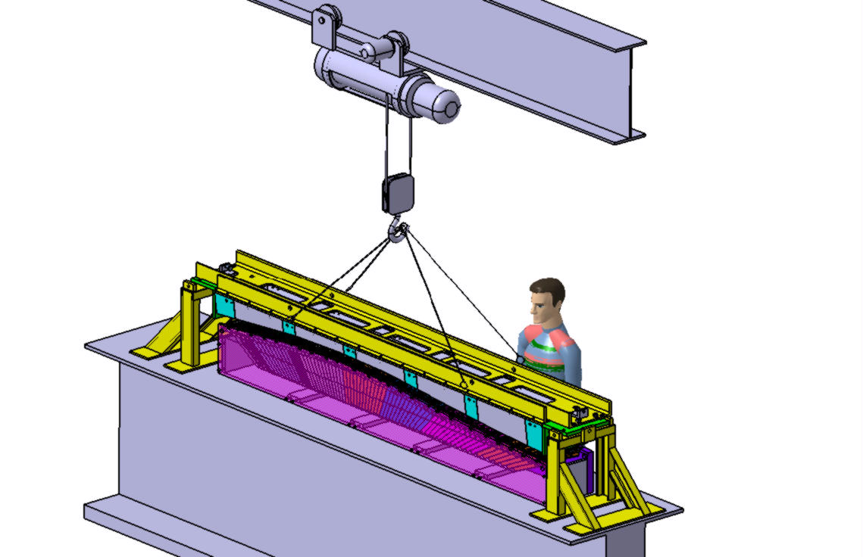
How to assemble barrel (by V. Ferapontov)

Slide 11
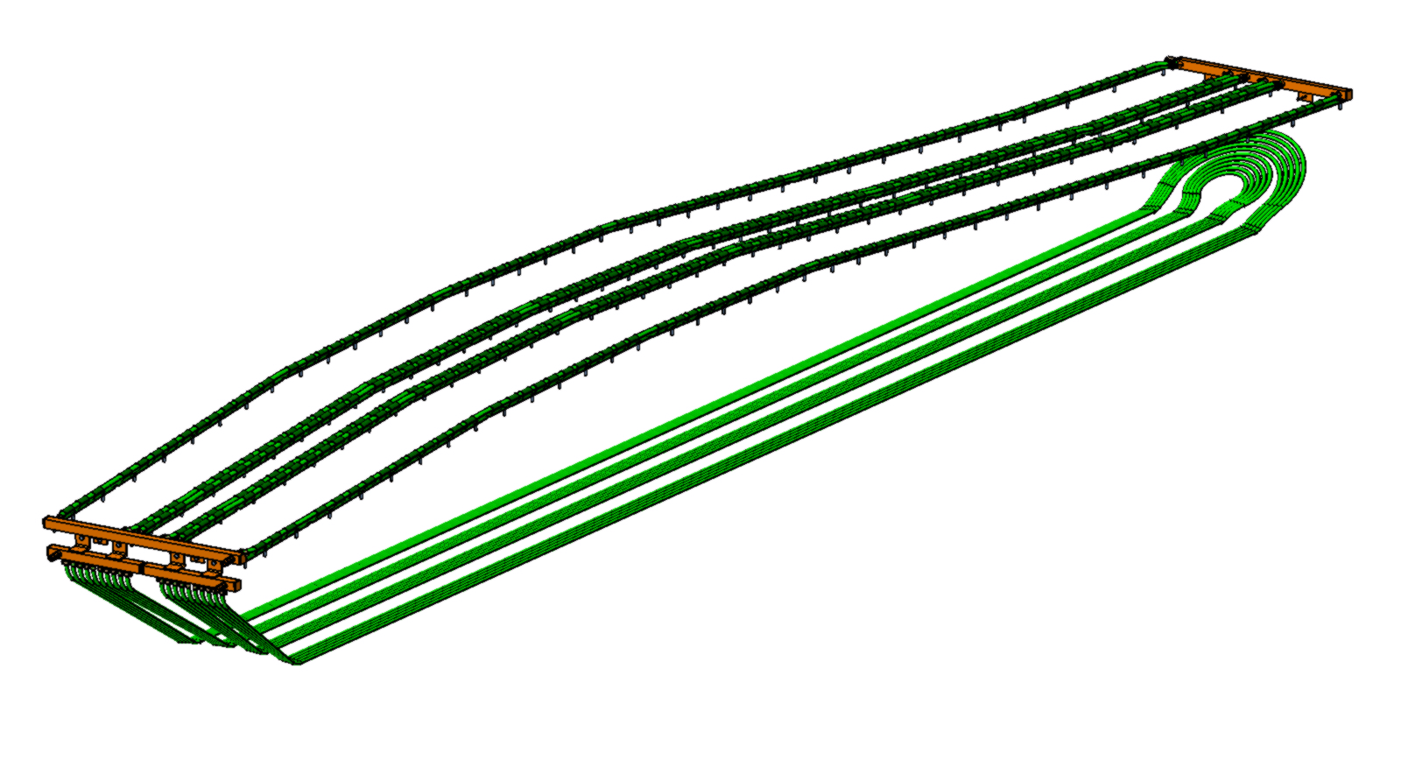
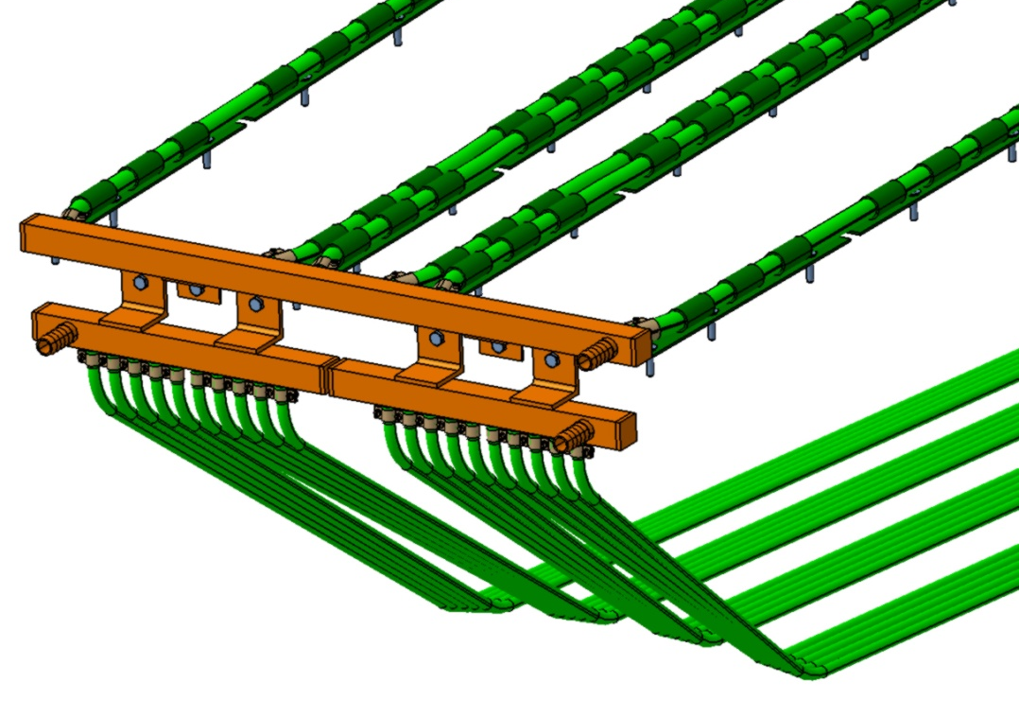
Slice cooling (current design by Le Galliard Ch.)
4 stainless steel manifolds
Upper cooling system =
3 PU pipes φ 8x6
D_{v}= 4 l/mn
Lower cooling system =
10 PU pipes φ 5.5x3.5
D_{v}= 0.75 l/mn

Slide 12
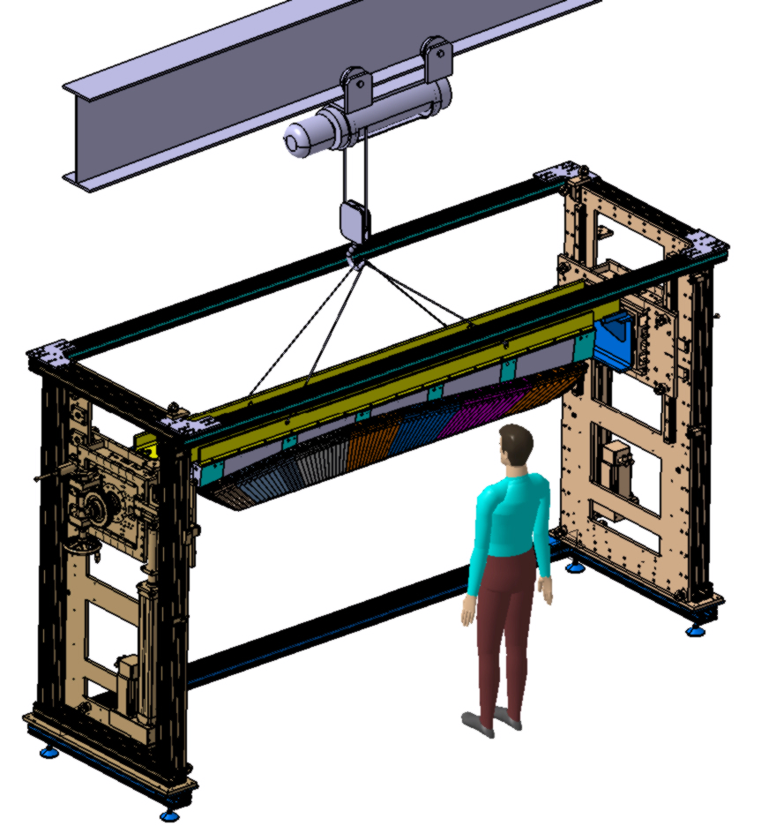
How to assemble barrel (by V. Ferapontov)

Slide 13
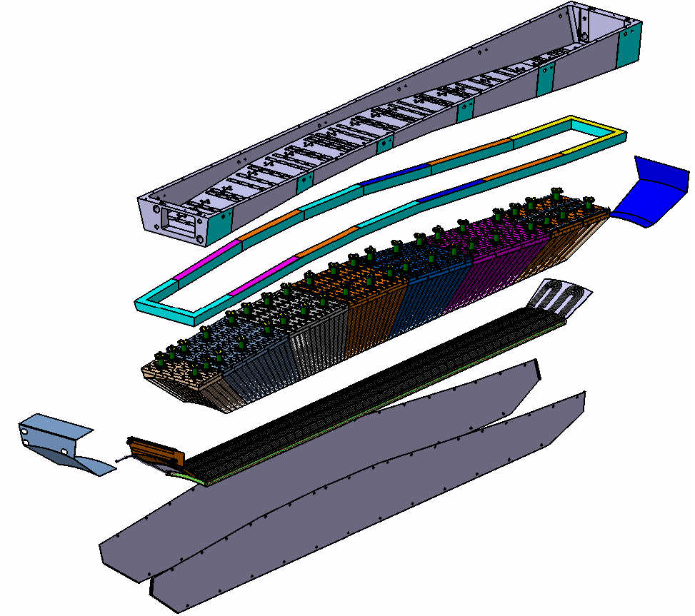
Current design of EMC Barrel slice (by Valery Ferapontov)
Aluminum Support Beam
Foam
Back Cover
Super-Modules
Cooling System
Side Covers

Slide 14
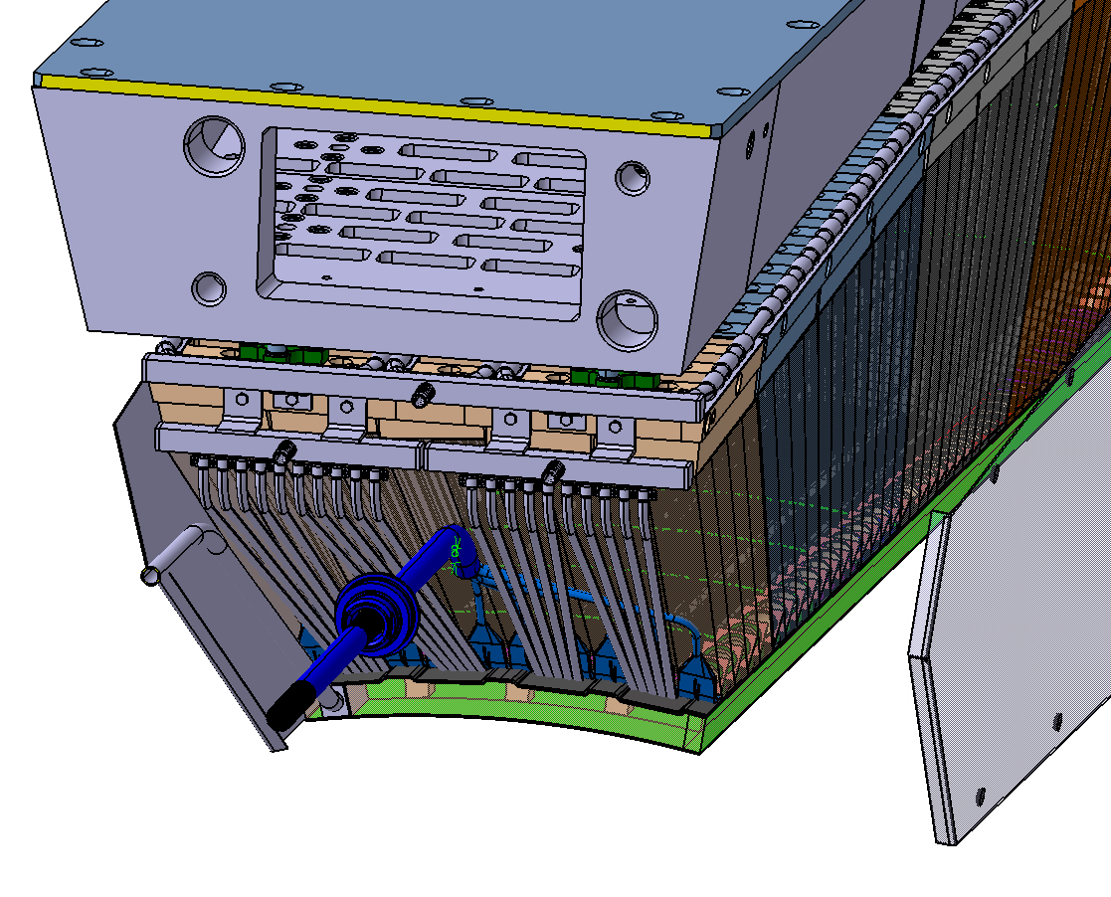
How to assemble barrel (by V. Ferapontov)

Slide 15
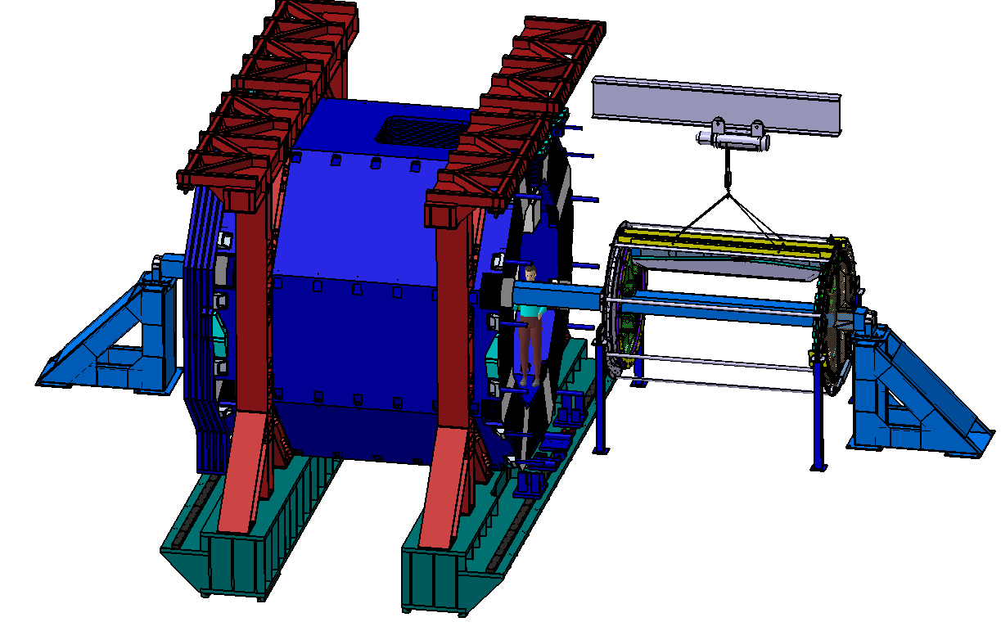
How to assemble barrel (by V. Ferapontov)

Slide 16
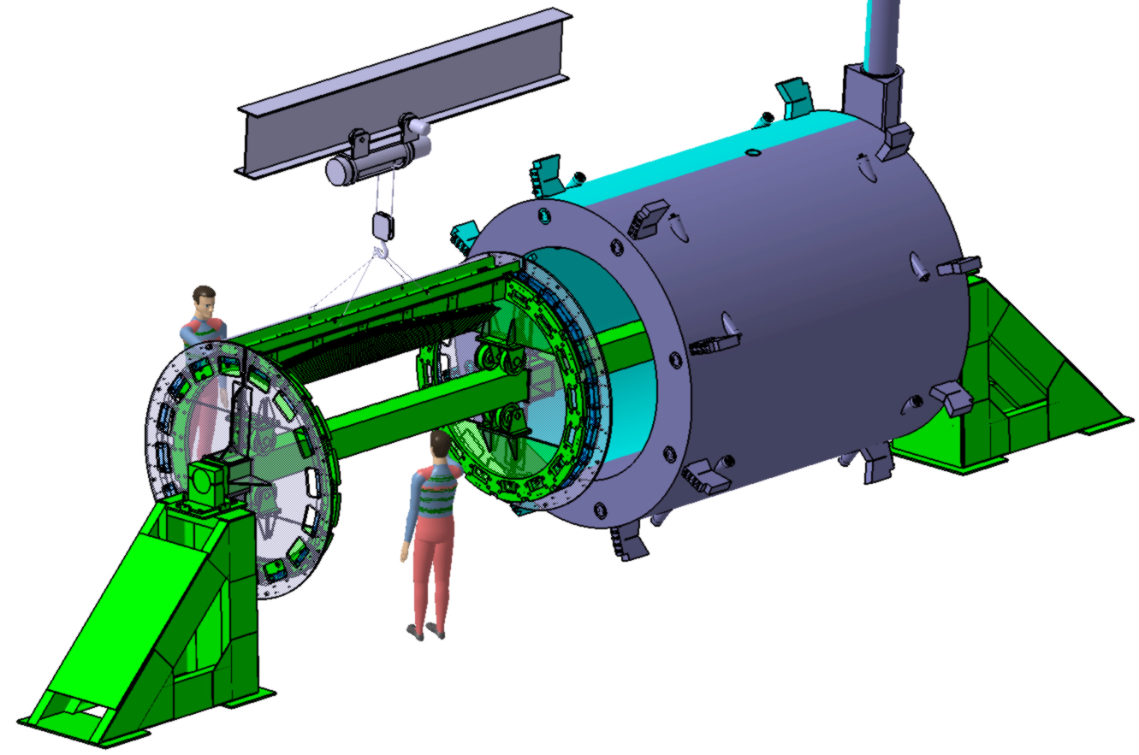
How to assemble barrel (by V. Ferapontov)
STEP 1. Fully assembled Slice is placed on
two Technological Flanges adjusted
with special devices and fixed

Slide 17
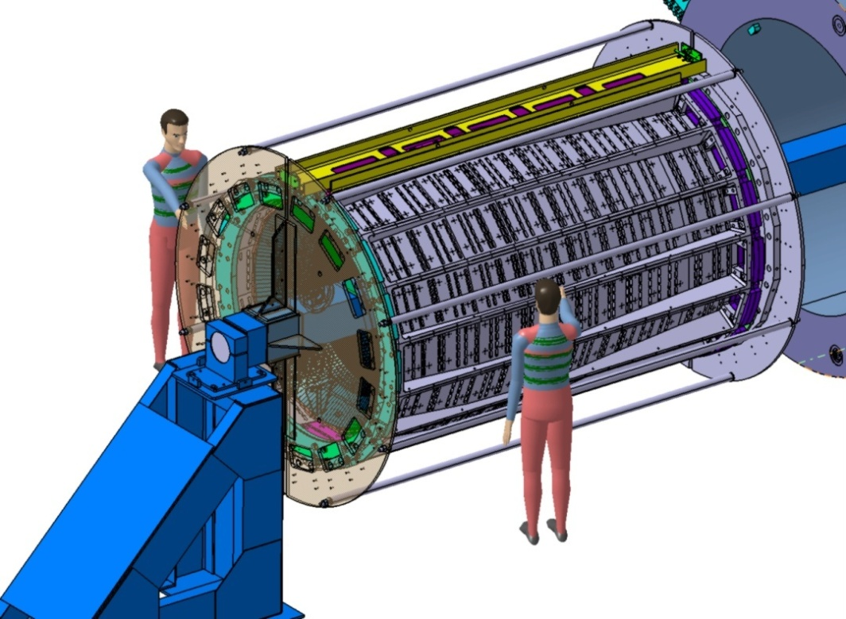
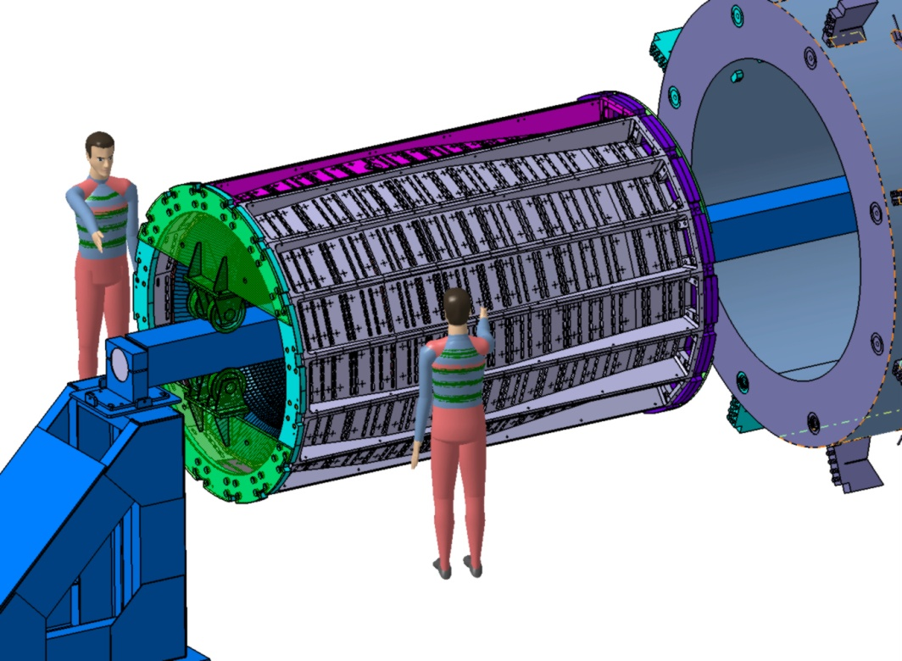
How to assemble barrel (by V. Ferapontov)
STEP 2. 16 assembled Slices are placed and joined one-by-one on
Technological Flanges and fixed
STEP 3. Two Support Rings are fixed with special Pins and Bolts.
STEP 4. Technological Flanges are disassembled

Slide 18
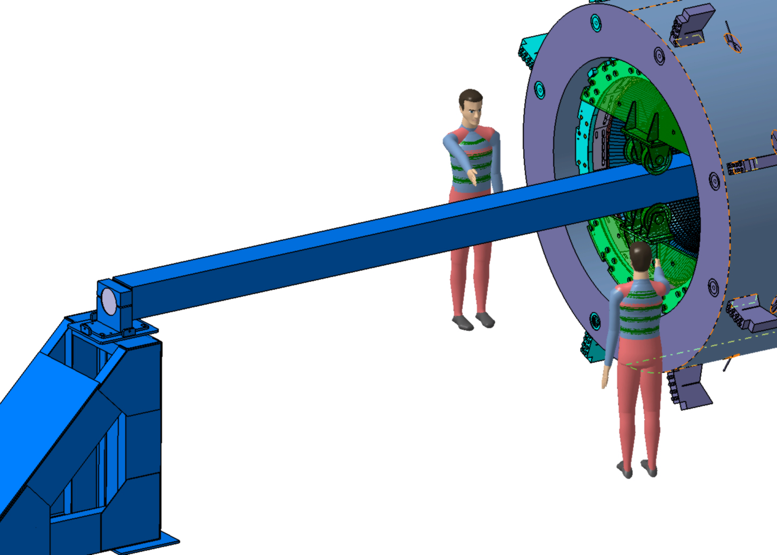
How to assemble barrel (by V. Ferapontov)
STEP 5. Barrel is moved inside the cryostat,
adjusted in it’s working position relative to holes for the target pipes and the axis of the cryostat and fixed with supporting bolts

Slide 19
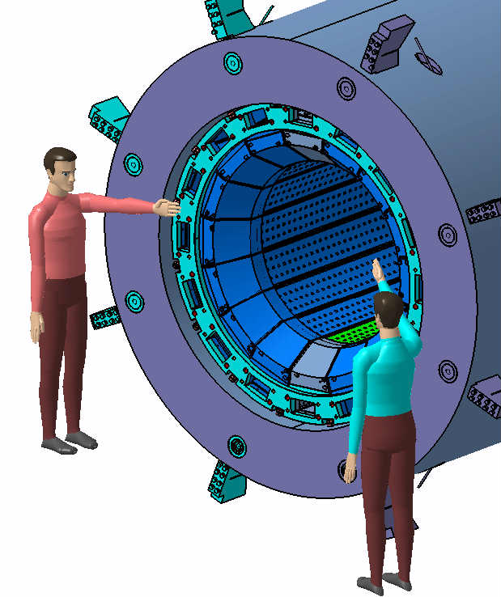
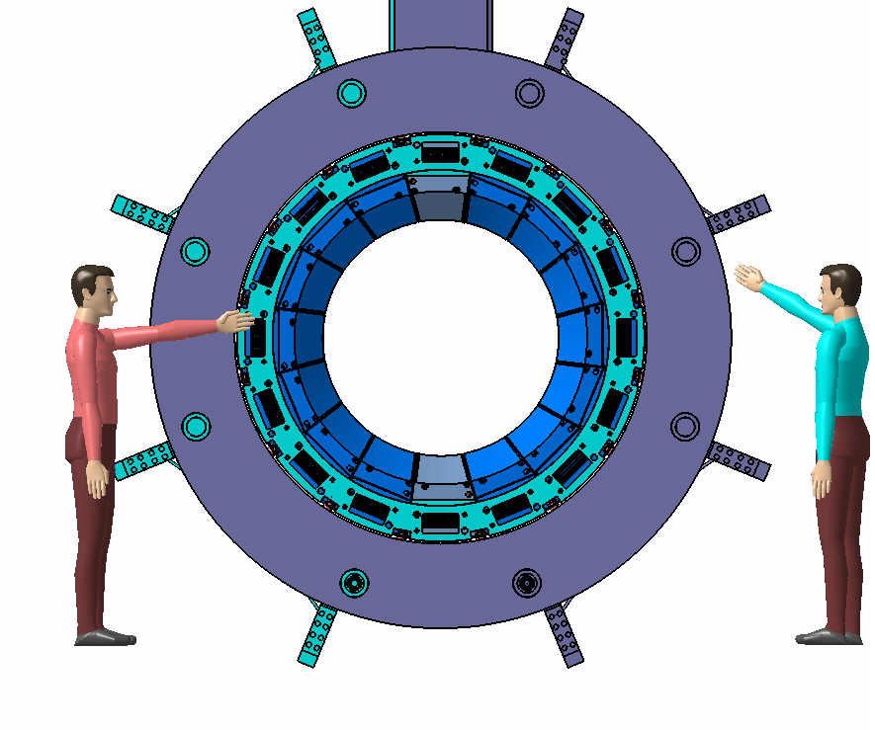
How to assemble barrel (by V. Ferapontov)
STEP 6. All technological devices and tools are disassembled

Slide 20
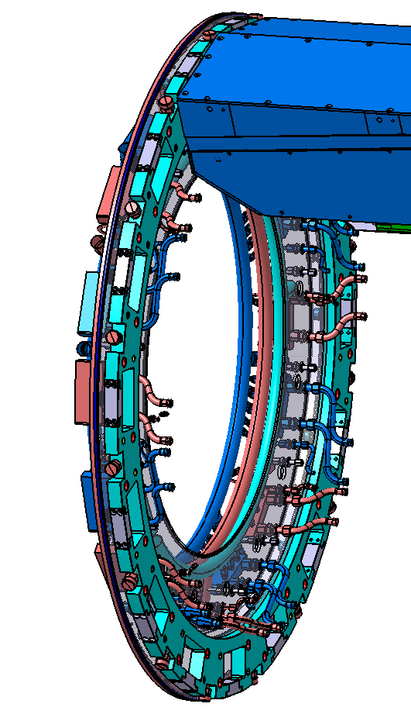
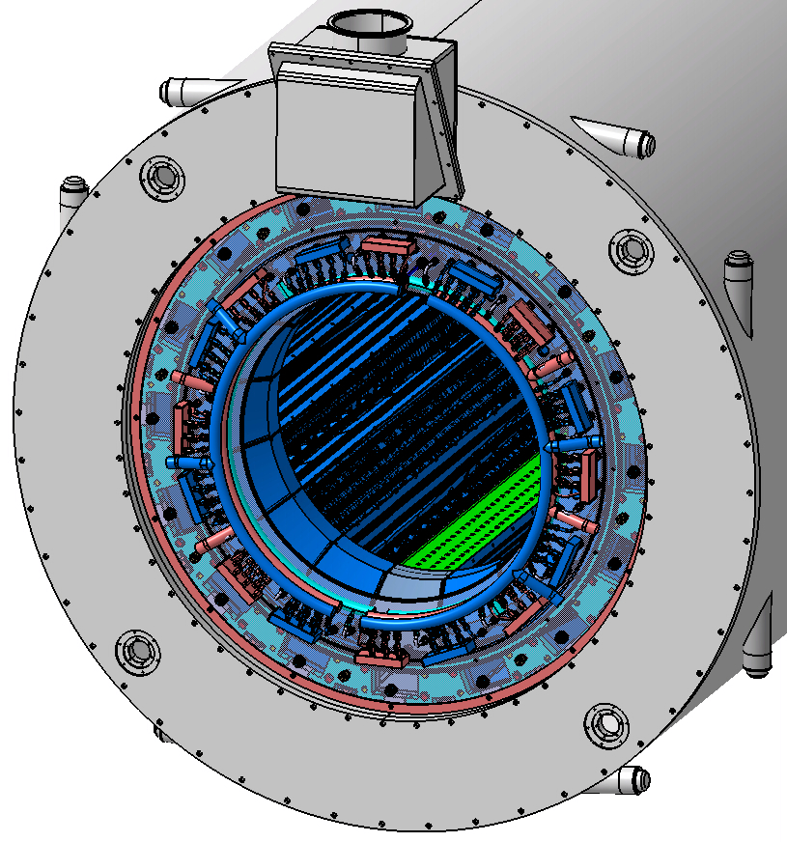
How to assemble barrel (by V. Ferapontov)

Slide 21
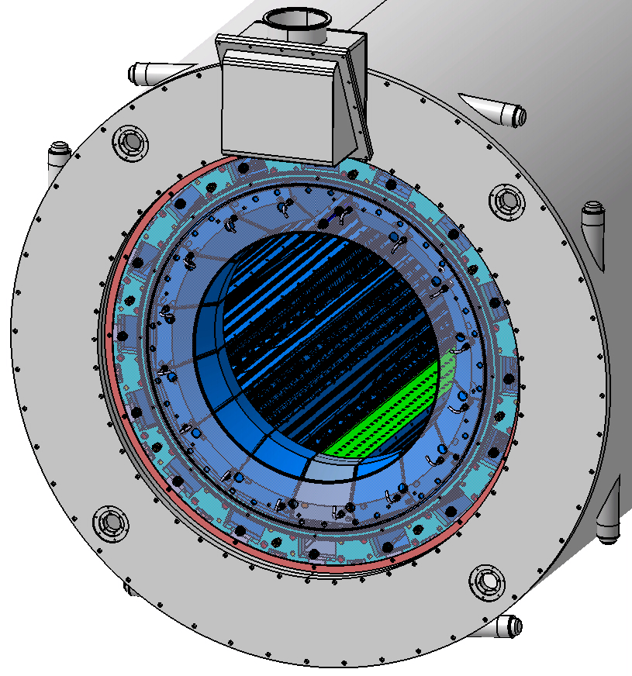
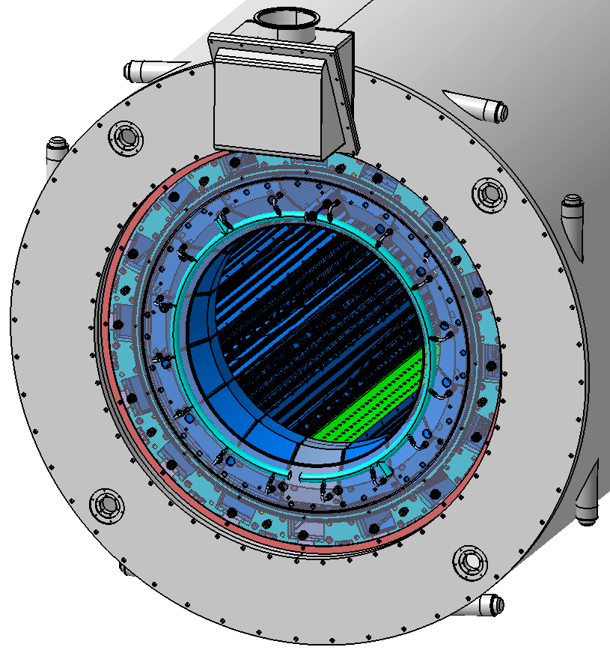
How to assemble barrel (by V. Ferapontov)

Slide 22
Summary and open questions
Batch 1 of the pre-series slice (excluding assembling devices) is shipped to Giessen.
All 18 types of molds and assembly devices were produced and delivered to IHEP, production of the alveoli packs for the Batch 2 of the pre-series slice will be completed in time (September 2015).
Assembling scenario was developed – additional tools and devices will be necessary to execute this work. They have been designed. We need a plan of the working space where the slice will be assembled.
Production of back module plates, support feet and support beam was not started because the complete design of the pre-series slice is not yet approved - waiting for the successful PROTO120 tests !!!
Design of front inserts was suggested and some prototype was made at Giessen - waiting for the final solution about the monitoring system
Final solution on the electronics & cables inside the support beam – PROTO 120 test !!!
Cooling system design and integration - ???

