Slide 1
Status of works on the Collaboration
Contract between IHEP and FAIR
  Andrey Ryazantsev
  on behalf of the IHEP-Protvino group

Slide 2
Major milestones for the EMC Barrel Mechanics
“Batch 1 of the Pre-Series Slice (PSS-B1) comprises 70 to 80% of the components for the full Pre-Series Slice while batch 2 (PSS-B2) comprises all remaining components to be delivered for the Pre-series Slice.”

Slide 3
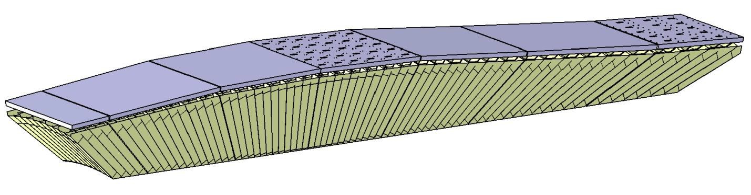
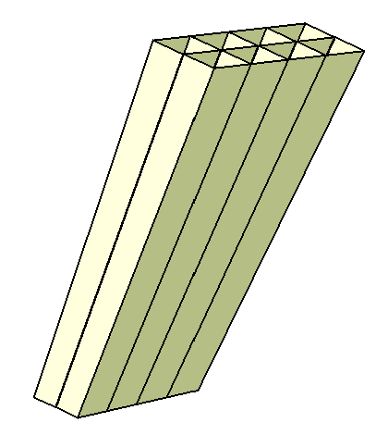
Crystals support structure
Super Module types
#1 #2 #3 #4 #5 #6 #7
(1 module) (3 different modules in each) ( 2 different modules)
Beam
Proto 120
7(-) 6(-) 5(-) 4(-) 3(-) 2(-) 1(-) 1(+) 2(+) 3(+) 4(+) 5(+) 6(+) 7(+) 8(+) 9(+) 10(+) 11(+)
18 different types of the single carbon fiber alveoli units of 2×4 cells [2×3 cells for 11(+)]
(5 units / module)

Slide 4
Single alveoli units production
10 of 18 different type molds are available: from 1(-) through 9(+)
9 of them - from 1(+) through 9(+) - have successfully passed the input acceptance tests at IHEP with the use of the CMM DEA Mistral; type 1(-) is being measured nowadays.
Types 2(-) and 3(-) will be ready soon
Several single alveoli units of each type from 1(+) through 9(+) were produced (only preliminary cut) and measured with the CMM. The results of the measurements showed a good compliance to the 3D tolerance model.
Tools for the precise cutting of the single carbon alveoli units of type from 1(+) through 9(+) were produced, delivered and accepted; production of remaining types is in progress.

Slide 5
Alveoli packs production
The assembly devices to glue alveoli packs and to assemble modules of type from 1(-) through 9(+) were produced and delivered to IHEP, 2(-) and 3(-) will be ready soon.
Parts of the assembly device of type 8(+) that define geometry correctness of the alveoli packs were carefully measured with CMM. All dimensions are within tolerances.
First alveoli pack of type 8(+) was produced.
Rear inserts and intermediate plates of type from 1(-) through 3(-) and from 1(+) through 3(+) were delivered and passed the acceptance tests → ready to produce alveoli packs of type 1(+), 2(+) and 3(+).
Rear inserts and intermediate plates of type from 4(+) through 9(+) and from 4(-) through 7(-) are expected to be ready at the end of October.

Slide 6
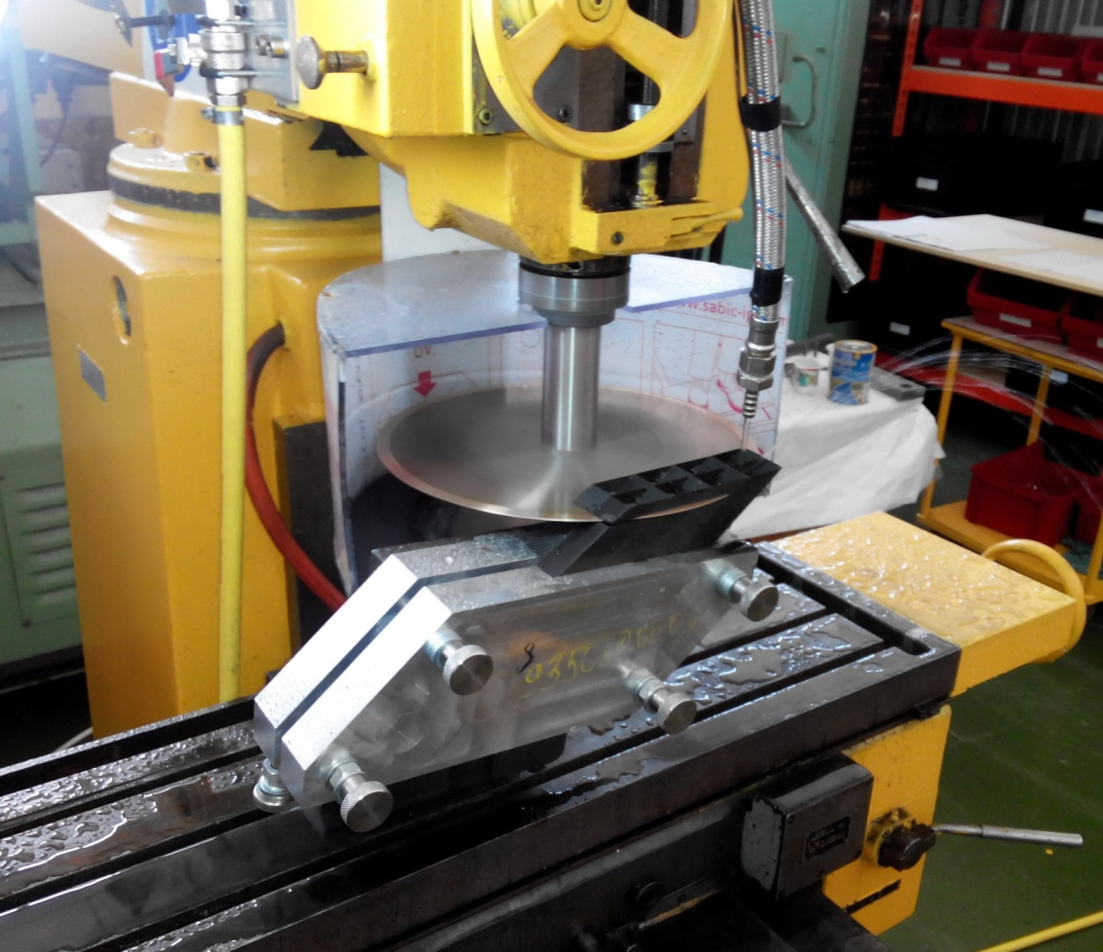
First alveoli pack of type 8(+)
5 single alveoli units were cut precisely with the use of the new cutting tool

Slide 7
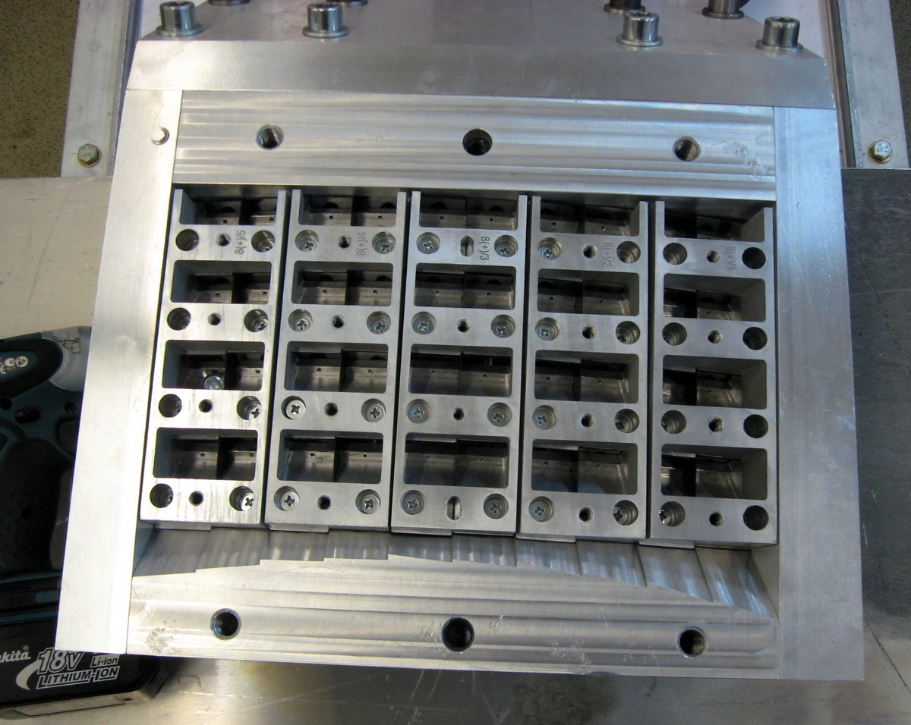
First alveoli pack of type 8(+)
5 single alveoli units filled up with the “dummy crystals” and jointed with a glue
are in the assembly device with rear inserts and intermediate plates

Slide 8
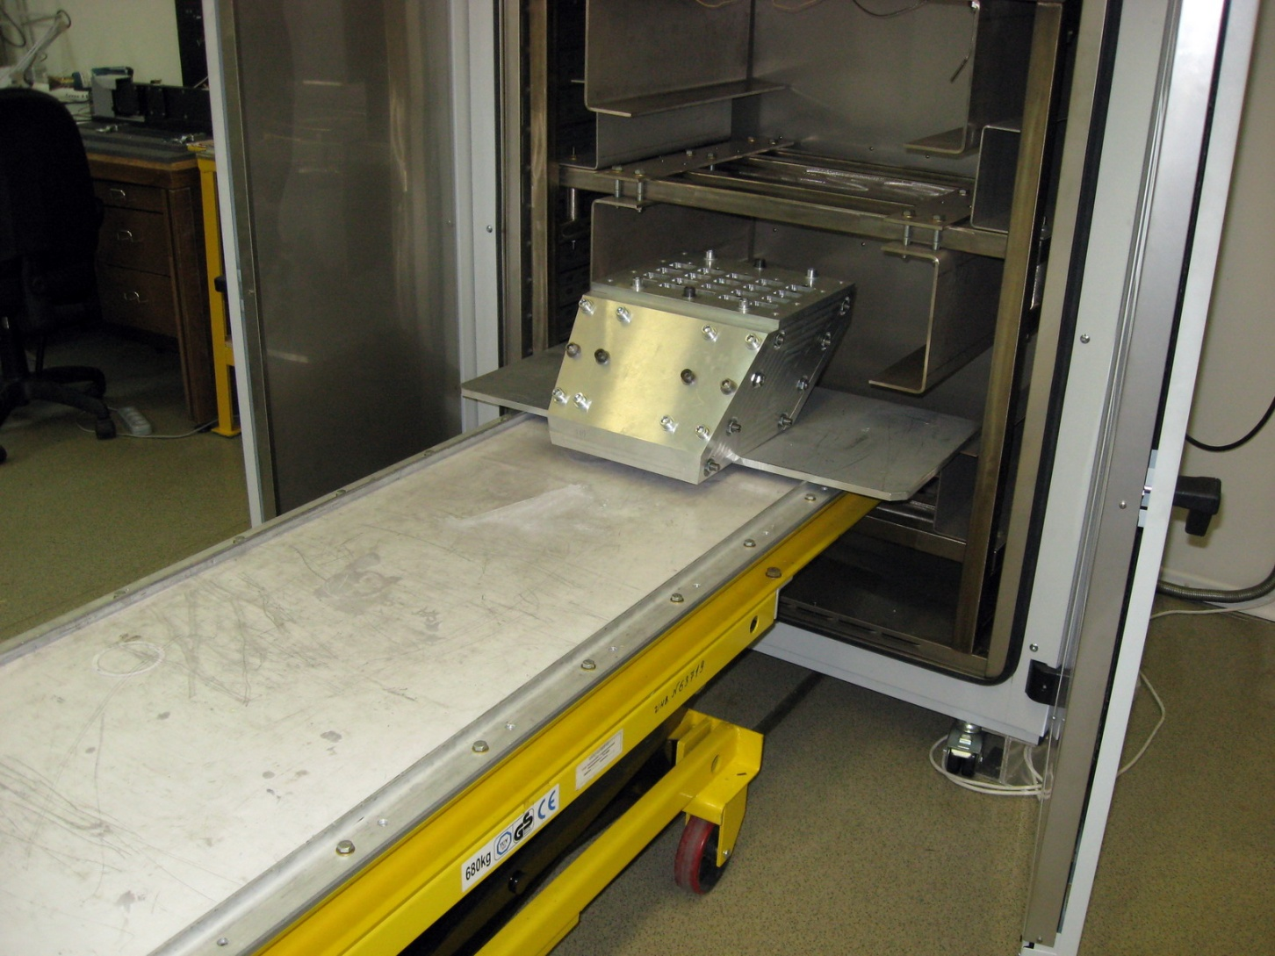
First alveoli pack of type 8(+)
Assembly device is being placed in the oven

Slide 9
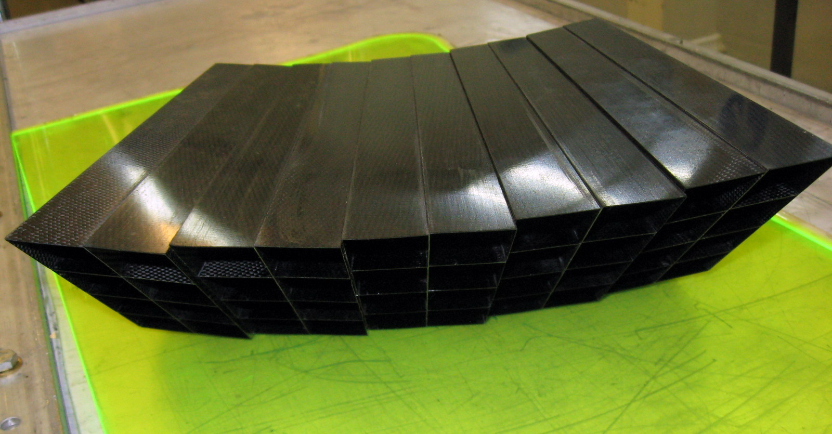
First alveoli pack of type 8(+)

Slide 10
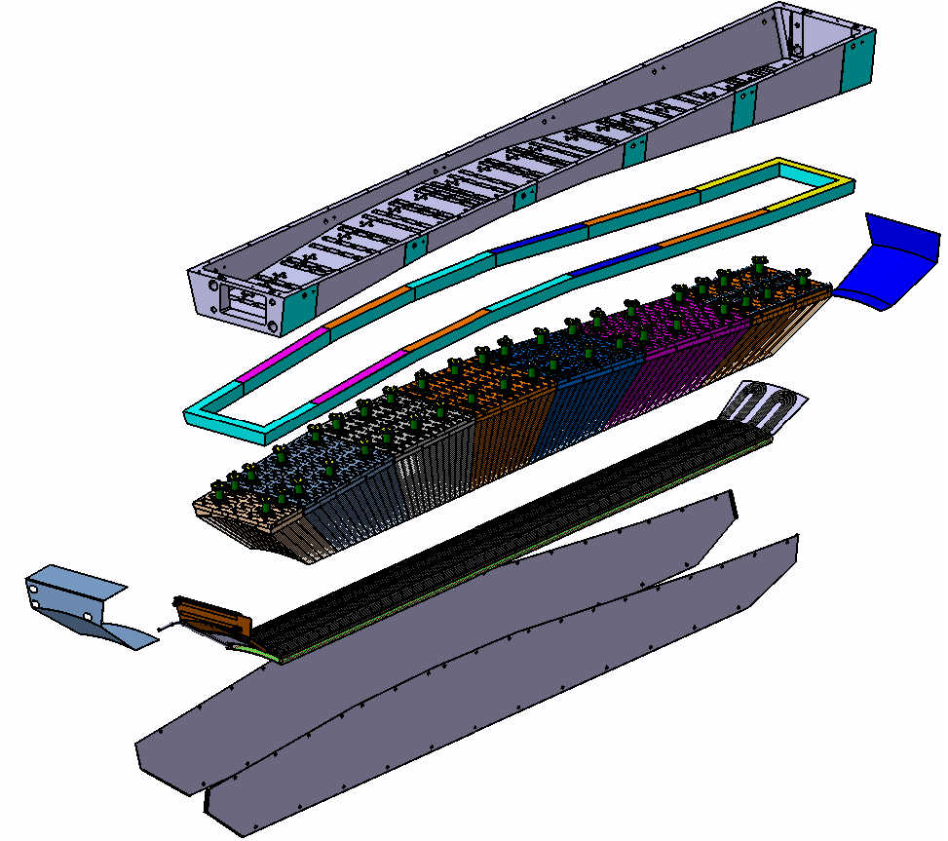
Design of EMC Barrel slice (by Valery Ferapontov)
Aluminum Support Beam
Foam
Back Cover
Super-Modules
Cooling System
Side Covers

Slide 11
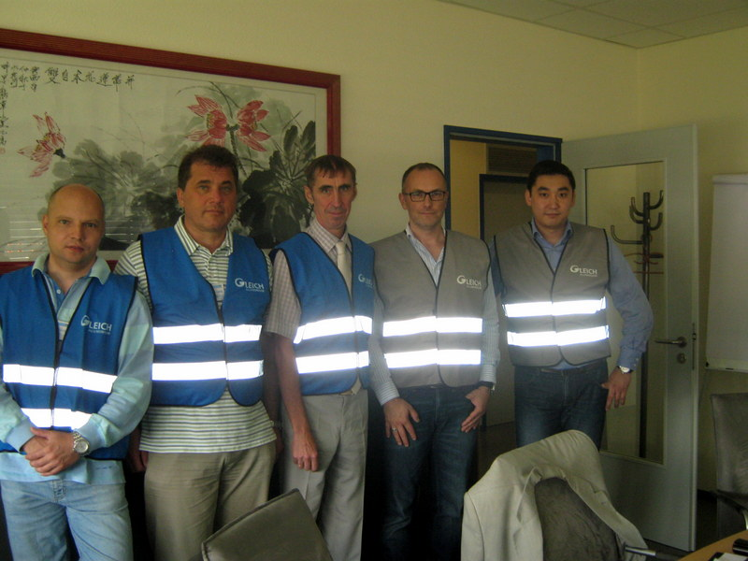
Pre-series support beam production
Three experts from IHEP visited the manufacturing companies in Germany:
-Hamburg, GLEICH Aluminiumwerk GmbH & Co/KG Kaltenkirchen
-Jena, M&B GmbH Siegmar

Slide 12
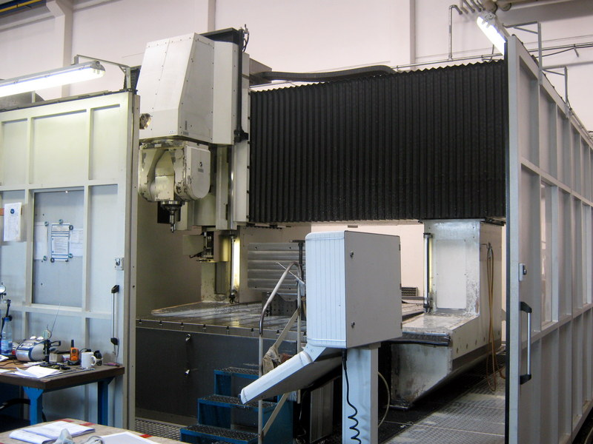
Pre-series support beam production
Five-axis machine in Jena with a base of 2.5×4.0 m

Slide 13
Pre-series support beam production
Tender is required!
In case of success, M&B GmbH Siegmar will produce the support beam from an aluminum blank provided by GLEICH Aluminiumwerk GmbH & Co/KG Kaltenkirchen .
Expected time:
2 months for the tender procedure,
35 working days - production cycle,
~ 2 weeks for shipping and custom formalities.

Slide 14
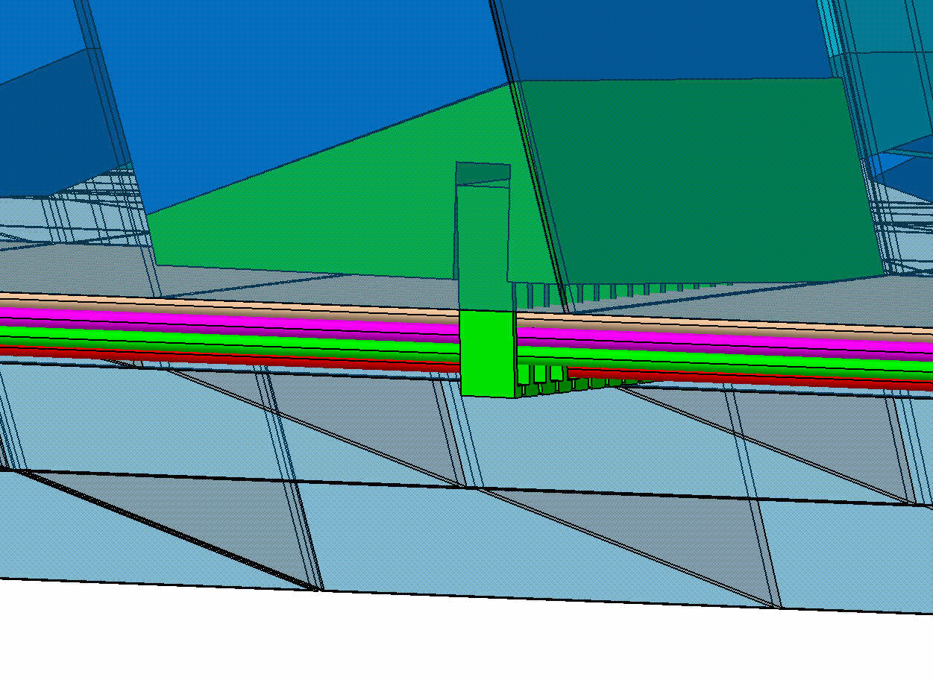
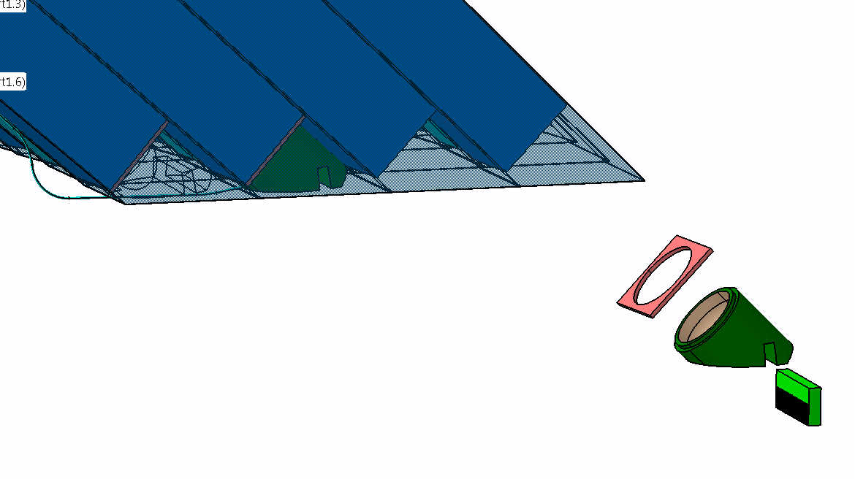
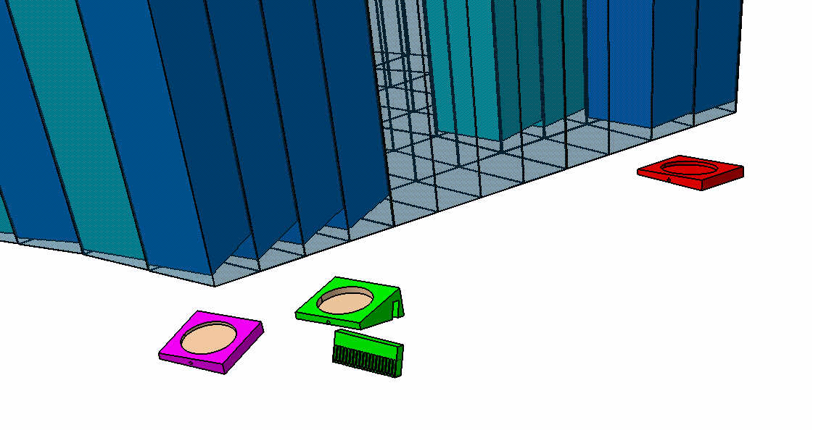
Design of front inserts and optical fibers tracing
(Suggested by V. Ferapontov and A. Levin)

Slide 15
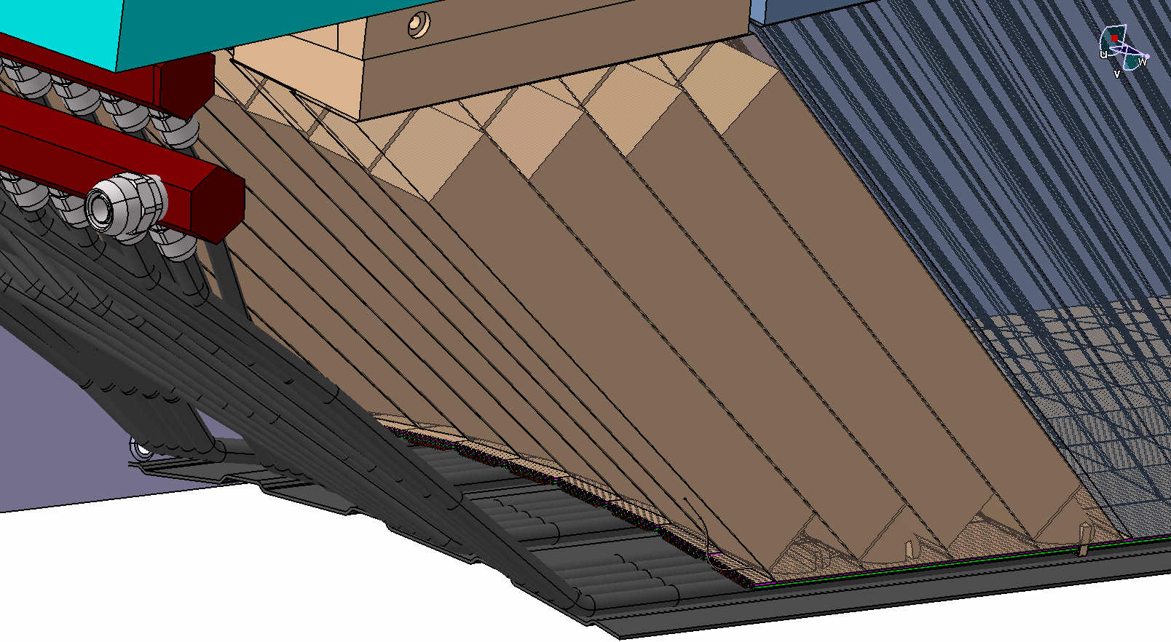
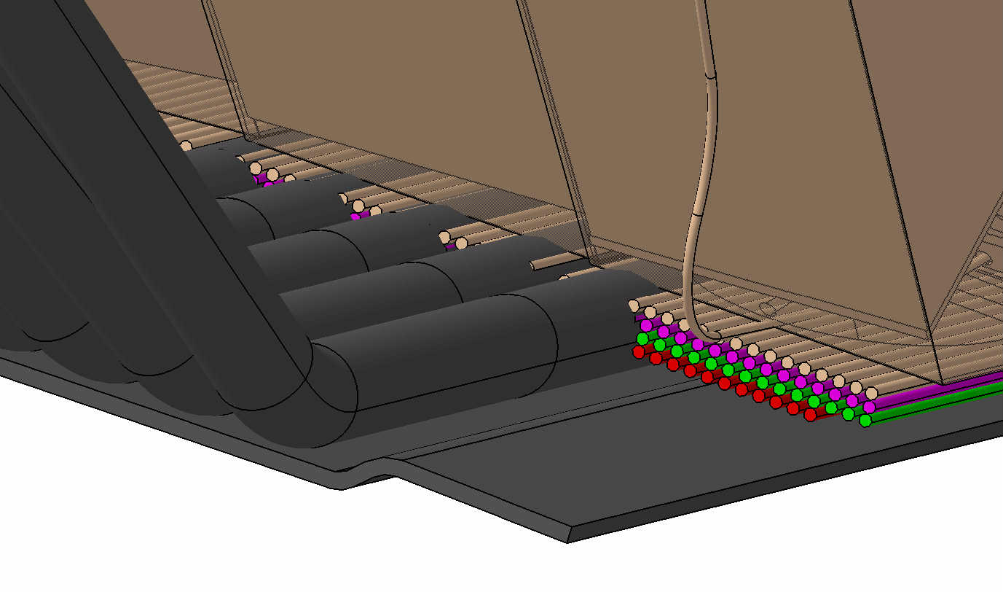
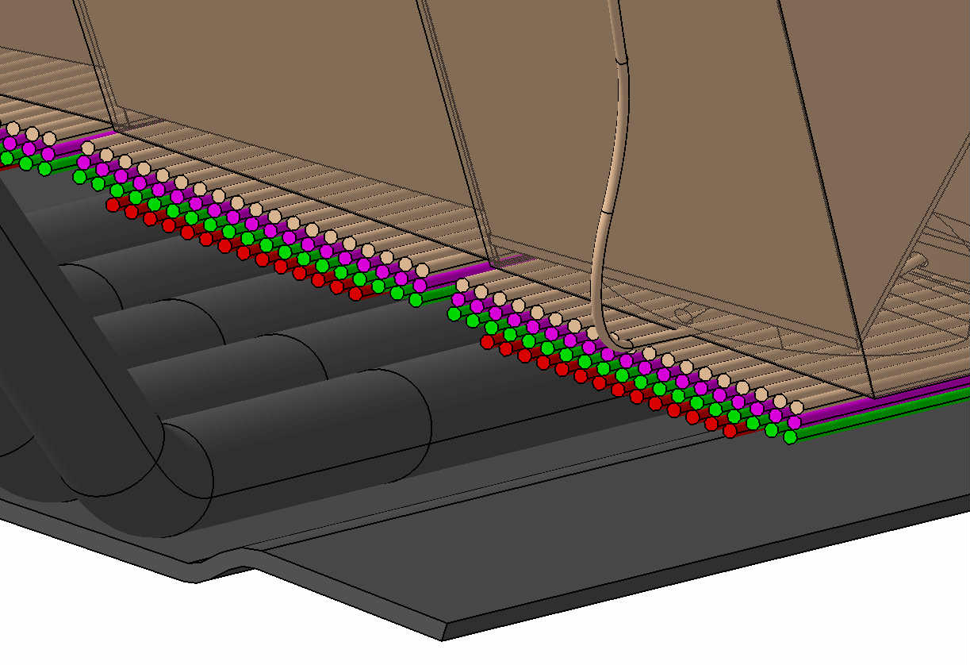
Design of front inserts and optical fibers tracing
(Suggested by V. Ferapontov and A. Levin)
Currently !!!
Under discussion with Philippe Rosier

Slide 16
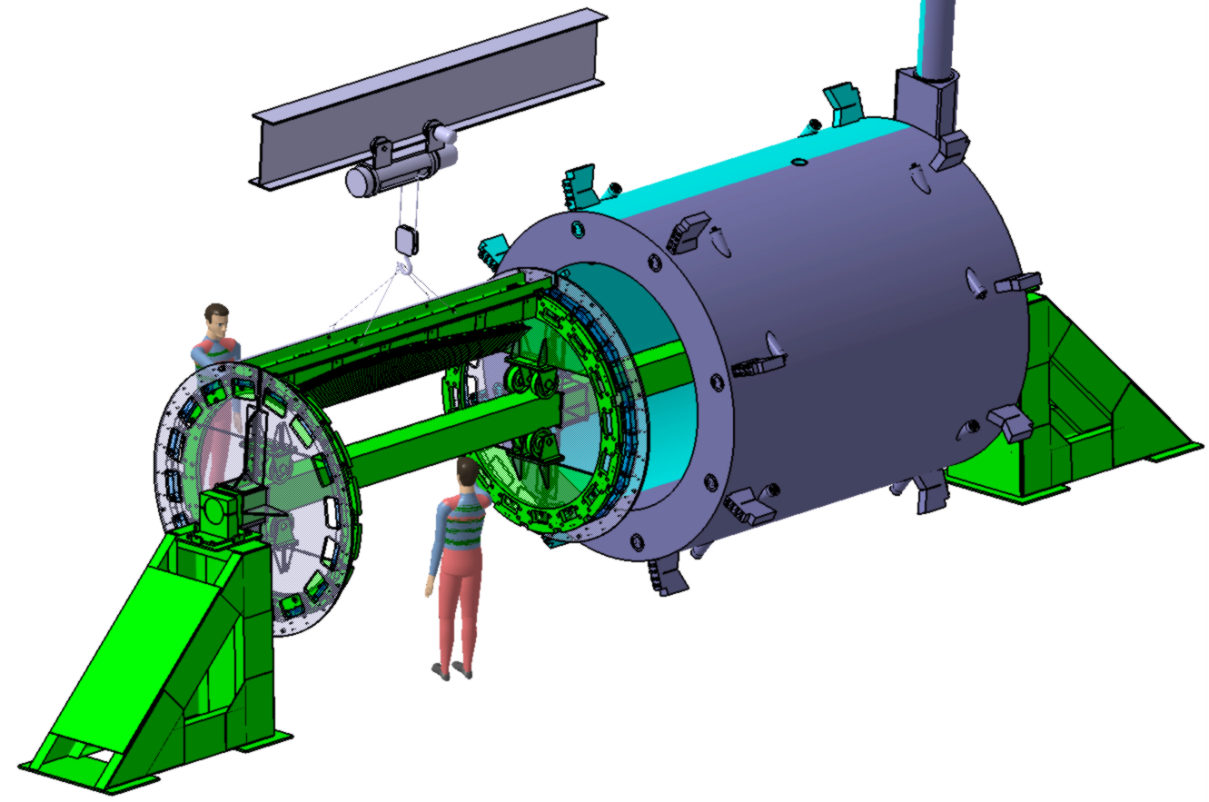
EMC Barrel assembly (by Valery Ferapontov)
Technological beam
V. Ferapontov needs the technical drawing of the support structure for the pre-series slice assembly and tests to finalize design of the technological beam

Slide 17
Summary and open questions
  Design of the pre-series slice (uploaded in EDMS) is ready. Waiting for the official approval (Milestone M7 – Final design review for pre-series slice).
  Almost all technological tools for the alveoli production and modules assembly of all the types were designed, their production is in progress. More than 50% of them were delivered to IHEP, passed the acceptance tests and are currently in use.
  About 60 % from the volume of crystal support structure to be delivered in the batch 1 is ready.
Design of front inserts and fibers tracing - need to solve the lack of space problem.
Scenario of the slice assembly – need the revision of existing assembly tools .

