Slide 1
The Potential for Baryon Spectroscopy at PANDA and the „Day-1 Setup“
Sep 14, 2016 | Albrecht Gillitzer, IKP Forschungszentrum Jülich
LVIII PANDA Meeting, Mainz, September 2016

Slide 2
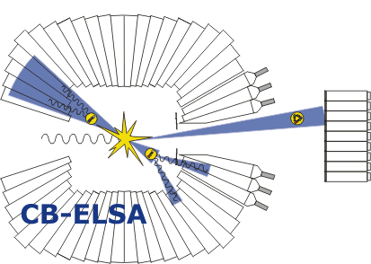
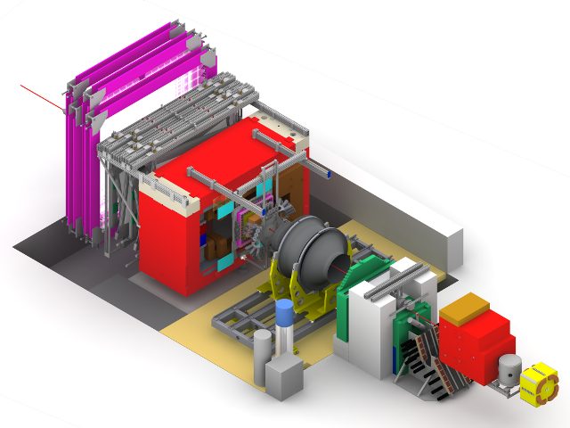
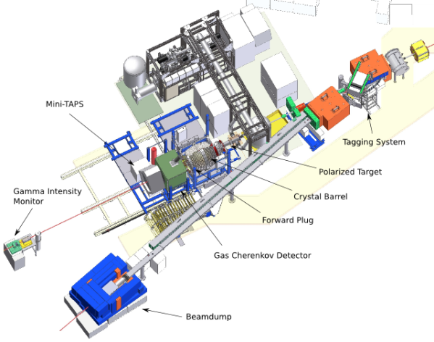
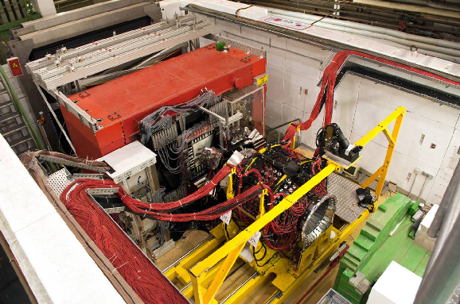
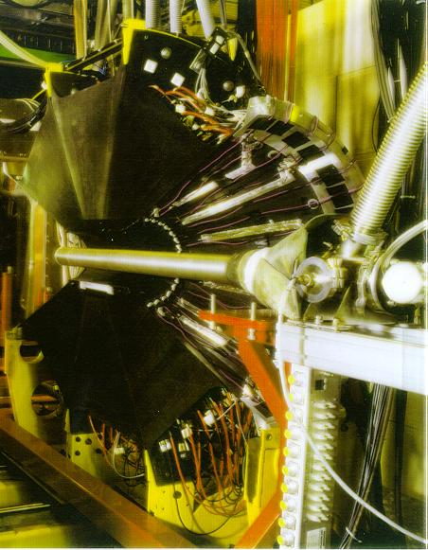
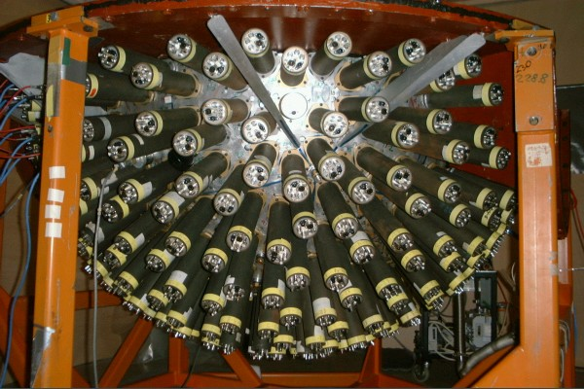
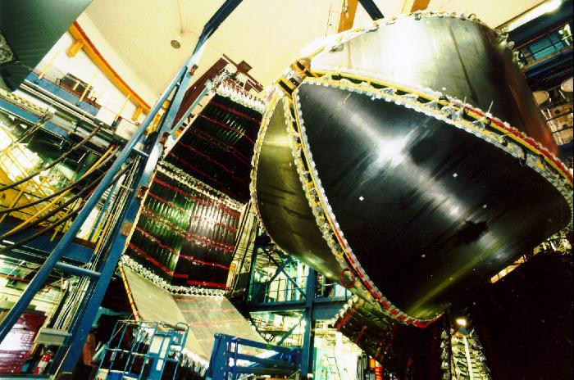
Why to be Interested in Baryons?
No understanding of strong interaction without understanding the excitation pattern of baryons!
Strong worldwide activity in „Baryon Spectroscopy“ with photo-induced reactions

Slide 3
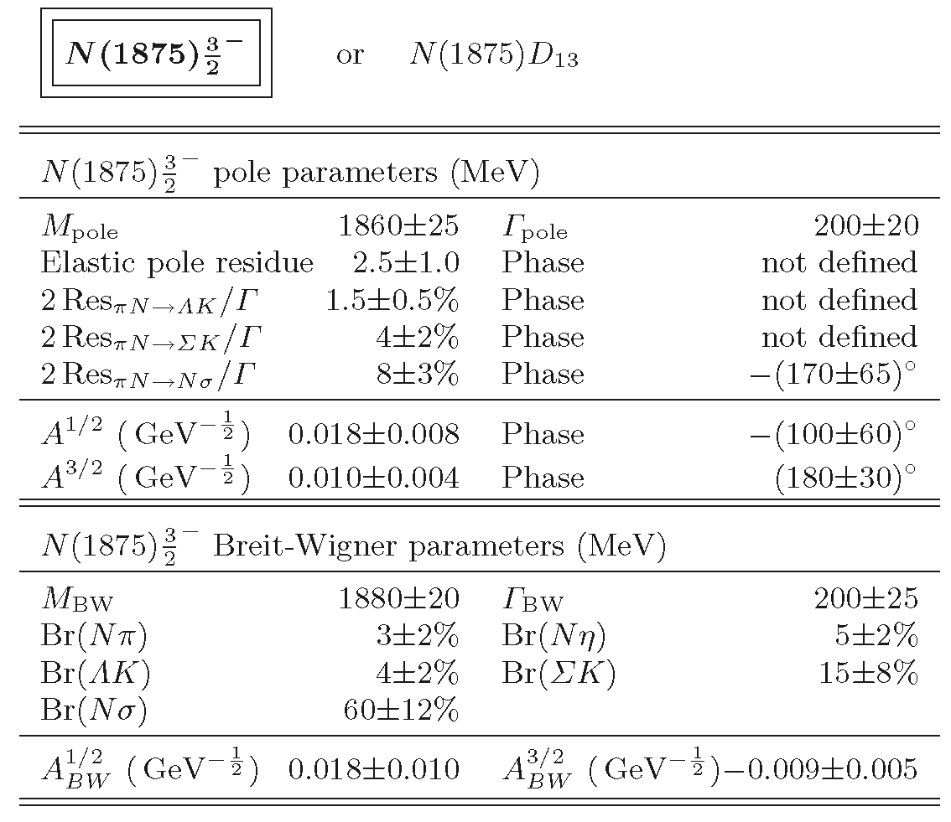
Achievements in N* Spectroscopy
BnGa PWA:
A.V. Anisovich et al., EPJA 48 (2012) 15

Slide 4
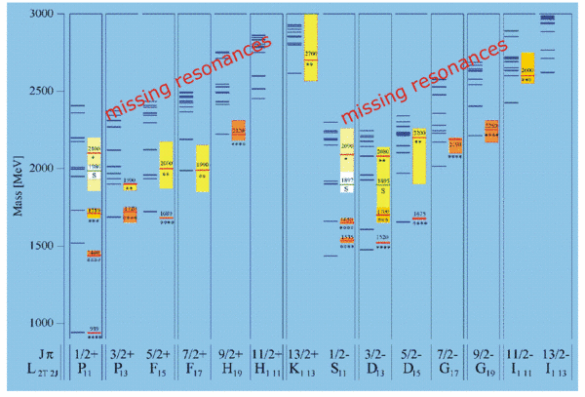
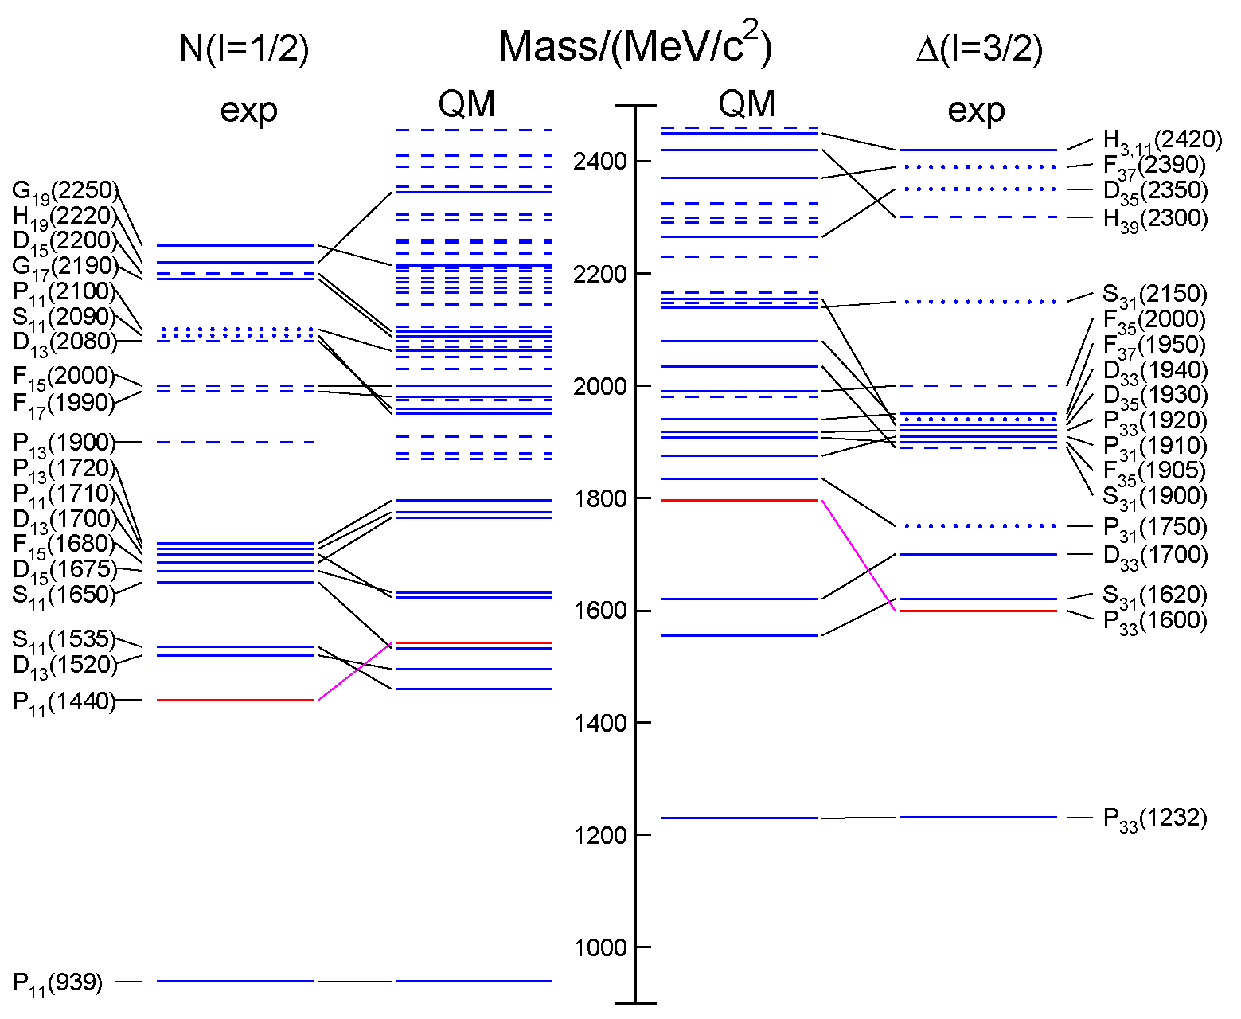
Open Questions
Missing resonances
Wrong masses, wrong sequence
Relevant degrees of freedom?
3-quark?
quark-diquark?
meson-baryon dynamics
from RPP 2014 / QM: S. Capstick, W. Roberts

Slide 5
Strange Partners
Approximate SU(3) flavor symmetry
N* & Δ states have partners in the strange sector
focus on Ξ and Ω
Ξ: as many states as N* & Δ together ⁽¹⁾
Ω: as many states as Δ
scrutinize our understanding of the baryon excitation pattern
⁽¹⁾ in case of SU(3) symmetry !

Slide 6
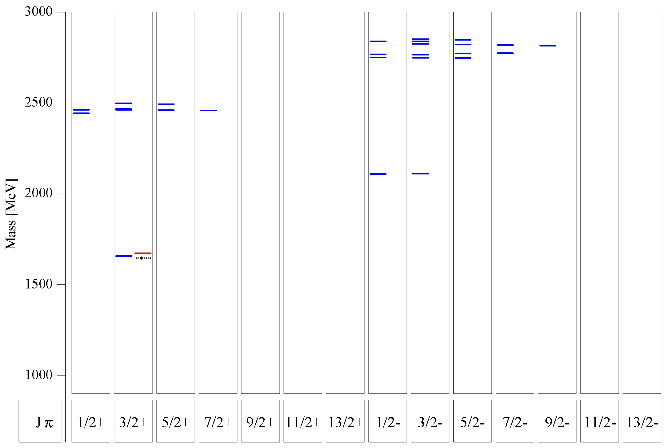
Quark Model for Ξ & Ω
Ξ:
many states predicted below 3 GeV
compare 1/2⁺ and 1/2⁻ excitation
Ω:
several states predicted between 2 GeV and 3 GeV
compare 3/2⁺ and 3/2⁻ excitation
Ξ
U. Löring et al., EPJA 10 (2001) 447
Ω
s.a.: M. Pervin, W. Roberts, PRC 77 (2008) 025202

Slide 7
Most Promising: Study Ξ Resonances
very little known ←→ rather high cross section
find missing resonances
determine branching to various decay modes:
$Ξπ, Ξπ^{+}π^{−}, Ξπ^{0}π^{0}, ΛK^{−}, Σ\overline{K}, Ξη, Ξηπ, Ξη^{′}, Ξω, Ξφ, …$
determine J^{P} quantum numbers if possible
recent progress:
PAWIAN now includes baryons
see talk by Bertram Kopf
strategy:
select $\overline{p}$ momentum to produce a specific resonance close to threshold

Slide 8
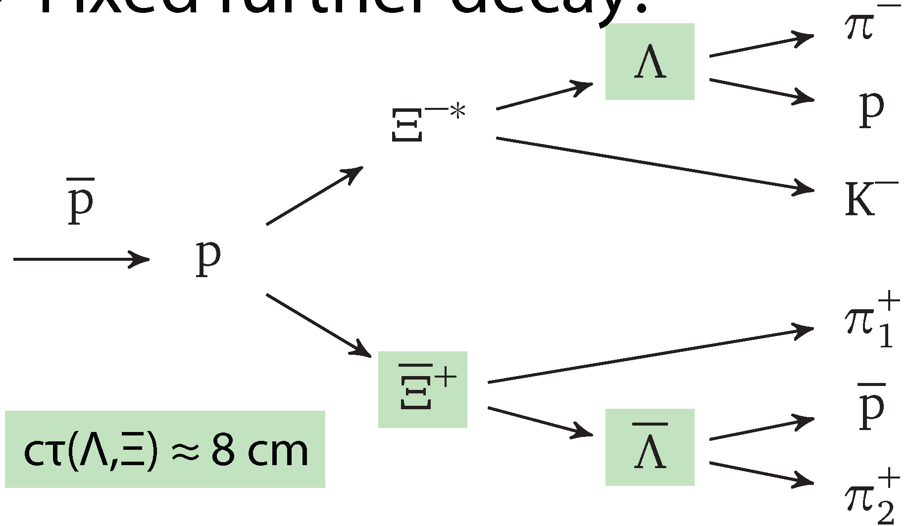
Recent Simulation & Analysis
new MC simulations & analyses:
André Zambanini, completed, PhD thesis U Bochum 2015
4.1 GeV/c pp → Ξ(1690)⁻Ξ⁺ → K⁻ΛΞ⁺
~0.5⋅10⁶ signal events, ~50⋅10⁶ DPM background events
Jennifer Pütz, PhD thesis fully devoted to Ξ spectroscopy
4.6 GeV/c pp → Ξ(1820)⁻Ξ⁺ → K⁻ΛΞ⁺ & c.c.
1.5⋅10⁶ signal events, 15⋅10⁶ DPM background events so far
_
_
_
_
_
_
reco eff. 2.2 %

Slide 9
Early Physics: Expected Rates for Strange Baryons
initial phase: $L≅{10}^{31}{cm}^{−2}s^{−1}$ instead of $L≅{2∙10}^{32}{cm}^{−2}s^{−1}$
nevertheless the $Ξ\overline{Ξ}$ production rate will be $R_{Ξ\overline{Ξ}}≅10/s≅{10}^{6}/d$
for $Ω\overline{Ω}$ production we expect $R_{Ω\overline{Ω}}≅0.3/s≅{3∙10}^{4}/d$
for excited states the cross section should be of the same order of magnitude as for the ground state for given $\sqrt{s}−\sqrt{s_{thr}}$
the detected rate depends on the specific decay mode (branching & reconstruction efficiency)
e.g. $\overline{p}p→{\overline{Ξ}}^{+}Ξ^{∗−}→$ ${\overline{Ξ}}^{+}Ξ^{−}π^{0}→\overline{Λ}π^{+}Λπ^{−}π^{0}→\overline{p}π^{+}π^{+}pπ^{−}π^{−}π^{0}$ assume $b=0.5∙{0.64}^{2}=0.2$ and $ε=5\%$ → $R_{det}≅$ ${10}^{4}/d$

Slide 10
Current Version of the PANDA ‚Start Setup‘
Day-1 master macros distributed by Stefano July 25 as basis for the physics simulation and analysis studies:
Cluster Jet Target
No GEM planes → need MVD or STT_{stereo} for p_{z}
No Disc DIRC → no K/π separation
FTS planes 1 2 3 4 (no 5 6 ) → poor p resolution
No RICH
How does this affect Hyperon Spectroscopy & Hyperon Spin Physics?

Slide 11
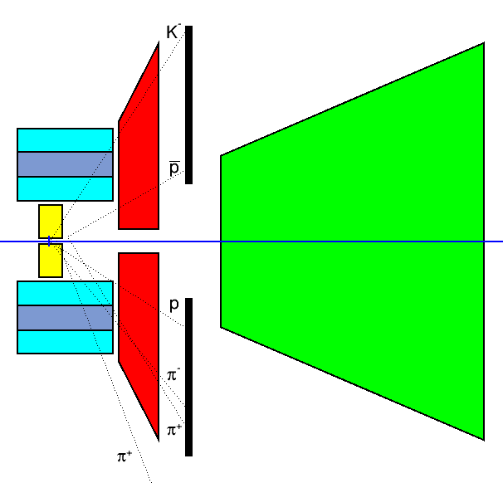
Fast Geometric Analysis with Straight Tracks
EvtGen events
4.1 GeV $\overline{p}p→{\overline{Ξ}}^{+}ΛK^{−}$
$\overline{p}π^{+}π^{+}p{π^{−}K}^{−}$final state
simplified geometry of MVD, STT, GEM, FTS
neglect magnetic field (conservative)
evaluate path length in each sub-detector volume & R(z_{STT})

Slide 12
Scan of 100 Events in Event Display
display primary particles only
display MVD, STT, GEM, FTS points only
minimum requirement: all 6 tracks visible on ‚global‘ scale
how „straight“ are the tracks?
what is the event topology?
1 : both p & p in FTS
2 : one of p, p in FTS
3 : both p & p in GEM
4 : one of π, K in FTS
5 : both p & p vertex ‚beyond‘ MVD
6 : one of p, p vertex ‚beyond‘ MVD
_
_
_
any of these disfavors recostruction with MVD & STT only
_
_

Slide 13
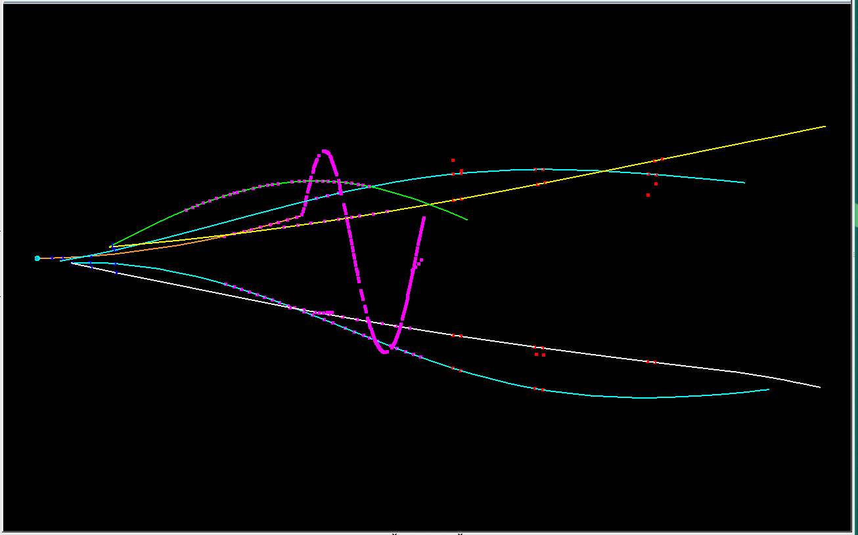
event #04
GEM
STT
p
MVD
π⁺
π⁻
K⁻
FTS →
_
π⁺
p
3 6

Slide 14
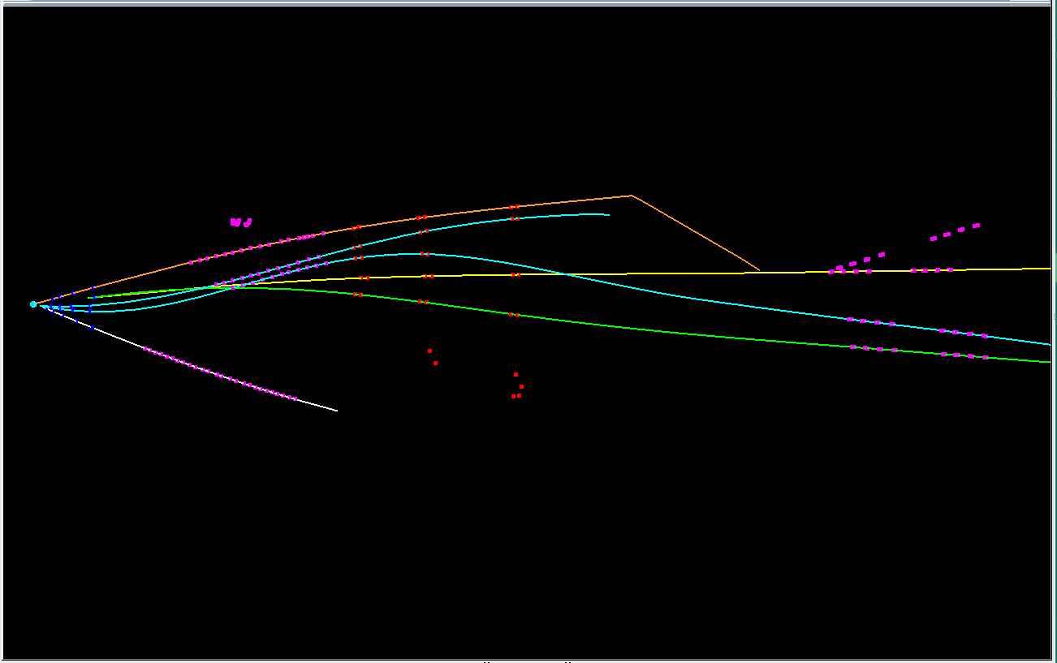
event #15
GEM
STT
K⁻
FTS
π⁺
MVD
p
π⁺
π⁻
_
p
2 4 6

Slide 15
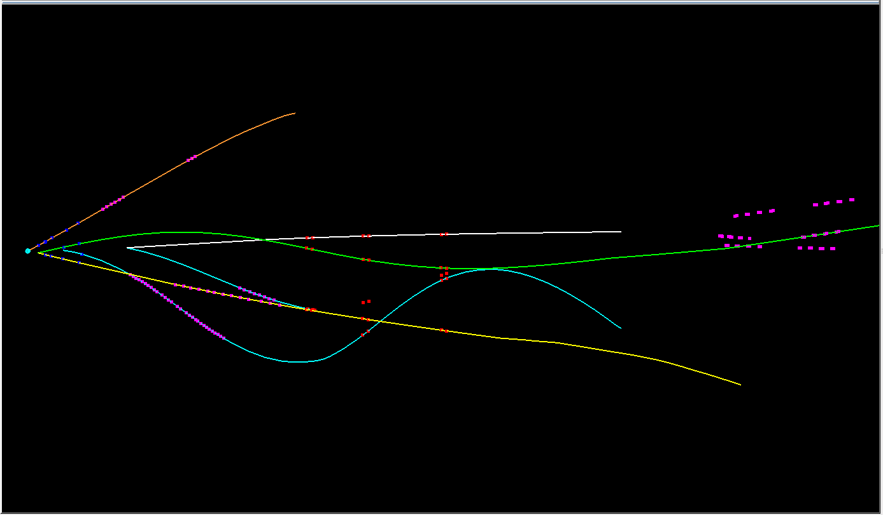
event #17
3 4 6

Slide 16
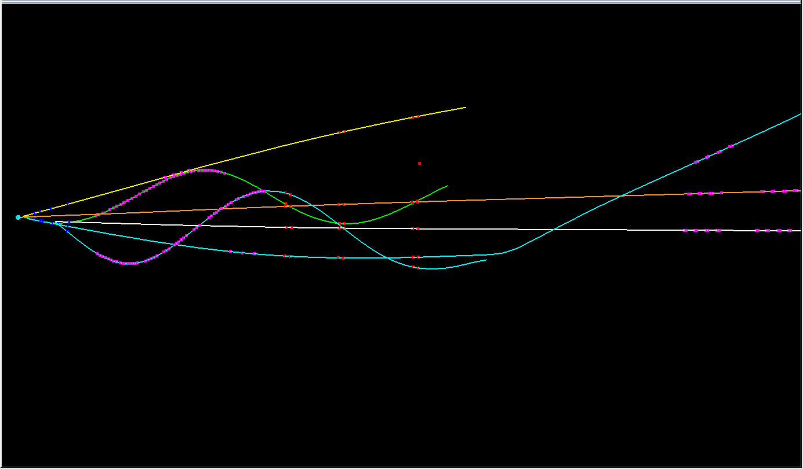
event #34
2 3 4 6

Slide 17
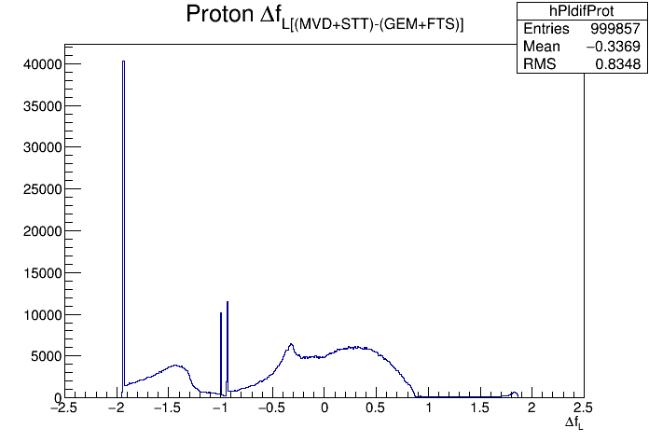
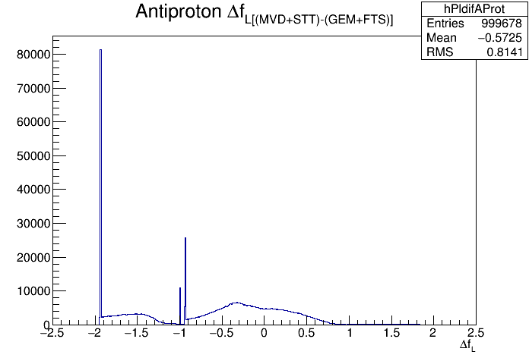
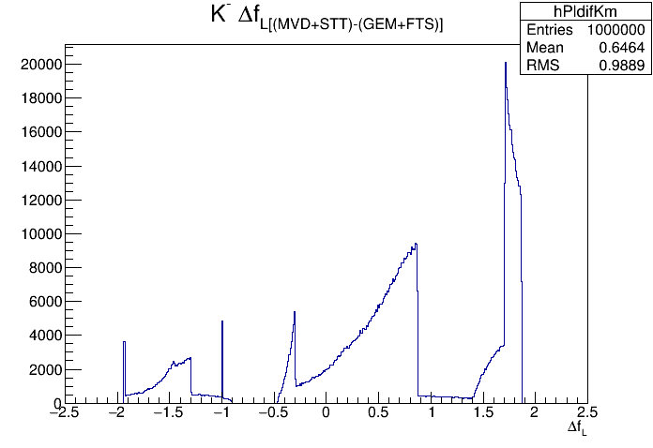
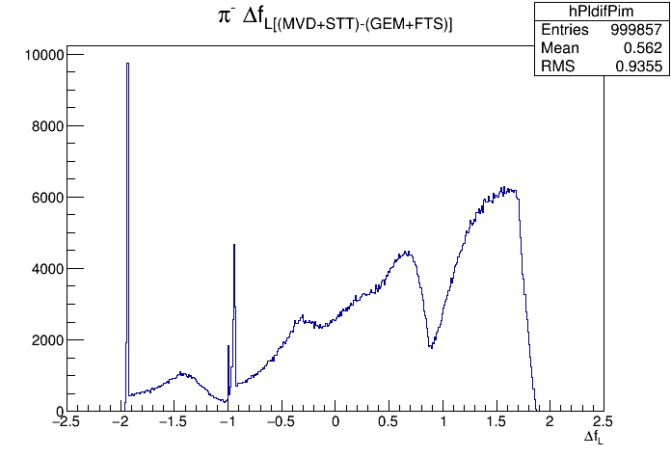
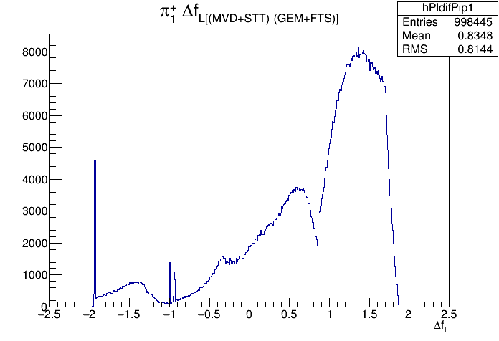
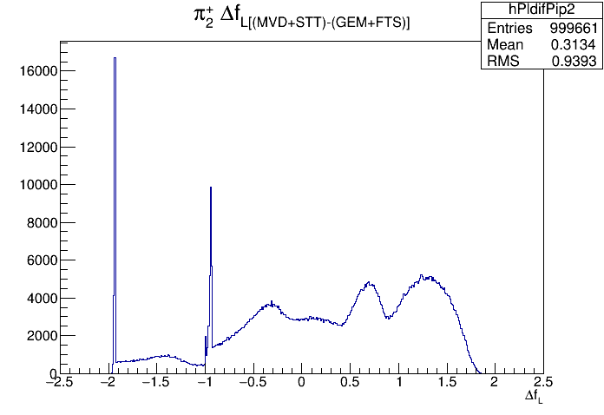
Fractional Path Length Difference (MVD+STT) – (GEM+FTS)
_
p
p
K⁻
π⁻
π⁺
π⁺
₁
₂
Δf_{L} = f_{L}(MVD) + f_{L}(STT) – f_{L}(GEM) – f_{L}(FTS); f_{L} = L/L_{max}

Slide 18
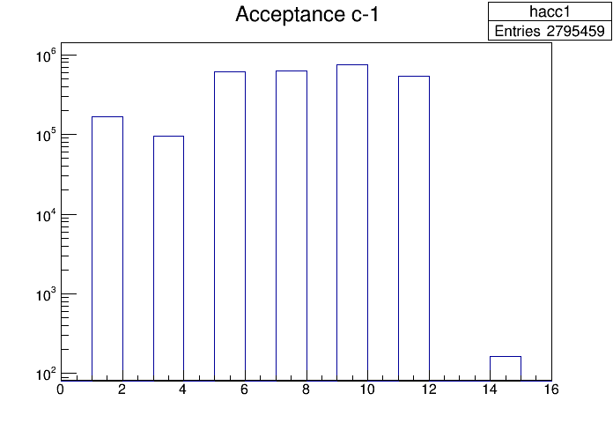
Acceptance ( ΔF_{L} > 0 )
particle | f_{acc}
$$p$$ | 0.425
$$\overline{p}$$ | 0.265
$$K^{−}$$ | 0.808
$$π^{−}$$ | 0.743
$${π^{+}}_{1}$$ | 0.856
$${π^{+}}_{2}$$ | 0.635
all | 0.034
_
all
p
p
K⁻
π⁻
π⁺
π⁺
₁
₂

Slide 19
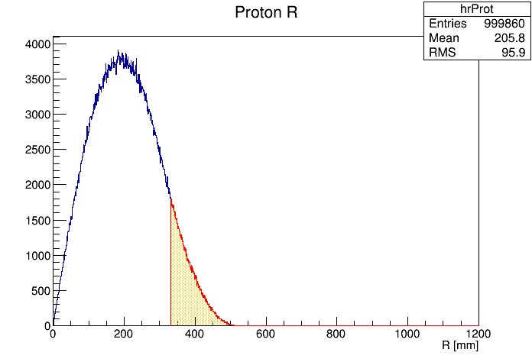
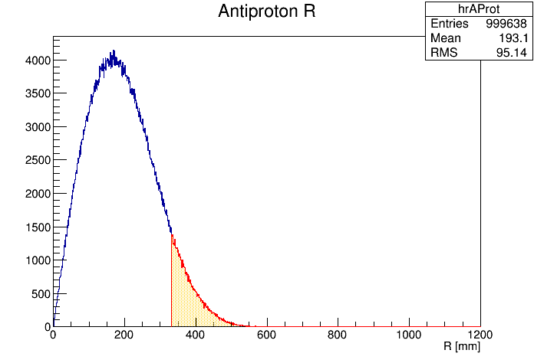
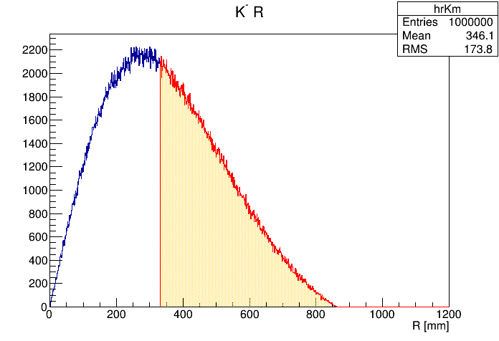
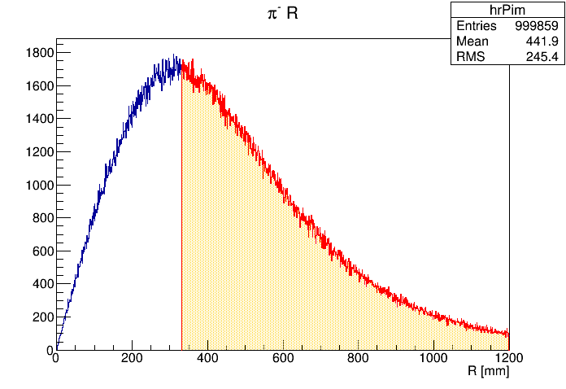
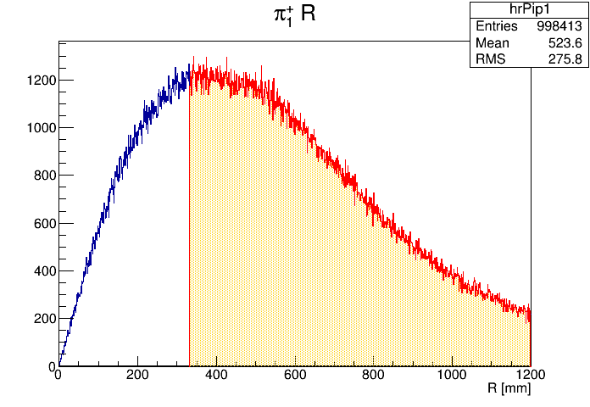
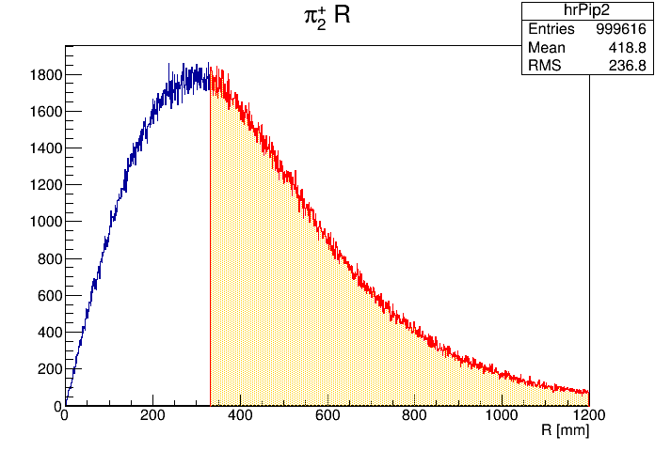
Radial Distribution at STT End Plane

Slide 20
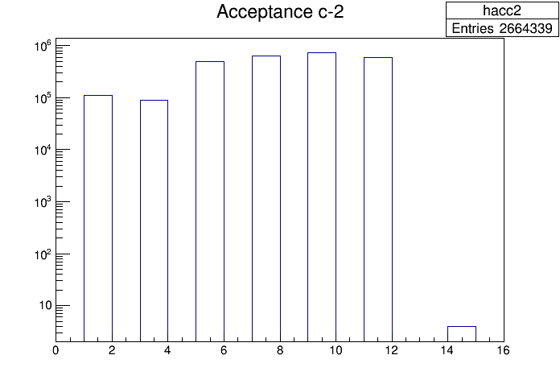
Acceptance ( R > R_{crit} )
R_{crit} = 331 mm
particle | f_{acc}
$$p$$ | 0.109
$$\overline{p}$$ | 0.088
$$K^{−}$$ | 0.498
$$π^{−}$$ | 0.630
$${π^{+}}_{1}$$ | 0.745
$${π^{+}}_{2}$$ | 0.594
all | 4⋅10⁻⁶
_
all
p
p
K⁻
π⁻
π⁺
π⁺
₁
₂
→ almost zero efficiency if p_{z} information from STT is required !

Slide 21
More Realistic: Combine MVD & STT for p_{z}
need both p_{z} and p_{T} information from central detector
a track starting downstream of MVD must pass the STT stereo layer
a track starting inside MVD must at least pass the last two MVD discs and two axial STT double-layers
L_{MVD} ⋅ cosθ > 70 mm L_{STT} ⋅ sinθ > 40 mm

Slide 22
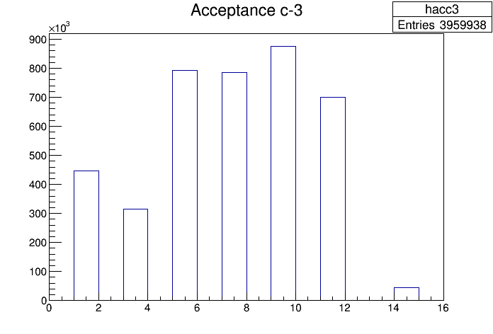
Acceptance (R > R_{crit}) || ((L_{MVD} > L_{c1}) && (L_{STT} > L_{c2}))
particle | F_{acc}
$$p$$ | 0.447
$$\overline{p}$$ | 0.314
$$K^{−}$$ | 0.793
$$π^{−}$$ | 0.785
$${π^{+}}_{1}$$ | 0.876
$${π^{+}}_{2}$$ | 0.700
all | 0.045
_
p
p
K⁻
π⁻
π⁺
π⁺
all
₁
₂
L_{c1} > 70 mm / cosθ : hits in last 2 discs
L_{c2} > 40 mm / sinθ : hits in inner two double layers

Slide 23
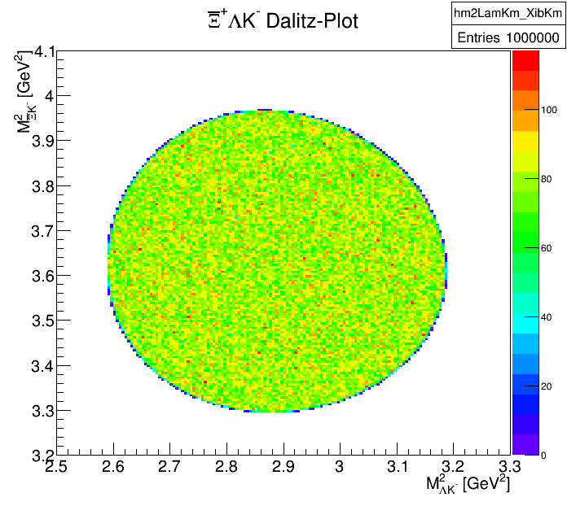
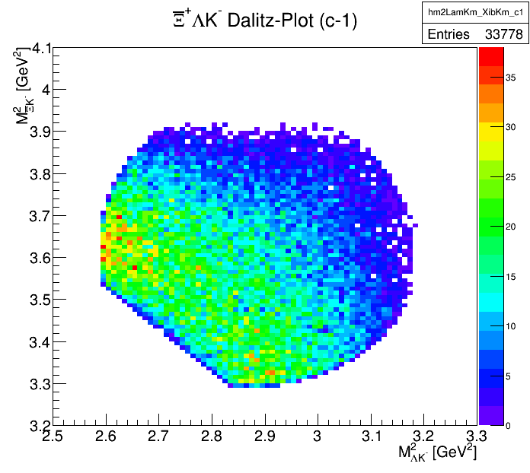
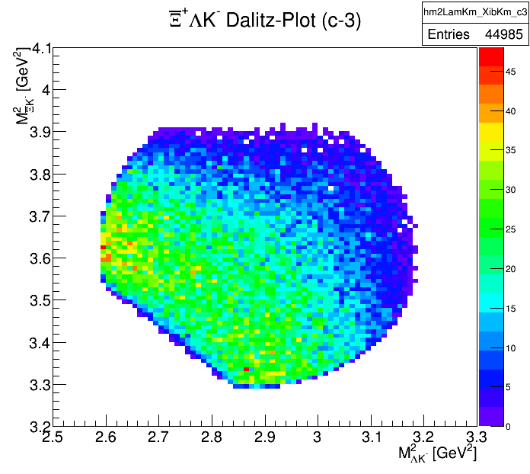
Effect on Ξ⁺ΛK⁻ Dalitz Plot
_

Slide 24
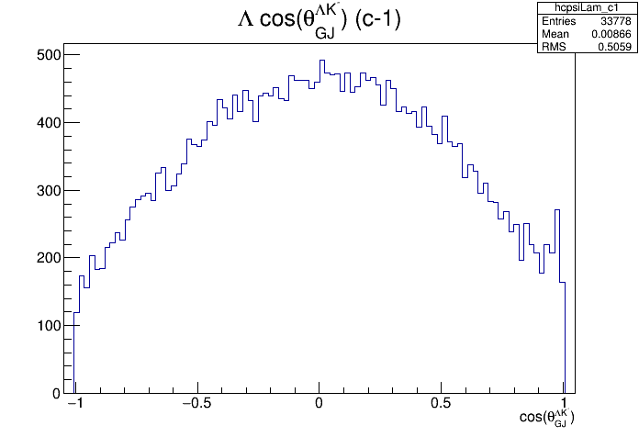
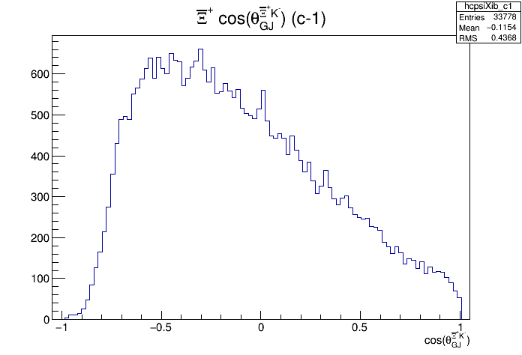
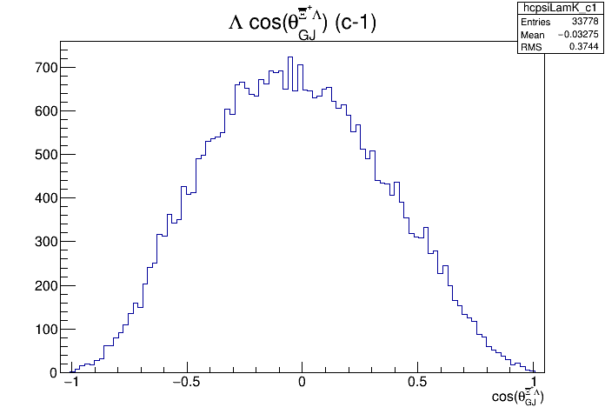
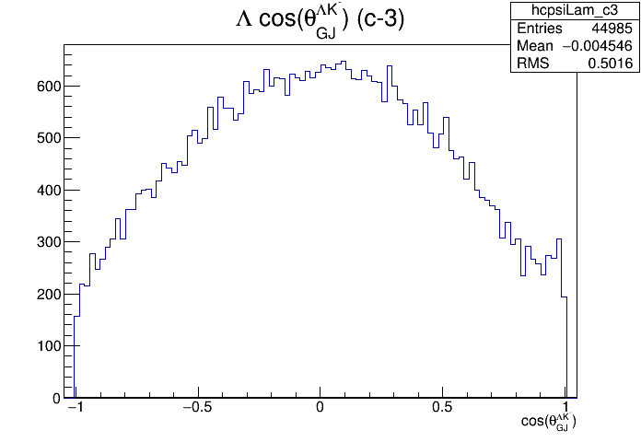
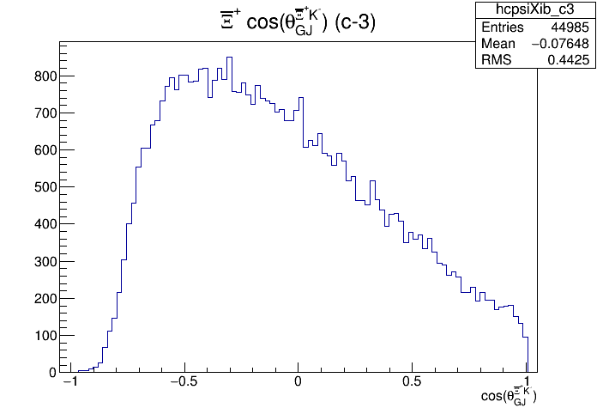
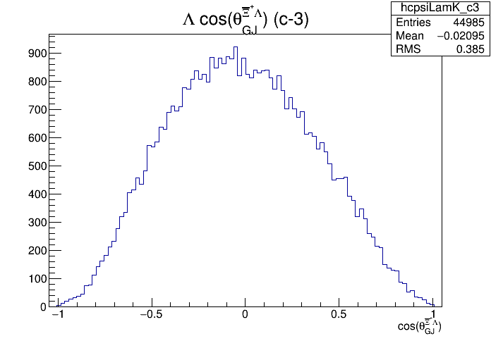
Effect on Angular Distribution (GJ Frame)

Slide 25
Jenny Pütz:
full PandaRoot simulation

Slide 26
Conclusion
Hyperon spectroscopy is an important topic in hadron physics which has not received the deserved attention in the past
PANDA is the ideal instrument for a comprehensive Ξ and Ω spectroscopy program
A large part of the program can already be pursued at reduced luminosity
However: for these studies the GEM detector and the FTS (preferrentially including a detector behind the dipole) are required

